Slide 1


Welcome to Diabetes in the 21st Century
Beverly Dyck Thomassian, RN, MPH, BC-ADM, CDE
President, Diabetes Education Services
www.DiabetesEd.net
© Copyright 1999-2015, Diabetes Education Services, All Rights Reserved.

Slide 2

It’s Good to be Back
Special Thanks to Debora Nagata

Slide 3
Diabetes in the 21st Century: A Clinical and Educational Update
Describe impact of diabetes
Discuss prevention, management strategies
Discuss different types of diabetes
Describe insulin therapy
Review glucose patterns and determine how to adjust therapy to improve glucose.
Discuss medical nutrition therapy
Gain understanding of Type 2 Meds.
Demonstrate successful teaching strategies

Slide 4
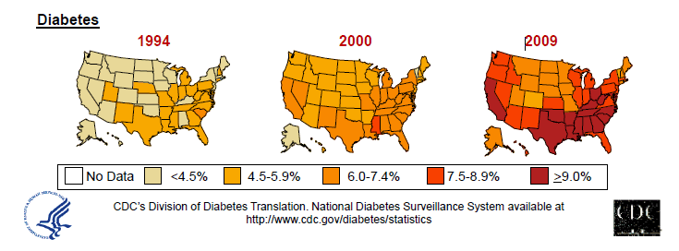
Diabetes in America 2015
29 million or > 9.3%
27% don’t know they have it
37% of US adults have pre diabetes (86 mil)

Slide 5
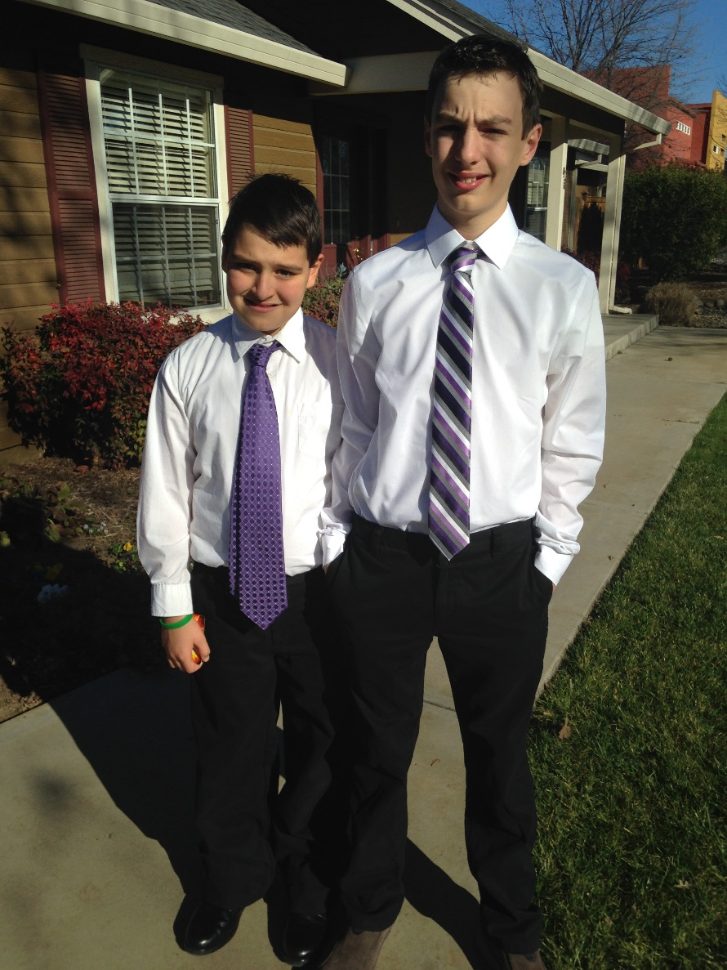
My Boys –Robert and Jackson
By the time they are 50, 1/3 will have diabetes

Slide 6
CDC Announces
35% of Americans will have Diabetes by 2050
Boyle, Thompson, Barker, Williamson
2010, Oct 22:8(1)29
www.pophealthmetrics.com

Slide 7


Type 2 in Kids
7 fold increase 1990
1 in 6 overwt kids (age 12- 19) have prediabetes.
~2,500 to 3,700 new cases in U.S. annually.
Highest risk: very obese, minority, female, low socioeconomic status, limited education
In age range 12-19, less than 1% have Type 2 – NHANES
Environmental changes to urgently needed

Slide 8

Global Epidemic
Every 10 seconds
1 person dies with diabetes
2 people develop diabetes
Every year
3 million deaths
6 million new cases
World Diabetes Day is November 14
March is ADA Sound the Alert Day “find people w/ undetected diabetes”

Slide 9


World Diabetes Day November 14

Slide 10
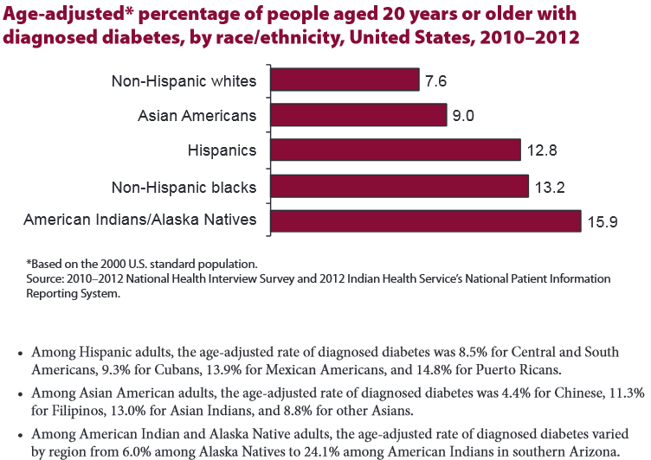

Age-adjusted Diabetes Prevalence 20 yrs or older, by race/ethnicity— U.S. 20014

Slide 11

Free Live Webinars and Live Seminars at DiabetesEd.net
Free Webinars
Preparing to take CDE
New Frontiers
New Medications
BC-ADM

Slide 12



Slide 13
Role of the Pancreas Endocrine Functions
Beta Cells - Insulin
Anabolic hormone - helps store glucose as glycogen in muscle, liver
secreted in response to elevated glucose
halts breakdown of glycogen in liver
increases protein synthesis, fat storage
powerful hypoglycemic
Beta Cells - Amylin
secreted in 1:1 ratio with insulin
Causes satiety
Lowers post-prandial glucagon response
Slows gastric emptying
Type 1 make none
Type 2 make less than normal amounts

Slide 14
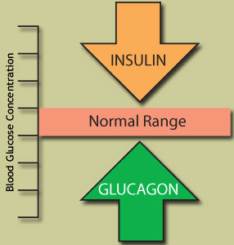
Role of the Pancreas Endocrine Functions
Alpha cells - Glucagon
Opposes action of insulin at the liver
stimulated in response to low glucose levels
stimulates liver to convert glycogen to glucose
inhibits liver from glucose uptake
causes hyperglycemia

Slide 15
Hormones Effect on Glucose
Hormone
Glucagon (pancreas)
Stress hormones (kidney)
Epinephrine (kidney)
Insulin (pancreas)
Amylin (pancreas)
Gut hormones - incretins (GLP-1) released by L cells of intestinal mucosa, beta cell has receptors)
Effect



⇒
⇒
⇒

Slide 16
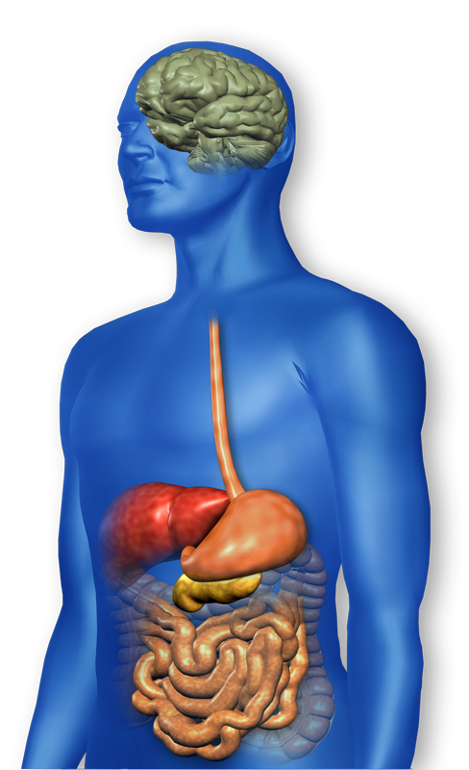
GLP-1 Effects in Humans Understanding the Natural Role of Incretins
GLP-1 secreted upon the ingestion of food
Promotes satiety and reduces appetite
Alpha cells:
↓ Postprandial glucagon secretion
↑ Beta-cell
response
Liver: ↓ Glucagon reduces hepatic glucose output
Beta cells: Enhances glucose-dependent insulin secretion
Stomach: Helps regulate gastric emptying
Adapted from Flint A, et al. J Clin Invest. 1998;101:515-520 Adapted from Larsson H, et al. Acta Physiol Scand. 1997;160:413-422 Adapted from Nauck MA, et al. Diabetologia. 1996;39:1546-1553 Adapted from Drucker DJ. Diabetes. 1998;47:159-169
GLP-1 degraded by
DPP-4 w/in minutes
Notes:
16
16
Required
DISCUSSION POINTS:
--Upon food ingestion, GLP-1 is secreted into the circulation from L cells of small intestine.
--GLP-1 increases beta-cell response by enhancing glucose-dependent insulin secretion.
--GLP-1 decreases beta-cell workload and hence the demand for insulin secretion by:
--Regulating the rate of gastric emptying such that meal nutrients are delivered to the small intestine and, in turn, absorbed into the circulation more smoothly, reducing peak nutrient absorption and insulin demand (beta-cell workload)
--Decreasing postprandial glucagon secretion from pancreatic alpha cells, which helps to maintain the counterregulatory balance between insulin and glucagon
--Reducing postprandial glucagon secretion, GLP-1 has an indirect benefit on beta-cell workload, since decreased glucagon secretion will produce decreased postprandial hepatic glucose output
--Having effects on the central nervous system, resulting in increased satiety (sensation of satisfaction with food intake) and a reduction of food intake
--By decreasing beta-cell workload and improving beta-cell response, GLP-1 is an important regulator of glucose homeostasis.
SLIDE BACKGROUND:
--Effect on Beta-cell: Drucker DJ. Diabetes. 1998; 47:159-169
--Effect on Alpha cell: Larsson H, et al. Acta Physiol Scand. 1997; 160:413-422
--Effects on Liver: Larsson H, et al. Acta Physiol Scand. 1997; 160:413-422
--Effects on Stomach: Nauck MA, et al. Diabetologia. 1996; 39:1546-1553
--Effects on CNS: Flint A, et al. J Clin Invest. 1998; 101:515-520

Slide 17
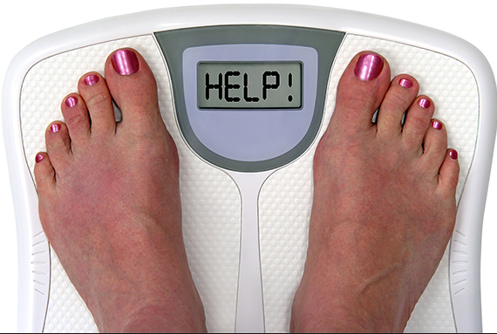
Incretin Mimetics Byetta, Bydureon, Trulicity, Tanzeum
Action (synthetic gut hormone)
Insulin release in response to meal
Slows gastric emptying
Causes Satiety – promotes wt loss
Preserves Beta Cells
Details:
Daily and long acting version - 1x week injection
Efficacy: Decreases A1c by 0.5 – 1.6%, wt by 3lbs +
Benefits/Issues – wt loss, no hyp. Expensive, N/V
Pancreatitis Warning – report signs immediately
Notes:
17
17

Slide 18
Bariatric Surgery
Consider on diabetes pts w/ BMI >35, esp with comorbidities
Remission (BG normalized)
rates range from 40 – 95%
Better results with newer diabetes (more beta cell mass)
Due to increase incretins (gut hormones)
Still researching long term benefits, cost effectiveness and risk

Slide 19
Natural History of Diabetes
Normal
FBG <100
Random <140
A1c <5.7%
Prediabetes
FBG 100-125
Random 140 - 199
A1c ~ 5.7- 6.4%
50% working pancreas
Diabetes
FBG 126 +
Random 200 +
A1c 6.5% or +
20% working pancreas
Yes!
NO
Development of type 2 diabetes happens over years or decades

Slide 20
Signs of Diabetes
Polyuria
Polydipsia
Polyphasia
Weight loss
Fatigue
Skin and other
infections
Blurry vision
Glycosuria, H₂O losses
Dehydration
Fuel Depletion
Loss of body tissue, H₂O
Poor energy utilization
Hyperglycemia increases incidence of infection
Osmotic changes

Slide 21

Diabetes Classifications
Type 1
Type 2
Gestational
Secondary
Notes:
Type 1-absent insulin
Type 2-too much insulin early, then resistence and less secretion
GDm-simliar to Type 2, found during pregnancy

Slide 22
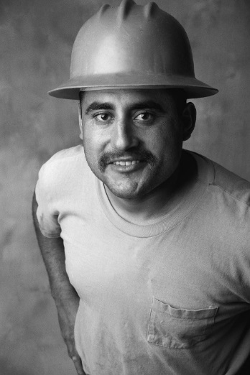

Case Study
1. Pt profile: 5’8”, 192 lb male
Diabetes 12 years, on insulin 3 yrs
What type of DM and how do you know?
2. Pt profile: 5’6”, 108 lb female
On insulin 3u Novolog before meals,
10u Lantus at bedtime
What type of DM and how do you know?

Slide 23
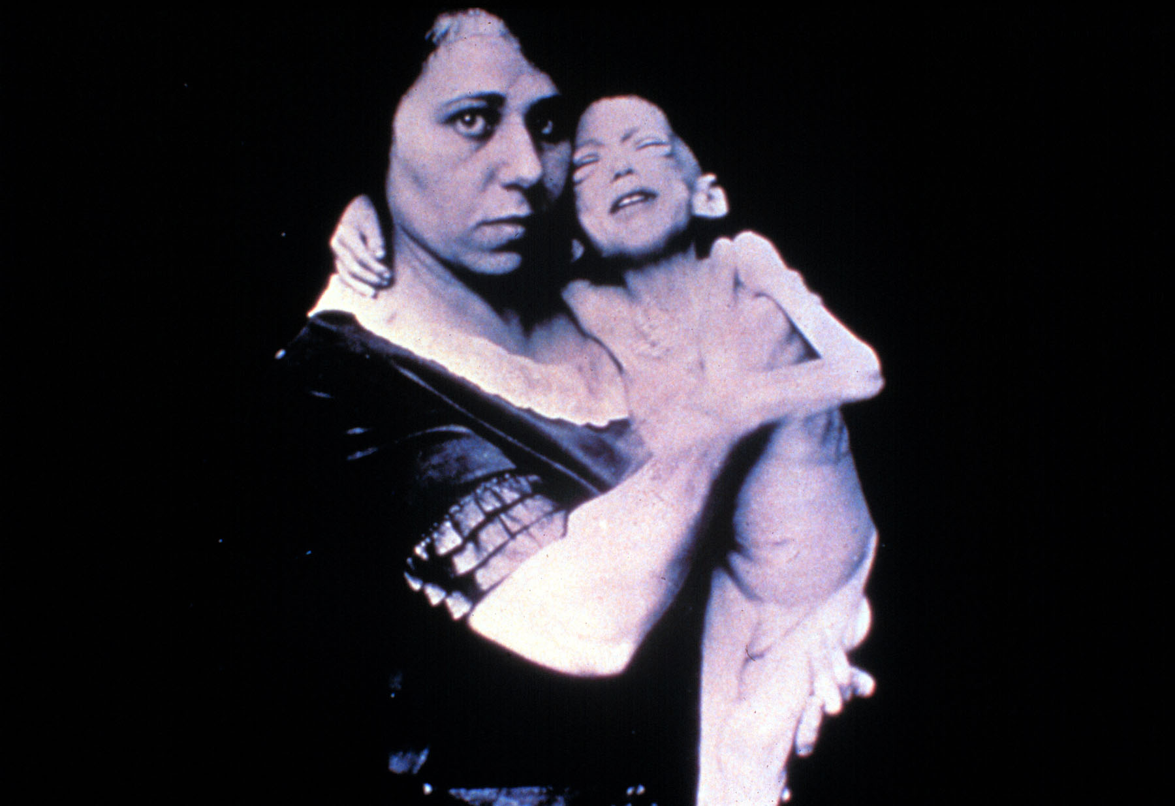

Slide 24
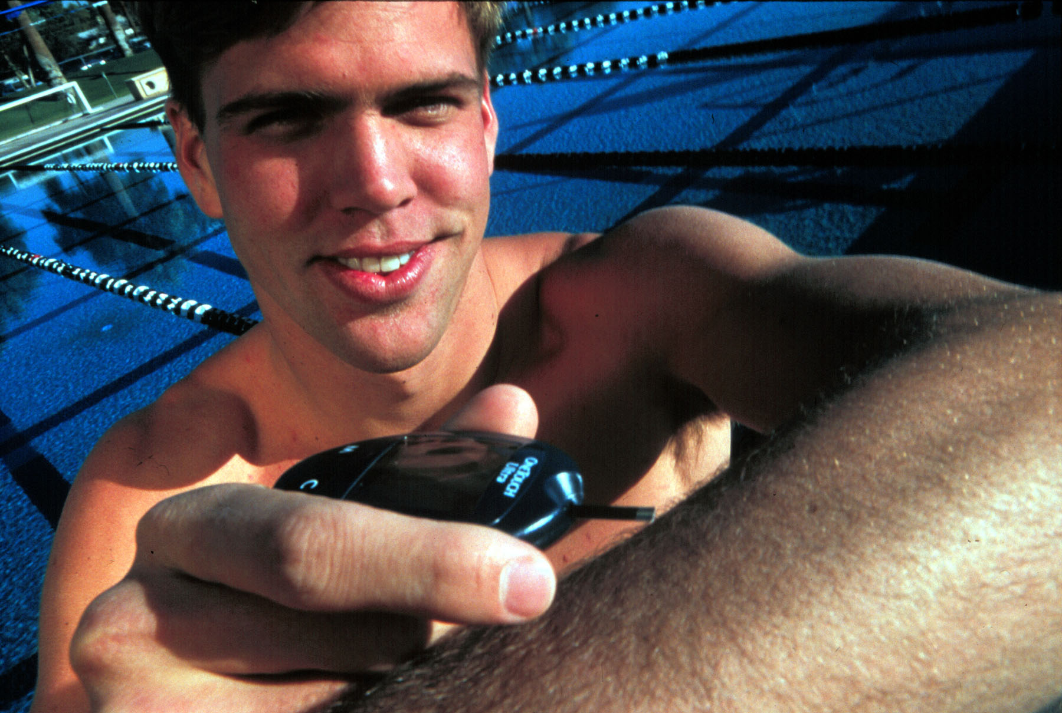

Slide 25

Type 1 Rates Increasing Globally
23% rise in type 1 diabetes incidence from 2001-2009
Why?
Autoimmune disease rates increasing over all
Changes in environmental exposure and gut bacteria?
Hygiene hypothesis
Obesity?

Slide 26
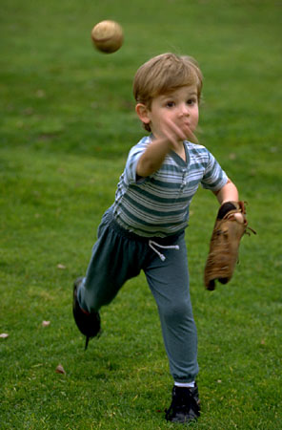
Incidence of Type 1 in Youth
General Pop 0.3%
Sibling 4%
Mother 2-3%
Father 6-8%
Rate doubling every 20 yrs
Many trials underway to detect and prevent (Trial Net)

Slide 27

Type 1 – 10% of all Diabetes Genetics and Risk Factors
Auto-immune pancreatic beta cells destruction
Most commonly expressed at age 10-14
Insulin sensitive (require 0.5 - 1.0 units/kg/day)
Combo of genes and environment:
Autoimmunity tends to run in families
Higher rates in non breastfed infants
Viral triggers: congenital rubella, coxsackie virus B, cytomegalovirus, adenovirus and mumps.

Slide 28
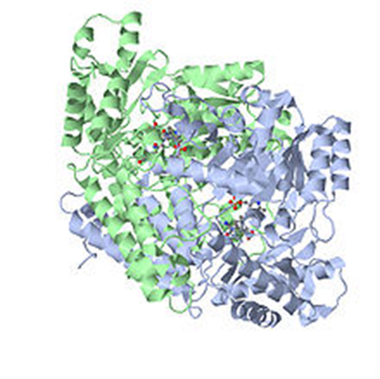
Autoantibodies Assoc w/ Type 1
Panel of autoantibodies –
GAD65 - Glutamic acid decarboxylase –
ICA - Islet Cell Cytoplasmic Autoantibodies
IAA - Insulin Autoantibodies

Slide 29
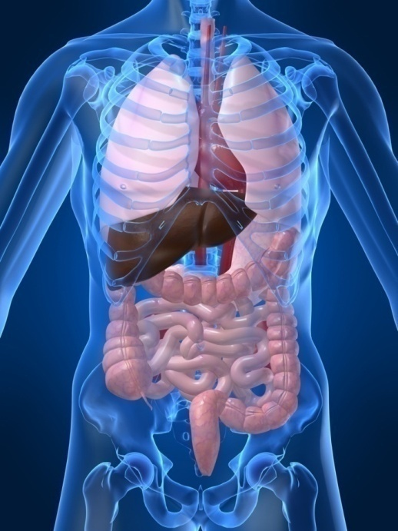
Type 1 Diabetes Associated with other immune conditions
Celiac disease (gluten intolerance)
Thyroid disease
Addison’s Disease
Rheumatoid arthritis
Other

Slide 30

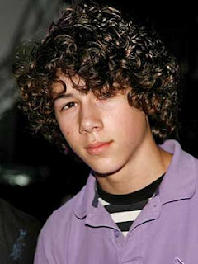



What Does Type 1 Look Like?
Bret Michaels
Mary Tyler Moore
Adam Morrison
Nick Jonas
Justice Sonia Sotomayor
From Debbie Nagata’s slide collection

Slide 31

Type 1 Summary
Autoimmune
Complete pancreatic destruction
Need insulin shots
Often first present in DKA

Slide 32

Type 1 in Hospital
43 yr old admitted to evaluate angina.
Morning blood sugar is 92.
Based on Regular insulin sliding scale, no insulin required.
Breakfast tray shows up and patient says, I need my insulin shot before I eat.
What do you say?

Slide 33
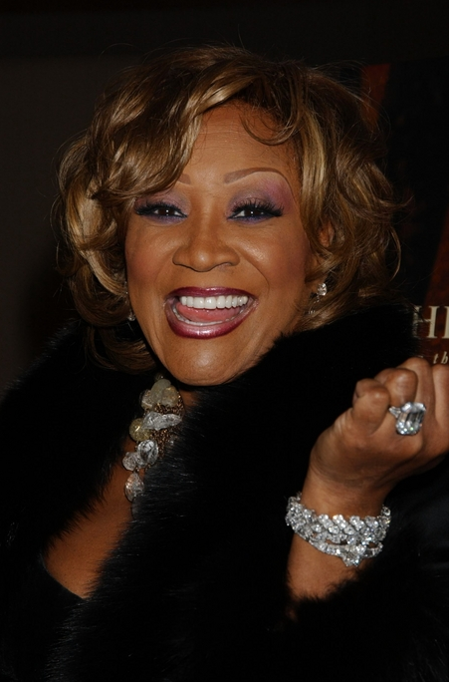
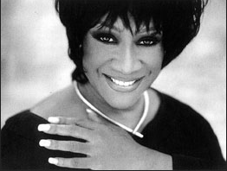
Patti Labelle
"divabetic" -- that's a mix of diabetic and diva

Slide 34
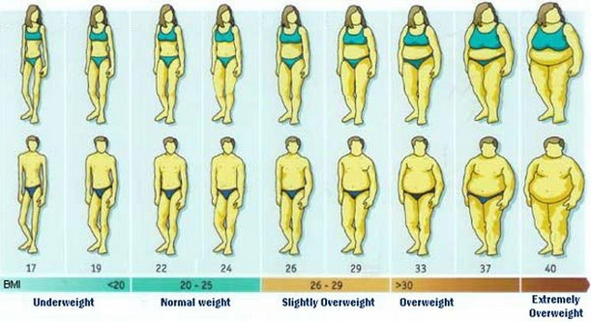
BMI Categories

Slide 35

Diabetes 2 - Who is at Risk? (ADA Clinical Practice Guidelines)
Testing should be considered in all adults who are overweight (BMI ≥ 25) and have additional risk factors:
First-degree relative w/ diabetes
Member of a high-risk ethnic population
Habitual physical inactivity
PreDiabetes
History of heart disease

Slide 36

Diabetes 2 - Who is at Risk? (ADA Clinical Practice Guidelines)
Risk factors cont’d
HTN - BP > 140/90
HDL < 35 or triglycerides > 250
baby >9 lb or history of Gestational Diabetes Mellitus (GDM
Polycystic ovary syndrome (PCOS)
Other conditions assoc w/ insulin resistance:
Severe obesity, acanthosis nigricans (AN)

Slide 37
Acanthosis Nigricans (AN)
Signals high insulin levels in bloodstream
Patches of darkened skin over parts of body that bend or rub against each other
Neck, underarm, waistline, groin, knuckles, elbows, toes
Skin tags on neck and darkened areas around eyes, nose and cheeks.
No cure, lesions regress with treatment of insulin resistance

Slide 38
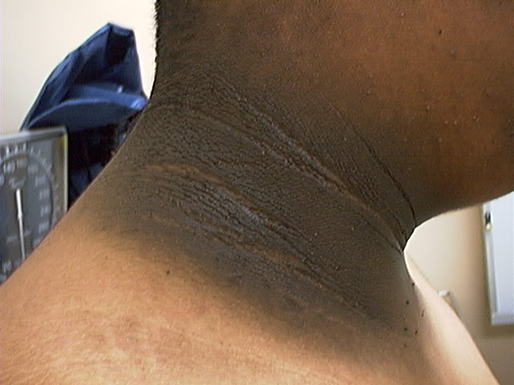
Acanthosis Nigricans

Slide 39

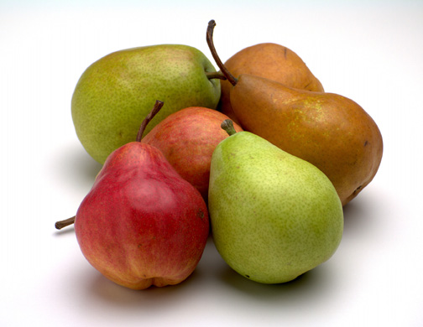
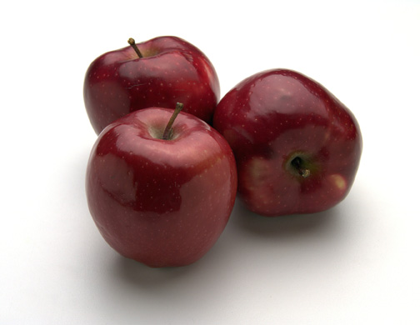

Slide 40
Natural Progression of Type 2 Diabetes
Plasma
Glucose
Postprandial glucose
Fasting glucose
126 mg/dL
Relative β-Cell Function
Insulin resistance
Insulin secretion
-20
-10
0
10
20
30
Years of Diabetes
Prior to diagnosis
After diagnosis
Adapted from Bergenstal et al. 2000; International Diabetes Center.
Notes:
These graphs show the typical progressive nature of type 2 diabetes in terms of 2 key indices: increasing plasma glucose level (top panel) and decline in relative β-cell function as reflected by the drop in endogenous insulin and rise in insulin resistance (lower panel).
In the natural history of type 2 diabetes, insulin resistance rises, insulin secretion falls, and glucose levels begin to rise before diabetes is diagnosed.
Based on the natural history, type 2 diabetes is a disease of progressive insulin failure as shown in the graphic model developed by researchers at the International Diabetes Center.¹
Before the onset of diabetes, glucose levels start to rise, with a slightly sharper increase in the postprandial value than in fasting glucose. Both postprandial and fasting plasma glucose levels continue to rise if diabetes is left untreated.²
Prior to the diagnosis of diabetes, resistance of cell receptor sites to insulin starts to increase, while insulin secretion by β-cells decreases. Insulin resistance reaches a peak and remains constant. Endogenous insulin secretion continues to decline over the course of diabetes.²
References:
1. Kendall DM. Postprandial blood glucose in the management of type 2 diabetes: the emerging role of incretin mimetics. Available at: http://www.medscape.com/viewarticle/515693. Accessed April 21, 2006.
2. Ramlo-Halsted BA, Edelman SV. The natural history of type 2 diabetes: implications for clinical practice. Prim Care. 1999;26:771-789.

Slide 41
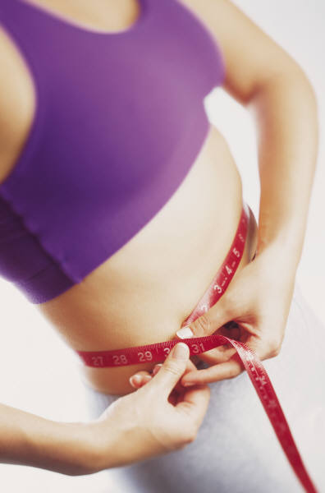
Cardio Metabolic Risk - 5 Hypers -
Hyperinsulinemia (resistance)
Hyperglycemia
Hyperlipidemia
Hypertension
Hyper”waistline”emia (35” women, 40” men)
Manifestations of Insulin Resistance

Slide 42
Metformin – 1st agent of choice
Action: decrease hepatic glucose (glycogen)
Metformin (Glucophage)
Starting dose: 500 BID, max 2500mg daily
Metformin XR - extended release – less GI upset
Efficacy:
Decrease fasting plasma glucose 60-70 mg/dl
Reduce A1C 1.0-2.0%
Benefits / Issues
Cheap, no weight gain; some lose weight, lowers LDL, no hypo
Not indicated if creat > 1.4-1.5 or GFR < 60 (cleared by kidney)
© Copyright 1999-2015, Diabetes Educational Services, All Rights Reserved.
Notes:
42
42
The mechanism of action of metformin is not entirely understood, but it's predominant effect is to suppress hepatic glucose production and to enhance insulin sensitivity in peripheral tissues (primarily muscle). It is unclear if insulin sensitivity occurs by metformin binding to cell receptors,which leads to an increase in glucose transporter expression, or whether insulin sensitivity is simply a secondary effect of the suppressed glucose production.
Metformin's ability to lower A1C and decrease fasting plasma glucose is similar to that of sulfonylurea drugs. However, the UKPDS showed that those who received metformin had less hypoglycemia and weight gain than those who received sulfonylureas.
Metformin must be avoided in patients with renal impairments, as those patients are at higher risk of experiencing lactic acidosis. However, metformin is an effective monotherapy and may be an ideal drug for overweight patients since it does not cause weight gain and has been seen to cause modest amounts of weight loss when first administered. Diarrhea and abdominal discomfort can be alleviated by changes in diet and slow increases in metformin dosage.

Slide 43
Diabetes Detectives Needed
On average – takes 6.5 years to diagnose diabetes
1/4 of all people with diabetes don’t know they have it

Slide 44
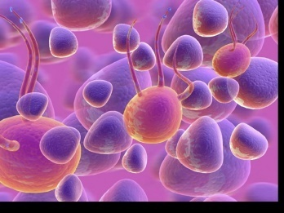
Ominous Octet
Decreased satiation neuro-
transmission
Increased renal glucose reabsorption
Decreased amylin, β-cell secretion
80% loss at dx
Decreased Gut hormones
Increased glucagon secretion
G
I
G
I
G
G
I
Increased lipolysis
I
G
G
G
I
I
G
G
I
Increase glucose
production
I
G
G
Decreased glucose
uptake
Notes:
44
44

Slide 45

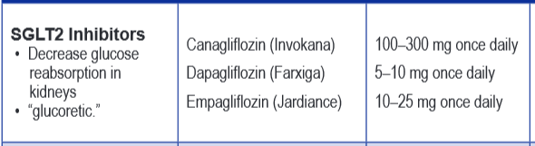
SGLT2 Inhibitors- “Glucoretics”
Action: “Glucoretic” decreases renal reabsorption in the proximal tubule of the kidneys (reset renal threshold and increase glycosuria)
Benefits: Lowers A1c 0.7 – 1.5%, lowers wt 1-3 lbs, no hypo
Issues: Can initially lower GFR, monitor kidney function and lytes. Watch for hypotension/ GU infections. Expensive
Decreases Glucose
Reabsorption
Notes:
45
45
Thiazolidinediones (TZDs) enhance insulin sensitivity in muscle and adipose tissue by binding to cell receptors,which leads to an increase in glucose transporter expression. TZDs encourage beta cells to respond more efficiently by lowering the amount of glucose and free fatty acids in the bloodstream, both of which are known to be detrimental to insulin secretion. Finally, these drugs reduce glucose production in the liver.
Clinical trials indicate that pioglitazone and rosiglitazone are slightly more effective at reducing A1C (1.5-1.6% reduction) than troglitazone (1.1% reduction).
Some of the beneficial side effects of thiazolidinediones include an increase in HDL cholesterol and reduction of triglyceride concentrations. This class of drugs has also been shown to lower blood pressure and decrease vascular inflammation in vitro. There are clinical studies underway to further examine the cardiovascular benefit to TZDs.
Some adverse effects of TZDs include weight gain, a potential increase in LDL cholesterol levels, and a possible increase in alanine aminotransferase levels (ALT). Because of the risk of weight gain, edema, and increased LDL cholesterol, thiazolidinediones are contraindicated in patients with advanced forms of congestive heart failure. Due to reported cases of liver failure and liver toxicity caused by the increase in ALT levels, TZDs are contraindicated in patients with abnormal liver function.
TZDs are the most expensive of the oral antidiabetic agents.

Slide 46
Comparison of Type 1 and Type 2
Type 1
Type 2
Obesity
x
xxx
Insulin dependence
xxx
30%
Respond to oral agents
0
xxx
Ketosis
xxx
x
Antibodies present
xxx
0
Typical Age of onset
teens
adult
Insulin Resistance
0
xxx

Slide 47
Other Causes of Hyperglycemia
Steroids
Agent Orange
Tube feedings / TPN
Transplant medications
Cystic Fibrosis
Regardless of cause, requires treatment
Insulin always works
Sign of pancreatic malfunction

Slide 48

Diabetes is also associated with:
Fatty liver disease
Obstructive sleep apnea
Cancer; pancreas, liver, breast
Alzheimer’s
Depression

Slide 49
Diabetes Bingo - “DiaBingo” Shout out Right Answer

Slide 50
DiaBingo
B Frequent skin and yeast infections
B A BMI of ____ or greater is considered overweight
B To reduce complications, control A1c, Blood pressure, Cholesterol
B PreDiabetes – fasting glucose level of ___ to ____
B Erectile dysfunction indicates greater risk for ____
B Diabetes – fasting glucose level____ or greater
B Type 1 diabetes is best described as an ______ disease
B People with diabetes are ______ times more likely to die of heart dx
B Elevated triglycerides, < HDL, smaller dense LDL
B Each percentage point of A1c = _____ mg/dl glucose
B At dx of type 2, about __% of the beta cell function is lost
B Diabetes – random glucose ____ or greater

Slide 51

Life Study – Mrs. Jones
Mrs. Jones is 62 years old, overweight and complaining of feeling tired and urinating several times a night. She is admitted with a urinary tract Infection. Her WBC is 12.3, glucose 237. She is hypertensive with a history of gestational diabetes. No ketones in urine.
What are her risk factors, signs of diabetes
What type of diabetes does she have?
Does she have insulin resistance?

Slide 52

Strategies – One Step at a Time, Focus on Survival Skills
Look for “teaching moment” opportunities

Slide 53
What Do You Say? Mrs. Jones asks you
What is type 2 diabetes?
Will this go away?
Will I get complications?
Will I need to take diabetes medication for the rest of my life?
How come I got diabetes?
Do I have to check my blood sugars?

Slide 54
I don’t want to!

Slide 55
No one is Unmotivated
…. to lead and long and healthy life
These are the 3 usual Critical Barriers
Perceived worthlessness
Too many personal obstacles
Absence of support and resources
Bill Polonsky, PhD, CDE

Slide 56
Overcoming barriers
Confront the key misbelief. Ask the question, does dm cause complications?
Offer pts evidence based hope message –
Frequent contact
Paired glucose testing
Ask pt, “Tell me 1 thing that is driving you crazy about your diabetes”
Discuss medication beliefs
To improve outcomes, see pts more often
Bill Polonsky, PhD, CDE

Slide 57
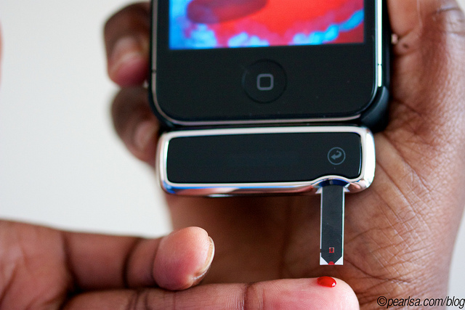
How Often Should I Check?
Be realistic!!
Type 2 on orals – Medicare covers 100 strips for 3 months
Based on individual - Consider:
Types and timing of meds
Goals
Ability (physical and emotional)
Finances / Insurance

Slide 58
How will it help me?
See if your treatment plan is working
Make decisions regarding food and/or med adjustment when exercising
Find out how that pizza affected your BG
Avoid unwanted weight gain
Enhanced athletic performance
Find patterns
Manage illness

Slide 59

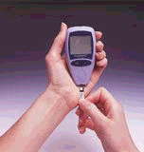
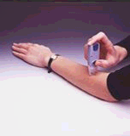
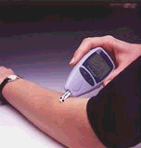
New Meters – a little goes a long way
0.3 microliters of blood
minimal pain
Customer Service (toll-free): Look for 800 number

Slide 60

Spiritual Care

Slide 61

“Getting diabetes saved my life.” ~ Sherri Sheperd
Sherri Shepard decided to embrace diabetes and use it as a motivator to improve her health.

Slide 62

Diabetes Vacations

Slide 63
Complications - Why?
Degree of hyperglycemia “glucose toxicity”
Duration of hyperglycemia
Genes
Multiple risk factors: smoking, vascular disease, dyslipidemia, hypertension, other

Slide 64

Diabetes Complications
Heart disease leading cause of death.
CAD death rates are about 2 -4x’s as high as adults without diabetes (it’s not getting better)
Risk of stroke is 2 - 4 times higher
60% - 65% of people with DM have HTN.
DM accounts for 40% of new cases of ESRD
60 - 70% have mild - severe forms of neuropathy
Diabetes is the leading cause of blindness
Accounts for 50% of lower limb amputations

Slide 65
Control Matters
Trials
Practice Recommendations

Slide 66

Financial Advisor
Mid 30s, friendly, he smiles to greet you and you notice his gums are inflamed. You’d guess a BMI of 26 or so, with most of the extra weight in the waist area.
If you could give him some health related suggestions, what would they be?

Slide 67

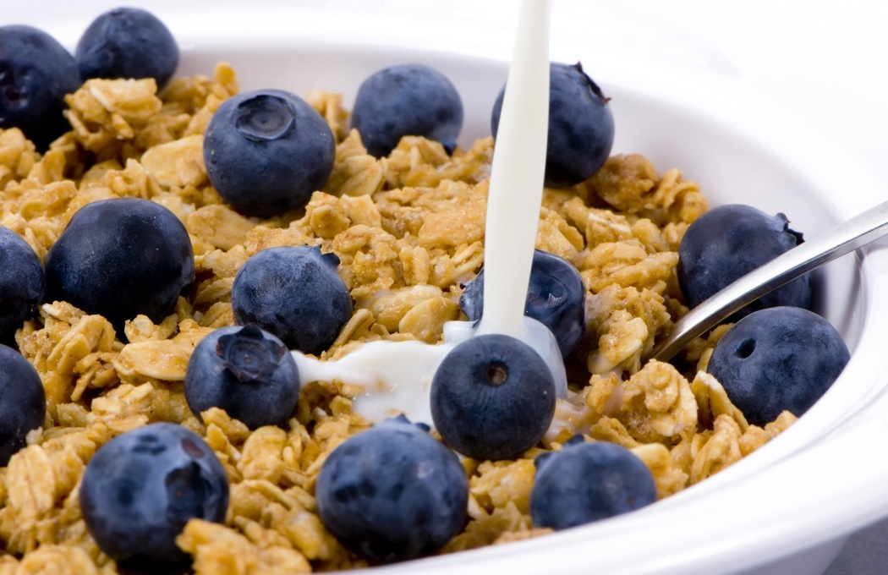


Preventing Pre Diabetes

Slide 68
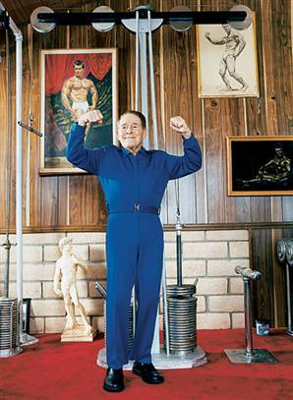
Can Type 2 be Prevented in Older Adults?
Overall, 9 of 10 new cases of diabetes attributable to these 5 lifestyle factors.
89% risk reduction when all at goal.
35% rel risk reduction for each additional
Physical activity (30 mins a day)
Dietary score (higher fiber intake, low saturated fat and trans-fat , lower mean glycemic index)
Not Smoking
Alcohol use (up to 2 drinks a day);
BMI <25 and waist circumference
Dariush Mozaffarian, MD,
Arch Intern Med. 2009;169(8):798-807.

Slide 69
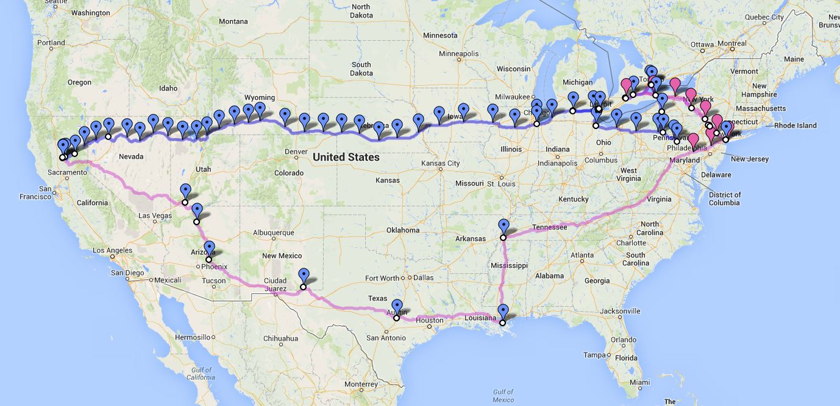
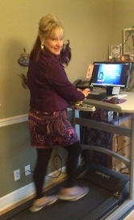
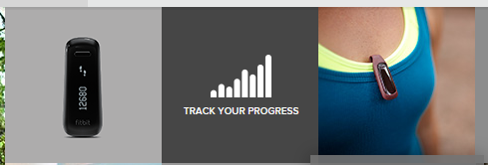
We Made It – 3129 miles- Now Walking Back
Track miles with fitbit
Fitbit.com
Lifespan Treadmill Desk - Amazon

Slide 70

Can we stop pre diabetes from progressing?
3, 234 people w/ Pre-Diabetes randomized:
Placebo
Diet/Exercise or
Metformin
over a three year period
Diabetes Prevention Program (DPP) 2001

Slide 71

Diabetes Prevention Program
Standard Group - 29% developed DM
Lifestyle Results - 14% developed DM
58% (71% for 60yrs +) Risk reduction
30 mins daily activity
5-7% of body wt loss
Metformin 850 BID - 22% developed DM
31% risk reduction (less effective with elderly and thinner pt’s)

Slide 72

Weight loss and Prevention
For every 2.2 pounds of weight loss, risk of type 2 diabetes was reduced by 13%.

Slide 73
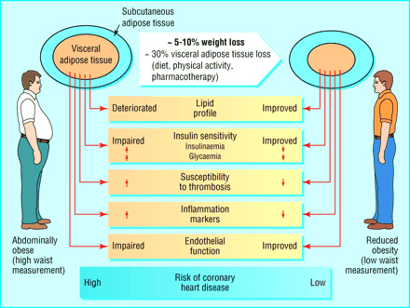

Slide 74

Goals of Care

Slide 75

ABCs of Diabetes –
A1c less than 7% (avg 3 month BG)
Pre-meal BG 80-130
Post meal BG <180
Blood Pressure < 140/90
Cholesterol
DM and 40 yrs, start statin
HDL >40
Triglyceride < 150
E xercise, Education
H ealthy Eating

Slide 76

1% decrease in A₁c reduces microvascular complications by 35%
1% decrease in A₁c reduces diabetes related deaths by 25%
B/P control (144/82) reduced risk of:
Heart failure (56%)
Stroke (44%)
Death from diabetes (32%)
Lancet 352: 837-865, 1998

Slide 77
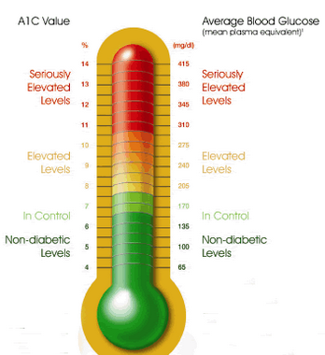
6. Glycemic Targets
Adult non pregnant A1c goals
A1c < 7% - a reasonable goal for adults.
A1c < 6.5% - may be appropriate for those without significant risk of hypoglycemia or other adverse effects of treatment.
A1c < 8% - may be appropriate for patients with history of hypoglycemia, limited life expectancy, or those with longstanding diabetes and vascular complications.

Slide 78
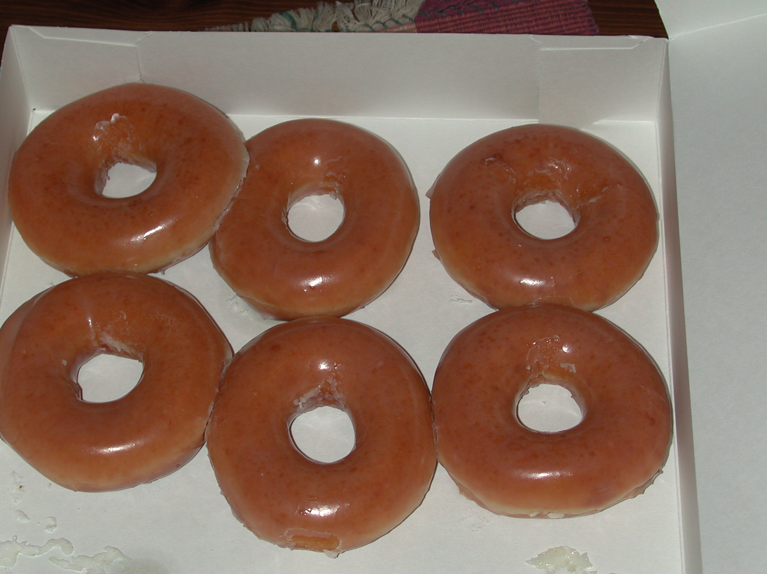


Slide 79

A1c and Estimated Avg Glucose (eAG) 2008
A1c (%) eAG
5 97
6 126
7 154
8 183
9 212
10 240
11 269
12 298
eAG = 28.7 x A1c-46.7 ~ 29 pts per 1%
Translating the A1c Assay Into Estimated Average Glucose Values – ADAG Study
Diabetes Care: 31, #8, August 2008
Order teaching tool kit free at diabetes.org

Slide 80

“Legacy Effect”
For participants of DCCT and UKPDS
long lasting benefit of early intensive BG control prevents
microvascular complications
Macrovascular complications (15-55% decrease)
Even though their BG levels increased over time
Message – Catch early and
Treat aggressively

Slide 81
ABCs of Diabetes –
A1c less than 7% (avg 3 month BG)
Pre-meal BG 80-130
Post meal BG <180
Blood Pressure < 140/90
Cholesterol
DM and 40 yrs, start statin
HDL >40
Triglyceride < 150
E xercise, Education
H ealthy Eating

Slide 82

Education
People with diabetes and pre diabetes should receive DSME
Monitor for effective self-management and quality of life
Address psychosocial issues and emotional well being
Results in cost savings and improved outcomes, should be reimbursed by third party payers.

Slide 83
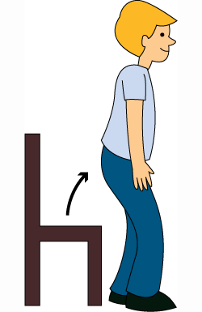
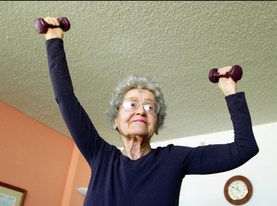
Exercise Recommendations
Activity update –Don’t sit more than 90 minutes
Evidence supports that everyone, including with diabetes should be encouraged to reduce sedentary time, by not sitting for more than 90 minutes at a time.
It is recommended that people with pre diabetes and diabetes engage in 150 minutes of activity a week and at least 2 weekly sessions of resistance exercise.

Slide 84
Good Exercise Info / Quotes
20 % of people walk 30 mins a day
Exercise decrease A1c 0.7%
No change in body wt, but 48% loss in visceral fat
ADA PostGrad 2010
“If you don’t have time for exercise, you better make time for disease.”
“I don’t have time to exercise, I MAKE time.”
Mike Huckabee

Slide 85
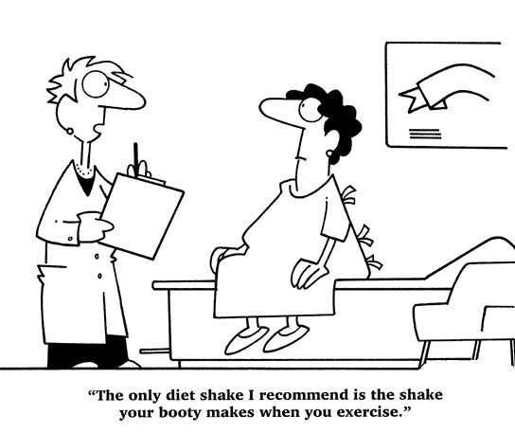
Best Shake For People with Diabetes
From Debbie Nagata’s slide collection

Slide 86
Vaccinations- Immunizations
Flu vaccine
every year starting 6 months
Pneumococcal starting at 2 years.
One time Revaccination for those over 64 and had first vaccine >5 years prior
Hepatitis B Vaccine
For diabetes pts age 19 – 59 (not previously vaccinated)
Double risk of Hep B due to lancing devices/ glucose meter exposure

Slide 87
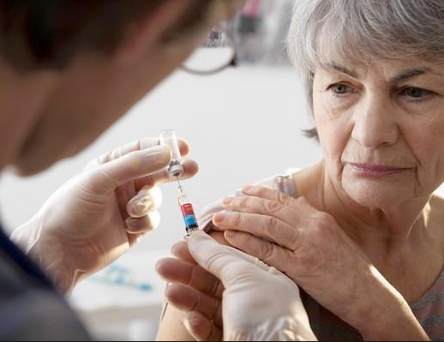
Pneumonia Vaccination Update
Pneumonia polysaccharide PPSV23 vaccine to all patients starting at age 2
Adults ≥ 65 years of age, if not previously vaccinated, should receive pneumococcal conjugate vaccine 13 (PCV13), followed by PPSV23 6-12 months after initial vaccination.
Adults ≥ 65 years of age, if previously vaccinated with PPSV23 should receive a follow-up ≥ 12 months with PCV13.

Slide 88
Diabetes Bingo “DiaBingo” Shout out Right Answer

Slide 89
DiaBingo- G
G ADA goal for A1c is less than ____%
G People with DM need to see their provider at least every month
G Blood pressure goal is less than
G People with DM should see eye doctor (ophthalmologist) at least
G The goal for triglyceride level is less than
G Goal for my HDL cholesterol is more than
G The goal for blood sugars 1-2 hours after a meal is less than:
G People with DM should get this shot every year
G People with DM need to get urine tested yearly for ___________
G Periodontal disease indicates increased risk for heart disease
G The goal for blood sugar levels before meals is:
G The activity goal is to do ___ minutes on most days

Slide 90
Mr. Jones - What are Your Recommendations?
Self-Care Skills
Walks dog around block 3 x’s a week
Bowls every Friday
3 beers daily
What meds?
What referrals?
My foot hurts
Admitted to hospital
Patient Profile
64 yr old with type 2 for 11 yrs. Hx of CVD.
Labs:
A1c 9.3%
HDL 37 mg/dl
Triglyceride 260mg/dl
Proteinuria - neg
B/P 152/94

Slide 91

Glucose Management and Hospitalized Patients
In hospitalized patients with critical illness, hyperglycemia is a signal that warrants our attention.

Slide 92

Hospitals and Hyperglycemia What’s the Big Deal?
Hyperglycemia is associated with increased morbidity and mortality in hospital settings.
Acute Myocardial Infarction
Stroke
Cardiac Surgery
Infection
Longer lengths of stay

Slide 93
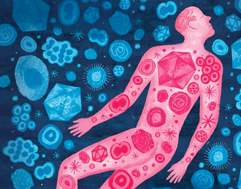
Stress response and hyperglycemia
Decreased WBC’s
Catabolism
Abnormal inflammatory response
Endothelial cell dysfunction
Increased clotting, blood viscosity
Tissue breakdown
Inflammatory changes
Increased blood pressure, pulse
Leads to: Longer lengths of stay, complications, death
Inflammation, “the body on fire”
Diabetes Care, v. 27, #2, Feb 2004

Slide 94
Hyperglycemia*: A Common Comorbidity in Medical-Surgical Patients in a Community Hospital
12%
26%
62%
Normoglycemia
n = 2,020
* Hyperglycemia: Fasting BG ≥ 126 mg/dl
or Random BG ≥ 200 mg/dl X 2
Known Diabetes
New Hyperglycemia
Umpierrez G et al, J Clin Endocrinol Metabol 87:978, 2002
Umpierrez et al
Notes:
In a more recent study that involved 2020 consecutive patients admitted to a community hospital in Atlanta, we found that 64% of patients had normal glucose values, 26% had a prior history of diabetes, and that 12% of patients with hyperglycemia, as determined by 2 or more FBG > 126 or RBG > 200, did not had a know history of diabetes prior to admission.

Slide 95
Effect of Hyperglycemia on Hospital Mortality
Prior history of
*
Mortality (%)
*
*
*P<.01 compared with normoglycemia and known diabetes.
Umpierrez GE et al. J Clin Endocrinol Metab. 2002;87:978-982.
Notes:
The medical records of 2030 consecutive adult patients were analyzed for the presence of hyperglycemia and any association with poor hospital outcomes.
New hyperglycemia was associated with a 16% mortality rate compared with 3% and 1.7% for patients with a prior history of diabetes or normoglycemia (P<.01).
The mortality rate was significantly higher for patients with new hyperglycemia regardless of whether they were admitted to the ICU (P<.01 for both ICU and non-ICU patients compared with those with diabetes or normoglycemia). Mortality rates were 10% for non-ICU patients with new hyperglycemia and 31% for ICU patients.
Reference
Umpierrez GE, Isaacs SD, Bazargan N, You X, Thaler LM, Kitabchi AE. Hyperglycemia: an independent marker of in-hospital mortality in patients with undiagnosed diabetes. J Clin Endocrinol Metab. 2002;87:978-982.

Slide 96

BG Above Normal = Trouble
Pre Diabetes
Fasting Glucose = 100-125mg/dl
A1c 5.7 – 6.4%
Diabetes
Fasting Glucose = 126 mg/dl +
Random Glucose = 200 mg/dl +
A1c 6.5% +
Any blood glucose above 140 requires treatment
Umpierrez et al

Slide 97
Diabetes Detectives Needed
On average – takes 6.5 years to diagnose diabetes
1/4 of all people with diabetes don’t know they have it

Slide 98
Recommendations for Managing Patients With Diabetes in the Hospital Setting
Antihyperglycemic Therapy
Insulin
Recommended
Oral DM Meds Not Generally Recommended
IV Insulin
Critically ill patients in the ICU
SC Insulin
Non-critically ill patients
Umpierrez et al
ACE/ADA Task Force on Inpatient Diabetes. Diabetes Care. 2006 & 2009
Diabetes Care. 2009;31(suppl 1):S1-S110..

Slide 99
Management of Hyperglycemia and Diabetes
Non-ICU
Basal/bolus therapy (MDI)
NPH and Regular insulin
Long-acting and rapid-acting insulin
Premixed insulin
ICU and Critical Care
Insulin Drips
Basal /Bolus

Slide 100
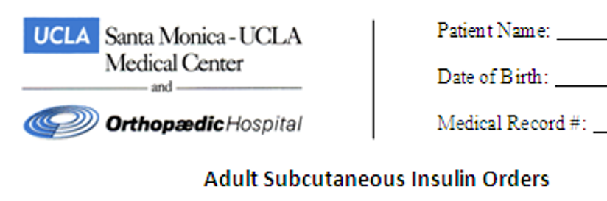
Glucose Goals For Hospitalized Patients
Sub-Q Insulin
Blood glucose goals:
Premeal 100 -140
Post meal <180
Insulin Drip Goals
glucose goal 140-180

Slide 101
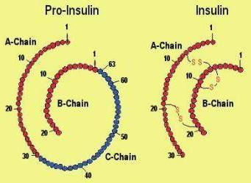
Insulin – the Ultimate Hormone Replacement Therapy
Objectives:
Discuss the actions of different insulins
Describe using pattern management as an insulin adjustment tool.

Slide 102
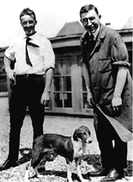

Slide 103
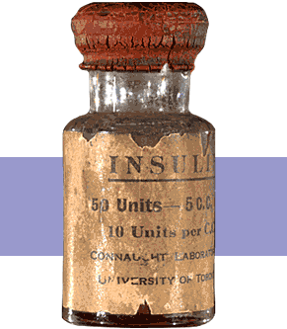
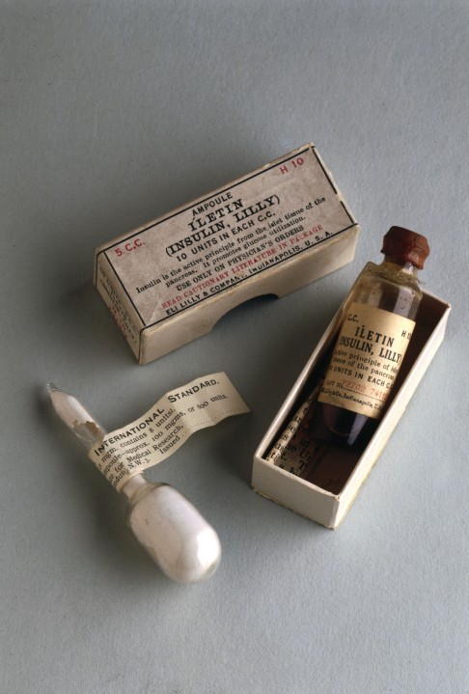
Insulin Finally Available - 1922

Slide 105
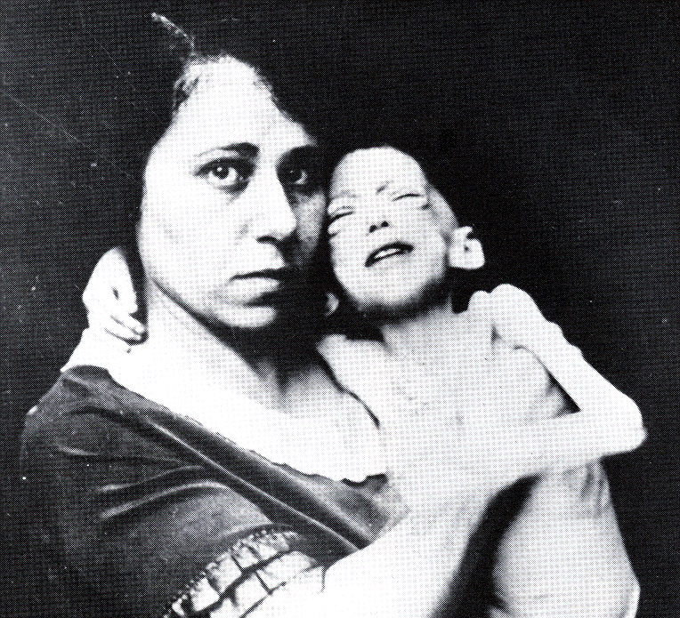

The Miracle of Insulin
The Miracle of Insulin
Patient J.L., December 15, 1922
February 15, 1923

Slide 106

Psychological Insulin Resistance (PIR)
50% of providers in study threatened pts “with the needle”.
Less than 50% of providers realized insulins’ positive effect on type 2 dm
Most pts don’t believe that insulin would “better help them manage their diabetes”.
Solutions: Find the root of PIR and address it, use more insulin pens
Diabetes Attitudes, Wishes, Needs Study - Rubin

Slide 107
Physiologic Insulin Secretion: 24-Hour Profile
50
Insulin
(µU/mL)
Bolus Insulin
25
0
Basal Insulin
Breakfast Lunch Dinner
150
Glucose
(mg/dL)
100
Mealtime Glucose
50
Basal Glucose
0
7
8
9
10
11
12
1
2
3
4
5
6
7
8
9
A.M.
P.M.
Time of Day

Slide 108

Life Study – Mrs. Jones
Mrs. Jones is 62 years old, a little heavy and complains of feeling tired and urinating several times a night. She is admitted with a urinary tract Infection. Her WBC is 12.3, glucose 237. She is hypertensive with a history of gestational diabetes. No ketones in urine.

Slide 109
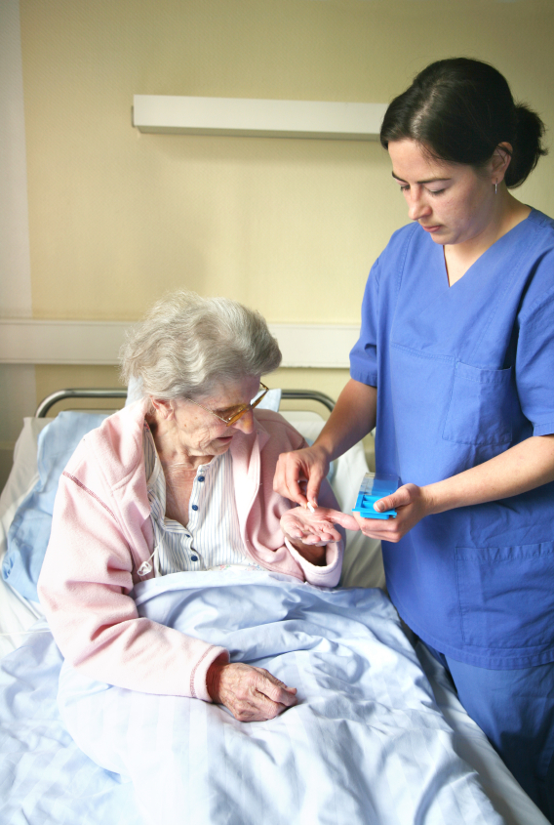
Life Study – Mrs. Jones
How would we manage her BG in hospital?

Slide 110
Initiating Insulin in Hospital
Stop oral agents - Obtain patient wt in kg
Calculate total daily dose (TDD) as 0.3-0.7 units per kg/day
Choose the dosing schedule
50% of TDD as basal insulin
50% of TDD as prandial or nutritional insulin
Use Correction Insulin for BG above goal
Adjust according to results of BSGM
Adjust dose for NPO status or changes in clinical status

Slide 111
Insulin Action Teams
Bolus: lowers after meal glucose levels
Rapid Acting
Aspart, Lispro, Glulisine
Short Acting
Regular
Basal: controls glucose between meals, hs
Intermediate
NPH
Long Acting
Detemir (Levemir)
Glargine (Lantus)

Slide 112
Bolus Insulins (½ of total daily dose ÷ meals)
Name Onset Peak Action
*Aspart (NovoLog) 5-15 min 0.5 -1.5 hrs
Lispro (Humalog)
Glulisine (Apidra)
*Aspart is insulin of choice
Short Acting – for gastroparesis patients
Regular 30 -60 min 2 - 3 hrs

Slide 113
Bolus Insulin Summary
Aspart, Humalog, Apidra, Regular
Starts working fast (15-30 mins)
Gets out fast (3-6 hours)
Post meal BG reflects effectiveness
Should comprise about ½ total daily dose
Covers food and/or hyperglycemia.
1 unit
Covers ≈ 10 -20 gms of carb
Lowers BG ≈ 30 – 50 points

Slide 114
More than 200 units a Day?
Consider U-500 (5 x’s more potent)
1 unit on U-100 syringe = 5 units insulin
Has basal/bolus properties
Dosing – based on individual patient
2 – 3 times a day
Safety is number one concern
Must have Endocrinology consult
TB Syringe must be used
U-500 Insulin: When More With Less Yields Success: Diabetes Spectrum March 20, 2009 vol. 22 no. 2 116-122

Slide 115
Dosing Conversion for U-500 using U-100 vs TB Syringe
U-500 Dose U-100 Insulin Syringe/5 TB Syringe x.002
25 5 0.05
50 10 0.1
75 ___ 0.15
___ 20 0.2
125 25 ____
150 ____ ____
175 35 ____
200 0.4

Slide 116
Dosing Conversion for U-500 using U-100 vs TB Syringe
U-500 Dose U-100 Insulin Syringe/5 TB Syringe x.002
25 5 0.05
50 10 0.1
75 15 0.15
100 20 0.2
125 25 0.25
150 30 0.3
175 35 0.35
200 40 0.4

Slide 117

Bolus Insulin Timing
How is the effectiveness of bolus insulin determined?
Before next meal blood glucose
Inpt Glucose goals (ADA) – may be modified by provider/pt
1-2 hours post meal <180
Before next meal – 100- 140

Slide 118
Insulin Therapy Components
Prandial or meal insulin – a bolus insulin that covers food, IV dextrose, enteral nutrition
Correction insulin – bolus insulin dosed to correct for hyperglycemia in addition to basal and meal insulin
Usually given before meals w/ prandial insulin
Basal insulin – long acting insulin covers between meals and through night

Slide 119
Choosing the Right Bolus Insulin Algorithm
Prandial –
Choose insulin:carb ratio
Correction –
Choose Algorithm

Slide 120

How Much Insulin? – Consider the Individual
It depends, based on:
Body weight
Overwt, normal wt, or thin
Frail, elderly
Eating status
Normal, poor intake or NPO
Renal or hepatic insufficiency
Type of Diabetes
Current meds; steroids, insulin, oral dm agents
Infected or Septic

Slide 121
Mealtime Bolus
Carbohydrate/ Prandial Coverage
Match the insulin to the carbohydrates
1 unit for 8gms Resistant
1 unit for 10 gms
1 unit for 15 gms
1 unit for 20 gms Sensitive
Adjust ratios depending on
Post meal glucose and patterns
Notes:
Importance of MD writing for a diabetic diet cannot be overemphasized. It sets into motion the timing of meals that are delivered, makes it easier for RN to know when to check glucose and administer the insulin.

Slide 122

Please calculate the following.
Ate 45 gms of carb
How much insulin?
1:8
1:10
1:15
Ate 75 gms of carb
How much insulin
1:10
1:20
1:15
__________________
Blood Glucose 84
Blood Glucose 147

Slide 123
Please calculate the following.
Ate 45 gms of carb
How much insulin?
1:8 – 5.5
1:10 – 4.5
1:15 - 3
Ate 75 gms of carb
How much insulin
1:10 – 7.5
1:20 - 3.5
1:15 - 5
________________
Blood Glucose 84
Blood Glucose 147

Slide 124
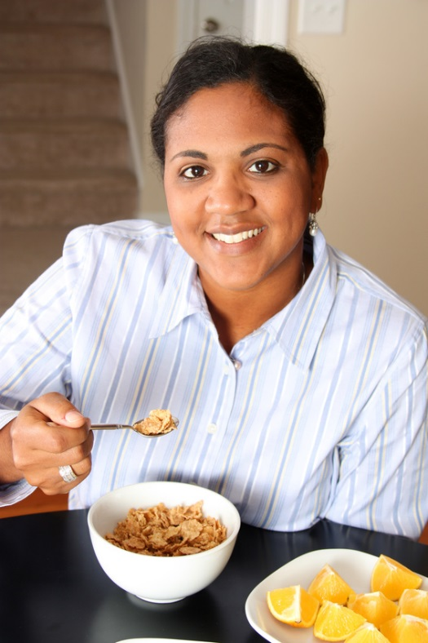
Max Carb Servings per Meal
Breakfast
45 gms
3 servings carb
Lunch / Dinner
75 gms or
5 servings carb

Slide 125
Now What?
Nurse administered insulin and pt only ate a few bites of turkey and drank non sugar tea?
Nurse had an emergency and pt already ate lunch?
You just gave 3 units of Aspart and patient needs to go to OR NOW!

Slide 126

Now that we covered food, what about Elevated BG?
That’s where the Correction Bolus comes into play.

Slide 127
Calculating Correction Bolus
Algorithm 1
Insulin Sensitive - BMI < 20, Type 1, ESRD
Algorithm 2
For avg pt, BMI 20-29, Known Type 2
Algorithm 3
Insulin resistant pt - Obese, on steroids
Consider continuing usual home insulin dose

Slide 128
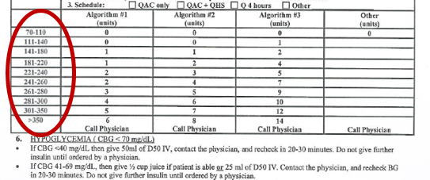
Correction Bolus

Slide 129

For following BG levels- How much corrective insulin?
BG Alg 1 Alg 2 Alg 3
74
159
378

Slide 130
For following BG levels- How much corrective insulin?
BG Alg 1 Alg 2 Alg 3
74 0 0 0
159 1 1 2
378* 6 8 14
*Notify MD

Slide 131
Basal Insulins (½ of total daily dose)
Long Acting Peak Action Duration
Detemir (Levemir) No peak 6 - 24 hrs
Glargine (Lantus) No peak 20- 24 hrs
Intermediate Acting Peak Action Duration
NPH 4-10 hrs 10-16
Fasting BG reflects efficacy of basal

Slide 132
Basal Insulin Summary
NPH, Levemir, Lantus
Covers in between meals, through night
Starts working slow (4 hours)
Stays in long (12-24 hours)
NPH 12 hrs
Levemir, Lantus 20-24 hrs
Fasting blood glucose reflects effectiveness

Slide 133
Combination SQ Insulin

Slide 134
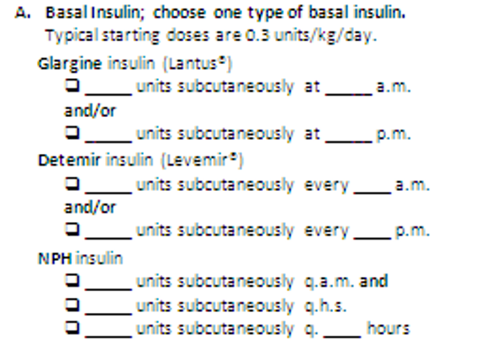

Slide 135
Calculate Basal Insulin Needs
Typical starting dose
Body wt in Kg x .3
May need more or less based on clinical presentation
10 units common starting dose
Less 0.1 u/kg 0.2u/kg More 0.35 u/kg
Thin, elderly,  creat Heavy, infection, steroids

Slide 136
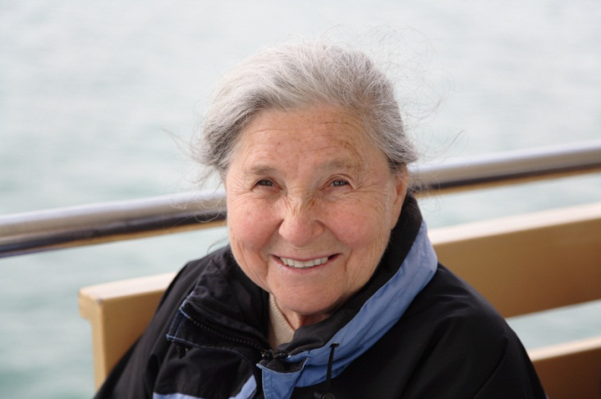
Inpt Study – Mrs. Jones
Mrs. Jones is 62 years old, weighs 70kg and complains of feeling tired and urinating several times a night. She is admitted with a urinary tract Infection. Her WBC is 12.3,
BG 237
A1c 8.9%
Creat 1.1
BMI 25
What insulin dose would we start Mrs. Jones on?

Slide 137

Insulin Dose – Mrs. Jones
Basal
0.3u/ins x 70 kg = 21units
Insulin/Carb ratio
1:15
Why?
Depends on clinical picture and other oral meds
Average weight, good oral intake, type 2

Slide 138

Corrective Insulin – Novolog – Algorithm 2 Rapid/Fast Acting Insulin
Blood Glucose Insulin Dose 70-110 0 unit 111-140 0 unit 141-180 1 unit 181-220 2 unit 221-240 3 units 241-260 4 units 261-280 5 units 281-300 6 units 301-350 7 units >350 8 units and call MD

Slide 139
Mrs. Jones – Carb 1:15 Alg 2 correction, 21 unit Lantus hs

Slide 140

Preparation for Surgery
Try to schedule surgery in am, resume meds/insulin when eating and stable.
Basal Insulin: Night before
Lantus/Detemir – 100%
NPH –
Give 100% night before
50% am dose
Corrective insulin dose: as prescribed
Have D5 or D10 IV available in case of hypo

Slide 141

BG Running Low?
Possible Causes
Too much insulin
Premeal bolus
HS basal
Glucose toxicity improving
Infection improving
Stopped/lowered steroids
Poor kidney function
Skipped meal, poor PO intake
Not eating enough carbs

Slide 142

Hypoglycemia Symptoms
Neuroglycopenia
Irritability
Drowsiness
Dizziness
Blurred Vision
Difficulty with speech
Confusion
Feeling faint
Autonomic
Anxiety
Palpitations
Sweating
Tingling
Trembling
Hypoglycemic Unawareness

Slide 143

Hypoglycemia – The Limiting Factor
Defined as BG of 70mg/dl or below
50% of episodes occur during night
Higher mortality rate with severe hypoglycemia secondary to sulfonylureas
Especially (glyburide) Micronase®, Diabeta®
Blood glucose levels don’t describe severity, response is individual

Slide 144
UCLA Hypo Guidelines
BG 41 – 69 mg/dl
BG <40 mg/dl
Give 50 ml D50 IV
Contact MD
Recheck and retreat every 15 minutes until BG > 70
DO NOT give further insulin until ordered by MD
If eating:
½ cup of juice
Not eating
25 ml of D50 IV
Contact MD
Recheck and retreat every 15 mins until BG > 70
DO NOT give further insulin until ordered by MD

Slide 145
15 - 20 Gms Carb Sources
3 - 4 Glucose Tablets
8 - 10 Lifesavers candy
2 to 3 peppermints
2 Tablespoons Raisins
4 - 6 oz’s Nondiet soda
4 oz’s Fruit Juice
8 oz Milk (non fat)
Peds – 15 Skittles

Slide 146
BG Too Low? Insulin Adjustment Guidelines
Before meal Blood glucose <70?
Implement hypoglycemia protocol
Evaluate cause and make needed adjustments
Missed meal?
Too much insulin?
Morning blood glucose < 100?
Decrease evening Lantus
Evaluate trends, provide feedback

Slide 147

Mrs. Jones ready to go home.
What glucose management strategies for home?
Her A1c = 8.9%
Creat 1.1
BMI 25

Slide 148
Discharge insulin Algorithm
Discharge Treatment
A1C < 7%
A1C 7%-9%
A1C >9%
Re-start outpatient treatment regimen
(Orals and/or insulin)
Re-start outpatient oral agents and D/C on glargine once daily at 50-80% of hospital dose
D/C on basal bolus at same hospital dose.
Alternative: re-start oral agents and D/C on glargine once daily at 50-80% of hospital dose
Clinical Guidelines for the Managment of Hyperglycemia in Hospitalized Patients in a Non-Critical Care Setting

Slide 149

Discharge Teaching
What supplies will she need?
What top 5 things do we need to teach her?
What resources can we provide?
What referrals?

Slide 150

5 Survival Skills
Basics of Diabetes
Can patient perform self blood glucose monitoring? Do they need meter?
Can pt safely take meds / insulin? Teach side effects.
Meal Planning?
Self Care
Follow-Up plan - Does pt know who to contact when need help?

Slide 151

When to Call Provider?*
Blood glucose <70
Blood glucose > 250 twice in a day (adults)
Blood glucose >300 anytime, adults and peds
*When sick
*Individualize based on pt/provider

Slide 152

Mr. R has a foot ulceration How Much Insulin Needed?
Creatinine 1.6
76 years old
Not very hungry
BMI 19
Weighs 80kg
Glucotrol 5mg at home
A1c 7.2%

Slide 153
Foot Care
Lift the sheets and look at the Feets!

Slide 154

Foot Wounds
Blisters Ulcers Bone infection
Calluses

Slide 155
A Quick Foot Assessment
Ask - What do you do to take care of your feet?
Look - texture, toenails, structural deformities, lesions, corns
Assess sensation
Assess risk factors
Teach, teach, teach

Slide 156


Slide 157
Calculate Basal Insulin Needs
Typical starting dose
Body wt in Kg x .3
May need more or less based on clinical presentation
10 units common starting dose
Less 0.1 u/kg 0.2u/kg More 0.35 u/kg
Thin, elderly,  creat Heavy, infection, steroids

Slide 158
Calculate Insulin Needs Basal/ insulin carb/ correct
Body wt in Kg x 0.2
80kg x 0.2 = 16 units once daily
What insulin:carb ratio?
1:20
What correction alg?
Alg 1

Slide 159
Corrective Insulin – Novolog – Algorithm 1 Rapid/Fast Acting Insulin
Blood Glucose Insulin Dose 70-110 0 unit 111-140 0 unit 141-180 1 unit 181-220 1 unit 221-240 2 units 241-260 2 units 261-280 3 units 281-300 4 units 301-350 5 units >350 6 units and call MD)

Slide 160
3 days poor intake, pt started on Tube Feeding
If on continuous tube feeding, how would this change his insulin regimen?
If on intermittent tube feeding, how would this change his insulin regimen?
If patients tube feeding is interrupted, what precautions would you take?

Slide 161
Mr. R- Pattern – meal + correction Algorithm 1 plus 16u Lantus hs

Slide 162
Glycemic Management of the Patient Receiving Enteral Nutrition
Continuous enteral nutrition (EN)
Basal insulin: NPH Q8 or Q12
Prandial bolus insulin: to match the feeding
Cycled enteral nutrition
Based on situation: possibilities include:
Basal insulin
Bolus insulin administered q4 to 6 hours
Correctional insulin given for BG above goal
Bolus enteral nutrition
Rapid acting analog or short acting insulin given prior to each bolus
If tube pulled out, hang D10% at 40cc/hr

Slide 163


Slide 164
Mr. R after 9 days feeling better, non wt bearing R. Foot. Eating again, regaining strength. DC today.
What supplies will he need?
What top 3 things do we need to teach him?
What resources and referrals?

Slide 165



No Bathroom Surgery

Slide 166

5.07 monofilament = 10gms linear pressure If pt can’t feel pressure = neuropathy
Free Monofilaments
http://www.hrsa.gov/leap/

Slide 167
3 Most Important Foot Care Tips
Three Most Important Foot Care Tips
Inspect and apply lotion to your feet every night before you go to bed.
Do NOT go barefoot, even in your house. Always wear shoes!
Every time you see your doctor, take off your shoes and show your feet.

Slide 168
Glucose Management for DC?
Creatinine 1.6
76 years old
Not very hungry
BMI 19
Weighs 80kg
Glucotrol 5mg at home
A1c 7.2%

Slide 169
Discharge insulin Algorithm
Discharge Treatment
A1C < 7%
A1C 7%-9%
A1C >9%
Re-start outpatient treatment regimen
(Orals and/or insulin)
Re-start outpatient oral agents and D/C on glargine once daily at 50-80% of hospital dose
D/C on basal bolus at same hospital dose.
Alternative: re-start oral agents and D/C on glargine once daily at 50-80% of hospital dose
Clinical Guidelines for the Management of Hyperglycemia in Hospitalized Patients in a Non-Critical Care Setting

Slide 170
5 Survival Skills
Basics of Diabetes
Can patient perform self blood glucose monitoring? Do they need meter?
Can pt safely take meds / insulin? Teach side effects.
Meal Planning?
Self Care
Follow-Up plan - Does pt know who to contact when need help?

Slide 171

How Much Insulin Needed? Mr. K
Wt 120kg – BMI 31
Creat 0.9
Infected Foot Ulcer
Asthma
Meds
Metformin
Exenatide (ran out)
Actos (worried about ankles swelling)
A1c 10.8%

Slide 172

Started on Prednisone 60mg qd for Asthma
Blood glucose levels running 300-500.

Slide 173

BG Running High?
Possible Causes
Glucose Toxic
Infection
Started on steroids
Physical stress
Insulin dose too low

Slide 174
BG Too High? Insulin Adjustment Guidelines
Morning BG > 140?
Consider:
Could pt be having nocturnal hypo?
Increasing evening Lantus by 10%
Pre Lunch/Dinner BG > 140?
Post meal BG > 180?
Consider:
Increasing mealtime coverage
Increasing insulin correction scale

Slide 175
Calculate Insulin Needs Basal/ insulin carb/ correct
Body wt in Kg x 0.3
120kg x 0.3 = 36 units once daily
What insulin:carb ratio?
1:10
What correction alg?
Alg 3

Slide 176
Corrective Novolog Insulin Resistant - Algorithm 3 Insulin Resistant, BMI >30, Steroids
Blood Glucose Insulin Dose 70-110 0 unit 111-140 1 unit 141-180 2 unit 181-220 4 unit 221-240 5 units 241-260 7 units 261-280 9 units 281-300 10 units 301-350 12 units >350 14 units and call MD)

Slide 177
Mr. K- Pattern (1:10 carb ratio, Algorithm 3 and 36 Lantus am

Slide 178
Mr. K BG Levels Too High Insulin Drip Started
100 units insulin in 100 cc NS Bag
1 cc = 1unit of insulin

Slide 179

IV Insulin Infusion
Give extra IV Push insulin x 1 if initial:
BG 200 -300 – 5units
BG >300 10 units
Monitor BG Q 1 hour for first 4 hours or if BG <100 or >200. Otherwise, monitor Q 2 hours.

Slide 180
Initial Infusion Rate
3 algorithms:
A = insulin sensitive BMI ≤25
B = insulin resistant BMI ≥ 30
C = Special order only
Custom
If patient eating, also needs novolog at meals

Slide 181

Don’t Stop Insulin Infusion…
Before giving Sub Q Basal insulin!
Give SubQ 2 hours before stopping drip

Slide 182
What Glucose Managment Strategy for Discharge?
Waistline 46”
Infected Foot Ulcer
A1c 10.8%
Creat 1.3
Asthma (on pred)
Meds?
Basal/Bolus Insulin
Metformin

Slide 183
Discharge insulin Algorithm
Discharge Treatment
A1C < 7%
A1C 7%-9%
A1C >9%
Re-start outpatient treatment regimen
(Orals and/or insulin)
Re-start outpatient oral agents and D/C on glargine once daily at 50-80% of hospital dose
D/C on basal bolus at same hospital dose.
Alternative: re-start oral agents and D/C on glargine once daily at 50-80% of hospital dose
Clinical Guidelines for the Management of Hyperglycemia in Hospitalized Patients in a Non-Critical Care Setting

Slide 184

MR K. Stable, ready for discharge.
What is your biggest concern?
What supplies will he need?
What top 3 things do we need to teach him?
What resources and referrals?

Slide 185
Insulin Teaching Keys
Bolus insulin with meals
Basal 1-2xs daily
Can’t mix Glargine or Detemir with other insulins
Abdomen preferred injection site
Stay 1” away from previous site
Can re-use syringes if patient at low risk for infection
Keep unopened insulin in refrigerator
Toss opened insulin vial after 28 days
Proper disposal
Review patients ability to withdraw and inject.
Side effects include hypoglycemia/wt gain

Slide 186
5 Survival Skills
Basics of Diabetes
Can patient perform self blood glucose monitoring? Do they need meter?
Can pt safely take meds / insulin? Teach side effects.
Meal Planning?
Self Care
Follow-Up plan - Does pt know who to contact when need help?

Slide 187
Diabetes Bingo - “DiaBingo” Shout out Right Answer

Slide 188
DiaBingo - I
I Inhaled insulin
I Glargine, Detemir, NPH are types of
I Breakdown of glycogen into glucose
I Anabolic hormone
I Insulin is released when glucose levels are low
I Once opened, insulin vials are good for one _____
I Elevated post-prandial glucose indicate need for pre-meaI
I Epinephrine increases insulin resistance
I Creation of glucose from amino acids and lactate
I Decreasing renal function for people on insulin can cause
I Bolus insulins
I A hormone that increases blood glucose levels

Slide 189


Slide 190


U.S. Weight - 68% overweight or obese
34% BMI 25-29
34% BMI 30 +
1/3 of all overwt people don’t get diabetes
We burn 100 cals less a day at work
Overall, food costs ~ 10-15% of income
Calorie Intake is on the rise

Slide 191

Bigger Meals, Bigger Kids

Slide 192

Average American Consumes 25 teaspoons of sugar a day (400 cals)
Warning label on sodas proposed
One soda has 12 teaspoons soda
On avg, 1 person consumes 40 gallons of soda each year
ADA guidelines “limit sodas and beverages with sugar, High Fructose Corn Syrup, (HFCS)

Slide 193

Medical Nutrition Therapy – ADA 2014 Updates
No ideal percentage of calories from protein, carbohydrate and fat for people with diabetes.
Macronutrient distribution should be based on an individualized assessment of eating patterns, preferences and metabolic goals.

Slide 194
Medical Nutrition Therapy – ADA
Focus on the Individual
Maintain pleasure of eating
Provide positive messages about food
Limit food choices only when backed by science
Provide practical tools
Refer to a RD and Diabetes Education – Lowers A1c by 1-2%

Slide 195

Approach Depends on Patient
New Type 2
Portion Control
Plate Method
Record Keeping
Education
On Insulin?
Carb counting
Post prandial checks

Slide 196

What are next steps?
72 yr old, thin, lives alone, A1c 7.3%. History of MI, stroke. DM for 12 yrs, “diet controlled”. Limited income. Creat 1.4.

Slide 197
DPP-4 Inhibitors – “Incretin Enhancers” Januvia (sitagliptin) – Tradjenta (linagliptin) Onglyza (saxagliptin) Nesina (alogliptin)
Action:
Increase insulin release w/ meals
Suppress glucagon
Dosing: Januvia – 100mg a day
Onglyza – up to 5mg a day
Tradjenta – 5mg a day
Nesina – up to 25 mg a day
Efficacy: Decreases A1c by 0.6 -0.8%
Benefits/ Issues: weight neutral, no hypo, few side effects. Expensive
Notes:
197
197

Slide 198
Losing 2-8kg Early in diagnosis Type 2 Helpful ADA 2014
Weight Loss –
The optimal macronutrient intake to lose weight not known
The literature does not support one particular nutrition therapy to reduce weight, but rather a spectrum of eating patterns that result in reduced energy intake.
To lose one pound – avoid 3,500 cals
Decrease intake 250-500 cals daily + exercise

Slide 199

Successful weight loss strategies include
Weekly self-weighing
Eat breakfast
Reduce fast food intake.
Decrease portion size
Increase physical activity
Use meal replacements
Eat healthy foods

Slide 200

Diabetes Prevention Program Focus on fat = wt loss success
http://www.cdc.gov/diabetes/prevention/recognition/curriculum.htm

Slide 201
How nutrients affect blood sugar

Slide 202

Teaching About Eating Healthy
Major food groups
“Handy Diet”
Plate Method
Exchange Lists
Food Diaries / Glucose Records
Carbohydrate Counting
Assess what is best for the situation.

Slide 203






Move toward the Tomato

Slide 204


ADA recommendation Eat Less Junk Food & Sugary Drinks –
Less Processed Foods
Less Sugary Beverages
increase visceral adiposity
With sugar or
High fructose corn syrup
Soda Tax?
Junk Food Tax?
12 teaspoons sugar in one soda

Slide 205
10 Superfoods
Beans
Dark Green Leafy Vegs
Citrus Fruit
Sweet Potatoes
Berries
Tomatoes
Fish High in Omega-3 Fatty Acids
Whole Grains
Nuts
Fat-Free Milk and Yogurt

Slide 206
USDA Plate Method www.myplate.gov
Balancing Calories
Enjoy your food, but eat less.
Avoid oversized portions.
Foods to Increase
Make half your plate fruits and vegetables.
Make at least half your grains whole grains.
Switch to fat-free or low-fat (1%) milk.
Foods to Reduce
Compare sodium in foods like soup, bread, and frozen meals ― and choose the foods with lower numbers.
Drink water instead of sugary drinks.

Slide 207

Another plate example

Slide 208

Nutrition Facts
Serving Size 1/2 cup (114 g)
Servings Per Container 4
Amount Per Serving
Calories 90 Calories from Fat 30
Fooducate App – gives grade and nutrition info.
% Daily Value*
Total Fat 3g 5%
Saturated Fat 0g 0%
Cholesterol 0g 0%
Sodium 300mg 13%
Total Carbohydrate 13g 4%
Dietary Fiber 3g 12%
1 tsp sugar =4 gms
Sugars 3g
Protein 3g
Vitamin A 80% * Vitamin C 60%
Calcium 4% * Iron 4%
* Percent Daily Values are based on a 2,000 calorie diet. Your daily values may be higher or lower depending on your calorie needs:
Calories _ 2000 2500
Total Fat Less than 65g 80g
Sat Fat Less than 20g 25g
Cholesterol Less than 300mg 300mg
Sodium Less than 2400mg 2400mg
Total Carbohydrate 300g 375g
Fiber 25g 30g
Calories per gram: Fat 9 Carbohydrates 4 Protein 4

Slide 209

Carbs affect Post meal Blood Glucose
Starch
Fruit
Milk
Desserts

Slide 210

Carbohydrate Needs for Most Adults
Grams Servings
Each Meal 45-60 gm 3 - 4
Snacks 15-30 gm 1- 2
Carbs affect Post Meal Blood Glucose

Slide 211

Choose Healthy Carbs
Carbs have fiber, vitamins, minerals and phytonutrients
25 gms of fiber a day
Power Carbs include:
Beans
Veggies
Fruits
Whole grain foods

Slide 212










Carb Counting - Starch
Each Food has:
80 Calories
15 grams carb
1 small ear of corn or 1/2 cup corn
1/3 cup cooked pasta
1/2 cup
cooked beans
3/4 cup cold cereal
1 slice bread
1/3 cup cooked rice
1 small potato
1/2 English muffin
1 small tortilla
5-6 small crackers

Slide 213









Carb counting- fruit
Each Food has:
60 Calories
15 grams carb
½ cup fruit juice
½ banana
1 small fresh fruit
½ cup unsweetened apple sauce
1 slice bread
17 small grapes
1 cup melon
¼ cup dried fruit
2 tbsp raisins
1 1/4 cup strawberries

Slide 214







Carb Counting - Milk
Each Food has:
90-150 calories
12-15 grams carb
8 oz buttermilk
1 packet diet hot cocoa
1 slice bread
6 oz plain yogurt
8 oz milk
6 oz light fruit yogurt
8 oz soy milk

Slide 215









Carb Counting - Sweets
Each Food has:
Calories vary
15 grams carb
2 inch square cake or brownie, unfrosted
½ cup regular jello
2 tbsp light syrup
½ cup diet pudding
1 slice bread
1 tbsp syrup, jam, jelly, table sugar, honey
2 small cookies
¼ cup sorbet
½ cup ice cream or frozen yogurt
½ cup sherbet

Slide 216
Using Alcohol Safely
Women- 1 or fewer alcoholic drinks a day
Men 2 or fewer alcoholic drinks a day
1 alcoholic drink equals
12 oz beer, 5 oz glass of wine, or 1.5 oz distilled spirits (vodka, gin etc)
If drink, limit amount and drink w/ food.
Ask HCP if safe for you to drink. Tell them your usual quantity and frequency.
Can cause hypo and worsen neuropathy

Slide 217
Ms. Gonzales’ Daily Meal plan

Slide 218

Diabetes Bingo - “DiaBingo” Shout out Right Answer

Slide 219
DiaBingo - N
N DPP demonstrated that exercise and diet reduced risk of DM by ___%
N An _______a day can help prevent heart attack and stroke
N Rebound hyperglycemia
N Scare tactics are effective at motivating patients to change behavior
N Losing ___ % of body weight, can improve blood glucose, BP, lipids
N Drugs that can cause hyperglycemia
N 2/3 cups of rice equals ______ serving carbohydrate
N A1c of 7% equals glucose of
N One % drop in A1c reduces risk of complications by ___ %
N 1 gm of fat equal _____kilo/calories
N Metabolic syndrome = hyperglycemia, hyperlipidemia, hypertension
N Average American consumes 25 teaspoons of sugar a day.

Slide 220

Thank You
Questions?
Email bev@diabetesed.net
Web www.DiabetesEd.net

