Slide 1

5 Things you Can do to Prevent diabetes
Beverly Thomassian, RN, MPH, CDE, BC-ADM
Diabetes Nurse Specialist for a really long time.

Slide 2

Goals for Today
Gain momentum toward better health
Move toward the tomato
Getting creative with activity
Debunking diabetes myths
Keeping it positive – Be your own best coach

Slide 3
CDC Announces
1 in 3 Americans may have Diabetes by 2050
Boyle, Thompson, Barker, Williamson
2010, Oct 22:8(1)29
www.pophealthmetrics.com

Slide 4


Slide 5
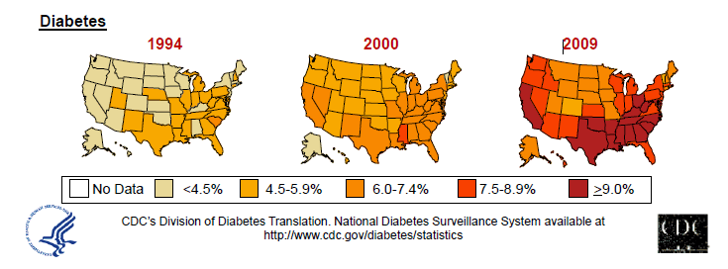
Diabetes in America 2014
29 million 9.3%
79 million have pre diabetes
New cases increased 90% in past 10 years.
4.8 per 1,000 people during 1995-1997 to
9.1 per 1,000 in 2005-2007 in 33 states.
CDC 2011

Slide 6


Slide 7
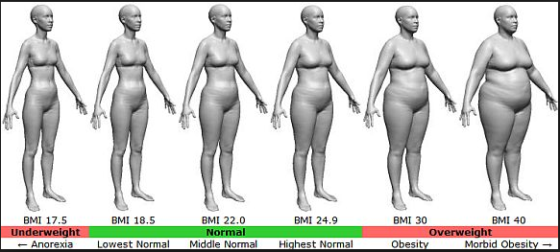
BMI – Visual Image

Slide 8




Slide 9

Diabetes 2 - Who is at Risk? (ADA Clinical Practice Guidelines)
Testing should be considered in all adults who are overweight (BMI ≥ 25) and have additional risk factors:
First-degree relative w/ diabetes
Member of a high-risk ethnic population
Habitual physical inactivity
PreDiabetes
History of heart disease

Slide 10
Diabetes 2 - Who is at Risk? (ADA Clinical Practice Guidelines)
Risk factors cont’d
HTN - BP > 140/90
HDL < 35 or triglycerides > 250
baby >9 lb or history of Gestational Diabetes Mellitus (GDM
Polycystic ovary syndrome (PCOS)
Other conditions assoc w/ insulin resistance:
Severe obesity, acanthosis nigricans (AN)

Slide 11

Signs of Diabetes
Polyuria
Polydipsia
Polyphasia
Weight loss
Fatigue
Skin and other
infections
Blurry vision
Glycosuria, H₂O losses
Dehydration
Fuel Depletion
Loss of body tissue, H₂O
Poor energy utilization
Hyperglycemia increases incidence of infection
Osmotic changes

Slide 12

Preventing Diabetes

Slide 13

Can Type 2 be Prevented in Older Adults?
Overall, 9 of 10 new cases of diabetes attributable to these 5 lifestyle factors.
89% risk reduction when all at goal.
35% rel risk reduction for each additional
Physical activity (30 mins a day)
Dietary score (higher fiber intake, low saturated fat and trans-fat, lower mean glycemic index)
Not Smoking
Alcohol use (up to 2 drinks a day);
BMI <25 and waist circumference
Dariush Mozaffarian, MD,
Arch Intern Med. 2009;169(8):798-807.

Slide 14

Financial Advisor
Mid 30s, friendly, he smiles to greet you and you notice his gums are inflamed. You’d guess a BMI of 26 or so, with most of the extra weight in the waist area.
If you could give him some health related suggestions, what would they be?

Slide 15

Can we stop pre diabetes from progressing?
3, 234 people w/ Pre-Diabetes randomized:
Placebo
Diet/Exercise or
Metformin
over a three year period
Diabetes Prevention Program (DPP) 2001

Slide 16

Diabetes Prevention Program
Standard Group - 29% developed DM
Lifestyle Results - 14% developed DM
58% (71% for 60yrs +) Risk reduction
30 mins daily activity
5-7% of body wt loss
Metformin 850 BID - 22% developed DM
31% risk reduction (less effective with elderly and thinner pt’s)

Slide 17
Natural History of Diabetes
Normal
FBG <100
Random <140
A1c <5.7%
Prediabetes
FBG 100-125
Random 140 - 199
A1c ~ 5.7- 6.4%
50% working pancreas
Diabetes
FBG 126 +
Random 200 +
A1c 6.5% or +
20% working pancreas
Yes!
NO
Development of type 2 diabetes happens over years or decades

Slide 18
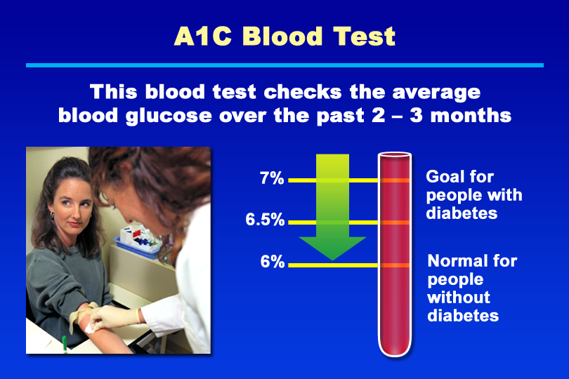
A1C Blood Test
Notes:
KEY MESSAGE: The A1C test measures a person’s average blood glucose over the previous 2 to 3 months.
Supporting Points
The A1C test is used to monitor blood glucose control. The test measures the level of glycosylated hemoglobin, which forms when glucose binds to hemoglobin in red blood cells. Because the lifespan of red blood cells is approximately 120 days, the glycosylated hemoglobin level is a good measure of average blood glucose over the past 2 to 3 months.
The American Diabetes Association recommends an A1C goal of less than 7% for people with diabetes. In people without diabetes, the normal A1C level is below 6%. For most people with diabetes, the A1C test is recommended at least twice yearly. Some people are advised to have more frequent (quarterly) A1C testing. An A1C value of 8% or higher almost always necessitates a change in the person’s treatment plan.
The American College of Endocrinology (ACE) and American Association of Clinical Endocrinology (AACE) recommend an A1C goal of 6.5% or less. An ACE consensus panel recommended this lower A1C goal to further reduce the risk of complications in people with diabetes. The American Association of Diabetes Educators has stated its support of this lower A1C goal.* The ADA recommends considering more stringent A1C goals (normal A1C; less than 6%) in individual patients.
Keeping the A1C level within the goal range can prevent or delay long-term complications of diabetes. Improved glycemic control is associated with reduced risk of cardiovascular events and microvascular complications, such as retinopathy, neuropathy, and nephropathy. The United Kingdom Prospective Diabetes Study found that lowering blood glucose in type 2 diabetes with intensive therapy (median A1C of 7%) reduced overall microvascular complications by 25%. The Diabetes Control and Complications Trial found that for every 1% reduction in A1C, the risk of microvascular complications was reduced by 40% on average.
* Berkowitz KJ. AADE supports new guidelines for diabetes management. Diabetes Educator. 2002;28(1):26,29.

Slide 19


Slide 20

A1c and Estimated Avg Glucose (eAG) 2008
A1c (%) eAG
5 97
6 126
7 154
8 183
9 212
10 240
11 269
12 298
eAG = 28.7 x A1c-46.7 ~ 29 pts per 1%
Translating the A1c Assay Into Estimated Average Glucose Values – ADAG Study
Diabetes Care: 31, #8, August 2008
Order teaching tool kit free at diabetes.org

Slide 21
Diabetes ABC’s
A 1c
B lood Pressure
C holesterol

Slide 22
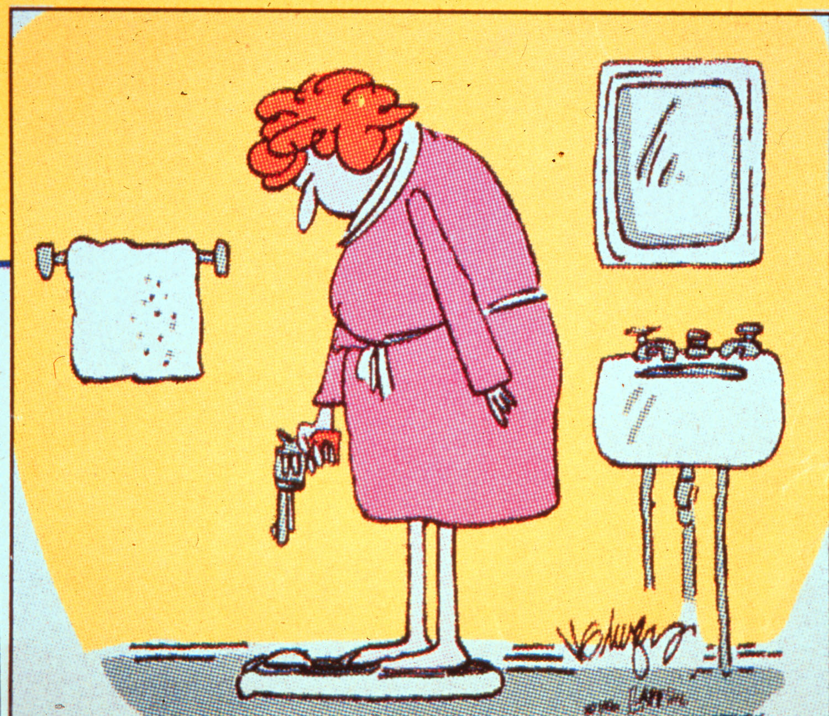

Slide 23
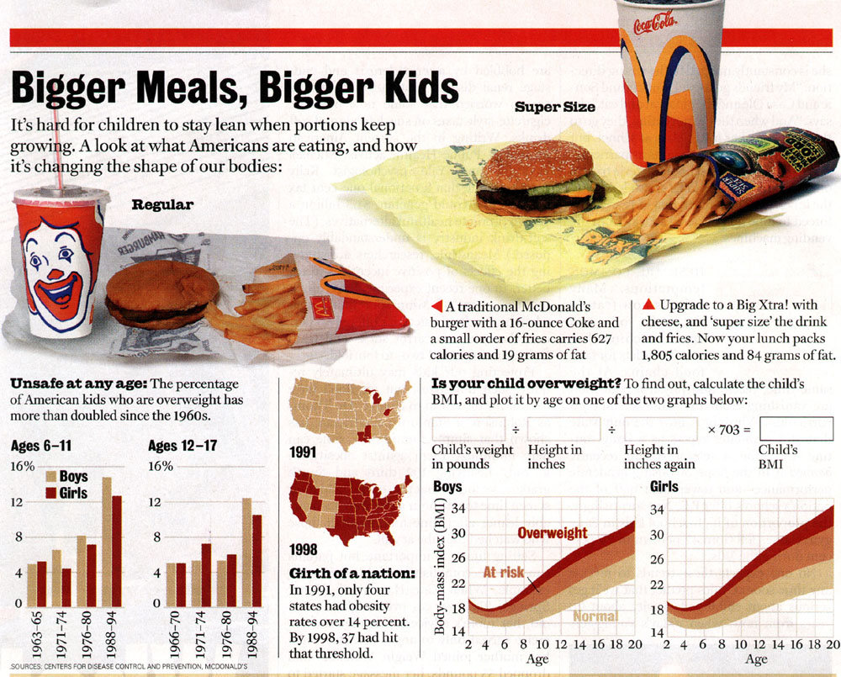

Slide 24






Move toward the Tomato

Slide 25
Medical Nutrition Therapy 2014 - ADA
Focus on the Individual
Maintain pleasure of eating
Provide positive messages about food
Limit food choices only when backed by science
Provide practical tools
Refer to a RD and Diabetes Education – Lowers A1c by 1-2%

Slide 26

Medical Nutrition Therapy – ADA 2014 Updates
No ideal percentage of calories from protein, carbohydrate and fat for people with diabetes.
Macronutrient distribution should be based on an individualized assessment of eating patterns, preferences and metabolic goals.

Slide 27
Losing 2-8kg Early in diagnosis Type 2 Helpful ADA 2014
Weight Loss –
The optimal macronutrient intake to lose weight not known
The literature does not support one particular nutrition therapy to reduce weight, but rather a spectrum of eating patterns that result in reduced energy intake.
Wt loss goal ½ pound to 1 lb a week
Decrease intake 250-500 cals daily + exercise
2013 – Try and keep less than 2,300 mg a day
Vitamin and mineral supplements not recommended -lack of evidence.
Fiber 25 -38 gms a day

Slide 28

Successful weight loss strategies include
Weekly self-weighing
Eat breakfast
Reduce fast food intake.
Decrease portion size
Increase physical activity
Use meal replacements
Eat healthy foods

Slide 29
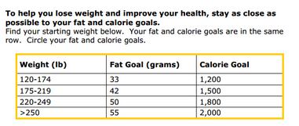
Diabetes Prevention Program Focus on fat = wt loss success
http://www.cdc.gov/diabetes/prevention/recognition/curriculum.htm

Slide 30


ADA recommendation Eat Less Junk Food & Sugary Drinks –
Less Processed Foods
Less Sugary Beverages
increase visceral adiposity
With sugar or
High fructose corn syrup
Soda Tax?
Junk Food Tax?

Slide 31

USDA Plate www.myplate.gov
Balancing Calories
Enjoy your food, but eat less.
Avoid oversized portions.
Foods to Increase
Make half your plate fruits and vegetables.
Make at least half your grains whole grains.
Switch to fat-free or low-fat (1%) milk.
Foods to Reduce
Compare sodium in foods like soup, bread, and frozen meals ― and choose the foods with lower numbers.
Drink water instead of sugary drinks.

Slide 32
10 Superfoods
Beans
Dark Green Leafy Vegs
Citrus Fruit
Sweet Potatoes
Berries
Tomatoes
Fish High in Omega-3 Fatty Acids
Whole Grains
Nuts
Fat-Free Milk and Yogurt

Slide 33
Label Lessons
Nutrition Facts
Serving Size 1/2 cup (114 g)
Servings Per Container 4
Amount Per Serving
Calories 90 Calories from Fat 30
% Daily Value*
Total Fat 3g 5%
Saturated Fat 0g 0%
Cholesterol 0g 0%
Sodium 300mg 13%
Total Carbohydrate 13g 4%
Dietary Fiber 3g 12%
Sugars 3g
Protein 3g
Vitamin A 80% * Vitamin C 60%
Calcium 4% * Iron 4%
* Percent Daily Values are based on a 2,000 calorie diet. Your daily values may be higher or lower depending on your calorie needs:
Calories _ 2000 2500
Total Fat Less than 65g 80g
Sat Fat Less than 20g 25g
Cholesterol Less than 300mg 300mg
Sodium Less than 2400mg 2400mg
Total Carbohydrate 300g 375g
Fiber 25g 30g
Calories per gram: Fat 9 Carbohydrates 4 Protein 4

Slide 34

Choose Healthy Carbs
Carbs have fiber, vitamins, minerals and phytonutrients
25 gms of fiber a day
Power Carbs include:
Beans
Veggies
Fruits
Whole grain foods

Slide 35
Handy Meal Plan
Per Meal Serving
Each finger = 15 gms carb (can have 3-4 servings/meal)
Palm of hand = 3 oz’s protein
Thumbnail = 1 tsp fat serving

Slide 36
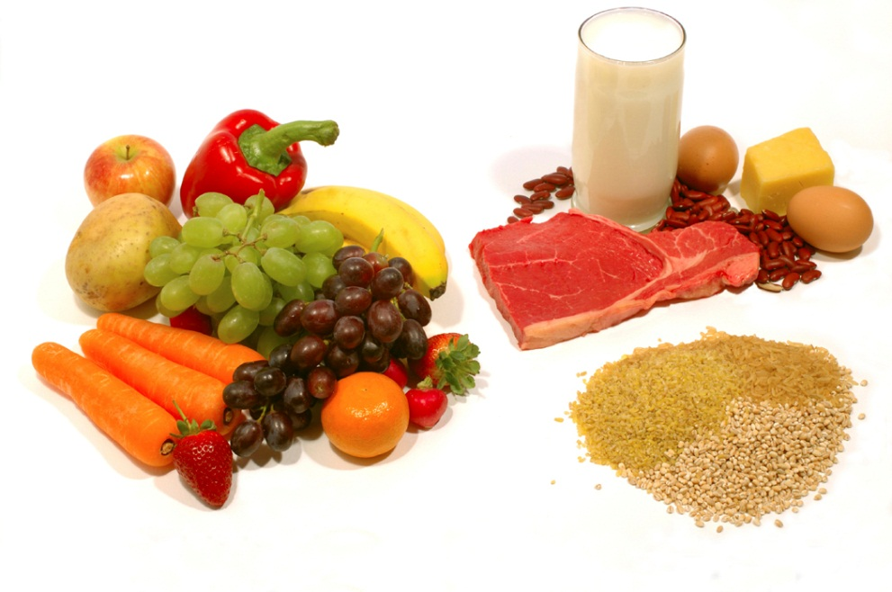
Goal Ideas
Eat less processed foods
Eat 3 oz portions of lean meat / fish
Eat foods that have less fat and salt
Eat foods with more fiber

Slide 37

Get Active

Slide 38

Choose a SMART Goal
Specific
Measurable
Attainable
Realistic
Timely

Slide 39

Goal Example –
I will make 3 laps around my block on Monday, Wednesday and Friday for one month.

Slide 40

Keeping it Positive – Be y0ur own Best coach
Brush and floss daily
Get your flu shot
Move, move, move
Ask for help as needed

Slide 41
Which Famous Person with Type 2 Diabetes?
“Too much of a good thing is wonderful?”

Slide 42


Mae West - lived into her 80’s

Slide 43

Thank You
Notes:
Diabetes Educational Services© (530) 893 - 8635
43

