Slide 1


Advanced Level Pattern Management Gone Crazy – Part II
Beverly Thomassian, RN, MPH, BC-ADM, CDE
President, Diabetes Education Services
© Copyright 1999-2015, Diabetes Education Services, All Rights Reserved.

Slide 2
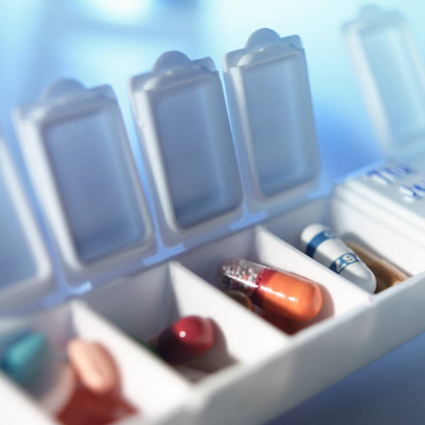
Diabetes Meds for Type 2: Objectives
1. Describe the main action of the different categories of type 2 diabetes medications.
2. Discuss using the AACE and ADA 2015 Guidelines to determine best therapeutic approach.
3. Using the ADA Guidelines, describe strategies to initiate and adjust insulin therapy.
© Copyright 1999-2015, Diabetes Educational Services, All Rights Reserved.
Notes:
2
2

Slide 3

Path to Type 2 Diabetes

Slide 4
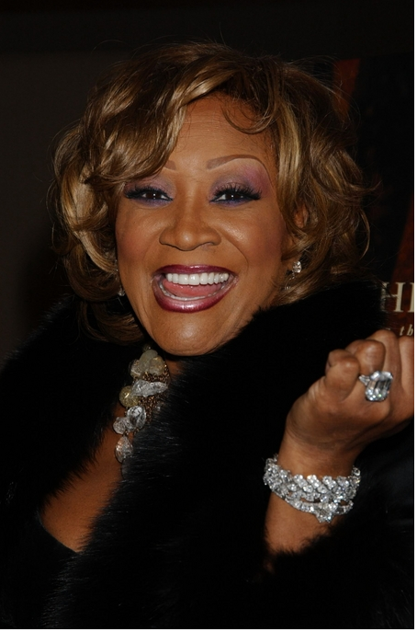
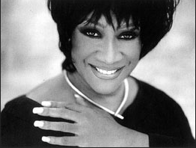
Patti Labelle
"divabetic" -- that's a mix of diabetic and diva

Slide 5




Slide 6
Natural Progression of Type 2 Diabetes
Plasma
Glucose
Postprandial glucose
Fasting glucose
126 mg/dL
Relative β-Cell Function
Insulin resistance
Insulin secretion
-20
-10
0
10
20
30
Years of Diabetes
Prior to diagnosis
After diagnosis
Adapted from Bergenstal et al. 2000; International Diabetes Center.
Notes:
These graphs show the typical progressive nature of type 2 diabetes in terms of 2 key indices: increasing plasma glucose level (top panel) and decline in relative β-cell function as reflected by the drop in endogenous insulin and rise in insulin resistance (lower panel).
In the natural history of type 2 diabetes, insulin resistance rises, insulin secretion falls, and glucose levels begin to rise before diabetes is diagnosed.
Based on the natural history, type 2 diabetes is a disease of progressive insulin failure as shown in the graphic model developed by researchers at the International Diabetes Center.¹
Before the onset of diabetes, glucose levels start to rise, with a slightly sharper increase in the postprandial value than in fasting glucose. Both postprandial and fasting plasma glucose levels continue to rise if diabetes is left untreated.²
Prior to the diagnosis of diabetes, resistance of cell receptor sites to insulin starts to increase, while insulin secretion by β-cells decreases. Insulin resistance reaches a peak and remains constant. Endogenous insulin secretion continues to decline over the course of diabetes.²
References:
1. Kendall DM. Postprandial blood glucose in the management of type 2 diabetes: the emerging role of incretin mimetics. Available at: http://www.medscape.com/viewarticle/515693. Accessed April 21, 2006.
2. Ramlo-Halsted BA, Edelman SV. The natural history of type 2 diabetes: implications for clinical practice. Prim Care. 1999;26:771-789.

Slide 7



Antihyperglycemic Therapy – 1st Step
Lifestyle Changes
Weight control
Healthy eating
Activity
Diabetes Care 2012;35:1364–1379
Diabetologia 2012;55:1577–1596
ADA-EASD Position Statement: Management of Hyperglycemia in T2DM

Slide 8
Patient Centered Approach
“...providing care that is respectful of and responsive to individual patient preferences, needs, and values - ensuring that patient values guide all clinical decisions.”
Gauge patient’s preferred level of involvement.
Explore, where possible, therapeutic choices.
Utilize decision aids.
Shared decision making – final decisions re: lifestyle choices ultimately lie with the patient.
Diabetes Care 2012;35:1364–1379
Diabetologia 2012;55:1577–1596
ADA-EASD Position Statement: Management of Hyperglycemia in T2DM

Slide 9
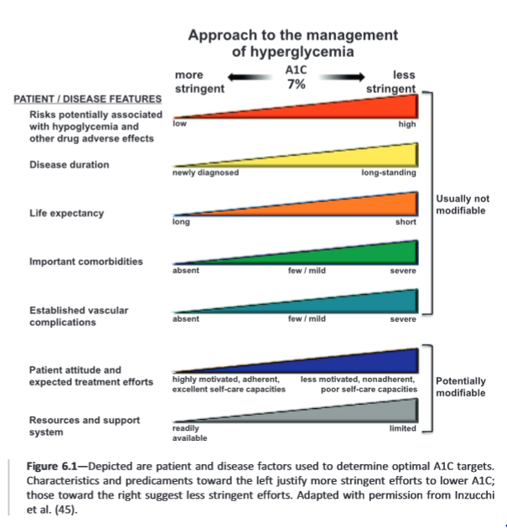
ADA Standards of Care 2015

Slide 10
Other Considerations
Cost
Hypoglycemia
Age
Weight
Comorbidities
Kidney disease
Heart disease – CHF, CAD
Liver dysfunction
ADA-EASD Position Statement: Management of Hyperglycemia in T2DM
Diabetes Care 2012;35:1364–1379
Diabetologia 2012;55:1577–1596

Slide 11
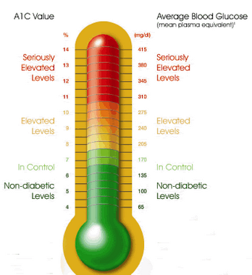
Glycemic Targets - ADA
Adult non pregnant A1c goals
A1c < 7% - a reasonable goal for adults.
A1c < 6.5% - may be appropriate for those without significant risk of hypoglycemia or other adverse effects of treatment.
A1c < 8% - may be appropriate for patients with history of hypoglycemia, limited life expectancy, or those with longstanding diabetes and vascular complications.

Slide 12
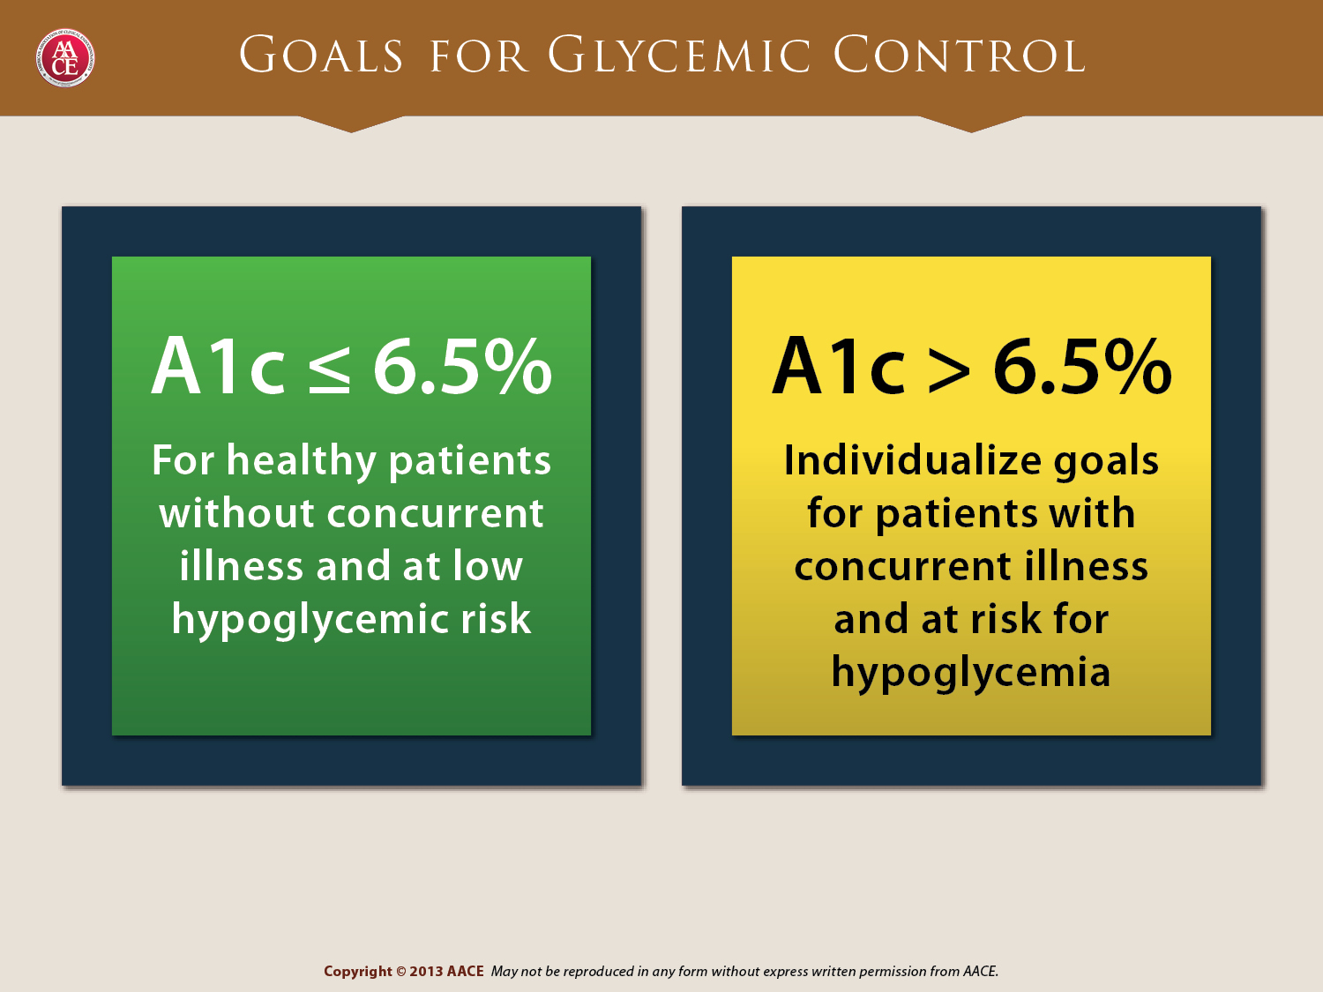

Slide 13
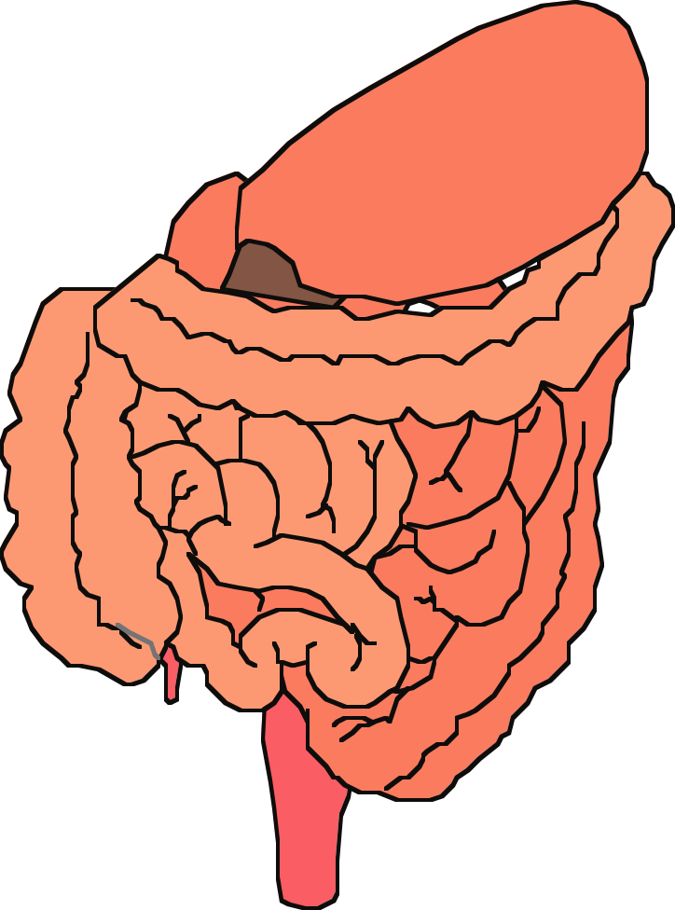
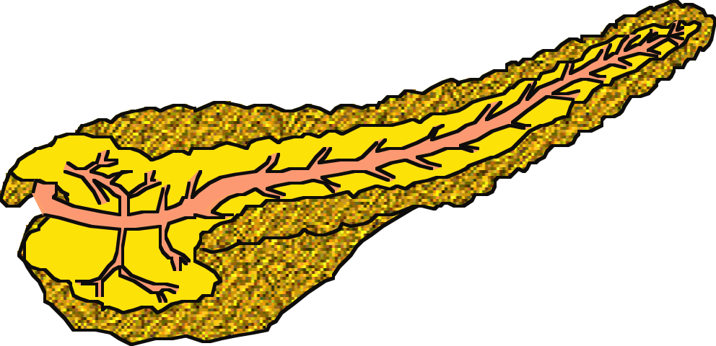


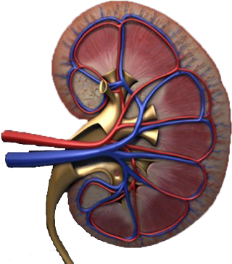
Multiple, Complex Pathophysiological Abnormalities in T2DM
Adapted from: Inzucchi SE, Sherwin RS in: Cecil Medicine 2011
pancreatic
insulin
secretion
incretin
effect
pancreatic
glucagon
secretion
_
?
gut
carbohydrate
delivery &
absorption
HYPERGLYCEMIA
_
+
hepatic
glucose
production
peripheral
glucose
uptake
renal glucose excretion
Notes:
This slide provides a broad overview of the main pathophysiological defects in type 2 diabetes. Insulin resistance is demonstrated in peripheral tissues, such as skeletal muscle and adipocytes. The pancreas develops relative insulin secretory failure and is no longer provide the amount of insulin required for normal glucose. The pancreas also demonstrates a failure of the normal suppression of glucagon after meals. This may be mediated through abnormalities in the incretin axis. Hepatic glucose production is also increased. Renal glucose output is set at a higer threshold than normal. Many of these defects may be influenced by abnormal central control of metabolism.

Slide 14

Treating Hyperglycemia with Meds
For all of the following case studies, we assume we are providing ongoing education on lifestyle – including referral to a RD and diabetes educator.
In describing what meds match the patient best, I am speaking as an advocate for patients and a consultants to providers.

Slide 15
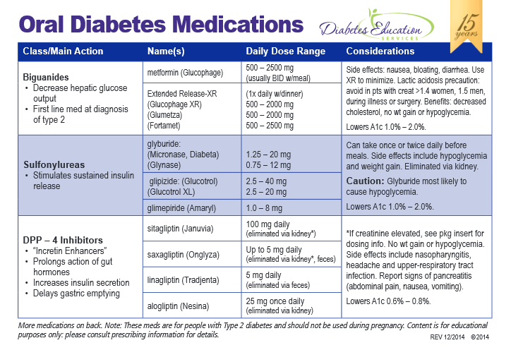

Slide 16
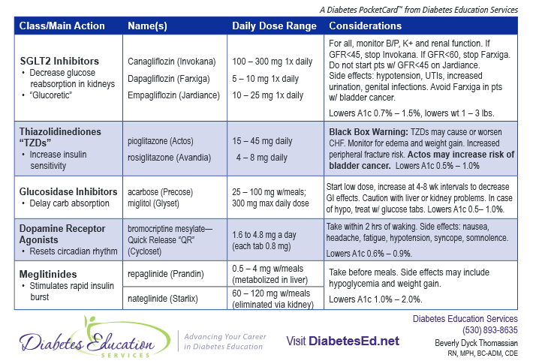

Slide 17
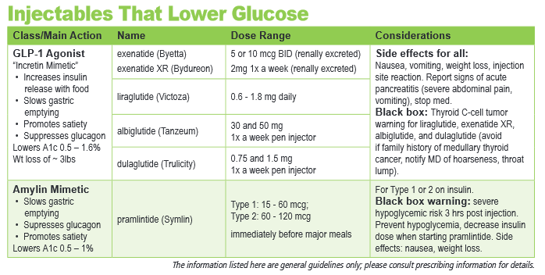

Slide 18
Multiple, Complex Pathophysiological Abnormalities in T2DM
Adapted from: Inzucchi SE, Sherwin RS in: Cecil Medicine 2011
GLP-1R
agonists
Insulin
pancreatic
insulin
secretion
incretin
effect
Glinides
S U s
DPP-4
inhibitors
Amylin
mimetics
pancreatic
glucagon
secretion
_
Dopamine R agonists
?
A G I s
gut
carbohydrate
delivery &
absorption
HYPERGLYCEMIA
_
T Z D s
Metformin
+
SGLT2 Inhibitors
peripheral
glucose
uptake
hepatic
glucose
production
renal glucose excretion
Notes:
Anti-hyperglycemic drugs for patients with T2DM are targeted at one or more of the pathophysiological abnormalities of this disease. On this slide, the main sites of action of the currently available 12 individual drug classes is depicted. Combination glucose-lowering therapy has become a standard treatment strategy when patients do not adequately respond to a single agent (often metformin.)

Slide 19

Life Study
61 year old overweight woman with type 2 diabetes 3 months. Has been trying to control diabetes with diet and exercise. GFR in 90s. Worried about weight gain.
Most recent A1c 6.9%
ADA
AACE
Cash pay

Slide 20
ADA Step Wise Approach to Hyperglycemia 2015
Start with lifestyle coaching
When lifestyle alone is not achieving A1c goal – Metformin should be added at, or soon after diagnosis (unless contraindicated).
Metformin has a long standing evidence base for efficacy and safety, is cheap and may reduce CV risk.

Slide 21
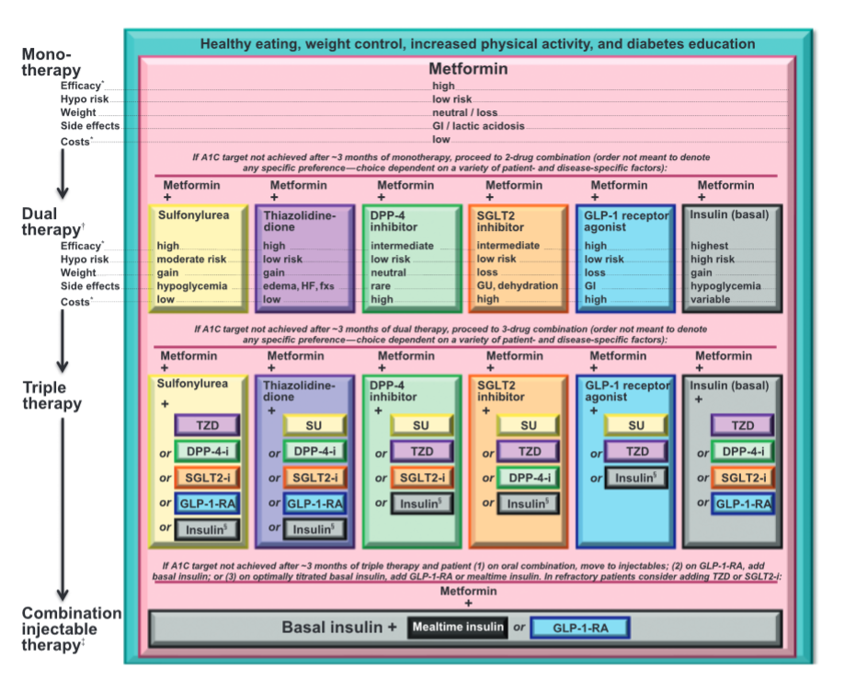
ADA Standards of Care 2015

Slide 22
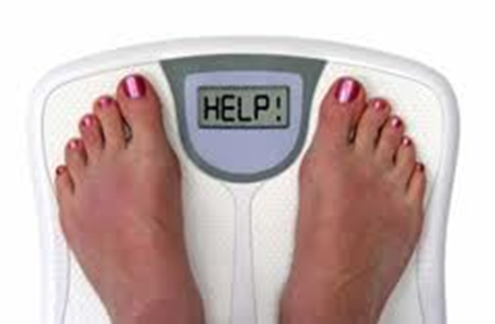
When goal is to avoid weight gain
These meds are weight neutral
Metformin
DPP-IV Inhibitors: Januvia, Onglyza, Tradjenta, Nesina
Acarbose
These meds associated with wt loss
GLP-1 agonists (Byetta, Bydureon, Victoza, Tanzeum, Trulicity)
SGLT-2 Inhibitors (Canagliflozin, Dapagliflozin, Empagliflozin)
Symlin (Pramlintide)

Slide 23
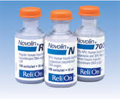
When goal is to minimize cost
Go generic.
Oral Meds -Metformin and Sulfonylureas
Walmart offers 3 mo supply of following meds for ~ $10
Metformin and Metformin XR
Glipizide, Glyburide, Glimepiride
Insulins – Oldies but Goodies
NPH, Regular, 70/30 mix
$25 a vial at Walmart – ReliOn
Vials and needles cheaper

Slide 24
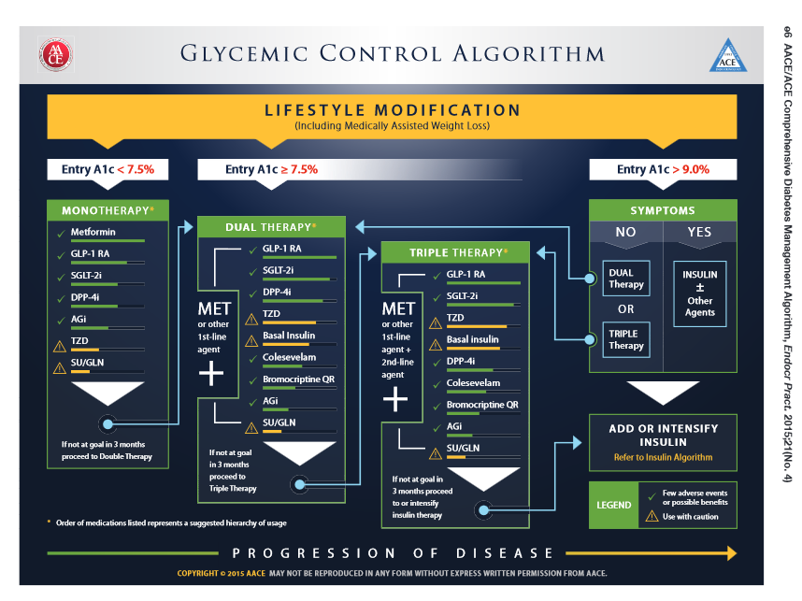

Slide 25
Life Study
61 year old overweight woman with type 2 diabetes 3 months. Has been trying to control diabetes with diet and exercise. GFR in 90s. Worried about weight gain.
Most recent A1c 6.9%
ADA
AACE
Cash pay
Solutions?
Start no meds and monitor (ADA)
Start Metformin 500 mg 1-2 x a day

Slide 26

Life Study
54 year old smoker, creatinine 1.2, BMI 27. Not checking BG, even though he has glucose meter. On Metformin 500mg BID for past 4 months. Had bad experience with hypoglycemia on glyburide.
Most recent A1c 7.9%
ADA
AACE

Slide 27

When goal is to avoid Hypoglycemia
Avoid sulfonylureas
Careful insulin dosing
May need to up adjust glucose goals
Monitor kidney function
Reinforce for patients on insulin to “TIE”
Test
Inject
Eat

Slide 28
ADA Standards of Care 2015

Slide 30

Life Study
54 year old smoker, creatinine 1.2, BMI 27. Not checking BG, even though he has glucose meter. On Metformin 500mg BID for past 4 months. Had bad experience with hypoglycemia on glyburide.
Most recent A1c 7.9%
Solution:
Change to Metformin XR and double dose
Add SGLT-2 or
Add GLP-1
If cash pay consider adding SU or insulin

Slide 31


Life Study
71 year old woman with type 2 diabetes for past year. BMI 24. Has been trying to control diabetes by limiting carbs and exercise. Creat 1.6. Good social support.
Most recent A1c 8.6%
She has great insurance or
She is cash pay or
She hates needles

Slide 32
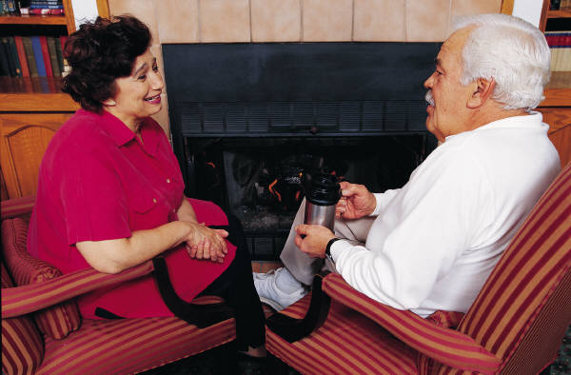
Older Adults - Considerations
Reduced life expectancy
Higher CVD burden
Reduced GFR
At risk for adverse events from polypharmacy
More likely to be compromised from hypoglycemia
Less ambitious targets
A1c <7.5–8.0%
Focus on drug safety
Diabetes Care 2012;35:1364–1379
Diabetologia 2012;55:1577–1596

Slide 33
ADA Standards of Care 2015

Slide 34
Life Study
71 year old woman with type 2 diabetes for past year. BMI 24. Has been trying to control diabetes by limiting carbs and exercise. Creat 1.6. Good social support.
Most recent A1c 8.6%
She has great insurance or
She is cash pay or
She hates needles

Slide 36

Life Study
71 year old woman type 2 diabetes. BMI 24. Has been trying to control diabetes by limiting carbs and exercise. Creat 1.6. GFR low 30s. Good social support.
Most recent A1c 8.6%
Solutions
Great insurance – DPP-IV Inhibitor + Basal insulin
She is cash pay or – Sulfonylurea, NPH or 70/30
She hates needles – Sulfonylurea, DPP-IV Inhibitor - if doesn’t work, see if she will reconsider insulin

Slide 37
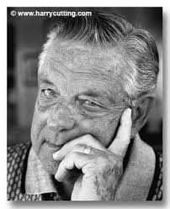
What next?
69 year old male, BMI 31, on Metformin 2000mg a day and Glipizide 40mg a day.
A1c 9.1%. Creat 1.2
Pt is obese, 11 yr history of diabetes
What next?
Insurance
No insurance

Slide 38
Notes:
In patients intolerant of, or with contraindications to metformin, consider initial drug from other classes depicted under “Dual therapy” and proceed accordingly. In this circumstance, while published trials are generally lacking, it is reasonable to consider three-drug combinations that do not include metformin.
Consider starting with 2-drug combinations in patients with very high HbA1c (e.g. ≥9%) to achieve control more rapidly (although a step-wise approach will eventually the patient to target as well.)
Insulin has the advantage of being effective where other agents may not be and should be considered a part of any combination regimen when hyperglycemia is severe, especially if the patient is symptomatic or if any catabolic features (weight loss, any ketosis) are evident. Consider initiating combination injectable therapy with insulin when blood glucose is >300–350 mg/dL (>16.7–19.4 mmol/L) and/or HbA1c >10–12%. Potentially, as the patient’s glucose toxicity resolves, the regimen can be subsequently simplified.

Slide 39
What next?
69 year old male, BMI 31, on Metformin 2000mg a day and Glipizide 40mg a day. Wt 100kg
A1c 9.1%. Creat 1.2
Pt is obese, 11 yr diabetes
Solutions
Insurance – Add SGLT-2, GLP-1
No insurance – Stop Glipizide, keep metformin
Add 70/30 insulin 1-2 times a day. 100kg x 0.5 = 50 units daily (30units am/ 20units dinner)

Slide 40

Case Study
70 yr old, weighs 100kg
History of CABG, tobacco
A1c – 11.3%, BG 400-500 for past weeks
Insulin – 100+ units Lantus at hs (solostar)
Oral Meds: Metformin, Invokana
Pt can’t afford Lantus insulin pen or Invokana – what other option?

Slide 41
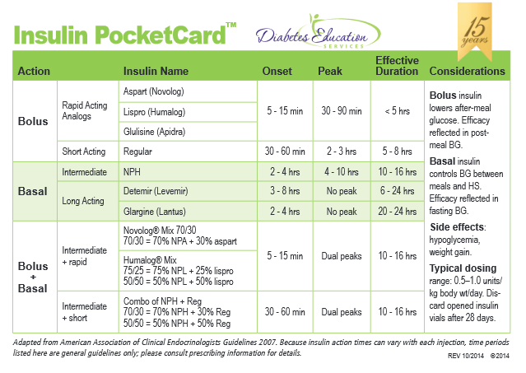

Slide 42
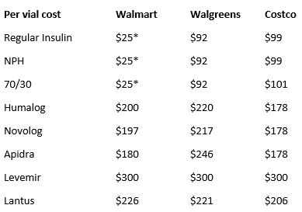
Cost Per Vial in Northern CA

Slide 43
Case Study
70 yr old, weighs 100kg
History of CABG
A1c – 11.3%, BG 400-500 for past weeks
Insulin – 100+ units Lantus at hs (solostar).
Metformin 1000mg BID
What is max basal insulin should he be on?

Slide 44
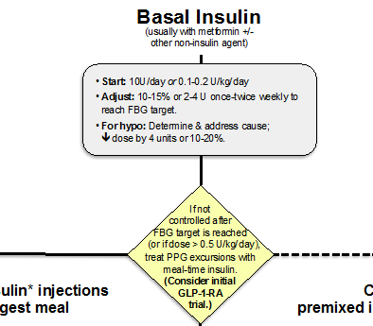
When is it Too much basal insulin?

Slide 45
Case Study
70 yr old, weighs 100kg
History of CABG
A1c – 11.3%, BG 400-500 for past weeks
Insulin – 100+ units Lantus at hs (solostar)
Metformin 1000mg BID
What is max basal insulin should he be on?
100kg x 0.5 = 50 units a day
What can we do next to improve BG?

Slide 46
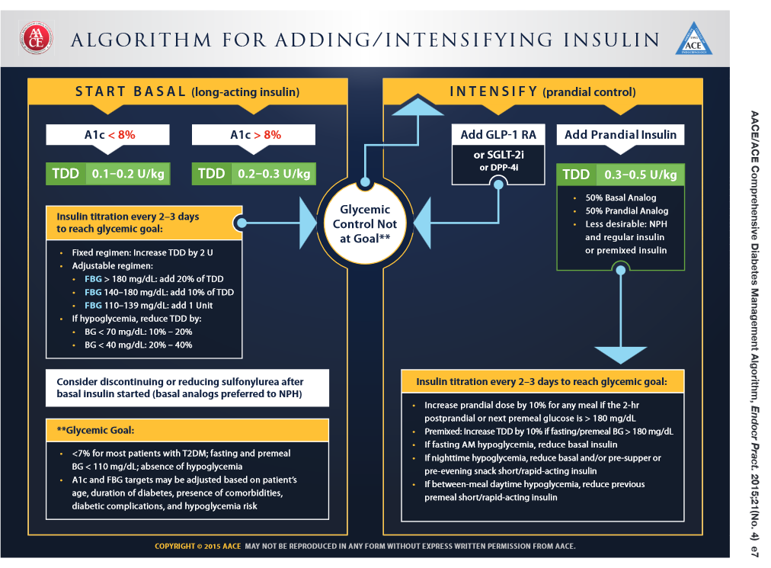

Slide 47
Notes:
Basal insulin alone is usually the optimal initial regimen, beginning at 0.1-0.2 U/kg body weight, depending on the degree of hyperglycemia. It is usually prescribed in conjunction with 1-2 non-insulin agents, although insulin secretagogues (sulfonylureas, meglitinides) are typically stopped once more complex regimens beyond basal insulin are utilized.
In patients still not at target after basal insulin has been adequately titrated, and the patient is willing to take >1 injections, there are several options. First, consider GLP-1 receptor agonists (see Fig. 2). The combination of basal insulin + GLP-1RA is becoming well established after several studies confirmed its efficacy on par with more complex multi-dose insulin regimens, but with less hypoglycemia and with weight loss instead of weight gain. If such an approach is not possible or has been tried and proven unsuccessful, there are 3 possible advanced insulin regimens:
Adding 1 injection of a rapid acting insulin analogue before the largest meal,
Adding 2-3 injections of a rapid acting insulin analogue before 2-3 meals, or
Using premixed insulin BID
Each approach has its advantages and disadvantages. The figure describes the number of injections required at each stage, together with the relative complexity and flexibility.
Once a strategy is initiated, titration of the insulin dose is important, with dose adjustments made based on the prevailing BG levels as reported by the patient.
Comprehensive education regarding self-monitoring of BG, diet, exercise, and the avoidance of, and response to, hypoglycemia are critical in any patient on insulin therapy.

Slide 48

Case Study
What is max basal insulin should he be on?
100kg x 0.5 = 50 units a day
What can we do next to improve BG?
Add GLP-1 (Exenatide, Victoza, Trulicity, Tanzeum)
Add bolus insulin to largest meal
Switch him to 70/30 insulin ac breakfast and dinner
Total previous basal dose – 100 units
2/3 in am – 65 units am (43 NPH and 22 regular)
1/3 pre dinner – 35 units pm (23 NPH and 12 regular)

Slide 49
Case Study
70 yr old, weighs 100kg
History of CABG, tobacco
A1c – 11.3%, BG 400-500 for past weeks
What will inform you of how to proceed?
Insurance coverage
His willingness to stick to a complex regimen
His ability to self-monitor
His social support and connection to his medical team

Slide 50
Critical Points
Individualize Glycemic targets & BG-lowering
Diet, exercise, & education: foundation T2DM therapy
Metformin = optimal 1st-line drug.
After metformin, data limited. Combo therapy reasonable
Ultimately, many T2 patients will require insulin therapy
All treatment decisions should be made in conjunction with the patient (focus on preferences, needs & values.)
CV risk reduction - a major focus of therapy.
Diabetes Care 2012;35:1364–1379
Diabetologia 2012;55:1577–1596
ADA-EASD Position Statement: Management of Hyperglycemia in T2DM

Slide 51
Pattern Management Gone Crazy
Incorporating national guidelines into practice
Explore the importance of patient assessment in determining a realistic dosing strategy.
Discuss strategies to initiate and modify insulin therapy with a focus on safety.
List strategies on adjusting bolus and basal insulin to achieve glucose control.
Glucose patterns and adjustment strategies

Slide 52
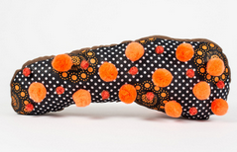

Pattern Management –AKA
How to think like a pancreas

Slide 53
Physiologic Insulin Secretion: 24-Hour Profile
50
Insulin
(µU/mL)
Bolus Insulin
25
0
Basal Insulin
Breakfast Lunch Dinner
150
100
Mealtime Glucose
Glucose
(mg/dL)
50
Basal Glucose
0
7
8
9
10
11
12
1
2
3
4
5
6
7
8
9
A.M.
P.M.
Time of Day

Slide 54

Poll question 1
Which of the following are bolus insulins?
a. Lantus, Levemir
b. Novolog, Humalog, NPH
c. Reg, Novolog, Afrezza
d. Insulin pens
e. not sure

Slide 55
Insulin Action Teams
Bolus: lowers after meal glucose levels
Rapid Acting
Aspart, Lispro, Glulisine, Afrezza
Short Acting
Regular
Basal: controls glucose between meals, hs
Intermediate
NPH
Long Acting
Detemir (Levemir)
Glargine (Lantus)

Slide 56

Insulin Efficacy
How is the effectiveness of bolus insulin determined?
2 hour post meal (if you can get it)
Target < 180
Before next meal blood glucose
Target 80-130
How is the effectiveness of basal insulin determined?
Fasting blood glucose
Target 80-130

Slide 57
Glycemic Targets
Adult non pregnant A1c goals
A1c < 7% - a reasonable goal for adults.
A1c < 6.5% - may be appropriate for those without significant risk of hypoglycemia or other adverse effects of treatment.
A1c < 8% - may be appropriate for patients with history of hypoglycemia, limited life expectancy, or those with longstanding diabetes and vascular complications.

Slide 58
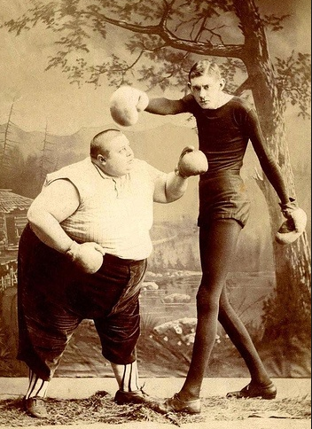
Approach Depends on Patient
Insulin dosing is relative to body weight
Kidney function
Other meds
Activity level
Social support
Goals of care
Patients ability

Slide 59
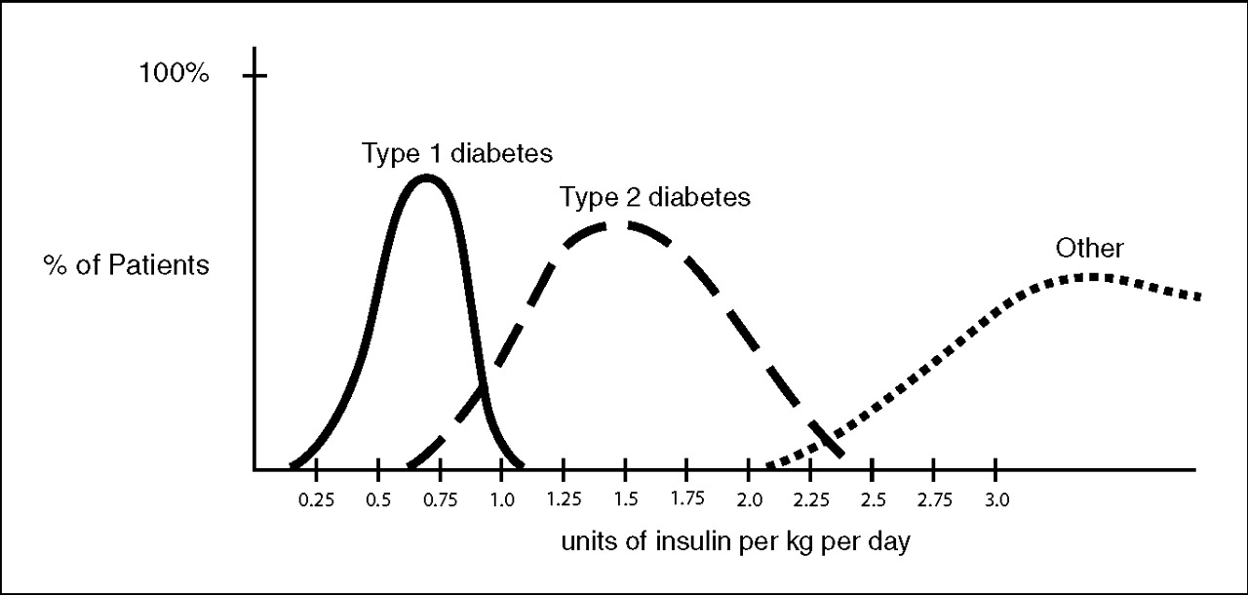
Insulin Dosing Type 1 & 2
U-500 Insulin: When More With Less Yields Success: Diabetes Spectrum March 20, 2009 vol. 22 no. 2 116-122

Slide 60
Poll question 2
What best describes inhaled insulin?
a. Liquid insulin that is aerosolized.
b. Powdered long acting insulin.
c. Insulin that is inhaled via a pipe.
d. Regular insulin in powdered form.

Slide 61
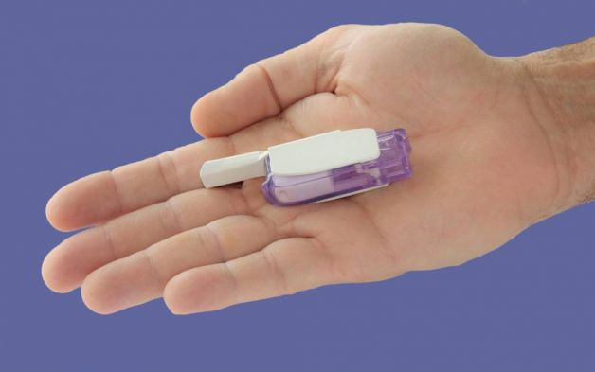

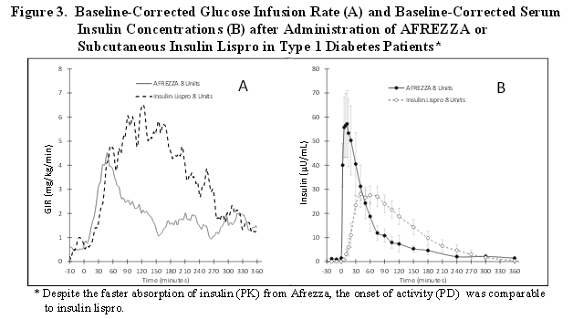
Afrezza – Inhaled Insulin – Approved 2014 – Type 1 or 2
Only studied in adults over 18
Not indicated for pregnancy, while breastfeeding

Slide 62
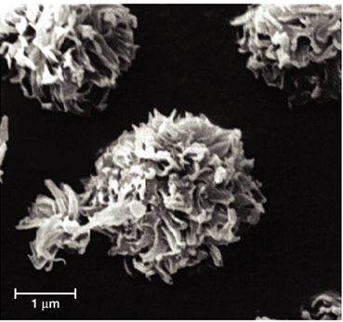
Steps, Cost, Terms
1st step – FDA approved. Will take time to produce, market and distribute
Pricing –similar pricing as pens ~ $300 a month
Afrezza is regular human insulin in powder form using Technosphere technology.
Referred to as TI in papers – “Technosphere Insulin”

Slide 63
Afrezza Dosing and Considerations
Bolus regular insulin – inhaled before meals
Dosing: 4 and 8 unit cartridges
Convert with 1:1 ratio to existing insulin dose
Lung function test before start (FEV1)
Not for pts w/ chronic lung issues
Asthma, COPD, history of lung cancer, smokers
Can cause acute bronchospasm – Black box warning
Side effects:
Hypoglycemia, sore throat, cough
Less hypoglycemia than injected insulin

Slide 64
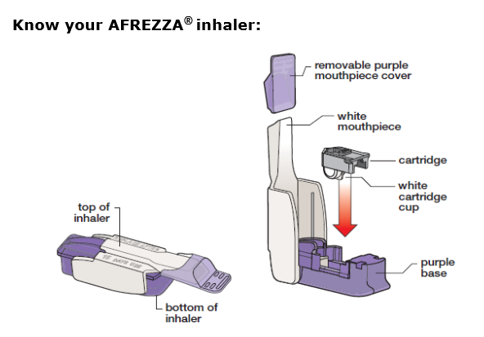
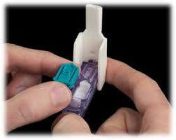
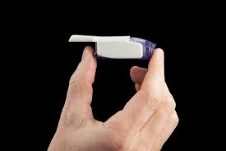
Afrezza Inhaler
Replace inhaler every 15 days –Do not wash

Slide 65
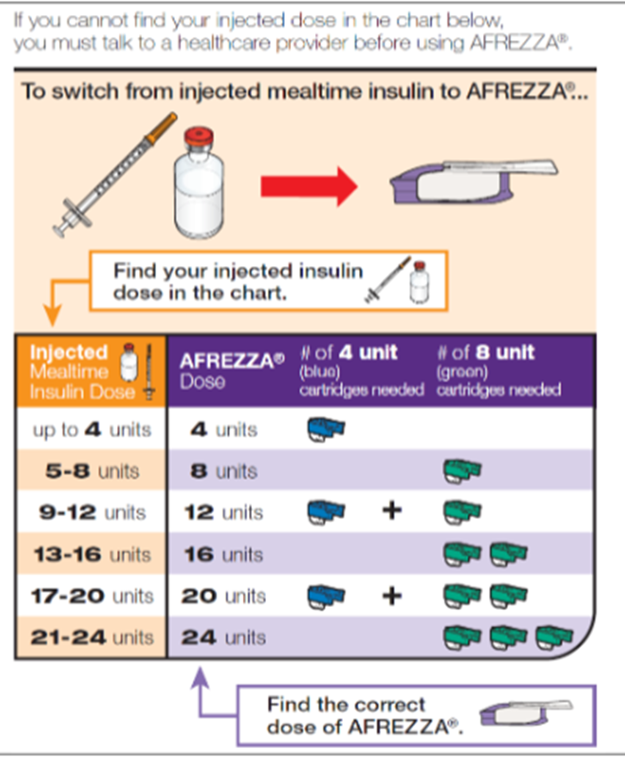
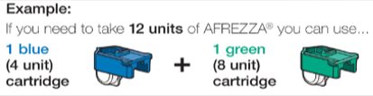
Afrezza – Combos to get right dose

Slide 66
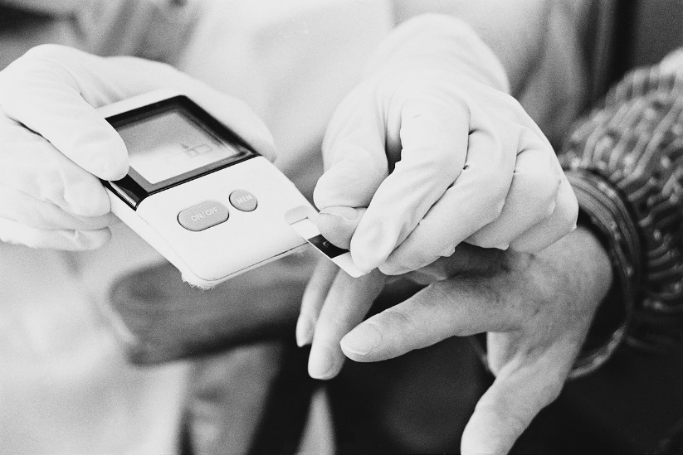
Sample situations - Pt on….
7 units Humalog at meals, 20 u Lantus at hs
5 units regular break, dinner, 10 units detemir
10 units aspart at meals, 30 Lantus
Carb counts – 1:15 .. Had 75 gms
Type 1
Type 2
BG before meal 67
BG before meal 170

Slide 67
Sample situations - Pt on….
7 units Humalog at meals, 20 u Lantus at hs
Type 1 or 2 - 8 units Afrezza. BG 67 – reduce to 4 units? BG 170 – 8 units ok
5 units regular break, dinner, 10 units detemir
Type 1 – 4 units, Type 2 - 8 units?
BG 67 – 4 units. BG 170 – Type 1, 4 units. Type 2, 8 units?
10 units aspart at meals, 30 Lantus
Type 1, 8 or 12 units? Type 2, 12 units.
BG 170 – 12 units both. BG 67, 8 units both
BG 140 - Carb counts – 1:15 .. Had 75 gms carb
Type 1, 4 units (ck in 2 hrs, give more?). Type 2, 8 units?

Slide 68
Pattern Management

Slide 69

Poll Question - 3
When looking at glucose patterns, which problem do you fix first?
a. Hyperglycemia
b. Hypoglycemia
c. non-compliance
d. legible writing
e. not sure

Slide 70
Pattern Management
Safety 1st!! - Evaluate 3 day patterns
Hypo: eval 1st and fix:
If possible, decrease medication dose
Timing of meals, exercise, medications
Hyperglycemia: evaluate 2nd
Identify patterns
Before increase insulin, make sure not missing something (carbs, exercise, omission)

Slide 71

Case Study
68 yr old, avid walker
BMI 24, Weighs 90kg
A1c – 9.6%, BG 270s during day for past mos
Insulin – 40 units Lantus
Oral Meds: glyburide, metformin
What medication changes?
What insulin changes?
Big insurance copay

Slide 72
Type 2, 90kg – A1c 9.6% Pt on Metformin, Glyburide- Max dose- Lantus started

Slide 73
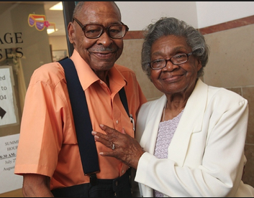
Next Step - Insulin
Add GLP1 Agonist? No
Add a SGLT-2 Inhibitor? no
DPP-IV? No due to $$
Stop Glyburide (not indicated if on insulin. Increase risk for hypo and mortality)
Need to improve insulin therapy
Look at eating patterns
Refer to RD, Education
Great support system

Slide 74
Notes:
Basal insulin alone is usually the optimal initial regimen, beginning at 0.1-0.2 U/kg body weight, depending on the degree of hyperglycemia. It is usually prescribed in conjunction with 1-2 non-insulin agents, although insulin secretagogues (sulfonylureas, meglitinides) are typically stopped once more complex regimens beyond basal insulin are utilized.
In patients still not at target after basal insulin has been adequately titrated, and the patient is willing to take >1 injections, there are several options. First, consider GLP-1 receptor agonists (see Fig. 2). The combination of basal insulin + GLP-1RA is becoming well established after several studies confirmed its efficacy on par with more complex multi-dose insulin regimens, but with less hypoglycemia and with weight loss instead of weight gain. If such an approach is not possible or has been tried and proven unsuccessful, there are 3 possible advanced insulin regimens:
Adding 1 injection of a rapid acting insulin analogue before the largest meal,
Adding 2-3 injections of a rapid acting insulin analogue before 2-3 meals, or
Using premixed insulin BID
Each approach has its advantages and disadvantages. The figure describes the number of injections required at each stage, together with the relative complexity and flexibility.
Once a strategy is initiated, titration of the insulin dose is important, with dose adjustments made based on the prevailing BG levels as reported by the patient.
Comprehensive education regarding self-monitoring of BG, diet, exercise, and the avoidance of, and response to, hypoglycemia are critical in any patient on insulin therapy.

Slide 75
When is it Too much basal insulin?

Slide 76

Next steps
Insulin – Max basal dose is 45 units (90kg x 0.5). At 40 units now.
Next step – Add bolus insulin or switch to 70/30.
After discussing with patient, decide to add regular* insulin to largest meal.
Dose – 4 units or 10% of basal (40 x 10% = 4 units.
When is largest meal (most carbs)?
*Cheapest

Slide 77
Cost Per Vial in Northern CA

Slide 78

Food diary – Finding Largest Meal
Breakfast
Big bowl of oatmeal with walnuts, banana, coffee
Lunch
Sandwich and piece of fruit
A few cookies around 3pm
Dinner
Big salad, BBQ meat, dinner roll, glass of wine
Late night snacking
Peanut butter on celery, nuts, cheese

Slide 79
Poll Question 4
Which is his largest meal from a carb perspective?
A. Breakfast
B. Lunch
C. Dinner
D. Breakfast or Lunch

Slide 80
Pt on Metformin, Lantus 40 Type 2, 90kg – A1c 9.6%

Slide 81
Intensive Diabetes Therapy Insulin Dosing Strategy
50/50 Rule
0.5-1.0 units/kg day
(.5 units/kg most common)
Basal = 50% of total
Glargine Q day
NPH or Detemir BID
Bolus = 50% of total
usually divided into 3 meals
Example
Wt 90kg x 0.5 = 45 units of insulin/day
Basal dose: 23 units
Glargine 23 units Q day
NPH/Detemir 12u BID
Bolus dose: 22 units
7 units NovoLog, Apidra, Reg, Humalog each meal

Slide 82
Pt on Metformin, Lantus 40 Type 2, 90kg – A1c 7.6%

Slide 83
Intensive Diabetes Therapy Insulin Dosing Strategy
50/50 Rule
0.3-1.0 units/kg day
(.5 units/kg most common)
Basal = 50% of total
Glargine Q day
NPH or Detemir BID
Bolus = 50% of total
usually divided into 3 meals
Example – You Try
Wt 80 kg x 0.5 = ___ units of insulin/day
Basal dose: ____ units
Glargine ____ units QD
NPH/Detemir ____ BID
Bolus dose: ____ units
___units NovoLog, Apidra Humalog each meal

Slide 84
Poll Question - 5
Pt weight 80 Kg. Based on 50/50 rule, what is the bolus dose each meal?
a. 5 units
b. 8 units
c. 6-7 units
d. Not sure

Slide 85
Intensive Diabetes Therapy Insulin Dosing Strategy
50/50 Rule
0.3-1.0 units/kg day
Basal = 50% of total
Glargine Q day
NPH or Detemir BID
Bolus = 50% of total
usually divided into 3 meals
Example – You Try
Wt 80kg x 0.5 = 40 units of insulin/day
Basal dose: 20 units
Glargine 20 units HS or
NPH/Detemir 10u BID
Bolus dose: 20 units
6-7 NovoLog, Apidra Humalog Reg w/meal

Slide 86

Nancy - 78 yr old on 4 injections a day
A1c 9.3%, BMI 27 – Wt 70kg
BG levels consistently above 200
Checks BG 3-4 xs a day, keeps log.
Pt starting to have dementia, husband primary care giver
Insulin dose:
5 units Apidra at each meal
6 units Lantus at bedtime

Slide 87
Based on Body Wt of 70 kg
Calculate insulin needs
70 x 0.5 = 35 units a day
½ Basal = 18 units
½ bolus = 17 / 3 meals – 6 break 6 lunch 5 dinner
Other issues
In am, pt injects insulin at 6am and eats at 8am
Rest of day, pt takes insulin after meals
Husband needs to assist with all BG checks, logs and insulin administration
Husband tells you, BG is often above 200 and I don’t know how to adjust insulin. MD just says to increase.

Slide 88

Assessment
Given situation, is this a realistic plan or is it too intensive?
Keep things safe and don’t make too many changes at once.
Pt’s husband needs framework to adjust insulin based on BG levels.
When leaving, husband mentions that the Apidra and Lantus are very expensive. They are having difficulty affording it.
Husband is getting tired.

Slide 89
Plan
What A1c and BG targets are realistic?
A1c < 8% (now 9.3%).. Want to drop BG by 40 points
BG premeal 100-140, post meal <180
Keep checking BG 3-4 times a day
Give Apidra 5 units plus supplemental scale BEFORE each meal
TIE – Test, Inject and Eat within 5 mins of injecting insulin
Continue 6 units Lantus at night
Call with glucose results in one week

Slide 90
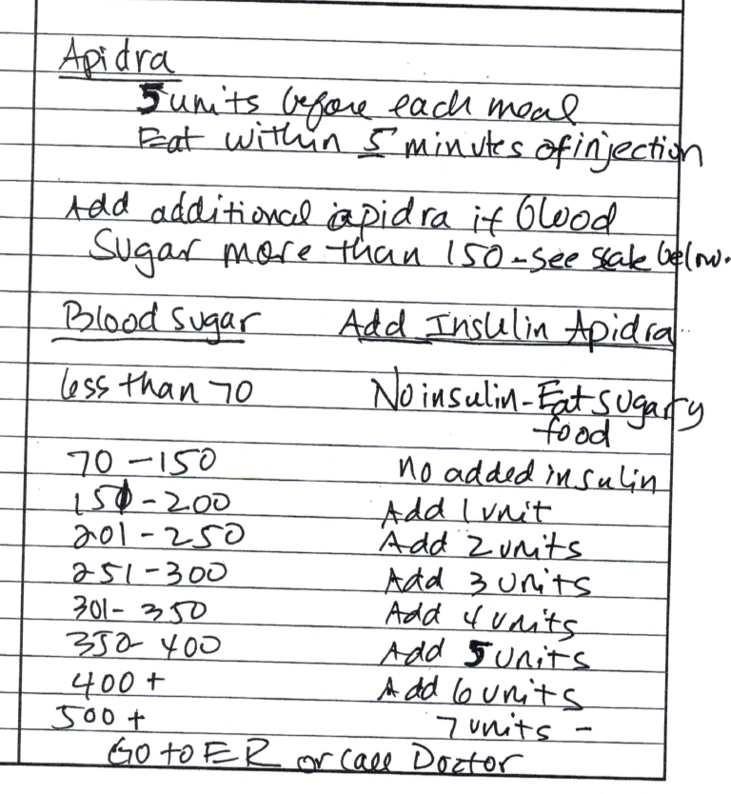
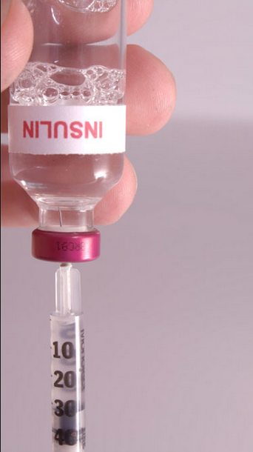
Apidra Scale

Slide 91
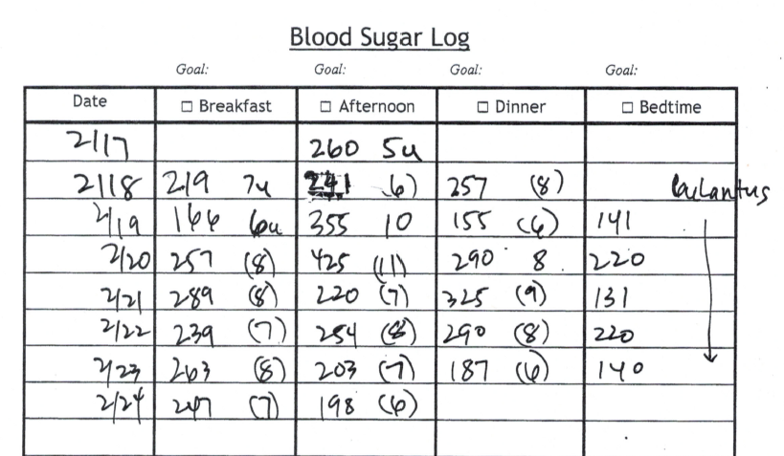
After One Week

Slide 92
Recommendations
Increase Apidra to 6 units at breakfast and lunch.
Increase Lantus to 8 units at hs
Check back in one week
Consider changing to 70/30 insulin
Calculating 70/30
Add up TOTAL insulin she takes a day ~ 30 units
Compare to weight calculation 70 x 0.5 = 35 units/day
Start conservative – 30 units
2/3 am 20 units (14 basal + 6 bolus)
1/3 before dinner 10 units (7 basal +3 bolus)
Gradually increase to get to target

Slide 93
Poll question 6
What best describes 70/30 insulin?
A. 70 percent bolus, 30 percent basal
B. 70 percent analog, 30 percent bolus
C. 70 percent basal, 30 percent aerosolized
D. 70 percent basal, 30 percent bolus
E. Not sure

Slide 94
Combo Sub-Q Insulin

Slide 95

Type 1 for 30 Years – On injections Lantus and Humalog
Rob weighs 80kg, BMI 23
Insulin dosing
Lantus 22 units AM
Humalog
Before breakfast 9-14 units
Lunch 2-4 units
Dinner 2-6 units
Bedtime 1-2 units if > 200
2. Not keeping any type of log
3. Not counting carbs – just ballparking
4. A1c 6.7 – no Endo

Slide 96
Type 1 for 30 Years – 80kg
Based on wt, dose of insulin?
Total daily dose -80 x 0.5 = 40 units/day
Basal dose 50% = 20 units a day
Bolus dose 50% = 20 units/3 meals = 7 + 6 + 6
Current dose (total = 26) “Adjusted”
14 breakfast 10 units
4 lunch 4 units
4 -6 dinner 4 units
1. Adjusts insulin down if active at work
2. Starts to feel hypo around 60-70
3. Doesn’t always have snacks

Slide 97
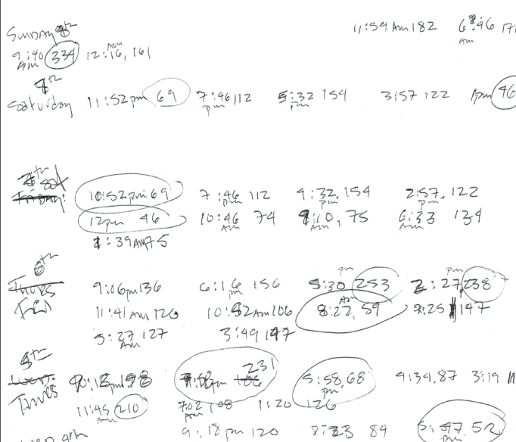
Plan – Keep BG log for 1 week Prevent Hypos as much as possible
Day before appt, wife got results off of meter and wrote them down. Wife also circled numbers she was concerned about.

Slide 98
Type 1 for 30 Years – On injections Lantus and Humalog (6 x’s a day)
Rob weighs 80kg, BMI 23
Insulin dosing
Lantus 22 units AM
Humalog
Before breakfast 9-14 units
2 hrs post breakfast 2 more units (based on BG)
Lunch 2-4 units
Dinner 2-6 units
2 hours after lunch, 2-4 more units (based on BG)
Bedtime 1-2 units if > 200
Worried about getting complications

Slide 99

Plan
Keep detailed log for one wk, include insulin dose and carbs eaten
Decrease Lantus to 18 units in am
Try not to stack humalog (take extra after meal)
Try to carb count
Breakfast - 1 unit for every 10gm
Lunch/dinner – 1 unit for every 15 gms
When BG < 70, don’t wait – treat

Slide 100
Bolus Basics
Carbohydrate/ Prandial Coverage
Match the insulin to the carbohydrates
1 unit for 10 - 15 gms - Common starting point
Correction Bolus - targets hyperglycemia
1 unit for every 30-50 points over target
Adjust ratios depending on sensitivity and response
Notes:
Importance of MD writing for a diabetic diet cannot be overemphasized. It sets into motion the timing of meals that are delivered, makes it easier for RN to know when to check glucose and administer the insulin.

Slide 101
Adjusting Bolus and Correction Doses Carbohydrate-to-Insulin Ratio
Based on three questions before meals:
How much carbohydrate am I going to eat?
What is my insulin dose for this amount of carbohydrate?
Should I lower the dose because I plan to be very active or have recently been active?

Slide 102
Carbohydrate Ratio How does that work? Rapid/Fast Acting Insulin
Serving Size | Gms CHO | Insulin
1 | 10 gms cho | 1 unit
2 | 20 gms cho | 2 units
3 | 30 gms cho | 3 units
4 | 40 gms cho | 4 units
5 | 50 gms cho | 5 units
6 | 60 gms cho | 6units
7 | 70 gms cho | 7units
Breakfast (70 gms cho)
Rice Chex (60 gms)
Milk
(12 gms)
Black coffee
Carb coverage
1 unit for every 10 gms
Blood Glucose 165mg/dl

Slide 103
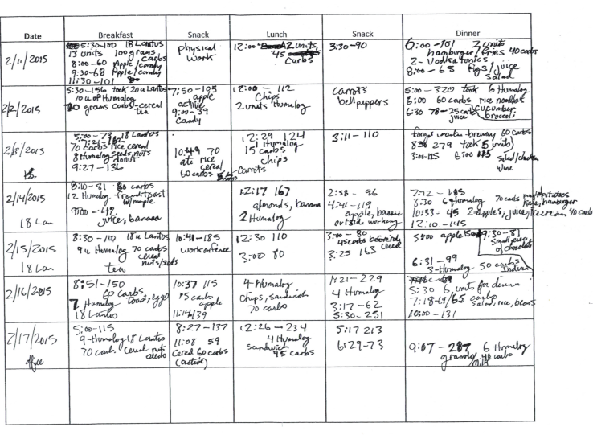

Slide 104

Outcomes
Keep detailed log for one wk, include insulin dose and carbs eaten - success
Decrease Lantus to 18 units in am - success
Try not to stack humalog, just take before meals and try to carb count – success
Count carbs – some success – Refer to RD
When BG < 70, don’t wait, treat. Needs work

Slide 105

Next Steps
Put alarm on phone to eat snack at 9am.
If drinking, 15gms carb for every drink. May need to decrease insulin coverage (be conservative)
Consider insulin pump, CGM and downloading glucose results
When BG above 130 premeal, add correction bolus (1700 rule) – 1 unit for every 45 above target
Return visit in 3-6 months

Slide 106
More detailed Insulin Plan – Clarify correction scale
Carb ratio:
1 unit for every 10 gms at breakfast
1 unit for every 15gm at lunch and dinner
Insulin Sensitivity Calculation:
1700 Rule
1700 / Total Daily Dose = insulin sensitivity
1700 / 40 = 43 (42.5)
1 unit drops BG 45 points – “Correction”
Carb coverage plus correction = total mealtime bolus dose

Slide 107
Poll question 7
If Robs BG is 68 before eating, what is the best insulin adjustment strategy?
A. Take bolus insulin ½ hour after eating
B. Reduce usual bolus insulin dose by 1 unit
C. Eat 30 gms of carb, then eat meal
D. Decrease pm basal

Slide 108
Correction Bolus for Rob Analog Insulin (1 unit:45 mg/dl>130)
Less than 70 mg/dl | Subtract 1 unit
70-130 mg/dl | 0 units
130-175 mg/dl | 1 unit
176-220 mg/dl | 2 units
221-265 mg/dl | 3 units
266-310 mg/dl | 4 units
311-356 mg/dl | 5 units

Slide 109
Adjusting Robs Bolus Insulin With Ratios
Rob plans to eat 70 gms of carbohydrate, BG before breakfast 165.
Carb coverage: 70gms / 10 = 7 units insulin
Correction Scale - 165-130 = 35 over target – 1 unit
7 units bolus insulin to cover carbs in meal
1 units bolus insulin to correct to target
Total adjusted dose: 8 units humalog insulin

Slide 110
Adjusting Robs Bolus Insulin With Ratios - You Try
BG before breakfast 175, plans to eat 80 gms of carbohydrate.
____-130 = ____ over target, ____/45 = ____units
______gms / ____ = ____ units ins for carbs
_____ units insulin to correct for hyperglycemia
_____ units insulin to cover carbs in meal
Total adjusted dose: ___ units novolog insulin

Slide 111
Adjusting Robs Bolus Insulin With Ratios - Answers
BG before breakfast 175, plans to eat 80 gms of carbohydrate.
175- 130 = 45 over target, 45 /45 = 1 units
80 gms / 10 = 8 units for carbs
1 units insulin to correct hyperglycemia
8 units insulin to cover carbs in meal
Total adjusted dose: 9 units novolog insulin

Slide 112
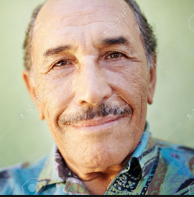
Based on Mr R’s clinical picture – In hospital How Much Insulin Needed?
Creatinine 1.6
76 years old
Not very hungry
BMI 21
Weighs 80kg
Glucotrol 5mg at home
A1c 7.2%

Slide 113
Calculate Daily Insulin Needs
Based on unique characteristics of pt, where would you start?
Body wt in Kg x _________ = total daily dose
May need more or less based on clinical presentation
Less 0.3 u/kg 0.5u/kg More 1.0 u/kg
Thin, elderly,  creat Heavy, infection, steroids

Slide 114
Calculate Insulin Needs Basal/ insulin carb/ correct
Body wt in Kg x 0.3
80kg x 0.3 = 24 units daily
Basal = 12 units
Bolus = 12 units / 3 meals = 4 units each meal
What if he is nauseated?

Slide 115
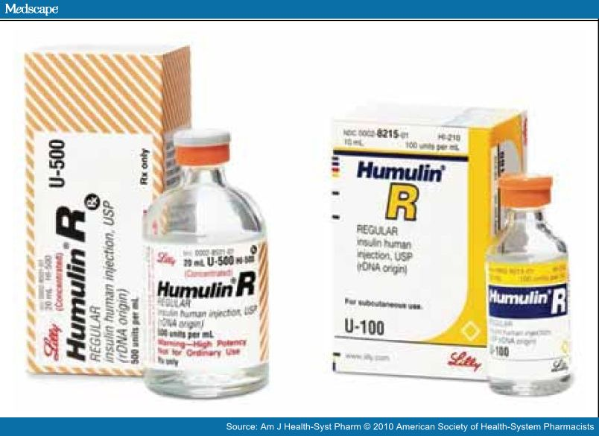
More than 200 units a day?

Slide 116
Consider u-500
Consider U-500 (5 x’s more potent)
1 unit on U-100 syringe = 5 units insulin
Dosing – take total daily needs and split into two doses
60% am / 40% pm
500 units per mL – 20 units a vial = 10,000 units per vial
Costs ~ $400 per vial
No basal insulin needed, because U-500 has bolus and basal action
Needs careful monitoring/ education
U-500 Insulin: When More With Less Yields Success: Diabetes Spectrum March 20, 2009 vol. 22 no. 2 116-122

Slide 117
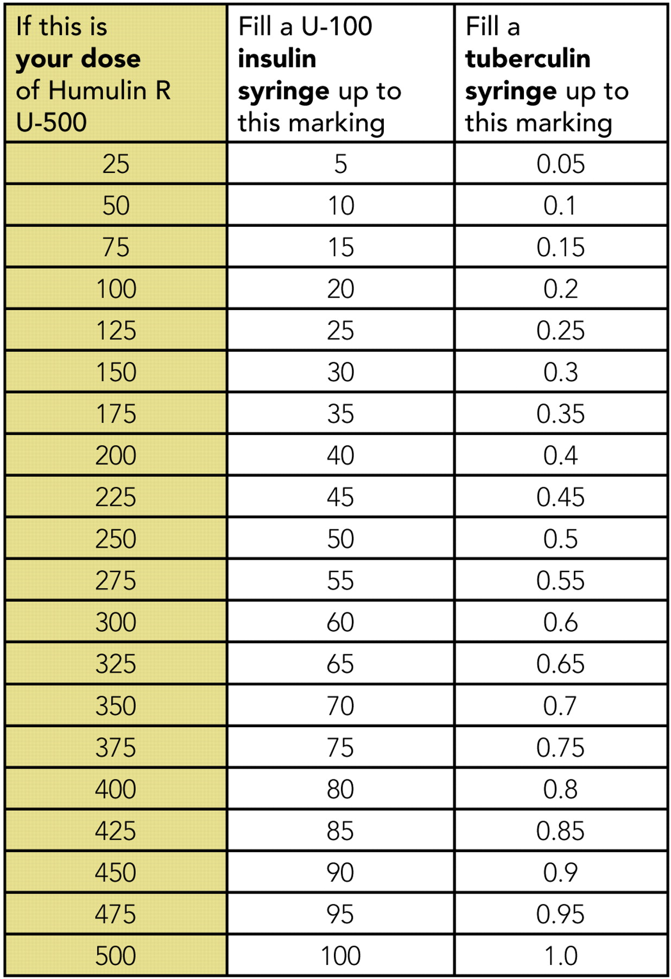
U-500 Dose U-100 syringe and TB Syringe

Slide 118
Convert Pt from u-100 to u-500
Pt currently on a total dose of 250 units a day
250/ 5 = 50 units a day
2/3 in am = 30 units u500
1/3 in pm = 20 units u500
Pt currently on a total dose of 300 units a day
300/ 5 =
2/3 in am =
1/3 in pm =

Slide 119
Poll question 8
Pt on 300 units of u-100 insulin a day. Which is an accurate conversion to u-500.
A. Take 50 units daily
B. Take 30 units daily
C. Take 36 units am and pm
D. Take 36 units am and 24 units pm

Slide 120
Convert Pt from u-100 to u-500
Pt currently on a total dose of 250 units a day
250/ 5 = 50 units a day
2/3 in am = 30 units u500
1/3 in pm = 20 units u500
Pt currently on a total dose of 300 units a day
300/ 5 = 60
2/3 in am = 36 units
1/3 in pm = 24 units

Slide 121
Critical Assessment
Beverly Dyck Thomassian, RN, MPH, BC-ADM, CDE
President, Diabetes Education Services
www.DiabetesEd.net

Slide 122
Objectives
1. Identify common yet often under diagnosed complications associated w/ type 1 and type 2 diabetes.
2. State strategies to identify previously undiscovered diabetes complications during patient assessments.
3. Demonstrate steps involved in lower extremity assessment.

Slide 123
Honing Detective Skills
During patient interviews, strategies to identify previously undiscovered diabetes complications

Slide 124

We are Unique

Slide 125
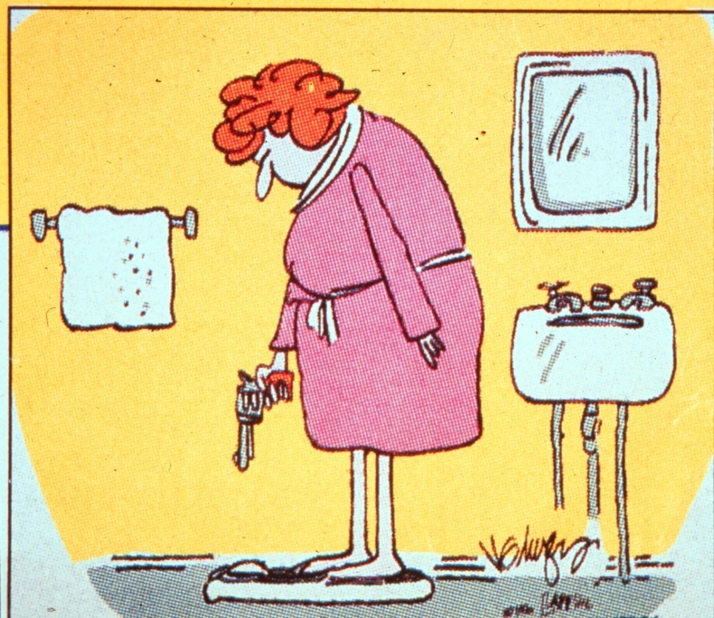
Patient is Gaining Weight
68 yr old female complains of 4 lb wt gain a week for past month. Wt 140lbs, BMI 27. BG levels 200-300s. B/P 142/96
Reported daily meds include:
glyburide 10mg ac breakfast
Actos 30mg ac breakfast
Glargine 30units at night
Lispro sliding scale with meals
Synthroid (not sure of dose)
Lasix 20mg a day

Slide 126
Fluid Weight Gain
People with diabetes at greater risk for Congestive Heart Failure (CHF) due to increased CVD risk factors.
Actos and Avandia, (TZD’s), can cause fluid wt gain and worsen CHF.

Slide 127
Thyroid Disease and Diabetes
27 mil Americans have over or under active thyroid glands, but more than half remain undiagnosed.
More than 8 out of 10 pts w/ thyroid disease women.
15 to 30% of people w/ diabetes & their siblings or parents are likely to develop thyroid disease (compared to 4.5 percent of the general population).
Check TSH on Type 1 & 2 annually or if indicated.
AACE Website

Slide 128

Thyroid & TSH* Levels
*Thyroid Stimulating Hormone - secreted by pituitary gland
controls thyroid hormone thyroxine production
first and best test
TSH Norm = up to 4.5 mIU/mL
Treatment based on TSH plus symptoms.
4.5 – 10 based on risk, s/s
10 or more = treat
Lower = hyperthyroidism
Higher = hypothyroidism–
AACE 2012 Guidelines

Slide 129
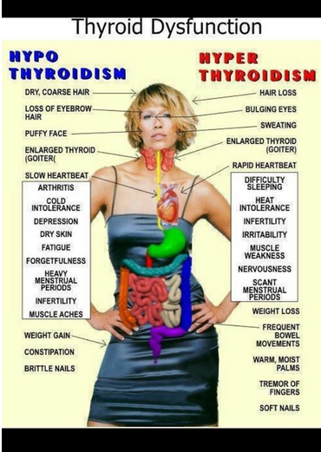

Slide 130
Hypothyroidism
Hashimoto’s thyroiditis – autoimmune thyroid
most common cause of hypothyroidism w/ dm
Type 1 and type 2 at greater risk
Screen annually for thyroid disease in diabetes
Clinical features: fatigue, wt gain, dry skin, cold intolerance, depression, constipation, dyslipidemia
Higher risk of CVD – monitor risk
Dx: high TSH, then test for free T4, autoantibodies, and thyroid scans as needed
Tx: replacement with levothyroxine (75-125 ug)
AACE Thyroid Guidelines

Slide 131
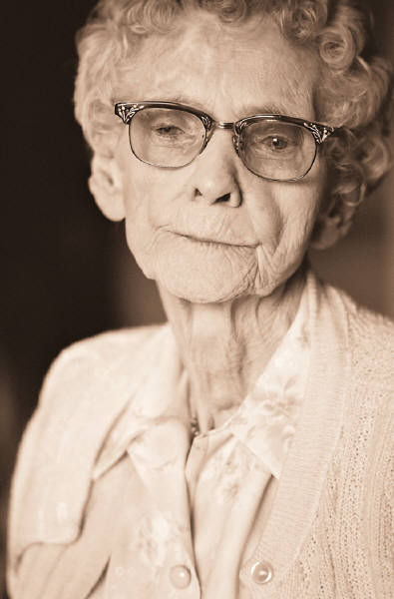
Diabetes – Distress and Depression Ask and Address
Treatment includes:
referral to mental health professional
Medications

Slide 132
Novel / Atypical Antipsychotics Linked to Hyperglycemia
Severe cases of hyperglycemia – even death reported
Monitor BG regularly for DM patients started on this class of med
If pt at risk for DM, determine fasting glucose before initiating therapy and monitor closely during treatment
Weight gain may require increased dosing of diabetes therapies.
Summary of FDA warning statement for atypical antipsychotics, 2004

Slide 133

Novel/ Atypical Antipsychotics Linked to Hyperglycemia
Zyprexa – olanzapine
Geodon - ziprasidone
Seroquel – quetiapine
Risperdal - risperadone
Clozaril - clozapine
Abilify – aripiprazole
Latuda - lurasidone
Consensus Development Conference on Antipsychotic Drugs and Diabetes 2004

Slide 134

Patient is Losing Weight
SR, 49 yr old woman w/ lean “type 2” 7 yrs.
Monitors BG 1 x daily
A1c 13.9%
Insulin: 14 u Lantus at hs (uses pens)
Humalog if BG > 200 (says too expensive)
Also on Metformin 500mg BID
At 5’7, her usual wt is 120, but now 106 lbs
C/O of nausea, fullness, fatigue
No health insurance

Slide 135
Diabetes Detective
What other comorbidities are you suspecting?
Any labs you would like to check?
What type of diabetes?
Social situation?
Consider her lack of insurance and low income level during your discussion.
Medication changes?

Slide 136

Suggested changes
Regular insulin 2- 3 times a day – 3 units if don’t check BG (eat 45 gms of carb)
If check BG, add 1 unit for each 50 pts above 150
Try and eat 3 times a day – use liquid calories as needed, low fiber
Check BG at least once a day
Weekly phone call check in

Slide 137
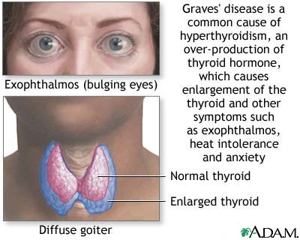
Hyperthyroidism
Graves Disease (most common)
0.5 – 2.0% risk in type 1
Autoimmune disorder:
Symptoms: wt loss, hypermetabolism, tremor, exopthalmus, palpitations, tachycardia, heat intolerance, nervousness, hyperglycemia
Diagnosis: Dx: low TSH, then check T3 & T4, autoantibodies, and thyroid scans
Treatment: antithyroid drugs, surgery, radioactive iodine. After treatment, may need thyroid replacement therapy.
AACE Thyroid Guidelines 2002

Slide 138
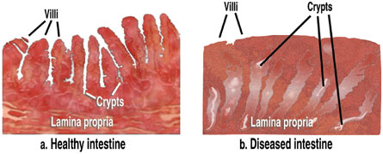
Celiac Disease
Type 1 – Affects 1-16%
Immune reaction to gluten - affects function of villi in intestine, decreasing nutrient absorption
S/S: bloating, malabsorption, wt loss, fatty stools, diarrhea, muscle tenderness, failure to thrive
Diagnosis: measure either anti-endomysial antibodies (EMA) titers or tissue transglutaminase.
If positive, refer to GI specialist for endoscopy and biopsy of small intestine to confirm diagnosis.

Slide 139
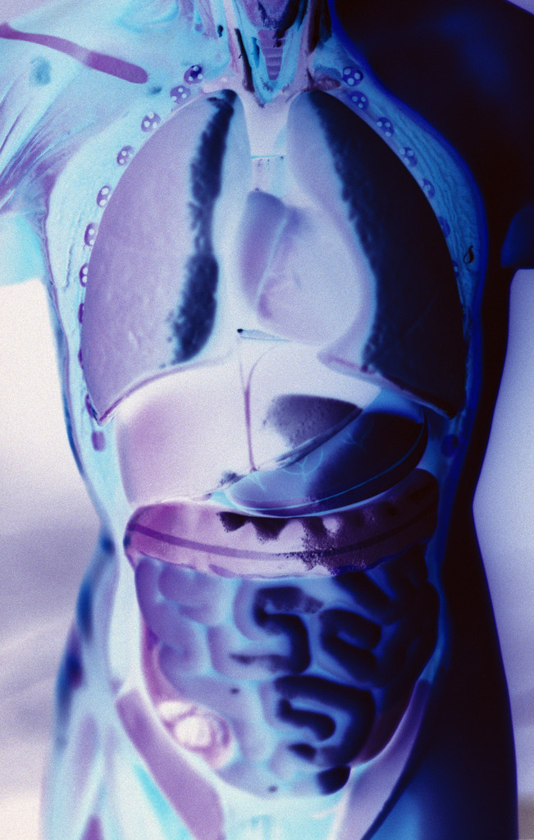
Gastroparesis
Gastroparesis: affects 20 – 30% of pt’s w/ longstanding dm
Delayed emptying of stomach contents due to nerve damage
S/S include early satiety, fullness, postprandial hypo, vomiting
Diagnosis: gastric emptying studies, post-prandial hypoglycemia
Tx: improve BG, small, low fat & fiber meals meds: reglan, erythromycin

Slide 140

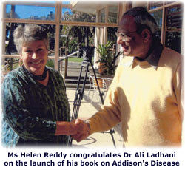

What do JFK, Helen Reddy and Jane Austin have in common?

Slide 141



Addison’s Disease
1 in 250 w/ type 1 (thyroid dx = > risk)
Autoimmune destruction adrenal glands
Cortisol deficiency
decreases hypoglycemia awareness
decreases glycogenolysis
S/S weakness, wt loss, hypoglycemia, dehydration, hyperpigmentation, muscle weakness, salt craving, hyponatremia, hyperkalemia
Diagnosis: test Anti-21- hydroxylase autoantibody, adrenocorticotropic hormone cortisol stimulation test
Treatment: oral hydrocortisone replacement

Slide 142

Hyperglycemia and Special Situations
Cancer
Post transplant hyperglycemia
Cystic Fibrosis
Liver Disease

Slide 143

Diabetes and Cancer
People with diabetes have a
2 fold higher risk for cancers of
the liver, pancreas and endometrium
1.2 to 1.5 fold risk of cancers of the
colon, breast and bladder.
Lower risk of prostate cancer only.
Diabetes and Cancer: A Consensus Report Cancer J Clinic 2010
Joint statement American Cancer Society and American Diabetes Assoc

Slide 144
Links
Cancer is the 2nd leading cause of death in U.S.
Diabetes is the 7th leading cause of death
Cancer and diabetes diagnosed within the same individual more frequently than would be expected, even after adjusting for age.

Slide 145
Risk Factors Common to Both Diseases
Aging
Sex
Obesity
Diet
Physical inactivity
Smoking
Alcohol
Biologic links incompletely understood

Slide 146

Possible Mechanisms for a Direct Link
Hyperinsulinemia
Hyperglycemia
Inflammation

Slide 147

What Can Health Professionals Do?
Promote healthy diet, physical activity and weight management.
Encourage appropriate screening for cancer and to report any symptoms
Studies indicate metformin may decrease cancer risk
Focus on DM prevention

Slide 148
The Problem w/ Cancer + Hyperglycemia:
Increased risk of infection in an already immuno-compromised patient
Increased weight loss
Fatigue
Dehydration / lack of sleep
Depression
How to Manage Steroid Diabetes in the Pt w/ Cancer
Oyer et al Supportive Oncology, v4/#9 Oct 2006

Slide 149
Mr. Carter – 83 yrs young Diagnosed w/ Leukemia
Medical situation
Diabetes 11 years, usually controlled on oral medications (glipizide).
A1c usually less than 6.5%. Now 7.6%
On prednisone taper
Creat 1.1
Blood transfusions every 2 weeks
5’11 – weighs 182 (has lost 10 lbs over past 6 months, but is holding now)

Slide 150

Mr. Carter – 83 yrs young Social Situation
Social Situation
Lost wife 3 months ago
Lives alone – very active
Rates his health as good to excellent
Has extensive social network
Tells you “I am worried about my blood sugars and want to get them down”.

Slide 151

What Action?
Blood glucose testing frequency
Med changes?
Activity suggestions?
Nutrition ideas?

Slide 152
7 Key Facts about Steroids and Cancer
Primarily effects post meal BG
Glucose levels tend to normalize overnt
Oral agents usually don’t work
Insulin always works
Bolus / prandial insulin primary need
Basal insulin given in am
Consult w/ RD, CDE’s and other specialists as needed.

Slide 153
What Action?
Blood glucose testing frequency
Med changes?
Activity suggestions?
Nutrition ideas?

Slide 154
Special Populations: Post Organ Transplant
Post transplant kidney, heart, liver, lung transplant have about 20% chance of developing diabetes
Increased risk for hyperglycemia due to steroid therapy, tacrolimus, cyclosporine, physical stress, pre-existing risk factors
Early detection and aggressive treatment important to prevent infection and complications
Mgmt: oral agents/insulin, BGM, exercise, MNT
New Onset Diabetes Mellitus After Transplantation
Endocrinol Metab Clin N Am36 (2007) 873–890

Slide 155

Cystic Fibrosis Related Diabetes (CFRD)
Cystic fibrosis
Affects >30,000 in U.S.
1000 children dx each year
Abnormally thick mucus clogs lungs
Partial fibrotic destruction of islet cell mass leads to hyperglycemia
Due to improved treatment, survival rates improving

Slide 156

Cystic Fibrosis Related Diabetes (CFRD)
CFRD distinct clinical entity
Insulin deficient but not prone to ketosis
Slow moving – 2-4 yrs before diagnosis
Abnormal glucose tolerance associated with progressive clinical deterioration
Associated w/ poor nutritional status, lung disease, resp failure
Lowers survival rate at 30 yrs
Only 25% live to 30 w/ CFRD
60% live to 30 years when no CFRD

Slide 157
Cystic Fibrosis Related Diabetes (CFRD)
CFRD Magnitude with CF
20% of adolescents
40% of adult pts, develop CFRD
CFRD Consensus Panel recommends:
FPG yearly after 14 yrs age or symptoms
Monitor BG closely during steroid therapy
A1c may not be accurate (false low)
Clinical Practice Recommendations for CFRD 2010

Slide 158
Cystic Fibrosis Related Diabetes (CFRD)
Treatment Philosophy
“Eat, we will cover”
Goal of therapy: maintain glucose/ weight
Daily cals – 120 to 150% RDA (2,400 – 3000)
40% fat, 15-20% protein,
May be on steroid pulses
Med regimen needs flexibility
Bolus insulin w/meals, carb counting + basal
Monitor BG levels annually or if s/s of DM

Slide 159
23 yr old newly diagnosed CFRD
A1c 8.3%
Lost 6 lbs over past 3 months
BMI 21
Creat 0.9
On and off steroids
Meds?
Insulin?
Food?
Activity?

Slide 160
23 yr old newly diagnosed CFRD
A1c 8.3%
Lost 6 lbs over past 3 months
BMI 21
Creat 0.9
On and off steroids
Meds?
Insulin?
Food?
Activity?

Slide 161

NonAlcoholic Fatty Liver Disease (NAFLD)
Increasing worldwide prevalence
25% of adults
75% of people w/ DM or obese
Up to 50% of obese children
NAFLD = greater than 5.5% fat in liver that can’t be attributed to other cause .
Due to Insulin Resistance and Obesity
The Metabolically Benign & Malignant Fatty Liver - 2011

Slide 162

DM & Fatty Liver
Fatty Liver and hepatic inflammation is associated with insulin resistance and measures of visceral adiposity
It also predicts:
Incidence of type 2 diabetes
Heart disease
Fatty liver disease is directly involved in the pathogenesis of these diseases. Maybe a cause?

Slide 163
Finding Liver Disease
No makers are accurate for diagnosing NASH – only biopsy
Obese pts or those with metabolic syndrome should be evaluated
Signs of advanced disease include:
Portal hypertension, spider angiomas, reddening of palms, declining platelet counts an family hx

Slide 164

Natural History of NAFLD to NASH

Slide 165
Finding Liver Disease
No markers are accurate for diagnosing NASH – only biopsy
Obese pts or those with metabolic syndrome should be evaluated
Signs of advanced disease include:
Portal hypertension, spider angiomas, reddening of palms, declining platelet counts, family hx

Slide 166
Treating NAFLD
Since there is no approved treatment for NAFLD and almost every patient with NAFLD will have to change their lifestyle – lose weight, exercise, and eat a healthy diet – it is not necessary to biopsy routinely." NIH Clinical Center, Dr. Yaron Rotman
Wt loss of 7-10% linked w/ 50% drop in liver fat
Clinical Endocrinology News 12/12

Slide 167
Natural History of NAFLD-
Over 3.5 - 11 year period
“Benign” Group
60% remain stable
13% have improvement
“Malignant” Group
28% progress to liver damage
The Metabolically Benign & Malignant Fatty Liver - 2011

Slide 168
Diabetes + Obesity = Progression to NASH
50% progress from “Benign” fatty liver to Steatohepatitis.
2-4 fold risk of developing advanced liver disease compared to those without diabetes.
About 15% develop cirrhosis and are at increased risk for liver cancer

Slide 169

NASH
Represents the hepatic manifestation of metabolic syndrome:
Abdominal obesity
Hypertension
Diabetes
Dyslipidemia
25 million Americans will develop NASH by 2025 with 20% progressing to cirrhosis, cancer or both

Slide 170

Over Time Leads to NASH or SteatoHepatitis …
Fibrosis and Cirrhosis
Liver Cancer
Liver Failure
Future epidemic of liver transplants??

Slide 171

Lets take a Look at Lower Extremities and Assess

Slide 172
Lower Extremity Amputations Dropping over past 10yrs
60% of amputations in 7% of pop
Higher in men, elderly, minorities, Chronic Kidney Disease (CKD)
Lower extremity complications represent 20% of hospitalizations for elderly
Amputations cost $40,000
Amputation associated w/ earlier death compared to revascularization
10 yr survival after LEA

Slide 173

Diabetes and Lower Extremity Ulcers
Up to 15% of DM patients have ulcers in their lifetime
Mortality with foot ulcers is twice usual

Slide 174

Risk factors for Foot Ulcers/ Amputation
Previous amputation
Past foot ulcer history
Peripheral neuropathy
Foot deformity
Peripheral vascular disease
Visual impairment
Diabetic nephropathy (especially patients on dialysis)
Poor glycemic control
Cigarette smoking
ADA Task Force - 2008

Slide 175
What Leads to Ulcers
86% single precipitating event leading to ulcer 1. Tight shoe 3 classes 1. Neouropathic 2. Ischemic (hard to heal) 3. neuro-ischemic (worst)

Slide 176
Neuropathy Leads to Lower Extremity Complications
Neuropathies
Sensory
loss of sensation, painless trauma, repetitive low grade stress
Motor
muscle atrophy, unbalanced tendon pulling, bone/gait changes, deformities, claw foot
Motor + Sensory changes = ulcerations
Autonomic
decreased perspiration, fissures, Charcot’s foot

Slide 177




Pressure Area Breakdown

Slide 178

Neuropathic Diabetes Foot Ulcers

Slide 179



Foot Motor/Nerve Deformities

Slide 180



Walking Cast for Neuropathic Ulcers
Emotional aspects & Impact on BG

Slide 181
Circulation Issues lead to Lower Extremity Problems
Peripheral Arterial Disease
Vascular Disease
Assessment

Slide 182

Peripheral Arterial Disease Assessment

Slide 183



Pitting Edema

Slide 184

Venous Ulceration

Slide 185

Diabetes and Charcot Foot
Damaged nerves
Blocked blood vessels
Shifting bones
Collapsed arch joints

Slide 186




Charcot’s
Neurotraumatic theory:
bony destruction due to loss of pain sensation and proprioception + repetitive and mechanical trauma to foot.
Neurovascular theory:
joint destruction secondary to autonomically stimulated hyperemia and periarticular osteopenia associated with trauma.
45 yr old, type 2 on orals, Random BG 201mg/dl
Tx during acute phase = Casting for 3-6 mo’s then custom footwear

Slide 187



Comprehensive Foot Exam

Slide 188
1st Step – Watch Pt Walk

Slide 189

Foot Exam – Patient History
Previous foot ulceration
Previous amputation
Diabetes > 10 years
A1c ≥ 7%
Impaired Vision
Neuropathic Symptoms
Claudication

Slide 190

Foot Exam – Dermatologic Exam
Dry Skin
Absence of hair
Ingrown nail edges, long or sharp nails
Interspace maceration
Ulceration
Cleanliness

Slide 191


Flexibility Assessment Stiff joint syndromes

Slide 192
Biomechanical Foot Assessment –
Test
Plantarflexion & Dorsiflexion of ankles, great toes
Watch pt ambulate
Inspect Shoes
Inspect for deformity
Significant Finding
Diminished joint mobility
Decreased vision, gait imbalance, need for assistive devices
Ability to see/ reach feet
Corn, calluses, bunions, prominent metatarsal heads, hammertoes, claw toes

Slide 193

Visual Inspection/Palpation
Breaks in the skin
Erythema
Trauma
Pallor on elevation
Dependent rubor
Changes in the size or shape of the foot
Nail deformities
Extensive callus
Tinea pedis
Pitting edema
VA Guidelines 2004

Slide 194
Foot Exam – Screening for Neuropathy
Test
Semmes-Weinstein monofilament 10g
Vibration perception threshold testing
Tuning Fork 128 Hz
Significant Finding
Lack of perception at one or > sites
Vibration perception threshold >24 volts
Abnormal vibration perception

Slide 195

Loss of Protective Sensation
Monofilament Testing
5.07 touched to plantar
surface and top of foot
C shape delivers 10 gms pressure
Test four sites
Plantar surfaces of
Each great toe
1st, 3rd and 5th metatarsal head

Slide 196
Monofilament (MF) Procedure (Int Consensus Grp)
Demonstrate procedure on pts forearm or hand
Have pt close their eyes
Test four sites in random sequence
(if callus or ulcer, test adjacent surface)
Bow the MF and ask, “Do you feel it touch you, yes or no?”
Randomly test at each site 3 times (one of which is a “sham” application – MF not applied)

Slide 197

5.07 monofilament = 10gms linear pressure

Slide 198

Tuning Fork to Detect Polyneuropathy
128 tuning fork
Plantar halax
Compare sensation to that of examiner
Back to Basics in Diagnosing Diabetic Polyneuropathy with the Tuning Fork! Meijer,et all Diabetes Care, Vol 28, #9 Sept 2005

Slide 199
Tuning Fork (TF) Procedure
Demonstrate sensation to pt on wrist or elbow w/ and without vibration
Ask pt to close eyes
Apply TF perpendicularly with constant pressure to dorsum of hallux (1st great toe) just proximal to nail bed. Place your index finger of the hand beneath the pts toe to feel vibration and verify.

Slide 200
Tuning Fork Procedure
Use initial sham test and apply non-vibrating TF to be sure pt does not mistake pressure for vibration and ask.. Is the TF vibrating? (No is right answer)
Use “on-off” method to score.
Conduct testing 2xs on each great toe

Slide 201
Tuning Fork Procedure
On each test:
Ask pt to ID beginning of vibration
“Is it vibrating”?
Ask pt to ID cessation by dampening TF.
“Tell me when the vibrating stops”
The number of correct responses = 0-8
At least 5 incorrect responses = peripheral neuropathy (must get 3 right)

Slide 202
Foot Exam – Vascular Exam
Test
Palpation of pulses
dorsalis pedis
tibial
Ankle – Brachial Index (ABI)
Significant Finding
Absent pulses
ABI <0.90, consistent w/ peripheral arterial disease

Slide 203

Vascular Status Assessment
Posterior tibial pulse
Dorsalis pedis pulse
Temperature
Appearance

Slide 204

Dorsalis Pedis Pulse

Slide 205

Taking the DP Pulse

Slide 206

Posterior Tibial Pulse

Slide 207

Taking the Posterior Tibial Pulse

Slide 208
We Save Feet through Patient Education
Proper footwear – no going barefoot, even indoors
Daily foot inspection – look between toes and on sole of foot
Prompt reporting of any foot lesions, discolorations or swelling

Slide 209
Important Stuff to Remember
Always start with where the patient is at!
Consider the entire milieu
Listen
Keep it simple
Check in often
Open lines of communication with medical team

Slide 210


Thank You
www.DiabetesEd.net

