Slide 1


Diabetes Boot Camp – Class 2
Beverly Dyck Thomassian, RN, MPH, BC-ADM, CDE
President, Diabetes Education Services
www.DiabetesEd.net

Slide 2


Important Stuff
Welcome to our First Boot Camp ever
We will meet for 4 consecutive Thursdays – from 11:30am to 1pm
I will stay after the program to answer any questions “off – line”
The course will be recorded and available for viewing within 4 hours of completion of the session
Login to the Online University to hear the recorded version, take the quiz and get your CEs
Please email us with any questions or concerns at Lainey@diabetesed.net

Slide 3
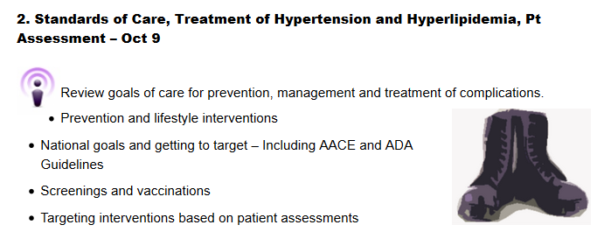
Boot Camp 2 – Standards of Care, Treatment of HTN, Lipids, Hypo, Monitoring and Sick Days

Slide 4
Poll Question 1
Which of the following diabetes Self Care Behaviors are part of the AADE 7?
Compliance
Assessment
Adherence
Reducing Risk

Slide 5

Assessing Diabetes Self Care
Healthy Coping with
Diabetes

Slide 6

Assess the Situation

Slide 7


Beliefs, Attitudes, Readiness
(reveal extent of information to give…) Check out where they at and start there

Slide 8
Assessment Factors:
Stress response and coping strategies are based on:
Health beliefs and Perceptions
Cultural traditions, family system.
Social, religious and employment influences
Personal factors: attitudes, cognitive factors, literacy, learning styles
Psychosocial factors
Developmental age and stage
Finances
Environment (transportation, location, safety)

Slide 9
Poll Question 2
If a patient is in denial about their diabetes, what is the best approach?
Immediately help them accept that they have diabetes
Show them how to safely take an insulin injection
Acknowledge their feelings
Set SMART goals based on their cultural beliefs

Slide 10
Adaptation to the Emotional Stress of Chronic Disease (Kubler-Ross, Rubin RR, WHPolonsky)
Denial | Don’t agree, but listen Acknowledge Survival Skills only!
Anger | Indicates: Awareness, Learning Begins Be clear, concise instructs No long WHY answers
Bargaining | Identifies w/ others Group classes good Focus Education on what pt. wants to know
Depression & Frustration | Realize permanency of disease and treatment Psycho-social support referral Emphasize + change made
Accept & Adapt | Sense of responsibility for Self-care;

Slide 11
Asking Questions: clear, accepting manner
What is important to you?
What do you think of your diabetes?
What are your goals and expectations?
How are YOUR feelings about all of this?
Get to The WHY.
WIIFM – What is in it for me?

Slide 12
Social Support Assessment Tool
Who helps you?
With practical or emotional support ?
What would you like in support for day-to-day?
One thing you could do so you will get the support you need?
Have resource sheet ready

Slide 13
Types of Social Support
Emotional support
Caring, empathy, love, trust----most important
( perceived )
Informational support
provided during time of stress-problem solving, chat, blog, apps
Instrumental support
goods/services--- “help”
Meters, insulin supplies, log book
Affirmational support
affirming acts or statements

Slide 14
Promoting Learning and Behavior Change

Slide 15
Poll Question 3
What is the most effective way to teach blood glucose monitoring?
Ask patient to carefully read instructions included in box.
Send patient home with video instruction
Demonstrate how to use a meter
Review steps and ask pt for return demonstration

Slide 16

Adult Learners*
Self-directed must feel need to learn
Problem oriented rather than subject oriented
Learn better when own experience is used
Prefer active participation

Slide 17

Empowerment Perspective
99% of dm care is self-care
Responsibility rests on the person with diabetes
Pt -experts in own life (HCP- experts in clinical aspects)
Posits: self goals, freely chosen- more successful, longer; self responsibility.

Slide 18

Facilitating Self-Care - Specific Skills Training
Most effective education includes:
demo of skills
practice
direct practical feedback for efforts
Didactic: less effective
Action, involvement-- Make the Behavior Real for patient

Slide 19
No one is Unmotivated
…. to lead and long and healthy life
These are the 3 usual Critical Barriers
Perceived worthlessness
Too many personal obstacles
Absence of support and resources
Bill Polonsky, PhD, CDE

Slide 20
Overcoming barriers
Confront the key misbelief GENTLY. Ask the question, does dm cause complications?
Offer pts evidence based hope message
Paired glucose testing
(Seeing+believing)
Ask pt, “Tell me 1 thing that is driving you crazy about your diabetes”
Discuss medication beliefs, ask ask ask!
To improve outcomes, contact pts more often
Bill Polonsky, PhD, CDE

Slide 21

Reevaluating Traditional Methods – Focus on Mindfulness
Help explore, identify, accept feelings.
Be “mindful”, compassionate, informed listener
We are not responsible for fixing pt’s negative emotions (*help pts use their personal resources…we facilitate)

Slide 22
Control Matters
Trials
Practice Recommendations

Slide 23
Poll Question 4
Which study demonstrated that keeping A1c less than 7% reduces complications for Type 1?
Diabetes Prevention Trial
Diabetes Control and Complications Trial
United Kingdom Prospective Diabetes Study
YOUTH Trial

Slide 24

Can we stop pre diabetes from progressing?
3, 234 people w/ Pre-Diabetes randomized:
Placebo
Diet/Exercise or
Metformin
over a three year period
Diabetes Prevention Program (DPP) 2001

Slide 25

Diabetes Prevention Program
Standard Group - 29% developed DM
Lifestyle Results - 14% developed DM
58% (71% for 60yrs +) Risk reduction
30 mins daily activity
5-7% of body wt loss
Metformin 850 BID - 22% developed DM
31% risk reduction (less effective with elderly and thinner pt’s)

Slide 26

Weight loss and Prevention
For every 2.2 pounds of weight loss, risk of type 2 diabetes was reduced by 13%.

Slide 27

Have Pre-Diabetes? Steps to Prevent Type 2
Lose 7% of body weight
Healthy eating, high fiber, low fat, avoid sugar sweetened beverages, reduce total caloric intake
Exercise 150 minutes a week
Consider Metformin Therapy for
Women with history of GDM
Patients with BMI of 35 or greater
Under the age of 60
Follow-up and group education
Annual monitoring and tx of CVD risk factors

Slide 28

Diabetes Control and Complications Trial (DCCT)
In June, 1993 the New England Journal of Medicine published the results of the landmark DCCT.
The largest, most comprehensive diabetes study ever conducted. The 10 year study involved more than 1400 subjects with Type 1 DM. It compared the effects of two treatment regimens-standard therapy and intensive control-on the complications of diabetes.

Slide 29
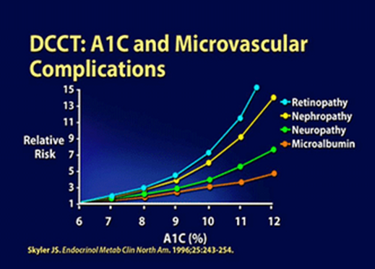
DCCT Conclusions
By maintaining A1C < 7%:
Eye disease - 76% risk reduction
Kidney disease - 50% risk reduction
Nerve disease - 60% risk reduction
Management elements:
SMBG 4 or more times a day
4 daily insulin injections or insulin pump
Greater risk of hypoglycemia

Slide 30
UKPDS Results United kingdom Prospective Diabetes Study
Conducted over 20 years involving over 5,100 patients with Type 2 diabetes
1% decrease in A₁c reduces microvascular complications by 35%
1% decrease in A₁c reduces diabetes related deaths by 25%
B/P control (144/82) reduced risk of:
Heart failure (56%)
Stroke (44%)
Death from diabetes (32%)
Lancet 352: 837-865, 1998

Slide 31

“Legacy Effect”
For participants of DCCT and UKPDS
long lasting benefit of early intensive BG control prevents
microvascular complications
Macrovascular complications (15-55% decrease)
Even though BG levels increased over time
Message – Catch early and
Treat aggressively

Slide 32

Goals of Care

Slide 33
Poll Question 5
What is the preferred approach when setting goals with patients?
Utilize shared decision making
Encourage patients to meet national standards
Highlight risk of complications when goals aren’t met
Focus on the ABCs

Slide 34
Patient Centered Approach
“...providing care that is respectful of and responsive to individual patient preferences, needs, and values - ensuring that patient values guide all clinical decisions.”
Gauge patient’s preferred level of involvement.
Explore, where possible, therapeutic choices.
Utilize decision aids.
Shared decision making – final decisions re: lifestyle choices ultimately lie with the patient.
Diabetes Care 2012;35:1364–1379
Diabetologia 2012;55:1577–1596
ADA-EASD Position Statement: Management of Hyperglycemia in T2DM

Slide 35
ABC’s of Diabetes
A1C
Blood Pressure
Cholesterol
Standards of Medical Care – American Diabetes Association

Slide 36
A1c Test
Measures glycation of RBC’s over 2-3 months
Weighted mean (50% preceding month)
Each 1% ~ 29mg/dl
Accuracy: affected by some anemias, hemoglobinopathies
A measurement of glucose in fasting and postprandial states

Slide 37


Slide 38
A1c Goals for Non Pregnant Adults Individualize Targets – ADA
< 7% for patients in general
For individual pts, as close to normal as possible (<6%) w/out significant hypo*
Goals based on:
Duration of dm
Life expectancy
Co morbid conditions
Know CVD or advanced micro complications
Individual patient considerations

Slide 39
Recommendations: Glycemic Goals in Adults
Less stringent A1C goals (such as <8%) may be appropriate for patients with
History of severe hypoglycemia, limited life expectancy, advanced microvascular or macrovascular complications, extensive comorbid conditions
Those with longstanding diabetes in whom the general goal is difficult to attain despite diabetes self-management education, appropriate glucose monitoring, and effective doses of multiple glucose lowering agents including insulin
ADA. V. Diabetes Care. Diabetes Care 2013;36(suppl 1):S19.
Notes:
Glycemic control is fundamental to the management of diabetes; recommendations for glycemic goals in nonpregnant adults are reviewed on three slides
Slide 3 of 3
Less-stringent A1C goals (such as <8%) may be appropriate for patients with a history of severe hypoglycemia, limited life expectancy, advanced microvascular or macrovascular complications, extensive comorbid conditions, and those with longstanding diabetes in whom the general goal is difficult to attain despite DSME, appropriate glucose monitoring, and effective doses of multiple glucose lowering agents including insulin (B)
Reference
American Diabetes Association. Standards of medical care in diabetes—2014. Diabetes Care 2013;36(suppl 1):S19.

Slide 40

A1c and Estimated Avg Glucose (eAG) 2008
A1c (%) eAG
5 97
6 126
7 154
8 183
9 212
10 240
11 269
12 298
eAG = 28.7 x A1c-46.7 ~ 29 pts per 1%
Translating the A1c Assay Into Estimated Average Glucose Values – ADAG Study
Diabetes Care: 31, #8, August 2008
Order teaching tool kit free at diabetes.org

Slide 41
Glucose Goals Individualize Targets – ADA
Pre-Prandial BG 70- 130
1-2 hr post prandial < than 180
*for nonpregnant adults

Slide 42
Poll Question 6
According to the American Association of Clinical Endo (AACE), what is the A1c goal?
Less than 6.5 for all patients
Pre meal blood glucose less than 110
A1c less than 7
A1c less than 6.5 for healthy patients

Slide 43
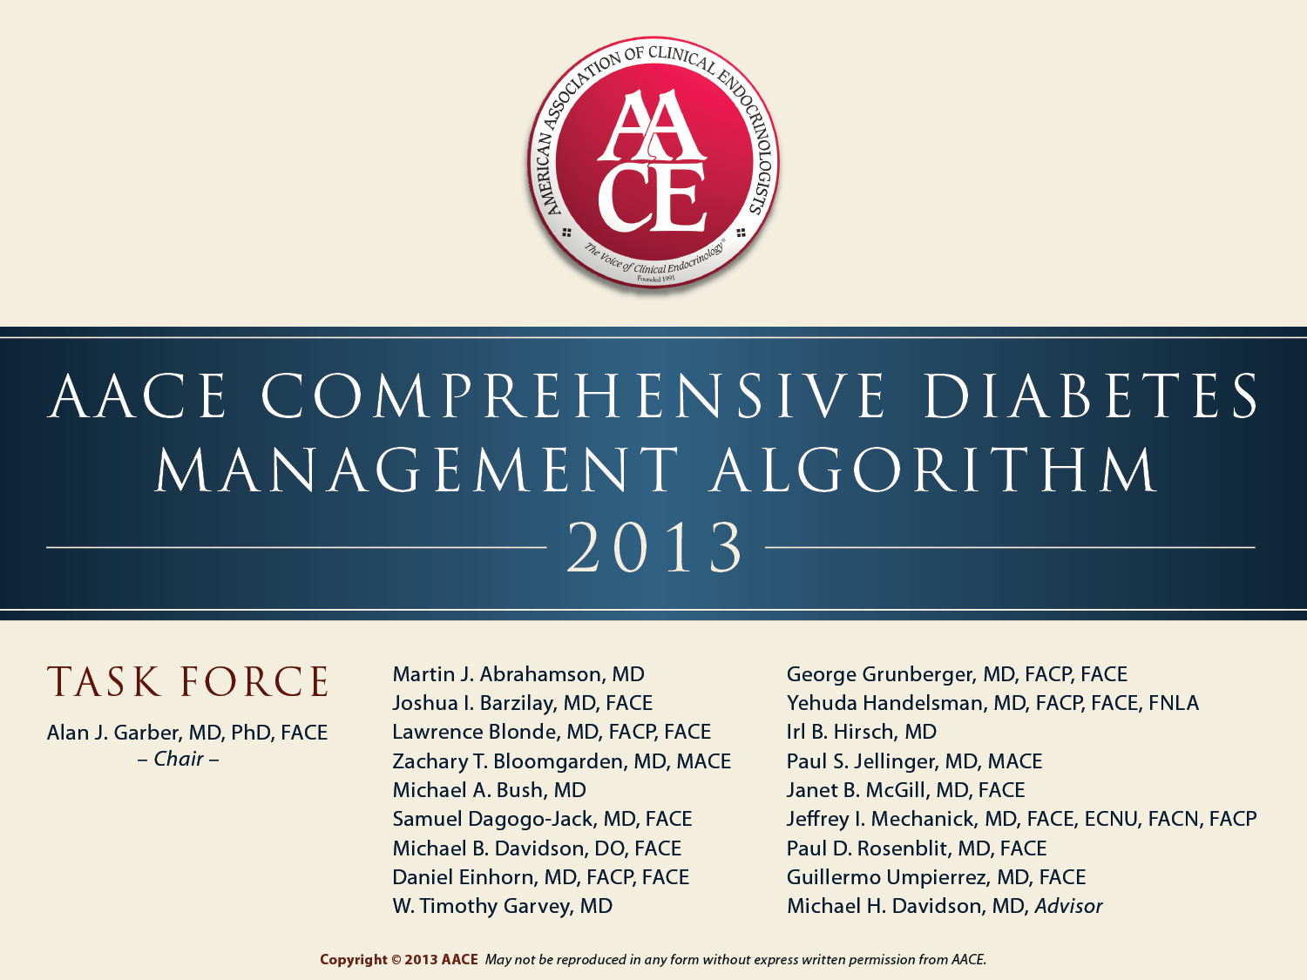

Slide 44
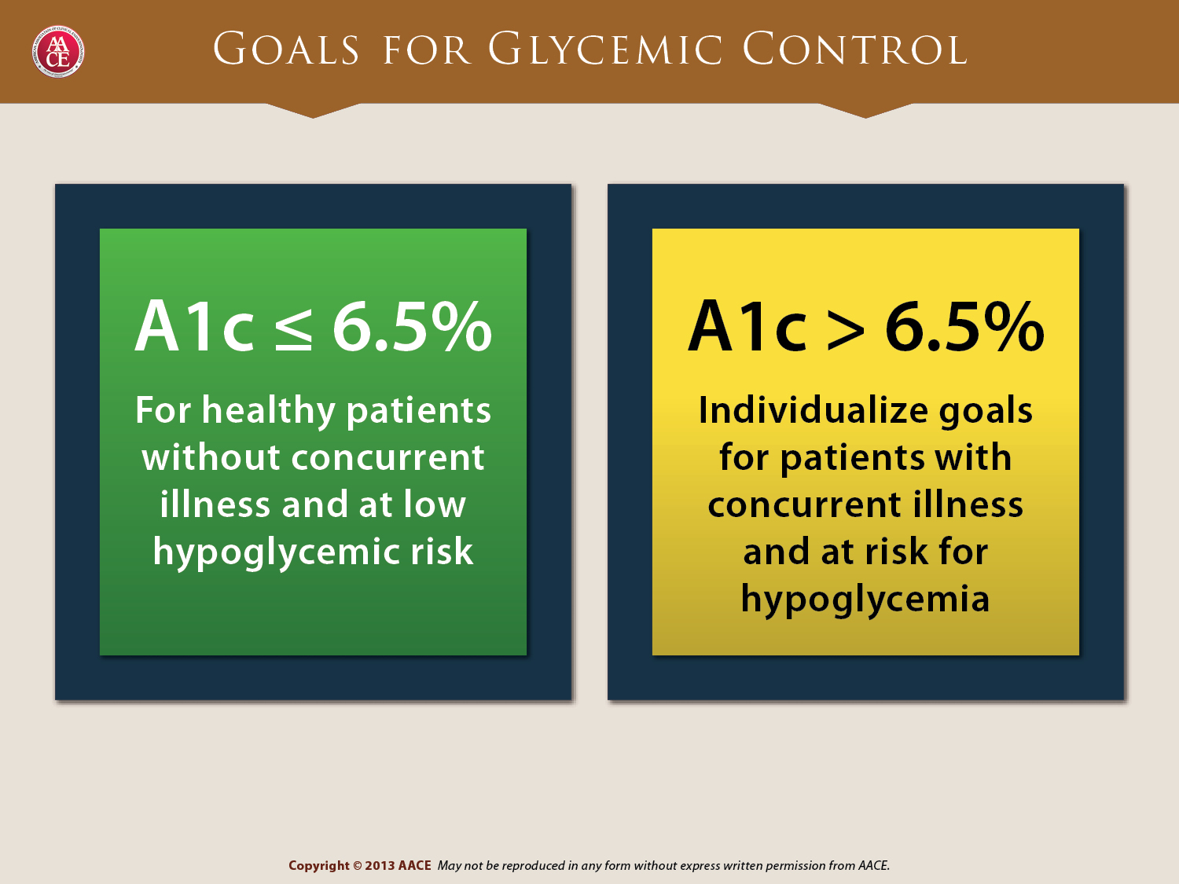
PreMeal BG goal – less than 110 mg/dl
Post meal BG goal – less than 140 mg/dl

Slide 45
BP Goal ADA Clinical Practice Recommendations
BP < 140 / 80
Some pts may benefit from B/P 130/80
Lifestyle changes +
First Line B/P Drugs
ACE Inhibitors-
Angiotensin receptor blocker (ARBs) (type 2)
Then add diuretic
Many pts require 2 or > anti-HTN meds

Slide 46
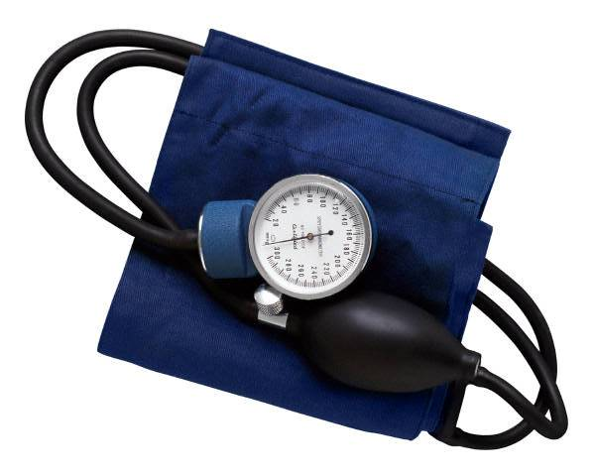
Detecting Hypertension
If either
systolic 140 or > diastolic 80 or > repeat on separate day.
Hypertension = Repeat systolic or diastolic above or equal to these levels
When taking B/P
Pt sit still for 5 min’s
Feet on floor,
Arm supported at heart level
Right size cuff

Slide 47
ACE Inhibitors “ils” for HTN
Dosing:
1-3 x’s a day (start low dose, same time everyday).
Adding diuretic may be more effective than increasing dose.
Adverse effects: cough (10-20%)
Can try different ACE- I
Caution in pts w/ renal stenosis, hepatic dysfunction
Monitor: B/P, lytes esp K+, renal function at baseline and periodically

Slide 48
Angiotensin Receptor Blockers (ARBs) “sartans” for HTN
Dosing: Once daily (same time everyday)
Adverse Effects
Well tolerated. Dizziness, drowsiness, hyperkalemia, hypotension, allergic reaction
Monitor: B/P, lytes- esp K+, renal function at baseline & periodically after (monitor ⬆ creat).

Slide 49
Beta Blockers “lols” for HTN
Beneficial for DM pts w/ concurrent cardiac problems (esp post MI, heart failure)
Dosing: Once or twice daily (strive for lowest dose possible), Do not abruptly stop can cause HTN crisis
Adverse Effects
Dizziness, drowsiness, lightheadedness, erectile dysfunction, bad dreams
Contraindicated in sinus bradycardia (HR< 50)
Can block signs of hypoglycemia, including tachycardia
Monitoring: heart rate (watch for pulse < 50), watch for exercise intolerance

Slide 50
Diuretics
Thiazide (combined w/ other meds)
1 x daily in am
Watch for lyte imbalances, muscle cramps, weakness, arrhythmias.
Loop for resistant HTN
1x daily, same side effects at Thiazide, but more intense.
Need potassium replacement, used if GFR<30 or greater diuresis required.

Slide 51
*Lipid Goals ADA Clinical Practice Recommendations
LDL < 100 mg/dL
LDL <70 in high risk pts = CVD + DM
HDL > 40 mg/dL men
HDL > 50 mg/dL women
Trig < 150 mg/dl
*alternative goal is 40% lower than baseline levels if on max statin therapy & above goals not met
Screen biannually or annually, more often if indicated

Slide 52
Lipid Management ADA Clinical Practice Recommendations
Add Statins for pts (regardless of LDL)
With CVD
Without CVD who are 40+ with CVD risk factor
Treatment Recommendations
Lifestyle interventions
reduce saturated & trans fat, cholesterol,
More viscous fiber, n-3 fatty acids, plant stenols/sterols
wt loss, exercise, stop smoking,

Slide 53
Lipid Management ADA Clinical Practice Recommendations
LDL cholesterol lowering - first goal
1st choice - statins
HDL cholesterol raising
wt loss, stop smoking, exercise
Niacin (caution) or fibrates
Triglyceride lowering
Glycemic control, lifestyle intervention
If > 1000 - Fibrates, or niacin, fish oil

Slide 54
HMG-CoA Reductase inhibitors – Statins for Diabetic Dyslipidemia
Main effect: ⬇ LDL, secondary ⬇ TG, ⬆HDL
Dosing: once daily at hs
Adverse effects: elevated liver enzymes, muscle aches, rare rhabdomyolysis (1-5% of pts), rare reversible memory loss, hyperglycemia
D/C statin if liver enzymes 3x greater than norm
Report muscle weakness, pain, tenderness, jaundice
Monitor: baseline lipid profile, liver function test. Monitor labs closely for 6 mo’s or if reported muscle pain
Statins metabolized in liver through CYP-3A4 pathway, so high rate of drug interactions

Slide 55
Niacin to treat Diabetic Dyslipidemia?
Main effect – increase HDL, lower Trig
Niaspan, Slo-Niacin (sustained release) at hs with food
Dosing: start 100mg 3x day to 2-3gms a day
Adverse effects: GI, N&V, diarrhea, flushing, BG elevations
Take w/ meals or aspirin to reduce flushing
Monitor liver function, D/C if 3x’s greater than normal

Slide 56

Aspirin Therapy (75-162/day)
Use for men >50 yrs, or women >60 yrs who smoke or have CV risk factor – primary prev)
Use aspirin therapy for diabetes pts with history of CV disease (secondary prev)
Combo therapy of aspirin + clopidogrel is reasonable for a year after MI
Do not use in pts < 30, w/ allergy (use clopidogrel), bleeding tendency
ADA Clinical Practice Recommendations

Slide 57
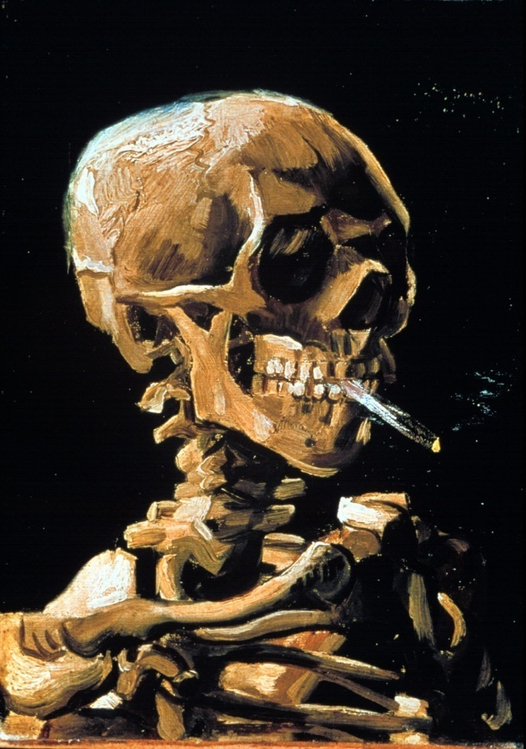
Smoking and Diabetes
Smoking and Diabetes
Smoking increases risk of diabetes 30%
Ask
Assess
Advise
Assist
Arrange
Organize your clinic

Slide 58
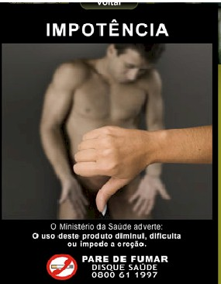

Slide 59
A 78 yr old man, smokes ppd
A1c was 8.1% (down from 10.4%)
B/P 136/76 AM BG 100, 2 hr pp 190
Chol – TG 54, HDL 46, LDL 98
Meds:
Insulin – 16 units Lantus at HS
Benazepril 20 mg
Metropolol 50mg
Warfarin 5mg
Actos 15 mg
What class of meds is this patient on?
Any special instructions?
Any med missing?

Slide 60
Poll Question 7
78 year old, A1c 8.1, LDL 98, smokes ppd. Based on ADA guidelines, what med is missing?
Sulfonylurea
Vitamin D
SGLT2 Inhibitor
Statin

Slide 61
Diabetes Care Guidelines- ADA
Test / Exam Frequency
A1c At least twice a year
B/P Each diabetes visit
Cholesterol (LDL, HDL, Tri) Yearly (less if normal)
Weight each diabetes visit
Microalbumin/GFR/Creat Yearly
Eye exam Yearly
Dental Care At least twice a year
Comprehensive Foot Exam Yearly (more if high risk)
Physical Activity Plan As needed to meet goals
Preconception counseling As needed

Slide 62
Vaccinations- Immunizations
Flu vaccine
every year starting 6 months
Pneumococcal starting at 2 years.
One time Revaccination for those over 64 and had first vaccine >5 years prior
Hepatitis B Vaccine
For diabetes pts age 19 – 59 (not previously vaccinated)
Double risk of Hep B due to lancing devices/ glucose meter exposure

Slide 63

ABCs of Diabetes
A1c less than 7% (avg 3 month BG)
Pre-meal BG 70-130
Post meal BG <180
Blood Pressure < 140/80
Cholesterol
HDL >40
LDL <100 (if CHD, <70)
Triglyceride < 150

Slide 64

Mr. Jones - What are Your Recommendations for Self-Care?
Patient Profile
62 yr old with newly dx type 2. History of previous MI.
Meds: Lasix, synthroid
Labs:
A1c 9.3%
HDL 37 mg/dl
LDL 156 mg/dl
Triglyceride 260mg/dl
Proteinuria - neg
B/P 142/92
Self-Care Skills
Walks dog around block 3 x’s a week
Bowls every Friday
Widowed, so usually eats out

Slide 65

Treatment Goals Not Met?
Consider Diabetes Distress

Slide 66

Diabetes Self Management Education and Support (DSMES)
People w/ DM and prediabetes need education that:
Addresses psychosocial and emotional well-being
Meets National Standards
Focuses on promoting self-care and behavior change
Evidence that DSMES programs work
Lower A1c, wt loss, improved quality of life, better coping and lower costs

Slide 67
Hypoglycemia - The limiting factor

Slide 68

Hypoglycemia
Objectives:
Describe identification and treatment of hypoglycemia.
Discuss it’s impact on the person living with diabetes

Slide 69
Hypoglycemia – “Limiting Factor”
Defined as glucose of 70mg/dl or below
50% of episodes occur during the night
Mortality with severe hypoglycemia secondary to sulfonylureas
Especially (glyburide) Micronase®, Diabeta®
Blood glucose levels don’t describe severity, response is individual

Slide 70
Hypoglycemia: Clinical Risk Factors
diabetes medications
intensive insulin therapies
impaired kidney or liver function
advanced age, poor nutrition
near normal A1c
history of frequent hypoglycemic episodes
neuropathy

Slide 71
Glycemic Threshold Values John White, PharmD, Diabetes Spectrum, 2007
Classification BG Physical Response
Lower euglycemia 80-90’s Endogenous insulin
Hypoglycemia 70’s Glucagon, adrenaline
Symptoms 60s Growth hormone, cortisol
50’s Cognitive deterioration
Neuroglycopenia 40’s
30’s
Severe 20’s Coma, seizures
neuroglycopenia 10
(shortage of glucose in the brain
affects function of the neurons)

Slide 72

Hypoglycemia Symptoms
Autonomic
Anxiety
Palpitations
Sweating
Tingling
Trembling
Hypoglycemic Unawareness
Neuroglycopenia
Irritability
Drowsiness
Dizziness
Blurred Vision
Difficulty with speech
Confusion
Feeling faint

Slide 73

Nocturnal Hypoglycemia
Signs include:
Vivid dreams
Waking up with headache
Night sweats
Waking up hungry
Elevated (rebound) or low morning blood glucose

Slide 74

Hypoglycemia Awareness
autonomic symptoms adrenergically based
after 2-5 yrs of type 1 dm,
glucagon secretion impaired
epinephrine secretion becomes primary mechanism to restore BG levels
over time, epi response diminished or delayed
decreases awareness of hypo and hormonal response

Slide 75
Learn Their Own, Most Reliable Symptoms - BGAT
symptom diary to identify their unique response
type and magnitude can differ for given individuals
alcohol can increase risk
beta blockers may mask early signs (Lopressor, Atenolol, Coreg)
BGAT - blood glucose awareness training

Slide 76
Treatment of Hypoglycemia
If blood glucose 70mg/dl or below:
10-15 gms of carb to raise BG 30 - 45mg/dl
Retest in 15 minutes, if still low, treat again, even without symptoms
Follow with usual meal or snack
If BG less than 40, allow recovery time

Slide 77
Tx of Severe Hypoglycemia
If can swallow w/out risk of aspiration, try gel,
honey, etc. inside cheek
If unable to swallow, D50 IV or Glucagon
Glucagon injection – teach support person
Dosing:
Adults 1mg
Children <20kg 0.5mg
Glycemic effect 20 - 30mg, short lived
Must intake carb as soon as able
Need prescription, check exp. date

Slide 78
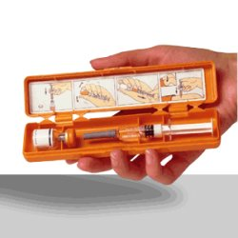

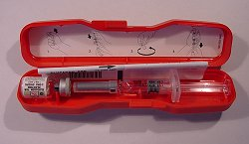
Glucagon Emergency Kit
Store 68-77 degrees prior to reconstitution
single use only

Slide 79
Preventing Hypoglycemia
Nocturnal Lows
Don’t skip presleep snacks
If bedtime glucose <110, increase cals
If increased activity, increase cals
Eval hs insulin/meds
Other
Monitor kidney function / wt changes
Monitor BG trends
Don’t over medicate
Balance food / activity
Plan ahead
Alcohol

Slide 80
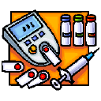
Monitoring, sick day management and Hospital goals
Objectives:
Identify barriers to monitoring and strategies to overcome them.
Discuss sick day management
State glucose goals during hospitalization.

Slide 81
Self-Monitoring Why Should I do it?
Feel better everyday – sense of control
Avoid hospital admissions
Fewer missed work /school days
Avoid hypoglycemia or embarrassing situations related to hypo
Avoid unwanted weight gain
Enhanced athletic performance

Slide 82
How will it help me?
See if your treatment plan is working
Make decisions regarding food and/or med adjustment when exercising
Find out how that pizza affected your BG
Find patterns
Manage illness

Slide 83
How Often Should I Check?
Be realistic!!
Type 2 on orals – Medicare covers 100 strips for 3 months
Based on individual - Consider:
Types and timing of meds
Goals
Ability (physical and emotional)
Finances / Insurance

Slide 84
ADA Guidelines
Self monitoring before: meals, snacks, bedtime
Occasional postprandial and before exercise
When patient suspects low blood glucose; after treating low blood glucose until patients are normoglycemic
Before critical tasks such as driving
Some patients will need to test more depending on activity level, frequency of eating.
Be practical, no two patients or two days are alike

Slide 85
Glucose Monitoring Baseline Learning
Care for meter and test strips
Perform quality control
Proper disposal of lancets
Identify BG target and when to test
Recording and interpreting data
800 number
Adequate sample
User Error most common reason for inaccurate results

Slide 86

Alternate Site Testing?
Yes
Finger fatigue
No risk of hypo
Stable BG Levels
If BG< 90, recheck on finger
No
Pregnant
On intensive insulin therapy
During hypoglycemia
During illness
Not as accurate during glucose fluctuations

Slide 87
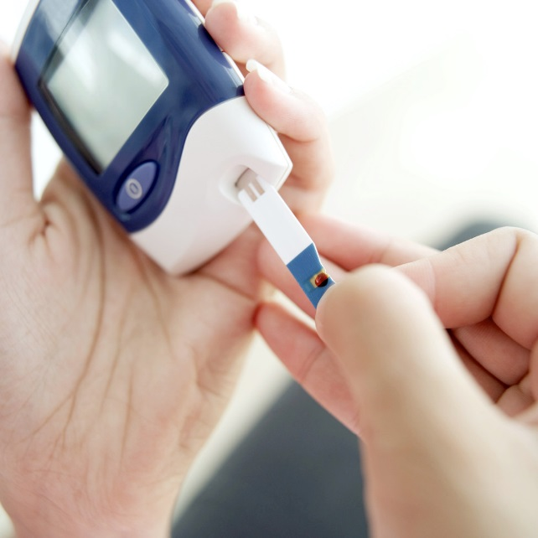
Monitoring Issues
“Monitor Talk”
avoid judging glucose levels as good and bad
Say stuff like..
I am impressed that you are checking your blood sugar at least once a day and writing it down.
I am curious to learn what is helping you succeed with blood sugar testing.
I am interested to see that you are skipping some days, can you share more about that?

Slide 88
Poll Question 8
What is the best sick day recommendation?
Stop all diabetes medications
Test BG every 2 hours
Continue to take diabetes meds
Only drink sugar free beverages

Slide 89

Sick Day Patient Guidelines
Continue to take diabetes medication, may need adjust dose down or up
Test glucose at least every 4 hrs
Drink plenty of liquids
Rest
Contact physician
Plan ahead
Check urine ketones, if BG >240 & ill

Slide 90
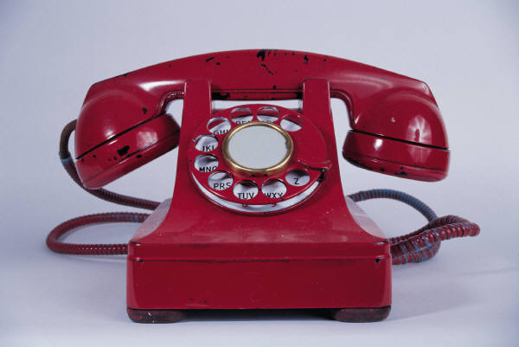
Sick Day Guidelines Reasons to Call MD
Vomiting more than once
Diarrhea > than 5x’s or for > 24 hrs
Difficulty breathing
Blood glucose > than 300mg/dl on 2 consecutive readings
Temperature > 101 F.
Positive ketones in urine.

Slide 91

Hospitals and Hyperglycemia What’s the Big Deal?
Hyperglycemia is associated with increased morbidity and mortality in hospital settings.
Acute Myocardial Infarction
Stroke
Cardiac Surgery
Infection
Longer lengths of stay

Slide 92

BG Above Normal = Trouble
Pre Diabetes
Fasting Glucose = 100-125mg/dl
A1c 5.7 – 6.4%
Diabetes
Fasting Glucose = 126 mg/dl +
Random Glucose = 200 mg/dl +
A1c 6.5% +
Any blood glucose above 140 requires treatment
Umpierrez et al

Slide 93

WHAT SHOULD WE AIM FOR?
Critically Ill pts
BG > 180- Start insulin
BG goal 140-180
Non Critically Ill patients BG Goals
Premeal <140
Post meal <180
Insulin therapy preferred treatment
Consensus: Inpt Hyperglycemia, Endocr Pract. 2009;15 (No.4)

Slide 94

Management of Hyperglycemia and Diabetes
Stop oral agents (ie) metformin & sulfonylurea on admission
“The sole use of Sliding Scale insulin is discouraged” For discharge, oral meds can be resumed
Start Basal/bolus therapy
NPH and Regular insulin
Long-acting and rapid-acting insulin
Premixed insulin
– ADA 2014

Slide 95
Preparation for Surgery
Try to schedule surgery in am, resume meds/insulin when eating and stable.
Oral medications: In am, hold all diabetes oral medications
Basal Insulin: for type 2s, give 50%-100% of usual am basal dose and for type 1s give 100% of basal dose.
Bolus insulin: Use mild insulin bolus coverage for type 1 and type 2’s

Slide 96

Online Courses to Review
Hyperglycemic Crises
Setting up a Successful Diabetes Program -Diabetes Self Management Education and Support
Chronic Complications

Slide 97

Thank You
Standards of Care
Glucose goals for kids and during pregnancy

