Slide 1

Providing Diabetes Care
Setting up successful delivery systems
Assessing the unique needs of each individual
Supporting diabetes self-care

Slide 2

Change the Care System – Focus on Quality of Care delivered
Optimal diabetes management requires:
organized, systematic approach
involvement of a coordinated team of dedicated health care professionals,
working in an environment where patient centered high quality care is a priority.

Slide 3
Change the Care System – Focus on Quality of Care delivered
Evidence based, interdisciplinary teams providing intensive disease management is the strategy that works best.
Redesign health care process
Electronic health record tools
Activating and educating patients
Remove financial barriers and reduce cost of care
Public policy changes (ie soda tax)
Community resources (low cost dental care, farmers market, recreation opportunities.

Slide 4
Diabetes Care Concepts - Tenants
Keep it patient centered
Consider the individual
Customize standard goals based on assessment
Diabetes Across the lifespan
We are getting diabetes earlier and living longer
Promote coordinated care across lifespan
Advocacy
Active support and engagement
Address social determinants and underlying causes of health disparities. Let your voice be heard.

Slide 5

Major Barriers to Diabetes Care
Fragmented health system
Lack of electronic information sharing
Duplication of services
Poorly designed to deliver coordinated care for those with chronic diseases

Slide 6
Chronic Care Model - CCM
6 core elements for optimal diabetes care
Proactive (vs reactive) care delivery system.
Planned visits coordinated through a team based approach
Self Management support
Decision support (basing care on evidence based guidelines)
Clinical information systems (registries that provide patient specific and population based support to team)
Community policies and resources to support healthy lifestyles
Health systems that create a culture of quality

Slide 7

Redefining Roles and Building Teams
Utilizing staff to focus on their strengths and supporting patient self management.
Collaborative multi-disciplinary team are best suited to provide diabetes care and support patients in succeeding at self management.

Slide 8

Moving on to each Unique Individual

Slide 9
How to Improve Chronic Care Model
Optimize Provider and Team Behavior
Appropriate and timely intensification of lifestyle if BG not at target
Explicit goal setting
Use evidence based guidelines and clinical information tools
Incorporate care management teams:
Pharmacists, nurses and other providers to improve outcomes
Address literacy and cultural barriers

Slide 10

Assess Literacy
Numeral
130 could look same as 310, 013
Health
Not sure how to use the health system
Prescriptions, appointments, insurance coverage
Functional
Ability to use reading, writing and computation at levels adequate to everyday situations (checkbooks, signs, etc)

Slide 11

Reading: Go direct!
Do you read???
Is this # less or more than this?
How much insulin do you give?
When you have this much sugar in your blood??
Return Demo (please draw it up)

Slide 12
Quick question
Which of the following strategies are best used when someone has low literacy skills?
A. speak slowly and clearly
B. underline key points on educational materials
C. direct the teaching to the support person and encourage reinforcement.
D. be concrete and focus on problem solving

Slide 13

Teaching Approaches: Low Literacy
Be Concrete
Word usage (be sensitive!)
Identify 1-2 messages
Be patient, use teaching aids
Small group- problem solving
Tech level - video, computer, printed info, “apps”
Engage support people

Slide 14
When Treatment Goals aren’t met
Reassess treatment regimen and barriers
Literacy
Diabetes related distress or depression
Poverty
Competing demands including those related to family responsibilities and dynamics
Culturally appropriate education?
Referral to social worker for assistance with insurance coverage
Medication taking behavior and regimen
Other?

Slide 15
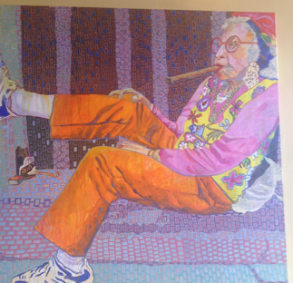

Slide 16

Psychosocial Assessment
Include assessment of the pts psychological and social situation as part of the ongoing medical management of diabetes
Psychosocial screening may include:
Attitudes about diabetes
Expectations of medical management and outcomes
Affect/ mood and quality of life
Available resources (financial, social, emotional)
Psychiatric history

Slide 17

Assessment Factors:
Stress response and coping strategies are based on:
Health beliefs
Perceptions
Cultural* traditions, family system.
Social*, religious and employment influences
Personal factors: attitudes, cognitive factors, literacy, learning styles
Psychosocial factors

Slide 18
*Cultural Sensitivity TOOL: Asking Questions: clear, accepting manner…ask what …
is important to you?
do you think of your diabetes?
the best way to communicate with you?
are your goals and expectations?
are your Personal beliefs and values?
are your Cultural and religious practices?
How ARE you feeling about all of this?

Slide 19
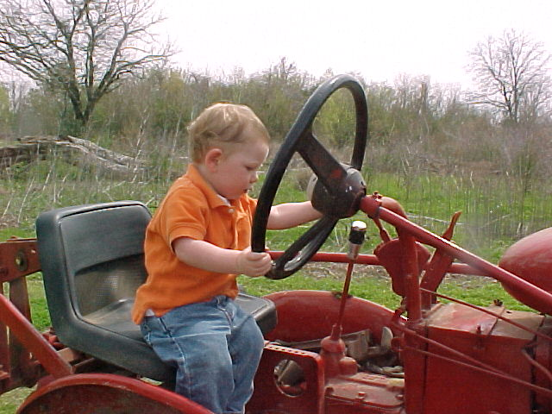
Assessment Factors
Developmental age and stage
Finances
Environment (transportation, location, safety)

Slide 20
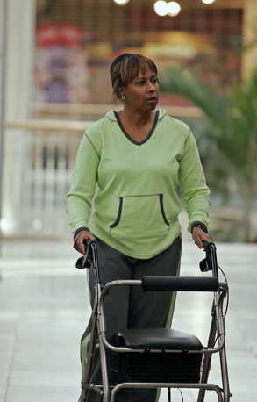
Assess: Capabilities/limits
Physical:
Visual/ hearing/ , psycho-motor, meter, group environ, injection
Substance Abuse
Alcohol, tobacco, caffeine, illicit drugs
Support System, who, when, where…)

Slide 21
*Social Support Assessment Tool
Who helps you?
With practical or emotional support ?
Who makes it harder?
What would you like in support for day-to-day?
One thing you could do so you will get the support?
What can I do to help you get the support you want?

Slide 22
Types of Social Support (virtual or live)
Emotional support
Caring, empathy, love, trust----most important
( perceived )
Informational support
provided during time of stress-problem solving, chat, blog, apps
Instrumental support
goods/services--- “help” / Apps
Affirmational support
affirming acts or statements

Slide 23

Assess: Learning Style:
Method: read, listen, discuss
Sensors: problem solving: demo.
Feelers: listening, discussion
Thinkers: Facts…lecture

Slide 24

Routine Mental Health Screening
Depression – affects 20-25% of DM
Increases risk of MI and mortality
High priority to screen and treat for those over 65
Provide a collaborative care approach to treat depression
Diabetes related distress (18-45% of pts)
Anxiety
Eating disorders (Dana will discuss)
Cognitive impairment

Slide 25
Quick Question
Which of the following statements by a patient reflects they are depressed?
I used to love gardening, now I don’t even care if my garden is overrun by weeds.
Yes, I feel sad that I have diabetes.
Some mornings, it’s just hard to check my blood sugars.
I am so tired of everyone telling me how to eat!

Slide 26
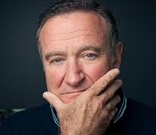
Depression
Characterized by depressed mood
Loss of interest in activities usually found pleasurable
Difficulty concentrating, sleeping, changes in appetite
Difficulty in following through with self care behaviors

Slide 27

Is Mr. Jones coping well?
Mr. Jones is 67 yrs old, has Type 2 diabetes (12 yrs) with unknown A1C, is widowed and has a low income job (close to lay off), and is teetering on foreclosure of his home.
What are some risk factors that may make coping difficult for Mr. Jones?

Slide 28
Mr. Jones Assessment
He helps take care of his elderly mother, struggles with “feeling blue” and when asked, states he has a few drinks a day….
What are the chances Mr. Jones is depressed?
Why?
How could you find out?
What questions would you ask?

Slide 29
Depression Assessment
Depression:
Over the last 2 weeks, have you felt down, depressed or hopeless?
Over the last 2 weeks, have you felt little pleasure in doing things?
Depression
Pt. Health Questionnaire (PHQ-9)
Beck Depression Inventory (BDI)
Symptom Checklist (SCL-90)
Referral to Mental Health:
Refer to therapy (list ready!)
Pharmacologic TX Anti-depressants: 50% of pt’s with diabetes

Slide 30
Anxiety – Exaggerated response to normal fears
Anxiety
Symptoms - (must have 5 for over 6mo’s)
restlessness,
keyed-up or on-edge
easily fatigued
difficulty concentrating or mind going blank
irritability
muscle tension
sleep disturbances
Diabetes causes fear –
Hypoglycemia
Complications
Living with chronic condition
Impact of Anxiety
1.Counterreg hormones
2. Self-care behavior diminishes

Slide 31

Cognitive Impairment
People with diabetes more like to have:
Dementia (associated with hyperglycemia and other causes)
Alzheimer's
Treatment:
Refer to specialist for assessment
Achieve optimal BG control
Pharmacist to evaluate drug safety and potential drug interactions

Slide 32

Diabetes Related Emotional Distress=DRED
DRED - unique emotional issues directly related to the burdens and worries of living with a chronic disease. (embarrassed, guilty)
More than worry: can overlap with depression, anxiety and stress.
Normal-to some extent
Associated with stress of living with diabetes
Express high levels stress and depressive symptoms; but not clinical depression
Not rare: linked to poor health outcomes

Slide 33

DDS 17: Diabetes distress scale
Yields a total Diabetes Distress Scale score plus 4 sub scores:
Emotional burden
Physician related Distress
Regimen related Distress
Interpersonal Distress
***Begin a conversation with any item rated 3 or >
44.5% of patients reported diabetes distress
Only 24% of providers asked pts how diabetes affected their life (DAWN Study)

Slide 34
Diabetes Distress Scale cont.
Feeling that diabetes is taking up too much of my mental and physical
energy every day.
Feeling that my doctor doesn't know enough about diabetes and
diabetes care/ doesn't give me clear enough directions .
Feeling angry, scared, and/or depressed … think about living with diabetes
4. Feeling that I am not testing my blood sugars frequently enough.
5. Feeling that I am often failing with my diabetes routine.
Feeling that friends or family are not supportive enough of self-care
efforts (planning activities that …, encourage me to eat the "wrong" foods).
7. Feeling that diabetes controls my life.
8. Not feeling motivated to keep up my diabetes self management.
DDS (17) Scoring

Slide 35
Strategies to handle DRED:
People w/ DM
1 thing at a time
Take it slowly
Speak up to:
Family, PCP,
People that understand.
Set Appropriate Goals!!!
Small, discreet
HCProviders (you!)
Handle 1 thing at a time
Take it slowly
Set Appropriate Goals. Small, discreet
Be mindful, mundane, careful about the goal set- do not rush
Paired testing before/after (more tangible)

Slide 36
Quick Question
Which of the following is a SMART Goal?
a. I will lose 5% of my body weight
b. I will eat less sugary foods throughout the week
c. I will monitor my blood sugar on a regular basis
d. I will eat one less bag of chips every day for 1 week.

Slide 37
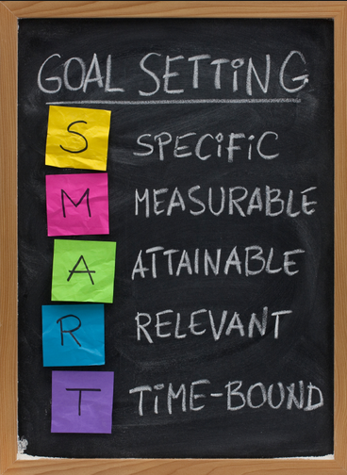
SMART Goals

Slide 38

Mental health – Build a Foundation
Although the educator might not feel qualified to treat psychological problems, optimizing the patient / educator relationship as a foundation to increase likelihood of acceptance.

Slide 39

Key opportunities to Screen for Emotional Health
Newly diagnosed
Hospitalized
When medical status changes (BG no longer controlled with one med)
When complications start
During regular visits

Slide 40

Assess Emotional Health
Assess- first meeting and regularly.
Use instruments and open ended questions;
ASK! Consider Diabetes Distress vs depression.
Encourage Optimism and Resilience:
Hardiness and humor, resources, self confidence!
Develop network of specialists to help YOU for your own self balance and care!
Name 3 NOW!

Slide 41
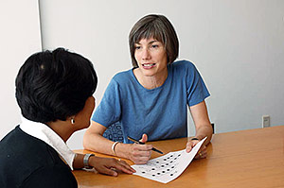
Referral to Mental Health Specialist
Indications
Gross disregard for medical regimen
Depression
Stress related to work-life balance
Possibility of self harm
Debilitating anxiety and/or depression
Eating disorder
Poor cognitive functioning that impairs judgement

Slide 42

Emotional Well Being
Important part of diabetes care and self-management
Psychological and Social Problems can impair the ability to self-care and lead to poor health

Slide 43

Reevaluating Traditional Methods – instead~
Help explore, identify, accept feelings.
Be “mindful”, compassionate, informed listener
We are not responsible for fixing pt’s negative emotions (*help pts use their personal resources…we facilitate and refer as needed)

Slide 44
Patient Perspective Matters!
“I am no where.”
“I am now here!”

Slide 45

Perception Matters: Help them see the possibilities, differently!

Slide 46

Promoting Learning and Behavior Change

Slide 47
Promoting Learning…*
Objectives Summary: state, discuss, describe:
Strategies to promote change.
Barriers to learning and change
4 Learning theories.
“Stages of readiness”.
Roles and responsibilities
MC, MI, Brief Negotiation, timely tools.

Slide 48
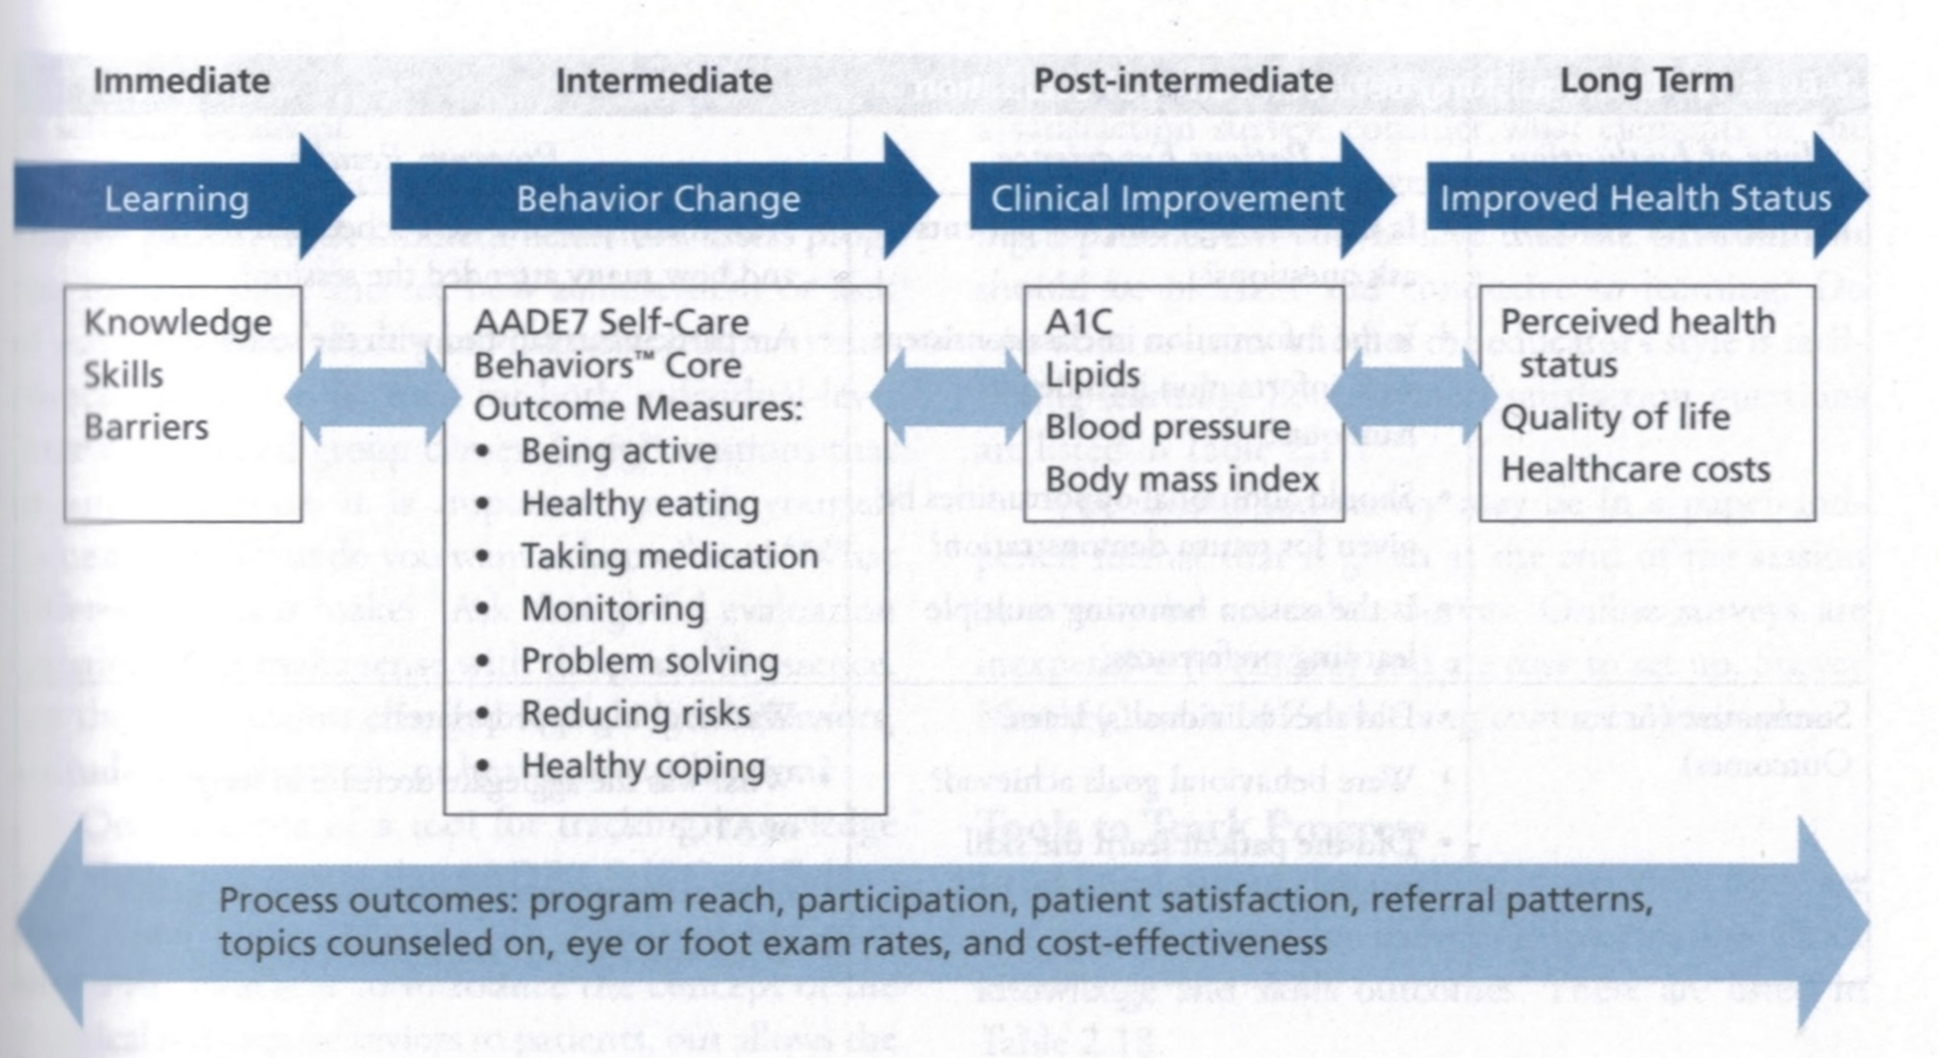

Slide 49
Overview- Envision:
Theories
(Empowerment, Health Belief,
Social Cognitive,Transtheoretical)
Patient’s Readiness to Change (stages)
Our Attitude, Approach
Brief Negotiation, MI
Alter ambivalence
Change

Slide 50
Quick Question
A patient arrives at the educator's office for his individual assessment and states that he only wants to learn how to use his new glucose meter. What is the best approach is this situation?
The educator should gently inform the patient that they are required to cover 7 different content areas
Focus on the areas where the educator has the most knowledge and skills to impart
Acknowledge the patient’s request and frame the response based on the educators desired program outcomes.
Base the education on the needs of the individual

Slide 51
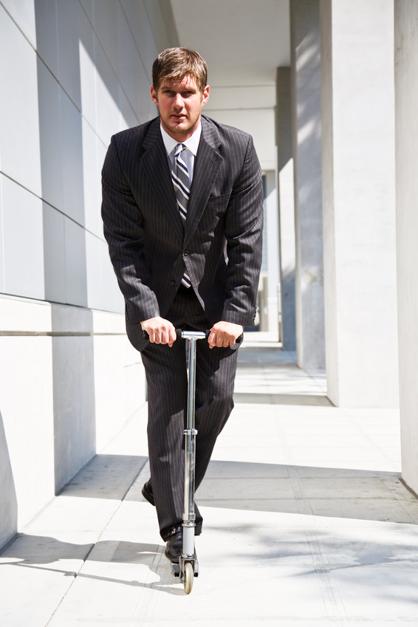
Adult Learners
Self-directed must feel need to learn
Problem oriented rather than subject oriented
Learn better when own experience is used
Prefer active participation

Slide 52

Facilitating Self-Care - Specific Skills Training
Most effective education includes:
demo of skills
practice
direct practical feedback for efforts
Didactic: less effective
Provides knowledge without skill
Talk Less – Encourage Patient to Participate More
Make the Behavior Real for that patient

Slide 53

Effective Diabetes Self-Management: requires behavior change
Barriers to behavior change
Income
Health literacy
Poverty
Health insurance
Competing demands – family, work, other obligations
Diabetes Denial
Diabetes Distress or Depression
Lack of knowledge

Slide 54

Barriers to Learning (and behavior change)
Her/his perception
Of MY ATTITUDE
And MY WILLINGNESS
to understand …
“A place of preaching is not a place of meeting…” Mother Theresa

Slide 55
Overcoming barriers
Identify barriers and help with problem solving
Offer patients evidence based hope message
Frequent contact – phone, support group, letter, etc.
Paired glucose testing
(Seeing is believing)
Ask pt, “Tell me 1 thing that is driving you crazy about your diabetes”(or find out via DDS)
Discuss medication beliefs, ask ask ask!
To improve outcomes, see pts more often
Bill Polonsky, PhD, CDE

Slide 56

“Mindfulness-based Interventions”
Avoid compliance model
Focus on empowerment and acceptance
Mindfulness
“Pay attention-on purpose “
Non-judgmental
In-the-present
Better chance to be present to life and become less reactive to the tides of distraction.
Really HEAR your clients!

Slide 57
1. Health Belief Model*
Individuals perceived risk and seriousness of illness determines the likelihood of adopting preventive behaviors.
The more perceived risk, the more likely to take make necessary changes.
Influencing factors:
Level of personal vulnerability about developing illness
How serious person believes the illness is
Efficacy of behavior in preventing or minimizing consequences of illness
Costs or deterrents associated with making changes

Slide 58

Expanded Health Belief Model
Perceived susceptibility
Perceived severity
Perceived benefits
Perceived barriers
Self-Efficacy
Level of confidence one has with regard to performing a behavior successfully
Cues to Action
External stimulus used to activate health behavior (ie TV about the benefits of a glucose meter)

Slide 59

2. Social Cognitive Theory*
Pts learn from own AND observing “others” behaviors and consequences.
Health behavior is a constantly changing and evolving interaction between their environment.
Environment
Behavioral capability
Expectations
Observational Learning
Reinforcement, Self-efficacy

Slide 60
Quick Question
Which of the following statements by the educator best reflects using the empowerment approach?
We are here to motivate you to get your A1c to target.
A motivated patient will always be able to achieve an A1c less than 7%.
What motivates you to improve your A1c?
If you follow our suggestions, you will achieve your goals.

Slide 61

3. Pt. Empowerment Defined
“Helping pt’s discover and develop their inherent capacity to be responsible for their own lives and gain mastery over their diabetes”.
Posits:
Choices made by pts (not HCPs) have greatest impact.
Pts are in control of their self-management
The consequences of self-management decisions affect pts most. It is their right and responsibility to be the primary decision makers.

Slide 62
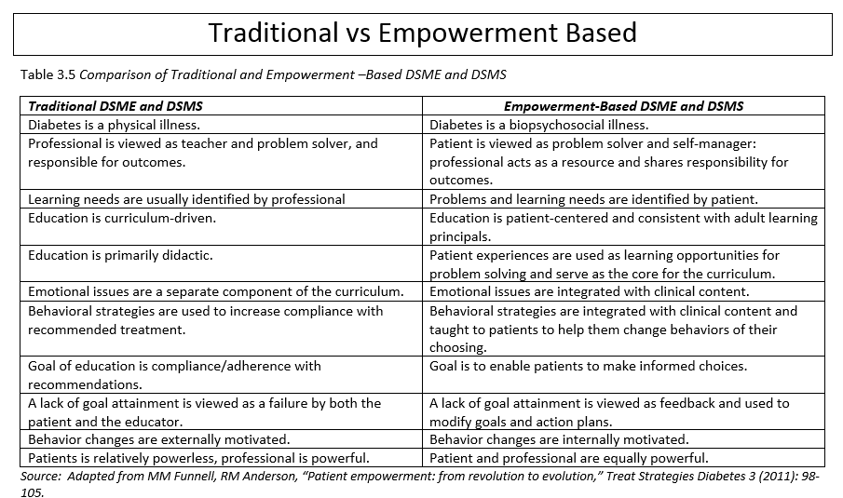
Traditional vs Empowerment Based
This philosophy is important to know for the exam

Slide 63
Empowerment Based, Self-Directed Behavior Change Protocol
Define problem
What part of living with diabetes is most difficult or unsatisfying for you?
Identify feelings
How does the situation make you feel?
Identify long term-goal
How would this situation have to change for you to feel better about it?
What barriers will you face?
How important is it for you to address this issue?
What are the costs and benefits of addressing or not addressing this problem?

Slide 64


Gauge it!
Low High
Get an idea of: ~how they feel about the problem, ~their desire to change… ~ would help them succeed… ~ their confidence… ~ what would hold them back…
Low
High

Slide 65
Empowerment Based, Self-Directed Behavior Change Protocol
Identify short-term behavior change experiment
What are some steps that you could take to bring you closer to where you want to be?
Is there on thing that you will do when you leave to improve things for yourself?
Implement and evaluate plan
How diet the plan we discussed at your last visit work out?
What did you learn?
What would you do differently next time?
What will you do when you leave here today?

Slide 66
Quick Question
A patient tells you that they have been thinking about starting an exercise program. Using the trans theoretical model, what stage of change are they in?
1. Precontemplation
2. Contemplation
3. Preparation
4. Action
5. Maintenance
6. Termination (relapse, recycle)

Slide 67
Transtheoretical Theory*
“Readiness” Level determines the approach!
Patients pass through similar stages as they prepare for change (eating better, decreasing drinking)
Simplified version of the Stages of Change:
Not ready -no intentions.
Unsure: Ambivalent
Ready: Committed, just needs to know HOW!

Slide 68
4. Transtheoretical Model*
Stages of Change (Behavior Change Process)
1. Precontemplation
2. Contemplation
3. Preparation
4. Action
5. Maintenance
6. Termination (relapse, recycle)

Slide 69



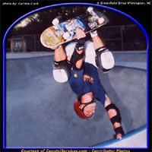

Readiness determines Approach*
Precontem-plation:
NOPE!
Contem-plation:
Maybe
Preparation: Action/Maintenance:
OK! I want to! I’m Doing it! -- X 6 Mo
Relapse:Stuck
OOOOPS!

Slide 70
Readiness determines Approach*
Precontem-plation:
Raise doubt
Re: status quo.
Info?
NOPE!
Contem-plation:
Explore + resolve abiva-
Lence.
+ Gains?
Maybe
Preparation: Action/Maint:
Committed to change just needs to know how!
Who-What- Where
Prepping? Praise-Support
Plan?
OK! I want to! I’m Doing it x6m
Relapse Stuck
Support-plan- reframe??
OOOOPS!

Slide 71
Is your patient truly ready to change? Most are unsure re: change … they need to prepare first!
Not Ready 20%
and Ready 20%
Unsure 30%
Unsure 30%

Slide 72

Yellow= Ambivalence- concentrate energy here!

Slide 73
Explore Ambivalence
Ask questions to help the pt. see pros and cons of the issue
Why keep things the same? (disadvantages)
Why change things? (advantages)
{Where does this (your decision) leave you}
Summarizing Ambivalence:
Begin with reasons for maintaining the status quo,
give options,
end with +++ reasons for making a change.

Slide 74
Breaking barriers with Better Approaches~
Speak up to/with Pt; have a conversation about their DDS (>3), what’s really bothering them…
Set Appropriate Goals with the Patient!!! Small, discreet, WRITTEN.
Be mindful,
hear the “mundane”-but important,
Be careful about the goal set- do not rush to the “dramatic goal”.
Use your expertise to guide in the right direction
Be aware of where you are meeting- giving “more” than the patient?

Slide 75
Pt. Centered Motivational COUNSELING:
~Helping patients explore and resolve their ambivalence about change.
~Central Task: Examine/ resolve ambivalence
~Help pt do as much “Change Talk” as possible
~“Change Talk”= in favor of change
~“Status Quo Talk”=maintain Status Quo

Slide 76
Recycle/ relapse (being stuck*) is part of the cycle!
Realistic...
Acceptable...
To be expected...
To be prepared for…and talked about… “a contingency plan”.
Surmountable ( with preparation!)
Reframe (+resources)

Slide 77

Dealing with Train Wrecks
1895 Montparnasse derailment:
Caused by faulty brake and drivers trying to make up for lost time

Slide 78
Provider Burn-Out: think must “install change”-this evokes resistance…
4 guiding Principles: R-U-L-E
R- RESIST “RIGHTING-REFLEX” (Rx, tell, control)
U- UNDERSTAND patient and motivations to change (be *Mindful!)
L- LISTEN- Listen with empathy, not sympathy, about them, not me! This VALIDATION is critical for success!
E- EMPOWER Patient, build their confidence! Maybe not prepared / trained, so NOT CONFIDENT!

Slide 79
Central Concepts of* Motivational Counseling
Exploring ambivalence (pt feels understood / accepted)= fastest way to resolve it!!!
Best strategy to elicit Change talk: ASK!!
Hear change talk- summarize it -pt hears x2
Hearing “Status quo talk” = signal to change strategies. Explore their “options!”

Slide 80
Roll with Resistance
Make suggestions…invite client to consider other perspectives.
Shift focus ... Reframe...
Emphasize personal choice and control “what change do you feel open to making???”

Slide 81
Central Concepts of Motivational Counseling
Motivation to change = from the patient
Change is the pts’ responsibility
Direct persuasion is counterproductive!
MC style is quiet and eliciting (pts=talking)
“Readiness”- product of the interaction

Slide 82

So there you are… the perfect place, the right time…
The Intentional, mindful, compassionate Listener that you are PLUS A STRATEGY!

Slide 83

Support Self-Confidence
Support positive expectations for change…
emphasize *personal responsibility,
*instill confidence and hope,
* increase sense of ability to cope.
“From what you’ve told me about your past successes…it really seems like you can do this!”

Slide 84
7 Steps for doing Behavior Change Counseling
1. Choose one area together
Select a topic the pt. is interested in… why are they there??

Slide 85
2. CHANGE TALK+++
Get Patient’s perspective on this area (really listen for CHANGE TALK!)
“I’m really ready to lose wt. to get my Diabetes under control, I want to be able to really move- have some get up and go … just don’t put me on any medicine!”…
discuss: what’s happened in the past… and why they are so interested at this point- in change:+++
Use a RULER or gauge…

Slide 86
2. CHANGE TALK (cont.)
Use a RULER or gauge…
How important is it FOR YOU to change (1-5)?
What would it take…?
How strongly do you feel…?/confidence?
What would get in your way? (barriers)
What would it take…?
1---|---2---|---3--|---4--|---5

Slide 87
3. Summarizing Change Talk
Summarize :
Patient’s perspective and
The Patient NOT DOING ANYTHING. VS. CHANGE TALK (+++)(Pro’s and Con’s)

Slide 88
4. SHARE INFO: ASK 1ST.
Share Information or give advice with permission
(Ask- Give- Check out)
Ask Pt’s. ideas
Give info/ education
Check-out Pt’s reaction and Commitment

Slide 89
5. ASK the KEY QUESTION:
“SO WHERE DOES THAT LEAVE YOU?
(they / you may be uncomfortable now
as YOU BOTH struggle with AMBIVALENCE!...
Be mindful…present…
Clarify and Move On!…………..

Slide 90
6. Clarify behavior change goal: use SMART!!!!!
If ready- go on to Clarify Action Plan related to SMART Goal
SPECIFIC
MEASURABLE
ACHIEVABLE
REALISTIC
TIME-RELATED (picture it!!)

Slide 91
7. END ON A POSITIVE NOTE!
Summarize CHANGE TALK (with them).
End meeting on a positive note...
mBe accessible

Slide 92
Try it, you’ll like it! Time for free, behavioral/educational counseling!
Your Behavior Change Challenge Card
Exploring Ambivalence / Ruler
7 steps for doing Behavior Change Counseling.

Slide 93
Simply Trying is “Success”
Partner: 1 Facilitator-Educator, 1 client
Use the 7 steps>>>> Write a goal
Use the “Ruler” to hear Change talk.
10 minute Brief Negotiations

Slide 94

Central Concept Patient Centered Counseling
You can raise a person’s hope JUST by
lending them YOURS…
(+ using a systematic, structured and mindful coaching approach!)

Slide 95

Thank You
Web www.diabetesed.net

