Slide 1

Welcome Everyone
Welcome to Day 2!
Visit Product Tables
Enter Raffle
Team names
Day 1 eval

Slide 2

Thank You
Mini Pharmacy
Tandem Diabetes Care
Sanofi Aventis
Eli Lilly
Takeda
Boehringer -Ingelheim
Astra Zeneca
Tandem Insulin Pump
Our faculty has no conflict of interest.

Slide 3

Day 2 Topics
Insulin and Pattern Management
Healthy Coping
Lunch
Microvascular disease
Behavior Change

Slide 4
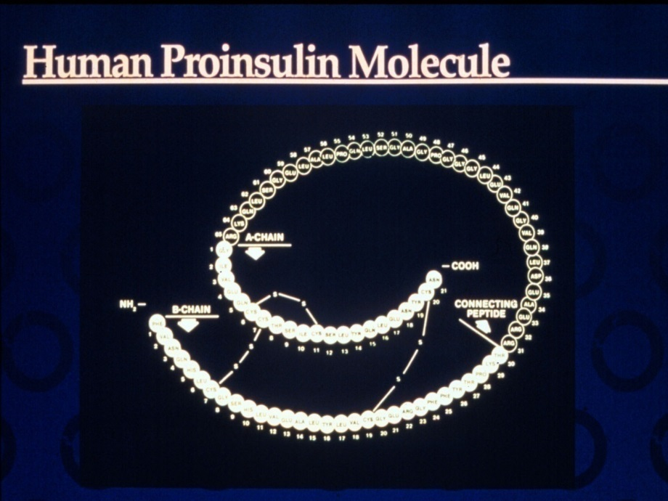
Objectives – Insulin and Pattern Management
Objectives:
Discuss the actions of different insulins
Describe pattern management as an insulin adjustment tool.

Slide 5
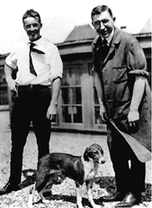
Dr. Banting and Best with Marjorie at University of Toronto

Slide 6
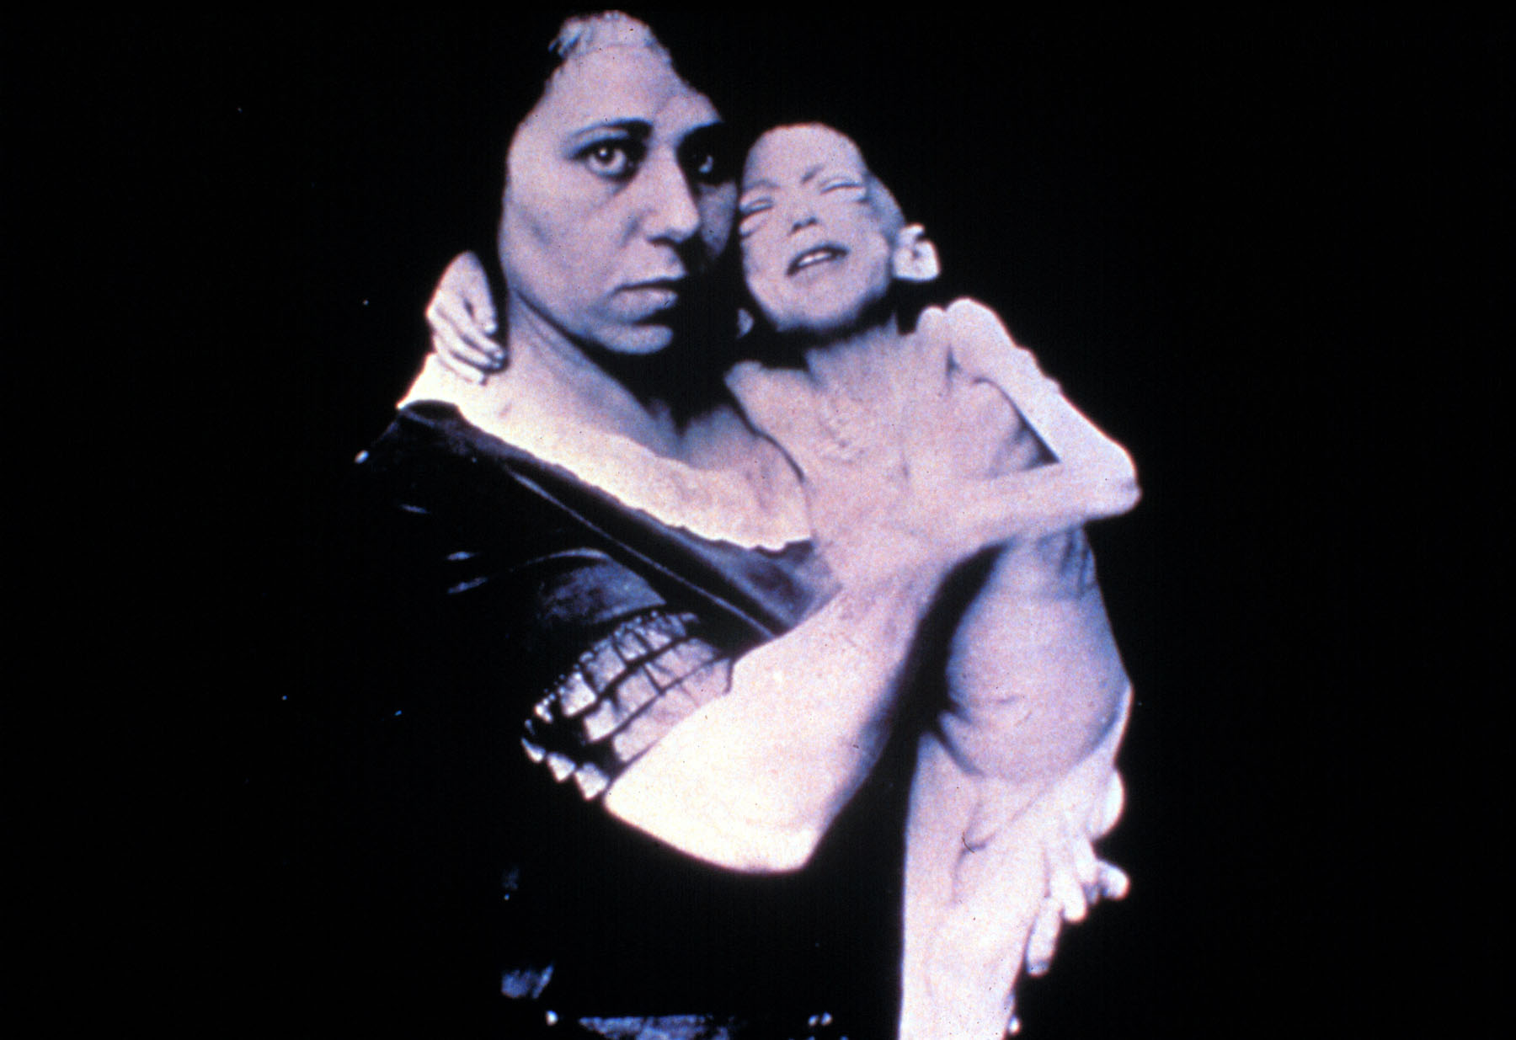

Slide 7
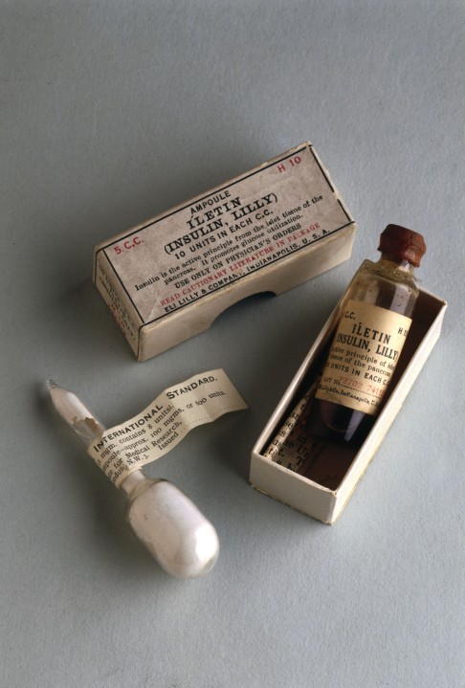
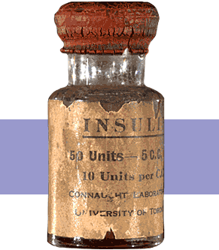
Insulin Finally Available - 1922

Slide 8
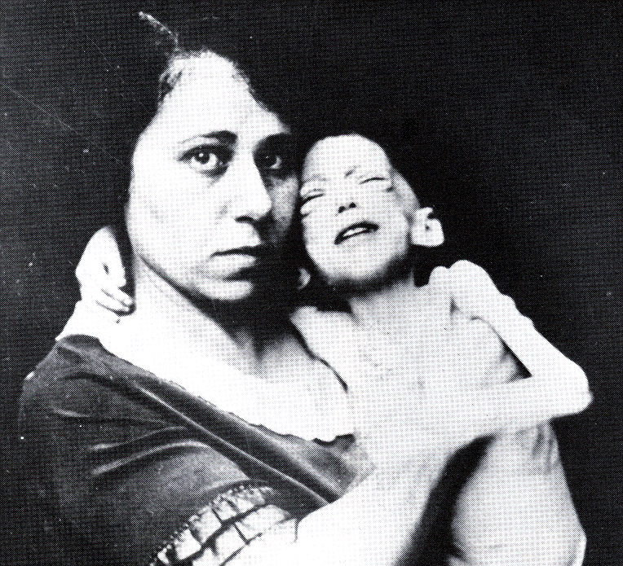

Miracle of Insulin
The Miracle of Insulin
Patient J.L., December 15, 1922
February 15, 1923

Slide 9

Poll question
A patient tells you she doesn't want to start on insulin. What is your best response?
a. The needles are so small, you won't feel a thing.
b. You might die if you don't take insulin.
c. Tell me why.
d. There is a doctors' order to start insulin.
e. Not sure

Slide 10

Psychological Insulin Resistance (PIR)
50% of providers in study threatened pts “with the needle”.
Less than 50% of providers realized insulins’ positive effect on type 2 dm
Most pts don’t believe that insulin would “better help them manage their diabetes”.
Solutions: Find the root of PIR and address it, use more insulin pens
Diabetes Attitudes, Wishes, Needs Study - Rubin

Slide 11
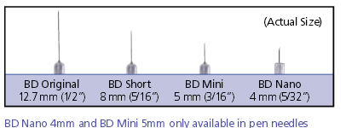
Needle Size often a Barrier Size Does Matter
Use more short needles – 4 mm
Effective for pts with BMI of 24- 49
Keeps it subq
If pt thin, inject at angle
To avoid leakage, count to 10 before withdrawing needle
½ the patients who could benefit from insulin are not using it due to needle phobias
Consider inhaled insulin

Slide 12
Physiologic Insulin Secretion: 24-Hour Profile
50
Insulin
(µU/mL)
Bolus Insulin
25
0
Basal Insulin
Breakfast Lunch Dinner
150
100
Mealtime Glucose
Glucose
(mg/dL)
50
Basal Glucose
0
7
8
9
10
11
12
1
2
3
4
5
6
7
8
9
A.M.
P.M.
Time of Day

Slide 13
Insulin Action Teams
Bolus: lowers after meal glucose levels
Rapid Acting
Aspart, Lispro, Glulisine
Short Acting
Regular
Afrezza - Inhaled
Basal: controls glucose between meals, hs
Intermediate
NPH
Long Acting
Detemir (Levemir)
Glargine (Lantus)

Slide 14
Poll question
What best describes the role of bolus insulins?
a. cover carbs at meals and hyperglycemia
b. helps to lower fasting blood glucose
c. keeps overnight blood sugars under control
d. should be used during hypoglycemic episodes
e. not sure

Slide 15
Bolus Insulins (½ of total daily dose ÷ meals)
Name Onset Peak Action
Lispro (Humalog) 15-30 min 1-1.5 hrs
Aspart (NovoLog)
Glulisine (Apidra)
Afrezza (Inhaled)
Regular 30 mins 2-4 hrs

Slide 16
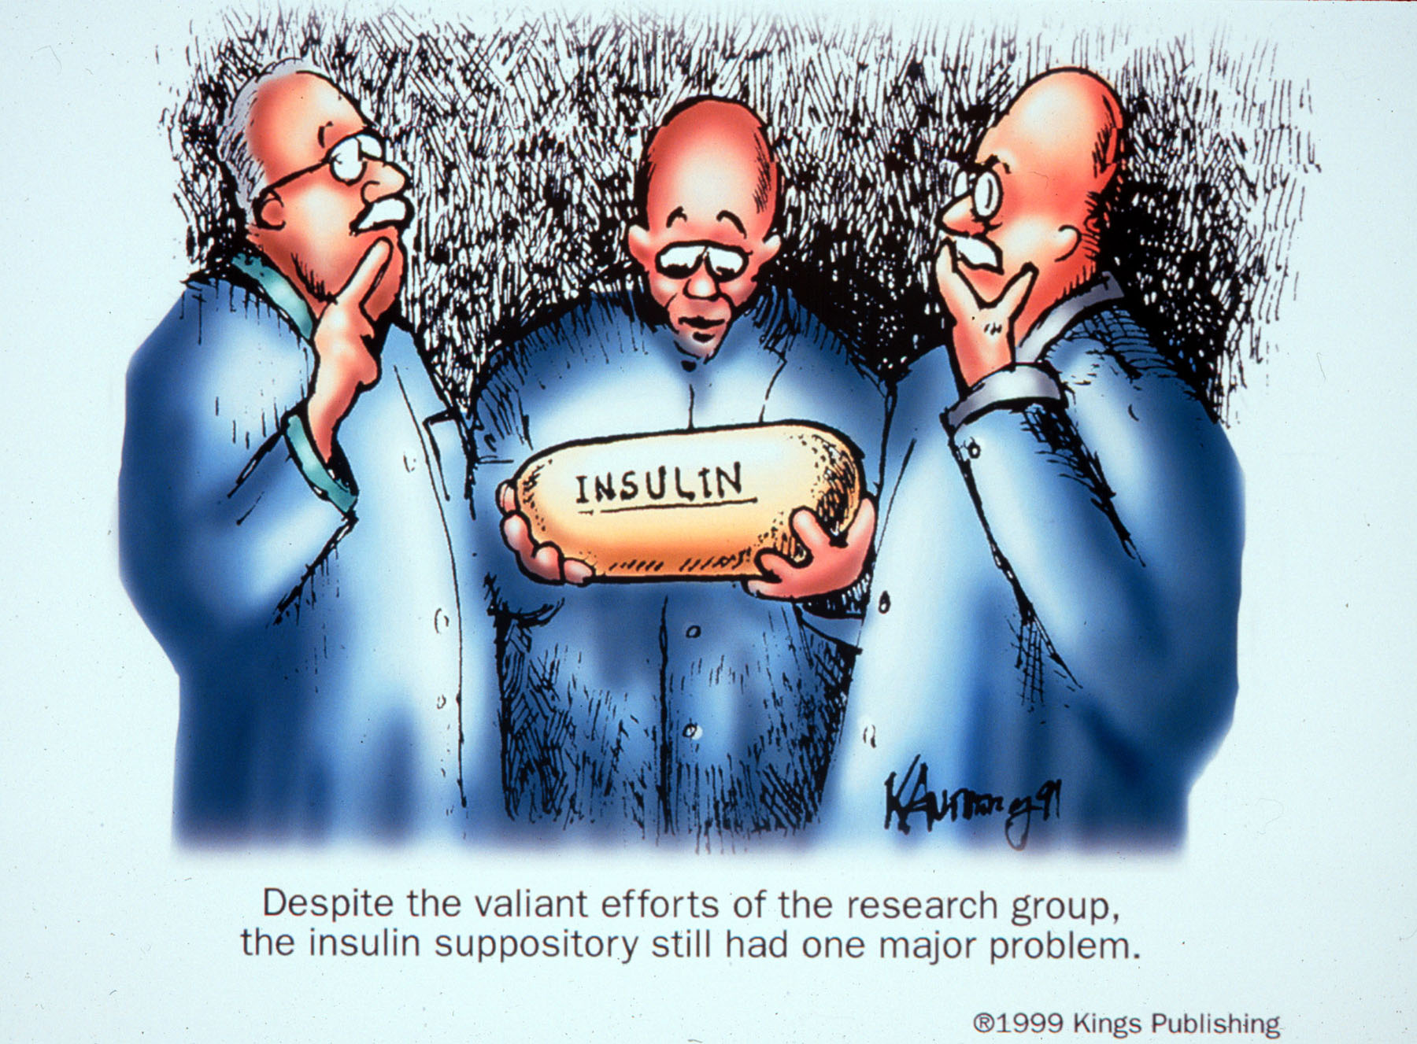

Slide 17
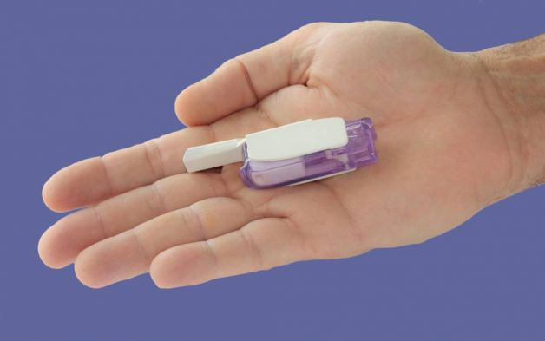

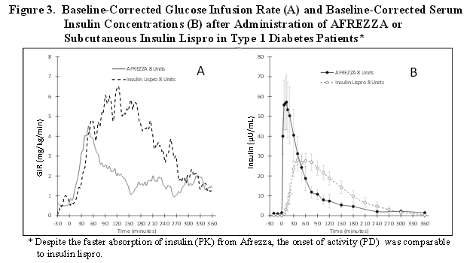
Afrezza – Inhaled Insulin – Approved 2014 – Type 1 or 2
Only studied in adults over 18
Not indicated for pregnancy, while breastfeeding

Slide 18
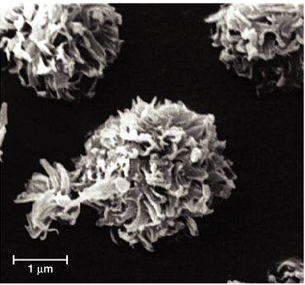
Steps, Cost, Terms
1st step – FDA approved. Will take time to produce, market and distribute
Pricing –similar pricing as pens ~ $300 a month
Afrezza is regular human insulin in powder form using Technosphere technology.
Referred to as TI in papers – “Technosphere Insulin”

Slide 19
Afrezza Dosing and Considerations
Bolus regular insulin – inhaled before meals
Dosing: 4 and 8 unit cartridges
Convert with 1:1 ratio to existing insulin dose
Lung function test before start (FEV1)
Not for pts w/ chronic lung issues
Asthma, COPD, history of lung cancer, smokers
Can cause acute bronchospasm – Black box warning
Side effects:
Hypoglycemia, sore throat, cough
Less hypoglycemia than injected insulin

Slide 20
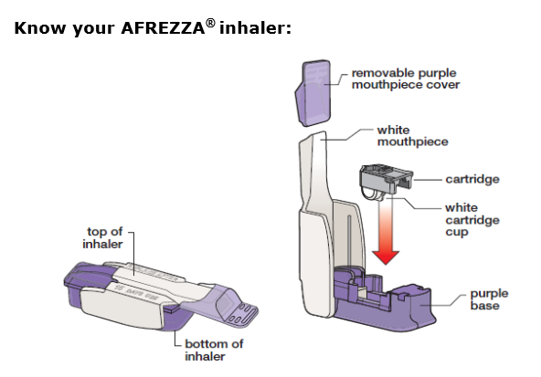
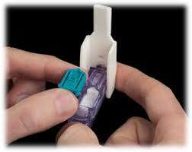
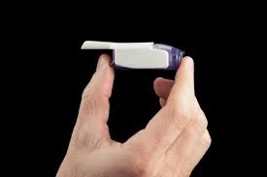
Afrezza Inhaler
Replace inhaler every 15 days –Do not wash

Slide 21
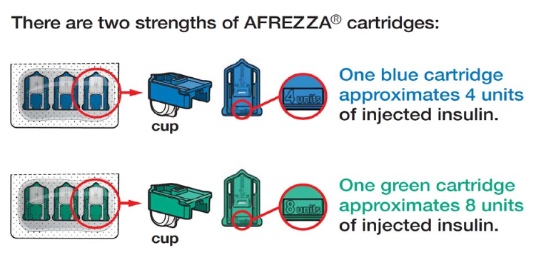
Afrezza – Strengths
Let insulin cartridges and inhaler sit at room temp for 10 minutes before using

Slide 22
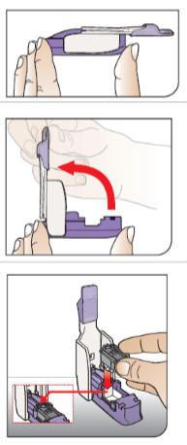
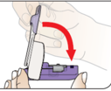
Afrezza – Loading Cartridge into device
Hold inhaler level
Open inhaler by lifting white mouthpiece
Hold insulin cartridge with cup facing down.
Place cartridge inside and close lid. Keep level.
Make sure cartridge has been at room temp for 10 minutes

Slide 23
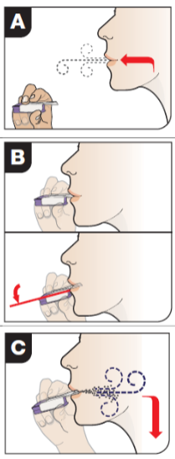
Afrezza – Proper Inhale Technique
Exhale
Position inhaler in mouth (take off cover)
Tilt inhaler down toward chin, keep head level
Inhale deeply and hold breath for as long as comfortable
Remove cartridge
Replace cover

Slide 24
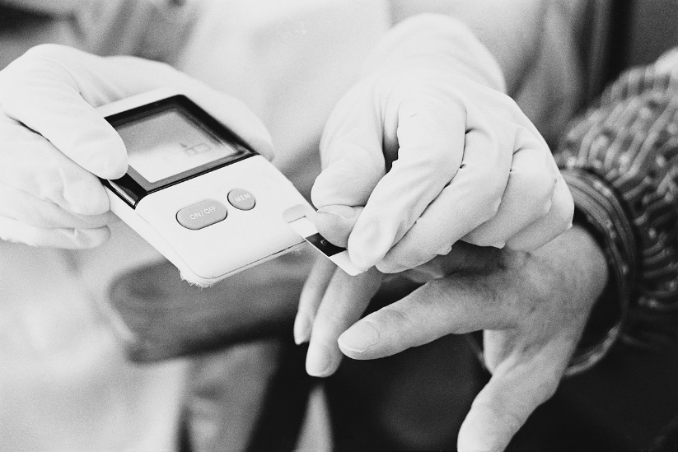
Sample situations - Pt on….
7 units Humalog at meals, 20 u Lantus at hs
5 units regular break, dinner, 10 units detemir
10 units aspart at meals, 30 Lantus
Carb counts – 1:15 .. Had 75 gms
Type 1
Type 2
BG before meal 67
BG before meal 170

Slide 25
Bolus Insulin Summary
Regular, Novolog, Humalog, Apidra, Afrezza
Starts working fast (15-30 mins)
Gets out fast (3-6 hours)
Post meal BG reflects effectiveness
Should comprise about ½ total daily dose
Covers food or hyperglycemia.
1 unit
Covers ≈ 10 -15 gms of carb
Lowers BG ≈ 30 – 50 points

Slide 26
Bolus Insulin Timing
How is the effectiveness of bolus insulin determined?
2 hour post meal (if you can get it)
Before next meal blood glucose
Glucose goals (ADA) – may be modified by provider/pt
1-2 hours post meal <180
Before next meal – 80 - 130

Slide 27
Bolus – Insulin Sliding Scale Starts at 150, 2 units for every 50 mg/dl >150

Slide 28
Basal Insulins (½ of total daily dose)
Intermediate Acting Peak Action Duration
NPH 4-12 hrs 12-24
Long Acting Peak Action Duration
Detemir (Levemir) peakless 20 hrs
Glargine (Lantus) No peak 24 hrs
Glargine (Toujeo) No peak 24 hrs
Concentrated glargine - 300 units/mL in 1.5 mL pen
Fasting BG reflects efficacy of basal

Slide 29
Basal Insulin Summary
NPH, Levemir, Lantus, Toujeo
Covers in between meals, through night
Starts working slow (4 hours)
Stays in long (12-24 hours)
NPH/ Lente 12 hrs
Levemir, Lantus, Toujeo 20-24 hrs
Fasting blood glucose reflects effectiveness

Slide 30


Pattern Management –AKA
How to think like a pancreas

Slide 31

Poll Question
When looking at glucose patterns, which problem do you fix first?
a. Hyperglycemia
b. Hypoglycemia
c. non-compliance
d. legible writing
e. not sure

Slide 32
Pattern Management
Safety 1st!! - Evaluate 3 day patterns
Hypo: eval 1st and fix:
If possible, decrease medication dose
Timing of meals, exercise, medications
Hyperglycemia: evaluate 2nd
Identify patterns
Before increase insulin, make sure not missing something (carbs, exercise, omission)

Slide 33
Type 2 – BMI 32. New diagnosis, No meds. What Patterns? Recommendations? Meds?

Slide 34
Type 2 – glyburide 10mg AM, Detemir 12 units at hs

Slide 35

Basal + Metformin Type 2, 80kg – A1c 8.7%

Slide 36
Notes:
Basal insulin alone is usually the optimal initial regimen, beginning at 0.1-0.2 U/kg body weight, depending on the degree of hyperglycemia. It is usually prescribed in conjunction with 1-2 non-insulin agents, although insulin secretagogues (sulfonylureas, meglitinides) are typically stopped once more complex regimens beyond basal insulin are utilized.
In patients still not at target after basal insulin has been adequately titrated, and the patient is willing to take >1 injections, there are several options. First, consider GLP-1 receptor agonists (see Fig. 2). The combination of basal insulin + GLP-1RA is becoming well established after several studies confirmed its efficacy on par with more complex multi-dose insulin regimens, but with less hypoglycemia and with weight loss instead of weight gain. If such an approach is not possible or has been tried and proven unsuccessful, there are 3 possible advanced insulin regimens:
Adding 1 injection of a rapid acting insulin analogue before the largest meal,
Adding 2-3 injections of a rapid acting insulin analogue before 2-3 meals, or
Using premixed insulin BID
Each approach has its advantages and disadvantages. The figure describes the number of injections required at each stage, together with the relative complexity and flexibility.
Once a strategy is initiated, titration of the insulin dose is important, with dose adjustments made based on the prevailing BG levels as reported by the patient.
Comprehensive education regarding self-monitoring of BG, diet, exercise, and the avoidance of, and response to, hypoglycemia are critical in any patient on insulin therapy.

Slide 37
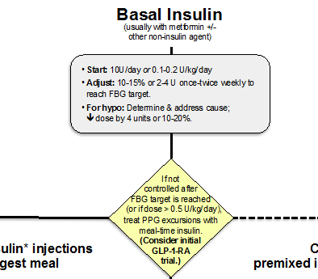
When is it Too much basal insulin?

Slide 38
Next Steps
At max basal dose
80 x 0.5 = 40 units
Don’t add sulfonylurea to insulin (increases mortality)
Consider Adding a SGLT-2 Inhibitor
Consider a GLP-1 Agonist
Start bolus insulin at largest meal
Or switch to 70/30 Insulin

Slide 39
Combo Sub-Q Insulin

Slide 40
Next Steps – Switch from 40 units basal to 70/30 Insulin
Switch to 70/30 Insulin
Take current dose and give 2/3 in am and 1/3 in pm.
2/3 of basal in am
40 units x 0.6 = 24 units 70/30
1/3 of basal in *pm
40 units x 0.4 = 16 units 70/30
*pm = before dinner

Slide 41
24u 70/30 am, 16 u 70/30 pm Patterns? Changes needed?

Slide 42

Case Study
70 yr old, weighs 100kg
History of CABG, tobacco
A1c – 11.3%, BG 400-500 for past weeks
Insulin – 100+ units Lantus at hs (solostar)
Oral Meds: Metformin, Invokana
Pt can’t afford Lantus insulin pen or Invokana – what other option?

Slide 43

Poll question
Which insulins are cheapest?
a. Lantus, Levemir
b. Novolog, Humalog
c. Reg, NPH
d. Insulin pens
e. not sure

Slide 44
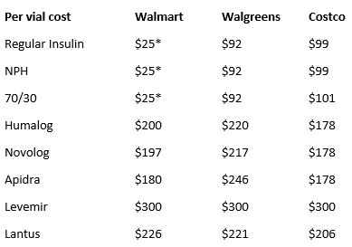
Cost Per Vial in Northern CA

Slide 45
Case Study
70 yr old, weighs 100kg
History of CABG
A1c – 11.3%, BG 400-500 for past weeks
Insulin – 100+ units Lantus at hs (solostar).
Metformin 1000mg BID
What is max basal insulin should he be on?

Slide 46
Case Study
70 yr old, weighs 100kg
History of CABG
A1c – 11.3%, BG 400-500 for past weeks
Insulin – 100+ units Lantus at hs (solostar)
Metformin 1000mg BID
What is max basal insulin should he be on?
100kg x 0.5 = 50 units a day
What can we do next to improve BG?

Slide 47

Case Study
What is max basal insulin should he be on?
100kg x 0.5 = 50 units a day
What can we do next to improve BG?
Add GLP-1 (Exenatide, Victoza, Trulicity, Tanzeum)
Add 4 units bolus insulin to largest meal (or 10% of basal)
Switch him to 70/30 insulin ac breakfast and dinner
Total previous basal dose – 100 units
2/3 in am – 65 units am (43 NPH and 22 regular)
1/3 pre dinner – 35 units pm (23 NPH and 12 regular)

Slide 48
Case Study
70 yr old, weighs 100kg
History of CABG, tobacco
A1c – 11.3%, BG 400-500 for past weeks
What will inform you of how to proceed?
Insurance coverage
His willingness to stick to a complex regimen
His ability to self-monitor
His social support and connection to his medical team

Slide 49
Quick Calculation
Pt takes:
30 units of Humalog at breakfast and dinner.
20 units of Humalog at lunch and in between breakfast and lunch if BG over 200.
A1c 8.7%
How many vial(s) of insulin would he use a month?

Slide 50
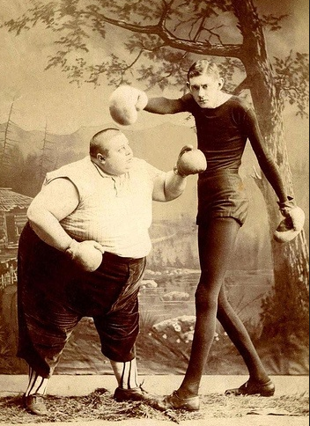
Approach Depends on Patient

Slide 51
Poll Question
How much insulin does a patient with type 2 diabetes need a day?
About 1 unit per pound per day
No more than 0.5 units/kg per day
Approximately 5 units/kg per day
About 0.5 to 1.0 units/kg per day

Slide 52
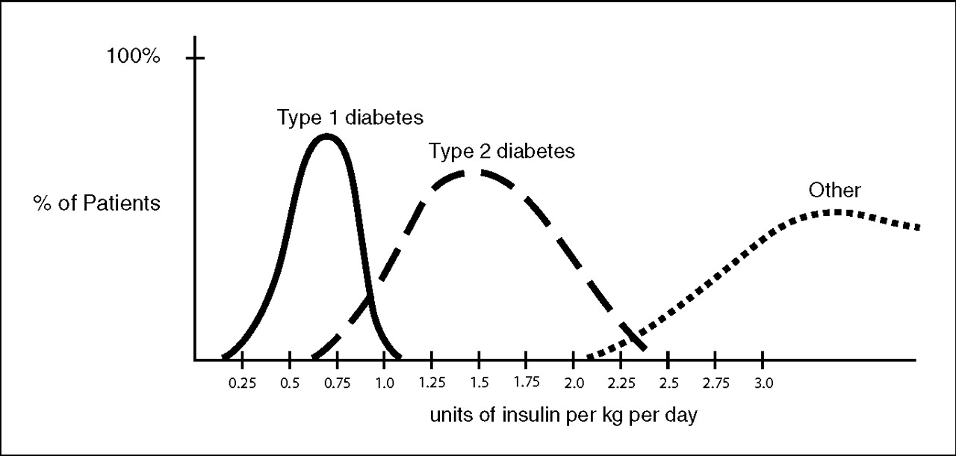
Insulin Dosing Type 1 & 2
U-500 Insulin: When More With Less Yields Success: Diabetes Spectrum March 20, 2009 vol. 22 no. 2 116-122

Slide 53
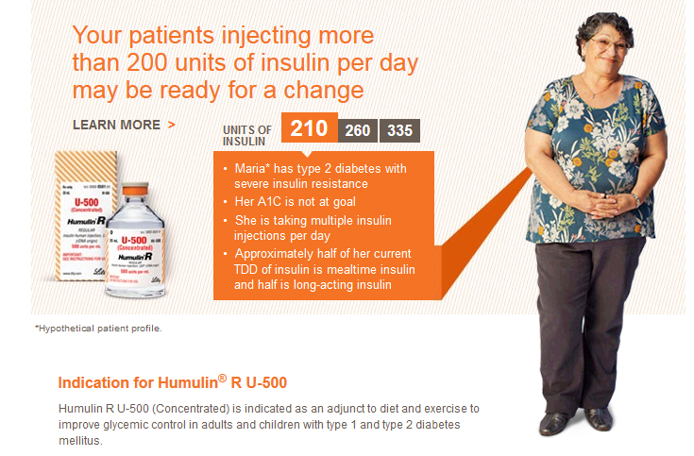
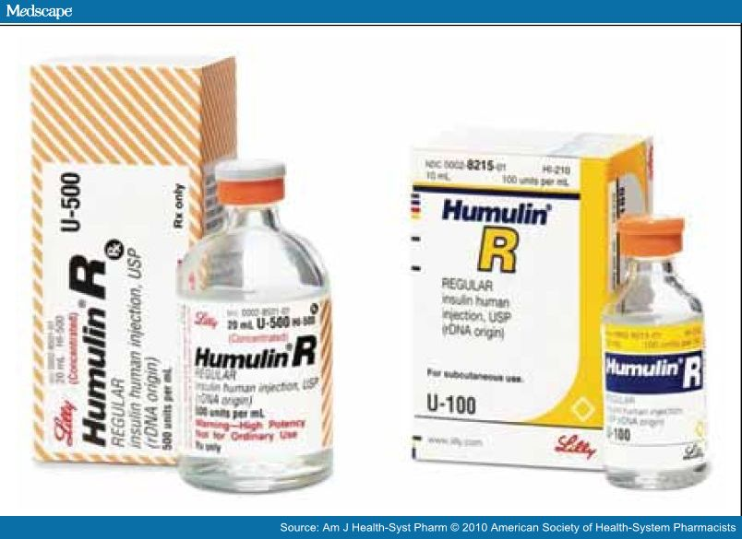
More than 200 units a day?

Slide 54

Consider u-500 High Potency Insulin
5 x’s the concentration of u100
500 units per mL vs 100 units per mL
How much- When converting from u100?
Take total daily dose and divide by 5
200 units a day/5 = 40 units a day of u500
300 units a day/5 = ____ units a day of u500
20 mL a vial. 500 units per mL= 10,000 units/vial
Costs ~ $400 $1,200 per vial – less expensive unit for unit?
Less volume
U-500 Insulin: When More With Less Yields Success: Diabetes Spectrum March 20, 2009 vol. 22 no. 2 116-122

Slide 55
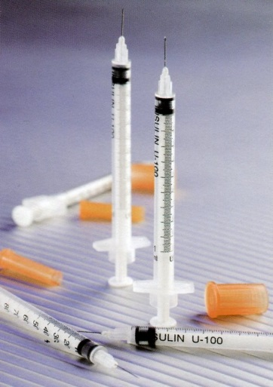
Dosing Strategies u-500
Consider U-500 (5 x’s more potent)
1 unit on U-100 syringe = 5 units insulin
Dosing – take total daily needs and split into 2-3 doses
2 doses: 60% am / 40% pm or
3 doses: 40/30/30 or 40/40/20
No basal insulin needed, because U-500 has bolus and basal action
Needs careful monitoring/ education
U-500 Insulin: When More With Less Yields Success: Diabetes Spectrum March 20, 2009 vol. 22 no. 2 116-122

Slide 56
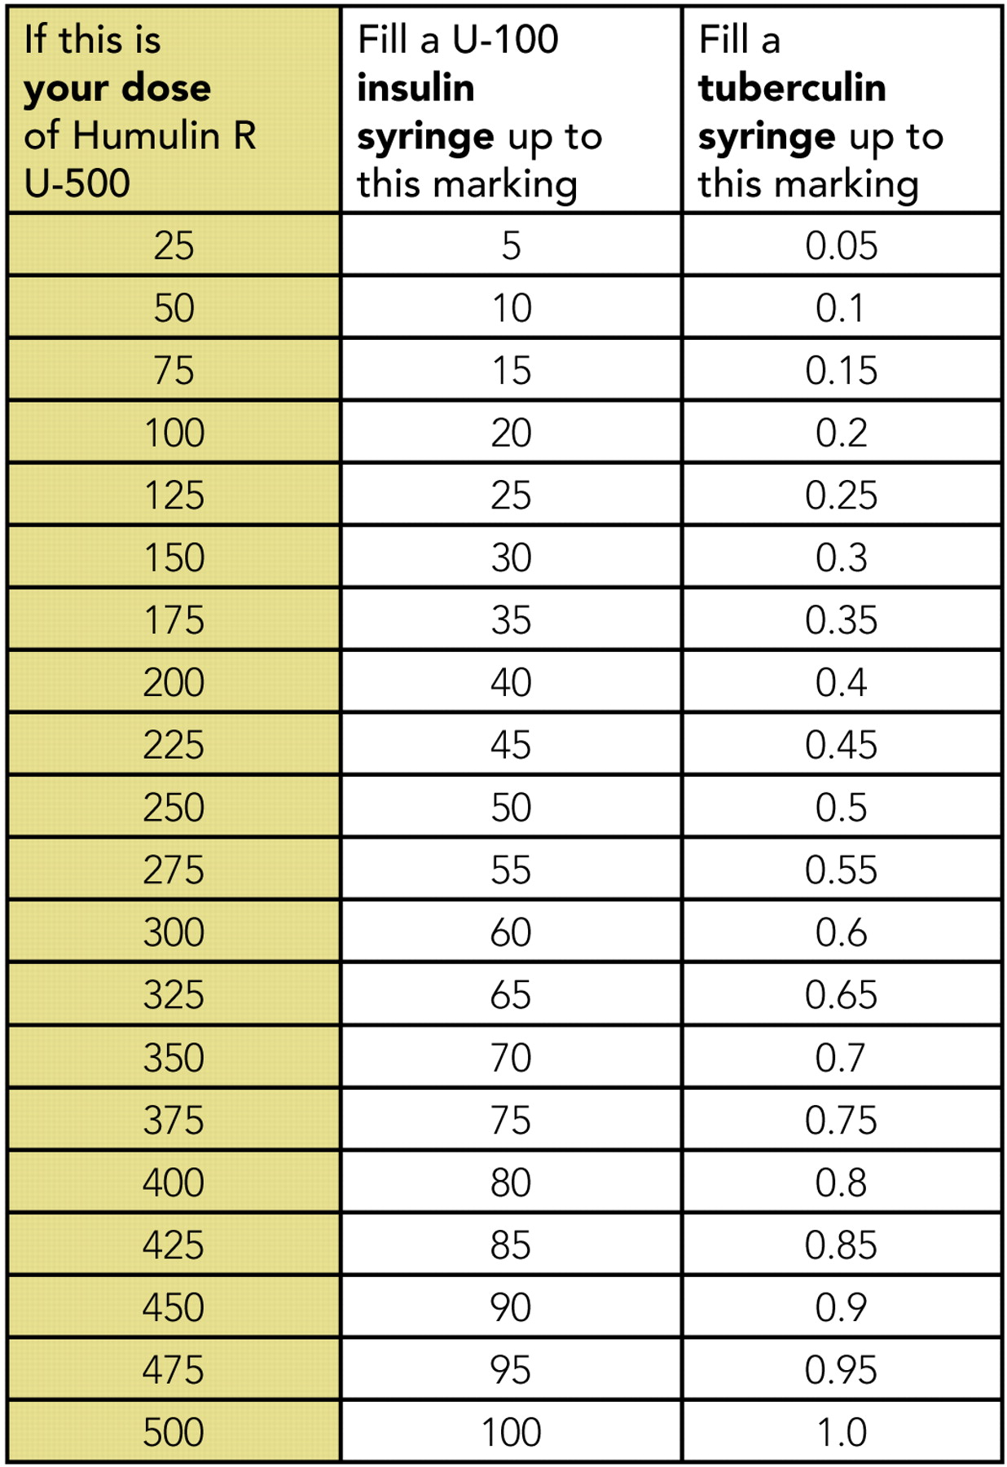
U-500 Dose U-100 syringe and TB Syringe

Slide 57
Quick Calculation - U500
Pt takes:
300 units of insulin a day.
A1c 10.3%
Convert patient to u-500
60% am / 40% pm
Morning dose
Before dinner dose

Slide 58
Quick Calculation u-500
Pt takes:
300 units of insulin a day.
A1c 10.3%
Convert patient to u-500
60% am / 40% pm
300 / 5 = 60 units
60 x 60% = 36 units of u500
60 x 40% = 24 units of u500

Slide 59
Basal Bolus – What Adjustments? Pt weighs 80kg

Slide 60
Intensive Diabetes Therapy Insulin Dosing Strategy
50/50 Rule
0.5-1.0 units/kg day
(.5 units/kg most common)
Basal = 50% of total
Glargine Q day
NPH or Detemir BID
Bolus = 50% of total
usually divided into 3 meals
Example
Wt 50kg x 0.5 = 25 units of insulin/day
Basal dose: 13 units
Glargine 13 units Q day
NPH/Detemir 6u BID
Bolus dose: 12 units
4 units NovoLog, Apidra, Reg, Humalog each meal

Slide 61
Intensive Diabetes Therapy Insulin Dosing Strategy
50/50 Rule
0.3-1.0 units/kg day
(.5 units/kg most common)
Basal = 50% of total
Glargine Q day
NPH or Detemir BID
Bolus = 50% of total
usually divided into 3 meals
Example – You Try
Wt 80 kg x 0.5 = ___ units of insulin/day
Basal dose: ____ units
Glargine ____ units QD
NPH/Detemir ____ BID
Bolus dose: ____ units
___units NovoLog, Apidra Humalog each meal

Slide 62
Intensive Diabetes Therapy Insulin Dosing Strategy
50/50 Rule
0.3-1.0 units/kg day
Basal = 50% of total
Glargine Q day
NPH or Detemir BID
Bolus = 50% of total
usually divided into 3 meals
Example – You Try
Wt 80kg x 0.5 = 40 units of insulin/day
Basal dose: 20 units
Glargine 20 units HS or
NPH/Detemir 10u BID
Bolus dose: 20 units
6-7 NovoLog, Apidra Humalog Reg w/meal

Slide 63
Basal Bolus – Using 50/50 Rule – Pt weighs 80kg

Slide 64
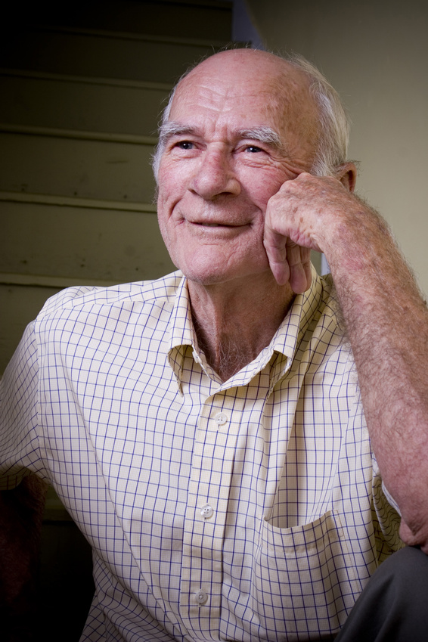
Based on Mr R’s clinical picture – In hospital How Much Insulin Needed?
Creatinine 1.6
76 years old
Not very hungry
BMI 21
Weighs 80kg
Glucotrol 5mg at home
A1c 7.2%

Slide 65
Calculate Daily Insulin Needs
Based on unique characteristics of pt, where would you start?
Body wt in Kg x _________ = total daily dose
May need more or less based on clinical presentation
Less 0.3 u/kg 0.5u/kg More 1.0 u/kg
Thin, elderly,  creat Heavy, infection, steroids

Slide 66
Calculate Insulin Needs Basal/ insulin carb/ correct
Body wt in Kg x 0.3
80kg x 0.3 = 24 units daily
Basal = 12 units
Bolus = 12 units / 3 meals = 4 units each meal
What if he is nauseated?

Slide 67

Basal Bolus
Carb counting
Prandial coverage
Correcting for hyper and hypoglycemia

Slide 68
Bolus Basics
Carbohydrate/ Prandial Coverage
Match the insulin to the carbohydrates
1 unit for 15 gms - Common starting point
Correction Bolus - targets hyperglycemia
1 unit for every 30-50 points over target
Adjust ratios depending on sensitivity and response
Notes:
Importance of MD writing for a diabetic diet cannot be overemphasized. It sets into motion the timing of meals that are delivered, makes it easier for RN to know when to check glucose and administer the insulin.

Slide 69
Carbohydrate Ratio How does that work? Rapid/Fast Acting Insulin
Serving Size | Gms CHO | Insulin
1 | 15 gms cho | 1 unit
2 | 30 gms cho | 2 units
3 | 45 gms cho | 3 units
4 | 60 gms cho | 4 units
Dinner (60 gms cho)
Lemon Chicken
1 cup rice pilaf
(45 gms cho)
Asparagus
Dinner Roll
(15 gms cho)
Blood Glucose 165mg/dl

Slide 70
Adjusting Bolus and Correction Doses Carbohydrate-to-Insulin Ratio
Based on three questions before meals:
How much carbohydrate am I going to eat?
What is my insulin dose for this amount of carbohydrate?
Should I lower the dose because I plan to be very active or have recently been active?

Slide 71
Correction Bolus Rapid/Fast Acting Insulin (1 unit:50 mg/dl>150)
Less than 70 | Subtract 1 unit
70-150 mg/dl | 0 units
151-200 mg/dl | 1 unit
201-250 mg/dl | 2 units
251-300 mg/dl | 3 units
301-350 mg/dl | 4 units
351-400 mg/dl | 5 units

Slide 72

Type 1 and a Teen
Cindy is trying to carb count and adjust her insulin, but is still having trouble. She weighs 60kg.
What is her daily dose of insulin?
What is her basal dose?
1. Pre meal target BG is 120
2. Post meal goal < 180.
3. Carb ratio: 1 unit for every 15 gms
4. Hyperglycemic correction factor is one unit for every 55 above goal (she uses Humalog and 1700 rule)
1700 Rule
1700 / TDD = insulin sensitivity
1700 / 30 = 56
1 unit drops BG 56 points

Slide 73
Correction Bolus for Cindy Analog Insulin (1 unit:55 mg/dl>120)
Less than 70 mg/dl | Subtract 1 unit
70-119 mg/dl | 0 units
120-175 mg/dl | 1 unit
176-230 mg/dl | 2 units
231-285 mg/dl | 3 units
286-340 mg/dl | 4 units
341-395 mg/dl | 5 units

Slide 74
Adjusting Cindy’s Bolus Insulin With Ratios
BG before lunch 285, she plans to eat 45 gms of carbohydrate.
285-120 = 165 over target, 165/55 = 3
45gms / 15 = 3
3 units bolus insulin to correct to target
3 units bolus insulin to cover carbs in meal
Total adjusted dose: 6 units humalog insulin

Slide 75
Adjusting Cindy’s Bolus Insulin With Ratios - You Try
BG before lunch 230, plans to eat 60 gms of carbohydrate.
____-120 = ____ over target, ____/55 = ____units
______gms / ____ = ____ units ins for carbs
_____ units insulin to correct for hyperglycemia
_____ units insulin to cover carbs in meal
Total adjusted dose: ___ units humalog insulin

Slide 76
Adjusting Cindy’s Bolus Insulin With Ratios - Answers
Fingerstick before lunch 220, plans to eat 60 gms of carbohydrate.
220 -120 = 110 over target, 110/55 = 2
60 gms / 15 = 4 units for carbs
2 units insulin to correct hyperglycemia
4 units insulin to cover carbs in meal
Total adjusted dose: 6 units humalog insulin

Slide 77
How much Insulin Needed?
Morning - BG 173
Breakfast – slice cold pizza, ½ c. applesauce
Lunch BG 69
Menu- ham sandwich, pear, diet 7-up, mini snickers bar.
2 hours after lunch, BG 148 - ran track
Before dinner - BG 98
Cheeseburger, small fries, chocolate chip cookie
At bedtime, BG 173

Slide 78
How much Insulin Needed?
Morning - BG 173
Breakfast – slice cold pizza, ½ c. applesauce
45 gms = 3 units 1 unit for hyper total = 4 units
Lunch BG 69
Menu- ham sandwich, pear, diet 7-up, mini snickers
60 gms = 4 units -1 unit since < 70 total = 3 units
2 hours after lunch, BG 148 – ran track
Before dinner - BG 98
Cheeseburger, small fries, chocolate chip cookie
75 gms = 5 units 0 units for hyper
At bedtime, BG 173 – 15 unit Lantus

Slide 79
Cindy, 60kg, Carb (1u/15gms) Target 120 pre meal, Hyper 1 for 55

Slide 80
Insulin Teaching Keys
Bolus insulin with meals
Basal 1-2xs daily
Abdomen preferred injection site
Stay 1” away from previous site
Don’t re-use ultra fine syringes
Keep unopened insulin in refrigerator
Look for hyper
Toss opened insulin vial after 28 days
Proper disposal
Review patients ability to withdraw and inject.
Side effects include hypoglycemia/wt gain
Insulin pens –
Prime needle to assure accurate insulin dose given
Hold needle in for 5 seconds after injection
Roll 70/30 pens

Slide 81
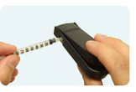
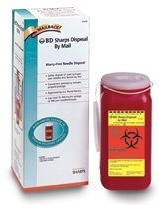
Sharps Disposal: Product and Info
Look in the Government section white pages for a household hazardous waste listing for your city or county.
Call 1-800-CLEANUP (1-800-253-2687)
Search for collection centers on the California Integrated Waste Management Board (CIWMB) Web site: http://www.ciwmb.ca.gov/HHW/HealthCare/Collection/

Slide 82
“DiaBingo” Shout out Right Answer

Slide 83
I Injected hormone that is an analog of amylin
I Glargine, Detemir, NPH are types of
I Breakdown of glycogen into glucose
I Anabolic hormone
I Insulin is released when glucose levels are low
I Once opened, insulin vials are good for one _____
I Elevated post-prandial glucose indicate need for pre-meaI
I Epinephrine increases insulin resistance
I Creation of glucose from amino acids and lactate
I Decreasing renal function for people on insulin can cause
I Bolus insulins
I A hormone that increases blood glucose levels

Slide 84

Providing Diabetes Care
Setting up successful delivery systems
Assessing the unique needs of each individual
Supporting diabetes self-care

Slide 85

Change the Care System – Focus on Quality of Care delivered
Optimal diabetes management requires:
organized, systematic approach
involvement of a coordinated team of dedicated health care professionals,
working in an environment where patient centered high quality care is a priority.

Slide 86
Change the Care System – Focus on Quality of Care delivered
Evidence based, interdisciplinary teams providing intensive disease management is the strategy that works best.
Redesign health care process
Electronic health record tools
Activating and educating patients
Remove financial barriers and reduce cost of care
Public policy changes (ie soda tax)
Community resources (low cost dental care, farmers market, recreation opportunities.

Slide 87
Diabetes Care Concepts - Tenants
Keep it patient centered
Consider the individual
Customize standard goals based on assessment
Diabetes Across the lifespan
We are getting diabetes earlier and living longer
Promote coordinated care across lifespan
Advocacy
Active support and engagement
Address social determinants and underlying causes of health disparities. Let your voice be heard.

Slide 88

Major Barriers to Diabetes Care
Fragmented health system
Lack of electronic information sharing
Duplication of services
Poorly designed to deliver coordinated care for those with chronic diseases

Slide 89
Chronic Care Model - CCM
6 core elements for optimal diabetes care
Proactive (vs reactive) care delivery system.
Planned visits coordinated through a team based approach
Self Management support
Decision support (basing care on evidence based guidelines)
Clinical information systems (registries that provide patient specific and population based support to team)
Community policies and resources to support healthy lifestyles
Health systems that create a culture of quality

Slide 90

Redefining Roles and Building Teams
Utilizing staff to focus on their strengths and supporting patient self management.
Collaborative multi-disciplinary team are best suited to provide diabetes care and support patients in succeeding at self management.

Slide 91

Moving on to each Unique Individual

Slide 92
How to Improve Chronic Care Model
Optimize Provider and Team Behavior
Appropriate and timely intensification of lifestyle if BG not at target
Explicit goal setting
Use evidence based guidelines and clinical information tools
Incorporate care management teams:
Pharmacists, nurses and other providers to improve outcomes
Address literacy and cultural barriers

Slide 93

Assess Literacy
Numeral
130 could look same as 310, 013
Health
Not sure how to use the health system
Prescriptions, appointments, insurance coverage
Functional
Ability to use reading, writing and computation at levels adequate to everyday situations (checkbooks, signs, etc)

Slide 94

Reading: Go direct!
Do you read???
Is this # less or more than this?
How much insulin do you give?
When you have this much sugar in your blood??
Return Demo (please draw it up)

Slide 95
Quick question
Which of the following strategies are best used when someone has low literacy skills?
A. speak slowly and clearly
B. underline key points on educational materials
C. direct the teaching to the support person and encourage reinforcement.
D. be concrete and focus on problem solving

Slide 96

Teaching Approaches: Low Literacy
Be Concrete
Word usage (be sensitive!)
Identify 1-2 messages
Be patient, use teaching aids
Small group- problem solving
Tech level - video, computer, printed info, “apps”
Engage support people

Slide 97
When Treatment Goals aren’t met
Reassess treatment regimen and barriers
Literacy
Diabetes related distress or depression
Poverty
Competing demands including those related to family responsibilities and dynamics
Culturally appropriate education?
Referral to social worker for assistance with insurance coverage
Medication taking behavior and regimen
Other?

Slide 98
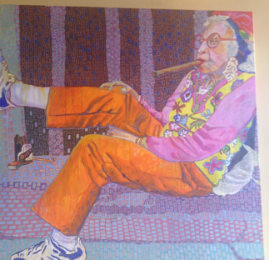

Slide 99

Psychosocial Assessment
Include assessment of the pts psychological and social situation as part of the ongoing medical management of diabetes
Psychosocial screening may include:
Attitudes about diabetes
Expectations of medical management and outcomes
Affect/ mood and quality of life
Available resources (financial, social, emotional)
Psychiatric history

Slide 100

Assessment Factors:
Stress response and coping strategies are based on:
Health beliefs
Perceptions
Cultural* traditions, family system.
Social*, religious and employment influences
Personal factors: attitudes, cognitive factors, literacy, learning styles
Psychosocial factors

Slide 101
*Cultural Sensitivity TOOL: Asking Questions: clear, accepting manner…ask what …
is important to you?
do you think of your diabetes?
the best way to communicate with you?
are your goals and expectations?
are your Personal beliefs and values?
are your Cultural and religious practices?
How ARE you feeling about all of this?

Slide 102
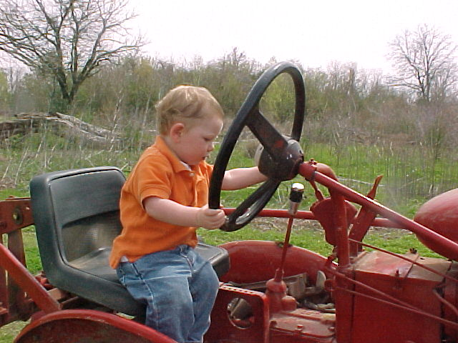
Assessment Factors
Developmental age and stage
Finances
Environment (transportation, location, safety)

Slide 103
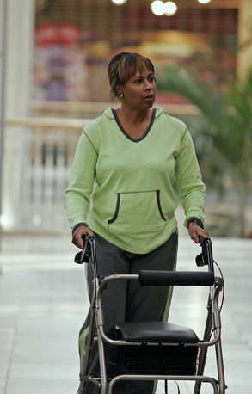
Assess: Capabilities/limits
Physical:
Visual/ hearing/ , psycho-motor, meter, group environ, injection
Substance Abuse
Alcohol, tobacco, caffeine, illicit drugs
Support System, who, when, where…)

Slide 104
*Social Support Assessment Tool
Who helps you?
With practical or emotional support ?
Who makes it harder?
What would you like in support for day-to-day?
One thing you could do so you will get the support?
What can I do to help you get the support you want?

Slide 105
Types of Social Support (virtual or live)
Emotional support
Caring, empathy, love, trust----most important
( perceived )
Informational support
provided during time of stress-problem solving, chat, blog, apps
Instrumental support
goods/services--- “help” / Apps
Affirmational support
affirming acts or statements

Slide 106

Assess: Learning Style:
Method: read, listen, discuss
Sensors: problem solving: demo.
Feelers: listening, discussion
Thinkers: Facts…lecture

Slide 107

Routine Mental Health Screening
Depression – affects 20-25% of DM
Increases risk of MI and mortality
High priority to screen and treat for those over 65
Provide a collaborative care approach to treat depression
Diabetes related distress (18-45% of pts)
Anxiety
Eating disorders (Dana will discuss)
Cognitive impairment

Slide 108
Quick Question
Which of the following statements by a patient reflects they are depressed?
I used to love gardening, now I don’t even care if my garden is overrun by weeds.
Yes, I feel sad that I have diabetes.
Some mornings, it’s just hard to check my blood sugars.
I am so tired of everyone telling me how to eat!

Slide 109
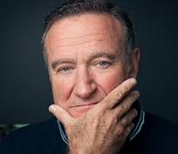
Depression
Characterized by depressed mood
Loss of interest in activities usually found pleasurable
Difficulty concentrating, sleeping, changes in appetite
Difficulty in following through with self care behaviors

Slide 110

Is Mr. Jones coping well?
Mr. Jones is 67 yrs old, has Type 2 diabetes (12 yrs) with unknown A1C, is widowed and has a low income job (close to lay off), and is teetering on foreclosure of his home.
What are some risk factors that may make coping difficult for Mr. Jones?

Slide 111
Mr. Jones Assessment
He helps take care of his elderly mother, struggles with “feeling blue” and when asked, states he has a few drinks a day….
What are the chances Mr. Jones is depressed?
Why?
How could you find out?
What questions would you ask?

Slide 112
Depression Assessment
Depression:
Over the last 2 weeks, have you felt down, depressed or hopeless?
Over the last 2 weeks, have you felt little pleasure in doing things?
Depression
Pt. Health Questionnaire (PHQ-9)
Beck Depression Inventory (BDI)
Symptom Checklist (SCL-90)
Referral to Mental Health:
Refer to therapy (list ready!)
Pharmacologic TX Anti-depressants: 50% of pt’s with diabetes

Slide 113
Anxiety – Exaggerated response to normal fears
Anxiety
Symptoms - (must have 5 for over 6mo’s)
restlessness,
keyed-up or on-edge
easily fatigued
difficulty concentrating or mind going blank
irritability
muscle tension
sleep disturbances
Diabetes causes fear –
Hypoglycemia
Complications
Living with chronic condition
Impact of Anxiety
1.Counterreg hormones
2. Self-care behavior diminishes

Slide 114

Cognitive Impairment
People with diabetes more like to have:
Dementia (associated with hyperglycemia and other causes)
Alzheimer's
Treatment:
Refer to specialist for assessment
Achieve optimal BG control
Pharmacist to evaluate drug safety and potential drug interactions

Slide 115

Diabetes Related Emotional Distress=DRED
DRED - unique emotional issues directly related to the burdens and worries of living with a chronic disease. (embarrassed, guilty)
More than worry: can overlap with depression, anxiety and stress.
Normal-to some extent
Associated with stress of living with diabetes
Express high levels stress and depressive symptoms; but not clinical depression
Not rare: linked to poor health outcomes

Slide 116

DDS 17: Diabetes distress scale
Yields a total Diabetes Distress Scale score plus 4 sub scores:
Emotional burden
Physician related Distress
Regimen related Distress
Interpersonal Distress
***Begin a conversation with any item rated 3 or >
44.5% of patients reported diabetes distress
Only 24% of providers asked pts how diabetes affected their life (DAWN Study)

Slide 117
Diabetes Distress Scale cont.
Feeling that diabetes is taking up too much of my mental and physical
energy every day.
Feeling that my doctor doesn't know enough about diabetes and
diabetes care/ doesn't give me clear enough directions .
Feeling angry, scared, and/or depressed … think about living with diabetes
4. Feeling that I am not testing my blood sugars frequently enough.
5. Feeling that I am often failing with my diabetes routine.
Feeling that friends or family are not supportive enough of self-care
efforts (planning activities that …, encourage me to eat the "wrong" foods).
7. Feeling that diabetes controls my life.
8. Not feeling motivated to keep up my diabetes self management.
DDS (17) Scoring

Slide 118
Strategies to handle DRED:
People w/ DM
1 thing at a time
Take it slowly
Speak up to:
Family, PCP,
People that understand.
Set Appropriate Goals!!!
Small, discreet
HCProviders (you!)
Handle 1 thing at a time
Take it slowly
Set Appropriate Goals. Small, discreet
Be mindful, mundane, careful about the goal set- do not rush
Paired testing before/after (more tangible)

Slide 119
Quick Question
Which of the following is a SMART Goal?
a. I will lose 5% of my body weight
b. I will eat less sugary foods throughout the week
c. I will monitor my blood sugar on a regular basis
d. I will eat one less bag of chips every day for 1 week.

Slide 120

SMART Goals

Slide 121

Mental health – Build a Foundation
Although the educator might not feel qualified to treat psychological problems, optimizing the patient / educator relationship as a foundation to increase likelihood of acceptance.

Slide 122

Key opportunities to Screen for Emotional Health
Newly diagnosed
Hospitalized
When medical status changes (BG no longer controlled with one med)
When complications start
During regular visits

Slide 123

Assess Emotional Health
Assess- first meeting and regularly.
Use instruments and open ended questions;
ASK! Consider Diabetes Distress vs depression.
Encourage Optimism and Resilience:
Hardiness and humor, resources, self confidence!
Develop network of specialists to help YOU for your own self balance and care!
Name 3 NOW!

Slide 124
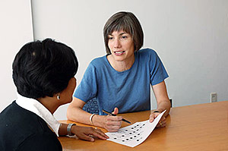
Referral to Mental Health Specialist
Indications
Gross disregard for medical regimen
Depression
Stress related to work-life balance
Possibility of self harm
Debilitating anxiety and/or depression
Eating disorder
Poor cognitive functioning that impairs judgement

Slide 125

Emotional Well Being
Important part of diabetes care and self-management
Psychological and Social Problems can impair the ability to self-care and lead to poor health

Slide 126

Reevaluating Traditional Methods – instead~
Help explore, identify, accept feelings.
Be “mindful”, compassionate, informed listener
We are not responsible for fixing pt’s negative emotions (*help pts use their personal resources…we facilitate and refer as needed)

Slide 127
Patient Perspective Matters!
“I am no where.”
“I am now here!”

Slide 128

Perception Matters: Help them see the possibilities, differently!

Slide 129

Diabetes – From the Mouth to the Toes

Slide 130
Diabetes –Microvascular Complications and Goals of Care
Objectives:
Discuss the importance of oral care
Identify vascular complications
Describe modifiable and non-modifiable risk factors for diabetes complications
List screening guidelines

Slide 131

Financial Advisor
Mid 30s, friendly, he smiles to greet you and you notice his gums are inflamed. You’d guess a BMI of 26 or so, with most of the extra weight in the waist area.
If you could give him some health related suggestions, what would they be?

Slide 132
Diabetes and Oral Health – It’s all the RAGE
People w/ DM 2-3x’s more likely to have periodontal disease (gingivitis and periodontitis)
People with periodontal disease are more likely to be hyperglycemic
Both groups may have excess RAGE
(receptors for Advanced Glycation Endproducts = inflammation)

Slide 133
Diabetes
*Advanced Glycation Endproduct Receptors
Periodontal Disease
RAGE*

Slide 134
Periodontal disease – 6th complication of diabetes?
Chronic inflammatory disorder by the anaerobic bacteria invasion into periodontal tissues including gingival connective tissue, periodontal ligament, and alveolar bone.
Periodontal disease major stages-
gingivitis – inflammation of the gums
Periodontitis inflammation and infection of the ligaments and bones that support the teeth

Slide 135
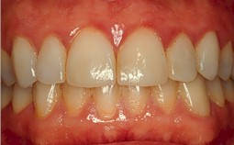
Gingivitis

Slide 136
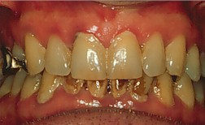
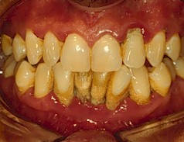
Mild to Severe Periodontitis

Slide 137
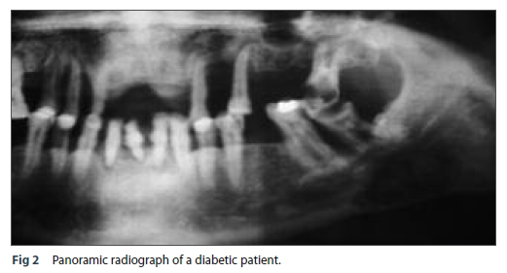
Periodontal Disease

Slide 138
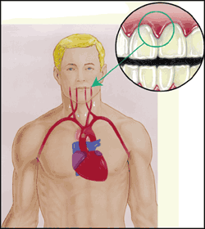
Periodontal disease and Heart Disease
Heart disease link:
oral bacteria enter the blood stream, attach to fatty plaques in coronary arteries increasing clot formation
inflammation increases plaque build up, which may contribute to arterial inflammation
Hyperglycemia = Gingivitis = Heart Disease

Slide 139

Periodontitis
17% people with diabetes
9% in general population
Diabetes + Smoking = 20xs the risk of periodontitis plus loss of supporting bone
Due to decreased or impaired immune response, loss of collagen, delayed wound healing due to AGEs (inflammation)
Assoc w/ vascular disease/ cardiorenal dx

Slide 140

Salivary Dysfunction and Xerostomia (dry mouth) in DM
Less saliva uptake and excretion = less protection against bacteria
Hyperglycemia increases glucose levels in saliva, providing medium for bacterial growth- also promotes dry mouth
Dry mouth increases risk of infection and can alter nutritional intake (due to chewing, swallowing difficulties)

Slide 141
Keeping Oral Healthy
Oral disease linked with heart disease
Dental exams (every 6 mo’s)
Metabolic control critical
Quit smoking
Pts may not understand
importance of dental hygiene.
Treat infections with ATB’x, can lower A1c by 1-2%. Lowering BG shortens infection.

Slide 142

Economics Affects Dental Care
For many people, dental care = cash out of pocket
Medicare – no dental benefits
Medicaid- limited
Private payors – limited
People who make less money, less likely to get dental care (up to 50%)

Slide 143

Diabetes – Microvascular Complications
Microvascular Complications
Diabetic eye disease, nephropathy and neuropathy

Slide 144

Quick Question
Does diabetes cause complications?
Yes
No
Uncontrolled diabetes causes complications

Slide 145
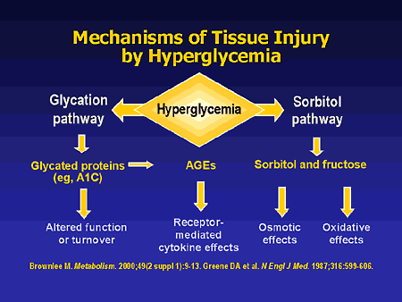

Slide 146

Quick Question
Which of the following are modifiable risk factors for microvascular disease?
Blood pressure, glucose levels, smoking
Age, type A personality, blood pressure
Ethnicity, blood pressure, diet
Blood glucose, genetics, activity level

Slide 147
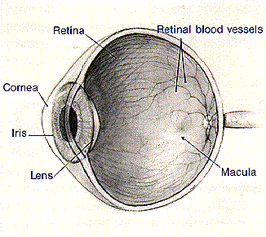
Eye Disease and Education
Diabetes Retinopathy
Other Diabetes Eye Complications
Prevention and Treatment
Promoting Self-Care

Slide 148
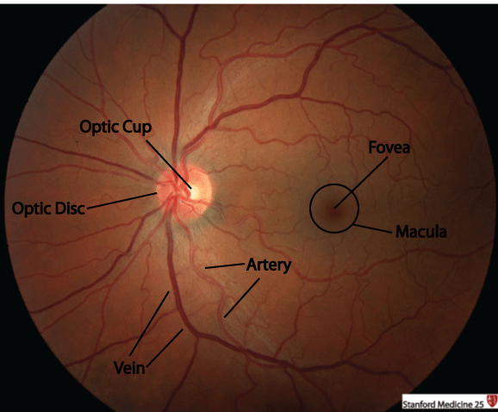
Fundus Geography
The retina is the only portion of the central nervous system visible from the exterior.
Likewise the fundus is the only location where vasculature can be visualized.
Fundoscopy
Optic Nerve
Macula

Slide 149
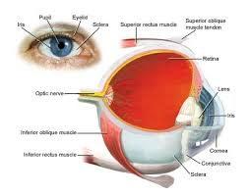
Eye Disease Overview
Leading cause of adult blindness
Retinopathy and Diabetic Macular Edema
DM = 25x’s risk of ocular complications
Including cataracts
20% of type 2 have retinopathy at diagnosis
Only 60% of pt’s receive appropriate treatment

Slide 150
Retinopathy Risk Factors
Duration of diabetes, age at diagnosis, race other genetic factors
Glycemic control, hypertension, smoking, hyperlipidemia, proteinuria and renal disease

Slide 151
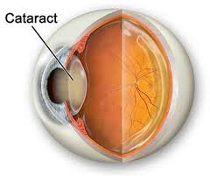
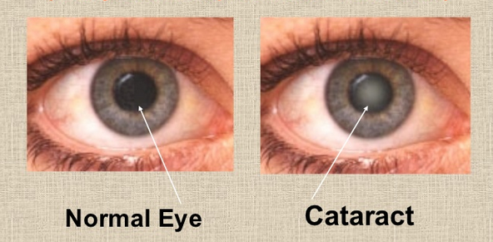
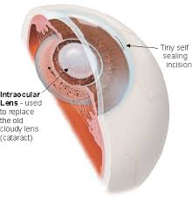
Cataracts
Cataracts – elevated glucose levels glycosylate lens, decreasing permeability
Treatment = surgery

Slide 152
Macular Edema
Macular edema
Risk 10-15% for pt’s with dm 15yrs +
macula responsible for central vision
retinal thickening w/in 3mm from the macula
can impair central vision – causing blurring to blindness
Tx: focal laser treatment or
Lucentis, Avastin or Eylea, injected into eye

Slide 153
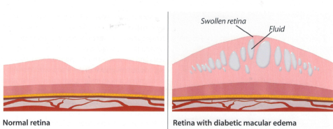
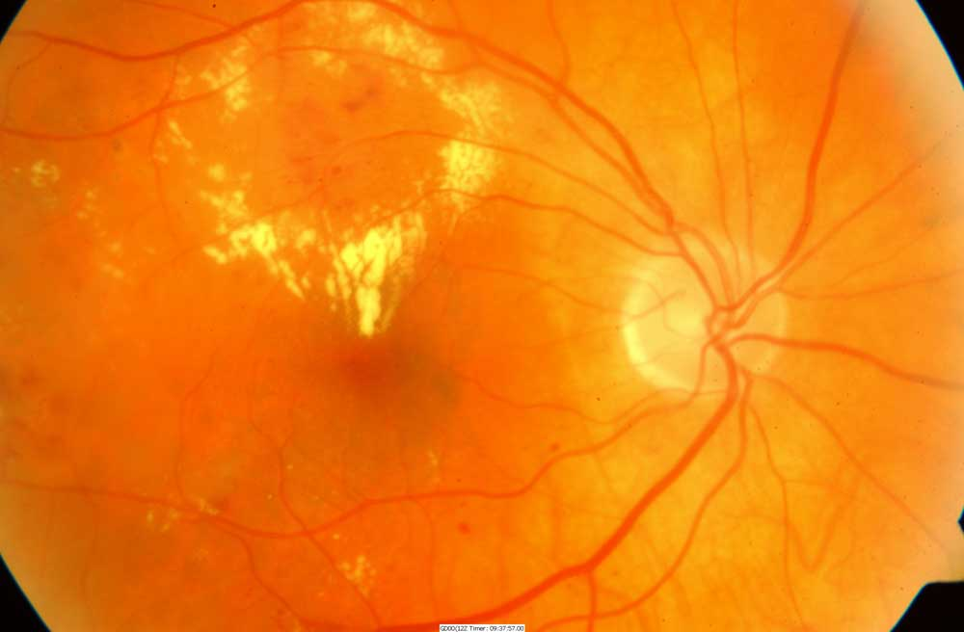
Macular Edema
Macular swelling caused by leaking microaneurisms with exudates (in yellow). Most common cause of visual loss among type 2 diabetes
http://www.virginiaretina.org/diabetic_retinopathy.html

Slide 154
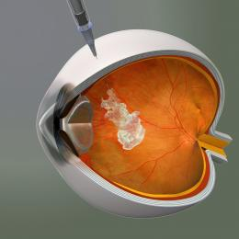
New Approved Treatment for Macular Edema
Anti-vascular endothelial growth factor (VEGF) therapy is indicated for diabetic macular edema
Trials using Ranibizumab (Lucentis) Avastin or Eylea demonstrated improved vision with treatment
Once a month injection

Slide 155
Quick question
Which of the following describes proliferative retinopathy?
A. Cotton wool spot and hemorrhages
B. Increased lens opacity
C. Stiffening of the lens
D. New blood vessel growth

Slide 156
What is Retinopathy?
Retina – layer of nerve tissue in back of eye responsible for processing images and light
Damage to the microvascular layer that nourishes the retina
Leads to leakage of blood components through vessel walls and creation of unstable blood vessels secondary to hypoxia
Disturbance in nerve layer = visual symptoms

Slide 157
Natural History of Diabetic Retinopathy
Mild nonproliferative diabetic retinopathy (NPDR)
Microaneurysms only
Reexamined annually
Moderate NPDR
Microaneurysms plus other abnormalities
Reexamined w/in 6-12 months
Notes:
There are several stages of retinopathy. The earliest clinical stage of diabetic retinopathy is identified as mild nonproliferative diabetic retinopathy (NPDR). Progression of disease from NPDR to proliferative diabetic retinopathy (PDR) is related to the level or severity of NPDR, and therefore the severity of NPDR should determine follow-up and management of diabetic retinopathy.
The next four slides will review the clinical findings and management of each stage of retinopathy.

Slide 158
Severe non-proliferative retinopathy
Any of the following:
20+ intraretinal hemorrhages in each 4 quadrants
Venous beading in 2 or > quadrants
Prominent intraretinal microvascular abnormalities in 1 or more quadrant
No signs of proliferative disease
Reexamination several times a year

Slide 159

Non Proliferative
Dilated capillaries (microaneurisms) leak red blood cells and plasma into retina. Results in retinal hemorrhages, edema and deposits (exudates).

Slide 160

Non - Proliferative to Proliferative Diabetic Retinopathy

Slide 161
Proliferative Diabetic Retinopathy (PDR)
Clinical Findings
Ischemia induced neovascularization
at the optic disk (NVD)
elsewhere in the retina (NVE)
Vitreous hemorrhage
Retinal traction, tears, and detachment
Diabetes Macular Edema must also be evaluated
Notes:
When proliferation of new blood vessels occurs, the patient is diagnosed as having PDR. New blood vessel formation is caused by retinal ischemia. Neovascularization can occur at the optic disk (NVD) or elsewhere in the retina (NVE). These new vessels are weak and, when they break, can cause vitreous hemorrhage. They can also cause retinal traction, retinal tears, and retinal detachment over time.

Slide 162

Proliferative retinopathy
new blood vessel formation on surface of retina or the optic nerve. Severe visual loss can occur due to vitreous hemorrhage and retinal detachment. Note fine network of new blood vessels on the surface of the optic nerve

Slide 163


PDR Signs
Blurred central or side vision (left, blurred side vision) or a blind spot in central vision (right) may indicate diabetic retinopathy

Slide 164


Retinopathy Changes How We See
View of boys by person with normal vision
View of boys by person with diabetic retinopathy.

Slide 165
PDR Management
Management/Treatment
2-4 month follow-up
Color fundus photography
Panretinal photocoagulation (3-4 month follow-up)
Vitrectomy if bleeding into vitreous
If macular edema present: fluorescein angiography and injected meds
Notes:
PDR should be managed with panretinal laser photocoagulation, color fundus photography, and follow-up every 3-4 months to monitor treatment success. If panretinal photocoagulation is not performed, patients should be evaluated every two to three months because of the high risk of developing CSME, retinal detachment, or vitreous hemorrhage that can lead to vision loss. Vitrectomy should be considered when there is substantial amount of hemorrhaging in the vitreous fluid, and when neovascularization causes retinal traction or retinal detachment. CSME is treated in the same manner as described for severe NPDR.

Slide 166

Fluorescein Angiogram
Fluorescein Angiogram, 5 Minutes After Dye Injection.
Fuzzy white areas represent dye leaking into retina from microaneurisms. This illustrates the mechanism which causes macular edema.

Slide 167

Pan Retinal Photocoagulation
Decreases risk of severe vision loss by 50% or more
Destroys 12% of retina and loss of visual field.
Once stabilized, can achieve excellent control of PDR
if B/P and BG well controlled.

Slide 168
Retinopathy Prevention
To reduce the risk or slow the progression of retinopathy
Optimize glycemic control
Optimize blood pressure control

Slide 169
Quick Question
Which of the following is correct regarding eye screening for people with diabetes?
A. All people with diabetes must get a complete eye exam every year
B. All people diagnosed with type 1 should receive an immediate eye exam.
C. All people diagnosed with type 2 should receive an immediate eye exam.
D. People with diabetes over age of 60 should receive an eye exam every 6 months.

Slide 170

Retinopathy Screening
Screen with initial dilated and comprehensive eye exam by ophthalmologist or optometrist
Type 2 at diagnosis, then every 1 to 2 years
Type 1 within 5 yrs of dx, then every 1-2 years
Can use high quality fundus photography as screening tool- Initial exam should be done in person
Promptly refer pts with macular edema, and severe non-proliferative disease to trained specialist

Slide 171

High Quality Fundus Photography to Screen for Retinopathy
Can detect most clinically significant diabetic retinopathy
Interpretation of the images
Performed by a trained eye care provider
May serve as a screening tool for retinopathy, it is not a substitute for a comprehensive eye exam
Perform comprehensive eye exam at least initially and at intervals thereafter
Notes:
A comprehensive eye exam should be given to all patients with diabetes. The exam should include all of the components recommended by the American Academy of Ophthalmology and the American Optometric Association for non-diabetic patients, however additional attention should be given to assess abnormalities of the retina and vitreous fluid. Dilated indirect ophthalmoscopy, slitlamp biomicroscopy, and fundus examination should be used to identify retinal or vitreous hemorrhages, microaneurysms, retinal tears or detachment, intraretinal microvascular abnormality (IRMA), neovascularization at the optic disk (NVD) and elsewhere in the retina (NVE).
Patients with type 1 diabetes should be screened for NPDR (non-proliferative diabetic retinopathy) within three to five years of diagnosis after age 10. Retinopathy leading to vision loss rarely develops in children prior to puberty, regardless of how long the child has had diabetes. Patients with type 2 diabetes should be screened at time of diagnosis.
Finally, women with preexisting diabetes should be screened prior to conception and during the first trimester. Follow-up exams should be scheduled at the physicians discretion based on the results of the first trimester exam.
Note that follow-up exams should be conducted yearly, however new ADA Clinical Practice Recommendations state that less frequent exams every 2-3 years can be considered in the setting of a normal eye exam upon the advice of an eye care professional.

Slide 172

Retinopathy Screening
Women with preexisting diabetes who are planning pregnancy or are pregnant
Comprehensive eye examination in the first trimester
Close follow-up throughout pregnancy and for 1 year postpartum
Notes:
A comprehensive eye exam should be given to all patients with diabetes. The exam should include all of the components recommended by the American Academy of Ophthalmology and the American Optometric Association for non-diabetic patients, however additional attention should be given to assess abnormalities of the retina and vitreous fluid. Dilated indirect ophthalmoscopy, slitlamp biomicroscopy, and fundus examination should be used to identify retinal or vitreous hemorrhages, microaneurysms, retinal tears or detachment, intraretinal microvascular abnormality (IRMA), neovascularization at the optic disk (NVD) and elsewhere in the retina (NVE).
Patients with type 1 diabetes should be screened for NPDR (non-proliferative diabetic retinopathy) within three to five years of diagnosis after age 10. Retinopathy leading to vision loss rarely develops in children prior to puberty, regardless of how long the child has had diabetes. Patients with type 2 diabetes should be screened at time of diagnosis.
Finally, women with preexisting diabetes should be screened prior to conception and during the first trimester. Follow-up exams should be scheduled at the physicians discretion based on the results of the first trimester exam.
Note that follow-up exams should be conducted yearly, however new ADA Clinical Practice Recommendations state that less frequent exams every 2-3 years can be considered in the setting of a normal eye exam upon the advice of an eye care professional.

Slide 173

Ongoing Retinopathy Screening
After initial exam, then…
Annual exam
Less frequent (every 2-3) yrs can be considered if 1 or more normal eye exam
More frequent exams if retinopathy progressing
Notes:
A comprehensive eye exam should be given to all patients with diabetes. The exam should include all of the components recommended by the American Academy of Ophthalmology and the American Optometric Association for non-diabetic patients, however additional attention should be given to assess abnormalities of the retina and vitreous fluid. Dilated indirect ophthalmoscopy, slitlamp biomicroscopy, and fundus examination should be used to identify retinal or vitreous hemorrhages, microaneurysms, retinal tears or detachment, intraretinal microvascular abnormality (IRMA), neovascularization at the optic disk (NVD) and elsewhere in the retina (NVE).
Patients with type 1 diabetes should be screened for NPDR (non-proliferative diabetic retinopathy) within three to five years of diagnosis after age 10. Retinopathy leading to vision loss rarely develops in children prior to puberty, regardless of how long the child has had diabetes. Patients with type 2 diabetes should be screened at time of diagnosis.
Finally, women with preexisting diabetes should be screened prior to conception and during the first trimester. Follow-up exams should be scheduled at the physicians discretion based on the results of the first trimester exam.
Note that follow-up exams should be conducted yearly, however new ADA Clinical Practice Recommendations state that less frequent exams every 2-3 years can be considered in the setting of a normal eye exam upon the advice of an eye care professional.

Slide 174
Assess adaptation to low vision
necessary vision to perform self-care skills?
insulin
BGM
read instructions
shopping/home safety/transportation
refer to rehab education (800-AFBLIND)
psychosocial issues

Slide 175

Prodigy Voice Meter – A+ Access Award Am Fed Blind
Prodigy Meter only completely accessible meter for sale in U.S. - independent access for visually impaired -
www.prodigymeter.com
800-243-2636
Independent set up
Self coding
Audible Memory
Audible warning/error
Cost: $84.95
50 Strips $34.95

Slide 176

Nephropathy Objectives
Epidemiology of diabetes nephropathy / Kidney Disease
Basic functions of the kidney
Major stages in progression of nephropathy
Diagnostic tests to assess and monitor renal function
Treatment and prevention

Slide 177
Quick Question
John’s dad had diabetes and kidney failure. He wants to learn the risk factors for kidney disease. Which of the following describe those at increased risk for kidney disease?
A. Excessive alcohol intake and daily Tylenol
B. Family history of kidney disease, smoking
C. High protein diet and excessive trans-fat intake
D. Diet high in processed foods and sodium

Slide 178
Kidney Physiology
Size and shape of Idaho potato - retroperitoneal
Filter entire blood volume every 30 minutes
excretory organ:
removes water, urea, waste
maintains blood volume
acid base balance and lytes
regulates B/P
synthesizes erythropoietin – RBC
Maintains calcium /phosphorus levels, activates vitamin D – helps absorb calcium

Slide 179

Risk Factors of Kidney Disease
2 leading risk factors: Hypertension and hyperglycemia
Other risk factors:
Kidney stones, obesity, smoking and CV disease
Family history of kidney disease and age 60 or older
Kidney disease often has no symptoms, can undetected until very late

Slide 180

Diabetic Nephropathy
Most new cases of Chronic Kidney Disease (CKD) are attributed to diabetes.
220,000 people in US have kidney failure due to diabetes (2013)
Minorities experience higher than average rates of nephropathy and kidney disease
Notes:
Diabetes is the most common cause of kidney failure, accounting for more than 40% of new cases. Treatment for end stage renal disease is expensive; in 2001 it cost the United States over $22 billion to treat patients with kidney failure. Dialysis, one form of treatment for kidney failure, can relieve the symptoms of kidney disease, but over time the damaged kidneys will continue to contribute to problems such as heart disease, bone disease, arthritis, nerve damage, infertility, and malnutrition. Kidney transplant, another treatment alternative, may prove to be a more permanent solution to kidney disease for some patients. However, transplantation has its own risks including the risk of surgery, the risk of organ rejection, and the risk of infection and other complications from immunosuppressant drugs.
The best course of action is to prevent kidney disease from developing in the first place. Minorities with diabetes have an even greater challenge in preventing kidney disease, since African Americans, Hispanics, and American Indians experience higher rates of kidney disease than Caucasians.

Slide 181

Diabetes and Chronic Kidney Disease (CKD) Considerations
CVD leading cause of death in CKD
microalbuminuria = increased risk of CVD
1/4 to 1/3 of insulin cleared by kidney
renal retinal syndrome
70 - 80% of people with diabetse DON’T get kidney disease
Early and aggressive intervention crucial

Slide 182

What is Nephropathy?
Hyperglycemia causes renal hyperfiltration and glomerular capillary hyperperfusion.
Causes functional and structural damage to glomeruli, increasing permeability, proteinuria, mesangial expansion and sclerosis… destroys nephrons
Due to insufficient insulin, glycosylation, increased growth hormone, glucagon, and vasoactive hormones.

Slide 183

Nephropathy

Slide 184

Keep Kidneys Healthy
To reduce the risk or slow the progression of nephropathy
Optimize glucose control (A)
Optimize blood pressure control (A)

Slide 185

Screening for Kidney Disease
Screen for:
Urine Albumin-Creatinine Ratio (UACR) and
Glomerular Filtration Rate (GFR):
Type 2 at dx then yearly
Type 1 with diabetes for 5 years, then yearly
Measure serum creatinine and GFR yearly
Treat hypertension and intensify as needed

Slide 186
Definitions of Abnormalities in Albumin Excretion
Urine albumin – creatinine ratio (spot collection)
Category mg/g creatinine
normal <30
Increased urinary albumin excretion 30-299
2 of 3 tests w/in 3-6 mo abnormal to confirm
Exercise within 24 h, infection, fever, CHF, marked hyperglycemia, and marked hypertension may elevate urinary excretion over baseline values. ADA

Slide 187

Stages of Chronic Kidney Disease

Slide 188

ADA Management of CKD

Slide 189

Kidney disease treatment - ADA
ACE or ARB NOT recommended for prevention of kidney disease if BP normal and urinary albumin excretion (UAE) < 30 mg/g
ACE or ARB if UAE of >30 mg/g
Monitor creat and K+ when on ACE or ARB
When GFR < 60, evaluate/manage potential complications of CKD
Consider referral to specialist when management is difficult and kidney disease is advanced
Protein restriction not recommended

Slide 190

Treatment of Chronic Kidney Disease (CKD)
There are four primary treatment options for individuals who experience ESRD:
1. Hemodialysis
2. Peritoneal Dialysis
3. Kidney Transplantation
120, 000 Americans waiting for kidney
Only 17,000 receive one each year
Every day, 12 people die waiting for a kidney
4. No treatment
Notes:
There are currently three treatment options available to patients who experience kidney failure: Hemodialysis, peritoneal dialysis, and kidney transplantation. Although kidney transplantation is a serious operation, it offers patients with kidney failure their best opportunity for survival. For patients who choose dialysis, approximately one third are still alive after five years of treatment vs. a possible 90% survival rate for individuals who receive a kidney from a living relative. The next part of this presentation will review the procedures, risks and complications associated with each of these options.

Slide 191

Psychosocial Issues associated with Chronic Kidney Failure
depression
stress
anxiety
support groups, counseling and coping skills

Slide 192
Diabetes Bingo - “DiaBingo” Shout out Right Answer

Slide 193
DiaBingo - N
N DPP demonstrated that exercise and diet reduced risk of DM by ___%
N An _______a day can help prevent heart attack and stroke
N Rebound hyperglycemia
N Scare tactics are effective at motivating patients to change behavior
N Losing ___ % of body weight, can improve blood glucose, BP, lipids
N Drugs that can cause hyperglycemia
N 2/3 cups of rice equals ______ serving carbohydrate
N A1c of 7% equals glucose of
N One % drop in A1c reduces risk of complications by ___ %
N 1 gm of fat equal _____kilo/calories
N Metabolic syndrome = hyperglycemia, hyperlipidemia, hypertension
N Average American consumes 25 teaspoons of sugar a day.

Slide 194

Diabetes Nerve Disease Objectives
Causes of neuropathy
Different types of neuropathy
Detection, prevention and treatment
Key info to teach about neuropathy

Slide 195
Microvascular Disease and Polyol Theory
hyperglycemia ↑ glucose level in cells
sorbitol pathway - glucose reduced to sorbitol by aldose reductase
polylol pathway - sorbitol oxidized to fructose by sorbitol dehydrogenase
glucose, sorbitol, fructose toxic to cells
nerve velocity, oxygenation, increases oxidative stress

Slide 196

Quick question
Mary has had diabetes for 10 years and wants to reduce her risk of neuropathy. What are most important steps she can take to limit risk? A. Lose weight and decrease coffee intake
B. Control blood glucose
C. Take vitamin B12 daily
D. Apply capsaicin cream to extremities twice daily.

Slide 197

What is Neuropathy?
Diabetic Neuropathy (DN) = demonstrable nerve disorder and destruction, either clinical or subclinical- that occurs w/ diabetes, w/out other causes (10% of neuropathy due to other causes)
2 abnormalities present (symptoms, signs, abnormal quantitative test results)

Slide 198
Neuropathy Risk Factors
Age
Hypertension
Hyperglycemia
Elevated LDL
Smoking
Overweight
Excess alcohol
Nutrition (eat lots of omega-3 fatty acids)
Lack of exercise

Slide 199
Quick Question
What 2 office tests can be used to detect diabetes neuropathy?
A. Pin prick and electrophysiology testing
B. Monofilament and tuning fork
C. Hot/Cold discrimination testing
D. Babinski reflex assessment

Slide 200

Nerve disease Screening
Screen all patients for nerve disease using simple tests, such as a monofilament
Type 2 at diagnosis, then annually
Type 1 diabetes at 5 years, then annually
Tight glycemic control is the only strategy shown to prevent or delay the development and progression of neuropathy.
Assess and treat patients to reduce pain and symptoms to improve quality of life.

Slide 201



Skin Biopsy to Assess Neuropathy

Slide 202

3 Types of Neuropathy
Generalized Symmetrical Polyneuropathy
Acute sensory
Chronic sensory (distal)
Small fiber
Large fiber
Autonomic Neuropathy
Focal and Multifocal Neuropathy

Slide 203

Generalized Symmetrical Polyneuropathy - Acute Sensory Neuropathy
Severe pain, wasting, weight loss, depression and erectile dysfunction
Foot pain- burning, unremitting, deep, sharp, stabbing, “shock like”..worse at night, hypersensitive to light touch
Associated w/ hyperglycemia or w/ rapid improvement of glucose
Goal – improve BG – resolve in year

Slide 204
Generalized Symmetrical Polyneuropathy Chronic Sensorimotor Neuropathy Small Nerve Fiber
Sensory deficits in distal portions, spreading medially “stocking-glove”
Small Nerve Fiber Neuropathy
C-fiber pain = burning and superficial
Allodynia (all stimuli interpreted as painful)
Later, loss of pressure and temp sensation
Decrease blood flow, sweating
Detect w/ Monofilament
High risk for ulceration, Charcot, gangrene

Slide 205
Generalized Symmetrical Polyneuropathy Chronic Sensorimotor Neuropathy – Large Nerve Fiber
Involve sensory and/or motor nerves
Fibers are myelinated, rapid conductors
Can detect destruction w/ nerve testing
Symptoms may be minimal:
Impaired vibration perception/position sense
Ataxia “moon-walking”, in-coordination
Pain described as deep-seated gnawing
Shortening of Achilles tendon and claw foot
Increased blood flow “hot foot”

Slide 206

Treating Neuropathy
Improve glycemic control
Control pain
Relief from depression from chronic pain
Massage, stretching, pain control clinic, TENS, avoiding alcohol, relaxation exercises....

Slide 207
Pharmacologic Therapy for Neuropathy
Try Alpha lipoic acid: 600 – 1,800mg /day
Prescription Therapy
1st line
Tricyclic antidepressants (ie amitriptyline, nortriptyline
Calcium channel modulators (ie gababentin, pregabalin)
Serotonin Norepinephrine Reuptake Inhibitors (SNRI)
2nd line
Topical Capsaicin Cream
Opioids (tramadol, oxycodone)
Reasons for treatment failure:
Dose too low, inadequate trial, pt expecting elimination of symptoms, not changing class when no response
Ziegler, D Painful diabetic neuropathy. Diabetes Care, 2009

Slide 208
Quick Question
Which of the following patients are at most risk for developing diabetes autonomic neuropathy?
Diabetes for 1 year with A1c of 7.6%
Person with diabetes for 16 years with A1c never above 6.9%
Person with type 1 diabetes for 8 years with retinopathy
Person with type 2 for 19 years with A1c less than 7.5%

Slide 209
“DAN” Diabetic Autonomic Neuropathy
50% of pt’s with peripheral neuropathy also have DAN
DAN increases M & M rates
neurogenic bladder, sexual dysfunction
GI related disorders / gastroparesis
orthostatic hypotension
fixed heart rate, silent MI, sudden death
hypoglycemia unawareness
sudomotor, pupillary

Slide 210

Sexual Functions as We Age
20-30 years trice daily
30-40 years tri weekly
40-50 years try weekly
50-60 years try weakly
60-70 years try oysters
70-80 years try anything
80-90 years try to remember
A touch of humor from AADE-New Perspectives on Erectile Dysfunction, 1999

Slide 211

Erectile Dysfunction
Affects about 50% of men with diabetes
Loss of erections sufficient for intercourse
Due to combo of vascular and nerve damage
Tests: penile tumescence to eval if organic or psychogenic
Treatment:
Sildenafil (Viagra), Vardenafil (Levitra), Tadalfil (Cialis)
Use caution if taking nitrate drugs. Check w/ MD first
Other meds, vacuum devices, prosthetics
HRT- testosterone gel, patches, injections, pills

Slide 212


Assistive Devices

Slide 213
Take Charge. Talk T. www.diabeteseducator.org
Men w/ DM, 2x risk of low testosterone levels
Symptoms include low sex drive, ED, depression, lack of energy and vitality
Low T easily diagnosed and managed, only 10% of men currently treated
Initial Screening:
Total testosterone: if < 300 ng/dl = hypogonadal
am testing preferred, repeat to confirm
Treatment: determine cause, testosterone replacement therapy

Slide 214


Slide 215

Focal Neuropathies
Often occurs in middle aged pt’s or those w/ polyneuropathy
4 major focal neuro
mono - compression or entrapment
carpal tunnel most common
plexopathy- femoral neuropathy
pain from hip to ant and lat aspects of thigh
radioculopathy - intercostal neuropathy
cranial - abrupt onset, HA, eye pain

Slide 216

Neuropathy Key Considerations
Very common long-term complication often not recognized and treated
Management / treatment complex
Thorough history /assessment critical
Treatment based on underlying process, presentation, and cost effectiveness
Treatable condition with new therapies on horizon.

Slide 217
The ABC’s of Diabetes Control
A - A1c less than 7%
B - Blood pressure less than 140/90
C - Cholesterol HDL > 40, Triglycerides < 150
D - Drugs- Keep list for emergencies/ MD
E - Exercise and Eyes
F - Food and Feet
G – Glucose checks and goals
H- Healthy Coping - Hoorah for your hard work!

Slide 218

Hyperglycemic Crisis – See Online Courses

Slide 219
Promoting Learning and Behavior Change

Slide 220
Promoting Learning…*
Objectives Summary: state, discuss, describe:
Strategies to promote change.
Barriers to learning and change
4 Learning theories.
“Stages of readiness”.
Roles and responsibilities
MC, MI, Brief Negotiation, timely tools.

Slide 221


Slide 222
Overview- Envision:
Theories
(Empowerment, Health Belief,
Social Cognitive,Transtheoretical)
Patient’s Readiness to Change (stages)
Our Attitude, Approach
Brief Negotiation, MI
Alter ambivalence
Change

Slide 223
Quick Question
A patient arrives at the educator's office for his individual assessment and states that he only wants to learn how to use his new glucose meter. What is the best approach is this situation?
The educator should gently inform the patient that they are required to cover 7 different content areas
Focus on the areas where the educator has the most knowledge and skills to impart
Acknowledge the patient’s request and frame the response based on the educators desired program outcomes.
Base the education on the needs of the individual

Slide 224

Adult Learners
Self-directed must feel need to learn
Problem oriented rather than subject oriented
Learn better when own experience is used
Prefer active participation

Slide 225

Facilitating Self-Care - Specific Skills Training
Most effective education includes:
demo of skills
practice
direct practical feedback for efforts
Didactic: less effective
Provides knowledge without skill
Talk Less – Encourage Patient to Participate More
Make the Behavior Real for that patient

Slide 226

Effective Diabetes Self-Management: requires behavior change
Barriers to behavior change
Income
Health literacy
Poverty
Health insurance
Competing demands – family, work, other obligations
Diabetes Denial
Diabetes Distress or Depression
Lack of knowledge

Slide 227

Barriers to Learning (and behavior change)
Her/his perception
Of MY ATTITUDE
And MY WILLINGNESS
to understand …
“A place of preaching is not a place of meeting…” Mother Theresa

Slide 228
Overcoming barriers
Identify barriers and help with problem solving
Offer patients evidence based hope message
Frequent contact – phone, support group, letter, etc.
Paired glucose testing
(Seeing is believing)
Ask pt, “Tell me 1 thing that is driving you crazy about your diabetes”(or find out via DDS)
Discuss medication beliefs, ask ask ask!
To improve outcomes, see pts more often
Bill Polonsky, PhD, CDE

Slide 229

“Mindfulness-based Interventions”
Avoid compliance model
Focus on empowerment and acceptance
Mindfulness
“Pay attention-on purpose “
Non-judgmental
In-the-present
Better chance to be present to life and become less reactive to the tides of distraction.
Really HEAR your clients!

Slide 230
1. Health Belief Model*
Individuals perceived risk and seriousness of illness determines the likelihood of adopting preventive behaviors.
The more perceived risk, the more likely to take make necessary changes.
Influencing factors:
Level of personal vulnerability about developing illness
How serious person believes the illness is
Efficacy of behavior in preventing or minimizing consequences of illness
Costs or deterrents associated with making changes

Slide 231

Expanded Health Belief Model
Perceived susceptibility
Perceived severity
Perceived benefits
Perceived barriers
Self-Efficacy
Level of confidence one has with regard to performing a behavior successfully
Cues to Action
External stimulus used to activate health behavior (ie TV about the benefits of a glucose meter)

Slide 232

2. Social Cognitive Theory*
Pts learn from own AND observing “others” behaviors and consequences.
Health behavior is a constantly changing and evolving interaction between their environment.
Environment
Behavioral capability
Expectations
Observational Learning
Reinforcement, Self-efficacy

Slide 233
Quick Question
Which of the following statements by the educator best reflects using the empowerment approach?
We are here to motivate you to get your A1c to target.
A motivated patient will always be able to achieve an A1c less than 7%.
What motivates you to improve your A1c?
If you follow our suggestions, you will achieve your goals.

Slide 234

3. Pt. Empowerment Defined
“Helping pt’s discover and develop their inherent capacity to be responsible for their own lives and gain mastery over their diabetes”.
Posits:
Choices made by pts (not HCPs) have greatest impact.
Pts are in control of their self-management
The consequences of self-management decisions affect pts most. It is their right and responsibility to be the primary decision makers.

Slide 235

Traditional vs Empowerment Based
This philosophy is important to know for the exam

Slide 236
Empowerment Based, Self-Directed Behavior Change Protocol
Define problem
What part of living with diabetes is most difficult or unsatisfying for you?
Identify feelings
How does the situation make you feel?
Identify long term-goal
How would this situation have to change for you to feel better about it?
What barriers will you face?
How important is it for you to address this issue?
What are the costs and benefits of addressing or not addressing this problem?

Slide 237


Gauge it!
Low High
Get an idea of: ~how they feel about the problem, ~their desire to change… ~ would help them succeed… ~ their confidence… ~ what would hold them back…
Low
High

Slide 238
Empowerment Based, Self-Directed Behavior Change Protocol
Identify short-term behavior change experiment
What are some steps that you could take to bring you closer to where you want to be?
Is there on thing that you will do when you leave to improve things for yourself?
Implement and evaluate plan
How diet the plan we discussed at your last visit work out?
What did you learn?
What would you do differently next time?
What will you do when you leave here today?

Slide 239
Quick Question
A patient tells you that they have been thinking about starting an exercise program. Using the trans theoretical model, what stage of change are they in?
1. Precontemplation
2. Contemplation
3. Preparation
4. Action
5. Maintenance
6. Termination (relapse, recycle)

Slide 240
Transtheoretical Theory*
“Readiness” Level determines the approach!
Patients pass through similar stages as they prepare for change (eating better, decreasing drinking)
Simplified version of the Stages of Change:
Not ready -no intentions.
Unsure: Ambivalent
Ready: Committed, just needs to know HOW!

Slide 241
4. Transtheoretical Model*
Stages of Change (Behavior Change Process)
1. Precontemplation
2. Contemplation
3. Preparation
4. Action
5. Maintenance
6. Termination (relapse, recycle)

Slide 242





Readiness determines Approach*
Precontem-plation:
NOPE!
Contem-plation:
Maybe
Preparation: Action/Maintenance:
OK! I want to! I’m Doing it! -- X 6 Mo
Relapse:Stuck
OOOOPS!

Slide 243
Readiness determines Approach*
Precontem-plation:
Raise doubt
Re: status quo.
Info?
NOPE!
Contem-plation:
Explore + resolve abiva-
Lence.
+ Gains?
Maybe
Preparation: Action/Maint:
Committed to change just needs to know how!
Who-What- Where
Prepping? Praise-Support
Plan?
OK! I want to! I’m Doing it x6m
Relapse Stuck
Support-plan- reframe??
OOOOPS!

Slide 244
Is your patient truly ready to change? Most are unsure re: change … they need to prepare first!
Not Ready 20%
and Ready 20%
Unsure 30%
Unsure 30%

Slide 245

Yellow= Ambivalence- concentrate energy here!

Slide 246
Explore Ambivalence
Ask questions to help the pt. see pros and cons of the issue
Why keep things the same? (disadvantages)
Why change things? (advantages)
{Where does this (your decision) leave you}
Summarizing Ambivalence:
Begin with reasons for maintaining the status quo,
give options,
end with +++ reasons for making a change.

Slide 247
Breaking barriers with Better Approaches~
Speak up to/with Pt; have a conversation about their DDS (>3), what’s really bothering them…
Set Appropriate Goals with the Patient!!! Small, discreet, WRITTEN.
Be mindful,
hear the “mundane”-but important,
Be careful about the goal set- do not rush to the “dramatic goal”.
Use your expertise to guide in the right direction
Be aware of where you are meeting- giving “more” than the patient?

Slide 248
Pt. Centered Motivational COUNSELING:
~Helping patients explore and resolve their ambivalence about change.
~Central Task: Examine/ resolve ambivalence
~Help pt do as much “Change Talk” as possible
~“Change Talk”= in favor of change
~“Status Quo Talk”=maintain Status Quo

Slide 249
Recycle/ relapse (being stuck*) is part of the cycle!
Realistic...
Acceptable...
To be expected...
To be prepared for…and talked about… “a contingency plan”.
Surmountable ( with preparation!)
Reframe (+resources)

Slide 250

Dealing with Train Wrecks
1895 Montparnasse derailment:
Caused by faulty brake and drivers trying to make up for lost time

Slide 251
Provider Burn-Out: think must “install change”-this evokes resistance…
4 guiding Principles: R-U-L-E
R- RESIST “RIGHTING-REFLEX” (Rx, tell, control)
U- UNDERSTAND patient and motivations to change (be *Mindful!)
L- LISTEN- Listen with empathy, not sympathy, about them, not me! This VALIDATION is critical for success!
E- EMPOWER Patient, build their confidence! Maybe not prepared / trained, so NOT CONFIDENT!

Slide 252
Central Concepts of* Motivational Counseling
Exploring ambivalence (pt feels understood / accepted)= fastest way to resolve it!!!
Best strategy to elicit Change talk: ASK!!
Hear change talk- summarize it -pt hears x2
Hearing “Status quo talk” = signal to change strategies. Explore their “options!”

Slide 253
Roll with Resistance
Make suggestions…invite client to consider other perspectives.
Shift focus ... Reframe...
Emphasize personal choice and control “what change do you feel open to making???”

Slide 254
Central Concepts of Motivational Counseling
Motivation to change = from the patient
Change is the pts’ responsibility
Direct persuasion is counterproductive!
MC style is quiet and eliciting (pts=talking)
“Readiness”- product of the interaction

Slide 255

So there you are… the perfect place, the right time…
The Intentional, mindful, compassionate Listener that you are PLUS A STRATEGY!

Slide 256

Support Self-Confidence
Support positive expectations for change…
emphasize *personal responsibility,
*instill confidence and hope,
* increase sense of ability to cope.
“From what you’ve told me about your past successes…it really seems like you can do this!”

Slide 257
7 Steps for doing Behavior Change Counseling
1. Choose one area together
Select a topic the pt. is interested in… why are they there??

Slide 258
2. CHANGE TALK+++
Get Patient’s perspective on this area (really listen for CHANGE TALK!)
“I’m really ready to lose wt. to get my Diabetes under control, I want to be able to really move- have some get up and go … just don’t put me on any medicine!”…
discuss: what’s happened in the past… and why they are so interested at this point- in change:+++
Use a RULER or gauge…

Slide 259
2. CHANGE TALK (cont.)
Use a RULER or gauge…
How important is it FOR YOU to change (1-5)?
What would it take…?
How strongly do you feel…?/confidence?
What would get in your way? (barriers)
What would it take…?
1---|---2---|---3--|---4--|---5

Slide 260
3. Summarizing Change Talk
Summarize :
Patient’s perspective and
The Patient NOT DOING ANYTHING. VS. CHANGE TALK (+++)(Pro’s and Con’s)

Slide 261
4. SHARE INFO: ASK 1ST.
Share Information or give advice with permission
(Ask- Give- Check out)
Ask Pt’s. ideas
Give info/ education
Check-out Pt’s reaction and Commitment

Slide 262
5. ASK the KEY QUESTION:
“SO WHERE DOES THAT LEAVE YOU?
(they / you may be uncomfortable now
as YOU BOTH struggle with AMBIVALENCE!...
Be mindful…present…
Clarify and Move On!…………..

Slide 263
6. Clarify behavior change goal: use SMART!!!!!
If ready- go on to Clarify Action Plan related to SMART Goal
SPECIFIC
MEASURABLE
ACHIEVABLE
REALISTIC
TIME-RELATED (picture it!!)

Slide 264
7. END ON A POSITIVE NOTE!
Summarize CHANGE TALK (with them).
End meeting on a positive note...
mBe accessible

Slide 265
Try it, you’ll like it! Time for free, behavioral/educational counseling!
Your Behavior Change Challenge Card
Exploring Ambivalence / Ruler
7 steps for doing Behavior Change Counseling.

Slide 266
Simply Trying is “Success”
Partner: 1 Facilitator-Educator, 1 client
Use the 7 steps>>>> Write a goal
Use the “Ruler” to hear Change talk.
10 minute Brief Negotiations

Slide 267

Central Concept Patient Centered Counseling
You can raise a person’s hope JUST by
lending them YOURS…
(+ using a systematic, structured and mindful coaching approach!)

Slide 268

Thank You
Web www.diabetesed.net

