Slide 1

Diabetes Education Services Presents:
Optimizing GLP-1 Therapy with Lifestyle: A Practical Clinical Approach
2026
Beverly Thomassian, RN, MPH, CDCES, BC-ADM
www.DiabetesEd.net

Slide 2
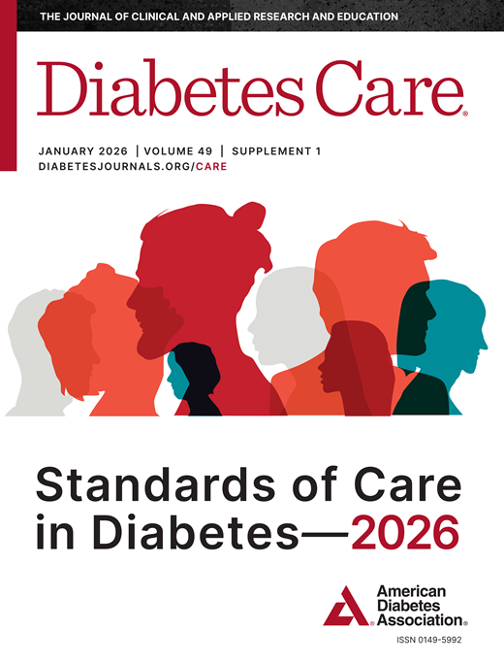
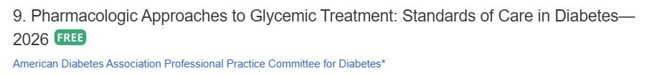

ADA Standards of Care
Notes:
9. Pharmacologic Approaches to Glycemic Treatment: Standards of Care in Diabetes—2026 Diabetes Care 2026;49(Suppl. 1):S183–S215 | https://doi.org/10.2337/dc26-S009
10. Cardiovascular Disease and Risk Management: Standards of Care in Diabetes—2026 Diabetes Care 2026;49(Suppl. 1):S216–S245 | https://doi.org/10.2337/dc26-S010

Slide 3

Topics
Provide person-centered care that effectively considers body weight and glycemic goals.
Utilize a judgement-free approach when providing counsel on lifestyle and behavior change.
State the optimal use of GLP-1s to improve health outcomes and overall well-being.

Slide 4

Diabetes Visit – What do you think?
JR arrives at the clinic and is reluctant to get weighed. They have type 2 diabetes and are struggling to lose weight.
HCP says “Wow, looks like you put on a few pounds since our last visit. I thought you met with the RDN to learn about healthy eating?
How Does JR Feel?
Defeated
Embarrassed
Ashamed
Angry
Hurt
How does the HCP feel?

Slide 5

Missed Appointments due to Stigma and Shame
A recent survey of over 2,600 people with diabetes across eight countries revealed that nearly 40% of missed doctor’s appointments are due to stigma or shame.
Abbott. (2025, February 4). Abbott’s Above the Bias film reveals misconceptions can impact diabetes care. https://abbott. mediaroom.com/2025-02-04-Abbotts-Above-the-Bias-FilmReveals-Misconceptions-Can-Impact-Diabetes-Care
Notes:
Many healthcare professionals incorrectly assume that people with
diabetes are not reaching their goals due to a lack of effort. If they
“just tried hard enough,” they could reach the recommended timein-range target. Unfortunately, this false belief can build a wall of
misunderstanding between the HCP and the person with diabetes

Slide 6
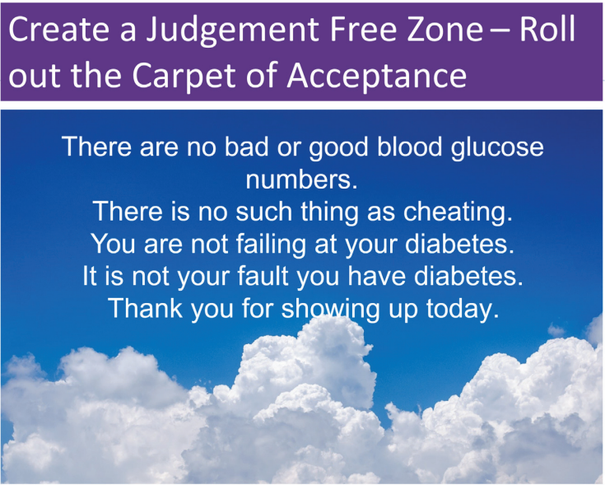

Slide 7

Commit to Listening at least Half of the Time

Slide 8

No one can give themselves diabetes.

Slide 9
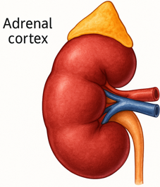
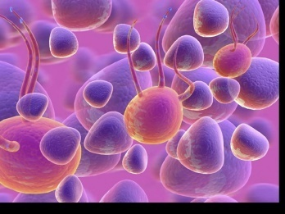
The Noxious Nine – Pathophysiology T2D
Hypercortisolism
Neurotrans-mission dysfunction
Decreased Insulin β-cell secretion
Increased renal glucose reabsorption
Decreased incretin effect Gut hormones
G
Increased glucagon α-cell secretion
I
G
I
G
G
I
I
G
Increased lipolysis
G
G
I
I
G
G
I
Increased hepatic glucose
production
I
G
G
Decreased muscle glucose uptake
DeFronzo, Auchus-Hypercortisolism June 2025
Notes:
9
ummary: The Noxious Nine in Diabetes Pathophysiology
Ralph A. DeFronzo expanded his earlier conceptual model of diabetes—known as the Ominous Octet—to include a ninth element: hypercortisolism. This updated framework is referred to as the Noxious Nine, highlighting the important role of cortisol dysregulation in difficult-to-control type 2 diabetes currentsciencedaily.com+8HCP Live+8HCP Live+8.
Recent research, including the CATALYST trial, shows that about 24% of patients with difficult-to-control T2D have underlying hypercortisolism. Treating this condition with mifepristone, a glucocorticoid receptor antagonist, led to significant improvements in HbA1c—averaging around a 1.5% reduction pmc.ncbi.nlm.nih.gov+3HCP Live+3medscape.com+3.
These findings emphasize the importance of recognizing hypercortisolism in T2D care and suggest that addressing it may help improve glycemic and metabolic control in a subset of patients.
9

Slide 10
ADA 2026 Summary
A1c less than 7% (individualize)
Pre-meal BG 80-130
Post meal BG <180
Time in Range (70-180) >70%
BP <130/80 or <120/80
Cholesterol
Statin therapy based on age & risk status
If 40+ with ASCVD Risk, decrease LDL by 50%, LDL <70
If 40+ with ASCVD, decrease LDL by 50%, LDL <55
Glycemic targets need to be woven into the overall person-centered strategy.

Slide 11

Diabetes Visit – Let’s Go through
JR has type 2 diabetes and are struggling to lose weight. Their weight increased a few pounds since last visit.
HCP smiles and says, “Hi JR, good to see you. I heard you met the dietitian? How did that go?”
JR, “It went great. I just can’t seem to lose weight. My friend mentioned they are on a once-a-week injection?”
Door Open – Connection made
How Does JR Feel?
Heard & Seen
Recognized
Connected
How does the HCP feel?
A small adjustment can make a BIG Difference
Healing to HCP
Bidirectional Healing
Healing to Person

Slide 12

GLP & GIP Receptor Agonists
Reduce Major Adverse Cardiovascular Events (MACE)

Slide 13
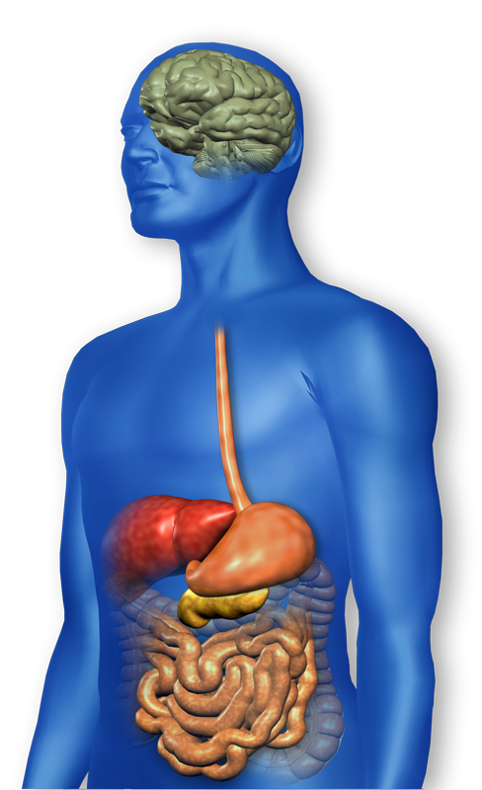
GLP-1 Effects in Humans Understanding the Natural Role of Incretins
GLP-1 secreted upon the ingestion of food
Promotes satiety and reduces appetite
Alpha cells:
↓ Postprandial glucagon secretion
↑ Beta-cell
response
Liver: ↓ Glucagon reduces hepatic glucose output
Beta cells: Enhances glucose-dependent insulin secretion
Stomach: Helps regulate gastric emptying
Adapted from Flint A, et al. J Clin Invest. 1998;101:515-520 Adapted from Larsson H, et al. Acta Physiol Scand. 1997;160:413-422 Adapted from Nauck MA, et al. Diabetologia. 1996;39:1546-1553 Adapted from Drucker DJ. Diabetes. 1998;47:159-169
GLP-1 degraded by
DPP-4 w/in minutes
Notes:
13
13
Required
DISCUSSION POINTS:
--Upon food ingestion, GLP-1 is secreted into the circulation from L cells of small intestine.
--GLP-1 increases beta-cell response by enhancing glucose-dependent insulin secretion.
--GLP-1 decreases beta-cell workload and hence the demand for insulin secretion by:
--Regulating the rate of gastric emptying such that meal nutrients are delivered to the small intestine and, in turn, absorbed into the circulation more smoothly, reducing peak nutrient absorption and insulin demand (beta-cell workload)
--Decreasing postprandial glucagon secretion from pancreatic alpha cells, which helps to maintain the counterregulatory balance between insulin and glucagon
--Reducing postprandial glucagon secretion, GLP-1 has an indirect benefit on beta-cell workload, since decreased glucagon secretion will produce decreased postprandial hepatic glucose output
--Having effects on the central nervous system, resulting in increased satiety (sensation of satisfaction with food intake) and a reduction of food intake
--By decreasing beta-cell workload and improving beta-cell response, GLP-1 is an important regulator of glucose homeostasis.
SLIDE BACKGROUND:
--Effect on Beta-cell: Drucker DJ. Diabetes. 1998; 47:159-169
--Effect on Alpha cell: Larsson H, et al. Acta Physiol Scand. 1997; 160:413-422
--Effects on Liver: Larsson H, et al. Acta Physiol Scand. 1997; 160:413-422
--Effects on Stomach: Nauck MA, et al. Diabetologia. 1996; 39:1546-1553
--Effects on CNS: Flint A, et al. J Clin Invest. 1998; 101:515-520

Slide 14
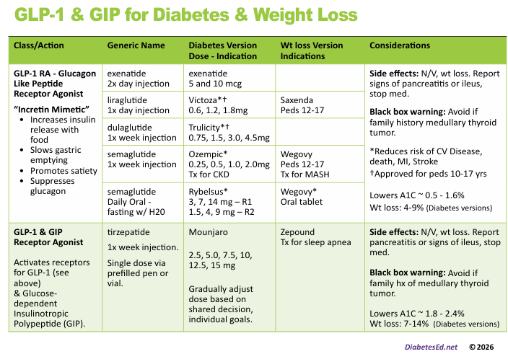
Pocket Card: GLP-1 & GIP RA

Slide 15
Benefits of GLP-1 RA & GIP/GLP-1 Receptor Agonists
A1C lowering
Substantial Weight loss
Cardiovascular benefits*
Decreased appetite
Lowers post meal glucose
Ease of use
*semaglutide, liraglutide, dulaglutide

Slide 16
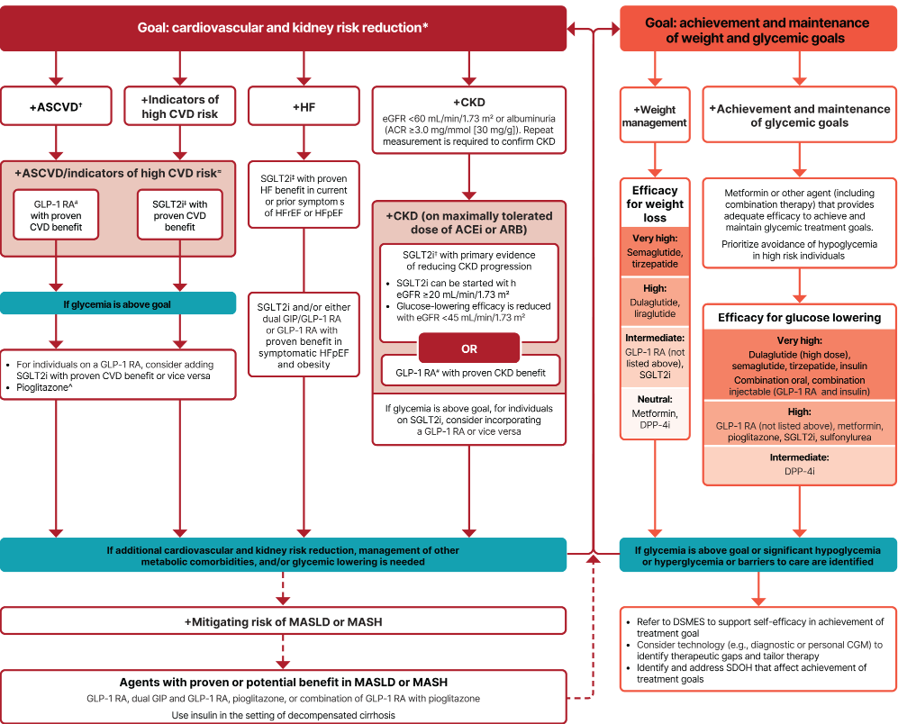
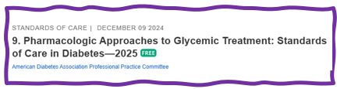
Let’s Break it Down ADA 2025
From: 9. Pharmacologic Approaches to Glycemic Treatment: Standards of Care in Diabetes—2026

Slide 17
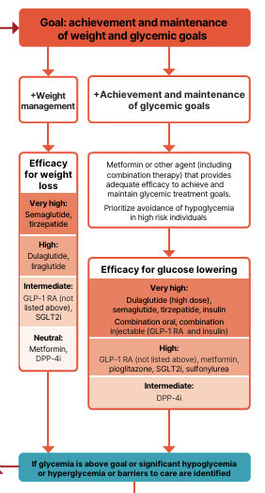

Discuss Weight Loss Goals
These meds associated with weight loss:
GLP-1 RA and GLP/GIP agonists
SGLT-2 Inhibitors
These meds are weight neutral:
Metformin
DPP-4 Inhibitors
These meds can cause wt gain:
Sulfonylureas
Insulin
Pioglitazone

Slide 18
GLP-1 /GIPs Approved for Weight Loss
Liraglutide:
Victoza 1.8 mg (diabetes)
Saxenda 3 mg (wt loss)
6% wt loss
Semaglutide:
Ozempic 2mg (diabetes)
Wegovy 2.4mg (wt loss)
9.6% wt loss
Tirzepatide
Mounjaro 15mg (diabetes)
Zepbound (wt loss)
14.7% wt loss
All 3 Approved for use in adults with a:
BMI of ≥ 30 or
BMI of ≥ 27 or greater who have hypertension, type 2 diabetes, or dyslipidemia.

Slide 19

Poll 1
RT is on max dose of metformin and is started on tirzepatide to help with BMI of 39 and decrease CV risk. What outcomes can KR expect at highest dose?
A1C drop of 3-4%, Wt loss of 3-5kg
Increased risk of UTI, A1C drop of 1-2%
Potential for ~10% body wt loss
Doubles risk of pancreatic cancer

Slide 20
GLP-1/GIP Receptor Agonist Indications
Drug | Lower BG Diabetes Version | CV Indication | Wt Loss Version | Other
Exenatide IR (Byetta) | Yes | No | No
Dulaglutide (Trulicity) | Yes for 10 yrs and older | Yes | No
Semaglutide (Ozempic, Rybelsus Wegovy) | Yes Ozempic Rybelsus | Yes-all versions | Yes Wegovy 2.4mg, 12yrs and over | MASH-Wegovy CKD-Ozempic
Liraglutide (Victoza) | Yes for 10 yrs and older | Yes | Yes Saxenda 3mg 12yrs and over
Tirzepatide (Mounjaro, Zepbound) | Mounjaro Yes for 10 yrs and older | No | Yes, Zepbound 15 mg | Sleep Apnea-Zepbound
Package inserts, dailymed.nlm.nih.gov

Slide 21
Are GLPs a lifelong commitment?
About 50% - 75% of people stop taking their GLP/GIP by 1 year
Due to cost, side effects, access, impact on food desire
Results in weight regain back to baseline by ~18 months (about 1lb regain a week)
What are some suggestions?
Involve the individual in all decision making
Address nausea
Slowly increase dose only after careful discussion
Once reach goal weight, consider microdosing or increasing length of time between doses.
Consider oral version

Slide 22

Nutrition Issues
Regular visits with RDN are critical part of care plan.
Prioritize high-protein, nutrient-dense foods
Lean proteins (fish, chicken, eggs, tofu)
High-fiber foods (leafy greens, whole grains)
Healthy fats (avocado, nuts).
Promote fluid intake, hydration
Maintain muscle mass through strength training
Can decrease binge eating.
Can decrease craving for alcohol & other substances:
nicotine, cannabis, and opioids
More research needed.
Be on the look out for disordered eating.

Slide 23


Obesity in Type 1 Diabetes
Prevalence of Extra Weight in Type 1
30-40% with overweight
15-20% with obesity
matching general adult statistics.
Increased Health Risks
Obesity in people with type 1 diabetes raises the risk of cardiovascular and microvascular complications, impacting overall health.
Promising Treatments
Clinical trials show GLP-1 RA therapies and metabolic surgery offer positive outcomes for type 1 diabetes
Notes:
Image source: Microsoft 365 content library Overweight affects 30–40% and obesity 15–30% of people with type 1 diabetes, similar to general adult rates. Obesity in this group increases cardiovascular and microvascular complication risks. Clinical trials show promising outcomes with GLP-1 RA therapies or metabolic surgery for those with type 1 diabetes and obesity.

Slide 24

Treatment of Obesity in Type 1 Diabetes
8.29 Apply obesity management strategies used in the general adult population for adults with type 1 diabetes who have obesity (BMI ≥30, or ≥27.5 in Asian American individuals).
Treatments can include:
GLP-1 RA-based therapy
Metabolic surgery.
Shared decision-making informs individualized care.
8. Obesity and Weight Management for the Prevention and Treatment of Diabetes

Slide 25
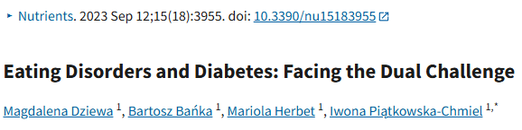
Types of Disordered Eating in Individuals with Diabetes
1. Severe Dietary Restriction —Severe limitation of calories or essential macronutrients in the diet
2. Objective Binge Eating —Consuming an unusually large amount of food in a short period while feeling out of control
3. Subjective Binge Eating —Feeling a loss of control over eating without necessarily consuming large quantities of food
4. Other Maladaptive Weight Control Strategies —Restricting life-saving insulin
https://pmc.ncbi.nlm.nih.gov/articles/PMC10538145/

Slide 26

JR Asks You
I heard these meds can cause liver or kidney problems?

Slide 27

Counseling Points: GLP-1 RA & GLP-1/GIP
Avoid if personal or family history of medullary thyroid cancer or personal history of Multiple Endocrine Neoplasia type 2 (MEN-2)
Avoid in combo with DPP-4 inhibitors
Watch for intestinal obstruction
Increased risk of biliary disease
Education: Eat smaller meals to reduce nausea and limit high fat meals
Use of non-FDA compounded products not recommended
From: 9. Pharmacologic Approaches to Glycemic Treatment: Standards of Care in Diabetes—2026
Notes:
Biliary disease: evaluate for gallbladder disease if chole lithiasis or cholecystitis is suspected; avoid use in at-risk individuals • Ileus: reported, but risk level is not well established • Diabetic retinopathy: close monitoring of retinopathy in those at high risk (older individuals and those with longer duration of T2D [≥10 years]) • Nonarteritic anterior ische mic optic neuropathy (NAION) reported (rare inci dence); monitor for NAION during eye examinations

Slide 28
Counseling Points: GLP-1 RA & GLP-1/GIP
Potential risk of pancreatitis
Can cause diarrhea or constipation
If on tirzepitide and oral contraceptives, use back up contraception for first 4 weeks
Warning about aspiration during surgery
Ask about recent eye exam
Potential increase in diabetes retinopathy
Nonarteritic anterior ischemic optic neuropathy (NAION) reported (rare incidence)
From: 9. Pharmacologic Approaches to Glycemic Treatment: Standards of Care in Diabetes—2026
Notes:
Biliary disease: evaluate for gallbladder disease if chole lithiasis or cholecystitis is suspected; avoid use in at-risk individuals • Ileus: reported, but risk level is not well established • Diabetic retinopathy: close monitoring of retinopathy in those at high risk (older individuals and those with longer duration of T2D [≥10 years]) • Nonarteritic anterior ische mic optic neuropathy (NAION) reported (rare inci dence); monitor for NAION during eye examinations

Slide 29
Let’s Break it Down ADA 2025
From: 9. Pharmacologic Approaches to Glycemic Treatment: Standards of Care in Diabetes—2026

Slide 30
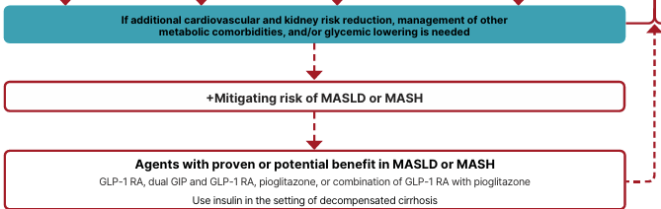
Mitigating Risk of MASLD or MASH
MASLD: metabolic-dysfunction associated steatotic liver disease
MASH: Metabolic-dysfunction associated steatohepatitis
From: 9. Pharmacologic Approaches to Glycemic Treatment: Standards of Care in Diabetes—2026

Slide 31
Pocket Card: GLP-1 & GIP RA

Slide 32
Liver Disease: MASLD or MASH
In adults with T2D, MASLD and overweight/obesity,
Consider using a GLP-1 RA with demonstrated benefits in MASH
Or a GLP-1/GIP RA with potential benefits for MASH
In adults with biopsy proven MASH,
GLP-1 RA is preferred.
Pioglitazone or a dual GIP/GLP-1 RA can be considered for glycemic management due to potential beneficial effects on MASH.
Insulin preferred for decompensated cirrhosis
Semaglutide
Tirzepatide
Pioglitazone

Slide 33
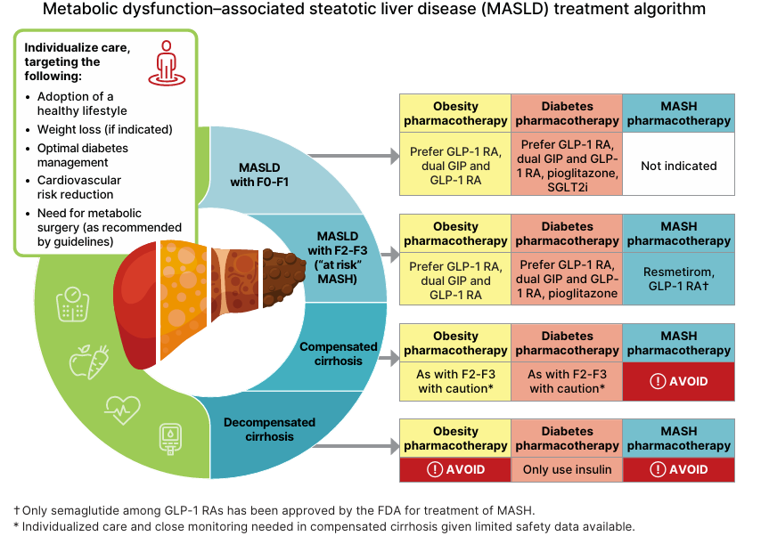
MASLD Treatment (Section 4 SOC)

Slide 34

Life Study
71-year-old woman with type 2 diabetes for past year. BMI 32 and she has MASH. GFR 40s, UACR 320 mg/g. Takes empagliflozin, lisinopril and a statin.
A1c 8.3%
What is next best action?
Add pioglitazone.
Maintain current plan.
Add semaglutide
Start low dose metformin

Slide 35

Indicators of High CV Risk
Over 55 years with 2 or more additional risk factors:
Obesity
Hypertension
Smoking
Dyslipidemia
Albuminuria

Slide 36

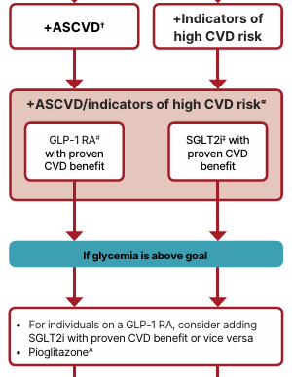
Cardiovascular Disease or High Risk
Most effective meds based on Cardiovascular Outcomes Trial (CVOT) to Reduce MACE
GLP-1 RA’s Preferred semaglutide (Ozempic), liraglutide (Victoza), dulaglutide (Trulicity)
~ Or~
SGLT2i empagliflozin (Jardiance), canagliflozin (Invokana),
ASCVD = atherosclerotic cardiovascular disease
MACE: major adverse cardiovascular events
Notes:
For people with established atherosclerotic cardiovascular disease or indicators of high risk our recommendation is to choose a GLP-1 receptor agonist or an SGLT-2 inhibitor with proven cardiovascular benefit. In case HbA1c remains above target one should add an agent from the other category or pioglitazone as deemed necessary. Our recommendation is based on the favourable results of cardiovascular outcomes trials that established the favourable effect of GLP-1 receptor agonists and SGLT-2 inhibitors on a series of hard clinical outcomes including major adverse cardiovascular events and all-cause mortality.

Slide 37


Poll Question 2
What next? 67 yrs, BMI 28, on max dose metformin/dapagliflozin. History of CV Disease. A1c 8.9%. GFR 63, UACR 37mg/g.
a. Add a once weekly GLP-1 RA.
b. Start basal insulin
c. Add SGLT-2 Inhibitor
d. Start bolus insulin

Slide 38
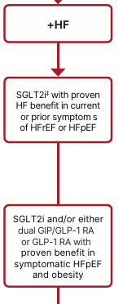
Heart Failure
In people with heart failure, use SGLT2i because they improve heart failure and kidney outcomes.
New for 2026:
9.9 In adults with T2D, obesity, and symptomatic HFpEF, the glucose-lowering treatment plan should include a GIP/GLP-1 agonist or GLP-1 agonist with demonstrated benefits for HF-related symptoms and reduction in HF events (irrespective of A1C).
SGLT2i Empagliflozin
Canagliflozin
Dapagliflozin
Ertugliflozin
GLP-1 RA Semaglutide
GLP-1/GIP RA
Tirzepatide
From: 9. Pharmacologic Approaches to Glycemic Treatment: Standards of Care in Diabetes—2026
Notes:
For individuals with heart failure our recommendation is that SGLT2i with proven benefit should be used because they improve heart failure and kidney outcomes.

Slide 39
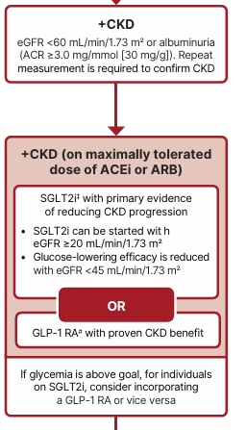
Chronic Kidney Disease - Choosing glucose-lowering medication
In kidney disease, use SGLT-2 in people with GFR ≥ 20 and continue until initiation of dialysis or transplantation.
(When GFR <45, SGLT-2’s don’t lower BG much.)
Or
GLP-1 RA with proven CVD CKD benefit
*Semaglutide improves kidney function (FLOW trial)
From: 9. Pharmacologic Approaches to Glycemic Treatment: Standards of Care in Diabetes—2026

Slide 40

New in 2026: GLP-1 in Kidney Disease
In adults with T2D and advanced CKD (eGFR <30), a GLP-1 RA is preferred for glycemic management due to lower risk of hypoglycemia and for CV event reduction.
Individuals on dialysis can be safely initiated or continued on GLP-1 based therapy to reduce CV risk and mortality
Reminder: only GLP-1 with renal restrictions are exenatide and lixisenatide
From: 9. Pharmacologic Approaches to Glycemic Treatment: Standards of Care in Diabetes—2026

Slide 41

Overcoming Treatment Inertia
Reassessing Current Therapies
Regularly evaluate treatment effectiveness to avoid stagnation and ensure progression toward their weight-related and health goals.
Intensifying Treatment Strategies
Consider adding behavioral interventions or pharmacotherapy to boost treatment effectiveness
Considering Metabolic Surgery
Metabolic surgery may provide an effective next step for sustained weight control when other options are insufficient.
- Randomized controlled (nonblinded) clinical trials demonstrated metabolic surgery achieves:
Superior glycemic management and reduction of cardiovascular risk in type 2 diabetes compared with nonsurgical intervention.
Decreases microvascular, cancer, all cause mortality and steatosis.
Notes:
Image source: Microsoft 365 content library If patients do not reach or maintain weight-related treatment goals, it is crucial to avoid treatment inertia by reassessing current therapies. Intensifying treatment may involve adding new strategies, such as behavioral interventions or pharmacotherapy. For some individuals, metabolic surgery can be considered as a next step for effective weight management.

Slide 42

Keep checking in
In all cases, treatment plans need to be continuously reviewed for efficacy, side effects, and burden.
Individual may require medication reduction or discontinuation.
Common reasons for this include ineffectiveness, intolerable side effects, new contraindications, expense, or a change in glycemic goals

Slide 43

Keeping it Person Centered is beneficial for both the Receiver & Giver

Slide 44

We Can Make a Big Difference
We can make a difference in moving care forward.
Through behavior change, coaching, and advocating for best care, we can improve well-being, decrease complications and improve quality of life!

Slide 45

Thank You
Thanks for joining us!
Please let us know if we can be of more service
www.DiabetesEd.net
info@diabetesed.net
530 /893-8635

