Slide 1

Standard 14: Children and Adolescents 2026
Beverly Thomassian, RN, MPH, BC-ADM, CDCES
Pronouns: She, her, hers
www.DiabetesEd.net

Slide 2
Land Acknowledgment
We acknowledge and are mindful that Diabetes Education Services stands on lands that were originally occupied by the first people of this area, the Mechoopda, and we recognize their distinctive spiritual relationship with this land, the flora, the fauna, and the waters that run through this area.

Slide 3

We are Here to Help!
Bryanna Sabourin
Director of Operations
If you have questions, you can chat with us at www.DiabetesEd.net or call 530 / 893-8635 or email at info@diabetesed.net

Slide 4

Diabetes Education Services Inclusion Statement
Based on the IDEA Initiative inspired by CDR
Inclusion
Diversity
Equity
Access
We are committed to promoting diversity and inclusion in our educational offerings.
We recognize, respect, and include differences in ability, age, culture, ethnicity, gender, gender identity, sexual orientation, size, and socioeconomic characteristics.
Our goal is to promote equity and access, acknowledging historical and institutional inequities.
We are committed to practicing cultural humility and cultivating our cultural competence.
We wish to create a safe space within our community where one's beliefs, experiences, identity, and differences in ability, age, size, socio-cultural/socioeconomic characteristics, and political affiliations are considered and respected.

Slide 5
Lori Bednarz, RN, MSN, CDCES Intro
2022 ADCES Power of Our Impact Award recipient
Contributing author, 2024 ADCES Diabetes Care & Education Curriculum (Risk Reduction)
Speaker on diabetes technology, person-centered care, and nutrition education
Diabetes educator at UPMC; former Children’s Hospital of Pittsburgh diabetes team member

Slide 6
Lori Bednarz Conflicts of Interest
She’s not on any speaker's bureau
Does not invest or have any financial relationships with diabetes related companies.
Gathers information from reading package inserts, research, and articles
The ADA Standards of Medical Care are the main resource for course content
She is a certified pump trainer for MiniMed
Previously a certified pump trainer for Tandem Diabetes

Slide 7



References

Slide 8

Diabetes Management
Children & Adolescents Topics
  Discuss the goals of care for Peds with Type 1 and Type 2 Diabetes
  State strategies to prevent acute and chronic complications
  Describe actions to minimize acute and chronic complications
  Discuss the importance of positive psychosocial adjustment and resources
Notes:
Diabetes care of children and adolescents is different than the care of adults with diabetes.
For example, the developmental needs of children will guide diabetes education and the parents and/or caregivers will provide care. These topics will be discussed throughout this course.

Slide 9

Support is Critical
Self-management in pediatric diabetes involves both the youth and their parents/adult caregivers.
No matter how sound the medical regimen is, it can only be effective if the family and/or affected individuals are able to implement it.

Slide 10

Type 1 ~ Auto Immune Diabetes Mediated
5-10% of Diabetes
1.5 2.1 Million people have type 1 in U.S.
314, 000 children and adolescents younger than 20 years of age diagnosed with type 1
Prevalence increasing:
2001 – 1.48 per 1000 youths diagnosed with diabetes
2017 - 2.15 per 1000 youths diagnosed with diabetes
Incidence & Prevalence increasing:
2022 – 21,732 new diagnoses of type 1 diabetes for children and adolescents younger than 20 years of age
Highest incidence in Finland or Northern Europe.
https://diabetes.org/about-diabetes/type-1
https://www.cdc.gov/diabetes/php/data-research/index.html
Notes:
Autoimmune type 1 diabetes occurs when the body’s immune system attacks the beta cells of the pancreas.
Immune-Mediated

Slide 11

Type 1 or Type 2?
Distinguishing between type 1 and type 2 diabetes in children can be difficult.
  Excess weight is common in children with type 1 diabetes
  Autoantibodies and ketosis may be present at the time of diagnosis, which are typical features of type 1 diabetes, and excess weight and acanthosis nigricans may also be present, which are features of type 2 diabetes
  Positive islet autoantibodies is are associated with faster progression to insulin deficiency
With new type 2 diabetes diagnosis in youth (ages 10-19) Diabetic Ketoacidosis (DKA) occurs in ∼11% of youth
Notes:
Current obesity epidemic in America.
Type 2 features include obesity and acanthosis nigricans
Auto antibodies may be tested at time of diabetes diagnosis

Slide 12

Poll Question 1
JR’s mom has type 1 diabetes and JR’s dad has type 2 diabetes. JR is 17 years old and in the emergency room with a glucose of 482 mg/dl. Besides checking glucose, ketones and A1C levels, which of the following lab test can be used to determine if someone has autoimmune diabetes?
Endogenous insulin titer
Glutamic Acid Decarboxylase
Beta cells auto antibodies
Langerhan’s antibody
Notes:
What is Glutamic Acid Decarboxylase? (Otherwise referred to as GAD).
We will discuss in the next slide.

Slide 13

How do we know if a child has
Type 1 vs Type 2?
Type 1 - Positive antibodies
  GAD - glutamic acid decarboxylase (primary)
  IA2 - islet antigen 2, or
  ZnT8 - zinc transporter 8
Can also check C-peptide levels to determine endogenous insulin production
Younger people develop quickly
Older people take longer to develop
https://diabetesjournals.org/care/article/49/Supplement_1/S27/163926/2-Diagnosis-and-Classification-of-Diabetes
Notes:
Antibodies are proteins that the immune system uses to destroy foreign bodies.
The diagnosis of type 1 diabetes is confirmed by lab testing of autoimmune markers, including GAD.
GAD is an enzyme and it is the main antibody measured.
If the GAD is negative, testing should be done for the islet antigen 2 (IA2), IA-2b and zinc transporter 8 (ZnT8).
C-peptide (connecting peptide) is a protein produced in the pancreas. Insulin and c-peptide are both released into the bloodstream. Because the amounts released are similar, the measurement of c-peptide will indicate if insulin is being produced, distinguishing type 1 and type 2 diabetes.

Slide 14

Determine if Type 1 - Use AABBCC Approach
Age
  e.g., for individuals <35 years old, consider type 1 diabetes
Autoimmunity
  e.g., personal or family history of autoimmune disease or polyglandular autoimmune syndromes
Body habitus
  e.g., BMI <25 kg/m2
Background
  e.g., family history of type 1 diabetes
Control
  e.g., level of glucose control on noninsulin therapies
Comorbidities
  e.g., treatment with immune checkpoint inhibitors for cancer can cause acute autoimmune type 1 diabetes or presence of other autoimmune conditions

Slide 15

Type 1 = 10% of all Diabetes
Immune mediated pancreatic beta cells destruction
75% of new cases are diagnosed < age 18
  Most common during puberty, age 10 – 14
  30% of new diagnosis present in DKA
Insulin sensitive (require 0.5 - 1.0 units of insulin/kg/day)
Expression due to a combo of genes and environment:
  Autoimmunity tends to run in families
  Exposure to virus or other environmental factors
15
Diagnostic Criteria for Diabetes
Notes:
When you get to the insulin piece, please mention we will get into great detail about insulin in the pharmacotherapy module

Slide 16

Poll Question 2
Which factor would most make you suspect type 1 diabetes?
  a. Enuresis
  b. Presents with low HDL cholesterol
  c. Friend tells you she has been eating "tons of sweets“
  d. Reports vivid dreams

Slide 17

Signs of Type 1 Diabetes
Sudden onset of nighttime bedwetting
Weight loss, thirst, hunger
May present in DKA
  Ketone positive (blood or urine)
  Nausea, Vomiting, Abdominal Pain
  Dry mouth, poor skin turgor
  Fruity breath
  Rapid breathing = Kussmaul breathing
  “Out of it”
  Hypothermic
  Other
See Level 2 - Hyperglycemic Crises
Notes:
Consider growth and development. If a child starts ‘bedwetting’ it will have an impact on both the child and parents, who may or may not have knowledge of diabetes and symptoms.
Cardinal symptoms of new type 1 diabetes diagnosis include: polyuria, polydipsia and polyphagia
DKA may be a life-threatening condition and requires immediate intervention
Kussmaul breathing = Deep, rapid Breaths (hyperventilation), sign of metabolic acidosis, with the body attempting to rid excess carbon dioxide and restore the acid base balance

Slide 18


Type 1 Diabetes Features?
For JR, a 17 admitted to the ICU with a blood glucose of 476 mg/dl, pH of 7.1, anion gap of 15. Recently lost 13 pounds.
Type 1 Most Discriminative Features
Younger than 35 years at diagnosis
Lower BMI (<25 kg/m²)
Unintentional weight loss
Ketoacidosis
Glucose 360 mg/dl or greater.

Slide 19
Type 1 Diabetes Progression
 | Stage 1 | Stage 2 | Stage 3
Characteristics | • Autoimmunity | • Autoimmunity | • Autoimmunity
 | • Normoglycemia | • Dysglycemia | • Overt hyperglycemia
 | • Presymptomatic | • Presymptomatic | • Symptomatic
Diagnostic criteria | • Multiple islet autoantibodies GAD, glutamic acid decarboxylase (primary) islet antigen 2, or Zinc transporter 8 (ZnT8) | • Islet autoantibodies Dysglycemia: Elevated IFG and/or IGT • FPG 100–125 mg/dL • 2-h PG 140–199 mg/dL • A1C 5.7–6.4% or ≥10% increase in A1C | • Autoantibodies may disappear over time (5-10% may not express antibodies) • Diabetes diagnosed by standard criteria
www.DiabetesEd.net
Notes:
IFG = Impaired fasting glucose
IGT = Impaired glucose tolerance

Slide 20
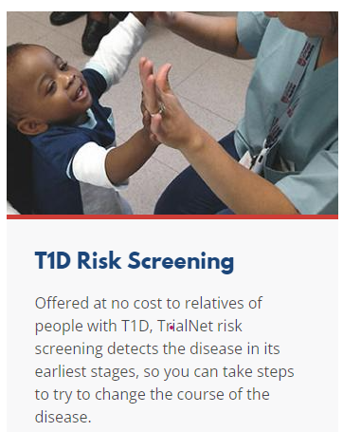

3. Prevention or Delay of Diabetes and Associated Comorbidities
(for Preclinical Type 1 Diabetes)
Positive Antibodies with Prediabetes:
  A1c 5.7 – 6.4% or fasting BG 100 -125mg/dl
Action:
  Screen A1C every 6 months
  75 - OGTT every year
  Modify screening based on antibodies and glycemic metrics.
  May benefit from CGM to monitor progression
Trialnet.org
Notes:
Lab Values for diagnosis of prediabetes
75-OGTT is the 75 gram oral glucose tolerance test, which includes measurement of fasting glucose and 2 hours after ingestion of the glucose. It is commonly used to dx pre-diabetes (and is also used during pregnancy to test for GDM)

Slide 21
Type 1 & Lifestyle Prevention
Observational studies in those with antibodies, shed light on factors that increase β-cell demand:
  Less physical activity
  Consuming higher glycemic index foods
  Sugar intake.
Factors that reduced risk of progression from TEDDY study:
Increase Ddaily minutes spent doing vigorous physical exercise.
More info needed
Notes:
Examples of high glycemic index foods include white breads, cereals, baked goods/pastries and snack foods
TEDDY study = (The Environmental Determinants of Diabetes in the Young)
Study based out of 3 sites in Europe: Finland, Germany, and Sweden and 3 sites in U.S.: Colorado, Georgia, Washington.
Evaluated environmental factors which triggered the onset of type 1 diabetes in children who were genetically predisposed.

Slide 22
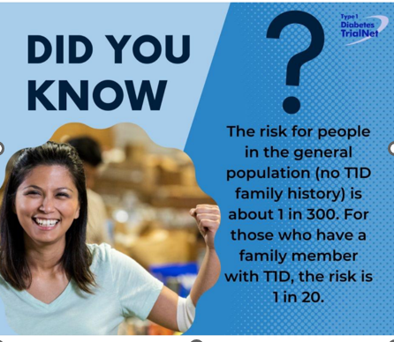
Type 1 Diabetes TrialNet
Screening is offered at no cost to eligible individuals to evaluate their personal risk of developing T1DM.
ADCES In Practice - March 2024 Recent Advances in Type 1 Diabetes: Teplizumab (Tzeild®)
Karen S. Fiano, PHARMD, BCACP, Devada Singh-Franco, PHARMD, CDCES, Young M. Kwon, BS, PHD

Slide 23


Pharmacologic Intervention to Delay Symptomatic Type 1 (in Stage 2)
In a single trial, 44 individuals received 14-day course of teplizumab vs 32 placebo.
The median time to stage 3 diagnosis of type 1
  48.4 months in tep group
  24.4 months placebo
Cost: $193,000
Provention Bio/Sanofi has financial assistance programs.
Teplizumab CD3-monoclonal antibody
14-day infusion can delay the onset of symptomatic type 1 diabetes (stage 3)
An option in selected individuals aged ≥8 years with stage 2 type 1 diabetes.
Notes:
Teplizumab CD3-monoclonal antibody = Tzield manufactured by Sanofi

Slide 24
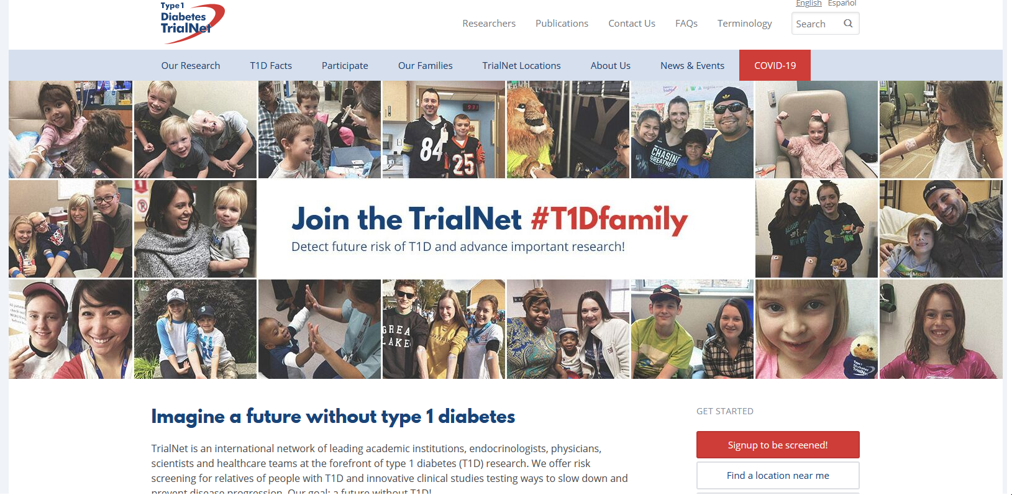
  Type 1 (stage 2) Delayed with Teplizumab by 2 years www.DiabetesTrialNet.org
How to get families linked to screening?
Notes:
To participate in TrialNet: Go to website to determine eligibility. 3 options presented: in-home test kit, test kit to take to local lab or visit a TrialNet center.

Slide 25

Case Study
10-year-old female goes to Emergency Room, since mom suspected new diabetes. Based on ED report:
  Blood glucose levels 500+ in ED
  Urine ketones positive
  Body weight 108 lbs
Family history
  One parent has type 2
  Uncle, older sister have type 1
  No ATB results yet
  Born in Mexico
Treatment?
Notes:
Insulin
Based upon the positive ketones, and glucose >500, insulin is the first line of treatment.
Factors that predispose her to T2DM include Mexican heritage, with Hispanic Americans are 17% more likely to develop T2DM and parent with T2DM.
ATB will confirm dx and long-term treatment.

Slide 26

Poll Question 3
A 10-year-old comes to ER with symptoms of new hyperglycemia and an A1c of 8.7% and positive urine ketones. What is most important initial treatment?
A. Insulin therapy
  B. Try changes in diet immediately
  C. Start exercise program STAT
  D. Start a GLP-1 RA
Notes:
GLP1 is not insulin and is not used to treat positive ketones or elevated glucoses.
Note: FDA approval of medications and age of patient must be reviewed. Example: Victoza and Trulicity are approved for ages 10 years and older.
Other FDA approved GLP1 medications are not approved for 10 years of age.

Slide 27
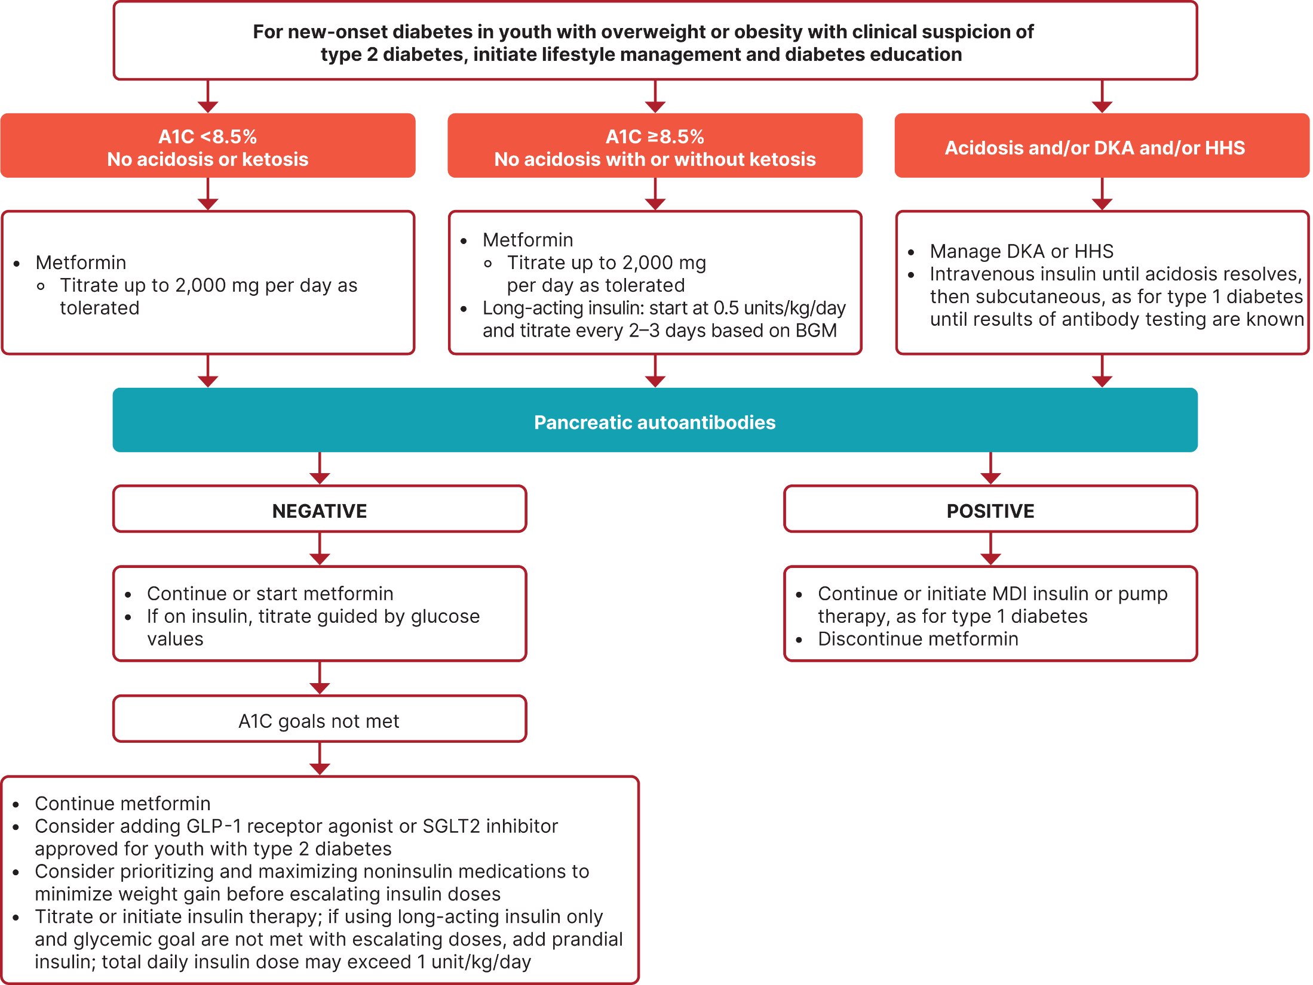
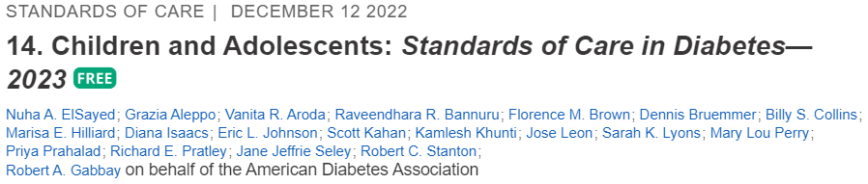

Slide 28
Case Study
10-year-old female goes to Emergency Room, since mom suspected new diabetes. Based on ED report:
  Blood glucose levels 500+ in ED
  Urine ketones positive
  Body weight 108 lbs
Family history
  One parent has type 2
  Uncle, older sister with type 1
  GAD, IA2 antibodies positive
Treatment
  22 units basal at HS
  1:7 carb ratio
Notes:
positive GAD and IA2 antibodies = dx of type 1 diabetes

Slide 29
Poll Question 4
How would you definitively differentiate between type 1 and type 2 diabetes?
A. Body weight at presentation
B. Positive ketone bodies
C. Autoantibody testing
D. Absence of acanthosis nigricans
Notes:
Acanthosis nigricans (dark, velvety patches of skin seen at the neck, arm pits and groin) is a sign of insulin resistance.
It is more common in T2DM, however it may be seen in individuals with T1DM who are overweight and insulin resistant.
Insulin resistance = elevated insulin levels = skin cell proliferation = thickened, dark skin = acanthosis nigricans

Slide 30

Pediatric A1C Goals for Type 1 - Individualize
A1C of <7% appropriate for many peds.
A1C of <6.5% for selected individuals
<7.5% if cannot articulate symptoms of hypoglycemia or at high risk
<8.0% may be appropriate for some
If using CGM (Continuous Glucose Monitor), evaluate Time in Range.
No standard TIR goal at this time.
Individualize Goals ~ minimize hyper/hypo glycemia and keep safe
Blood glucose goals are higher in children with frequent hypoglycemia or hypoglycemia unawareness.
Measure postprandial blood glucose when there is a discrepancy between preprandial blood glucose values and A1C levels
Notes:
These goals apply to all pediatric age groups.
CGMs provide information regarding glucoses TIR of 70 - 180, as well as glucoses <70 and >250.
This provides a more accurate representation of glycemic management.
Evaluate 7 – 14 days of CGM data to assess glycemia.
30
References
American Diabetes Association. Standards of medical care in diabetes—2014. Diabetes Care 2014;37(suppl 1):S50
Seaquist ER, Anderson J, Childs B, et al. Hypoglycemia and diabetes: a report of a workgroup of the American Diabetes Association and The Endocrine Society. Diabetes Care 2013;36:1384–1395
Wysocki T, Harris MA, Mauras N, et al. Absence of adverse effects of severe hypoglycemia on cognitive function in school-aged children with diabetes over 18 months. Diabetes Care 2003;26:1100–1105
Blasetti A, Chiuri RM, Tocco AM, et al. The effect of recurrent severe hypoglycemia on cognitive performance in children with type 1 diabetes: a metaanalysis. J Child Neurol 2011;26:1383–1391
Cooper MN, O’Connell SM, Davis EA, Jones TW. A population-based study of risk factors for severe hypoglycaemia in a contemporary cohort of childhood-onset type 1 diabetes. Diabetologia 2013;56:2164–2170

Slide 31

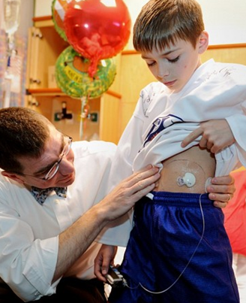
Strategies for Type 1 Management
Initiate intensive insulin regimens, either via multiple daily injections (MDI) or insulin pump.
Monitor glucose with BG monitor or CGM up to 10 times daily including premeal, post meal, pre bedtime, and as needed for safety.
Offer CGM as soon as possible for youth using insulin
Offer automated insulin delivery (AID) systems to youth with type 1 diabetes who are capable of using the devices safely (or with caregiver help).

Slide 32

Insulin Dosing
Younger children
  Dose may be low during honeymoon period
  After honeymoon – dose is 0.5 – 1.0 unit/kg/day
  Basal / bolus combo
  If difficulty injecting bolus at lunch, consider NPH pre breakfast
Pubertal hormones increase insulin required
  up to 1.5 units/kg/day
Keep it flexible, may need to inject after meals
Insulin pump therapy coupled with CGM = AID Pumps are recommended
Notes:
The ‘Honeymoon Period’, also referred to as ‘partial remission’, is the time period after T1DM diagnosis when there is an increase in the release of endogenous insulin from the beta cells, due to the administration of exogenous insulin (injections or insulin pump).

Slide 33
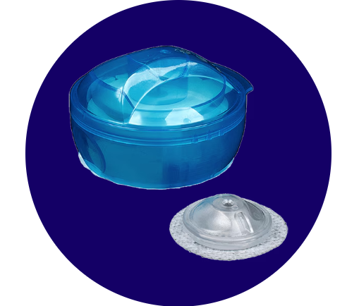

Insulin
Needle phobias common
  Try pens, pumps, auto-injectors
Needles
  31 gauge 6 mm short insulin syringes or
  4 mm pen needles
  Use smallest barrel possible (ie 30 unit syringe)
  Use ½ unit increment pens/syringes
Sites: Rotate each injection by 1 inch
  Young children: legs, arm, buttocks
  School age can also use abdomen
  Note: abdomen has most rapid absorption
Notes:
Note: syringes are not recommended for children under 6 years of age, due to risk of injection into muscle.
Pen needles are preferred.
See Minimed i-Port Advance injection port.
Change port every 3 days, ~size of quarter, use with syringe or pen with needle 5-8 mm.
*See presentation on Medications for more information on insulin delivery.

Slide 34

Type 1 Nutrition Goals
Individualized medical nutrition therapy (MNT) as is an essential component of treatment plan.
Monitor carbohydrate intake
  by carbohydrate counting or experience-based estimation.
  Apps can be helpful
Comprehensive MNT
  At diagnosis, with annual updates
  by experienced registered dietitian nutritionist
  Assess caloric and nutrition intake in relation to age and weight status
  Eval cardiovascular disease risk factors to inform macronutrient choices.
Foster a positive relationship with food
Notes:
Promote a balanced meal plan with macronutrients: carbohydrates, protein and fats at every meal and snack.
Glucose excursions are seen more rapidly in meals which are solely CHO.
Promote less processed foods, sugar sweetened beverages and refined grains.
Individualized meal plans include embracing culturally diverse foods, religious needs and finances.
Continued use of greens, lentils and beans is encouraged.
Refer to nutrition module – Beverly which should I refer to?

Slide 35

Special Issues for Type 1

Slide 36
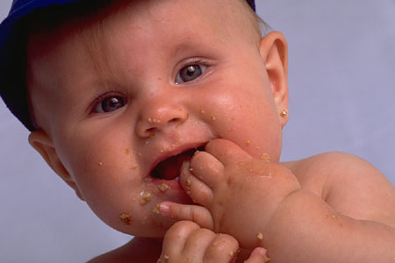
Infant and Toddler
(Birth to 2 years)
3-4 hour feeding schedule - regular nighttime feedings very important
Require lots of sleep and naps
Toddlers begin to separate, individuate
Lispro/aspart or used after meals
Aspart (Fiasp) & lispro-aabc (Lyumjev) insulin also approved after 2 years of age
At risk for dehydration during illness, notify MD
Notes:
Rapid acting insulins start working in 15 minutes.
Fiasp and Lyumjev start working faster. More info provided in the pharmacology module
Dehydration risk is great related to body mass of infant/toddler, and fluid loss related to hyperglycemia, fever and V/D

Slide 37

Infant and Toddler Educational Approaches
Education directed toward parents/primary caregivers
Provide child with limited choices
Teach parents signs of hypoglycemia:
  pallor, listlessness, crying, clammy skin, sleepy, hunger, restless, shakiness

Slide 38

Preschool children (3 - 5)
Educational Approaches
Engage in magical thinking
  play therapy helpful to express
  concerns
Concerned about intactness of
body
  Reassure them that body will remain
  intact, use Band-Aids after injection
Give limited choices
  Would you like your injection on your right side or left side?
Can identify s/s hypo and alert adults
Provide education to staff in preschool/daycare
Notes:
2026 SOC discusses the importance of diabetes training for daycare/school staff.
Many children spend the majority of their day in these settings and may need insulin delivery.
Later slides will discuss the ADA platform ‘Safe at School’

Slide 39

Diabetes and Rights
The Individuals with Disabilities
Education Act (IDEA) of 1991 and American Disabilities Act protect children and adults with diabetes against discrimination.
Federal law requires an assessment of the child and accommodations in the school setting.
For more information and care plans visit:
  American Diabetes Association www.diabetes.org
  Breakthrough T1D (formerly JDRF) www.breakthrought1d.org and www.breakthrought1d.org/t1d-resources/school/
  Childrenwithdiabetes.org
Notes:
All students with an IEP (Individualized Education Program) or Section 504 plan (Americans with Disabilities Act) are entitled to accommodations at the school and at school related activities.

Slide 40
Safe at School per the ADA
Schools need to provide trained staff to:
  Monitor blood sugar levels, administer insulin and glucagon
  Provide diabetes care during field trips, extracurricular events and all school-sponsored activities
  Allow capable students to self-manage their diabetes anytime, anywhere
Schools should not:
  Make family members go to school to care for a student’s diabetes
  Transfer students to a different school to get needed diabetes care
  Prevent students with diabetes from participating in field trips, sports and other school-sponsored activities
https://www.diabetes.org/resources/know-your-rights/safe-at-school-state-laws

Slide 41

Resources at Diabetes.Org (ADA)
Notes:
ADA = Safe at School program is included in the ADA’s Advocacy platform.
The 3 principals of Safe at School: 1. Basic Diabetes training for staff 2. Shared responsibilities for care (school nurse and school staff)
3. Self Management by students with capacity

Slide 42

School-Age Child (6 - 12)
Educational Approaches
Speaks fluently, able to share and cooperate
  Games are good teaching tools
Power, protection of by parent/care giver very important
  Parent/care giver needs to assume most of responsibility
  Child can participate in self-care
Try to fit diabetes management into normal routine
Notes:
Ages 6-12 often participate in sports/clubs/activities. Coaches/leaders will need to be trained re diabetes basics.
Focus on Rule of 15 – hypoglycemia.

Slide 43

Special Focus on Hypo for Kids under 6 years of age
In 10 – 20% of peds, extra exercise responsible for hypo events
  At high risk for nocturnal hypo, even if hs BG > 130
  Exercise can lower BG 1 – 16 hrs post event
Prevention critical:
  May need insulin dose adjustment
  Extra carb to cover extra activity
  3 am checks if worried / Continuous Glucose Monitoring
  Use AID systems when possible; and use the activity and exercise settings
Notes:
CGMs include alerts for high and low glucoses. Beneficial for parent and child, to alert nocturnal lows

Slide 44
Exercise Guidelines Type 1 | Hypo
Pre-exercise glucose target 126-180 (individualize)
Strategies to prevent exercise related hypoglycemia:
  Reduce prandial insulin dosing for the meal/snack preceding (and, if needed, following) exercise
  Reduce basal insulin dose by ~20% on heavy exercise days
  Decrease pump basal rate by 10-50% during and for a few hours after exercise. Put on exercise mode.
  Increase peri exercise carb intake, eating bedtime snacks, and/or using continuous glucose monitoring.
Carb coverage before or during activity – Ensure access
  If fasting, 10–15 g of carb for low-to-moderate intensity aerobic activities (30–60 min)
  Consider 0.5–1.0 g of carbohydrates/kg per hour of exercise (∼30–60 g)
Strategies related to exercise and hyperglycemia:
  Activity should be postponed with glucoses >350 and moderate to large ketones
Notes:
All children should obtain 60 minutes of moderate-vigorous activity daily, & >3 week bone and muscle strengthening (recommendations per the NIH and CDC).
Pump basal rates should be decreased 60-90 minutes prior to exercise, with use of exercise mode of a temporary basal rate.
The 0.5-1.0 g/CHO/kg/hour is comparable to recommendations for persons without T1diabetes
Hyperglycemia related to insulin deficiency, will worsen with exercise.

Slide 45
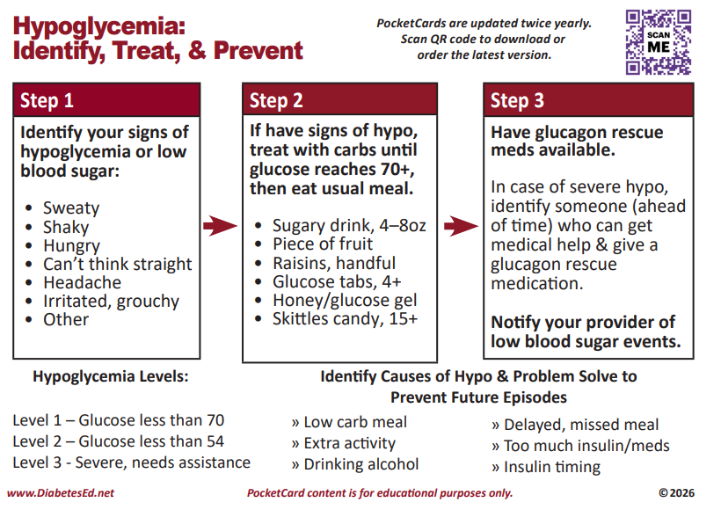

Slide 46
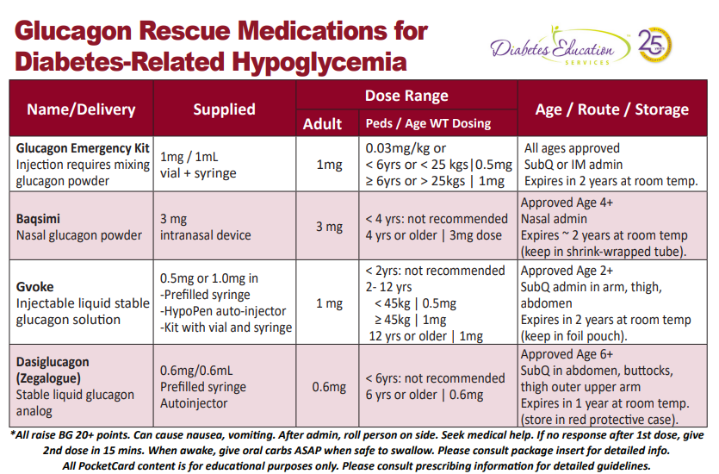
Notes:
Rule of 15 = 15 grams of quick acting CHO, re-test BG in 15 minutes

Slide 47

Recommendations for
Pediatric Psychosocial Issues
At diagnosis and during routine follow-up care, assess psychosocial issues and family stresses that could impact with diabetes management/self-care.
Assess food security, housing, literacy and social supports.
Provide appropriate referrals to trained mental and behavioral health professionals, preferably experienced in childhood diabetes
Notes:
Diabetes management places substantial burdens on the youth and family
Ongoing parental/guardian involvement is necessary, due to the complexities of diabetes management
47
References
Arnett JJ. Emerging adulthood. A theory of development from the late teens through the twenties. Am Psychol 2000;55:469–480
Weissberg-Benchell J, Wolpert H, Anderson BJ. Transitioning from pediatric to adult care: a new approach to the post-adolescent young person with type 1 diabetes. Diabetes Care 2007;30:2441–2446
Peters A, Laffel L, for the American Diabetes Association Transitions Working Group. Diabetes care for emerging adults: recommendations for transition from pediatric to adult diabetes care systems: a position statement of the American Diabetes Association, with representation by other groups. Diabetes Care 2011;34:2477–2485
American Diabetes Association. Standards of medical care in diabetes—2014. Diabetes Care 2014;37(suppl 1):S53

Slide 48

Psychosocial Issues – Youth with diabetes
Assess for diabetes-related distress, generally starting at 7–8 years of age
Offer appts by themselves with provider at developmentally appropriate age (12 ish)
Screen youth with type 1 diabetes for distress, depression, anxiety, fear of hypo, disordered eating behavior between 10 -18 years of age.
  The Diabetes Eating Problems Survey-Revised (DEPS-R)
  Reliable, valid, and brief screening tool
Starting at puberty, preconception counseling, Assess for Social Determinants of Health

Slide 49

Screen for Disordered Eating
“DiaBulimia”
People with diabetes give themselves less insulin than needed to lose weight
Tends to start in adolescence, more likely to occur in women than men.
Signs: Avoiding CGM, elevated A1C, weight loss, lack of prescription refills for diabetes meds, records that don’t match A1C.
Treatment – Referrals to mental health specialist and diabetes team

Slide 50


Autoimmune Conditions -Type 1 Diabetes
Screening
Assess for the presence of additional autoimmune conditions at diagnosis and if symptoms develop
Notes:
Because of the increased frequency of autoimmune disease in type 1 diabetes, screening for thyroid dysfunction, vitamin B12 deficiency, (due to autoimmune gastritis), and celiac disease should be considered on based on signs and symptoms.
There are other autoimmune conditions (ie, Addison’s disease, etc.) that should be assessed and monitored as clinically indicated.
50
References
American Diabetes Association. Standards of medical care in diabetes—2014. Diabetes Care 2014;37(suppl 1):S50
Daniels M, DuBose SN, Maahs DM, et al.; T1D Exchange Clinic Network. Factors associated with microalbuminuria in 7,549 children and adolescents with type 1 diabetes in the T1D Exchange clinic registry. Diabetes Care 2013;36:2639–2645

Slide 51
Poll Question 5
What is the most common autoimmune condition associated with type 1 diabetes?
  A. Thyroid disease
  B. Celiac disease
  C. DiaBulemia
  D. Irritable bowel syndrome
Notes:
Thyroid disease occurs in 17-30% of all persons with T1D, most commonly hypothyroidism.

Slide 52
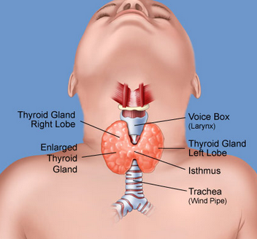
Screening for Pediatric Hypothyroidism - Type 1
25% positive for thyroid disease at diagnosis of type 1
Screen for anti-thyroid peroxidase, anti-thyroglobulin antibodies soon after diagnosis
Measure Thyroid-stimulating hormone (TSH) concentrations after metabolic control established.
    If normal, consider rechecking every 1–2 years
    Recheck if develops symptoms of thyroid dysfunction:
      thyromegaly, abnormal growth rate, or unusual BG variation
Notes:
Consider screening children with type 1 diabetes for antithyroid peroxidase and antithyroglobulin antibodies at diagnosis (E)¹
Measuring TSH concentrations soon after diagnosis of type 1 diabetes, after metabolic control has been established, is reasonable.
If normal, consider rechecking every 1–2 years, especially if the patient develops symptoms of thyroid dysfunction, thyromegaly, an abnormal growth rate, or unusual glycemic variation (E)¹
Autoimmune thyroid disease is the most common autoimmune disorder associated with diabetes, occurring in 17-30% of patients with type 1 diabetes²
About one-quarter of children with type 1 diabetes have thyroid autoantibodies at the time of diagnosis;³ presence of thyroid autoantibodies is predictive of thyroid dysfunction, generally hypothyroidism but less commonly hyperthyroidism⁴
Subclinical hypothyroidism may be associated with increased risk of symptomatic hypoglycemia⁵ and with reduced linear growth;⁶
hyperthyroidism alters glucose metabolism, potentially resulting in deterioration of metabolic control¹
52
References
American Diabetes Association. Standards of medical care in diabetes—2014. Diabetes Care 2014;37(suppl 1):S52
Roldán MB, Alonso M, Barrio R. Thyroid autoimmunity in children and adolescents with Type 1 diabetes mellitus. Diabetes Nutr Metab 1999;12:27–31
Triolo TM, Armstrong TK, McFann K, et al. Additional autoimmune disease found in 33% of patients at type 1 diabetes onset. Diabetes Care 2011;34:1211–1213
Kordonouri O, Deiss D, Danne T, Dorow A, Bassir C, Gruüters-Kieslich A. Predictivity of thyroid autoantibodies for the development of thyroid disorders in children and adolescents with Type 1 diabetes. Diabet Med 2002;19:518–521
Mohn A, Di Michele S, Di Luzio R, Tumini S, Chiarelli F. The effect of subclinical hypothyroidism on metabolic control in children and adolescents with Type 1 diabetes mellitus. Diabet Med 2002;19:70–73
Chase HP, Garg SK, Cockerham RS, Wilcox WD, Walravens PA. Thyroid hormone replacement and growth of children with subclinical hypothyroidism and diabetes. Diabet Med 1990;7:299–303

Slide 53

Screen for Pediatric Celiac Disease – Type 1
  At diagnosis, screen by measuring IgA anti-tissue transglutaminase. Check again after 2 years then again at 5 yrs or more frequently with symptoms:
Consider testing in children with
    Positive family history of celiac disease
    Growth failure
    Failure to gain weight, weight loss
    Diarrhea, flatulence, abdominal pain, signs of malabsorption
    Frequent unexplained hypoglycemia or deterioration in glycemic control
Notes:
Recommendations for the care of children with type 1 diabetes and celiac disease are summarized in two slides¹
Slide 1 of 2
Consider screening children with type 1 diabetes for celiac disease by measuring IgA antitissue transglutaminase or antiendomysial antibodies, with documentation of normal total serum IgA levels, soon after the diagnosis of diabetes (E)
Testing should be considered in children with a positive family history of celiac disease, growth failure, failure to gain weight, weight loss, diarrhea, flatulence, abdominal pain, or signs of malabsorption or in children with frequent unexplained hypoglycemia or deterioration in glycemic control (E)
Celiac disease is an immune-mediated disorder that occurs with increased frequency in patients with type 1 diabetes (1–16% of individuals compared with 0.3–1% in the general population)^{2,3}
Screening for celiac disease includes measuring serum levels of tissue transglutaminase or anti-endomysial antibodies, then small bowel biopsy in antibody positive children
In symptomatic children with type 1 diabetes and celiac disease, gluten-free diets reduce symptoms and rates of hypoglycemia⁴
53
References
American Diabetes Association. Standards of medical care in diabetes—2014. Diabetes Care 2014;37(suppl 1):S52
Holmes GK. Screening for coeliac disease in type 1 diabetes. Arch Dis Child 2002;87:495–498
Rewers M, Liu E, Simmons J, Redondo MJ, Hoffenberg EJ. Celiac disease associated with type 1 diabetes mellitus. Endocrinol Metab Clin North Am 2004;33:197–214, xi
Abid N, McGlone O, Cardwell C, McCallion W, Carson D. Clinical and metabolic effects of gluten free diet in children with type 1 diabetes and coeliac disease. Pediatr Diabetes 2011;12:322–325

Slide 54

Children with Celiac Disease – Type 1
Asymptomatic children with positive antibodies
  Consider referral to gastroenterologist for evaluation with possible endoscopy and biopsy for confirmation of celiac disease
Children with biopsy-confirmed celiac disease
  Place on a gluten-free diet
  Consult with a dietitian experienced in managing both diabetes and celiac disease
Notes:
Recommendations for the care of children with type 1 diabetes and celiac disease are summarized in two slides
Slide 2 of 2
Consider referral to a gastroenterologist for evaluation with possible endoscopy and biopsy for confirmation of celiac disease in asymptomatic children with positive antibodies (E)
Children with biopsy-confirmed celiac disease should be placed on a gluten-free diet and have consultation with a dietitian experienced in managing both diabetes and celiac disease (B)
54
Reference
American Diabetes Association. Standards of medical care in diabetes—2014. Diabetes Care 2014;37(suppl 1):S52

Slide 55

Stretch Break

Slide 56

Case Study
  17-year-old, diagnosed with diabetes at age 14.
  Blood glucose in office 482
  Urine ketones 2+ positive
  On metformin, but only takes it intermittently
  Weight: 184 lbs, ht 5’5”
Family history
  One parent has type 2
  ATB results came back neg
Plan
  Review nutrition and activity
  Add exenatide XR
This Photo by Unknown Author is licensed under CC BY-ND

Slide 57
Poll Question 6
Which factor puts children at higher risk of getting type 2?
  A. Higher Income families
  B. Living in rural areas
  C. Limited opportunities
  D. Eating a lot of sweets
Notes:
Stigmas and Sterotypes. Persons do not develop diabetes due to ‘eating a lot of sweets’.

Slide 58

Risk based Screening for Prediabetes or Type 2 Children and Adolescents
Test at 10 yrs or puberty and every 2 yrs
Test children with excess weight
    BMI >85% for age and sex, weight for height >85% or >120% of ideal for height
Plus any ONE of the following risk factors
    Family history
    Signs of insulin resistance (acanthosis nigricans), HTN, dyslipidemia, Polycystic Ovary Syndrome (PCOS )or
    small or large for gestational age birth weight
    Maternal diabetes or GDM during child’s gestation
    American Indian, African American, Hispanic, Asian American, South Pacific Islander
Notes:
Screen if first degree relative (biological parent or sibling) or second degree relative (biological grandparents, aunts/uncles) has dx of T2D.

Slide 59


Type 2 in Kids
~5,000 new cases in U.S. annually.
New cases of type 2 in youth increasing 2.3% a year
Prevalence will quadruple in 40 years
Disproportionately impacts marginalized communities
Can occur in complex psychosocial and cultural environments, which may make it difficult to sustain healthy lifestyle changes and self-management behaviors
Other risk factors: adiposity, family history of diabetes, female sex, and low socioeconomic status.

Slide 60

Engaging and supporting Kids to help slow the Type 2 Diabetes epidemic
Phases of Life
  During Childhood
Environment
  Access to safe places to exercise
  Access to healthy foods
  Access to learning rich environments
  Access to health care
LifeStyle
  1 hour + a day of activity
  Healthy Snacks
  Limit processed foods and sugary beverages
  Fruits and Veggies
  Get the family involved

Slide 61

Type 2 Clinical Presentation
Glycosuria without ketonuria
  But 33% have ketonuria
  ~11% present in DKA (10-19 yrs)
  To make dx, assess antibodies prn
  May need insulin during acute phase
Mild thirst, increased urination, little or no wt loss
At onset, may have retinopathy, microalbuminuria, hypertension, hyperlipidemia
Majority of individuals with type 2 diabetes diagnosed as youth had microvascular complications by young adulthood

Slide 62
Poll Question 7
LM is 11 years old and struggles with weight. LM blood pressure is elevated and LM has acanthosis nigricans.
Fasting blood glucose is 197 and 205 on 2 different lab draws.
Negative ketones.
What is best action?
A. Start insulin therapy
B. Discuss healthy eating
C. Initiate semaglutide
D. Start metformin and lifestyle

Slide 63
Type 2s– New Diagnosis
Start lifestyle modification program and metformin therapy.
Since fewer than 10% of children with T2DM will attain glucose goals with lifestyle changes alone, initiate metformin alongside exercise and healthy eating.
Start metformin at low dose to mitigate GI side effects.
If glucose is not at target, add a GLP-1 medication, SGLT-2 and/or insulin therapy.
Notes:
Metformin first line of medication treatment for T2D, unless altered kidney function
Glucagon-like peptide (GLP1) hormones include Liraglutide/Victoza and Exenatide XR/Bydureon

Slide 65

Type 2 Medication Strategy - Kids
Initiate pharmacologic therapy, in addition to lifestyle therapy, at diagnosis of type 2 diabetes.
If A1c <8.5% and asymptomatic, start metformin
If A1c >8.5% and no ketosis, start metformin and insulin
If ketotic, start insulin. Once resolved continue insulin, add metformin.
If A1C above target on metformin, add approved GLP-1 and/or SGLT-2 (empagliflozin or dapagliflozin)
If still above target start basal insulin therapy, start at 0.5 units/kg/day.
Notes:
Lifestyle = exercise and nutrition/diet

Slide 66

New Type 2 – Start Basal Insulin for:
10-18 yr olds w/ new onset hyperglycemia and:
  A1c 8.5% or greater
  Ketotic not sure if type 1 and type 2.
Even if it turns out a ketone positive child has T2DM, insulin therapy helps stop glucose toxicity so beta cells can "rest and recover".
Draw autoantibodies to determine correct diagnosis
If antibody negative, decrease and stop insulin of possible

Slide 67
Poll Question 8
Which of the following medications are FDA approved for pediatrics after the age of 10?
  A. Glipizide, liraglutide, dapagliflozin
  B. Liraglutide, exenatide XR, metformin
  C. Metformin, sitagliptin, repaglinide
  D. Acarbose, liraglutide, glyburide
Notes:
Four drug classes are approved for the treatment of T2D in youth: metformin, insulin, GLP1 and SGLT-2s.
We will discuss the approved GLP1s and SGLT-2s in the next 2 slides.

Slide 68
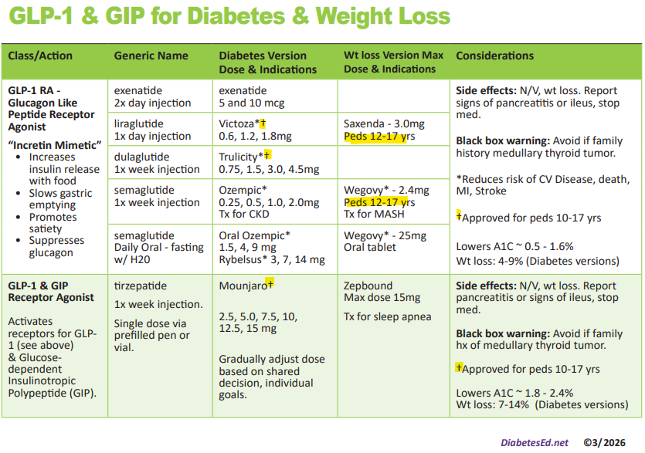
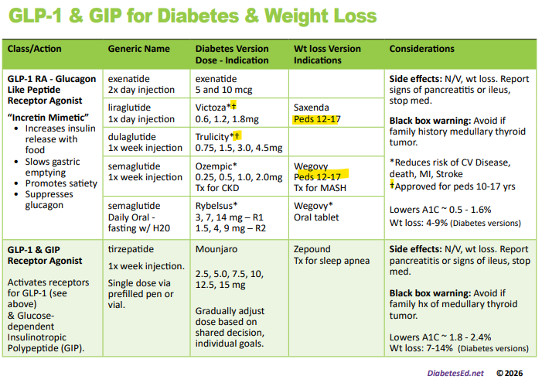
GLP-1s Approved for Kids 10yrs +
Notes:
Ozempic and Rybelsus – per medication prescribing information/insert: ‘the safety and efficacy of Ozempic/Rybelsus have not been established in pediatric patients’.

Slide 69
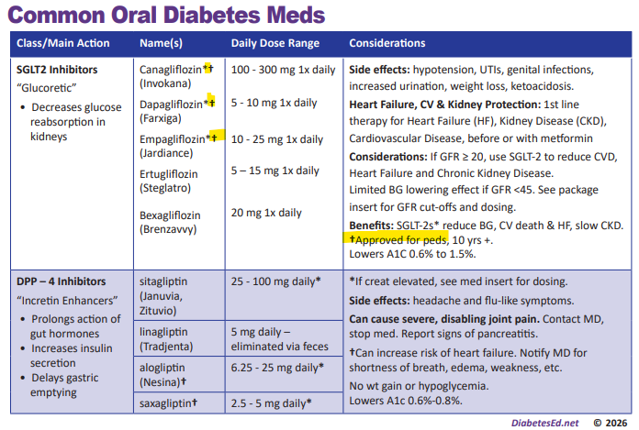
SGLT-2s Approved for 10 yrs & Up
Notes:
SGLT2s approved for 10 years and older: Invokana/Canagliflozin, Farxiga/Dapagliflozin and Jardiance/Empagliflozin.
DPP4 inhibitors approved for 10 years and older = none

Slide 70

Glycemic Targets - Type 2 Diabetes
A1C goal of < 6.5% if low risk of hypo.
  Individualize
Glucose monitoring frequency based on pharmacologic treatment
Measure A1C every 3 months
Use CGM for those using insulin. Evaluate time in range (TIR).
Notes:
The recommendation for glycemic control in children and adolescents with type 1 diabetes¹ is included in this slide
In selecting glycemic goals, the long-term health benefits of achieving a lower A1C should be balanced against the risks of hypoglycemia and the developmental burdens of intensive regimens in children and youth¹
Special consideration should be given to the unique risks of hypoglycemia in young children¹
For young children (<7 years old), glycemic goals may need to be modified since most at that age have a form of “hypoglycemic unawareness,” including immaturity of and a relative inability to recognize and respond to hypoglycemic symptoms; this places them at greater risk for severe hypoglycemia
While it was previously thought that young children were at risk for cognitive impairment after episodes of severe hypoglycemia, current data have not confirmed this²⁻⁴
Furthermore, new therapeutic modalities, such as rapid and long-acting insulin analogs, technological advances (e.g., low glucose suspend), and education may mitigate the incidence of severe hypoglycemia⁵
70
References
American Diabetes Association. Standards of medical care in diabetes—2014. Diabetes Care 2014;37(suppl 1):S50
Seaquist ER, Anderson J, Childs B, et al. Hypoglycemia and diabetes: a report of a workgroup of the American Diabetes Association and The Endocrine Society. Diabetes Care 2013;36:1384–1395
Wysocki T, Harris MA, Mauras N, et al. Absence of adverse effects of severe hypoglycemia on cognitive function in school-aged children with diabetes over 18 months. Diabetes Care 2003;26:1100–1105
Blasetti A, Chiuri RM, Tocco AM, et al. The effect of recurrent severe hypoglycemia on cognitive performance in children with type 1 diabetes: a metaanalysis. J Child Neurol 2011;26:1383–1391
Cooper MN, O’Connell SM, Davis EA, Jones TW. A population-based study of risk factors for severe hypoglycaemia in a contemporary cohort of childhood-onset type 1 diabetes. Diabetologia 2013;56:2164–2170

Slide 71
Special Issues for Type 2

Slide 72
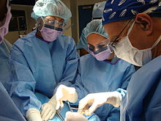
Metabolic Surgery in Youth
Metabolic surgery may be considered for the treatment of adolescents with type 2 diabetes with:
  BMI >35 or >120% of 95th percentile for age and sex
  elevated A1C and/or
  serious comorbidities despite lifestyle and pharmacologic intervention.
Surgical Team must include interprofessional team: experienced surgeon, endocrinologist, registered dietician nutritionist, behavioral health specialist and nurse.

Slide 73

Type 2 Peds Special Issues
Steatosis (MASLD)
Metabolic Dysfunction-Associated Steatotoic Liver Disease.
  Measure AST and ALT at diagnosis and annually.
Obstructive sleep apnea
  Screen at each visit, refer to pediatric sleep specialist.
Polycystic ovary syndrome
  Eval for PCOS in females with type 2
  Metformin improves menstrual cyclicity and hyperandrogenism
Notes:
MASLD is a chronic liver condition.
Refer to gastroenterologist as needed, if transaminases are continually elevated

Slide 74

Preventing CV Disease 1 & 2
Youth with diabetes, both type 1 and 2, are at higher risk of CV disease
  Encourage healthy habits early to protect blood vessels and quality of life
  Management of dyslipidemia, hypertension, and glucose important to prevent overt macrovascular disease in early adulthood

Slide 75

Healthy Eating Type 2 Kids
Incorporate Evidence Based Nutrition Guidelines
Familiarity with carb counting (use apps)
Eat regular meals, reduce portion sizes if weight is an issue
Choose calorie free beverages
More fruits, veggies, limit high fat foods.
Choose less fast foods and processed foods.
Notes:
Popular Nutrition Apps include: Calorie King, MyFitnessPal and recent Snaq App/purchase, which uses photos to calculate meals.

Slide 76

Activity Goals for all
Engage in physical exercise for at least 60 minutes daily plus strengthening activities 3x per week
Limit nonacademic screen time to less than 2 hours per day.
Create an individualized approach that can be incorporated into the daily routine
Tailor to the child's physical ability and preferences while taking the families circumstances into account.

Slide 77

Behavior Change
Engage youth and family in decision making to maintain lifestyle and medication changes
Set realistic goals and take into account the families' health beliefs and behaviors.
Explore family's perception of diabetes
Dispel any myths or misconception negotiating a management plan.
Ensure culturally appropriate, family-centered care along with ongoing education.
This Photo by Unknown Author is licensed under CC BY

Slide 78

Screening at Diagnosis of 2 Diabetes
Due to the delay in detecting type 2 diabetes and insulin resistance, these tests are recommended at diagnosis:
  Blood pressure measurement
  Fasting lipid panel
  Albumin excretion assessment
  Dilated eye examination
Thereafter, screening and treatment guidelines in youth with type 2 diabetes are similar to youth with type 1 diabetes
Notes:
Autoantibodies and ketosis may be present in patients with features of type 2 diabetes
ADA consensus report “Type 2 Diabetes in Children and Adolescents”
78
References
Arnett JJ. Emerging adulthood. A theory of development from the late teens through the twenties. Am Psychol 2000;55:469–480
Weissberg-Benchell J, Wolpert H, Anderson BJ. Transitioning from pediatric to adult care: a new approach to the post-adolescent young person with type 1 diabetes. Diabetes Care 2007;30:2441–2446
Peters A, Laffel L, for the American Diabetes Association Transitions Working Group. Diabetes care for emerging adults: recommendations for transition from pediatric to adult diabetes care systems: a position statement of the American Diabetes Association, with representation by other groups. Diabetes Care 2011;34:2477–2485
American Diabetes Association. Standards of medical care in diabetes—2014. Diabetes Care 2014;37(suppl 1):S53

Slide 79
Poll Question 9
What is the blood pressure target for kids with type 1 or 2 diabetes before age 13?
  A. Less than 140/90
  B. Less than 120/70
  C. Depends on family genetics
  D. Less than 90th percentile for age, sex, and height

Slide 80

Screening and Treating for Hypertension in Peds
Measure blood pressure at each routine visit;
  Target is less than 90th percentile or less than 120/80 after age 13.
  confirm high-normal BP or hypertension on 3 separate days
  Treat hypertension w/ACE or ARB if:
    Systolic BP or Diastolic BP above 95th percentile for age, sex, height
    After age 13, if > 130/80
    Discuss preventing pregnancy
Notes:
Recommendations for the care of children and adolescents with hypertension¹ are summarized in four slides
Slide 1 of 4
Blood pressure should be measured at each routine visit; children found to have high-normal blood pressure or hypertension should have blood pressure confirmed on a separate day (B)
80
Reference
American Diabetes Association. Standards of medical care in diabetes—2014. Diabetes Care 2014;37(suppl 1):S50

Slide 81

Treatment for Pediatric Hypertension
Healthy eating, activity, weight loss if indicated
If target BP not reached with 3–6 months of lifestyle intervention, add meds
Pharmacologic treatment of hypertension:
  ACE inhibitors or ARBS
  Provide appropriate reproductive counseling due to potential teratogenic effects
  Eval urine albumin-to-creatinine ratio
Goal of treatment
  Blood pressure consistently below the 90th percentile for age, sex, and height or less than 130/80 after age 13
Notes:
Recommendations for the care of children and adolescents with hypertension¹ are summarized in four slides
Slide 2 of 4
Initial treatment of high-normal blood pressure (SBP or DBP consistently above the 90th percentile for age, sex, and height) includes dietary intervention and exercise, aimed at weight control and increased physical activity, if appropriate; if target blood pressure is not reached with 3–6 months of lifestyle intervention, pharmacological treatment should be considered (E)
Blood pressure measurements should be determined correctly, using the appropriate size cuff, and with the child seated and relaxed
Hypertension should be confirmed on at least three separate days
Normal blood pressure levels for age, sex, and height and appropriate methods for determinations are available online at www.nhlbi.nih.gov/health/prof/heart/hbp/hbp_ped.pdf
81
Reference
American Diabetes Association. Standards of medical care in diabetes—2014. Diabetes Care 2014;37(suppl 1):S50

Slide 82

Screening for Dyslipidemia with Peds w Diabetes
Screening
Obtain a fasting lipid profile at diagnosis (after glucose control has been established)
If elevated, recheck every year
Optimal lipid goals are:
  LDL <100
  HDL >35
  Triglycerides <150
Notes:
Recommendations for the screening and treatment of children and adolescents with type 1 diabetes for dyslipidemia are summarized in four slides¹
Slide 1 of 4
Children diagnosed with type 1 diabetes have a high risk of early subclinical²⁻⁴ and clinical⁵ CVD
82
References
American Diabetes Association. Standards of medical care in diabetes—2014. Diabetes Care 2014;37(suppl 1):S51
Hörtenhuber T, Rami-Mehar B, Satler M, et al. Endothelial progenitor cells are related to glycemic control in children with type 1 diabetes over time. Diabetes Care 2013;36:1647–1653
Haller MJ, Samyn M, Nichols WW, et al. Radial artery tonometry demonstrates arterial stiffness in children with type 1 diabetes. Diabetes Care 2004;27:2911–2917
Orchard TJ, Forrest KY, Kuller LH, Becker DJ, for the Pittsburgh Epidemiology of Diabetes Complications Study. Lipid and blood pressure treatment goals for type 1 diabetes: 10-year incidence data from the Pittsburgh Epidemiology of Diabetes Complications Study. Diabetes Care 2001;24:1053–1059

Slide 83
Poll Question 10
When is it indicated to start a statin for pediatrics with diabetes?
  A. When LDL is greater than 100
  B. After the age of 10
  C. When LDL is more than 130
  D. Both B and C

Slide 84

Treatment for Pediatric Dyslipidemia
Optimize BG, MNT aimed at 25-30% of dietary calories from fat, saturated fat <7%, avoid trans fats, 10% of cals from monounsaturated.
After age of 10 years, statin treatment is reasonable in those (after MNT and lifestyle changes) if:
    If LDL >130 after 6 mos, consider statin
Goal: LDL cholesterol <100 mg/dL
If triglycerides >400 fasting or >1,000 mg/dL nonfasting, optimize glycemia and begin fibrate, with a goal of <400 mg/dL fasting
Notes:
Recommendations for the screening and treatment of children and adolescents with type 1 diabetes for dyslipidemia are summarized in four slides
Slide 4 of 4
Initial therapy may consist of optimization of glucose control and MNT using a Step 2 AHA diet aimed at a decrease in the amount of saturated fat in the diet (B)
After the age of 10 years, the addition of a statin in patients who, after MNT and lifestyle changes, have LDL cholesterol >160 mg/dL (4.1 mmol/L) or LDL cholesterol >130 mg/dl (3.4 mmol/L) and one or more CVD risk factors is reasonable (E)
The goal of therapy is an LDL cholesterol value <100 mg/dL (2.6 mmol/L) (E)
Statins are not approved for use under the age of 10 years, and statin treatment should generally not be used in children with type 1 diabetes prior to this age
For postpubertal girls, issues of pregnancy prevention are paramount, since statins are category X in pregnancy
84
Reference
American Diabetes Association. Standards of medical care in diabetes—2014. Diabetes Care 2014;37(suppl 1):S51

Slide 85

Screening and Treatment for Ped Nephropathy
Screen annually for Urinary Albumin Creat Ratio
  Type 1 - start of puberty or age ≥10 years, whichever is earlier, once youth has had diabetes for 5 years
  Type 2 – check at time of diagnosis and annually
  random spot urine sample for albumin-to-creatinine (UACR) ratio – Goal is <30 mg/g
Measure creatinine clearance/ GFR at initial evaluation, then based on age, diabetes duration and treatment
Treatment
  Start ACE inhibitor or ARB with HTN and when elevated UACR (>30 mg/g) confirmed on 2 of 3 urine samples from different days over 6-months
  Or if GFR < 60 (type 2)
Notes:
Recommendations for pediatric nephropathy are summarized on this slide
Recent research demonstrates the importance of good glycemic and blood pressure control, especially as diabetes duration increases²
85
References
American Diabetes Association. Standards of medical care in diabetes—2014. Diabetes Care 2014;37(suppl 1):S50
Daniels M, DuBose SN, Maahs DM, et al.; T1D Exchange Clinic Network. Factors associated with microalbuminuria in 7,549 children and adolescents with type 1 diabetes in the T1D Exchange clinic registry. Diabetes Care 2013;36:2639–2645

Slide 86

Pediatric Eye Screening Guidelines
Type 1: after having type 1 diabetes for 3–5 years, provided they are aged ≥11 years or puberty has started, whichever is earlier.
Type 2: Consider initial dilated and comprehensive eye examination at diagnosis.
After initial examination
  Routine follow-up every 1-2 years generally recommended
Notes:
Recommendations for those with type 1 diabetes and pediatric retinopathy are summarized on this slide
An initial dilated and comprehensive eye examination should be considered for the child at the start of puberty or age ≥10 years of age, whichever is earlier, once the youth has had diabetes for 3–5 years (E)
After the initial examination, annual routine follow-up is generally recommended; less frequent examinations may be acceptable on the advice of an eye care professional (E)
Although retinopathy (like albuminuria) most commonly occurs after the onset of puberty and after 5–10 years of diabetes duration,² it has been reported in prepubertal children and with diabetes duration of only 1–2 years
Referrals should be made to eye care professionals with expertise in diabetic retinopathy, an understanding of retinopathy risk in the pediatric population, and experience in counseling the pediatric patient and family on the importance of early prevention/
intervention
86
References
American Diabetes Association. Standards of medical care in diabetes—2014. Diabetes Care 2014;37(suppl 1):S52
Cho YH, Craig ME, Hing S, Gallego PH, Poon M, Chan A, Donaghue KC: Microvascular complications assessment in adolescents with 2- to 5-yr duration of type 1 diabetes from 1990 to 2006. Pediatr Diabetes 2011;12:682–689

Slide 87

Pediatric Neuropathy Screening
Type 2, screen at diagnosis, then annually
Type 1 annual comprehensive foot exam for the child at the start of puberty or at age > 10 years, whichever is earlier, once the youth has had type 1 diabetes for 5 years
Include: inspection, assessment of foot pulses, pinprick and 10-g monofilament sensation tests, testing of vibration sensation using a 128-Hz tuning fork, and ankle reflex tests.
Notes:
Neuropathy rarely occurs in prepubertal children with 1-2 years diabetes duration
Foot inspection can be performed at each visit as education for youth regarding the importance of foot care
87
References
American Diabetes Association. Standards of medical care in diabetes—2014. Diabetes Care 2014;37(suppl 1):S52
Cho YH, Craig ME, Hing S, Gallego PH, Poon M, Chan A, Donaghue KC: Microvascular complications assessment in adolescents with 2- to 5-yr duration of type 1 diabetes from 1990 to 2006. Pediatr Diabetes 2011;12:682–689

Slide 88

The Social Context of Diabetes Self-Management

Slide 89
Poll Question 11
When working with kids and families with type 2 diabetes, which approach work best to support behavior change?
  A. Take time to understand their perception of diabetes self-care
  B. Gently support avoidance of sugary treats.
  C. Remind them about the risk of complications.
  D. Reinforce that unless they make changes, insulin may be required.

Slide 90

Pregnancy, Youth and Type2 Diabetes
The TODAY study documented that despite disease- and age-specific counseling
  10.2% of the females in the cohort became pregnant over an average of 3.8 years of study participation.
  26.4% of pregnancies ended in a miscarriage, stillbirth, or intrauterine death
  20.5% of the liveborn infants had a major congenital anomaly.

Slide 91

Preconception Planning:
Type 1 and Type 2 Diabetes
For teens of childbearing potential provide:
  Info on effective contraception or abstinence to prevent unplanned pregnancy.
  Use developmentally appropriate educational tools
  Enable adolescents to make well-informed decisions
  Free preconception counseling resources tailored for adolescents are available at ADA
  Include education about the risks of malformations associated with elevated glucose levels
Notes:
Preconception counselling is encouraged for the health of baby and mother.
Pregnancy may be managed by MDs who specialize in ‘high risk pregnancies’.

Slide 92


Social Context & Lifestyle Changes
Assess social context and apply that information to treatment decisions:
Eval potential food insecurity, literacy housing stability, financial barriers, and lack of support systems.
Find realistic life plan –
Shared decision making is essential
Social support, screenings, referrals
Diabetes Camps
Preconception counseling

Slide 93

Ongoing Care For Pediatric Diabetes
See provider every 3 months
Refer to behavioral specialist, CDCES and RDN at least yearly
Eval for hypo awareness/frequency each visit
Eval normal growth and development
  If delayed, assess hyperglycemia, celiac or thyroid disease (screen every 1-2 yrs)
Eval for distress starting at age 7-8
Depression screening at 10 yrs of age
Allow time for pt to see provider alone when appropriate

Slide 94

Pediatric Diabetes Self-Management Education and Support (DSMES)
  Provide DSMES at diagnosis and routinely thereafter that is:
  Culturally sensitive
  Developmentally appropriate
  Eval for social determinants of health.
  Mental health professionals should be part of the team
Notes:
No matter how sound the medical regimen, it can only be as good as the ability of the family and/or individual to implement it.
Family involvement remains important for optimal management in childhood and adolescence
It may be necessary to assess education skills/needs of day care providers, school nurses, or school personnel
94
References
American Diabetes Association. Standards of medical care in diabetes—2014. Diabetes Care 2014;37(suppl 1):S52
Cho YH, Craig ME, Hing S, Gallego PH, Poon M, Chan A, Donaghue KC: Microvascular complications assessment in adolescents with 2- to 5-yr duration of type 1 diabetes from 1990 to 2006. Pediatr Diabetes 2011;12:682–689

Slide 95

Strategies for Working with Teens
Avoid judgment
Specific plan / realistic goals
Teach real life problem solving
Gradual increase responsibility
  Diabetes self-care
  Doctors appts
  Referrals / prescriptions / insurance

Slide 96

Adolescence Overview
Hormones increase insulin resistance
Elevated glucose may be secondary to chronic family stress or parental over/under involvement
Identity and self image concerns
DKA & glucose levels above target can delay puberty
Movement to independence difficult due to parental protectiveness

Slide 97

Educational Content with Teens
Education directed primarily toward
adolescent with parents included
Substance and tobacco use
Alcohol use
Disordered eating
Risk taking behaviors
Driving considerations
Self care:
  Check glucose before driving, carrying supplies, safety

Slide 98

Tobacco, Electronic Cigarettes, and Cannabis
Advise all youth with diabetes not to use cannabis recreationally in any form.
  2 to 3 times higher risk of developing DKA.
  Can lead to cannabis hyperemesis syndrome
Screen adolescents and young for tobacco or nicotine, electronic cigarettes, substance use, and alcohol use at diagnosis and regularly thereafter.
Discourage smoking in youth who do not smoke and encourage smoking cessation in those who do smoke (including electronic cigarette use or vaping)
Notes:
Taboo topics. Education is key! Discuss with youth, allow questions and curiosity.
Alcohol may cause hypoglycemia
Smoking damages blood vessels. Elevated glucoses damage blood vessels.

Slide 99
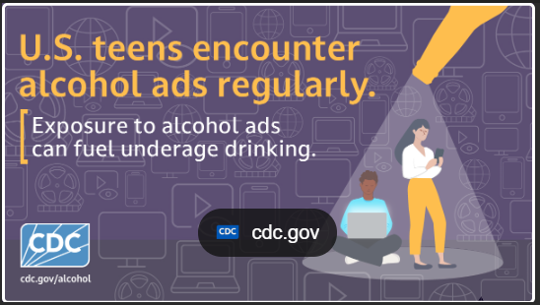

Alcohol use and youth
Increased risk of hypoglycemia
Delayed hypoglycemia 6-12 hours
after drinking alcohol
Hypoglycemia unawareness – symptoms of alcohol intoxication (drowsiness, confusion, slurred speech, difficulty walking) may be similar to hypo symptoms.
This may delay hypo treatment.
Notes:
Delayed hypoglycemia may occur during sleeping hours.
Provide youth with information/education re the importance of having snack/meal with alcohol,
carrying supplies to treat a low, and testing glucoses.
Discuss carb and sugar content of alcoholic beverages: lite beers vs mixed drinks vs fruity cocktails (which may contribute to hyperglycemia).

Slide 100
Poll Question 12
JR has type 1 diabetes for 7 years and is turning 18 this year. What will help him make a successful transition to diabetes self-care as an adult?
  A. Encourage complete autonomy
  B. Moving to his own apartment
  C. Requiring he pay for his own diabetes supplies
  D. Providing support and resources

Slide 101

Prepare for Transition from Pediatric to Adult Care
Prepare for transition at least 1 year ahead of time
Health care providers / families must recognize vulnerabilities and prepare
Both pediatricians and adult health care providers to provide support and resources for teen and emerging adult
Encourage family involvement in diabetes management tasks
  Recognize that premature transfer of diabetes care to the child can result in non-adherence and deterioration of glycemic control
Notes:
Care and close supervision of diabetes management is increasingly shifted from parents and other older adults throughout childhood and adolescence; however, the shift from pediatric to adult health care providers often occurs very abruptly as the older teen enters the next developmental stage, referred to as emerging adulthood,¹ a critical period for young people who have diabetes
Though scientific evidence continues to be limited, it is clear that early and ongoing attention be given to comprehensive coordinated planning for seamless transition of all youth from pediatric to adult health care^{2,3}
A comprehensive discussion regarding the challenges faced during this period is found in the ADA position statement “Diabetes Care for Emerging Adults: Recommendations for the Transition from Pediatric to Adult Diabetes Care Systems”³
The National Diabetes Education Program (NDEP) has materials available to facilitate the transition process (http://ndep.nih.gov/transitions/) and The Endocrine Society in collaboration with the ADA and other organizations has developed transition tools for clinicians and youth/families:
(http://www.endo-society.org/clinicalpractice/transition_of_care.cfm)
This slide includes recommendations for transitioning teens with diabetes into adulthood⁴
101
References
Arnett JJ. Emerging adulthood. A theory of development from the late teens through the twenties. Am Psychol 2000;55:469–480
Weissberg-Benchell J, Wolpert H, Anderson BJ. Transitioning from pediatric to adult care: a new approach to the post-adolescent young person with type 1 diabetes. Diabetes Care 2007;30:2441–2446
Peters A, Laffel L, for the American Diabetes Association Transitions Working Group. Diabetes care for emerging adults: recommendations for transition from pediatric to adult diabetes care systems: a position statement of the American Diabetes Association, with representation by other groups. Diabetes Care 2011;34:2477–2485
American Diabetes Association. Standards of medical care in diabetes—2014. Diabetes Care 2014;37(suppl 1):S53

Slide 102

Risk Reduction Critical – will have diabetes for a long time
Focus on prevention of complications
  Vaccinations, oral care, eye exams
  Glucose, lipid and blood pressure control
  Lifetime weight management
  Don’t smoke or use tobacco products
  Keep active
  Evaluate alcohol intake
  Get support
  Other

Slide 103

Diabetes self-management summary
No matter how sound the medical plan is,
self-management will only be effective if the affected individuals and/or family can implement it.
Notes:
Summary: the importance of individualizing care, recognizing that both the family and the child/adolescent must be provided with education and support. DSMES

Slide 104

Thank You
Questions?
We are here to help!
Email info@diabetesed.net
Call 530-893-8635
www.DiabetesEd.net

