Slide 1


Diabetes Pathophysiology
Beverly Dyck Thomassian, RN, MPH, BC-ADM, CDE
President, Diabetes Education Services
www.DiabetesEd.net

Slide 2
Lecture Objectives
Discuss the current epidemiologic impact of diabetes.
Describe the pathway of pathophysiological defects associated with the development of diabetes mellitus.
Describe and differentiate between the different types: prediabetes, Type 1, Type 2, LADA and GDM
Describe the laboratory tests used for the diagnosis of Diabetes Mellitus including FBG, OGTT, hemoglobin A1C, antibody testing and C-peptide.
List the characteristics that define the Insulin Resistance.
Differentiate between hypoglycemia, hyperglycemic crisis and the chronic macrovascular complications of DM.
Differentiate between hypothyroidism and hyperthyroidism and the symptoms associated with each.

Slide 3
Slide 2 of Important Stuff
Textbook Objectives
1. Describe the microvascular complications associated with uncontrolled hyperglycemia (ch 18)
2. Explain methods for diagnosing thyroid disorders (ch 20)
3. Discuss the most common thyroid complications and the symptoms of each (ch 20)
4. List the factors that contribute to Cardiometabolic Risk (ch. 39)

Slide 4

Global Epidemic
Every 10 seconds
  1 person dies with diabetes
  2 people develop diabetes
Every year
  3 million deaths
  6 million new cases
World Diabetes Day is November 14
March is ADA Sound the Alert Day “find people w/ undetected diabetes”

Slide 5


World Diabetes Day
November 14

Slide 6
CDC Announces
35% of Americans will have Diabetes by 2050
Boyle, Thompson, Barker, Williamson
2010, Oct 22:8(1)29
www.pophealthmetrics.com

Slide 7
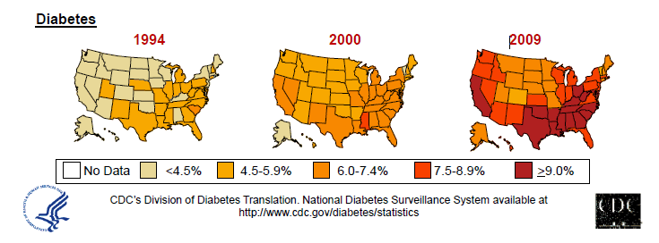
Diabetes in America 2014
29 million or > 9.3%
27% don’t know they have it
37% of US adults have pre diabetes (79 mil)

Slide 8
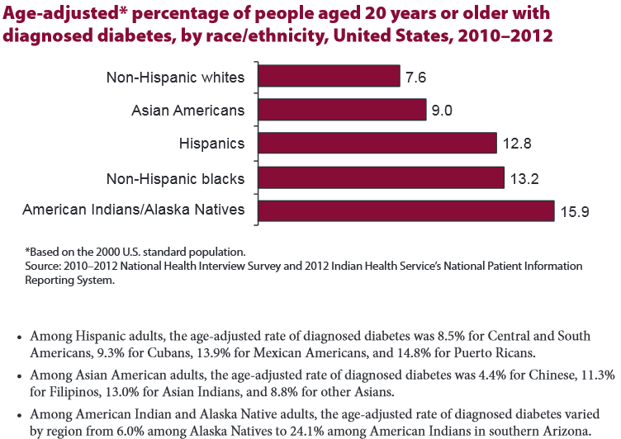

Age-adjusted Diabetes Prevalence
20 yrs or older, by race/ethnicity— U.S. 20014

Slide 9
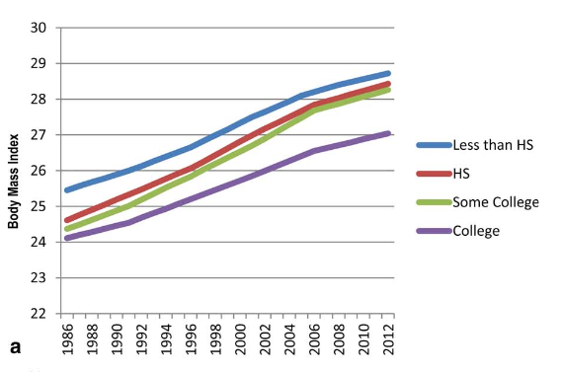
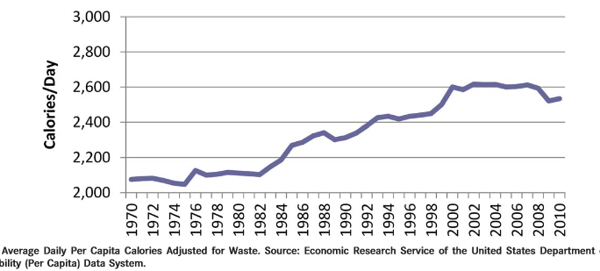
Obesity and Economics in America
68% overweight or obese
  34% BMI 30 +, 34% BMI 25-29
1/3 of all overwt people don’t get diabetes
We burn 100 cals less a day at work
Overall, food costs ~ 10-15% of income
Calorie Intake is on the rise

Slide 10

32% of Medicare dollars go to
Treat diabetes.
2012 - Total cost of diabetes $245 billion
  Indirect costs: $69 billion (disability, work loss, premature mortality)
People with diabetes had 2-4 x’s greater medical expenditures
The largest components of medical expenditures are:
  43% - hospital inpatient care
  18% - prescription meds to treat complications
  12% - diabetes meds supplies
  9% - physician office visits
  8% - nursing/residential facility stays

Slide 11


Now, let’s get to the Nitty Gritty

Slide 12


Slide 13
Insulin Secretion by the β-Cell
Roles of Glucose, K⁺, and Ca²⁺
Glucose entry
Insulin secretion
GLUT2 glucose
transporter
Insulin secretory granules
Glucokinase
Glucose metabolism
Ca²⁺
Ca²⁺
Ca²⁺
Ca²⁺
ADP/ATP
K+
Ca²⁺
K+
K+
Calcium channel
ADP/ATP
opens
SUR 1
Kir 6.2
Potassium (K_{ATP}) channel closes
K+
Sulfonylureas close K+ channels

Slide 14
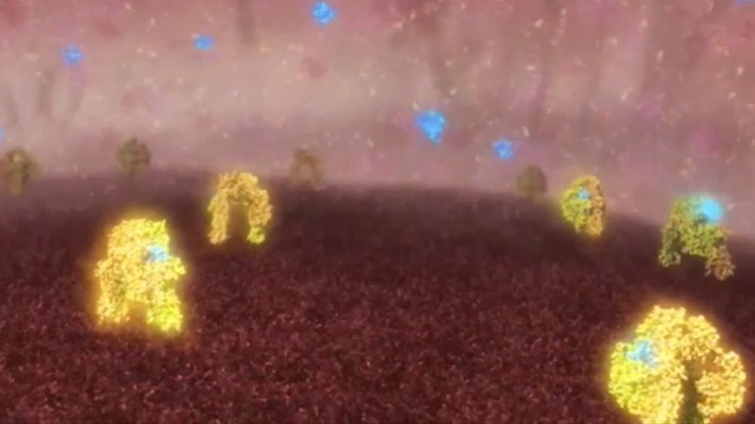
Images showing insulin (blue) molecules binding with insulin receptors (yellow) Jan 2013
The international research team was led by scientists from the Walter and Eliza Hall Institute (WEHI) in Melbourne, with collaborators from La Trobe University, the University of Melbourne, Case Western Reserve University, the University of Chicago, the University of York and the Institute of Organic Chemistry and Biochemistry in Prague.

Slide 15
Pancreas – Hormones that lower BG
Beta Cells - Insulin
  Anabolic hormone - helps store glucose as glycogen in muscle, liver
  secreted in response to elevated glucose
  halts breakdown of glycogen in liver
  increases protein synthesis, fat storage
  powerful hypoglycemic
Beta Cells - Amylin
  secreted in 1:1 ratio with insulin
  Causes satiety
  Lowers post-prandial glucagon response
  Slows gastric emptying
  Type 1 make none
  Type 2 make less than normal amounts

Slide 16
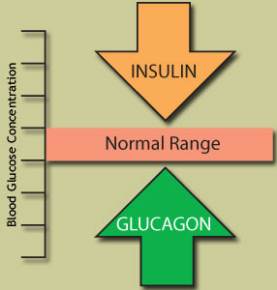
Pancreas – Hormone Raises BG
Alpha cells - Glucagon
  Opposes action of insulin at the liver
  stimulated in response to low glucose levels
  stimulates liver to convert glycogen to glucose
  inhibits liver from glucose uptake
  causes hyperglycemia

Slide 17
Hormones Effect on Glucose
Hormone
Glucagon (pancreas)
Stress hormones (kidney)
Epinephrine (kidney)
Insulin (pancreas)
Amylin (pancreas)
Gut hormones - incretins (GLP-1) released by L cells of intestinal mucosa, beta cell has receptors)
Effect



⇒
⇒
⇒

Slide 18
Signs of Diabetes
Polyuria
Polydipsia
Polyphasia
Weight loss
Fatigue
Skin and other infections
Blurry vision
Glycosuria, H₂O losses
Dehydration
Fuel Depletion
Loss of body tissue, H₂O
Poor energy utilization
Hyperglycemia increases incidence of infection
Osmotic changes

Slide 19
Natural History of Diabetes
Normal
FBG <100
Random <140
A1c <5.7%
Prediabetes
FBG 100-125
Random 140 - 199
A1c ~ 5.7- 6.4%
50% working pancreas
Diabetes
FBG 126 +
Random 200 +
A1c 6.5% or +
20% working pancreas
Yes!
NO
Development of type 2 diabetes happens over years or decades

Slide 20
Diagnostic Criteria
All test should be repeated in the absence of unequivocal hyperglycemia
If test abnormal, repeat same test to confirm diagnosis on a different day
If one test normal, the other abnormal, repeat the abnormal test to determine status
Medicare still using fasting as criteria for reimbursement for education

Slide 21

What Kind of Diabetes?
AJ, a 22 year old female admitted to the ICU with a blood glucose of 476 mg/dl and a pH of 7.1.
What further questions and or testing is needed to determine if patient has type 1 or type 2 diabetes?

Slide 22

Type 1 Diabetes

Slide 23
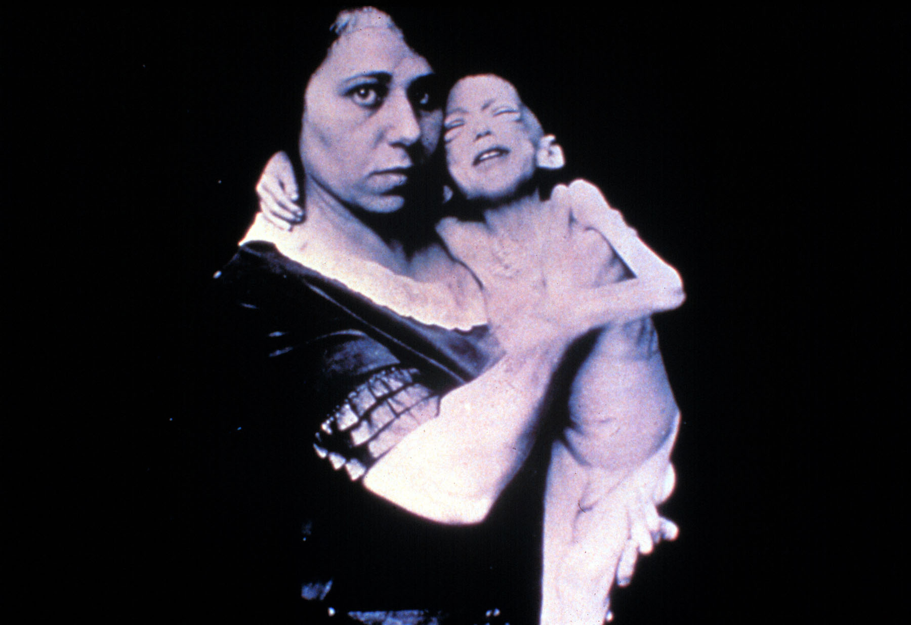

Slide 24


Slide 25
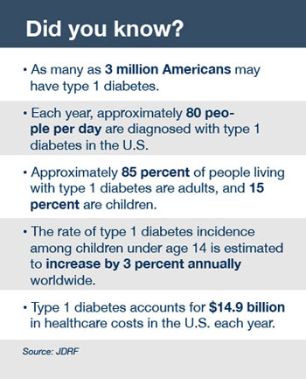
Type 1 Diabetes Facts

Slide 26

Type 1 Rates Increasing Globally
23% rise in type 1 diabetes incidence from 2001-2009
Why?
  Autoimmune disease rates increasing over all
  Changes in environmental exposure and gut bacteria?
  Hygiene hypothesis
  Obesity?

Slide 27

Incidence of Type 1 in Youth
General Pop 0.3%
Sibling 4%
Mother 2-3%
Father 6-8%
Rate doubling every 20 yrs
Many trials underway to detect and prevent (Trial Net)

Slide 28
Type 1 – 10% of all Diabetes
Genetics and Risk Factors
  Auto-immune pancreatic beta cells destruction
  Most commonly expressed at age 10-14
  Insulin sensitive (require 0.5 - 1.0 units/kg/day)
  Combo of genes and environment:
    Autoimmunity tends to run in families
    Higher rates in non breastfed infants
    Viral triggers: congenital rubella, coxsackie virus B, cytomegalovirus, adenovirus and mumps.

Slide 29

Type 1 Diabetes – Genetics and Risk Factors
  Combo of genes and disease susceptibility
  Risk Factors:
    Autoimmunity tends to run in families
    Higher rates in non breastfed infants
    Viral triggers: congenital rubella, coxsackie virus B, cytomegalovirus, adenovirus and mumps.
  Living longer (avg age expectancy 68.5)

Slide 30

How do we know someone has Type 1 vs Type 2?
Type 1
  Positive antibodies
    GAD
    ICA
    IAA and others
Younger people develop quickly
Older people take longer to develop
Body wt and presentation

Slide 31
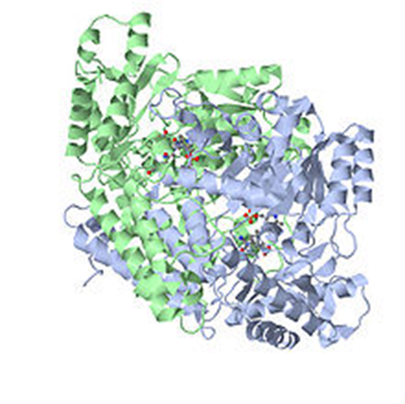
Autoantibodies Assoc w/ Type 1
Panel of autoantibodies –
  GAD65 - Glutamic acid decarboxylase –
  ICA - Islet Cell Cytoplasmic Autoantibodies
  IAA - Insulin Autoantibodies

Slide 32
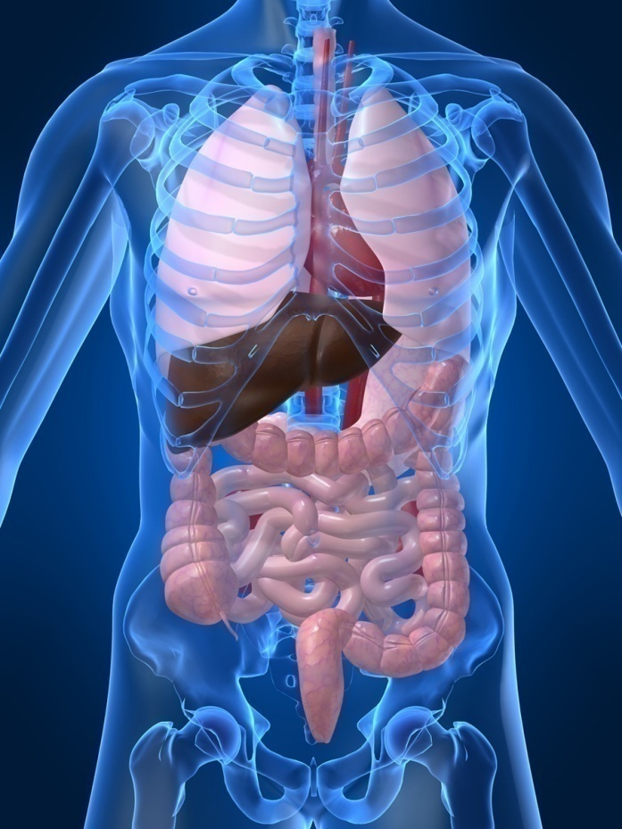
Type 1 Diabetes Associated with other immune conditions
Celiac disease (gluten intolerance)
Thyroid disease
Addison’s Disease
Rheumatoid arthritis
Other

Slide 33





What Does Type 1 Look Like?
Bret Michaels
Halle Berry
Sharon Stone
Mary Tyler Moore
From Debbie Nagata’s slide collection
Adam Morrison
Justice Sonia Sotomayor
Nick Jonas

Slide 34

Type 1 in Hospital
43 yr old admitted to evaluate angina.
Morning blood sugar is 92.
Based on Regular insulin sliding scale, no insulin required.
Breakfast tray shows up and patient says, I need my insulin shot before I eat.
What do you say?

Slide 35

Type 1 Summary
Autoimmune pancreatic destruction
Need insulin replacement therapy
Often first present in DKA
At risk for other autoimmune diseases

Slide 36
What kind of Diabetes?
Pt is 58, states she has had type 1 diabetes for 18 years. Quit smoking a year ago and gained about 20 lbs. BMI 25.
Meds
  Humalog 18-23 units before each meal
  Lantus 28 units at bedtime
  Metformin 500mg TID
What tests would you recommend?
25% of patients with Type 1 also have type 2 diabetes.
ADA Post Grad, 2010

Slide 37


Slide 38

What type of Diabetes?
72 Years old
A1c 3 months prior 6.2%
A1c now 13.9%
BMI 24.5
Lost about 10 pounds over last month

Slide 39

Latent AutoImmunity Diabetes in Adults (LADA)
Antibody positive to 1-2 of below
  GAD-65 autoantibodies
  Insulin Autoantibodies
  Islet Cell antigen-2
Adult Age at onset
Usually need insulin w/in first 6 months of diagnosis
Early insulin therapy may preserve beta cell function
Diabetes Care 26:536-538, 2003
Jerry P. Palmer, MD and Irl B. Hirsch, MD

Slide 40
LADA Clinical Features Compared to Type 2
Feature LADA Type 2
Age <50 63% 19%
Acute hyperglycemia 66 24
BMI < 25 33 13
Hx of autoimmune dx 27 12
Family hx autoimmune 46 35
Practical Diabetology March 08, Unger MD

Slide 41

Life Study – Mrs. Jones
Mrs. Jones is 62 years old, overweight and complaining of feeling tired and urinating several times a night. She is admitted with a urinary tract Infection. Her WBC is 12.3, glucose 237. She is hypertensive with a history of gestational diabetes. No ketones in urine.
What are her risk factors, signs of diabetes
What type of diabetes does she have?
Does she have insulin resistance?

Slide 42


Patti Labelle
"divabetic" -- that's a mix of diabetic and diva

Slide 43
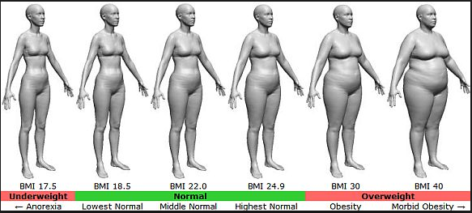
BMI – Visual Image

Slide 44

Diabetes 2 - Who is at Risk?
(ADA Clinical Practice Guidelines)
Testing should be considered in all adults who are overweight (BMI ≥ 25) and have additional risk factors:
  First-degree relative w/ diabetes
  Member of a high-risk ethnic population
  Habitual physical inactivity
  PreDiabetes
  History of heart disease

Slide 45

Diabetes 2 - Who is at Risk?
(ADA Clinical Practice Guidelines)
Risk factors cont’d
  HTN - BP > 140/90
  HDL < 35 or triglycerides > 250
  baby >9 lb or history of Gestational Diabetes Mellitus (GDM
  Polycystic ovary syndrome (PCOS)
  Other conditions assoc w/ insulin resistance:
    Severe obesity, acanthosis nigricans (AN)

Slide 46
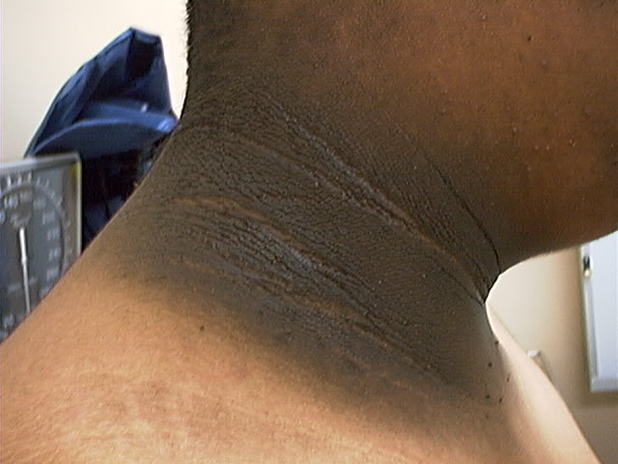
Acanthosis Nigricans

Slide 47
Acanthosis Nigricans (AN)
Signals high insulin levels in bloodstream
Patches of darkened skin over parts of body that bend or rub against each other
  Neck, underarm, waistline, groin, knuckles, elbows, toes
  Skin tags on neck and darkened areas around eyes, nose and cheeks.
No cure, lesions regress with treatment of insulin resistance

Slide 48

What is Type 2 Diabetes?
Complex metabolic disorder ….
  (Insulin resistance and deficiency)
with social, behavioral and environmental risk factors unmasking the effects of genetic susceptibility.
New Diagnosis?
Call 800 – DIABETES to request “Getting Started Kit”
www.Diabetes.org

Slide 49
Natural Progression of Type 2 Diabetes
Plasma
Glucose
Postprandial glucose
Fasting glucose
126 mg/dL
Relative
β-Cell
Function
Insulin resistance
Insulin secretion
-20
-10
0
10
20
30
Years of Diabetes
Prior to diagnosis
After diagnosis
Adapted from Bergenstal et al. 2000; International Diabetes Center.
Notes:
These graphs show the typical progressive nature of type 2 diabetes in terms of 2 key indices: increasing plasma glucose level (top panel) and decline in relative β-cell function as reflected by the drop in endogenous insulin and rise in insulin resistance (lower panel).
In the natural history of type 2 diabetes, insulin resistance rises, insulin secretion falls, and glucose levels begin to rise before diabetes is diagnosed.
Based on the natural history, type 2 diabetes is a disease of progressive insulin failure as shown in the graphic model developed by researchers at the International Diabetes Center.¹
Before the onset of diabetes, glucose levels start to rise, with a slightly sharper increase in the postprandial value than in fasting glucose. Both postprandial and fasting plasma glucose levels continue to rise if diabetes is left untreated.²
Prior to the diagnosis of diabetes, resistance of cell receptor sites to insulin starts to increase, while insulin secretion by β-cells decreases. Insulin resistance reaches a peak and remains constant. Endogenous insulin secretion continues to decline over the course of diabetes.²
References:
1. Kendall DM. Postprandial blood glucose in the management of type 2 diabetes: the emerging role of incretin mimetics. Available at: http://www.medscape.com/viewarticle/515693.
Accessed April 21, 2006.
2. Ramlo-Halsted BA, Edelman SV. The natural history of type 2 diabetes: implications for clinical practice. Prim Care. 1999;26:771-789.

Slide 50
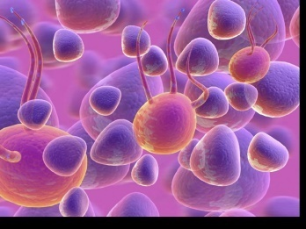
Ominous Octet
Decreased
satiation neuro-
transmission
Decreased
amylin, β-cell secretion
80% loss at dx
Increased renal glucose reabsorption
Decreased
Gut hormones
Increased glucagon secretion
G
I
G
I
G
G
I
I
G
G
Increased lipolysis
G
I
I
G
G
I
Increase glucose
production
I
G
G
Decreased glucose
uptake
Notes:
50
50

Slide 51
What Do You Say?
Mrs. Jones asks you
What is type 2 diabetes?
Will this go away?
Will I get complications?
Will I need to take diabetes medication for the rest of my life?
How come I got diabetes?
Do I have to check my blood sugars?

Slide 52
Overcoming barriers
Confront the key misbelief. Ask the question, does dm cause complications?
Offer pts evidence based hope message –
Frequent contact
Paired glucose testing
Ask pt, “Tell me 1 thing that is driving you crazy about your diabetes”
Discuss medication beliefs
To improve outcomes, see pts more often
  Bill Polonsky, PhD, CDE

Slide 53
Comparison of
Type 1,Type 2, LADA
Type 1
Type 2 LADA
Obesity
x
xxx x
Insulin dependence
xxx
30% 6mos
Respond to oral agents
0
xxx x
Ketosis
xxx
x x
Antibodies present
xxx
0 xx
Typical Age of onset
teens
adult adult
Insulin Resistance
0
xxx
x

Slide 54

Diabetes is also associated with
Fatty liver disease
Obstructive sleep apnea
Cancer; pancreas, liver, breast
Alzheimer’s
Depression

Slide 55


Other Types of Diabetes
Gestational
Other specific types of diabetes

Slide 56

Gestational DM ~ 7% of all Pregnancies
GDM prevalence increased by
  ∼10–100% during the past 20 yrs
Native Americans, Asians, Hispanics, African-American women at highest risk
Immediately after pregnancy, 5% to 10% of GDM diagnosed with type 2 diabetes
Within 5 years, 50% chance of developing DM in next 5 years.

Slide 57

Increasing Prevalence –
A public health perspective
Body weight before and during pregnancy influences risk of GDM and future diabetes
Children born to women with GDM at greater risk of diabetes
Focus on prevention

Slide 58
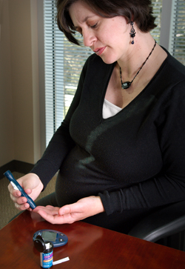
Diabetes in pregnant mothers associated with …
Offspring
  Fetal Complications
  Obesity and diabetes later in life
Mother
  More complicated pregnancy and delivery
  Diabetes later in life
Intrauterine environment is important

Slide 59

Screen Pregnant Women
Before 13 weeks
Screen for undiagnosed Type 2 at the first prenatal visit using standard risk factors.
Women found to have diabetes at their initial prenatal visit treated as “Diabetes in Pregnancy”
If normal, recheck at 24-28 weeks

Slide 60

Postpartum after GDM
50% risk of getting diabetes in 5 years
Screen at 6-12 wks post partum
Repeat at 3 yr intervals or signs of DM
  Encourage Breast Feeding
  Encourage weight control
  Encourage exercise
  Make sure connected with health care
  Lipid profile/ follow BP
  Preconception counseling

Slide 61
Diabetes Bingo
“DiaBingo” - Shout out Right Answer

Slide 62
DiaBingo
B Frequent skin and yeast infections
B A BMI of ____ or greater is considered overweight
B To reduce complications, control A1c, Blood pressure, Cholesterol
B PreDiabetes – fasting glucose level of ___ to ____
B Erectile dysfunction indicates greater risk for ____
B Diabetes – fasting glucose level____ or greater
B Type 1 diabetes is best described as an ______ disease
B People with diabetes are ______ times more likely to die of heart dx
B Elevated triglycerides, < HDL, smaller dense LDL
B Each percentage point of A1c = _____ mg/dl glucose
B At dx of type 2, about __% beta cell function is lost
B Diabetes – random glucose ____ or greater

Slide 63
Hyperglycemia and Insulin Resistance – From Head to Toe

Slide 64

Objectives
Describe the impact of insulin resistance
State the factors associated with of cardiometabolic risk.
State strategies to maintain oral health and keep lower extremities healthy

Slide 65
Insulin Action in Muscle and Fat Cells
Mobilization of GLUT4 to the Cell Surface
Plasma membrane
Insulin receptor
Intracellular signaling
cascades
Intracellular
GLUT4 vesicles
Insulin
GLUT4 vesicle mobilization
to plasma membrane
GLUT4 vesicle integration into plasma membrane
Glucose entry into cell
via GLUT4
GLUT4=glucose transporter 4

Slide 66
Mechanism of Glucotoxicity and Lipotoxicity
The Glucosamine Hypothesis
Glucose
FFA
Glucose
FFA
Other
pathways
Increased
glucosamine
Other
pathways
Impaired insulin
secretion from β-cell
Insulin resistance
in muscle and fat
Hawkins M et al. J Clin Invest. 1997;99:2173-2182; Rossetti L. Endocrinology. 2000;141:1922-1925
FFA=free fatty acid

Slide 67




Slide 68

Insulin Resistance is the Seed

Slide 69
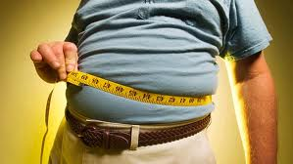
Factors Associated with Insulin Resistance
Abdominal obesity
Sedentary lifestyle
Genetics / Ethnicity
Gestational Diabetes
Polycystic ovary syndrome
Acanthosis Nigricans
Obstructive Sleep Apnea
Cancer
American College of Endocrinology, 2001

Slide 70

Cardio Metabolic Risk -
5 Hypers -
Hyperinsulinemia (resistance)
Hyperglycemia
Hyperlipidemia
Hypertension
Hyper”waistline”emia (35” women, 40” men)
Manifestations of Insulin Resistance

Slide 71
The Link Between Hyperglycemia, Insulin Resistance and Cardiovascular Disease

Slide 72
Heart Disease & DM = 3-5xs Risk
CHF
  7.9 % w/ diabetes vs.
  1.1 % no diabetes
Heart attack
  9.8 % w/ diabetes vs.
  1.8 % no diabetes
Coronary heart disease
  9.1 % w/ diabetes vs.
  2.1 % no diabetes
Stroke
  6.6 % w/ diabetes vs.
  1.8 % no diabetes
  2007 AACE

Slide 73
Vascular Disease & Diabetes “atheroscleropathy”
  Normal endothelial cells are protective
  Abnormal glucose = Endothelial cell dysfunction
    Lower Nitric Oxide levels = Poor vasodilation
    Release of inflammatory mediators
    Higher aldosterone levels
    Adipokines = > angiotensin = HTN
    = Increased risk of acute thrombotic event
  Increased arterial stiffness
      Due to chronic hyperglycemia, endothelial inflammation

Slide 74
Risk of CVD Is Elevated prior to Diagnosis of Type 2 Diabetes
Relative Risk of MI* or Stroke
*MI = myocardial infarction. Nurses Health Study
Adapted from: Hu F, et al. Diabetes Care. 2002;25:1129-1134.

Slide 75
CardioVascular Risk Factors
Cardio
Metabolic
Risk
Insulin
Resistance
Syndrome
Smoking
Physical
Inactivity
Age, Race
Gender,
Family hx
Inflammation
Hyper-
coagulation
Hypertension
Abnormal
Lipid
Metabolism
BMI >25
Waist
35” women
40” men
The more risk
factors = greater
risk of heart
disease and
diabetes
ADA 2007

Slide 76
People with Diabetes in the Dark about CVD Link
Recent survey of 2000 pt’s w/ DM
68% did not consider CVD a complication of diabetes
Only 17% thought DM increased risk of CVD
Survey: American Diabetes Association and American College of Cardiology

Slide 77
Bottom Line
Cardiovascular disease is the leading cause of death for people with diabetes
65% of people with diabetes die from heart disease (36% in general population)
Prevention and aggressive treatment of diabetes is critical

Slide 78
Now on to Hyperglycemic Crisis

Slide 79

Diabetes KetoAcidosis
135,000 Hospitalizations a year
$2.4 billion U.S. dollars spent on treatment
Often a cry for help
ADA article on Hyperglycemic Crises

Slide 80
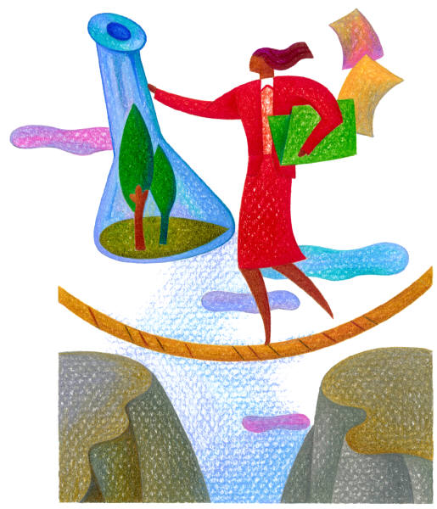
DKA Precipitating Factors
25 -30% of time, illness and infection
  increases stress hormone release
50% inadequate insulin dosage
initial manifestation of type 1
emotional stress - especially with teens, neglect or
mismanagement

Slide 81
Extreme Hyperglycemia –
Diabetes KetoAcidosis (DKA)
DKA - profound insulin deficiency
Excess stress hormones such as glucagon, epinephrine, and cortisol render insulin less effective
Excess glucose production by liver
Lipolysis leads to FFA’s and ketones
Osmotic diuresis, dehydration, lyte imbalances, acidosis

Slide 82
DKA Signs and Symptoms
hyperglycemia- leads to weakness, lethargy, malaise, headache
GI symptoms - N/V, abd pain
Kussmaul’s deep, rapid breathing
hypothermia, acetone breath
hyperpnea - to rid acidosis
changes in mentation, hyporeflexia/tonia
dehydration, ortho hypo

Slide 83
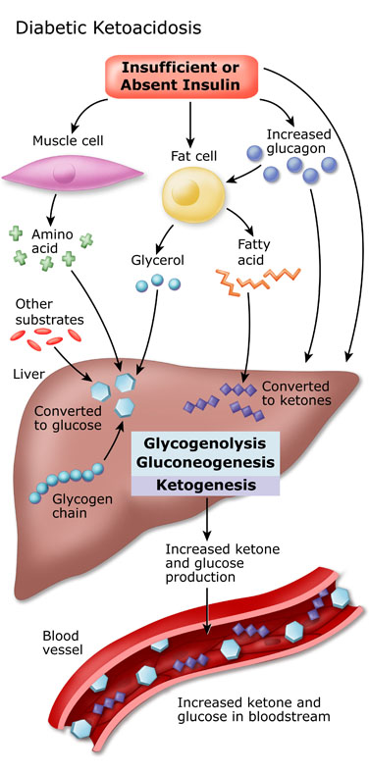
DKA Pathophysiolgy
DKA explained clearly
Video
Cells use fatty acids for energy.
Insulin not present to inhibit fatty acid breakdown
Acetone – blow off
Betahydroxybuterate
Acetoacetate
Acidosis – Anion Gap >12

Slide 84
Extreme Hyperglycemia –
Hyperosmolar Hyperglycemic State (HHS)
occurs in elderly pt’s w/ type 2 - esp if not closely monitored
often precipitated by illness or stress
symptoms may go unrecognized for wks
massive fluid loss from osmotic diuresis
  burns, hyperglycemia, diarrhea, hemodialysis, diuretics, steroids
MI, infections, hypertonic feedings

Slide 85
DKA vs HHS
Usually < 40 yrs old
< 2 days symptoms
Glucose >250
Serum Ketones: +++
pH low (<7.3)
Anion Gap > 12
Usually Type 1
3 – 10% mortality
Usually >60 yrs old
> 5 days symptoms
Glucose >600
Ketones: none to +
pH normal (>7.3)
Usually Type 2
10 - 20% mortality

Slide 86
DKA - HHS Presentation and Action
Labs
  NA - low to high
  K+ - moves into vascular space
  Hct and Hgb ⬆ dehydration
  BUN / Creatinine ⬆
  WBC ⬆ (no infect)
  pH low to normal
Action
  maintain insulin drip until ketone neg, glucose <200
  maintain hydration
  check BG q1 hour
  assess lytes (esp K+)
  give sub-Q insulin before d/c IV insulin
  teach, teach, teach

Slide 87
DKA and HHS
5 most important interventions
  Fluids (NS, →0.45 NS, →D51/2 NS once glucose 300mg/dl)
  Insulin (.05 - 0.1unit/kg per hour)
  Potassium / lyte replacement
    (K^{+,} Mg, Ca, Phos)
  Determine, treat precipitating cause
  Education to prevent future episodes

Slide 88

Hypoglycemia prevention
72 yr old, thin, lives alone, A1c 7.3%. History of MI, stroke. DM for 12 yrs, takes glyburide 10mg BID. Limited income. Creat 1.4.
What strategies
To prevent lows?

Slide 89

Hypoglycemia – “Limiting Factor”
Defined as glucose of 70mg/dl or below
50% of episodes occur during night
Higher mortality rate with severe hypoglycemia secondary to sulfonylureas
  Especially glyburide
Blood glucose levels don’t describe severity, response is individual

Slide 90
Glycemic Threshold Values
John White, PharmD, Diabetes Spectrum, 2007
Classification BG Physical Response
Lower euglycemia 80-90’s Endogenous insulin
Hypoglycemia 70’s Glucagon, adrenaline
Symptoms 60s Growth hormone, cortisol
50’s Cognitive deterioration
Neuroglycopenia 40’s
30’s
Severe 20’s Coma, seizures
neuroglycopenia 10
(shortage of glucose in the brain
affects function of the neurons)

Slide 91

Hypoglycemia Awareness
autonomic symptoms adrenergically based
after 2-5 yrs of type 1 dm,
  glucagon secretion impaired
  epinephrine secretion becomes primary mechanism to restore BG levels
over time, epi response diminished or delayed
decreases awareness of hypo and hormonal response

Slide 92

Hypoglycemia Symptoms
Autonomic
  Anxiety
  Palpitations
  Sweating
  Tingling
  Trembling
  Hypoglycemic Unawareness
Neuroglycopenia
  Irritability
  Drowsiness
  Dizziness
  Blurred Vision
  Difficulty with speech
  Confusion
  Feeling faint

Slide 93
Treatment of Hypoglycemia
If blood glucose 70mg/dl or below:
  10-15 gms of carb to raise BG 30 - 45mg/dl
Retest in 15 minutes, if still low, treat again, even without symptoms
Follow with usual meal or snack
If BG less than 40, allow recovery time

Slide 94
Tx of Severe Hypoglycemia
If can swallow w/out risk of aspiration, try gel,
honey, etc. inside cheek
If unable to swallow, D50 IV or Glucagon
Glucagon injection – teach support person
  Dosing:
    Adults 1mg
    Children <20kg 0.5mg
  Glycemic effect 20 - 30mg, short lived
  Must intake carb as soon as able
  Need prescription, check exp. date

Slide 95
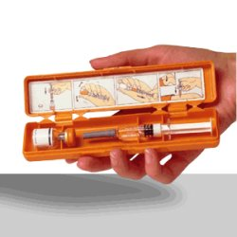

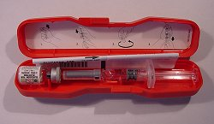
Glucagon Emergency Kit
Store 68-77 degrees prior to reconstitution
single use only

Slide 96
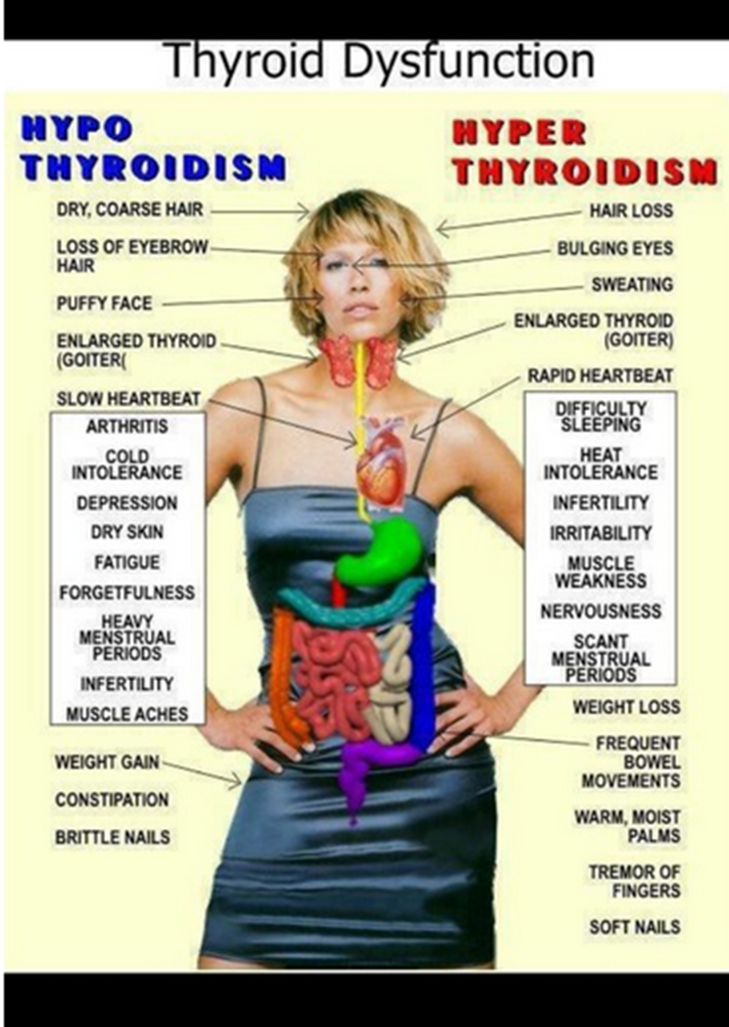
Thyroid Disease and Diabetes
27 mil Americans have over or under active thyroid glands, but more than half remain undiagnosed.
More than 8 out of 10 pts w/ thyroid disease women.
15 to 30% of people w/ diabetes & their siblings or parents are likely to develop thyroid disease (compared to 4.5 percent of the general population).
Check TSH on Type 1 & 2 annually or if indicated.
AACE Website

Slide 97

Thyroid & TSH* Levels
*Thyroid Stimulating Hormone - secreted by pituitary gland
  controls thyroid hormone thyroxine production
  first and best test
  TSH Norm = up to 4.5 mIU/mL
  Treatment based on TSH plus symptoms.
    4.5 – 10 based on risk, s/s
    10 or more = treat
  Lower = hyperthyroidism
  Higher = hypothyroidism–
AACE 2012 Guidelines

Slide 98


Slide 99
Hypothyroidism
Hashimoto’s thyroiditis – autoimmune thyroid
  most common cause of hypothyroidism w/ dm
Type 1 and type 2 at greater risk
Screen annually for thyroid disease in diabetes
Clinical features: fatigue, wt gain, dry skin, cold intolerance, depression, constipation, dyslipidemia
  Higher risk of CVD – monitor risk
Dx: high TSH, then test for free T4, autoantibodies, and thyroid scans as needed
Tx: replacement with levothyroxine (75-125 ug)
  AACE Thyroid Guidelines

Slide 100
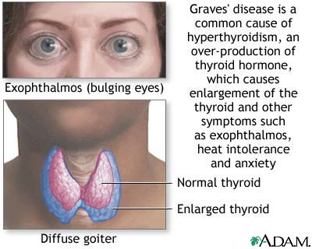
Hyperthyroidism
Graves Disease (most common)
0.5 – 2.0% risk in type 1
Autoimmune disorder:
  Symptoms: wt loss, hypermetabolism, tremor, exopthalmus, palpitations, tachycardia, heat intolerance, nervousness, hyperglycemia
  Diagnosis: Dx: low TSH, then check T3 & T4, autoantibodies, and thyroid scans
  Treatment: antithyroid drugs, surgery, radioactive iodine. After treatment, may need thyroid replacement therapy.
  AACE Thyroid Guidelines 2002

Slide 101

Thank You
www.DiabetesEd.net

