Slide 1


Diabetes and Insulin Pump for Type 2
Beverly Dyck Thomassian, RN, MPH, BC-ADM, CDE
President, Diabetes Education Services
www.DiabetesEd.net
© Copyright 1999-2015, Diabetes Education Services, All Rights Reserved.

Slide 2
Diabetes and Insulin Pump for T2s A Clinical and Educational Update
Describe impact of diabetes
Discuss different types of diabetes
Common Meds and Adjustment
Insulin Pump for Type 2
Barriers to Advanced Therapies
Psychosocial, lifestyle, behavior change and support
Demonstrate successful teaching strategies

Slide 3
CDC Announces
35% of Americans will have Diabetes by 2050
Boyle, Thompson, Barker, Williamson
2010, Oct 22:8(1)29
www.pophealthmetrics.com

Slide 4
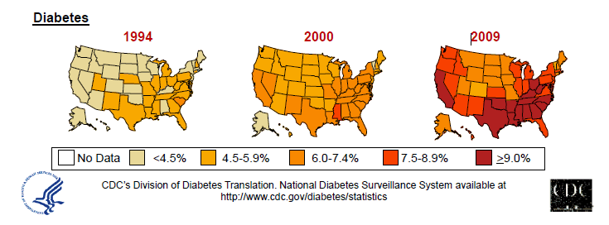
Diabetes in America 2015
29 million or > 9.3%
27% don’t know they have it
37% of US adults have pre diabetes (79 mil)

Slide 5

My Boys –Robert and Jackson
By the time they are 50, 1/3 will have diabetes

Slide 6


Type 2 in Kids
7 fold increase 1990
1 in 6 overwt kids (age 12- 19) have prediabetes.
~2,500 to 3,700 new cases in U.S. annually.
Highest risk: very obese, minority, female, low socioeconomic status, limited education
In age range 12-19, less than 1% have Type 2 – NHANES
Environmental changes to urgently needed

Slide 7
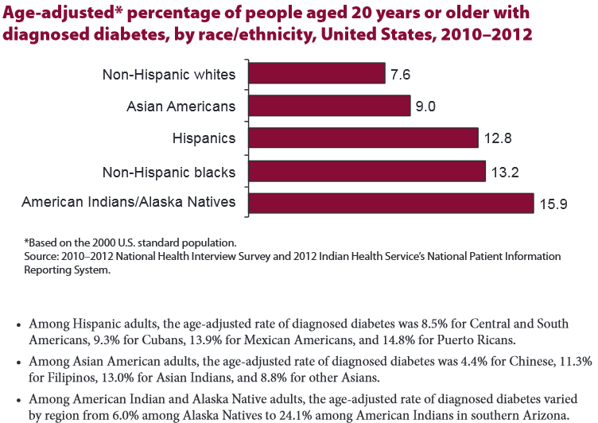

Age-adjusted Diabetes Prevalence 20 yrs or older, by race/ethnicity— U.S. 20014

Slide 8

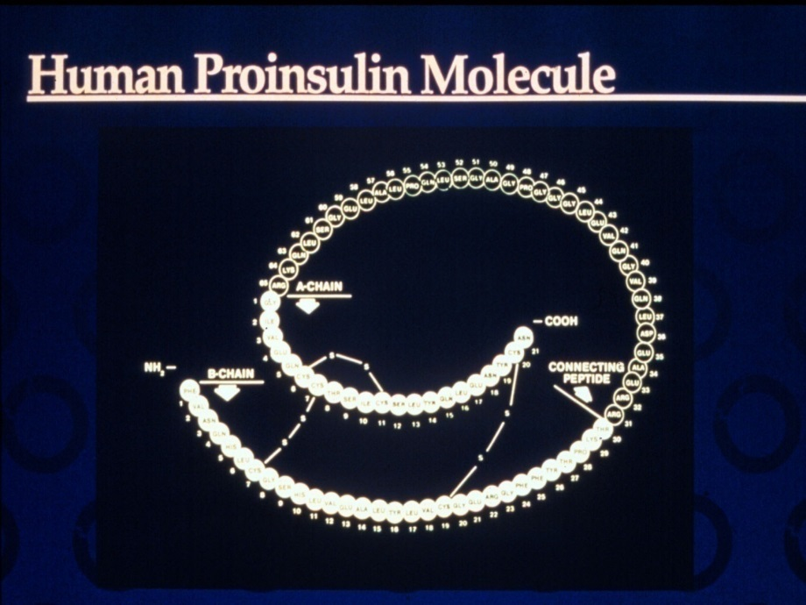


Slide 9
Hormones Effect on Glucose
Hormone
Glucagon (pancreas)
Stress hormones (kidney)
Epinephrine (kidney)
Insulin (pancreas)
Amylin (pancreas)
Gut hormones - incretins (GLP-1) released by L cells of intestinal mucosa, beta cell has receptors)
Effect



⇒
⇒
⇒

Slide 10
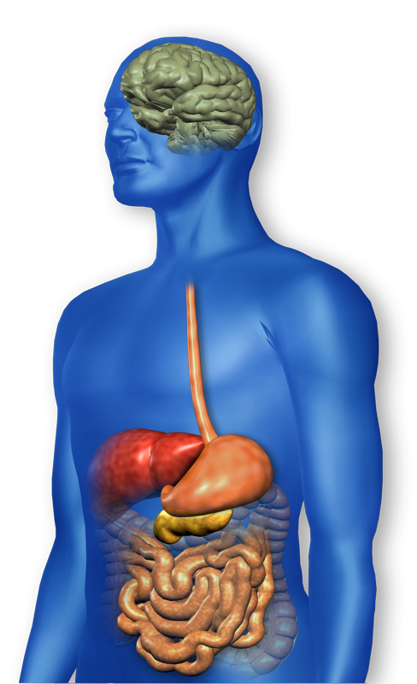
GLP-1 Effects in Humans Understanding the Natural Role of Incretins
GLP-1 secreted upon the ingestion of food
Promotes satiety and reduces appetite
Alpha cells:
↓ Postprandial glucagon secretion
↑ Beta-cell
response
Liver: ↓ Glucagon reduces hepatic glucose output
Beta cells: Enhances glucose-dependent insulin secretion
Stomach: Helps regulate gastric emptying
Adapted from Flint A, et al. J Clin Invest. 1998;101:515-520 Adapted from Larsson H, et al. Acta Physiol Scand. 1997;160:413-422 Adapted from Nauck MA, et al. Diabetologia. 1996;39:1546-1553 Adapted from Drucker DJ. Diabetes. 1998;47:159-169
GLP-1 degraded by
DPP-4 w/in minutes
Notes:
10
10
Required
DISCUSSION POINTS:
--Upon food ingestion, GLP-1 is secreted into the circulation from L cells of small intestine.
--GLP-1 increases beta-cell response by enhancing glucose-dependent insulin secretion.
--GLP-1 decreases beta-cell workload and hence the demand for insulin secretion by:
--Regulating the rate of gastric emptying such that meal nutrients are delivered to the small intestine and, in turn, absorbed into the circulation more smoothly, reducing peak nutrient absorption and insulin demand (beta-cell workload)
--Decreasing postprandial glucagon secretion from pancreatic alpha cells, which helps to maintain the counterregulatory balance between insulin and glucagon
--Reducing postprandial glucagon secretion, GLP-1 has an indirect benefit on beta-cell workload, since decreased glucagon secretion will produce decreased postprandial hepatic glucose output
--Having effects on the central nervous system, resulting in increased satiety (sensation of satisfaction with food intake) and a reduction of food intake
--By decreasing beta-cell workload and improving beta-cell response, GLP-1 is an important regulator of glucose homeostasis.
SLIDE BACKGROUND:
--Effect on Beta-cell: Drucker DJ. Diabetes. 1998; 47:159-169
--Effect on Alpha cell: Larsson H, et al. Acta Physiol Scand. 1997; 160:413-422
--Effects on Liver: Larsson H, et al. Acta Physiol Scand. 1997; 160:413-422
--Effects on Stomach: Nauck MA, et al. Diabetologia. 1996; 39:1546-1553
--Effects on CNS: Flint A, et al. J Clin Invest. 1998; 101:515-520

Slide 11
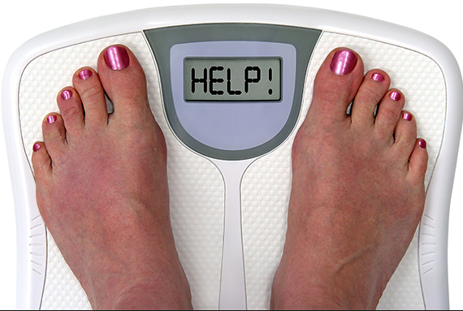
Incretin Mimetics Byetta, Bydureon, Trulicity, Tanzeum
Action (synthetic gut hormone)
Insulin release in response to meal
Slows gastric emptying
Causes Satiety – promotes wt loss
Preserves Beta Cells
Details:
Daily and long acting version - 1x week injection
Efficacy: Decreases A1c by 0.5 – 1.6%, wt by 3lbs +
Benefits/Issues – wt loss, no hyp. Expensive, N/V
Pancreatitis Warning – report signs immediately
Notes:
11
11

Slide 12
Natural History of Diabetes
Normal
FBG <100
Random <140
A1c <5.7%
Prediabetes
FBG 100-125
Random 140 - 199
A1c ~ 5.7- 6.4%
50% working pancreas
Diabetes
FBG 126 +
Random 200 +
A1c 6.5% or +
20% working pancreas
Yes!
NO
Development of type 2 diabetes happens over years or decades

Slide 13

Signs of Diabetes
Polyuria
Polydipsia
Polyphasia
Weight loss
Fatigue
Skin and other
infections
Blurry vision
Glycosuria, H₂O losses
Dehydration
Fuel Depletion
Loss of body tissue, H₂O
Poor energy utilization
Hyperglycemia increases incidence of infection
Osmotic changes

Slide 14

Diabetes Classifications
Type 1
Type 2
Gestational
Secondary
Notes:
Type 1-absent insulin
Type 2-too much insulin early, then resistence and less secretion
GDm-simliar to Type 2, found during pregnancy

Slide 15
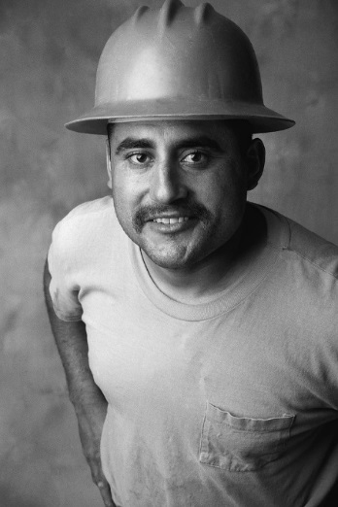

Case Study
1. Pt profile: 5’8”, 192 lb male
Diabetes 12 years, on insulin 3 yrs
What type of DM and how do you know?
2. Pt profile: 5’6”, 108 lb female
On insulin 3u Novolog before meals,
10u Lantus at bedtime
What type of DM and how do you know?

Slide 16


Slide 17


Slide 18

Type 1 – 10% of all Diabetes Genetics and Risk Factors
Auto-immune pancreatic beta cells destruction
Most commonly expressed at age 10-14
Insulin sensitive (require 0.5 - 1.0 units/kg/day)
Combo of genes and environment:
Autoimmunity tends to run in families
Higher rates in non breastfed infants
Viral triggers: congenital rubella, coxsackie virus B, cytomegalovirus, adenovirus and mumps.

Slide 19
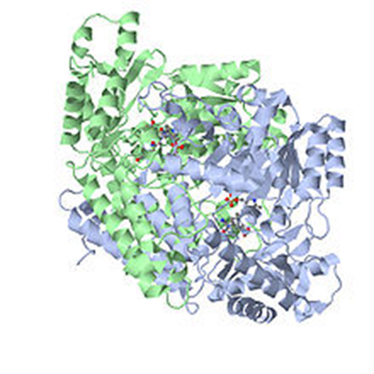
Autoantibodies Assoc w/ Type 1
Panel of autoantibodies –
GAD65 - Glutamic acid decarboxylase –
ICA - Islet Cell Cytoplasmic Autoantibodies
IAA - Insulin Autoantibodies

Slide 20
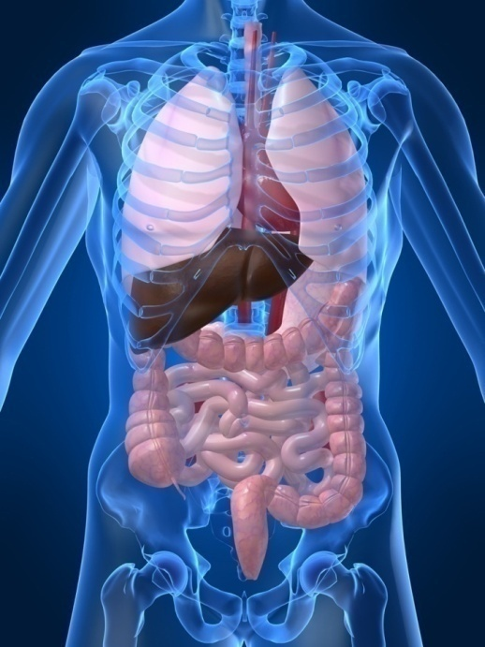
Type 1 Diabetes Associated with other immune conditions
Celiac disease (gluten intolerance)
Thyroid disease
Addison’s Disease
Rheumatoid arthritis
Other

Slide 21





What Does Type 1 Look Like?
Bret Michaels
Mary Tyler Moore
Adam Morrison
Nick Jonas
Justice Sonia Sotomayor
From Debbie Nagata’s slide collection

Slide 22



Ms. Idaho and Ms America – Pumpin’ It

Slide 23

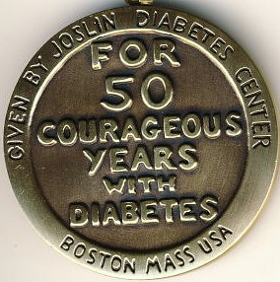
Medalist Study – Harvard Joslin Diabetes Center
After 50 years with diabetes
Many still produced some insulin
Many had no eye disease

Slide 24


Patti Labelle
"divabetic" -- that's a mix of diabetic and diva

Slide 25
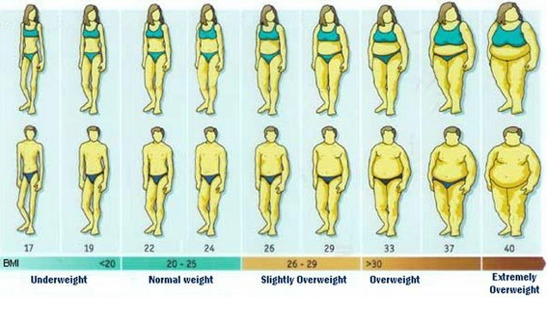
BMI Categories

Slide 26




Slide 27

Insulin Resistance is the Seed

Slide 28

Diabetes 2 - Who is at Risk? (ADA Clinical Practice Guidelines)
Testing should be considered in all adults who are overweight (BMI ≥ 25) and have additional risk factors:
First-degree relative w/ diabetes
Member of a high-risk ethnic population
Habitual physical inactivity
PreDiabetes
History of heart disease

Slide 29

Diabetes 2 - Who is at Risk? (ADA Clinical Practice Guidelines)
Risk factors cont’d
HTN - BP > 140/90
HDL < 35 or triglycerides > 250
baby >9 lb or history of Gestational Diabetes Mellitus (GDM
Polycystic ovary syndrome (PCOS)
Other conditions assoc w/ insulin resistance:
Severe obesity, acanthosis nigricans (AN)

Slide 30
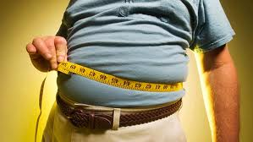
Factors Associated with Insulin Resistance
Abdominal obesity
Sedentary lifestyle
Genetics / Ethnicity
Gestational Diabetes
Polycystic ovary syndrome
Acanthosis Nigricans
Obstructive Sleep Apnea
Cancer
American College of Endocrinology, 2001

Slide 31

Cardio Metabolic Risk - 5 Hypers -
Hyperinsulinemia (resistance)
Hyperglycemia
Hyperlipidemia
Hypertension
Hyper”waistline”emia (35” women, 40” men)
Manifestations of Insulin Resistance

Slide 32
Natural Progression of Type 2 Diabetes
Plasma
Glucose
Postprandial glucose
Fasting glucose
126 mg/dL
Relative β-Cell Function
Insulin resistance
Insulin secretion
-20
-10
0
10
20
30
Years of Diabetes
Prior to diagnosis
After diagnosis
Adapted from Bergenstal et al. 2000; International Diabetes Center.
Notes:
These graphs show the typical progressive nature of type 2 diabetes in terms of 2 key indices: increasing plasma glucose level (top panel) and decline in relative β-cell function as reflected by the drop in endogenous insulin and rise in insulin resistance (lower panel).
In the natural history of type 2 diabetes, insulin resistance rises, insulin secretion falls, and glucose levels begin to rise before diabetes is diagnosed.
Based on the natural history, type 2 diabetes is a disease of progressive insulin failure as shown in the graphic model developed by researchers at the International Diabetes Center.¹
Before the onset of diabetes, glucose levels start to rise, with a slightly sharper increase in the postprandial value than in fasting glucose. Both postprandial and fasting plasma glucose levels continue to rise if diabetes is left untreated.²
Prior to the diagnosis of diabetes, resistance of cell receptor sites to insulin starts to increase, while insulin secretion by β-cells decreases. Insulin resistance reaches a peak and remains constant. Endogenous insulin secretion continues to decline over the course of diabetes.²
References:
1. Kendall DM. Postprandial blood glucose in the management of type 2 diabetes: the emerging role of incretin mimetics. Available at: http://www.medscape.com/viewarticle/515693. Accessed April 21, 2006.
2. Ramlo-Halsted BA, Edelman SV. The natural history of type 2 diabetes: implications for clinical practice. Prim Care. 1999;26:771-789.

Slide 33
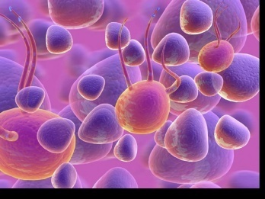
Ominous Octet
Decreased satiation neuro-
transmission
Increased renal glucose reabsorption
Decreased amylin, β-cell secretion
80% loss at dx
Decreased Gut hormones
Increased glucagon secretion
G
I
G
I
G
G
I
Increased lipolysis
I
G
G
G
I
I
G
G
I
Increase glucose
production
I
G
G
Decreased glucose
uptake
Notes:
33
33

Slide 34

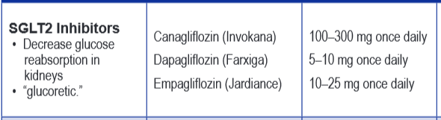
SGLT2 Inhibitors- “Glucoretics”
Action: “Glucoretic” decreases renal reabsorption in the proximal tubule of the kidneys (reset renal threshold and increase glycosuria)
Benefits: Lowers A1c 0.7 – 1.5%, lowers wt 1-3 lbs, no hypo
Issues: Can initially lower GFR, monitor kidney function and lytes. Watch for hypotension/ GU infections. Expensive
Decreases Glucose
Reabsorption
Notes:
34
34
Thiazolidinediones (TZDs) enhance insulin sensitivity in muscle and adipose tissue by binding to cell receptors,which leads to an increase in glucose transporter expression. TZDs encourage beta cells to respond more efficiently by lowering the amount of glucose and free fatty acids in the bloodstream, both of which are known to be detrimental to insulin secretion. Finally, these drugs reduce glucose production in the liver.
Clinical trials indicate that pioglitazone and rosiglitazone are slightly more effective at reducing A1C (1.5-1.6% reduction) than troglitazone (1.1% reduction).
Some of the beneficial side effects of thiazolidinediones include an increase in HDL cholesterol and reduction of triglyceride concentrations. This class of drugs has also been shown to lower blood pressure and decrease vascular inflammation in vitro. There are clinical studies underway to further examine the cardiovascular benefit to TZDs.
Some adverse effects of TZDs include weight gain, a potential increase in LDL cholesterol levels, and a possible increase in alanine aminotransferase levels (ALT). Because of the risk of weight gain, edema, and increased LDL cholesterol, thiazolidinediones are contraindicated in patients with advanced forms of congestive heart failure. Due to reported cases of liver failure and liver toxicity caused by the increase in ALT levels, TZDs are contraindicated in patients with abnormal liver function.
TZDs are the most expensive of the oral antidiabetic agents.

Slide 35
Comparison of Type 1 and Type 2
Type 1
Type 2
Obesity
x
xxx
Insulin dependence
xxx
30%
Respond to oral agents
0
xxx
Ketosis
xxx
x
Antibodies present
xxx
0
Typical Age of onset
teens
adult
Insulin Resistance
0
xxx

Slide 36

Life Study – Mrs. Jones
Mrs. Jones is 62 years old, overweight and complaining of feeling tired and urinating several times a night. She is admitted with a urinary tract Infection. Her WBC is 12.3, glucose 237. She is hypertensive with a history of gestational diabetes. No ketones in urine.
What are her risk factors, signs of diabetes
What type of diabetes does she have?
Does she have insulin resistance?

Slide 37
What kind of Diabetes?
Pt is 58, states she has had type 1 diabetes for 18 years. Quit smoking a year ago and gained about 20 lbs. BMI 25.
Meds
Humalog 18-23 units before each meal
Lantus 28 units at bedtime
Metformin 500mg TID
What tests would you recommend?
25% of patients with Type 1 also have type 2 diabetes.
ADA Post Grad, 2010

Slide 38


Slide 39

What type of Diabetes?
72 Years old
A1c 3 months prior 6.2%
A1c now 13.9%
BMI 24.5
Lost about 10 pounds over last month

Slide 40

Latent AutoImmunity Diabetes in Adults (LADA)
Antibody positive to 1-2 of below
GAD-65 autoantibodies
Insulin Autoantibodies
Islet Cell antigen-2
Adult Age at onset
Usually need insulin w/in first 6 months of diagnosis
Early insulin therapy may preserve beta cell function
Diabetes Care 26:536-538, 2003 Jerry P. Palmer, MD and Irl B. Hirsch, MD

Slide 41
LADA Clinical Features Compared to Type 2
Feature LADA Type 2
Age <50 63% 19%
Acute hyperglycemia 66 24
BMI < 25 33 13
Hx of autoimmune dx 27 12
Family hx autoimmune 46 35
Practical Diabetology March 08, Unger MD

Slide 42

Gestational DM ~ 7% of all Pregnancies
GDM prevalence increased by
∼10–100% during the past 20 yrs
Native Americans, Asians, Hispanics, African-American women at highest risk
Immediately after pregnancy, 5% to 10% of GDM diagnosed with type 2 diabetes
Within 5 years, 50% chance of developing DM in next 5 years.

Slide 43

Start Metformin therapy
For women with PreDiabetes and History of GDM

Slide 44
Metformin – 1st agent of choice
Action: decrease hepatic glucose (glycogen)
Metformin (Glucophage)
Starting dose: 500 BID, max 2500mg daily
Metformin XR - extended release – less GI upset
Efficacy:
Decrease fasting plasma glucose 60-70 mg/dl
Reduce A1C 1.0-2.0%
Benefits / Issues
Cheap, no weight gain; some lose weight, lowers LDL, no hypo
Not indicated if creat > 1.4-1.5 or GFR < 60 (cleared by kidney)
© Copyright 1999-2015, Diabetes Educational Services, All Rights Reserved.
Notes:
44
44
The mechanism of action of metformin is not entirely understood, but it's predominant effect is to suppress hepatic glucose production and to enhance insulin sensitivity in peripheral tissues (primarily muscle). It is unclear if insulin sensitivity occurs by metformin binding to cell receptors,which leads to an increase in glucose transporter expression, or whether insulin sensitivity is simply a secondary effect of the suppressed glucose production.
Metformin's ability to lower A1C and decrease fasting plasma glucose is similar to that of sulfonylurea drugs. However, the UKPDS showed that those who received metformin had less hypoglycemia and weight gain than those who received sulfonylureas.
Metformin must be avoided in patients with renal impairments, as those patients are at higher risk of experiencing lactic acidosis. However, metformin is an effective monotherapy and may be an ideal drug for overweight patients since it does not cause weight gain and has been seen to cause modest amounts of weight loss when first administered. Diarrhea and abdominal discomfort can be alleviated by changes in diet and slow increases in metformin dosage.

Slide 45
Diabetes Bingo - “DiaBingo” Shout out Right Answer

Slide 46
DiaBingo
B Frequent skin and yeast infections
B A BMI of ____ or greater is considered overweight
B To reduce complications, control A1c, Blood pressure, Cholesterol
B PreDiabetes – fasting glucose level of ___ to ____
B Erectile dysfunction indicates greater risk for ____
B Diabetes – fasting glucose level____ or greater
B Type 1 diabetes is best described as an ______ disease
B People with diabetes are ______ times more likely to die of heart dx
B Elevated triglycerides, < HDL, smaller dense LDL
B Each percentage point of A1c = _____ mg/dl glucose
B At dx of type 2, about __% of the beta cell function is lost
B Diabetes – random glucose ____ or greater

Slide 47

Goals of Care

Slide 48

ABC’s of Diabetes
A1C
Blood Pressure
Cholesterol

Slide 49

1% decrease in A₁c reduces microvascular complications by 35%
1% decrease in A₁c reduces diabetes related deaths by 25%
B/P control (144/82) reduced risk of:
Heart failure (56%)
Stroke (44%)
Death from diabetes (32%)
Lancet 352: 837-865, 1998

Slide 50
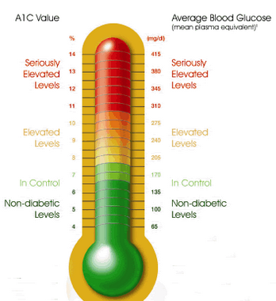
Glycemic Targets
Adult non pregnant A1c goals
A1c < 7% - a reasonable goal for adults.
A1c < 6.5% - may be appropriate for those without significant risk of hypoglycemia or other adverse effects of treatment.
A1c < 8% - may be appropriate for patients with history of hypoglycemia, limited life expectancy, or those with longstanding diabetes and vascular complications.

Slide 51

A1c and Estimated Avg Glucose (eAG) 2008
A1c (%) eAG
5 97
6 126
7 154
8 183
9 212
10 240
11 269
12 298
eAG = 28.7 x A1c-46.7 ~ 29 pts per 1%
Translating the A1c Assay Into Estimated Average Glucose Values – ADAG Study
Diabetes Care: 31, #8, August 2008
Order teaching tool kit free at diabetes.org

Slide 52


Slide 53

“Legacy Effect”
For participants of DCCT and UKPDS
long lasting benefit of early intensive BG control prevents
microvascular complications
Macrovascular complications (15-55% decrease)
Even though their BG levels increased over time
Message – Catch early and
Treat aggressively

Slide 54
ABCs of Diabetes –
A1c less than 7% (avg 3 month BG)
Pre-meal BG 80-130
Post meal BG <180
Blood Pressure < 140/90
Cholesterol
DM and 40 yrs, start statin
HDL >40
Triglyceride < 150
E xercise, Education
H ealthy Eating

Slide 55

Insulin Therapy From Ants to Analogs:

Slide 56
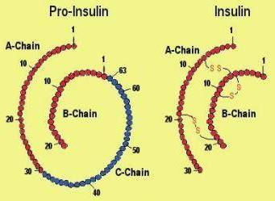
Insulin – the Ultimate Hormone Replacement Therapy
Objectives:
Discuss the actions of different insulins
Describe using pattern management as an insulin adjustment tool.

Slide 57
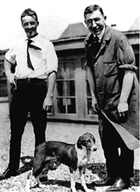

Slide 59
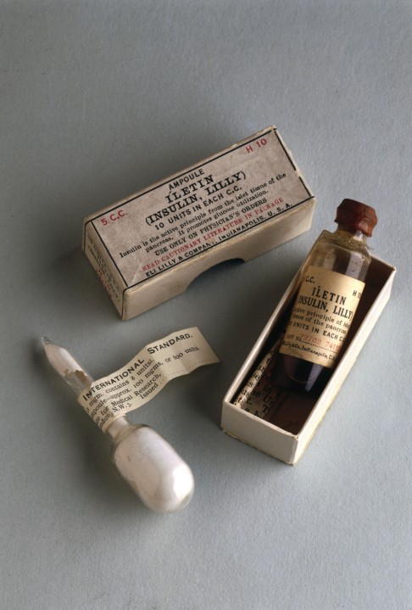
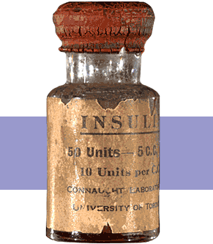
Insulin Finally Available - 1922

Slide 60


The Miracle of Insulin
The Miracle of Insulin
Patient J.L., December 15, 1922
February 15, 1923

Slide 61


Pattern Management –AKA
How to think like a pancreas

Slide 62
Physiologic Insulin Secretion: 24-Hour Profile
50
Insulin
(µU/mL)
Bolus Insulin
25
0
Basal Insulin
Breakfast Lunch Dinner
150
100
Mealtime Glucose
Glucose
(mg/dL)
50
Basal Glucose
0
7
8
9
10
11
12
1
2
3
4
5
6
7
8
9
A.M.
P.M.
Time of Day

Slide 63
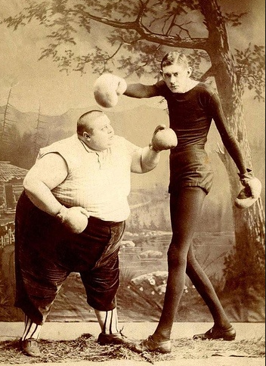
Approach Depends on Patient

Slide 64
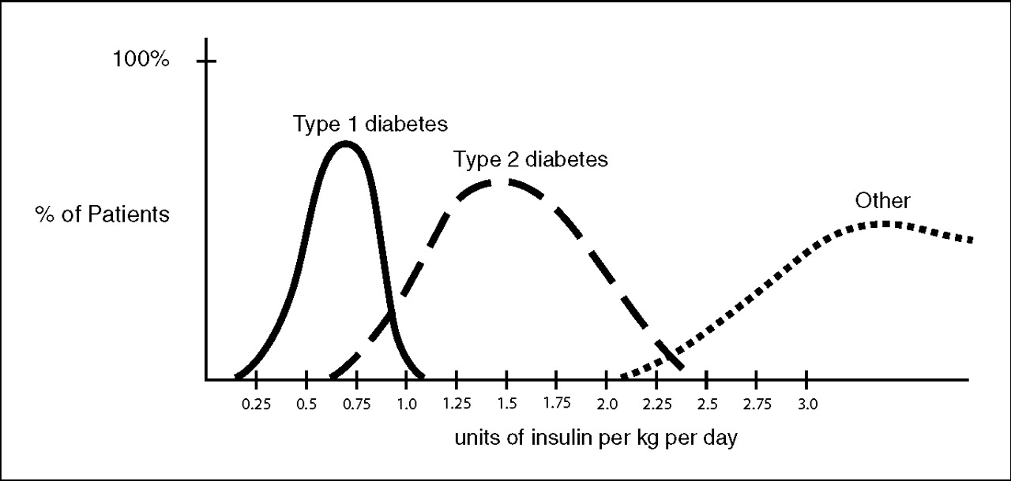
Insulin Dosing Type 1 & 2
U-500 Insulin: When More With Less Yields Success: Diabetes Spectrum March 20, 2009 vol. 22 no. 2 116-122

Slide 65

Case Study
38 yr old,
BMI 32, Weighs 200kg
A1c – 12%, BG 290s for mos
Insulin – 70 units Lantus
Oral Meds: max dose glipizide + metformin
MD is contemplating starting her on insulin pump

Slide 66
Type 2 Pump Candidates?
Severe insulin resistance
Poor glycemic control despite sufficient insulin titration and adherence to diet and exercise.
Integrate ability to cope with pump, absence of cognitive or operative disability, personal willingness and ability to monitor blood glucose levels.

Slide 67
Advantages of Using an Insulin Pump: ADA Website
Eliminates individual insulin injections
Delivers insulin more accurately than injections
Outperform MDI in improving A1C
Less large swings in blood glucose levels
Flexibility with food
Minimizes severe low blood glucose episodes
Eliminates unpredictable effects of intermediate- or long-acting insulin
Allows exercise without having to eat large amounts of carbohydrate

Slide 68
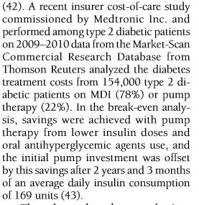
Disadvantages
Hooked up to something
More monitoring? For type 2, avg frequency was 3.8 times a day (OpT2mise)
Site irritation, infection
Cost?

Slide 69

If you are already insulin resistant, why give more insulin?
Yes, type 2 diabetes is a situation of insulin resistance, but also insulin deficiency
When pts are glucose toxic (BG in the 300s), they may initially require higher doses of insulin, but as toxicity diminishes, insulin requirements diminish
One strategy to overcome insulin resistance is through physiologic insulin replacement therapy.
The pump helps to achieve glucose control with less insulin

Slide 70
ADA Step Wise Approach to Hyperglycemia 2015
Start with lifestyle coaching
Add Metformin
Next step: Metformin and add 1-2 more meds based pt and A1c
If A1c 9% or more
3 meds (ie Metformin, glyburide and Januvia)
Metformin plus basal insulin / GLP-1 Agonist
Basal/Bolus – Multiple daily injections (MDI)

Slide 71
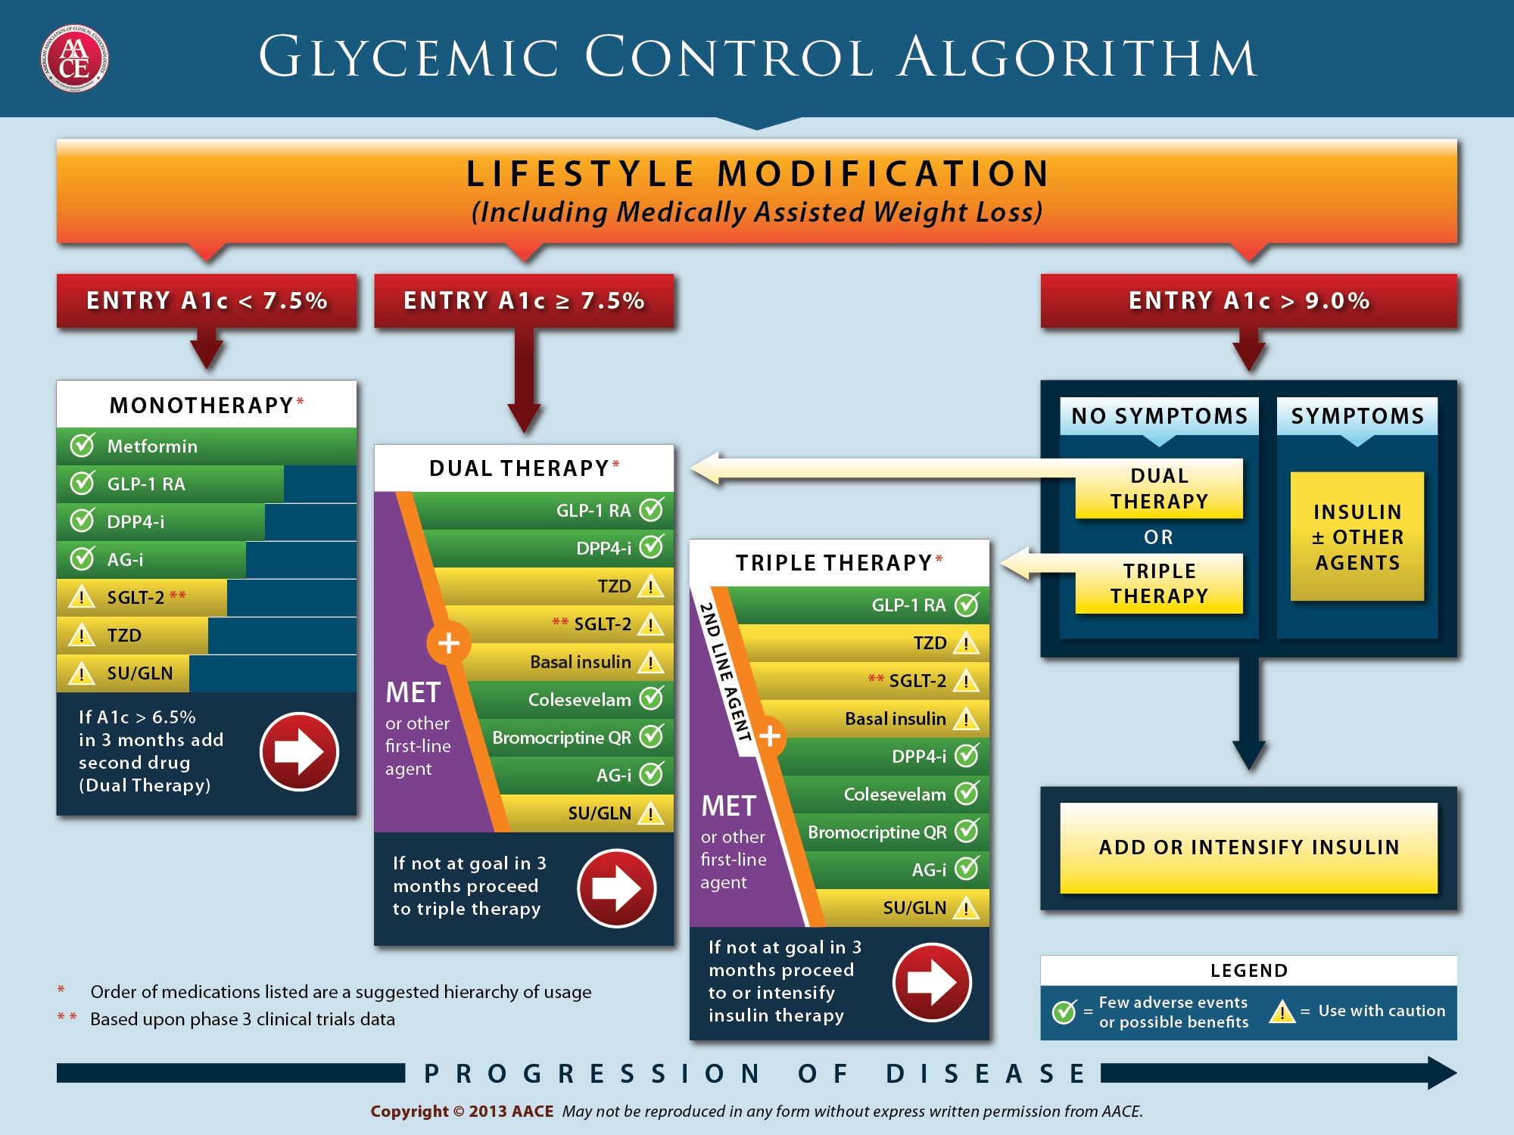

Slide 72
Notes:
In patients intolerant of, or with contraindications to metformin, consider initial drug from other classes depicted under “Dual therapy” and proceed accordingly. In this circumstance, while published trials are generally lacking, it is reasonable to consider three-drug combinations that do not include metformin.
Consider starting with 2-drug combinations in patients with very high HbA1c (e.g. ≥9%) to achieve control more rapidly (although a step-wise approach will eventually the patient to target as well.)
Insulin has the advantage of being effective where other agents may not be and should be considered a part of any combination regimen when hyperglycemia is severe, especially if the patient is symptomatic or if any catabolic features (weight loss, any ketosis) are evident. Consider initiating combination injectable therapy with insulin when blood glucose is >300–350 mg/dL (>16.7–19.4 mmol/L) and/or HbA1c >10–12%. Potentially, as the patient’s glucose toxicity resolves, the regimen can be subsequently simplified.

Slide 73
Notes:
Basal insulin alone is usually the optimal initial regimen, beginning at 0.1-0.2 U/kg body weight, depending on the degree of hyperglycemia. It is usually prescribed in conjunction with 1-2 non-insulin agents, although insulin secretagogues (sulfonylureas, meglitinides) are typically stopped once more complex regimens beyond basal insulin are utilized.
In patients still not at target after basal insulin has been adequately titrated, and the patient is willing to take >1 injections, there are several options. First, consider GLP-1 receptor agonists (see Fig. 2). The combination of basal insulin + GLP-1RA is becoming well established after several studies confirmed its efficacy on par with more complex multi-dose insulin regimens, but with less hypoglycemia and with weight loss instead of weight gain. If such an approach is not possible or has been tried and proven unsuccessful, there are 3 possible advanced insulin regimens:
Adding 1 injection of a rapid acting insulin analogue before the largest meal,
Adding 2-3 injections of a rapid acting insulin analogue before 2-3 meals, or
Using premixed insulin BID
Each approach has its advantages and disadvantages. The figure describes the number of injections required at each stage, together with the relative complexity and flexibility.
Once a strategy is initiated, titration of the insulin dose is important, with dose adjustments made based on the prevailing BG levels as reported by the patient.
Comprehensive education regarding self-monitoring of BG, diet, exercise, and the avoidance of, and response to, hypoglycemia are critical in any patient on insulin therapy.

Slide 74
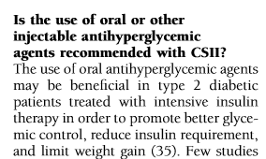
Case Study
38 yr old,
BMI 32, Weighs 200kg
A1c – 12%, BG 290s for mos
Insulin – 70 units Lantus
Oral Meds: max dose glipizide + metformin
Keep pt on Metformin
Stop glipizide

Slide 75
Switching to Insulin via Pump
BMI 32, Weighs 200kg
1: 1 ratio of current dose
Options:
Based on current dose - 70 units
70 units / 24 ~ 3 units an hour? No
Based on her body weight x 0.8
100kg x .8 = 80 units a day
50% basal = 40/24 or ~ 1.6 units hr
50% bolus = 40 units / 3 meals 12 12 14

Slide 76
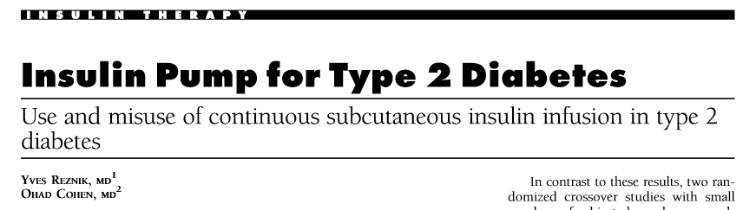
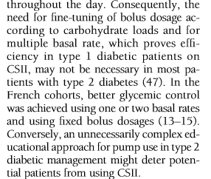

Slide 77

Quality of Life
Older adults – MDI or CSII had similar quality of life scores
Younger Adults- CSII improved QOL scores
Less hospitalization and ER room visits

Slide 78
What about weight gain and hypo?
When BG levels improve using insulin therapy, some weight gain is expected.
Studies indicate that there is no greater weight gain on insulin pumps vs multiple daily injections ~ 1.5 kgs
No increased risk of hypo compared to multiple daily injections.

Slide 79

Summary of Benefits
No increase rate of hypo as compared to multiple daily injections
Insulin dose cut by ~ 20% when using pump
A1c decreased by 0.7% compared to MDI
Make result in cost savings
Less hospital and ER Visits

Slide 80
No one is Unmotivated
…. to lead and long and healthy life
These are the 3 usual Critical Barriers
Perceived worthlessness
Too many personal obstacles
Absence of support and resources
Bill Polonsky, PhD, CDE

Slide 81

Keeping Healthy in Long Run
HUG Patients
Unconditional Positive Regard –
involves showing complete support and acceptance of a person no matter what that person says or does.
Carl Rogers
Help with
Unconditional
Guidance and Support
Anne Peters, MD, CDE
ADA Post Grad

Slide 82

Thank You
Questions?
Email bev@diabetesed.net
Web www.DiabetesEd.net

