Slide 1

Recycle/ relapse (being stuck) is part of the cycle!
Realistic...
Acceptable...
To be expected...
To be prepared for…and talked about… “a contingency plan”.
Surmountable ( with preparation!)
Reframe (+resources)

Slide 2
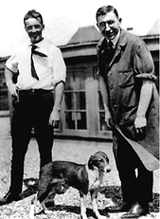
Dr. Banting and Best with Marjorie at University of Toronto

Slide 3


Slide 4
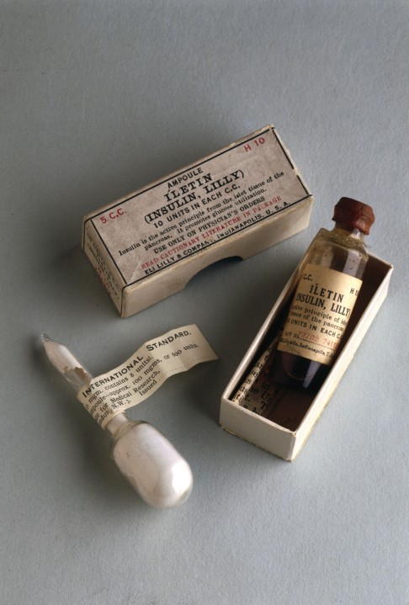
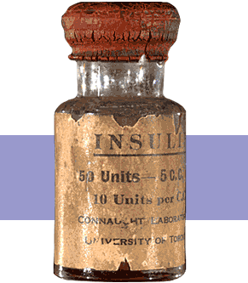
Insulin Finally Available - 1922

Slide 5


Miracle of Insulin
The Miracle of Insulin
Patient J.L., December 15, 1922
February 15, 1923

Slide 6
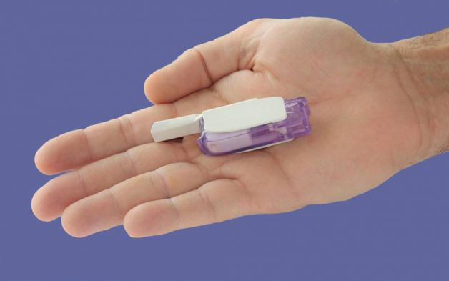

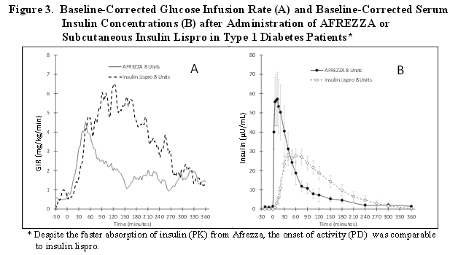
Afrezza – Inhaled Insulin – Approved 2014 – Type 1 or 2
Only studied in adults over 18
Not indicated for pregnancy, while breastfeeding

Slide 7
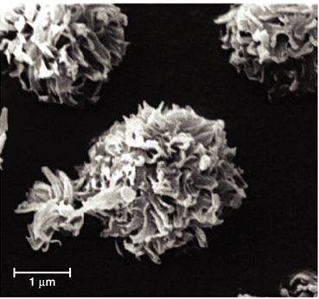
Steps, Cost, Terms
1st step – FDA approved. Will take time to produce, market and distribute
Pricing –similar pricing as pens ~ $300 a month
Afrezza is regular human insulin in powder form using Technosphere technology.
Referred to as TI in papers – “Technosphere Insulin”

Slide 8
Afrezza Dosing and Considerations
Bolus regular insulin – inhaled before meals
Dosing: 4 and 8 unit cartridges
Convert with 1:1 ratio to existing insulin dose
Lung function test before start (FEV1)
Not for pts w/ chronic lung issues
Asthma, COPD, history of lung cancer, smokers
Can cause acute bronchospasm – Black box warning
Side effects:
Hypoglycemia, sore throat, cough
Less hypoglycemia than injected insulin

Slide 9
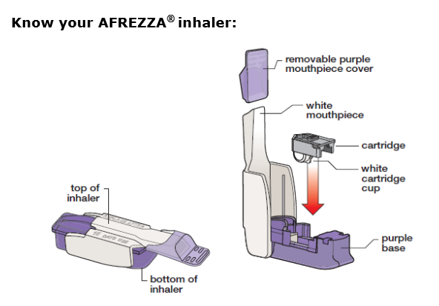
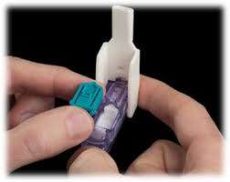
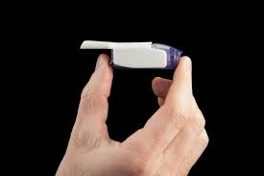
Afrezza Inhaler
Replace inhaler every 15 days –Do not wash

Slide 10
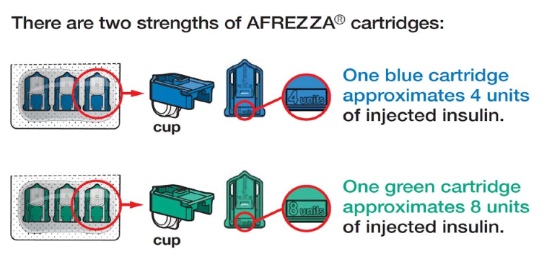
Afrezza – Strengths
Let insulin cartridges and inhaler sit at room temp for 10 minutes before using

Slide 11
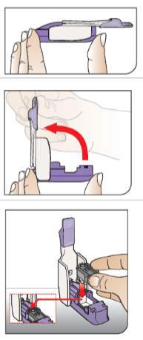
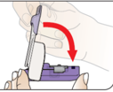
Afrezza – Loading Cartridge into device
Hold inhaler level
Open inhaler by lifting white mouthpiece
Hold insulin cartridge with cup facing down.
Place cartridge inside and close lid. Keep level.
Make sure cartridge has been at room temp for 10 minutes

Slide 12
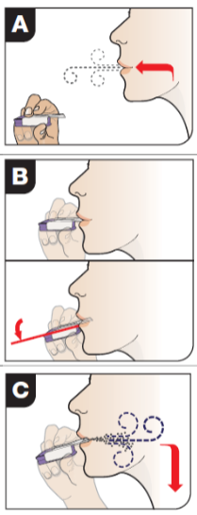
Afrezza – Proper Inhale Technique
Exhale
Position inhaler in mouth (take off cover)
Tilt inhaler down toward chin, keep head level
Inhale deeply and hold breath for as long as comfortable
Remove cartridge
Replace cover

Slide 13

Sample situations - Pt on….
7 units Humalog at meals, 20 u Lantus at hs
5 units regular break, dinner, 10 units detemir
10 units aspart at meals, 30 Lantus
Carb counts – 1:15 .. Had 75 gms
Type 1
Type 2
BG before meal 67
BG before meal 170

Slide 14
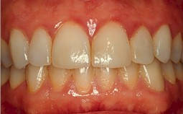
Gingivitis

Slide 15
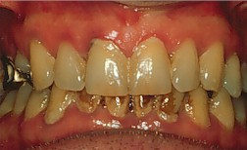
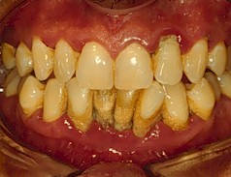
Mild to Severe Periodontitis

Slide 16
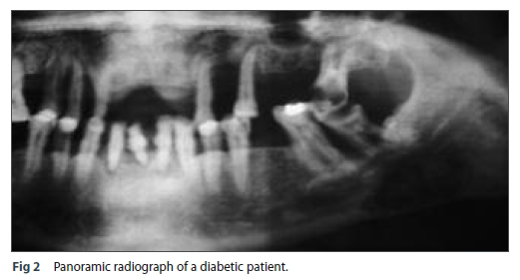
Periodontal Disease

Slide 17
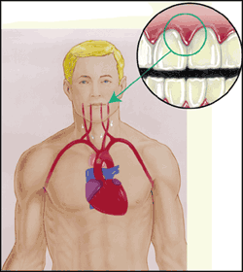
Periodontal disease and Heart Disease
Heart disease link:
oral bacteria enter the blood stream, attach to fatty plaques in coronary arteries increasing clot formation
inflammation increases plaque build up, which may contribute to arterial inflammation
Hyperglycemia = Gingivitis = Heart Disease

Slide 18
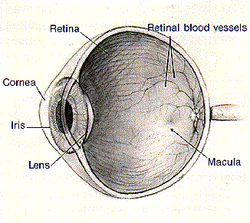
Eye Disease and Education
Diabetes Retinopathy
Other Diabetes Eye Complications
Prevention and Treatment
Promoting Self-Care

Slide 19
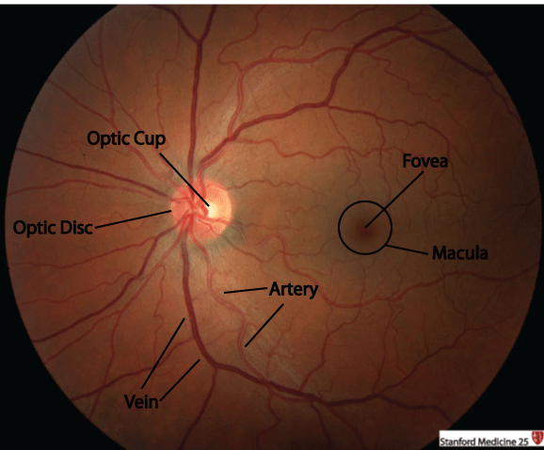
Fundus Geography
The retina is the only portion of the central nervous system visible from the exterior.
Likewise the fundus is the only location where vasculature can be visualized.
Fundoscopy
Optic Nerve
Macula

Slide 20
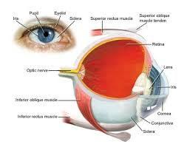
Eye Disease Overview
Leading cause of adult blindness
Retinopathy and Diabetic Macular Edema
DM = 25x’s risk of ocular complications
Including cataracts
20% of type 2 have retinopathy at diagnosis
Only 60% of pt’s receive appropriate treatment

Slide 21
Retinopathy Risk Factors
Duration of diabetes, age at diagnosis, race other genetic factors
Glycemic control, hypertension, smoking, hyperlipidemia, proteinuria and renal disease

Slide 22
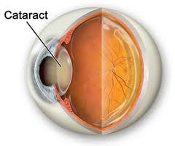
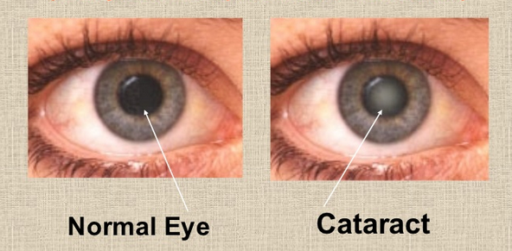
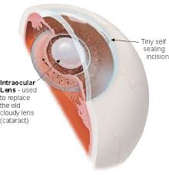
Cataracts
Cataracts – elevated glucose levels glycosylate lens, decreasing permeability
Treatment = surgery

Slide 23
Macular Edema
Macular edema
Risk 10-15% for pt’s with dm 15yrs +
macula responsible for central vision
retinal thickening w/in 3mm from the macula
can impair central vision – causing blurring to blindness
Tx: focal laser treatment or
Lucentis, Avastin or Eylea, injected into eye

Slide 24
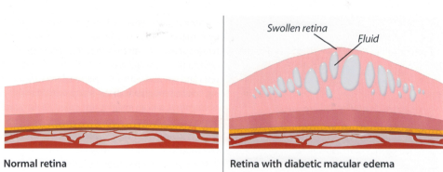
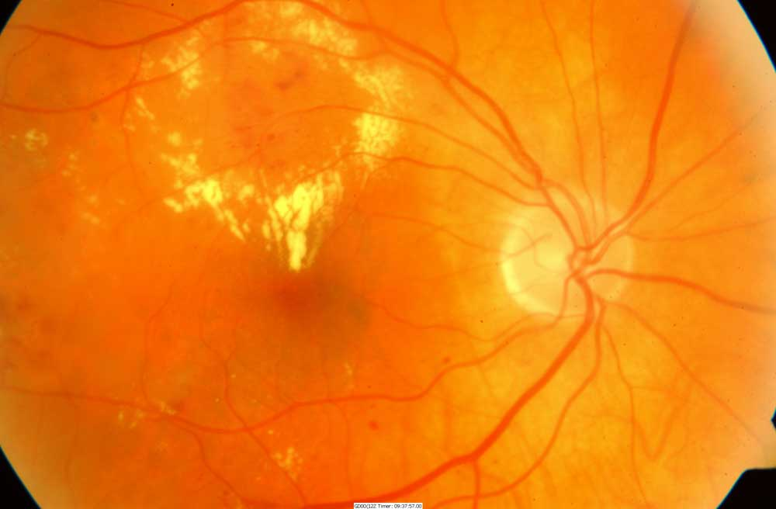
Macular Edema
Macular swelling caused by leaking microaneurisms with exudates (in yellow). Most common cause of visual loss among type 2 diabetes
http://www.virginiaretina.org/diabetic_retinopathy.html

Slide 25
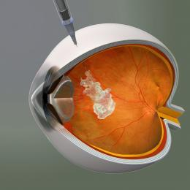
New Approved Treatment for Macular Edema
Anti-vascular endothelial growth factor (VEGF) therapy is indicated for diabetic macular edema
Trials using Ranibizumab (Lucentis) Avastin or Eylea demonstrated improved vision with treatment
Once a month injection

Slide 26

Quick question
Which of the following describes proliferative retinopathy?
A. Cotton wool spot and hemorrhages
B. Increased lens opacity
C. Stiffening of the lens
D. New blood vessel growth

Slide 27
What is Retinopathy?
Retina – layer of nerve tissue in back of eye responsible for processing images and light
Damage to the microvascular layer that nourishes the retina
Leads to leakage of blood components through vessel walls and creation of unstable blood vessels secondary to hypoxia
Disturbance in nerve layer = visual symptoms

Slide 28
Natural History of Diabetic Retinopathy
Mild nonproliferative diabetic retinopathy (NPDR)
Microaneurysms only
Reexamined annually
Moderate NPDR
Microaneurysms plus other abnormalities
Reexamined w/in 6-12 months
Notes:
There are several stages of retinopathy. The earliest clinical stage of diabetic retinopathy is identified as mild nonproliferative diabetic retinopathy (NPDR). Progression of disease from NPDR to proliferative diabetic retinopathy (PDR) is related to the level or severity of NPDR, and therefore the severity of NPDR should determine follow-up and management of diabetic retinopathy.
The next four slides will review the clinical findings and management of each stage of retinopathy.

Slide 29
Severe non-proliferative retinopathy
Any of the following:
20+ intraretinal hemorrhages in each 4 quadrants
Venous beading in 2 or > quadrants
Prominent intraretinal microvascular abnormalities in 1 or more quadrant
No signs of proliferative disease
Reexamination several times a year

Slide 30
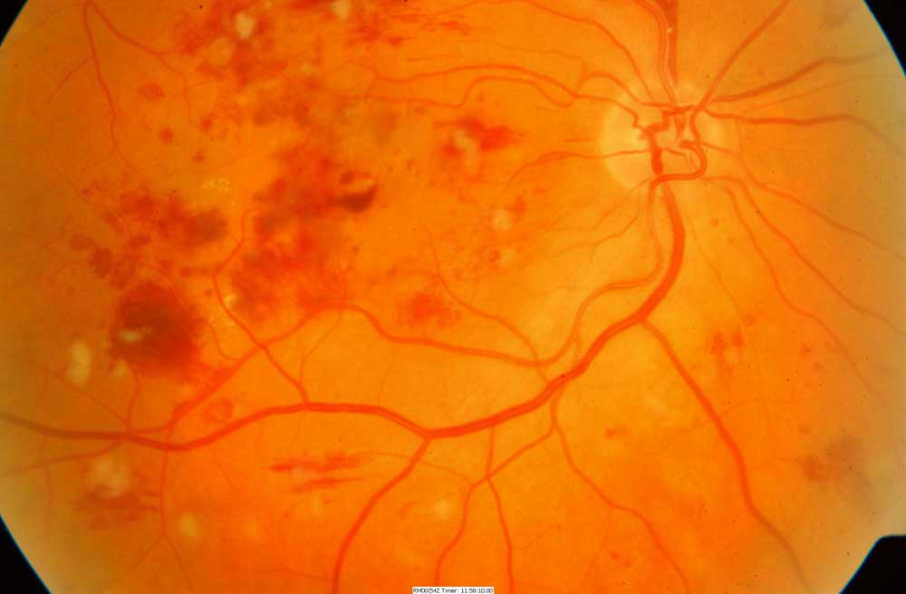
Non Proliferative
Dilated capillaries (microaneurisms) leak red blood cells and plasma into retina. Results in retinal hemorrhages, edema and deposits (exudates).

Slide 31
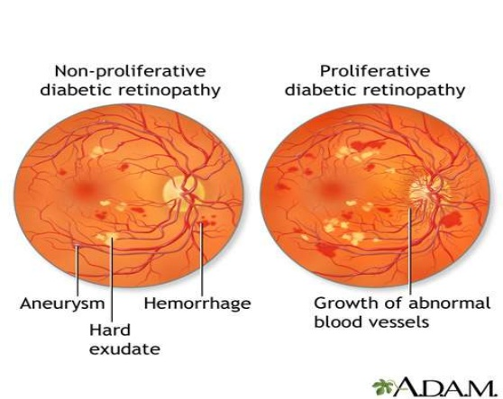
Non - Proliferative to Proliferative Diabetic Retinopathy

Slide 32
Proliferative Diabetic Retinopathy (PDR)
Clinical Findings
Ischemia induced neovascularization
at the optic disk (NVD)
elsewhere in the retina (NVE)
Vitreous hemorrhage
Retinal traction, tears, and detachment
Diabetes Macular Edema must also be evaluated
Notes:
When proliferation of new blood vessels occurs, the patient is diagnosed as having PDR. New blood vessel formation is caused by retinal ischemia. Neovascularization can occur at the optic disk (NVD) or elsewhere in the retina (NVE). These new vessels are weak and, when they break, can cause vitreous hemorrhage. They can also cause retinal traction, retinal tears, and retinal detachment over time.

Slide 33
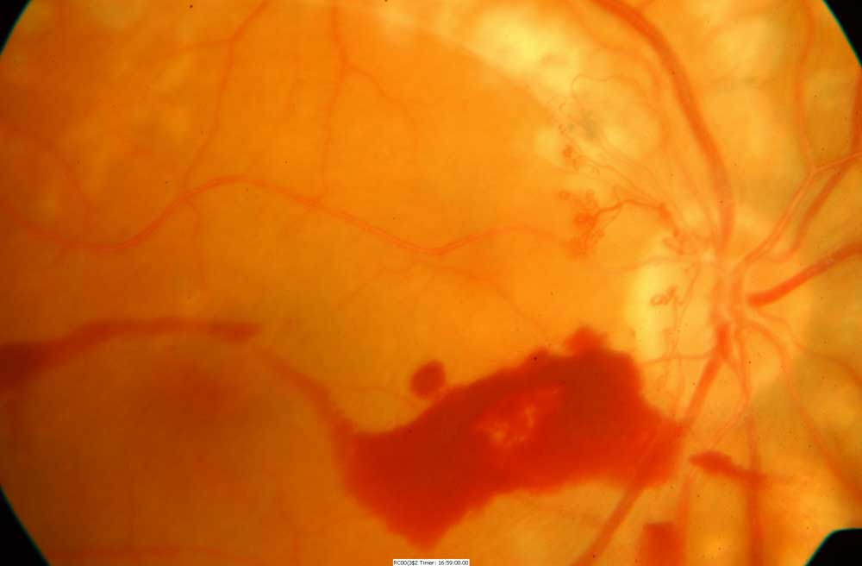
Proliferative retinopathy
new blood vessel formation on surface of retina or the optic nerve. Severe visual loss can occur due to vitreous hemorrhage and retinal detachment. Note fine network of new blood vessels on the surface of the optic nerve

Slide 34


PDR Signs
Blurred central or side vision (left, blurred side vision) or a blind spot in central vision (right) may indicate diabetic retinopathy

Slide 35


Retinopathy Changes How We See
View of boys by person with normal vision
View of boys by person with diabetic retinopathy.

Slide 36
PDR Management
Management/Treatment
2-4 month follow-up
Color fundus photography
Panretinal photocoagulation (3-4 month follow-up)
Vitrectomy if bleeding into vitreous
If macular edema present: fluorescein angiography and injected meds
Notes:
PDR should be managed with panretinal laser photocoagulation, color fundus photography, and follow-up every 3-4 months to monitor treatment success. If panretinal photocoagulation is not performed, patients should be evaluated every two to three months because of the high risk of developing CSME, retinal detachment, or vitreous hemorrhage that can lead to vision loss. Vitrectomy should be considered when there is substantial amount of hemorrhaging in the vitreous fluid, and when neovascularization causes retinal traction or retinal detachment. CSME is treated in the same manner as described for severe NPDR.

Slide 37
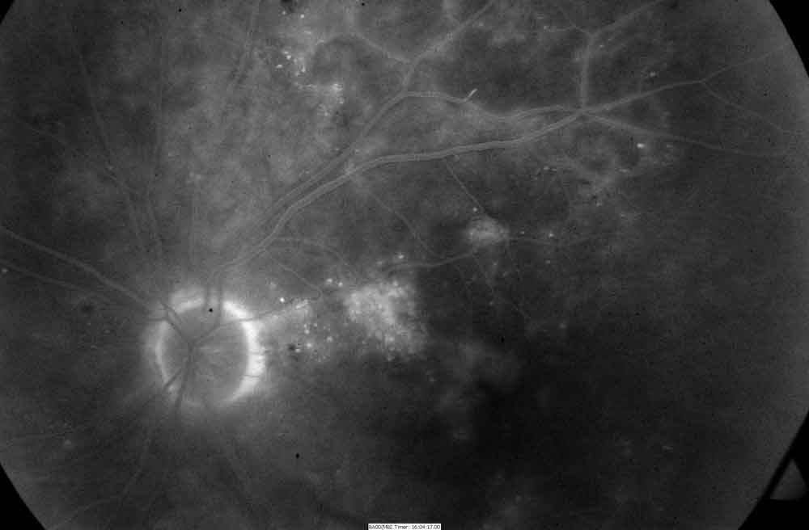
Fluorescein Angiogram
Fluorescein Angiogram, 5 Minutes After Dye Injection.
Fuzzy white areas represent dye leaking into retina from microaneurisms. This illustrates the mechanism which causes macular edema.

Slide 38
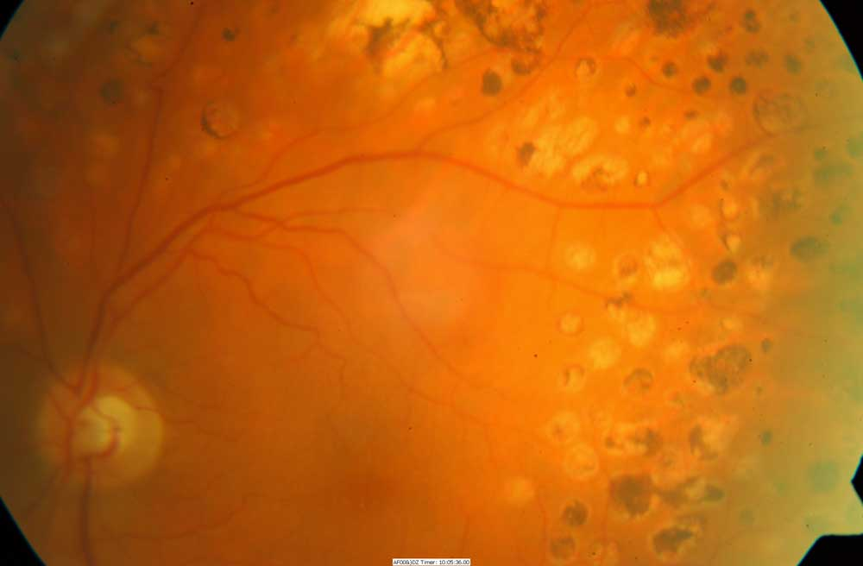
Pan Retinal Photocoagulation
Decreases risk of severe vision loss by 50% or more
Destroys 12% of retina and loss of visual field.
Once stabilized, can achieve excellent control of PDR
if B/P and BG well controlled.

Slide 39
Retinopathy Prevention
To reduce the risk or slow the progression of retinopathy
Optimize glycemic control
Optimize blood pressure control

Slide 40
Quick Question
Which of the following is correct regarding eye screening for people with diabetes?
A. All people with diabetes must get a complete eye exam every year
B. All people diagnosed with type 1 should receive an immediate eye exam.
C. All people diagnosed with type 2 should receive an immediate eye exam.
D. People with diabetes over age of 60 should receive an eye exam every 6 months.

Slide 41
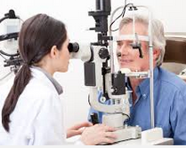
Retinopathy Screening
Screen with initial dilated and comprehensive eye exam by ophthalmologist or optometrist
Type 2 at diagnosis, then every 1 to 2 years
Type 1 within 5 yrs of dx, then every 1-2 years
Can use high quality fundus photography as screening tool- Initial exam should be done in person
Promptly refer pts with macular edema, and severe non-proliferative disease to trained specialist

Slide 42
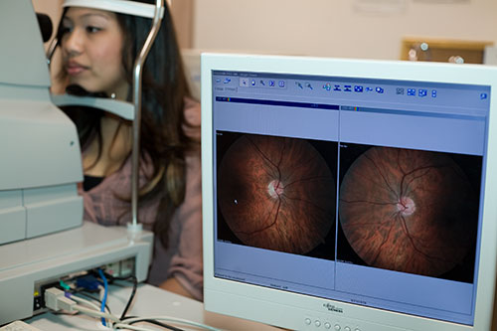
High Quality Fundus Photography to Screen for Retinopathy
Can detect most clinically significant diabetic retinopathy
Interpretation of the images
Performed by a trained eye care provider
May serve as a screening tool for retinopathy, it is not a substitute for a comprehensive eye exam
Perform comprehensive eye exam at least initially and at intervals thereafter
Notes:
A comprehensive eye exam should be given to all patients with diabetes. The exam should include all of the components recommended by the American Academy of Ophthalmology and the American Optometric Association for non-diabetic patients, however additional attention should be given to assess abnormalities of the retina and vitreous fluid. Dilated indirect ophthalmoscopy, slitlamp biomicroscopy, and fundus examination should be used to identify retinal or vitreous hemorrhages, microaneurysms, retinal tears or detachment, intraretinal microvascular abnormality (IRMA), neovascularization at the optic disk (NVD) and elsewhere in the retina (NVE).
Patients with type 1 diabetes should be screened for NPDR (non-proliferative diabetic retinopathy) within three to five years of diagnosis after age 10. Retinopathy leading to vision loss rarely develops in children prior to puberty, regardless of how long the child has had diabetes. Patients with type 2 diabetes should be screened at time of diagnosis.
Finally, women with preexisting diabetes should be screened prior to conception and during the first trimester. Follow-up exams should be scheduled at the physicians discretion based on the results of the first trimester exam.
Note that follow-up exams should be conducted yearly, however new ADA Clinical Practice Recommendations state that less frequent exams every 2-3 years can be considered in the setting of a normal eye exam upon the advice of an eye care professional.

Slide 43

Retinopathy Screening
Women with preexisting diabetes who are planning pregnancy or are pregnant
Comprehensive eye examination in the first trimester
Close follow-up throughout pregnancy and for 1 year postpartum
Notes:
A comprehensive eye exam should be given to all patients with diabetes. The exam should include all of the components recommended by the American Academy of Ophthalmology and the American Optometric Association for non-diabetic patients, however additional attention should be given to assess abnormalities of the retina and vitreous fluid. Dilated indirect ophthalmoscopy, slitlamp biomicroscopy, and fundus examination should be used to identify retinal or vitreous hemorrhages, microaneurysms, retinal tears or detachment, intraretinal microvascular abnormality (IRMA), neovascularization at the optic disk (NVD) and elsewhere in the retina (NVE).
Patients with type 1 diabetes should be screened for NPDR (non-proliferative diabetic retinopathy) within three to five years of diagnosis after age 10. Retinopathy leading to vision loss rarely develops in children prior to puberty, regardless of how long the child has had diabetes. Patients with type 2 diabetes should be screened at time of diagnosis.
Finally, women with preexisting diabetes should be screened prior to conception and during the first trimester. Follow-up exams should be scheduled at the physicians discretion based on the results of the first trimester exam.
Note that follow-up exams should be conducted yearly, however new ADA Clinical Practice Recommendations state that less frequent exams every 2-3 years can be considered in the setting of a normal eye exam upon the advice of an eye care professional.

Slide 44

Ongoing Retinopathy Screening
After initial exam, then…
Annual exam
Less frequent (every 2-3) yrs can be considered if 1 or more normal eye exam
More frequent exams if retinopathy progressing
Notes:
A comprehensive eye exam should be given to all patients with diabetes. The exam should include all of the components recommended by the American Academy of Ophthalmology and the American Optometric Association for non-diabetic patients, however additional attention should be given to assess abnormalities of the retina and vitreous fluid. Dilated indirect ophthalmoscopy, slitlamp biomicroscopy, and fundus examination should be used to identify retinal or vitreous hemorrhages, microaneurysms, retinal tears or detachment, intraretinal microvascular abnormality (IRMA), neovascularization at the optic disk (NVD) and elsewhere in the retina (NVE).
Patients with type 1 diabetes should be screened for NPDR (non-proliferative diabetic retinopathy) within three to five years of diagnosis after age 10. Retinopathy leading to vision loss rarely develops in children prior to puberty, regardless of how long the child has had diabetes. Patients with type 2 diabetes should be screened at time of diagnosis.
Finally, women with preexisting diabetes should be screened prior to conception and during the first trimester. Follow-up exams should be scheduled at the physicians discretion based on the results of the first trimester exam.
Note that follow-up exams should be conducted yearly, however new ADA Clinical Practice Recommendations state that less frequent exams every 2-3 years can be considered in the setting of a normal eye exam upon the advice of an eye care professional.

Slide 45
Assess adaptation to low vision
necessary vision to perform self-care skills?
insulin
BGM
read instructions
shopping/home safety/transportation
refer to rehab education (800-AFBLIND)
psychosocial issues

Slide 46
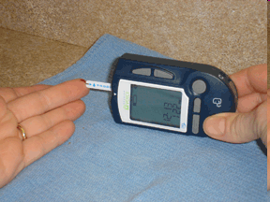
Prodigy Voice Meter – A+ Access Award Am Fed Blind
Prodigy Meter only completely accessible meter for sale in U.S. - independent access for visually impaired -
www.prodigymeter.com
800-243-2636
Independent set up
Self coding
Audible Memory
Audible warning/error
Cost: $84.95
50 Strips $34.95

Slide 47
Kidney Physiology
Size and shape of Idaho potato - retroperitoneal
Filter entire blood volume every 30 minutes
excretory organ:
removes water, urea, waste
maintains blood volume
acid base balance and lytes
regulates B/P
synthesizes erythropoietin – RBC
Maintains calcium /phosphorus levels, activates vitamin D – helps absorb calcium

Slide 48

Risk Factors of Kidney Disease
2 leading risk factors: Hypertension and hyperglycemia
Other risk factors:
Kidney stones, obesity, smoking and CV disease
Family history of kidney disease and age 60 or older
Kidney disease often has no symptoms, can undetected until very late

Slide 49
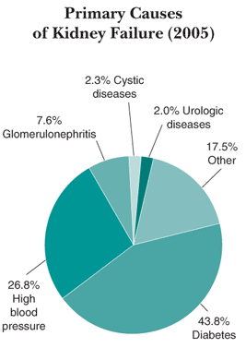
Diabetic Nephropathy
Most new cases of Chronic Kidney Disease (CKD) are attributed to diabetes.
220,000 people in US have kidney failure due to diabetes (2013)
Minorities experience higher than average rates of nephropathy and kidney disease
Notes:
Diabetes is the most common cause of kidney failure, accounting for more than 40% of new cases. Treatment for end stage renal disease is expensive; in 2001 it cost the United States over $22 billion to treat patients with kidney failure. Dialysis, one form of treatment for kidney failure, can relieve the symptoms of kidney disease, but over time the damaged kidneys will continue to contribute to problems such as heart disease, bone disease, arthritis, nerve damage, infertility, and malnutrition. Kidney transplant, another treatment alternative, may prove to be a more permanent solution to kidney disease for some patients. However, transplantation has its own risks including the risk of surgery, the risk of organ rejection, and the risk of infection and other complications from immunosuppressant drugs.
The best course of action is to prevent kidney disease from developing in the first place. Minorities with diabetes have an even greater challenge in preventing kidney disease, since African Americans, Hispanics, and American Indians experience higher rates of kidney disease than Caucasians.

Slide 50
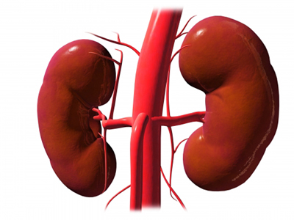
Diabetes and Chronic Kidney Disease (CKD) Considerations
CVD leading cause of death in CKD
microalbuminuria = increased risk of CVD
1/4 to 1/3 of insulin cleared by kidney
renal retinal syndrome
70 - 80% of people with diabetes DON’T get kidney disease
Early and aggressive intervention crucial

Slide 51
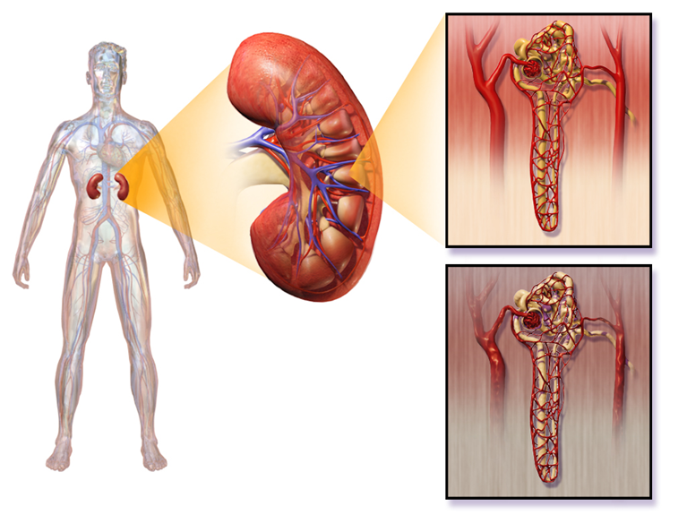
What is Nephropathy?
Hyperglycemia causes renal hyperfiltration and glomerular capillary hyperperfusion.
Causes functional and structural damage to glomeruli, increasing permeability, proteinuria, mesangial expansion and sclerosis… destroys nephrons
Due to insufficient insulin, glycosylation, increased growth hormone, glucagon, and vasoactive hormones.

Slide 52
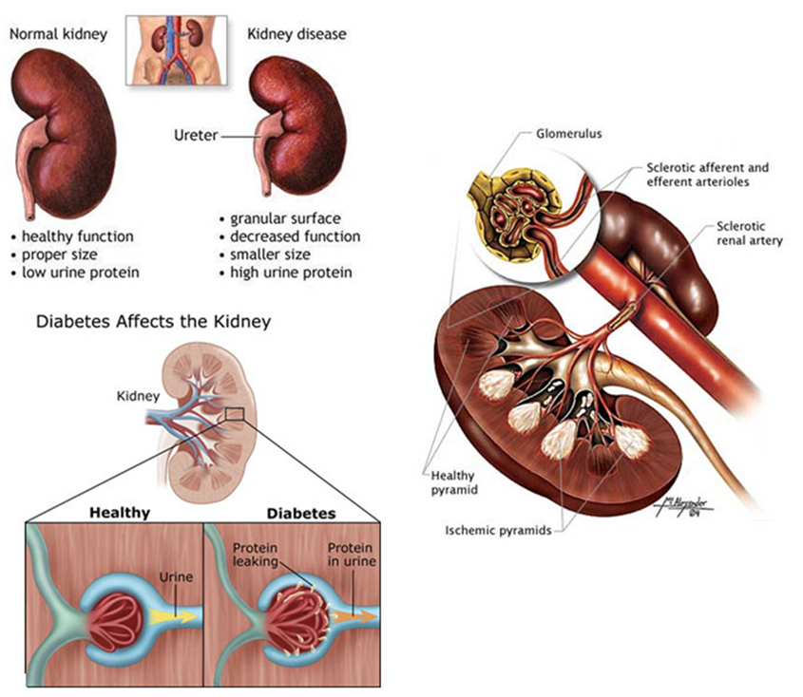
Nephropathy

Slide 53

Keep Kidneys Healthy
To reduce the risk or slow the progression of nephropathy
Optimize glucose control (A)
Optimize blood pressure control (A)

Slide 54
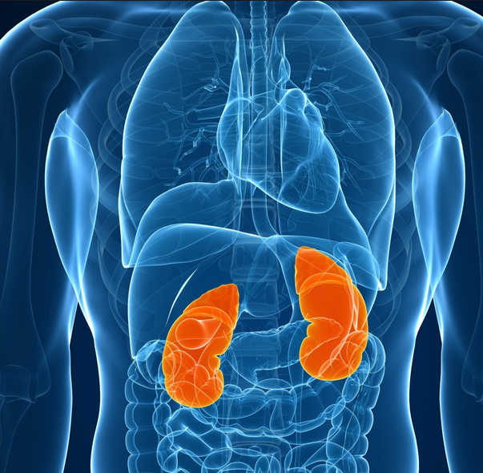
Screening for Kidney Disease
Screen for:
Urine Albumin-Creatinine Ratio (UACR) and
Glomerular Filtration Rate (GFR):
Type 2 at dx then yearly
Type 1 with diabetes for 5 years, then yearly
Measure serum creatinine and GFR yearly
Treat hypertension and intensify as needed

Slide 55
Definitions of Abnormalities in Albumin Excretion
Urine albumin – creatinine ratio (spot collection)
Category mg/g creatinine
normal <30
Increased urinary albumin excretion 30-299
2 of 3 tests w/in 3-6 mo abnormal to confirm
Exercise within 24 h, infection, fever, CHF, marked hyperglycemia, and marked hypertension may elevate urinary excretion over baseline values. ADA

Slide 56
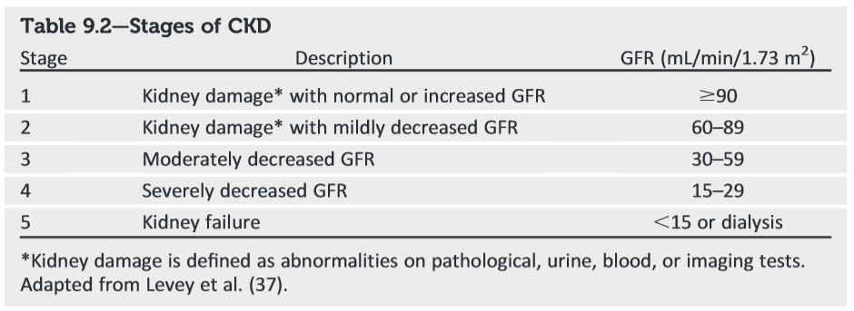
Stages of Chronic Kidney Disease

Slide 57
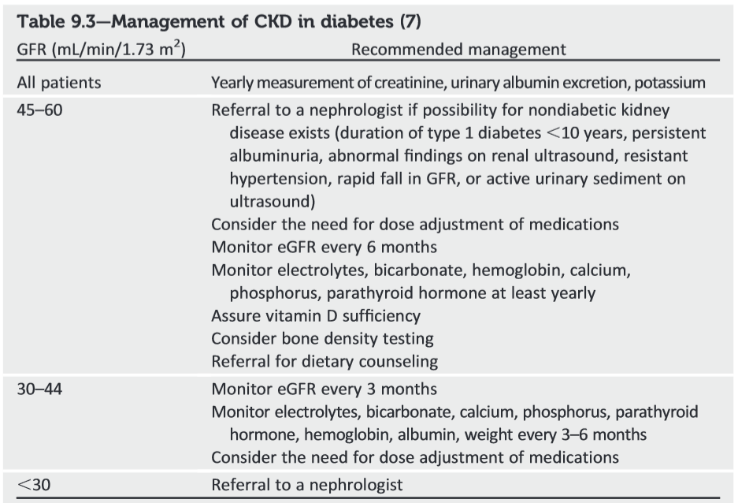
ADA Management of CKD

Slide 58

Kidney disease treatment - ADA
ACE or ARB NOT recommended for prevention of kidney disease if BP normal and urinary albumin excretion (UAE) < 30 mg/g
ACE or ARB if UAE of >30 mg/g
Monitor creat and K+ when on ACE or ARB
When GFR < 60, evaluate/manage potential complications of CKD
Consider referral to specialist when management is difficult and kidney disease is advanced
Protein restriction not recommended

Slide 59
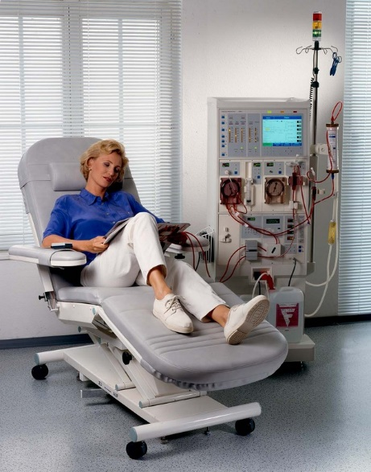
Treatment of Chronic Kidney Disease (CKD)
There are four primary treatment options for individuals who experience ESRD:
1. Hemodialysis
2. Peritoneal Dialysis
3. Kidney Transplantation
120, 000 Americans waiting for kidney
Only 17,000 receive one each year
Every day, 12 people die waiting for a kidney
4. No treatment
Notes:
There are currently three treatment options available to patients who experience kidney failure: Hemodialysis, peritoneal dialysis, and kidney transplantation. Although kidney transplantation is a serious operation, it offers patients with kidney failure their best opportunity for survival. For patients who choose dialysis, approximately one third are still alive after five years of treatment vs. a possible 90% survival rate for individuals who receive a kidney from a living relative. The next part of this presentation will review the procedures, risks and complications associated with each of these options.

Slide 60

Psychosocial Issues associated with Chronic Kidney Failure
depression
stress
anxiety
support groups, counseling and coping skills

Slide 61

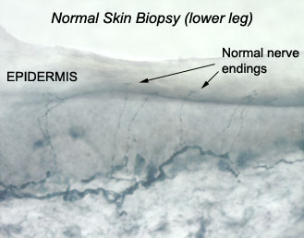
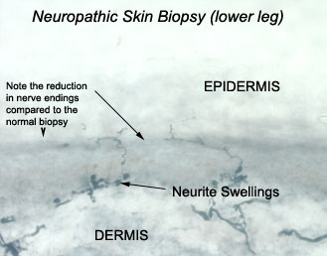
Skin Biopsy to Assess Neuropathy

Slide 62
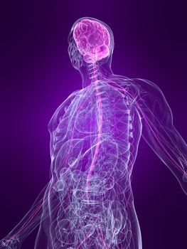
3 Types of Neuropathy
Generalized Symmetrical Polyneuropathy
Acute sensory
Chronic sensory (distal)
Small fiber
Large fiber
Autonomic Neuropathy
Focal and Multifocal Neuropathy

Slide 63

Treating Neuropathy
Improve glycemic control
Control pain
Relief from depression from chronic pain
Massage, stretching, pain control clinic, TENS, avoiding alcohol, relaxation exercises....

Slide 64
Pharmacologic Therapy for Neuropathy
Try Alpha lipoic acid: 600 – 1,800mg /day
Prescription Therapy
1st line
Tricyclic antidepressants (ie amitriptyline, nortriptyline
Calcium channel modulators (ie gababentin, pregabalin)
Serotonin Norepinephrine Reuptake Inhibitors (SNRI)
2nd line
Topical Capsaicin Cream
Opioids (tramadol, oxycodone)
Reasons for treatment failure:
Dose too low, inadequate trial, pt expecting elimination of symptoms, not changing class when no response
Ziegler, D Painful diabetic neuropathy. Diabetes Care, 2009

Slide 65
“DAN” Diabetic Autonomic Neuropathy
50% of pt’s with peripheral neuropathy also have DAN
DAN increases M & M rates
neurogenic bladder, sexual dysfunction
GI related disorders / gastroparesis
orthostatic hypotension
fixed heart rate, silent MI, sudden death
hypoglycemia unawareness
sudomotor, pupillary

Slide 66

Sexual Functions as We Age
20-30 years trice daily
30-40 years tri weekly
40-50 years try weekly
50-60 years try weakly
60-70 years try oysters
70-80 years try anything
80-90 years try to remember
A touch of humor from AADE-New Perspectives on Erectile Dysfunction, 1999

Slide 67

Erectile Dysfunction
Affects about 50% of men with diabetes
Loss of erections sufficient for intercourse
Due to combo of vascular and nerve damage
Tests: penile tumescence to eval if organic or psychogenic
Treatment:
Sildenafil (Viagra), Vardenafil (Levitra), Tadalfil (Cialis)
Use caution if taking nitrate drugs. Check w/ MD first
Other meds, vacuum devices, prosthetics
HRT- testosterone gel, patches, injections, pills

Slide 68

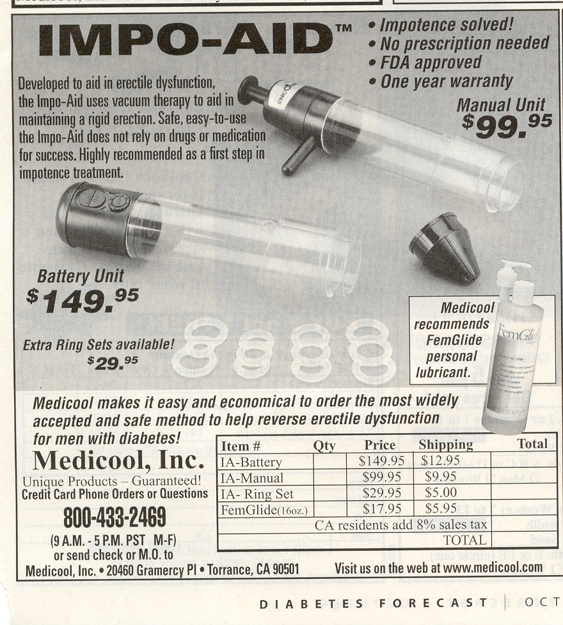
Assistive Devices

Slide 69
Take Charge. Talk T. www.diabeteseducator.org
Men w/ DM, 2x risk of low testosterone levels
Symptoms include low sex drive, ED, depression, lack of energy and vitality
Low T easily diagnosed and managed, only 10% of men currently treated
Initial Screening:
Total testosterone: if < 300 ng/dl = hypogonadal
am testing preferred, repeat to confirm
Treatment: determine cause, testosterone replacement therapy

Slide 70
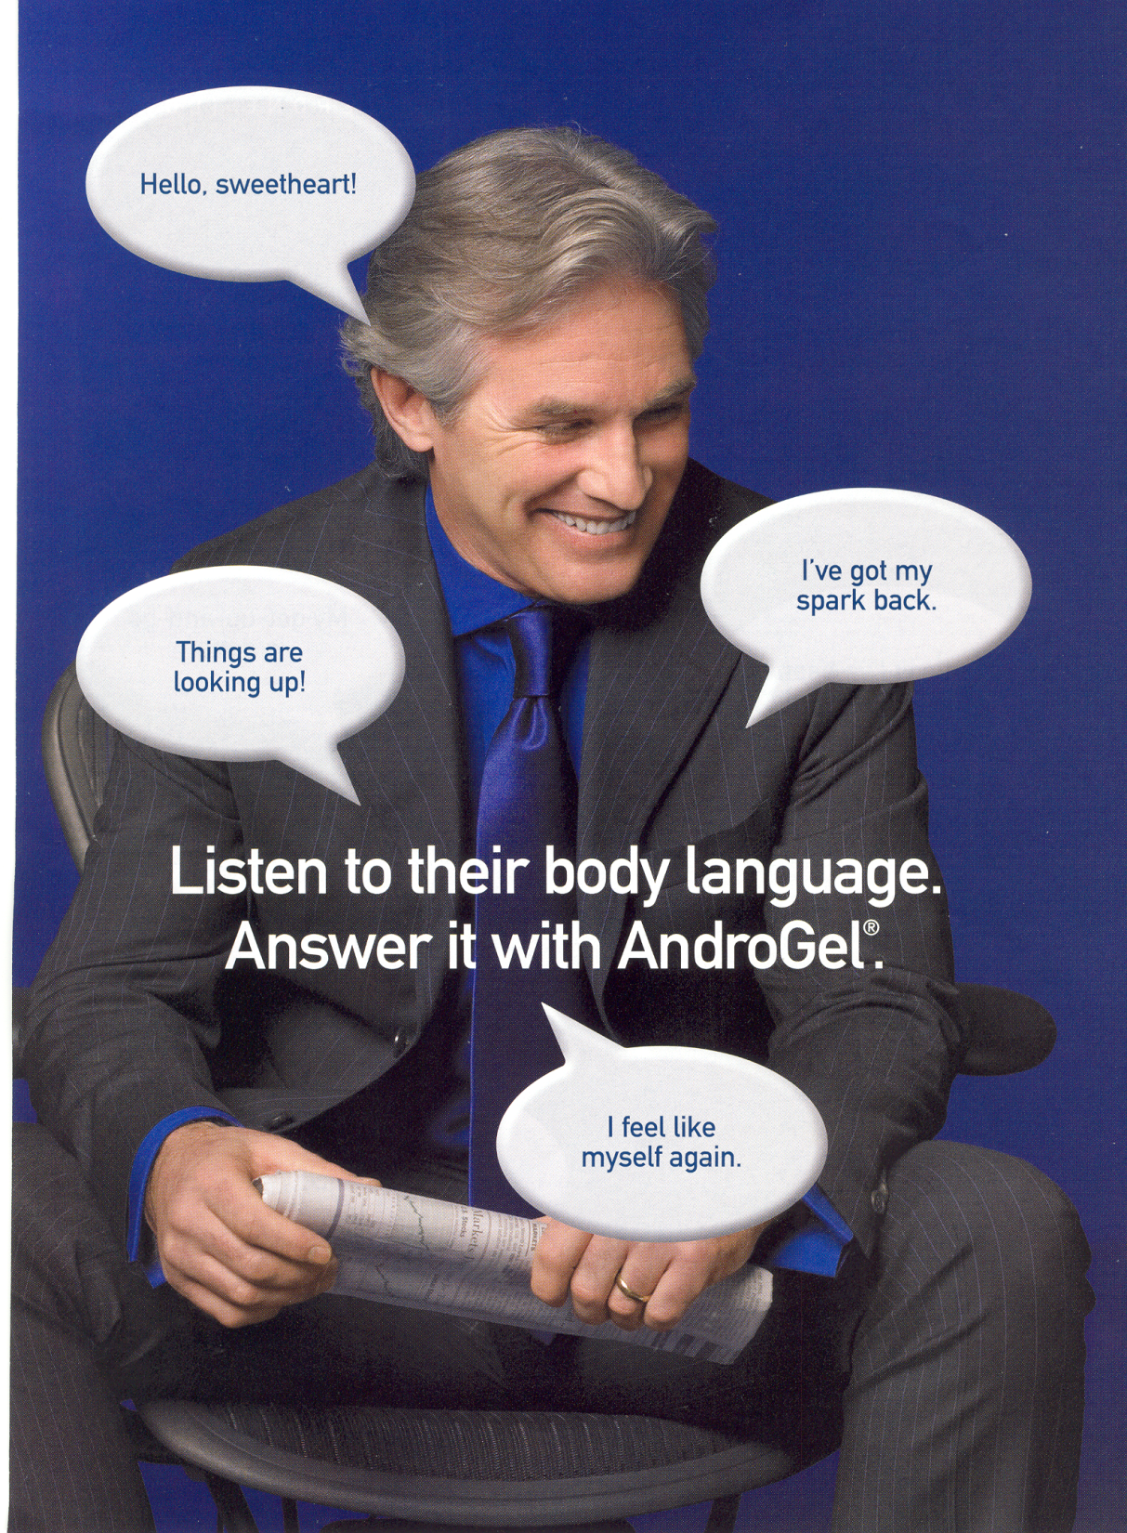

Slide 71
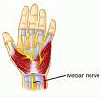
Focal Neuropathies
Often occurs in middle aged pt’s or those w/ polyneuropathy
4 major focal neuro
mono - compression or entrapment
carpal tunnel most common
plexopathy- femoral neuropathy
pain from hip to ant and lat aspects of thigh
radioculopathy - intercostal neuropathy
cranial - abrupt onset, HA, eye pain

Slide 72

Neuropathy Key Considerations
Very common long-term complication often not recognized and treated
Management / treatment complex
Thorough history /assessment critical
Treatment based on underlying process, presentation, and cost effectiveness
Treatable condition with new therapies on horizon.

Slide 73
The ABC’s of Diabetes Control
A - A1c less than 7%
B - Blood pressure less than 140/90
C - Cholesterol HDL > 40, Triglycerides < 150
D - Drugs- Keep list for emergencies/ MD
E - Exercise and Eyes
F - Food and Feet
G – Glucose checks and goals
H- Healthy Coping - Hoorah for your hard work!

Slide 74

Promoting Learning and Behavior Change

Slide 75
Promoting Learning…*
Objectives Summary: state, discuss, describe:
Strategies to promote change.
Barriers to learning and change
4 Learning theories.
“Stages of readiness”.
Roles and responsibilities
MC, MI, Brief Negotiation, timely tools.

Slide 76
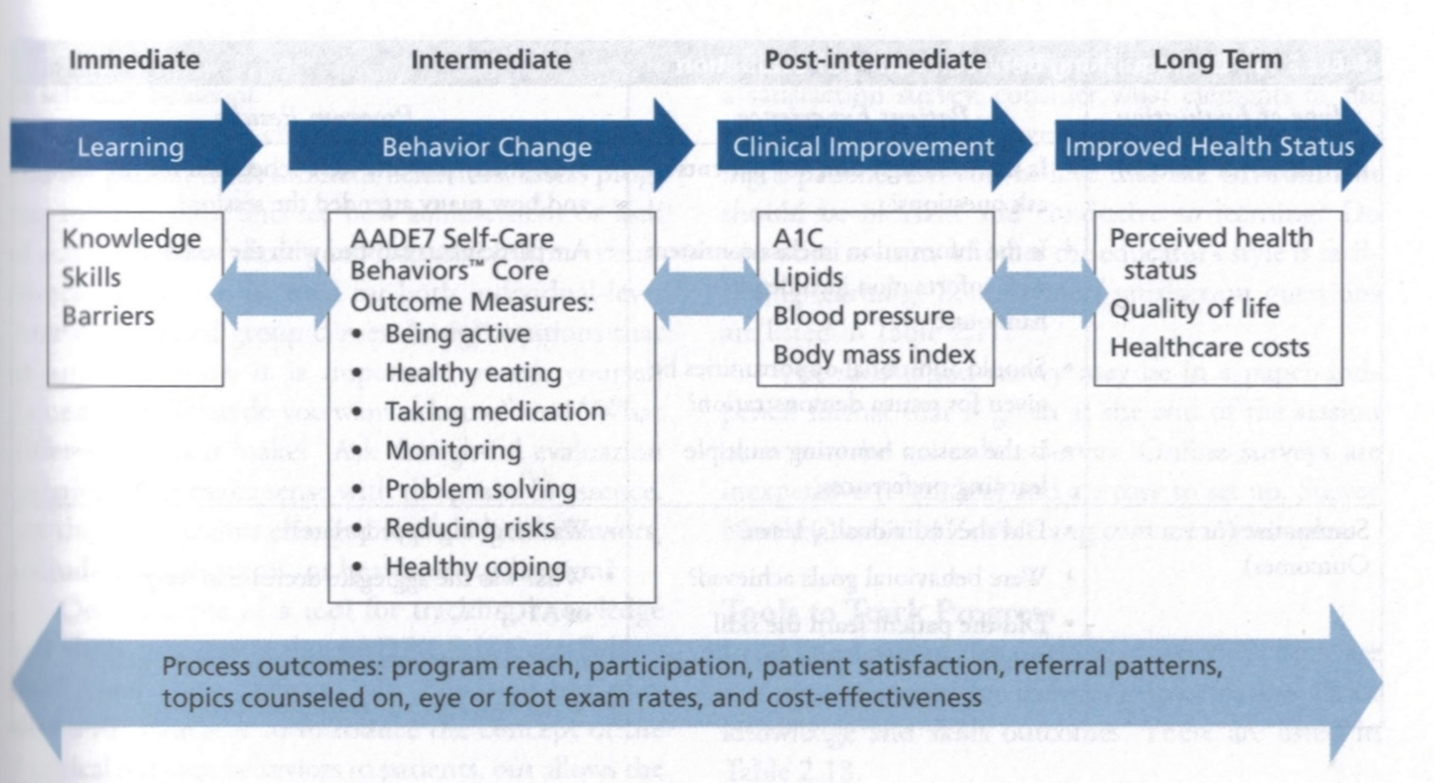

Slide 77
Overview- Envision:
Theories
(Empowerment, Health Belief,
Social Cognitive,Transtheoretical)
Patient’s Readiness to Change (stages)
Our Attitude, Approach
Brief Negotiation, MI
Alter ambivalence
Change

Slide 78

Adult Learners
Self-directed must feel need to learn
Problem oriented rather than subject oriented
Learn better when own experience is used
Prefer active participation

Slide 79





Readiness determines Approach*
Precontem-plation:
NOPE!
Contem-plation:
Maybe
Preparation: Action/Maintenance:
OK! I want to! I’m Doing it! -- X 6 Mo
Relapse:Stuck
OOOOPS!

Slide 80
Readiness determines Approach*
Precontem-plation:
Raise doubt
Re: status quo.
Info?
NOPE!
Contem-plation:
Explore + resolve abiva-
Lence.
+ Gains?
Maybe
Preparation: Action/Maint:
Committed to change just needs to know how!
Who-What- Where
Prepping? Praise-Support
Plan?
OK! I want to! I’m Doing it x6m
Relapse Stuck
Support-plan- reframe??
OOOOPS!

Slide 81
Is your patient truly ready to change? Most are unsure re: change … they need to prepare first!
Not Ready 20%
and Ready 20%
Unsure 30%
Unsure 30%

Slide 82

Central Concept Patient Centered Counseling
You can raise a person’s hope JUST by
lending them YOURS…
(+ using a systematic, structured and mindful coaching approach!)

Slide 83

Thank You
Web www.diabetesed.net

