Slide 1


Insulin Historical Slides
Beverly Thomassian, RN, MPH, BC-ADM, CDE
President, Diabetes Education Services
www.DiabetesEd.net

Slide 2
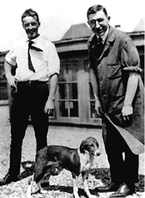
Dr. Banting and Best with Marjorie at University of Toronto

Slide 3
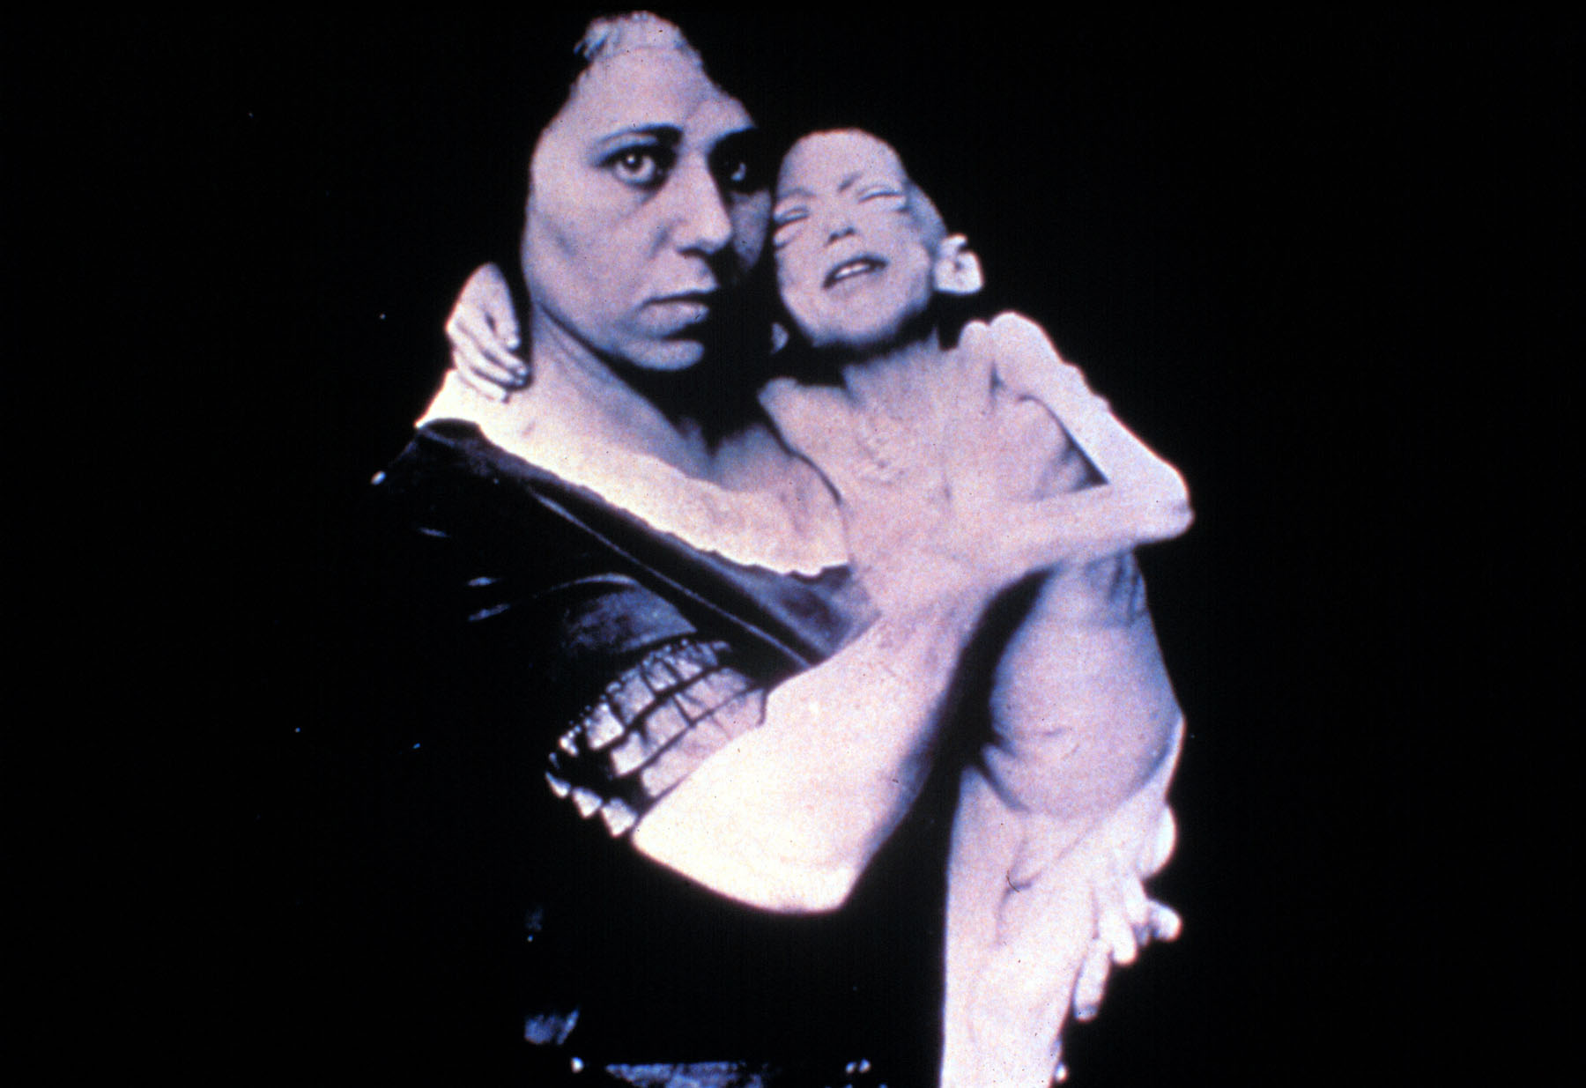

Slide 4
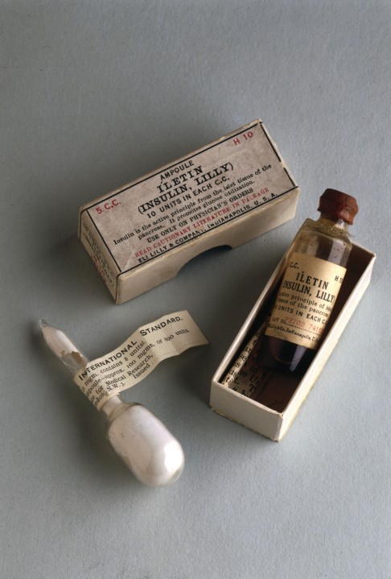
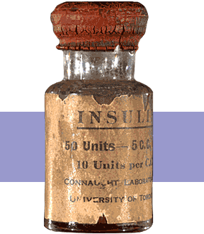
Insulin Finally Available - 1922

Slide 5
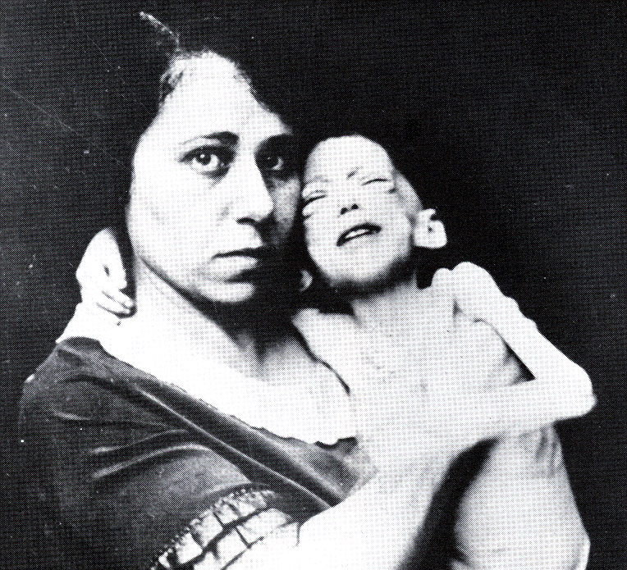

Miracle of Insulin
The Miracle of Insulin
Patient J.L., December 15, 1922
February 15, 1923

