Slide 1


Welcome to Diabetes in 21st Century
Beverly Dyck Thomassian, RN, MPH, BC-ADM, CDE
President, Diabetes Education Services
www.DiabetesEd.net

Slide 2
Diabetes in the 21st Century: A Clinical and Educational Update
Describe impact of diabetes
Discuss prevention, management strategies
Discuss different types of diabetes
Describe insulin therapy
Review glucose patterns and determine how to adjust therapy to improve glucose.
Discuss medical nutrition therapy
Gain understanding of Type 2 Meds.
Demonstrate successful teaching strategies

Slide 3
CDC Announces
35% of Americans will have Diabetes by 2050
Boyle, Thompson, Barker, Williamson
2010, Oct 22:8(1)29
www.pophealthmetrics.com

Slide 4
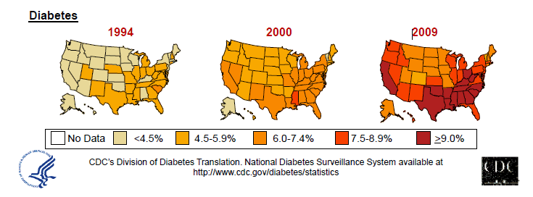
Diabetes in America 2014
29 million or > 9.3%
27% don’t know they have it
37% of US adults have pre diabetes

Slide 5

My Boys –Robert and Jackson
By the time they are 50, 1/3 will have diabetes

Slide 6

Global Epidemic
Every 10 seconds
1 person dies with diabetes
2 people develop diabetes
Every year
3 million deaths
6 million new cases
World Diabetes Day is November 14
March is ADA Sound the Alert Day “find people w/ undetected diabetes”

Slide 7


World diabetes day – November 14
DIABETES: PROTECT OUR FUTURE

Slide 8
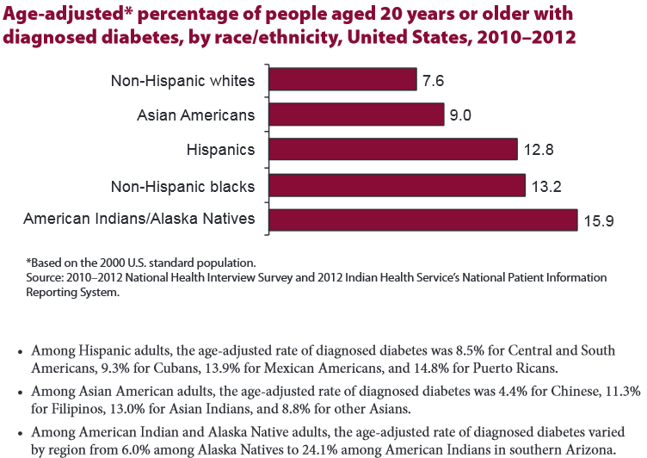

Age-adjusted Diabetes Prevalence 20 yrs or older, by race/ethnicity— U.S. 2014

Slide 9

Why Should Zip Code Determine Life Expectancy?
Measureofamerica.org

Slide 10
The relationship between BMI and the risk of developing type 2 diabetes
93.2
100
Women
70
54.0
Men
40.3
42.1
40
27.6
21.3
15.8
11.6
Risk of type 2 diabetes
10
8.1
6.7
4.3
5.0
4.4
5
2.9
1.5
2.2
1.0
1.0
1.0
0
<22
<23
23-
24-
25-
27-
29-
31-
33-
35+
23.9
24.9
26.9
28.9
30.9
32.9
34.9
Body mass index (kg/m2))

Slide 11


Type 2 in Kids
7 fold increase since 1990
1 in 6 overwt kids (age 12- 19) have prediabetes.
~2,500 to 3,700 new cases in U.S. annually.
Highest risk: very obese, minority, female, low socioeconomic status, limited education
In age range 12-19, less than 1% have Type 2 – NHANES
Environmental changes urgently needed

Slide 12
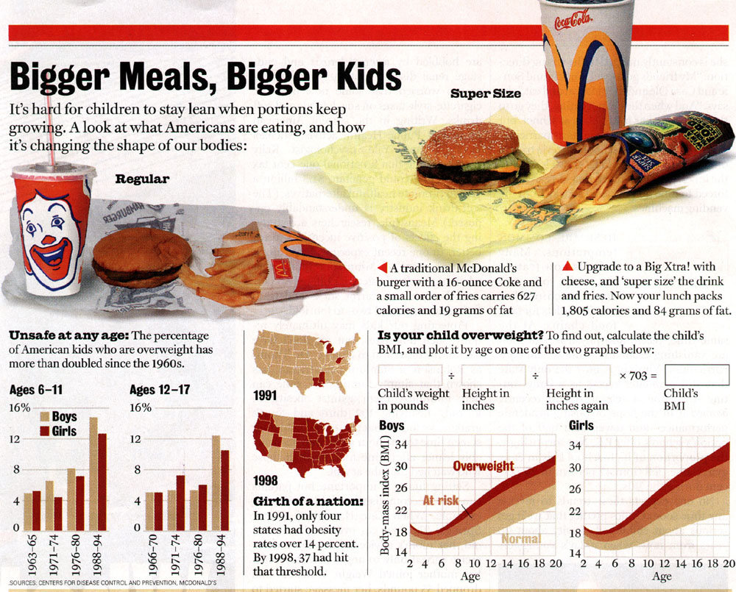

Slide 13
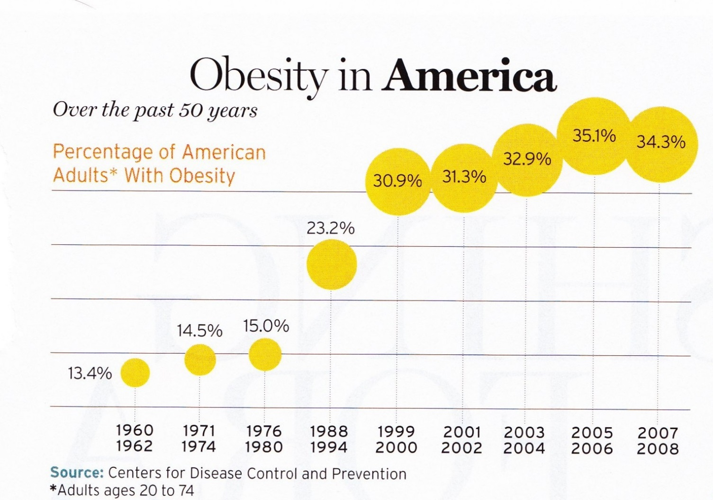
34% BMI 30 +, 34% BMI 25-29
We burn 100 cals less a day at work
1/3 of all overwt people don’t get diabetes

Slide 14


Thoughts on Diabetes, Weight, Social Change
“The only way on a societal basis to reduce the prevalence of obesity is through community action” – Dr. Frieden, CDC
In the past 20 yrs:
the price of soda has gone up 20%
Fruits and vegetables have gone up 100+%
Obesity (BMI 30+) prevalence 22% to 40%
Poverty, Obesity, Diabetes inter-related

Slide 15
New and Early Research on Gut Bacteria
Leaner people appear to have higher proportion of bacteroidetes
Gut bacteria less efficient at converting food to calories
Obese people appear to have higher levels of firmicutes
Gut bacteria very efficient at calorie extraction
Bacteria tend to run in families
Newsweek. Don’t Just Blame Calories – July 6, 2010 DM Forecast – Feb 2011

Slide 16

Free Live Webinars and Live Seminars at DiabetesEd.net
Free Webinars
Preparing to take CDE
New Frontiers
New Medications
BC-ADM

Slide 17
Role of the Pancreas Endocrine Functions
Beta Cells - Insulin
Anabolic hormone - helps store glucose as glycogen in muscle, liver
secreted in response to elevated glucose
halts breakdown of glycogen in liver
increases protein synthesis, fat storage
powerful hypoglycemic
Beta Cells - Amylin
secreted in 1:1 ratio with insulin
Causes satiety
Lowers post-prandial glucagon response
Slows gastric emptying
Type 1 make none
Type 2 make less than normal amounts

Slide 18
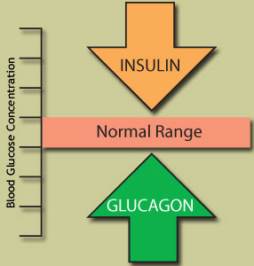
Role of the Pancreas Endocrine Functions
Alpha cells - Glucagon
Opposes action of insulin at the liver
stimulated in response to low glucose levels
stimulates liver to convert glycogen to glucose
inhibits liver from glucose uptake
causes hyperglycemia

Slide 19
Hormones Effect on Glucose
Hormone
Glucagon (pancreas)
Stress hormones (kidney)
Epinephrine (kidney)
Insulin (pancreas)
Amylin (pancreas)
Gut hormones - incretins (GLP-1) released by L cells of intestinal mucosa, beta cell has receptors)
Effect



⇒
⇒
⇒

Slide 20
Bariatric Surgery
Consider on diabetes pts w/ BMI >35, esp with comorbidities
Remission (BG normalized)
rates range from 40 – 95%
Better results with newer diabetes (more beta cell mass)
Due to increase incretins (gut hormones)
Still researching long term benefits, cost effectiveness and risk

Slide 21
Signs of Diabetes
Polyuria
Polydipsia
Polyphasia
Weight loss
Fatigue
Skin and other infections
Blurry vision
Glycosuria, H₂O losses
Dehydration
Fuel Depletion
Loss of body tissue, H₂O
Poor energy utilization
Hyperglycemia increases incidence of infection
Osmotic changes

Slide 22
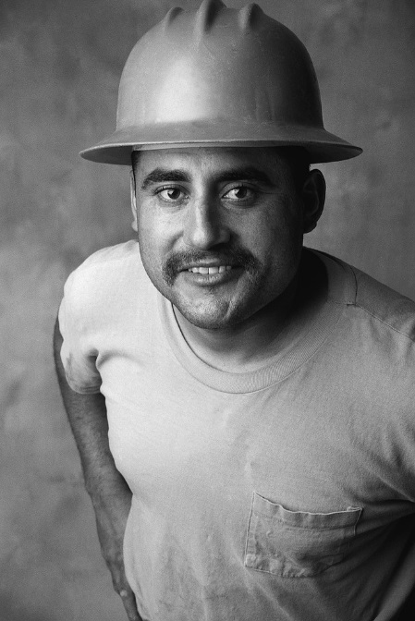

Case Study
1. Pt profile: 5’8”, 192 lb male
Diabetes 12 years, on insulin 3 yrs
What type of DM and how do you know?
2. 5’6”, 108 lb female
On insulin 3u Regular before meals, 10u NPH at bedtime
What type of DM and how do you know?

Slide 23


Slide 24
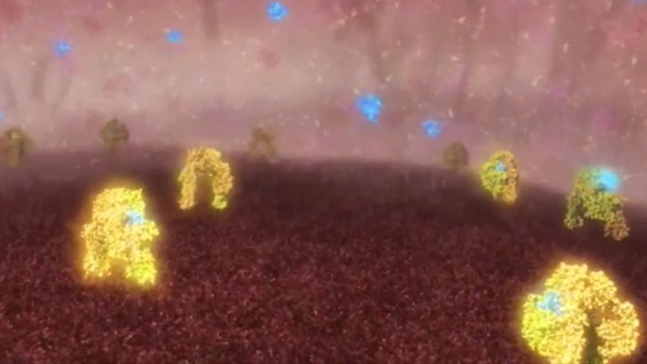
Images shows insulin (blue) molecules binding with insulin receptors (yellow) Jan 2013
The international research team was led by scientists from the Walter and Eliza Hall Institute (WEHI) in Melbourne, with collaborators from La Trobe University, the University of Melbourne, Case Western Reserve University, the University of Chicago, the University of York and the Institute of Organic Chemistry and Biochemistry in Prague.

Slide 25
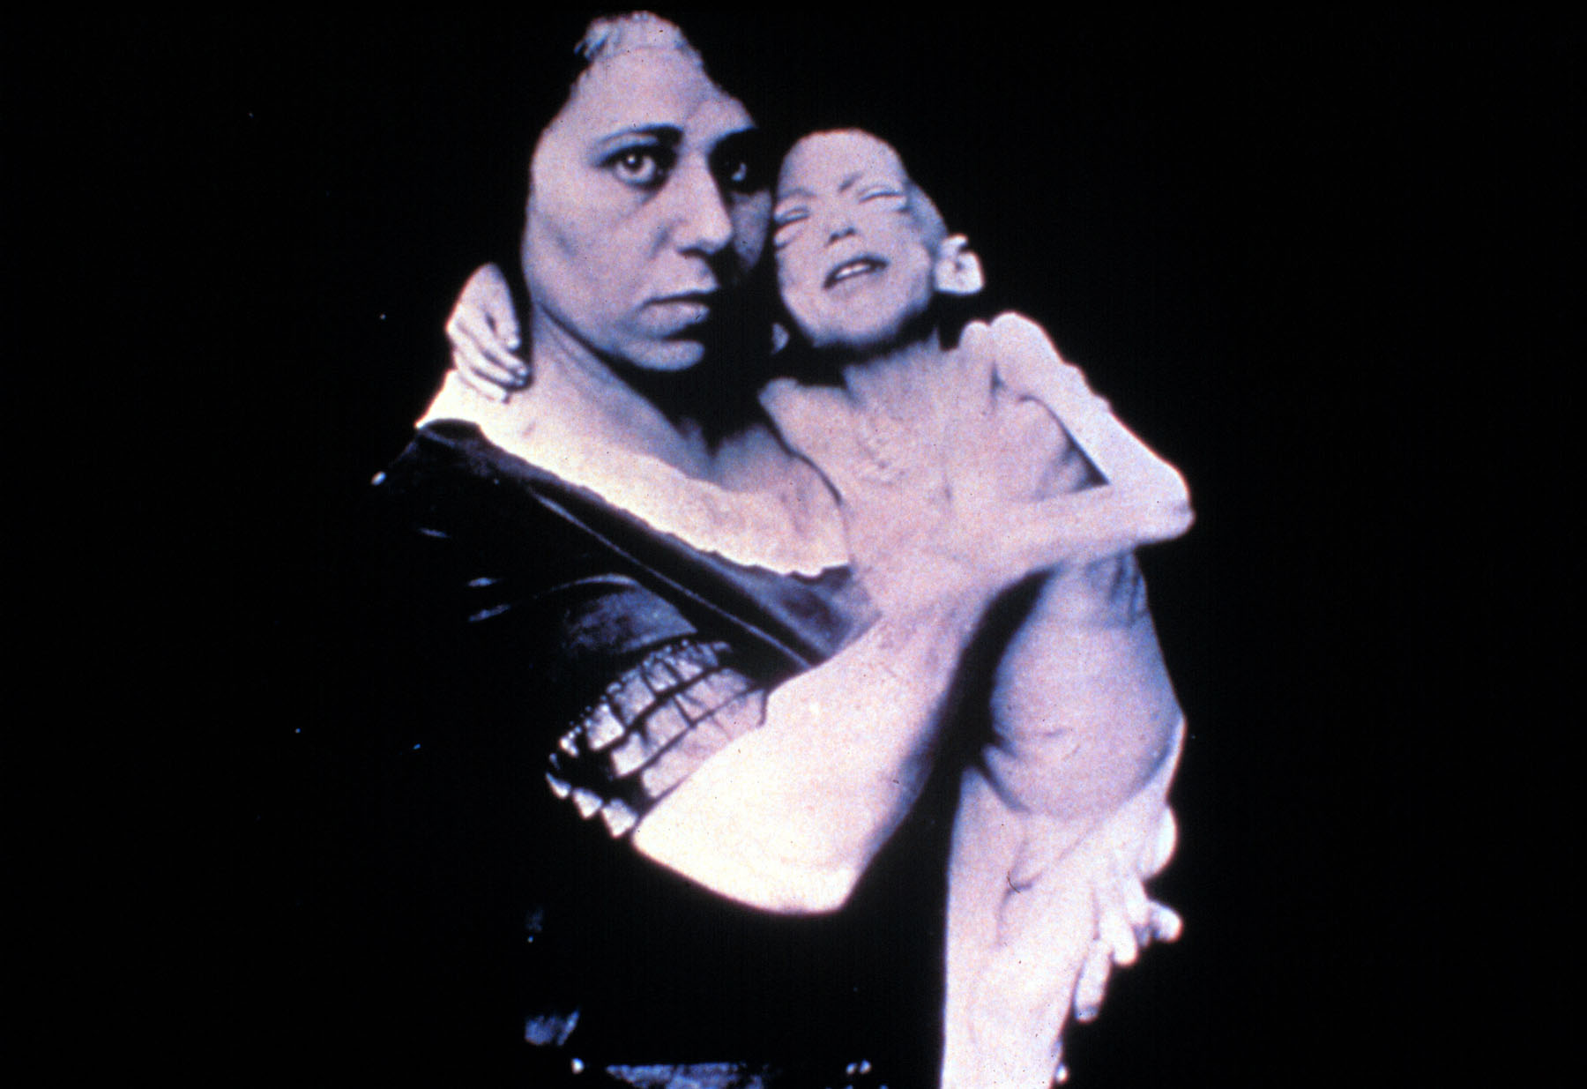

Slide 26


Slide 27
Type 1 Diabetes – Genetics and Risk Factors
1- 400 to 1-1000 = Risk of type 1 in gen pop
1-20 to 1-50 in offspring of diabetes parents
Combo of genes and disease susceptibility
Risk Factors:
Autoimmunity tends to run in families
Higher rates in non breastfed infants
Viral triggers: congenital rubella, coxsackie virus B, cytomegalovirus, adenovirus and mumps.

Slide 28
Type 1 Diabetes – 10% of all DM
Auto-immune pancreatic beta cells destruction
Most commonly expressed at age 10-14
More rapid destruction in youth (vs. adults)
Insulin sensitive (require 0.5 - 1.0 units/kg/day)
Auto-immune Markers
Positive Glutamic Acid Decarboxylase (GAD), Insulin & Islet Cell Autoantibodies (IAA & ICA’s)
New marker – ZnT8 (zinc transporter) antibodies to this (ZnT8) found in 60-80% of type 1
Other clues
Low C-Peptide level < 0.5
Usually lean and present in sick state

Slide 29
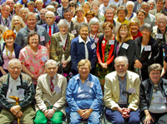
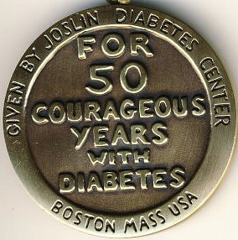
Medalist Study – Harvard Joslin Diabetes Center
After 50 years with diabetes
Many still produced some insulin
Many had no eye disease

Slide 30



Ms. Idaho and Ms America – Pumpin’ It

Slide 31





What Does Type 1 Look Like?
Bret Michaels
Sharon Stone
Halle Berry
Mary Tyler Moore
From Debbie Nagata’s slide collection
Adam Morrison
Nick Jonas
Justice Sonia Sotomayor

Slide 32
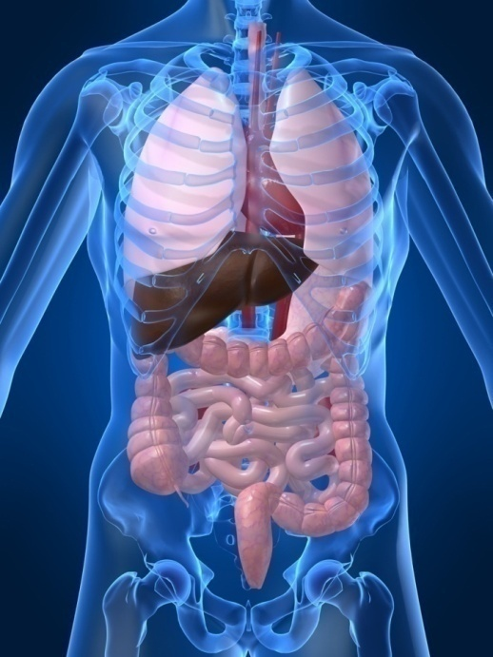
Type 1 Diabetes Associated with other immune conditions
Celiac disease (gluten intolerance)
Thyroid disease
Addison’s Disease
Rheumatoid arthritis
Other

Slide 33
Type 1 Summary
Autoimmune and often associated w/
Complete pancreatic destruction
Need insulin shots
Often first present in Diabetic KetoAcidosis (DKA)

Slide 34

Type 1 in Hospital
43 yr old admitted to evaluate angina.
Morning blood sugar is 92.
Based on Regular insulin sliding scale, no insulin required.
Breakfast tray shows up and patient says, I need my insulin shot before I eat.
What do you say?

Slide 35
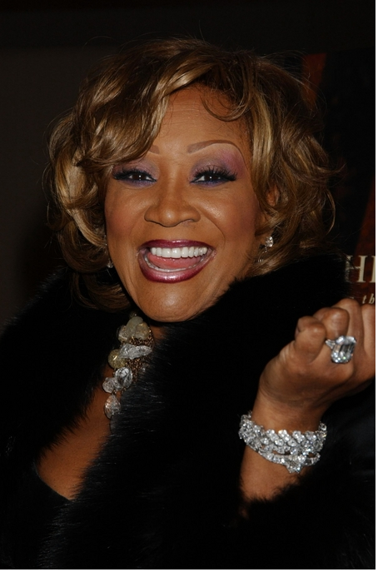
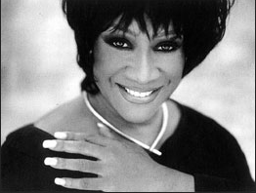
Patti Labelle
"divabetic" -- that's a mix of diabetic and diva

Slide 36

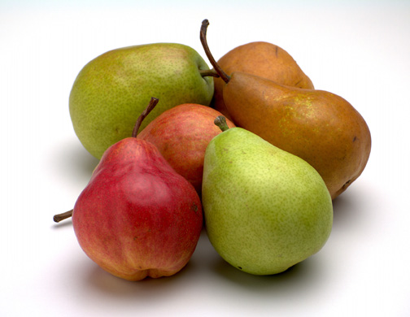


Slide 37
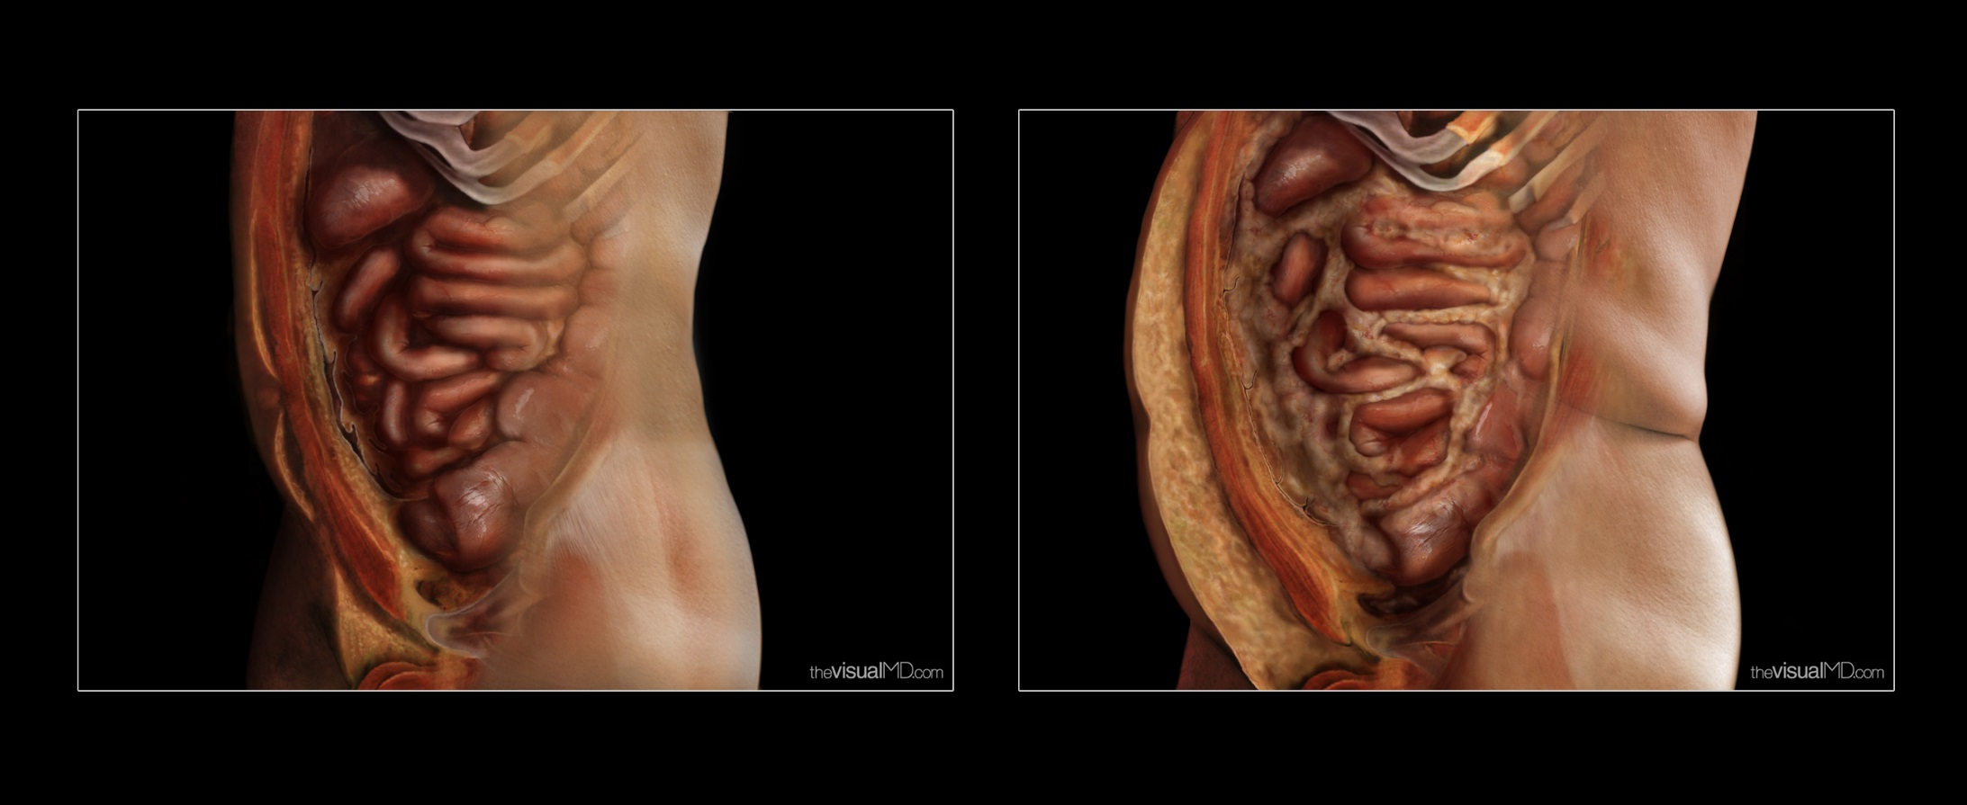
Visceral Fat – “Endocrine Organ”

Slide 38
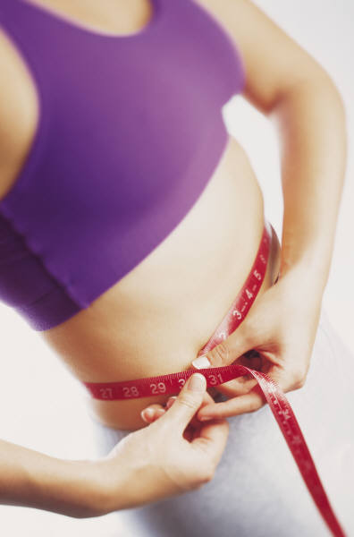
Cardio Metabolic Risk - 5 Hypers -
Hyperinsulinemia (resistance)
Hyperglycemia
Hyperlipidemia
Hypertension
Hyper”waistline”emia (35” women, 40” men)
Manifestations of Insulin Resistance

Slide 39
Flash Mob – World Diabetes Day to Beat It
March R/C/R
Fred Astaire
Point R/L
Arms up, down
Shoulder Walk
Punch down/up
Scoot Rt/Left
Reach up R/L
Shoulder Walk
Open door
Ride Horse
Scoot Rt/Left
Turn R & Clap, then L
Shoulder Walk
Punch down/up

Slide 40
Natural Progression of Type 2 Diabetes
Plasma
Glucose
Postprandial glucose
Fasting glucose
126 mg/dL
Relative β-Cell Function
Insulin resistance
Insulin secretion
-20
-10
0
10
20
30
Years of Diabetes
Prior to diagnosis
After diagnosis
Adapted from Bergenstal et al. 2000; International Diabetes Center.

Slide 41
Natural History of Diabetes
Normal
FBG <100
Random <140
A1c <5.7%
Prediabetes
FBG 100-125
Random 140 - 199
A1c ~ 5.7- 6.4%
50% working pancreas
Diabetes
FBG 126 +
Random 200 +
A1c 6.5% or +
20% working pancreas
Yes!
NO
Development of type 2 diabetes happens over years or decades

Slide 42
Diagnostic Criteria
All test should be repeated in the absence of unequivocal hyperglycemia
If test abnormal, repeat same test to confirm diagnosis
Kaiser Diabetes Screening Guidelines:
Fasting Plasma Glucose (FPG) preferred screening test – after 8 hr fast
A1c acceptable alternative screening test

Slide 43

Diabetes 2 - Who is at Risk? (ADA Clinical Practice Guidelines)
Testing should be considered in all adults who are overweight (BMI ≥ 25) and have additional risk factors:
First-degree relative w/ diabetes
Member of a high-risk ethnic population
Habitual physical inactivity
PreDiabetes
History of heart disease

Slide 44

Diabetes 2 - Who is at Risk? (ADA Clinical Practice Guidelines)
Risk factors cont’d
HTN - BP > 140/90
HDL < 35 or triglycerides > 250
baby >9 lb or history of Gestational Diabetes Mellitus (GDM
Polycystic ovary syndrome (PCOS)
Other conditions assoc w/ insulin resistance:
Severe obesity, acanthosis nigricans (AN)

Slide 45
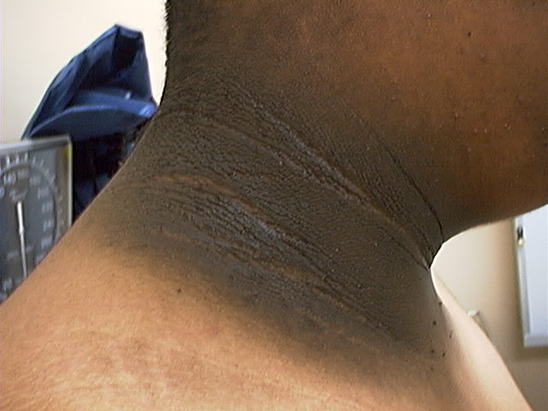
Acanthosis Nigricans

Slide 46
Acanthosis Nigricans (AN)
Signals high insulin levels in bloodstream
Patches of darkened skin over parts of body that bend or rub against each other
Neck, underarm, waistline, groin, knuckles, elbows, toes
Skin tags on neck and darkened areas around eyes, nose and cheeks.
No cure, lesions regress with treatment of insulin resistance

Slide 47

Diabetes is also associated with
Fatty liver disease
Obstructive sleep apnea
Cancer; pancreas, liver, breast
Alzheimer’s
Depression

Slide 48
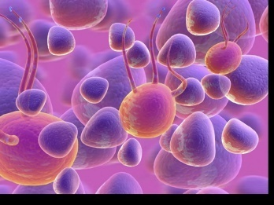
Ominous Octet
Decreased satiation neuro-
transmission
Decreased amylin, β-cell secretion
80% loss at dx
Increased renal glucose reabsorption
Decreased Gut hormones
Increased glucagon secretion
G
I
G
I
G
G
I
I
G
G
Increased lipolysis
G
I
I
G
G
I
Increase glucose
production
I
G
G
Decreased glucose
uptake
© Copyright 1999-2013, Diabetes Educational Services, All Rights Reserved.
Notes:
48
48

Slide 49
Diabetes Detectives Needed
On average – takes 6.5 years to diagnose diabetes
1/4 of all people with diabetes don’t know they have it

Slide 50
Comparison of Type 1,Type 2, LADA
Type 1
Type 2
Obesity
x
xxx
Insulin dependence
xxx
30%
Respond to oral agents
0
xxx
Ketosis
xxx
x
Antibodies present
xxx
0
Typical Age of onset
teens
adult
Insulin Resistance
0
xxx

Slide 51

Gestational DM ~ 7% of all Pregnancies
GDM prevalence increased by
∼10–100% during the past 20 yrs
Native Americans, Asians, Hispanics, African-American women at highest risk
Immediately after pregnancy, 5% to 10% of GDM diagnosed with type 2 diabetes
Within 5 years, 50% chance of developing DM in next 5 years.

Slide 52
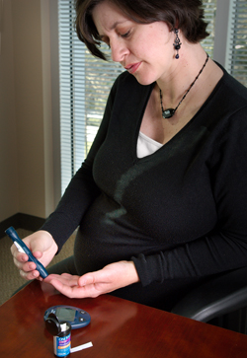
Diabetes in pregnant mothers associated with …
Offspring
Fetal Complications
Obesity and diabetes later in life
Mother
More complicated pregnancy and delivery
Diabetes later in life
Intrauterine environment is important

Slide 53

Screen Pregnant Women Before 13 weeks
Screen for undiagnosed Type 2 at the first prenatal visit using standard risk factors.
Women found to have diabetes at their initial prenatal visit treated as “Diabetes in Pregnancy”
If normal, recheck at 24-28 weeks

Slide 54

Increasing Prevalence – A public health perspective
Body weight before and during pregnancy influences risk of GDM and future diabetes
Children born to women with GDM at greater risk of diabetes
Focus on prevention

Slide 55
Postnatal Health: Maternal Behavior
Encourage breastfeeding for one year
(25% of women achieving this goal)
Screening 6-12 weeks post partum using non-pregnant OGTT criteria (50%)
Repeat at 3 yr intervals or signs of DM
Encourage weight control and exercise
Make sure connected with health care
Preconception counseling

Slide 56

Start Metformin therapy
For women with PreDiabetes and History of GDM

Slide 57
Other Causes of Hyperglycemia
Steroids
Agent Orange
Tube feedings / TPN
Transplant medications
Cystic Fibrosis
Regardless of cause, requires treatment
Insulin always works
Sign of pancreatic malfunction

Slide 58
Diabetes Bingo “DiaBingo” Shout out Right Answer

Slide 59
DiaBingo
B Frequent skin and yeast infections
B A BMI of ____ or greater is considered overweight
B To reduce complications, control A1c, Blood pressure, Cholesterol
B PreDiabetes – fasting glucose level of ___ to ____
B Erectile dysfunction indicates greater risk for ____
B Diabetes – fasting glucose level____ or greater
B Type 1 diabetes is best described as an ______ disease
B People with diabetes are ______ times more likely to die of heart dx
B Elevated triglycerides, < HDL, smaller dense LDL
B Each percentage point of A1c = _____ mg/dl glucose
B At dx of type 2, about __% of the beta cell function is lost
B Diabetes – random glucose ____ or greater

Slide 60

Life Study – Mrs. Jones
Mrs. Jones is 62 years old, overweight and complaining of feeling tired and urinating several times a night. She is admitted with a urinary tract Infection. Her WBC is 12.3, glucose 237. She is hypertensive with a history of gestational diabetes. No ketones in urine.
What are her risk factors, signs of diabetes
What type of diabetes does she have?
Does she have insulin resistance?

Slide 61
What Do You Say? Mrs. Jones asks you
What is type 2 diabetes?
Will this go away?
Will I get complications?
Will I need to take diabetes medication for the rest of my life?
How come I got diabetes?
Do I have to check my blood sugars?

Slide 62
I don’t want to!

Slide 63

Unconditional Positive regard
Unconditional Positive Regard –
involves showing complete support and acceptance of a person no matter what that person says or does.
Help with
Unconditional
Guidance and Support
Anne Peters, MD, CDE
ADA Post Grad
Term coined by humanist, Carl Rogers

Slide 64
No one is Unmotivated
…. to lead and long and healthy life
These are the 3 usual Critical Barriers
Perceived worthlessness
Too many personal obstacles
Absence of support and resources
Bill Polonsky, PhD, CDE

Slide 65
Overcoming barriers
Confront the key misbelief. Ask the question, does dm cause complications?
Offer pts evidence based hope message –
Frequent contact
Paired glucose testing
Ask pt, “Tell me 1 thing that is driving you crazy about your diabetes”
Discuss medication beliefs
To improve outcomes, see pts more often
Bill Polonsky, PhD, CDE

Slide 66
How will blood glucose testing help me?
See if your treatment plan is working
Make decisions regarding food and/or med adjustment when exercising
Find out how that pizza affected your BG
Avoid unwanted weight gain
Enhanced athletic performance
Find patterns
Manage illness

Slide 67
How Often Should I Check?
Be realistic!!
Type 1 – at least pre and post meal
Type 2 – as often as needed to achieve goals (ADA)
Consider:
Types and timing of meds
Goals
Ability (physical and emotional)
Finances

Slide 68
Complications - Why?
Degree of hyperglycemia “glucose toxicity”
Duration of hyperglycemia
Genes
Multiple risk factors: smoking, vascular disease, dyslipidemia, hypertension, other

Slide 69
Diabetes Complications
Heart disease leading cause of death.
CAD death rates are about 2 -4x’s as high as adults without diabetes (it’s not getting better)
Risk of stroke is 2 - 4 times higher
60% - 65% of people with DM have HTN.
DM accounts for 40% of new cases of ESRD
60 - 70% have mild - severe forms of neuropathy
Diabetes is the leading cause of blindness
Accounts for 50% of lower limb amputations

Slide 70
Control Matters
Prevention
Trials
Practice Recommendations

Slide 71

Financial Advisor
Mid 30s, friendly, he smiles to greet you and you notice his gums are inflamed. You’d guess a BMI of 26 or so, with most of the extra weight in the waist area.
If you could give him some health related suggestions, what would they be?

Slide 72

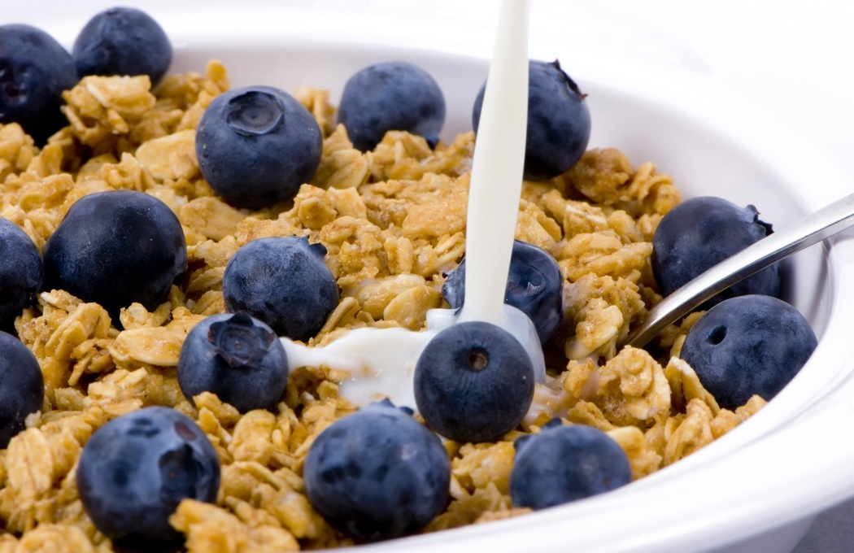


Preventing Pre Diabetes

Slide 73
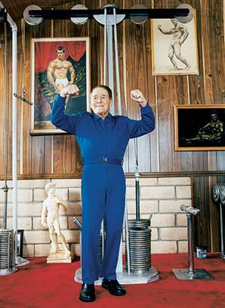
Can Type 2 be Prevented in Older Adults?
Overall, 9 of 10 new cases of diabetes attributable to these 5 lifestyle factors.
89% risk reduction when all at goal.
35% rel risk reduction for each additional
Physical activity (30 mins a day)
Dietary score (higher fiber intake, low saturated fat and trans-fat, lower mean glycemic index)
Not Smoking
Alcohol use (up to 2 drinks a day);
BMI <25 and waist circumference
Dariush Mozaffarian, MD,
Arch Intern Med. 2009;169(8):798-807.

Slide 74
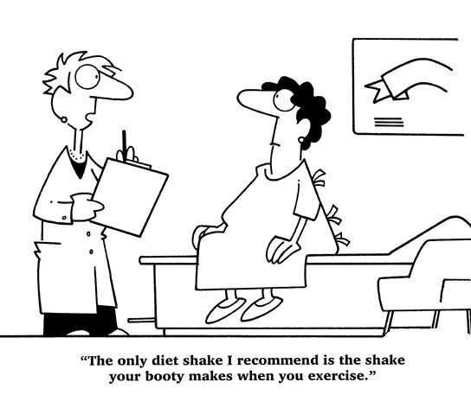
Best Shake For People with Diabetes
From Debbie Nagata’s slide collection

Slide 75
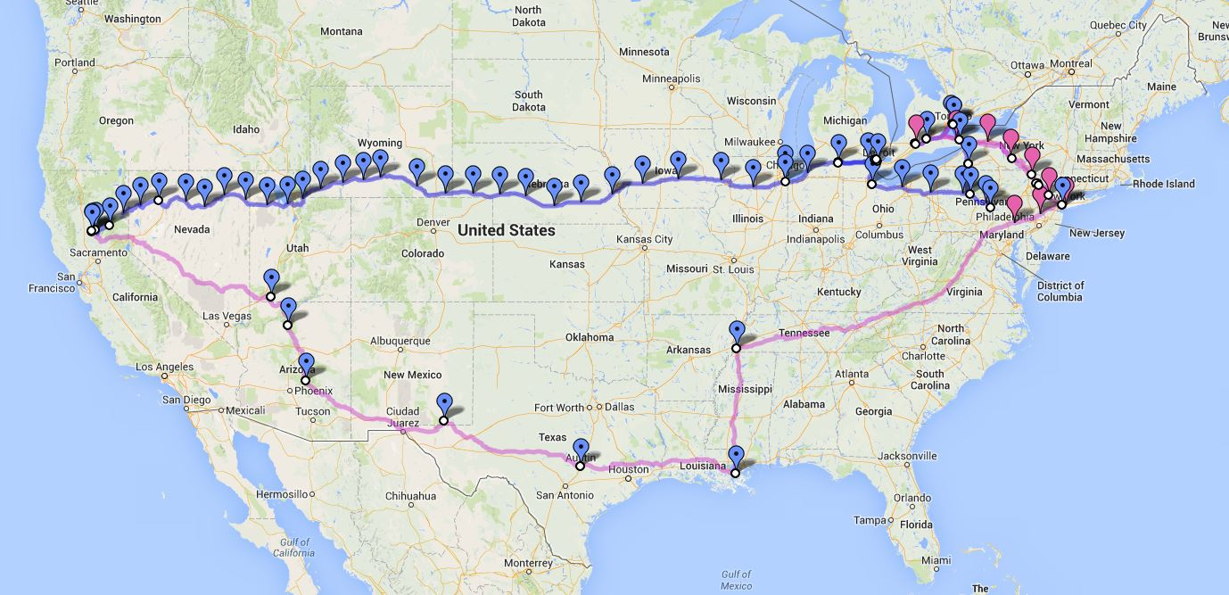
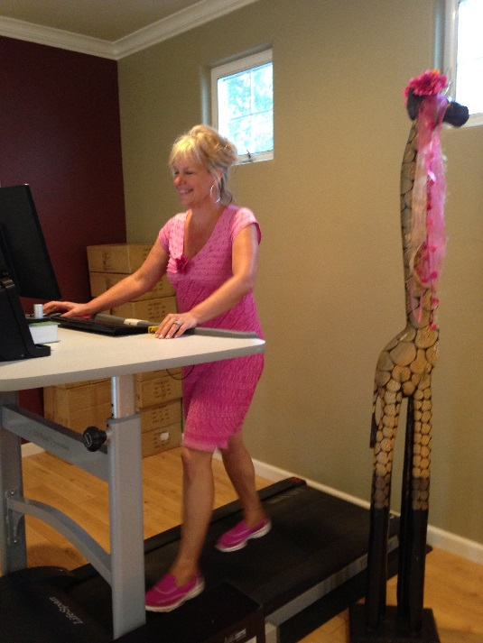
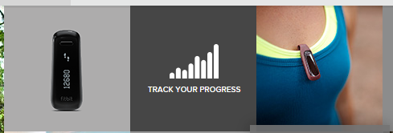
We Made It – 3129 miles- Now Walking Back
Track miles with fitbit
Fitbit.com
Lifespan Treadmill Desk - Amazon

Slide 76

Can we stop pre diabetes from progressing?
3, 234 people w/ Pre-Diabetes randomized:
Placebo
Diet/Exercise or
Metformin
over a three year period
Diabetes Prevention Program (DPP) 2001

Slide 77

Diabetes Prevention Program
Standard Group - 29% developed DM
Lifestyle Results - 14% developed DM
58% (71% for 60yrs +) Risk reduction
30 mins daily activity
5-7% of body wt loss
Metformin 850 BID - 22% developed DM
31% risk reduction (less effective with elderly and thinner pt’s)

Slide 78

Weight loss and Prevention
For every 2.2 pounds of weight loss, risk of type 2 diabetes was reduced by 13%.

Slide 79
Diabetes Prevention Programs
Delay or Prevent Type 2 Diabetes
Save $5.7 billion over 25 years
Programs
Partnering with YMCA’s
CDC now recognizes Diabetes Prevention Programs www.cdc.gov/diabetes/prevention
Health Affairs 31, No 1 2012 p50-60

Slide 80
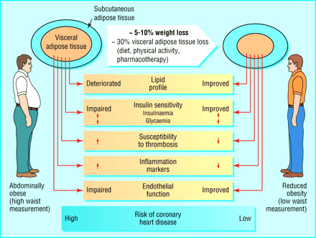

Slide 81

Goals of Care

Slide 82
ABC’s of Diabetes
A1C
Blood Pressure
Cholesterol
professional.diabetes.org

Slide 83

1% decrease in A₁c reduces microvascular complications by 35%
1% decrease in A₁c reduces diabetes related deaths by 25%
B/P control (144/82) reduced risk of:
Heart failure (56%)
Stroke (44%)
Death from diabetes (32%)
Lancet 352: 837-865, 1998

Slide 84
A1c Goals for Non Pregnant Adults Individualize Targets – ADA
< 7% for patients in general
For individual pts, as close to normal as possible (<6%) w/out significant hypo
< 8% for frail elderly
Goals based on:
Duration of diabetes
Life expectancy and Age
Co morbid conditions
Know CVD or advanced micro complications
Ind pt considerations, shared decision making

Slide 85
A1c and Estimated Avg Glucose (eAG) 2008
http://professional.diabetes.org/GlucoseCalculator.aspx
A1c (%) eAG
5 97
6 126
7 154
8 183
9 212
10 240
11 269
12 298
eAG = 28.7 x A1c-46.7 ~ 29 pts per 1%
Translating the A1c Assay Into Estimated Average Glucose Values – ADAG Study
Diabetes Care: 31, #8, August 2008

Slide 86


Slide 87

“Legacy Effect”
For participants of DCCT and UKPDS
long lasting benefit of early intensive BG control prevents
microvascular complications
Macrovascular complications (15-55% decrease)
Even though their BG levels increased over time
Message – Catch early and
Treat aggressively

Slide 88
Glucose Goals Individualize Targets – ADA
Pre-Prandial BG 70- 130
1-2 hr post prandial < than 180
*for nonpregnant adults

Slide 89
ABCs of Diabetes –
A1c less than 7% (avg 3 month BG)
Pre-meal BG 70-130
Post meal BG <180
Blood Pressure < 140/80
Cholesterol
HDL >40
LDL <100 (if CHD, <70)
Triglyceride < 150

Slide 90
BP Goal for KP NCAL
BP 139/ 89 or less

Slide 91
“Legacy Effect”
For participants of DCCT and UKPDS
long lasting benefit of early intensive BG control prevents
microvascular complications
Macrovascular complications (15-55% decrease)
Even though their BG levels increased over time
Message – Catch early and
Treat aggressively

Slide 92
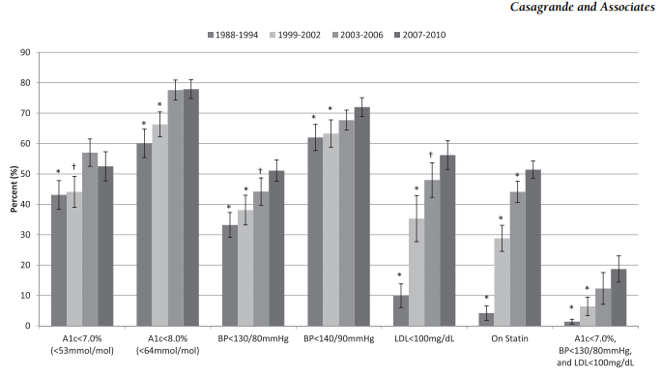
How are we doing? Reaching goal
Diabetes Care, 2/13

Slide 93
Diabetes Care Guidelines- ADA
Test / Exam Frequency
A1c At least twice a year
B/P Each diabetes visit
Cholesterol (LDL, HDL, Tri) Yearly (less if normal)
Weight each diabetes visit
Microalbumin/GFR/Creat Yearly
Eye exam Yearly
Dental Care At least twice a year
Comprehensive Foot Exam Yearly (more if high risk)
Physical Activity Plan As needed to meet goals
Preconception counseling As needed

Slide 94
Vaccinations- Immunizations
Flu vaccine
every year starting 6 months
Pneumococcal starting at 2 years.
One time Revaccination for those over 64 and had first vaccine >5 years prior
Hepatitis B Vaccine (ADA Stds 2013, pg s28)
For diabetes pts age 19 – 59 (not previously vaccinated)
Double risk of Hep B due to lancing devices/ glucose meter exposure

Slide 95

Mr. Calhoun - What are Your Recommendations for Self-Care
Patient Profile
62 yr old with newly dx type 2. History of previous MI.
Meds: Lasix, synthroid
Labs:
A1c 9.3%
HDL 37 mg/dl
LDL 156 mg/dl
Triglyceride 260mg/dl
Proteinuria - neg
B/P 142/92
Self-Care Skills
Walks dog around block 3 x’s a week
Bowls every Friday
Widowed, so usually eats out

Slide 96
Diabetes Bingo “DiaBingo” Shout out Right Answer

Slide 97
DiaBingo- G
G ADA goal for A1c is less than ____%
G People with DM need to see their provider at least every month
G Blood pressure goal is less than
G People with DM should see eye doctor (ophthalmologist) at least
G The goal for triglyceride level is less than
G Goal for my HDL cholesterol is more than
G The goal for blood sugars 1-2 hours after a meal is less than:
G People with DM should get this shot every year
G People with DM need to get urine tested yearly for ___________
G Periodontal disease indicates increased risk for heart disease
G The goal for blood sugar levels before meals is:
G The activity goal is to do ___ minutes on most days

Slide 98
Mr. Calhoun - What are Your Recommendations?
Patient Profile
64 yr old with type 2 for 11 yrs. Hx of CVD.
Labs:
A1c 9.3%
HDL 37 mg/dl
LDL 114 mg/dl
Triglyceride 260mg/dl
Proteinuria - neg
B/P 142/92
Self-Care Skills
Walks dog around block 3 x’s a week
Bowls every Friday
3 beers daily
Widowed, so usually eats out
15 lbs overweight
“My foot hurts”

Slide 99
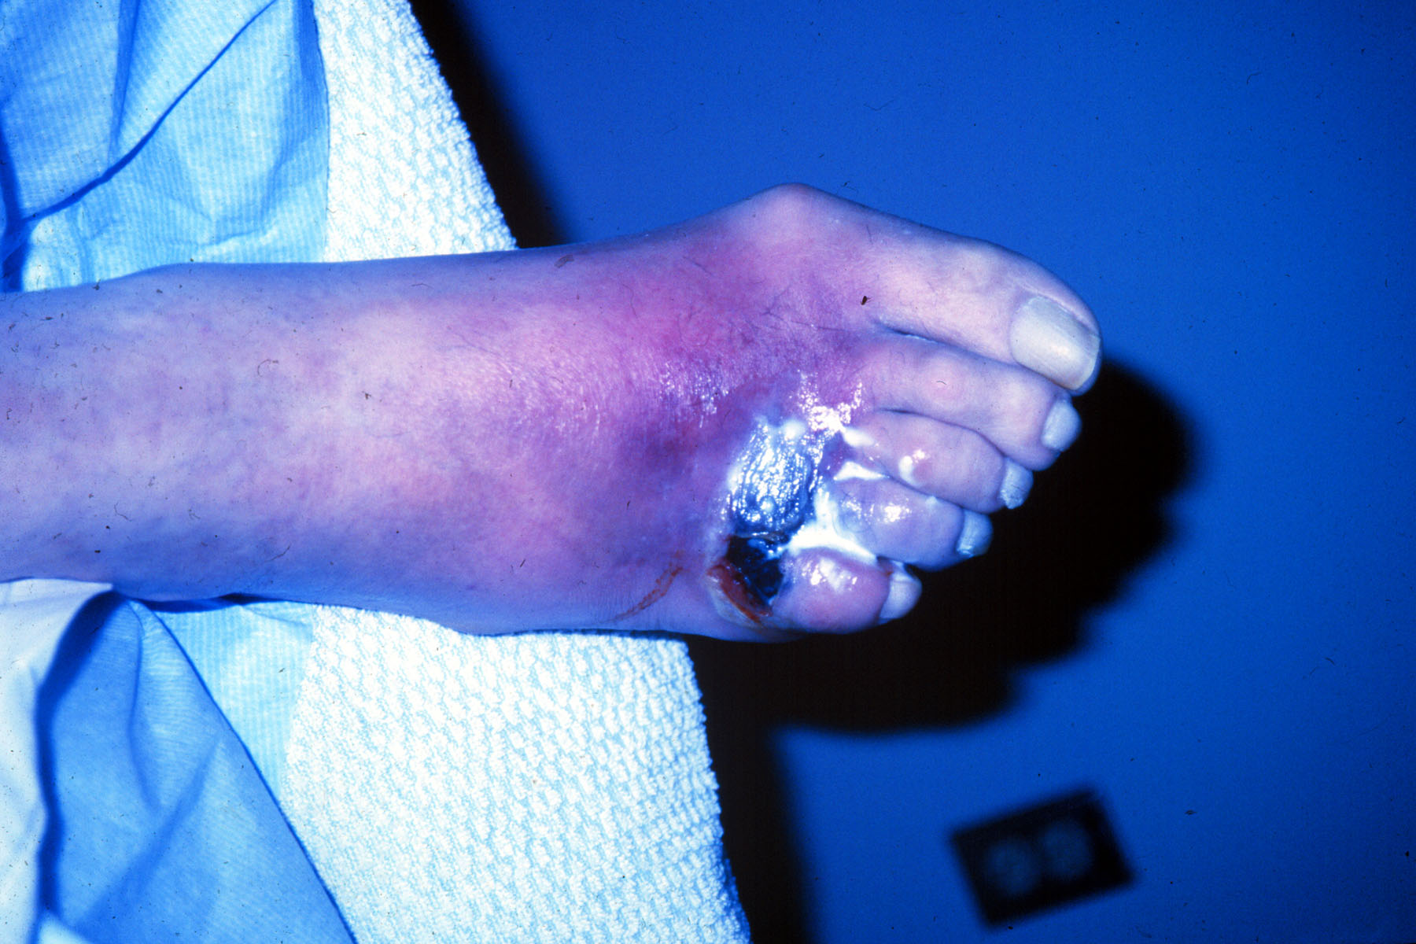

Slide 100
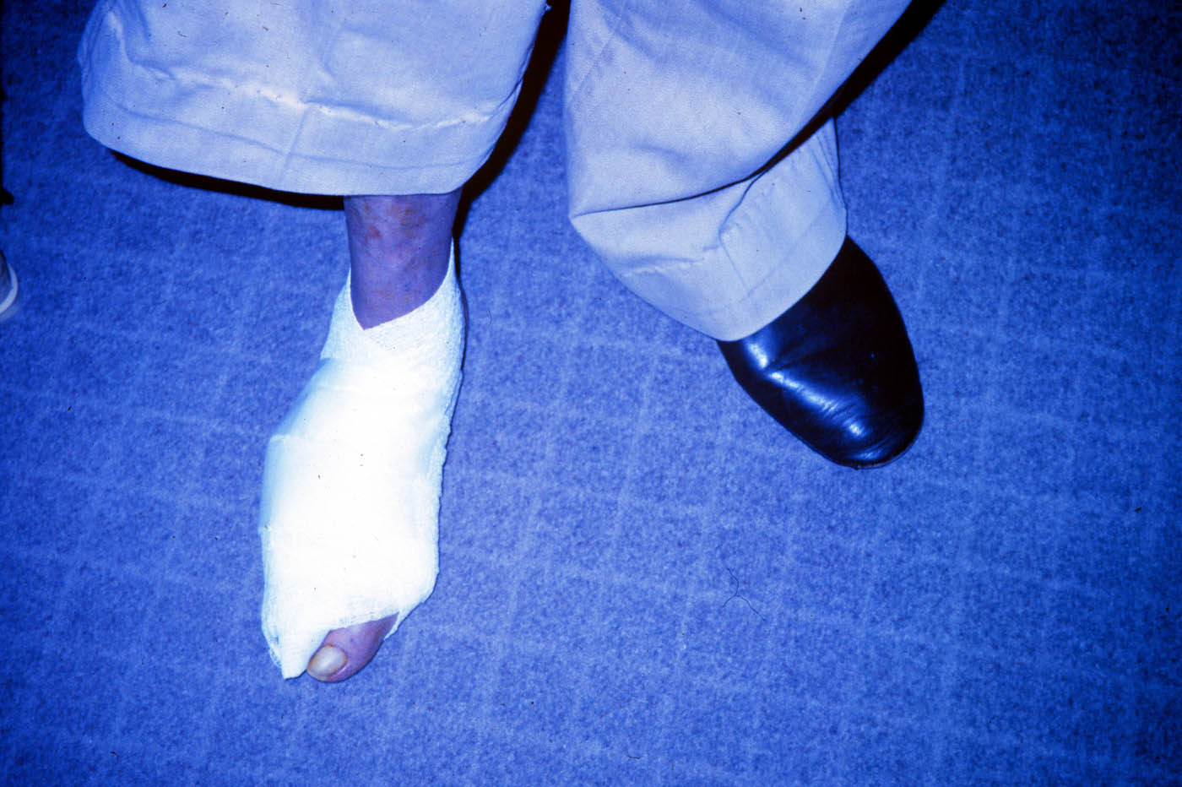

Slide 101
Foot Care
Lift the sheets and look at the Feets!

Slide 102
A Quick Foot Assessment
Ask - What do you do to take care of your feet?
Look - texture, toenails, structural deformities, lesions, corns
Assess sensation
Assess risk factors
Teach, teach, teach

Slide 103
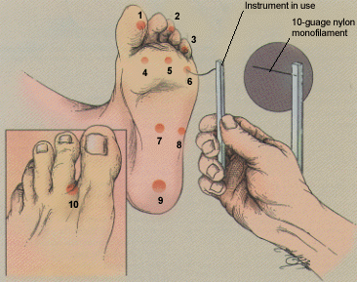
5.07 monofilament = 10gms linear pressure
Free Monofilaments
http://www.hrsa.gov/leap/

Slide 104
Three Most Important Foot Care Tips
Inspect and apply lotion to your feet every night before you go to bed.
Do NOT go barefoot, even in your house. Always wear shoes!
Every time you see your doctor, take off your shoes and show your feet.

Slide 105
Diabetes Self-Management
Self Monitor Blood Glucose
Meal Plan
Exercise / Activity
Medications

Slide 106

Medical Nutrition Therapy – ADA 2014 Updates
No ideal percentage of calories from protein, carbohydrate and fat for people with diabetes.
Macronutrient distribution should be based on an individualized assessment of eating patterns, preferences and metabolic goals.

Slide 107
Medical Nutrition Therapy 2014 - ADA
Focus on the Individual
Maintain pleasure of eating
Provide positive messages about food
Limit food choices only when backed by science
Provide practical tools
Refer to a RD and Diabetes Education – Lowers A1c by 1-2%

Slide 108

Approach Depends on Patient
New Type 2
Portion Control
Plate Method
Record Keeping
Education
On Insulin?
Carb counting

Slide 109
Losing 2-8kg Early in diagnosis Type 2 Helpful ADA 2014
Weight Loss –
The optimal macronutrient intake to lose weight not known
The literature does not support one particular nutrition therapy to reduce weight, but rather a spectrum of eating patterns that result in reduced energy intake.
Wt loss goal ½ pound to 1 lb a week
Decrease intake 250-500 cals daily + exercise
2013 – Try and keep less than 2,300 mg a day
Vitamin and mineral supplements not recommended -lack of evidence.
Fiber 25 -38 gms a day

Slide 110
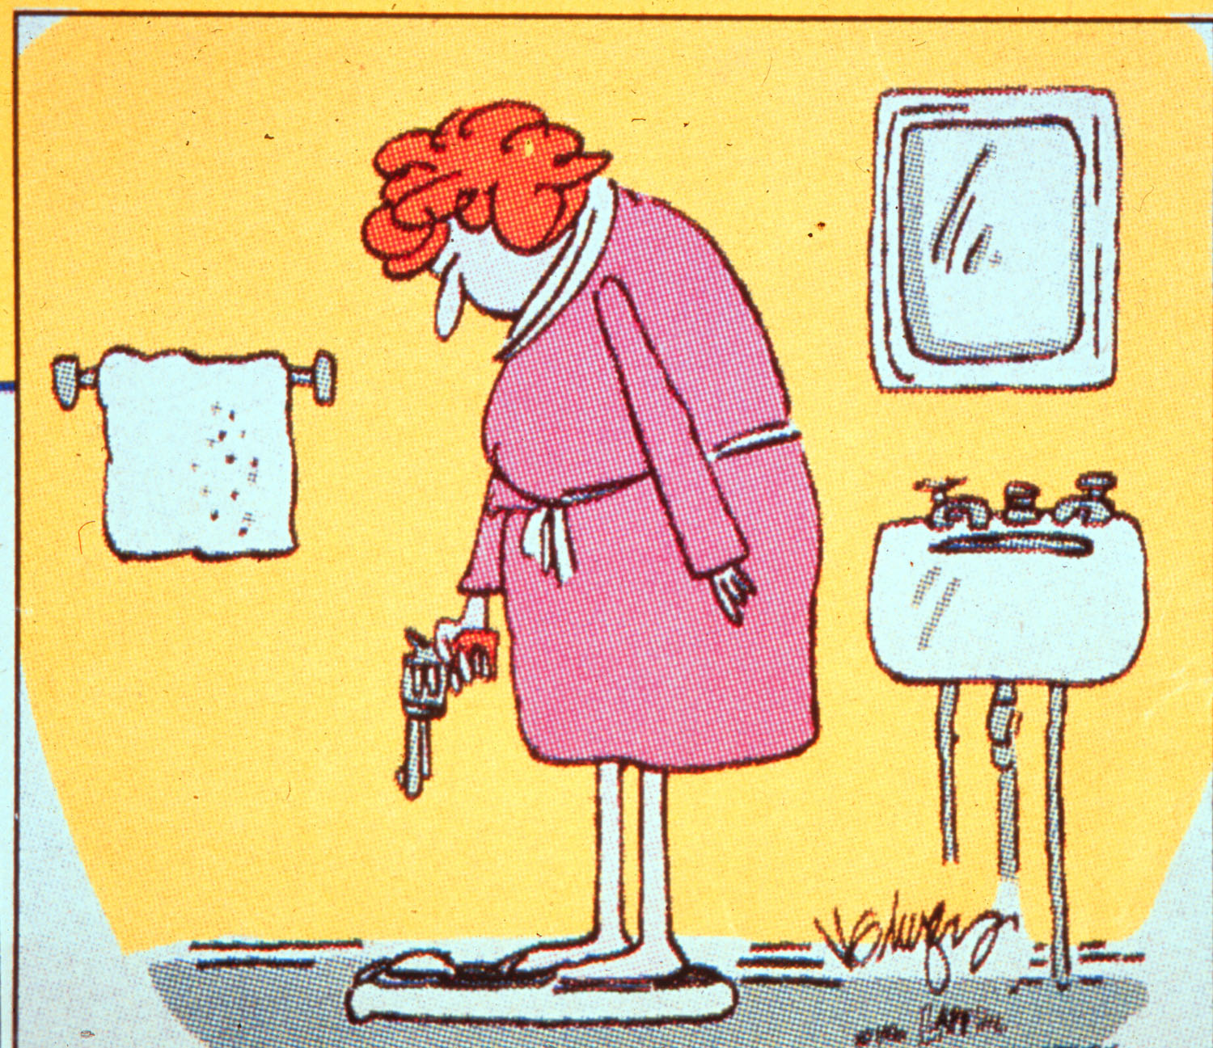

Slide 111
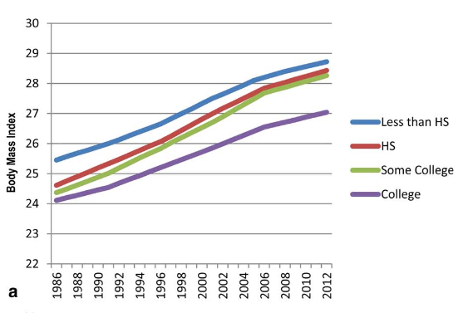
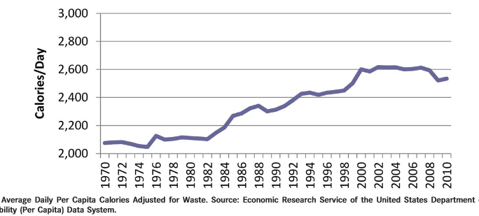
Obesity in America
68% overweight or obese
34% BMI 30 +, 34% BMI 25-29
1/3 of all overwt people don’t get diabetes
We burn 100 cals less a day at work
Overall, food costs ~ 10-15% of income
Calorie Intake is on the rise

Slide 112
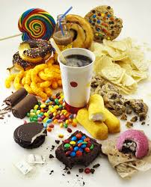
Average American Consumes 25 teaspoons of sugar a day (400 cals)
Warning label on sodas proposed
One soda has 12 teaspoons soda
On avg, 1 person consumes 40 gallons of soda each year
ADA guidelines “limit sodas and beverages with sugar, High Fructose Corn Syrup, (HFCS)

Slide 113
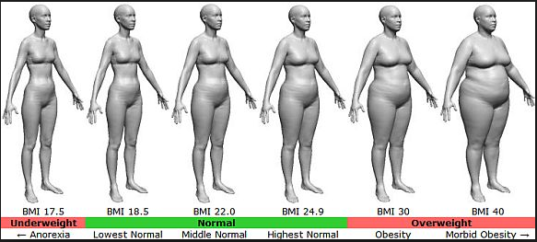
BMI – Visual Image

Slide 114

Successful weight loss strategies include
Weekly self-weighing
Eat breakfast
Reduce fast food intake.
Decrease portion size
Increase physical activity
Use meal replacements
Eat healthy foods

Slide 115
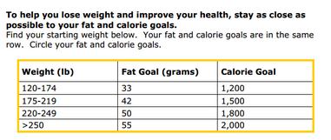
Diabetes Prevention Program Focus on fat = wt loss success
http://www.cdc.gov/diabetes/prevention/recognition/curriculum.htm

Slide 116






Move toward the Tomato

Slide 117
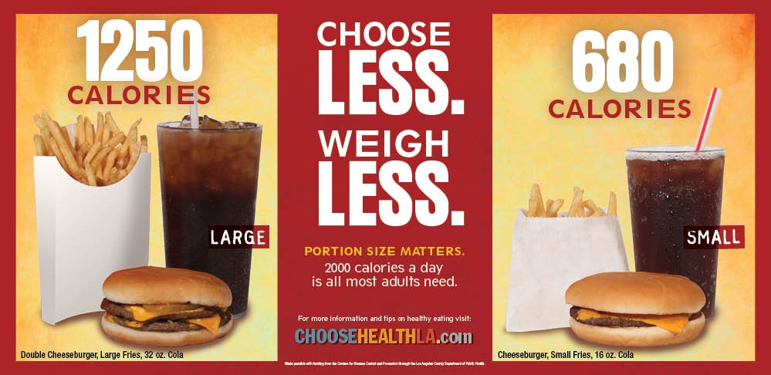
Health Campaigns

Slide 118

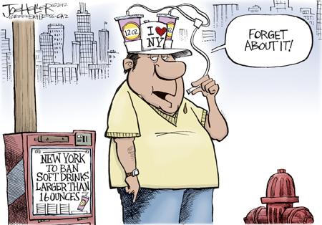
ADA recommendation Eat Less Junk Food & Sugary Drinks –
Less Processed Foods
Less Sugary Beverages
increase visceral adiposity
With sugar or
High fructose corn syrup
Soda Tax?
Junk Food Tax?

Slide 119
10 Superfoods
Beans
Dark Green Leafy Vegs
Citrus Fruit
Sweet Potatoes
Berries
Tomatoes
Fish High in Omega-3 Fatty Acids
Whole Grains
Nuts
Fat-Free Milk and Yogurt

Slide 120
How nutrients affect blood sugar

Slide 121
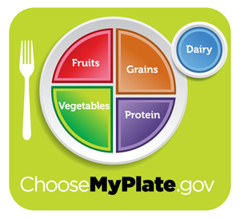
Teaching About Eating Healthy
Major food groups
“Handy Diet”
Plate Method
Exchange Lists
Food Diaries / Glucose Records
Carbohydrate Counting
Assess what is best for the situation.

Slide 122
USDA Food Pyramid www.myplate.gov
Balancing Calories
Enjoy your food, but eat less.
Avoid oversized portions.
Foods to Increase
Make half your plate fruits and vegetables.
Make at least half your grains whole grains.
Switch to fat-free or low-fat (1%) milk.
Foods to Reduce
Compare sodium in foods like soup, bread, and frozen meals ― and choose the foods with lower numbers.
Drink water instead of sugary drinks.

Slide 123
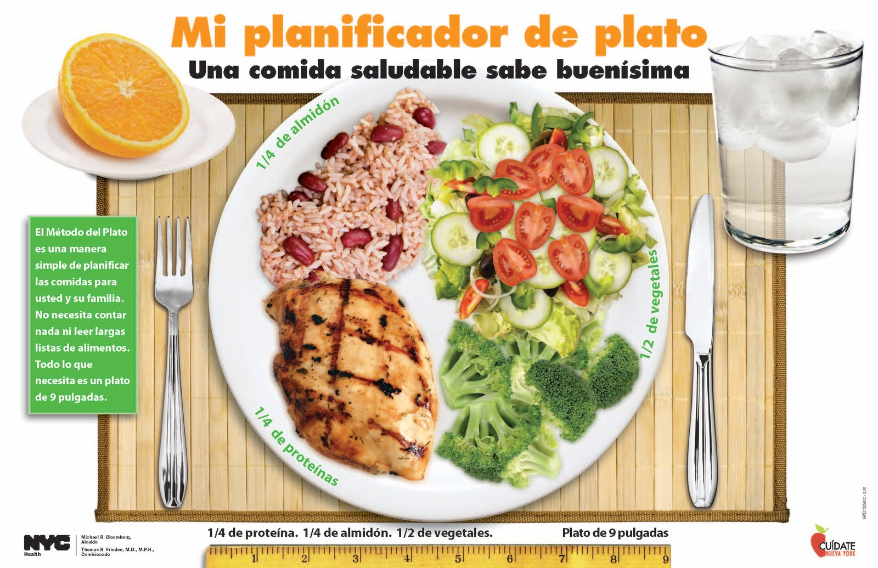
Another plate example

Slide 124
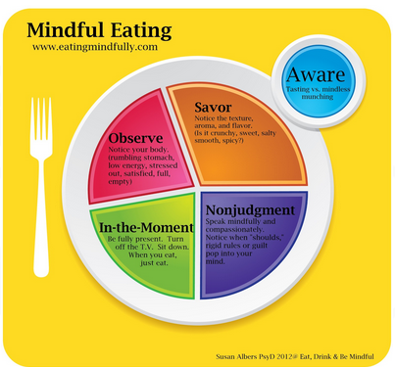
Mindful Eating

Slide 125
Label Lessons
Nutrition Facts
Serving Size 1/2 cup (114 g)
Servings Per Container 4
Amount Per Serving
Calories 90 Calories from Fat 30
% Daily Value*
Total Fat 3g 5%
Saturated Fat 0g 0%
Cholesterol 0g 0%
Sodium 300mg 13%
Total Carbohydrate 13g 4%
Dietary Fiber 3g 12%
Sugars 3g
Protein 3g
Vitamin A 80% * Vitamin C 60%
Calcium 4% * Iron 4%
* Percent Daily Values are based on a 2,000 calorie diet. Your daily values may be higher or lower depending on your calorie needs:
Calories _ 2000 2500
Total Fat Less than 65g 80g
Sat Fat Less than 20g 25g
Cholesterol Less than 300mg 300mg
Sodium Less than 2400mg 2400mg
Total Carbohydrate 300g 375g
Fiber 25g 30g
Calories per gram: Fat 9 Carbohydrates 4 Protein 4

Slide 126
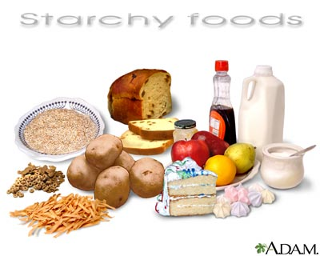
Carbs affect Post meal Blood Glucose
Starch
Fruit
Milk
Desserts

Slide 127

Carbohydrate Needs for Most Adults
Grams Servings
Each Meal 45-60 gm 3 - 4
Snacks 15-30 gm 1- 2
Carbs affect Post Meal Blood Glucose

Slide 128

Choose Healthy Carbs
Carbs have fiber, vitamins, minerals and phytonutrients
25 gms of fiber a day
Power Carbs include:
Beans
Veggies
Fruits
Whole grain foods

Slide 129
Handy Meal Plan
Per Meal Serving
Each finger = 15 gms carb (can have 3-4 servings/meal)
Palm of hand = 3 oz’s protein
Thumbnail = 1 tsp fat serving

Slide 130
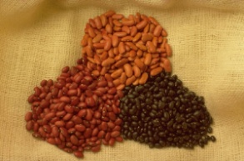


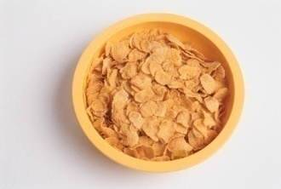
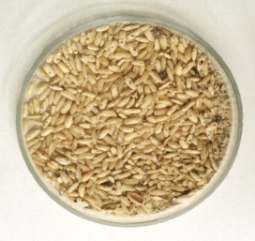
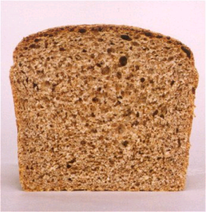

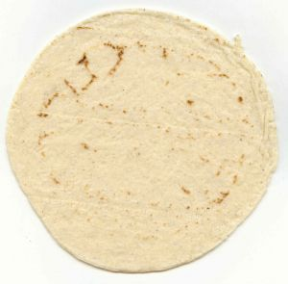

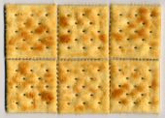
Each Food has:
80 Calories
15 grams carb
Carb counting- starch
1 small ear of corn or 1/2 cup corn
1/3 cup cooked pasta
1/2 cup
cooked beans
3/4 cup cold cereal
1 slice bread
1/3 cup cooked rice
1 small potato
1 small tortilla
1/2 English muffin
5-6 small crackers

Slide 131



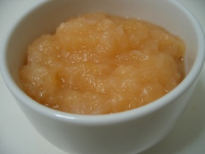



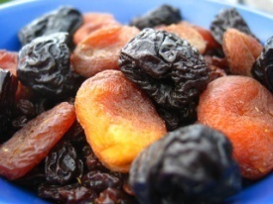

Each Food has:
60 Calories
15 grams carb
Carb counting- fruit
½ cup fruit juice
1 small fresh fruit
½ banana
½ cup unsweetened apple sauce
1 slice bread
17 small grapes
1 cup melon
¼ cup dried fruit
1 1/4 cup strawberries
2 tbsp raisins

Slide 132







Each Food has:
90-150 calories
12-15 grams carb
Carb counting- milk
8 oz buttermilk
1 packet diet hot cocoa
1 slice bread
6 oz plain yogurt
8 oz milk
6 oz light fruit yogurt
8 oz soy milk

Slide 133









Carb counting - sweets
Each Food has:
Calories vary
15 grams carb
½ cup regular jello
2 tbsp light syrup
½ cup diet pudding
2 inch square cake or brownie, unfrosted
1 slice bread
1 tbsp syrup, jam, jelly, table sugar, honey
2 small cookies
½ cup ice cream or frozen yogurt
¼ cup sorbet
½ cup sherbet

Slide 134


Go Lean with Protein
Choose lean protein
Poultry, fish, egg, lean beef
Plant sources- beans, lentils, nuts
Low fat cheese- cottage cheese, mozzarella cheese
Limit high fat protein
Bacon & sausage
High fat cuts of beef
Whole milk cheese
Serving size
1 oz = ¼ cup
3 oz = deck of cards

Slide 135

Fats- Aim for heart health
Saturated fats (LIMIT)
Solid
Animal
Tropical (palm, coconut)
Trans fats (deep fried)
Monounsaturated
Olive & canola oils
Nuts
Avocado
Polyunsaturated
veg oils: canola, corn, walnut, safflower, soybean
Serving sizes
1 tsp butter, margarine, oil, mayonnaise
1 Tbsp salad dressing, cream cheese, seeds
2 Tbsp avocado, cream, sour cream
1 slice bacon

Slide 136
Using Alcohol Safely
Women- 1 or fewer alcoholic drinks a day
Men 2 or fewer alcoholic drinks a day
1 alcoholic drink equals
12 oz beer, 5 oz glass of wine, or 1.5 oz distilled spirits (vodka, gin etc)
If drink, limit amount and drink w/ food.
Ask HCP if safe for you to drink. Tell them your usual quantity and frequency.
Can cause hypo and worsen neuropathy

Slide 137
Ms. Gonzales’ General Diet Pattern

Slide 138
Resources
www.eatright.org American Dietetic Association website for nutrition information, resources, and access to Registered Dietitians
www.diabetes.org American Diabetes Association website, advocates to prevent, cure and improve the lives of all people affected diabetes
www.americanheart.org American Heart Association website; resources, recipes and tips; learn about efforts to reduce death caused by cardiovascular disease
www.dce.org/publications/education-handouts/

Slide 139
Resources
www.nhlbi.nih.gov contains information for professionals and the general public about heart and vascular diseases, lung diseases, blood diseases.
www.niddk.nih.gov National Institute of Diabetes and Digestive and Kidney Diseases (NIDDK) information and resources clearinghouse.

Slide 140

Insulin – the Ultimate Hormone Replacement Therapy
Objectives:
Discuss the actions of different insulins
Describe using pattern management as an insulin adjustment tool.

Slide 141


Slide 143


Insulin Finally Available - 1922

Slide 144


The Miracle of Insulin
Patient J.L., December 15, 1922
February 15, 1923

Slide 145

Psychological Insulin Resistance (PIR)
50% of providers in study threatened pts “with the needle”.
Less than 50% of providers realized insulins’ positive effect on type 2 dm
Most pts don’t believe that insulin would “better help them manage their diabetes”.
Solutions: Find the root of PIR and address
Diabetes Attitudes, Wishes, Needs Study - Rubin

Slide 146
Needle Size often a Barrier Size Does Matter
Use more short needles – 4 mm
Effective for pts with BMI of 24- 49
Keeps it subq
If pt thin, inject at angle
To avoid leakage, count to 10 before withdrawing needle
½ the patients who could benefit from insulin are not using it due to needle phobias

Slide 147
Physiologic Insulin Secretion: 24-Hour Profile
50
Insulin
(µU/mL)
Bolus Insulin
25
0
Basal Insulin
Breakfast Lunch Dinner
150
Glucose
(mg/dL)
100
Mealtime Glucose
50
Basal Glucose
0
7
8
9
10
11
12
1
2
3
4
5
6
7
8
9
A.M.
P.M.
Time of Day

Slide 148
Insulin Action Teams
Bolus: lowers after meal glucose levels
Rapid Acting
Aspart, Lispro, Glulisine
Short Acting
Regular
Basal: controls glucose between meals, hs
Intermediate
NPH
Long Acting
Detemir (Levemir)
Glargine (Lantus)

Slide 149
Bolus Insulins (½ of total daily dose ÷ meals)
Name Onset Peak Action
Lispro (Humalog) 15-30 min 1-1.5 hrs
Aspart (NovoLog)
Glulisine (Apidra)
Regular 30 mins 2-4 hrs

Slide 150
Bolus Insulin Summary
Regular, Novolog, Humalog, Apidra,
Starts working fast (15-30 mins)
Gets out fast (3-6 hours)
Post meal BG reflects effectiveness
Should comprise about ½ total daily dose
Covers food or hyperglycemia.
1 unit
Covers ≈ 10 -15 gms of carb
Lowers BG ≈ 30 – 50 points

Slide 151
Bolus Insulin Timing
How is the effectiveness of bolus insulin determined?
2 hour post meal (if you can get it)
Before next meal blood glucose
Glucose goals (ADA) – may be modified by provider/pt
1-2 hours post meal <180
Before next meal – 70 - 130

Slide 152


Slide 153


Inhaled insulin – Approved 2014

Slide 154



Afrezza Inhaler – Bolus Regular Ins
Replace inhaler every 15 days

Slide 155
Bolus – Reg Insulin Sliding Scale Starts at 150, 2 units for every 50 mg/dl >150

Slide 156
Basal Insulins (½ of total daily dose)
Intermediate Acting Peak Action Duration
NPH 4-12 hrs 12-24
Long Acting Peak Action Duration
Detemir (Levemir) peakless 20 hrs
Glargine (Lantus) No peak 24 hrs
Fasting BG reflects efficacy of basal

Slide 157
Basal Insulin Summary
NPH, Levemir, Lantus
Covers in between meals, through night
Starts working slow (4 hours)
Stays in long (12-24 hours)
NPH/ Lente 12 hrs
Levemir, Lantus 20-24 hrs
Fasting blood glucose reflects effectiveness

Slide 158
Basal Only Type 2, 60kg

Slide 159

Diabetes Care 32:193-203, 2009

Slide 160
Combination SQ Insulin

Slide 161
10u 70/30 BID Patterns? Changes needed?

Slide 162
Pattern Management

Slide 163
Pattern Management
Safety 1st!! - Evaluate 3 day patterns
Hypo eval 1st and fix:
If possible, decrease medication dose
Timing of meals, exercise, medications
Hyperglycemia: evaluate 2nd
Identify patterns:
fix fasting first, r/o Somogyi (check 3am BG)
QA: check meter, insulin, meds

Slide 164
Type 2 – New diagnosis – No meds Patterns? Questions

Slide 165
Type 2 – Glucotrol 20mg AM, 10u NPH pm

Slide 166
Basal Bolus – What Adjustments? Pt weighs 80kg

Slide 167
Intensive Diabetes Therapy Insulin Dosing Strategy
50/50 Rule
0.5-1.0 units/kg day
Basal = 50% of total
Bolus = 50% of total
Divided into 3 meals
Example
Wt 50kg x 0.5 = 25 units of insulin/day
Basal dose: 13 units
Bolus dose: 12 units
4 units at each meal

Slide 168
Intensive Diabetes Therapy Insulin Dosing Strategy
50/50 Rule
0.5-1.0 units/kg day
Basal = 50% of total
Bolus = 50% of total divided into 3 meals
Example – You Try
Wt 60 kg x 0.5 = ___ units of insulin/day
Basal dose: ____ units
Bolus dose: ____ units
at each meal

Slide 169
Basal Bolus – Using 50/50 Rule – Pt weighs 80kg A = Aspart

Slide 170

Type 1 and a Teen
Cindy is trying to carb count and adjust her insulin, but is still having trouble. She weighs 60kg.
What is her daily dose of insulin?
What is her basal dose?
1. Pre meal target BG is 120
2. Post meal goal < 180.
3. Carb ratio: 1 unit for every 15 gms
4. Hyperglycemic correction factor is one unit for every 50 above goal

Slide 171
Correction Bolus – Add to mealtime insulin Rapid/Fast Acting Insulin (1 unit:50 mg/dl>120)
70-120 mg/dl | 0 units
121-170 mg/dl | 1 unit
171-220 mg/dl | 2 units
221-270 mg/dl | 3 units
271-320 mg/dl | 4 units
321-400 mg/dl | 5 units

Slide 172

Grams of Carb per meal?
Morning - BG 173
Breakfast – slice cold pizza, ½ c. juice
Lunch BG 69
Menu- ham sandwich, pear, diet 7-up, mini snickers bar.
2 hrs after lunch, BG 148 - ran track
Before dinner - BG 98
Cheeseburger, small fries, chocolate chip cookie
At bedtime, BG 173

Slide 173
Carbs? How much Insulin?
Morning - BG 173
Breakfast – slice cold pizza, ½ c. applesauce
45 gms
Lunch BG 69
Menu- ham sandwich, pear, diet 7-up, mini snickers
60 gms
2 hours after lunch, BG 148 – ran track
Before dinner - BG 98
Cheeseburger, small fries, chocolate chip cookie
75 gms
At bedtime, BG 173 – 15 unit Lantus

Slide 174
Insulin Teaching Keys
Bolus insulin with meals
Basal 1-2xs daily
Can’t mix Glargine or Detemir with other insulins
Abdomen preferred injection site
Stay 1” away from previous site
Don’t re-use ultra fine syringes
Keep unopened insulin in refrigerator
Toss opened insulin vial after 28 days
Proper disposal
Review patients ability to withdraw and inject.
Side effects include hypoglycemia/wt gain

Slide 175
Medical Waste Management Act Effective Sept 1, 2008
CA Senate Bill 1305
New law requires proper disposal of home generated syringes, needles, lancets
Disposal in solid waste containers no longer permitted
EPA in 2004 also discourages sharps disposal in trash.

Slide 176

Sharps Disposal: Product and Info
Look in the Government section white pages for a household hazardous waste listing for your city or county.
Call 1-800-CLEANUP (1-800-253-2687)
Search for collection centers on the California Integrated Waste Management Board (CIWMB) Web site: http://www.ciwmb.ca.gov/HHW/HealthCare/Collection/

Slide 177
Diabetes Bingo “DiaBingo” Shout out Right Answer

Slide 178
DiaBingo - I
I Injected hormone that is an analog of amylin
I Glargine, Detemir, NPH are types of
I Breakdown of glycogen into glucose
I Anabolic hormone
I Insulin is released when glucose levels are low
I Once opened, insulin vials are good for one _____
I Elevated post-prandial glucose indicate need for pre-meaI
I Epinephrine increases insulin resistance
I Creation of glucose from amino acids and lactate
I Decreasing renal function for people on insulin can cause
I Bolus insulins
I A hormone that increases blood glucose levels

Slide 179

Diabetes Meds for Type 2: Objectives
1. Describe the main action of the 5 different categories of type 2 diabetes medications.
2. Discuss strategies to determine the right medication for the right patient.
3. List the side effects and clinical considerations of each category of medication.
Notes:
179
179

Slide 180
Action/Classes of Type 2 Meds
1. Suppressor
2. Squirter
3. Satiators
4. Sensitizer
5. Glucoretics
6.Circadian Switchers
7. Slower
Biguanide – Metformin
Sulfonylureas
Meglitinides
AmylinoMimetics
Incretin Mimetics
DPP-4 Inhibitors
Thiazolidinediones (TZD)
SGLT2 Inhibitors
Dopamine Receptor Agonists
Alpha-glucosidase inhibitors
Notes:
180
180
There are five major classes of oral diabetes medications: thiazolidinediones, biguanides, sulfonylureas, meglitinides, and alpha-glucosidase inhibitors. These five classes of medication operate in essentially three different ways.
Thiazolidinediones and biguanides decrease glucose production in the liver and increase insulin sensitivity in peripheral body tissues.
Sulfonylureas and meglitinides stimulate the pancreatic beta cells to make more insulin.
Finally, alpha-glucosidase inhibitors slow the absorption of starches in the gut, reducing the amount of glucose that enters the bloodstream.

Slide 181

Diabetes Care 2012;35:1364–1379
Diabetologia 2012;55:1577–1596
(Adapted with permission from: Ismail-Beigi et al. Ann Intern Med 2011;154:554)
Figure 1
Notes:
Depiction of the elements of decision-making used to determine appropriate efforts to achieve glycaemic targets. Greater concerns about a particular domain are represented by increasing height of the ramp. Thus, characteristics/predicaments towards the left justify more stringent efforts to lower HbA1c, whereas those towards the right are compatible with less stringent efforts. Where possible, such decisions should be made in conjunction with the patient, reflecting his or her preferences, needs and values. This ‘scale’ is not designed to be applied rigidly but to be used as a broad construct to help guide clinical decisions. Adapted with permission from Ismail-Beigi et al [ref 20]

Slide 182
Diabetes Agents Considerations
Diabetes medications can be used as monotherapy, in combo or with insulin
Combining agents from different classes has additive effect
Most reduce A1c 0.5 – 2.0%
Not to be used during preconception, pregnancy or when breastfeeding
© Copyright 1999-2013, Diabetes Educational Services, All Rights Reserved.
Notes:
182
182

Slide 183
ADA-EASD Position Statement: Management of Hyperglycemia in T2DM
Patient-Centered Approach
“...providing care that is respectful of and responsive to individual patient preferences, needs, and values - ensuring that patient values guide all clinical decisions.”
Gauge patient’s preferred level of involvement.
Explore, where possible, therapeutic choices.
Utilize decision aids.
Shared decision making – final decisions re: lifestyle choices ultimately lie with the patient.
Diabetes Care 2012;35:1364–1379
Diabetologia 2012;55:1577–1596

Slide 184
Ideal Diabetes Medication -
No hypoglycemia
No weight gain
Affordable
Lowers CV risk
Most people can tolerate /use

Slide 185
Biguanides - Metformin
Action: decrease hepatic glucose (glycogen)
Names:
Metformin (Glucophage)
Starting dose: 500 BID, max 2500mg daily
Metformin XR - extended release – less GI upset
Starting dose 500mg at dinner, max dose 2000 to 2500 mg daily
Efficacy:
Decrease fasting plasma glucose 60-70 mg/dl
Reduce A1C 1.0-2.0%
© Copyright 1999-2013, Diabetes Educational Services, All Rights Reserved.
Notes:
185
185
The mechanism of action of metformin is not entirely understood, but it's predominant effect is to suppress hepatic glucose production and to enhance insulin sensitivity in peripheral tissues (primarily muscle). It is unclear if insulin sensitivity occurs by metformin binding to cell receptors,which leads to an increase in glucose transporter expression, or whether insulin sensitivity is simply a secondary effect of the suppressed glucose production.
Metformin's ability to lower A1C and decrease fasting plasma glucose is similar to that of sulfonylurea drugs. However, the UKPDS showed that those who received metformin had less hypoglycemia and weight gain than those who received sulfonylureas.
Metformin must be avoided in patients with renal impairments, as those patients are at higher risk of experiencing lactic acidosis. However, metformin is an effective monotherapy and may be an ideal drug for overweight patients since it does not cause weight gain and has been seen to cause modest amounts of weight loss when first administered. Diarrhea and abdominal discomfort can be alleviated by changes in diet and slow increases in metformin dosage.

Slide 186
Biguanides - Metformin
Benefits
Decrease LDL cholesterol and triglycerides
No weight gain, possible modest weight loss
Cancer protective?
Concerns
Diarrhea and abdominal discomfort – Use XR
Lactic acidosis if improperly prescribed
Watch for B12 deficiency
Hold prior to IV contrast dye studies and use caution during acute illness. Resume when kidney function adequate
Notes:
186
186
The mechanism of action of metformin is not entirely understood, but it's predominant effect is to suppress hepatic glucose production and to enhance insulin sensitivity in peripheral tissues (primarily muscle). It is unclear if insulin sensitivity occurs by metformin binding to cell receptors,which leads to an increase in glucose transporter expression, or whether insulin sensitivity is simply a secondary effect of the suppressed glucose production.
Metformin's ability to lower A1C and decrease fasting plasma glucose is similar to that of sulfonylurea drugs. However, the UKPDS showed that those who received metformin had less hypoglycemia and weight gain than those who received sulfonylureas.
Metformin must be avoided in patients with renal impairments, as those patients are at higher risk of experiencing lactic acidosis. However, metformin is an effective monotherapy and may be an ideal drug for overweight patients since it does not cause weight gain and has been seen to cause modest amounts of weight loss when first administered. Diarrhea and abdominal discomfort can be alleviated by changes in diet and slow increases in metformin dosage.

Slide 187
Considerations Biguanide - Metformin (Glucophage®)
Contraindications due to lactic acidosis:
creatinine >1.4 females, >1.5 males
liver disease
alcohol abuse
over 80 years old
risk of acidosis
during IV dye study
CHF requiring meds
Notes:
187
187

Slide 188

Sulfonylureas –
Action: tells pancreas to squirt insulin all day
Who?
Lean type 2
Notes:
188
188

Slide 189
Sulfonylureas - Squirts
Action: Increase endogenous insulin secretion
Efficacy:
Decrease FPG 60-70 mg/dl
Reduce A1C by 1.0-2.0%
Primary failures: about 20% no response
R/O glucose toxicity or low beta cell function
Secondary failures: 5-10% shortly after initial response, many more later
Usually after 5 or more years of therapy due to natural history of DM 2
Notes:
189
189
Sulfonylureas (SUs) increase insulin secretion by binding to receptors on the surface of pancreatic beta cells, triggering a series of reactions which leads to insulin secretion.
Because SUs cause circulating insulin levels to increase, there is a risk of hypoglycemia. There is also some concern that increased insulin levels are associated with cardiovascular disease, however the UKPDS did not show a relationship between increased mortality and SU administration. Finally, there is concern that SUs will exhaust beta cell function by increasing insulin secretion. However, the decline in beta cell function is more likely caused by the disease itself, and not the use of SUs.
First generation sulfonylureas are just as efficacious as the second generation drugs, however the second generation may be more potent and safer than first. When diet and exercise fail, SUs are an effective monotherapy.

Slide 190
Sulfonylureas: 2nd Generation
Generic Trade Duration
Glyburide Diabeta, Micronase, 12-24 hrs
Glynase Prestabs
Glipizide* Glucotrol, Glucotrol Xl 12-24 hrs
Glimepiride Amaryl 16-24 hrs
*take short acting product on empty stomach
Notes:
190
190

Slide 191

What questions?
72 yr old, thin, lives alone, A1c 7.3%. History of MI, stroke. DM for 12 yrs, “diet controlled”. Limited income. Creat 1.4.

Slide 192
Sulfonylureas
Other Effects
Hypoglycemia
Weight gain
Cleared by kidney, use caution for pts with kidney problems
Generally the least expensive class of medication
Notes:
192
192
Sulfonylureas (SUs) increase insulin secretion by binding to receptors on the surface of pancreatic beta cells, triggering a series of reactions which leads to insulin secretion.
Because SUs cause circulating insulin levels to increase, there is a risk of hypoglycemia. There is also some concern that increased insulin levels are associated with cardiovascular disease, however the UKPDS did not show a relationship between increased mortality and SU administration. Finally, there is concern that SUs will exhaust beta cell function by increasing insulin secretion. However, the decline in beta cell function is more likely caused by the disease itself, and not the use of SUs.
First generation sulfonylureas are just as efficacious as the second generation drugs, however the second generation may be more potent and safer than first. When diet and exercise fail, SUs are an effective monotherapy.

Slide 193
Hypoglycemia – “Limiting Factor”
Defined as glucose of 70mg/dl or below
50% of episodes occur during the night
Higher mortality rate with severe hypoglycemia secondary to sulfonylureas
Especially (chlorpropamide) Diabenese® and (glyburide) Micronase®, Diabeta®
Blood glucose levels don’t describe severity, response is individual

Slide 194

Hypoglycemia Symptoms
Autonomic
Anxiety
Palpitations
Sweating
Tingling
Trembling
Hypoglycemic Unawareness
Neuroglycopenia
Irritability
Drowsiness
Dizziness
Blurred Vision
Difficulty with speech
Confusion
Feeling faint

Slide 195
Treatment of Hypoglycemia
If blood glucose 70mg/dl or below:
15 gms of carb to raise BG 30 - 45mg/dl
Retest in 15 minutes, if still low, treat again, even without symptoms
Follow with usual meal or snack
If BG less than 40, allow recovery time

Slide 196
15 - 20 Gms Carb Sources
3 - 4 Glucose Tablets
8 - 10 Lifesavers candy
8 - 10 Hard candies
2 Tablespoons Raisins
4 - 6 oz’s Nondiet soda
4 - 6 oz’s Fruit Juice
8 oz Milk (non fat)

Slide 197




Slide 198

Next Step?
69 year old male, BMI 25, on Metformin 1000mg BID and Glucotrol 20mg before breakfast and dinner.
Pt overweight - A1c 8.1%. Creat 1.2

Slide 199
Indications for Insulin Sensitizers Rosiglitazone (Avandia®), Pioglitazone (Actos®)
Action: Sensitizers
Who?
Insulin resistant patient
Dysmetabolic syndrome
Notes:
199
199

Slide 200
Thiazolidinediones – TZD’s
Action: decrease insulin resistance by making muscle and adipose cells more sensitive to insulin. Decrease free fatty acids
Names:
pioglitazone (Actos) – bladder cancer warning
Dosing: 15-45 mg daily
rosiglitazone (Avandia) – restriction removed
Dosing: 4-8 mg daily
Efficacy:
Decrease fasting plasma glucose ~35-40 mg/dl
Reduce A1C ~0.5-1.0%
6 weeks for maximum effect
$30 a month
Notes:
200
200
Thiazolidinediones (TZDs) enhance insulin sensitivity in muscle and adipose tissue by binding to cell receptors,which leads to an increase in glucose transporter expression. TZDs encourage beta cells to respond more efficiently by lowering the amount of glucose and free fatty acids in the bloodstream, both of which are known to be detrimental to insulin secretion. Finally, these drugs reduce glucose production in the liver.
Clinical trials indicate that pioglitazone and rosiglitazone are slightly more effective at reducing A1C (1.5-1.6% reduction) than troglitazone (1.1% reduction).
Some of the beneficial side effects of thiazolidinediones include an increase in HDL cholesterol and reduction of triglyceride concentrations. This class of drugs has also been shown to lower blood pressure and decrease vascular inflammation in vitro. There are clinical studies underway to further examine the cardiovascular benefit to TZDs.
Some adverse effects of TZDs include weight gain, a potential increase in LDL cholesterol levels, and a possible increase in alanine aminotransferase levels (ALT). Because of the risk of weight gain, edema, and increased LDL cholesterol, thiazolidinediones are contraindicated in patients with advanced forms of congestive heart failure. Due to reported cases of liver failure and liver toxicity caused by the increase in ALT levels, TZDs are contraindicated in patients with abnormal liver function.
TZDs are the most expensive of the oral antidiabetic agents.

Slide 201

Incretin Mimetics – GLP-1 Agonists “Gut Hormone Imitators” DPP-IV Inhibitors
How do they work?
Notes:
201
201

Slide 202

GLP-1 Effects in Humans Understanding the Natural Role of Incretins
GLP-1 secreted upon the ingestion of food
Promotes satiety and reduces appetite
Alpha cells:
↓ Postprandial glucagon secretion
↑ Beta-cell
response
Liver: ↓ Glucagon reduces hepatic glucose output
Beta cells: Enhances glucose-dependent insulin secretion
Stomach: Helps regulate gastric emptying
Adapted from Flint A, et al. J Clin Invest. 1998;101:515-520 Adapted from Larsson H, et al. Acta Physiol Scand. 1997;160:413-422 Adapted from Nauck MA, et al. Diabetologia. 1996;39:1546-1553 Adapted from Drucker DJ. Diabetes. 1998;47:159-169
GLP-1 degraded by
DPP-4 w/in minutes
Notes:
202
202
Required
DISCUSSION POINTS:
--Upon food ingestion, GLP-1 is secreted into the circulation from L cells of small intestine.
--GLP-1 increases beta-cell response by enhancing glucose-dependent insulin secretion.
--GLP-1 decreases beta-cell workload and hence the demand for insulin secretion by:
--Regulating the rate of gastric emptying such that meal nutrients are delivered to the small intestine and, in turn, absorbed into the circulation more smoothly, reducing peak nutrient absorption and insulin demand (beta-cell workload)
--Decreasing postprandial glucagon secretion from pancreatic alpha cells, which helps to maintain the counterregulatory balance between insulin and glucagon
--Reducing postprandial glucagon secretion, GLP-1 has an indirect benefit on beta-cell workload, since decreased glucagon secretion will produce decreased postprandial hepatic glucose output
--Having effects on the central nervous system, resulting in increased satiety (sensation of satisfaction with food intake) and a reduction of food intake
--By decreasing beta-cell workload and improving beta-cell response, GLP-1 is an important regulator of glucose homeostasis.
SLIDE BACKGROUND:
--Effect on Beta-cell: Drucker DJ. Diabetes. 1998; 47:159-169
--Effect on Alpha cell: Larsson H, et al. Acta Physiol Scand. 1997; 160:413-422
--Effects on Liver: Larsson H, et al. Acta Physiol Scand. 1997; 160:413-422
--Effects on Stomach: Nauck MA, et al. Diabetologia. 1996; 39:1546-1553
--Effects on CNS: Flint A, et al. J Clin Invest. 1998; 101:515-520

Slide 203

For all the Following GLP-1 Agonists
Pancreatitis Warning
Please tell all patients to report signs right away and discontinue meds
Signs include:
Sudden abdominal pain, nausea and vomiting
Also investigating if use associated w/ increased risk of pancreatic cancer

Slide 204


Incretin Mimetics Exenatide (Byetta) XR (Bydureon)
Action:
Insulin release in response to meal
Slows gastric emptying
Causes Satiety
Exenatide Dosing: - 5-10 mcg ac break, dinner
Extended Release 2013 – Bydureon – 1x week
Efficacy: Decreases A1c by 0.7%, wt by 3lbs
Indication: For type 2s only - mono or in combo
Other: In prefilled pens in 5 or 10 mcg doses
Notes:
204
204

Slide 205
Incretin Mimetics – GLP-1 Analog Liraglutide (Victoza)
Liraglutide Dosing: 1x daily, time not critical
0.6 x 1 week – if tolerated (nausea), go to >
1.2 x 1 week – if tolerated go to >
1.8 mg daily
Efficacy: lowers; A1c by 1%, body wt by ~ 2.5kg
Indication: Monotherapy or in combo . Type 2 only
Other: In pen, with preset dosing
Black box–thyroid tumor warning (avoid if family hx, notify MD of hoarseness, lump).
Notes:
205
205

Slide 206
Incretin Mimetics Considerations Exenatide, Liraglutide, DPP - IVs
Store pens in refrig, toss after 30 days
Sub-Q Injection in abd, thigh, upper arm
To prevent hypoglycemia , reduce sulfonylurea/insulin dose when starting
Side effects include nausea, diarrhea
Pancreatitis warning (instruct pt to report abd pain, vomiting)
Don’t use w/ gastroparesis, severe renal disease
Exenatide Cost : $150-175 for month supply of pen devices
Notes:
206
206

Slide 207
DPP-4 Inhibitors – “Incretin Enhancers” Januvia (sitagliptin) Tradjenta (linagliptin) Onglyza (saxagliptin) Nesina (Alogliptin)
Action:
Increase insulin release w/ meals
Suppress glucagon
Promote satiety (slows gastric emptying)
Dosing: See pocketcard
Efficacy: Decreases A1c by 0.6 -0.8%
Indication: For type 2s
Notes:
207
207

Slide 208
DPP-4 Inhibitors- “Incretin Enhancers”
Januvia, Onglyza eliminated via kidney, lower dose needed
Do not cause wt gain or hypoglycemia
Side effects –headache, runny nose, sore throat- watch for pancreatitis
Cost $100 - $150 mo
© Copyright 1999-2013, Diabetes Educational Services, All Rights Reserved.
Notes:
208
208

Slide 209

SGLT2 Inhibitors
Cangliflozin (Invokana)
Dapagliflozin (Farxiga)
“Glucoretic” - Inhibit the reabsorption of glucose in the proximal kidney tubules
Monitor B/P, K+ & renal function.
If GFR < 60, see instructions
Side effects: hypotension, UTI, increased urination, genital yeast infections.
Lowers A1c 0.7%–1.0%, wt loss of 1-3 lbs.
Increased Glucose
Reabsorption

Slide 210
Diabetes Bingo “DiaBingo” Shout out Right Answer

Slide 211
DiaBingo - N
N Injected hormone called an incretin mimetic
N DPP demonstrated that exercise and diet reduced risk of DM by ___%
N An _______a day can help prevent heart attack and stroke
N Rebound hyperglycemia
N Scare tactics are effective at motivating patients to change behavior
N Losing ___ % of body weight, can improve blood glucose, BP, lipids
N Drugs that can cause hyperglycemia
N 2/3 cups of rice equals ______ serving carbohydrate
N A1c of 7% equals glucose of
N One % drop in A1c reduces risk of complications by ___ %
N 1 gm of fat equal _____kilo/calories
N Metabolic syndrome = hyperglycemia, hyperlipidemia, hypertension
N 1% A1c = _______ of Blood Glucose

Slide 212
High Numbers Got You Down?
By getting glucose less than 150 you will:
have more energy
spend fewer days in bed
feel less depressed
urinate less often
improve your vision
think more clearly
miss work less often
Testa, Simonson JAMA 280: 1998

Slide 213

Thank You
Questions?
Email bev@diabetesed.net
Web www.diabetesed.net

