Slide 1


Welcome to
Diabetes in the 21st Century
DiabetesEd.net
President, Diabetes Educational Services
Beverly Dyck Thomassian, RN, MPH, BC-ADM, CDE

Slide 2
Diabetes in the 21st Century:
A Clinical and Educational Update
1. Describe type 1 and type 2 diabetes.
2. List 4 manifestations of insulin resistance.
3. State unique qualities of diabetes agents.
4. List ADA diabetes management guidelines.
5. Discuss medical nutrition therapy
6. Describe diabetes survival skills

Slide 3
CDC Announces
1 in 3 Americans may have Diabetes by 2050
Boyle, Thompson, Barker, Williamson
2010, Oct 22:8(1)29
www.pophealthmetrics.com

Slide 4
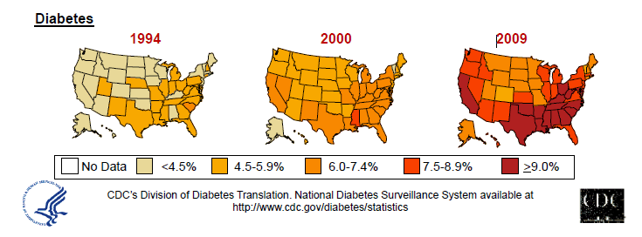
Diabetes in America 2013
26 million or 8.3%
79 million have pre diabetes
New cases increased 90% in past 10 years.
  4.8 per 1,000 people during 1995-1997 to
  9.1 per 1,000 in 2005-2007 in 33 states.
CDC 2011

Slide 5

Global Epidemic
Every 10 seconds
  1 person dies with diabetes
  2 people develop diabetes
Every year
  3 million deaths
  6 million new cases
World Diabetes Day is November 14
March is ADA Sound the Alert Day “find people w/ undetected diabetes”

Slide 6


World diabetes day-
November 14
DIABETES: PROTECT OUR FUTURE

Slide 7

Age-adjusted Diabetes Prevalence
20 yrs or older, by race/ethnicity— U.S. 2008
Native Americans 16.5%
Alaska Natives 16.5%
Blacks 11.8%
Hispanics 10.4%
Asian Americans 7.5%
Whites 6.6%
In 2002, Native Hawaiians and Japanese and Filipino residents of Hawaii aged twenty years or older were approximately 2 times as likely to have diagnosed diabetes as white residents of Hawaii

Slide 8
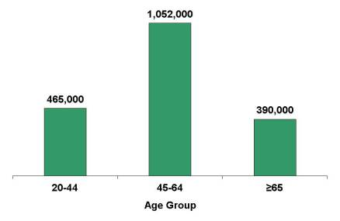
New cases of diagnosed diabetes 20 years + in United States, 2010
Source: 2007–2009 National Health Interview Survey estimates projected to year 2010.
.

Slide 9

Why Should Zip Code Determine Life Expectancy?

Slide 10
The relationship between BMI and the risk of developing type 2 diabetes
93.2
100
Women
70
54.0
Men
40.3
42.1
40
27.6
21.3
15.8
Risk of type 2 diabetes
11.6
10
8.1
6.7
4.3
5.0
4.4
5
2.9
2.2
1.0
1.0
1.0
1.5
0
<22
<23
23-
24-
25-
27-
29-
31-
33-
35+
23.9
24.9
26.9
28.9
30.9
32.9
34.9
Body mass index (kg/m²)

Slide 11
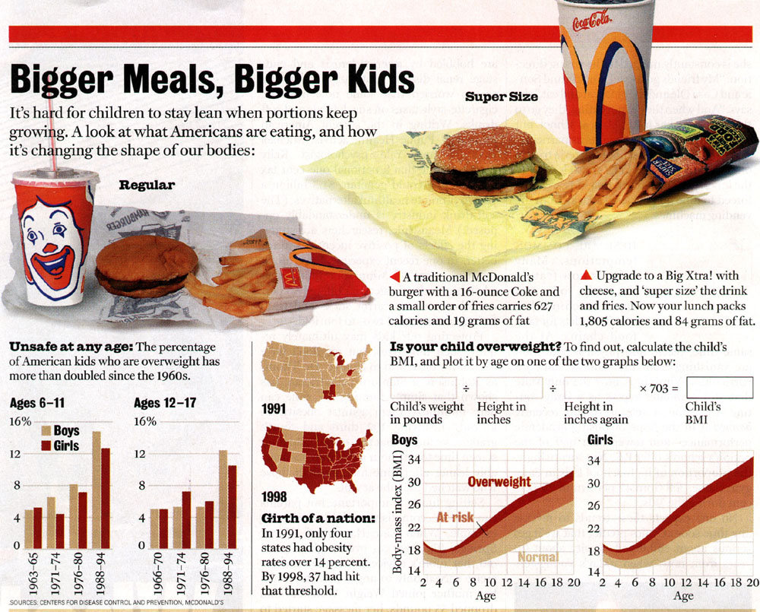

Slide 12
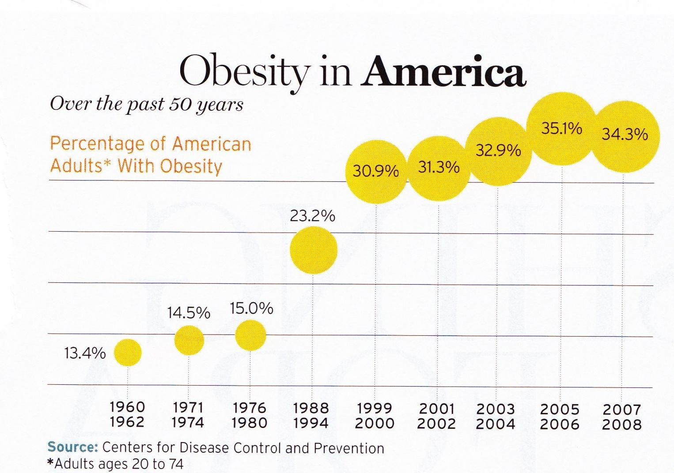
34% BMI 30 +, 34% BMI 25-29
We burn 100 cals less a day at work
1/3 of all overwt people don’t get diabetes

Slide 13


Thoughts on Diabetes, Weight, Social Change
“The only way on a societal basis to reduce the prevalence of obesity is through community action” – Dr. Frieden, CDC
In the past 20 yrs:
  the price of soda has gone up 20%
  Fruits and vegetables have gone up 100+%
Obesity (BMI 30+) prevalence 22% to 40%
Poverty, Obesity, Diabetes inter-related

Slide 14
Emerging Epidemic:
Youth with Type 2 DM
Up to 45% of children diagnosed w/ diabetes have type 2
Prevalence only 4% in 1990
Native Americans, Hispanic, African Americans highest incidence
85% are overweight at time of diagnosis
Key risk factor is insulin resistance
SEARCH for Diabetes in Youth 5 yrs Study (NIH)
  www.searchfordiabetes.org
Source: AACE 2007

Slide 15
New and Early Research on Gut Bacteria
Leaner people appear to have higher proportion of bacteroidetes
  Gut bacteria less efficient at converting food to calories
Obese people appear to have higher levels of firmicutes
  Gut bacteria very efficient at calorie extraction
Bacteria tend to run in families
Newsweek. Don’t Just Blame Calories – July 6, 2010 DM Forecast – Feb 2011

Slide 16
Role of the Pancreas
Endocrine Functions
Beta Cells - Insulin
  Anabolic hormone - helps store glucose as glycogen in muscle, liver
  secreted in response to elevated glucose
  halts breakdown of glycogen in liver
  increases protein synthesis, fat storage
  powerful hypoglycemic
Beta Cells - Amylin
  secreted in 1:1 ratio with insulin
  Causes satiety
  Lowers post-prandial glucagon response
  Slows gastric emptying
  Type 1 make none
  Type 2 make less than normal amounts

Slide 17
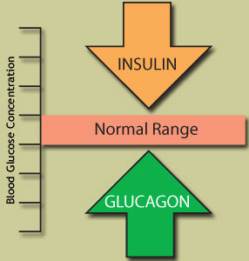
Role of the Pancreas
Endocrine Functions
Alpha cells - Glucagon
  Opposes action of insulin at the liver
  stimulated in response to low glucose levels
  stimulates liver to convert glycogen to glucose
  inhibits liver from glucose uptake
  causes hyperglycemia

Slide 18
Hormones Effect on Glucose
Hormone
Glucagon (pancreas)
Stress hormones (kidney)
Epinephrine (kidney)
Insulin (pancreas)
Amylin (pancreas)
Gut hormones - incretins (GLP-1) released by L cells of intestinal mucosa, beta cell has receptors)
Effect



⇒
⇒
⇒

Slide 19
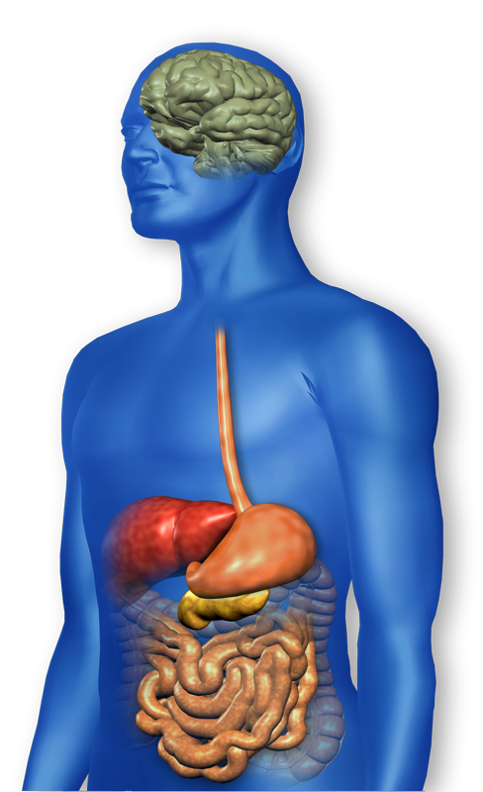
GLP-1 Effects in Humans
Understanding the Natural Role of Incretins
GLP-1 secreted upon the ingestion of food
Promotes satiety and
reduces appetite
Alpha cells:
↓ Postprandial
glucagon secretion
↑ Beta-cell
response
Liver:
↓ Glucagon reduces hepatic glucose output
Beta cells:
Enhances glucose-dependent insulin secretion
Stomach:
Helps regulate gastric emptying
GLP-1 degraded by
DPP-4 w/in minutes
Adapted from Flint A, et al. J Clin Invest. 1998;101:515-520
Adapted from Larsson H, et al. Acta Physiol Scand. 1997;160:413-422
Adapted from Nauck MA, et al. Diabetologia. 1996;39:1546-1553
Adapted from Drucker DJ. Diabetes. 1998;47:159-169
Notes:
19
19
Required
DISCUSSION POINTS:
--Upon food ingestion, GLP-1 is secreted into the circulation from L cells of small intestine.
--GLP-1 increases beta-cell response by enhancing glucose-dependent insulin secretion.
--GLP-1 decreases beta-cell workload and hence the demand for insulin secretion by:
--Regulating the rate of gastric emptying such that meal nutrients are delivered to the small intestine and, in turn, absorbed into the circulation more smoothly, reducing peak nutrient absorption and insulin demand (beta-cell workload)
--Decreasing postprandial glucagon secretion from pancreatic alpha cells, which helps to maintain the counterregulatory balance between insulin and glucagon
--Reducing postprandial glucagon secretion, GLP-1 has an indirect benefit on beta-cell workload, since decreased glucagon secretion will produce decreased postprandial hepatic glucose output
--Having effects on the central nervous system, resulting in increased satiety (sensation of satisfaction with food intake) and a reduction of food intake
--By decreasing beta-cell workload and improving beta-cell response, GLP-1 is an important regulator of glucose homeostasis.
SLIDE BACKGROUND:
--Effect on Beta-cell: Drucker DJ. Diabetes. 1998; 47:159-169
--Effect on Alpha cell: Larsson H, et al. Acta Physiol Scand. 1997; 160:413-422
--Effects on Liver: Larsson H, et al. Acta Physiol Scand. 1997; 160:413-422
--Effects on Stomach: Nauck MA, et al. Diabetologia. 1996; 39:1546-1553
--Effects on CNS: Flint A, et al. J Clin Invest. 1998; 101:515-520

Slide 20
Bariatric Surgery
Consider on diabetes pts w/ BMI >35, esp with comorbidities
Remission (BG normalized)
  rates range from 40 – 95%
  Better results with newer diabetes (more beta cell mass)
  Due to increase incretins (gut hormones)
Still researching long term benefits, cost effectiveness and risk

Slide 21
Signs of Diabetes
Polyuria
Polydipsia
Polyphasia
Weight loss
Fatigue
Skin and other infections
Blurry vision
Glycosuria, H₂O losses
Dehydration
Fuel Depletion
Loss of body tissue, H₂O
Poor energy utilization
Hyperglycemia increases incidence of infection
Osmotic changes

Slide 22
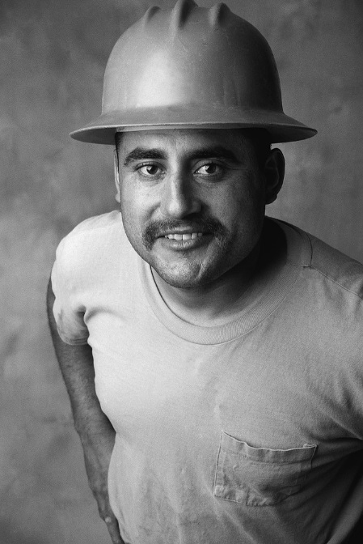

Case Study
1. Pt profile: 5’8”, 192 lb male
Diabetes 12 years, on insulin 3 yrs
What type of DM and how do you know?
2. 5’6”, 108 lb female
On insulin 3u Regular before meals, 10u NPH at bedtime
What type of DM and how do you know?

Slide 23


Slide 24


Slide 25


Slide 26
Type 1 Diabetes – Genetics and Risk Factors
  1- 400 to 1-1000 = Risk of type 1 in gen pop
  1-20 to 1-50 in offspring of diabetes parents
  Combo of genes and disease susceptibility
  Risk Factors:
    Autoimmunity tends to run in families
    Higher rates in non breastfed infants
    Viral triggers: congenital rubella, coxsackie virus B, cytomegalovirus, adenovirus and mumps.

Slide 27
Type 1 Diabetes – 10% of all DM
  Auto-immune pancreatic beta cells destruction
  Most commonly expressed at age 10-14
  More rapid destruction in youth (vs. adults)
  Insulin sensitive (require 0.5 - 1.0 units/kg/day)
  Auto-immune Markers
    Positive Glutamic Acid Decarboxylase (GAD), Insulin & Islet Cell Autoantibodies (IAA & ICA’s)
    New marker – ZnT8 (zinc transporter) antibodies to this (ZnT8) found in 60-80% of type 1
  Other clues
    Low C-Peptide level < 0.5
    Usually lean and present in sick state

Slide 28



Slide 29





What Does Type 1 Look Like?
Bret Michaels
Sharon Stone
Halle Berry
Mary Tyler Moore
From Debbie Nagata’s slide collection
Adam Morrison
Justice Sonia Sotomayor
Nick Jonas

Slide 30
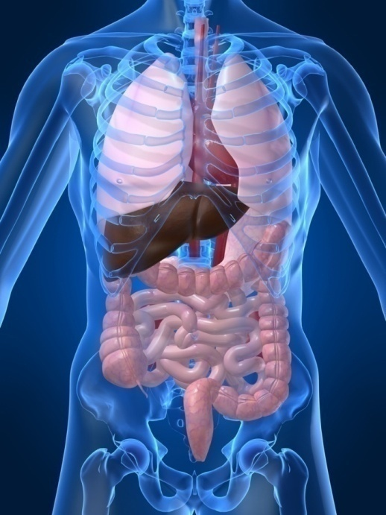
Type 1 Diabetes Associated with other immune conditions
Celiac disease (gluten intolerance)
Thyroid disease
Addison’s Disease
Rheumatoid arthritis
Other

Slide 31
Type 1 Summary
Autoimmune and often associated w/
Complete pancreatic destruction
Need insulin shots
Often first present in Diabetic KetoAcidosis (DKA)

Slide 32

Type 1 in Hospital
43 yr old admitted to evaluate angina.
Morning blood sugar is 92.
Based on Regular insulin sliding scale, no insulin required.
Breakfast tray shows up and patient says, I need my insulin shot before I eat.
What do you say?

Slide 33
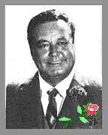
“How Sweet It Is”

Slide 34




Slide 35
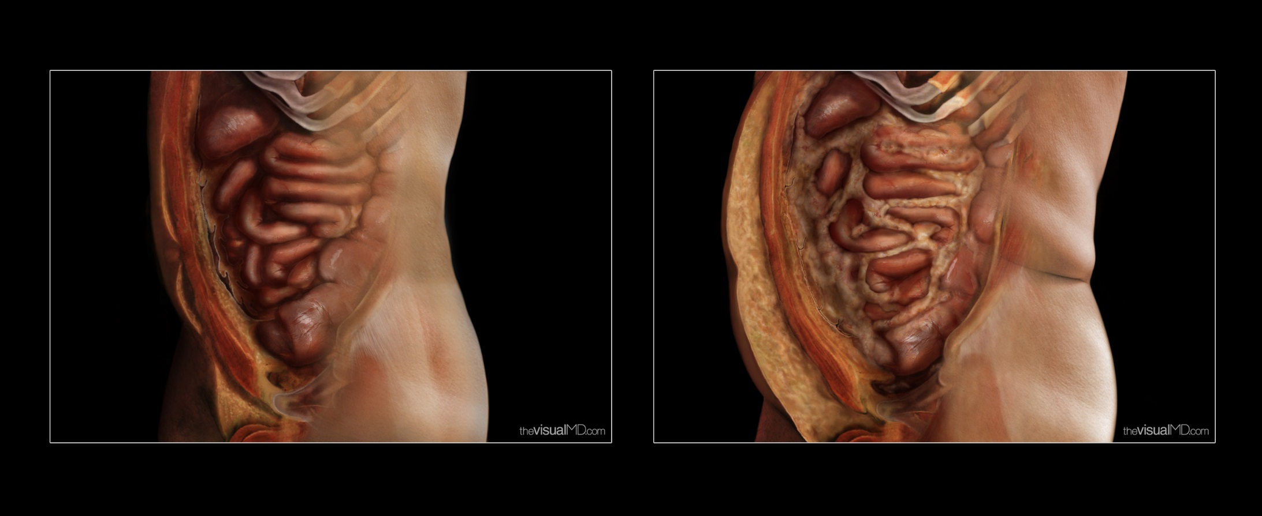
Visceral Fat –
“Endocrine Organ”

Slide 36

Cardio Metabolic Risk -
5 Hypers -
Hyperinsulinemia (resistance)
Hyperglycemia
Hyperlipidemia
Hypertension
Hyper”waistline”emia (35” women, 40” men)
Manifestations of Insulin Resistance

Slide 37
What is Type 2 Diabetes?
Complex metabolic disorder ….
  (Insulin resistance and deficiency)
with social, behavioral and environmental risk factors unmasking the effects of genetic susceptibility.

Slide 38
Natural Progression of Type 2 Diabetes
Plasma
Glucose
Postprandial glucose
Fasting glucose
126 mg/dL
Relative
β-Cell
Function
Insulin resistance
Insulin secretion
-20
-10
0
10
20
30
Years of Diabetes
Prior to diagnosis
After diagnosis
Adapted from Bergenstal et al. 2000; International Diabetes Center.

Slide 39
Natural History of Diabetes
Normal
FBG <100
Random <140
A1c <5.7%
Prediabetes
FBG 100-125
Random 140 - 199
A1c ~ 5.7- 6.4%
50% working pancreas
Diabetes
FBG 126 +
Random 200 +
A1c 6.5% or +
20% working pancreas
Yes!
NO
Development of type 2 diabetes happens over years or decades

Slide 40
Diagnostic Criteria
All test should be repeated in the absence of unequivocal hyperglycemia
If test abnormal, repeat same test to confirm diagnosis
Kaiser Diabetes Screening Guidelines:
Fasting Plasma Glucose (FPG) preferred screening test – after 8 hr fast
A1c acceptable alternative screening test

Slide 41
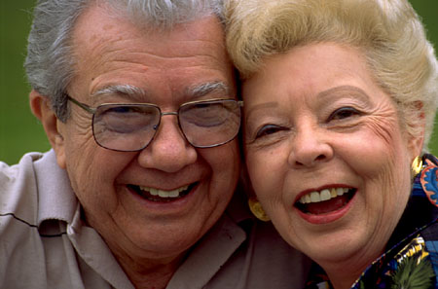
Diabetes 2 - Who is at Risk?
(ADA Clinical Practice Guidelines)
Testing should be considered in all adults who are overweight (BMI ≥ 25) and have additional risk factors:
  First-degree relative w/ diabetes
  Member of a high-risk ethnic population
  Habitual physical inactivity
  PreDiabetes
  History of heart disease

Slide 42
Diabetes 2 - Who is at Risk?
(ADA Clinical Practice Guidelines)
Risk factors cont’d
  HTN - BP > 140/90
  HDL < 35 or triglycerides > 250
  baby >9 lb or history of Gestational Diabetes Mellitus (GDM)
  Polycystic ovary syndrome (PCOS)
  Other conditions assoc w/ insulin resistance:
    Severe obesity, acanthosis nigricans (AN)

Slide 43
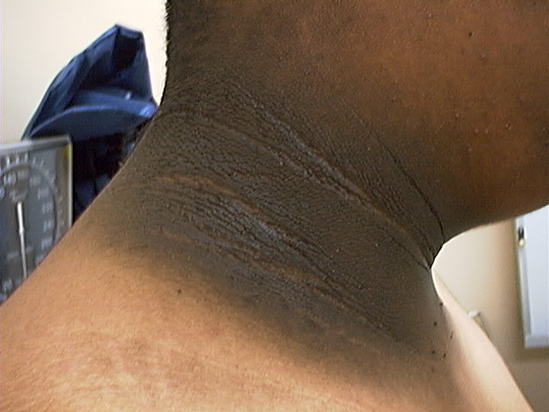
Acanthosis Nigricans

Slide 44
Acanthosis Nigricans (AN)
Signals high insulin levels in bloodstream
Patches of darkened skin over parts of body that bend or rub against each other
  Neck, underarm, waistline, groin, knuckles, elbows, toes
  Skin tags on neck and darkened areas around eyes, nose and cheeks.
No cure, lesions regress with treatment of insulin resistance

Slide 45

Diabetes is also associated with
Fatty liver disease
Obstructive sleep apnea
Cancer; pancreas, liver, breast
Alzheimer’s
Depression

Slide 46
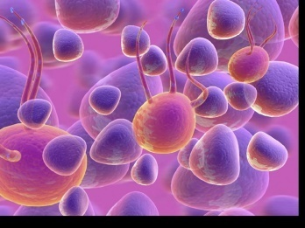
Ominous Octet
Decreased
satiation neuro-
transmission
Decreased
amylin, β-cell secretion
80% loss at dx
Increased renal glucose reabsorption
Decreased
Gut hormones
Increased glucagon secretion
G
I
G
I
G
G
I
I
G
G
Increased lipolysis
G
I
I
G
G
I
Increase glucose
production
I
G
G
Decreased glucose
uptake
© Copyright 1999-2013, Diabetes Educational Services, All Rights Reserved.
Notes:
46
46

Slide 47
Comparison of
Type 1,Type 2, LADA
Type 1
Type 2
Obesity
x
xxx
Insulin dependence
xxx
30%
Respond to oral agents
0
xxx
Ketosis
xxx
x
Antibodies present
xxx
0
Typical Age of onset
teens
adult
Insulin Resistance
0
xxx

Slide 48

Gestational Diabetes
GDM – hyperglycemia first recognized during pregnancy

Slide 49
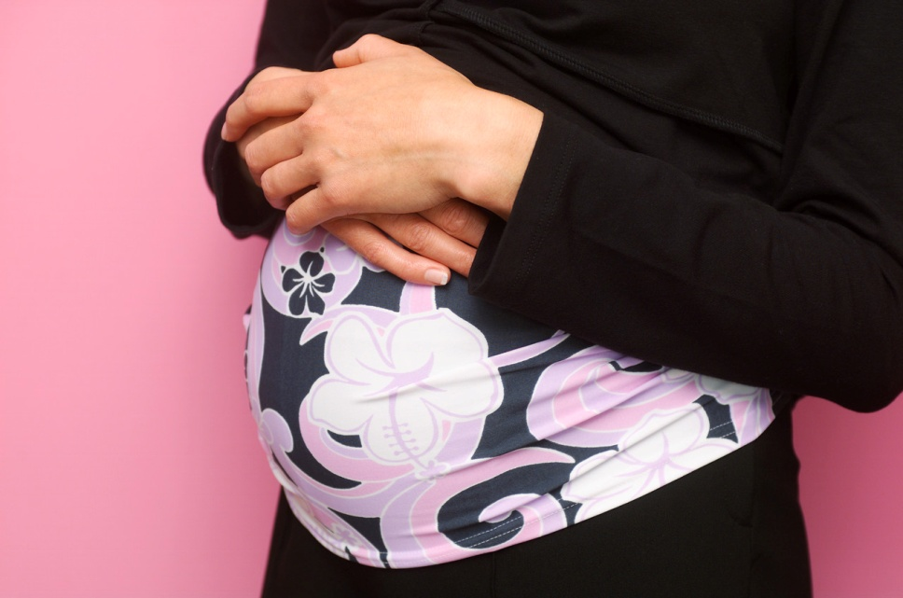
Screen for GDM
Screen for undiagnosed Type 2 at the first prenatal visit in those with risk factors using standard diagnostic criteria.
If normal, recheck at 24-28 weeks

Slide 50
GDM Diabetes Rates –
2-10% of all Pregnancies
GDM prevalence increased by
  ∼10–100% during the past 20 years
Native Americans, Asians, Hispanics, and African-American women at highest risk
Immediately after pregnancy, 5% to 10% of GDM diagnosed with type 2 diabetes
Women with gestational diabetes 35% to 60% chance of developing DM in next 10–20 years.

Slide 51

Increasing Prevalence of GDM
A public health perspective
Body weight before and during pregnancy influences risk of GDM and future diabetes
Children born to women with GDM at greater risk of diabetes
Focus on prevention

Slide 52
Postnatal Health:
Maternal Behavior
Encourage breastfeeding
Screening 6-12 weeks post partum using non-pregnant OGTT criteria
Repeat at 3 yr intervals or signs of DM
Encourage weight control and exercise
Make sure connected with health care
Preconception counseling

Slide 53
Other Causes of Hyperglycemia
  Steroids
  Agent Orange
  Tube feedings / TPN
  Transplant medications
  Cystic Fibrosis
  Regardless of cause, requires treatment
    Insulin always works
    Sign of pancreatic malfunction

Slide 54
Diabetes Detectives Needed
On average – takes 6.5 years to diagnose diabetes
1/3 of all people with diabetes don’t know they have it

Slide 55
Diabetes Bingo
“DiaBingo”
Shout out Right Answer

Slide 56
DiaBingo
B Frequent skin and yeast infections
B A BMI of ____ or greater is considered overweight
B To reduce complications, control A1c, Blood pressure, Cholesterol
B PreDiabetes – fasting glucose level of ___ to ____
B Erectile dysfunction indicates greater risk for ____
B Diabetes – fasting glucose level____ or greater
B Type 1 diabetes is best described as an ______ disease
B People with diabetes are ______ times more likely to die of heart dx
B Elevated triglycerides, < HDL, smaller dense LDL
B Each percentage point of A1c = _____ mg/dl glucose
B At dx of type 2, about __% of the beta cell function is lost
B Diabetes – random glucose ____ or greater

Slide 57

Life Study - Mr. Calhoun
Mr. Calhoun is 72 years old, has recently lost 10 pounds and complains of feeling very tired lately. He is admitted with an infected foot ulcer. His WBC is 12.3, glucose 284. He smokes a pack of cigarettes a day. He takes glyburide 10mg daily and doesn’t have a meter to test his BG.
What risk factors and signs of diabetes?
What type of diabetes does he have?

Slide 58
What Do You Say?
Mr. Calhoun asks you
What is type 2 diabetes?
Will this go away?
Will I get complications?
Will I need to take diabetes medication for the rest of my life?
How come I got diabetes?
Do I have to check my blood sugars?

Slide 59
I don’t want to!

Slide 60

Unconditional Positive regard
Unconditional Positive Regard –
involves showing complete support and acceptance of a person no matter what that person says or does.
Help with
Unconditional
Guidance and Support
  Anne Peters, MD, CDE
  ADA Post Grad
Term coined by humanist, Carl Rogers

Slide 61
No one is Unmotivated
…. to lead and long and healthy life
These are the 3 usual Critical Barriers
  Perceived worthlessness
  Too many personal obstacles
  Absence of support and resources
  Bill Polonsky, PhD, CDE

Slide 62
Overcoming barriers
Confront the key misbelief. Ask the question, does dm cause complications?
Offer pts evidence based hope message –
Frequent contact
Paired glucose testing
Ask pt, “Tell me 1 thing that is driving you crazy about your diabetes”
Discuss medication beliefs
To improve outcomes, see pts more often
  Bill Polonsky, PhD, CDE

Slide 63
Blood Glucose Testing -How will it help me?
See if your treatment plan is working
Make decisions regarding food and/or med adjustment when exercising
Find out how that pizza affected your BG
Avoid unwanted weight gain
Enhanced athletic performance
Find patterns
Manage illness

Slide 64
How Often Should I Check?
Be realistic!!
Type 1 – at least pre and post meal
Type 2 – as often as needed to achieve goals (ADA)
Consider:
  Types and timing of meds
  Goals
  Ability (physical and emotional)
  Finances

Slide 65
Complications - Why?
Degree of hyperglycemia “glucose toxicity”
Duration of hyperglycemia
Genes
Multiple risk factors: smoking, vascular disease, dyslipidemia, hypertension, other

Slide 66
Diabetes Complications
Heart disease leading cause of death.
CAD death rates are about 2 -4x’s as high as adults without diabetes (it’s not getting better)
Risk of stroke is 2 - 4 times higher
60% - 65% of people with DM have HTN.
DM accounts for 40% of new cases of ESRD
60 - 70% have mild - severe forms of neuropathy
Diabetes is the leading cause of blindness
Accounts for 50% of lower limb amputations

Slide 67
Control Matters
Prevention
Trials
Practice Recommendations

Slide 68

Financial Advisor
Mid 30s, friendly, he smiles to greet you and you notice his gums are inflamed. You’d guess a BMI of 26 or so, with most of the extra weight in the waist area.
If you could give him some health related suggestions, what would they be?

Slide 69

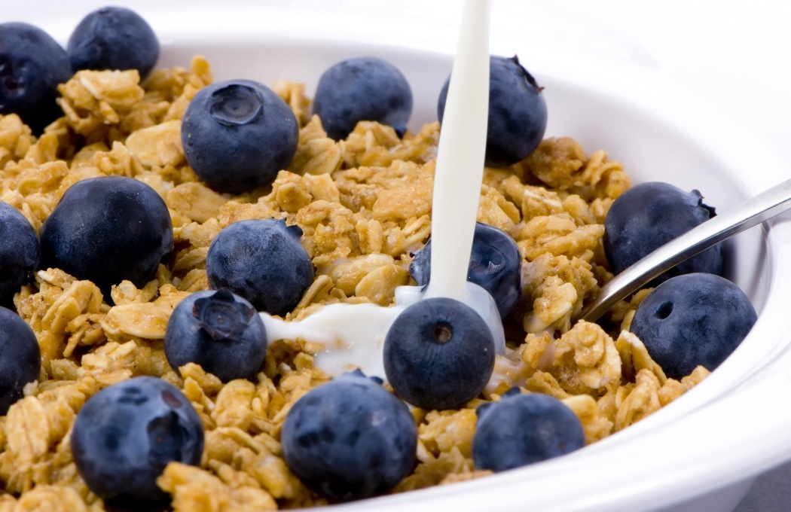


Preventing Pre Diabetes

Slide 70
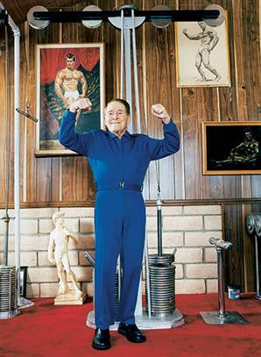
Can Type 2 be Prevented in Older Adults?
Overall, 9 of 10 new cases of diabetes attributable to these 5 lifestyle factors.
89% risk reduction when all at goal.
35% rel risk reduction for each additional
Physical activity (30 mins a day)
Dietary score (higher fiber intake, low saturated fat and trans-fat, lower mean glycemic index)
Not Smoking
Alcohol use (up to 2 drinks a day);
BMI <25 and waist circumference
Dariush Mozaffarian, MD,
Arch Intern Med. 2009;169(8):798-807.

Slide 71
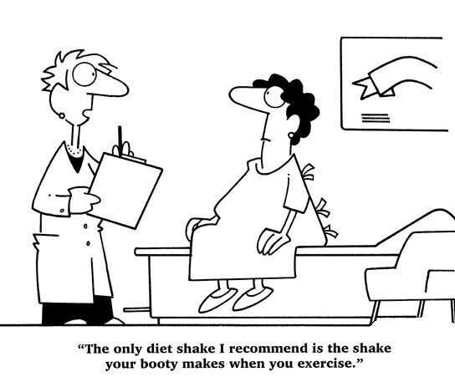
Best Shake For People with Diabetes
From Debbie Nagata’s slide collection

Slide 72
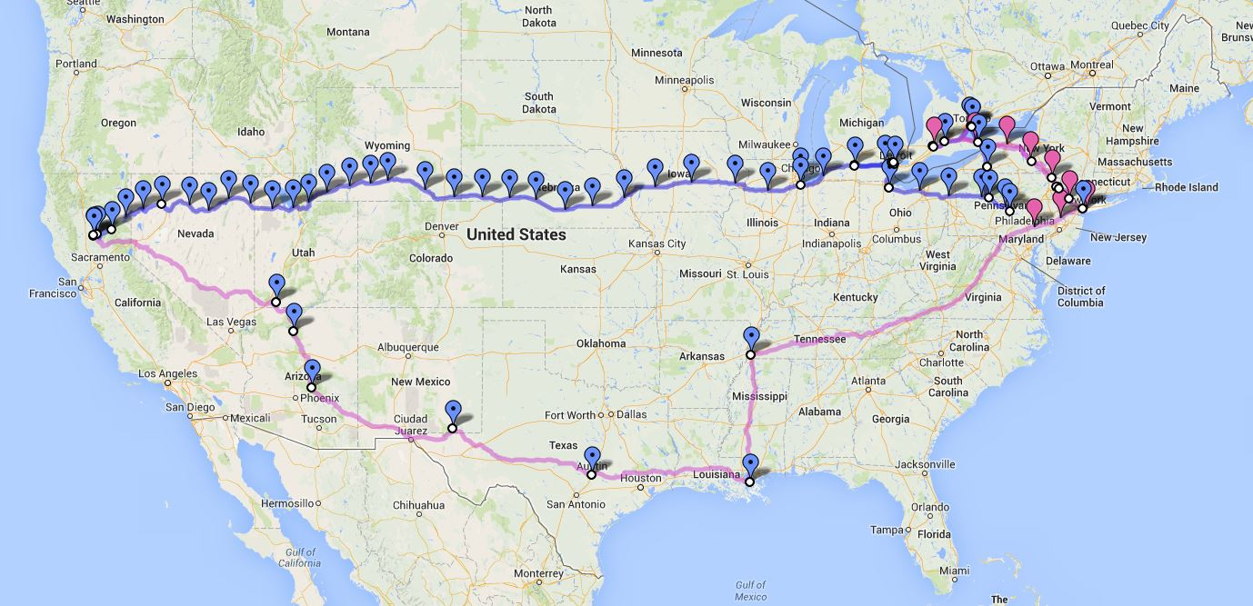

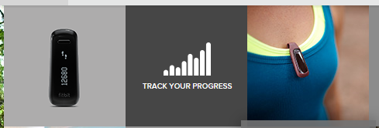
We Made It – 3129 miles- Now Walking Back
Track miles with fitbit
Fitbit.com
Lifespan Treadmill Desk - Amazon

Slide 73
Diabetes Prevention Program
(DPP) August 2001
3, 234 people w/ IGT randomized to Placebo, Diet/Exercise or Metformin for 3 years
Standard Group - 29% developed DM
Lifestyle Results - 14% developed DM
  30 mins daily mod activity/ low fat diet reduced DM risk by 58% (71% for 60yrs +)
  On avg, participants lost 5-7% of body wt
Metformin 850 BID - 22% developed DM
  reduced risk by 31% (less effective with elderly and thinner pt’s)

Slide 74
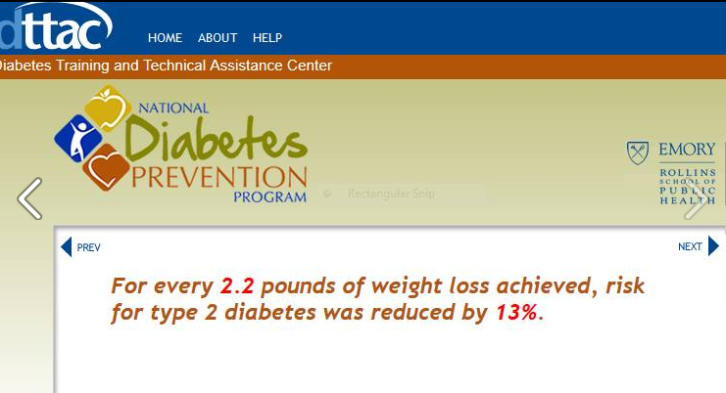
Weight loss and Prevention

Slide 75
Diabetes Prevention Programs
Delay or Prevent Type 2 Diabetes
Save $5.7 billion over 25 years
Programs
  Partnering with YMCA’s
  CDC now recognizes Diabetes Prevention Programs www.cdc.gov/diabetes/prevention
    Health Affairs 31, No 1 2012 p50-60

Slide 76
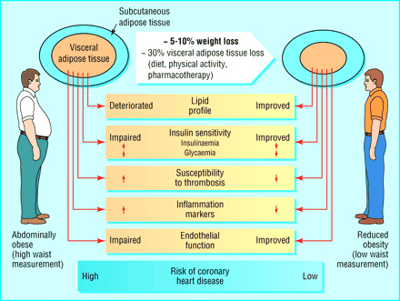

Slide 77
ABC’s of Diabetes
  A1C
  Blood Pressure
  Cholesterol
  professional.diabetes.org

Slide 78
Glucose and BP Control Matter
1% decrease in A₁c reduces microvascular complications by 35%
1% decrease in A₁c reduces diabetes related deaths by 25%
B/P control reduces risk of:
  Heart failure (56%)
  Stroke (44%)
  Death from diabetes (32%)
Lancet 352: 837-865, 1998

Slide 79
A1c Goals for Non Pregnant Adults
Individualize Targets – ADA
  < 7% for patients in general
  For individual pts, as close to normal as possible (<6%) w/out significant hypo
  < 8% for frail elderly
  Goals based on:
    Duration of diabetes
    Life expectancy and Age
    Co morbid conditions
    Know CVD or advanced micro complications
    Ind pt considerations, shared decision making

Slide 80
A1c and Estimated Avg Glucose (eAG) 2008
http://professional.diabetes.org/GlucoseCalculator.aspx
A1c (%) eAG
5 97
6 126
7 154
8 183
9 212
10 240
11 269
12 298
eAG = 28.7 x A1c-46.7 ~ 29 pts per 1%
Translating the A1c Assay Into Estimated Average Glucose Values – ADAG Study
Diabetes Care: 31, #8, August 2008

Slide 81


Slide 82

“Legacy Effect”
For participants of DCCT and UKPDS
  long lasting benefit of early intensive BG control prevents
    microvascular complications
    Macrovascular complications (15-55% decrease)
  Even though their BG levels increased over time
  Message – Catch early and
  Treat aggressively

Slide 83
Glucose Goals
Individualize Targets – ADA
  Pre-Prandial BG 70- 130
  1-2 hr post prandial < than 180
    *for nonpregnant adults

Slide 84

Diabetes Self Management Education and Support (DSMES)
People w/ DM and prediabetes need education that:
    Addresses psychosocial and emotional well-being
    Meets National Standards
    Focuses on promoting self-care and behavior change
Evidence that DSMES programs work
    Lower A1c, wt loss, improved quality of life, better coping and lower costs

Slide 85
Bariatric Surgery
Consider on diabetes pts w/ BMI >35, esp with comorbidities
Remission (BG normalized)
  rates range from 40 – 95%
  Better results with newer diabetes (more beta cell mass)
  Due to increase incretins (gut hormones)
Still researching long term benefits, cost effectiveness and risk

Slide 86
BP Goal – 140/80
ADA Clinical Practice Recommendations
If >140 / 80 = lifestyle + meds
Start lifestyle therapy when BP 120/80
Lifestyle (wt loss, exercise, DASH diet, limit ETOH)
First Line B/P Drugs
  ACE – I orAngiotensin receptor blocker (ARBs)
  Beta Blocker for post MI
  Diuretics often needed
  Monitor creat, GFR, potassium, sodium
Many pts require 2 or > anti-HTN meds

Slide 87
BP Goal for KP NCAL
BP < 139/ 89

Slide 88
*Lipid Goals
ADA Clinical Practice Recommendations
  LDL < 100 mg/dL
  LDL <70 an option for ind w/ overt CVD
  HDL > 40 mg/dL men
  HDL > 50 mg/dL women
  Trig < 150 mg/dl
*alternative goal is 40% lower than baseline levels if on max statin therapy & above goals not met
  Screen biannually or annually, more often if indicated

Slide 89
ABCs of Diabetes –
A1c less than 7% (avg 3 month BG)
  Pre-meal BG 70-130
  Post meal BG <180
Blood Pressure < 140/80
Cholesterol
  HDL >40
  LDL <100 (if CVD, <70)
  Triglyceride < 150

Slide 90
“Legacy Effect”
For participants of DCCT and UKPDS
  long lasting benefit of early intensive BG control prevents
    microvascular complications
    Macrovascular complications (15-55% decrease)
  Even though their BG levels increased over time
  Message – Catch early and
  Treat aggressively

Slide 91
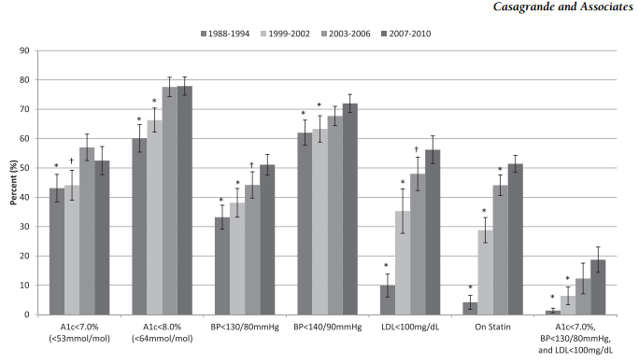
How are we doing?
Reaching goal
Diabetes Care, 2/13

Slide 92
Diabetes Care Guidelines- ADA
Test / Exam Frequency
A1c At least twice a year
B/P Each diabetes visit
Cholesterol (LDL, HDL, Tri) Yearly (less if normal)
Weight each diabetes visit
Microalbumin/GFR/Creat Yearly
Eye exam Yearly
Dental Care At least twice a year
Comprehensive Foot Exam Yearly (more if high risk)
Physical Activity Plan As needed to meet goals
Preconception counseling As needed

Slide 93
Vaccinations- Immunizations
Flu vaccine
  every year starting 6 months
Pneumococcal starting at 2 years.
  One time Revaccination for those over 64 and had first vaccine >5 years prior
Hepatitis B Vaccine (ADA Stds 2013, pg s28)
  For diabetes pts age 19 – 59 (not previously vaccinated)
  Double risk of Hep B due to lancing devices/ glucose meter exposure

Slide 94

Mr. Calhoun - What are Your Recommendations for Self-Care
Patient Profile
62 yr old with newly dx type 2. History of previous MI.
Meds: Lasix, synthroid
Labs:
  A1c 9.3%
  HDL 37 mg/dl
  LDL 156 mg/dl
  Triglyceride 260mg/dl
  Proteinuria - neg
  B/P 142/92
Self-Care Skills
Walks dog around block 3 x’s a week
Bowls every Friday
Widowed, so usually eats out

Slide 95
Diabetes Bingo
“DiaBingo”
Shout out Right Answer

Slide 96
DiaBingo- G
G ADA goal for A1c is less than ____%
G People with DM need to see their provider at least every month
G Blood pressure goal is less than
G People with DM should see eye doctor (ophthalmologist) at least
G The goal for triglyceride level is less than
G Goal for my HDL cholesterol is more than
G The goal for blood sugars 1-2 hours after a meal is less than:
G People with DM should get this shot every year
G People with DM need to get urine tested yearly for ___________
G Periodontal disease indicates increased risk for heart disease
G The goal for blood sugar levels before meals is:
G The activity goal is to do ___ minutes on most days

Slide 97
Mr. Calhoun - What are Your Recommendations?
Patient Profile
64 yr old with type 2 for 11 yrs. Hx of CVD.
Labs:
  A1c 9.3%
  HDL 37 mg/dl
  LDL 114 mg/dl
  Triglyceride 260mg/dl
  Proteinuria - neg
  B/P 142/92
Self-Care Skills
Walks dog around block 3 x’s a week
Bowls every Friday
3 beers daily
Widowed, so usually eats out
15 lbs overweight
“My foot hurts”

Slide 98
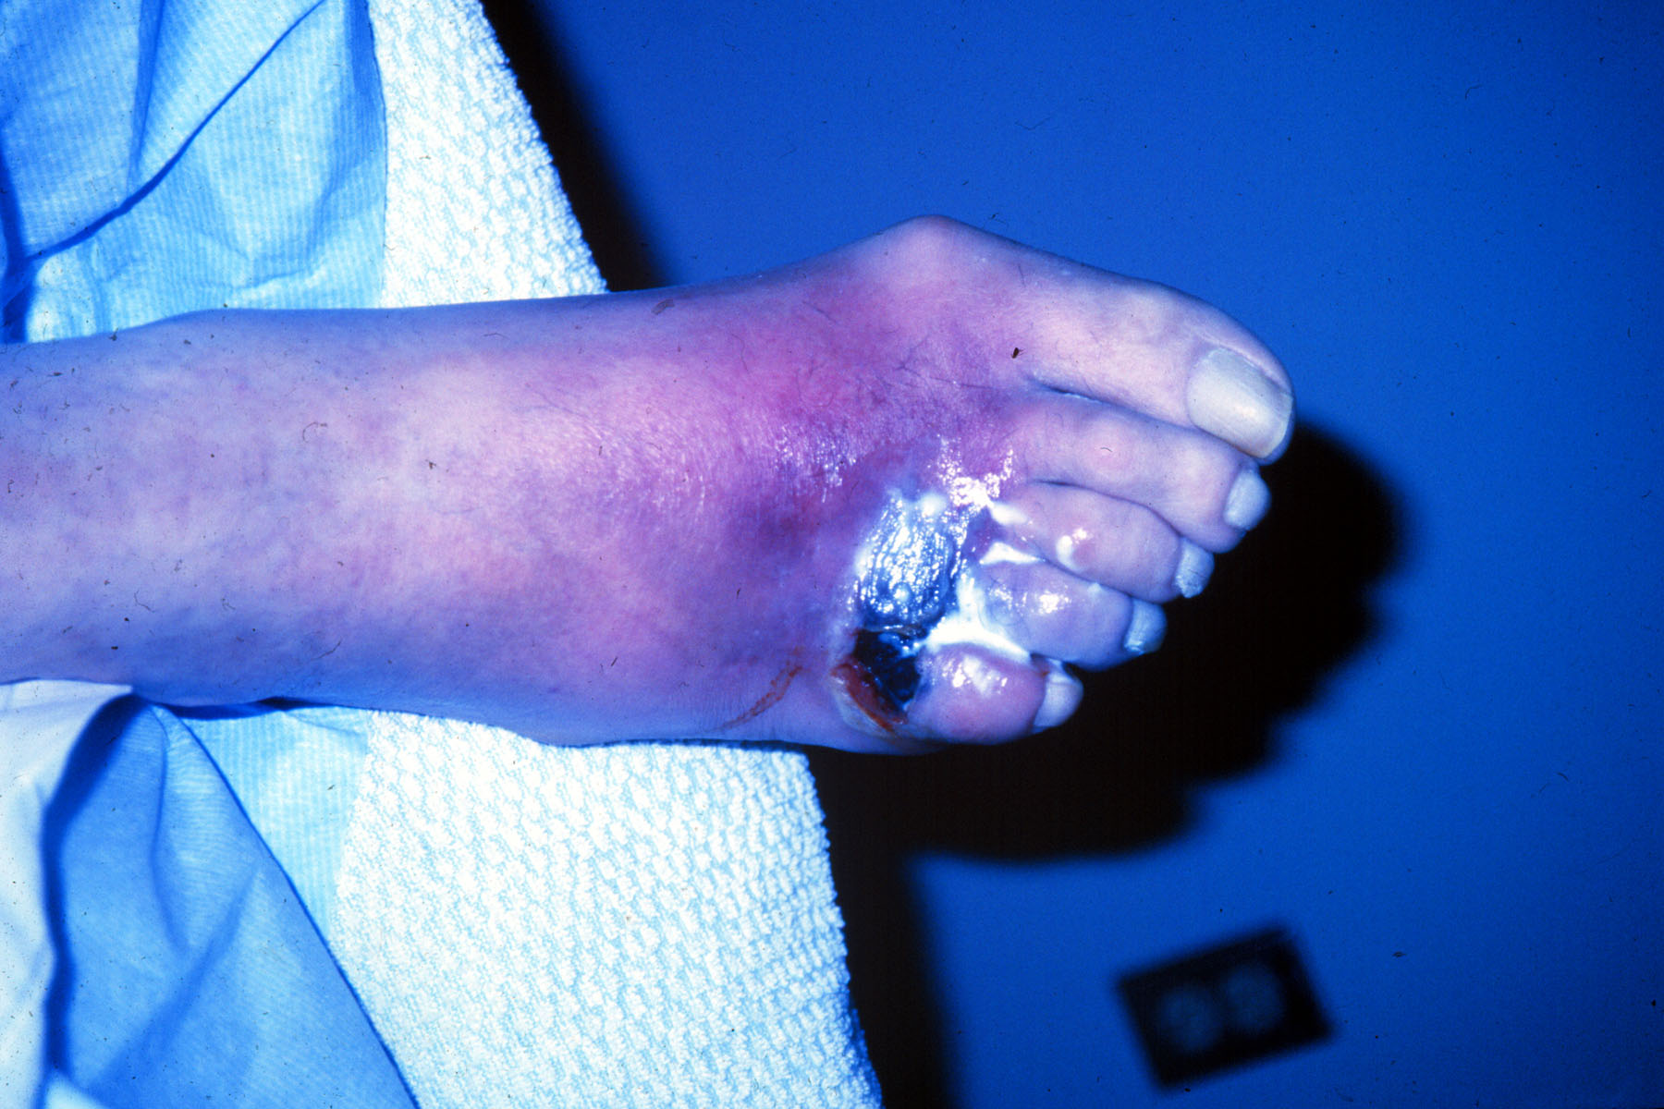

Slide 99
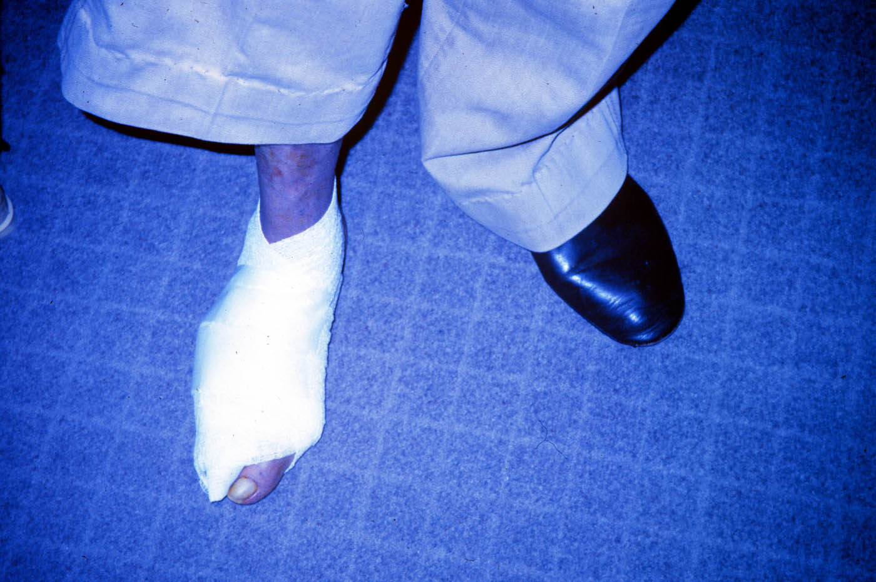

Slide 100
Foot Care
Lift the sheets and look at the Feets!

Slide 101
A Quick Foot Assessment
Ask - What do you do to take care of your feet?
Look - texture, toenails, structural deformities, lesions, corns
Assess sensation
Assess risk factors
Teach, teach, teach

Slide 102
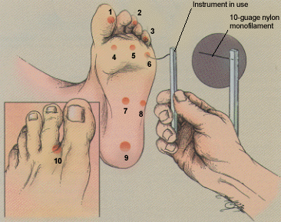
5.07 monofilament = 10gms linear pressure
Free Monofilaments
http://www.hrsa.gov/leap/

Slide 103
Three Most Important
Foot Care Tips
Inspect and apply lotion to your feet every night before you go to bed.
Do NOT go barefoot, even in your house. Always wear shoes!
Every time you see your doctor, take off your shoes and show your feet.

Slide 104
Diabetes Self-Management
Self Monitor Blood Glucose
Meal Plan
Exercise / Activity
Medications

Slide 105

Medical Nutrition Therapy – ADA 2014 Updates
No ideal percentage of calories from protein, carbohydrate and fat for people with diabetes.
Macronutrient distribution should be based on an individualized assessment of eating patterns, preferences and metabolic goals.

Slide 106
Medical Nutrition Therapy
2014 - ADA
Focus on the Individual
Maintain pleasure of eating
Provide positive messages about food
Limit food choices only when backed by science
Provide practical tools
Refer to a RD and Diabetes Education – Lowers A1c by 1-2%

Slide 107

Approach Depends on Patient
New Type 2
  Portion Control
  Plate Method
  Record Keeping
  Education
On Insulin?
  Carb counting

Slide 108
Losing 2-8kg Early in diagnosis Type 2 Helpful
ADA 2014
Weight Loss –
  The optimal macronutrient intake to lose weight not known
  The literature does not support one particular nutrition therapy to reduce weight, but rather a spectrum of eating patterns that result in reduced energy intake.
  Wt loss goal ½ pound to 1 lb a week
    Decrease intake 250-500 cals daily + exercise
2013 – Try and keep less than 2,300 mg a day
  Vitamin and mineral supplements not recommended -lack of evidence.
  Fiber 25 -38 gms a day

Slide 109
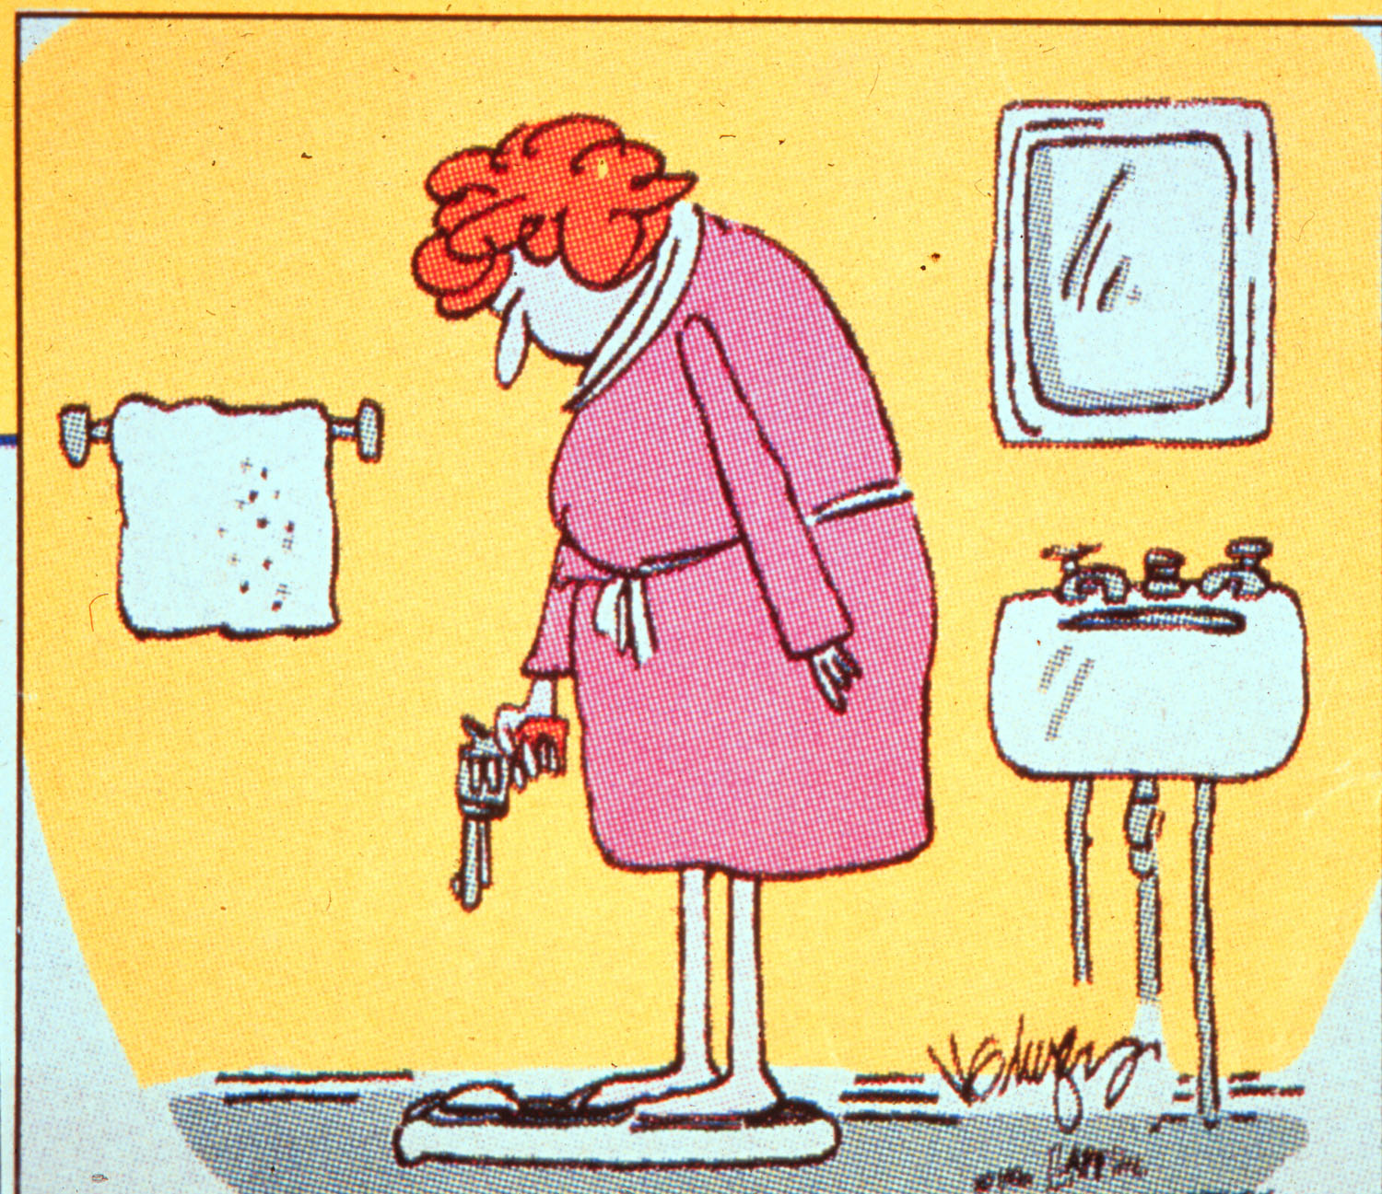

Slide 110

Successful weight loss strategies include
Weekly self-weighing
Eat breakfast
Reduce fast food intake.
Decrease portion size
Increase physical activity
Use meal replacements
Eat healthy foods

Slide 111
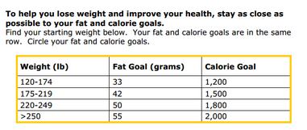
Diabetes Prevention Program
Focus on fat = wt loss success
http://www.cdc.gov/diabetes/prevention/recognition/curriculum.htm

Slide 112






Move toward the Tomato

Slide 113
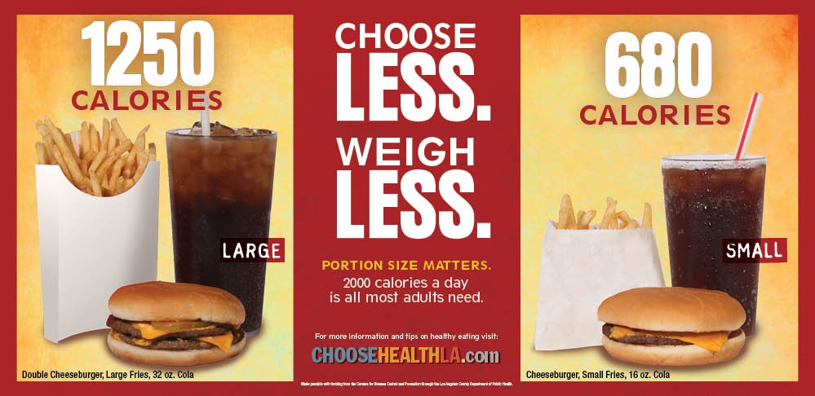
Health Campaigns

Slide 114

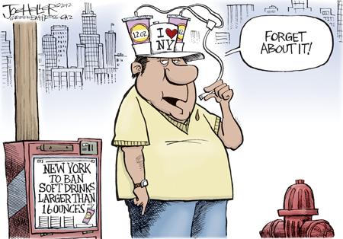
ADA recommendation
Eat Less Junk Food & Sugary Drinks –
Less Processed Foods
Less Sugary Beverages
  increase visceral adiposity
  With sugar or
  High fructose corn syrup
Soda Tax?
Junk Food Tax?

Slide 115
10 Superfoods
Beans
Dark Green Leafy Vegs
Citrus Fruit
Sweet Potatoes
Berries
Tomatoes
Fish High in Omega-3 Fatty Acids
Whole Grains
Nuts
Fat-Free Milk and Yogurt

Slide 116
How nutrients affect blood sugar

Slide 117
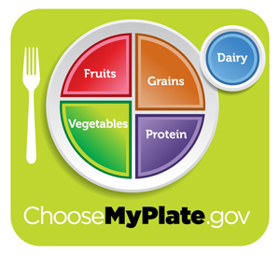
Teaching About Eating Healthy
Major food groups
“Handy Diet”
Plate Method
Exchange Lists
Food Diaries / Glucose Records
Carbohydrate Counting
Assess what is best for the situation.

Slide 118
USDA Food Pyramid www.myplate.gov
Balancing Calories
Enjoy your food, but eat less.
Avoid oversized portions.
Foods to Increase
Make half your plate fruits and vegetables.
Make at least half your grains whole grains.
Switch to fat-free or low-fat (1%) milk.
Foods to Reduce
Compare sodium in foods like soup, bread, and frozen meals ― and choose the foods with lower numbers.
Drink water instead of sugary drinks.

Slide 119
Label Lessons
Nutrition Facts
Serving Size 1/2 cup (114 g)
Servings Per Container 4
Amount Per Serving
Calories 90 Calories from Fat 30
% Daily Value*
Total Fat 3g 5%
Saturated Fat 0g 0%
Cholesterol 0g 0%
Sodium 300mg 13%
Total Carbohydrate 13g 4%
Dietary Fiber 3g 12%
Sugars 3g
Protein 3g
Vitamin A 80% * Vitamin C 60%
Calcium 4% * Iron 4%
* Percent Daily Values are based on a 2,000 calorie diet. Your daily values may be higher or lower depending on your calorie needs:
Calories _ 2000 2500
Total Fat Less than 65g 80g
Sat Fat Less than 20g 25g
Cholesterol Less than 300mg 300mg
Sodium Less than 2400mg 2400mg
Total Carbohydrate 300g 375g
Fiber 25g 30g
Calories per gram: Fat 9 Carbohydrates 4 Protein 4

Slide 120
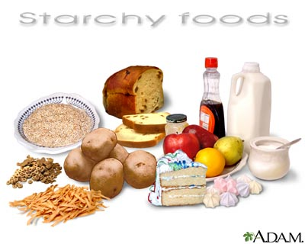
Carbs affect Post meal Blood Glucose
Starch
Fruit
Milk
Desserts

Slide 121

Carbohydrate Needs for
Most Adults
Grams Servings
Each Meal 45-60 gm 3 - 4
Snacks 15-30 gm 1- 2
Carbs affect Post Meal Blood Glucose

Slide 122

Choose Healthy Carbs
Carbs have fiber, vitamins, minerals and phytonutrients
25 gms of fiber a day
Power Carbs include:
  Beans
  Veggies
  Fruits
  Whole grain foods

Slide 123
Handy Meal Plan
Per Meal Serving
  Each finger = 15 gms carb (can have 3-4 servings/meal)
  Palm of hand = 3 oz’s protein
  Thumbnail = 1 tsp fat serving

Slide 124
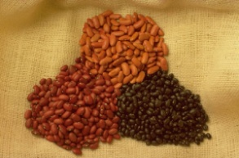


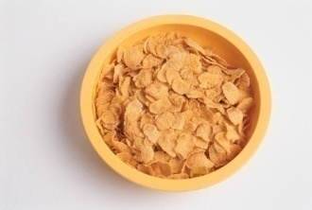
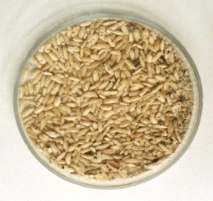
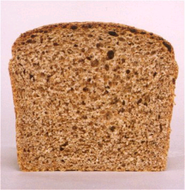

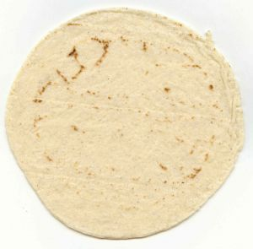

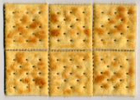
Each Food has:
80 Calories
15 grams carb
Carb counting- starch
1 small ear of corn or 1/2 cup corn
1/3 cup cooked pasta
1/2 cup
cooked beans
3/4 cup cold cereal
1 slice bread
1/3 cup cooked rice
1 small potato
1 small tortilla
1/2 English muffin
5-6 small crackers

Slide 125



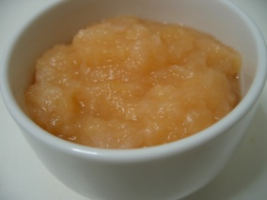



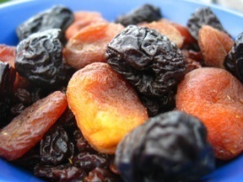

Each Food has:
60 Calories
15 grams carb
Carb counting- fruit
½ cup fruit juice
1 small fresh fruit
½ banana
½ cup unsweetened apple sauce
1 slice bread
17 small grapes
1 cup melon
¼ cup dried fruit
1 1/4 cup strawberries
2 tbsp raisins

Slide 126


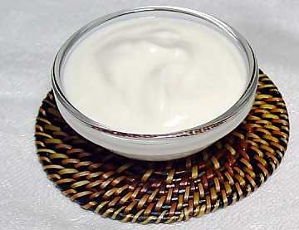
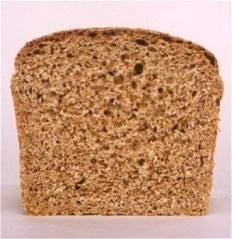


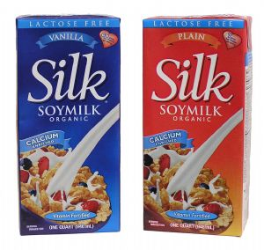
Each Food has:
90-150 calories
12-15 grams carb
Carb counting- milk
8 oz buttermilk
1 packet diet hot cocoa
1 slice bread
6 oz plain yogurt
8 oz milk
6 oz light fruit yogurt
8 oz soy milk

Slide 127
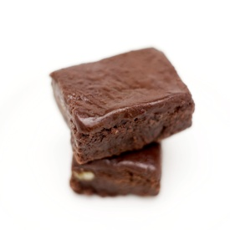
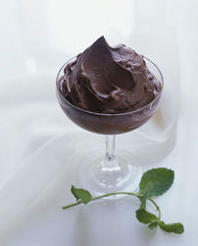
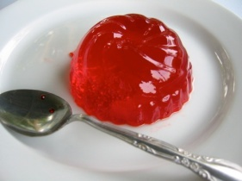

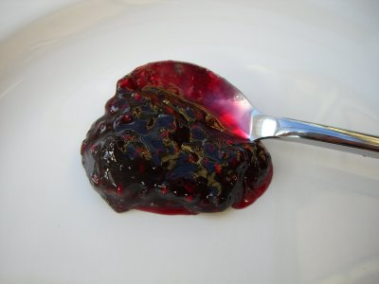
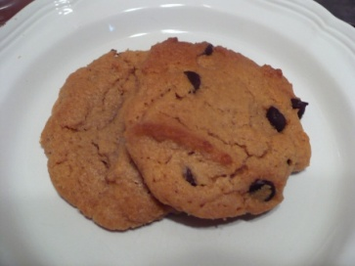



Each Food has:
Calories vary
15 grams carb
Carb counting - sweets
½ cup regular jello
2 tbsp light syrup
½ cup diet pudding
2 inch square cake or brownie, unfrosted
1 slice bread
1 tbsp syrup, jam, jelly, table sugar, honey
2 small cookies
½ cup ice cream or frozen yogurt
¼ cup sorbet
½ cup sherbet

Slide 128

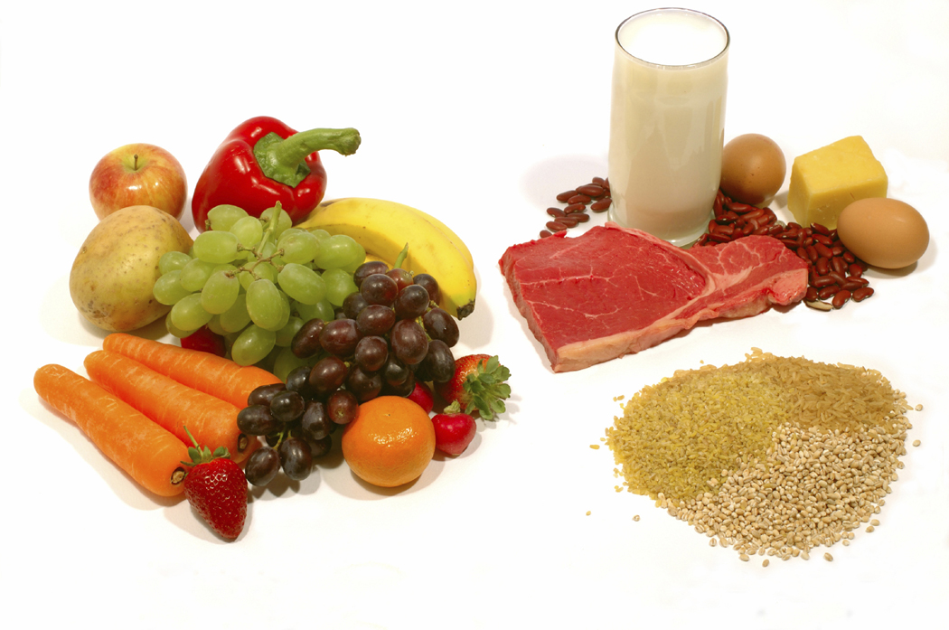
Go Lean with Protein
Choose lean protein
  Poultry, fish, egg, lean beef
  Plant sources- beans, lentils, nuts
  Low fat cheese- cottage cheese, mozzarella cheese
Limit high fat protein
  Bacon & sausage
  High fat cuts of beef
  Whole milk cheese
Serving size
  1 oz = ¼ cup
  3 oz = deck of cards

Slide 129
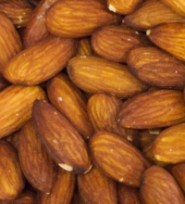
Fats- Aim for heart health
Saturated fats (LIMIT)
  Solid
  Animal
  Tropical (palm, coconut)
  Trans fats (deep fried)
Monounsaturated
  Olive & canola oils
  Nuts
  Avocado
Polyunsaturated
  veg oils: canola, corn, walnut, safflower, soybean
Serving sizes
1 tsp butter, margarine, oil, mayonnaise
1 Tbsp salad dressing, cream cheese, seeds
2 Tbsp avocado, cream, sour cream
1 slice bacon

Slide 130
Using Alcohol Safely
Women- 1 or fewer alcoholic drinks a day
Men 2 or fewer alcoholic drinks a day
  1 alcoholic drink equals
    12 oz beer, 5 oz glass of wine, or 1.5 oz distilled spirits (vodka, gin etc)
If drink, limit amount and drink w/ food.
Ask HCP if safe for you to drink. Tell them your usual quantity and frequency.
Can cause hypo and worsen neuropathy

Slide 131
Ms. Gonzales’
General Diet Pattern

Slide 132
Resources
www.eatright.org American Dietetic Association website for nutrition information, resources, and access to Registered Dietitians
www.diabetes.org American Diabetes Association website, advocates to prevent, cure and improve the lives of all people affected diabetes
www.americanheart.org American Heart Association website; resources, recipes and tips; learn about efforts to reduce death caused by cardiovascular disease
www.dce.org/publications/education-handouts/

Slide 133
Resources
www.nhlbi.nih.gov contains information for professionals and the general public about heart and vascular diseases, lung diseases, blood diseases.
www.niddk.nih.gov National Institute of Diabetes and Digestive and Kidney Diseases (NIDDK) information and resources clearinghouse.

Slide 134
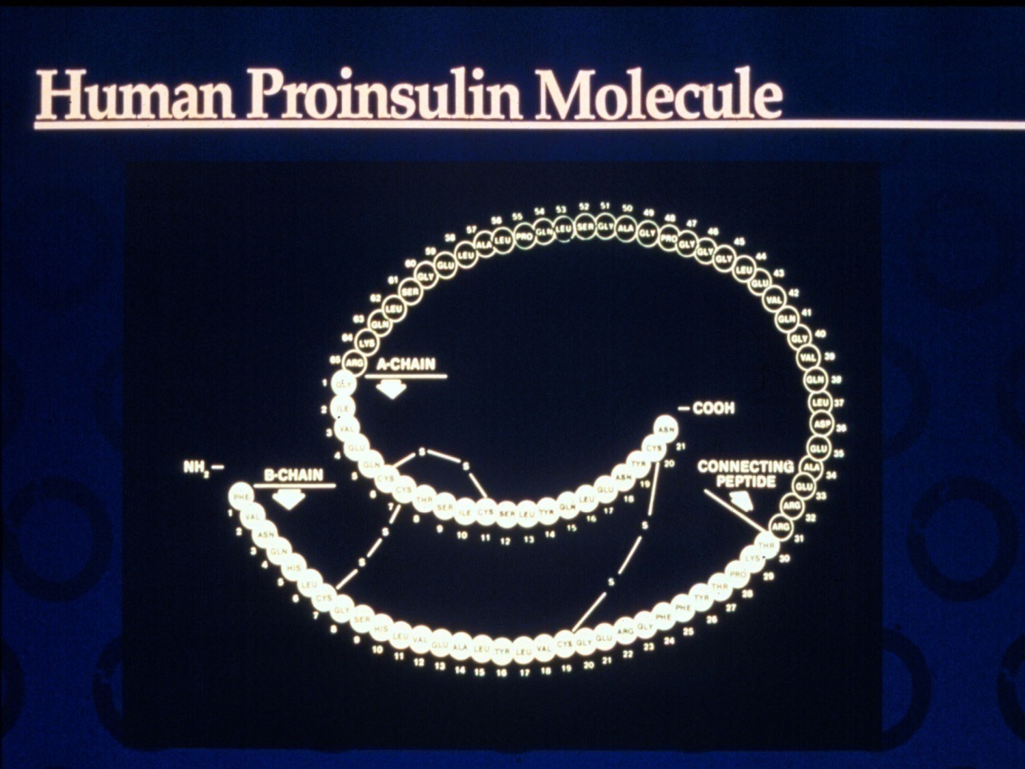
Insulin – the Ultimate Hormone Replacement Therapy
  Objectives:
  Discuss the actions of different insulins
  Describe using pattern management as an insulin adjustment tool.

Slide 135


Slide 136


Welcome to Diabetes in the 21st Century

Slide 138


Insulin Finally Available - 1922

Slide 139


The Miracle of Insulin
Patient J.L., December 15, 1922
February 15, 1923

Slide 140

Psychological Insulin Resistance (PIR)
50% of providers in study threatened pts “with the needle”.
Less than 50% of providers realized insulins’ positive effect on type 2 dm
Most pts don’t believe that insulin would “better help them manage their diabetes”.
Solutions: Find the root of PIR and address
Diabetes Attitudes, Wishes, Needs Study - Rubin

Slide 141
Needle Size often a Barrier
Size Does Matter
Use more short needles – 4 mm
Effective for pts with BMI of 24- 49
Keeps it subq
If pt thin, inject at angle
To avoid leakage, count to 10 before withdrawing needle
½ the patients who could benefit from insulin are not using it due to needle phobias

Slide 142
Physiologic Insulin Secretion: 24-Hour Profile
50
Insulin
(µU/mL)
Bolus Insulin
25
0
Basal Insulin
Breakfast Lunch Dinner
150
Glucose
(mg/dL)
100
Mealtime Glucose
50
Basal Glucose
0
7
8
9
10
11
12
1
2
3
4
5
6
7
8
9
A.M.
P.M.
Time of Day

Slide 143
Insulin Action Teams
Bolus: lowers after meal glucose levels
  Rapid Acting
    Aspart, Lispro, Glulisine
  Short Acting
    Regular
Basal: controls glucose between meals, hs
  Intermediate
    NPH
  Long Acting
    Detemir (Levemir)
    Glargine (Lantus)

Slide 144
Bolus Insulins
(½ of total daily dose ÷ meals)
Name Onset Peak Action
Lispro (Humalog) 15-30 min 1-1.5 hrs
Aspart (NovoLog)
Glulisine (Apidra)
Regular 30 mins 2-4 hrs

Slide 145
Bolus Insulin Summary
Regular, Novolog, Humalog, Apidra,
Starts working fast (15-30 mins)
Gets out fast (3-6 hours)
Post meal BG reflects effectiveness
Should comprise about ½ total daily dose
Covers food or hyperglycemia.
1 unit
  Covers ≈ 10 -15 gms of carb
  Lowers BG ≈ 30 – 50 points

Slide 146
Bolus Insulin Timing
How is the effectiveness of bolus insulin determined?
  2 hour post meal (if you can get it)
  Before next meal blood glucose
Glucose goals (ADA) – may be modified by provider/pt
  1-2 hours post meal <180
  Before next meal – 70 - 130

Slide 147


Slide 148



Inhaled insulin – past to future

Slide 149
Bolus – Reg Insulin Sliding Scale
Starts at 150, 2 units for every 50 mg/dl >150

Slide 150
Basal Insulins
(½ of total daily dose)
Intermediate Acting Peak Action Duration
NPH 4-12 hrs 12-24
Long Acting Peak Action Duration
Detemir (Levemir) peakless 20 hrs
Glargine (Lantus) No peak 24 hrs
Fasting BG reflects efficacy of basal

Slide 151
Basal Insulin Summary
NPH, Levemir, Lantus
Covers in between meals, through night
Starts working slow (4 hours)
Stays in long (12-24 hours)
  NPH/ Lente 12 hrs
  Levemir, Lantus 20-24 hrs
Fasting blood glucose reflects effectiveness

Slide 152
Basal Only
Type 2, 60kg

Slide 153

Diabetes Care 32:193-203, 2009

Slide 154
Combination SQ Insulin

Slide 155
10u 70/30 BID
Patterns? Changes needed?

Slide 156
Pattern Management

Slide 157
Pattern Management
Safety 1st!! - Evaluate 3 day patterns
Hypo eval 1st and fix:
  If possible, decrease medication dose
  Timing of meals, exercise, medications
Hyperglycemia: evaluate 2nd
  Identify patterns:
  fix fasting first, r/o Somogyi (check 3am BG)
QA: check meter, insulin, meds

Slide 158
Pattern Management
Insulin adjustment general guidelines:
  1 unit increments if dose < 10 units
  2 unit increments if dose double digit
  In general, adjust dose 10-20%
Evaluate trends
Provide frequent follow-up & feedback

Slide 159
Type 2 – New diagnosis – No meds Patterns? Questions

Slide 160
Type 2 – Glucotrol 20mg AM,
10u NPH pm

Slide 161
Basal Bolus – What Adjustments? Pt weighs 80kg

Slide 162
Intensive Diabetes Therapy
Insulin Dosing Strategy
50/50 Rule
0.5-1.0 units/kg day
Basal = 50% of total
Bolus = 50% of total
  Divided into 3 meals
Example
Wt 50kg x 0.5 = 25 units of insulin/day
Basal dose: 13 units
Bolus dose: 12 units
  4 units at each meal

Slide 163
Intensive Diabetes Therapy
Insulin Dosing Strategy
50/50 Rule
0.5-1.0 units/kg day
Basal = 50% of total
Bolus = 50% of total divided into 3 meals
Example – You Try
Wt 60 kg x 0.5 = ___ units of insulin/day
Basal dose: ____ units
Bolus dose: ____ units
  at each meal

Slide 164
Basal Bolus – Using 50/50 Rule –
Pt weighs 80kg A = Aspart

Slide 165

Type 1 and a Teen
Cindy is trying to carb count and adjust her insulin, but is still having trouble. She weighs 60kg.
What is her daily dose of insulin?
What is her basal dose?
1. Pre meal target BG is 120
2. Post meal goal < 180.
3. Carb ratio: 1 unit for every 15 gms
4. Hyperglycemic correction factor is one unit for every 50 above goal

Slide 166

Grams of Carb per meal?
Morning - BG 173
  Breakfast – slice cold pizza, ½ c. juice
Lunch BG 69
  Menu- ham sandwich, pear, diet 7-up, mini snickers bar.
2 hrs after lunch, BG 148 - ran track
Before dinner - BG 98
  Cheeseburger, small fries, chocolate chip cookie
At bedtime, BG 173

Slide 167
Carbs? How much Insulin?
Morning - BG 173
  Breakfast – slice cold pizza, ½ c. applesauce
  45 gms
Lunch BG 69
  Menu- ham sandwich, pear, diet 7-up, mini snickers
  60 gms
2 hours after lunch, BG 148 – ran track
Before dinner - BG 98
  Cheeseburger, small fries, chocolate chip cookie
  75 gms
At bedtime, BG 173 – 15 unit Lantus

Slide 168
Correction Bolus – Add to mealtime insulin
Rapid/Fast Acting Insulin (1 unit:50 mg/dl>120)
70-120 mg/dl | 0 units
121-170 mg/dl | 1 unit
171-220 mg/dl | 2 units
221-270 mg/dl | 3 units
271-320 mg/dl | 4 units
321-400 mg/dl | 5 units

Slide 169
Insulin Teaching Keys
Bolus insulin with meals
Basal 1-2xs daily
Can’t mix Glargine or Detemir with other insulins
Abdomen preferred injection site
Stay 1” away from previous site
Don’t re-use ultra fine syringes
Keep unopened insulin in refrigerator
Toss opened insulin vial after 28 days
Proper disposal
Review patients ability to withdraw and inject.
Side effects include hypoglycemia/wt gain

Slide 170
Medical Waste Management Act Effective Sept 1, 2008
CA Senate Bill 1305
New law requires proper disposal of home generated syringes, needles, lancets
Disposal in solid waste containers no longer permitted
EPA in 2004 also discourages sharps disposal in trash.

Slide 171

Sharps Disposal: Product and Info
Look in the Government section white pages for a household hazardous waste listing for your city or county.
Call 1-800-CLEANUP (1-800-253-2687)
Search for collection centers on the California Integrated Waste Management Board (CIWMB) Web site: http://www.ciwmb.ca.gov/HHW/HealthCare/Collection/

Slide 172
Diabetes Bingo
“DiaBingo”
Shout out Right Answer

Slide 173
DiaBingo - I
I Injected hormone that is an analog of amylin
I Glargine, Detemir, NPH are types of
I Breakdown of glycogen into glucose
I Anabolic hormone
I Insulin is released when glucose levels are low
I Once opened, insulin vials are good for one _____
I Elevated post-prandial glucose indicate need for pre-meaI
I Epinephrine increases insulin resistance
I Creation of glucose from amino acids and lactate
I Decreasing renal function for people on insulin can cause
I Bolus insulins
I A hormone that increases blood glucose levels

Slide 174

Diabetes Meds for Type 2:
Objectives
1. Describe the main action of the 5 different categories of type 2 diabetes medications.
2. Discuss strategies to determine the right medication for the right patient.
3. List the side effects and clinical considerations of each category of medication.
Notes:
174
174

Slide 175
Action/Classes of Type 2 Meds
1. Suppressor
2. Squirter
3. Satiators
4. Sensitizer
5. Glucoretics
6.Circadian Switchers
7. Slower
  Biguanide – Metformin
  Sulfonylureas
  Meglitinides
  AmylinoMimetics
  Incretin Mimetics
  DPP-4 Inhibitors
  Thiazolidinediones (TZD)
  SGLT2 Inhibitors
  Dopamine Receptor Agonists
  Alpha-glucosidase inhibitors
Notes:
175
175
There are five major classes of oral diabetes medications: thiazolidinediones, biguanides, sulfonylureas, meglitinides, and alpha-glucosidase inhibitors. These five classes of medication operate in essentially three different ways.
Thiazolidinediones and biguanides decrease glucose production in the liver and increase insulin sensitivity in peripheral body tissues.
Sulfonylureas and meglitinides stimulate the pancreatic beta cells to make more insulin.
Finally, alpha-glucosidase inhibitors slow the absorption of starches in the gut, reducing the amount of glucose that enters the bloodstream.

Slide 176

Diabetes Care 2012;35:1364–1379
Diabetologia 2012;55:1577–1596
(Adapted with permission from: Ismail-Beigi et al. Ann Intern Med 2011;154:554)
Figure 1
Notes:
Depiction of the elements of decision-making used to determine appropriate efforts to achieve glycaemic targets. Greater concerns about a particular domain are represented by increasing height of the ramp. Thus, characteristics/predicaments towards the left justify more stringent efforts to lower HbA1c, whereas those towards the right are compatible with less stringent efforts. Where possible, such decisions should be made in conjunction with the patient, reflecting his or her preferences, needs and values. This ‘scale’ is not designed to be applied rigidly but to be used as a broad construct to help guide clinical decisions. Adapted with permission from Ismail-Beigi et al [ref 20]

Slide 177
Diabetes Agents Considerations
Diabetes medications can be used as monotherapy, in combo or with insulin
Combining agents from different classes has additive effect
Most reduce A1c 0.5 – 2.0%
Not to be used during preconception, pregnancy or when breastfeeding
© Copyright 1999-2013, Diabetes Educational Services, All Rights Reserved.
Notes:
177
177

Slide 178
Ideal Diabetes Medication -
No hypoglycemia
No weight gain
Affordable
Lowers CV risk
Most people can tolerate /use

Slide 179
Biguanides – Suppressor
Metformin (Glucophage®)
Action: suppresses release of glycogen from the liver
Who?
  Fasting hyperglycemia
  Dysmetabolic Syndrome
  For pediatrics starting age 10
    (XR age 17)
Glycogen Stopper
© Copyright 1999-2013, Diabetes Educational Services, All Rights Reserved.
Notes:
179
179

Slide 180
Biguanides - Metformin
Action: decrease hepatic glucose (glycogen)
Names:
  Metformin (Glucophage)
    Starting dose: 500 BID, max 2500mg daily
  Metformin extended release (3 different versions)
    Starting dose 500mg at dinner, max dose 2000 to 2500 mg daily
  Efficacy:
    Decrease fasting plasma glucose 60-70 mg/dl
    Reduce A1C 1.0-2.0%
© Copyright 1999-2013, Diabetes Educational Services, All Rights Reserved.
Notes:
180
180
The mechanism of action of metformin is not entirely understood, but it's predominant effect is to suppress hepatic glucose production and to enhance insulin sensitivity in peripheral tissues (primarily muscle). It is unclear if insulin sensitivity occurs by metformin binding to cell receptors,which leads to an increase in glucose transporter expression, or whether insulin sensitivity is simply a secondary effect of the suppressed glucose production.
Metformin's ability to lower A1C and decrease fasting plasma glucose is similar to that of sulfonylurea drugs. However, the UKPDS showed that those who received metformin had less hypoglycemia and weight gain than those who received sulfonylureas.
Metformin must be avoided in patients with renal impairments, as those patients are at higher risk of experiencing lactic acidosis. However, metformin is an effective monotherapy and may be an ideal drug for overweight patients since it does not cause weight gain and has been seen to cause modest amounts of weight loss when first administered. Diarrhea and abdominal discomfort can be alleviated by changes in diet and slow increases in metformin dosage.

Slide 181
Biguanides - Metformin
Side effects
  Diarrhea and abdominal discomfort
  Lactic acidosis if improperly prescribed
  Consider B12 deficiency for long term users
  Decrease LDL cholesterol and triglycerides
  No weight gain, with possible modest weight loss
Hold prior to IV contrast dye studies and use caution during acute illness. Resume when kidney function adequate
© Copyright 1999-2013, Diabetes Educational Services, All Rights Reserved.
Notes:
181
181
The mechanism of action of metformin is not entirely understood, but it's predominant effect is to suppress hepatic glucose production and to enhance insulin sensitivity in peripheral tissues (primarily muscle). It is unclear if insulin sensitivity occurs by metformin binding to cell receptors,which leads to an increase in glucose transporter expression, or whether insulin sensitivity is simply a secondary effect of the suppressed glucose production.
Metformin's ability to lower A1C and decrease fasting plasma glucose is similar to that of sulfonylurea drugs. However, the UKPDS showed that those who received metformin had less hypoglycemia and weight gain than those who received sulfonylureas.
Metformin must be avoided in patients with renal impairments, as those patients are at higher risk of experiencing lactic acidosis. However, metformin is an effective monotherapy and may be an ideal drug for overweight patients since it does not cause weight gain and has been seen to cause modest amounts of weight loss when first administered. Diarrhea and abdominal discomfort can be alleviated by changes in diet and slow increases in metformin dosage.

Slide 182
Considerations
Biguanide - Metformin (Glucophage®)
Contraindications due to lactic acidosis:
  creatinine >1.4 females, >1.5 males
  liver disease
  alcohol abuse
  over 80 years old
  risk of acidosis
  during IV dye study
  CHF requiring meds
© Copyright 1999-2013, Diabetes Educational Services, All Rights Reserved.
Notes:
182
182

Slide 183

Sulfonylureas –
Action: tells pancreas to squirt insulin all day
Who?
  Lean type 2
© Copyright 1999-2009, Diabetes Educational Services
Notes:
183
183

Slide 184
Sulfonylureas - Squirts
Action: Increase endogenous insulin secretion
Efficacy:
  Decrease FPG 60-70 mg/dl
  Reduce A1C by 1.0-2.0%
Primary failures: about 20% no response
  R/O glucose toxicity or low beta cell function
Secondary failures: 5-10% shortly after initial response, many more later
  Usually after 5 or more years of therapy due to natural history of DM 2
© Copyright 1999-2013, Diabetes Educational Services, All Rights Reserved.
Notes:
184
184
Sulfonylureas (SUs) increase insulin secretion by binding to receptors on the surface of pancreatic beta cells, triggering a series of reactions which leads to insulin secretion.
Because SUs cause circulating insulin levels to increase, there is a risk of hypoglycemia. There is also some concern that increased insulin levels are associated with cardiovascular disease, however the UKPDS did not show a relationship between increased mortality and SU administration. Finally, there is concern that SUs will exhaust beta cell function by increasing insulin secretion. However, the decline in beta cell function is more likely caused by the disease itself, and not the use of SUs.
First generation sulfonylureas are just as efficacious as the second generation drugs, however the second generation may be more potent and safer than first. When diet and exercise fail, SUs are an effective monotherapy.

Slide 185
Sulfonylureas:
2nd Generation
Generic Trade Duration
  Glyburide Diabeta, Micronase, 12-24 hrs
        Glynase Prestabs
  Glipizide* Glucotrol, Glucotrol Xl 12-24 hrs
  Glimepiride Amaryl 16-24 hrs
  *take short acting product on empty stomach
© Copyright 1999-2013, Diabetes Educational Services, All Rights Reserved.
Notes:
185
185

Slide 186
Sulfonylureas
Other Effects
  Hypoglycemia
  Weight gain
  Cleared by kidney, use caution for pts with kidney problems
  Generally the least expensive class of medication
© Copyright 1999-2013, Diabetes Educational Services, All Rights Reserved.
Notes:
186
186
Sulfonylureas (SUs) increase insulin secretion by binding to receptors on the surface of pancreatic beta cells, triggering a series of reactions which leads to insulin secretion.
Because SUs cause circulating insulin levels to increase, there is a risk of hypoglycemia. There is also some concern that increased insulin levels are associated with cardiovascular disease, however the UKPDS did not show a relationship between increased mortality and SU administration. Finally, there is concern that SUs will exhaust beta cell function by increasing insulin secretion. However, the decline in beta cell function is more likely caused by the disease itself, and not the use of SUs.
First generation sulfonylureas are just as efficacious as the second generation drugs, however the second generation may be more potent and safer than first. When diet and exercise fail, SUs are an effective monotherapy.

Slide 187
Hypoglycemia – “Limiting Factor”
Defined as glucose of 70mg/dl or below
50% of episodes occur during the night
Higher mortality rate with severe hypoglycemia secondary to sulfonylureas
  Especially (chlorpropamide) Diabenese® and (glyburide) Micronase®, Diabeta®
Blood glucose levels don’t describe severity, response is individual

Slide 188

Hypoglycemia Symptoms
Neuroglycopenia
  Irritability
  Drowsiness
  Dizziness
  Blurred Vision
  Difficulty with speech
  Confusion
  Feeling faint
Autonomic
  Anxiety
  Palpitations
  Sweating
  Tingling
  Trembling
  Hypoglycemic Unawareness

Slide 189
Treatment of Hypoglycemia
If blood glucose 70mg/dl or below:
  10-15 gms of carb to raise BG 30 - 45mg/dl
Retest in 15 minutes, if still low, treat again, even without symptoms
Follow with usual meal or snack
If BG less than 40, allow recovery time

Slide 190
15 - 20 Gms Carb Sources
3 - 4 Glucose Tablets
8 - 10 Lifesavers candy
8 - 10 Hard candies
2 Tablespoons Raisins
4 - 6 oz’s Nondiet soda
4 - 6 oz’s Fruit Juice
8 oz Milk (non fat)

Slide 191




Slide 192
Indications for Insulin Sensitizers Rosiglitazone (Avandia®), Pioglitazone (Actos®)
Action: Sensitizers
Who?
  Insulin resistant patient
  Dysmetabolic syndrome
© Copyright 1999-2013, Diabetes Educational Services, All Rights Reserved.
Notes:
192
192

Slide 193
Thiazolidinediones – TZD’s
Action: decrease insulin resistance by making muscle and adipose cells more sensitive to insulin. Decrease free fatty acids
Names:
  pioglitazone (Actos)
    Dosing: 15-45 mg daily
  rosiglitazone (Avandia) – restriction removed
    Dosing: 4-8 mg daily
Efficacy:
  Decrease fasting plasma glucose ~35-40 mg/dl
  Reduce A1C ~0.5-1.0%
  6 weeks for maximum effect
  $30 a month
© Copyright 1999-2013, Diabetes Educational Services, All Rights Reserved.
Notes:
193
193
Thiazolidinediones (TZDs) enhance insulin sensitivity in muscle and adipose tissue by binding to cell receptors,which leads to an increase in glucose transporter expression. TZDs encourage beta cells to respond more efficiently by lowering the amount of glucose and free fatty acids in the bloodstream, both of which are known to be detrimental to insulin secretion. Finally, these drugs reduce glucose production in the liver.
Clinical trials indicate that pioglitazone and rosiglitazone are slightly more effective at reducing A1C (1.5-1.6% reduction) than troglitazone (1.1% reduction).
Some of the beneficial side effects of thiazolidinediones include an increase in HDL cholesterol and reduction of triglyceride concentrations. This class of drugs has also been shown to lower blood pressure and decrease vascular inflammation in vitro. There are clinical studies underway to further examine the cardiovascular benefit to TZDs.
Some adverse effects of TZDs include weight gain, a potential increase in LDL cholesterol levels, and a possible increase in alanine aminotransferase levels (ALT). Because of the risk of weight gain, edema, and increased LDL cholesterol, thiazolidinediones are contraindicated in patients with advanced forms of congestive heart failure. Due to reported cases of liver failure and liver toxicity caused by the increase in ALT levels, TZDs are contraindicated in patients with abnormal liver function.
TZDs are the most expensive of the oral antidiabetic agents.

Slide 194
rosiglitazone (Avandia)
  Avandia FDA Restriction lifted.
    New studies show not associated w/ increased risk of Myocardial Infarction
Notes:
194
194
Thiazolidinediones (TZDs) enhance insulin sensitivity in muscle and adipose tissue by binding to cell receptors,which leads to an increase in glucose transporter expression. TZDs encourage beta cells to respond more efficiently by lowering the amount of glucose and free fatty acids in the bloodstream, both of which are known to be detrimental to insulin secretion. Finally, these drugs reduce glucose production in the liver.
Clinical trials indicate that pioglitazone and rosiglitazone are slightly more effective at reducing A1C (1.5-1.6% reduction) than troglitazone (1.1% reduction).
Some of the beneficial side effects of thiazolidinediones include an increase in HDL cholesterol and reduction of triglyceride concentrations. This class of drugs has also been shown to lower blood pressure and decrease vascular inflammation in vitro. There are clinical studies underway to further examine the cardiovascular benefit to TZDs.
Some adverse effects of TZDs include weight gain, a potential increase in LDL cholesterol levels, and a possible increase in alanine aminotransferase levels (ALT). Because of the risk of weight gain, edema, and increased LDL cholesterol, thiazolidinediones are contraindicated in patients with advanced forms of congestive heart failure. Due to reported cases of liver failure and liver toxicity caused by the increase in ALT levels, TZDs are contraindicated in patients with abnormal liver function.
TZDs are the most expensive of the oral antidiabetic agents.

Slide 195

Pioglitazone (Actos) Warning
Bladder Cancer Risk
  Risk increased with increasing dose and duration
  France has pulled Actos, Germany restricted access
  Patient Instructions
    Report symptoms of bladder cancer: blood or red color in urine; urgent need to urinate or pain while urinating; pain in back or lower abdomen.
© Copyright 1999-2013, Diabetes Educational Services, All Rights Reserved.
Notes:
195
195
Thiazolidinediones (TZDs) enhance insulin sensitivity in muscle and adipose tissue by binding to cell receptors,which leads to an increase in glucose transporter expression. TZDs encourage beta cells to respond more efficiently by lowering the amount of glucose and free fatty acids in the bloodstream, both of which are known to be detrimental to insulin secretion. Finally, these drugs reduce glucose production in the liver.
Clinical trials indicate that pioglitazone and rosiglitazone are slightly more effective at reducing A1C (1.5-1.6% reduction) than troglitazone (1.1% reduction).
Some of the beneficial side effects of thiazolidinediones include an increase in HDL cholesterol and reduction of triglyceride concentrations. This class of drugs has also been shown to lower blood pressure and decrease vascular inflammation in vitro. There are clinical studies underway to further examine the cardiovascular benefit to TZDs.
Some adverse effects of TZDs include weight gain, a potential increase in LDL cholesterol levels, and a possible increase in alanine aminotransferase levels (ALT). Because of the risk of weight gain, edema, and increased LDL cholesterol, thiazolidinediones are contraindicated in patients with advanced forms of congestive heart failure. Due to reported cases of liver failure and liver toxicity caused by the increase in ALT levels, TZDs are contraindicated in patients with abnormal liver function.
TZDs are the most expensive of the oral antidiabetic agents.

Slide 196

Incretin Mimetics – GLP-1s
“Gut Hormone Imitators”
DPP-IV Inhibitors
How do they work?
© Copyright 1999-2013, Diabetes Educational Services, All Rights Reserved.
Notes:
196
196

Slide 197
GLP-1 Effects in Humans
Understanding the Natural Role of Incretins
GLP-1 secreted upon the ingestion of food
Promotes satiety and
reduces appetite
Alpha cells:
↓ Postprandial
glucagon secretion
↑ Beta-cell
response
Liver:
↓ Glucagon reduces hepatic glucose output
Beta cells:
Enhances glucose-dependent insulin secretion
Stomach:
Helps regulate gastric emptying
GLP-1 degraded by
DPP-4 w/in minutes
Adapted from Flint A, et al. J Clin Invest. 1998;101:515-520
Adapted from Larsson H, et al. Acta Physiol Scand. 1997;160:413-422
Adapted from Nauck MA, et al. Diabetologia. 1996;39:1546-1553
Adapted from Drucker DJ. Diabetes. 1998;47:159-169
Notes:
197
197
Required
DISCUSSION POINTS:
--Upon food ingestion, GLP-1 is secreted into the circulation from L cells of small intestine.
--GLP-1 increases beta-cell response by enhancing glucose-dependent insulin secretion.
--GLP-1 decreases beta-cell workload and hence the demand for insulin secretion by:
--Regulating the rate of gastric emptying such that meal nutrients are delivered to the small intestine and, in turn, absorbed into the circulation more smoothly, reducing peak nutrient absorption and insulin demand (beta-cell workload)
--Decreasing postprandial glucagon secretion from pancreatic alpha cells, which helps to maintain the counterregulatory balance between insulin and glucagon
--Reducing postprandial glucagon secretion, GLP-1 has an indirect benefit on beta-cell workload, since decreased glucagon secretion will produce decreased postprandial hepatic glucose output
--Having effects on the central nervous system, resulting in increased satiety (sensation of satisfaction with food intake) and a reduction of food intake
--By decreasing beta-cell workload and improving beta-cell response, GLP-1 is an important regulator of glucose homeostasis.
SLIDE BACKGROUND:
--Effect on Beta-cell: Drucker DJ. Diabetes. 1998; 47:159-169
--Effect on Alpha cell: Larsson H, et al. Acta Physiol Scand. 1997; 160:413-422
--Effects on Liver: Larsson H, et al. Acta Physiol Scand. 1997; 160:413-422
--Effects on Stomach: Nauck MA, et al. Diabetologia. 1996; 39:1546-1553
--Effects on CNS: Flint A, et al. J Clin Invest. 1998; 101:515-520

Slide 198
For all the Following GLP-1 Inhibitors
Pancreatitis Warning
  Please tell all patients to report signs right away and discontinue meds
  Signs include:
  Sudden abdominal pain, nausea and vomiting
  Also investigating if use associated w/ increased risk of pancreatic cancer

Slide 199


Incretin Mimetics
Exenatide (Byetta) XR (Bydureon)
Action:
  Insulin release in response to meal
  Slows gastric emptying
  Causes Satiety
Exenatide Dosing: - 5-10 mcg ac break, dinner
    Extended Release 2013 – Bydureon – 1x week
Efficacy: Decreases A1c by 0.7%, wt by 3lbs
Indication: For type 2s only - mono or in combo
Other: In prefilled pens in 5 or 10 mcg doses
© Copyright 1999-2013, Diabetes Educational Services, All Rights Reserved.
Notes:
199
199

Slide 200
Incretin Mimetics – GLP-1 Analog
Liraglutide (Victoza)
Liraglutide Dosing: 1x daily, time not critical
0.6 x 1 week – if tolerated (nausea), go to >
1.2 x 1 week – if tolerated go to >
1.8 mg daily
Efficacy: lowers; A1c by 1%, body wt by ~ 2.5kg
Indication: Monotherapy or in combo . Type 2 only
Other: In pen, with preset dosing
Black box–thyroid tumor warning (avoid if family hx, notify MD of hoarseness, lump).
© Copyright 1999-2013, Diabetes Educational Services, All Rights Reserved.
Notes:
200
200

Slide 201
Incretin Mimetics Considerations Exenatide, Liraglutide, DPP - IVs
Store pens in refrig, toss after 30 days
Sub-Q Injection in abd, thigh, upper arm
To prevent hypoglycemia , reduce sulfonylurea/insulin dose when starting
Side effects include nausea, diarrhea
Pancreatitis warning (instruct pt to report abd pain, vomiting)
Don’t use w/ gastroparesis, severe renal disease
Exenatide Cost : $150-175 for month supply of pen devices
© Copyright 1999-2013, Diabetes Educational Services, All Rights Reserved.
Notes:
201
201

Slide 202
DPP-4 Inhibitors – “Incretin Enhancers” Januvia (sitagliptin)
Tradjenta (linagliptin)
Onglyza (saxagliptin)
Nesina (Alogliptin)
Action:
  Increase insulin release w/ meals
  Suppress glucagon
  Promote satiety (slows gastric emptying)
Dosing: See pocketcard
Efficacy: Decreases A1c by 0.6 -0.8%
Indication: For type 2s
© Copyright 1999-2013, Diabetes Educational Services, All Rights Reserved.
Notes:
202
202

Slide 203
DPP-4 Inhibitors- “Incretin Enhancers”
Januvia, Onglyza eliminated via kidney, lower dose needed
Do not cause wt gain or hypoglycemia
Side effects –headache, runny nose, sore throat- watch for pancreatitis
Cost $100 - $150 mo
© Copyright 1999-2013, Diabetes Educational Services, All Rights Reserved.
Notes:
203
203

Slide 204

SGLT2 Inhibitors
Cangliflozin (Invokana)
Dapagliflozin (Farxiga)
“Glucoretic” - Inhibit the reabsorption of glucose in the proximal kidney tubules
Monitor B/P, K+ & renal function.
If GFR < 60, see instructions
Side effects: hypotension, UTI, increased urination, genital yeast infections.
Lowers A1c 0.7%–1.0%, wt loss of 1-3 lbs.
Increased Glucose
Reabsorption

Slide 205
Mr. Jones - Which Diabetes Medication would you start?
Mr. Jones is 62 with newly diagnosed type 2 diabetes. He is overweight with a slow healing foot sore. His blood glucose levels are ranging from 160 – 250. His creatinine is 1.1. Lipid results are pending. He has medical insurance and lives alone. He walks his dog 3 times a week.

Slide 206
List the Treatment Options
42 yr old, obese, Type 2, newly diagnosed. FBG 178, LDL 154, normal creatinine.
2. 72 yr old, thin, lives alone, newly diagnosed. FBG 141, Creat 1.3, Triglycerides 132, LDL 97.
3. 59 yr old, overweight on glyburide 10mg QD, average FBG 170’s, pm glucose 210’s. Creat 1.0, HDL 38, LDL 127.
4. 58 year old overweight on Metformin 1000mg BID before breakfast and dinner. AM glucose 120s, A1c 8.1%. Creat 1.4, LDL 106
5. Overweight 64 yr old on glucotrol 10mg daily, 500mg metformin, 15 mg Actos®. FBG 150’s, post prandial BG 190’s. Creat 1.2, LDL 138.

Slide 207
Diabetes Bingo
“DiaBingo”
Shout out Right Answer

Slide 208
DiaBingo - N
N Injected hormone called an incretin mimetic
N DPP demonstrated that exercise and diet reduced risk of DM by ___%
N An _______a day can help prevent heart attack and stroke
N Rebound hyperglycemia
N Scare tactics are effective at motivating patients to change behavior
N Losing ___ % of body weight, can improve blood glucose, BP, lipids
N Drugs that can cause hyperglycemia
N 2/3 cups of rice equals ______ serving carbohydrate
N A1c of 7% equals glucose of
N One % drop in A1c reduces risk of complications by ___ %
N 1 gm of fat equal _____kilo/calories
N Metabolic syndrome = hyperglycemia, hyperlipidemia, hypertension
N 1% A1c = _______ of Blood Glucose

Slide 209
High Numbers Got You Down?
By getting glucose less than 150 you will:
  have more energy
  spend fewer days in bed
  feel less depressed
  urinate less often
  improve your vision
  think more clearly
  miss work less often
  Testa, Simonson JAMA 280: 1998

Slide 210
Plant Seeds of Hope

Slide 211
Thank You!

Slide 212

Thank You
For Resources, CE and more.. Visit
DiabetesEd.net
© Copyright 1999-2013, Diabetes Educational Services, All Rights Reserved.

Slide 213
Flash Mob – World Diabetes Day to Beat It
  March R/C/R
  Fred Astaire
  Point R/L
  Arms up, down
  Shoulder Walk
  Punch down/up
  Scoot Rt/Left
  Reach up R/L
  Shoulder Walk
Open door
Ride Horse
Scoot Rt/Left
Turn R & Clap, then L
Shoulder Walk
Punch down/up

Slide 214
Diabetes Bingo
“DiaBingo”
Shout out Right Answer

Slide 215
DiaBingo
B Frequent skin and yeast infections
B A BMI of ____ or greater is considered overweight
B To reduce complications, control A1c, Blood pressure, Cholesterol
B PreDiabetes – fasting glucose level of ___ to ____
B Erectile dysfunction indicates greater risk for ____
B Diabetes – fasting glucose level____ or greater
B Type 1 diabetes is best described as an ______ disease
B People with diabetes are ______ times more likely to die of heart dx
B Elevated triglycerides, < HDL, smaller dense LDL
B Each percentage point of A1c = _____ mg/dl glucose
B At dx of type 2, about __% of the beta cell function is lost
B Diabetes – random glucose ____ or greater

Slide 216
We Made It – 3129 miles- Now Walking Back
Track miles with fitbit
Fitbit.com
Lifespan Treadmill Desk - Amazon

Slide 217
How are we doing?
Reaching goal
Diabetes Care, 2/13

Slide 218
Vaccinations- Immunizations
Flu vaccine
  every year starting 6 months
Pneumococcal starting at 2 years.
  One time Revaccination for those over 64 and had first vaccine >5 years prior
Hepatitis B Vaccine (ADA Stds 2013, pg s28)
  For diabetes pts age 19 – 59 (not previously vaccinated)
  Double risk of Hep B due to lancing devices/ glucose meter exposure

Slide 219
Diabetes Bingo
“DiaBingo”
Shout out Right Answer

Slide 220
DiaBingo- G
G ADA goal for A1c is less than ____%
G People with DM need to see their provider at least every month
G Blood pressure goal is less than
G People with DM should see eye doctor (ophthalmologist) at least
G The goal for triglyceride level is less than
G Goal for my HDL cholesterol is more than
G The goal for blood sugars 1-2 hours after a meal is less than:
G People with DM should get this shot every year
G People with DM need to get urine tested yearly for ___________
G Periodontal disease indicates increased risk for heart disease
G The goal for blood sugar levels before meals is:
G The activity goal is to do ___ minutes on most days

Slide 221
Diabetes Meds for Type 2:
Objectives
1. Describe the main action of the 5 different categories of type 2 diabetes medications.
2. Discuss strategies to determine the right medication for the right patient.
3. List the side effects and clinical considerations of each category of medication.
Notes:
221
221

Slide 222

Resources for Medications
Partnership for Prescription Assistance
  www.pparx.org
NeedyMeds.org
www.rxassist.org
Notes:
222
222

Slide 223
Diabetes Agents Considerations
Diabetes medications can be used as monotherapy, in combo or with insulin
Combining agents from different classes has additive effect
Most reduce A1c 0.5 – 2.0%
Not to be used during preconception, pregnancy or when breastfeeding
Notes:
223
223

Slide 224
ADA-EASD Position Statement: Management of Hyperglycemia in T2DM
Patient-Centered Approach
“...providing care that is respectful of and responsive to individual patient preferences, needs, and values - ensuring that patient values guide all clinical decisions.”
Gauge patient’s preferred level of involvement.
Explore, where possible, therapeutic choices.
Utilize decision aids.
Shared decision making – final decisions re: lifestyle choices ultimately lie with the patient.
Diabetes Care 2012;35:1364–1379
Diabetologia 2012;55:1577–1596

Slide 225

Diabetes Care 2012;35:1364–1379
Diabetologia 2012;55:1577–1596
(Adapted with permission from: Ismail-Beigi et al. Ann Intern Med 2011;154:554)
Figure 1
Notes:
Depiction of the elements of decision-making used to determine appropriate efforts to achieve glycaemic targets. Greater concerns about a particular domain are represented by increasing height of the ramp. Thus, characteristics/predicaments towards the left justify more stringent efforts to lower HbA1c, whereas those towards the right are compatible with less stringent efforts. Where possible, such decisions should be made in conjunction with the patient, reflecting his or her preferences, needs and values. This ‘scale’ is not designed to be applied rigidly but to be used as a broad construct to help guide clinical decisions. Adapted with permission from Ismail-Beigi et al [ref 20]

Slide 226
Ideal Diabetes Med -
No hypoglycemia
No weight gain
Affordable
Lowers CV risk
Most people can tolerate /use?

Slide 227
Action/Classes of Type 2 Meds
1. Suppressor
2. Squirter
3. Satiators
4. Sensitizer
5. Glucoretics
6.Circadian Switchers
7. Slower
  Biguanide – Metformin
  Sulfonylureas
  Meglitinides
  AmylinoMimetics
  Incretin Mimetics
  DPP-4 Inhibitors
  Thiazolidinediones (TZD)
  SGLT2 Inhibitors
  Dopamine Receptor Agonists
  Alpha-glucosidase inhibitors
Notes:
227
227
There are five major classes of oral diabetes medications: thiazolidinediones, biguanides, sulfonylureas, meglitinides, and alpha-glucosidase inhibitors. These five classes of medication operate in essentially three different ways.
Thiazolidinediones and biguanides decrease glucose production in the liver and increase insulin sensitivity in peripheral body tissues.
Sulfonylureas and meglitinides stimulate the pancreatic beta cells to make more insulin.
Finally, alpha-glucosidase inhibitors slow the absorption of starches in the gut, reducing the amount of glucose that enters the bloodstream.

Slide 228
Biguanides – Suppressor
Metformin (Glucophage®)
Action: suppresses release of glycogen from the liver
Who?
  Fasting hyperglycemia
  Dysmetabolic Syndrome
  For pediatrics starting age 10
    (XR age 17)
Glycogen Stopper
© Copyright 1999-2013, Diabetes Educational Services, All Rights Reserved.
Notes:
228
228

Slide 229
Biguanides - Metformin
Action: decrease hepatic glucose (glycogen)
Names:
  Metformin (Glucophage)
    Starting dose: 500 BID, max 2500mg daily
  Metformin extended release (3 different versions)
    Starting dose 500mg at dinner, max dose 2000 to 2500 mg daily
  Efficacy:
    Decrease fasting plasma glucose 60-70 mg/dl
    Reduce A1C 1.0-2.0%
© Copyright 1999-2013, Diabetes Educational Services, All Rights Reserved.
Notes:
229
229
The mechanism of action of metformin is not entirely understood, but it's predominant effect is to suppress hepatic glucose production and to enhance insulin sensitivity in peripheral tissues (primarily muscle). It is unclear if insulin sensitivity occurs by metformin binding to cell receptors,which leads to an increase in glucose transporter expression, or whether insulin sensitivity is simply a secondary effect of the suppressed glucose production.
Metformin's ability to lower A1C and decrease fasting plasma glucose is similar to that of sulfonylurea drugs. However, the UKPDS showed that those who received metformin had less hypoglycemia and weight gain than those who received sulfonylureas.
Metformin must be avoided in patients with renal impairments, as those patients are at higher risk of experiencing lactic acidosis. However, metformin is an effective monotherapy and may be an ideal drug for overweight patients since it does not cause weight gain and has been seen to cause modest amounts of weight loss when first administered. Diarrhea and abdominal discomfort can be alleviated by changes in diet and slow increases in metformin dosage.

Slide 230
Biguanides - Metformin
Side effects
  Diarrhea and abdominal discomfort
  Lactic acidosis if improperly prescribed
  Decrease LDL cholesterol and triglycerides
  No weight gain, with possible modest weight loss
  Watch for B12 deficiency
Hold prior to IV contrast dye studies and use caution during acute illness. Resume when kidney function adequate
© Copyright 1999-2013, Diabetes Educational Services, All Rights Reserved.
Notes:
230
230
The mechanism of action of metformin is not entirely understood, but it's predominant effect is to suppress hepatic glucose production and to enhance insulin sensitivity in peripheral tissues (primarily muscle). It is unclear if insulin sensitivity occurs by metformin binding to cell receptors,which leads to an increase in glucose transporter expression, or whether insulin sensitivity is simply a secondary effect of the suppressed glucose production.
Metformin's ability to lower A1C and decrease fasting plasma glucose is similar to that of sulfonylurea drugs. However, the UKPDS showed that those who received metformin had less hypoglycemia and weight gain than those who received sulfonylureas.
Metformin must be avoided in patients with renal impairments, as those patients are at higher risk of experiencing lactic acidosis. However, metformin is an effective monotherapy and may be an ideal drug for overweight patients since it does not cause weight gain and has been seen to cause modest amounts of weight loss when first administered. Diarrhea and abdominal discomfort can be alleviated by changes in diet and slow increases in metformin dosage.

Slide 231

Considerations
Biguanide - Metformin (Glucophage®)
Contraindications due to lactic acidosis:
  creatinine >1.4 females, >1.5 males
  liver disease
  alcohol abuse
  over 80 years old
  risk of acidosis
  during IV dye study
  CHF requiring meds
© Copyright 1999-2013, Diabetes Educational Services, All Rights Reserved.
Notes:
231
231

Slide 232
Metformin – How does it rate?
Question Answer
Cause hypoglycemia?
Cause weight gain?
Affordable?
Lowers CV risk?
Can most tolerate /use?
(GI, creat)
No
No
Yes
Yes
Yes/No

Slide 233

What questions would you ask?
35 yr old, BMI 28, A1c 6.7%. LDL 154, enjoys “occasional” beer.

Slide 234

Sulfonylureas –
Action: tells pancreas to squirt insulin all day
Who?
  Lean type 2
© Copyright 1999-2013, Diabetes Educational Services
Notes:
234
234

Slide 235
Sulfonylureas - Squirts
Action: Increase endogenous insulin secretion
Efficacy:
  Decrease FPG 60-70 mg/dl
  Reduce A1C by 1.0-2.0%
Primary failures: about 20% no response
  R/O glucose toxicity or low beta cell function
Secondary failures: 5-10% shortly after initial response, many more later
  Usually after 5 or more years of therapy due to natural history of DM 2
Notes:
235
235
Sulfonylureas (SUs) increase insulin secretion by binding to receptors on the surface of pancreatic beta cells, triggering a series of reactions which leads to insulin secretion.
Because SUs cause circulating insulin levels to increase, there is a risk of hypoglycemia. There is also some concern that increased insulin levels are associated with cardiovascular disease, however the UKPDS did not show a relationship between increased mortality and SU administration. Finally, there is concern that SUs will exhaust beta cell function by increasing insulin secretion. However, the decline in beta cell function is more likely caused by the disease itself, and not the use of SUs.
First generation sulfonylureas are just as efficacious as the second generation drugs, however the second generation may be more potent and safer than first. When diet and exercise fail, SUs are an effective monotherapy.

Slide 236
Sulfonylureas:
2nd Generation
Generic Trade Duration
  Glyburide Diabeta, Micronase, 12-24 hrs
        Glynase Prestabs
  Glipizide* Glucotrol, Glucotrol Xl 12-24 hrs
  Glimepiride Amaryl 16-24 hrs
  *take short acting product on empty stomach
Notes:
236
236

Slide 237

Sulfonylureas
Other Effects
  Hypoglycemia
  Weight gain
  Cleared by kidney, use caution for pts with kidney problems
  Generally the least expensive class of medication
  Amaryl safest for those with CV Disease
Notes:
237
237
Sulfonylureas (SUs) increase insulin secretion by binding to receptors on the surface of pancreatic beta cells, triggering a series of reactions which leads to insulin secretion.
Because SUs cause circulating insulin levels to increase, there is a risk of hypoglycemia. There is also some concern that increased insulin levels are associated with cardiovascular disease, however the UKPDS did not show a relationship between increased mortality and SU administration. Finally, there is concern that SUs will exhaust beta cell function by increasing insulin secretion. However, the decline in beta cell function is more likely caused by the disease itself, and not the use of SUs.
First generation sulfonylureas are just as efficacious as the second generation drugs, however the second generation may be more potent and safer than first. When diet and exercise fail, SUs are an effective monotherapy.

Slide 238
Indication for “Fast Acting” Insulin Secretagogues- Meglitinides
Action: tells pancreas to squirt insulin with meals
Who?
  Targets post-prandial hyperglycemia
Med Names –
  Prandin
  Starlix
Notes:
238
238

Slide 239
Squirters – How does they rate?
Question Answer
Cause hypoglycemia?
Cause weight gain?
Affordable?
Lowers CV risk?
Can most tolerate /use?
Yes
Yes
Yes
No
Yes/No
© Copyright 1999-2013, Diabetes Educational Services, All Rights Reserved.

Slide 240
What Medications Cause Hypoglycemia?
Insulin
Sulfonylureas
Meglitinides
Or any combo medication that includes these

Slide 241
Hypoglycemia – “Limiting Factor”
Defined as glucose of 70mg/dl or below
50% of episodes occur during the night
Higher mortality rate with severe hypoglycemia secondary to sulfonylureas
  Especially (glyburide) Micronase®, Diabeta®
Blood glucose levels don’t describe severity, response is individual

Slide 242
Hypoglycemia Symptoms
Autonomic
  Anxiety
  Palpitations
  Sweating
  Tingling
  Trembling
  Hypoglycemic Unawareness
Neuroglycopenia
  Irritability
  Drowsiness
  Dizziness
  Blurred Vision
  Difficulty with speech
  Confusion
  Feeling faint

Slide 243
Treatment of Hypoglycemia
If blood glucose 70mg/dl or below:
  10-15 gms of carb to raise BG 30 - 45mg/dl
Retest in 15 minutes, if still low, treat again, even without symptoms
Follow with usual meal or snack
If BG less than 40, allow recovery time

Slide 244
15 - 20 Gms Carb Sources
3 - 4 Glucose Tablets
8 - 10 Lifesavers candy
8 - 10 Hard candies
2 Tablespoons Raisins
4 - 6 oz’s Nondiet soda
4 - 6 oz’s Fruit Juice
8 oz Milk (non fat)

Slide 245

What questions?
72 yr old, thin, lives alone, A1c 7.3%. History of MI, stroke. DM for 12 yrs, “diet controlled”. Limited income. Creat 1.4.

Slide 246

If on Metformin and Sulfonylurea – BG still high, other options?

Slide 247

Incretin Mimetics –
“Gut Hormone Imitators”
GLP-1 Agonists
How do they work?
Notes:
247
247

Slide 248
GLP-1 Effects in Humans
Understanding the Natural Role of Incretins
GLP-1 secreted upon the ingestion of food
Promotes satiety and
reduces appetite
Alpha cells:
↓ Postprandial
glucagon secretion
↑ Beta-cell
response
Liver:
↓ Glucagon reduces hepatic glucose output
Beta cells:
Enhances glucose-dependent insulin secretion
Stomach:
Helps regulate gastric emptying
GLP-1 degraded by
DPP-4 w/in minutes
Adapted from Flint A, et al. J Clin Invest. 1998;101:515-520
Adapted from Larsson H, et al. Acta Physiol Scand. 1997;160:413-422
Adapted from Nauck MA, et al. Diabetologia. 1996;39:1546-1553
Adapted from Drucker DJ. Diabetes. 1998;47:159-169
Notes:
248
248
Required
DISCUSSION POINTS:
--Upon food ingestion, GLP-1 is secreted into the circulation from L cells of small intestine.
--GLP-1 increases beta-cell response by enhancing glucose-dependent insulin secretion.
--GLP-1 decreases beta-cell workload and hence the demand for insulin secretion by:
--Regulating the rate of gastric emptying such that meal nutrients are delivered to the small intestine and, in turn, absorbed into the circulation more smoothly, reducing peak nutrient absorption and insulin demand (beta-cell workload)
--Decreasing postprandial glucagon secretion from pancreatic alpha cells, which helps to maintain the counterregulatory balance between insulin and glucagon
--Reducing postprandial glucagon secretion, GLP-1 has an indirect benefit on beta-cell workload, since decreased glucagon secretion will produce decreased postprandial hepatic glucose output
--Having effects on the central nervous system, resulting in increased satiety (sensation of satisfaction with food intake) and a reduction of food intake
--By decreasing beta-cell workload and improving beta-cell response, GLP-1 is an important regulator of glucose homeostasis.
SLIDE BACKGROUND:
--Effect on Beta-cell: Drucker DJ. Diabetes. 1998; 47:159-169
--Effect on Alpha cell: Larsson H, et al. Acta Physiol Scand. 1997; 160:413-422
--Effects on Liver: Larsson H, et al. Acta Physiol Scand. 1997; 160:413-422
--Effects on Stomach: Nauck MA, et al. Diabetologia. 1996; 39:1546-1553
--Effects on CNS: Flint A, et al. J Clin Invest. 1998; 101:515-520

Slide 249
Incretin Mimetics
Exenatide (Byetta), Exenatide XR
Action:
  Insulin release in response to meal
  Slows gastric emptying
  Causes Satiety
Exenatide Dosing: - 5-10 mcg ac break, dinner
    Long acting version in pipeline (LAR)
Efficacy: Decreases A1c by 0.7%, wt by 3lbs
Indication: For type 2s only - mono or in combo
Other: In prefilled pens in 5 or 10 mcg doses
Notes:
249
249

Slide 250
Incretin Mimetics –
Exenatide XR - Bydureon
Once a Week Dosing: 2mg
Efficacy: Decreases A1c by 1.6%, wt by ~6lbs
Indication: For type 2s only
Other: Pt will need to mix powdered form and inject
Caution: not indicated for those with history of medullary thyroid tumor - pancreatitis warning
Notes:
250
250

Slide 251

$323.44 for four doses, or about $4,200 a year.

Slide 252








Basic Overview of
Exenatide XR Set-Up

Slide 253
Incretin Mimetics
GLP-1 Analog
Liraglutide (Victoza)
Liraglutide Dosing: 1x daily, time not critical
0.6 x 1 week – if tolerated (nausea), go to >
1.2 x 1 week – if tolerated go to >
1.8 mg daily
Efficacy: lowers; A1c by 1%, body wt by ~ 2.5kg
Indication: Monotherapy or in combo . Type 2 only
Other: In pen, with preset dosing
Black box–thyroid tumor warning (avoid if family hx, notify MD of hoarseness, lump).
Notes:
253
253

Slide 254
Incretin Mimetics – How do they rate?
Question Answer
Cause hypoglycemia?
Cause weight gain?
Affordable?
Lowers CV risk?
Can most tolerate /use?
(GI)
No
No
No
No
Yes/No

Slide 255
DPP-4 Inhibitors –
“Incretin Enhancers”
Januvia (sitagliptin) – Tradjenta (linagliptin)
Onglyza (saxagliptin) Nesina (alogliptin)
Action:
  Increase insulin release w/ meals
  Suppress glucagon
Dosing: Januvia – 100mg a day
        Onglyza – up to 5mg a day
        Tradjenta – 5mg a day
        Nesina – up to 25 mg a day
Efficacy: Decreases A1c by 0.6 -0.8%
Indication: For type 2s
Notes:
255
255

Slide 256
DPP-4 Inhibitors – “Incretin Enhancers” Januvia (sitagliptin) – Tradjenta (linagliptin)
Onglyza (saxagliptin) - Nesina (alogliptin)
Januvia, Onglyza eliminated via kidney, lower dose needed
Do not cause wt gain or hypoglycemia
Side effects – headache, runny nose, sore throat - watch for pancreatitis
Cost $100 - $150 mo
Notes:
256
256

Slide 257
DPP-IV Inhibitors – How do they rate?
Question Answer
Cause hypoglycemia?
Cause weight gain?
Affordable?
Lowers CV risk?
Can most tolerate /use?
No
No
No
No
Yes
© Copyright 1999-2013, Diabetes Educational Services, All Rights Reserved.

Slide 258
For all the Previous GLP-1 Agonists
Pancreatitis Warning
  Please tell all patients to report signs right away and discontinue meds
  Signs include:
  Sudden abdominal pain, nausea and vomiting
May also be associated w/ increased risk of pancreatic cancer? Studies ongoing.

Slide 259

What questions?
69 year old male, BMI 25, on Metformin 1000mg BID and Exenatide 5mcg before breakfast and dinner. AM glucose 120s, A1c 8.1%. Creat 1.4
© Copyright 1999-2012, Diabetes Educational Services, All Rights Reserved.

Slide 260
Indications for Insulin Sensitizers
Rosiglitazone (Avandia), Pioglitazone (Actos)
Action: Sensitizers
Who?
  Insulin resistant patient
  Dysmetabolic syndrome
© Copyright 1999-2013, Diabetes Educational Services, All Rights Reserved.
Notes:
260
260

Slide 261
Thiazolidinediones – TZD’s
Action: decrease insulin resistance by making muscle and adipose cells more sensitive to insulin. Decrease free fatty acids
Names:
  pioglitazone (Actos)
    Dosing: 15-45 mg daily
  rosiglitazone (Avandia) – restriction relaxed
    Dosing: 4-8 mg daily
Efficacy/ Considerations
  Reduce A1C ~0.5-1.0%
  6 weeks for maximum effect
  $30 a month
  Can cause fluid retention, not indicated w/ CHF
© Copyright 1999-2013, Diabetes Educational Services, All Rights Reserved.
Notes:
261
261
Thiazolidinediones (TZDs) enhance insulin sensitivity in muscle and adipose tissue by binding to cell receptors,which leads to an increase in glucose transporter expression. TZDs encourage beta cells to respond more efficiently by lowering the amount of glucose and free fatty acids in the bloodstream, both of which are known to be detrimental to insulin secretion. Finally, these drugs reduce glucose production in the liver.
Clinical trials indicate that pioglitazone and rosiglitazone are slightly more effective at reducing A1C (1.5-1.6% reduction) than troglitazone (1.1% reduction).
Some of the beneficial side effects of thiazolidinediones include an increase in HDL cholesterol and reduction of triglyceride concentrations. This class of drugs has also been shown to lower blood pressure and decrease vascular inflammation in vitro. There are clinical studies underway to further examine the cardiovascular benefit to TZDs.
Some adverse effects of TZDs include weight gain, a potential increase in LDL cholesterol levels, and a possible increase in alanine aminotransferase levels (ALT). Because of the risk of weight gain, edema, and increased LDL cholesterol, thiazolidinediones are contraindicated in patients with advanced forms of congestive heart failure. Due to reported cases of liver failure and liver toxicity caused by the increase in ALT levels, TZDs are contraindicated in patients with abnormal liver function.
TZDs are the most expensive of the oral antidiabetic agents.

Slide 262
rosiglitazone (Avandia)
  Avandia FDA Restriction lifted.
    New studies show not associated w/ increased risk of Myocardial Infarction
Notes:
262
262
Thiazolidinediones (TZDs) enhance insulin sensitivity in muscle and adipose tissue by binding to cell receptors,which leads to an increase in glucose transporter expression. TZDs encourage beta cells to respond more efficiently by lowering the amount of glucose and free fatty acids in the bloodstream, both of which are known to be detrimental to insulin secretion. Finally, these drugs reduce glucose production in the liver.
Clinical trials indicate that pioglitazone and rosiglitazone are slightly more effective at reducing A1C (1.5-1.6% reduction) than troglitazone (1.1% reduction).
Some of the beneficial side effects of thiazolidinediones include an increase in HDL cholesterol and reduction of triglyceride concentrations. This class of drugs has also been shown to lower blood pressure and decrease vascular inflammation in vitro. There are clinical studies underway to further examine the cardiovascular benefit to TZDs.
Some adverse effects of TZDs include weight gain, a potential increase in LDL cholesterol levels, and a possible increase in alanine aminotransferase levels (ALT). Because of the risk of weight gain, edema, and increased LDL cholesterol, thiazolidinediones are contraindicated in patients with advanced forms of congestive heart failure. Due to reported cases of liver failure and liver toxicity caused by the increase in ALT levels, TZDs are contraindicated in patients with abnormal liver function.
TZDs are the most expensive of the oral antidiabetic agents.

Slide 263
Pioglitazone (Actos) Warning
Bladder Cancer Risk
  Risk increased with increasing dose and duration
  France has pulled Actos, Germany restricted access
  Patient Instructions
    Report symptoms of bladder cancer: blood or red color in urine; urgent need to urinate or pain while urinating; pain in back or lower abdomen.
© Copyright 1999-2013, Diabetes Educational Services, All Rights Reserved.
Notes:
263
263
Thiazolidinediones (TZDs) enhance insulin sensitivity in muscle and adipose tissue by binding to cell receptors,which leads to an increase in glucose transporter expression. TZDs encourage beta cells to respond more efficiently by lowering the amount of glucose and free fatty acids in the bloodstream, both of which are known to be detrimental to insulin secretion. Finally, these drugs reduce glucose production in the liver.
Clinical trials indicate that pioglitazone and rosiglitazone are slightly more effective at reducing A1C (1.5-1.6% reduction) than troglitazone (1.1% reduction).
Some of the beneficial side effects of thiazolidinediones include an increase in HDL cholesterol and reduction of triglyceride concentrations. This class of drugs has also been shown to lower blood pressure and decrease vascular inflammation in vitro. There are clinical studies underway to further examine the cardiovascular benefit to TZDs.
Some adverse effects of TZDs include weight gain, a potential increase in LDL cholesterol levels, and a possible increase in alanine aminotransferase levels (ALT). Because of the risk of weight gain, edema, and increased LDL cholesterol, thiazolidinediones are contraindicated in patients with advanced forms of congestive heart failure. Due to reported cases of liver failure and liver toxicity caused by the increase in ALT levels, TZDs are contraindicated in patients with abnormal liver function.
TZDs are the most expensive of the oral antidiabetic agents.

Slide 264
TZD – How does they rate?
Question Answer
Cause hypoglycemia?
Cause weight gain?
Affordable?
Lowers CV risk?
Can most tolerate /use?
No
Yes
Yes
Yes
??
© Copyright 1999-2013, Diabetes Educational Services, All Rights Reserved.

Slide 265
SGLT2 Inhibitor-
Action: “Glucoretic” decreases renal reabsorption in the proximal tubule of the kidneys (reset renal threshold and increase glucosuria)
Name:
  Canagliflozin (Invokana)
  Dosing: 100 – 300 mg once daily ac first meal
    If eGFR 45-60: do not exceed 100mg a day
    If eGFR <45, do not use
Efficacy:
  Weight loss of 1-3 lbs
  Reduce A1C ~0.7-1.0%
Decreases Glucose
Reabsorption
© Copyright 1999-2013, Diabetes Education Services, All Rights Reserved.
Notes:
265
265
Thiazolidinediones (TZDs) enhance insulin sensitivity in muscle and adipose tissue by binding to cell receptors,which leads to an increase in glucose transporter expression. TZDs encourage beta cells to respond more efficiently by lowering the amount of glucose and free fatty acids in the bloodstream, both of which are known to be detrimental to insulin secretion. Finally, these drugs reduce glucose production in the liver.
Clinical trials indicate that pioglitazone and rosiglitazone are slightly more effective at reducing A1C (1.5-1.6% reduction) than troglitazone (1.1% reduction).
Some of the beneficial side effects of thiazolidinediones include an increase in HDL cholesterol and reduction of triglyceride concentrations. This class of drugs has also been shown to lower blood pressure and decrease vascular inflammation in vitro. There are clinical studies underway to further examine the cardiovascular benefit to TZDs.
Some adverse effects of TZDs include weight gain, a potential increase in LDL cholesterol levels, and a possible increase in alanine aminotransferase levels (ALT). Because of the risk of weight gain, edema, and increased LDL cholesterol, thiazolidinediones are contraindicated in patients with advanced forms of congestive heart failure. Due to reported cases of liver failure and liver toxicity caused by the increase in ALT levels, TZDs are contraindicated in patients with abnormal liver function.
TZDs are the most expensive of the oral antidiabetic agents.

Slide 266
SGLT2 Inhibitors – Considerations
Monitor B/P, K+ & renal function.
Side effects: hypotension, UTI, increased urination, genital yeast infections.
Improves beta cell function?
  Reverses glucoses toxicity by increasing GLUT4 transport in muscle
  Increase liver sensitivity to insulin and decreases gluconeogenesis.

Slide 267
Juvisync
Januvia + Simvastatin
Incretin Enhancer + Cholesterol Lowering
3 Doses:
  100 mg sitaglipitin + 10 mg simvistatin
  100 mg sitaglipitin + 20 mg simvistatin
  100 mg sitaglipitin + 40 mg simvistatin
Plan to develop 50 mg sitagliptin dose
Observe precautions of each.
Pancreatitis & muscle weakness/ soreness
© Copyright 1999-2013, Diabetes Educational Services, All Rights Reserved.

Slide 268
Combo Pills for Type 2
Sulfonylurea + Biguanide
Glyburide + Metformin - Glucovance
Glipizide + Metformin - Metaglip
Thiazolidinedione + Biguanide
Pioglitazone + Metformin - Actoplus Met
Thiazolidinedione + Sulfonylurea
Actos + Amaryl - Duetact
DPP-4 Inhibitor + Biguanide
Januvia + Metformin - Janumet
Onglyza + Metformin XR Kombiglyze
DPP-4 Inhibitor + Statin
Januvia + Zocor - Juvisync
© Copyright 1999-2013 Diabetes Educational Services, All Rights Reserved.
Notes:
268
268
This slide illustrates the fixed combination pills available.

Slide 269


Slide 270
List the Treatment Options
35 yr old, BMI 28, creat 0.8, A1c 6.7%
  Sit 1: Wants to try lifestyle changes before meds
  Sit 2: Started on Januvia, can’t afford it. What alt med?
72 yr old, thin, lives alone, A1c 7.3%. History of MI, stroke. On glyburide 10mg a day and beta blocker. Creat 1.4.
69 year old male, BMI 25, on Metformin 1000mg BID. AM glucose 120s, A1c 8.1%. Creat 1.3
64 yr old on daily; amaryl 4mg, Januvia 100mg, Avandia® 4 mg. A1c 9.2%. Pt c/o of 12 lb wt gain over past month. Creat 1.2, LDL 138
Pt on Exenatide 10mcg BID, c/o of sudden abd pain.

Slide 271
Diabetes Self-Management
Self Monitor Blood Glucose
Meal Plan
Exercise / Activity
Medications

Slide 272

Insulin Therapy
From Ants to Analogs:

Slide 273
Insulin – the Ultimate Hormone Replacement Therapy
  Objectives:
  Discuss the actions of different insulins
  Describe using pattern management as an insulin adjustment tool.

Slide 276
Insulin Finally Available - 1922

Slide 277
The Miracle of Insulin
Patient J.L., December 15, 1922
February 15, 1923

Slide 278
Psychological Insulin Resistance (PIR)
50% of providers in study threatened pts “with the needle”.
Less than 50% of providers realized insulins’ positive effect on type 2 dm
Most pts don’t believe that insulin would “better help them manage their diabetes”.
Solutions: Find the root of PIR and address it, use more insulin pens
Diabetes Attitudes, Wishes, Needs Study - Rubin

Slide 279
Needle Size often a Barrier
Size Does Matter
Use more short needles – 4 mm
Effective for pts with BMI of 24- 49
Keeps it subq
If pt thin, inject at angle
To avoid leakage, count to 10 before withdrawing needle
½ the patients who could benefit from insulin are not using it due to needle phobias

Slide 280
Physiologic Insulin Secretion: 24-Hour Profile
50
Insulin
(µU/mL)
Bolus Insulin
25
0
Basal Insulin
Breakfast Lunch Dinner
150
100
Mealtime Glucose
Glucose
(mg/dL)
50
Basal Glucose
0
7
8
9
10
11
12
1
2
3
4
5
6
7
8
9
A.M.
P.M.
Time of Day

Slide 281
Insulin Action Teams
Bolus: lowers after meal glucose levels
  Rapid Acting
    Aspart, Lispro, Glulisine
  Short Acting
    Regular
Basal: controls glucose between meals, hs
  Intermediate
    NPH
  Long Acting
    Detemir (Levemir)
    Glargine (Lantus)

Slide 282
Bolus Insulins
(½ of total daily dose ÷ meals)
Name Onset Peak Action
Lispro (Humalog) 15-30 min 1-1.5 hrs
Aspart (NovoLog)
Glulisine (Apidra)
Regular 30 mins 2-4 hrs

Slide 284
Bolus Insulin Summary
Regular, Novolog, Humalog, Apidra,
Starts working fast (15-30 mins)
Gets out fast (3-6 hours)
Post meal BG reflects effectiveness
Should comprise about ½ total daily dose
Covers food or hyperglycemia.
1 unit
  Covers ≈ 10 -15 gms of carb
  Lowers BG ≈ 30 – 50 points

Slide 285
Bolus Insulin Timing
How is the effectiveness of bolus insulin determined?
  2 hour post meal (if you can get it)
  Before next meal blood glucose
Glucose goals (ADA) – may be modified by provider/pt
  1-2 hours post meal <180
  Before next meal – 70 - 130

Slide 286
Bolus – Insulin Sliding Scale
Starts at 150, 2 units for every 50 mg/dl >150

Slide 287
Basal Insulins
(½ of total daily dose)
Intermediate Acting Peak Action Duration
NPH 4-12 hrs 12-24
Long Acting Peak Action Duration
Detemir (Levemir) peakless 20 hrs
Glargine (Lantus) No peak 24 hrs
Fasting BG reflects efficacy of basal

Slide 288
Basal Insulin Summary
NPH, Levemir, Lantus
Covers in between meals, through night
Starts working slow (4 hours)
Stays in long (12-24 hours)
  NPH/ Lente 12 hrs
  Levemir, Lantus 20-24 hrs
Fasting blood glucose reflects effectiveness

Slide 289
Basal Only
Type 2, 60kg

Slide 290
Diabetes Care 32:193-203, 2009

Slide 291
Combination SQ Insulin

Slide 292
10u 70/30 BID
Patterns? Changes needed?

Slide 293
Pattern Management

Slide 294
Pattern Management
Safety 1st!! - Evaluate 3 day patterns
Hypo: eval 1st and fix:
  If possible, decrease medication dose
  Timing of meals, exercise, medications
Hyperglycemia: evaluate 2nd
  Identify patterns
  Before increase insulin, make sure not missing something (carbs, exercise, omission)

Slide 295
Type 2 – New diagnosis – No meds Patterns? Questions

Slide 296
Type 2 – Amaryl 4mg AM, 10u Lantus pm

Slide 297
Basal Bolus – What Adjustments? Pt weighs 80kg

Slide 298
Intensive Diabetes Therapy
Insulin Dosing Strategy
50/50 Rule
0.5-1.0 units/kg day
Basal = 50% of total
  Glargine QD
  NPH or Detemir BID
Bolus = 50% of total
  usually divided into 3 meals
Example
Wt 50kg x 0.5 = 25 units of insulin/day
Basal dose: 13 units
  Glargine 13 units QD
  NPH/Detemir 6u BID
Bolus dose: 12 units
  4 units NovoLog, Apidra Humalog, Regular each meal

Slide 299
Intensive Diabetes Therapy
Insulin Dosing Strategy
50/50 Rule
0.5-1.0 units/kg day
Basal = 50% of total
  Glargine QD
  NPH or Detemir BID
Bolus = 50% of total
  usually divided into 3 meals
Example – You Try
Wt 60 kg x 0.5 = ___ units of insulin/day
Basal dose: ____ units
  Glargine ____ QD
  NPH/Detemir __ BID
Bolus dose: ____ units
___units NovoLog, Apidra Humalog, Reg each meal

Slide 300
Intensive Diabetes Therapy
Insulin Dosing Strategy
50/50 Rule
0.5-1.0 units/kg day
Basal = 50% of total
  Glargine QD
  NPH or Detemir BID
Bolus = 50% of total
  usually divided into 3 meals
Example – You Try
Wt 60kg x 0.5 = 30 units of insulin/day
Basal dose: 15 units
  Glargine 15 QD or
  NPH/Detemir 7u BID
Bolus dose: 15 units
  5 NovoLog, Apidra, Humalog, Reg each meal

Slide 301
Basal Bolus – Using 50/50 Rule - Pt weighs 80kg

Slide 302
Insulin Teaching Keys
Bolus insulin with meals
Basal 1-2xs daily
Abdomen preferred injection site
Stay 1” away from previous site
Don’t re-use ultra fine syringes
Keep unopened insulin in refrigerator
Toss opened insulin vial after 28 days
Proper disposal
Review patients ability to withdraw and inject.
Side effects include hypoglycemia/wt gain
Insulin pens –
    Prime needle to assure accurate insulin dose given
    Hold needle in for 5 seconds after injection
    Roll 70/30 pens

Slide 303
Medical Waste Management Act Effective Sept 1, 2008
CA Senate Bill 1305
New law requires proper disposal of home generated syringes, needles, lancets
Disposal in solid waste containers no longer permitted
EPA in 2004 also discourages sharps disposal in trash.

Slide 304

Sharps Disposal: Product and Info
Look in the Government section white pages for a household hazardous waste listing for your city or county.
Call 1-800-CLEANUP (1-800-253-2687)
Search for collection centers on the California Integrated Waste Management Board (CIWMB) Web site: http://www.ciwmb.ca.gov/HHW/HealthCare/Collection/

Slide 305
Diabetes Bingo
“DiaBingo”
Shout out Right Answer

Slide 306
DiaBingo - I
I Injected hormone that is an analog of amylin
I Glargine, Detemir, NPH are types of
I Breakdown of glycogen into glucose
I Anabolic hormone
I Insulin is released when glucose levels are low
I Once opened, insulin vials are good for one _____
I Elevated post-prandial glucose indicate need for pre-meaI
I Epinephrine increases insulin resistance
I Creation of glucose from amino acids and lactate
I Decreasing renal function for people on insulin can cause
I Bolus insulins
I A hormone that increases blood glucose levels

Slide 307
Diabetes Bingo
“DiaBingo”
Shout out Right Answer

Slide 308
DiaBingo - N
N Injected hormone called an incretin mimetic
N DPP demonstrated that exercise and diet reduced risk of DM by ___%
N An _______a day can help prevent heart attack and stroke
N Rebound hyperglycemia
N Scare tactics are effective at motivating patients to change behavior
N Losing ___ % of body weight, can improve blood glucose, BP, lipids
N Drugs that can cause hyperglycemia
N 2/3 cups of rice equals ______ serving carbohydrate
N A1c of 7% equals glucose of
N One % drop in A1c reduces risk of complications by ___ %
N 1 gm of fat equal _____kilo/calories
N Metabolic syndrome = hyperglycemia, hyperlipidemia, hypertension
N 1% A1c = _______ of Blood Glucose

Slide 309

Glucose Management and Hospitalized Patients
In hospitalized patients with critical illness, hyperglycemia is a signal that warrants our attention.

Slide 310

Hospitals and Hyperglycemia What’s the Big Deal?
Hyperglycemia is associated with increased morbidity and mortality in hospital settings.
  Acute Myocardial Infarction
  Stroke
  Cardiac Surgery
  Infection
  Longer lengths of stay

Slide 311
Stress response and hyperglycemia
Decreased WBC’s
Catabolism
Abnormal inflammatory response
Endothelial cell dysfunction
Increased clotting, blood viscosity
Tissue breakdown
Inflammatory changes
Increased blood pressure, pulse
Leads to: Longer lengths of stay, complications, death
Diabetes Care, v. 27, #2, Feb 2004

Slide 312
In Patient Strategies – Start Early, Focus on Survival Skills

Slide 313

BG Above Normal = Trouble
Pre Diabetes
  Fasting Glucose = 100-125mg/dl
  A1c 5.7 – 6.4%
Diabetes
  Fasting Glucose = 126 mg/dl +
  Random Glucose = 200 mg/dl +
  A1c 6.5% +
  Any blood glucose above 140 requires treatment
Umpierrez et al

Slide 314
Diabetes Detectives Needed
On average – takes 6.5 years to diagnose diabetes
1/4 of all people with diabetes don’t know they have it

Slide 315
Hyperglycemia*: A Common Comorbidity in Medical-Surgical Patients in a Community Hospital
12%
26%
62%
Normoglycemia
n = 2,020
* Hyperglycemia: Fasting BG ≥ 126 mg/dl
or Random BG ≥ 200 mg/dl X 2
Known Diabetes
New Hyperglycemia
Umpierrez G et al, J Clin Endocrinol Metabol 87:978, 2002
Umpierrez et al
Notes:
In a more recent study that involved 2020 consecutive patients admitted to a community hospital in Atlanta, we found that 64% of patients had normal glucose values, 26% had a prior history of diabetes, and that 12% of patients with hyperglycemia, as determined by 2 or more FBG > 126 or RBG > 200, did not had a know history of diabetes prior to admission.

Slide 316
Effect of Hyperglycemia on Hospital Mortality
Prior history of
*
Mortality (%)
*
*
*P<.01 compared with normoglycemia and known diabetes.
Umpierrez GE et al. J Clin Endocrinol Metab. 2002;87:978-982.
Notes:
The medical records of 2030 consecutive adult patients were analyzed for the presence of hyperglycemia and any association with poor hospital outcomes.
New hyperglycemia was associated with a 16% mortality rate compared with 3% and 1.7% for patients with a prior history of diabetes or normoglycemia (P<.01).
The mortality rate was significantly higher for patients with new hyperglycemia regardless of whether they were admitted to the ICU (P<.01 for both ICU and non-ICU patients compared with those with diabetes or normoglycemia). Mortality rates were 10% for
non-ICU patients with new hyperglycemia and 31% for ICU patients.
Reference
Umpierrez GE, Isaacs SD, Bazargan N, You X, Thaler LM, Kitabchi AE. Hyperglycemia: an independent marker of in-hospital mortality in patients with undiagnosed diabetes. J Clin Endocrinol Metab. 2002;87:978-982.

Slide 317

WHAT SHOULD WE AIM FOR?
Critically Ill pts
  BG > 180- Start insulin
  BG goal 140-180
Non Critically Ill patients BG Goals
  Premeal <140
  Post meal <180
Insulin therapy preferred treatment
Consensus: Inpt Hyperglycemia, Endocr Pract. 2009;15 (No.4)

Slide 318
Management of Hyperglycemia and Diabetes
Non-ICU
  Basal/bolus therapy (MDI)
    NPH and Regular insulin
    Long-acting and rapid-acting insulin
    Premixed insulin
ICU and Critical Care
  Insulin Drips
  Basal /Bolus

Slide 319
Preparation for Surgery
Try to schedule surgery in am, resume meds/insulin when eating and stable.
Oral medications: In am, hold all diabetes oral medications
Basal Insulin: for type 2s, give 50% of usual am basal dose and for type 1s give 100% of basal dose.
Bolus insulin: Use mild insulin bolus coverage for type 1 and type 2’s

Slide 320

Bottom Line
30-40% of hospitalized patients have diabetes
  10% aren’t officially diagnosed
Cardiovascular disease is the leading cause of hospitalization for people with diabetes
Look for patients with hyperglycemia and cardiometabolic risk factors: smokers, HTN,
central obesity, abnormal lipids, Acanthosis.
Provide education and promote self-advocacy

Slide 321
Summary
Hyperglycemia is a marker of metabolic dysregulation and deserves our attention.
Glucose control improves outcomes.
Insulin drips and basal bolus regimes are two strategies to improve glucose.
Inpatient glucose control is cost effective.
We can make a difference.

Slide 322

Thank You
Questions?
Email – bev@diabetesed.net
Web- www.diabetesed.net
We are happy to help

