Slide 1

Diabetes Pathophysiology
Beverly Dyck Thomassian, RN, MPH, BC-ADM, CDE
President, Diabetes Education Services
www.DiabetesEd.net|2026

Slide 2
Lecture Objectives
Discuss the current impact of diabetes.
Describe the pathophysiological pathway associated with the development of diabetes
Describe and differentiate between the different types: prediabetes, Type 1, Type 2, and GDM
Describe the laboratory tests used for the diagnosis of diabetes
State signs of hypoglycemia and prevention.

Slide 3

CDC Announces
35% of Americans will have Diabetes by 2050
Boyle, Thompson, Barker, Williamson
2010, Oct 22:8(1)29
www.pophealthmetrics.com

Slide 4
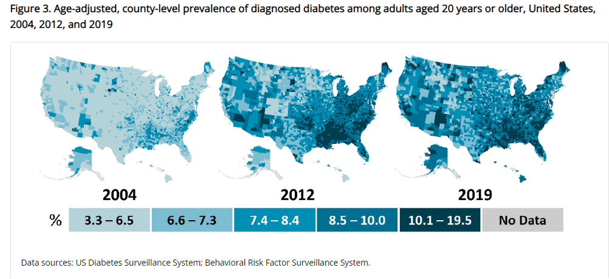
Type 2 Diabetes in America 2026
14.7% with Diabetes - 38 million adults
25% don’t know they have it
38% with Prediabetes – 100+ million adults
https://gis.cdc.gov/grasp/diabetes/diabetesatlas-statsreport.html

Slide 5
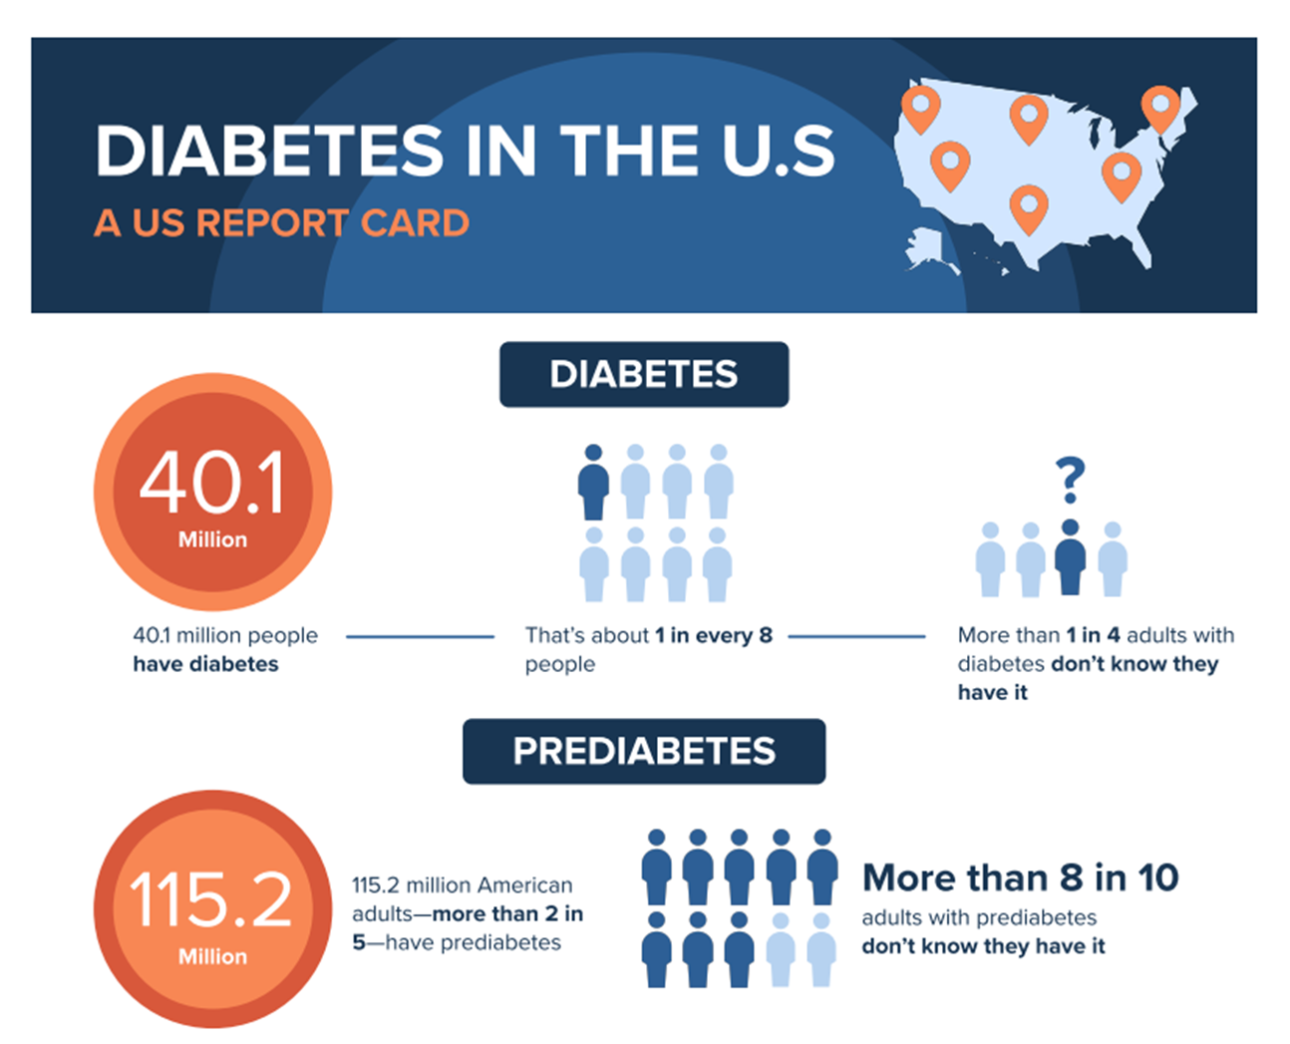

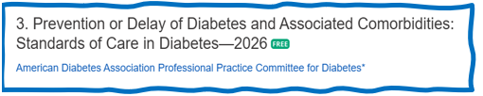
PreDiabetes is FREAKING ME OUT
35%+ people in US
80% don’t know they have it
In 3-5 years, about 30% of predm will get diabetes
Associated with higher rates of heart attack, stroke, neuropathy and vessel disease

Slide 6

Diabetes Prevalence Stats
For adults in U.S., diabetes prevalence:
American Indians and Alaska Natives – highest rates
Non-Hispanic Blacks (17.4%),
People of Hispanic origin (15.5%),
Non-Hispanic Asians (16.7%)
White Individuals (13.6%)
Education and SES and Location
Less than high school ed (13.1%)
More than high school (6.9%)
Living below federal poverty (13.1%)
Living at 500% of federal poverty (5.1%)
Rural living (9.5%)
Metropolitan (8.1%)

Slide 7
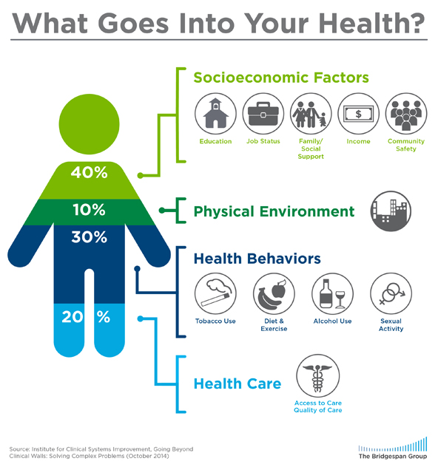
Address Barriers to Self Management
Barriers exist within health system, payer, health care professional & individual.
Address barriers through innovation, including community health workers, telehealth, other digital health solutions.
Consider social drivers of health in the target population when designing care.
https://coveragetoolkit.org/health-equity/defining-health-equity/
Notes:
Access and health equity is the ultimate goal when designing and delivering DSMES.
Creating culturally appropriate and varied modalities of settings has been shown to improve outcomes.
We know barriers to care exist at every level from the health system to individual.
However we can address these barriers by working to educate participants and health care providers on the critical times when DSMES is needed.
We can work with health systems and clinics to develop population health screening and clinical outreach,
create protocols to reduce time for referral and
collaborate health and community systems to address social needs.
We can include other health partners including community health workers to support delivery of diabetes peer support.
Barriers can be also be addressed by developing a diversity of delivery models.
From traditional inperson classrooms to community-based strategies and technology enabled solutions including telehealth or virtual environments varying modes can serve different needs.

Slide 8


Now, let’s get to the Nitty Gritty

Slide 9



Slide 10
Hormones Effect on Glucose
Hormone
Glucagon (pancreas)
Stress hormones (kidney)
Epinephrine (kidney)
Insulin (pancreas)
Amylin (pancreas)
Gut hormones - incretins (GLP-1) intestinal mucosa, beta cell has receptors)
Effect



⇒
⇒
⇒

Slide 11
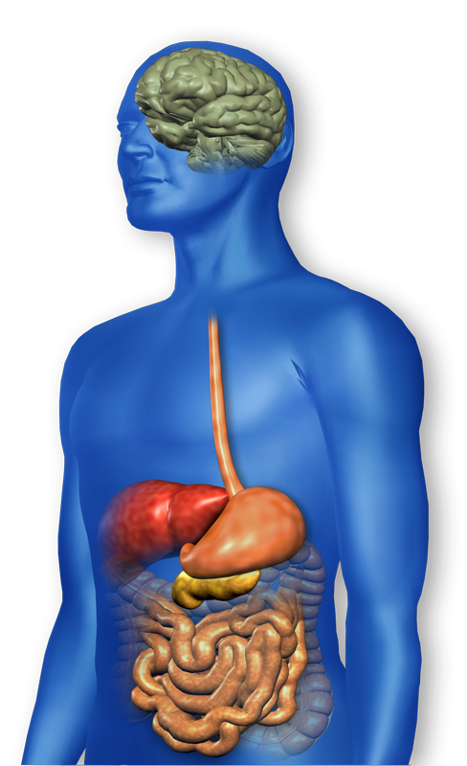
Understanding the Natural Role of Incretins
GIP secreted by K-cells upon ingestion of food in the proximal small intestine
GLP-1 secreted upon ingestion of food by L-cells in the distal small intestine
Promotes satiety and reduces appetite
Alpha cells:
↓ Postprandial glucagon secretion
↑ Beta-cell
response
Liver: ↓ Glucagon reduces hepatic glucose output
Beta cells: Enhances glucose-dependent insulin secretion
Stomach: Helps regulate gastric emptying
Adapted from Flint A, et al. J Clin Invest. 1998;101:515-520 Adapted from Larsson H, et al. Acta Physiol Scand. 1997;160:413-422 Adapted from Nauck MA, et al. Diabetologia. 1996;39:1546-1553 Adapted from Drucker DJ. Diabetes. 1998;47:159-169
GLP-1 degraded by
DPP-4 w/in minutes
Notes:
11
11
DISCUSSION POINTS:
--Upon food ingestion, GLP-1 is secreted into the circulation from L cells of small intestine.
--GLP-1 increases beta-cell response by enhancing glucose-dependent insulin secretion.
--GLP-1 decreases beta-cell workload and hence the demand for insulin secretion by:
--Regulating the rate of gastric emptying such that meal nutrients are delivered to the small intestine and, in turn, absorbed into the circulation more smoothly, reducing peak nutrient absorption and insulin demand (beta-cell workload)
--Decreasing postprandial glucagon secretion from pancreatic alpha cells, which helps to maintain the counterregulatory balance between insulin and glucagon
--Reducing postprandial glucagon secretion, GLP-1 has an indirect benefit on beta-cell workload, since decreased glucagon secretion will produce decreased postprandial hepatic glucose output
--Having effects on the central nervous system, resulting in increased satiety (sensation of satisfaction with food intake) and a reduction of food intake
--By decreasing beta-cell workload and improving beta-cell response, GLP-1 is an important regulator of glucose homeostasis.
SLIDE BACKGROUND:
--Effect on Beta-cell: Drucker DJ. Diabetes. 1998; 47:159-169
--Effect on Alpha cell: Larsson H, et al. Acta Physiol Scand. 1997; 160:413-422
--Effects on Liver: Larsson H, et al. Acta Physiol Scand. 1997; 160:413-422
--Effects on Stomach: Nauck MA, et al. Diabetologia. 1996; 39:1546-1553
--Effects on CNS: Flint A, et al. J Clin Invest. 1998; 101:515-520

Slide 12
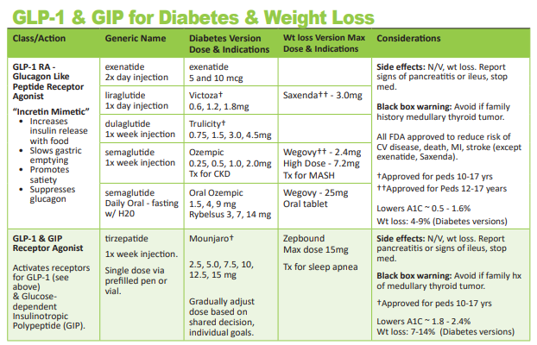
Pocket Card: GLP-1 & GIP RA

Slide 13







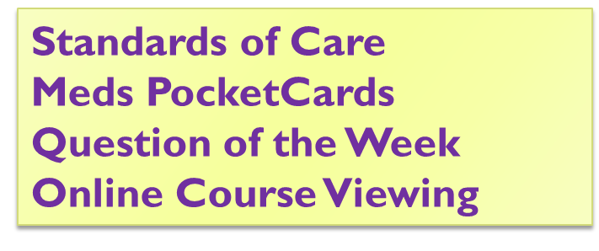

Slide 14

Signs of Diabetes
Polyuria
Polydipsia
Polyphasia
Weight loss
Fatigue
Skin and other infections
Blurry vision
Glycosuria, H₂O losses
Dehydration
Fuel Depletion
Loss of body tissue, H₂O
Poor energy utilization
Hyperglycemia increases incidence of infection
Osmotic changes

Slide 15
Natural History of Diabetes
Healthy
FBG <100
Random <140
A1c <5.7%
Prediabetes
FBG 100-125
Random 140 - 199
A1c ~ 5.7- 6.4%
50% working pancreas
Diabetes
FBG 126 +
Random 200 +
A1c 6.5% or +
20% working pancreas
Yes!
NO
Development of type 2 diabetes happens over years or decades

Slide 16

A1c and Estimated Avg Glucose (eAG)
A1c (%) eAG
5 97
6 126
7 154
8 183
9 212
10 240
11 269
12 298
eAG = 28.7 x A1c-46.7 ~ 29 pts per 1%
Translating the A1c Assay Into Estimated Average Glucose Values – ADAG Study
Diabetes Care: 31, #8, August 2008
Order teaching tool kit free at diabetes.org

Slide 17


Slide 18
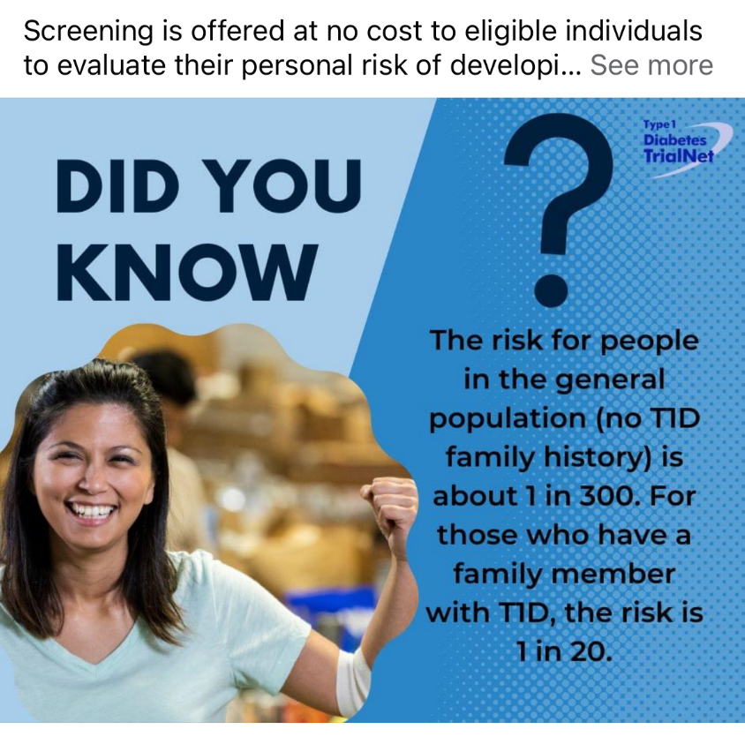

Type 1 ~ Immune Mediated 5-10% of Diabetes
1.5 Million people have type 1 in U.S.
Prevalence increasing:
2001 – 1.48 per 1000 youths diagnosed with diabetes
2017 - 2.15 per 1000 youths diagnosed with diabetes
Incidence & Prevalence increasing
Highest incidence in Finland or Northern Europe.
ADCES In Practice - March 2024 Recent Advances in Type 1 Diabetes: Teplizumab (Tzeild®)
Karen S. Fiano, PHARMD, BCACP, Devada Singh-Franco, PHARMD, CDCES, Young M. Kwon, BS, PHD

Slide 19
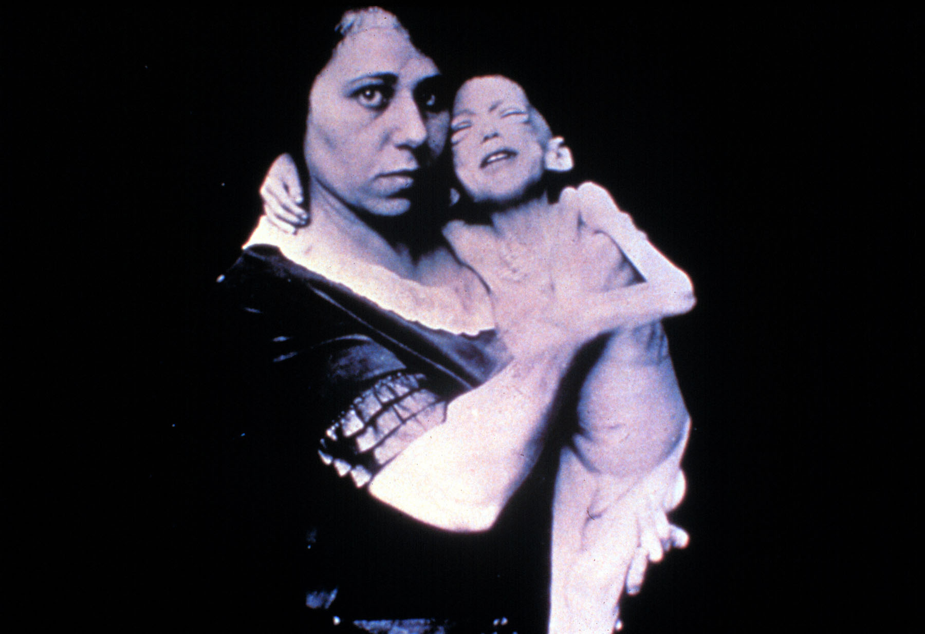

Slide 20



“Diabetes is my biggest competitor” Gary Hall Jr

Slide 21
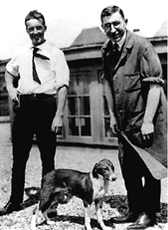
Dr. Banting and Best with Marjorie at University of Toronto

Slide 22
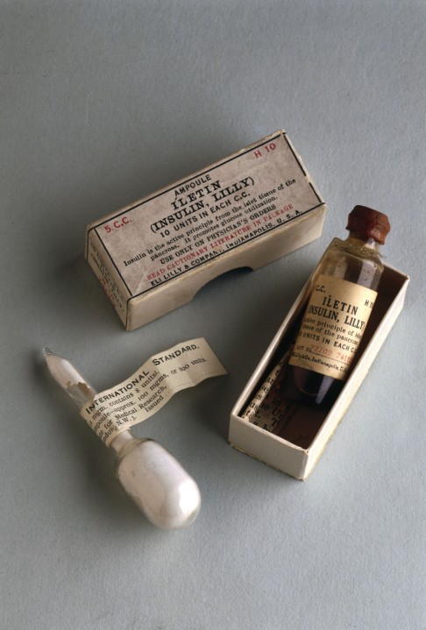
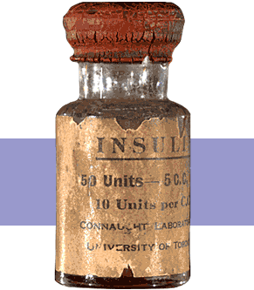
Insulin Finally Available - 1922

Slide 23
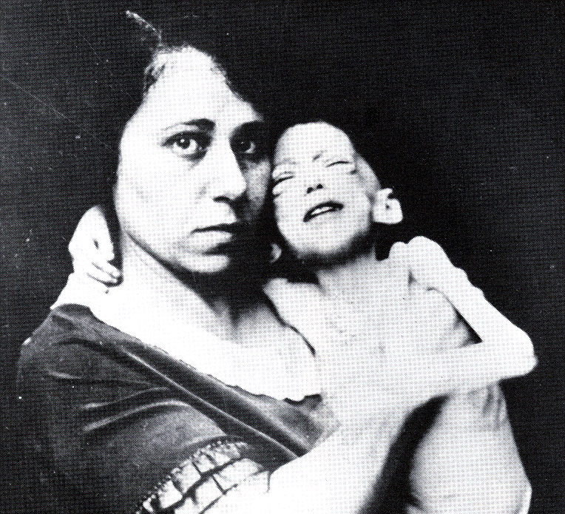

Miracle of Insulin
The Miracle of Insulin
Patient J.L., December 15, 1922
February 15, 1923

Slide 24

Type 1 – 10% of all Diabetes
Auto-immune pancreatic beta cells destruction
Most commonly expressed at age 10 - 14
Insulin sensitive (require 0.5 - 1.0 units/kg/day)
Expression due to a combo of genes and environment:
Autoimmunity tends to run in families
Exposure to virus or other environmental factors
24
Diagnostic Criteria for Diabetes
Notes:
When you get to the insulin piece, please mention we will get into great detail about insulin in the pharmacotherapy module

Slide 25

Signs of Type 1 Diabetes
Sudden onset of nighttime bedwetting
Weight loss, thirst, hunger
May present in DKA
Fruity breath
Hypothermic
Poor skin turgor
“Out of it”
Ketone positive (blood or urine)
Other

Slide 26

How do we know someone has Type 1 vs Type 2?
Type 1
Positive antibodies
GAD
IA2
ZnT8
Younger people develop quickly
Older people take longer to develop
Body wt and presentation

Slide 27

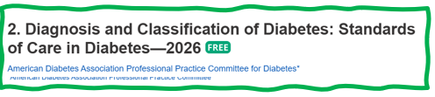
Type 1 Diabetes Features?
For JR, a 28 admitted to the ICU with a blood glucose of 476 mg/dl, pH of 7.1, anion gap of 15. Recently lost 13 pounds.
Type 1 Most Discriminative Features
Younger than 35 years at diagnosis
Lower BMI (<25 kg/m²)
Unintentional weight loss
Ketoacidosis
Glucose 360 mg/dl or greater.
Misdiagnosis is common and can occur in ∼40% of adults with new type 1 diabetes

Slide 28



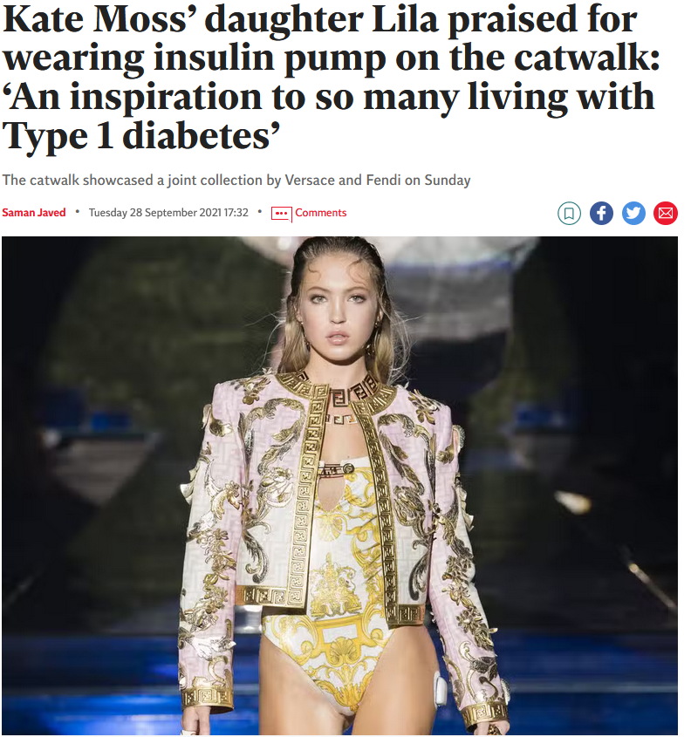


What Does Type 1 Look Like?
Mary Tyler Moore
Justice Sonia Sotomayor
Bret Michaels
Nick Jonas
Lila Grace Moss

Slide 29
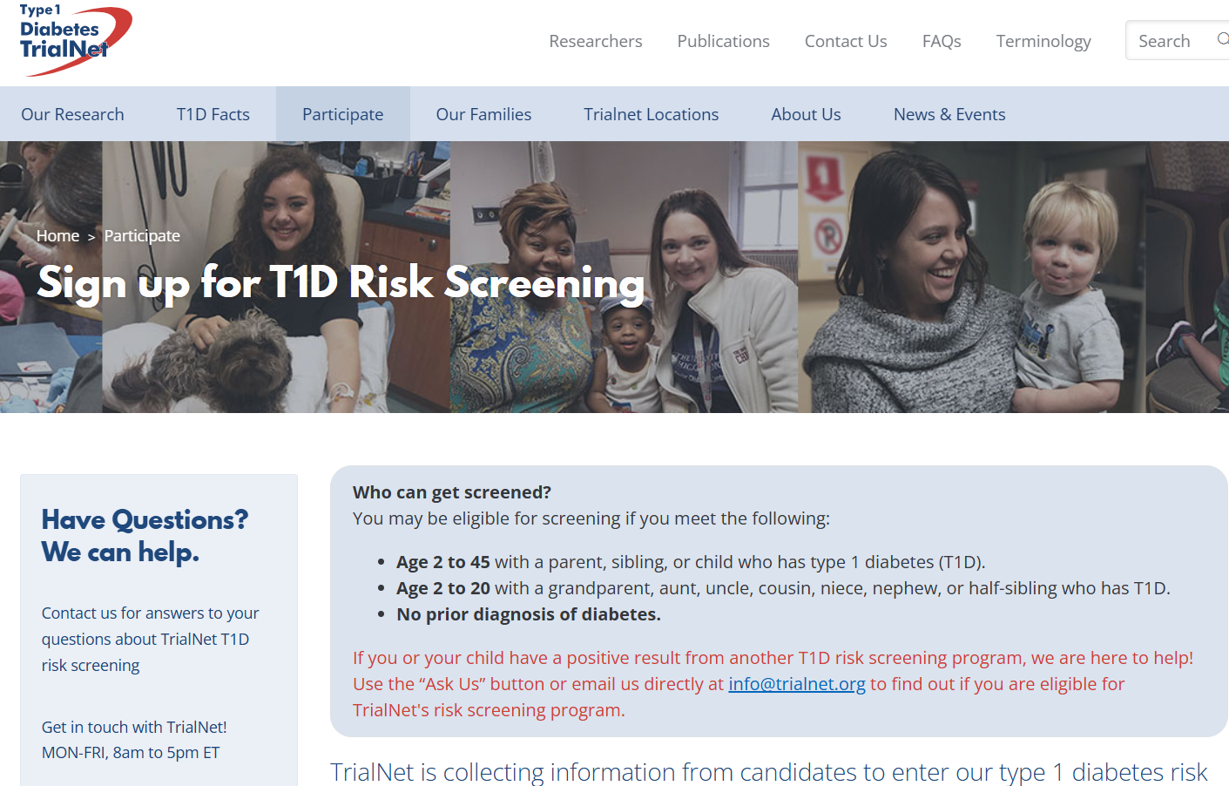
www.TrialNet.org
How to get families linked to screening?

Slide 30


Patti Labelle
"divabetic”
“I have diabetes, it doesn’t have me”

Slide 31




Slide 32
Natural Progression of Type 2 Diabetes
Plasma
Glucose
Postprandial glucose
Fasting glucose
126 mg/dL
Relative β-Cell Function
Insulin resistance
Insulin secretion
-20
-10
0
10
20
30
Years of Diabetes
Prior to diagnosis
After diagnosis
Adapted from Bergenstal et al. 2000; International Diabetes Center.
Notes:
These graphs show the typical progressive nature of type 2 diabetes in terms of 2 key indices: increasing plasma glucose level (top panel) and decline in relative β-cell function as reflected by the drop in endogenous insulin and rise in insulin resistance (lower panel).
In the natural history of type 2 diabetes, insulin resistance rises, insulin secretion falls, and glucose levels begin to rise before diabetes is diagnosed.
Based on the natural history, type 2 diabetes is a disease of progressive insulin failure as shown in the graphic model developed by researchers at the International Diabetes Center.¹
Before the onset of diabetes, glucose levels start to rise, with a slightly sharper increase in the postprandial value than in fasting glucose. Both postprandial and fasting plasma glucose levels continue to rise if diabetes is left untreated.²
Prior to the diagnosis of diabetes, resistance of cell receptor sites to insulin starts to increase, while insulin secretion by β-cells decreases. Insulin resistance reaches a peak and remains constant. Endogenous insulin secretion continues to decline over the course of diabetes.²
References:
1. Kendall DM. Postprandial blood glucose in the management of type 2 diabetes: the emerging role of incretin mimetics. Available at: http://www.medscape.com/viewarticle/515693. Accessed April 21, 2006.
2. Ramlo-Halsted BA, Edelman SV. The natural history of type 2 diabetes: implications for clinical practice. Prim Care. 1999;26:771-789.

Slide 33
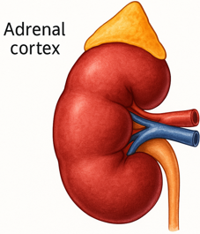
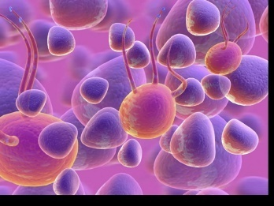
The Noxious Nine – Pathophysiology T2D
Hypercortisolism
Neurotrans-mission dysfunction
Decreased Insulin β-cell secretion
Increased renal glucose reabsorption
Decreased incretin effect Gut hormones
G
Increased glucagon α-cell secretion
I
G
I
G
G
I
I
G
Increased lipolysis
G
G
I
I
G
G
I
Increased hepatic glucose
production
I
G
G
Decreased muscle glucose uptake
DeFronzo, Auchus-Hypercortisolism June 2025
Notes:
33
ummary: The Noxious Nine in Diabetes Pathophysiology
Ralph A. DeFronzo expanded his earlier conceptual model of diabetes—known as the Ominous Octet—to include a ninth element: hypercortisolism. This updated framework is referred to as the Noxious Nine, highlighting the important role of cortisol dysregulation in difficult-to-control type 2 diabetes currentsciencedaily.com+8HCP Live+8HCP Live+8.
Recent research, including the CATALYST trial, shows that about 24% of patients with difficult-to-control T2D have underlying hypercortisolism. Treating this condition with mifepristone, a glucocorticoid receptor antagonist, led to significant improvements in HbA1c—averaging around a 1.5% reduction pmc.ncbi.nlm.nih.gov+3HCP Live+3medscape.com+3.
These findings emphasize the importance of recognizing hypercortisolism in T2D care and suggest that addressing it may help improve glycemic and metabolic control in a subset of patients.
33

Slide 34

What is Type 2 Diabetes?
Complex metabolic disorder ….
(Insulin resistance and deficiency)
with social, behavioral and environmental risk factors unmasking the effects of genetic susceptibility.
New Diagnosis? Call 800 – DIABETES to request “Getting Started Kit”
www.Diabetes.org

Slide 35


What is Type 2 Diabetes?
Type 2 diabetes is associated with insulin secretory defects related to
genetic predisposition,
epigenetic changes (how genes are expressed)
inflammation, and
metabolic stress.
Future classification schemes for diabetes will likely focus on the pathophysiology of the underlying β-cell dysfunction.

Slide 36

Life Study – Mrs. Jones
MJ is 62 years old, with a BMI of 36 and complains of feeling tired and urinating several times a night. Has a urinary tract infection. Her A1c is 8.3%, glucose 237.
MJ is hypertensive with a history of gestational diabetes. No ketones in urine.
What are risk factors and signs of diabetes?
You find a few moments to teach and MJ asks you some questions.

Slide 37
What Do You Say? Mrs. Jones asks you
What is type 2 diabetes?
Will this go away?
Will I get complications?
Will I need to take diabetes medication for the rest of my life?
How come I got diabetes?
Do I have to check my blood sugars?

Slide 38
Comparison of Type 1 & Type 2
Type 1
Type 2
Obesity
x
xxx
Insulin dependence
xxx
30%
Respond to oral agents
0
xxx
Ketosis
xxx
x
Antibodies present
xxx
0
Typical Age of onset
teens
adult
Insulin Resistance
xxx
0

Slide 39

Pre Diabetes & Type 2- Screening Guidelines (ADA 2026 Clinical Practice Guidelines)
Start screening all people at age 35.
Screen at any age if BMI ≥ 25 (Asians BMI ≥ 23) plus one or > additional risk factor:
First-degree relative w/ diabetes
Member of a high-risk ethnic population
Habitual physical inactivity
History of heart disease
Check more frequently if taking high risk meds; antiretrovirals, 2nd generation antipsychotics or steroids, thiazide diuretics, statins
History of pancreatitis, prediabetes, GDM, periodontal disease

Slide 40

Diabetes 2 - Who is at Risk? (ADA Clinical Practice Guidelines)
Risk factors cont’d
HTN - BP > 140/90
HDL < 35 or triglycerides > 250
History of Gestational Diabetes Mellitus
Polycystic ovary syndrome (PCOS)
Other conditions assoc w/ insulin resistance:
Elevated BMI, acanthosis nigricans (AN)
Screening in dental practices can help detect diabetes. ~30% of dental patients over age of 30, have some degree of dysglycemia.

Slide 41
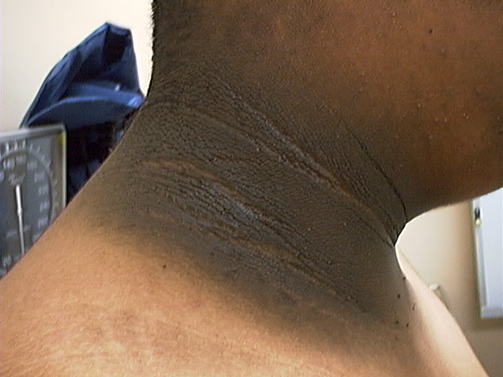
Acanthosis Nigricans

Slide 42
Acanthosis Nigricans (AN)
Signals high insulin levels in bloodstream
Patches of darkened skin over parts of body that bend or rub against each other
Neck, underarm, waistline, groin, knuckles, elbows, toes
Skin tags on neck and darkened areas around eyes, nose and cheeks.
No cure, lesions regress with treatment of insulin resistance

Slide 43

Sleep quality and Diabetes Risk
Sleep quality “an individual’s self-satisfaction with all aspects of sleep experience.”
Sleep modulates important metabolic, endocrine, cardiovascular processes.
Poor sleep quality associated with 40% increased risk of developing type 2 diabetes
Night owls have 2.5 higher odds for type 2 than early birds (chronotype)

Slide 44
Quick Self-Assessment
LS arrives late for appointment and says they forgot their log book. LS has only been taking their metformin a couple times a week and has gone back to getting fast food each morning for breakfast.
What feelings would this evoke?
LS doesn’t care
Non-compliant
Lazy
Better scare them
Exasperation
Other?
curiosity

Slide 45

Language of Diabetes Education
Old Way
New Way
Control diabetes
Test BG
Patient
Normal BG
Non-adherent, compliant
Refuse
Manage
Check
Participant
BG in target range
Focus on what they are accomplishing
Decided, chose

Slide 46
ADA 2026 ABC Goals
A1c less than 7% (individualize)
Pre-meal BG 80-130
Post meal BG <180
Time in Range (70-180) 70% of time
Blood Pressure
<130/80
<120/80 for high risk
Cholesterol
Statin therapy based on age & risk status
If 40+ with ASCVD Risk, decrease LDL by 50%, LDL <70
If 40+ with ASCVD, decrease LDL by 50%, LDL <55

Slide 47


Where are we on this continuum?

Slide 48
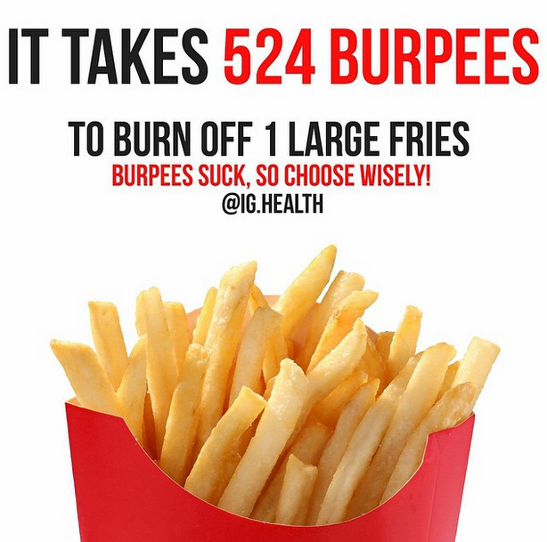
A hard truth
Exercise alone doesn’t cause weight loss
But….
It helps keep weight off
Decreases visceral adiposity
Decreases CV Risk
To combat the rise in body weight, we need to change the food environment
“You cannot outrun an unhealthy diet”.

Slide 49




Plate Method Works
Notes:
Plate Model benefits is it simplicity and way we can communicate different types of foods, portions and general selections.
Harvard School of Public Health alternative =“Healthy Eating Plate” inspis
Visit www.hsph.harvard.edu/nutritionsource

Slide 50

Diabetes is also associated with
Steatosis
Obstructive sleep apnea
Cancer; pancreas, liver, breast
Alzheimer’s & Dementia
Depression, Distress and Anxiety

Slide 51


Other Types of Diabetes
Gestational
Other specific types of diabetes

Slide 52

Diabetes in Pregnancy Background
Prevalence of diabetes in pregnancy is increasing
Definitions
Pre-gestational diabetes: pre-existing type 1 or type 2 diabetes in pregnancy
Gestational diabetes: diabetes diagnosed in the 2nd or 3rd trimester of pregnancy
Notes:
ADA SOC

Slide 53
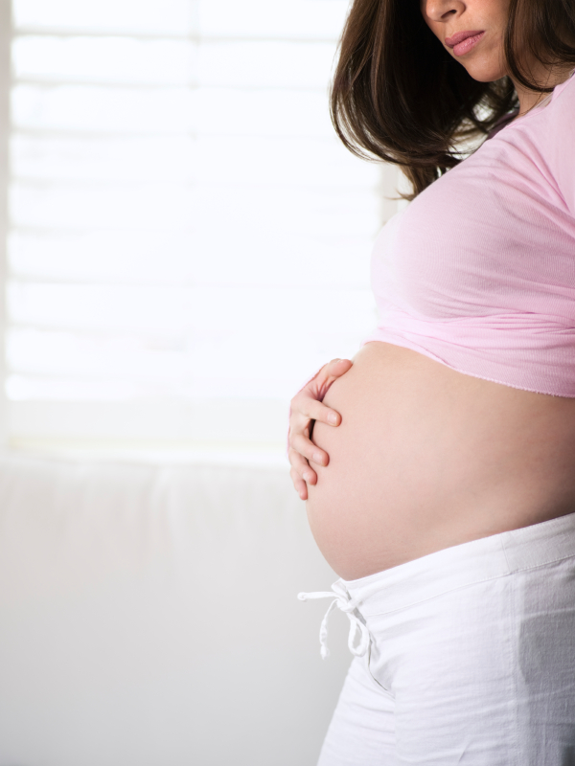
Gestational DM ~ 9% of all Pregnancies
Detected at 24-28 weeks of pregnancy (most insulin resistant phase)
Rates are increasing:
Women getting pregnant later
Higher rates of obesity
50% chance of getting diabetes post delivery
Offspring at greater risk of insulin resistance and diabetes

Slide 54
Specific type of diabetes due to other causes
Medications:
Steroids
Anti-retroviral meds,
Antipsychotic meds
Transplant meds
Checkpoint inhibitors
Exocrine pancreas disease:
Cystic fibrosis
Type 3c
Pancreatitis
Monogenic diabetes syndromes
Agent Orange

Slide 55

Hypoglycemia prevention
72 yr old, thin, lives alone, A1c 7.3%. History of MI, stroke. DM for 12 yrs, takes glyburide 10mg BID. Limited income. Creat 1.4.
What strategies to
Prevent hypo?

Slide 56

Hypoglycemia Symptoms
Autonomic
Anxiety
Palpitations
Sweating
Tingling
Trembling
Hypoglycemic Unawareness
Neuroglycopenia
Irritability
Drowsiness
Dizziness
Blurred Vision
Difficulty with speech
Confusion
Feeling faint

Slide 57
Treatment of Hypoglycemia
If blood glucose 70mg/dl or below:
10-15 gms of carb to raise BG 30 - 45mg/dl
Retest in 15 minutes, if still low, treat again, even without symptoms
Follow with usual meal or snack
If BG less than 40, allow recovery time
Severe hypo may require glucagon

Slide 58
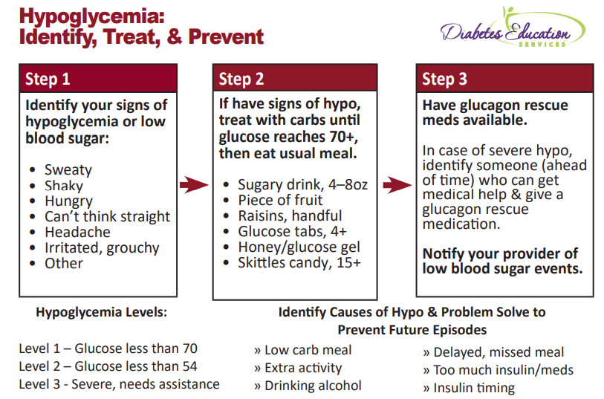

Slide 59
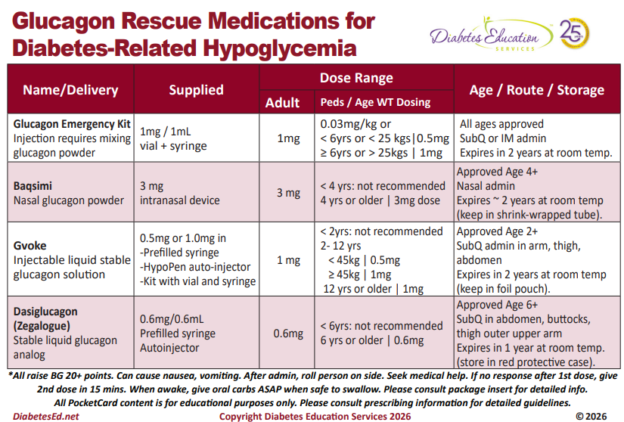

Slide 60
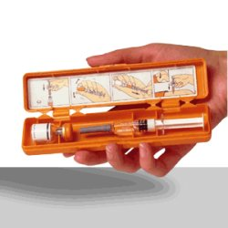

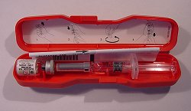
Glucagon Emergency Kit
Store 68-77 degrees prior to reconstitution, single use only

Slide 61
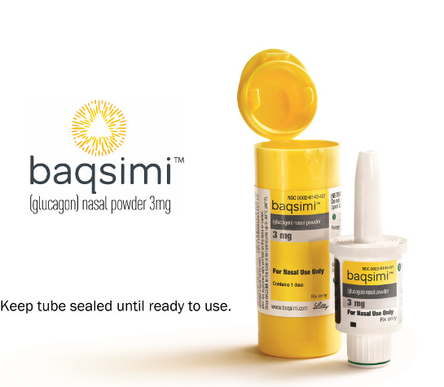
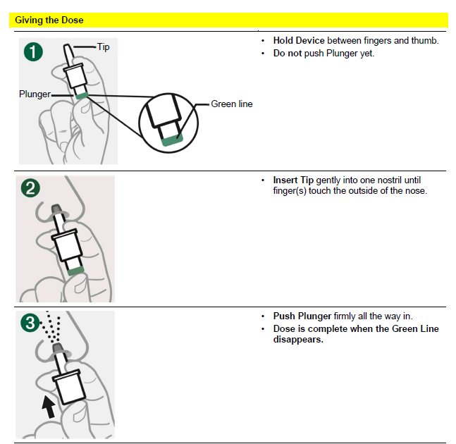
Nasal Glucagon - Baqsimi
Approved for ages 4 +
Absorbed nasally
No reconstitution or refrigeration needed
Kept in temps up to 86
Raises BG 67-73 mg/dl
Don’t use in those with
Pheochromocytoma
Insulinoma
See package insert

Slide 62

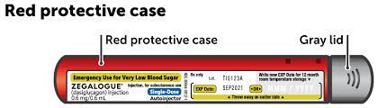
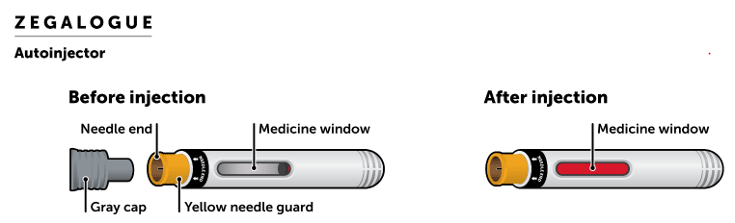
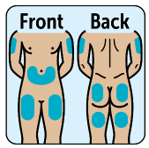
Dasiglucagon (Zegalogue)

Slide 63
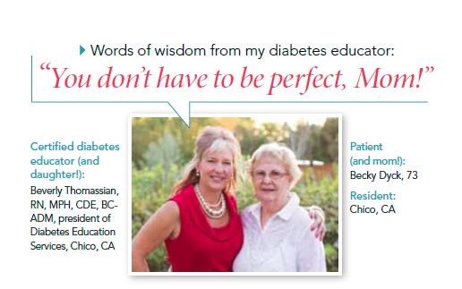
80 /20 Rule – Perfect Not Required

Slide 64

Key points
At the center of diabetes is someone living with it everyday.
Focus on their successes
Coach and support

Slide 65

Thank You
bev@diabetesed.net
www.DiabetesEd.net

