Slide 1

Virtual DiabetesEd Training Conference 2026 – Day 1
Beverly Thomassian, RN, MPH, BC-ADM, CDCES
Founder - www.DiabetesEd.net

Slide 2
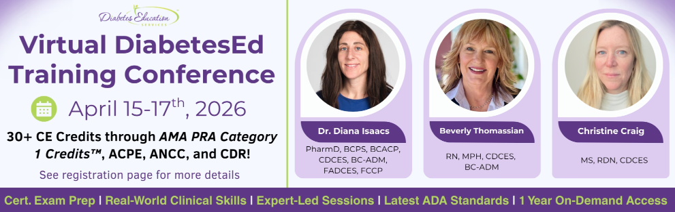
Welcome Everyone
Good Morning and Welcome.
Grab your coffee, tea or other beverage, a healthy snack and get comfy.
We will start promptly at 8:00 AM Pacific Time.
If you are having any technical difficulty, please chat with Bryanna at www.DiabetesEd.net or call 530 / 893-8635 or email at info@diabetesed.net

Slide 3
Land Acknowledgment
“We acknowledge that we are gathered on the traditional territory of the Kumeyaay Nation. We pay respect to their elders, both past and present, and acknowledge their enduring relationship to this land and their continuing sovereignty and cultural traditions in the San Diego community".

Slide 4

Diabetes Education Services Inclusion Statement
Based on the IDEA Initiative inspired by CDR
Inclusion
Diversity
Equity
Access
We are committed to promoting diversity and inclusion in our educational offerings.
We recognize, respect, and include differences in ability, age, culture, ethnicity, gender, gender identity, sexual orientation, size, and socioeconomic characteristics.
Our goal is to promote equity and access, acknowledging historical and institutional inequities.
We are committed to practicing cultural humility and cultivating our cultural competence.
We wish to create a safe space within our community where one's beliefs, experiences, identity, and differences in ability, age, size, socio-cultural/socioeconomic characteristics, and political affiliations are considered and respected.

Slide 5

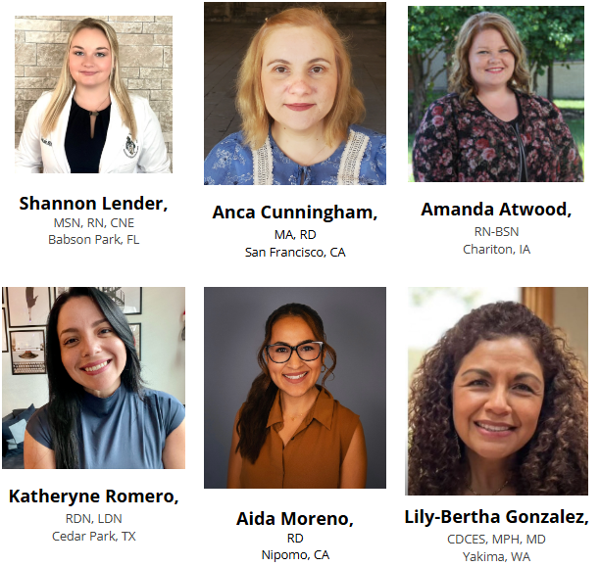


Slide 6
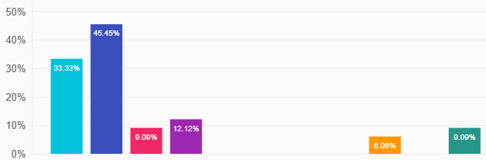
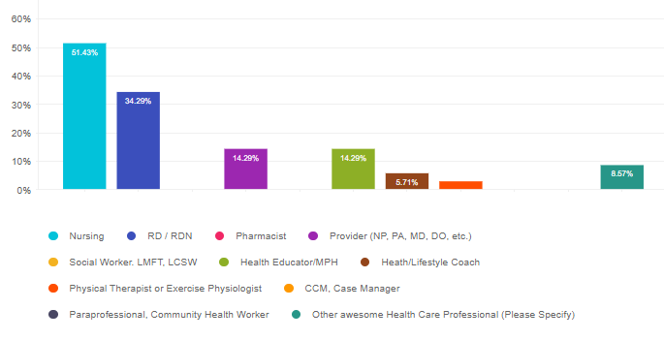
Who is attending this conference?
Other Credentialed School Nurse
MSN, RN, DTR, CDCES

Slide 7
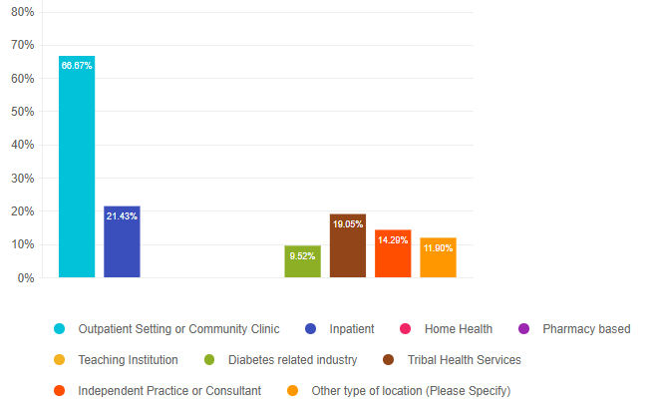
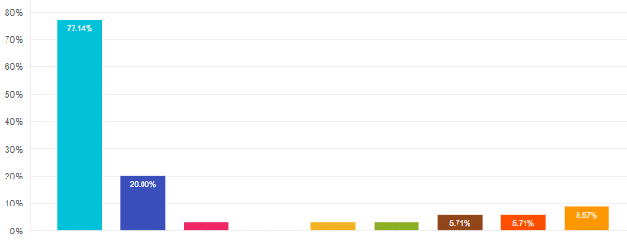
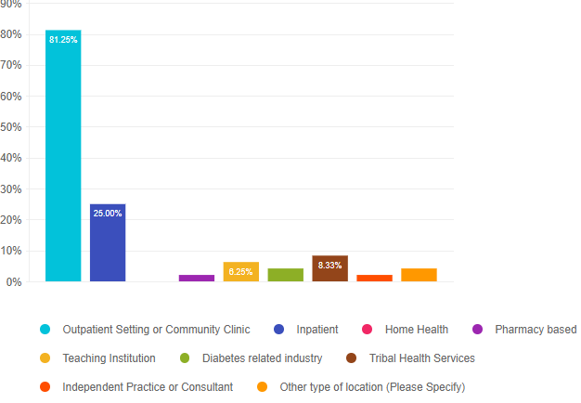
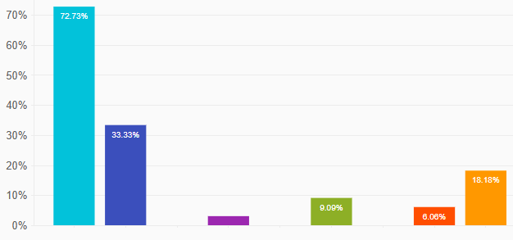
What is your job setting?
Other
Long term care
Urban Indian Org
Operating Room
California School District Classrooms
Med School (DO)
- Education

Slide 8
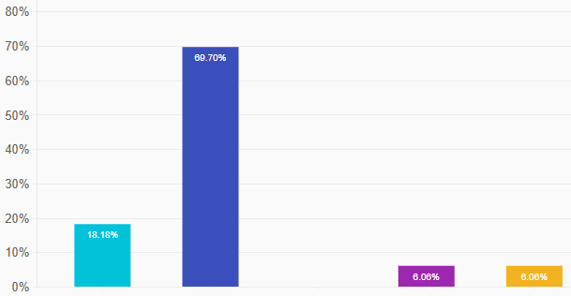
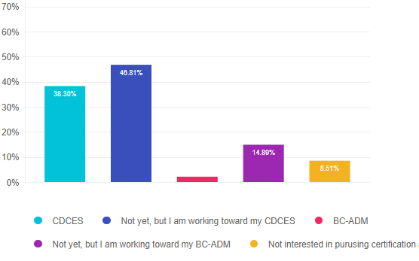
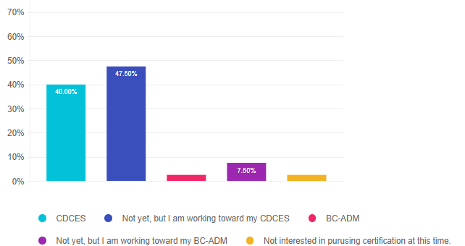
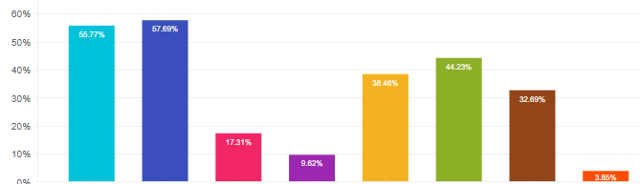
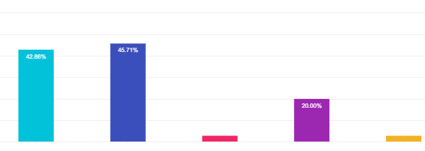
Certifications?

Slide 9
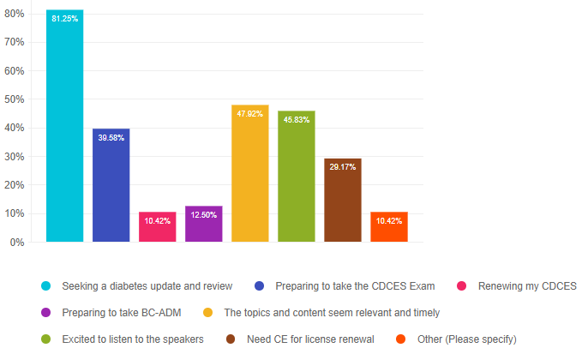
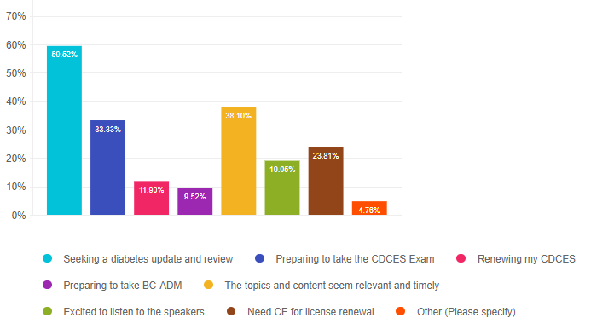
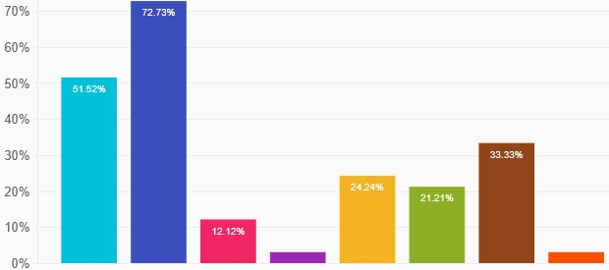
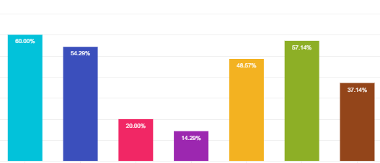
What motivated you to attend?
“I attend this conference either in person or virtually every 1-2 yrs”

Slide 10
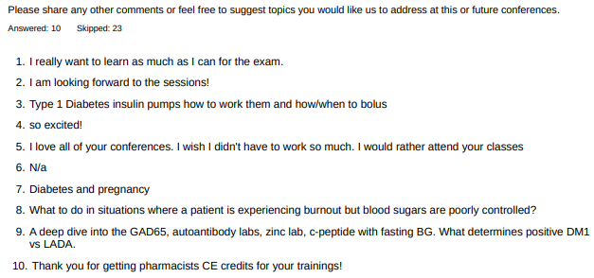
Other Comments of Interest

Slide 11
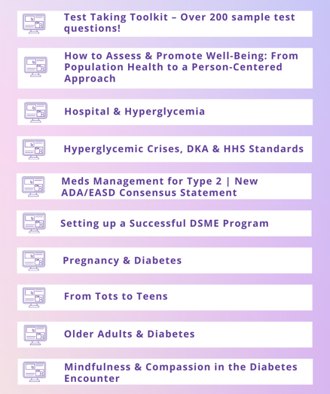
FREE Bonus Courses on Online University
We can’t cover it all in this live course.
So, we provide supplemental courses.
Now includes “Learning Theories made Easy”

Slide 12


Thank you for Being a Part of This Awesome Community

Slide 13
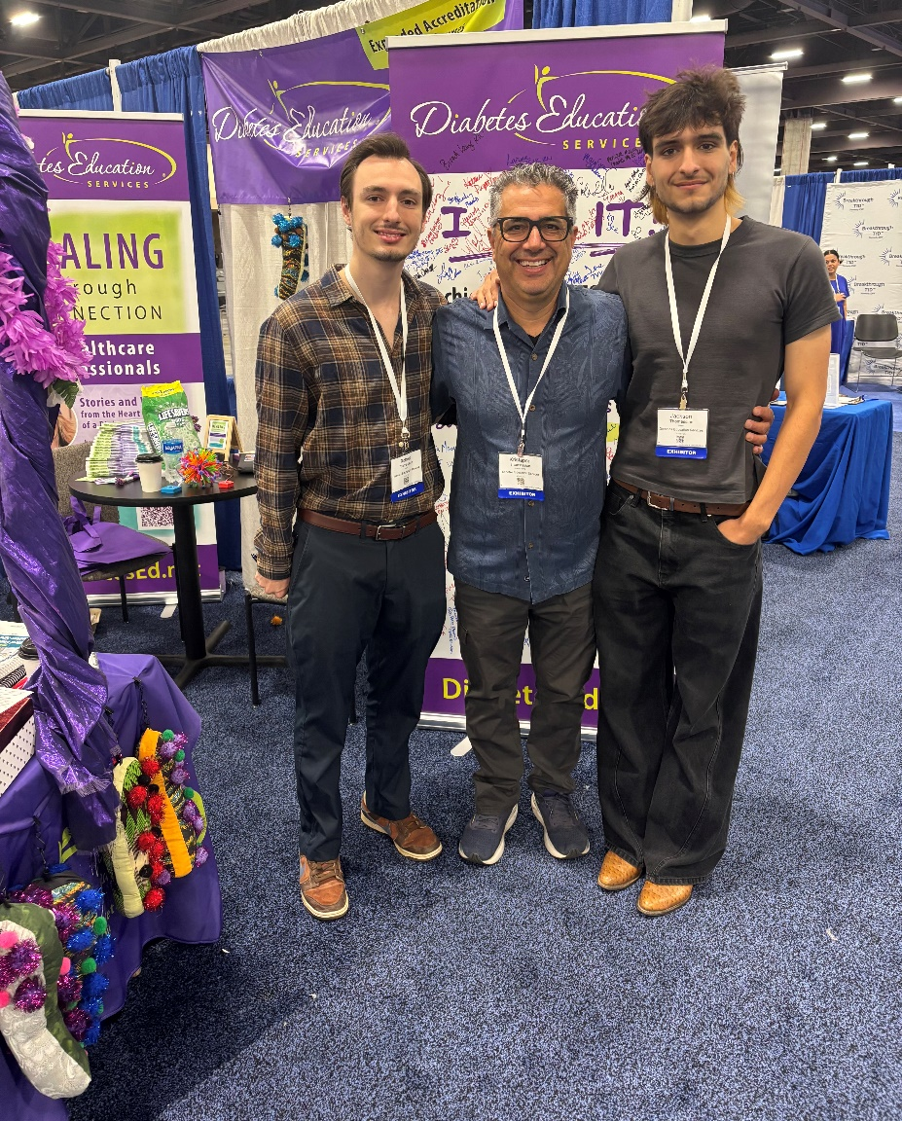
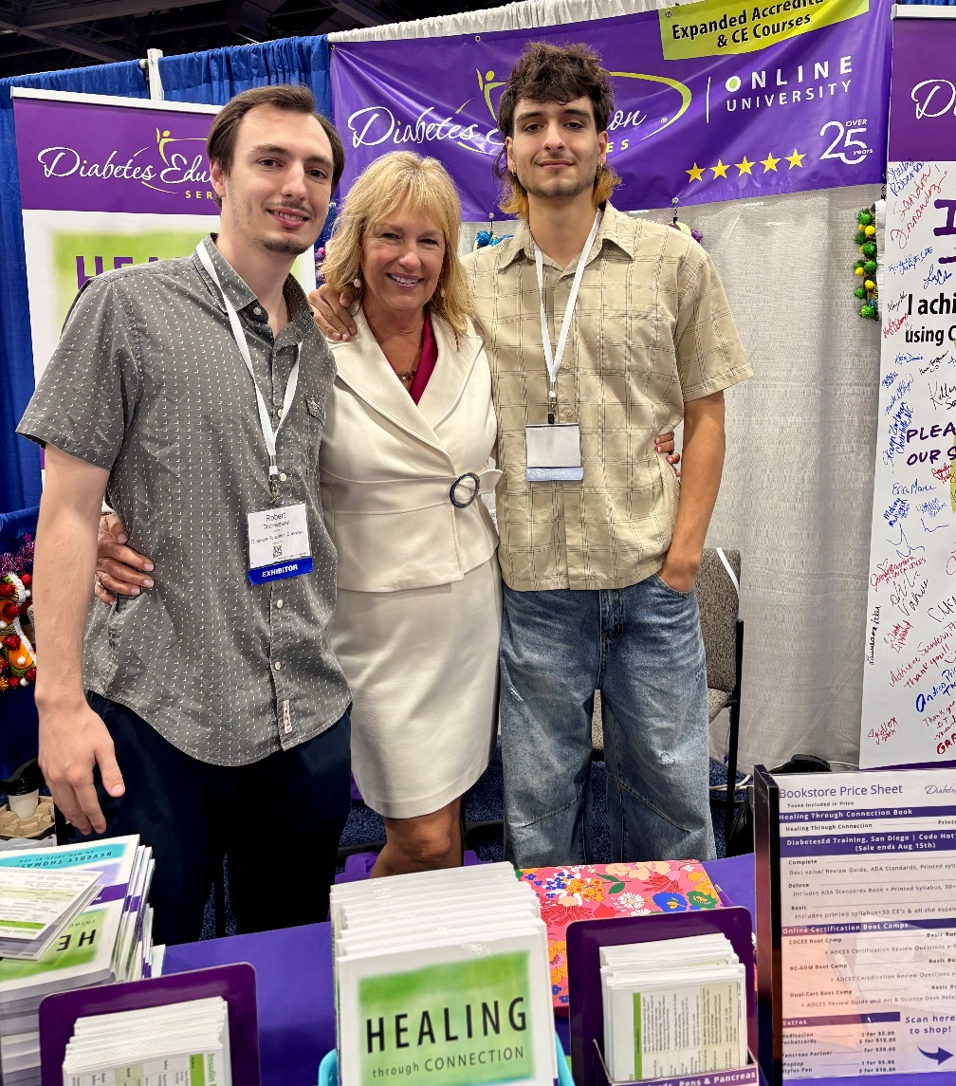
Thank you to my Boys

Slide 14
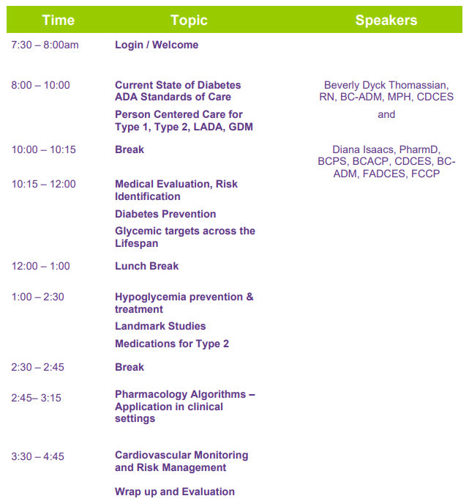
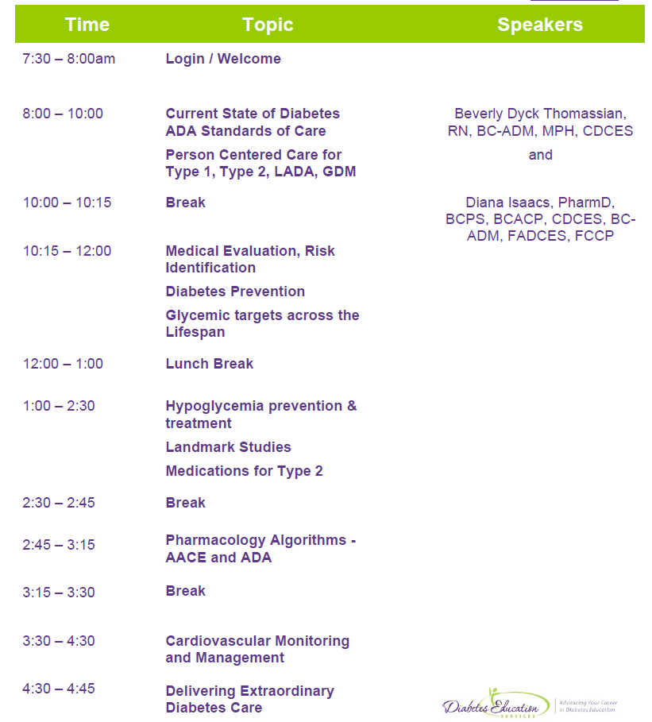
Course Schedule – Day 1 April 15, 2026
Handouts & Resource Page

Slide 15
Coach Bev has no Conflict of Interest
She’s not on any speaker's bureau
Does not invest or have any financial relationships with diabetes related companies.
Gathers information from reading package inserts, research and articles
The ADA Standards of Medical Care is main resource for course content

Slide 16

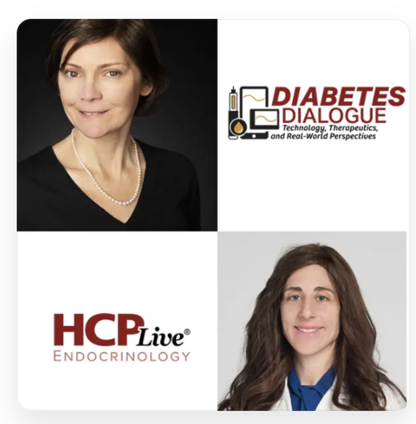
Diana Isaacs, PharmD, BCPS, BCACP, BC-ADM, CDCES, FADCES, FCCP
Provides diabetes care to diverse population including T1D, T2D, transplant, pregnancy and other high-risk individuals
Engaged in clinical research and diabetes advocacy
Usually sees about 10 clients a day – Constantly mentoring
Author, Researcher, Podcaster, Thought Leader
Endocrine Clinical Pharmacy Specialist
Director, Education & Training in Diabetes Technology
Co-Director Center for Endocrine Disorders in Pregnancy
Cleveland Clinic Endocrinology and Metabolism Institute
ADCES Educator of the Year in 2020 ADA Diabetes Educator of Year 2026

Slide 17


Conflict of Interest
Faculty and Disclosure of Conflicts of Interest
Partners requires every individual in a position to control educational content to disclose all financial relationships with ineligible companies that have occurred within the past 24 months. Ineligible companies are organizations whose primary business is producing, marketing, selling, re-selling, or distributing healthcare products used by or on patients.
All relevant financial relationships for anyone with the ability to control the content of this educational activity are listed below and have been mitigated according to Partners policies. Others involved in the planning of this activity have no relevant financial relationships.
Faculty | Financial Relationships
Beverly Thomassian | Has no relevant financial relationships.
​Diana Isaacs ​ | Consultant, Advisor, Speaker: Abbott, Dexcom, MiniMed, Novo Nordisk, Insulet, Lilly, Cequr, Sanofi, Beta Bionics, and ​Sequel

Slide 18

Diabetes Overview and Glycemic Goals
Objectives:
Discuss current Diabetes ADA Standards
Describe person-centered care for Type 1, Type 2, LADA, GDM
List steps for Medical Evaluation, Risk Identification and Prevention
State glycemic targets across the lifespan
Discuss hypoglycemia prevention & treatment
Describe significance of Landmark Diabetes Studies
List medications considerations for Type 2
Describe the pharmacology Algorithms
Discuss most recent cardiovascular risk mitigation strategies and goals.

Slide 19

17. Diabetes Advocacy
People living with diabetes deserve to be free from the burden of discrimination.
We need to all be a part of advocating to ensure a healthy and productive life for people living with diabetes.
Make sure cost is not a barrier to diabetes self-management.
Diabetes Care needs to meet outlined standards in all settings.
- In school setting
Young children in childcare
For Drivers
In work settings
In Detention Facilities
Insulin Access & Affordability

Slide 20

CDC Announces
35% of Americans will have Diabetes by 2050
Boyle, Thompson, Barker, Williamson
2010, Oct 22:8(1)29
www.pophealthmetrics.com

Slide 21

Poll Question 1
What percent of total people in the U.S. are living with undiagnosed and diagnosed type 2 diabetes?
A. About 30%
B. 11.3%
C. 14.7%
D. 25.6%

Slide 22
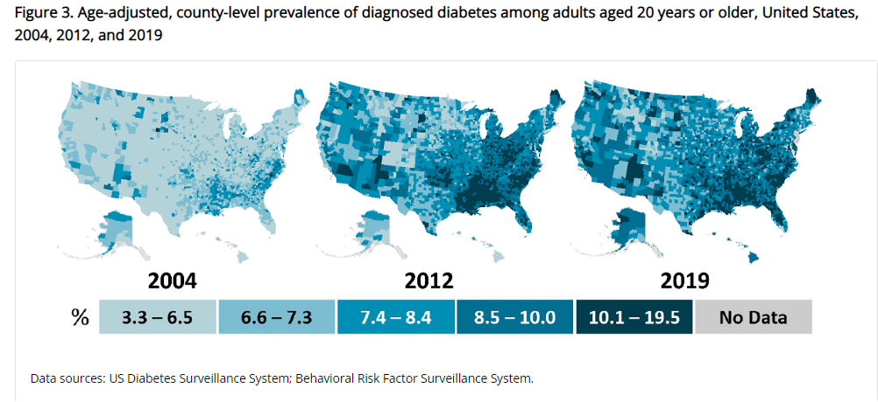
Type 2 Diabetes in America 2026
14.7% with Diabetes - 38 million adults
25% don’t know they have it
38% with Prediabetes – 100+ million adults
https://gis.cdc.gov/grasp/diabetes/diabetesatlas-statsreport.html

Slide 23
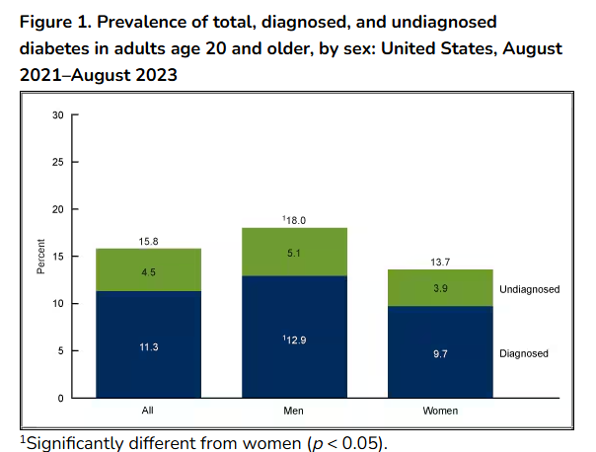
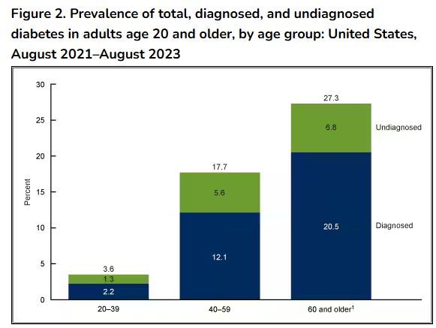
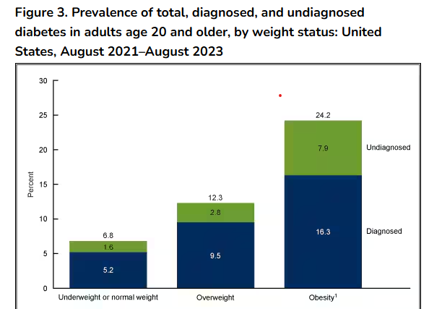
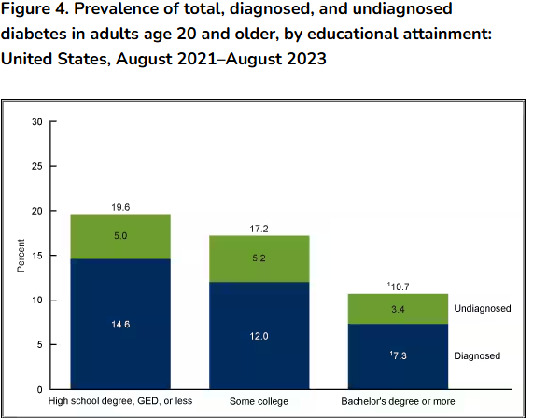
National Center for Health Statistics CDC | Data Brief No. 516, November 2024
https://www.cdc.gov/nchs/products/databriefs/db516.htm

Slide 24


1. Improving Care - Population Health
“Health outcomes of a group of individuals
including the distribution of health outcomes within the group”
These outcomes can be measured in terms of health outcome:
mortality, morbidity, health, and functional status
disease burden
(incidence and prevalence)
behavioral and metabolic factors
(exercise, diet, A1C, etc.)
ADA Standards 2026

Slide 25
Diabetes Prevalence Stats
For adults in U.S., diabetes prevalence:
American Indians and Alaska Natives – highest rates
Non-Hispanic Blacks (17.4%),
People of Hispanic origin (15.5%),
Non-Hispanic Asians (16.7%)
White Individuals (13.6%)
Education and SES and Location
Less than high school ed (13.1%)
More than high school (6.9%)
Living below federal poverty (13.1%)
Living at 500% of federal poverty (5.1%)
Rural living (9.5%)
Metropolitan (8.1%)

Slide 26

Social Determinants of Health (SDOH)
Factors often beyond an individual’s direct control and potentially representing lifelong risks—play a significant role in both clinical and psychosocial outcomes.
To improve health, support overall well-being, and eliminate disparities, it is crucial to address these determinants, particularly for individuals from racial and ethnic minoritized communities, underserved geographic areas (rural or urban), and those facing socioeconomic barriers to care and health

Slide 27
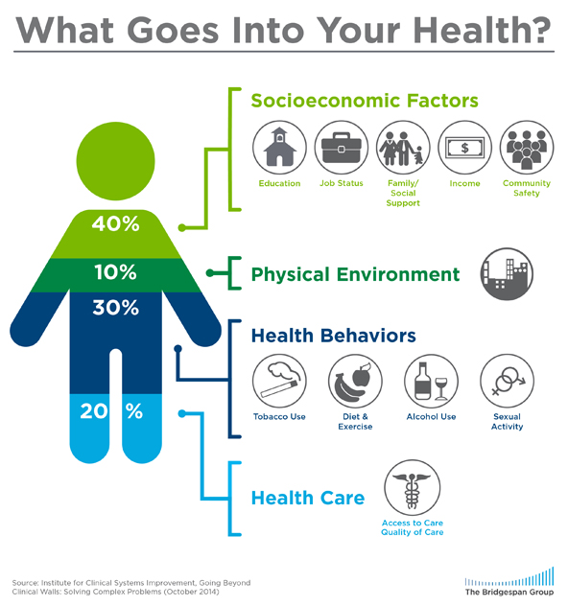
Address Barriers to Self Management
Barriers exist within health system, payer, health care professional & individual.
Address barriers through innovation, including community health workers, telehealth, other digital health solutions.
Consider social drivers of health in the target population when designing care.
https://coveragetoolkit.org/health-equity/defining-health-equity/
Notes:
Access and health equity is the ultimate goal when designing and delivering DSMES.
Creating culturally appropriate and varied modalities of settings has been shown to improve outcomes.
We know barriers to care exist at every level from the health system to individual.
However we can address these barriers by working to educate participants and health care providers on the critical times when DSMES is needed.
We can work with health systems and clinics to develop population health screening and clinical outreach,
create protocols to reduce time for referral and
collaborate health and community systems to address social needs.
We can include other health partners including community health workers to support delivery of diabetes peer support.
Barriers can be also be addressed by developing a diversity of delivery models.
From traditional inperson classrooms to community-based strategies and technology enabled solutions including telehealth or virtual environments varying modes can serve different needs.

Slide 28

Improving Care and Promoting Health in Populations
For optimal outcomes individualize individual’s context and care needs across life span.
Improve population health through a combination of policy-level, system-level, and person-level approaches.
Person-centered care:
care that considers an individual’s comorbidities and prognoses
respectful of and responsive to individual preferences, needs, and values;
ensures that the individual’s values guide all clinical decisions

Slide 29

Status of Diabetes Care
In 2015–2018, U.S. community-dwelling adults with diabetes achieved:
A1C <7% by 50.5%
75.4% achieved A1C <8%.
BP target of <130/80 achieved by 47.7%
70.4% achieved blood pressure <140/90 mmHg.
Lipid control (non-HDL cholesterol) <130 mg/dL, achieved by 55.7%
22.2% met targets for all three risk factors
Many not receiving adequate lifestyle or pharmacotherapy.

Slide 30

Rising Complication Rates
Since 2010, adults with diabetes across the U.S. complication rates are increasing for:
kidney failure,
nontraumatic lower-extremity amputations,
stroke,
heart failure, and
hyperglycemic crises
Rates of myocardial infarction have plateaued, reversing decades of earlier improvements

Slide 31


Notes:
Measurement of C-peptide is preferable to the measurement of insulin as it has a longer half-life, not subjected to the first-pass hepatic metabolism, and a steady-state clearance from the circulation. Insulin undergoes first-pass hepatic metabolism, has variable clearance, a much shorter half-life, and exogenously administered insulin can confound results.

Slide 32
Hormones Effect on Glucose
Effect



⇒
⇒
⇒
Hormone
Glucagon (pancreas)
Stress hormones (kidney)
Epinephrine (kidney)
Insulin (pancreas)
Amylin (pancreas)
Gut hormones
Incretins (GLP-1) released by L cells of small intestine and colon
GIP found in K cells in duodenum and some in small intestine
Beta cells have receptors

Slide 33

Pre Diabetes & Type 2- Screening Guidelines (ADA 2026 Clinical Practice Guidelines)
Start screening all people at age 35.
Screen at any age if BMI ≥ 25 (Asians BMI ≥ 23) plus one or > additional risk factor:
First-degree relative w/ diabetes
Member of a high-risk ethnic population
Habitual physical inactivity
History of heart disease
Check more frequently if taking high risk meds; antiretrovirals, 2nd generation antipsychotics or steroids, thiazide diuretics, statins
History of pancreatitis, prediabetes, GDM, periodontal disease

Slide 34
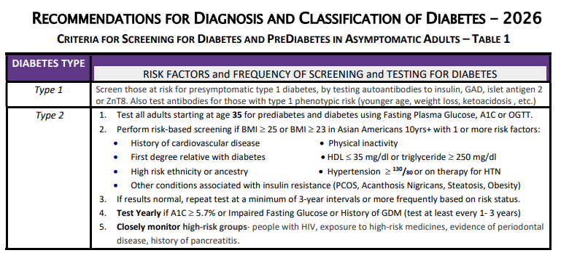
Diabetes Screening Guidelines (ADA 2026 Clinical Practice Guidelines – Cheat Sheet)

Slide 35

Poll Question 2
Which of the following level is considered pre-diabetes range?
a. Fasting BG of 62
b. A1c of 5.9 %
c. After meal BG of 137
d. A1c of 7.1 %

Slide 36
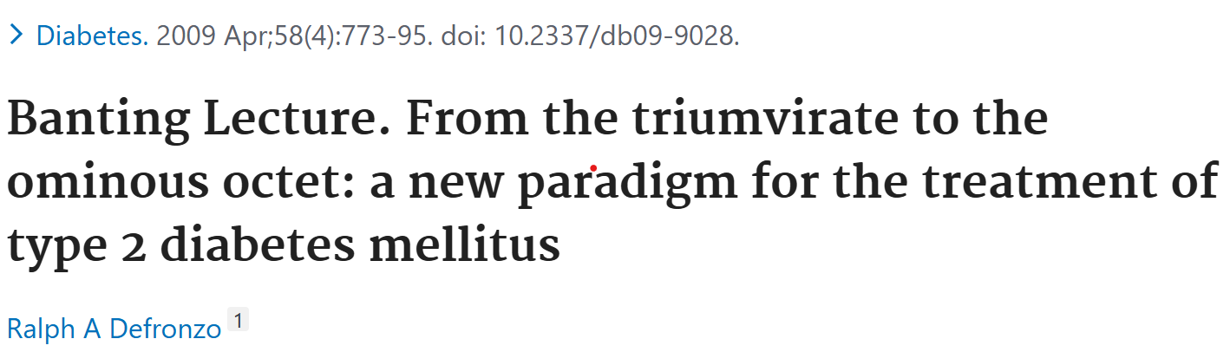
Natural History of Diabetes
Healthy
FBG <100
Random <140
A1c <5.7%
Prediabetes
FBG 100-125
Random 140 - 199
A1c ~ 5.7- 6.4%
50% working pancreas
Diabetes
FBG 126 +
Random 200 +
A1c 6.5% or +
20% working pancreas
Yes!
NO
Development of type 2 diabetes happens over years or decades

Slide 37

Poll Question 3
What best describes prediabetes?
Prediabetes affects 18-20% of people above the age of 20.
The prevalence of prediabetes and diabetes are almost equal.
Most people with BMI of 30 or greater have prediabetes.
Prediabetes is associated with increased risk of CV disease

Slide 38
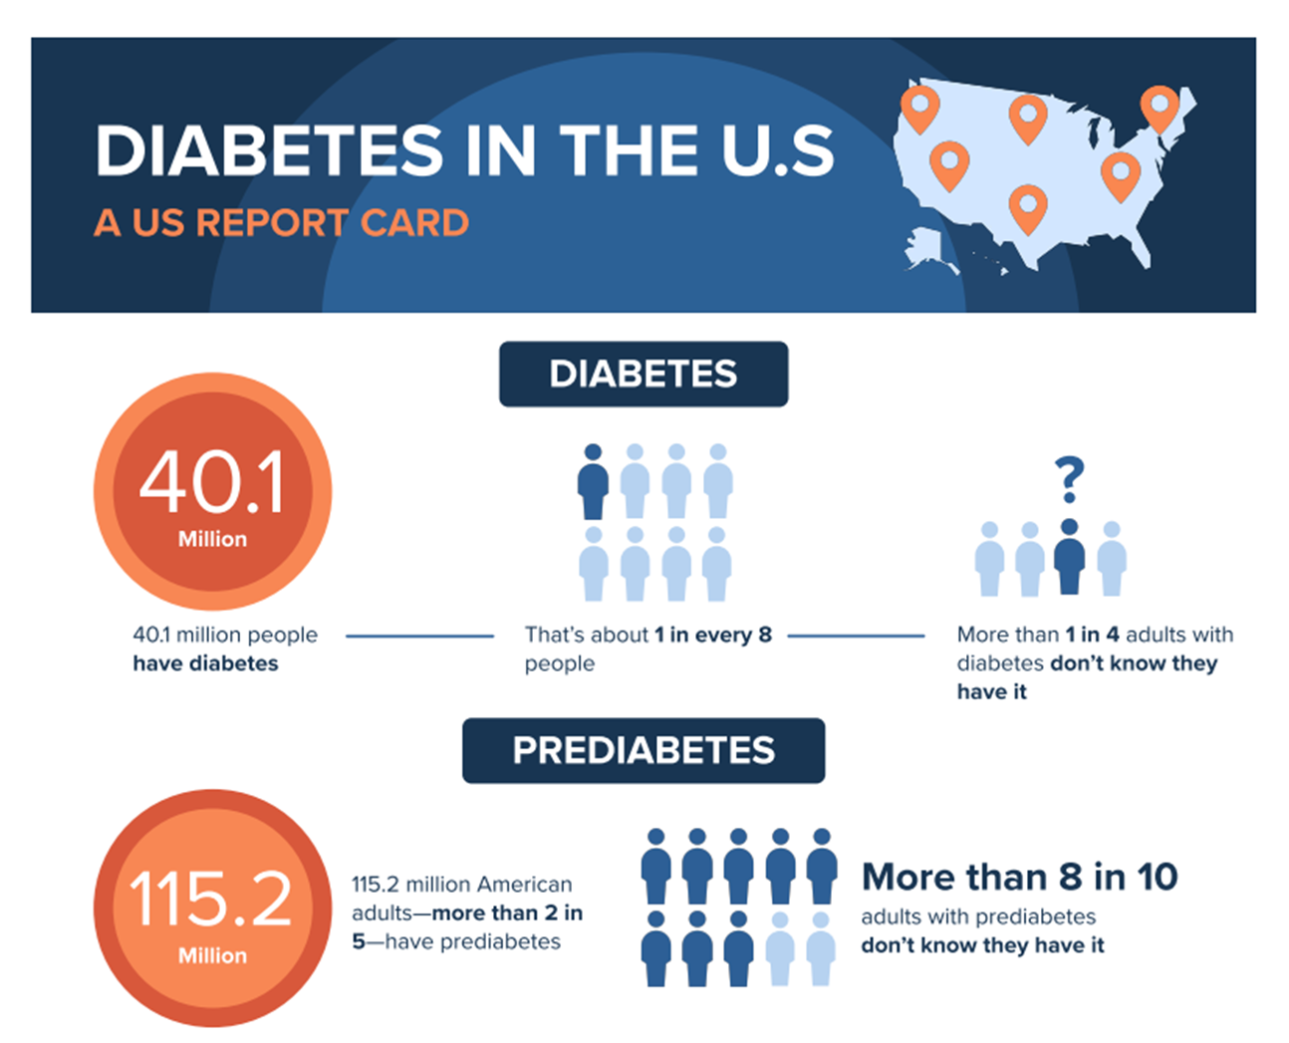

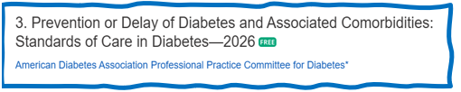
PreDiabetes is FREAKING ME OUT
96 million people in US
80% don’t know they have it
In 3-5 years, about 30% of predm will get diabetes
Associated with higher rates of heart attack, stroke, neuropathy and vessel disease

Slide 39

3. Prevent or Delay Diabetes for those with Prediabetes
Prediabetes defined as:
A1c 5.7 – 6.4% or fasting BG 100 -125mg/dl
Action:
Screen yearly for diabetes
For adults with BMI 23/25
Refer to DPP approved programs
Includes intensive behavioral lifestyle interventions with 5-7% wt reduction goal + 150 min exercise week
Provide in person or certified assisted programs

Slide 40

3. Detecting PreDiabetes Matters
Given the effectiveness of the Diabetes Prevention Program (DPP)
Refer adults with BMI 25+ at risk of diabetes to DPP
Achieve/maintain wt reduction of 5-7% through evidence-based eating patterns (Mediterranean, low carb, DASH.)
Participate in 150+ minutes activity a week
Should be covered by third-party payers,
Address inconsistencies in access – leverage technology
Monitor people with prediabetes at least annually for development of type 2 diabetes.

Slide 41

Sleep quality and Diabetes Risk
Sleep quality “an individual’s self-satisfaction with all aspects of sleep experience.”
Sleep modulates important metabolic, endocrine, cardiovascular processes.
Poor sleep quality associated with 40% increased risk of developing type 2 diabetes
Night owls have 2.5 higher odds for type 2 than early birds (chronotype)

Slide 42
3. Metformin & Prediabetes
Use metformin for prevention of type 2 for those at high risk:
25–59 yrs with BMI ≥35
A1C 6.0% or more
History of GDM
Periodic assess of B12, esp if have anemia, peripheral neuropathy.
Consider Metformin to prevent hyperglycemia in high-risk individuals:
Ind’s treated with Chemo medications:
Phosphatidylinositol 3-kinase α (PI3Kα) inhibitor (e.g., alpelisib and inavolisib).
High dose steroids

Slide 43

GLP-1 Therapy for Prediabetes?
The use glucagon-like peptide 1–based therapies for weight management in individuals with BMI of 25+ is highly beneficial and should be considered.
Every kilogram of weight loss confers a 16% reduction in risk of progression over 3.2 years

Slide 44
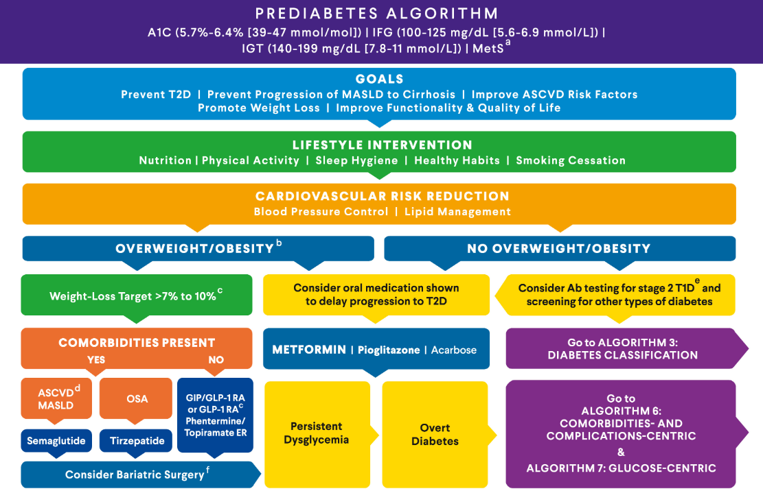
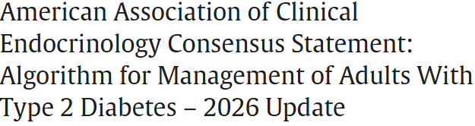

Slide 45

Diabetes is Complex
Goal – achieve well being and negotiated outcomes
Psychological factors:
Environmental
Social
Behavioral
Emotional
Keep it person centered while integrating care into daily life
Consider the individual

Slide 46

Remember by Joy Harjo – Poet Laureate
Remember the earth whose skin you are: red earth, black earth, yellow earth, white earth, brown earth, we are earth.
Remember the plants, trees, animal life who all have their tribes, their families, their histories, too. Talk to them, listen to them. They are alive poems.
Remember the wind. Remember her voice. She knows the origin of this universe.
Remember you are all people and all people are you. Remember you are this universe and this universe is you. Remember all is in motion, is growing, is you. Remember language comes from this. Remember the dance language is, that life is. Remember.
We are all connected

Slide 47

Let’s meet people where they are at.

Slide 48
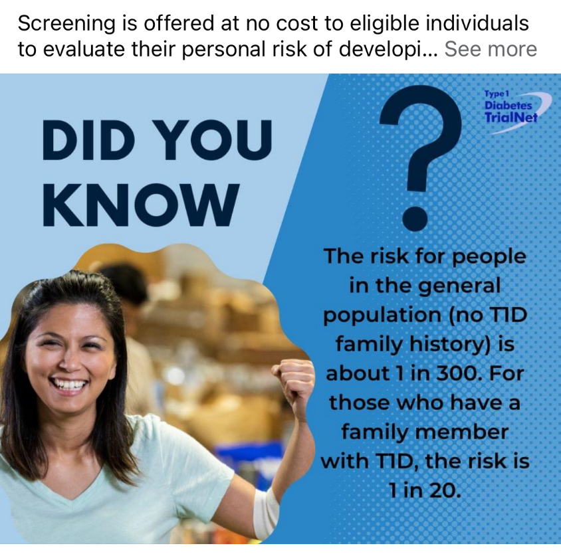

Type 1 ~ Immune Mediated 5-10% of Diabetes
1.5 Million people have type 1 in U.S.
Prevalence increasing:
2001 – 1.48 per 1000 youths diagnosed with diabetes
2017 - 2.15 per 1000 youths diagnosed with diabetes
Incidence & Prevalence increasing
Highest incidence in Finland or Northern Europe.
ADCES In Practice - March 2024 Recent Advances in Type 1 Diabetes: Teplizumab (Tzeild®)
Karen S. Fiano, PHARMD, BCACP, Devada Singh-Franco, PHARMD, CDCES, Young M. Kwon, BS, PHD

Slide 49


Slide 50



“Diabetes is my biggest competitor” Gary Hall Jr

Slide 51

Type 1 is 5- 10% of all Diabetes
Auto-immune pancreatic beta cells destruction
Most commonly expressed at age 10 – 14
Insulin sensitive (require 0.5 - 1.0 units/kg/day)
Expression due to a combo of genes and environment:
Autoimmunity tends to run in families
Exposure to virus or other environmental factors
51
Diagnostic Criteria for Diabetes
Notes:
When you get to the insulin piece, please mention we will get into great detail about insulin in the pharmacotherapy module

Slide 52
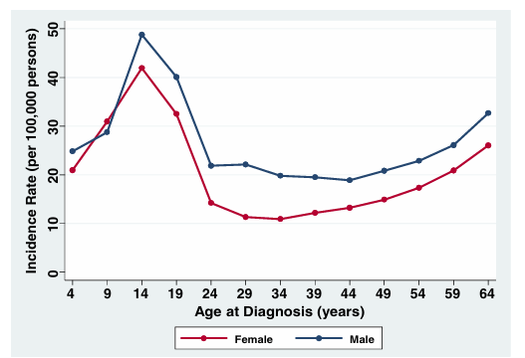
Clinical onset of T1D can occur at any age
* A longitudinal study comprising 32,476 commercially insured Americans aged 0-64 years who developed T1D between 2001 and 2015.
Rogers MAM, et al. BMC Med. 2017;15(1):199.

Slide 53
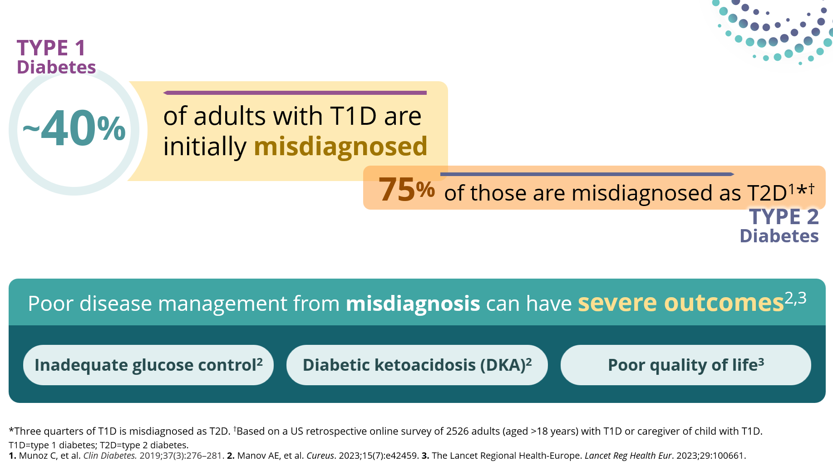
T1D is Often Misdiagnosed as T2D in Adults

Slide 54
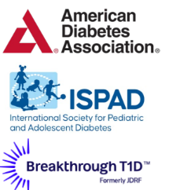
Screen people at increased risk of T1D
First-degree relatives of individuals with T1D
Individuals with personal or family history of select autoimmune diseases
Screening for T1D autoantibodies is recommended by
2-3X greater risk of T1D in individuals with select autoimmune diseases
~15x greater risk
of T1D versus the general population
Thyroid disorders
Hashimoto’s thyroiditis
Graves’ disease
Celiac disease
Also screen those with phenotypic risk factors that overlap with T1D (ex. Younger age at diagnosis, intentional weight loss, ketoacidosis, short to insulin treatment)

Slide 55
Benefits of early detection of pre-symptomatic T1D
Decreased frequency of insulin treatment at diagnosis
Lower HbA1C
Lower rates of DKA
98.1%
10.5%
62%
6.8%
72.3%
6%
Screened & diagnosed
Not screened
Screened & diagnosed
Not screened
Screened and diagnosed
Not screened
Sims E. et al. Diabetes. 2022 Apr 1;71(4):610-623.
Hummel S, et al. Diabetologia. 2023 Sep;66(9):1633-1642
Notes:
Hummel S, et al. Diabetologia. 2023 Sep;66(9):1633-1642. doi: 10.1007/s00125-023-05953-0. Epub 2023 Jun 17. PMID: 37329450; PMCID: PMC10390633.

Slide 56
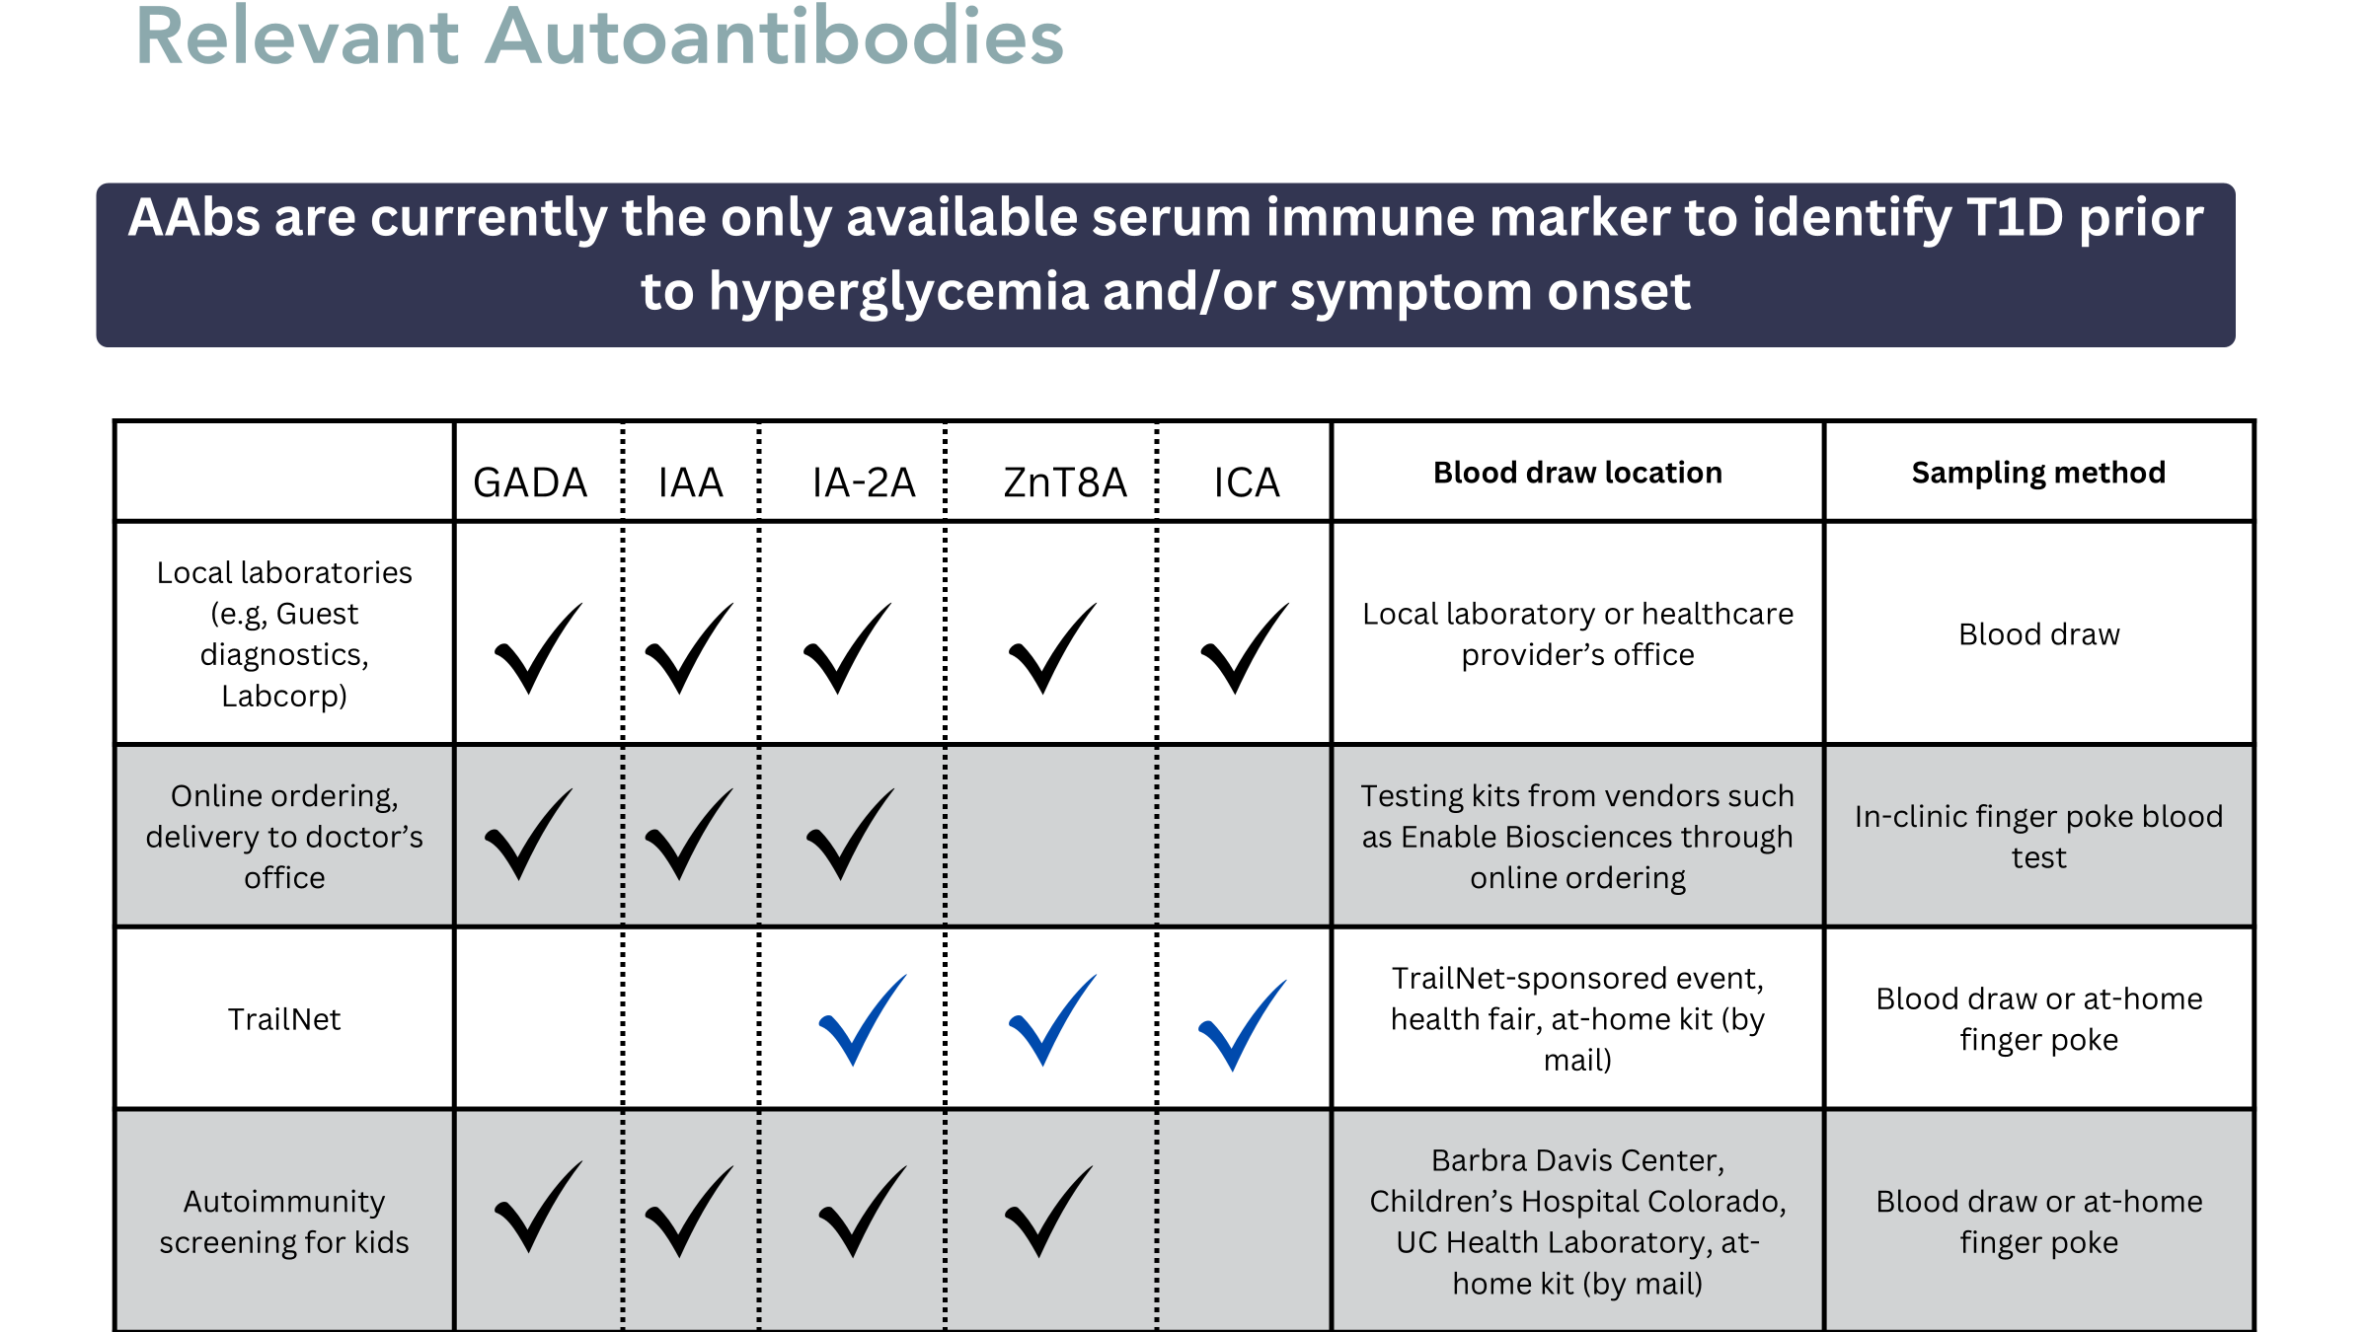
Ordering Autoantibodies
Patients at increased risk should be screened for type 1 diabetes
First-degree relatives of individuals with T1D
Individuals with personal or family history of select autoimmune diseases
Screened for T1D autoantibodies is recommended by
2-3X greater risk of T1D in individuals with select autoimmune diseases
~15x greater risk
of T1D versus the general population
Thyroid disorders
Hashimoto’s thyroiditis
Graves’ disease
Celiac disease
Glutamic acid decarboxylase 65 autoantibody (GADA)
Insulin autoantibody (IAA)
Insulinoma-associated antigen 2 autoantibody (IA-2A)
Zinc transporter 8 autoantibody (ZnT8A)
Islet cell autoantibody (ICA)

Slide 57
Stages of T1D
 | Stage 1 | Stage 2 | Stage 3
Characteristics | • Autoimmunity | • Autoimmunity | • Autoimmunity
 | • Normoglycemia | • Dysglycemia | • Overt hyperglycemia
 | • Presymptomatic | • Presymptomatic | • Symptomatic
Diagnostic criteria | • 2 or more islet autoantibodies Glucose levels are in normal range FBG<100mg/dL A1C<5.6% 2-h PG <140mg/dL | • 2 or more islet autoantibodies Dysglycemia: Elevated IFG and/or IGT • FPG 100–125 mg/dL • 2-h PG 140–199 mg/dL • A1C 5.7–6.4% or ≥10% increase in A1C | • Autoantibodies may disappear over time (5-10% may not express antibodies) • Diabetes diagnosed by standard criteria

Slide 58
Pharmacologic Intervention to Delay Stage 3 T1D
Teplizumab-Tzield (CD3-monoclonal antibody)
14-day infusion can delay the onset of symptomatic T1D (stage 3)
An option for individuals aged ≥8 years with stage 2 T1D
In a single trial, 44 individuals received 14-day course of teplizumab vs 32 in placebo
The median time to delay stage 3 T1D was 2 years
48.4 months in teplizumab group vs. 24.4 months placebo
Financial assistance available
Herold KC, et al; Type 1 Diabetes TrialNet Study Group. An Anti-CD3 Antibody, Teplizumab, in Relatives at Risk for Type 1 Diabetes. N Engl J Med. 2019 Aug 15;381(7):603-613.
Notes:
Herold KC, Bundy BN, Long SA, Bluestone JA, DiMeglio LA, Dufort MJ, Gitelman SE, Gottlieb PA, Krischer JP, Linsley PS, Marks JB, Moore W, Moran A, Rodriguez H, Russell WE, Schatz D, Skyler JS, Tsalikian E, Wherrett DK, Ziegler AG, Greenbaum CJ; Type 1 Diabetes TrialNet Study Group. An Anti-CD3 Antibody, Teplizumab, in Relatives at Risk for Type 1 Diabetes. N Engl J Med. 2019 Aug 15;381(7):603-613. doi: 10.1056/NEJMoa1902226. Epub 2019 Jun 9. Erratum in: N Engl J Med. 2020 Feb 6;382(6):586. doi: 10.1056/NEJMx190033. PMID: 31180194; PMCID: PMC6776880.

Slide 59
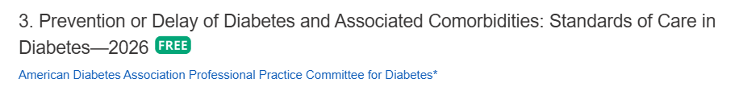
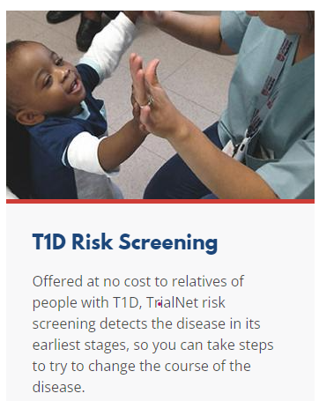
Monitoring for T1D Progression
In people with presymptomatic T1D; Monitor for disease progression
A1C every 6 months
75- OGTT every year
Modify screening frequency based on number/type of antibodies, age and glycemic metrics.
May benefit from CGM to monitor progression
In kids, monitor every 3 months
Trialnet.org
Phillip M, et al. Diabetes Care. 2024 Aug 1;47(8):1276-1298.

Slide 60
Type 1 & Lifestyle Prevention
Observational studies in those with antibodies, shed light on factors that increase β-cell demand:
Less physical activity
Consuming higher glycemic index foods
Sugar intake
Factors that reduced risk of progression from TEDDY study:
Daily minutes spent doing vigorous physical exercise.
More info needed

Slide 61
Quick Question 4
Question: LT is diagnosed with stage 1, type 1 diabetes. He has 2 positive autoantibodies and his glucose is slightly elevated. He asks you if he is a candidate for “that therapy” that can protect beta cells and slow progression of type 1 diabetes. What is the most accurate response?
Unfortunately, you are not a candidate, since you already have 2 positive autoantibodies.
Let’s talk to your provider about the possibility of starting Teplizumab therapy.
With your blood sugar elevation, the best early intervention is insulin therapy.
Since you are in stage 1, the therapy is not indicated, but let’s talk about monitoring.
Notes:
Answer, D

Slide 62
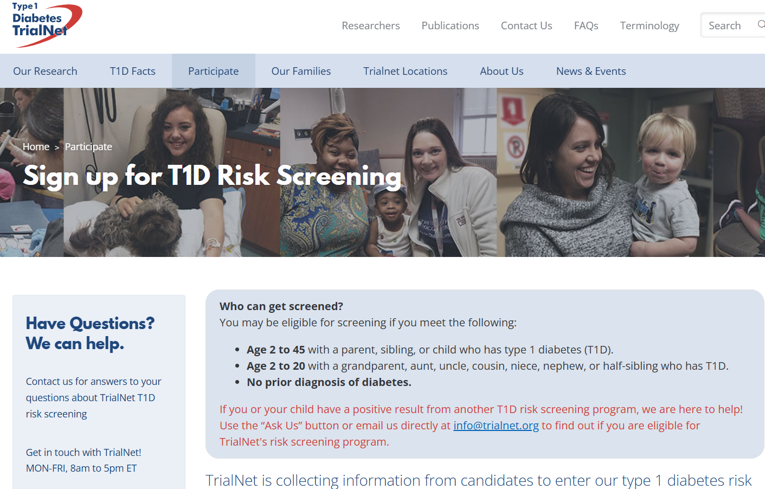
www.TrialNet.org
How to get families linked to screening?

Slide 63

Determine if Type 1 - Use AABBCC Approach
Age
e.g., for individuals <35 years old, consider type 1 diabetes
Autoimmunity
e.g., personal or family history of autoimmune disease or polyglandular autoimmune syndromes
Body habitus
e.g., BMI <25 kg/m2
Background
e.g., family history of type 1 diabetes
Control
e.g., level of glucose control on noninsulin therapies
Comorbidities
e.g., treatment with immune checkpoint inhibitors for cancer can cause acute autoimmune type 1 diabetes or presence of other autoimmune conditions

Slide 64

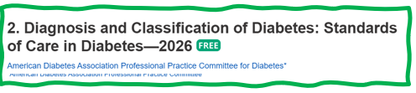
Type 1 Diabetes Features?
For JR, a 28 admitted to the ICU with a blood glucose of 476 mg/dl, pH of 7.1, anion gap of 15. Recently lost 13 pounds.
Type 1 Most Discriminative Features
Younger than 35 years at diagnosis
Lower BMI (<25 kg/m²)
Unintentional weight loss
Ketoacidosis
Glucose 360 mg/dl or greater.
Misdiagnosis is common and can occur in ∼40% of adults with new type 1 diabetes

Slide 65


Medalist Study – Harvard Joslin Diabetes Center
After 50 years with diabetes
Many still produced some insulin
Many had no eye disease

Slide 66

What kind of Diabetes?
58 yr old, states she has had type 1 diabetes for 18 years. Quit smoking a year ago and gained about 20 lbs. BMI 25.
Meds
Lispro 18-23 units before each meal
Glargine 28 units at bedtime
Metformin 500mg TID
What tests would you recommend?
25% of ind’s with Type 1 also have type 2 diabetes.
ADA Post Grad, 2010

Slide 67

Type 1 & Type 2 - Double Diabetes?
May be appropriate to recognize a person with type 1 diabetes and features classically associated with type 2 diabetes (e.g., insulin resistance, obesity, and other metabolic abnormalities.
Can help facilitate access to appropriate treatment:
(e.g., GLP-1 RA or SGLT-2 inhibitor therapies for potential weight and other cardiometabolic benefits) and monitoring systems.

Slide 68
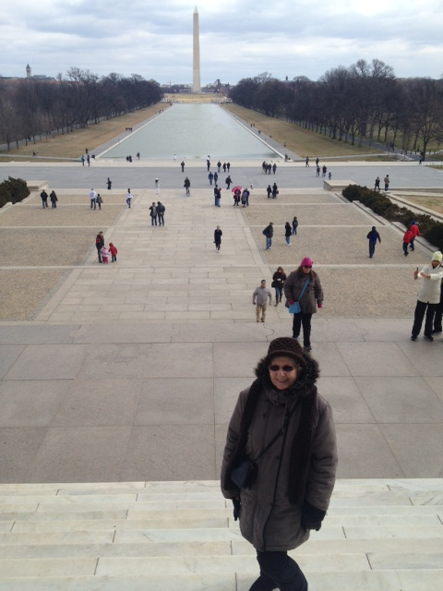
What type of Diabetes?
72 Years old
A1c 3 months prior 6.2%
A1c now 13.9%
BMI 24.5
Lost about 10 pounds over last month

Slide 69

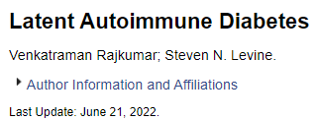
Latent AutoImmunity Diabetes in Adults (LADA)
Antibody positive to 1-2 of below
GAD-65 autoantibodies
Insulin Autoantibodies
Islet Cell antigen-2
ZnT8
Adult Age at onset
Usually benefit from insulin w/in first 6 months of diagnosis
Early insulin therapy may preserve beta cell function
Diabetes Care 26:536-538, 2003 Jerry P. Palmer, MD and Irl B. Hirsch, MD

Slide 70
LADA Clinical Features Compared to Type 2
Feature LADA Type 2
Age <50 63% 19%
Acute hyperglycemia 66 24
BMI < 25 33 13
Hx of autoimmune dx 27 12
Family hx autoimmune 46 35
Practical Diabetology March 08, Unger MD

Slide 71

What about Latent Autoimmunity Diabetes in Adults (LADA)
Slowly progressive autoimmune diabetes with an adult onset should be termed:
LADA or type 1 diabetes.
Slow autoimmune β-cell destruction can lead to a long duration of marginal insulin secretory capacity.
For this classification, all forms of diabetes mediated by autoimmune β-cell destruction independent of age of onset are included under the rubric of type 1 diabetes.

Slide 72
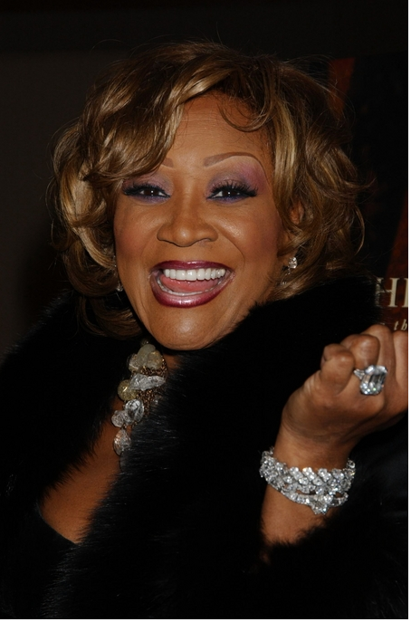
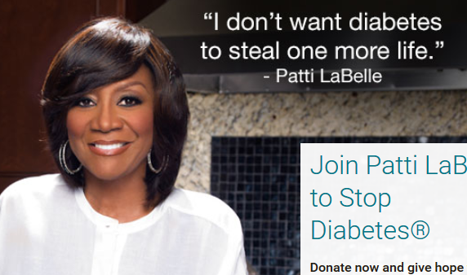
Patti Labelle
"divabetic”
“I have diabetes, it doesn’t have me”

Slide 73
Signs of Diabetes
Polyuria
Polydipsia
Polyphasia
Weight loss
Fatigue
Skin and other infections
Blurry vision
Glycosuria, H₂O losses
Dehydration
Fuel Depletion
Loss of body tissue, H₂O
Poor energy utilization
Hyperglycemia increases incidence of infection
Osmotic changes

Slide 74




Slide 75

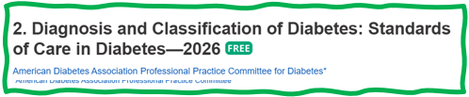
What is Type 2 Diabetes?
Type 2 diabetes is associated with insulin secretory defects related to
genetic predisposition,
epigenetic changes (how genes are expressed)
inflammation, and
metabolic stress.
Future classification schemes for diabetes will likely focus on the pathophysiology of the underlying β-cell dysfunction.

Slide 76

Life Study – Mrs. Jones
MJ is 62 years old, with a BMI of 36 and complains of feeling tired and urinating several times a night. Has a urinary tract infection. Her A1c is 8.3%, glucose 237.
MJ is hypertensive with a history of gestational diabetes. No ketones in urine.
What are risk factors and signs of diabetes?
You find a few moments to teach and MJ asks you some questions.

Slide 77


The Noxious Nine – Pathophysiology T2D
Hypercortisolism
Neurotrans-mission dysfunction
Decreased Insulin β-cell secretion
Increased renal glucose reabsorption
Decreased incretin effect Gut hormones
G
Increased glucagon α-cell secretion
I
G
I
G
G
I
I
G
Increased lipolysis
G
G
I
I
G
G
I
Increased hepatic glucose
production
I
G
G
Decreased muscle glucose uptake
DeFronzo, Auchus-Hypercortisolism June 2025
Notes:
77
ummary: The Noxious Nine in Diabetes Pathophysiology
Ralph A. DeFronzo expanded his earlier conceptual model of diabetes—known as the Ominous Octet—to include a ninth element: hypercortisolism. This updated framework is referred to as the Noxious Nine, highlighting the important role of cortisol dysregulation in difficult-to-control type 2 diabetes currentsciencedaily.com+8HCP Live+8HCP Live+8.
Recent research, including the CATALYST trial, shows that about 24% of patients with difficult-to-control T2D have underlying hypercortisolism. Treating this condition with mifepristone, a glucocorticoid receptor antagonist, led to significant improvements in HbA1c—averaging around a 1.5% reduction pmc.ncbi.nlm.nih.gov+3HCP Live+3medscape.com+3.
These findings emphasize the importance of recognizing hypercortisolism in T2D care and suggest that addressing it may help improve glycemic and metabolic control in a subset of patients.
77

Slide 78
Hypercortisolism in Type 2
Cortisol increases gluconeogenesis in the liver
Reduces peripheral glucose uptake → insulin resistance
Stimulates protein catabolism and lipolysis
Chronic cortisol elevation → persistent hyperglycemia and hypertension
Can lead to “Difficult to Control Type 2 Diabetes”
CATALYST study revealed about 24% of people with elevated BG despite meds, may be due to hypercortisolism.
Treatment with mifepristone decreased weight and BG.
DeFronzo, Auchus-Hypercortisolism June 2025
pmc.ncbi.nlm.nih.gov+3HCP

Slide 79
Comparison of Type 1,Type 2, LADA
Type 1
Type 2 LADA
Excess weight
x
xxx x
Insulin dependence
xxx
30% 6mos
Respond to oral agents
0
xxx x
Ketosis
xxx
x x
Antibodies present
xxx
0 xx
Typical Age of onset
teens
adult adult
Insulin Resistance
0
xxx
x

Slide 80

Break

Slide 81

SGLT-2 Inhibitors

Slide 82

SGLT and the Kidney

Slide 83

Additional SGLT2 Inhibitor Effects
Gaggini M, et al. Cells. 2025 Mar 6;14(5):387. doi: 10.3390/cells14050387.
Notes:
Gaggini M, Sabatino L, Suman AF, Chatzianagnostou K, Vassalle C. Insights into the Roles of GLP-1, DPP-4, and SGLT2 at the Crossroads of Cardiovascular, Renal, and Metabolic Pathophysiology. Cells. 2025 Mar 6;14(5):387. doi: 10.3390/cells14050387. PMID: 40072115; PMCID: PMC11898734

Slide 84

Poll Question 5
FZ has type 2 diabetes and heart failure. He was recently diagnosed with an A1C of 7.1%. What is the best medication to start?
Pioglitazone
Tirzepatide
Metformin
Dapagliflozin
Notes:
Answer: d

Slide 85


SGLT-2 Inhibitors- “Flozins”
Action: decreases renal reabsorption of glucose in the proximal tubule of kidneys (reset renal threshold)
Preferred diabetes treatment for people with heart and kidney failure. Decreases BG & CV Risk
AWP: ~$650 a month
% ‘f
Notes:
85
85

Slide 86
SGLT-2 Inhibitor Dosing and Renal Adjustments
Drug | Dose | Renal Adjustment
Ertugliflozin (Steglatro) | 5-15 mg daily | Not recommended for eGFR <45
Dapagliflozin (Farxiga) | 5-10 mg daily | Not recommended to initiate with eGFR <45 (glycemic control) or <25 (other conditions): may continue for CV, CKD benefits
Empagliflozin (Jardiance) | 10-25 mg daily | Not recommended to initiate for eGFR <30 (glycemic control) , may continue for CV, CKD benefits
Canagliflozin (Invokana) | 100-300 mg daily | eGFR 30 to <60: 100 mg once daily eGFR <30: avoid initiation, may continue 100mg daily for kidney benefits
Bexagliflozin (Brenzavvy) | 20 mg daily | Not recommended for eGFR <30
Package inserts, dailymed.nlm.nih.gov
Package inserts, dailymed.nlm.nih.gov
Notes:
Withhold DAPAGLIFLOZIN TABLETS for at least 3 days, if possible, prior to major surgery or procedures associated with prolonged fasting.

Slide 87
SGLT-2 Inhibitor Indications
Drug | Lowers BG | Reduces CV Risk? | Heart Failure Indication? | Kidney Indication?
Dapagliflozin (Farxiga) | Yes, for 10 yrs and older | Yes | Yes +/- Diabetes | Yes +/- Diabetes
Empagliflozin (Jardiance) | Yes for 10 yrs and older | Yes | Yes +/- Diabetes | Yes +/- Diabetes
Canagliflozin (Invokana) | Yes , for 10 yrs and older | Yes | Yes w/ Diabetes | Yes w/ Diabetes
Ertugliflozin (Steglatro) | Yes | No | No | No
Bexagliflozin (Brenzavvy) | Yes | No | No | No
Package inserts, dailymed.nlm.nih.gov

Slide 88
Benefits of SGLT-2 Inhibitors
A1C lowering
Modest weight loss
Cardiovascular
Renal
Heart failure
Blood pressure lowering

Slide 89
Side Effects of SGLT-2 Inhibitors
Tip: Hold for 3 days prior to surgery or procedures with prolonged fasting
Genitourinary infections
Volume depletion
Increased urination
Hypotension
Electrolyte changes
Diabetes ketoacidosis (DKA)
Amputation risk, Bone fracture (Canagliflozin)

Slide 90

Managing Adverse Effects
Maintain good hygiene to reduce risk of genital mycotic infections
Higher risk with higher glucose
DKA risk
Use caution with reducing insulin dose
Report nausea, vomiting and malaise
Monitor BP
May need to reduce antihypertensive meds
UTI risk greater with hyperglycemia

Slide 91
Where do SGLT2-2 Inhibitors Fit within the Guidelines?

Slide 92



Slide 94

AACE Glucose-Centric Algorithm

Slide 95


Slide 96

Case Study: Rick
Rick is a 51yoM diagnosed with type 2 diabetes 5 years ago.
He takes metformin 1000mg twice daily and semaglutide 2mg weekly. His A1C=6.7%.
In the last 3 months, he was diagnosed with kidney disease. He has albuminuria and eGFR=50.
Weight: 205lbs, 5”7, BMI=32kg/m²
He lost 20lbs in the last year
Notes:
Answer: D Metformin

Slide 97
Case Study: Rick 5A
What is the best drug to add to Rick’s regimen?
Glipizide
Empagliflozin
Pioglitazone
Linagliptin
Notes:
Answer: B.

Slide 98
SGLT2 Inhibitors- How do they rate?
Question Answer
Cause hypoglycemia?
Cause weight gain?
Affordable?
Lowers Cardiorenal risk?
Can most tolerate /use?
No
No
No
Yes
Yes

Slide 99


Other Types of Diabetes
Gestational
Other specific types of diabetes

Slide 100

Diabetes in Pregnancy Background
Prevalence of diabetes in pregnancy is increasing
Definitions
Pre-gestational diabetes: pre-existing type 1 or type 2 diabetes in pregnancy
Gestational diabetes: diabetes diagnosed in the 2nd or 3rd trimester of pregnancy
Notes:
ADA SOC

Slide 101

Poll question 6
What best describes gestational diabetes?
Diabetes discovered within the first 12 weeks of pregnancy.
Diabetes discovered in the 24-28 weeks of pregnancy.
Risk of getting diabetes before pregnancy.
Diabetes discovered at any point during pregnancy.

Slide 102

Rates of Gestational Diabetes (GDM) and Diabetes in Pregnancy increasing
1% to 2% have type 1 or type 2 during pregnancy
6% to 9% develop GDM
From 2000 to 2010
GDM rates increased 56%
Type 1 or type 2 before pregnancy increased 37%.
Asian and Hispanic women have higher rates of GDM
Black and Hispanic women have higher rates of type 1 or type 2 diabetes during pregnancy.
CDC https://www.cdc.gov/reproductivehealth/maternalinfanthealth/diabetes-during-pregnancy.htm

Slide 103
Screening in Early Pregnancy
Before 15 weeks, screen those with risk factors (B)
Consider screening everyone before 15 weeks (E)
If BG in normal range, recheck at 24-28 weeks for Gestational Diabetes using OGTT
If fasting BG 110+ or A1C 5.9%+
At higher risk of adverse outcomes and more likely to experience GDM and need insulin.
2. Diagnosis and Classification of Diabetes: Standards of Care in Diabetes—2026 Diabetes Care 2026;49(Suppl. 1):S27–S49 | https://doi.org/10.2337/dc26-S002

Slide 104

Gestational DM ~ 9% of all Pregnancies
Detected at 24-28 weeks of pregnancy (most insulin resistant phase)
Rates are increasing:
Women getting pregnant later
Higher rates of obesity
50% chance of getting diabetes post delivery
Offspring at greater risk of insulin resistance and diabetes

Slide 105

See Diabetes and Pregnancy Level 2
Screening and Diagnosis of Diabetes Cheat Sheet

Slide 106
Specific type of diabetes due to other causes
Medications:
Steroids
Anti-retroviral meds,
Antipsychotic meds
Transplant meds
Checkpoint inhibitors
Exocrine pancreas disease:
Cystic fibrosis
Type 3c
Pancreatitis
Monogenic diabetes syndromes
Agent Orange

Slide 107
Type 3c Diabetes (Pancreatogenic)
Includes both structural and functional loss of insulin secretion in the context of exocrine pancreatic dysfunction.
About 5-10% of diabetes, often misdiagnosed as type 2 diabetes.
Insulin sensitive
Assess wt loss, fatty stools – indications may need pancreatic enzyme replacement therapy (PERT).
The diverse set of etiologies includes:
pancreatitis (acute and chronic) ~70%
trauma or pancreatectomy
neoplasia
cystic fibrosis
hemochromatosis
fibrocalculous pancreatopathy
Screen for diabetes within 3-6 months of pancreatitis & annually.

Slide 108

Pancreatitis
People with diabetes 2xs risk of acute pancreatitis
After episode of pancreatitis, one third of people will get prediabetes or diabetes
About 25% to 80% of people with chronic pancreatitis develop Type 3c diabetes.
Pancreatitis is an exocrine dysfunction:
Disrupts global architecture or physiology of pancreas
Results in both exocrine and endocrine dysfunction.
Screen people for diabetes within 3–6 months following an episode of acute pancreatitis and annually thereafter

Slide 109

AACE 2026 Classification Algorithm

Slide 110
Diabetes Bingo “DiaBingo” Shout out Right Answer

Slide 111
DiaBingo
B Frequent skin and yeast infections
B A BMI of ____ or greater indicates increased pre/diabetes risk?
B To reduce complications, control A1c, Blood pressure, Cholesterol
B PreDiabetes – fasting glucose level of ___ to ____
B Erectile dysfunction indicates greater risk for ____
B Diabetes – fasting glucose level____ or greater
B Type 1 diabetes is best described as an ______ disease
B People with diabetes are ______ times more likely to die of heart dx
B Elevated triglycerides, < HDL, smaller dense LDL
B Each percentage point of A1C = _____ mg/dl glucose
B At dx of type 2, about __% of the beta cell function is lost
B Diabetes – random glucose ____ or greater

Slide 112

Incretins:
GLP-1 & GLP-1/GIP Receptor Agonists
GLP-1: glucagon like peptide 1
GIP: glucose-dependent insulinotropic polypeptide

Slide 113

The Rise of GLP-1 Agonists
1st available in 2005 (exenatide)
Semaglutide FDA approval 2017
Tirzepatide FDA approval 2022
12% (1 in 8 adults) said they have taken a GLP-1 agonist
KFF Health Tracking Poll May 2024: The Public’s Use and Views of GLP-1 Drugs | KFF
Notes:
KFF Health Tracking Poll May 2024: The Public’s Use and Views of GLP-1 Drugs | KFF
12% (1 in 8 adults) said they have taken a GLP-1 agonist including 43% of people with diabetes

Slide 114
Polling Question 6A
GLP-1 Medications are approved for all of the following conditions except:
Obesity
Type 2 Diabetes
Sleep apnea
Alcohol use disorder
Kidney disease
Notes:
Correct answer: D

Slide 115

Understanding the Natural Role of Incretins
GIP secreted by K-cells upon ingestion of food in the proximal small intestine
GLP-1 secreted upon ingestion of food by L-cells in the distal small intestine
Promotes satiety and reduces appetite
Alpha cells:
↓ Postprandial glucagon secretion
↑ Beta-cell
response
Liver: ↓ Glucagon reduces hepatic glucose output
Beta cells: Enhances glucose-dependent insulin secretion
Stomach: Helps regulate gastric emptying
Adapted from Flint A, et al. J Clin Invest. 1998;101:515-520 Adapted from Larsson H, et al. Acta Physiol Scand. 1997;160:413-422 Adapted from Nauck MA, et al. Diabetologia. 1996;39:1546-1553 Adapted from Drucker DJ. Diabetes. 1998;47:159-169
GLP-1 degraded by
DPP-4 w/in minutes
Notes:
115
115
DISCUSSION POINTS:
--Upon food ingestion, GLP-1 is secreted into the circulation from L cells of small intestine.
--GLP-1 increases beta-cell response by enhancing glucose-dependent insulin secretion.
--GLP-1 decreases beta-cell workload and hence the demand for insulin secretion by:
--Regulating the rate of gastric emptying such that meal nutrients are delivered to the small intestine and, in turn, absorbed into the circulation more smoothly, reducing peak nutrient absorption and insulin demand (beta-cell workload)
--Decreasing postprandial glucagon secretion from pancreatic alpha cells, which helps to maintain the counterregulatory balance between insulin and glucagon
--Reducing postprandial glucagon secretion, GLP-1 has an indirect benefit on beta-cell workload, since decreased glucagon secretion will produce decreased postprandial hepatic glucose output
--Having effects on the central nervous system, resulting in increased satiety (sensation of satisfaction with food intake) and a reduction of food intake
--By decreasing beta-cell workload and improving beta-cell response, GLP-1 is an important regulator of glucose homeostasis.
SLIDE BACKGROUND:
--Effect on Beta-cell: Drucker DJ. Diabetes. 1998; 47:159-169
--Effect on Alpha cell: Larsson H, et al. Acta Physiol Scand. 1997; 160:413-422
--Effects on Liver: Larsson H, et al. Acta Physiol Scand. 1997; 160:413-422
--Effects on Stomach: Nauck MA, et al. Diabetologia. 1996; 39:1546-1553
--Effects on CNS: Flint A, et al. J Clin Invest. 1998; 101:515-520

Slide 116

GLP-1 and GIP
Rosen CJ, Ingelfinger JR. GLP-1 Receptor Agonists. N Engl J Med. 2026 Apr 2;394(13):1313-1324.

Slide 117

Pocket Card: GLP-1 & GIP RA

Slide 118
Incretin Device Show/Tell

Slide 119
Oral Semaglutide (Rybelsus, Ozempic)
Barriers to GLP-1 oral absorption:
Degradation by gastrointestinal enzymes
pH induced conformational changes
Limited protein permeability of the intestinal membrane
Semaglutide co-formulated with sodium N-(8-[2-hydroxybenzoyl] amino) caprylate (SNAC), an absorption enhancer
Absorbed in stomach where SNAC causes a localized increase in pH, leading to higher solubility and protection against proteolytic degradation
Take daily at least 30 mins before first food, beverage, or other oral meds
Take with no more than 4 ounces of plain water
Swallow tablets whole (don't cut or crush)

Slide 120


SURPASS (Tirzepatide): A1C Change
Rosenstock J, et al. Lancet. 2021;398:143–55. Frias JP, et al. N Engl J Med. 2021;358:503–15. 82. Ludvik B, et al. Lancet. 2021;398:583–98. 83. Del Prato S et al. Lancet. 2021;398:1811–24. 84. Dahl Det al. Diabetologia. 2021:64(Suppl. 1):S13. Abstr 20. Kaneko S.. touchREV Endocrinol. 2022 Jun;18(1):10-19.

Slide 121

SURPASS (Tirzepatide): Body Weight Change
Rosenstock J, et al. Lancet. 2021;398:143–55. Frias JP, et al. N Engl J Med. 2021;358:503–15. 82. Ludvik B, et al. Lancet. 2021;398:583–98. 83. Del Prato S et al. Lancet. 2021;398:1811–24. 84. Dahl Det al. Diabetologia. 2021:64(Suppl. 1):S13. Abstr 20. Kaneko S.. touchREV Endocrinol. 2022 Jun;18(1):10-19.

Slide 122

GLP-1 Safety Profile
Drucker DJ. Efficacy and Safety of GLP-1 Medicines for Type 2 Diabetes and Obesity. Diabetes Care. 2024 Nov 1;47(11):1873-1888.
Notes:
Figure 2—Established and putative AEs associated with GLP-1 medicines. AEs in gray background described with red boldface text are established and common, with gastrointestinal AEs observed in 40%–65% of participants, whereas gallbladder AEs are reported in up to 3% of exposed participants, acute kidney injury is reported in

Slide 123

Poll Question 7
Alice injects tirzepatide once a week. Which of the following is true?
May experience constipation
May cause hypoglycemia
Muscle aches are common
Doubles risk of pancreatic cancer
Notes:
Answer: A

Slide 124
GLP-1 Adverse Effects
GI side effects
Nausea, appetite loss, diarrhea, constipation, dyspepsia, abdominal pain
Pancreatitis
Hypoglycemia with concomitant use of insulin or secretagogues
Acute kidney injury
Thyroid C-Cell tumors –black box warning
Avoid if personal or family history of medullary thyroid carcinoma or personal history of MEN-2
Acute gallbladder disease
Worsening retinopathy
Package inserts.
Notes:
Pancreatitis: Acute pancreatitis, including fatal and nonfatal hemorrhagic or necrotizing pancreatitis, has been observed in patients treated with GLP-1 receptor agonists. Pancreatitis has been reported in Mounjaro clinical trials. Mounjaro has not been studied in patients with a prior history of pancreatitis. It is unknown if patients with a history of pancreatitis are at higher risk for development of pancreatitis on Mounjaro. Observe patients for signs and symptoms including persistent severe abdominal pain sometimes radiating to the back, which may or may not be accompanied by vomiting. If pancreatitis is suspected, discontinue Mounjaro and initiate appropriate management.
In both male and female rats, tirzepatide causes dose-dependent and treatment-duration-dependent thyroid C-cell tumors at clinically relevant exposures. It is unknown whether Mounjaro causes thyroid C-cell tumors, including medullary thyroid carcinoma (MTC), in humans as human relevance of tirzepatide-induced rodent thyroid C-cell tumors has not been determined.
Mounjaro is contraindicated in patients with a personal or family history of MTC or in patients with Multiple Endocrine Neoplasia syndrome type 2 (MEN 2). Counsel patients regarding the potential risk for MTC with the use of Mounjaro and inform them of symptoms of thyroid tumors (e.g., a mass in the neck, dysphagia, dyspnea, persistent hoarseness). Routine monitoring of serum calcitonin or using thyroid ultrasound is of uncertain value for early detection of MTC in patients treated with Mounjaro.
Mounjaro has been associated with gastrointestinal adverse reactions, which include nausea, vomiting, and diarrhea. These events may lead to dehydration, which if severe could cause acute kidney injury. In patients treated with GLP-1 receptor agonists, there have been postmarketing reports of acute kidney injury and worsening of chronic renal failure, sometimes requiring hemodialysis. Some of these events have been reported in patients without known underlying renal disease. A majority of reported events occurred in patients who had experienced nausea, vomiting, diarrhea, or dehydration. Monitor renal function when initiating or escalating doses of Mounjaro in patients with renal impairment reporting severe adverse gastrointestinal reactions.
In clinical trials, acute gallbladder disease was reported by 0.6% of Mounjaro-treated patients and 0% of placebo-treated patients. If cholelithiasis is suspected, gallbladder diagnostic studies and appropriate clinical follow-up are indicated.

Slide 125
GLP-1 FDA Warning
Pulmonary Aspiration During General Anesthesia or Deep Sedation
Rare post marketing reports of pulmonary aspiration in patients receiving GLP-1 RA undergoing elective surgeries or procedures requiring general anesthesia or deep sedation who had residual gastric contents despite following preoperative fasting recommendations
Instruct patients to inform healthcare providers prior to any planned surgeries or procedures if they are taking a GLP-1 RA

Slide 126
Holding GLP-1 RA Before Surgery?
Balance withholding GLP-1 RA with risk of hyperglycemia
Consider rapid sequence intubation, longer liquid fast or POC ultrasound to reduce risk of aspiration
Bridging off therapy can be resource intensive, and lead to other SE-hyperglycemia or hypoglycemia
If decision to hold, general guidance
1 day for daily formulations
1 week for weekly formulations
Joshi, Girish P. et al. Preprocedure Care of Patients on Glucagon-like Peptide-1 Receptor Agonists: A Multisociety Clinical Practice Guidance. Anesthesiology 141(6):p 1208-1209, December 2024.
Notes:
1a. When an elevated risk of delayed gastric emptying and aspiration exist, withholding of GLP 1RAs should be balanced with the surgical and med ical risk of inducing the potential for a hazardous, metabolic disease state, like hyperglycemia. Further, bridging therapy off a GLP-1RA may be resource intensive, cost or insurance prohibitive, and risk other adverse side effects like hypoglycemia. Finally, with holding GLP-1RA perioperatively only for patients with the diseases of overweight and obesity, without an indication as described in Recommendation 1a, could constitute overweight and obesity bias, which should be avoided. c) If the decision to hold GLP-1RAs is indicated givenan unacceptable safety profile following shared decision making in the preoperative period, the duration to hold therapy is unknown [7]. At this time, it is suggested to follow the original guidance of the American Society of Anesthesiologists, holding the day of surgery for daily formulations, and a week prior to surgery for weekly formulations [4]. All patients should still be assessed on the day of procedure for symptoms sug gestive of delayed gastric emptying.

Slide 127

Counseling Points: GLP-1 RA & GLP-1/GIP
Avoid if personal or family history of medullary thyroid cancer or personal history of MEN-2
Avoid in combo with DPP-4 inhibitors
Watch for intestinal obstruction
Increased risk of biliary disease
Education: Eat smaller meals to reduce nausea and limit high fat meals
Use of non-FDA compounded products not recommended
Notes:
Biliary disease: evaluate for gallbladder disease if chole lithiasis or cholecystitis is suspected; avoid use in at-risk individuals • Ileus: reported, but risk level is not well established • Diabetic retinopathy: close monitoring of retinopathy in those at high risk (older individuals and those with longer duration of T2D [≥10 years]) • Nonarteritic anterior ische mic optic neuropathy (NAION) reported (rare inci dence); monitor for NAION during eye examinations

Slide 128
Counseling Points: GLP-1 RA & GLP-1/GIP
Potential risk of pancreatitis
If on tirzepitide, use back up contraception for first 4 weeks
Warning about aspiration during surgery
Ask about recent eye exam
Potential increase in diabetes retinopathy
Nonarteritic anterior ischemic optic neuropathy (NAION) reported (rare incidence)
Notes:
Biliary disease: evaluate for gallbladder disease if chole lithiasis or cholecystitis is suspected; avoid use in at-risk individuals • Ileus: reported, but risk level is not well established • Diabetic retinopathy: close monitoring of retinopathy in those at high risk (older individuals and those with longer duration of T2D [≥10 years]) • Nonarteritic anterior ische mic optic neuropathy (NAION) reported (rare inci dence); monitor for NAION during eye examinations

Slide 129
Poll Question 8
AR is 36 years old with type 2 diabetes and a BMI of 41kg/m². Current diabetes medications include: metformin, sitagliptin (Januvia) and empagliflozin (Jardiance) at maximum doses. AR is prescribed tirzepatide (Mounjaro). Based on this information, what action do you recommend to the provider?
Verify kidney function first.
Stop the sitagliptin when initiating tirzepatide.
Decrease the dose of metformin to prevent hypoglycemia.
Evaluate thyroid function before starting tirzepatide.
Notes:
Answer is B.

Slide 130
Injectable Incretins Approved for Weight Loss
Liraglutide:
Victoza 1.8 mg (diabetes)
Saxenda 3 mg (wt loss)
Semaglutide inj:
Ozempic 2mg (diabetes)
Wegovy 7.4mg (wt loss)
Tirzepatide
Mounjaro 15mg (diabetes)
Zepbound 15mg (wt loss)
All 3 Approved for use in adults with :
BMI of ≥ 30 or
BMI of ≥ 27 or greater who have hypertension, type 2 diabetes, or dyslipidemia.
Semaglutide (Wegovy) also indicated for those overweight/obesity & ASCVD to reduce CVD events and for those with metabolic dysfunction-associated steatohepatitis (MASH)
Tirzepatide (Zepbound) also indicated for those with obesity & Sleep Apnea

Slide 131
Oral GLP-1 RA Approved for Weight Loss
Semaglutide oral:
Rybelsus 14mg (Diabetes)
Ozempic 9mg (Diabetes)
Wegovy 25mg (wt. loss)
Orforglipron oral
Foundayo 17.2 mg (wt loss)
Both Approved for use in adults with :
BMI of ≥ 30 or
BMI of ≥ 27 or greater who have hypertension, type 2 diabetes, or dyslipidemia.
Oral Semaglutide (Wegovy) also indicated for those overweight/obesity & ASCVD to reduce CVD events
Notes:
Orforglipron is a non-peptide small molecule that doesn’t require special consdierations when eating/drinking or taking other pills.

Slide 132

GLP-1/GIP Receptor Agonist Indications
Package inserts, dailymed.nlm.nih.gov 2026

Slide 133
Where Do Incretins Fit within the Guidelines for Diabetes?

Slide 135
AACE Glucose-Centric Algorithm

Slide 137
The Future of Incretins is Bright
TIRZEPATIDE
PEMVIDUTIDE
SURVADUTIDE
ORAL
Monthly GLP-1/GIP agonist
Amylin and GLP-1 Agonist
Cagri-Sema Redefine
GIP
Glucagon
GLP-1 Agonist
Monoclonal antibody blocking activin type 2 receptors
GIP/GLP-1 Agonist
SURMOUNT trials
Glucagon/
GLP-1 Agonist
GLP-1 Agonist
High dose oral semaglutide
Non peptide
Orforglipron
Maritide
CAGRILINTIDE-SEMAGLUTIDE
RETATRUTIDE
BIMAGRUMAB

Slide 138

Medication Taking Behaviors
Adequate medication taking is defined as 80% of prescribed doses
23% of time, if A1c, B/P, lipids above target - due to med taking behavior
Assess for barriers
If taking meds 80% of time and goals not met, consider medication intensification
Barriers include:
Forgetting to fill Rx, forgetting to take, fear, depression, health beliefs, med complexity, cost, knowledge gap, system factors, etc.
Work on targeted approach for specific barrier

Slide 139

6. Glycemic Goals & Hypo
A1C
Blood Pressure
Cardiovascular risk reduction

Slide 140
ADA 2026 ABC Goals
A1c less than 7% (individualize)
Pre-meal BG 80-130
Post meal BG <180
Time in Range (70-180) 70% of time
Blood Pressure
<130/80
<120/80 for high risk
Cholesterol
Statin therapy based on age & risk status
If 40+ with ASCVD Risk, decrease LDL by 50%, LDL <70
If 40+ with ASCVD, decrease LDL by 50%, LDL <55

Slide 141


Poll Question 9
Which of the following methods can be used to assess glycemic status?
A. A1C
B. Blood glucose monitoring
C. Time in Range
D. Fructosamine
E. All of the above

Slide 142


6. Assess Glycemic Status
A1C measurement
Blood glucose monitoring (BGM)
by capillary (finger-stick) devices
Continuous glucose monitoring (CGM)
using time in range (TIR) or
mean CGM glucose.
Fructosamine – 2-4 wk glucose average
glycated albumin for those with anemia or hemoglobinopathies

Slide 143

6. Glycemic Targets for Non-Pregnant Adults
A1c < 7% - a reasonable goal for adults.
A1c < 6.5% - for those without significant risk of hypoglycemia
A1c < 8% - for those with history of hypoglycemia, limited life expectancy, or those with longstanding diabetes and vascular complications.
A1c Check Frequency:
If meeting goal - At least 2 times a year
If not meeting goal – Quarterly
Also review Ambulatory Glucose Profile

Slide 144
6. Glycemic Targets Individualize Targets – ADA
Pre-Prandial BG 80- 130
1-2 hr post prandial < than 180
*for nonpregnant adults
Time in Range: 70%
BG of 70-180 mg/dL

Slide 145

A1c and Estimated Avg Glucose (eAG)
A1c (%) eAG__
5 97 (76-120)
6 126 (100-152)
7 154 (123-185)
8 183 (147-217)
9 212 (170 -249)
10 240 (193-282)
11 269 (217-314)
12 298 (240-347)
eAG = 28.7 x A1c-46.7 ~ 29 pts per 1%
Translating the A1c Assay Into eAG – ADAG Study

Slide 146


Slide 147

(
American Diabetes Association Dia Care 2022 6.2 45- S89
Table 6.2
Notes:
Patient and disease factors used to determine optimal glycemic targets. Characteristics and predicaments toward the left justify more stringent efforts to lower A1C; those toward the right suggest less stringent efforts. A1C 7% = 53 mmol/mol. Adapted with permission from Inzucchi et al. (59).

Slide 148

Blood Glucose Monitoring vs. Continuous Glucose Monitoring (CGM)
= glucometer readings
Undetected hyperglycemia
Undetected hypoglycemia
Image created and permission to use granted by John Moorman, PharmD.
SMBG, self-monitoring of blood glucose.

Slide 149

A1C Alone is Not Enough
https://diatribe.org/time-range.

Slide 150


Ambulatory Glucose Profile
Standardized report with visual cues for those on CGM devices; time in range
Evaluate Time in Range (TIR)
Target 70-180 mg/dl (70% of time)
Eval % time below goal
< 70 (less than 4% of time)
<54 (less than 1% of time)
Eval % time above > 180 (less than 25% of time)
Eval % time above > 250 (less than 5% of time)
For those with frailty or at high risk of hypoglycemia recommend:
- Target of 50% time in range
- Less than1% time below range

Slide 151

Time in Range
Strong correlation between TIR and A1C, with a goal of 70% TIR aligning with an A1C of ∼7%
Battelino T, et al. Diabetes Care. 2019;42(8):1593-1603.
Notes:
Beck RW, Bergenstal RM, Cheng P, Kollman C, Carlson AL, Johnson ML, Rodbard D. The Relationships Between Time in Range, Hyperglycemia Metrics, and HbA1c. J Diabetes Sci Technol. 2019 Jul;13(4):614-626. doi: 10.1177/1932296818822496. Epub 2019 Jan 13. PMID: 30636519; PMCID: PMC6610606.

Slide 152

Ambulatory Glucose Profile Report
CGM key metrics
AGP
Daily tracings

Slide 153

Glucose Monitoring in Pregnancy
Check FBG and 1 or 2 hour PPG
Pre-existing type 1, need to also check premeal BG
CGM can help to achieve A1C targets when used in addition to pre- and postprandial glucose monitoring
Recommended for T1D and may be beneficial for other types of diabetes in pregnancy
Can reduce macrosomia and neonatal hypoglycemia in pregnancy complicated by type 1 diabetes.
15. Management of Diabetes in Pregnancy: Standards of Care in Diabetes—2026 Diabetes Care 2026;49(Suppl. 1):S321–S338

Slide 154
Glucose Targets in Pregnancy
 | Blood Glucose Goal
Glucose measurement | T1D or T2D | GD treated with insulin | GD not treated with insulin
Fasting glucose | 70-95 mg/dL | 70-95 mg/dL | <95 mg/dL
1 hr post-prandial glucose | 110-140 mg/dL | 110-140 mg/dL | <140 mg/dL
2 hr post-prandial glucose | 100-120 mg/dL | 100-120 mg/dL | <120 mg/dL
Monitor at least 4 times daily (FBG, PPG after each meal) or use CGM)
ADA. Diabetes Care. 2026; 49(Suppl 1): S27-49
Notes:
Lower glucose limits do not apply to individuals with t2DM treated with nutrition alone. Aim for less stringent goals if these cannot be achieved without significant hypoglycemia, based on clinical experience and individualization of care
* Optimal goal includes either a 1 hour post-prandial glucose level or 2 hour post-prandial glucose level within column of type of diabetes

Slide 155
CGM targets in Pregnancy
Pregnancy:
T1D
Pregnancy:
T2D
Pregnancy: GD
>140 mg/dL
<25%
>140 mg/dL
<15%
>140 mg/dL
<15%
Target range:
63-140 mg/dL
>70%
Target range:
63-140 mg/dL
Target range:
63-140 mg/dL
>80%
>90%
<63 mg/dL
<4%
<63 mg/dL
<4%
<63 mg/dL
<4%
<54 mg/dL
<1%
<54 mg/dL
<1%
<54 mg/dL
<1%
.
Battelino T, et al. Diabetes Care. 2019;42(8):1593-1603.
Benhalima K, et al. Lancel Diab, 2025. doi: 10.1016/S2213-8587(25)00335-3.

Slide 156

Pharmacologic Treatment during Pregnancy
Insulin is preferred therapy for all forms of diabetes in pregnancy
Does not cross placenta
Can overcome insulin resistance assoc w/ type 2
Sulfonylureas pass through placenta / associated with neonatal hypo (glyburide)
Metformin – lower risk of hypo and maternal wt gain but may increase prematurity rate/childhood obesity
Passes through placenta
If using for PCOS, stop by end of first trimester
Refer to specialized center

Slide 157

Pregnancy and Hypertension
If pregnant with diabetes and hypertension
Blood pressure target of 110–135/85 mmHg
Reduces risk for accelerated maternal hypertension
Minimizes impaired fetal growth
Stop potentially harmful medications in prep for pregnancy
Avoid ACE inhibitors, angiotensin receptor blockers (ARBs), statins in sexually active women of childbearing age if not using reliable contraception
Preferred HTN meds: labetolol, nifedipine , clonidine, methyldopa
Other beta blockers except atenolol can be used
15. Management of Diabetes in Pregnancy: Standards of Care in Diabetes—2026 Diabetes Care 2026;49(Suppl. 1):S321–S338

Slide 158

Case Study - Janet
Janet is a 36yoF with a history of GDM and newly diagnosed with type 2 diabetes. A1C=7.4%. Normal kidney function. Past medical history includes hypertension for which she takes HCTZ 25mg daily.
Weight: 140lbs, BMI=26kg/m²
Social history
Works full time as an accountant
Skips breakfast, eats a small lunch, eats a large dinner, snacks in evening
No Exercise
Loves Starbucks Frappuccino's
Notes:
Answer: D Metformin

Slide 159
Poll 11. What Treatment Should Janet Be Started On?
A. Semaglutide (GLP-1 inhibitor)
B. Linagliptin (DPP-4 inhibitor)
C. Empagliflozin (SGLT-2 inhibitor)
D. Metformin (Biguanide)
E. Lifestyle modifications only
Notes:
Answer: D

Slide 160

Enjoy Lunch Break 12:00 to 1:00 PM

Slide 161

Why Metformin?
Longstanding evidence
High efficacy and safety
Inexpensive - 3 months for $12
Weight neutral
Reduces risk of microvascular complications, cardiovascular events, and death

Slide 162
Metformin Dosing and Mechanism
Mechanism: decreases hepatic glucose production
Do not initiate when eGFR < 45
May be safely continued with eGFR of 30-45 mL/min/1.73m² with dose reductions
Max effective dose: 2000mg/day, max dose 2550mg/day
Monitor vitamin B12 levels and renal function
GI issues: nausea, vomiting, diarrhea
Consider long-acting formulation, dose reduction

Slide 163

Metformin

Slide 164
AACE Glucose-Centric Algorithm

Slide 165
Poll Question 12
Ricki is started on Metformin 500mg BID. Which of the following is true?
Hold metformin if blood glucose is below 80 mg/dL
Alcohol is contraindicated when taking metformin.
Metformin is weight neutral.
Metformin can cause kidney damage.
Notes:
Correction answer: C

Slide 166
Metformin – How Does it Rate?
Question Answer
Cause hypoglycemia?
Cause weight gain?
Affordable?
Lowers CV risk?
Can most tolerate /use?
(GI, CKD)
No
No
Yes
Yes
Yes/No

Slide 167

Peds, Older Adults & Med Assess
The next 20 slides (that were originally parked here), will be discussed at the end of the day today!
Thank You

Slide 168

Immunization Schedule for Diabetes 2026
Vaccine | Who by Age | Series and Frequency
Hepatitis B Vaccine | Adults ≤ 60 years* | 2-3 dose series
RSV | Adults ≥ 60 years | Single dose
Influenza (avoid live attenuated vaccine) | All | Annually
Tetanus, diphtheria, pertussis (Tdap) | All adults; extra dose during pregnancy | Booster every 10 years.
Zoster | Adults ≥ 50 years | 2 dose Shingrix
COVID-19 | Starting at age 6 mo’s | Initial vaccination and boosters
Pneumonia (PPSV23) Pneumovax | Adults19-64* | See Standards for schedule and details and for those 65 or older.
*Pneumococcal Conjugate Vaccine (PCV15, PCV20) | Adults 19-64 with underlying risk factors or no previous vaccination* | May need PPSV23 follow-up vaccine ≥1 year.* If 65+, discuss with provider.
2026 ADA Standards, Vol.49, s67 – s68 *See Table 4.3 for detailed info/considerations
.
For education purposes only. Compliments of www.DiabetesEd.net

Slide 169

Samson SL, Vellanki P, Blonde L, Hirsch IB, Hoang TD, Isaacs SD, Izuora KE, Low Wang CC, Ooi CP, Padilla BI, Schulman-Rosenbaum R, Twining CL, Umpierrez GE, Valencia WM. American Association of Clinical Endocrinology Consensus Statement: Algorithm for Management of Adults With Type 2 Diabetes - 2026 Update. Endocr Pract. 2026 Mar 17:S1530-891X(26)00022-4. doi: 10.1016/j.eprac.2026.01.006. Epub ahead of print. PMID: 41842862.
Notes:
Samson SL, Vellanki P, Blonde L, Hirsch IB, Hoang TD, Isaacs SD, Izuora KE, Low Wang CC, Ooi CP, Padilla BI, Schulman-Rosenbaum R, Twining CL, Umpierrez GE, Valencia WM. American Association of Clinical Endocrinology Consensus Statement: Algorithm for Management of Adults With Type 2 Diabetes - 2026 Update. Endocr Pract. 2026 Mar 17:S1530-891X(26)00022-4. doi: 10.1016/j.eprac.2026.01.006. Epub ahead of print. PMID: 41842862.
CopyDownload .nbib

Slide 170

Herbal Supplements
Berberine
Zinc
Vitamin D
Cinnamon
Ginseng
Aloe Vera
Chromium
Alpha lipoic acid
Magnesium
Gymnema
Notes:
10 Supplements to Help Lower Blood Sugar
NatMed Pro
Natureal medicine database

Slide 171

Deciding to Take Herbal Supplements
Lack of regulation with herbal supplements
Provide reliable education on costs/benefits/risks
Empower patients to make informed decisions

Slide 172


Hypoglycemia (Glucose) Alert Values
BG <70mg/dl – Level 1
Follow 15/15 rule and contact provider to make needed changes
BG < 54mg/dl – Level 2
Indicates serious hypo. Contact provider for med change. Glucagon Emergency Kit
Severe Hypoglycemia – Level 3
Requires external assistance – no threshold

Slide 173



Slide 174
Hypo Marker of CV Events & Mortality
Severe hypoglycemia is strongly associated with cardiovascular events and mortality.
HCP need to be vigilant in preventing hypoglycemia.
Avoid aggressively attempting to achieve near-normal A1C levels if such goals cannot be safely and reasonably achieved.

Slide 175
SDOH and Hypoglycemia
Food insecurity, housing instability, underinsured, under-resourced living areas is associated with increased risk of hypoglycemia-related emergency department visits
Identify if fasting part of religious observances
Young children and older adults at highest risk due to lack of recognition of hypo symptoms
Insulin pumps with automated low-glucose suspend and automated insulin delivery systems have been shown to be effective in reducing hypoglycemia in type 1 diabetes

Slide 176
Assess for Hypo
Review history of hypoglycemia at every clinical encounter for all individuals at risk for hypoglycemia
Evaluate hypoglycemic events
Screen for impaired hypoglycemia awareness at least annually or as needed.
Consider individual’s risk for hypoglycemia when selecting diabetes medications and glycemic goals.
Use of CGM is beneficial and recommended for individuals at high risk for hypoglycemia.

Slide 177

Hypoglycemia: Clinical Risk Factors

Slide 178

Tx of Level 2 & 3 Hypoglycemia
If can swallow w/out risk of aspiration, try gel, honey, etc. inside cheek
If unable or unwilling to swallow, D50 IV or Glucagon
If on Insulin at risk for high risk for hypoglycemia, prescribe Glucagon ER Kit.
Glucagon injection (need Rx)
Inform and instruct caregivers, school personnel, family, coworkers of hypo signs and appropriate action
Dosing: Adults 1mg, Children <20kg 0.5mg
Glycemic effect 20 - 30mg, short lived
Must intake carb as soon as able
Re-evaluate diabetes med treatment plan.

Slide 179


Poll Question 16
JL is 78 and drinks a “few cocktails” every night. Lives with partner and takes basal insulin at night and bolus insulin as needed. Has had a few low blood glucose levels in past week of 62, 49 and 51. What is the most important recommendation?
A. Decrease alcohol intake
B. Check BG at least 4 times a day.
C. Double check injection sites.
D. Get glucagon rescue medication.

Slide 180


Sulfonylureas - Secretagogues or “Squirters”
Mechanism: Stimulate beta cells to release insulin
Dosed 1-2x daily before meals
Adverse effects
Hypoglycemia, weight gain, watch renal function
Low cost, $12 for 3 months supply
Can help with glucose toxicity, lowers A1C 1-2%
Notes:
CAROLINA tral (linagliptin vs glimepiride)
Meta-analysis: In type 2 diabetes, the use of sulfonylureas is associated with increased mortality and a higher risk of stroke

Slide 181
Meglitinides - Squirts
Action: stimulate insulin secretion (rapid and short duration) when glucose present
Names:
Repaglinide (Prandin)
Dosing: 0.5 to 4 mg a.c. max dose 16mg
Metabolized by liver and mostly excreted in feces (some renally).
Nateglinide (Starlix)
Dosing: 120 mg tid with meals
Metabolized by liver, excreted by kidney
Efficacy:
Decreases peak postprandial glucose
Decreases plasma glucose 60-70 mg/dl
Reduce A1C 0.5-1%%
Notes:
181
181
The mechanism of action of repaglinide is similar to that of the sulfonylurea drugs: binding to beta cell receptors to stimulate insulin secretion. The major difference between the two drug classes is that meglitinides are shorter-acting, and are most effective when taken after meals in the presence of glucose.
Adverse effects include weight gain and hypoglycemia. An additional drawback to this drug is the dosing schedule since it must be taken with meals.

Slide 182

Case Study Ken – Poll 17
Ken is a 67yoM with type 2 diabetes x 5 years. He complains of dizziness/shakiness 3x/week. Last A1C=6.7%. Which of his medications is most likely causing hypoglycemia?
A. Metformin
B. Sitagliptin
C. Glimepiride
D. Pioglitazone
Notes:
Answer. C

Slide 183

Reducing Hypoglycemia
Which are the only diabetes meds that directly cause hypoglycemia?
Insulin
Secretagogues (sulfonylureas, glitinides)

Slide 184
AACE Glucose-Centric Algorithm

Slide 185



Slide 186

Quick Question 18
JZ is excited about his A1c of 5.4%. He takes rapid acting insulin 3 times a day using a pen to keep his BG to target. Plus, he adjusts glargine as needed if his pm BG is elevated. What is your biggest concern?
A. Does he change his needle each time?
B. How is he adjusting glargine?
C. Is he adjusting insulin for exercise?
D. How many hypoglycemic events per week?

Slide 187
Preventing Hypoglycemia
In people taking insulin or secretagogues
Nocturnal Lows
If bedtime glucose <110, reduce meds
If increased daytime activity, may need extra snack
Eval pre-dinner insulin/meds
Other
Monitor kidney function / wt loss
Monitor BG trends
Too much meds?
Skipped /delayed meals?
Plan ahead
Alcohol precautions
Exercise planning
CGM

Slide 188

Landmark Trials

Slide 189

Quick Question 19
Which study demonstrated that keeping A1c less than 7% reduces complications for Type 1?
Diabetes Prevention Trial
Diabetes Control and Complications Trial
United Kingdom Prospective Diabetes Study
YOUTH Trial

Slide 190

Diabetes Control and Complications Trial (DCCT) Type 1 – Does getting A1c <7% matter?
The largest, most comprehensive diabetes study ever conducted.
10 year study involved more than 1400 subjects with Type 1 DM.
Compared the effects of two treatment regimens:
standard therapy and
intensive control-on the complications of diabetes.

Slide 191

DCCT Conclusions
By maintaining A1C < 7%:
Eye disease - 76% reduced risk
Kidney disease - 50% reduced risk
Nerve disease - 60% reduced risk
Management elements included:
SMBG 4 or more times a day
4 daily insulin injections or insulin pump
Greater risk of hypoglycemia
More associated weight gain

Slide 192
UKPDS Results United kingdom Prospective Diabetes Study
Conducted over 20 years involving over 5,100 patients with Type 2 diabetes
1% decrease in A₁c reduces microvascular complications by 35%
1% decrease in A₁c reduces diabetes related deaths by 25%
B/P control (144/82) reduced risk of:
Heart failure (56%)
Stroke (44%)
Death from diabetes (32%)
Lancet 352: 837-865, 1998

Slide 193

“Legacy Effect”
For participants of DCCT and UKPDS
long lasting benefit of early intensive BG control prevents
Microvascular complications
Macrovascular complications (15-55% decrease)
Even though their BG levels increased over time
Message – Catch early and
Treat aggressively

Slide 194
Diabetes Bingo “DiaBingo” Shout out Right Answer

Slide 195
DiaBingo- G
G ADA goal for A1c is less than ____%
G People with DM need to see their provider at least every month
G Blood pressure goal is less than
G People with DM should see eye doctor every
G The goal for triglyceride level is less than
G Goal for LDL cholesterol if 40+ with diabetes is ____
G The goal for blood sugars 1-2 hours after a meal is less than:
G People with DM need this shot every year
G People with DM need to get urine tested yearly for ___________
G Periodontal disease indicates increased risk for heart disease
G The goal for blood sugar levels before meals is:
G The activity goal is to do ___ minutes on most days

Slide 196
How Many Drug Options for Diabetes?
Biguanide
Sulfonylureas
Meglitinides
Glucagon-like-peptide-1 (GLP-1) receptor agonists
GLP/GIP receptor agonist
Sodium glucose cotransporter-2 (SGLT-2) inhibitors
Thiazolidinediones (TZD’s)
Dipeptidylpeptidase-4 (DPP-4) inhibitors
Alpha-glucosidase inhibitors
Bile acid sequestrant
Dopamine-2-agonist
Insulin
Glucagon
GIP: glucose-dependent insulinotropic polypeptide

Slide 197
Drug Targets in T2D: Back to the Noxious 9
Hypercortisolism
Neurotrans-mission dysfunction
Decreased Insulin β-cell secretion
Increased renal glucose reabsorption
Decreased incretin effect Gut hormones
G
Increased glucagon α-cell secretion
I
G
I
G
G
I
I
G
Increased lipolysis
G
G
I
I
G
G
I
Increased hepatic glucose
production
I
G
G
Decreased muscle glucose uptake
DeFronzo, Auchus-Hypercortisolism June 2025
Notes:
197
ummary: The Noxious Nine in Diabetes Pathophysiology
Ralph A. DeFronzo expanded his earlier conceptual model of diabetes—known as the Ominous Octet—to include a ninth element: hypercortisolism. This updated framework is referred to as the Noxious Nine, highlighting the important role of cortisol dysregulation in difficult-to-control type 2 diabetes currentsciencedaily.com+8HCP Live+8HCP Live+8.
Recent research, including the CATALYST trial, shows that about 24% of patients with difficult-to-control T2D have underlying hypercortisolism. Treating this condition with mifepristone, a glucocorticoid receptor antagonist, led to significant improvements in HbA1c—averaging around a 1.5% reduction pmc.ncbi.nlm.nih.gov+3HCP Live+3medscape.com+3.
These findings emphasize the importance of recognizing hypercortisolism in T2D care and suggest that addressing it may help improve glycemic and metabolic control in a subset of patients.
197

Slide 198


Insulin Sensitizers
Action: decrease insulin resistance by making muscle and adipose cells more sensitive to insulin; decrease free fatty acids
Names:
pioglitazone (Actos) – bladder cancer warning
Dosing: 15-45 mg daily
Consider adding low dose if history of stroke or have steatosis
Efficacy/ Considerations
Reduce A1C ~0.5-1.0%
6 weeks for maximum effect
pioglitazone $5 a month, rosiglitazone $300 a month
Can cause fluid retention, not indicated w/ CHF
Notes:
198
198

Slide 200
AACE Glucose-Centric Algorithm

Slide 202
TZDs – How Do They Rate?
Question Answer
Cause hypoglycemia?
Cause weight gain?
Affordable?
Lowers CV risk?
Can most tolerate /use?
No
Yes
Generic
Yes
Watch HF

Slide 203
Dipeptidyl Peptidase-4 (DPP-4) Inhibitors
Mechanism of action
Prevents the breakdown of GLP-1 and GIP, resulting in 2-3X increased endogenous incretin levels
Efficacy
Hemoglobin A1C reduction by 0.6%–0.8%
Primarily lowers postprandial glucose levels
Not as effective as GLP-1 agonists
CV neutral, increased HF hospitalization with alogliptin/saxagliptin
Adverse effects
Generally well tolerated, dosed once daily
Avoid in combo with GLP-1 agonist
Caution with h/o pancreatitis
Potential joint pain
Dipeptidyl Peptidase-4 (DPP-4) Inhibitors

Slide 204
DPP4 Inhibitor Dosing
Drug | Dose | Renal Adjustment
Sitagliptin | 100 mg daily | 50 mg/day eGFR 30–45 mL/min/1.73m² 25 mg/day eGFR <30 mL/min/1.73m²
Linagliptin | 5 mg daily | None necessary
Saxagliptin | 5 mg daily | 2.5 mg/day eGFR < 45 mL/min/1.73m²
Alogliptin | 25 mg daily | 12.5 mg/day eGFR 30–59 mL/min/1.73m² 6.25 mg/day for eGFR <30 mL/min/1.73m²
Where do DPP4 inhibitors fit within the treatment algorithm?

Slide 206
AACE Glucose-Centric Algorithm

Slide 207

Alpha-glucosidase Inhibitors
Action: blocks enzymes that digest starches in the small intestine
Name: acarbose (Precose) or miglitol (Glyset)
Dosing: 25-100mg TID, max 300mg/day
Efficacy
Decrease postprandial glucose 40-50 mg/dl
Decrease A1C 0.5-1.0%
Other Effects
Flatulence or abdominal discomfort
Contraindicated in patients with inflammatory bowel disease or cirrhosis
Special Consideration
In case of hypoglycemia, treat with glucose tabs or milk
(other starches are blocked by medication))
Notes:
207
207
Alpha-glucosidase inhibitors (AGIs) work by blocking the enzyme in the small intestine that breaks down complex carbohydrates, alpha-glucosidase. By blocking this enzyme these drugs prevent starches from being absorbed into the bloodstream and in doing so lower blood glucose levels. AGIs are the only drug class used to treat type 2 diabetes that does not specifically target the pathology of the disease.
Because AGIs work in the digestive tract, they are more effective at lowering postprandial glucose levels than fasting plasma glucose levels. On average, AGIs are less effective at lowering A1c levels than biguanides or sulfonylureas.
What makes this class of drug attractive to patients and physicians is it's disassociation with weight gain and hypoglycemia. However, it is known to cause abdominal discomfort and diarrhea. AGIs are also rarely used as monotherapy because of their low efficacy.

Slide 208

Other Med Classes

Slide 209
Non-Insulin Drug Comparison
Class | Efficacy | Hypo | Weight | Effect on MACE | Heart Failure | Kidney | MASH | Cost
Metformin | High | No | Neutral/ Loss | Potential benefit | Neutral | Neutral | Neutral | Low
SGLT2 Inhibitors | Intermediate to High | No | Loss, intermediate | Benefit | Benefit | Benefit | Unknown | High
GLP-1 RA | High to Very High | No | Loss, intermediate to very high | Benefit | Benefit: sema | Benefit | Benefit | High
GIP and GLP-1 RA | High to Very High | No | Loss, very high | Under investigation | Under investigation | Under investigation | Potential Benefit | High
DPP-4 Inhibitors | Intermediate | No | Neutral | Neutral | Risk: saxa/alogliptin | Neutral | Unknown | High
Pioglitazone | High | No | Gain | Potential benefit | Risk | Neutral | Potential Benefit | Low
Sulfonylurea | High | Yes | Gain | Neutral | Neutral | Neutral | Unknown | Low

Slide 210


Slide 211

Check Your Knowledge - 20
Which of the following medications is least affordable?
Pioglitazone (Actos)
Metformin (Glucophage)
Glimepiride (Amaryl)
Semaglutide (Ozempic)

Slide 212
Medication Cost Considerations
Lowest cost medications - AWP for a month
Metformin - $3
Sulfonylureas $3
Pioglitazone $3
Bexagliflozin -$48,
Insulin-$35 co-pay or lower cost insulin (ex. NPH)
Highest cost medications – AWP for a month
GLP-1 RA - $1000
GLP-1/GIP RA - 1000+
SGLT2i - $650
DPP4i - $550-600
Lilly and Novo Nordisk have direct purchase programs

Slide 213

Cost Related Barriers
Among people with chronic illnesses, 2/3 of those who reported not taking medications as prescribed due to CRB never shared this with their physician.
Especially associated with diabetes medications and insulin.

Slide 214


Slide 215
Diabetes + CKD – Increases CVD Risk
Chronic kidney disease (CKD) is a frequent complication in diabetes
Type 1 diabetes ~30%
Type 2 diabetes ~up to 40%
In several studies, participants on SGLT2i with GFRs of 30-60 (stage 3) reduced ASCVD risk and improved renal function
Slowed kidney disease or death
Reduced albuminuria
National Kidney Foundation. https://www.kidney.org/atoz/content/diabetes

Slide 216

Chronic Kidney Disease - Choosing glucose-lowering medication
In kidney disease, use SGLT-2 in people with GFR ≥ 20 and continue until initiation of dialysis or transplantation.
(When GFR <45, SGLT-2’s don’t lower BG much.)
Or
GLP-1 RA with proven CVD CKD benefit
*Semaglutide improves kidney function (FLOW trial)
New in 2026: In adults with T2D and advanced CKD (eGFR <30), a GLP-1 RA is preferred for glycemic management due to lower risk of hypoglycemia and for CV event reduction

Slide 217


Risk of CKD Progression, CVD

Slide 218

Treating CKD
Use max tolerated ACEI or ARB
Optimize glucose and BP to protect kidneys
Aim to reduce urinary albumin by ≥30% in people with CKD
*SGLT-2i’s with proven benefit
Empagliflozin (Jardiance), canagliflozin (Invokana), dapagliflozin (Farxiga)
*GLP-1 RA’s with proven benefit
Semaglutide (Ozempic)-has indication, liraglutide (Victoza), dulaglutide (Trulicity)

Slide 219
New in 2026: GLP-1 in Kidney Disease
In adults with T2D and advanced CKD (eGFR <30), a GLP-1 RA is preferred for glycemic management due to lower risk of hypoglycemia and for CV event reduction.
Individuals on dialysis can be safely initiated or continued on GLP-1 based therapy to reduce CV risk and mortality
Reminder: only GLP-1 with renal restrictions are exenatide and lixisenatide

Slide 220
SGLT2 Inhibitor CKD Evidence Summary
Trial Name | SGLT2 Inhibitor vs placebo | Outcomes (Primary Bolded)
CREDENCE | Canagliflozin | N=4401, Median follow-up 2.6 years, Prior CVD 50.4% ESRD, doubling of creatinine or death from renal or CV cause (primary): HR 0.70 (0.59-0.82) 3 point MACE 0.80 (0.67-0.95)
DAPA-CKD | Dapagliflozin | N=4304, 2906 with diabetes, Median follow-up 2.4 years, Prior CVD 37.4% >50% decline in eGFR, ESKD or renal/CV death (primary): HR 0.61 (0.51-0.72)
EMPA-Kidney | Empagliflozin | N=6609, Median follow-up 2.0 years, Prior CVD 27%, 46% with DM ESRD, >40% decline in eGFR, ESKD, or renal/CV death (primary): HR 0.72 (0.64-0.82), stopped early due to positive benefit
Perkovic V, Jardine MJ, Neal B, et al. Canagliflozin and renal outcomes in type 2 diabetes and nephropathy. N Engl J Med. 2019;380:2295–2306.
Heerspink HJL, Stefansson BV, Correa-Rotter R, et al. Dapagliflozin in patients with chronic kidney disease. N Engl J Med. 2020;383:1436–1446.
EMPA-KIDNEY Collaborative Group, Herrington WG, Staplin N, Wanner C, et al. Empagliflozin in Patients with Chronic Kidney Disease. N Engl J Med. 2022 Nov 4. doi: 10.1056/NEJMoa2204233. Epub ahead of print. PMID: 36331190.

Slide 221
GLP-1 Receptor Agonists in CKD
Flow: Semaglutide in CKD
Effects of Semaglutide on Chronic Kidney Disease in Patients with Type 2 Diabetes (FLOW)
Study Design | Phase III randomized, double-blind, placebo-controlled trial
Size & Duration | N = 3,533; median follow-up: 3.4 years
Intervention | Semaglutide 1 mg per week vs. placebo
Patient Population | Adults aged ≥ 18 years with type 2 diabetes (A1C level ≤10%) eGFR 25 to <50 mL/min/1.73m² and UACR > 100 mg/g to 5000 mg/g OR eGFR 50 to 75 mL/min/1.73m² and UACR ≥ 300 mg/g to 5000 mg/g On stable, max-tolerated ACEI or ARB; or patients with documented intolerance
Endpoints | Primary Composite Endpoint¹ HR 0.76 (0.66–0.88); NNT 23 → ≥50% reduction from baseline in eGFR: HR 0.73 (0.59–0.89) → Death from cardiovascular causes: HR 0.71 (0.56–0.89)
¹ Primary composite endpoint: onset of kidney failure (dialysis, transplantation, or an eGFR of <15 ml per minute per 1.73 m²), at least a 50% reduction in the eGFR from baseline, or death from kidney-related or cardiovascular causes
Perkovic V, et al. N Engl J Med. 2024;391(2):109-121.
Notes:
Perkovic V, Tuttle KR, Rossing P, et al. Effects of Semaglutide on Chronic Kidney Disease in Patients with Type 2 Diabetes. N Engl J Med. 2024;391(2):109-121.

Slide 222

Finerenone Resource
In people with CKD and albuminuria, a nonsteroidal MRA effective if eGFR 25+

Slide 223

Kidney Goals and MNT
Nutrition Recommendations
For people with non–dialysis-dependent stage 3 or higher chronic kidney disease
dietary protein intake aimed to a target level of 0.8 g/kg body weight per day.
For those on dialysis,
consider protein intake of 1.0–1.2 g/kg/day since protein energy wasting is a major problem in some individuals on dialysis
Refer to nephrology
If GFR < 30 or uncertain CKD etiology

Slide 224

Figure 11-12 Holistic Approach to Diabetes + CKD

Slide 225
Diabetes Bingo “DiaBingo” Shout out Right Answer

Slide 226
DiaBingo - O
SGLT-2 Inhibitors main action
Sitagliptin (Januvia) belongs to which class?
These classes of diabetes pills increase insulin release
People with high am glucose may benefit from pm
On Acarbose (Precose) should treat hypo with ___
On Metformin (Glucophage) stop med if GFR ___
On which med should ind’s know about hypoglycemia
Possible side effects of TZD’s include
Metformin can damage kidney function
What warning for DPP- IV and GLP-1 RA
GLP-1 Receptor agonists cause increased satiety
If GI side effects on Metformin try ____

Slide 227



Slide 228


Stroke and Heart Attack
Make sure people with diabetes know the signs and seek immediate help.
People with diabetes may not experience intense chest or jaw pain during heart attack due to neuropathy.

Slide 229



Stroke of Luck

Slide 230

10. Cardiovascular Disease and Risk Management
CVD includes ASCVD and heart failure
ASCVD
Acute coronary syndrome
Myocardial infarction (MI)
Stable or unstable angina
Coronary or other arterial revascularization
Stroke, transient ischemic attack
Peripheral artery disease (PAD) including aortic aneurysm
CVD is the leading cause of morbidity and mortality in people with diabetes
Large benefits are seen when multiple CV risk factors are addressed simultaneously
With more aggressive goals, rates of CVD have decreased.
CV Risks predicted to increase in future.

Slide 231

Assess ASCVD and Heart Failure Risk
Duration of diabetes
BMI
Hypertension
Dyslipidemia
Smoking
Family history of premature coronary disease
Chronic kidney disease – presence of albuminuria
ASCVD risk factors and 10-year ASCVD risk assessment
Treat modifiable risk factors as described in ADA guidelines.
Notes:
ASCVD and heart failure history
ASCVD risk factors and 10-year ASCVD risk assessment

Slide 232

Reducing CV Risk Factors
Modifiable
Sleep
Smoking
Oral Care
Weight
Dietary Habits
Glucose
Blood Pressure
Lipids
UACR
Make small, achievable goals. We are in this for the long run.

Slide 233


ASCVD Targets
Targets Achieved in US Adults 2015-2018
A1C <7% by 50.5%
BP target of <130/80 achieved by 47.7%
Lipid control (non-HDL cholesterol) <130 mg/dL, achieved by 55.7%
22.2% met targets for all three risk factors
Largest contributor to direct and indirect costs - $37.3 billion/year
Rates of heart failure hospitalization are 2x higher in people with diabetes.
Notes:
Defined as ACS, history of MI, stable or unstable angina, coronary or other arterial revascularization, stroke, TIA, or PAD of atherosclerotic origin
Prevalence of HTN is 80% in adults with type 2 DM (AHA HTN guideline)

Slide 234

High Risk or Establish CVD, CKD, HF

Slide 235
Indicators of High CV Risk
Over 55 years with 2 or more additional risk factors:
Obesity
Hypertension
Smoking
Dyslipidemia
Albuminuria

Slide 236

Calculating ASCVD Risk
http://tools.acc.org/ASCVD-Risk-Estimator-Plus/#!/calculate/estimate/

Slide 237


Cardiovascular Disease or High Risk
Most effective meds based on Cardiovascular Outcomes Trial (CVOT) to Reduce MACE
GLP-1 RA’s Preferred semaglutide (Ozempic), liraglutide (Victoza), dulaglutide (Trulicity)
~ Or~
SGLT2i empagliflozin (Jardiance), canagliflozin (Invokana),
Dapagliflozin (Farxiga)
ASCVD = atherosclerotic cardiovascular disease
MACE: major adverse cardiovascular events
Notes:
For people with established atherosclerotic cardiovascular disease or indicators of high risk our recommendation is to choose a GLP-1 receptor agonist or an SGLT-2 inhibitor with proven cardiovascular benefit. In case HbA1c remains above target one should add an agent from the other category or pioglitazone as deemed necessary. Our recommendation is based on the favourable results of cardiovascular outcomes trials that established the favourable effect of GLP-1 receptor agonists and SGLT-2 inhibitors on a series of hard clinical outcomes including major adverse cardiovascular events and all-cause mortality.

Slide 238


Slide 239

Heart Failure
In people with heart failure, use SGLT2i because they improve heart failure and kidney outcomes.
New for 2026:
9.9 In adults with T2D, obesity, and symptomatic HFpEF, the glucose-lowering treatment plan should include a GIP/GLP-1 agonist or GLP-1 agonist with demonstrated benefits for HF-related symptoms and reduction in HF events (irrespective of A1C).
GLP-1 RA Semaglutide
GLP-1/GIP RA
Tirzepatide
SGLT2i Empagliflozin
Canagliflozin
Dapagliflozin
Ertugliflozin
HFpEF Heart failure with preserved ejection fraction ≥40% )
(HFrEF) Heart failure with reduced ejection fraction ≤40% )
Notes:
For individuals with heart failure our recommendation is that SGLT2i with proven benefit should be used because they improve heart failure and kidney outcomes.

Slide 240


Heart Failure in People with Diabetes

Slide 241
SGLT2 Inhibitor HF/ASCVD Evidence Summary
Trial Name | SGLT2 Inhibitor vs. placebo | Outcomes (Primary Bolded)
EMPA-REG Outcome | Empagliflozin | N=7020, Median follow-up 3.1 years, Prior CVD 99% 3 Point MACE (primary): 0.86 (0.74-0.99), CV death: 0.62 (0.49-0.77)
EMPEROR Reduced | Empagliflozin | N=3730, 1856 with diabetes, Median follow-up 1.3 years, 100% HF with reduced EF CV death or HF hospitalization (primary) 0.75 (0.65-0.86)
EMPEROR Preserved | Empagliflozin | N=5988, 2938 with diabetes, Median follow-up 2.2 years, 100% HF with EF > 40% CV death or HF hospitalization (primary) 0.79 (0.69-0.90)
CANVAS Program | Canagliflozin | N=10142, Median follow-up 3.6 years, Prior CVD 65.6% 3 point MACE (primary): 0.86 (0.75-0.97), Worsening nephropathy 0.60 (0.47-0.77)
DECLARE-TIMI 58 | Dapagliflozin | N=17160, Median follow-up 4.2 years, Prior CVD 40% 3 point MACE (primary): 0.93 (0.84-1.03) CV death or HF hospitalization: 0.83 (0.73-0.95),
DAPA-HF | Dapagliflozin | N=4744 (1983 with diabetes), Median follow-up 1.5 years, 100% HF Worsening Hf or CV death (primary) 0.74 (0.65-0.85)
DELIVER | Dapagliflozin | N=6263, 2807 with diabetes, Median follow-up 2.3 years, 100% with HF with EF > 40% Worsening HF or CV death (primary) 0.82 (0.73-0.92)
VERTIS-CV | Ertugliflozin | N=8246, Median follow-up 3.5 years, Prior CVD 99.9% 3 point MACE (primary) 0.97 (0.85-1.11), HF hospitalization 0.70 (0.51-0.90)
American Diabetes Association. 10. Cardiovascular disease and risk management: Standards of Care in Diabetes—2023. Diabetes Care 2023;46(Suppl. 1):S158–S190

Slide 242
Sotagliflozin (Impefa)
SGLT1/SGLT2 inhibitor
Indicated to reduce risk of CV death, hospitalization for HF, and urgent HF visit in adults with:
HF or
T2D, CKD, and other CV risk factors
Dose: 200mg once daily not more than 1 hour before first meal
Titrate up to 400mg daily after at least 2 weeks
Studied in the SCORED and SOLOIST trials.
SCORED: A total of 10.584 people with T2D and additional CV risk factors
After 16 months, rate of primary endpoint (death from CV causes, hospitalization for HF and urgent visits for GF) was reduced (5.6 events/100 patient years with sotagliflozin compared to 7.5/100 patient years with placebo)
Notes:
Sotagliflozin was evalu ated in the SCORED trial (281) and SOLOIST-WHF trial (297). A total of 10,584 people with type 2 diabetes, CKD, and additional cardiovascular risk were enrolled in SCORED and random ized to sotagliflozin200mgoncedaily (uptitrated to 400 mg once daily if toler ated) or placebo. SCORED ended early due to a lack of funding; thus, changes to the prespecified primary end points were made prior to unblinding to accom modate a lower-than-anticipated number of end point events. The primary end point of the trial was the total number of deaths from cardiovascular causes, hospi talizations for heart failure, and urgent visits for heart failure. After a median of 16 months of follow-up, the rate of pri mary end point events was reduced with sotagliflozin (5.6 events per 100 patient years in the sotagliflozin group and 7.5 events per 100 patient-years in the pla cebo group [HR 0.74; [95% CI 0.63–0.88]; P < 0.001]). Sotagliflozin also reduced the risk of the secondary end point of to tal number of hospitalizations for heart failure and urgent visits for heart failure (3.5% in the sotagliflozin group and 5.1% in the placebo group [HR 0.67 [95% CI 0.55–0.82]; P < 0.001]) but not the sec ondary end point of deaths from cardio vascular causes.

Slide 243
SGLT-2 Inhibitor Dosing & Indication
Once an SGLT2i is initiated, it is reasonable to continue an SGLT2i even if the eGFR falls below 20 ml/min/1.73 m2 , unless it is not tolerated or kidney replacement therapy is initiated.
Drug | Dose | FDA Approved Indications
Ertugliflozin (Steglatro) | 5-15 mg daily | As an adjunct to diet and exercise to improve glycemic control in adults with T2DM (All)
Dapagliflozin (Farxiga) | 5-10 mg daily | To reduce the risk of hospitalization for HF in adults with T2DM and established CVD or multiple CV risk factors. To reduce the risk of CV death and hospitalization for HF, and urgent HF visit in adults with HF. To reduce the risk of sustained eGFR decline, ESKD, CV death, and hospitalization for HF in adults with CKD at risk of progression.
Empagliflozin (Jardiance) | 10-25 mg daily | To reduce the risk of CV death in adults with T2DM and established CVD. To reduce the risk of CV death and hospitalization for HF in adults with HF To reduce the risk of sustained decline in eGFR, ESKD, CV death, and hospitalization in adults with CKD at risk of progression.
Canagliflozin (Invokana) | 100-300mg daily | To reduce MACE in adults with T2DM and established CVD. To reduce the risk of ESKD, doubling of serum creatinine, CV death, and hospitalization for HF in adults with T2DM and diabetic nephropathy with albuminuria >300 mg/day.
Bexagliflozin (Brenzavvy) | 20mg daily | As an adjunct to diet and exercise to improve glycemic control in adults with T2DM
Package inserts, dailymed.nlm.nih.gov

Slide 244
GLP-1 CV Evidence Summary
Trial name | GLP-1 agent/ comparator | Outcomes (primary bolded)
SUSTAIN-6^{d} | Semaglutide injection/placebo | 60% Prior CVD, 3-point MACE 0.74 (0.58-0.95) N = 3297, Median follow-up 2.1 y Worsening nephropathy 0.64 (0.46-0.88)
LEADER^{b} | Liraglutide/placebo | 81% Prior CVD, 3-point MACE 0.87 (0.58-0.95) N = 9340, Median follow-up 3.8 y Worsening nephropathy 0.78 (0.67-0.92)
ELIXA^{c} | Lixisenatide/placebo | 100% Prior CVD, 4-point MACE 1.02 (0.89-1.17) N = 6068, Median follow-up 2.1 y
SOULe | Semaglutide oral/placebo | 56.6% Prior CVD, 3-point MACE 0.79 (0.77-0.96) N = 9650, Median follow-up 4.1 y
EXSCEL^{f} | Exenatide–(weekly)/placebo | 73.1% Prior CVD, 3-point MACE 0.86 (0.83-1.00) N = 14,752, Median follow-up 3.2 y
REWIND^{g} | Dulaglutide/placebo | 32% Prior CVD, 3-point MACE 0.88 (0.79-0.99) N = 9901, Median follow-up 5. 4 y Worsening nephropathy 0.85 (0.77-0.93)
SURPASS-CVOT^{h} | Tirzepatide/placebo | 100% Prior CVD, Composite of death from CV causes, MI, or stroke 0.92 (0.83-1.01) N = 13,165, Median follow-up 4 y
Notes:
MACE: CV death, non-fatal myocardial infarction, or non-fatal stroke)
Abbreviations: CKD, chronic kidney disease; CV, cardiovascular; CVD, cardiovascular disease; eGFR, estimated glomerular filtration rate; FDA = US Food and Drug Administration; GLP-1 = glucagon-like peptide-1; HF, heart failure; MACE = major adverse cardiovascular events; MI, myocardial infarction; T2D, type 2 diabetes.
ªPerkovic V, Mann JFE, Wheeler DC, et al. Effects of semaglutide on chronic kidney disease in patients with type 2 diabetes. N Engl J Med. 2024;391(2):109-121.
^{b}Marso SP, Daniels GH, Brown‑Frandsen K, et al. Liraglutide and cardiovascular outcomes in type 2 diabetes. N Engl J Med. 2016;375(4):311-322.
^{c}Pfeffer MA, Claggett B, Diaz R, et al. Lixisenatide in patients with type 2 diabetes and acute coronary syndrome. N Engl J Med. 2015;373(23):2247-2257.
^{d}Marso SP, Bain SC, Consoli A, et al. Semaglutide and cardiovascular outcomes in patients with type 2 diabetes. N Engl J Med. 2016;375(19):1834-1844.
^{e}SOUL Study Group. Cardiovascular outcomes with oral semaglutide in patients with type 2 diabetes. Presented at: American Diabetes Association 85th Scientific Sessions; June 22, 2025; Chicago, IL.
^{f}Holman RR, Bethel MA, Mentz RJ, et al. Effects of once‑weekly exenatide on cardiovascular outcomes in type 2 diabetes. N Engl J Med. 2017;377(13):1228-1239.
^{g}Gerstein HC, Colhoun HM, Dagenais GR, et al. Dulaglutide and cardiovascular outcomes in type 2 diabetes (REWIND). N Engl J Med. 2019;380(24):2307-2319.
^{h}Nicholls SJ, Paco I, Bhatt DL, et al. Cardiovascular outcomes with tirzepatide versus dulaglutide in type 2 diabetes. N Engl J Med. 2025;393(24):2409-2420.

Slide 245
Meet Alice
Alice is a 56yo AAF presenting for follow-up for type 2 diabetes. Alice reports that her blood pressure has been higher lately. Denies s/sx of hypoglycemia.
PMH
Type 2 diabetes x5 years
HTN x 5 years
Depression
Meds
Metformin1000mg PO bid
Glipizide 10mg PO qam
Chlorthalidone 25mg PO daily
Escitalopram 10mg PO daily
PE
Ht: 5’3” Wt: 185lbs , BMI:32.8kg/m²
BP: 140/88mmHg
A1c=6.9%, K: 4.5mEq/L, Scr:0.8mg/dL, ACR 202 mg/g
Tchol=204mg/dL, HDL=34mg/dL, LDL=120mg/dL, TG=250mg/dL
Social history
(+)Alcohol: 1-2 drinks/week
(+) Tobacco use: 1/2ppd
Exercise: walks 15 min twice/week
Occ: receptionist
Home monitoring
FBG and pre-meal: 110-130 mg/dL
BP: 140-150/80-90mmHg

Slide 246

Questions to Think About
What are Alice’s blood pressure, cholesterol and glucose targets?
What lifestyle changes should be advised to reduce cardiovascular risk?
What changes should be made to optimize Alice’s medication regimen?

Slide 247

Hypertension Management in People with Diabetes

Slide 248
Classifying Hypertension
BP Category | SBP |  | DBP
Normal | <120 mmHg | And | <80mmHg
Elevated | 120-129mmHg | And | <80mmHg
Hypertension
Stage 1 | 130-139 mmHg | Or | 80-89mmHg
Stage 2 | ≥140mmHg | Or | ≥90mmHg
Individuals with SBP and DBP in 2 categories should be designated to the higher BP category

Slide 249


Taking an accurate Blood Pressure

Slide 250

BP and Diabetes Targets 2026
BP target <130/80 (if it can be safely attained)
A systolic BP <120 should be encouraged in individuals with high CV or kidney risk
Confirm systolic BP ≥ 130 or diastolic BP ≥ 80 using multiple readings, including measurements on a separate day, to diagnose hypertension.
If BP ≥ 180/110, can be diagnosed at single visit
BP target based on individual assessment, shared decision making and potential adverse effects
Monitor BP at each office visit and home for those with HTN
During pregnancy, BP Target of 110 -135/85

Slide 251

Cost vs Benefit of BP Target<130/80
Consider potential adverse effects of BP medications
Hypotension, syncope, falls, acute kidney injury, and electrolyte abnormalities
Older people, those with CKD, and frailty have been shown to be at higher risk
People with orthostatic hypotension, substantial comorbidity, functional limitations, or polypharmacy higher risk and may prefer relaxed BP targets to enhance quality of life.

Slide 252

BP Treatment in addition to Lifestyle
First Line BP Drugs if 130/80 +
With albuminuria or CAD
Start either ACE or ARB*
No albuminuria - Any of the 4 classes of BP meds can be used:
ACE Inhibitors, ARBs, thiazide-like diuretics or calcium channel blockers.
Monitor K+/Scr 7-14 days after initiation and dose increase for diuretics, ACEI/ARB
Avoid ACE and ARB at same time
Multiple Drug Therapy often required
If BP ≥ 150 /90 start 2 drug combo
*Albuminuria = Urinary albumin creatinine ratio of 30+

Slide 253

Hypertension Management

Slide 254

Hypertension Management (Cont)

Slide 255

HTN Lifestyle Treatment Strategies
If BP > 120/80, start with lifestyle
DASH Diet
Weight loss if indicated
Sodium intake <2,300mg/day
Eat more fruits & veggies (8-10 a day)
Low fat dairy products (2-3 servings/day)
Limit alcohol 1-2 drinks a day
Increase activity level

Slide 256

Cardiac and Renal Disease
The combination of 3 comorbidities has been termed cardiorenal metabolic disease or cardiovascular-kidney-metabolic health
ASCVD, heart failure, and chronic kidney disease (CKD)
Recognized interrelationship of cardiometabolic risk factors leading to cardiovascular disease and adverse kidney outcomes in people with diabetes.
3 comorbidities frequently associated with metabolic risk factors & extra weight
Incidence of all three conditions rises with increasing A1C levels.

Slide 257

Back to Alice
Alice is a 56yo AAF presenting for follow-up for type 2 diabetes. Alice reports that her blood pressure has been higher lately. Denies s/sx of hypoglycemia.
PMH
Type 2 diabetes x5 years
HTN x 5 years
Depression
Meds
Metformin1000mg PO bid
Glipizide 10mg PO qam
Chlorthalidone 25mg PO daily
Escitalopram 10mg PO daily
PE
Ht: 5’3” Wt: 185lbs , BMI:32.8kg/m²
BP: 140/88mmHg
A1c=6.9%, K: 4.5mEq/L, Scr:0.8mg/dL, ACR 202 mg/g
Tchol=204mg/dL, HDL=34mg/dL, LDL=120mg/dL, TG=250mg/dL
Social history
(+)Alcohol: 1-2 drinks/week
(+) Tobacco use: 1/2ppd
Exercise: walks 15 min twice/week
Occ: receptionist
Home monitoring
FBG and pre-meal: 110-130 mg/dL
BP: 140-150/80-90mmHg

Slide 258
Calculating ASCVD Risk
http://tools.acc.org/ASCVD-Risk-Estimator-Plus/#!/calculate/estimate/

Slide 259


What Is Alice’s ASCVD risk?
42% risk of a cardiovascular event in the next 10 years
This puts Alice at HIGH risk

Slide 260


Poll 1 - What is the blood pressure goal for Alice?
A. BP<120/80 mmHg
B. BP<130/80 mmHg
C. BP<140/80 mmHg
D. BP<140/90 mmHg
What drugs should we use to treat?
Notes:
Answer A

Slide 261

BP & Lipid Meds Cheat Sheet
www.DiabetesEd.net

Slide 262

ACE Inhibitors
Initial dose adjustment may be needed for renal dysfunction or elderly
See Med Cheat Sheets

Slide 263

Angiotensin Receptor blockers (ARB’s)
Initial dose adjustment may be needed for renal dysfunction or elderly
Med Cheat Sheets

Slide 264

ACEI/ARB Adverse Effects
Adverse effects
Dry cough with ACEI
Caused by inhibition of bradykinin breakdown
Hyperkalemia
Angioedema (< 1%)
Occurs 2-4x more frequently in African Americans
Bump in SCr
Up to 30% is acceptable
Orthostatic hypotension (initial dose)
Skin rash (captopril)
Contraindications
Pregnancy
Bilateral renal artery stenosis
Notes:
Hyperkalemia, especially in patients receiving potassium sparing diuretic, adlosterone antagonist, ARB or direct renin inhibitor,

Slide 265

Thiazide diuretics
See Med Cheat Sheets

Slide 266

Calcium Channel Blockers

Slide 267

Resistant hypertension
Not meeting BP targets on 3 classes of antihypertensive meds (including a diuretic) at optimal doses
Add mineralocorticoid receptor antagonist
Spironolactone (Aldactone®) 25-100mg daily
Eplerenone (Inspira®) 50-100mg daily
Monitor serum creatinine, potassium
Avoid use with finerenone

Slide 268

Beta Blockers
Use in recurrent MI, heart failure, angina
Side effects: depression, sexual dysfunction, exercise intolerance, sedation, dizziness
Monitor BP, lipids, heart rate, glucose
When stopping, taper dose gradually
Can elevate glucose and mask adrenergic symptoms of hypoglycemia (ex. tachycardia)
Sweating will still occur (cholinergic mediated)

Slide 269

AHA/ACC/AANP/AAPA/ABC/ACCP/ACPM/AGS/AMA/ASPC/NMA/PCNA/SGIM Guideline for the Prevention, Detection, Evaluation and Management of High Blood Pressure in Adults: A Report of the American College of Cardiology/American Heart Association Joint Committee on Clinical Practice Guidelines. Aug 14, 2025.

Slide 270

Other Hypertension Meds
Direct renin inhibitors (Alsikiren-Tekturna®)
Similar side effects to ACEI/ARB, rarely used in clinical practice
Loop diuretics (Furosemide, Torsemide, Bumetanide)
Use when eGFR<30 or if greater diuresis is needed, monitor electrolytes
Potassium sparing diuretics (ex. Amiloride, Triamterene)
Use in combination with thiazide to retain potassium, minimal effect on BP

Slide 271

Additional HTN Med Options
AHA/ACC/AANP/AAPA/ABC/ACCP/ACPM/AGS/AMA/ASPC/NMA/PCNA/SGIM Guideline for the Prevention, Detection, Evaluation and Management of High Blood Pressure in Adults: A Report of the American College of Cardiology/American Heart Association Joint Committee on Clinical Practice Guidelines. Aug 14, 2025.

Slide 272
Poll 2 - What Changes are Best to Make to Alice’s Hypertension Regimen?
Add lisinopril
Replace chlorthalidone with lisinopril
Add amlodipine
Replace chlorthalidone with amlodipine
Assume all choices include lifestyle modifications
Notes:
Answer: A

Slide 273
Lipid Goals – Primary Prevention
For people with diabetes aged 40–75: use a moderate intensity statin + lifestyle
Higher cardiovascular risk*
(*HTN, Smoke, CKD, BMI 30+ albuminuria, family hx ACSVD)
Use High-intensity statin therapy is recommended
Reduce LDL cholesterol by at least 50% of baseline AND
Target LDL <70 mg/dL.
If intolerant to statin, use bempedoic acid
If LDL >70mg/dL, It may be reasonable to add ezetimibe or a PCSK9 inhibitor to maximum tolerated statin therapy.

Slide 274


Lipid Therapy for Primary Prevention
180mg

Slide 275

Poll Question 3
RZ is 47 years old with type 2 diabetes and hypertension. RZ takes metformin 1000 mg BID, plus lisinopril 20mg daily. RZs LDL is 140 mg/dL. Based on the most recent ADA Standards, what is the LDL Cholesterol target for RZ?
LDL less than 100 mg/dL.
LDL less than 70mg/dL
LDL less than 55mg/dL
Determine LDL target based on ASCVD risk.
Notes:
Answer: B since primary prevention.

Slide 276


Lipid Goals/Therapy for People with ASCVD
For people of all ages with diabetes and ASCVD:
Add high-intensity statin to lifestyle therapy.
Reduce LDL cholesterol by 50% or greater from baseline with LDL goal <55.
Addition of ezetimibe or a PCSK9 inhibitor with proven benefit is recommended if goal is not achieved on max tolerated statin therapy.

Slide 277


Slide 278


Slide 279
Statin Dosing
High Intensity:
Lowers LDL ≥50%
Moderate Intensity:
Lower LDL 30-<50%
Atorvastatin (lipitor)
40-80mg
Rosuvastatin (crestor)
20-40mg
Atorvastatin (lipitor)
10-20mg
Rosuvastatin (crestor)
5-10mg
Simvastatin (zocor)
20-40mg
Pravastatin (pravachol)
40 – 80mg
Lovastatin (mevacor)
40 mg
Fluvastatin (lescol/XL)
80mg
Pitavastatin (livalo)
2-4mg
***If person can’t tolerate intended statin dose, use maximally tolerated dose
See Med Cheat Sheets

Slide 280

Do Statins Work?
Meta-analyses, including data from over 18,000 people with diabetes from 14 randomized trials of statin therapy (mean follow-up 4.3 years).
Statin therapy demonstrated
9% proportional reduction in all-cause mortality and
13% reduction in vascular mortality for each 39 mg/dL reduction in LDL cholesterol

Slide 281
Additional Agents to Lower LDL
Bempedoic acid (Nexletol)
Novel LDL cholesterol lowering agent acting in the same pathway as statin but without activity in skeletal muscle, which limits the muscle-related adverse effects
Lowers LDL cholesterol levels by 15% for those on statins and 24% for those not taking statins
CLEAR Outcomes trial found a reduction in 4 point MACE events by 13% compared with placebo for individuals with established ASCVD or high ASCVD risk
Dose: 180mg orally once daily
Available with ezetimibe as Nexlizet
Once daily with or without food
Notes:
. The Evaluation of Major Cardiovas cular Events in Patients With, or at High Risk for, Cardiovascular Disease Who Are Statin Intolerant Treated With Bempedoic Acid or Placebo (CLEAR Outcomes) trial found a reduction in four-point major ad verse cardiovascular events by 13% com pared with placebo for individuals with established ASCVD (70% of population) o

Slide 282
Additional Agents to Lower LDL
PCSK9 Inhibitors
Evolucumab (Repatha) and Alirocumab (Praluent)
Auto-injector
When added to max tolerated statin, decreases LDL from 52-65%
No CV outcome trials for primary prevention
For secondary prevention, significantly reduced the risk of MACE by 15-20% in FOURIER (evolucumab) and ODYSSEY (Alirocumab)
Fewer skeletal muscle adverse effects compared to statins
Notes:
When added to a maximally tolerated statin, these agents reduced LDL cholesterol by ∼60% (115) and significantly reduced the risk of major adverse cardiovascular events by 15–20% in the FOURIER (evolo cumab) and ODYSSEY OUTCOMES (Evalu

Slide 283

From Meds Cheat Sheet Page – Diabetesed.net

Slide 284
Additional Agents to Lower LDL
Iclisiran (Leqvio)
Indicated as adjunct to diet and statin therapy to lower LDL
Lowers LDL by ~50% when added to statin
Targets PCSK9
SC injection, day 1, 90 days, then every 6 months
Exploratory analysis showed reduced CV events vs. placebo
Ongoing CV outcome trial in people with established CVD and primary prevention
Notes:
In addition to the monoclonal antibod ies, an siRNA, inclisiran, which also targets PSCK9, has demonstrated the ability to re duce LDL cholesterol by 49–52% in trials evaluating individuals with established cardiovascular disease or ASCVD risk equivalent (129). Inclisiran allows less frequent administration compared with monoclonal antibodies and was admin istered on day 1, on day 90, and every 6monthsinthesetrials.Inanexploratory analysis, the prespecified cardiovascular end point of nonadjudicated cardiovascu lar events, including cardiac death, signs or symptoms of cardiac arrest, nonfatal MI, or stroke, occurred less frequently with inclisiran than placebo (7.4% vs. 10.2% in one trial and 7.8% vs. 10.3% in another trial). Cardiovascular outcome trials using inclisiran in people with estab lished cardiovascular disease (130,131) and for primary prevention in those at high risk for cardiovascular disease (132) are currently ongoing.

Slide 285
Treating High TG
In adults with high fasting TG>150, evaluate secondary causes: diabetes, chronic liver or kidney disease, hypothyroidism, alcohol, meds that raise TG
Consider fibrates or fish oil when TG>500mg/dL and definitely when TG>1000mg/dL
High TG puts people at increased pancreatitis risk
In People with ASCVD or other CV risk factors on a statin with managed LDL but elevated TG (150-499mg/dL), adding icosapent ethyl (vascepa) can be considered to reduce CV risk (REDUCE-IT trial)
Individuals randomized to 2g BID who had either established CVD or diabetes + at least 1 risk factor, icosapent ethyl demonstrated a 25% risk reduction in 3 point MACE
Notes:
In individuals with ASCVD or other cardiovascular risk factors on a statin with managed LDL cholesterol but ele vated triglycerides (150–499 mg/dL [1.7–5.6 mmol/L]), the addition of ico sapent ethyl can be considered to re duce cardiovascular risk.

Slide 286

Fibrates
Statin plus fibrate combination therapy has not been shown to improve ASCVD outcomes and is generally not recommended. (A)
Fibrates include fenofibrate and gemfibrozil
May be appropriate for a person with very high TG
Statin plus niacin combination therapy has not been shown to provide additional cardiovascular benefit above statin therapy alone, may increase the risk of stroke with additional side effects, and is generally not recommended. (A)

Slide 287

Lipid and HTN Meds Cheat Sheets
Website: https://diabetesed.net/coach-bevs-diabetes-cheat-sheets/
On CDCES Coach App too
For exam, know major classes, when used, side effects and considerations.

Slide 288


For exam, be familiar with content on Cheat Sheets
For CDCES – be familiar with the action, side effects and monitoring for the main BP meds and lipid meds.
For BC-ADM, be familiar with list above, plus dosing parameters and be comfortable looking at research results.

Slide 289
Lipid Monitoring and Lifestyle Treatment Strategies
Lipid Goals
HDL >40 (men), >50 (women)
Triglycerides <150
LDL target based on risk
Weight loss if indicated
Mediterranean or DASH Diet
Reduction of saturated fat intake
Increase of omega-3 fatty acids, viscous fibers and plant stanols/sterols
Increase activity level
BG lowering
Reduce alcohol
Monitoring:
If not taking statins and underage of 40.
- check at time of diagnosis and every 5 yrs.
On statin
Monitor lipids at diagnosis, 4-12 weeks after starting statin or dose adjustment and yearly

Slide 290

Additional Lipid Screening Tests

Slide 291

Impacts on CV events with different agents
2025 AACE Dyslipidemia Guidelines

Slide 292

Back to Alice
Alice’s lipid panel is as follows:
Total cholesterol: 204mg/dL
LDL: 120mg/dL
HDL: 34mg/dL
Triglycerides: 250mg/dL
Which ASCVD risk factors does Alice have?
Low HDL, smokes, obesity, HTN, albuminuria
10 year ASCVD risk=42%

Slide 293
Poll 4 - What is the best Lipid Recommendation for Alice?
Optimize lifestyle modifications only
Lifestyle + initiate a moderate intensity statin
Lifestyle + initiate a high intensity statin
Lifestyle + initiate high intensity statin + icosapent ethyl
Lifestyle + initiate high intensity statin + bempedoic acid
Notes:
Answer: C
Technically ezetimibe + high intensity statin could be considered since she’s such high risk.

Slide 294
Antiplatelet Agents

Slide 295

10 - ADA Antiplatelet Agents
Use aspirin therapy (75–162 mg/day) as a secondary prevention strategy in those with diabetes and a history of atherosclerotic cardiovascular disease.
Aspirin therapy dose (75–162 mg/day)
Increased bleeding risk
Dual antiplatelet therapy with a P2Y12 inhibitor for 1 year after acute coronary syndrome and may have benefits beyond
Aspirin may be considered as a primary prevention strategy in diabetes (usually over age 50) with increased CV risk.
Requires comprehensive discussion w/ person on benefits versus increased risk of bleeding.
Aspirin allergy, consider different agent

Slide 296

Should Alice start aspirin?
Yes
No
Individualized discussed with shared decision making
Notes:
Do not make this a polling question.

Slide 297
Would you change Alice’s Diabetes Regimen?
Current meds
Metformin1000mg PO bid
Glipizide 10mg PO qam
Chlorthalidone 25mg PO daily
Escitalopram 10mg PO daily
Home monitoring
FBG and pre-meal: 110-130mg/dL
Denies s/sx hypoglycemia.
A1C=6.9%

Slide 298
Which of the Following Changes Would you Make to Alice’s regimen? Poll 5
No changes since A1C is at target
Add empagliflozin (Jardiance)
Add dulaglutide (Trulicity)
Add linagliptin (Tradjenta)
If you add an agent, would you stop or decrease any of the others?
Notes:
Answer: b since albuminurea
And yes, would stop or decrease sulfonylurea.

Slide 299
ADA 2026 ABC Goal Summary
A1c less than 7% (individualize)
Pre-meal BG 80-130
Post meal BG <180
Time in Range (70-180) 70% of time
Blood Pressure
<130/80
<120/80 for high risk
Cholesterol
Statin therapy based on age & risk status
If 40+ with ASCVD Risk, decrease LDL by 50%, LDL <70
If 40+ with ASCVD, decrease LDL by 50%, LDL <55

Slide 300



Lifestyle Modifications to Reduce CV risk

Slide 301
Lifestyle modifications
Category | Recommendations
Nutrition | Maintain optimal weight Calorie restriction Plant based diet-high in polyunsaturated and monounsaturated fats Avoid trans fats, limit saturated fats Consider DASH/Mediterranean meal plans Increase omega-3 fatty acids, viscous fiber, plant stanols/sterols (lipids)
Physical Activity | 150 minutes/week moderate exertion Strength training
Sleep | 6-8 hours per night
Alcohol | 2 drinks/day for men 1 drink/day for women
Tobacco Cessation | Avoid tobacco products
Salt Intake | <2300mg/day

Slide 302
Poll 6- What Lifestyle Modifications are Recommended for Alice?
Tobacco cessation
Weight loss
Increase physical activity
Reduce alcohol intake
Reduce salt intake
Social history
(+)Alcohol: 1-2 drinks/week
(+) Tobacco use: 1/2ppd
Exercise: walks 15 min twice/week
Occ: receptionist
BMI:32.8kg/m²
Select all that apply

Slide 303

14. Risk-Based Screening for Prediabetes or Type 2 in Children and Youth
Test youth with excess weight (BMI >85% percentile)
Plus any ONE of following risk factors:
Maternal diabetes or GDM during child’s gestation
Family history type 2 in 1st or 2nd degree relative
Native American, African American, Latino, Asian American, Pacific Islander
Signs of insulin resistance (acanthosis nigricans, HTN, dyslipidemia, Polycystic Ovary Syndrome – PCOS, large or small for gestational-age birth weight
Test at 10 yrs or puberty (whichever is first and at least every 3 yrs or more frequently if indicated. Consider earlier screening if multiple risk factors.

Slide 304

14. Children & Adolescents: Individualize Glycemic Goals
Generally, goal is <7.0%
A goal <6.5% may be considered for those at low risk of excessive hypoglycemia
Less stringent goal of <7.5% may be needed for safety
CGM metrics are recommended to be used in conjunction with or without A1C whenever possible.
Please see Peds and Diabetes Level 2 Course

Slide 305
Type 2 and Kids Goals
A1c goal of 7% if on oral meds alone
A1c goal of 7.5% if at risk for hypoglycemia
Some children may benefit from A1c of 6.5% or less
Initiate pharmacologic therapy, in addition to lifestyle therapy, at diagnosis
Confirm diagnosis with antibody testing
Treat glucose, B/P and lipids
Engage in lifestyle coaching
Please see Kids and Diabetes Level 2 Course

Slide 306

Tobacco, Electronic Cigarettes, Alcohol, and Cannabis
Screen adolescents and young for tobacco or nicotine, electronic cigarettes, substance use, and alcohol use at diagnosis and regularly thereafter.
Discourage all youth with diabetes not to use cannabis recreationally in all form. Increase risks of hyperemesis syndrome.
For adolescents with type 1 diabetes presenting with hyperglycemic emergencies, consider hyperglycemic ketosis-cannabis hyperemesis syndrome in individuals with pH ≥7.4 and bicarbonate >15 mmol/L in the presence of ketosis.

Slide 307

When Does Old Age Start?

Slide 308

Poll Question 13
What percent of the population over the age of 65 has prediabetes?
50%
18%
29%
34%

Slide 309

13. Older Adults Goals – Whole Picture
Consider the assessment of medical, psychological and self-care domains to provide context to determine targets and therapeutic approaches for management.
Screen for geriatric issues
polypharmacy,
cognitive impairment, depression
urinary incontinence, falls, and persistent pain
that can affect diabetes self-management and diminish quality of life
See Level 2 Course, Older Adults and Diabetes

Slide 310

Treatment Goals Based On:
Length of time living with diabetes (new onset, undiagnosed for many years or longer history)
Presence or absence of complications
Comorbidities
Degree of frailty
Cognitive function
Life expectancy (often longer than expected)
Functional status

Slide 311
Poll Question 14
RT, is a healthy 74-year-old who is on metformin 1000mg BID. Has had diabetes for 11 years. Latest A1c was 7.3% What is best response?
A. Good job, let’s get the A1c less than 7%
B. Have you been snacking more than usual?
C. What do you think about your A1c level?
D. Let’s add on another medication to get your A1c to target.

Slide 312


13. Older Adults Healthy & Good Functional Status
Assess the medical, psychological, functional (self-management abilities), and social domains
Screen annually for geriatric syndromes (e.g., cognitive impairment, depression, urinary incontinence, falls, persistent pain, and frailty), hypoglycemia, and polypharmacy
may affect diabetes management and diminish quality of life.
If on insulin or hx of hypo, eval for CGM or AIDS
Goals:
Reasonable A1c goal <7.0 - 7.5%
TIR ~ 70%, Below range ≤4%
Fasting BG 80 – 130
Bedtime Glucose 80-180
Blood Pressure < 130/80
Statin unless contraindicated or not tolerated
65 or older
- 29% have diabetes
- 50% have prediabetes
Please see Older Adults Level 2 Course

Slide 313
Poll 15 – Review Question
HR is a 78-year-old with a stroke and limited cognition. She has had diabetes for 8 years and is on intensive insulin therapy: Bolus coverage at meals and basal at night. Her A1c is 6.2%. She has a part time care taker. What do you suggest?
A. Evaluate food intake
B. Discuss de-intensifying insulin regimen
C. Move Glargine to morning
D. Stop insulin and start on oral medications

Slide 314

Older Adults and Medications
In older adults at increased risk of hypoglycemia, meds with low risk of hypoglycemia are preferred.
Overtreatment of diabetes is common in older adults and should be avoided.
Deintensification (or simplification) of complex regimens is recommended to reduce the risk of hypoglycemia, if it can be achieved within the individualized A1C target.

Slide 315

Older Adults with Complications and Reduced Functionality - Less Intense Goals
Intermediate remaining life expectancy, high treatment burden, hypo and fall risk.
Consider DE-Intensification
Goals:
Reasonable A1c goal <8.0%
TIR ≥ 50%, Below range ≤1%
Fasting BG 90 – 150
Bedtime BG 100-180
Blood Pressure < 130/80
Statin unless contraindicated or not tolerated

Slide 316

4 M’s Framework of Age Friendly Health Systems

Slide 317


4. Comprehensive Medical Evaluation and Assessment of Comorbidities
Use person-centered communication, culturally sensitive, strength-based language and active listening;
Elicit individual preferences and beliefs; develop self-management plan together.
Diabetes Care coordinated by multi disciplinary team:
CDCES, Providers, nurses, dietitians, exercise specialists, pharmacists, dentists, podiatrists, and behavioral health professionals.
Goal is to optimize health outcomes and quality of life.

Slide 318


Slide 319

Diabetes Goals and Treatment Plan
The goals of treatment for diabetes are to prevent or delay complications and optimize quality of life.
Goals and plans co-created by the care team and individual based on preferences, values, and goals.
Management plan considers the person’s:
Age, cognitive abilities, school/work schedule and conditions,
Health beliefs, support systems, social situation, financial concerns, cultural factors, literacy and numeracy
Eating patterns, physical activity, (mathematical literacy)
Diabetes history (duration, complications, and current use of medications), comorbidities, disabilities, health priorities, other medical conditions
Preferences for care, access to health care services, and life expectancy

Slide 320


Standard 4 – Diabetes Medical Evaluation

Slide 321

Assessment and Treatment of Disabilities
Diabetes associated with increased risks of disability due to neuropathy, visual impairment and lower limb complications
Refer to specialist
Take preventive action to maximize quality of life.
Assess for disability at the initial visit and for decline in function at each subsequent. If a disability is impacting functional ability or capacity to manage their diabetes, refer to appropriate specialist.

Slide 322

Lab Eval at Initial & Annual Visit
A1c (each 3-6 mo’s)
Each year
Lipids, CBC with platelets
Liver function
Spot urinary albumin-to-creat ratio (UACR))
Serum creat and GFR
TSH, celiac (type 1)
B12 if on metformin >5yrs
Calcium, Vita D, and phosphorus if appropriate
Serum K
If on ACE, ARBs or diuretics

Slide 323

Referrals for Initial Care Mgmt
Eye professional – annual check
Family planning
RDN for Med Nutrition Therapy
DSMES - Diabetes Self-Management Education Support
Dentist for comprehensive dental examination
Behavioral health professional
Audiology if indicated
Social worker/community resources
Rehab medicine for cog/disability eval

Slide 324

Thank You
Questions:
We are here to help!
info@diabetesed.net
www.DiabetesEd.net
530 /893-8635

