Slide 1

Welcome to Day 2
Good Morning and Welcome.
Grab your coffee, tea or other beverage, a healthy snack and get comfy.
We will start promptly at 8:00 AM Pacific Time.
If you are having any technical difficulty, please chat with Bryanna at www.DiabetesEd.net or call 530 / 893-8635 or email at info@diabetesed.net

Slide 2
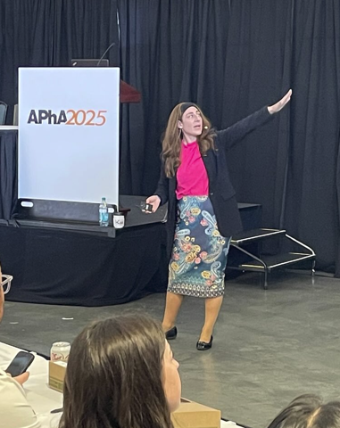
Insulin – Ultimate Hormone Replacement Therapy
Diana Isaacs, PharmD, BCPS, BCACP, CDCES, BC-ADM, FADCES, FCCP
Endocrine Clinical Pharmacy Specialist
Co-Director Endocrine Disorders in Pregnancy
Director, Education & Training in Diabetes Technology
Cleveland Clinic Diabetes Center
Notes:
2.5 hours.
Ideal is 150 slides.

Slide 3
Disclosures for Dr. Isaacs
Diana Isaacs, PharmD, BCPS, BCACP, CDCES, BC-ADM, FADCES, FCCP declares the following disclosures:
Speaker: Abbott, Dexcom, Novo Nordisk, Insulet, Medtronic, Lilly, Cequr, Sanofi, Corcept, Sequel

Slide 4
Integrating Technology: CGM, Connected Pens, and Insulin Pumps DiabetesEd Training Seminar 2026 – Day 2
Diana Isaacs, PharmD, BCPS, BC-ADM, BCACP CDCES, FADCES, FCCP
Director, Education & Training in Diabetes Technology
Co-Director, Endocrine Disorders in Pregnancy

Slide 5
Learning Objectives
Discuss continuous glucose monitoring (CGM) and the clinical benefits for managing diabetes
Compare and contrast different CGM, insulin pump, and connected pen devices
Describe critical teaching content for insulin pump, connected pen and CGM use
Describe appropriate candidates for insulin pump therapy
List inpatient considerations for insulin pump therapy and CGMs

Slide 6
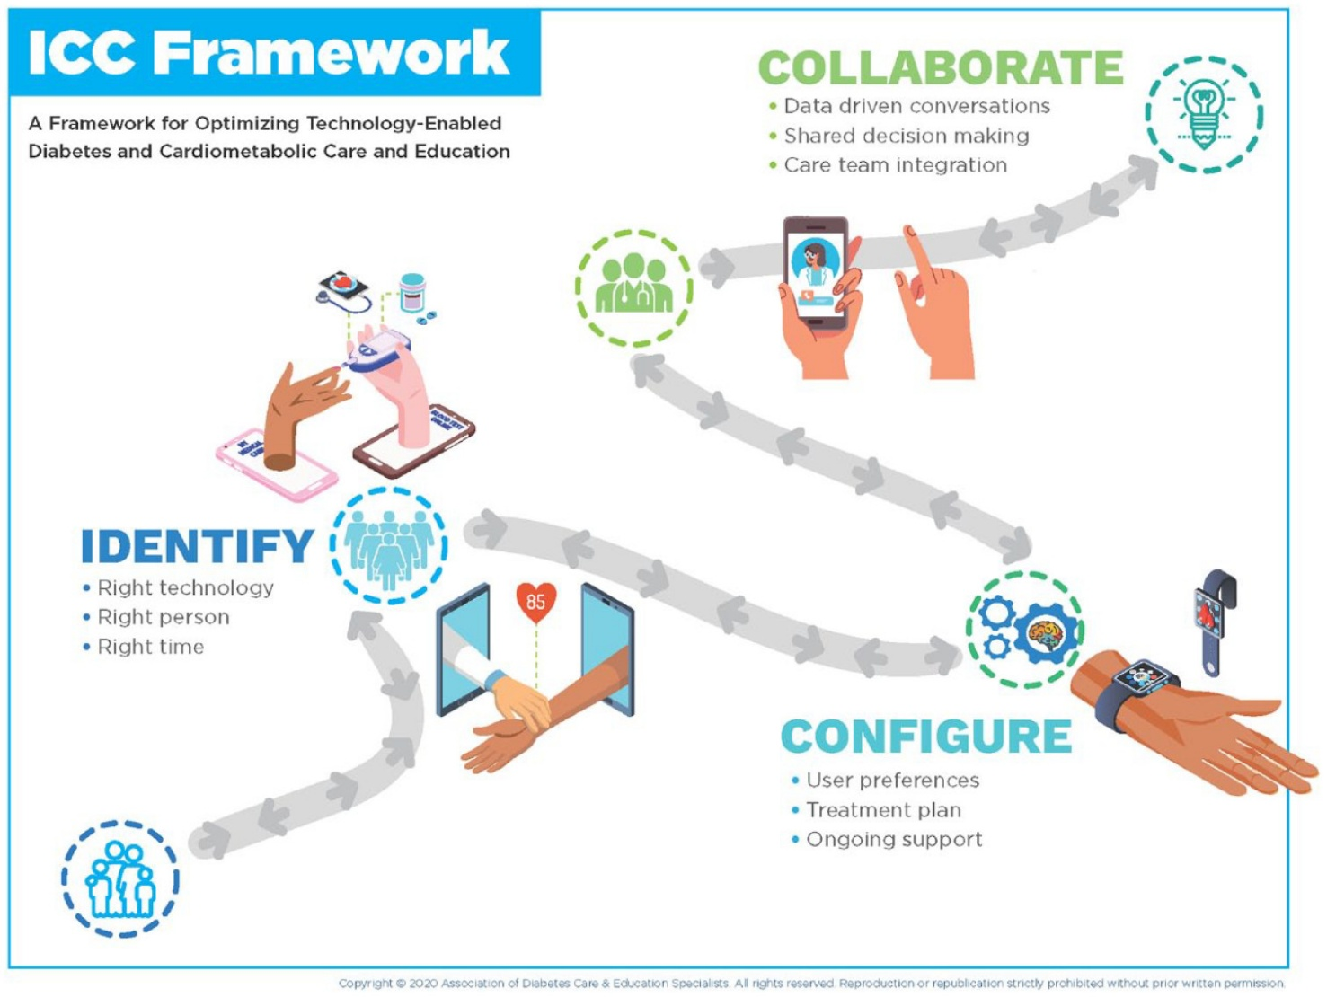
ICC Framework – Identify-Configure-Collaborate
A framework to overcome barriers to technology use and therapeutic inertia
Greenwood DA, Howell F, Scher L, et al. A Framework for Optimizing Technology-Enabled Diabetes and Cardiometabolic Care and Education: The Role of the Diabetes Care and Education Specialist. The Diabetes Educator. 2020;46(4):315-322. doi:10.1177/0145721720935125

Slide 7
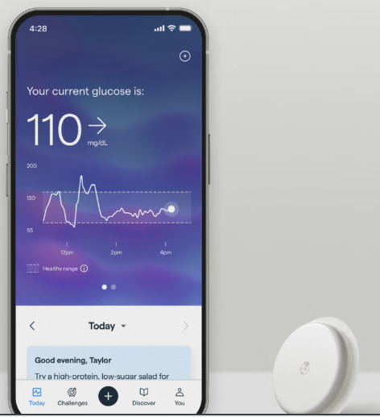

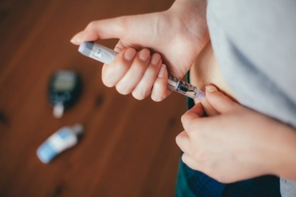
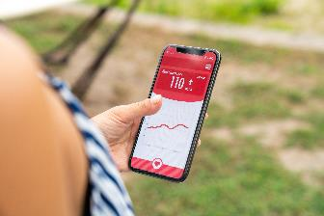
Technology is Here
CONTINUOUS GLUCOSE MONITORS (CGM)
INSULIN PUMPS
CONNECTED PENS AND CAPS
MOBILE APPS
Notes:
Diana start

Slide 8
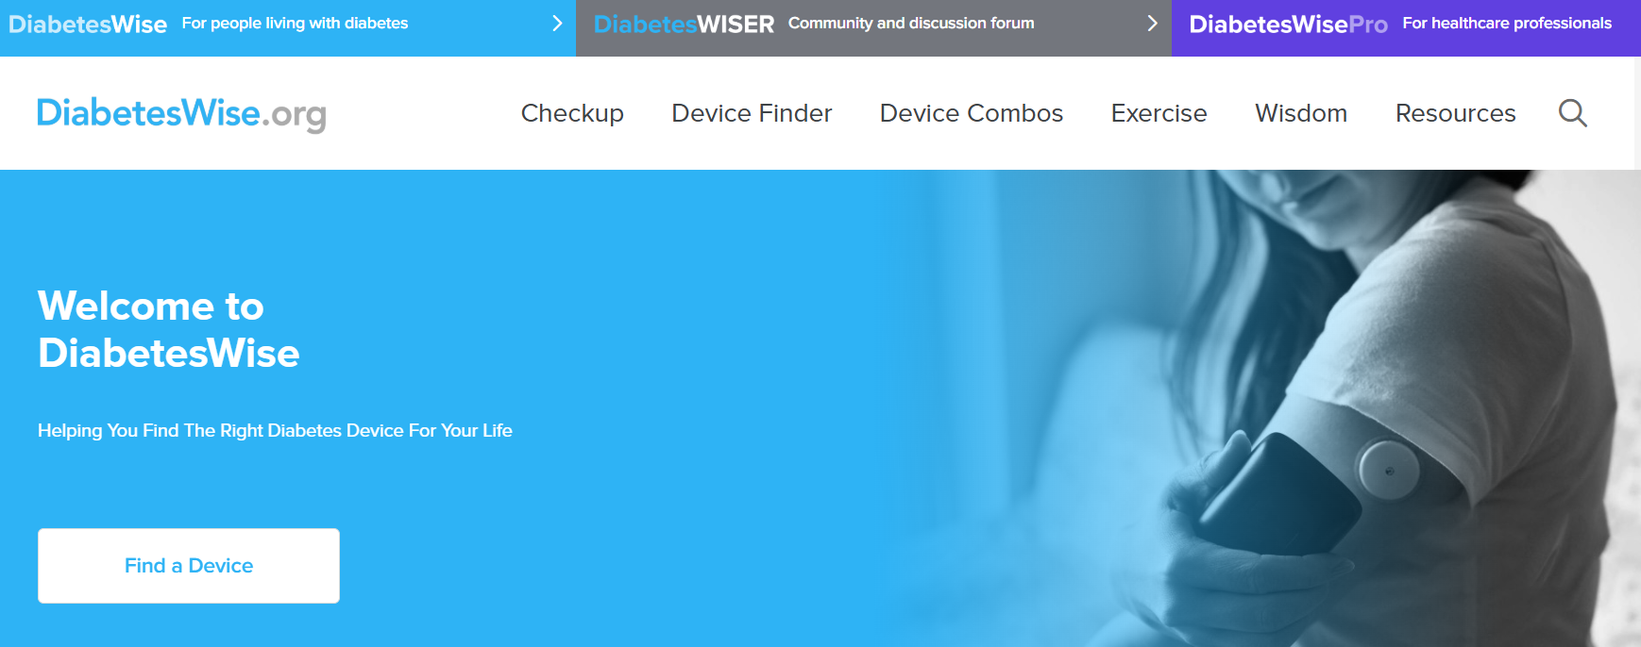
Identify: PWD Identify the “Right” Technology
Diabeteswise.org, providers.diabeteswise.org/#/

Slide 9
The Importance of Education & Training
“No device used in diabetes
management works optimally without education, training, and ongoing support.”
ADA. Diabetes Care.
Notes:
no device used in diabetes man agement works optimally without educa tion, training, and ongoing support

Slide 10
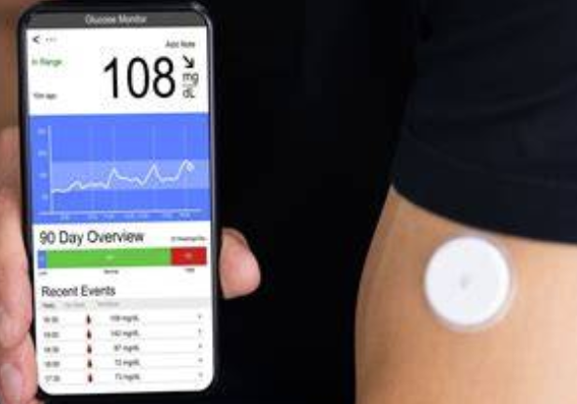
Continuous Glucose Monitors

Slide 11
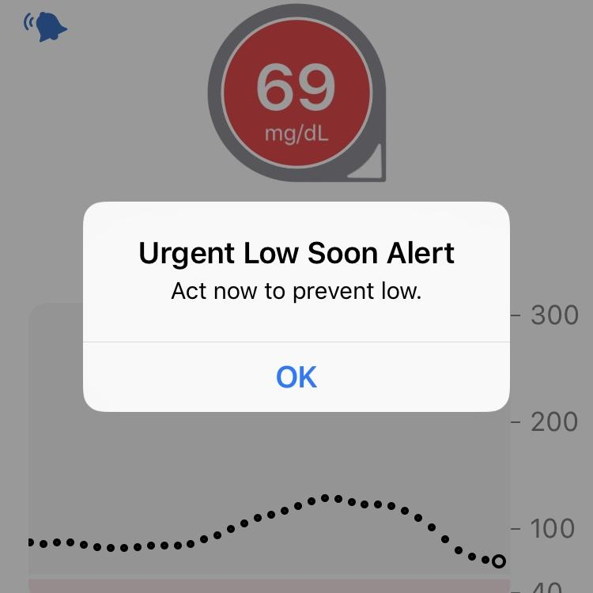
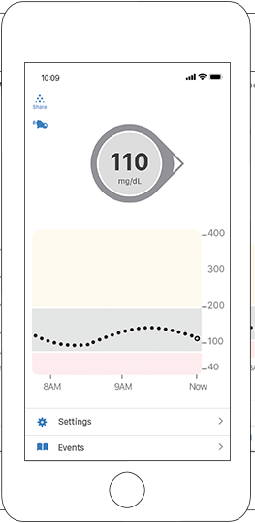
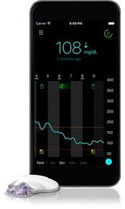
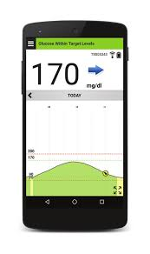
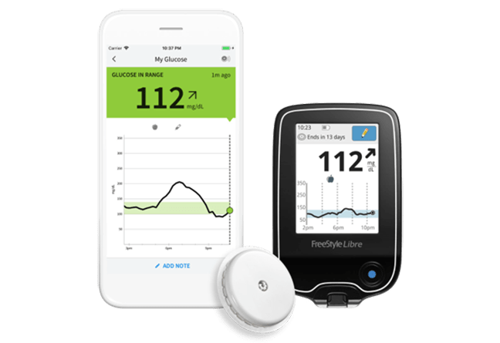
CGM: Real-Time Data

Slide 12

ADA Standards of Care 2026
Diabetes devices should be offered to people with diabetes (A)
Use of CGM is recommended at diabetes onset and anytime thereafter for children, adolescents and adults with diabetes who are on insulin (A) on nonsinulin therapies that can cause hypoglycemia (C ) and on any diabetes treatment where CGM helps in management (C ).
The specific CGM device and method for use should be made based on the individual’s circumstances, preferences and needs. (E )
In people with diabetes on insulin therapy, CGM devides should be used as close to daily as possible for maximal benefit (A)
People who wear CGM devices should be educated on potential interfering substances and other factors that may affect accuracy.
American Diabetes Association. Diabetes Care. 2026;.
Notes:
*Grade A: Clear evidence from well-conducted, generalizable randomized controlled trials that are adequately powered; †Grade B: Supportive evidence from well-conducted cohort studies; §Grade C: Supportive evidence from poorly controlled or uncontrolled studies.

Slide 13
Types of CGM
 | Professional | Personal | OTC
How to obtain | Owned by the clinic | Requires a prescription | Available without a prescription
Type | Blinded and unblinded (real-time feedback) | Real-time | Real time
Wear duration | Short-term use (10 days) | Long-term use | Short- or long-term use
Access | Insurance coverage for most people living with diabetes or prediabetes | Insurance coverage more focused on people taking insulin , although expanding | Cash pay, available to all adults
Compatibility | Smartphone app | Smartphones, reader/receiver, connected pens, mobile apps, insulin pumps | Smartphone app, mobile apps/Oura ring
American Diabetes Association Professional Practice Committee. Diabetes Care. 2025;48(Supplement_1):S146-S166.

Slide 14
Professional CGM
Characteristics | Dexcom G6 Pro
Blinded vs unblinded | Both
Maximum wear time of sensor | 10 days
Calibration | None
Downloading reports | Clarity
Care between transmitter use | Disposable-1 time use, must attached transmitter
Alarms for high/low glucose alerts | Yes
Interfering substances | Hydroxyurea
Mobile app | Dexcom G6
ADCES Practice Paper. The diabetes care and education specialist role in CGM.

Slide 15
Personal CGM Options (Rx)
Freestyle Libre 2+
Freestyle Libre 3+
Eversense 365
Dexcom G6
Dexcom G7
Instinct
Simplera

Slide 16
Personal CGM Comparison
​ | Dexcom G6​ | Dexcom G7​ |  | Dexcom G7 15 Day | Libre 2​+ |  | Libre 3​+ |  | Instinct | Simplera | Eversense​ 365
Max wear time​ | 10 d | 10.5 d |  | 15.5 d | 15 d |  |  |  |  | 7 d​ | 365 d
Warm-up time​ | 2 h​ | 30 min |  | 1 h | 1 h |  |  |  |  | Up to 2 h | 24 h
Calibrations ​ | Optional |  |  |  | None |  |  |  |  | Optional, | After 14 d, weekly
Water depth | 8 ft, 24 h |  |  |  | 3 ft, 30 min |  |  |  |  | 8 ft, 30 min | 3.28 ft, 30 min
Data platforms | Dexcom Clarity |  |  |  | LibreView |  |  | Carelink | Carelink |  | Eversense Data Management System
Mobile apps | Dexcom G6, Clarity, Dexcom Follow |  | Dexcom G7, Clarity, Dexcom Follow |  | Libre, LibreLinkUp |  |  | CareLink connect, MiniMed mobile |  |  | Eversense
Reader, receiver, smartphone compatibility | Receiver, smartphone, watch |  |  |  | Reader, smartphone |  |  | Smartphone |  |  | Smartphone
Pump Inregration | T:Slim X2, Mobi, Omnipod 5, iLet |  |  | iLet, Omnipod 5 | Omnipod 5 | T:Sliim X2, iLet, Twiist |  | Minimed 780G |  |  | Twiist
Information from Manufacturer’s user guides

Slide 17
Personal CGM Comparison (cont’d)
 | Dexcom G6 | Dexcom G7 | Dexcom G7 15 Day | Dexcom G7 15 Day | Libre 2+ | Libre 3+ |  | Instinct | Simplera Sync | Eversense
FDA-approved sites​ | Abdomen (age 2+ y) Upper buttocks (age 2-17 y)​ | Upper arm (age 7+ y)​ Upper buttocks (age 2-6 y)​ |  |  | Upper arm​ | Upper arm​ |  |  | Upper arm, abdomen​ Upper buttocks (age 2-13 y)​ | Upper arm​
Approved in pregnancy | No​ | Yes​ |  |  | Yes​ |  |  |  | No​ | No
Transmitter | 3 mo | Disposable |  |  | Disposable |  |  |  | Charge weekly | Charge daily
FDA-approved ages (years)​ | ≥ 2​ | ≥ 2​ |  | ≥ 18 | ≥ 2​ ​ | ≥4​ ​ |  |  | ≥ 7 | ≥ 18​ ​
Alarms | High, low, predictive (20 min), rise/fall rates | High, low, predictive (20 min), rise/fall rates, delayed first alert |  |  | High, low |  |  |  | High, low, predictive (60 min), rise/fall rates | High, low, predictive (30 min), rise/fall rates
Drug interactions​ | Hydroxyurea,​ acetaminophen (˃ 4 g/d) |  |  |  | Vitamin C​ (˃ 1 g/d) | Vitamin C​ |  |  | Acetaminophen, hydroxyurea​ | Tetracycline antibiotics, mannitol​
Max distance for signal | 20 ft | 33 ft |  |  | 20 ft |  | 33 ft |  | 20 ft | 24.9 ft, on body vibration alerts
Information from Manufacturer’s user guides: Dexcom G6, Dexcom G7, Libre 2, Libre 3, Medtronic Guardian Connect, Guardian 4, Eversense.
Notes:
Reference: Continuous Glucose Monitors (CGM) l Danatech
The comparison continues with additional details on device features. Understanding these nuances enables pharmacists to tailor recommendations and troubleshoot issues. Device selection should align with patient preferences, clinical goals, and insurance coverage.
For drug interactions, the original libre 2 and libre 3 had an interaction at doses of vitamin c over 500mg, now this is over 1000 mg with the plus versions.
Also, acetaminophen in doses over 1000 mg every 6 s or 4 grams per day will cause false high readings with the Dexcom devices, although this is beyond the max dose.
The alarms are different between devices. For example, libre devices have a high and low alarm. The other devices have high, low, predictive and rise and fall rates.
When used with smart phones, there are accessibility features that may allow the phone to read the information to you, for those that are visually impaired. Iphones may have a feature where you can ask siri what your glucose is.

Slide 18

Poll Question 17
Which of the following sensors is sold over the counter without a prescription?
Simplera Sync
Dexcom G7
Libre 3
Dexcom Stelo

Slide 19
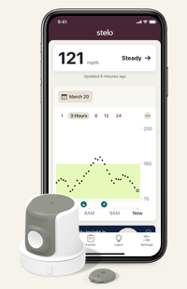
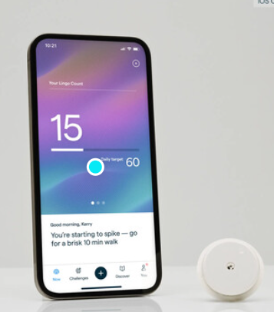
Over-The-Counter CGM
Available without a prescription
Ordered online
Intended for adults not taking insulin
No alerts for hypoglycemia
Works with mobile apps that incorporate education on lifestyle and glucose goals
Zahalka SJ, et al. Endocr Pract. 2025 May 21:S1530-891X(25)00893-6

Slide 20
OTC CGM Options
 | Dexcom Stelo | Abbott Lingo
Intended audience | Adults not on insulin with T2D, prediabetes, or who are interested in tracking their glucose | Adults not on insulin interested in understanding how to improve their metabolic health
Wear time | 15.5 days | 14 days
Ability to share data | Dexcom Clarity | No
Glucose range | 70-250mg/dL | 55-200mg/dL
Real-time alerts | Spike detection | No
Special features | “Spike Alerts” – notified that your glucose is rising at a rate the app determines to be a “Spike” Daily insights | Lingo Count – points assigned for elevations in glucose throughout the day, goal is to get fewer total points, Coaching program
Frequency of glucose readings | 15 minutes | 1 minute
Education within App | Yes | Yes
Age | ≥ 18 yr | ≥ 18 yr
Cost | $99/month or $85-$89/month with subscription plans | $49-1 sensor, $89-2 sensors, $249-6 sensors, subscription plan
Information from manufacturers websites: https://www.stelo.com/en-us, Lingo - Made by Abbott: Your body has the answers (hellolingo.com).
Notes:
Zahalka SJ, Akturk HK, Galindo RJ, Shah VN, Low Wang CC. Continuous Glucose Monitoring for Prediabetes - Roles, Evidence, and Gaps. Endocr Pract. 2025 May 21:S1530-891X(25)00893-6. doi: 10.1016/j.eprac.2025.05.742. Epub ahead of print. PMID: 40409607.
Adults not on insulin with type 2 diabetes, prediabetes or who are interested in tracking their glucose Adults not on insulin interested in understanding their metabolic health and a p

Slide 21
CGM Counseling Points
Important to check glucose when indicated
Symptoms do not match sensor value
During warm-up period for treatment decisions
Sensors are waterproof
Showering, bathing, swimming OK
Check water depth criteria for individual sensor
Overlays and skin preps to help it stay on
Avoid with MRI, CT, diathermy
Exception: Eversense implantable, transmitter should be removed
Libre now ok for MRI/CT
Not FDA approved
Dialysis, critically ill
Pregnancy-Guardian,simplera eversense, G6
If people choose to use, it is important they know it is off-label

Slide 22
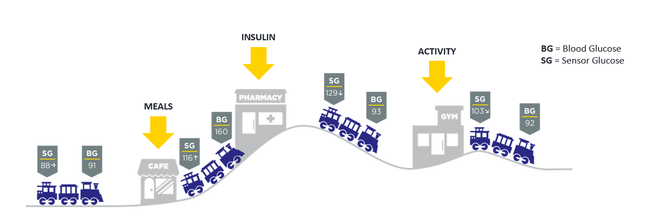
Lag Time
Refers to a slight delay in CGM sensor readings compared to finger sticks
Most apparent when glucose is changing rapidly
Counsel pwd on the train analogy

Slide 23
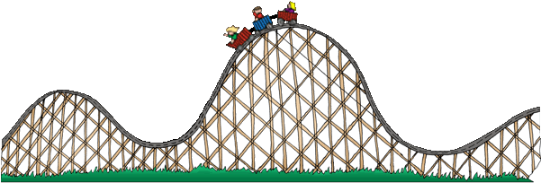
Lag Time
Refers to a delay in CGM sensor readings compared to finger stick blood glucose readings
Estimated CGM sensor reading ~5 minutes behind
Most apparent when glucose is changing rapidly
Counsel patients on the train analogy

Slide 24
Causes of Falsely High or Low Readings
Interfering substances
Falsely high
Vitamin C (Libre)
Acetaminophen (high dose Dexcom, Simplera)
Tetracycline antibiotics (Eversense)
Compression Lows
Dehydration
Faulty sensor

Slide 25
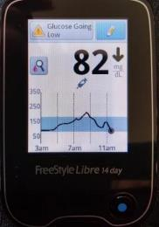
When to Check BGM?
A calibration or blood glucose symbol appears on the device
If making a dosing decisions
Symptoms or expectations do not match CGM readings
Off-label indications to ensure accuracy: dialysis, inpatient use
Possibly after correcting a low
If taking an interfering substance
Counsel pwd about “lag time”
Per ADA, every person using CGM should have access to a meter and test strips
Notes:
Image obtained from: https://lada-diabetes.com/freestyle-libre-14-day-system-review-first-week-thoughts/

Slide 26
Downloading CGM Data

Slide 27
CGM Key Metrics
Recommended Time in Range
for most people with T1D & T2D
Target time
Time above range (TAR)
< 1 hr, 12 min, > 250 mg/dL
< 6 hr, > 180 mg/dL
Number of days CGM is worn 14 days is recommended
Percentage of time CGM is active 70% of data from 14 days is recommended
Mean glucose
Glucose management indicator (GMI) Estimated A1C
Coefficient of variation (CV) This is a measure of glycemic variability. A CV >36% is considered unstable.
>250 mg/dL
<5% Very High
>180 mg/dL
<25%* High
Target Range: 70-180 mg/dL
Time in range (TIR)
> 16 hr, 48 min
>70% In Range
Correlates with A1c ~7.0%
Time below range (TBR)
< 1hr < 70mg/dL
< 15 min < 54mg/dL
<70 mg/dL
<4%** Low
<54 mg/dL
<1% Very Low
Battelino T et al. Diabetes Care. 2019;42(8):1593-1603. . 2. American Diabetes Association. Diabetes Care 2021;44(Suppl. 1):S73–S84 | https://doi.org/10.2337/dc21-S006.

Slide 28
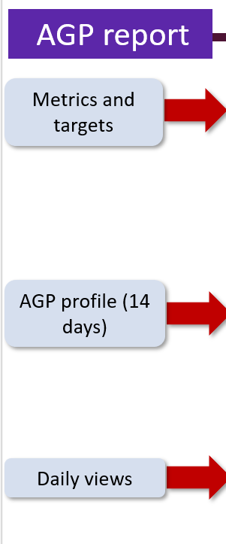
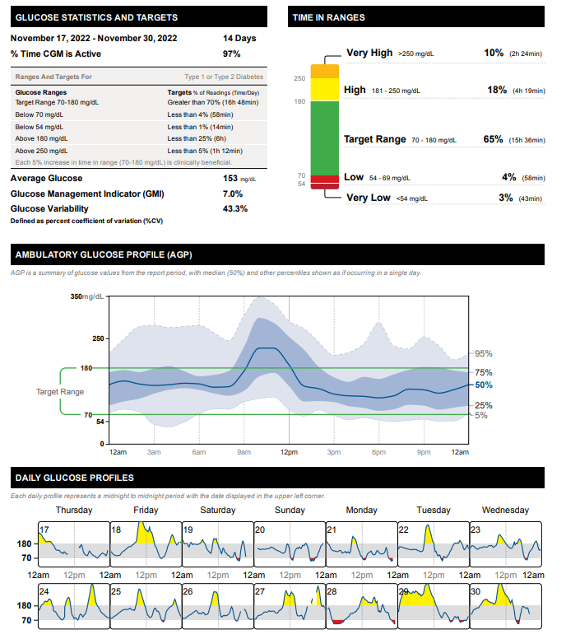
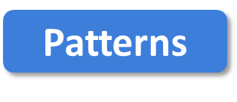
More Green, Less Red
FNIR
Flat Narrow
In Range
Notes:
Libreview report, my own image

Slide 29
Poll 18. What is the goal time in range for most adults with type 1 or 2 diabetes?
≥50%
≥70%
≥80%
≥90%
Notes:
Learning Objective #: 2
Rationale
Answer: B

Slide 30
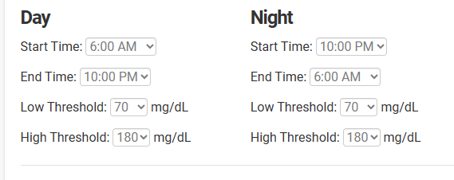
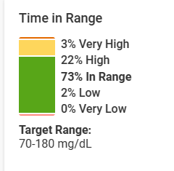
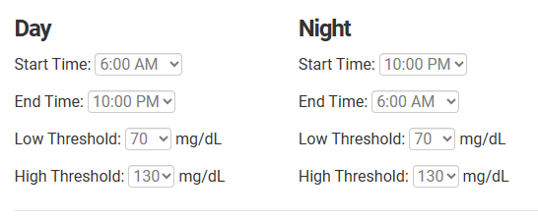
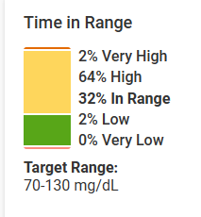
Target Glucose Ranges
Same person, same data, look at the difference in time in range!

Slide 31
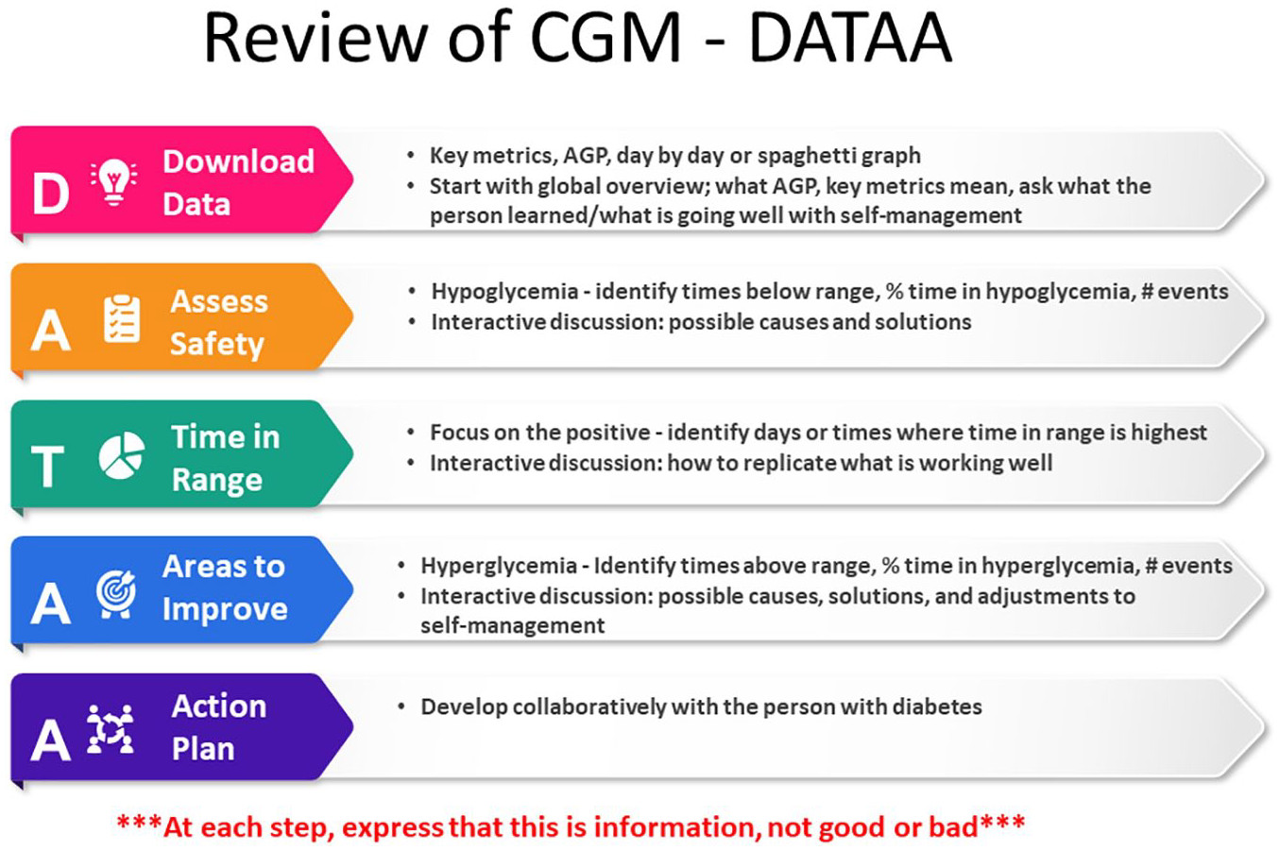
Isaacs D, Cox C, Schwab K, et al. Technology Integration: The Role of the Diabetes Care and Education Specialist in Practice. The Diabetes Educator. 2020;46(4):323-334. doi:10.1177/0145721720935123

Slide 32
Tips for DATA Interpretation
Start by asking the person what they’ve experienced and noticed with their glucose patterns
Avoid judgment
Learn from 1 time episodes, but make changes based on patterns
Fix lows first but some amount is expected (<1-4%) and if you remove all lows, you may end up with too many highs
If it’s not making sense, dig deeper (ex. missed doses, rationing, injection technique, food insecurity, etc)
Behavior Change
Mental Health
Medications

Slide 33

Case Studies & 2 min Stretch

Slide 34
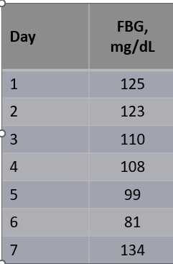
Case 1
Terrance is a 60-year-old man with T2D x 12 years
Current DM2 meds:
Metformin 1000 mg twice daily
Glimepiride 8mg daily
Other conditions
CKD
Hyperlipidemia
Hypertension
Works in project management
Eats 3 meals/day, snacks at night, no regular exercise
Glucose log
Checks BGM once daily
Pertinent Labs
SCr = 1.38 mg/dL, eGFR = 55
A1C = 8.2%, BMI = 34 kg/m²
Notes:
Terrance starts CGM

Slide 35
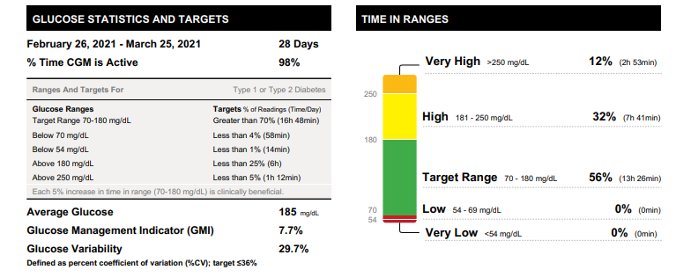


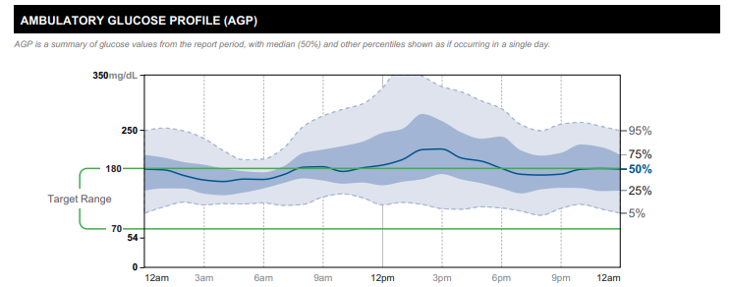
Starts CGM
Which CGM key metrics are at goal?
Which are not?
Overall patterns?

Slide 36
Poll Question 19
1. Which CGM key metrics are at goal?
Time in range
Time above range
Time below range
Glucose management indicator
Notes:
Correction answer: time below range

Slide 37
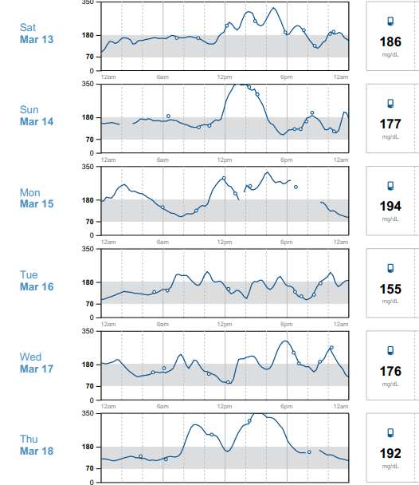

Time in Range
Focus on the positive: what’s worked well on Tue 3/16?
Time in range is high this day
Ate a granola bar for breakfast, grilled chicken salad at lunch, steak, greens, potato at dinner
No missed medication doses
Good night’s sleep, low stress

Slide 38

Areas for Improvement
Sun 3/14 glucose went high 12 pm
Reports eating rice bowl and coke
Silver lining
Walked around 3 pm (helped to lower glucose)
Avoided afternoon snacking
Ate low-carb dinner (salmon, salad, small potato)
Denies missed doses

Slide 39
Poll Question 20
What is the most appropriate medication adjustment for Terrance?
Add DPP4 inhibitor
Add GLP-1 receptor agonist
Add SGLT2 inhibitor
Lifestyle modifications only
More than 1 right answer
Notes:
Sglt2 inhibitor or semaglutide since CKD.

Slide 40

Action Plan
In collaboration with Terrance
Lifestyle changes
Incorporate a brisk walk 3 days per week
Reduce high-carbohydrate foods like fries
CGM optimization
Alerts, high for 280
Medication adjustments
Add a medication to help his CKD + optimize glucose → SGLT2 inhibitor
Follow-up in 3-4 weeks

Slide 41
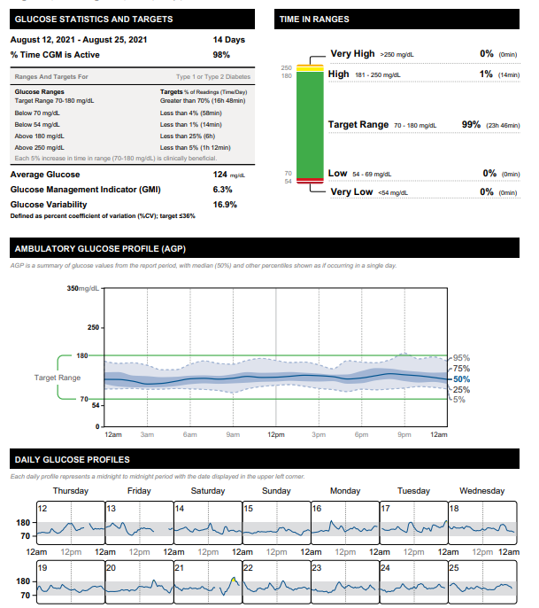
3 Months Later
T2D Meds:
Empagliflozin 10mg qday
Metformin 1000mg BID

Slide 42
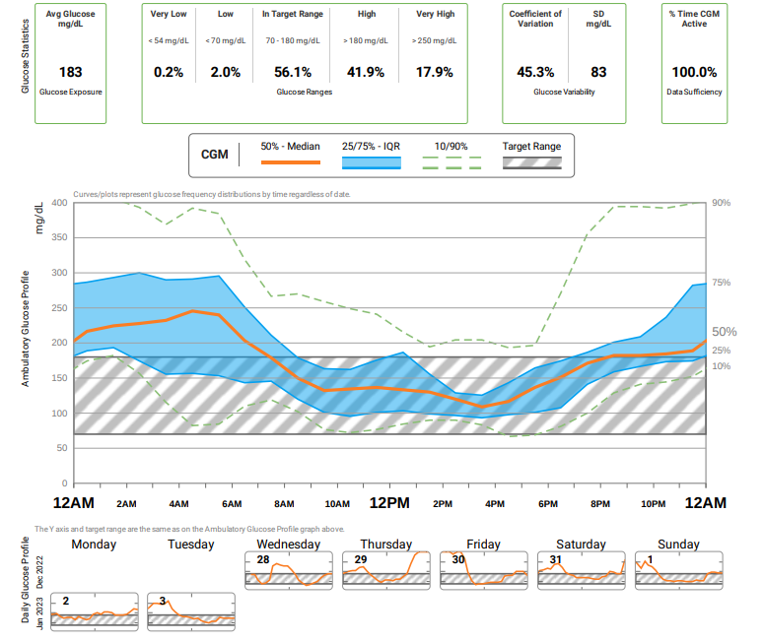

Case 2
75 yo F with 25 year h/o T2D. PMH includes HTN, hyperlipidemia, hypothyroid, obesity, ASCVD.
Current DM Meds
-Insulin glargine inject 50 units QAM and 40 at night
-Insulin aspart 8-10-10 units plus correction scale
-Metformin 1000 mg daily
-Semaglutide, 0.25mg weekly (2 doses so far)
Clarity report obtained from Diana Isaacs
Notes:
Did not tolerate higher dose of metformin

Slide 43

Poll 21. Which of the following CGM key metrics is at target?
Time in range
Time above range
Coefficient of variation
Time below range
Clarity report obtained from Diana Isaacs
Notes:
Answer: D

Slide 44
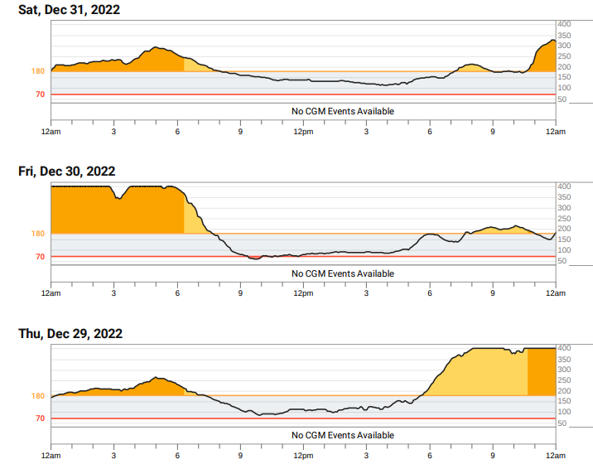



Using DATAA
Less of an appetite since taking semaglutide, often going low during the day
During the day, glucose often steady, but also having to drink juice to keep from going low
Skipping aspart doses because running low, leading to rebound highs
Clarity report obtained from Diana Isaacs

Slide 45

Action Plan
Continue semaglutide 0.25mg weekly x 2 more weeks, then titrate up to 0.5mg weekly
Decrease insulin glargine to 45 units qam and 35 units qpm
Continue insulin aspart 8-10-10 + correction scale
Continue metformin 1000mg daily
Notes:
Current DM Meds
-Insulin glargine inject 50 units QAM and 40 at night
-Insulin aspart 8-10-10 units plus SS
-Metformin 1000 mg daily
-Semaglutide, 0.25mg daily (2 doses so far)

Slide 46
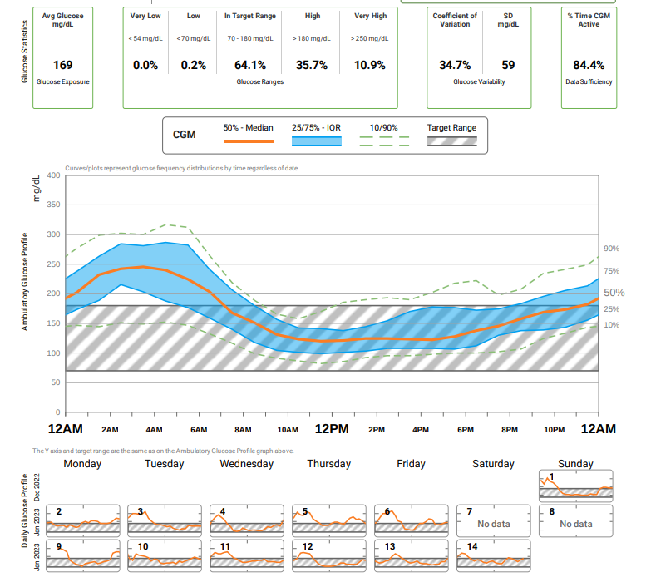
Follow-Up
1 month later
Average glucose improved
Time in range increased
Glucose variability improved
Less hypoglycemia
Clarity report obtained from Diana Isaacs
Notes:
Next plan: continue to titrate the semaglutide
Consider more aspart at dinner or lower carb dinner.
Continue to titrate down the glargine and aspart

Slide 47
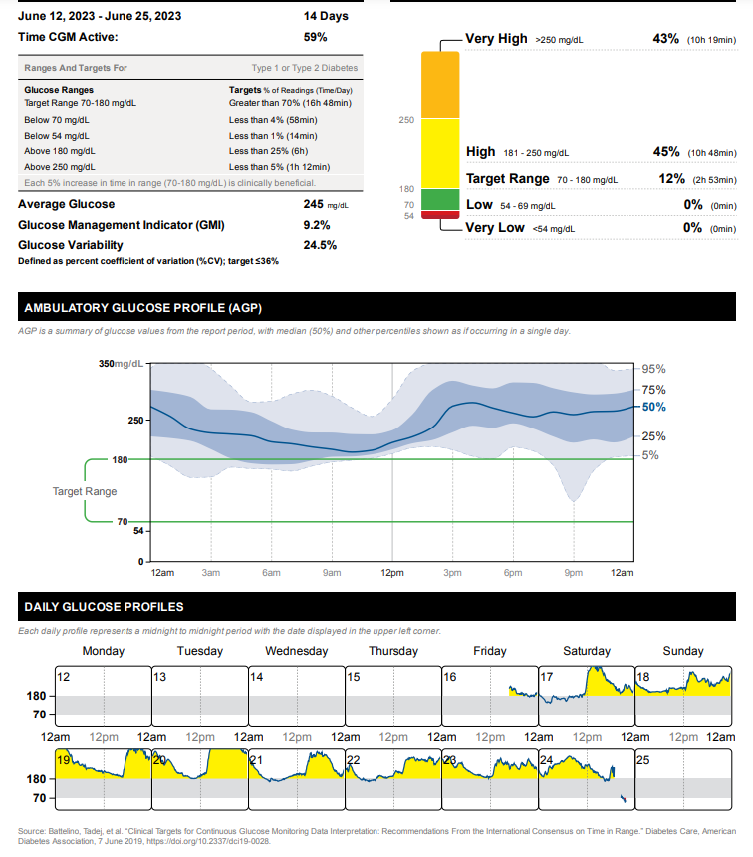
Case 3
Person with T2D taking metformin 1000mg twice daily and insulin glargine 20 units daily
Is TIR at goal?
What to ask?
What changes to make?
Notes:
The whole curve is elevated
Needs more insulin-is the person taking insulin?
Ability to use non insulin therapies?
Low on Saturday likely false low.

Slide 48
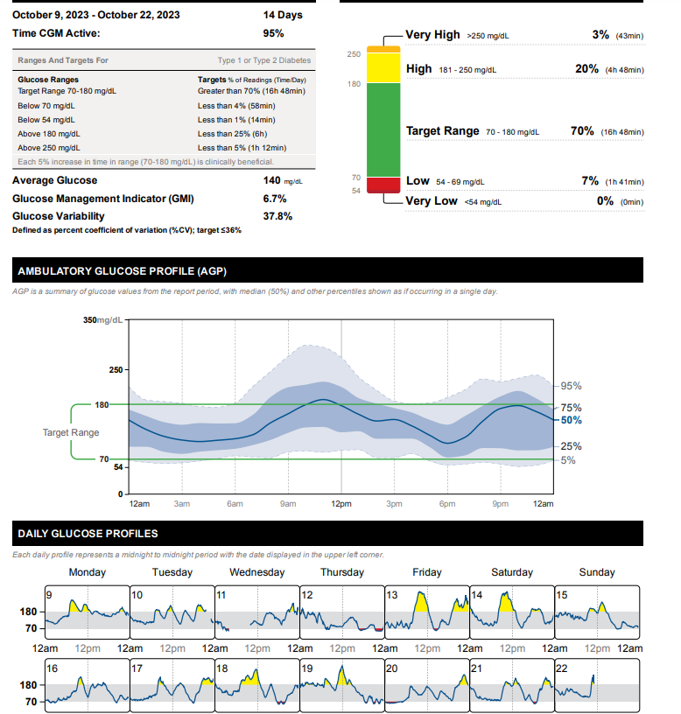
Case 4
Person with T2D
56yo, BMI=33, A1C=7%
Meds:
Degludec 40 units daily
Dulaglutide 4.5mg weekly
Dapagliflozin 10mg daily
Metformin 1000mg twice daily
Notes:
Fix lows: too much basals
Fix highs: dietary modifications, or another medication, possibly meal time insulin.

Slide 49
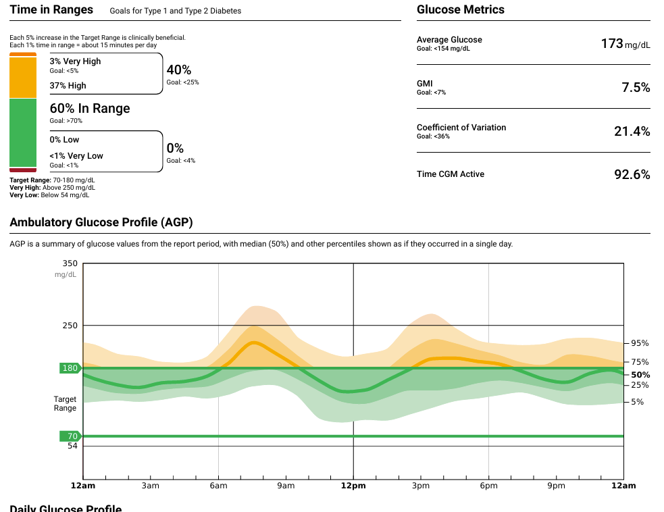
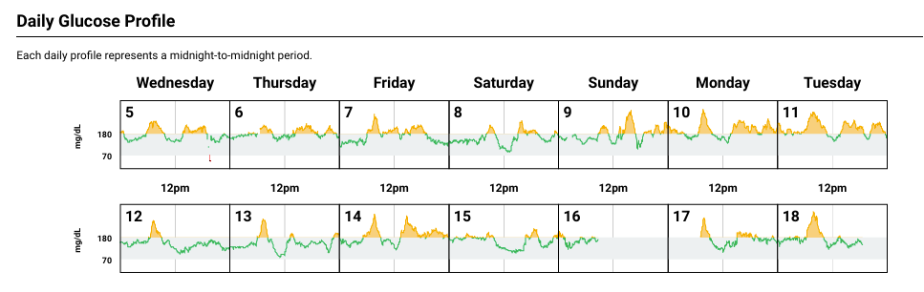
Case 5
40yo F with T2D, lost 20lbs since starting Semaglutide 6 months ago, A1C=7.4%, also has HTN, dyslipidemia, BMI=34kg/m2
DM Meds:
Metformin 1000mg twice daily
Empagliflozin 25mg daily
Semaglutide 2mg weekly
Is data at goal?
TBR?
TIR?
TAR?
Action plan?
Notes:
Options: Consider switch to tirzepatide or add basal insulin?

Slide 50
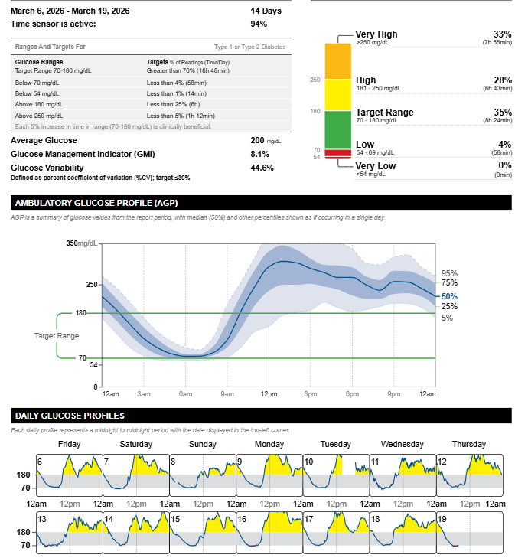
Patient Case 6
72yo with type 2 diabetes
Lispro 6 units three times daily with meals + SS#2
Glargine 12 units daily
Goal: transition to GLP-1
DATAA model for interpretation
Download data
Assess hypoglycemia
Time in range: what’s working well?
Areas for improvement
Action plan
Notes:
Shows oversalization but also the confusion that can occur from regimen complexity: this patient was actually taking glargine 3 to 4 times daily !

Slide 51
Insulin Pumps

Slide 52
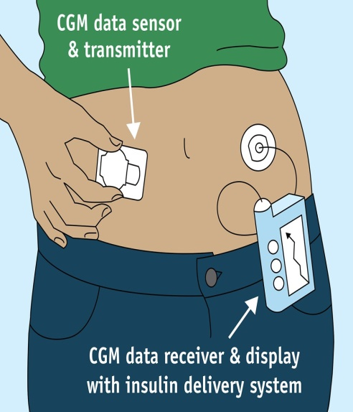
How a Pump Delivers Insulin
Usual Insulin Secretion
Insulin Pump
Insulin
Time
.
Notes:
52
Image available for reuse: https://www.flickr.com/photos/fdaphotos/15657970628

Slide 53
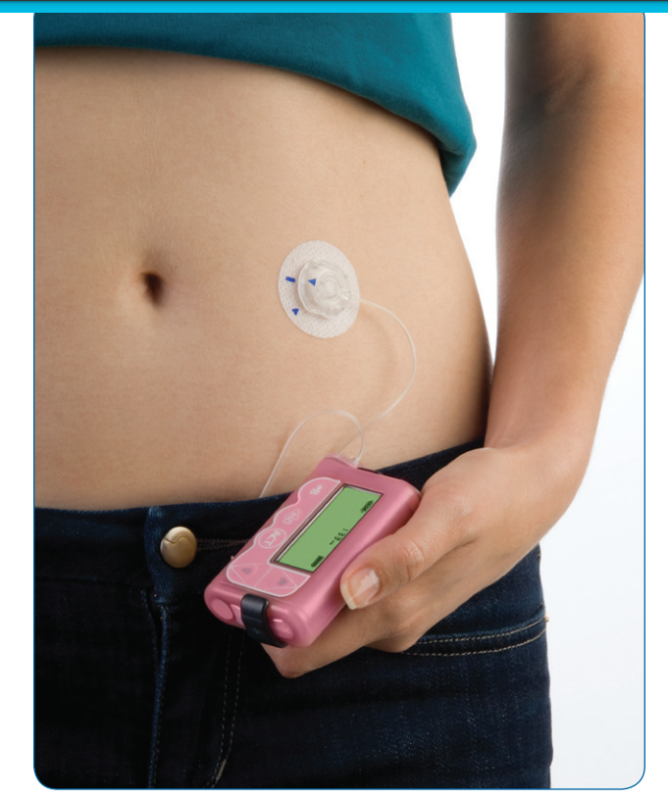
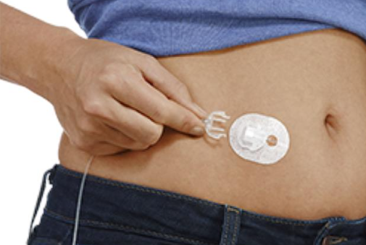
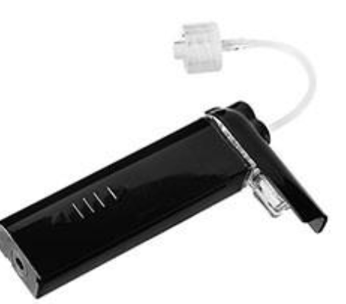
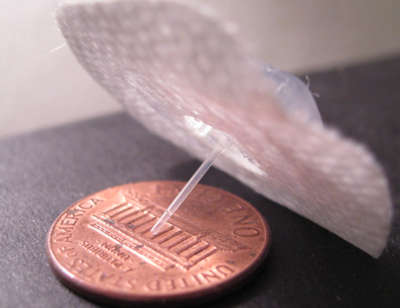
Insulin Pump Basics
Infusion Set
Tubing
Insulin reservoir
Pump

Slide 54
Insulin Pump Definitions
Basal rates
Carbohydrate ratios
Correction factors
Glucose targets
Active insulin time
Max bolus/Max basal
Extended boluses
Temp basals
Suspend on/before low
Sherr 2022

Slide 55
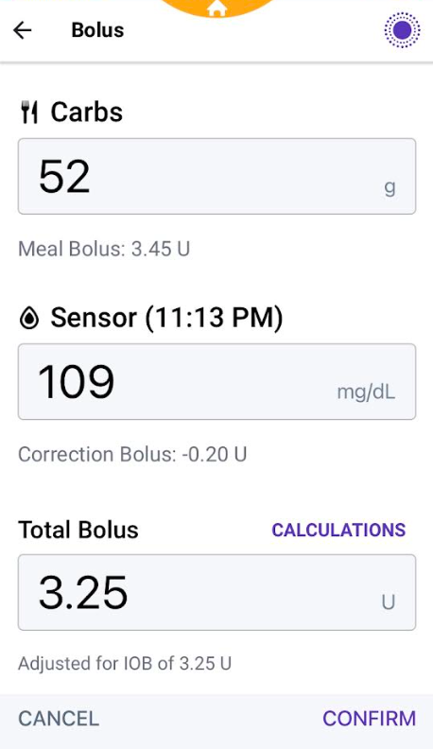
Insulin Pump Info
Uses U100 rapid-acting insulin
Minimizes insulin variability
Must have dexterity to fill cartridge or device
Bolus calculator incorporating settings
Active insulin to prevent stacking
Multiple basal rates or automated delivery
Small dose increments
Temporary basal rates or temporary glucose targets
Alarms and reminder features
Notes:
Insulin pump basics include the use of U100 rapid-acting insulin, bolus calculators, and customizable basal rates. These features help minimize insulin

Slide 56

Ideal Pump Candidates
Require meal-time insulin
Wearing CGM or frequently checking BGM
Carbohydrate awareness
Willing to follow up regularly with health care team
Can afford the pump/supplies
Problem solving skills (eg, troubleshoot and treating high or low glucose)
Able to use the device independently or with caregiver support
Diabetes Care. 2025;48(Supplement_1):S146-S166. doi:10.2337/dc25-S007.
Notes:
In the past, there was more rigid criteria for who should go on an insulin pump. Because of the improved outcomes, the criteria is much more

Slide 57
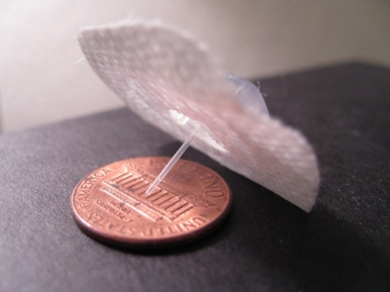
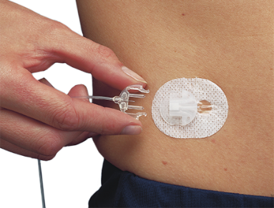
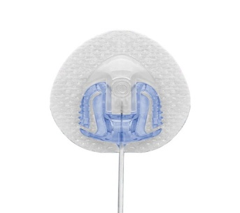
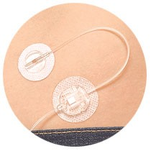
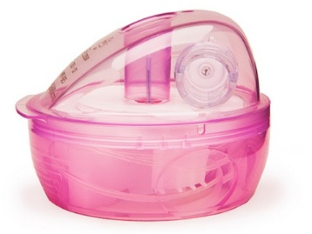
Infusion Sets
Infusion sets are usually Teflon
Available in different sizes (ex. 9mm vs 6mm)
Silhouette (angled) may be better for kids/thinner/very active people
Steel infusion sets a good option for people with frequent site occlusions
Insert at least 1 inch from CGM site
Auto-injectors vs. manually injecting
Site selection/rotation
Longer tubing options
Good if connected on leg, arm or wearing pump further from site
Caution with kids/babies/pets-pouches available to hide pump
When changing out infusion set, check glucose or CGM 1-2 hours after
Don't change right before bed

Slide 58
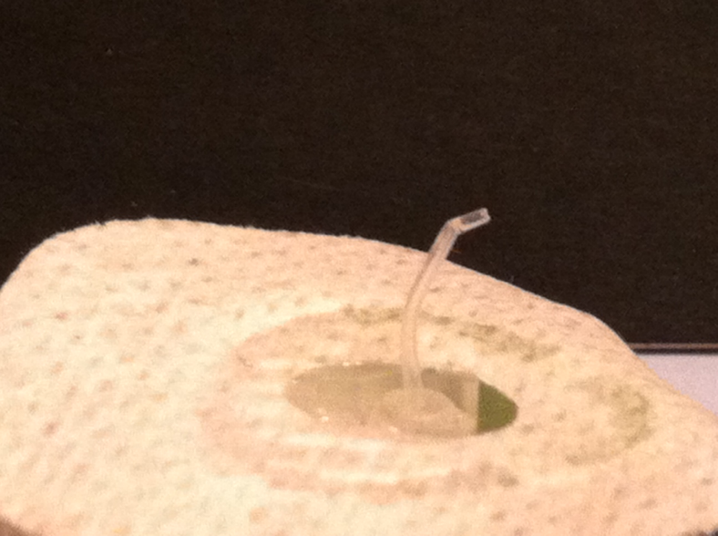
What Happens with a Bent Cannula?
Hyperglycemia
Hypoglycemia
No effect
Notes:
My own picture.

Slide 59








Where to Wear?

Slide 60


Patch Pumps
V-Go
Cequr Simplicity
24 hr. basal/bolus patch pump
Approved for adults with T2DM
Allows 20, 30, 40 unit basal rate options
On-demand bolus doses in 2 unit increments
Up to 36 units/24 hrs
Doses administered via clicks directly on the device
Must be changed daily
Bolus pump patch only
Approved for adults with T1DM or T2DM
Holds up to 200 units of rapid acting insulin
On-demand bolus doses in 2 unit increments
Doses administered via clicks directly on the device
Must be changed every 4 days
Cequr Simplicity Product Guide: https://myceqursimplicity.com/wp-content/uploads/User-Guide.pdf
V-Go Product Guide: https://www.go-vgo.com/wp-content/uploads/2018/06/instructions-for-patient-use.pdf

Slide 61
Automated Insulin Delivery Systems
Omnipod 5 (Insulet)
T:slim X2 (Tandem)
Control IQ+
780G
(Minimed)
iLet
(Beta Bionics)
Mobi (Tandem)
Control IQ+
Twiist Loop (Sequel)

Slide 62

Hybrid-Closed Loop
Automated insulin delivery (AID)
Auto adjust background insulin
Some systems give auto corrections
Maximize time 70-180mg/dL

Slide 63

Time in Range From AID Pivotal Trials
AID increases TIR, reduces hypoglycemia and improves A1C compared to MDI or manual pump therapy

Slide 64
The Evidence for AID in Type 2 Diabetes
Trial/System | Design | Intervention/ Device | Duration | Baseline glycemic control | Outcomes
SECURE-T2D | Single arm, open label N= 305 | Omnipod 5 | 13 weeks | A1C: 8.2% TIR: 45% | A1C: 7.4% TIR: 66%
2IQP | RCT, open label N= 219 | Control IQ+ | 13 weeks | AID: A1C 8.2%, TIR 48% Control: A1C 8.1%, TIR 51% | A1C: AID 7.3%, Control 7.7%, adjusted difference between groups 0.6% TIR: AID Group: 64%, Control Group 52%
IMPACT2D | Single-arm, open label N= 95 | MiniMed 780G | 13 weeks | A1C 7.9% TIR: 72% | A1C: 7.2% TIR: 80%
Pasquel, F. et al. JAMA Netw Open. 2025;8(2):e2459348; Kudva, Y. et al. N Egl J Med. 2025;392:1801-1812; Bhargava, A. et al. Diabetes Technol Ther. 2025;27(5):366-375
Notes:
Below is a table summarizing literature from landmark trials of AID systems currently FDA approved for use in T2DM. Of note, these studies each had diverse cohorts that are representative of a US population, both in regards to racial and ethnic composition, education level, income, as well as utilization of other antihyperglycemic agents especially SGLT2 inhibitors and GLP1 agonist, (example from SECURE-T2D) 55% using GLP1s, 44% on SGLT2, 27% using both) (2IQP: 40-52% GLP1, 35-39 SGLT2, 20-23% on both) SECURE-T2D: HbA1c reduced by ~0.8% (from 8.2% to 7.4%; 95% CI −1.0 to −0.7), significant for noninferiority & superiority.
2IQP: Of note, featured a randomized controlled trial. Not blinded due to nature of intervention. A1C reduced by 0.9% on average in AID group, 0.6% adjusted difference between groups. (95% confidence interval [CI], –0.8 to –0.4; P<0.00
Pasquel, F. JAMA Netw Open. 2025;8(2):e2459348; Kudva, Y. N Egl J Med. 2025;392:1801-1812; Bhargava, A. Diabetes Technol Ther. 2025;27(5):366-375 IMPAC T2D: daily insulin dose was increased from run-in to the end of the study (77.4 – 38.5 U vs. 91.8 – 49.3 U, P < 0.0001), announced carbohydrates were unchanged, and the number of daily user-initiated boluses was reduced (3.9 –1.9 vs. 3.2 – 1.8, P < 0.0001). There was no signiﬁcant change in participant weight or body mass index

Slide 65
Different Bolus Strategies
Automated Insulin Delivery in Adults with Type 2 Diabetes: a nonrandomized clinical trial. JAMA Netw Open. 2025; 8(2)
Notes:
Emphasis that patients should be carb aware, not necessarily a strict requirement for carbohydrate counting

Slide 66

Omnipod 5
Holds 200 units
Compatible with Dexcom G6, G7, Libre 2+
No tubing
Control system from a compatible smartphone or controller
Uses last 4-5 pods for adjustments, based on TDD
SmartBolus calculator informed by CGM value and trend
Glucose targets from 110-150 mg/dL adjustable in 10 mg/dL increments
Activity mode to protect from lows
Bluetooth connectivity with Glooko, automatic data uploads
Omnipod 5 Automated Insulin Delivery System. User Guide.

Slide 67
Minimed 780G
Holds 300 units
Compatible with Guardian 4, Simplera Sync, Instinct
Meal detection (auto correction + basal)
Adjustable target (100, 110, 120mg/dL)
Suspend before/on low options (in manual mode)
Bluetooth connectivity, remote software upgrades
MiniMed and Carelink apps for data sharing/viewing
7 day infusion set option
Uses AA battery
MiniMed™ 780G system - User Guides & Manuals | Medtronic

Slide 68
Beta Bionics iLet
Holds 180 units of insulin
Compatible with Dexcom G6, G7, Libre 3+
Works with pre-filled insulin cartridges (Fiasp) -160 units
Programmed by entering body weight and connecting to CGM
No other insulin pump settings
Glucose targets (110, 120, or 130mg/dL)
Meal estimates: no carb counting (usual, less, more)
Provides calculated back up settings for boluses
Requires charger
3 algorithms: meal, basal, correction
Bluetooth connected, Bionic Circle app for up to 10 followers
Beta Bionics User Resources

Slide 69
Tandem T:Slim X2 with Control-IQ+
Holds 300 units
Compatible with Dexcom G6, G7, Libre 3+
Algorithm adjusts insulin delivery from programed “manual” settings
Automatic correction doses
Up to 1 every hour based on projected glucose >180mg/dL
Calculated at 60% of programmed correction factor (target of 110)
Tandem T:Slim mobile app to bolus and for remote downloads
Requires charging cable
User Guides for Tandem Diabetes Care Products

Slide 70

Control IQ+ Targets
https://www.tandemdiabetes.com/providers/products/control-iq

Slide 71

Tandem Mobi with Control IQ+
Holds 200 units
Half the size of T:Slim X2
Dexcom G6, G7 integration
Runs the Control IQ algorithm
5-Inch tubing option
Everything controlled from mobile app except quick bolus option from pump (Tandem Mobi mobile app)
Syringe-driven pump fill
Wireless charging
IP28 water resistant rating (8 feet for 2 hours)
User Guides for Tandem Diabetes Care Products

Slide 72
Sequel Twiist
Holds 300 units of insulin
Superior occlusion detection
Tidepool Loop Algorithm
iPhone controlled
Bolus from Apple watch
6-hour predictions, uses manual settings for automation
Correction Range 87mg/dL-180 mg/dL
Glucose Safety Limit: 67-110 mg/dL
Food type for bolus speed
Lollipop, Taco, Pizza Bolus (up to 8 hr absorption)
Ability for retroactive carb entries
Pre-meal preset option (67-130mg/dL)
Work-out preset option (87-250mg/dL)
https://www.twiist.com/hcp-home

Slide 73
AID System Comparison
 | Omnipod 5 | Control IQ+ | 780G | iLet | Twiist
Max fill | 200 units | 300 units (T:Slim X2) 200 units (Mobi) | 300 units | 180 units | 300 units
CGM compatibility | Dexcom G6, G7, Libre 2+ | Dexcom G6, G7, Libre 2+, Libre 3+ | Guardian, Simplera Sync, Instinct | Dexcom G6, G7, Libre 3+ | Libre 3+
Lowest algorithm target/range | 110mg/dL 100mg/dL (coming soon) | 112.5-120mg/dL | 100mg/dL | 110mg/dL | 87mg/dL 67mg/dL (pre-meal preset)
Basal automation | Calculated from total daily insulin, updated each pod change, 60 min prediction | Increases or decreases from programmed basal rates, 30 min prediction | Calculated based on total daily insulin from past 2-6 days | Initiated based on user weight and adapts with glucose profile | Increases or decreased from programmed basal rates, 6 hour prediction
Automated correction bolus | No | 1/hour if glucose predicted >180mg/dL, 60% of calculated dose | If glucose > 120 mg/dL and at max "auto basal" delivery, up to every 5 min | Yes | No
Extended Bolus | No | Yes, up to 8 hours | No | No | No, carb absorption time up to 8 hours
Temp Basals | No | Yes | No | No | No
ICR: insulin to carbohydrate ratio, IAT: insulin action time, ISF: insulin sensitivity factor, NA: not available
Data obtained from user manuals
Notes:
Omnipod-5_User-guide.pdf
MiniMed_770G_System_User_Guide.pdf (medtronicdiabetes.com)
AW-1007704_B User Guide, Mobile Bolus, t:slim X2, Control-IQ, 7.6, mg/dL, Artwork.pdf (tandemdiabetes.com)
User manuals
Omnipod-5_User-guide.pdf
MiniMed_770G_System_User_Guide.pdf (medtronicdiabetes.com)
AW-1007704_B User Guide, Mobile Bolus, t:slim X2, Control-IQ, 7.6, mg/dL, Artwork.pdf (tandemdiabetes.com)
770g and 780 g max is 250 units.

Slide 74
Background Insulin Modulation
Control IQ+
Target range
ISF
iLet
Target
Omnipod 5
780G
Target
Target
Basal rates
Twiist
Correction range
ISF
Basal rates
Max basal
Glucose safety limit
ISF: insulin sensitivity factor

Slide 75
Bolus Insulin Modulation
Control IQ+
ICR
ISF
iLet
Meal announcements
Omnipod 5
780G
ICR
ICR
Twiist
Correction range
ISF
ICR
ISF
AIT
Reverse correction
Glucose target
Carb absorption
AIT
ISF: insulin sensitivity factor, ICR: insulin to carbohydrate ratio, AIT: active insulin time

Slide 76
Patient Case
47 years old
T2D x 20+ years
A1C=8.1%
BMI=39kg/m²
Works as a bank teller
No diabetes complications
Meds:
Insulin glargine 100 units qpm
Insulin aspart 45 units TID a.c.
Dapagliflozin 10mg daily
Dulaglutide 1.5 mg weekly
Is this a good candidate for an insulin pump?
Notes:
HPI: The patient has Type 2 diabetes and was diagnosed 20 + years ago. There is a history of diabetes in the family. The disease course has been stable . Initially, the symptoms were thirst , excessive urination and fatigue. Currently, there are no symptoms. Her weight has increased by approximately 20 pounds over the past few months, as she started insulin and controlled her DM. The initial treatment was oral agents, currently the treatment is insulin for the past 15 years.
Her control has been poor until about six months because she was not taking her insulin due to weight gain. She claims to the weight gain of 20 lbs is due to insulin, but she does have calorie count.
Currently, she is taking Lantus 48 units at bedtime. She using Novolog up to 60 units pre meal.
She is following a diet plan and is exercising a little. She does monitor blood glucose levels 4 times daily using a one touch ultra mini meter. She does keep written records of blood glucose levels in a log book.
Her log book looks OK. She is unhappy with weight gain,
She self measures and self injects insulin dose. Terri has had symptoms of hypoglycemia. She has an awareness of what the symptoms are and what to do if she is having a reaction.
She has no complications from diabetes.
She may be interested in a CSII pump.
She is currently seeing an ophthalmologist.
The patient has additional risk factors for disease including high blood pressure and hyperlipidemia.

Slide 77


Patient Case
47yo T2DM, A1C=8.1%, BMI=39kg/m²
TDD decreased by 30%
Follow-Up A1C=6.7%

Slide 78

ADA Standards of Care 2026
Diabetes Care 2026;49(Suppl. 1):S150–S165

Slide 79
Accessing Cloud-Based Data
System: | Associated Mobile Apps | Website to Access Portal | Data Sources
Glooko | Omnipod 5, Glooko | glooko.com | Omnipod 5
Carelink | MiniMed mobile, Carelink mobile | carelink.medtronic.com/login | Minimed pumps
Tidepool | Tidepool mobile, Twiist AID system, twist insight | tidepool.org | Twiist, Open-source Loop
Source | T:slim mobile, Mobi mobile | source.tandemdiabetes.com | Tandem pumps
Beta Bionics User Portal | Bionic circle, iLet app | report.betabionics.com/ | iLet

Slide 80

Umpierrez G et al. Diabetes Care 2018 Aug; 41(8): 1579-1589.
Notes:
Most insulin pump users are more knowledgeable than their hospital health care providers about diabetes management; therefore, experienced pump users may be encouraged to self-manage their diabetes during their hospitalization

Slide 81
Contraindications to Insulin Pumps in the Hospital
Impaired level of consciousness (except during short-term anesthesia)
Patient’s inability to correctly demonstrate appropriate pump settings
Critical illness requiring intensive care
Psychiatric illness that interferes with a patient’s ability to self-manage diabetes
Diabetic ketoacidosis and hyperosmolar hyperglycemic state
Refusal or unwillingness to participate in self-care
Lack of pump supplies
Lack of trained health care providers, diabetes educators, or diabetes specialist
Patient at risk for suicide
Umpierrez G et al. Diabetes Care 2018 Aug; 41(8): 1579-1589.

Slide 82
Connected Insulin Pens

Slide 83
Connected Insulin Pen Basics
A reusable pen or pen cap paired with a smartphone mobile app
Calculates and tracks insulin doses
Tracks active insulin time
Pairs with connected BGM and CGM
Cloud-based data access
Dose reminders
Insulin expiration
Temperature indicator

Slide 84
ADA SOC 2026: Who Should Use Connected Pens?
7.23 Offer connected insulin pens for people with diabetes taking multiple daily insulin injections when appropriate. B
7.24 FDA-approved insulin dose calculators/decision support systems may be helpful for calculating insulin doses. B

Slide 85
InPen
Reusable pen for up to 1 year without charging
InPen app – Bluetooth connected
Integrated with Simplera Sync and Dexcom G6/G7
Works with Fiasp, Humalog, NovoLog cartridges
Delivers boluses in 0.5 unit increments up to 30 units/dose
Monitors insulin temperature excursions
Dose calculator, records exact doses, priming doses

Slide 86

User Guide
Notes:
Can be set up in different ways
Fixed Dose
Meal Estimation

Slide 87



Dose Calculator
Carb Counting
Meal Estimation
Fixed Dose

Slide 88



Different Dose Calculators
Fixed dose
“I don’t even know what a carb is. I am just trying to reduce my portion sizes.“
Meal estimation
“Counting carbs is a bit overwhelming. But since I don’t always eat the same amount, I need to vary my dose!”
Carb counting
“I'm pretty good at figuring out the exact amount of carbs I eat; I use 3 different carb ratios in my dose calculator to match my insulin dose to my food.”
88

Slide 89




Therapy Settings
Customize insulin settings: Duration of Insulin Action
Target Blood Glucose
Insulin Sensitivity Factors
Insulin/carbohydrate ratios or meal-size dose
Carb Counting
Meal Estimation
Fixed Dose
Adjust based on time of day or use same settings for entire day
Notes:
Permission to use from companion medical
Showing how it can be set to carb counting or meal estimates, for small, medium or high carb meals or just using set doses.
With all of the, you can set the insulin sensitivity factor and BG target, to add or subtract insulin if glucose is out of range.

Slide 90
Connected Pen Settings
Correction factor: rule of 1700
1700/TDD
May use existing MDI settings
Long acting insulin
Meal time doses
Meal estimates:
Small: 20-25% less
Large: 20-25% more
Carb ratios: rule of 450
450/TDD

Slide 91
In Summary
There are several CGM, connected pen and insulin pump options, and the DCES can help PWD select the best device for their individual needs
New era of hybrid closed loops
No artificial pancreas yet, but we are getting closer to closing the loop
Connected data can be used to discussion diabetes self-management with the person with diabetes and help to make meaningful changes-think DATAA

Slide 92
Resources

Slide 93
Collaborate: How to Share Data
System: | Associated Mobile Apps | Data Sources
Glooko | Glooko | Omnipod 5, Dexcom, Libre, Eversense, many glucose meters, InPen
Clarity | Dexcom G6, G7, Clarity, Dexcom Follow, | Dexcom, InPen
LibreView | LibreLink, LibreLinkUp, Libre, Libre 2, Libre 3 | Libre 14 day, Libre 2+, Libre 3+
Carelink | MiniMed Connect, Carelink Connect | 780G, Simplera, Instinct, InPen
Tidepool | Tidepool Mobile | Twiist,, Dexcom, Libre, many glucose meters, InPen
Source | Tandem t:slim mobile app, Tandem mobi mobile app | T:Slim X2, Mobi
Eversense Data Management System | Eversense | Eversense
InPen Insights Report | InPen | InPen, Dexcom, Simplera

Slide 94





Simulation Apps/Websites
MiniMed Virtual Pumps
T:simulator app
Virtual Pump Demo | Medtronic (https://www.medtronicdiabetes.com/minimed-virtual-pump)
Omnipod 5 Simulator
Mobi (https://main.dugvvq4v5elvs.amplifyapp.com/dashboard)
iLet simulator
https://simulatorapp.betabionicsweb.com/SimulatorEntry
Notes:
Beta bionics
Bigfoot unity.

Slide 95




Learn All About the Tech
https://pro.diabeteswise.org/
https://www.diabeteseducator.org/danatech/home)/

Slide 96

A Great Resource: Panther Tools
https://www.pantherprogram.org/clinic-tools

Slide 97

Panther Tools
Data Interpretation
Diabetes Technology. Deciphered. | PANTHER Program (https://www.pantherprogram.org)

Slide 98

Diana Isaacs, PharmD
isaacsd@ccf.org
Instagram/Twitter: dianamisaacs
Podcast: https://www.hcplive.com/podcasts/diabetes-dialogue

Slide 99


ABCs of Assessing & Supporting Well-Being: Healing Through Connection
Beverly Thomassian, RN, MPH, CDCES, BC-ADM
Pronouns: She, her, hers
Notes:
Am I slides 205-207?

Slide 100

ABCs of Assessing & Supporting Well-Being: Healing Through Connection
State strategies to assess and address social determinants of health
Discuss health care delivery systems using a person-centered approach
List tools that can help detect distress, and mental health issues.
Describe psycho-social and emotional barriers to diabetes self-management
Discuss communication tools that healthcare professionals can use to address distress and support well-being.

Slide 101



Improving Care and Promoting Health in Populations

Slide 102


Facilitating Positive Health Behaviors and Well Being to Improve Health Outcomes – Standard 5
Building positive health behaviors and maintaining psychological well-being are foundational for achieving diabetes management goals and maximizing quality of life
Engage in person-centered collaborative care and shared decision making

Slide 103


Well-Being Key Goal of Care
Timely treatment based on evidence and SDOH in collaboration with individual
Integrate long term treatment approaches w/ person centered care team.
Facilitate in person & virtual team-based care along with community involvement
We want to help people move from
Dis – Ease to
Well- Being

Slide 104


Diabetes Care and Education Specialist (CDCES) Definition
“A compassionate teacher and expert who, as an integral member of the care team, provides collaborative, comprehensive, and person-centered care and education for people with diabetes”
When I get lost or discouraged, I remember my why.

Slide 105

Diabetes Self-Management Education
DSMES facilitates the knowledge, decision-making, and skills mastery necessary for optimal diabetes self-care and incorporate the needs, goals, and life experiences of the person with diabetes.
Consider the burden of treatment and the person’s level of confidence and self-efficacy for management behaviors as well as the level of social and family support.
Use positive, strength-based words and phrases putting people first

Slide 106

Barriers to DSMES
Only about 50% of eligible individuals receive DSMES
Barriers include health system, payor, clinic, HCP, and individual.
Due to lack of administrative leadership support to ineffective DSMES referral processes, transportation challenges etc.
Low participation can be due to lack of referrals, logistical issues (e.g., accessibility, timing, and costs), and lack of a perceived benefit
Efforts to identify and address potential barriers at all levels need to be made.

Slide 107


Critical Times to Provide/Modify DSMES
At diagnosis.
Annually and/or when not meeting treatment goals.
When complicating factors develop (medical, functional, psychosocial).
When transitions in life and care occur.
Powers MA, Bardsley JK, et al. DSMES Consensus Report, The Diabetes Educator, 2020
ADCES. AADE7 Self-Care Behaviors, The Diabetes Educator, 2020
Notes:
Referral to DSMES is fluid and applied when needed. The ADA has listed the critical times to refer to DSMES. All people with diabetes should participate in a developmentally and culturally appropriate DMSES as it helps identify appropriate strategies and coping skills.

Slide 108

DSMES Benefits
↑ Knowledge
↓ A1c and weight
↑ Quality of life
↓ Mortality
Positive coping
↓ Cost
< 10% referred receive DSMES
↑ primary care, preventive services
↓ frequency of acute care and inpt admissions
More likely to follow best practice recommendations (esp. those with Medicare)
Notes:
With engagement and tailoring of DSMES interventions we see greater outcomes and benefits.
DSMES has been shown to…..
Lower A1c by about 0.55% (https://www.cdc.gov/diabetes-toolkit/php/business-case/overall-value-roi.html#:~:text=A%20systematic%20review%20of%20DSMES,in%20hemoglobin%20A1C%20of%200.55%25.)
Reduced cost: In 2022 cost was 413 billion dollars annually (about 20000 per person) with $307 billon dollars in direct health care costs and the remainder in reduced productivity.
Less than 5% of Medicare beneficiaries and 6.8% of people with private insurance use these services in their first year of diagnosis. And only 53% of individuals eligible receive it.
https://www.cdc.gov/diabetes/health-equity/increase-diabetes-education.html

Slide 109


Improving Ind & Population Health
Requires engagement of and collaboration between people with diabetes and their caregivers, interprofessional health care teams, health systems, community partners, payors, policymakers, and public health agencies.
Health care community linkages promote translation of clinical goals into lifestyle changes in real world.
Community health workers
Community paramedics
Peer supporters
Lay leaders helpful

Slide 110
Chronic Care Model – 6 Core Elements
Delivery system design (moving from a reactive to a proactive care delivery system where planned visits are coordinated through a team-based approach)
Self-management support
Decision support (basing care on evidence-based, effective care guidelines)
Clinical information systems (using registries that can provide patient-specific and population-based support to the care team)
Community resources and policies (identifying or developing resources to support healthy lifestyles)
Health systems (to create a quality-oriented culture)
Studies show using chronic care delivery model decreases death & disease and improves outcomes.

Slide 111

Lived Experiences & Advocacy

Slide 112

Diabetes Admit for Hyperglycemia
John is admitted for hyperglycemia because he stopped taking his diabetes meds.
HCP says, “Don’t you realize you are going to get complications, like kidney disease or amputation if you don’t take your medications?”
Door Closed – No Connection made
How Does John Feel?
Embarrassed
Ashamed
Defeated
Angry
Unheard
How does HCP feel?
Frustrated
Defeated
Worried

Slide 113
Diabetes Visit – Let’s Go through
How Does John Feel?
A small adjustment can make a BIG Difference
Heard & Seen
Recognized
Connected
Engaged
How does the HCP feel?
Connected
Concerned
Collaborative
HCP says, “John, I am worried about you and your elevated blood glucose. Can you share what is going on in your life?”
Door Open – Connection made
Healing to HCP
Bidirectional Healing
Healing to Person

Slide 114

Missed Appointments due to Stigma and Shame
A recent survey of over 2,600 people with diabetes across eight countries revealed that nearly 40% of missed doctor’s appointments are due to stigma or shame.
Abbott. (2025, February 4). Abbott’s Above the Bias film reveals misconceptions can impact diabetes care. https://abbott. mediaroom.com/2025-02-04-Abbotts-Above-the-Bias-FilmReveals-Misconceptions-Can-Impact-Diabetes-Care
Notes:
Many healthcare professionals incorrectly assume that people with
diabetes are not reaching their goals due to a lack of effort. If they
“just tried hard enough,” they could reach the recommended timein-range target. Unfortunately, this false belief can build a wall of
misunderstanding between the HCP and the person with diabetes

Slide 115


Slide 116

EMBARK Trial
EMBARK: A Randomized, Controlled Trial Comparing Three Approaches to Reducing Diabetes Distress and Improving HbA_{1c} in Adults With Type 1 Diabetes. Diabetes Care 2024; dc232452. https://doi.org/10.2337/dc23-2452

Slide 117

Embark Trial – Emotions as Priority
I have finally given myself permission to make addressing the emotional aspects of diabetes a priority.
~Coach Beverly

Slide 118

Releasing the Brake
This strategy recognizes that diabetes distress acts as a brake on the application of existing diabetes knowledge and skills.
By releasing the diabetes distress brake through emotion-focused intervention, the negative cycle can be efficiently ended.

Slide 119

Commit to Listening at least Half of the Time

Slide 120

ABC’s of Diabetes Education
of Healing Through Connection

Slide 121
Ask about their life (SDOH)
Assess current self-management behaviors
Assess your feelings
Accept without judgement
Acknowledge one thing they are doing right
Advocate for needed resources

Slide 122

Case Study
34-year-old transgender female, with type 2 diabetes, ends up in urgent care with an abscess due to elevated blood glucose – A1C 9.4%. Living with roommates. On glipizide and metformin, but not taking because can’t afford strips to check glucose. Afraid of glucose going too low.
History of diabetes distress and anxiety.

Slide 123






Slide 124
Social Drivers of Health
To improve health, support overall well-being, and eliminate disparities, it is crucial to address these drivers.
Individuals from racial and ethnic minority communities, underserved geographic areas (rural or urban), and those facing socioeconomic barriers to care and health at higher risk.

Slide 125
Care Quality Gaps
Growing gaps in diabetes care quality and outcomes due to high & risings costs of care.
Increased disparities experienced by individuals from racial and ethnic minoritized backgrounds and those facing socioeconomic barriers to care.
Calls for urgent, substantial, and multisectoral system-level improvements to care delivery

Slide 126
Case Study
34-year-old transgender female, with type 2 diabetes, ends up in urgent care with an abscess due to elevated blood glucose – A1C 9.4%. Living with roommates. On glipizide and metformin, but not taking because can’t afford strips to check glucose. Afraid of glucose going too low.
History of diabetes distress and anxiety.

Slide 127
Ask about their life (SDOH)
Assess current self-management behaviors
Assess your feelings
Accept without judgement
Acknowledge one thing they are doing right
Advocate for needed resources

Slide 128

From Judgement to Curiosity

Slide 129

Psychosocial Care
Provide psychosocial care to all people with diabetes to optimize health-related quality of life and outcomes.
Integrate such care with routine medical care using a collaborative, person-centered, culturally informed approach.
Implement screening protocols for psychosocial concerns.

Slide 130


What to Assess?
Using standardized/validated tools
Diabetes Distress
Depression
Anxiety
Disordered Eating
Cognitive Capacity
Adverse Childhood Experiences
Suicidality if appropriate

Slide 131


Poll Question 1
JT, a nine-year-old with type 1 diabetes, is struggling. Which of the following statements reflects that they may dealing with diabetes distress?
I sometimes just guess my carbs.
I just don’t want to get out of bed in the morning.
I just can’t keep up with all this diabetes self-care stuff.
I don’t want to wear a diabetes bracelet or necklace.

Slide 132

Diabetes Distress=DD
Diabetes distress refers to significant negative psychological reactions related to emotional burdens and worries specific to an individual’s experience in having to manage a demanding chronic condition such as diabetes.
Can impact A1C, cognition and mental health
Type 2 - Affects ~ 60%
Type 1 – Affects 22-42%

Slide 133

DDS 17: Diabetes Distress Scale
Yields a total Diabetes Distress Scale score plus 4 sub scores:
Emotional burden
Physician related Distress
Regimen related Distress
Interpersonal Distress
Begin a conversation with any item rated 3 or more – See Distress Scale in your resources page
44.5% of individuals reported diabetes distress
Only 24% of providers asked pts how diabetes affected their life (DAWN Study)

Slide 134

Diabetes Distress Scale cont.
Feeling that diabetes is taking up too much of my mental and physical energy every day.
Feeling that my doctor doesn't know enough about diabetes and diabetes care/ doesn't give me clear enough directions .
Feeling angry, scared, and/or depressed … think about living with diabetes
Feeling that I am not testing my blood sugars frequently enough.
Feeling that I am often failing with my diabetes routine.
Feeling that friends or family are not supportive enough of self-care efforts (planning activities that …, encourage me to eat the "wrong" foods).
Feeling that diabetes controls my life.
Not feeling motivated to keep up my diabetes self management. DDS (17) Scoring
https://professional.diabetes.org/sites/default/files/media/ada_mental_health_toolkit_questionnaires.pdf.

Slide 135


Diabetes Distress – *Assess Annually
High levels of diabetes distress significantly impact medication-taking behaviors and are linked to higher A1C, lower self-efficacy, and poorer dietary and exercise behaviors
Can also contribute to higher stress hormone levels
Address Distress
Mindful Self-Compassion is important
Counseling and DSME can help

Slide 136

Trusting our Intuition
As healthcare professionals, we tend to focus on problem-solving around lifestyle, medications, and glucose levels.
The results of the Embark study confirm our intuition to prioritize addressing emotions to support individuals living with diabetes.
Let’s reprioritize our checklist by assessing and addressing distress and move into the heart of providing effective diabetes care.

Slide 137

Anxiety Symptoms Common in Diabetes
19.5% lifetime prevalence of generalized anxiety disorder in type 1 or type 2 diabetes*
People with diabetes have higher rates of:
generalized anxiety disorder,
body dysmorphic disorder,
obsessive compulsive disorder,
specific phobias,
Posttraumatic stress disorder.
*Behavioral Risk Factor Surveillance System estimates
Common Anxieties
Fear of Hypoglycemia
Not meeting glycemic goals
Insulin injection/infusion
Onset of complications

Slide 138
Consider Referral to Mental Health Provider for Eval and Treatment
Low engagement in diabetes self-management
Screens positive for depression, anxiety, FoH*
Disordered eating or disrupted eating patterns
Not taking insulin/meds to lose weight
Serious mental illness is suspected
Youth with repeated hospitalizations, distress
Cognitive impairment or impairment of DSME
Before bariatric/metabolic surgery *Fear of hypoglycemia

Slide 139
Care Study
Acknowledge – That makes sense you are not taking your meds due to fear of hypo.
What about just taking metformin?
If we can get strips for your meter, would you be interested in checking your BG?
34-year-old transgender female, with type 2 diabetes, ends up in urgent care with an abscess due to elevated blood glucose – A1C 9.4%. Living with roommates. On glipizide and metformin, but not taking because can’t afford strips to check glucose. Afraid of glucose going too low.
History of diabetes distress and anxiety.
curiosity

Slide 140
Empowering and Promoting Health for Individuals and Populations
Our Actions Make a Difference

Slide 141
Beliefs about health and diabetes
Barriers can be confused with non-compliance
Burnout lookout. On extended diabetes vacation due to diabetes distress?
Bouncing back – leaning into resilience

Slide 142

When Treatment Goals aren’t met
Reassess treatment regimen and barriers
Social determinants of Health
Health & Numeral Literacy
Language barriers
Diabetes related distress or depression
Competing demands
Medication costs
Action Steps
- Provide Diabetes Self- Management Education
- Refer to RD/RDN
- Social Services
- Community Health Worker
- Support Group
- Other

Slide 143

Individualized Care Strategies
Consider individualized care and create environmental structures to support people with:
Food insecurity
Living situation & Housing
Refugee, Migrant farm laborers
Language barriers
Health disparities related to:
Ethnicity, racism, culture, sex, socioeconomic status, LGBTQ

Slide 144

Food Insecurity
Food insecurity is the unreliable availability of nutritious food and the inability to consistently obtain food without resorting to socially unacceptable practices
Up to 20% in diabetes
Higher in African American, Latinos, low income, single moms
Type 2 diabetes risk doubled in those with food insecurity

Slide 145

Living Situation impacts self-care
The prevalence of diabetes in the unhoused population is estimated to be around 8%
Need secure places to keep supplies and meds
Help connect with social resources
Housing insecurity has been shown to be directly associated with a person’s ability to maintain their diabetes self-management

Slide 146

Refugee, Migrant & Seasonal Workers
Higher risk of having diabetes, CV Disease
Lower income associated with chronic stress, food insecurity and higher risk of diabetes
Many barriers to care:
Migration
Culture and language
Lack of funds for transportation
Other barriers
Health care professionals need to attune to individual’s working and living conditions

Slide 147

Look Beyond – What impacts DSM
Improving diabetes treatment outcomes requires looking at multiple factors:
Living situation
Childhood trauma
Adequacy of medical management
Cost-related barriers to medication use
Duration of diabetes
Other health related problems
Social structural factors
Access to Care

Slide 148

Question - What is ACE?
ACE =
Adverse
Childhood
Experiences
(before 18 yrs)
What is the relationship between childhood trauma and health?

Slide 149

10 Assessment Areas for ACE – Use 10 Question Screening Tool to Assess
https://www.npr.org/sections/health-shots/2015/03/02/387007941/take-the-ace-quiz-and-learn-what-it-does-and-doesnt-mean

Slide 150
ACE increases risk for 9 out of 10 leading causes of death in US
Leading Cause of Death
Odds Ratio with ≥ 4 ACEs
Heart Disease
Stroke
Diabetes
Kidney Disease
Cancer
Alzheimer’s
Suicide(attempts)
2.1
2.0
1.4
1.7
2.3
4.2
37.5
https://www.cdc.gov/vitalsigns/aces/index.html

Slide 151

Supportive Relationships & Resilience

Slide 152


Slide 153

Awareness >> to Healing
https://www.acesaware.org

Slide 154
Having the Conversation
Coaching that highlights their knowledge and resilience.
Carrots – problem solve together and dig for solutions that are meaningful in everyday life.
Compassion for the people in our care and ourselves.
Connection – What is one thing you want me to know about you?

Slide 155
Example of A More Helpful Expectation: From Perfectionism to “Healthy Good Enough”
Perfectionistic thinking: has 2 speeds, perfect or failure, not achievable for very long, exhausting, contributes to burnout
Healthy Good Enough
Personalized
Ambitious and realistic
Allows for normal fluctuations, mistakes and experiments
Sees small steps as valuable
Focus is on efforts made, not numbers
Forward looking: What now?
Used with permission from ReVive 5 Program; Larry Fisher, PhD & Susan Guzman, PhD

Slide 156
Poll question 2
LR is a 16-year-old on an insulin pump and Continuous Glucose Monitor and is feeling very distressed because their glucose keeps going above target range. What is an appropriate intervention?
A. Encourage them to ask their provider about starting medications for anxiety.
B. Help them set a SMART goal to improve carb to insulin ratios.
C. Explore their feelings.
D. Remind them that alcohol can actually lower blood glucose.

Slide 157



Time In Range – Person Centered
“Hyperglance-emia”
Each 1% is 15 minutes (4% an hour)
There is 24 hours in a day.
Goal is 17 hours in range = 70% TIR = A1C of 7%
You get 7 hours outside of range.
You are not defined by your blood glucose.
What range feels safe for you?
Try and step back and take in the whole picture.
Sometimes you need a donut!

Slide 158

Relationship Building Three Tools To Make It Happen
Relationship Building
1. Judgement Free Zone
2. Active Listening
3. Open-Ended Questions

Slide 159

Conversational Tools You Can Use To Address Diabetes Distress
The goal is to help people label, verbalize, share, consider, and evaluate these frequently unaddressed and often hidden feelings and thoughts about diabetes.
Building the relationship with conversational skills is the intervention!
Start with Open Ended Questions
Used with permission from ReVive 5 Program; Larry Fisher, PhD & Susan Guzman, PhD

Slide 160

Clinical Engagement Tools: Label & Address Feelings
Common feeling words:
Sad
Frustrated
Scared/fearful
Disappointed
Angry
Hopeless
Defeated
Ashamed/embarrassed
Burned out
Used with permission from ReVive 5 Program; Larry Fisher, PhD & Susan Guzman, PhD

Slide 161

Having the Conversation
Review and summarize the story you hear:
“Do I have this right?”
“Is there anything missing?”
Then ask:
“How does all of this strike you?”
“Does any of this surprise you?”
Used with permission from ReVive 5 Program; Larry Fisher, PhD & Susan Guzman, PhD

Slide 162
RT Loves Eating Out
RT loves to eat dinner out with their friends 2-3 times a week.
However, blood sugars always seem to go above target on those evenings.
Want to have improved time in range to feel better, worry less and enjoy time with friends.
States - I am such a failure, my blood sugars are always going too high. Makes me not even want to try.

Slide 163
Having the Conversation
Elicit diabetes story
Listening for the major diabetes distress themes
Communication Approaches
Open ended questions (O) -What, How, Why
Reflect feelings words (R) – Sad, upset, worried, hopeful, angry, happy, scared etc.
Summarize (S) – So what your saying is… Did I get that right?
Normalize (N) – A lot of people with diabetes feel that same way.
Active listening with empathy (E) – I hear you. That sounds really tough
Used with permission from ReVive 5 Program; Larry Fisher, PhD & Susan Guzman, PhD

Slide 164
Our response to RT
You Say / Ask
A lot of people living with diabetes say the same thing.
I hear you. This sounds really tough.
What do you envision are some next steps?
It sounds like you feel like you are a failure if your blood sugars go above a certain level? Did I get that right?
I am also hearing that going out with your friends for dinner is important for you?

Slide 165

RT Sets up Experiment/ Takes Action
Steps
RT Changes
Make a small change
Realize, that the story and tough feelings can be major barrier to change.
Discover an unexpected issue.
Be present with her fear of failure
Look up carbs on app/website.
Ask her friends for support
Asking for help is hard, but I think it will help.
See how drinking wine with dinner affects BG

Slide 166
Checking in with RT 2 weeks later
RT Responds
You Say / Ask
We went to the same restaurant 2 times in the same week. My friends helped me figure out the carbs in my favorite dish, but the first night, it still went high. I noticed the DD story of feeling like a failure.
A few nights later, I tolerated my DD, ordered the same dish, and increased my bolus by 2 units. My blood sugar was right on track!
Thank you for keeping logs on your eating out days.
What kind of feelings showed up for you?
Were you able to try any of your new approaches?
Did you discover anything new?

Slide 167
Checking in with RT 2 weeks later
RT Responds
You Say / Ask
I didn’t have a chance to check that out yet. But next time, I am going to eat the same dish, take the same amount of insulin and add have a glass of wine to see what happens.
I see that I need to keep challenging myself to not give in to feeling like a failure and keep making new choices.
I know you also mentioned you wanted to see how wine affected your blood sugars.
Did you discover anything new?

Slide 168

Support Self-Confidence
Support positive expectations for change…
emphasize personal responsibility,
instill confidence and hope,
increase sense of ability to cope.
“From what you’ve told me about your past successes…it really seems like you can do this!”

Slide 169

Step 8 Compassion for Yourself
Get enough sleep
Keep active
Remind yourself that you are not responsible for the decisions of others. Love and release.
Connect with friends and family
Investigate unhealthy behaviors
Nourish your body
Consider a hobby

Slide 170
Self Care Steps YOU are Taking
Travel
Hike/spend time outdoors
exercise
Pedicures
Yoga
Puzzle and tea time!
I enjoy crafting/sewing.
Wear my Dexcom and watch it throughout the day.
family walks
Go for long walks.
All kinds of crafts paired with a good audiobook. My home office is part craft store!
Walking
exercise and read
Gardening and yoga
Walk/exercise
Workout
Exercise, pray, work in the garden
Garden intensely
Walk my dogs.
I love cooking and trying new recipes!
exercise
walk
Go running
Sleep

Slide 171
Considering the Diabetes Connection as a Sacred Space
Have the stories of people living with diabetes stayed with you long after the conversation ended? Have their words, struggles, and triumphs echoed in your thoughts, quietly influencing the way you provide care?
Listening to these stories isn’t simply an exchange of information; it’s an invitation into someone’s lived experience. When we truly listen, with presence and without judgment, we enter a sacred space within diabetes care, where healing transcends clinical roles and traditional hierarchies. In these moments, connection becomes the medicine. The person receiving care feels seen, heard, and valued. And something extraordinary happens for us as HCPs, too.
We are reminded of our purpose. We feel reconnected to our humanity.

Slide 172
Celebrate and Recognize
In conclusion: Celebrate and Recognize Each Person's Efforts.
Making behavior changes, like losing weight or adjusting lifelong eating habits, can be extremely difficult.
Find a way to recognize and affirm their efforts even if there is no or little change in clinical measures.
Our belief in people makes a difference!

Slide 173

Thank You –
Thanks for joining us!
Questions?
Info@diabetesed.net
Call us at 530-893-8635
www.DiabetesEd.net

