Slide 1
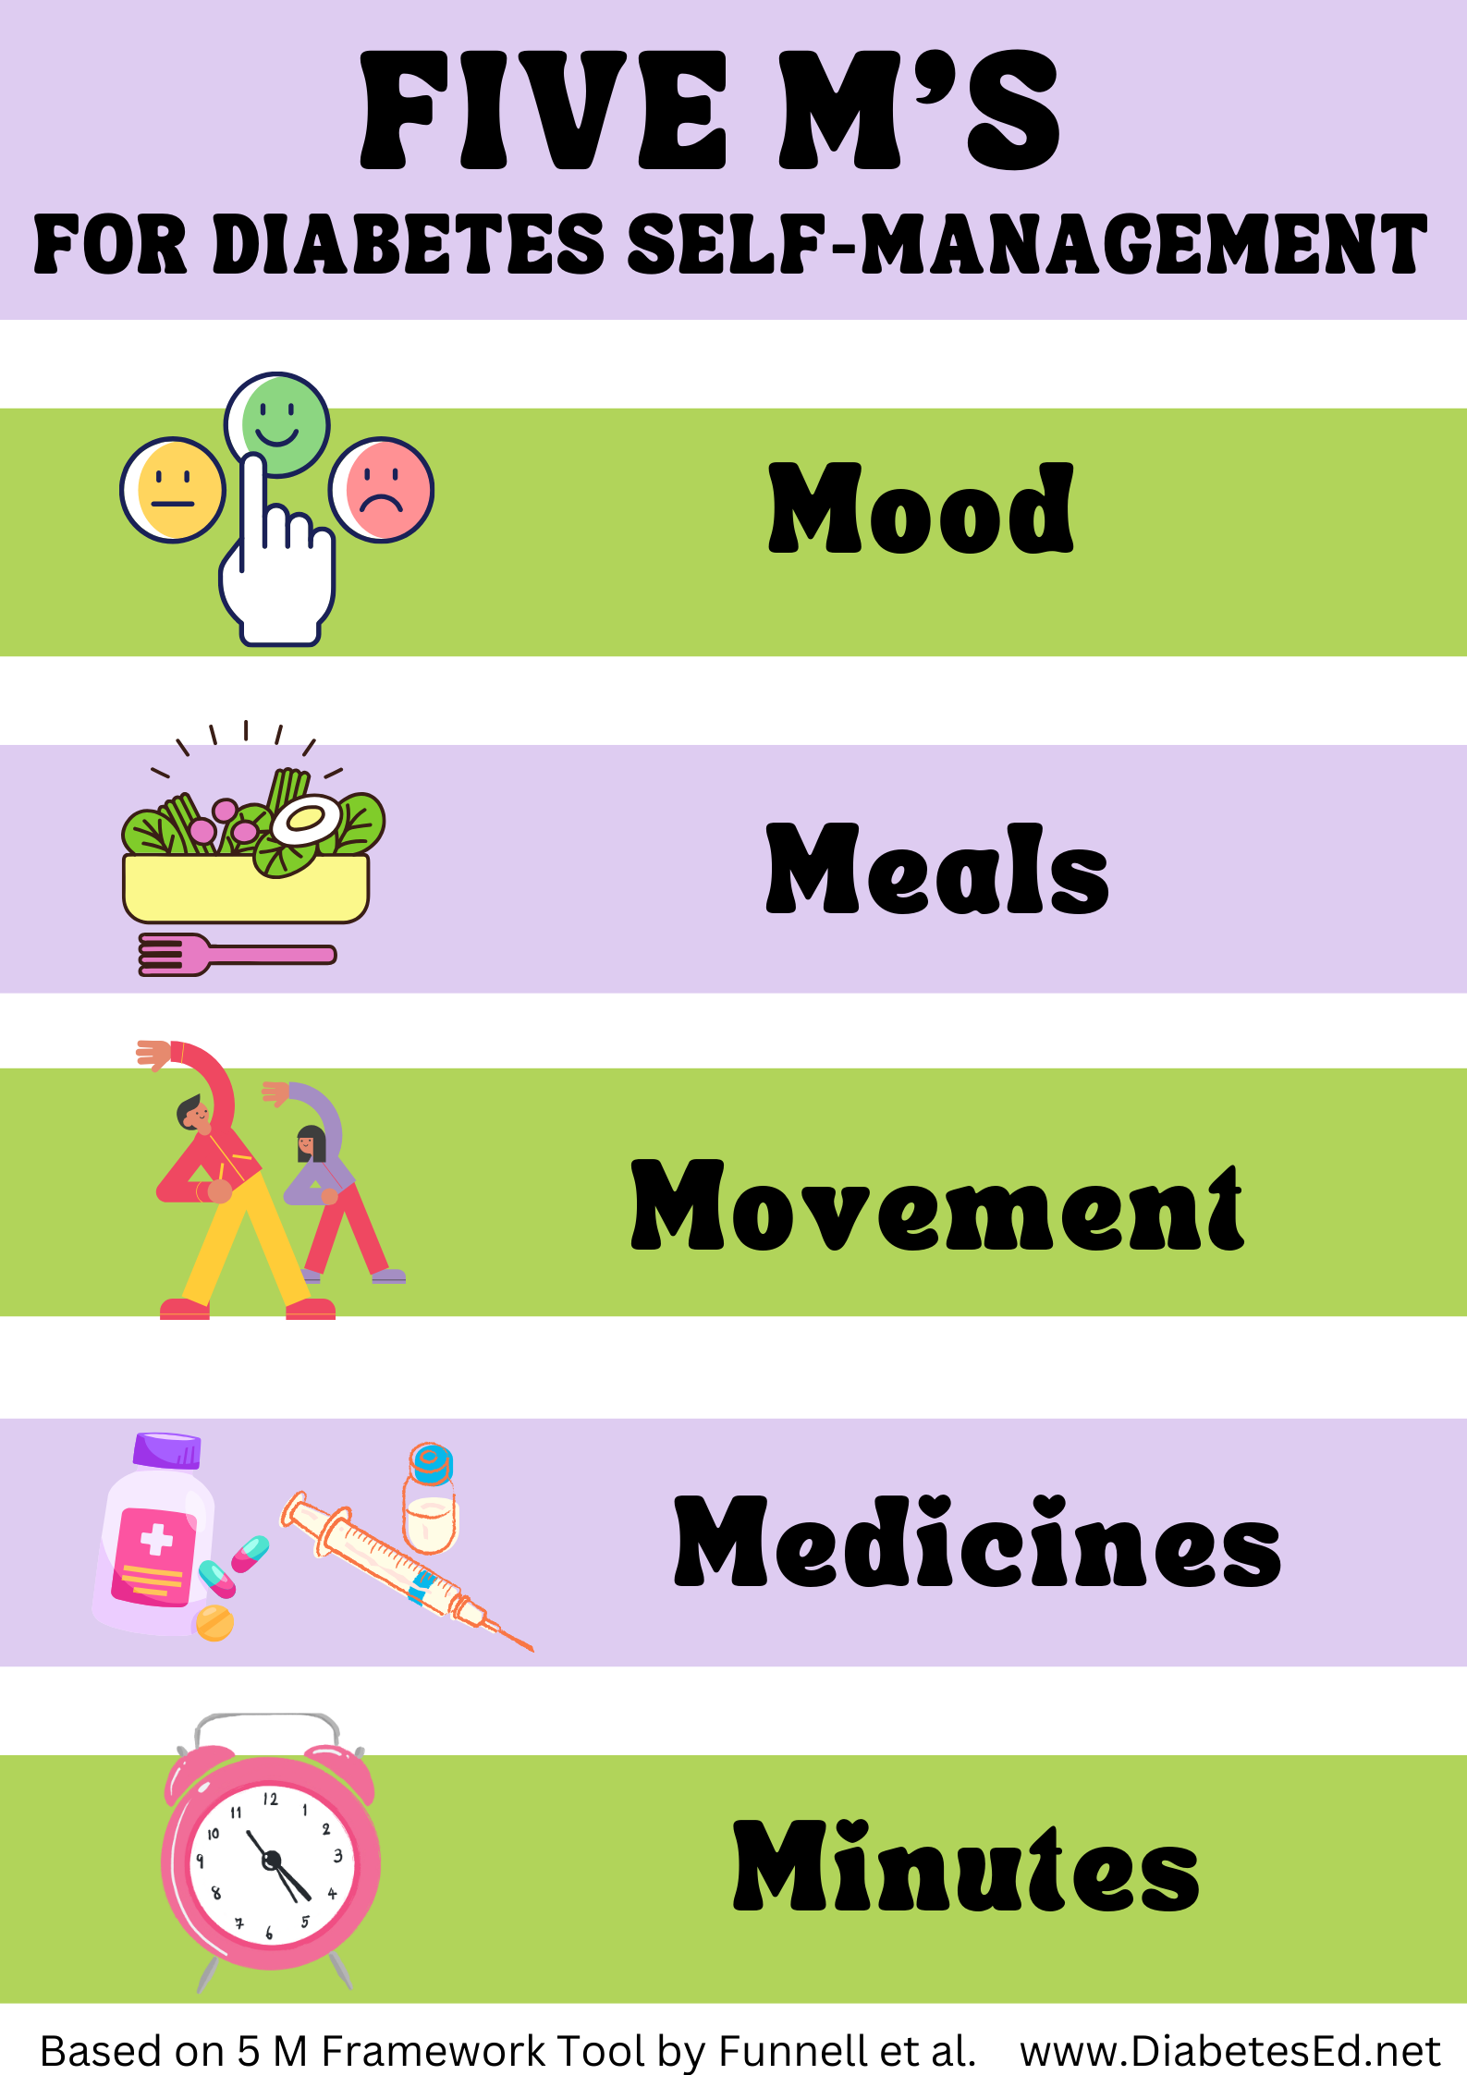
The 5 M’s of Diabetes Self-Care
With Coach Beverly Thomassian

Slide 2
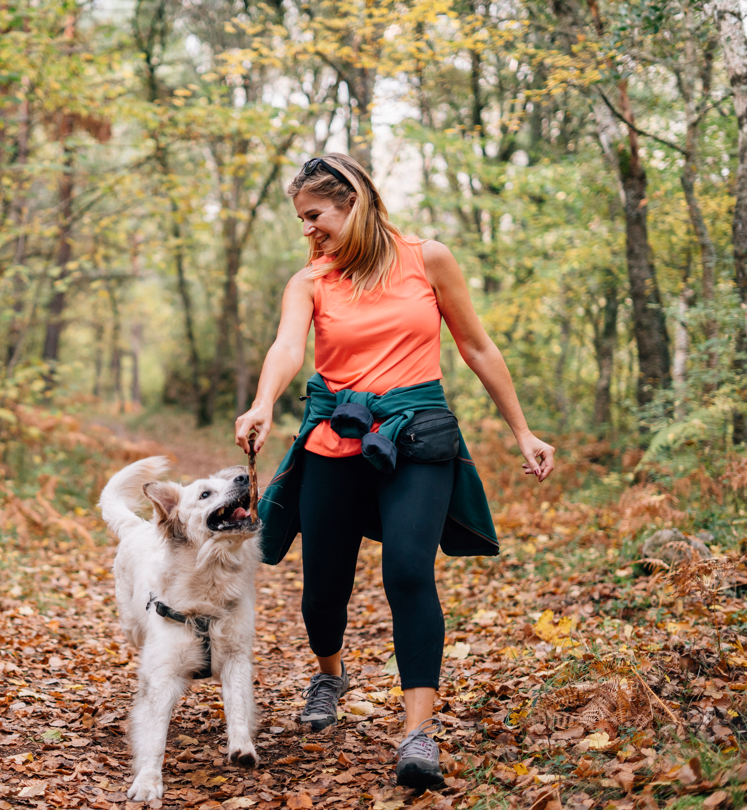
Goal of This Program
To help you:
Feel better prepared and able to manage diabetes
Live a longer, healthier and happier life
Notes:
P

Slide 3

Introductions
Your name
How long have you had T2D?
What’s one concern you have about T2D?
What is one thing you hope to gain from this program?
Notes:
P
On “white board” or in the Chat, write the one concern and one goal each person shares.
It is really important to keep the introductions brief! When introducing this slide emphasize this is will be a very brief introduction.

Slide 4
The 5 BIG Diabetes Facts
T2D is an insulin resistance problem, NOT a “sugar” problem.
T2D is NOT your fault; genetics and environmental (e.g., stress, activity, weight) matter a lot.
You DO NOT have to live a life of deprivation!
You can have a long, healthy and happy life!
Diabetes management is about making decisions to fit YOUR life (no “right” or “wrong” choices).
Notes:
E
Key Point: Treatment about DM is about prevention of the complications, not just “feel better today”.
You get to decide if the changes you make are “worth it” to you and if they work in your life.

Slide 5
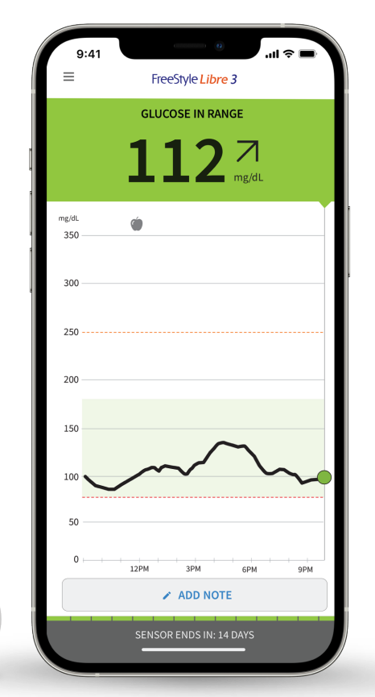
The 5 M’s
The 5 M’s: A Framework for Self-Management & Decisions
MEDICINES
(type, dose)
MOOD
(emotional and physical stress)
MOVEMENT (physical activity, exercise)
Glucose Number
MEALS
(food, beverages. portions)
MINUTES
(Timing of medicines, meals, movement and monitoring)
Notes:
E

Slide 6
5 Tips for Glucose Monitoring
Glucose values are NOT a judgment.
Focus on patterns of values, not just individual readings.
Time in range
What causes unexpected glucose values and patterns?
It could be meds, meals, movement, mood or minutes (5 M’s)
The pattern of values can help you to make informed and wise decisions.
You can also use the patterns to evaluate your decisions and decide your next step.
Notes:
E

Slide 7
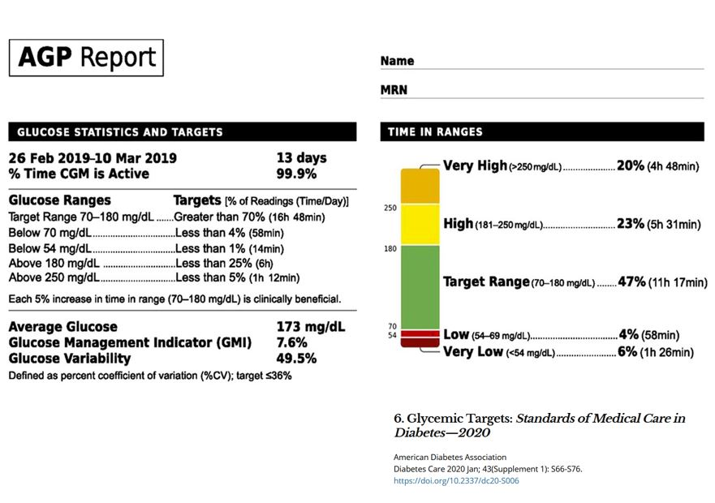
Joe’s REPORT – Step 1
standards, pg s76
Notes:
P
This is an AGP report. It gives a week in review or where your blood glucose levels were throughout the day. On the left side is a description of usual targets. For example, you can see target range is 70 – 180 mg/dl and on the CGM is having 70% of your numbers in this target range, This example is from Joe. On the right side are Joe’s readings. What do you see here for Joe?
Ask: What were your finger-stick targets before? Your A1C Target? What are your CGM targets? The recommended goal is a TIR of <70% and to minimize the number of low, very low and high and very high readings. Most people say they feel better when their blood glucose levels are more even (note variability).
TIR of 70% is consistent with an A1C of 7%. Large studies among people with diabetes have shown that an A1C of 7% or less lowers the risk for the long-term complications.

Slide 8
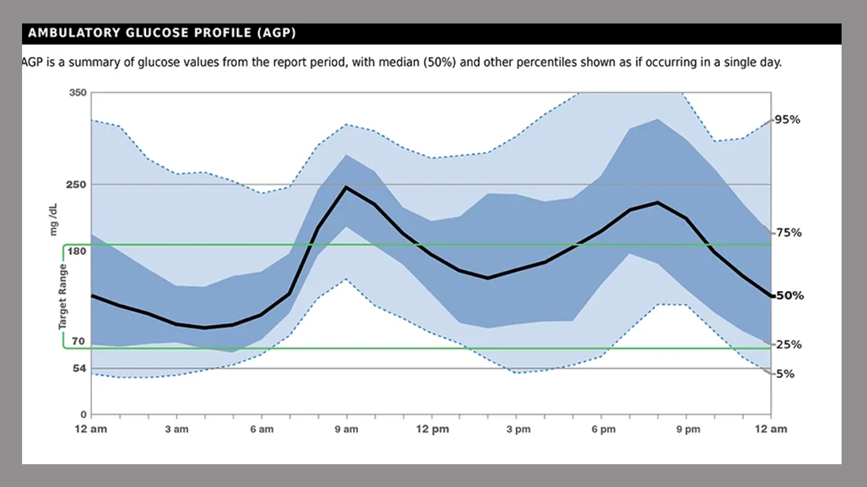
Joe’s REPORT – Step 2
Notes:
P
We call this the blue river. This other part of the AGP report gives you an hourly visual of your average blood glucose readings for a week. This allows you to see a pattern in your values over the time of day. For example, looking at the black line on Joe’s blue river, what does Joe’s BG tend to be at 9 am?
The blue river can help you think about how to get started – where focus your attention and make decisions about what to do next to help improve your overall time in range
Where might Joe start to focus his attention?

Slide 9
The 5 M’s:
The 5 M’s: A Framework for Self-Management & Decisions
MEDICINES
(type, dose)
MOOD
(emotional and physical stress)
MOVEMENT (physical activity, exercise)
Glucose number
MEALS
(food, beverages. portions)
MINUTES
(Timing of medicines, meals, movement and monitoring)
Notes:
p

Slide 10
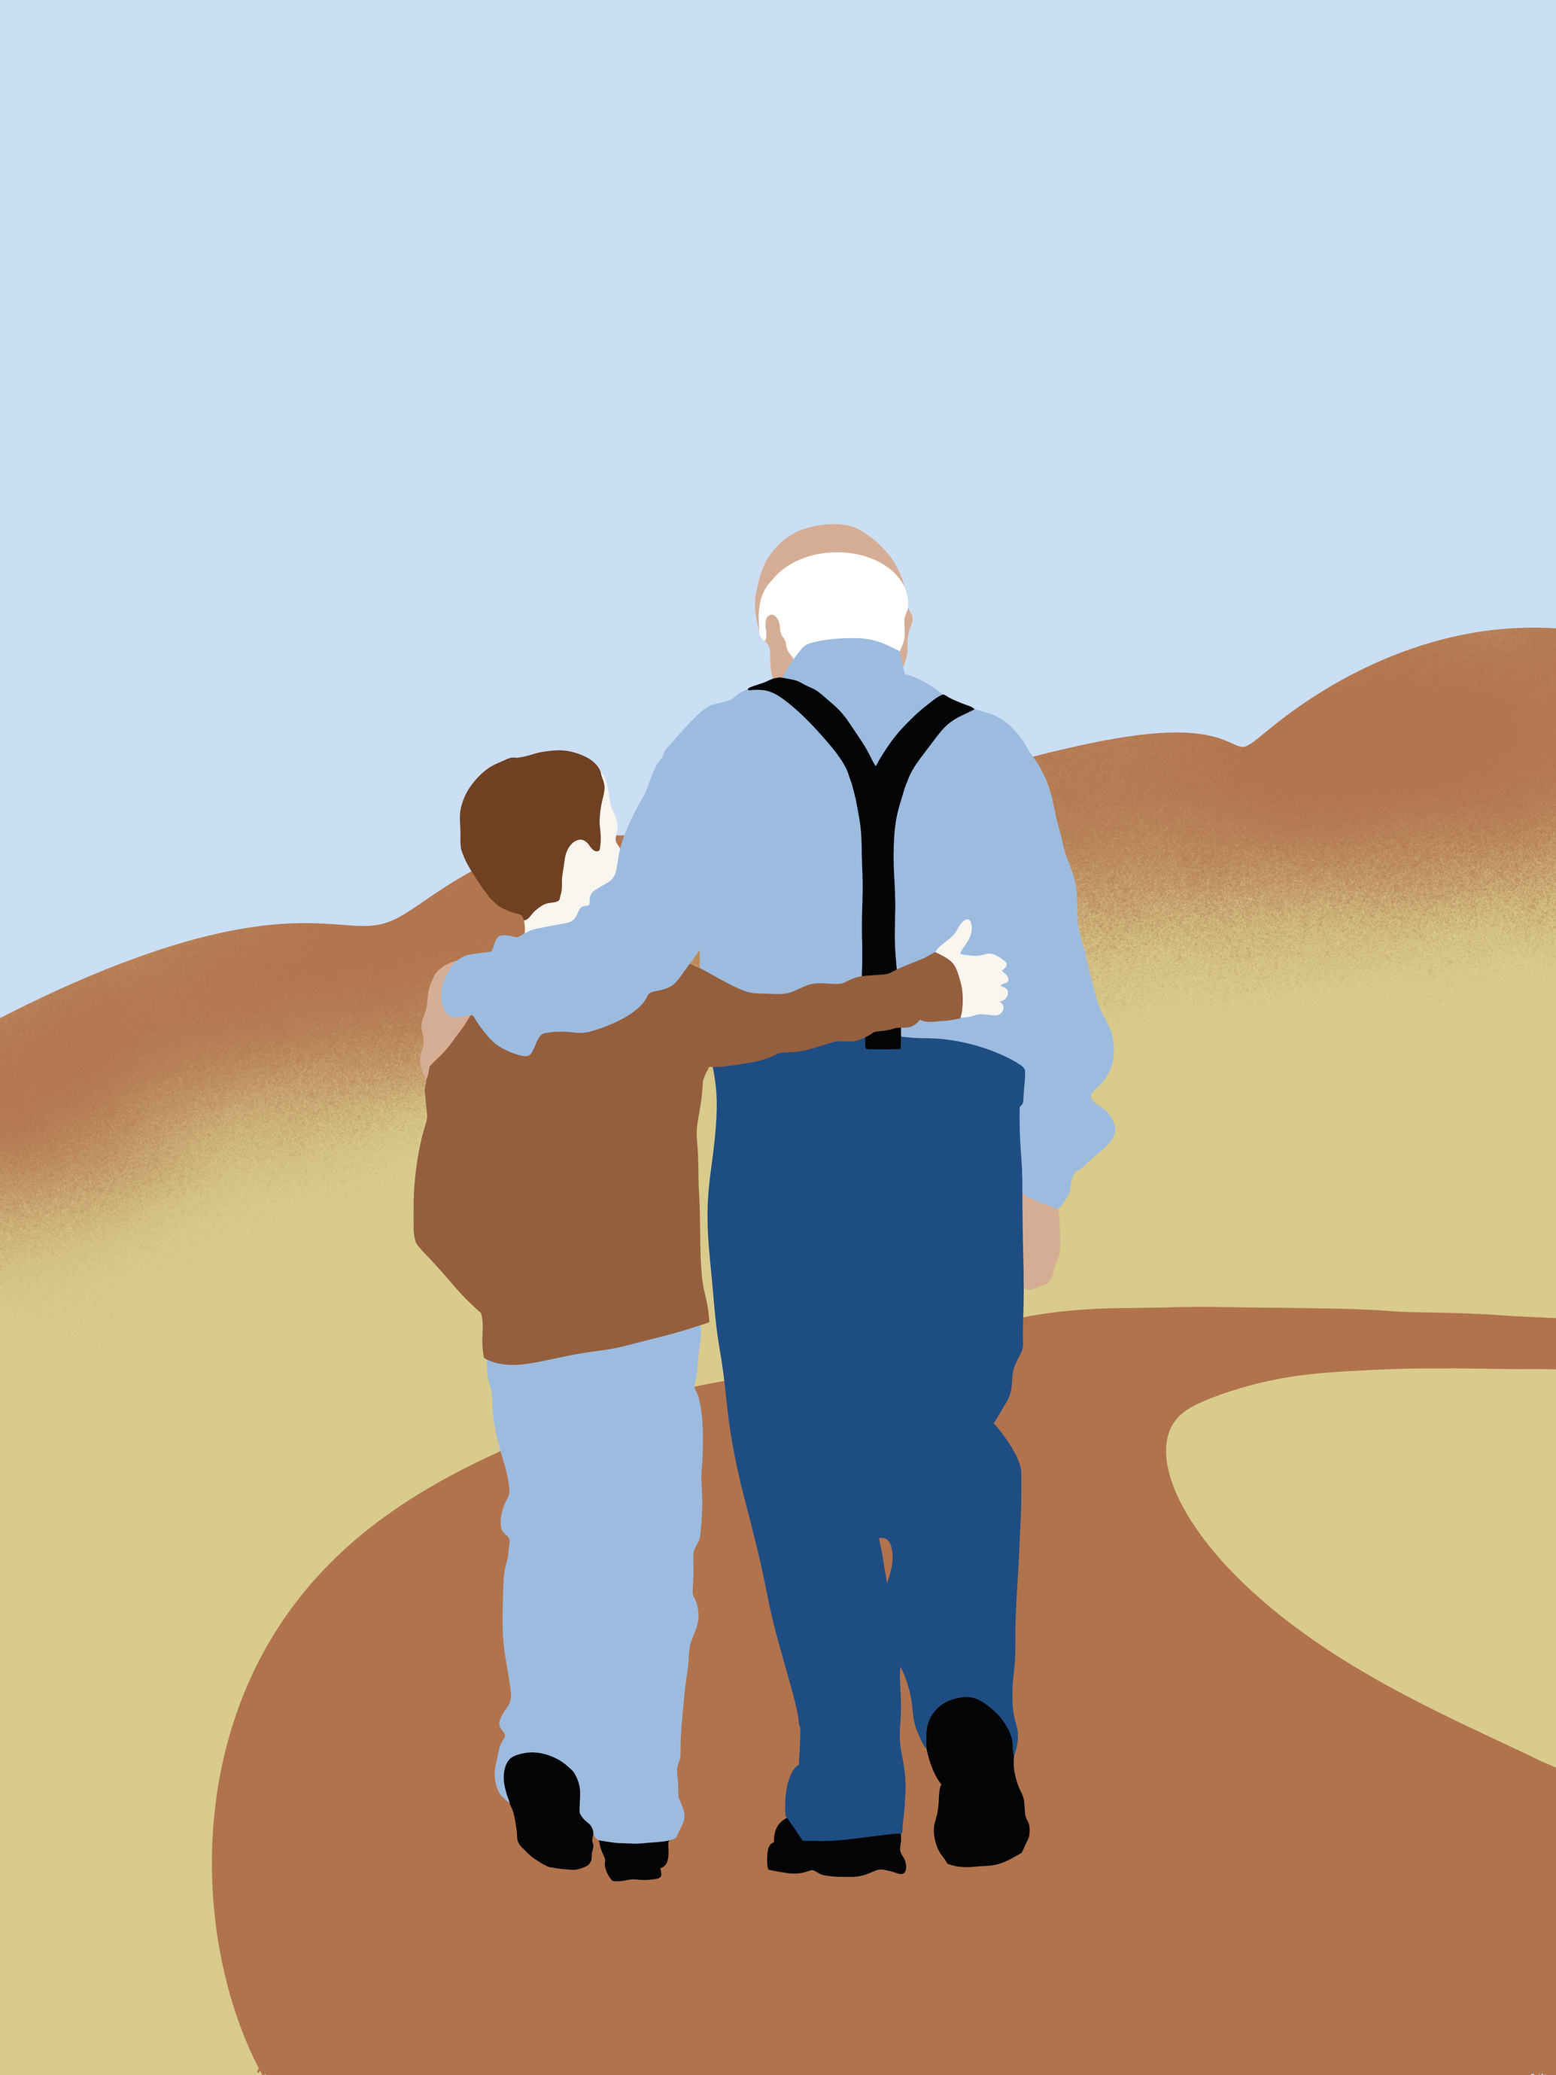
Example 1 Sam’s Experiment: Walking
Likes to walk with his grandson
Usually walks 5 days a week for 30 minutes
Wants to know how it affects him
Notes:
P
Current movement and timing (minutes) of this and how it relates to both the wise component of decision-making and using his CGM data.
Ask: Which of the M’s are related to his experiment? HOW MUCH Might Sam’s experiment affect his decisions going forward?

Slide 11
My Experiment: How does exercise affect my glucose?
Day | Before (mg/dL) | After (mg/dL) | Insight?
1 | 129 | 120 | -9
2 | 194 | 153 | -41 after dinner
3 | 157 | 94 | -63 after dinner
4
5 | 152 | 127 | -25
6
7 | 130 | 132 | +2
My experiment details:
_______________
Walk for 30 minutes for 5 days
_______________
Write down # before walk, right after
_______________
_______________
1
My A-Ha moment: Exercise really works for me, especially after dinner!
Notes:
P
Before him to know that really walking works, he would have to have data when he didn’t walk.

Slide 12

Questions
What happened on the days I didn’t walk?
Why did it drop more on some days?
Would it help if I walked every day?
Is after dinner the best time for me
to stick with my plan for walking?
If I can’t walk after dinner, is there
another time I can walk?
How might Sam’s experiment impact his decisions?
Notes:
P
Works for BG (informed) but does it work for his life (wise)?
Although is might not effect his BG as much if he walks at another time, but it still helps his heart, blood pressure and stress levels
Ask the group: how might Sam’s experiment impact his decisions?

Slide 13
The 5 M’s:
MEDICINES
(type, dose)
MOOD
(emotional and physical stress)
MOVEMENT (physical activity, exercise)
Glucose number
MEALS
(food, beverages. portions)
MINUTES
(Timing of medicines, meals, movement and monitoring)
Notes:
Introduction

Slide 14
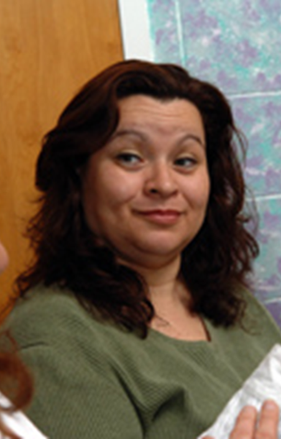
Example 2 Sonya’s experiment: Breakfast
Prior to T2D, stopped for a bagel or pastry for breakfast on her way to work
Now trying some different breakfast foods and wonders how they affect her glucose and morning routine
Notes:
P
Current food and work routine of this example and how it relates to both the wise component of decision-making and using his CGM data.
Ask: Which of the M’s are related to his experiment?
Meals and Minutes

Slide 15
My Experiment: How does breakfast affect my glucose?
Day | Before | After | Insight?
1 | 95 | 130 | +35 bagel
2 | 109 | 145 | +36 bagel
3 | 127 | 208 | +71 bagel and juice
4
5 | 99 | 103 | +4 eggs
6 | 135 | 136 | +1 eggs
7 | 128 | 132 | +4 eggs
My experiment details:
_______________
For 6 days write
down # before breakfast and
2 hours after
______________
3 days bagel
3 days eggs_
1
My A-Ha I had no idea! My choices really raised my glucose
Notes:
p

Slide 16
Sonya’s Questions
Was that an OK increase after eating a bagel? And the juice?
What else should I think about (besides glucose value) when deciding my breakfast?
Which of these would work best for me breakfast?
Should I tweak something, or am I satisfied with my current breakfast?
How might Sonya’s experiment impact her decisions?
Notes:
P
Ask: Which of the M’s are related to her experiment (Meals, timing)?
The experiment ends with some more questions. Here are some more questions that Sonya asked after this experiment.
Note for the second bullet: other things are weight considerations, blood pressure, feeling full and satisfied, getting up earlier for routine feasible?

Slide 17
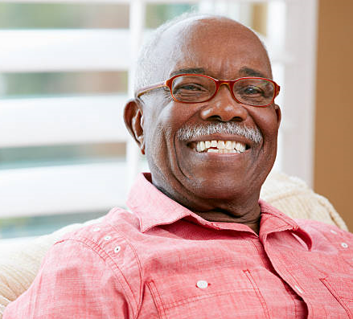
Meet Tom
Weekly pancake breakfast with his 5 year-old granddaughter
He found that his glucose is over 200 after this meal
Feels discouraged, thinks ”I’m going to have to give this up.”
What other information do you need to evaluate this experiment?
If you were Tom, what would your “Informed and Wise” decision be?
Notes:
E
After 1) How did it go with home experiments and 2) questions.
Remind about the difference in informed and wise decisions. (Evidence-based facts people need to know before they can make an informed decision or address their feelings about an issue in context of values and goals (wise decisions).
Key Points: What else do you need to know (where was his BG when before he ate? Minutes? Time in Range vs one glucose reading. How meaningful is the time with his granddaughter to Tom (Is it worth it in terms of his glucose? To Tom?)

Slide 18
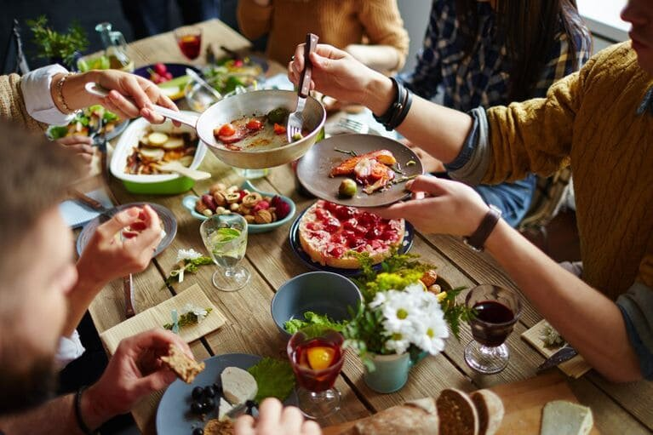
Key Points about Meals
No such thing as a “diabetic diet”.
The best meal “plan” is the one you can actually USE to make decisions, not one you just try to follow.
Foods are not “good” or “bad” or “healthy”.
No one food will “cure” your diabetes, or one you should never eat again.
Notes:
E – what do you think of these?

Slide 19
Key Points about Meals
When making changes, consider whether it is worth it (pleasure now vs. disappointing outcome later).
Eating a variety of foods helps you get needed vitamins and minerals; it is easier for most people to do over time.
An effective approach for everyone:
Choose non-starchy, high-fiber vegetables
Limit added sugars, sugar sweetened
beverages and refined grains
Choose whole foods vs. highly processed
Limit alcohol (1 a day for women, 2 a day for men)
Notes:
E
Nutrition recommendations: ADA and USDA
• Choose foods that are meaningful and pleasurable.
• Emphasize non-starchy, fiber-rich, whole-grain carbohydrates (vegetables and
fruit) with minimal added sugars and refined grains.
• Choose whole foods over highly processed foods.
• Choose water or unsweetened beverages over sugar-sweetened beverages.
• Limit alcoholic beverages (1 drink per day for women; 2 drinks per day for men). I would like to talk about alcohol and how it affects your blood sugar here. This also leads to the BRIEF discussion of the role of the liver. Should we have a simple word slide of this?
Ask: Do you have any questions about these points? How do you think alcohol affects your blood glucose – anyone noticed that?

Slide 20
The 5 M’s:
MEDICINES
(type, dose)
MOOD
(emotional and physical stress)
MOVEMENT (physical activity, exercise)
Glucose number
MEALS
(food, beverages. portions)
MINUTES
(Timing of medicines, meals, movement and monitoring)

Slide 21
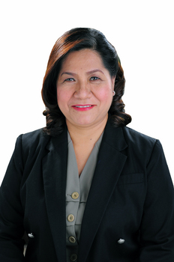
Meet Mary
Despite not snacking after dinner, she notices her glucose levels start rising after she awakens each morning
She feels like she’s failing at T2D.
”Maybe I should just give up on diabetes”
WHAT IS GOING ON?
Notes:
P

Slide 22
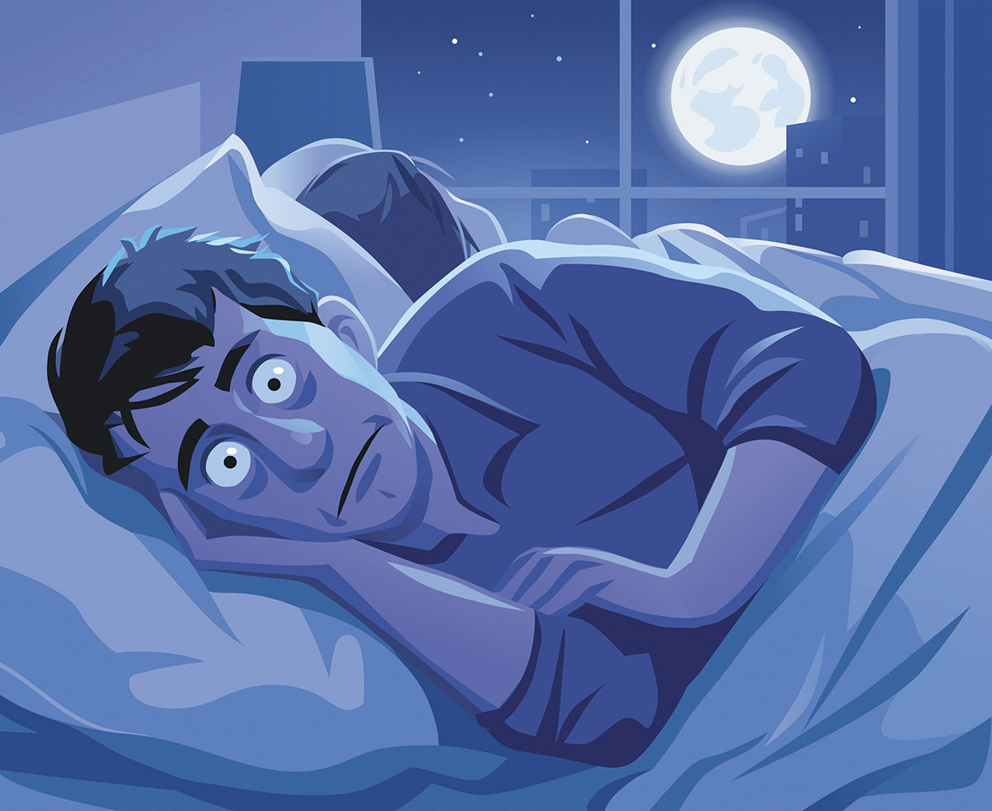
Key Points about Mood
Stress, emotional or physical, can affect glucose levels
Stress signals the body to prepare for possible action
Then glucose is raised in case action is needed
Physical stressors that can raise glucose levels:
Illness
Surgery
Significant pain
Poor sleep
Exercise
Notes:
P
Brain-liver-pancreas pathway for emotional or physical

Slide 23

Key Points about Mood
Emotional stress can affect glucose levels
Glucose changes can affect your mood
Diabetes can impair your mood:
Diabetes distress is VERY common.
Tough feelings like anger, worry, discouragement and embarrassment.
Different from life stress and depression.
Taking action to address diabetes distress
will likely lead to better glucose levels and well-being.
Notes:
P
For many patients, this is new info and also demonstrates that this program is different than usual their diabetes experiences.
ASK: What’s been tough for you? It is common for people to feel frustrated and disappointed, angry, guilty for struggling with making changes and embarrassment about having diabetes.

Slide 24
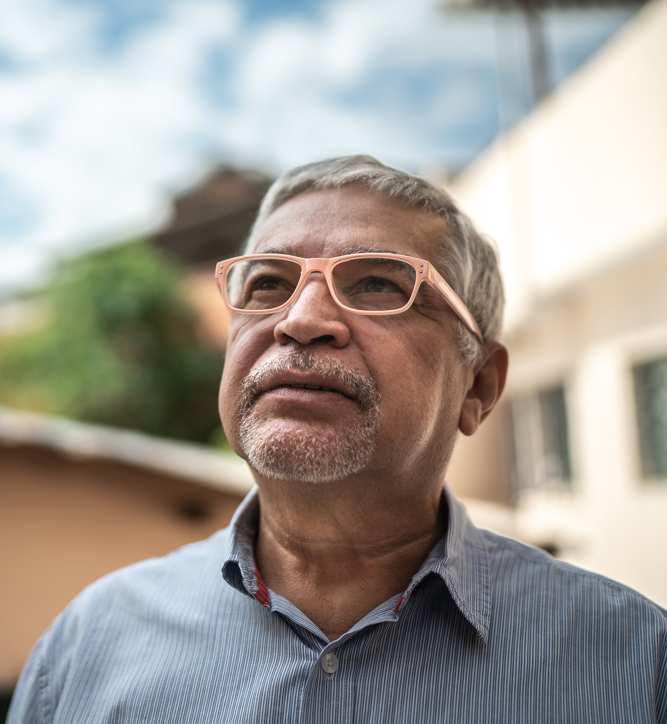
Key Points about Medications
Taking your meds regularly (including at the same time) is one of the most potent things you can do!
You will likely need more and different meds over the years:
Needing more does not mean you have failed or are sicker.
Needing to start insulin does not mean you have failed or are sicker.
Your current dosage is based on your body’s needs.
If you do nothing else, take your pills
Notes:
E
ASK: What medicines do you take for your diabetes? What questions do you have about your medicines?

Slide 25
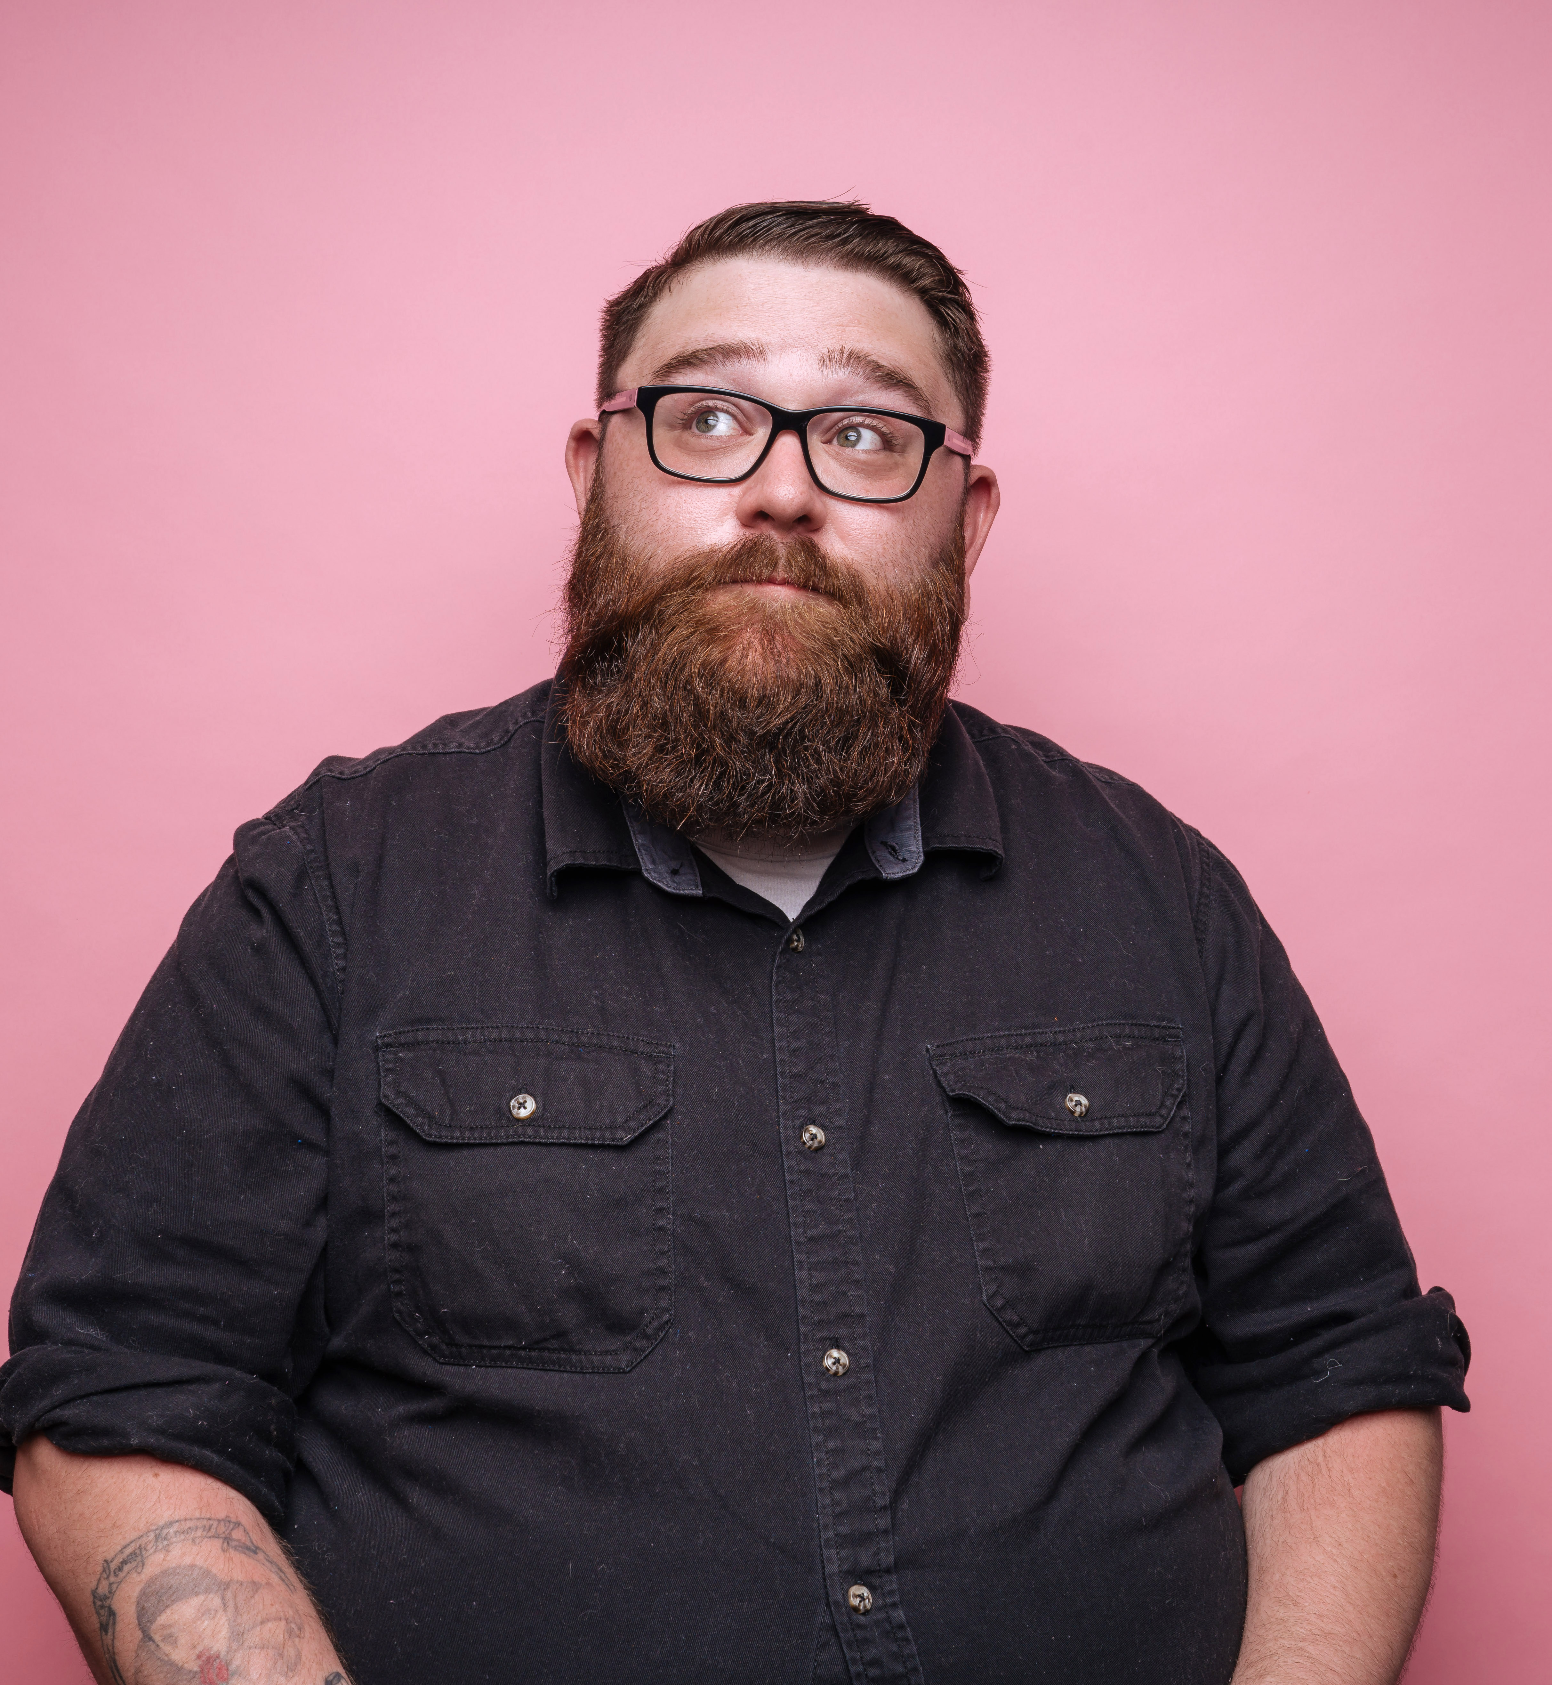
Home Experiments Ideas
Ask questions that are interesting and meaningful for YOU.
What happens when I eat my favorite snack?
Is there a better lunch choice for me?
How are my workday and weekend glucose readings different?
How does stress affect my glucose?
Notes:
E
You are making decisions and evaluating them.
Now Is the time to try something different when you have this opportunity for support and experts – others with diabetes and diabetes clinicians.

Slide 26

Home Experiments Ideas
Should address questions that are interesting and meaningful for YOU.
When am I feeling tired, is that because of low or high glucose?
What if I start taking my diabetes medicines more regularly, or closer to the same time?
What happens to my glucose if I exercise after dinner instead of in the morning?

Slide 27
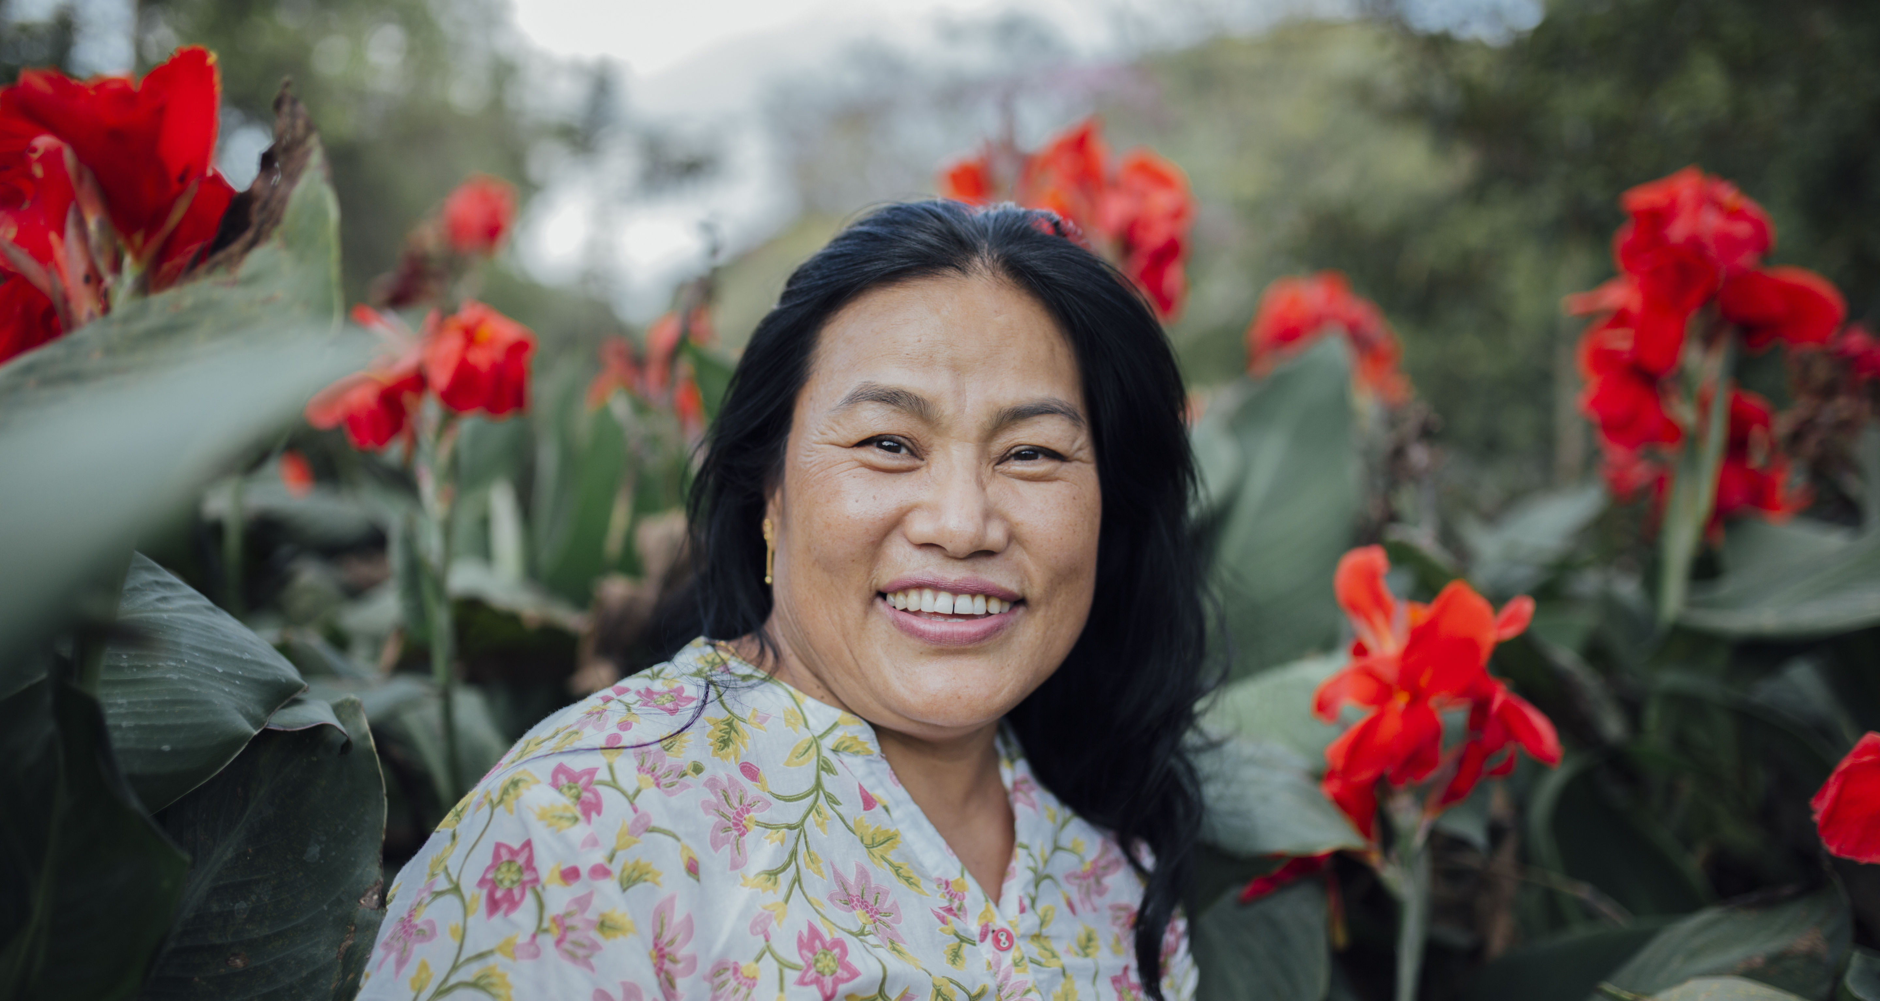
Thanks for Participating!!!

