Slide 1

  Meds Management for Type2 Diabetes
Beverly Thomassian, RN, MPH, BC-ADM, CDCES
Pronouns: She, her, and hers
President, Diabetes Education Services
Wife of KT - Pharmacist
www.DiabetesEd.net

Slide 2

Coach Bev has no Conflict of Interest
She’s not on any speaker's bureau
Does not invest or have any financial relationships with diabetes related companies.
Gathers information from reading package inserts, research and articles
The ADA Standards of Medical Care is main resource for course content

Slide 3

Meds Management for Type 2
Objectives:
1. Describe strategies to improve glucose levels for people with type 2 diabetes (inpatient and outpt).
2. Discuss the application of the new ADA Guidelines to improve glucose and reduce CV and renal risk.
3. List strategies to initiate & adjust oral & injectable therapy using a person-centered approach.
4. Apply new guidelines to individual case studies.

Slide 4
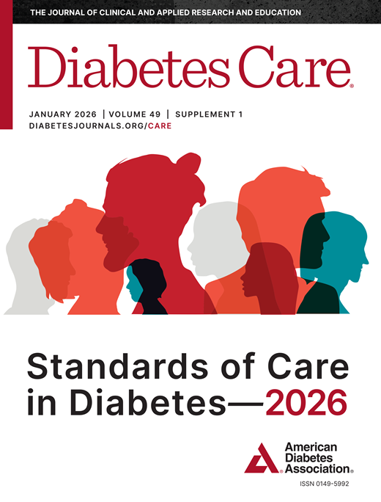
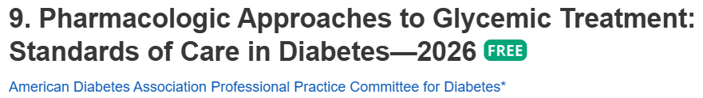
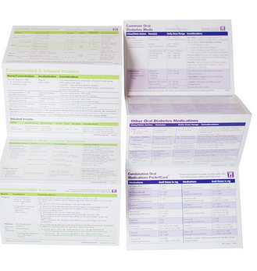
Meds for Type 2 Diabetes - Overview
Med PocketCards Available 3 ways:
- Home page on website
- CDCES Coach app
- Order your own laminated version

Slide 5
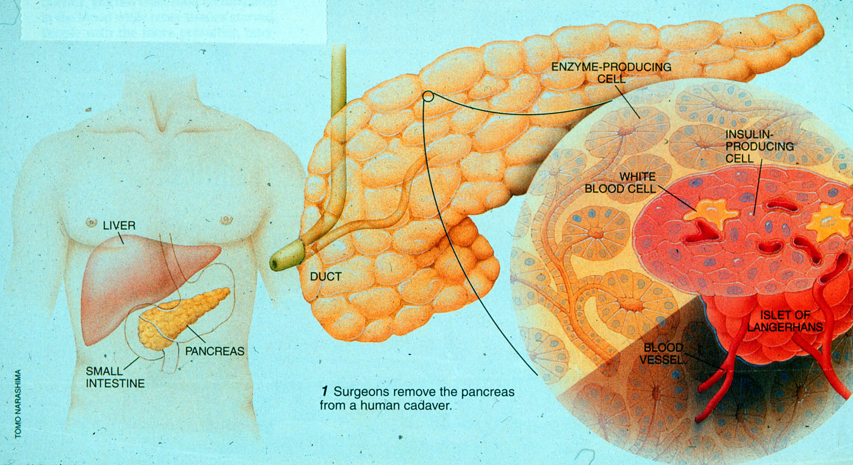

Notes:
Measurement of C-peptide is preferable to the measurement of insulin as it has a longer half-life, not subjected to the first-pass hepatic metabolism, and a steady-state clearance from the circulation. Insulin undergoes first-pass hepatic metabolism, has variable clearance, a much shorter half-life, and exogenously administered insulin can confound results.

Slide 6
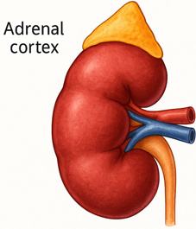
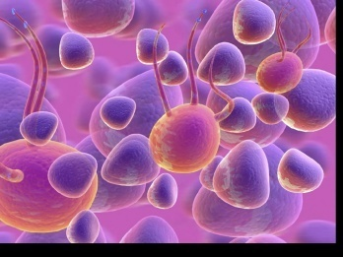
The Noxious Nine – Pathophysiology T2D
Hypercortisolism
Neurotrans-mission dysfunction
Decreased
Insulin β-cell secretion
Increased renal glucose reabsorption
Decreased
incretin effect
Gut hormones
G
Increased glucagon α-cell secretion
I
G
I
G
G
I
I
G
Increased lipolysis
G
G
I
I
G
G
I
Increased hepatic glucose
production
I
G
G
Decreased muscle glucose uptake
Notes:
6
ummary: The Noxious Nine in Diabetes Pathophysiology
Ralph A. DeFronzo expanded his earlier conceptual model of diabetes—known as the Ominous Octet—to include a ninth element: hypercortisolism. This updated framework is referred to as the Noxious Nine, highlighting the important role of cortisol dysregulation in difficult-to-control type 2 diabetes currentsciencedaily.com+8HCP Live+8HCP Live+8.
Recent research, including the CATALYST trial, shows that about 24% of patients with difficult-to-control T2D have underlying hypercortisolism. Treating this condition with mifepristone, a glucocorticoid receptor antagonist, led to significant improvements in HbA1c—averaging around a 1.5% reduction pmc.ncbi.nlm.nih.gov+3HCP Live+3medscape.com+3.
These findings emphasize the importance of recognizing hypercortisolism in T2D care and suggest that addressing it may help improve glycemic and metabolic control in a subset of patients.
6

Slide 7

What is Type 2 Diabetes?
Complex metabolic disorder ….
  (Insulin resistance and deficiency)
with social, behavioral and environmental risk factors unmasking the effects of genetic susceptibility.
New Diagnosis?
Call 800 – DIABETES to request “Getting Started Kit”
www.Diabetes.org

Slide 8
Natural History of Type 2 Diabetes
No Diabetes
FBG <100
Random <140
A1c <5.7%
Prediabetes
FBG 100-125
Random 140 - 199
A1c ~ 5.7- 6.4%
50% working pancreas
Diabetes
FBG 126 +
Random 200 +
A1c 6.5% or +
20% working pancreas
Yes!
NO
Development of type 2 diabetes happens over years or decades

Slide 9

Matching Meds to the Individual

Slide 10
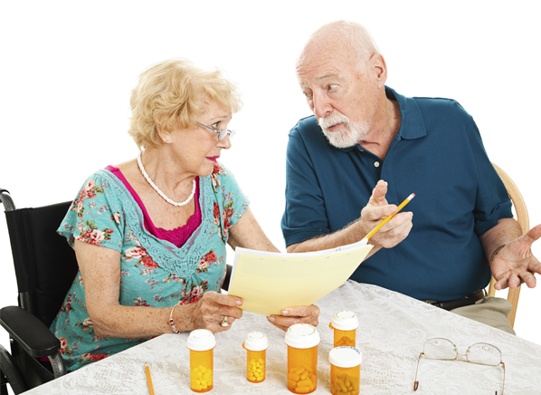
Medication Taking Behaviors
Adequate medication taking is defined as 80%
23% of time, if A1c, B/P, lipids above target - due to med taking behavior
Assess for barriers
If taking meds 80% of time and goals not met, consider medication intensification
Barriers include:
Forgetting to fill Rx, forgetting to take, fear, depression, health beliefs, med complexity, cost, knowledge gap, system factors, etc.
Work on targeted approach for specific barrier

Slide 11

Wait, What About Emotions?

Slide 12

Diabetes Admit for Hyperglycemia
JR is admitted for hyperglycemia because he stopped taking his diabetes meds.
HCP says, “Don’t you realize you are going to get complications, like kidney disease or amputation if you don’t take your medications?”
Door Closed – No Connection made
How Does JR Feel?
Embarrassed
Ashamed
Defeated
Angry
Unheard
How does HCP feel?
Frustrated
Defeated
Worried

Slide 13
Diabetes Visit – Let’s Go through
How Does JR Feel?
A small adjustment can make a BIG Difference
Heard & Seen
Recognized
Connected
Engaged
How does the HCP feel?
Connected
Concerned
Collaborative
HCP says, “JR, I am worried about you and your elevated blood glucose. Can you share what is going on in your life?”
Door Open – Connection made
Healing to HCP
Bidirectional Healing
Healing to Person

Slide 14

We can make a difference

Slide 15

Step Wise Approach to Hyperglycemia 2026
Usually, start one medication at a time
However, evidence supports initial combo therapy if A1C 8.5% or more, to quickly reach goals and slow decline of glucose control.
Where to start?
  Individual values
  CVD, Heart failure or Kidney Disease, MASH
  Minimize Hypoglycemia
  Minimize wt gain or promote wt loss
  Consider Cost
  Social determinants of health

Slide 16
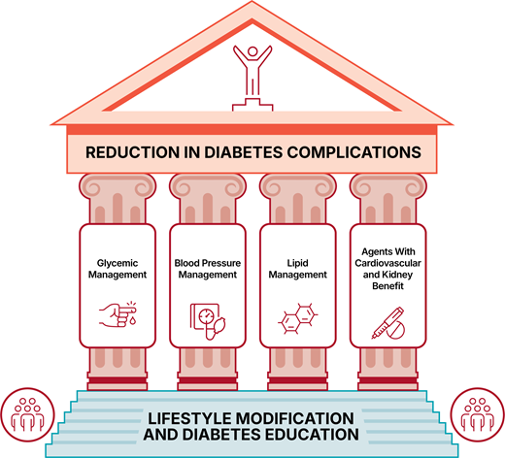
Glycemic management is just one pillar

Slide 17
ADA 2026 Goals Summary
A1c less than 7% (individualize)
Pre-meal BG 80-130
Post meal BG <180
Time in Range (70-180) 70% of time
Blood Pressure
<130/80
Cholesterol
Statin therapy based on age & risk status
If 40+ with ASCVD Risk, decrease LDL by 50%, LDL <70
If 40+ with ASCVD, decrease LDL by 50%, LDL <55
Hospital BG Goal is 100-180

Slide 18


Metformin, Sulfonylureas, DPP-IV Inhibitors & TZD’s

Slide 19
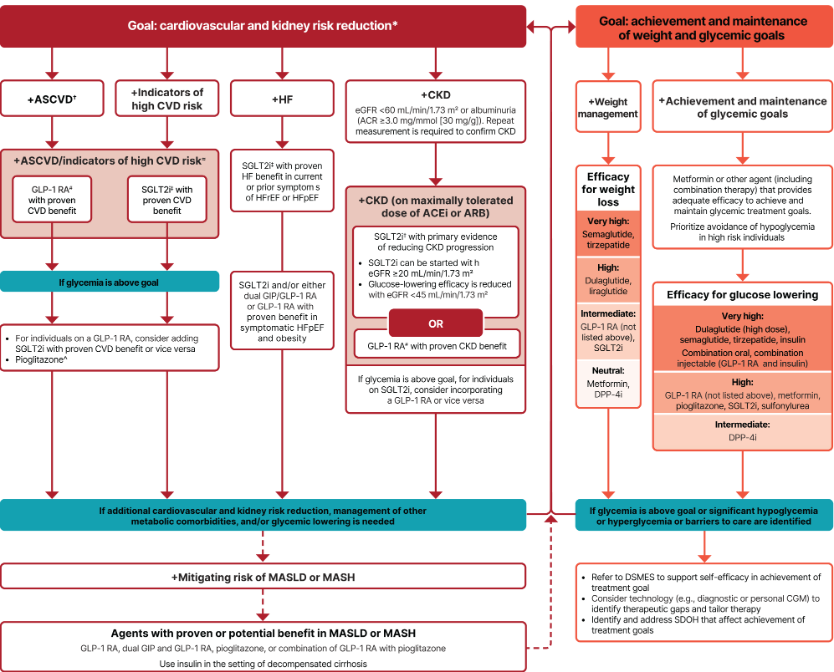
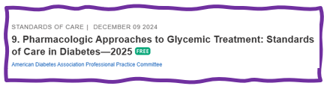
Let’s Break it Down ADA 2025
From: 9. Pharmacologic Approaches to Glycemic Treatment: Standards of Care in Diabetes—2026

Slide 20

Quick Question 1
RT, a 61-year-old woman with BMI of 28 and type 2 diabetes 3 months. She wanted to try to manage diabetes with diet and exercise. GFR in 90s, UACR 14mg/gm, A1c 7.4%. Based on this info, which medication would you start?
A. Pioglitazone (Actos)
B. Metformin
C. GLP1-RA
D. Sulfonylurea

Slide 21
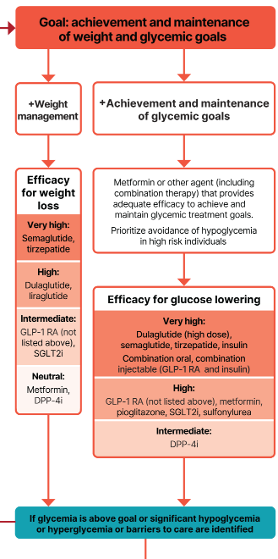
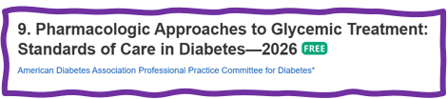
Metformin is “Usually” 1st Line
Why metformin?
  Longstanding evidence
  High efficacy and safety
  Inexpensive - 3 months for $12
  Weight neutral
  Check B12 levels at intervals especially if anemia or neuropathy.
If ASCVD, HF or CKD or high ASCVD risk, use SGLT2i or GLP-1 RA +/- metformin
If A1C ≥ 8.5%, consider combo therapy.

Slide 22
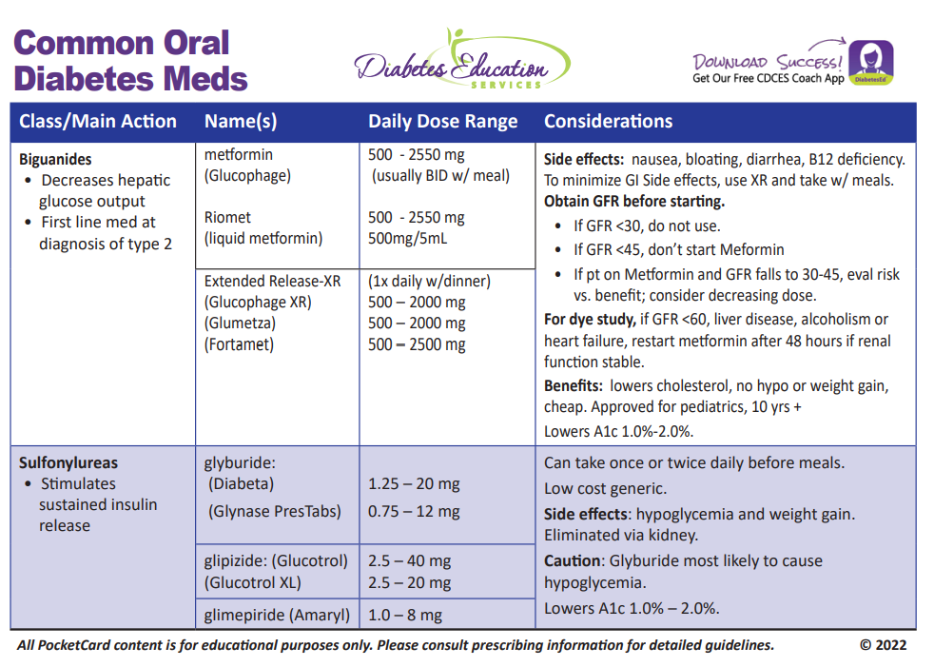
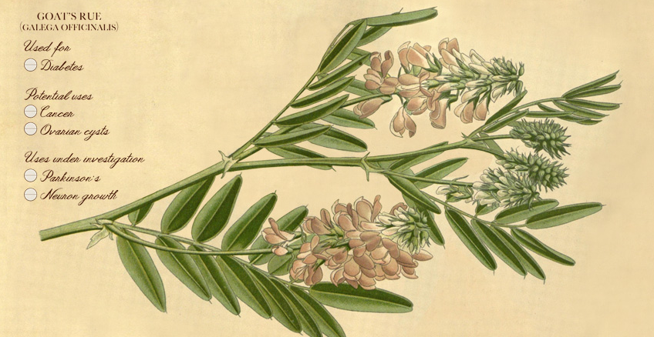
Biguanide derived from:
Goat’s Rue Galega officinalis,
French Lilac
Does NOT harm kidneys
$10 for 3-month supply from Walmart & other pharmacies

Slide 23

Metformin and Kidney Disease – 2026 Update
Metformin is also a preferred agent in CKD due to well-documented efficacy and safety profile in type 2 diabetes.
  However, there is no documented direct kidney benefit.
Don’t start metformin if eGFR is <45
Reduce dose of metformin if eGFR is <45 individual is already on metformin.
Stop metformin once eGFR is <30
Generally, hold metformin during hospital stay.

Slide 24

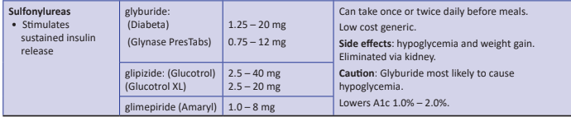
Sulfonylureas - Squirters
Mechanism: Stimulate beta cells to release insulin
Dosed 1-2x daily before meals
Adverse effects
  Hypoglycemia, Weight gain, watch renal function
Low cost, $12 for 3 months supply
Can help with glucose toxicity, lowers A1C 1-2%
Hold sulfonylureas inpatient to prevent hypoglycemia.
Notes:
CAROLINA tral (linagliptin vs glimepiride)
Meta-analysis: In type 2 diabetes, the use of sulfonylureas is associated with increased mortality and a higher risk of stroke

Slide 25

Case Study KR – Poll 2
KR is a 47yoM with type 2 diabetes x 5 years. Complains of dizziness/shakiness 3x a week, especially after surfing. Last A1C 6.7%. Which of their medications is most likely causing hypoglycemia?
  A. Metformin
  B. Sitagliptin (Januvia)
  C. Glimepiride (Amaryl)
  D. Pioglitazone (Actos)
Notes:
Answer. C

Slide 26
Hypoglycemia & Next Steps
Do NOT Cause Hypoglycemia
Can Cause Hypoglycemia
DPP-4 Inhibitor
GLP-1 RA / GIP
SGLT-2 Inhibitor
TZD, Metformin
Sulfonylurea
Meglitinides
Insulin

Slide 27
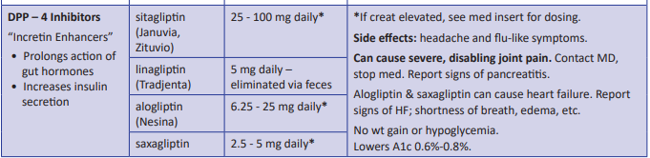
DPP-4 Inhibitors – “Incretin Enhancers”
Action:
  Increase insulin release w/ meals
  Suppress glucagon
Efficacy: Decreases A1c by 0.6 -0.8%
Alogliptin increased risk of heart failure
Average Wholesale Price: $650 month
Basal insulin plus sitagliptin can be considered during hospital stay.
Notes:
27
27

Slide 28

Case Study Question 3
MZ is complaining of nausea, and increased eructation?
What class of medication may be causing these side effects?
GLP-1/GIP Receptor Agonists
Metformin
SGLT-2 Inhibitor
DPP-IV Inhibitor

Slide 29

GLP & GIP Receptor Agonists
Reduce Major Adverse Cardiovascular Events (MACE)

Slide 30
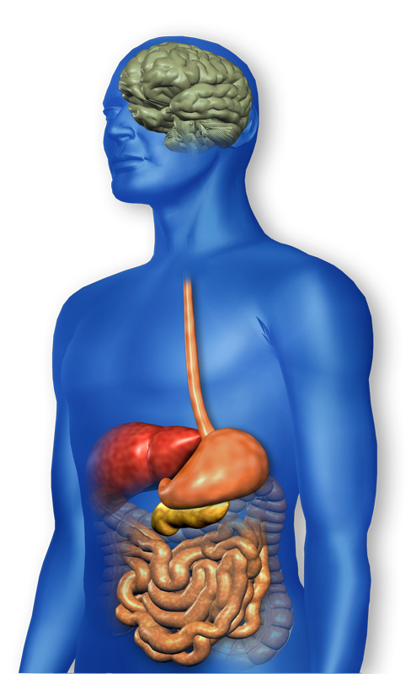
GLP-1 Effects in Humans
Understanding the Natural Role of Incretins
GLP-1 secreted upon the ingestion of food
Promotes satiety and
reduces appetite
Alpha cells:
↓ Postprandial
glucagon secretion
↑ Beta-cell
response
Liver:
↓ Glucagon reduces hepatic glucose output
Beta cells:
Enhances glucose-dependent insulin secretion
Stomach:
Helps regulate gastric emptying
GLP-1 degraded by
DPP-4 w/in minutes
Notes:
30
30
Required
DISCUSSION POINTS:
--Upon food ingestion, GLP-1 is secreted into the circulation from L cells of small intestine.
--GLP-1 increases beta-cell response by enhancing glucose-dependent insulin secretion.
--GLP-1 decreases beta-cell workload and hence the demand for insulin secretion by:
--Regulating the rate of gastric emptying such that meal nutrients are delivered to the small intestine and, in turn, absorbed into the circulation more smoothly, reducing peak nutrient absorption and insulin demand (beta-cell workload)
--Decreasing postprandial glucagon secretion from pancreatic alpha cells, which helps to maintain the counterregulatory balance between insulin and glucagon
--Reducing postprandial glucagon secretion, GLP-1 has an indirect benefit on beta-cell workload, since decreased glucagon secretion will produce decreased postprandial hepatic glucose output
--Having effects on the central nervous system, resulting in increased satiety (sensation of satisfaction with food intake) and a reduction of food intake
--By decreasing beta-cell workload and improving beta-cell response, GLP-1 is an important regulator of glucose homeostasis.
SLIDE BACKGROUND:
--Effect on Beta-cell: Drucker DJ. Diabetes. 1998; 47:159-169
--Effect on Alpha cell: Larsson H, et al. Acta Physiol Scand. 1997; 160:413-422
--Effects on Liver: Larsson H, et al. Acta Physiol Scand. 1997; 160:413-422
--Effects on Stomach: Nauck MA, et al. Diabetologia. 1996; 39:1546-1553
--Effects on CNS: Flint A, et al. J Clin Invest. 1998; 101:515-520

Slide 31
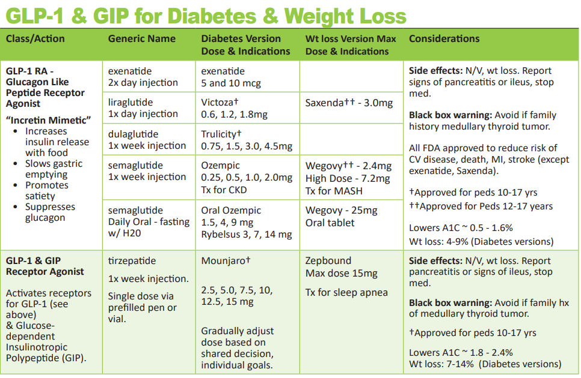
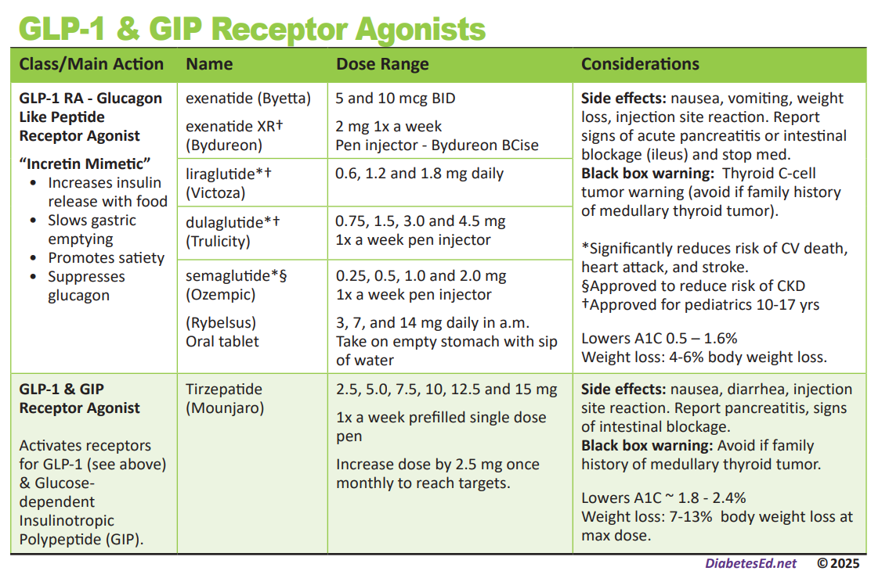
Pocket Card: GLP-1 & GIP RA
Notes:
Update with exenatide indication in pediatrics.

Slide 32
Let’s Break it Down ADA 2025
From: 9. Pharmacologic Approaches to Glycemic Treatment: Standards of Care in Diabetes—2026

Slide 33
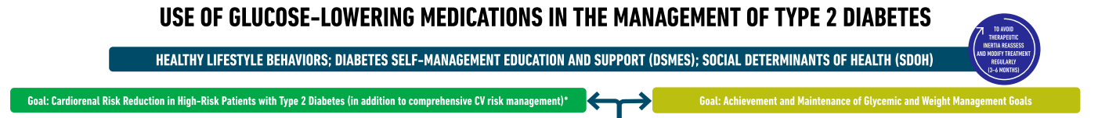
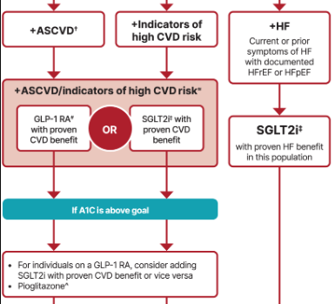
Choosing glucose-lowering medication in people with CVD
  Most effective meds based on Cardiovascular Outcomes Trial (CVOT)
  GLP-1 RA’s Preferred
  semaglutide (Ozempic), liraglutide (Victoza), dulaglutide (Trulicity)
  ~ Or~
  SGLT2i
  Empagliflozin (Jardiance), canagliflozin (Invokana), dapagliflozin (Farxiga)
ASCVD = atherosclerotic cardiovascular disease
Notes:
For people with established atherosclerotic cardiovascular disease or indicators of high risk our recommendation is to choose a GLP-1 receptor agonist or an SGLT-2 inhibitor with proven cardiovascular benefit. In case HbA1c remains above target one should add an agent from the other category or pioglitazone as deemed necessary. Our recommendation is based on the favourable results of cardiovascular outcomes trials that established the favourable effect of GLP-1 receptor agonists and SGLT-2 inhibitors on a series of hard clinical outcomes including major adverse cardiovascular events and all-cause mortality.

Slide 34
Next Step for KR – Question 4
KR is a 47yoM with type 2 diabetes x 5 years.
Had recent stroke. A1C was 6.7% now increased to 8.2% after stopping glimepiride. Not able to surf as much and gaining some weight. GFR 90+ and UACR less than 30mg/gm. What class of med would be best to start?
SGLT-2i
Biguanide - Metformin
DPP-IV
GLP-1 RA
Notes:
Answer. C

Slide 35
Benefits of GLP-1 RA & GIP/GLP-1 Receptor Agonists
A1C lowering
Substantial Weight loss
Cardiovascular benefits*
Decreased appetited
Lowers post meal glucose
Ease of use
*semaglutide, liraglutide, dulaglutide

Slide 36

Counseling Points: GLP-1 RA & GLP-1/GIP
Avoid if personal or family history of medullary thyroid cancer or personal history of Multiple Endocrine Neoplasia type 2 (MEN-2)
Avoid in combo with DPP-4 inhibitors
Watch for intestinal obstruction
Increased risk of biliary disease
Education: Eat smaller meals to reduce nausea and limit high fat meals
Use of non-FDA compounded products not recommended
Notes:
Biliary disease: evaluate for gallbladder disease if chole lithiasis or cholecystitis is suspected; avoid use in at-risk individuals • Ileus: reported, but risk level is not well established • Diabetic retinopathy: close monitoring of retinopathy in those at high risk (older individuals and those with longer duration of T2D [≥10 years]) • Nonarteritic anterior ische mic optic neuropathy (NAION) reported (rare inci dence); monitor for NAION during eye examinations

Slide 37
Counseling Points: GLP-1 RA & GLP-1/GIP
Potential risk of pancreatitis
If on tirzepatide and oral contraceptives, use back up contraception for first 4 weeks
Warning about aspiration during surgery
Ask about recent eye exam
  Potential increase in diabetes retinopathy
  Nonarteritic anterior ischemic optic neuropathy (NAION) reported (rare incidence)
Sudden discontinuation of semaglutide and tirzepatide results in regain of one-half to two-thirds of the weight loss within 1 year. Consider trying lowest effective dose, using intermittent therapy, or stopping medication followed by close weight monitoring.
Notes:
Biliary disease: evaluate for gallbladder disease if chole lithiasis or cholecystitis is suspected; avoid use in at-risk individuals • Ileus: reported, but risk level is not well established • Diabetic retinopathy: close monitoring of retinopathy in those at high risk (older individuals and those with longer duration of T2D [≥10 years]) • Nonarteritic anterior ische mic optic neuropathy (NAION) reported (rare inci dence); monitor for NAION during eye examinations

Slide 38

Poll Question 5
WR has diabetes is on max dose Metformin and Sulfonylurea. A1C is 8.4. Has been trying to lose weight with limited success. Which of the following medications would be indicated?
Basal insulin
GLP-1 Receptor Agonists
Meglitinides
Bolus insulin

Slide 39
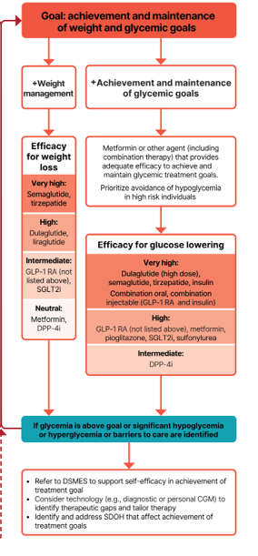
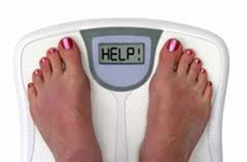
Assess Weight Loss Goals
These meds associated with weight loss
  GLP-1 RA and GLP/GIP agonists
  SGLT-2 Inhibitors
These meds are weight neutral
  Metformin
  DPP-4 Inhibitors

Slide 40
Pocket Card: GLP-1 & GIP RA
Notes:
Update with exenatide indication in pediatrics.

Slide 41
GLP-1 /GIPs Approved for Weight Loss
Liraglutide (Daily)
  Victoza 1.8 mg (diabetes)
  Saxenda 3 mg (wt loss)
  6% wt loss, $1349 a mo
Semaglutide:
  Ozempic 2mg (diabetes)
  Wegovy 2.4mg (wt loss)
  Wegovy 7.2mg (high dose)
  Oral Wegovy 25mg (oral)
  6% wt loss, $1349 a mo
Tirzepatide
  Mounjaro 15mg (diabetes)
  Zepbound 15mg(wt loss)
  13% wt loss - $1056 a mo
All 3 Approved for use in adults with a:
  BMI of ≥ 30 or
  BMI of ≥ 27 or greater who have hypertension, type 2 diabetes, or dyslipidemia.
Foundayo (Orforglipron): small-molecule, oral GLP-1 receptor agonist - a once-daily pill with no water or food restrictions – up to 17.2 mg daily

Slide 42
Diabetes Bingo
“DiaBingo” Shout out Right Answer

Slide 43
DiaBingo
B Frequent skin and yeast infections can indicate?
B A BMI of ____ or more increases risk of diabetes
B To reduce complications, control A1c, Blood pressure, Cholesterol
B PreDiabetes – fasting glucose level of ___ to ____
B Erectile dysfunction indicates greater risk for ____
B Diabetes – fasting glucose level____ or greater
B Type 1 diabetes is best described as an ______ disease
B People with diabetes are ______ times more likely to die of heart dx
B Each percentage point of A1c = _____ mg/dl glucose
B At dx of type 2, about __% of the beta cell function is lost
B Diabetes – random glucose ____ or greater

Slide 44

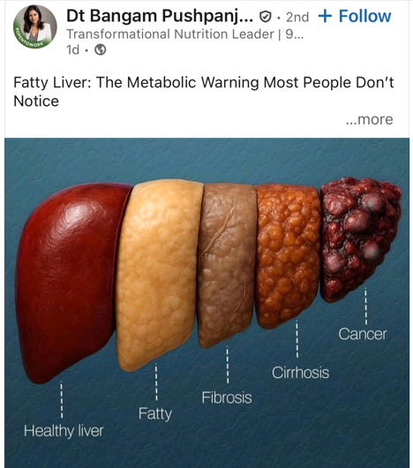
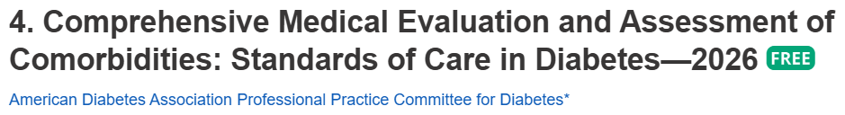

Metabolic dysfunction–associated steatotic liver disease (MASLD)
  Adults with type 2 diabetes.
  >70% have MASLD
    Of those 50% have MASH*
      12-20% have fibrosis
  Adults with type 1
    20% have MASLD
  MASH = 5% plus hepatic steatosis with inflammation and hepatocyte injury (hepatocyte ballooning), with or without evidence of liver fibrosis
Screen for liver fibrosis using FIB 4 Index
  Uses liver enzymes (ALT & AST), platelet count plus age – positive if (FIB ≥ 1.3)

Slide 45
Let’s Break it Down ADA 2025
From: 9. Pharmacologic Approaches to Glycemic Treatment: Standards of Care in Diabetes—2026

Slide 46
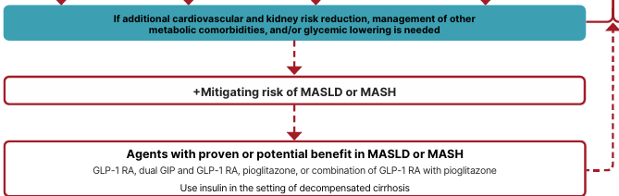
Mitigating Risk of MASLD or MASH
MASLD: metabolic-dysfunction associated steatotic liver disease
MASH: Metabolic-dysfunction associated steatohepatitis

Slide 47
Liver Disease: MASLD or MASH
In adults with T2D, MASLD and overweight/obesity, consider using a GLP-1 RA with demonstrated benefits in MASH or a GLP-1/GIP RA with potential benefits for MASH
In adults with biopsy proven MASH, GLP-1 RA is preferred.
Pioglitazone or a dual GIP/GLP-1 RA can be considered for glycemic management due to potential beneficial effects on MASH.
Insulin preferred for decompensated cirrhosis
Semaglutide
Tirzepatide
Pioglitazone

Slide 48

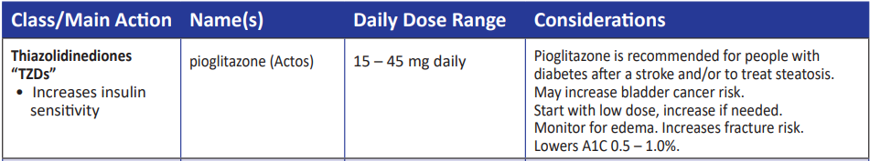
Indications for Insulin Sensitizers
Pioglitazone (Actos)
Action: decrease insulin resistance by making muscle and adipose cells more sensitive to insulin. Decrease free fatty acids
Names:
  pioglitazone – bladder cancer warning
    Dosing: 15-45 mg daily
    Consider adding low dose if history of stroke or have steatosis
Efficacy/ Considerations
  Reduce A1C ~0.5-1.0%
  6 weeks for maximum effect
  Pioglitazone $5 a month
  Can cause fluid retention, not indicated w/ CHF
Notes:
48
48
Thiazolidinediones (TZDs) enhance insulin sensitivity in muscle and adipose tissue by binding to cell receptors,which leads to an increase in glucose transporter expression. TZDs encourage beta cells to respond more efficiently by lowering the amount of glucose and free fatty acids in the bloodstream, both of which are known to be detrimental to insulin secretion. Finally, these drugs reduce glucose production in the liver.
Clinical trials indicate that pioglitazone and rosiglitazone are slightly more effective at reducing A1C (1.5-1.6% reduction) than troglitazone (1.1% reduction).
Some of the beneficial side effects of thiazolidinediones include an increase in HDL cholesterol and reduction of triglyceride concentrations. This class of drugs has also been shown to lower blood pressure and decrease vascular inflammation in vitro. There are clinical studies underway to further examine the cardiovascular benefit to TZDs.
Some adverse effects of TZDs include weight gain, a potential increase in LDL cholesterol levels, and a possible increase in alanine aminotransferase levels (ALT). Because of the risk of weight gain, edema, and increased LDL cholesterol, thiazolidinediones are contraindicated in patients with advanced forms of congestive heart failure. Due to reported cases of liver failure and liver toxicity caused by the increase in ALT levels, TZDs are contraindicated in patients with abnormal liver function.
TZDs are the most expensive of the oral antidiabetic agents.

Slide 49

Poll Question 6
ADA recommends pharmacologic agents along with lifestyle interventions to treat people with diabetes and MASH. Which of the following diabetes medications are recommended to treat MASH?
Vitamin E and SGLT-2
GLP-1 RA / GIP and Pioglitazone
Fish oil supplements and statin
Metformin and/or bolus insulin therapy

Slide 50

SGLT-2 Inhibitors

Slide 51
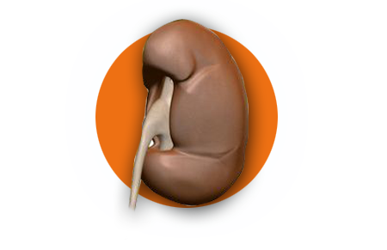
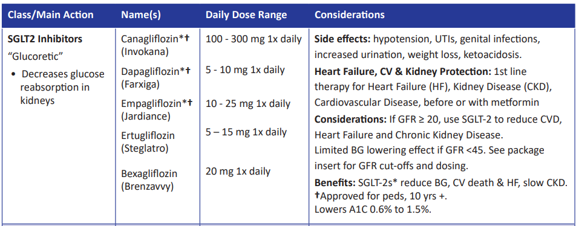
SGLT2 Inhibitors- “Glucoretics”
Action: decreases renal reabsorption of glucose proximal tubule of kidneys (reset renal threshold)
Preferred diabetes treatment for people with heart and kidney failure. Decreases BG & CV Risk.
AWP: ~$650 a month
% ‘f
Notes:
51
51
Thiazolidinediones (TZDs) enhance insulin sensitivity in muscle and adipose tissue by binding to cell receptors,which leads to an increase in glucose transporter expression. TZDs encourage beta cells to respond more efficiently by lowering the amount of glucose and free fatty acids in the bloodstream, both of which are known to be detrimental to insulin secretion. Finally, these drugs reduce glucose production in the liver.
Clinical trials indicate that pioglitazone and rosiglitazone are slightly more effective at reducing A1C (1.5-1.6% reduction) than troglitazone (1.1% reduction).
Some of the beneficial side effects of thiazolidinediones include an increase in HDL cholesterol and reduction of triglyceride concentrations. This class of drugs has also been shown to lower blood pressure and decrease vascular inflammation in vitro. There are clinical studies underway to further examine the cardiovascular benefit to TZDs.
Some adverse effects of TZDs include weight gain, a potential increase in LDL cholesterol levels, and a possible increase in alanine aminotransferase levels (ALT). Because of the risk of weight gain, edema, and increased LDL cholesterol, thiazolidinediones are contraindicated in patients with advanced forms of congestive heart failure. Due to reported cases of liver failure and liver toxicity caused by the increase in ALT levels, TZDs are contraindicated in patients with abnormal liver function.
TZDs are the most expensive of the oral antidiabetic agents.

Slide 52
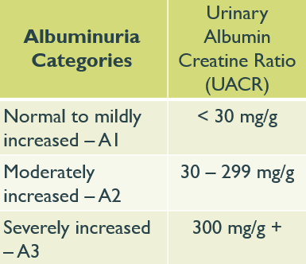

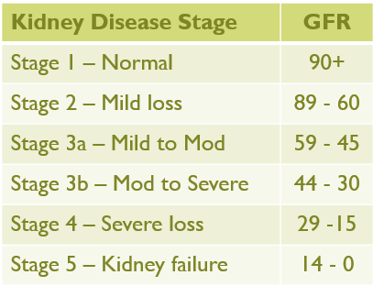
Case Study LS
LS is 69 with type 2 diabetes for over a decade. Takes metformin 1000mg twice daily. Admitted to hospital with heart failure.
A1C=7.3%.
UACR 212mg/gm
eGFR=56
B/P 146/82
What class of diabetes med do we need to start ASAP?
Notes:
Answer: D Metformin

Slide 53
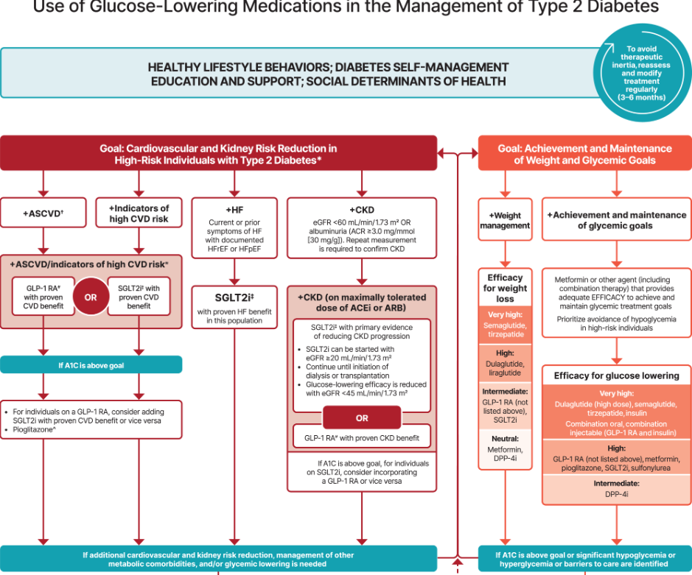
Let’s Break it Down ADA 2025

Slide 54
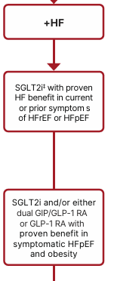
Heart Failure
In heart failure, use SGLT2i because they improve heart failure and kidney outcomes.
  Empagliflozin - Canagliflozin - Dapagliflozin - Ertugliflozin
New for 2026 –
9.9 In adults with T2D, obesity, and symptomatic HF with preserved ejection fraction, include a GIP/GLP-1 agonist or GLP-1 agonist with demonstrated benefits for BG reduction in HF events (irrespective of A1C).
  GLP-1 RA GLP-1/GIP RA
  Semaglutide Tirzepatide
HFpEF Heart failure with preserved ejection fraction ≥40% ),
(HFrEF) Heart failure with reduced ejection fraction ≤40% ),
Notes:
For individuals with heart failure our recommendation is that SGLT2i with proven benefit should be used because they improve heart failure and kidney outcomes.

Slide 55
Side Effects of SGLT-2 Inhibitors
Genitourinary infections
Volume depletion
Increased urination
Hypotension
Monitor Lytes
Diabetes ketoacidosis (DKA)
Notes:
Cana: bone mineral density decline: hip ≤1%; lumbar spine, femoral neck, and distal forearm <1%
UTI: 6%Genito infection: 11-12%
Increased serum K+: 9-27%
Amputation risk
Emgag: UTI: females 18%, males 4%
Genito infection: 5%
Dapag: UTI: 6%, genito infection: 3%

Slide 56
Case Study LS
LS is 69 with type 2 diabetes for over a decade. Takes metformin 1000mg twice daily. Admitted to hospital with heart failure.
A1C=7.3%.
UACR 212mg/gm
eGFR=46
B/P 146/82
What class of diabetes med do we need to start?
Notes:
Answer: D Metformin

Slide 57
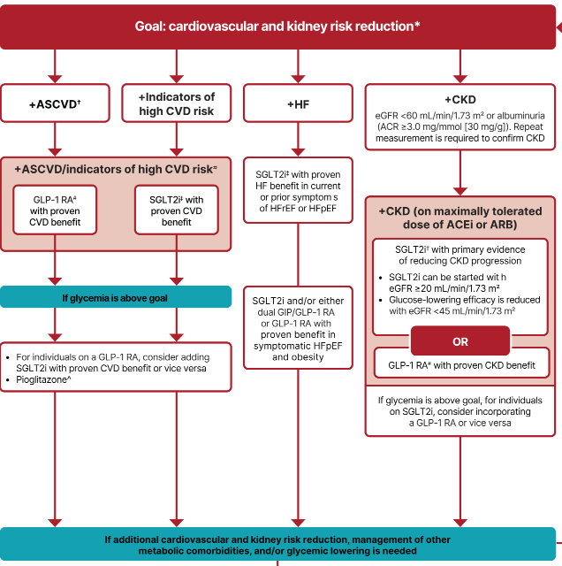
Chronic Kidney Disease - Choosing glucose-lowering medication
In renal failure, use SGLT-2 in people with GFR ≥ 20 and continue until initiation of dialysis or transplantation.
(When GFR <45, SGLT-2’s don’t lower BG much.)
Or
GLP* with proven CVD benefit if SGLT2 not tolerated or contraindicated
*Semaglutide improves kidney function.

Slide 58

New in 2026: GLP-1 in Kidney Disease
In adults with T2D and advanced CKD (eGFR <30), a GLP-1 RA is preferred for glycemic management due to lower risk of hypoglycemia and for CV event reduction.
Individuals on dialysis can be safely initiated or continued on GLP-1 based therapy to reduce CV risk and mortality
Reminder: only GLP-1 with renal restrictions are exenatide and lixisenatide
From: 9. Pharmacologic Approaches to Glycemic Treatment: Standards of Care in Diabetes—2026

Slide 59
SGLT-2i Indications Summary
Drug | Lower BG | Reduce CV Risk? | Use to treat Heart Failure? | Slow renal disease?
Dapagliflozin (Farxiga) | Yes | Yes | Yes +/- Diabetes | Yes
Empagliflozin (Jardiance) | Yes | Yes | Yes +/- Diabetes | Yes
Canagliflozin (Invokana) | Yes | Yes | Yes w/ Diabetes | Yes
Ertugliflozin (Steglatro) | Yes | No | Yes w/ Diabetes | Yes
Bexagliflozin (Brenzavvy) | Yes | NA | NA | NA
Package inserts, dailymed.nlm.nih.gov

Slide 60

Poll Question 7
JR, a 67-year-old with type 2 diabetes for 7 years, with an A1C of 9.7% was started on empagliflozin 10mg two weeks ago. Other labs include a GFR of 49 and a UACR of 34 mg/g. Also takes glargine 12 units and pioglitazone. JR drinks a few beers at night. Partner calls you in a panic and says JR is admitted to the hospital in DKA. What is the most likely explanation?
Excess alcohol intake leading to starvation ketosis
Potential side effect of SGLT-2 Inhibitors
Low GFR and elevated UACR increase hyperglycemic risk
JR is misdiagnosed and likely has type 1 diabetes

Slide 61
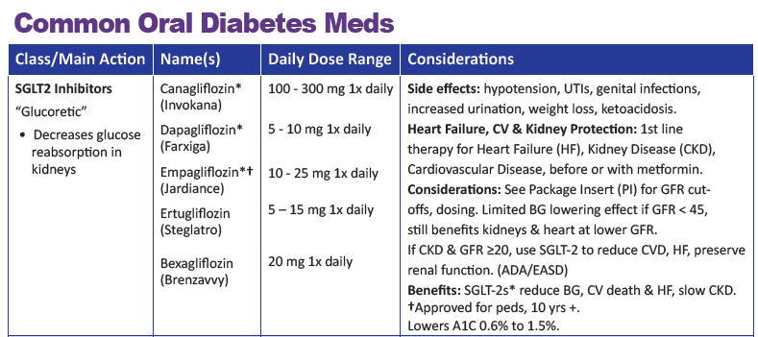
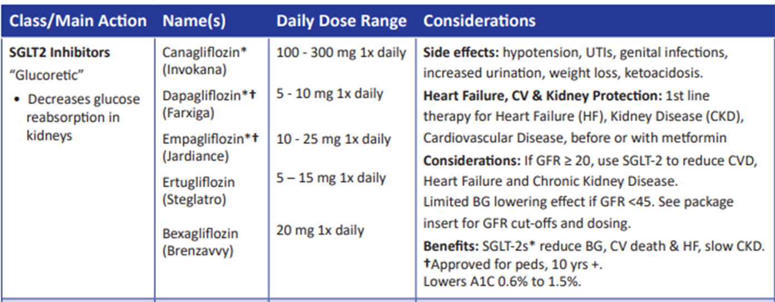

SGLT-2 Inhibitors – DKA Warning
FDA Warning of DKA – Not approved for Type 1 (but used off-label) ~ increases risk of EDKA by 4-6%
Increased risk for those with type 2 on insulin + SGLT-2 Inhibitor
Decreased insulin dose due to lower BG on SGLT-2 Inhibitors
Can lead to insulin deprivation and ketoacidosis

Slide 62


Signs and Symptoms Euglycemic DKA
Similar in presentation to hyperglycemic DKA.
Don’t usually have polydipsia or polyuria since serum glucose is normal.
S/S include nausea, vomiting, shortness of breath, generalized malaise, lethargy, loss of appetite, fatigue, or abdominal pain.
Ill feeling individuals with diabetes plus malaise, dyspnea, nausea, or vomiting need to eval serum pH and get blood or urine ketone testing.

Slide 63
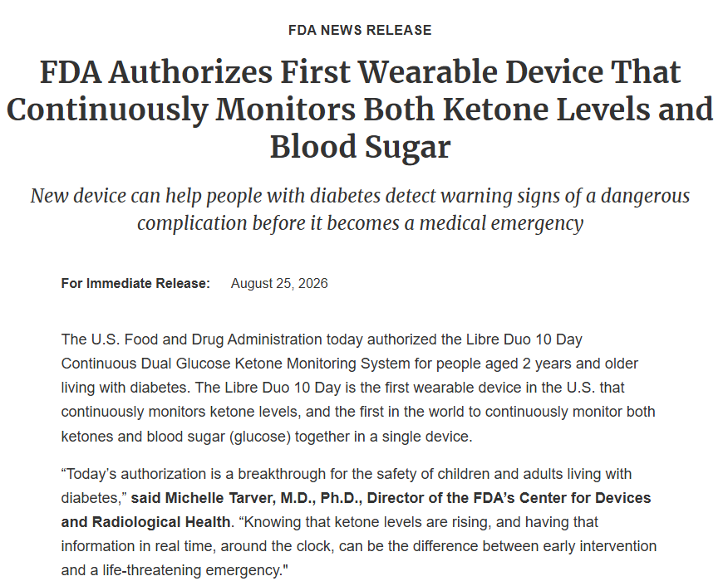

Slide 64

EDKA in Type 1 or Type 2
Characterized by
  euglycemia in presence of severe metabolic acidosis
    pH less than 7.3
    serum bicarbonate less than 18
    Beta-hydroxybutyrate levels (3 mmol/L +) or 2+ ketones in urine
  Can diagnosis someone with Euglycemic DKA with
    BG less than 200 mg/dL
    Or history of diabetes
Often insulin-using ind’s do not recognize their symptoms as DKA because BG is not elevated.
They may maintain or decrease their insulin dose.
ADA/EASD/AACE 2024 Hyperglycemic Crises in Adults Consensus Report

Slide 65
DKA EDKA
Labs | DKA | EDKA
Glucose | 200+ | <200
Beta-hydroxybutyrate | 3+ | 3+
Urine ketones | 2+ | 2+
Blood pH | < 7.3 | <7.3
Bicarb | <18 | <18
Anion gap | >12 | >12
Usually < 40 yrs old
< 2 days symptoms
Glucose 200+ or anyone with diabetes
Beta-hydroxybutyrate 3.0 + or Urine ketone of 2+
p
ADA/EASD/AACE 2024 Hyperglycemic Crises in Adults Consensus Report

Slide 66


LS needs surgery – Poll 8
LS is 69 with type 2 diabetes and HF. On empagliflozin (Jardiance) 10mg daily in hospital. A1C 7.1% Needs surgery for infected foot ulceration. What action is needed?
Give empagliflozin night before surgery.
Start basal bolus insulin therapy.
Hold empagliflozin 3 days before surgery.
Start low dose insulin infusion to get glucose to goal pre surgery.
Notes:
Answer: D Metformin

Slide 67


Diabetes and Surgery
20% of individuals undergoing major general surgery have diabetes,
23–60% have prediabetes or undiagnosed diabetes
A1C target <8% for elective surgeries or Time in Range >50%.
Perioperative glucose target of 100-180
Postponing surgery based on A1C or TIR not recommended, as it may lead to unnecessary delay or denial of required surgery.

Slide 68


Preparation for Surgery
Preoperative risk assess (heart, renal disease, neuropathy).
Hold SGLT-2 for 3-4 days before surgery
Evaluate GLP-1 Therapy
ADA 2026
The American Society of Anesthesiologists recommends holding GLP-1 RAs on the day of the procedure or surgery for daily dose agents and for at least 7 days prior to the procedures or surgery for once-weekly dose agents. Individualize.

Slide 69

Is Inpatient Diabetes Education Realistic?
Unique opportunity to address urgent learning needs
Brief and targeted education effective
Strategies
  Empathic listening and open ended questions
  “What are you most worried about when it comes to taking care of your diabetes.
Assist with needed supplies and referrals
Look for
“teaching moment” opportunities

Slide 70
Stigma associated with diabetes
Have you heard others using these words or phrases?
Cheats
No will power
Diabetic
Non-compliant
Train wreck
Frequent Flyer
Non-adherent
Doesn’t really care
If they would only lose some weight
Doesn’t monitor blood sugar
Forgot logbook/reader again
Doesn’t take their meds as directed
Eats junk food
Eats too much fruit
Loves sugar
They brought it on themselves

Slide 71
Self Reflective Question
A person shows up to the Emergency Room in a hyperglycemic crisis and tells you they are only taking their daily insulin injection about 4 times a week.
What feelings would that evoke?
  Doesn’t care
  Non-compliant
  Lazy
  Better scare them
  Exasperation
curiosity

Slide 72


Our Curiosity Makes a Difference
What is something you would like me to know about you?

Slide 73
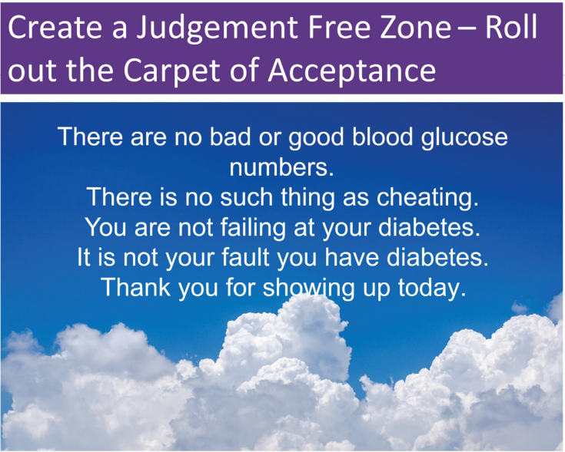

Slide 74

Life Study – Mrs. Jones
Mrs. Jones is 62 years old, with a BMI of 36 and complains of feeling tired and urinating several times a night. She has an urinary tract infection. Her A1c is 8.3%, glucose 237.
She is hypertensive with a history of gestational diabetes. No ketones in urine.
What are her risk factors and signs of diabetes?
You find a few moments to
teach and she asks you
some questions.

Slide 75

Language of Diabetes Education
Old Way
New Way
Control diabetes
Test BG
Patient
Normal BG
Non-adherent, compliant
Refuse
Manage
Check
Participant, Individual
BG in target range
Focus on what they are accomplishing
Decided, chose

Slide 76

Mrs. Jones asks you
What Do You Say?
What is diabetes?
They say I am a diabetic because I am obese?
How am I going to control this?
What is a normal blood sugar?
Do I have to test my blood sugars?
My doctor told me to stay away from white foods. Is that true?

Slide 77

Mrs. Jones asks you
What Do You Say?
You are wondering if your weight caused your diabetes?
You can manage your diabetes and improve your health at the same time.
For people without diabetes, fasting blood sugar is less than 100 and A1c is less than 5.7%
Checking blood sugars can help you figure out if the plan in working.

Slide 78

Let’s use language that (is)
Imparts hope
Neutral, nonjudgmental
Based on fact, actions or biology
Free from stigma
Respectful, inclusive
Fosters collaboration between person and provider
Avoids shame and blame

Slide 79

Quick Question 9
Which phrase represents the principles for communicating with people living with diabetes.
A. You are walking 3 times a week.
B. Let’s focus this appt on weight loss.
C. Do you know possible complications associated with elevated A1C levels?
D. You should try to eat 3 servings of fruits and veggies daily.

Slide 80

Guiding Language Principles
Strength Based
Person-first
Emphasize what people know, what they can do.
Focus on strengths that empower people
Words that indicate awareness
Sense of dignity
Positive attitude toward person with diabetes

Slide 81

Chapter 7 – The Body Tells the Story
I was admitted to the neuro floor with the diagnosis of epileptic seizures and started on anti-seizure medications. The seizures continued despite the medications.
The nurses would sit with me during these episodes, hold my hand, and give me tissues. They reassured me that I was not a loser. They were angels who loved and protected this broken little soul, trying to find her way.
When I woke up scared one night, they moved me right next to the nurse’s station so I would feel safe. They intuitively knew what I needed, and I felt blanketed in their nurturing.
Healing through Connection – Shout out to Enloe Nurses

Slide 82
Diabetes Bingo
“DiaBingo” Shout out Right Answer

Slide 83
DiaBingo- G
G ADA goal for A1c is less than ____%
G Blood pressure goal is less than
G People with DM should see eye doctor (ophthalmologist) at least
G The goal for blood sugars 1-2 hours after a meal is less than:
G People with DM should get this shot every year
G People with DM need to get these kidney tests yearly
G Periodontal disease indicates increased risk for heart disease
G The goal for blood sugar levels before meals is:
G The activity goal is to do ___ minutes on most days
G Name 3 healthy foods to include in daily meal plan

Slide 84

Thank You
Thank you for inviting me to be a part of this program!
Please let me know if you have any questions.
www.DiabetesEd.net
info@diabetesed.net
530 /893-8635

