Slide 1

Diabetes Care in the Hospital MarinHealth|2026
Diabetes Education Services Presents:
Beverly Thomassian, RN, MPH, BC-ADM, CDCES
Pronouns: She, her, hers
www.DiabetesEd.net

Slide 2
Coach Bev has no Conflict of Interest
She’s not on any speaker's bureau
Does not invest or have any financial relationships with diabetes related companies.
Gathers information from reading package inserts, research and articles
The ADA Standards of Medical Care is main resource for course content

Slide 3
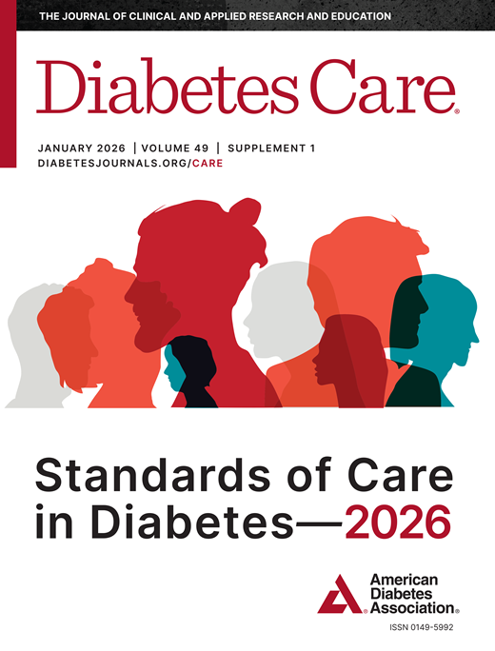

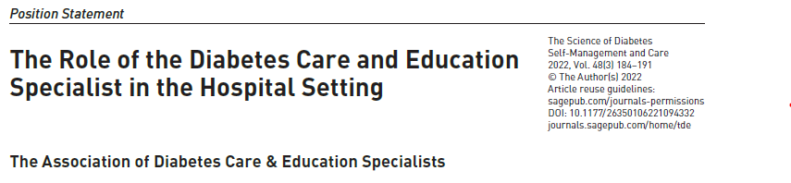
References
Plus other articles as cited on slides

Slide 4

Diabetes Care in the Hospital Topics
Discuss the importance of inpatient glucose management
Describe the goals of care
Describe basal bolus insulin therapy
Discuss management considerations for a variety of situations.

Slide 5

Glucose Management and Hospitalized Patients
People hospitalized with critical illness and hyperglycemia warrant our attention.
“Body on FIRE”
All healthcare professionals can advocate for best care.

Slide 6

Hospitals and Hyperglycemia-
What’s the Big Deal?
Hyperglycemia is associated with increased morbidity and mortality in hospital settings.
  Acute Myocardial Infarction
  Stroke
  Cardiac Surgery
  Infection
  Longer lengths of stay

Slide 7


Management of Inpatient Hyperglycemia and Diabetes in Older Adults
Hospitalization 3.1 times higher for all people with diabetes (compared to those without)
Diabetes increases with age:
  65-75 yrs, 20% with diabetes
  80 yrs plus, 40% with diabetes
Inpatients over the age of 65
  70% in critical care and cardiac surgery are hyperglycemic (BG > 140)
  30% of general medicine and surgery are hyperglycemic

Slide 8
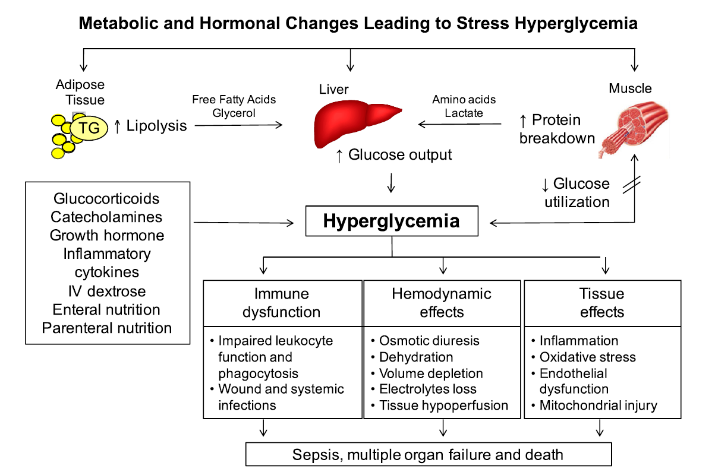
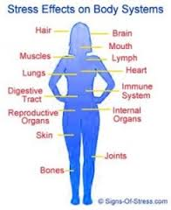
Stress response and hyperglycemia
Decreased WBC’s
Catabolism
Abnormal inflammatory response
Endothelial cell dysfunction
Increased clotting, blood viscosity
Tissue breakdown
Inflammatory changes
Increased blood pressure, pulse
Leads to: Longer lengths of stay, complications, death

Slide 9

Causes of Inpatient Hyperglycemia
Pre-existing Type 1 (insulin dependent)
Pre-existing Type 2 or prediabetes
Discovered diabetes / prediabetes
Holding of usual diabetes med(s)
Infection, Cardiac events
Admin of agents that cause hyperglycemia
  Steroids
  Enteral or parenteral nutrition

Slide 10
Hyperglycemia*: A Common Comorbidity in Medical-Surgical Patients in a Community Hospital
12%
26%
62%
Normoglycemia
n = 2,020
* Hyperglycemia: Fasting BG ≥ 126 mg/dl
or Random BG ≥ 200 mg/dl X 2
Known Diabetes
New Hyperglycemia
Umpierrez G et al, J Clin Endocrinol Metabol 87:978, 2002
Umpierrez et al
Notes:
In a more recent study that involved 2020 consecutive patients admitted to a community hospital in Atlanta, we found that 64% of patients had normal glucose values, 26% had a prior history of diabetes, and that 12% of patients with hyperglycemia, as determined by 2 or more FBG > 126 or RBG > 200, did not had a know history of diabetes prior to admission.

Slide 11
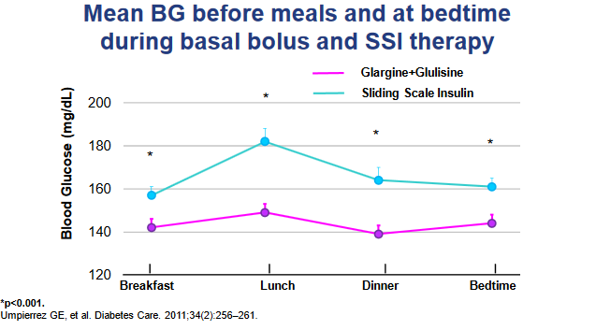
RABBIT 2 Trial

Slide 12
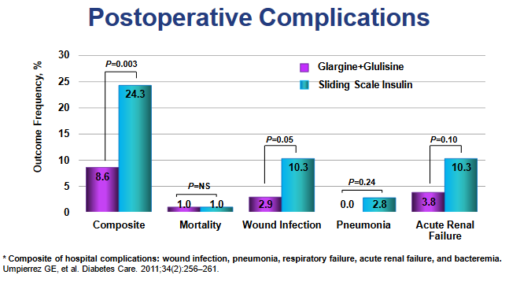
RABBIT 2 Trial

Slide 13
Hyperglycemia in Patients
With Undiagnosed Diabetes
Hyperglycemia in 38% of pts admitted to hospital
26% had known history of diabetes
12% had no history of diabetes
Mortality rate – non dx, dx and no diabetes
1.7% - pts without diabetes
3% - pts dx with diabetes
16% - hyperglycemia, undiagnosed or treated
All hospital patients screened for hyperglycemia?
Umpierrez GE et al. J Clin Endocrinol Metab. 2002;87:978–982.
Notes:
Hyperglycemia in Patients With Undiagnosed Diabetes
New hyperglycemia was defined as an admission or in-hospital fasting glucose
level of 126 mg/dL (7 mmol/L) or more or a random blood glucose level of 200 mg/dL (11.1 mmol/L) or more on 2 or more determinations. Hyperglycemia was present in 38% of patients admitted to the hospital, of whom 26% had a known history of diabetes and 12% had no history of diabetes before admission.
Newly discovered hyperglycemia was associated with a higher in-hospital mortality rate (16%) compared with patients with a history of diabetes (3%) and patients with normoglycemia (1.7%; both P<.01).
In addition, new hyperglycemic patients had longer hospital stays and a higher admission rate to an intensive care unit (ICU), and were less likely to be discharged to home, frequently requiring transfer to a transitional care unit or nursing home facility.
The results indicate that in-hospital hyperglycemia is a common finding and represents an important marker of poor clinical outcome and mortality in patients with and without a history of diabetes. Patients with newly diagnosed hyperglycemia had a significantly higher mortality rate and a lower functional outcome than patients with a known history of diabetes or normoglycemia.
Reference
Umpierrez GE, Isaacs SD, Bazargan N, et al. Hyperglycemia: an independent marker of in-hospital mortality in patients with undiagnosed diabetes. J Clin Endocrinol Metab. 2002;87:978-982.

Slide 14
Check A1C if DM or Hyperglycemia
On Admission
Any blood glucose above 140
  Check A1C (if no documented result over past 3 months)
  If A1c 6.5% or more, preexisting diabetes
If BG ≥ 180 (confirmed x 2) – start insulin therapy
Pre Diabetes criteria:
  Fasting Glucose = 100-125mg/dl
  A1c 5.7 – 6.4%
Diabetes criteria:
  Fasting Glucose = 126 mg/dl +
  Random Glucose = 200 mg/dl +
  A1c 6.5% +

Slide 15

16. Diabetes Care in the Hospital – Treatment Strategies
  Start subq insulin if BG > 180 x 2
    Basal + correction scale if higher risk for hypo
    Basal bolus therapy if eating
    Basal insulin plus oral meds
      May maintain DPP-IV
      Start SGLT-2i for those with heart failure
      Stop SGLT-2i before surgery (3-4 days)
  Critical Care:
    Basal bolus or Insulin drip

Slide 16
16. Diabetes Care in the Hospital - ADA Goals and Treatments For Hospitalized Patients
  Individualize Blood glucose goals
    Critical Care Goal 140-180
      (more stringent may be appropriate)
    Med Surg Goal 100-180
    Avoid hypo and hyper
Incorporate electronic / standardized insulin order sets
Monitor BG
  Before meal and hs if eating
  Q 4-6 hours if on TPN or tube feeding
Hypoglycemia prevention protocol
ADA Standards 2026

Slide 17

Glucose Goals – Clinical judgement required
More relaxed BG goals
At risk of hypo due to other health issues (up to 250)
Terminally ill
In setting where intensive checks not feasible
When setting goals consider:
Clinical status especially renal function
Severity of illness
Nutritional status
Glucose variability and trends
Usual management plan and ind’s expertise

Slide 18
CMS & Inpatient Glycemic Control
Hospitals Need to Report
Severe Hypoglycemia
  the percentage of pt stays that a pt has a blood glucose of <40 within 24 hours of receiving a diabetes-related medication
Severe Hyperglycemia
  percentage of patient days that a patient has a blood glucose >300, excluding the first 24 hours of treatment in hospital.
The Centers for Medicare & Medicaid Services (CMS) has added inpatient glycemic control to its Hospital Inpatient Quality Reporting (IQR) Program.
Poor glycemic control — whether from insulin overuse or missed diagnoses — can lead to longer lengths of stay, increased costs and serious patient safety risks.
If they fail to meet these requirements, hospitals can face financial penalties.

Slide 19

We Aren’t Saying It’s Easy
Hospitalization is one of the hardest places to manage glucose.
Acute illness, surgery, infection, steroids, changing intake, less movement, shifting insulin needs — all of it pushes glucose around, toward both highs and lows.
And this is not a small group. Around 38–40% of hospitalized patients have hyperglycemia or diabetes, rising to 70–80% of those admitted with critical illness or for cardiac surgery.

Slide 20


Diabetes Care in the Hospital - ADA
A1C on all patients with Diabetes or new hyperglycemia (if not done in past 3 mo’s)
Insulin dosing based on standard protocols that allow for predefined adjustments based on BG fluctuations
Consult with Glucose Management team
Have hypoglycemia treatment and prevention protocol.
Create structured discharge plan based on individual.

Slide 21

We can make a difference

Slide 22

BR Says “Where Is My Insulin?”
BR usually wears an insulin pump and uses a sensor, but it was taken off in the ambulance on the way to hospital.
BR has type 1 diabetes and takes takes 1 unit of bolus insulin for every 10 gms of carbohydrate.
An 80 gm carb breakfast tray arrives. BR’s blood glucose is 93 and BR let’s the nurse know they need 8 units of insulin.
What’s the best action?
Nurse informs BR that the orders say BR only gets insulin if glucose is 150 or greater.
BR states, I need my insulin.
22

Slide 23
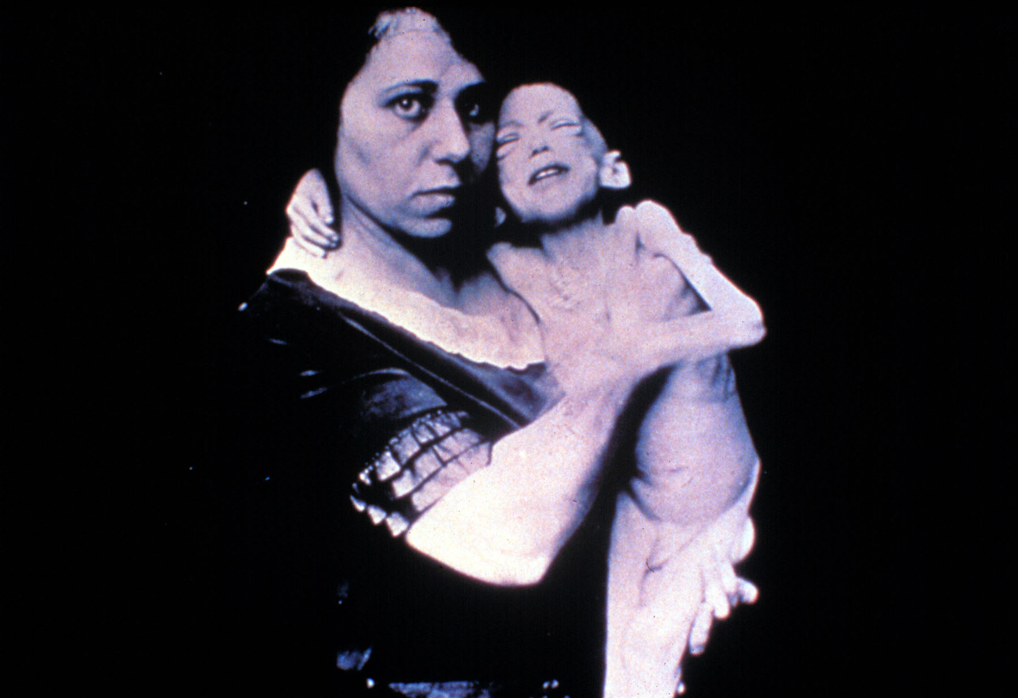

Slide 24
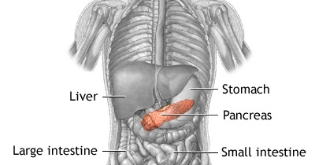

Review “How to Think Like a Pancreas”
We are going to try and imitate the work of your pancreas.
Your pancreas releases little doses of insulin through out the day and night.
  This is called basal insulin
Your pancreas also releases a squirt of insulin with meals or if your blood sugars are running above target
  This is called bolus insulin

Slide 25
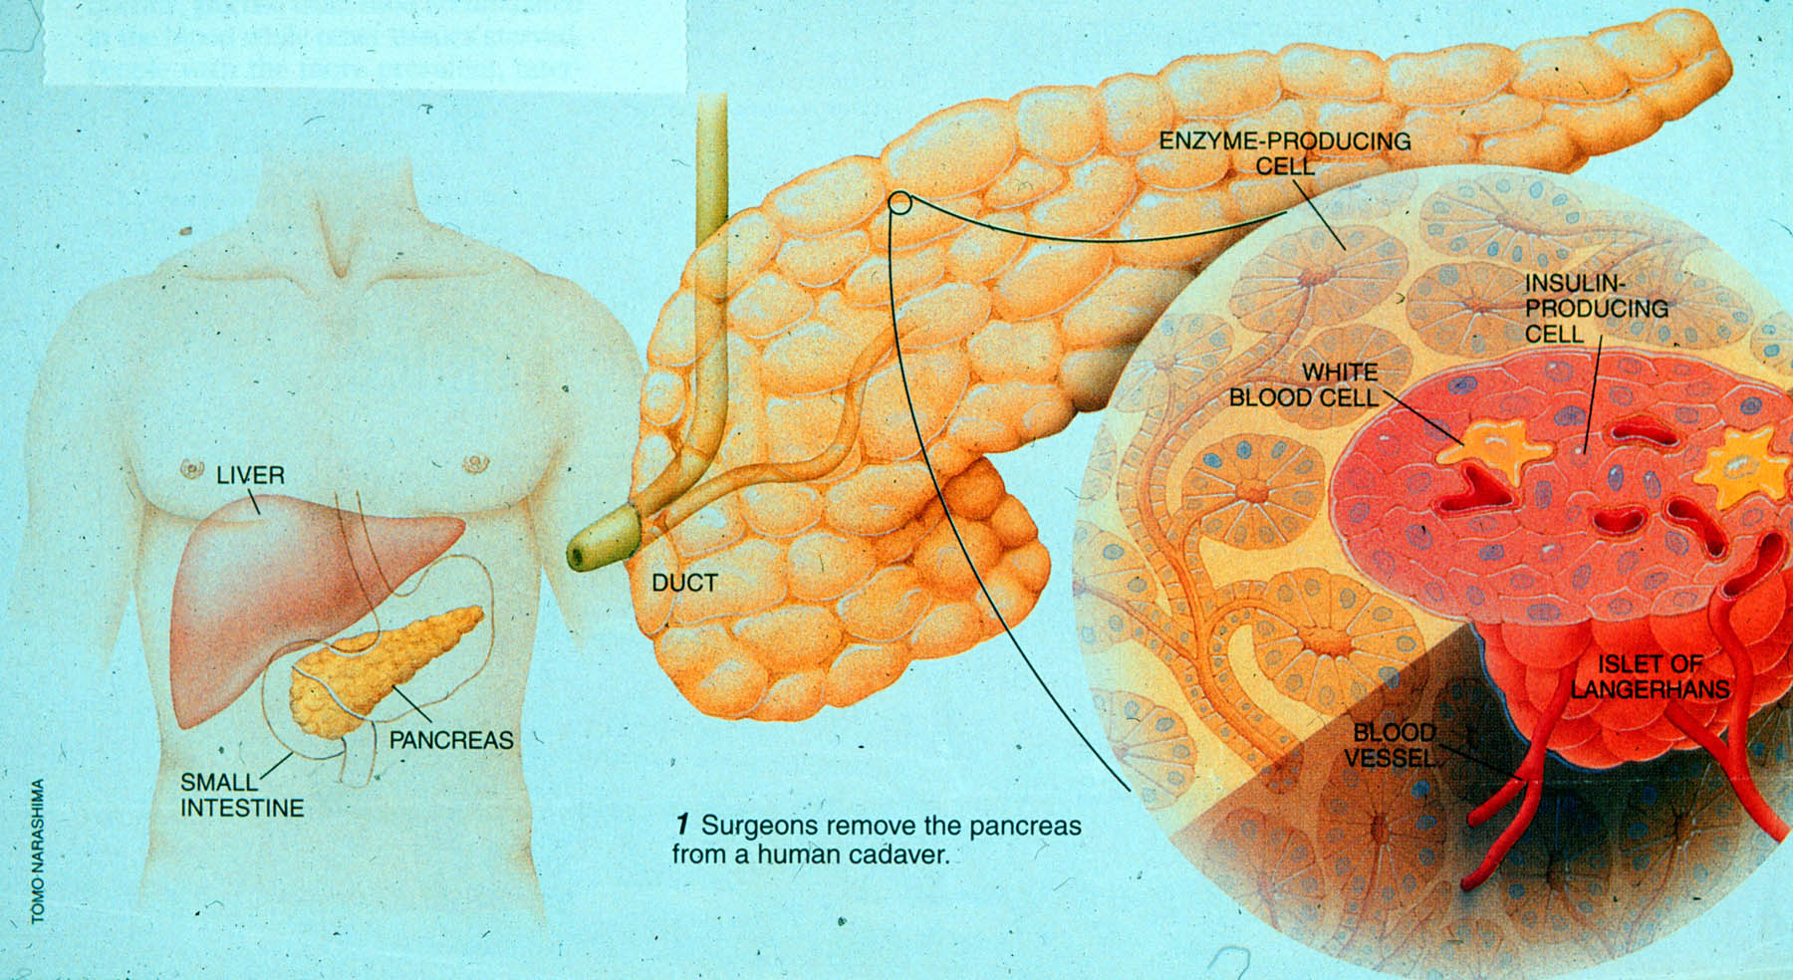

Slide 26
Physiologic Insulin Secretion: 24-Hour Profile
50
Insulin
(µU/mL)
Bolus Insulin
25
0
Basal Insulin
Breakfast Lunch Dinner
150
100
Mealtime Glucose
Glucose
(mg/dL)
50
Basal Glucose
0
7
8
9
10
11
12
1
2
3
4
5
6
7
8
9
A.M.
P.M.
Time of Day

Slide 27
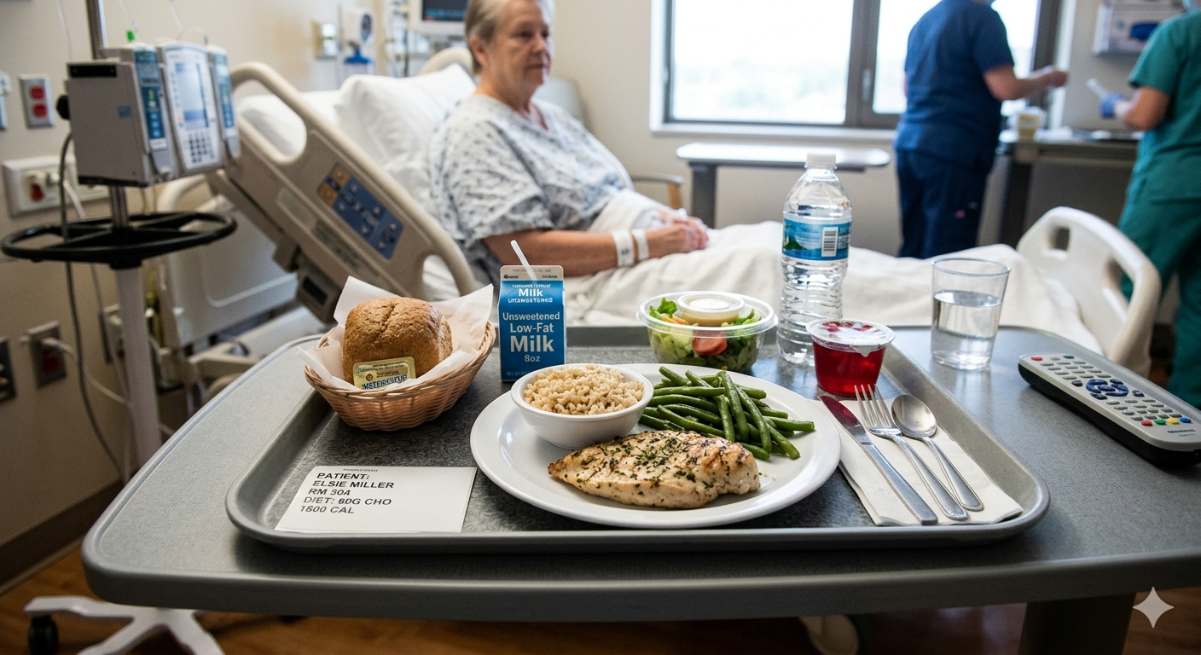
Where are the Carbs?

Slide 28
How nutrients affect blood sugar
If type 1, may need some insulin coverage for high fat / protein meals

Slide 29
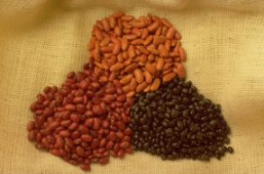


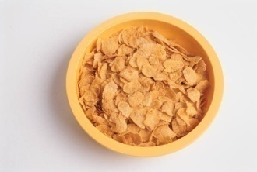
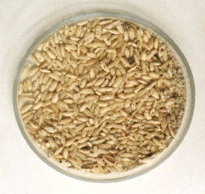
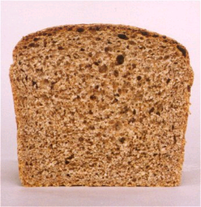
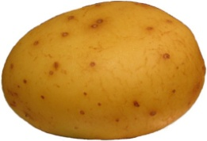
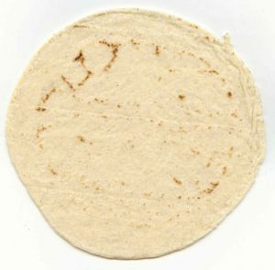
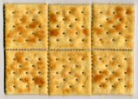

Carb Counting - Starch
Each Food has:
80 Calories
15 grams carb
1 small ear of corn or 1/2 cup corn
1/3 cup cooked pasta
1/2 cup
cooked beans
3/4 cup cold cereal
1 slice bread
1/3 cup cooked rice
1 small potato
1/2 English muffin
1 small tortilla
5-6 small crackers

Slide 30



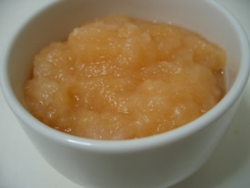





Carb counting- fruit
Each Food has:
60 Calories
15 grams carb
½ cup fruit juice
½ banana
1 small fresh fruit
½ cup unsweetened apple sauce
1 slice bread
17 small grapes
1 cup melon
¼ cup dried fruit
2 tbsp raisins
1 1/4 cup strawberries

Slide 31


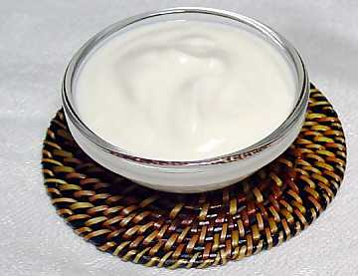
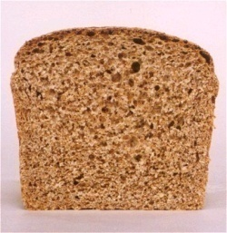

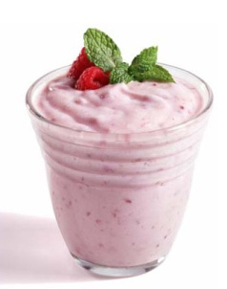

Carb Counting - Milk
Each Food has:
90-150 calories
12-15 grams carb
8 oz buttermilk
1 packet diet hot cocoa
1 slice bread
6 oz plain yogurt
8 oz milk
6 oz light fruit yogurt
8 oz soy milk

Slide 32
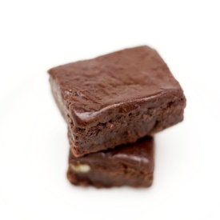
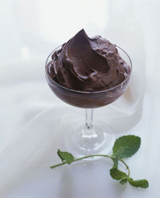
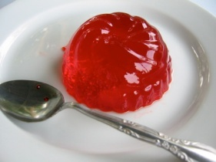

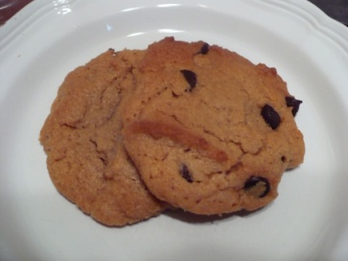
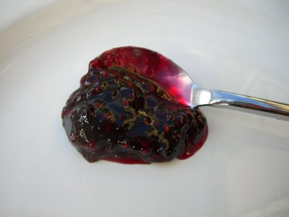



Carb Counting - Sweets
Each Food has:
Calories vary
15 grams carb
2 inch square cake or brownie, unfrosted
½ cup regular jello
2 tbsp light syrup
½ cup diet pudding
1 slice bread
1 tbsp syrup, jam, jelly, table sugar, honey
2 small cookies
¼ cup sorbet
½ cup ice cream or frozen yogurt
½ cup sherbet

Slide 33
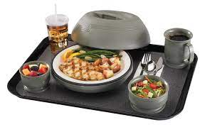
Hospital Meal – 1 unit /15 gms carb
½ cup of juice
2 pieces of toast
2 scrambled eggs
Coffee black
How many units lispro (Humalog)?
Turkey with gravy
Green salad
½ c. mashed potatoes
½ cup of corn
Roll with butter
½ cup of jello
How many units Reg?
15 + 30 = 45 gms
45/15 = 3 units
15 + 15 + 15 + 15 = 60 gms
60/15 = 4 units

Slide 34
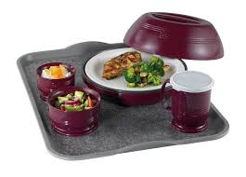
MNT In Hospital Setting
Goal of MNT
  Optimize glycemic control
  Adequate calories for metabolic demands
  Create meal plan guidelines for post discharge
Consistent Carb Meal plan most common
Nursing Staff & Team can help reinforce healthy eating concepts
RDN referral inpt > outpt
ADA Standards 2026

Slide 35

Type 1 Insulin Management
An insulin schedule with basal and correction components is necessary for all hospitalized individuals with type 1 diabetes, even when taking nothing by mouth, with the addition of prandial insulin when eating.
ADA Standards 2026

Slide 36
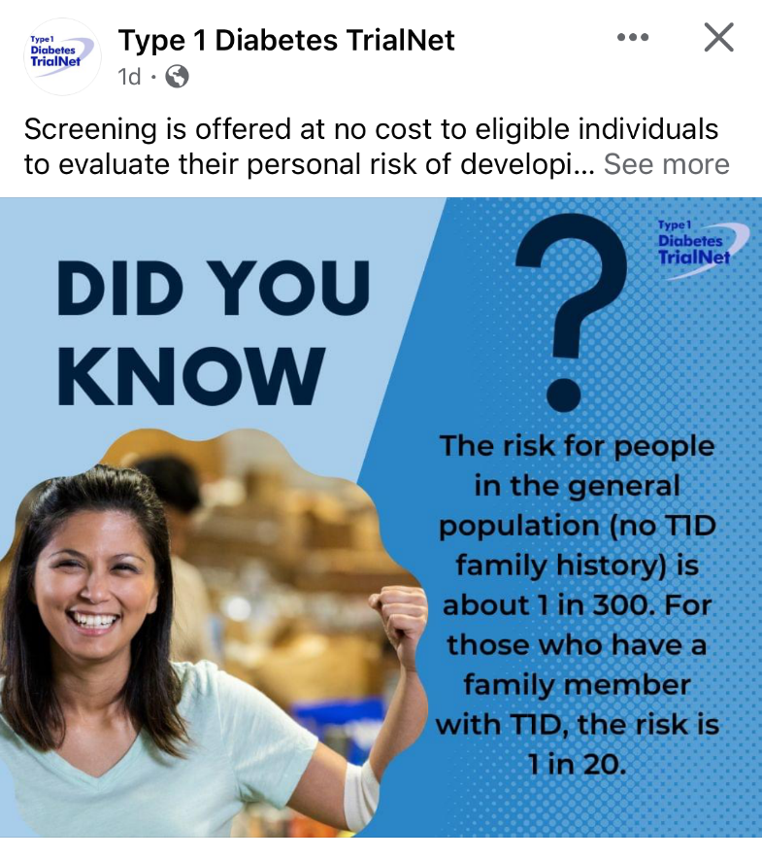

Type 1 ~ Immune Mediated
5-10% of Diabetes
1.5 Million people have type 1 in U.S.
Prevalence increasing:
2001 – 1.48 per 1000 youths diagnosed with diabetes
2017 - 2.15 per 1000 youths diagnosed with diabetes
Incidence & Prevalence increasing
Highest incidence in Finland or Northern Europe.
ADCES In Practice - March 2024 Recent Advances in Type 1 Diabetes: Teplizumab (Tzeild®)
Karen S. Fiano, PHARMD, BCACP, Devada Singh-Franco, PHARMD, CDCES, Young M. Kwon, BS, PHD

Slide 37

Type 1 is 5- 10% of all Diabetes
Auto-immune pancreatic beta cells destruction
Most commonly expressed at age 10 – 14
Insulin sensitive (require 0.5 - 1.0 units/kg/day)
Expression due to a combo of genes and environment:
  Autoimmunity tends to run in families
  Exposure to virus or other environmental factors
37
Diagnostic Criteria for Diabetes
Notes:
When you get to the insulin piece, please mention we will get into great detail about insulin in the pharmacotherapy module

Slide 38

Signs of Type 1 Diabetes
Sudden onset of nighttime bedwetting
Weight loss, thirst, hunger
40-60% discovered with acute DKA
  Fruity breath
  Hypothermic
  Poor skin turgor
  “Out of it”
  Ketone positive (blood or urine)
  Acidosis
  Other

Slide 39

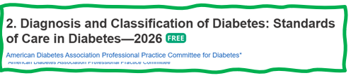
How do we know someone has Type 1 vs Type 2?
Type 1 - Positive antibodies
  GAD - glutamic acid decarboxylase (primary)
  IA2 - islet antigen 2, or
  ZnT8 - zinc transporter 8
Can also check C-peptide levels to determine endogenous insulin production
Younger people develop quickly
Older people take longer to develop
“misdiagnosis is common and can occur in ∼40% of adults with new type 1 diabetes”

Slide 40


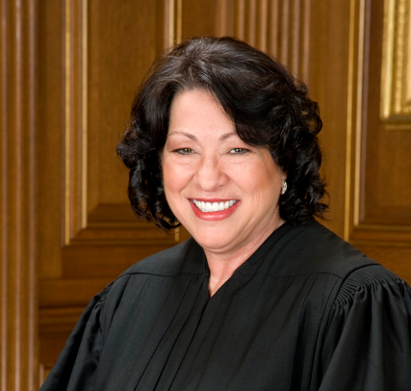
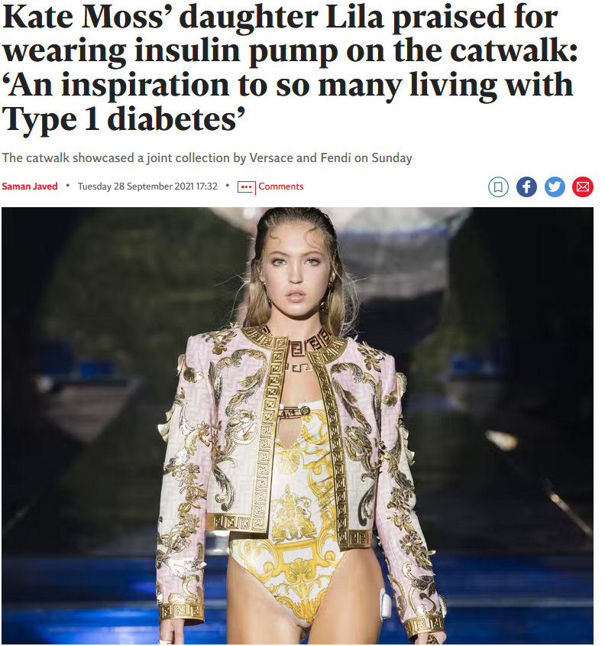


What Does Type 1 Look Like?
Mary Tyler Moore
Justice Sonia Sotomayor
Bret Michaels
Nick Jonas
Lila Grace Moss

Slide 41
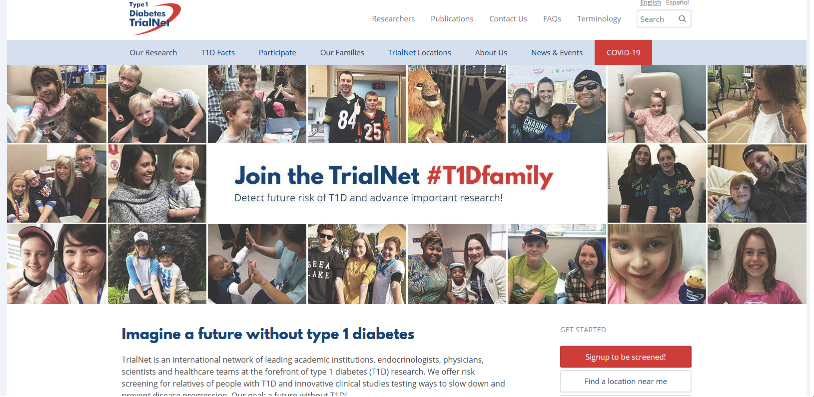
  Type 1 (stage 2) Delayed with Teplizumab by 2 years www.DiabetesTrialNet.org
How to get families linked to screening?

Slide 42

Type 1 Diabetes Features?
AJ, a 33-year-old admitted to the ICU with a blood glucose of 476 mg/dl, pH of 7.1, anion gap of 15. Recently lost 13 pounds.
Type 1 Most Discriminative Features
Younger than 35 years at diagnosis
Lower BMI (<25 kg/m²)
Unintentional weight loss
Ketoacidosis
Glucose 360 mg/dl or greater.

Slide 43
BR Says “Where Is My Insulin?” Action
BR has type 1 diabetes and takes takes 1 unit of bolus insulin for every 10 gms of carbohydrate.
An 80 gm carb breakfast tray arrives. BR’s blood glucose is 93 and BR let’s the nurse know they need 8 units of insulin.
What’s the best action?
Nurse calls the provider to get order that matches person’s usual insulin management plan.
Need to know usual:
Basal insulin
Bolus insulin for
  Carbs (prandial)
  Correction (hyper)
43
Can we get BR back on their pump and CGM?

Slide 44
Pumps & CGMs in Hospital
Eval if can keep insulin pump in place.
If need to remove
  Start IV insulin drip or
  Give basal insulin 2+ hours before stopping along with bolus insulin for meals and to correct for hyperglycemia.,
CGMs present during hospitalization
      RNs have patient sign our consent/waiver
      Document in EPIC under LDA
      Insulin dosing based on hospital approved glucose meter.
What if AID (automated insulin delivery system?)
See Insulin Pump Policy

Slide 45
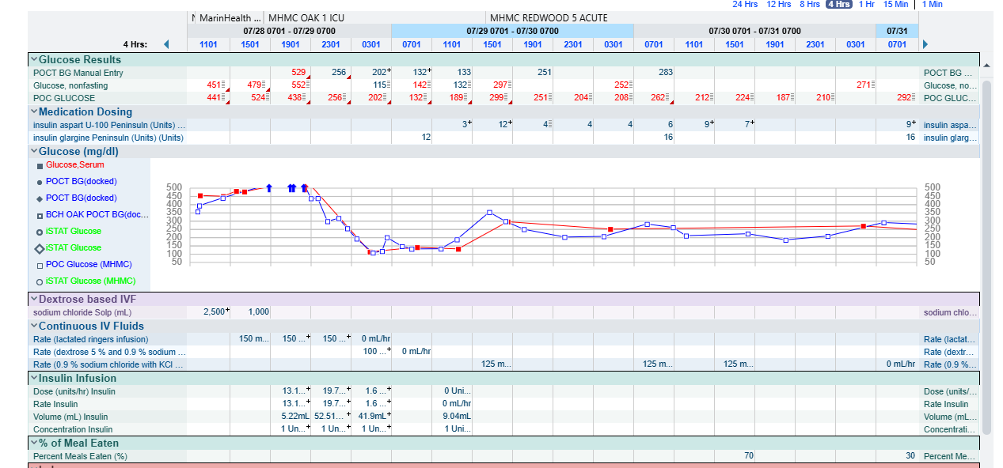
This is an example of IV insulin infusion titration to subq insulin (basal/nutritional/correctional) on pt with DKA. It is crucial to give basal insulin prior to discontinuation of the insulin drip:

Slide 46
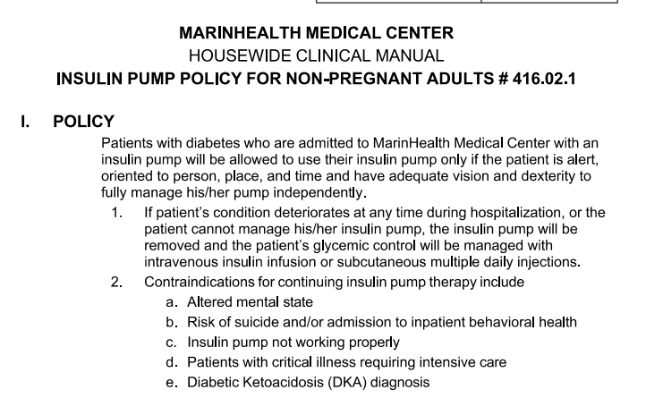

Pump Policy and Procedure

Slide 47
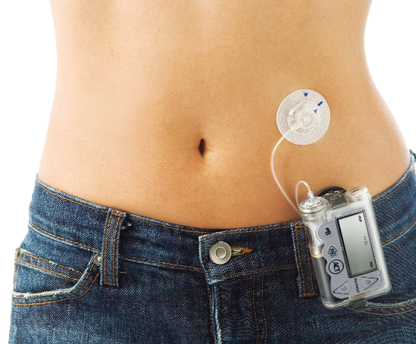
When to Take Off Insulin Pumps
Radiology & Imaging: Before entering an MRI, CT scan, X-ray, or fluoroscopy room, as the electromagnetic fields can cause the pump to malfunction.
Major Surgery: The procedure requires general anesthesia lasting longer than 2 to 3 hours.
Lack of Supplies: Person did not bring reservoirs, infusion sets, or compatible rapid-acting insulin, and the hospital does not stock them.

Slide 48
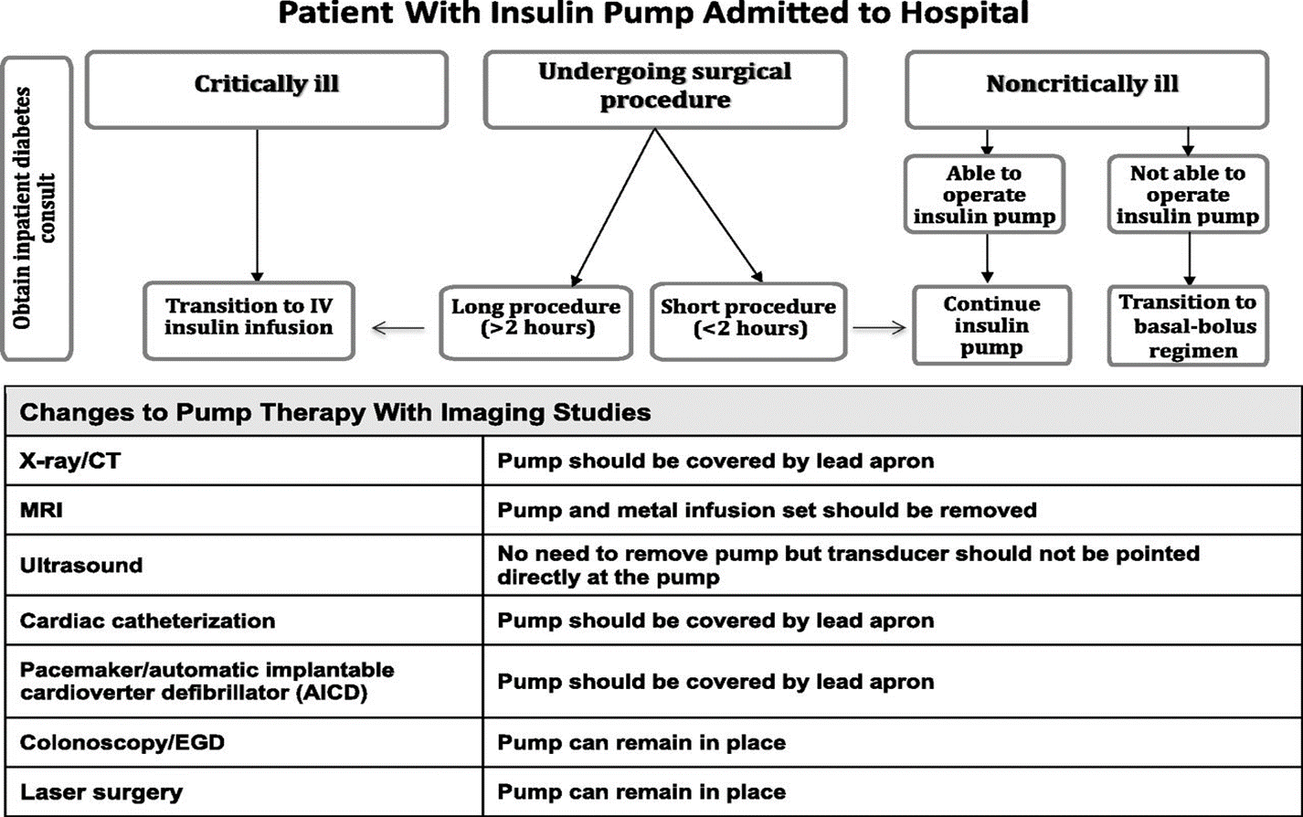
Considerations for Inpt Pumps
Umpierrez G et al. Diabetes Care 2018 Aug; 41(8): 1579-1589.
Umpierrez G et al. Diabetes Care 2018 Aug; 41(8): 1579-1589.

Slide 49
Insulin Pump Use in Hospitals
Many people with diabetes chose to use during hospital stay
  Bring ample supplies
  Will need to stop if not able to self manage
Hospital needs protocol on safe use
Insulin treatment plan needs to be documented
  Insulin sensitivity, insulin to carb ratio, basal rate and bolus amounts

Slide 50
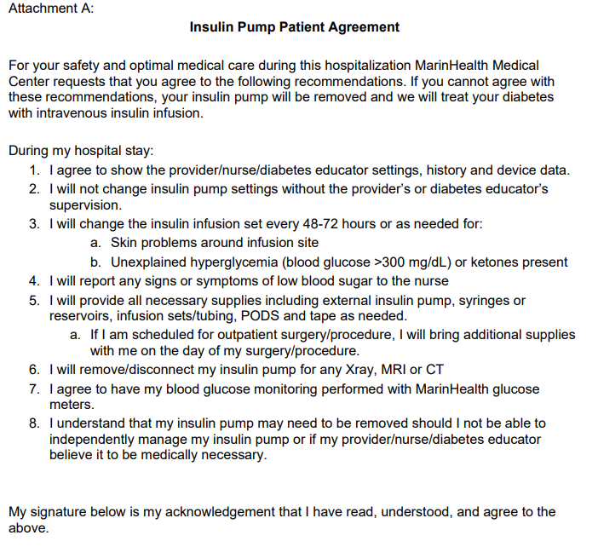
MarinHealth Patient Agreement

Slide 51
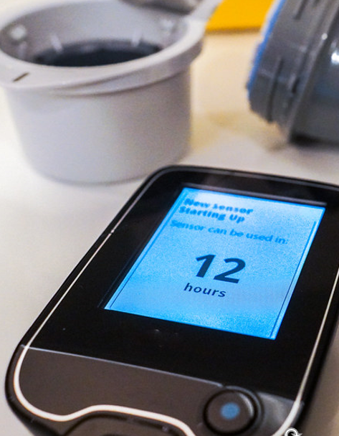
Continuous Glucose Monitoring Inpt
Not officially FDA approved
Many people with diabetes chose to use their own CGM during hospital stay
  Bring ample supplies
  Results less reliable in critical care setting
Hospital needs protocol on safe use
Point of Care (POC) monitoring used to guide insulin dosing and eval hypoglycemia.
ADA Standards 2026
Hospital blood glucose monitoring should be performed with U.S. Food and Drug Administration (FDA)-approved POC hospital-calibrated glucose monitoring systems

Slide 52
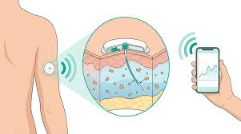
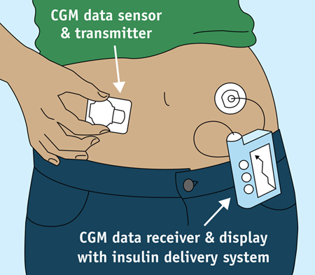

Slide 53

When to Take Off Glucose Sensors
The intense electromagnetic fields used in many medical scans can melt, warp, or corrupt the internal components of a CGM.
Dexcom and Medtronic Sensors: Must be completely removed before entering an MRI or CT scan room.
For standard X-rays, they may stay on only if they are entirely outside the area being scanned and covered by a heavy lead apron.
Abbott FreeStyle Libre Sensors: The FDA cleared the FreeStyle Libre 2 and 3 sensors to remain on your body during MRIs, CT scans, and X-rays.

Slide 54
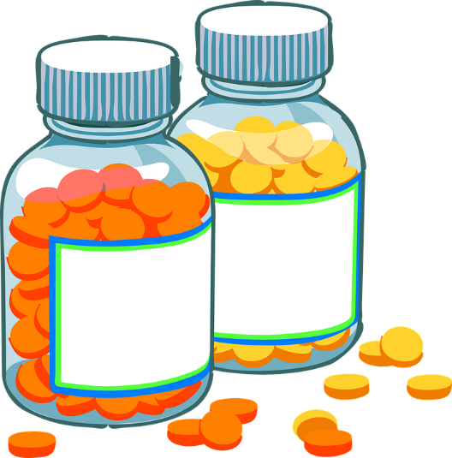
DKA – What Is The Cause? Poll
A 29-year-old arrives in the emergency room in DKA. She has a known history of type 1 diabetes. Her BMI is 23.9 and she is on intensive insulin therapy and an oral medication to help “clear extra sugar”.
On admission, her blood glucose is 149, her pH is 7.2 and she is ketone positive. What is the most likely cause?
She is taking a SGLT-2 Inhibitor
She is omitting her insulin to lose weight
There is a lab error in the glucose reading
New onset celiac disease
54

Slide 55
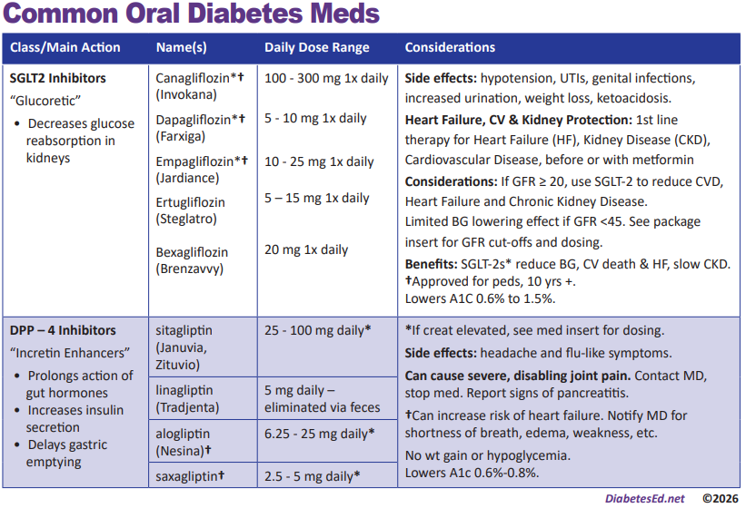

Oral Meds PocketCard

Slide 56
SGLT-2i Indications Summary
Drug | Lower BG | Reduce CV Risk? | Use to treat Heart Failure? | Slow renal disease?
Dapagliflozin (Farxiga) | Yes | Yes | Yes +/- Diabetes | Yes
Empagliflozin (Jardiance) | Yes | Yes | Yes +/- Diabetes | Yes
Canagliflozin (Invokana) | Yes | Yes | Yes w/ Diabetes | Yes
Ertugliflozin (Steglatro) | Yes | No | Yes w/ Diabetes | Yes
Bexagliflozin (Brenzavvy) | Yes | NA | NA | NA
Package inserts, dailymed.nlm.nih.gov

Slide 57
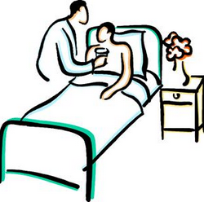
Poll question 3
PZ is admitted for CHF. GFR 53, UACR <30. On SGLT-2 at home. How would their diabetes best be managed in hospital setting according to ADA Standards?
  A. Keep PZ on SGLT-2
  B. Hold SGLT-2 and start sliding scale insulin
  C. Keep SGLT-2, add basal insulin
  D. Hold SGLT-2, start basal-bolus therapy

Slide 58
Natural History of Type 2 Diabetes
No Diabetes
FBG <100
Random <140
A1c <5.7%
Prediabetes
FBG 100-125
Random 140 - 199
A1c ~ 5.7- 6.4%
50% working pancreas
Diabetes
FBG 126 +
Random 200 +
A1c 6.5% or +
20% working pancreas
Yes!
NO
Development of type 2 diabetes happens over years or decades

Slide 59
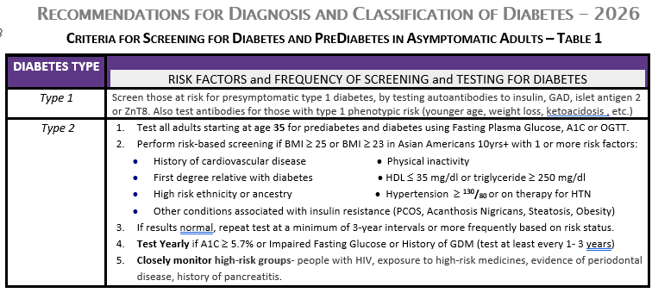

Diabetes Screening Guidelines
(ADA 2026 Clinical Practice Guidelines – Cheat Sheet)
DiabetesEd.net Cheat Sheets

Slide 60

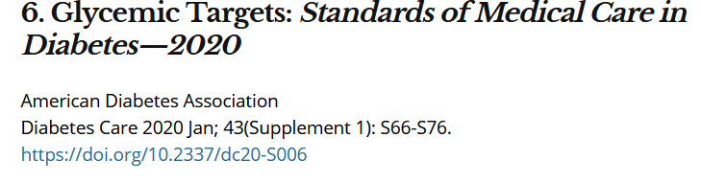
A1c and Estimated Avg Glucose (eAG)
A1c (%) eAG__
5 97 (76-120)
6 126 (100-152)
7 154 (123-185)
8 183 (147-217)
9 212 (170 -249)
10 240 (193-282)
11 269 (217-314)
12 298 (240-347)
eAG = 28.7 x A1c-46.7 ~ 29 pts per 1%
Translating the A1c Assay Into eAG – ADAG Study

Slide 61
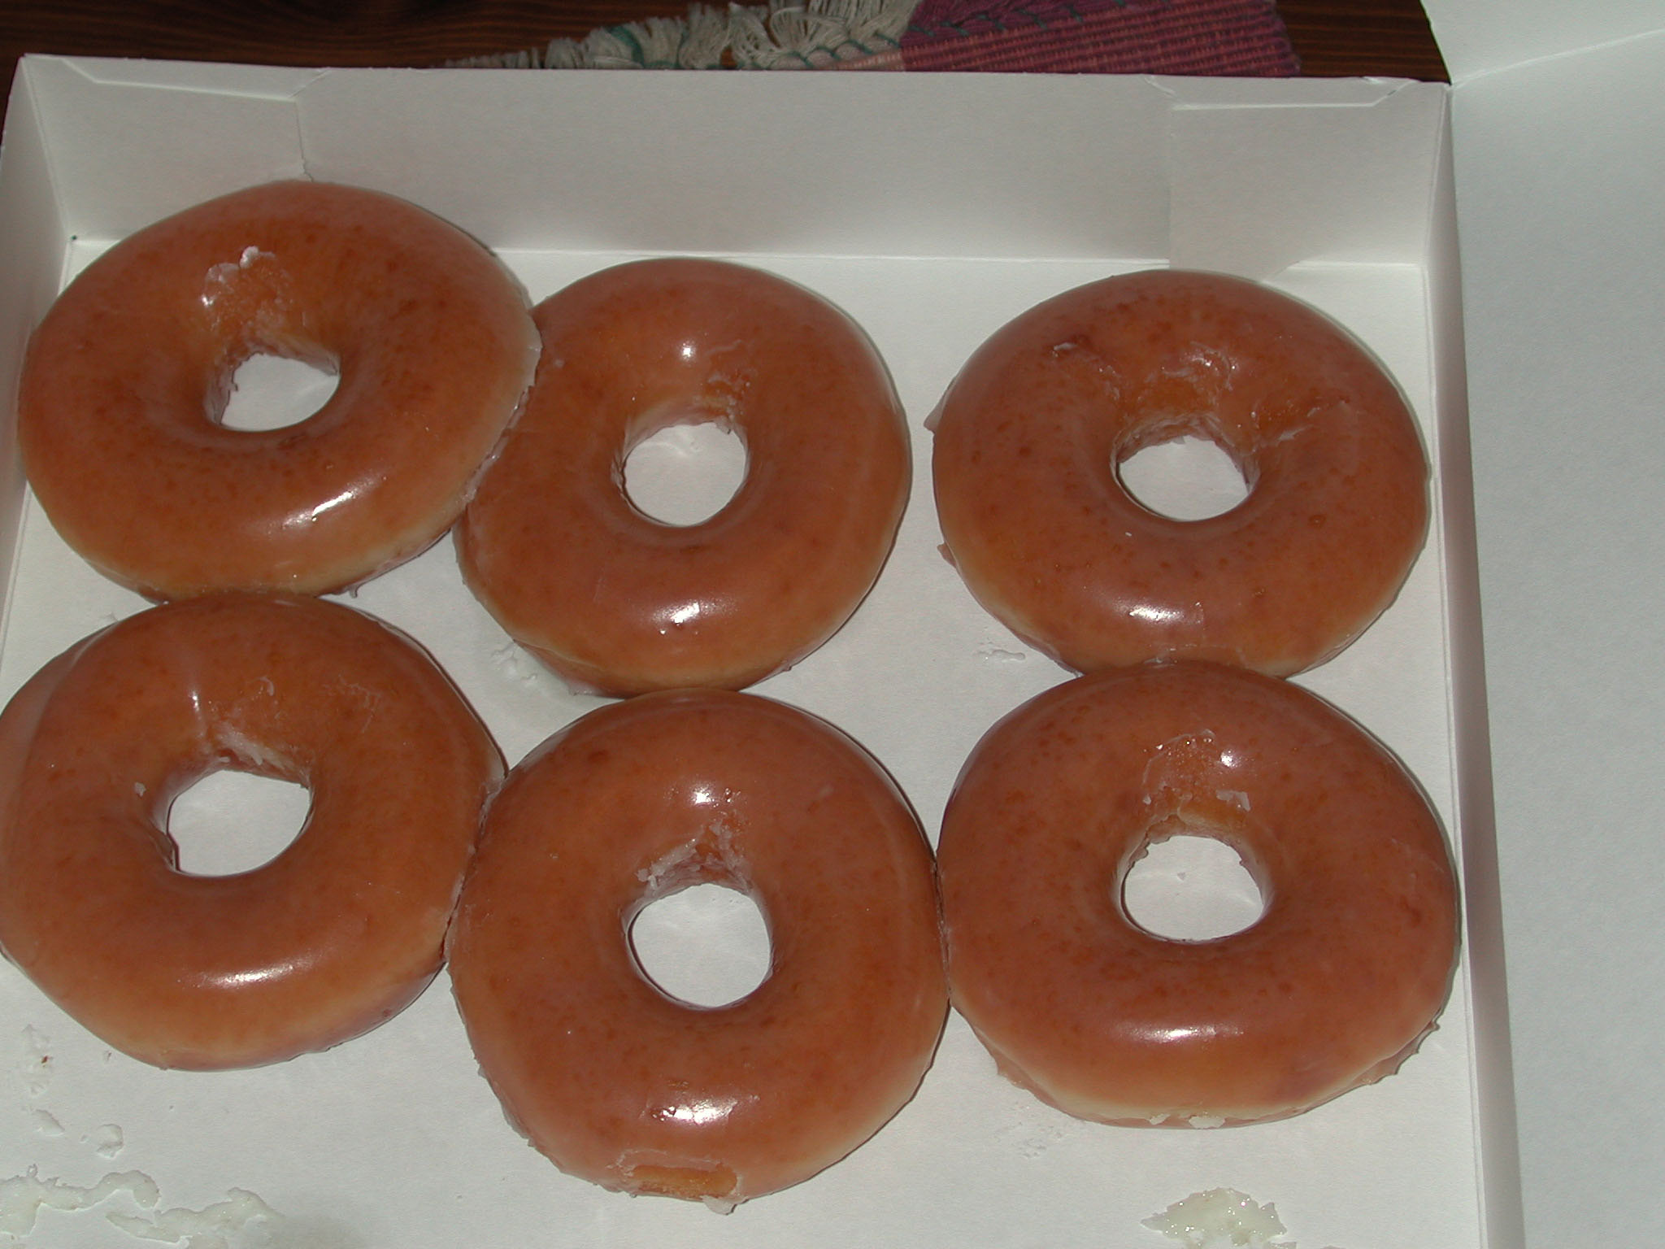

Slide 62

Signs of Diabetes
Polyuria
Polydipsia
Polyphasia
Weight loss
Fatigue
Skin and other
infections
Blurry vision
Glycosuria, H₂O losses
Dehydration
Fuel Depletion
Loss of body tissue, H₂O
Poor energy utilization
Hyperglycemia increases incidence of infection
Osmotic changes

Slide 63
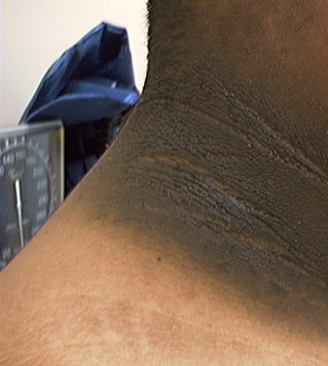
Acanthosis Nigricans
Signals high insulin levels in bloodstream
Patches of darkened skin over parts of body that bend or rub against each other
  Neck, underarm, waistline, groin, knuckles, elbows, toes
  Skin tags on neck and darkened areas around eyes, nose and cheeks.
No cure, lesions regress with treatment of insulin resistance

Slide 64
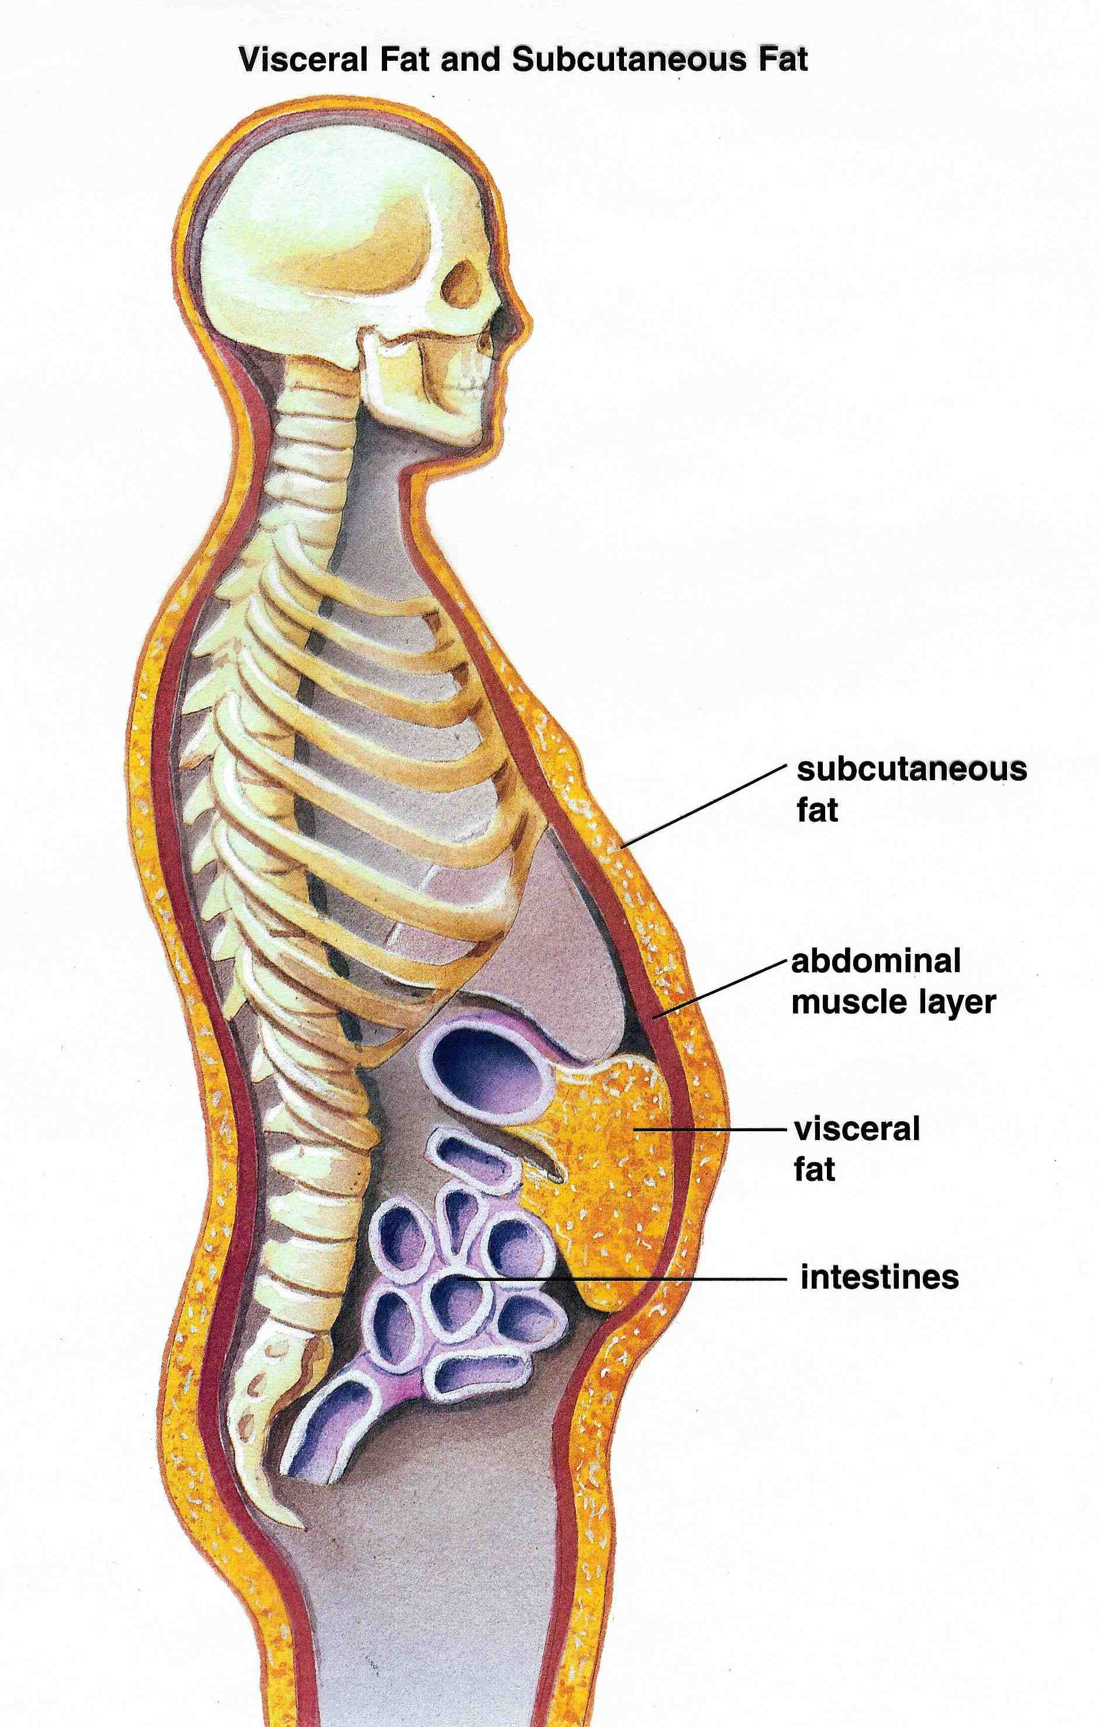



Slide 65

Poll Question 4
Frequent skin and yeast infections in people with diabetes are:
A sign of poor hygiene
Due to unhealthful diet
A sign of ongoing hyperglycemia
A result of high sugar intake

Slide 66
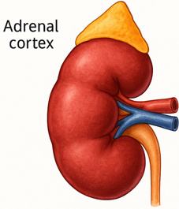

The Noxious Nine – Pathophysiology T2D
Hypercortisolism
Neurotrans-mission dysfunction
Decreased
Insulin β-cell secretion
Increased renal glucose reabsorption
Decreased
incretin effect
Gut hormones
G
Increased glucagon α-cell secretion
I
G
I
G
G
I
I
G
Increased lipolysis
G
G
I
I
G
G
I
Increased hepatic glucose
production
I
G
G
Decreased muscle glucose uptake
DeFronzo, Auchus-Hypercortisolism June 2025
Notes:
66
ummary: The Noxious Nine in Diabetes Pathophysiology
Ralph A. DeFronzo expanded his earlier conceptual model of diabetes—known as the Ominous Octet—to include a ninth element: hypercortisolism. This updated framework is referred to as the Noxious Nine, highlighting the important role of cortisol dysregulation in difficult-to-control type 2 diabetes currentsciencedaily.com+8HCP Live+8HCP Live+8.
Recent research, including the CATALYST trial, shows that about 24% of patients with difficult-to-control T2D have underlying hypercortisolism. Treating this condition with mifepristone, a glucocorticoid receptor antagonist, led to significant improvements in HbA1c—averaging around a 1.5% reduction pmc.ncbi.nlm.nih.gov+3HCP Live+3medscape.com+3.
These findings emphasize the importance of recognizing hypercortisolism in T2D care and suggest that addressing it may help improve glycemic and metabolic control in a subset of patients.
66

Slide 67


What is Type 2 Diabetes?
Type 2 diabetes is associated with insulin secretory defects related to
  genetic predisposition,
  epigenetic changes,
  inflammation, and
  metabolic stress.
Future classification schemes for diabetes will likely focus on the pathophysiology of the underlying β-cell dysfunction.

Slide 68

Diabetes is also associated with
Steatosis
Obstructive sleep apnea
Cancers:
  pancreas, liver, breast, endometrium, colon, bladder
Dementia / Alzheimer’s

Slide 69
Other Causes of Hyperglycemia
  Steroids
  Agent Orange
  Tube feedings / TPN
  Transplant medications
  Cystic Fibrosis
  Regardless of cause, requires treatment
    Insulin always works
    Sign of pancreatic malfunction

Slide 70
Diabetes Bingo
“DiaBingo” Shout out Right Answer

Slide 71
DiaBingo
B Frequent skin and yeast infections can indicate?
B A BMI of ____ or more increases risk of diabetes
B To reduce complications, control A1c, Blood pressure, Cholesterol
B PreDiabetes – fasting glucose level of ___ to ____
B Erectile dysfunction indicates greater risk for ____
B Diabetes – fasting glucose level____ or greater
B Type 1 diabetes is best described as an ______ disease
B People with diabetes are ______ times more likely to die of heart dx
B Each percentage point of A1c = _____ mg/dl glucose
B At dx of type 2, about __% of the beta cell function is lost
B Diabetes – random glucose ____ or greater

Slide 72

Is Inpatient Diabetes Education Realistic?
Unique opportunity to address urgent learning needs
Brief and targeted education effective
Strategies
  Empathic listening and open ended questions
  “What are you most worried about when it comes to taking care of your diabetes.
Assist with needed supplies and referrals
Look for
“teaching moment” opportunities

Slide 73
Stigma associated with diabetes
Have you heard others using these words or phrases?
Cheats
No will power
Diabetic
Non-compliant
Train wreck
Frequent Flyer
Non-adherent
Doesn’t really care
If they would only lose some weight
Doesn’t monitor blood sugar
Forgot logbook/reader again
Doesn’t take their meds as directed
Eats junk food
Eats too much fruit
Loves sugar
They brought it on themselves

Slide 74

Quick Question 5
Which phrase represents the principles for communicating with people living with diabetes.
A. You are walking 3 times a week.
B. Let’s focus this appt on weight loss.
C. Do you know possible complications associated with elevated A1C levels?
D. You should try to eat 3 servings of fruits and veggies daily.

Slide 75
Self Reflective Question
A person shows up to appointment, forgets their log book and meter and tells you they are only taking their daily insulin injection about 4 times a week.
What feelings would that evoke?
  Doesn’t care
  Non-compliant
  Lazy
  Better scare them
  Exasperation
curiosity

Slide 76

Let’s use language that (is)
Imparts hope
Neutral, nonjudgmental
Based on fact, actions or biology
Free from stigma
Respectful, inclusive
Fosters collaboration between person and provider
Avoids shame and blame

Slide 77

Life Study – Mrs. Jones
Mrs. Jones is 62 years old, with a BMI of 36 and complains of feeling tired and urinating several times a night. She has an urinary tract infection. Her A1c is 8.3%, glucose 237.
She is hypertensive with a history of gestational diabetes. No ketones in urine.
What are her risk factors and signs of diabetes?
You find a few moments to
teach and she asks you
some questions.

Slide 78

Language of Diabetes Education
Old Way
New Way
Control diabetes
Test BG
Patient
Normal BG
Non-adherent, compliant
Refuse
Manage
Check
Participant, Individual
BG in target range
Focus on what they are accomplishing
Decided, chose

Slide 79

Mrs. Jones asks you
What Do You Say?
What is diabetes?
They say I am a diabetic because I am obese?
How am I going to control this?
What is a normal blood sugar?
Do I have to test my blood sugars?
My doctor told me to stay away from white foods. Is that true?

Slide 80

Mrs. Jones asks you
What Do You Say?
You are wondering if your weight caused your diabetes?
You can manage your diabetes and improve your health at the same time.
For people without diabetes, fasting blood sugar is less than 100 and A1c is less than 5.7%
Checking blood sugars can help you figure out if the plan in working.

Slide 81

Guiding Language Principles
Strength Based
Person-first
Emphasize what people know, what they can do.
Focus on strengths that empower people
Words that indicate awareness
Sense of dignity
Positive attitude toward person with diabetes

Slide 82

Terminology matters – Avoiding weight stigma
For people with BMI >30, preferred terms
  “person with elevated BMI”.
  “person with higher weight”
  “person with excess weight”
Other terms
  Person in a larger body.
  Person with extra weight
Pearl RL, et al. JAMA Surg. Sept 2018; doi:10.1001/jamasurg.2018.2702

Slide 83

Missed Appointments due to Stigma and Shame
A recent survey of over 2,600 people with diabetes across eight countries revealed that nearly 40% of missed doctor’s appointments are due to stigma or shame.
Abbott. (2025, February 4). Abbott’s Above the Bias film reveals misconceptions can impact diabetes care. https://abbott. mediaroom.com/2025-02-04-Abbotts-Above-the-Bias-FilmReveals-Misconceptions-Can-Impact-Diabetes-Care
Notes:
Many healthcare professionals incorrectly assume that people with
diabetes are not reaching their goals due to a lack of effort. If they
“just tried hard enough,” they could reach the recommended timein-range target. Unfortunately, this false belief can build a wall of
misunderstanding between the HCP and the person with diabetes

Slide 84


Slide 85
Quick Question 6
  A 78-year-old tells you they stopped taking their blood pressure medications. “It doesn’t seem to matter whether or not I take them”. What is the best response?
  Acknowledge their honesty and ask them to discuss with their provider.
  Gently remind them that stopping their meds is dangerous.
  Ask them if they are experiencing trauma at home.
  Explore possible reasons for this action.

Slide 86


Barriers to Self Management
Design and deliver DSMES with ultimate goal of health equity across all populations.
Barriers exist within health system, payer, health care professional & individual.
Address barriers through innovation, including community health workers, telehealth, other digital health solutions.
Consider social determinants of health in the target population when designing care.
Notes:
Access and health equity is the ultimate goal when designing and delivering DSMES.
Creating culturally appropriate and varied modalities of settings has been shown to improve outcomes.
We know barriers to care exist at every level from the health system to individual.
However we can address these barriers by working to educate participants and health care providers on the critical times when DSMES is needed.
We can work with health systems and clinics to develop population health screening and clinical outreach,
create protocols to reduce time for referral and
collaborate health and community systems to address social needs.
We can include other health partners including community health workers to support delivery of diabetes peer support.
Barriers can be also be addressed by developing a diversity of delivery models.
From traditional inperson classrooms to community-based strategies and technology enabled solutions including telehealth or virtual environments varying modes can serve different needs.

Slide 87


Slide 88


Weight is a Heavy Issue

Slide 89

Standard American Diet is SAD
70% of food consumed is processed
Low fiber, high sugar
Intake of fruit and veggies decreasing
We are starving our good bacteria

Slide 90

Reduce refined Carbs, Added Sugars - ADA
Reduce risk of CVD and fatty liver disease
ADA strongly discourages consumption of:
  Sugar sweetened beverages
  Processed “low-fat” or “non-fat” foods with high amounts of refined grains & added sugar
Sugary and processed foods can displace healthier, more nutrient dense food choices

Slide 91


Slide 92


Slide 93

Choose Healthy Carbs
Carbs have fiber, vitamins, minerals and phytonutrients
25 gms of fiber a day
Power Carbs include:
  Beans
  Veggies
  Fruits
  Whole grain foods

Slide 94

Healthy Eating Patterns/Approaches
Eating Patterns:
Carb-Restricted
Mediterranean Diet
Plant based eating
DASH (Dietary Approaches to Stop Hypertension)
Structured low-calorie
Approaches:
Diabetes Plate Method
Carbohydrate Counting
Intermittent fasting/time restricted
Meal replacements
Notes:
The updated 2024 standards of care is the call out of the definitions of eating pattern, meal plan or dietary approach.
Simplified we can consider these calls outs to define What we eat, How much and How
Eating pattern is the foods we consume
Meal plan is developed by a dietitian as a specific individualized guideline
Dietary approach are the tools/ that support implementation of healthy eating patterns.
There is no one pattern that is better than another so we work with the individual with diabetes to determine an effective eating pattern and approach.
When considering approaches take into account religious fasting. (Add content)
New concept- chrononutrition

Slide 95





Plate example

Slide 96
ADA 2026 Summary
A1c less than 7% (individualize)
Pre-meal BG 80-130
Post meal BG <180
Time in Range (70-180) 70% of time
Blood Pressure
<130/80
Cholesterol
Statin therapy based on age & risk status
If 40+ with ASCVD Risk, decrease LDL by 50%, LDL <70
If 40+ with ASCVD, decrease LDL by 50%, LDL <55

Slide 97


5 M’s and Judgement Free Zone

Slide 98



Exercise Standards
Adults – 150 min/wk moderate intensity
  over 3 days a week.
  Don’t miss > 2 consecutive days w/out exercise
  Get up every 30 mins - Reduce sedentary time
  Flexibility and balance training 2-3 xs a week (Yoga and Tai Chi)
  T1 and T2 – resistance training 2 -3 xs a week

Slide 99

A hard truth
Exercise alone doesn’t cause weight loss
But….
  It helps keep weight off
  Decreases visceral adiposity
  Decreases CV Risk
To combat the rise in body weight, we need to change the food environment
“You cannot outrun an unhealthy diet”.

Slide 100


Where are we on this continuum?

Slide 101
Good Exercise Info / Quotes
“Passagiata” – take an after meal stroll
Exercise decreases A1c 0.7%
No change in body wt, but 48% loss in visceral fat
ADA PostGrad 2010
“Every minute of activity lowers blood sugar one point.”
“I don’t have time to exercise, I MAKE time.” Mike Huckabee

Slide 102

Best Shake For People with Diabetes
From Debbie Nagata’s slide collection

Slide 103
Mr. Jones - What are Your Recommendations?
Self-Care Skills
Walks dog around block 3 x’s a week
Bowls every Friday
3 beers daily
What meds?
What referrals?
My foot hurts
MJ Profile
64 yr old with type 2 for 11 yrs. Hx of CVD.
Labs:
  A1c 9.3%
  LDL 137 mg/dl
  Triglyceride 260mg/dl
  UACR 32mg/g GFR 54
  B/P 132/94

Slide 104



Lower Extremities
Lift the Sheets and Look at the Feet

Slide 105



Slide 107


Slide 108



No Bathroom Surgery

Slide 109

5.07 monofilament = 10gms linear pressure

Slide 110
Three Most Important
Foot Care Tips
Inspect and apply lotion to your feet every night before you go to bed.
Do NOT go barefoot, even in your house. Always wear shoes!
Every time you see your provider, take off your shoes and show your feet.

Slide 111
Diabetes Bingo
“DiaBingo” Shout out Right Answer

Slide 112
DiaBingo- G
G ADA goal for A1c is less than ____%
G Blood pressure goal is less than
G People with DM should see eye doctor (ophthalmologist) at least
G The goal for blood sugars 1-2 hours after a meal is less than:
G People with DM should get this shot every year
G People with DM need to get these kidney tests yearly
G Periodontal disease indicates increased risk for heart disease
G The goal for blood sugar levels before meals is:
G The activity goal is to do ___ minutes on most days
G Name 3 healthy foods to include in daily meal plan

Slide 113

Section 2
Surgery
Calculating insulin dose during hospital stay
  Basal dose
  Bolus dose
    Prandial
    Correction

Slide 114

Mr. Jones needs to go to surgery
In spite of antibiotics, her foot ulceration isn’t improving.

Slide 115

Poll Question 7
MJ woke up in the morning with a fasting glucose of 72 and pt needs to go to OR now! Best action?
  A. Call OR and tell them to postpone surgery
  B. Give the patient 4 ounces of juice
  C. Push 1 amp of D50
  D. Hang IV of 5-10% Dextrose and alert anesthesia

Slide 116


Diabetes and Surgery
20% of individuals undergoing major general surgery have diabetes,
23–60% have prediabetes or undiagnosed diabetes
A1C target <8% for elective surgeries or Time in Range >50%.
Perioperative glucose target of 100-180
Postponing surgery based on A1C or TIR not recommended, as it may lead to unnecessary delay or denial of required surgery.

Slide 117

Perioperative Meds & Monitoring
Hold any other oral glucose-lowering agents the morning of surgery or procedure.
Give half of NPH dose or
Give 75–80% doses of long-acting analog or insulin pump basal insulin based on the type of diabetes and clinical judgment.
Monitor BG at least every 2–4 h while NPO and dose with short- or rapid-acting insulin
ADA 2026

Slide 118

To Hold or Not Hold Basal If NPO or Stops Eating
  MarinHealth basal insulin orders have instructions as follows:
  “If patient becomes NPO for procedure or stops eating, give glargine dose.
  If BG less than 70 mg/dL in last 24 hours, call provider to consider adjusting glargine dose.”

Slide 119

Prep for Surgery – Poll 8
AR is living with type 2 diabetes, has an A1c of 7.4% and takes metformin 1000 BID and 60 units of glargine at bedtime. AR is admitted to the hospital overnight for early morning surgery. What adjustment in his diabetes medications are needed to prepare for a safe surgery?
Hold evening metformin and glargine night before surgery to prevent perioperative hypoglycemia.
Hold morning metformin the day of surgery and give about 45 units of bedtime glargine the night before surgery.
Hold metformin 3 days before surgery and give 60 units of bedtime glargine the night before surgery.
Hold the metformin the day before surgery and give the glargine the morning of surgery to prevent perioperative hyperglycemia.

Slide 120



Meds for Diabetes PocketCards

Slide 121

Preparation for Surgery
Preoperative risk assess (heart, renal disease, neuropathy).
Hold SGLT-2 for 3-4 days before surgery
Evaluate GLP-1 Therapy
ADA 2026
The American Society of Anesthesiologists recommends holding GLP-1 RAs on the day of the procedure or surgery for daily dose agents and for at least 7 days prior to the procedures or surgery for once-weekly dose agents. Individualize.

Slide 122

Poll Question 7
MS is 63, has type 1 diabetes and will be having knee surgery. In addition to using an insulin pump and CGM to manage their type 1 diabetes, MS also takes empagliflozin 25 mg daily to improve glucose levels.
In preparation for the upcoming surgery, which of the following is an accurate statement?
Transition to insulin injections in preparation for surgery
Perioperative glucose goal is 80-140.
Stop empagliflozin 3 days prior to surgery
Reduce basal insulin by half the night before surgery.

Slide 123
Meds for Diabetes PocketCards
Stop 3-4 days prior to surgery.
Use to treat CHF inpatient

Slide 124

GLP-1 Pre Surgery

Slide 125

GLP-1 Effects in Humans
Understanding the Natural Role of Incretins
GLP-1 secreted upon the ingestion of food
Promotes satiety and
reduces appetite
Alpha cells:
↓ Postprandial
glucagon secretion
↑ Beta-cell
response
Liver:
↓ Glucagon reduces hepatic glucose output
Beta cells:
Enhances glucose-dependent insulin secretion
Stomach:
Helps regulate gastric emptying
GLP-1 degraded by
DPP-4 w/in minutes
Notes:
125
125
Required
DISCUSSION POINTS:
--Upon food ingestion, GLP-1 is secreted into the circulation from L cells of small intestine.
--GLP-1 increases beta-cell response by enhancing glucose-dependent insulin secretion.
--GLP-1 decreases beta-cell workload and hence the demand for insulin secretion by:
--Regulating the rate of gastric emptying such that meal nutrients are delivered to the small intestine and, in turn, absorbed into the circulation more smoothly, reducing peak nutrient absorption and insulin demand (beta-cell workload)
--Decreasing postprandial glucagon secretion from pancreatic alpha cells, which helps to maintain the counterregulatory balance between insulin and glucagon
--Reducing postprandial glucagon secretion, GLP-1 has an indirect benefit on beta-cell workload, since decreased glucagon secretion will produce decreased postprandial hepatic glucose output
--Having effects on the central nervous system, resulting in increased satiety (sensation of satisfaction with food intake) and a reduction of food intake
--By decreasing beta-cell workload and improving beta-cell response, GLP-1 is an important regulator of glucose homeostasis.
SLIDE BACKGROUND:
--Effect on Beta-cell: Drucker DJ. Diabetes. 1998; 47:159-169
--Effect on Alpha cell: Larsson H, et al. Acta Physiol Scand. 1997; 160:413-422
--Effects on Liver: Larsson H, et al. Acta Physiol Scand. 1997; 160:413-422
--Effects on Stomach: Nauck MA, et al. Diabetologia. 1996; 39:1546-1553
--Effects on CNS: Flint A, et al. J Clin Invest. 1998; 101:515-520

Slide 126


Pocket Card: GLP-1 & GIP RA
Notes:
Update with exenatide indication in pediatrics.

Slide 127
Benefits of GLP-1 RA & GIP/GLP-1 Receptor Agonists
A1C lowering
Substantial Weight loss
Cardiovascular benefits*
Decreased appetited
Lowers post meal glucose
Ease of use
*semaglutide, liraglutide, dulaglutide

Slide 128

Counseling Points: GLP-1 RA & GLP-1/GIP
Avoid if personal or family history of medullary thyroid cancer or personal history of Multiple Endocrine Neoplasia type 2 (MEN-2)
Avoid in combo with DPP-4 inhibitors
Watch for intestinal obstruction
Increased risk of biliary disease
Education: Eat smaller meals to reduce nausea and limit high fat meals
Use of non-FDA compounded products not recommended
Notes:
Biliary disease: evaluate for gallbladder disease if chole lithiasis or cholecystitis is suspected; avoid use in at-risk individuals • Ileus: reported, but risk level is not well established • Diabetic retinopathy: close monitoring of retinopathy in those at high risk (older individuals and those with longer duration of T2D [≥10 years]) • Nonarteritic anterior ische mic optic neuropathy (NAION) reported (rare inci dence); monitor for NAION during eye examinations

Slide 129
Counseling Points: GLP-1 RA & GLP-1/GIP
Potential risk of pancreatitis
If on tirzepatide and oral contraceptives, use back up contraception for first 4 weeks
Warning about aspiration during surgery
Ask about recent eye exam
  Potential increase in diabetes retinopathy
  Nonarteritic anterior ischemic optic neuropathy (NAION) reported (rare incidence)
Sudden discontinuation of semaglutide and tirzepatide results in regain of one-half to two-thirds of the weight loss within 1 year. Consider trying lowest effective dose, using intermittent therapy, or stopping medication followed by close weight monitoring.
Notes:
Biliary disease: evaluate for gallbladder disease if chole lithiasis or cholecystitis is suspected; avoid use in at-risk individuals • Ileus: reported, but risk level is not well established • Diabetic retinopathy: close monitoring of retinopathy in those at high risk (older individuals and those with longer duration of T2D [≥10 years]) • Nonarteritic anterior ische mic optic neuropathy (NAION) reported (rare inci dence); monitor for NAION during eye examinations

Slide 130

Getting Mrs. Jones Ready for Discharge
Mrs. Jones is improved and ready to go home.
What glucose management strategies for home?
Her A1c = 7.9%
She was on correction insulin and basal during hospital stay.

Slide 131
Hospital Readmissions with Diabetes
ADA Standards 2026
Readmission rates of 14% and 20%
  nearly 2xs that those without diabetes
If diabetes and hospitalized
  30% have two or more hospital stays
  Hospitalization accounts for 60% of diabetes direct medical costs
Factors contributing to readmission include
  male sex - longer duration of prior hospitalization,
  number of previous hospitalizations,
  number and severity of comorbidities,
  lower socioeconomic and/or educational status;
To prevent readmissions, monitor insulin adjustments if A1C >9% or DKA - follow a transitional care model & recommend home health.

Slide 132

Discharge Plan Example

Slide 133

Topics to cover before discharge
Identification of the health care provider to provide diabetes care after discharge.
Level of understanding related to the diabetes diagnosis, self-monitoring of blood glucose, home blood glucose goals, and when to call the provider.
Definition, recognition, treatment, and prevention of hyperglycemia and hypoglycemia.
Information on making healthy food choices at home and referral to an outpatient RD/RDN
If relevant, when and how to take blood glucose–lowering medications, including insulin administration.
When to get help.
Proper use and disposal of needles and syringes.

Slide 134

Medication Reconciliation
Cross-check meds to make sure no chronic meds were stopped
Ensure the safety of new prescriptions
New or changed prescriptions reviewed with pt/ family before discharge
Avoid complex insulin regimens for those with limited cognition
  As pt heals, remind them that they may need less insulin / diabetes meds to control BG
  Supplies for insulin administration
    Novolog prescribed at discharge includes patient specific instructions
      RNs review AVS at discharge to ensure patient has instructions
      MDs place order with instructions present

Slide 135

MarinHealth Goals at Discharge
    Make sure patients with A1c > 9.0% have follow up appt scheduled prior to discharge
      RNs can check the AVS to ensure appt date/time is present
Safe & Realistic Diabetes treatment(s)
  Get back on home meds with modifications as needed.
  Avoid intensive insulin management if possible
  Consider home health

Slide 136
Getting Mrs. Jones Ready for Discharge
Mrs. Jones is improved and ready to go home.
What glucose management strategies for home?
Her A1c = 7.9%
Meds:
Metformin or SGLT-2 inhibitor
Glucose meter
Healthy eating
When to call for help (if BG 250 or greater.
FU with healthcare provider, DSME, RDN

Slide 137



Best and Banting – U of Toronto 1921

Slide 138


Miracle of Insulin
The Miracle of Insulin
Patient J.L., December 15, 1922
February 15, 1923

Slide 139


Insulin Finally Available - 1922

Slide 140


Problem Solving Tips for more comfortable injections
Short, fine needles hurt less
Make sure they are injecting subcutaneously, not in muscle
If participant thin, inject at an angle
Avoid areas with scar tissue
Use needle once and toss in sharps container
  Needle gets duller with each injections
To avoid leakage, count to 5-10
before withdrawing needle from
skin
Use pen needles and injectors

Slide 141

Insulin Teaching Keys
Abdomen preferred injection site
Stay 1” away from previous site
Don’t re-use syringes
Keep unopened insulin in refrigerator
Glucagon ER Kit?
Look for:
  Lipodystrophy (a)
  Lipohypertrophy (b)
Make sure insulin isn’t expired
Proper disposal – hazardous waste
Review person’s ability to withdraw and inject.
Report hypoglycemia and have plan in place

Slide 142


Slide 143

How Much Insulin is Needed?
It depends, based on:
  Body weight
    BMI < 25 or more than 25
  Frail, elderly
  Eating status
    Normal, poor intake or NPO
  Renal or hepatic insufficiency
  Type of Diabetes
  Current meds; steroids, insulin, oral DM agents
  Infected or Septic

Slide 144

Insulin Timing
For individuals who are eating, align insulin injections with meals.
Perform POC glucose monitoring immediately before meals.
If oral intake is inadequate, administer prandial insulin immediately after eating
  Adjust dose to match the amount of carbohydrates ingested
    At MarinHealth
    Insulin administration is within 30 minutes of BG check

Slide 145

Person on Insulin
73 yr old admitted to evaluate angina.
Morning blood sugar is 142.
You walk in with his insulin dose.
What best action for following scenarios?
  “I am so nauseated”
  “That dose won’t touch my blood sugar”
  “Can my wife bring in my insulin pump?”

Slide 146

Insulin Caution
Insulin one of most common meds causing adverse events in hospitalized individuals.
Errors in insulin dosing and missed doses happen frequently and include:
  Incorrect insulin type and
  Incorrect timing of dose
  Prescriber errors (ordering),
  Pharmacy error (dispensing), and
  Nursing (administration) errors
ADA Standards 2026

Slide 147

Insulin Strategies (ADA)
Continuous intravenous insulin infusion is recommended for achieving glycemic goals and avoiding hypoglycemia in critically ill individuals.
Basal insulin or a basal plus correction insulin is preferred treatment for noncritically ill hospitalized inds with poor or no oral intake.
An insulin plan with basal, prandial, and correction components is preferred treatment for most noncritically ill hospitalized individuals with adequate nutritional intake.
For most individuals, sole use of a correction or supplemental insulin without basal insulin (formerly referred to as a sliding scale) in the inpatient setting is discouraged.

Slide 148
Poll Question 1
MS is about to eat lunch and is scheduled to get 3 units lispro plus correction based on correction scale. BG is 68. What is the best action?
Administer 2 units lispro
Inject 3 units and make sure they eat right away.
Give the insulin 2-3 hours after the meal.
Hold the insulin & reassess

Slide 149

Hypoglycemia predicts Hypo
In people with diabetes in the ambulatory setting, it is well established that an episode of severe hypoglycemia increases the risk for a subsequent event, partly because of impaired counterregulation.

Slide 150

Hypoglycemia – Focus on Prevention
Stage 1 Hypoglycemia: BG < 70
Stage 2 Hypo: BG < 54
Stage 3 Hypo: Needs assistance
If BG < 100, consider adjusting insulin / meds
If BG < 70, insulin change required
Need hypoglycemia treatment policies / action
Need hypo Prevention Policies.

Slide 151

Hypoglycemic Symptoms
Autonomic
  Anxiety
  Palpitations
  Sweating
  Tingling
  Trembling
  Hypoglycemic Unawareness
Neuroglycopenia
  Irritability
  Drowsiness
  Dizziness
  Blurred Vision
  Difficulty with speech
  Confusion
  Feeling faint

Slide 152
Poll Question 2
You walk into RLs room (14 yr old with Type 1 diabetes) at 7am and notice they are pale and sweaty, but talking. The fingerstick BG is 58 mg/dl. What is the first action?
A. Recheck BG to confirm reading
B. Call lab stat to get more accurate result
C. Give glucagon or ½ amp of D50
D. Give 4-8 ounces of juice

Slide 153
Treatment of Hypoglycemia
If blood glucose 70mg/dl or below:
  10-15 gms of carb to raise BG 30 - 45mg/dl
Retest in 15 minutes, if still low, treat again, even without symptoms
Follow with usual meal or snack
If non responsive, give D50 IV or glucagon Emergency Kit
Figure out how to prevent in future

Slide 154
15 - 20 Gms Carb Sources
4 ounces apple juice
3 - 4 Glucose Tablets
8 - 10 Lifesavers candy
8 - 10 Hard candies
2 Tablespoons Raisins
4 - 6 oz’s Nondiet soda
4 - 6 oz’s Fruit Juice
8 oz Milk (non fat)

Slide 155





Slide 156


Slide 157



Glucagon Emergency Kit
Store 68-77 degrees prior to reconstitution
single use only

Slide 158


Gvoke HypoPen

Slide 159


Nasal Glucagon - Baqsimi
Approved for ages 4 +
Absorbed nasally
No reconstitution or refrigeration needed
Kept in temps up to 86
Raises BG 67-73 mg/dl
Don’t use in those with
  Pheochromocytoma
  insulinoma

Slide 160

Morning Hypoglycemia – Question 3
LS has type 2 diabetes in the hospital and is ordered for 60 units glargine at bedtime and lispro insulin sliding scale coverage with meals. LS is eating 30-45g of carb with each meal. The am blood glucose levels have been below 70 mg/dL two days in a row. Which of the following changes is most needed to prevent future morning hypoglycemia?
Give the lispro after meals
Make sure LS is on a high carbohydrate meal plan
Reduce glargine insulin dose
Switch LS to oral diabetes medications
160

Slide 161

Example of hypoglycemia due to too much basal on board and patient not eating much. Basal was discontinued and blood sugars recovered:

Slide 162

Steps to Prevent Hypo
Prior episode predicts future episode
Hypo is a sign of metabolic dysregulation
Basal insulin big contributor of hypo.
  Need protocol to take action to decrease basal dose
If fasting BG < 100, lower basal insulin
If renal failure, conservative insulin dose
Patient has N/V or not consistent eater?
  Give bolus insulin after meals or use hs scale

Slide 163

Steps to Prevent Hypo
Anticipate events that put pt at risk of hypo:
NPO for surgery
decreasing steroid dose,
improving infection,
recovering after cardiac event
Strive to admin the least amount of insulin necessary to reach glycemic targets
ADA Standards 2026

Slide 164

MarinHealth Hypo Policy

Slide 165

MarinHealth Hypo Policy

Slide 166


Slide 167
Diabetes Bingo
“DiaBingo” Shout out Right Answer

Slide 168
DiaBingo - N
N DPP demonstrated that exercise and diet reduced risk of DM by__%
N Average A1c of 7% = Avg BG of ____
N The goal is to eat 14 gms per 1000 cals of this nutrient a day
N Rebound hyperglycemia
N Scare tactics are effective at motivating behavior change
N Get LDL less than ____for most people with diabetes 40 years+
N Drugs that can cause hyperglycemia
N 2/3 cups of rice equals ______ serving carbohydrate
N 1% A1c = how many points of blood sugar _____
N 1 gm of fat equal _____kilo/calories
N Metabolic syndrome = hyperinsulinemia, hyperlipidemia, hypertension
N Average American consumes 15 teaspoons of sugar a day.
N Medication derived from the saliva of the Gila Monster

Slide 169

Poll question 4
What best describes the role of bolus insulins?
  a. cover carbs at meals and hyperglycemia
  b. helps to lower fasting blood glucose
  c. keeps overnight blood sugars on target
  d. used during hypoglycemic episodes

Slide 170
Insulin Therapy Components
Basal insulin – long acting insulin covers between meals and through night
Prandial or meal insulin – a bolus insulin that covers food, IV dextrose, enteral nutrition, TPN or other nutritional supplements
Correction insulin – bolus insulin dosed to correct for hyperglycemia that occurs despite use of basal and prandial insulin
  Usually given before meals w/ prandial insulin

Slide 171


Slide 172
Bolus – Insulin Sliding Scale
Starts at 150, 2 units for every 50 mg/dl >150

Slide 173
How Much Insulin Does a Patient Need?
It depends, based on:
  Body weight
  Frail, elderly
  Eating status
    Normal, poor intake or NPO
  Renal or hepatic insufficiency
  Type of Diabetes
  Current meds; steroids, insulin, diabetes meds
  Infected or Septic

Slide 174
Getting Glucose to Goal – How?
Subq insulin therapy (oral agents stopped)
  Determine insulin needs based on wt/BG
    0.3 units kg/day if insulin naïve or GFR less than 60
    0.4 units kg/day if BG 140-200mg/dl
    0.5 units kg/day if BG 201-400mg/dl
  50% of total dose - Basal Insulin (eg glargine, NPH)
    Increase by 20% if fasting BG elevated
    Reduce for fasting BG <100mg/dl
  50% of total dose Bolus Insulin (eg Reg, lispro) divided evenly into 3 meals
    If premeal BG elevated, increase bolus dose
RABBIT 2 Trial - Umpierrez

Slide 175
Ms. Jones is 60kg – GFR < 60, insulin naive?
Basal/Bolus Insulin Dosing Strategy
50/50 Rule
0.3-1.0 units/kg day
Basal = 50% of total
Bolus = 50% of total
  usually divided into 3 meals
Example – You Try
Wt 60 kg x 0.3 = ___ units of insulin/day
Basal dose: ____ units
Bolus dose: ____ units
___units bolus each meal

Slide 176
Basal/Bolus Insulin Dosing Strategy 0.3u/kg
50/50 Rule
0.3-1.0 units/kg day
Basal = 50% of total
Bolus = 50% of total
  usually divided into 3 meals
Example – MS
Wt 60 kg x 0.3 = 18 units of insulin/day
Basal dose: 9 units
Bolus dose: 9 units
3 units bolus each meal

Slide 177

Ms. K admitted to hospital
Ms. K came in with chest pain and diabetes on insulin. WBC is 12.3. GFR 56. Wt 90kg
Fasting glucose 237, A1c of 9.3%.
Home diabetes meds:
  60 units glargine at hs
  10 units lispro at breakfast and dinner
  Sitaglipitin 100mg a day
What type of diabetes does she have?
How much insulin should she be started on?

Slide 178
Basal/Bolus Insulin Dosing Strategy 0.5u/kg
50/50 Rule
0.3-1.0 units/kg day
Basal = 50% of total
Bolus = 50% of total
  usually divided into 3 meals
Example – MS
Wt 90 kg x 0.5 = 45 units of insulin/day
Basal dose: 23 units
Bolus dose: 22 units
7 units bolus each meal

Slide 179

Bolus Insulin Timing
How is the effectiveness of bolus insulin determined?
  Before next meal blood glucose
Inpt Glucose goals (ADA) – may be modified by provider/pt
  100-180

Slide 180
Bolus Basics
Carbohydrate/ Prandial Coverage
  Match the insulin to the carbohydrates
  1 unit for 15 gms - Common starting point
  Usual meal 45 – 60gms = 3 - 4 units insulin
Correction Bolus - targets hyperglycemia
  1 unit for every 30-50 points over target
Adjust ratios depending on sensitivity and response
Notes:
Importance of MD writing for a diabetic diet cannot be overemphasized. It sets into motion the timing of meals that are delivered, makes it easier for RN to know when to check glucose and administer the insulin.

Slide 181

This is an example of BG improvement with the additional of nutritional dosing (on 7/31/2026).
Basal and correctional already on board:

Slide 182

Now that we covered basal insulin and nutrititional, what about BG > 150?
That’s where the Correction Bolus comes into play.
Avoid Stacking Insulin
  Bolus insulin no more than every 4 hours

Slide 183
Correction Insulin Scale Dosing
Correctional insulin scales should be proportional to the total daily dose of insulin:
low scale for insulin dose <40 units/day,
medium for 40–80 units/day, and
high for >80 units/day.
Correctional insulin dosing typically starts at 140 or 150 mg/dL adequate glycemic management.

Slide 184
Correction Bolus Sensitive
Rapid/Fast Acting Insulin
70 or less | Treat for Hypo, hold dose. Once BG >=100, give -3 nutritional dose when eats
71-100 mg/dL | 1 unit less
101- 151 mg/dL | Just give nutritional dose Aspart
151-200 mg/dL | 1 unit
201-250 mg/dL | 2 unit
251-300 mg/dL | 3 units
301-350 mg/dL | 4 units
351-400 mg/dL | 5 units

Slide 185
Correction Bolus Average BMI
Rapid/Fast Acting Insulin Aspart
70 or less | Treat for Hypo. Once BG >=100, decrease nutritional dose by 3 units when eats
71-100 mg/dL | 2 unit less
101- 151 mg/dL | Just give nutritional dose Aspart
151-200 mg/dL | 2 unit
201-250 mg/dL | 4 unit
251-300 mg/dL | 6 units
301-350 mg/dL | 8 units
351-400 mg/dL | 10 units

Slide 186
Correction Bolus Resistant BMI
Rapid/Fast Acting Insulin Aspart
70 or less | Treat for Hypo. Once BG >=100, decrease nutritional dose by 4 units when eats
71-100 mg/dL | 3 units less
101- 151 mg/dL | Just give nutritional dose Aspart
131-150 mg/dL | 2 unit
151-200 mg/dL | 3 unit
201-250 mg/dL | 6 units
251-300 mg/dL | 9 units
301-350 mg/dL | 12 units

Slide 187
HS Correction Bolus Scale
Rapid/Fast Acting Insulin aspart
70 or less | Sensitive
71-150 mg/dL | 0 units
151-200 mg/dL | 0 units
201-250 mg/dL | 1 units
251-300 mg/dL | 2 units
301 + mg/dL | 3 units
Avg
0 units
0 units
2 units
4 units
6 units
Resist
0 units
0 units
3 units
6 units
9 units

Slide 188

How much Insulin?
I unit for every 10 gms carb
1 unit for every 50 points over 150.
60 gms carb. BG 240
70 gms carb, BG 69
45 gms carb, BG 148
60gms /10 = 6 units +
2 unit correction = 8 units
70 gms /10 = 7 units
-1 unit for hypoglycemia = 6 units
45 gms/10 = 4.5 units
0 unit for hyperglycemia
5 units

Slide 189


What About Basal Insulin?

Slide 190



Slide 191

Inpt Study – Ms. K
Mrs. K is 71 years old, with a BMI of 28. She weighs 60kg and has a good appetite. She is admitted with an infected foot ulceration. GFR is 62. New diabetes diagnosis. Her A1c 8.9%
What insulin dose would we start Ms. K on?

Slide 192

Insulin Dose – Ms. K
0.3 units/insulin/kg day or
Basal plus correction
  Why?
    Insulin naïve
    Good oral intake
    Moderate hyperglycemia

Slide 193
Basal/Bolus Insulin Dosing Strategy
50/50 Rule
0.2-0.5 units/kg day
Basal = 50% of total
Bolus = 50% of total
  usually divided into 3 meals
Example
Wt 50kg x 0.3 = 15 units of insulin/day
Basal dose: 8 units
Bolus dose: 7 units
  2-3 units each meal

Slide 194
Basal/Bolus Insulin Dosing Strategy 0.4u/kg
50/50 Rule
0.2-0.5 units/kg day
Basal = 50% of total
Bolus = 50% of total
  divided into 3 meals
Example – You Try
Wt 60 kg x 0.4 = ___ units of insulin/day
Basal dose: ____ units
Bolus dose: ____ units
___units each meal

Slide 195
Basal/Bolus Insulin Dosing Strategy 0.4u/kg
50/50 Rule
0.2-0.5 units/kg day
Basal = 50% of total
Bolus = 50% of total
  divided into 3 meals
Example – You Try
Wt 60 kg x 0.4 = 24 units of insulin/day
Basal dose: 12 units
Bolus dose: 12 units
4 units each meal

Slide 196
Ms. K Pattern
3 unit meal bolus + Correction 8 unit Glargine hs

Slide 197

Next Steps?
Ms. K is improved and ready to go home.
What glucose management strategies for home?
Her A1c = 8.9%
Metformin (Glucophage)
SGLT-2 or GLP-1 for CV and renal protection?
Clear guidelines of when to call provider

Slide 198

Discharge Teaching for Ms. K
What supplies will she need?
What top 3 things do we need to teach her?
What resources can we provide?
What referrals?

Slide 199

Mr. R has Pneumonia
How Much Insulin Needed?
GFR in 30s
76 years old
Not very hungry
BMI 22
Weighs 70kg
Glipizide 5mg at home
A1c 7.2%

Slide 200
Basal/Bolus Insulin
Dosing Strategy 0.2u/kg
50/50 Rule
0.2-0.5 units/kg day
Basal = 50% of total
Bolus = 50% of total
  divided into 3 meals
Example – You Try
Wt 70kg x 0.2 = ___ units of insulin/day
Basal dose: ___ units
Bolus dose: ___ units
  ___ w/meal

Slide 201
Basal/Bolus Insulin
Dosing Strategy 0.2u/kg
50/50 Rule
0.2-0.5 units/kg day
Basal = 50% of total
Bolus = 50% of total
  divided into 3 meals
Example – You Try
Wt 70kg x 0.2 = 14 units of insulin/day
Basal dose: 7 units
Bolus dose: ? units
  2 units or correction only w/meal

Slide 202

Decrease Risk of Hypo
Since Mr. R is lean, insulin naïve and GFR is in 30s, may consider:
Basal + Correction only
Or DDP-IV?

Slide 203
Sample Correction Bolus /HS Scale
Rapid/Fast Acting Insulin (1 unit:50 mg/dl>150)
70 or less | Treat for Hypo, hold dose , subtract 1 unit from carb cov
71-150 mg/dl | 0 units
151-200 mg/dl | 1 unit
201-250 mg/dl | 2 units
251-300 mg/dl | 3 units
301-350 mg/dl | 4 units
351-400 mg/dl | 5 units

Slide 204
Mr. R- Pattern / 2 unit meal bolus + Correction + 7u Glargine hs

Slide 205

Section 3
Glucose Crisis
  Hyperglycemia
  Insulin infusion
    Starting
    Stopping
    Subq calculation

Slide 206
Mr. R after 9 days feeling better. Eating again, regaining strength. DC today.
What glucose mgmt strategy?
What supplies will he need?
What top 3 things do we need to teach him?
What resources and referrals?

Slide 207

Mr. R leaving hospital.
Discharge plan?
GFR in 30s
76 years old
BMI 22
Weighs 70kg
A1c 7.2%
Stop glipizide 5mg switch to
a SGLT-2 Inhibitor for renal protection and hypo prevention.
Clear parameters of when to call provider

Slide 208

How Much Insulin Needed?
Mr. K
Waistline 46”, BMI 41, Weight 100kg
GFR >60
Congestive Heart Failure
Asthma
A1c 10.8%
Diabetes Meds
  Metformin 1000 BID
  Dulaglutide “ran out”
  Dapagliflozin

Slide 209
Basal/Bolus Insulin
Dosing Strategy 0.5u/kg
50/50 Rule
0.2- 0.5 units/kg day
Basal = 50% of total
Bolus = 50% of total
  divided into 3 meals
Example – You Try
Wt 100 kg x 0.5 = __ units of insulin/day
Basal dose: ____ units
Bolus dose: ____ units
___units each meal

Slide 210
Basal/Bolus Insulin
Dosing Strategy 0.5u/kg
50/50 Rule
0.2- 0.5 units/kg day
Basal = 50% of total
Bolus = 50% of total
  divided into 3 meals
Example – You Try
Wt 100 kg x 0.5 = 50 units of insulin/day
Basal dose: 25 units
Bolus dose: 25 units
8 units each meal

Slide 211

Started on Prednisone 60mg qd for Asthma
Blood glucose levels running 300-500.

Slide 212

Example of pt NOT receiving basal insulin due to basal being held (surgery/NPO) and also received a steroid.
Severe hyperglycemia and the patient had to be transferred to higher level of care for IV insulin drip.

Slide 213

BG Running High?
Possible Causes
  Glucose Toxic
  Infection
  Started on steroids
  Physical stress
  Insulin dose too low

Slide 214
BG Above Target? Insulin Adjustment Strategies
Meal Blood glucose above target?
  Increase prandial dose by 2 units and /or
  Increase correction scale by 1-2 units
Morning blood glucose > 140?
  Increase evening basal by 10%
Identify cause
Consider insulin drip
Diabetes Care 2018 Jan; 41 (Supplement 1): S144-S151

Slide 215
Mr. K- Pattern
8 unit meal bolus + High Correction 25 units basal am

Slide 216
Mr. K BG Levels WAY above target
Transferred to ICU for Insulin Drip
Insulin Drip
100 units insulin in 100 cc NS Bag
1 cc = 1unit of insulin
Start with 0.1 units/kg/hour
100kg x 0.1 = 10 units an hour

Slide 217

BG Levels Too High
Insulin Drip Started
100 units insulin in 100 cc NS Bag
1 cc = 1unit of insulin
  Rate based on body wt:
    0.05 to 0.1 units/kg per hour
    100kg x 0.1 = 10 units insulin /hr
Monitor BG q 1-2 hr and adjust per protocol
Before stop, give subq insulin 2 hours prior.
For Mild to Moderate DKA, sub-q insulin is an option
ADA 2026

Slide 218

Most Important Action? Poll 5
RT is a 49-year-old with type 1 diabetes, admitted to a local hospital to treat Diabetes Ketoacidosis (DKA). RT is on an insulin drip, fluids and potassium replacement therapy and is getting hungry. The IV insulin is running at 2 units an hour. Before stopping the IV insulin, what is the most important action?
Maintenance of glucose less than 200 for at least 4 hours
Give 3 units of bolus insulin via IV and at least 6 units of glargine
Evaluate labs to make sure that RT is ketone negative
Determine if potassium replacement is still needed
218

Slide 219

Before Stopping IV Insulin – Give Subq Insulin at least 2 hours before
For transitioning, the total daily dose of subcutaneous insulin may be calculated using:
A weight-based approach,
Based on prior home insulin dose or
Based on the insulin infusion rate during the prior 6–8 h when stable glycemic goals were achieved*
*If calculating from the insulin infusion rate, about 60% of the calculated total daily dose should be used to account for glucotoxicity.
Half of the estimated total daily insulin should be given as basal insulin and half as nutritional insulin.

Slide 220
How Much Insulin Needed?
Discharge Medications
Waistline 46”, BMI 41, Weight 100kg
GFR >60
Congestive Heart Failure
Asthma
A1c 10.8%
Resume Diabetes Meds
  Metformin 1000 BID
  Dulaglutide “ran out”
  Dapagliflozin
  Add basal insulin
Check in with affordability and his relationship with his diabetes.

Slide 221

MR K. Stable, ready for discharge.
What is your biggest concern?
What supplies will he need?
What top 3 things do we need to teach him?
What resources and referrals?

Slide 222

Strategies to Improve Inpatient Glucose Control in Hospital Setting
Standardized bolus / basal scales
Enhanced PharmD roles to determine insulin needs
Dedicated inpatient Diabetes Specialists
Evidence based IV insulin drip protocols
Computerized MD order sheets
A trained interdisciplinary team
Staff education and adequate staffing

Slide 223

Thank You
Questions? We are here to help!
Email info@diabetesed.net
Call 530/ 893-8635
www.diabetesed.net

