Slide 1
Medical Nutrition Therapy - Latest Updates Macronutrients: Carbs, Fats and Protein
2026 Live Seminar

Slide 2
Dietary Approaches:
Carbohydrate Mgmt
Therapy | Dietary Approach
Nutrition therapy only or on meds excluding insulin or insulin secretagogues | Consider reducing overall carb intake, portion sizes, simplified meal plan, plate method, or carb counting
Fixed insulin doses or insulin secretagogues | Educate on carbohydrate consistency with respect to time, amount & insulin action. Consider tools like carbohydrate counting or choices, plate method, simplified meal plan, or food lists
Flexible insulin therapy | Educate on advanced carbohydrate counting & using an insulin-to-carb ratio.
Franz, M. J., MacLeod, J., Evert, A., Brown, C., Gradwell, E., Handu, D., Reppert, A., & Robinson, M. (2017). Academy of Nutrition and Dietetics Nutrition practice guideline for type 1 and type 2 diabetes in adults: Systematic review of evidence for medical nutrition therapy effectiveness and recommendations for integration into the Nutrition Care Process. Journal of the Academy of Nutrition and Dietetics, 117(10), 1659–1679. https://doi.org/10.1016/j.jand.2017.03.022
Notes:
The previous strategies we discussed may assist you in guiding the PWD who is using dietary modifications, oral meds, or fixed insulin doses.
Now we are going to move into calculating meal time insulin for those who are on flexible insulin therapy. This will combine carb counting with use of an insulin to carb ratio, and we will also get into how to lower elevated blood sugars using a sensitivity factor.
Patients using multiple daily injection therapy: This consists of injecting basal insulin one to two times per day and bolus insulin at meals. Advanced carbohydrate counting is best suited for this therapy since bolus insulin can be adjusted based on carbohydrate intake to maximize postmeal blood glucose management.
• Patients willing to quantify their food intake: Patients must count the total carbohydrate grams or carbohydrate choices eaten to dose their mealtime insulin adequately. Whether they count carbohydrate grams or choices is a matter of choice and at the educator’s discretion.
• Patients using insulin pump therapy: Insulin pumps are designed to closely mimic normal pancreatic function. A three-day reservoir houses rapid-acting insulin that’s delivered as basal and bolus. Basal is a constant infusion delivered 24 hours per day to mimic pancreatic basal insulin secretion. Bolus is given as needed or on demand in response to meals or to correct high blood glucose. The pump is programmed with the individual’s ICR; the patient inputs the amount of carbohydrates eaten, and the pump calculates the bolus.
• Patients who can perform basic math skills: Individuals not using insulin pump therapy must calculate their bolus using their ICR. While those with poor math skills or who are intimidated by math can be taught to identify larger carb vs. smaller carb meals and inject predetermined bolus doses accordingly, this isn’t an optimal approach and should be used at the educator’s discretion after assessing patients’ skills and abilities.
• Patients willing to check blood glucose before and after meals: A premeal blood glucose reading is necessary to determine whether additional insulin should be added to the bolus to cover premeal blood glucose excursions using a sensitivity factor (SF). Initially after starting advanced carbohydrate counting, blood glucose readings are taken following a meal (about two hours after) to assess the ICR. As the ICR is determined to be correct, postmeal readings can then be taken periodically as needed.

Slide 3
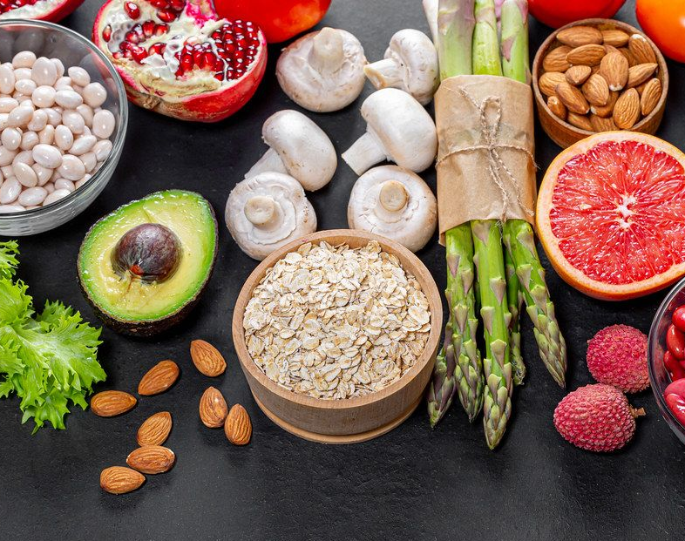
Calculating Mealtime Insulin
Advanced Carbohydrate Counting: Carbs & Carb Ratios PLUS Blood Sugar & Correction Factors

Slide 4
Dietary Approaches: Carbohydrate Mgmt
Therapy | Dietary Approach
Nutrition therapy only or on meds excluding insulin or insulin secretagogues | Consider reducing overall carb intake, portion sizes, simplified meal plan, plate method, or carb counting
Fixed insulin doses or insulin secretagogues | Educate on carbohydrate consistency with respect to time, amount & insulin action. Consider tools like carbohydrate counting or choices, plate method, simplified meal plan, or food lists
Flexible insulin therapy | Educate on advanced carbohydrate counting & using an insulin-to-carb ratio.
Franz, M. J., MacLeod, J., Evert, A., Brown, C., Gradwell, E., Handu, D., Reppert, A., & Robinson, M. (2017). Academy of Nutrition and Dietetics Nutrition practice guideline for type 1 and type 2 diabetes in adults: Systematic review of evidence for medical nutrition therapy effectiveness and recommendations for integration into the Nutrition Care Process. Journal of the Academy of Nutrition and Dietetics, 117(10), 1659–1679. https://doi.org/10.1016/j.jand.2017.03.022
Notes:
The previous strategies we discussed may assist you in guiding the PWD who is using dietary modifications, oral meds, or fixed insulin doses.
Now we are going to move into calculating meal time insulin for those who are on flexible insulin therapy. This will combine carb counting with use of an insulin to carb ratio, and we will also get into how to lower elevated blood sugars using a sensitivity factor.
Patients using multiple daily injection therapy: This consists of injecting basal insulin one to two times per day and bolus insulin at meals. Advanced carbohydrate counting is best suited for this therapy since bolus insulin can be adjusted based on carbohydrate intake to maximize postmeal blood glucose management.
• Patients willing to quantify their food intake: Patients must count the total carbohydrate grams or carbohydrate choices eaten to dose their mealtime insulin adequately. Whether they count carbohydrate grams or choices is a matter of choice and at the educator’s discretion.
• Patients using insulin pump therapy: Insulin pumps are designed to closely mimic normal pancreatic function. A three-day reservoir houses rapid-acting insulin that’s delivered as basal and bolus. Basal is a constant infusion delivered 24 hours per day to mimic pancreatic basal insulin secretion. Bolus is given as needed or on demand in response to meals or to correct high blood glucose. The pump is programmed with the individual’s ICR; the patient inputs the amount of carbohydrates eaten, and the pump calculates the bolus.
• Patients who can perform basic math skills: Individuals not using insulin pump therapy must calculate their bolus using their ICR. While those with poor math skills or who are intimidated by math can be taught to identify larger carb vs. smaller carb meals and inject predetermined bolus doses accordingly, this isn’t an optimal approach and should be used at the educator’s discretion after assessing patients’ skills and abilities.
• Patients willing to check blood glucose before and after meals: A premeal blood glucose reading is necessary to determine whether additional insulin should be added to the bolus to cover premeal blood glucose excursions using a sensitivity factor (SF). Initially after starting advanced carbohydrate counting, blood glucose readings are taken following a meal (about two hours after) to assess the ICR. As the ICR is determined to be correct, postmeal readings can then be taken periodically as needed.

Slide 5



Advanced Carb Counting:
Calculating Mealtime Insulin
Carb counting and using an insulin-to-carb ratio (ICR)
  Can be used with flexible insulin therapy, including MDI and CSII, where bolus insulin is used at mealtimes
Pros | Cons
Flexibility for the PWD Insulin/food matched precisely = improved BGs | Can lose sight of overall nutritional quality Requires math skills Fine tuning needed
Notes:
Carb counting can be used with flexible insulin therapy, including MDI and CSII, where bolus insulin is used at mealtimes
Pros
Flexibility for the PWD
Insulin/food matched precisely = improved BGs
Cons
It is easy to lose sight of overall nutritional quality
Requires not only basic carbohydrate counting knowledge but also understanding of insulin actions.

Slide 6
Calculating Mealtime Insulin
To calculate mealtime insulin, you will need the following pieces of information:
  Total grams of carbohydrate being eaten
  Carbohydrate ratio (ICR)
  Current BG
  Target BG
  Insulin sensitivity factor (ISF)
  Total Bolus ＝ food bolus + correction bolus
Food Bolus
Correction Bolus
Notes:
To calculate mealtime insulin using this method, you will need the following pieces of information: (ADVANCE)
** We are going to go through the calculation for the food bolus first, then the correction bolus afterwards***
To get the total bolus, we then add the two doses together

Slide 7
Calculating Mealtime Insulin
Insulin to Carb Ratio (ICR): how many grams of carb are “covered” by 1 unit of insulin.
  For example, a 1-unit-per-10-grams-of-carb (1:10) ratio ＝ 1 unit of insulin will “cover” 10 grams of carb
  ICRs are personalized based on insulin sensitivity
Use this formula to calculate the amount of insulin needed for carbs:
Food Bolus
# of units of insulin required to cover carbs
Total carbs (g) =
ICR
Notes:
Calculations used to determine need: 350-500*/Total Daily Dose (TDD) = ICR)
*Rule of 450 and 500 are most common, lower are used in AID therapies.

Slide 8
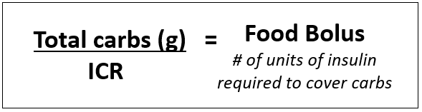
Calculating Mealtime Insulin
Example: VW needs to take Novolog, using an insulin pen, for a meal that has 86 grams of carbohydrate. The insulin to carb ratio is 1:8.
How many units of insulin are needed to cover food?
86 grams of carb ÷ 8
= 10.75 units of insulin

Slide 9
Calculating Mealtime Insulin
Insulin sensitivity factor (ISF) or Correction Factor (CF): specifies how far a unit of bolus insulin will lower glucose
  For example, a 1-unit-per-50 mg/dl (1:50) factor ＝ 1 unit of insulin will lower the glucose by 50 mg/dl.
  Based on personalized insulin sensitivity.
  Use the following formula to calculate amount of insulin to lower BG/SG* to goal:
(Current BG – Goal BG) =
ISF
Correction Bolus
# of units of insulin required to bring glucose to goal

Slide 10
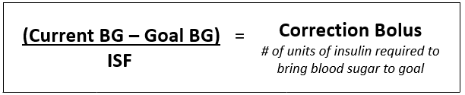
Calculating Mealtime Insulin
Example: VW checks their glucose and it is 280 mg/dl. Target glucose is 120 mg/dl. ISF is 1:40. How many units of insulin are needed to lower for “correction” to lower glucose to target?
(280 mg/dl – 120 mg/dl)
40
= 4.0 units of insulin

Slide 11
Calculating Mealtime Insulin
Food Bolus | Correction Bolus | Total Bolus
VW takes Novolog for a meal that has 86 grams of carbohydrate. The insulin to carb ratio is 1:8 | VW glucose is 280 mg/dl before the meal. Target glucose is 120 mg/dl. ISF is 1:40. | Add the food bolus and correction bolus to get the total
10.75 units | 4.0 units | 14.75 units
Since VW is using an insulin pen…
15 units
*Ideally take 15 minutes before eating,
with Regular Insulin 30 minutes before eating.

Slide 12
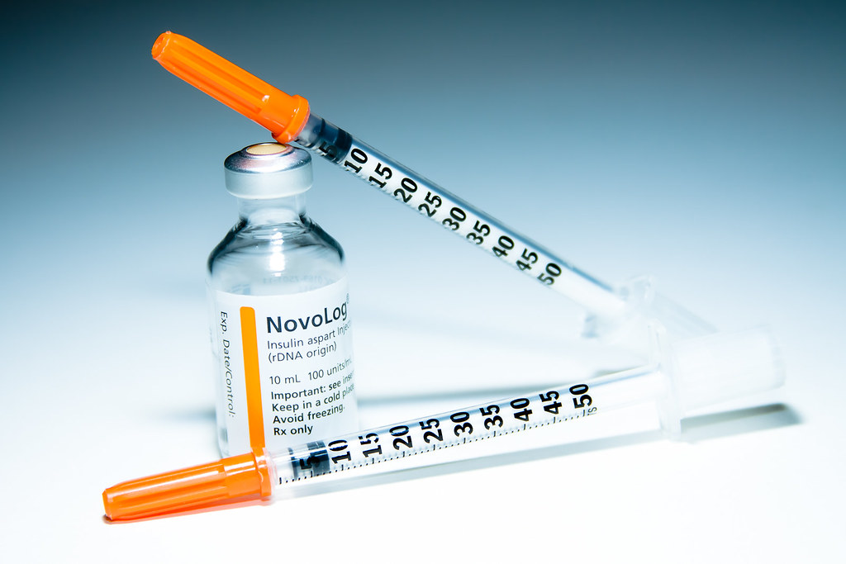
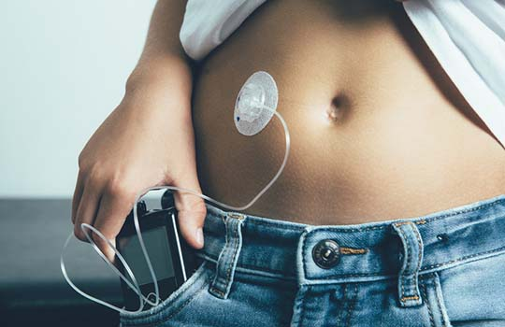
Calculating Mealtime Insulin
On the exam, round your final answer when using an insulin pen or syringe
  Round up to nearest whole unit if ≥ 0.5
  Round down to nearest whole unit if ≤ 0.4
On the exam, is ok to use decimal places if PWD uses CSII
In real life, consider:
  Insulin sensitivity
  Starting blood sugar/glucose
  What’s happening: exercise, alcohol, stress, illness
Notes:
On the exam, round your final answer when using an insulin pen or syringe
Round up to nearest whole unit if ≥ 0.5
Round down to nearest whole unit if ≤ 0.4
If a PWD is utilizing an insulin pump it is ok to use decimal places
In real life, consider:
Insulin sensitivity
Starting blood sugar (rounding up if starting blood sugar is above goal or down if starting blood sugar is below goal)
What’s happening next (round down if activity is expected or up if planning to be sedentary or if glucose elevated due to stress)

Slide 13

Flexible Insulin Therapy: T1 DM & Mixed Meals
Insulin in Mixed Meals (Carb + Fat/Protein)
Insulin needs not just based on carbs- protein & fat matter
High-fat/protein meals may require:
  More insulin
  Adjustment of timing
Monitor and individualize:
  Affect of protein/fat differ widely in individuals.
  Use CSII split-bolus, if available (Start 50/50% - modify)
  Check glucose 3 hours after
Research is ongoing: Optimal strategies vary.
  No formal ADA recommendation
*American Diabetes Association Professional Practice Committee for Diabetes*; 5. Facilitating Positive Health Behaviors and Well-being to Improve Health Outcomes: Standards of Care in Diabetes—2026. Diabetes Care 1 January 2026; 49 (Supplement_1): S89–S131
.
Notes:
Historically, the focus in type 1 diabetes has been to count carbs and match insulin to carb intake only, without considering the other macronutrients. Since 2022 it is been recommended those on MDI receive education on how carbs, fat and protein impact blood sugar.
acknowledging that high fat and/or high protein meals may impact the post prandial glucose response in a significant way and require more insulin.
I want to briefly review some of the thoughts behind how fat and protein impact blood sugar and then talk about strategies to deal with it when counseling individuals with type 1 diabetes.
Lets talk about fat, first:
Fat is very slow to digest relative to carbohydrate alone. When mixed with carb, it may delay the digestion and absorption of the carb to glucose. Also, free-fatty acids may induce insulin resistance, ultimately leading the person with diabetes to need more insulin. There might also be more gluconeogenesis later (and if you’re not remembering from biochemistry, I’ll remind you that gluconeogenesis is when the liver makes glucose from other sources)
Because of these factors, when research looks at the blood sugar levels in someone with diabetes following a meal higher fat meal, it was noted that:
Blood sugars are reduced in the first 2–3 h
Then this is often followed by: Hyperglycemia, which occurs later in the post-prandial period and can last for several hours, some research shows as long as 5-8 hours afterwards.
The impact appears to be dose dependent; so more dietary fat = more hyperglycemia later.
Lets now talk about protein:
After protein is digested and absorbed into the body, the amino acids can be converted into glucose. This takes some time to occur, so we may see a rise in glucose levels later in the post-prandial period. In fact, the research looking at this shows that blood glucose levels may rise between 100 minutes and 4 hours after the meal.
The extent to which this occurs appears to depend on the amount of protein consumed. More protein means more of a rise later-on. The effect also changes depending on how much carb is consumed with the protein.
So that’s some of the science behind fat and protein metabolism. While the research providing us with this information is strong, and the standards recommend that we educate on this topic, they also note that more research is needed. There is no consensus on optimal dosing strategies to address this.
If you do some reading online, there are a multitude of strategies that you may see, but none have been formally endorsed by ADA.
At our clinic, we do our best to address this issue despite the lack of formal advice. In counseling people with type 1 diabetes:
I always start by learning about how the person with diabetes eats. This helps to steer the conversation. Our discussion varies depending on whether the person follows a diet that is more balanced with carb/fat/protein vs if someone follows a lower carb diet.
For the person who follows a more balanced diet, my strategy is to:
Educate and focus on carbohydrate counting, using a ICR, and dosing accordingly. This will work for the majority of meals.
After that… then we talk fat and protein.
I acknowledge that fat and protein do impact blood sugar
I then go through examples of high fat and high protein meals that might cause this. Examples might include foods like pizza, fried chicken or steak with mashed potatoes and gravy, or a burger with fries and a milk shake, etc.
At this point we go through practical advice about how to approach these meals.
3) The person with diabetes can split doses for meals like this; basically, count the carbs and determine the dose for the carbs. Then, administer the insulin with special consideration to timing.
MDI: half at start of meal, half 1 hour later- we can increase the dose 20-35% based on previous patterns)
Pump: extended doses with ~50/50 split over 1-2.5 hours
4) Encourage monitoring glucose levels in the hours after the meal; administer a correction dose of insulin if needed.
We use this particular strategy of correcting after the fact because much of the available research on other strategies, where additional insulin is taken earlier, shows more hypoglycemia. Plus, the calculations can also be complicated.
For individuals following low carb diets, other strategies may be necessary.
I’ve found more of these individuals’ dose their insulin from “experience” rather than using a strategy that involves carb counting or use of an ICR. They also may benefit from dosing later – like at the start of the meal or a little after.
Up regular of amino acids conversion and type of protein does appear to make a big difference.

Slide 14

Knowledge Check: Poll Question #10
Sam is going to eat the following breakfast: A whole english muffin, 2 scrambled eggs with 1 oz cheese, ½ a large banana, and an 8 oz. glass of 1% milk. Using the exchange list, how many grams of carbohydrate are in the breakfast meal?
  42g
  57g
  60g
  72g
Notes:
SHOW BREAKFAST
Answer B

Slide 15
Knowledge Check: Answered
Food | Amount | Carbs (g)
English muffin | 1 whole | 15 x 2 = 30
Eggs, scrambled | 2 | 0 x 2 = 0
Cheese | 1 oz. | 0 x 1 = 0
Banana, large | ½ | 15 x 1 = 15
Milk, 1% | 8 oz. | 12 x 1 = 12
Total 57g

Slide 16
Knowledge Check – Continued - Poll #11
Before the meal Sam’s sensor glucose reads 298 mg/dl. The target is 150 mg/dl. How much Humalog insulin is need to take by syringe if the carb ratio is 1:12 and correction factor is 1:60?
7 units
7.2 units
8 units
9.7 units
10 units
Reminder: Total Carbs consumed is 57 grams
Notes:
Answer A
Give longer for this calcuation

Slide 17



Knowledge Check - Answered
Calculate the food dose
  Total Carbs: 57g
  ICR: 1:12
Calculate the correction dose
  Current sensor glucose: 298 mg/dl
  Target glucose: 150 mg/dl
  ISF: 1:60
  +
57g ÷ 12
=
4.75 units
=
2.46 units
60

Slide 18
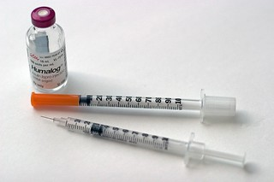
Knowledge Check - Answered
Sam will need: 4.75 units + 2.46 units = 7.21 units
  = 7 units
*Remember: Since Sam is injecting insulin with a syringe, dosing will be based on whole units of insulin

Slide 19
Knowledge Check: Poll Question #13
Ari has T2DM managed with lifestyle. A typical weekday breakfast is 2 eggs, 2 slices turkey bacon,1 slice WW toast with margarine, and ½ cup apple juice. During the week, the 2-hour post-prandial BG generally runs < 140. However on weekends, after a breakfast consisting of 1 English muffin with margarine, ½ banana, and 1 cup skim milk, 2-hour post-prandial BG generally runs higher. Why?
Breakfast carbohydrate intake is higher on the weekend
Breakfast carbohydrate intake is lower on the weekend
Physical activity is likely lower on the weekend
Variation in meal timing is contributing to glucose variation

Slide 20
Advanced Carb Counting:
Calculating Mealtime Insulin
Carb counting and using an insulin-to-carb ratio (ICR)
  Can be used with flexible insulin therapy, including MDI and CSII, where bolus insulin is used at mealtimes
  Insulin dose is based on consumed carbohydrate.
Pros | Cons
Flexibility for the PWD Carb consumed/Amt of Insulin matched = improved BGs | Can lose sight of overall nutritional quality Requires math skills Fine tuning needed
Notes:
Carb counting can be used with flexible insulin therapy, including MDI and CSII, where bolus insulin is used at mealtimes
Pros
Flexibility for the PWD
Insulin/food matched precisely = improved BGs
Cons
It is easy to lose sight of overall nutritional quality
Requires not only basic carbohydrate counting knowledge but also understanding of insulin actions.

Slide 21
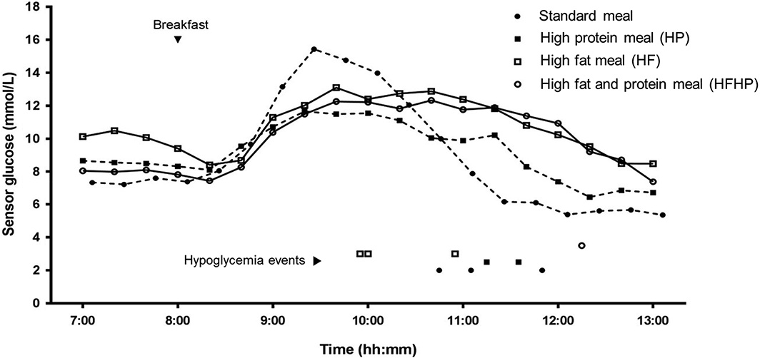
Glucose Trends in T1 DM &
Mixed Meals
3 hrs
5 hrs
Figure 1. Postprandial glucose profile (median sensor glucose and hypoglycaemic events) in the 5 hours following a standardized meal with either carbohydrate‐only (standard) or with added fat (HF), protein (HP) or both (HFHP)
Gingras V, et al. Diabetes Obes Metab. 2018 Nov;20(11):2695-2699.
Notes:
Mixed Meals have different impacts on glucose trends.
Fat is very slow to digest relative to carbohydrate alone. When mixed with carb, it may delay the digestion and absorption of the carb to glucose. Also, free-fatty acids may induce insulin resistance, ultimately leading the person with diabetes to need more insulin. There might also be more gluconeogenesis later (and if you’re not remembering from biochemistry, I’ll remind you that gluconeogenesis is when the liver makes glucose from other sources)
Because of these factors, when research looks at the blood sugar levels in someone with diabetes following a meal higher fat meal, it was noted that:
Blood sugars are reduced in the first 2–3 h
Then this is often followed by: Hyperglycemia, which occurs later in the post-prandial period and can last for several hours, some research shows as long as 5-8 hours afterwards.
The impact appears to be dose dependent; so more dietary fat = more hyperglycemia later.
Lets now talk about protein:
After protein is digested and absorbed into the body, the amino acids can be converted into glucose. This takes some time to occur, so we may see a rise in glucose levels later in the post-prandial period. In fact, the research looking at this shows that blood glucose levels may rise between 100 minutes and 4 hours after the meal.
The extent to which this occurs appears to depend on the amount of protein consumed. More protein means more of a rise later-on. The effect also changes depending on how much carb is consumed with the protein.

Slide 22
Flexible Insulin Therapy:
T1 DM & Mixed Meals
Insulin in Mixed Meals (Carb + Fat/Protein)
Insulin needs not just based on carbs - protein & fat matter
High-fat/protein meals may require:
  ↑ total dose
  Adjustment of timing (dual wave if on CSII)
Monitor and individualize:
  Affect of protein/fat differ widely in individuals.
  Use CSII split-bolus, if available (Start 50/50% - modify)
  Check glucose 3 hours after
Research is ongoing: Optimal strategies vary.
  No formal ADA recommendation
American Diabetes Association Professional Practice Committee for Diabetes*; 5. Facilitating Positive Health Behaviors and Well-being to Improve Health Outcomes: Standards of Care in Diabetes—2026. Diabetes Care 1 January 2026; 49 (Supplement_1): S89–S131
Notes:
Historically, the focus in type 1 diabetes has been to count carbs and match insulin to carb intake only, without considering the other macronutrients. Since 2022 it is been recommended those on MDI receive education on how carbs, fat and protein impact blood sugar.
acknowledging that high fat and/or high protein meals may impact the post prandial glucose response in a significant way and require more insulin.
I want to briefly review some of the thoughts behind how fat and protein impact blood sugar and then talk about strategies to deal with it when counseling individuals with type 1 diabetes.
So that’s some of the science behind fat and protein metabolism. While the research providing us with this information is strong, and the standards recommend that we educate on this topic, they also note that more research is needed. There is no consensus on optimal dosing strategies to address this.
If you do some reading online, there are a multitude of strategies that you may see, but none have been formally endorsed by ADA.
At our clinic, we do our best to address this issue despite the lack of formal advice. In counseling people with type 1 diabetes:
I always start by learning about how the person with diabetes eats. This helps to steer the conversation. Our discussion varies depending on whether the person follows a diet that is more balanced with carb/fat/protein vs if someone follows a lower carb diet.
For the person who follows a more balanced diet, my strategy is to:
Educate and focus on carbohydrate counting, using a ICR, and dosing accordingly. This will work for the majority of meals.
After that… then we talk fat and protein.
I acknowledge that fat and protein do impact blood sugar
I then go through examples of high fat and high protein meals that might cause this. Examples might include foods like pizza, fried chicken or steak with mashed potatoes and gravy, or a burger with fries and a milk shake, etc.
At this point we go through practical advice about how to approach these meals.
3) The person with diabetes can split doses for meals like this; basically, count the carbs and determine the dose for the carbs. Then, administer the insulin with special consideration to timing.
MDI: half at start of meal, half 1 hour later- we can increase the dose 20-35% based on previous patterns)
Pump: extended doses with ~50/50 split over 1-2.5 hours
4) Encourage monitoring glucose levels in the hours after the meal; administer a correction dose of insulin if needed.
We use this particular strategy of correcting after the fact because much of the available research on other strategies, where additional insulin is taken earlier, shows more hypoglycemia. Plus, the calculations can also be complicated.
For individuals following low carb diets, other strategies may be necessary.
I’ve found more of these individuals’ dose their insulin from “experience” rather than using a strategy that involves carb counting or use of an ICR. They also may benefit from dosing later – like at the start of the meal or a little after.
Up regular of amino acids conversion and type of protein does appear to make a big difference.

Slide 23
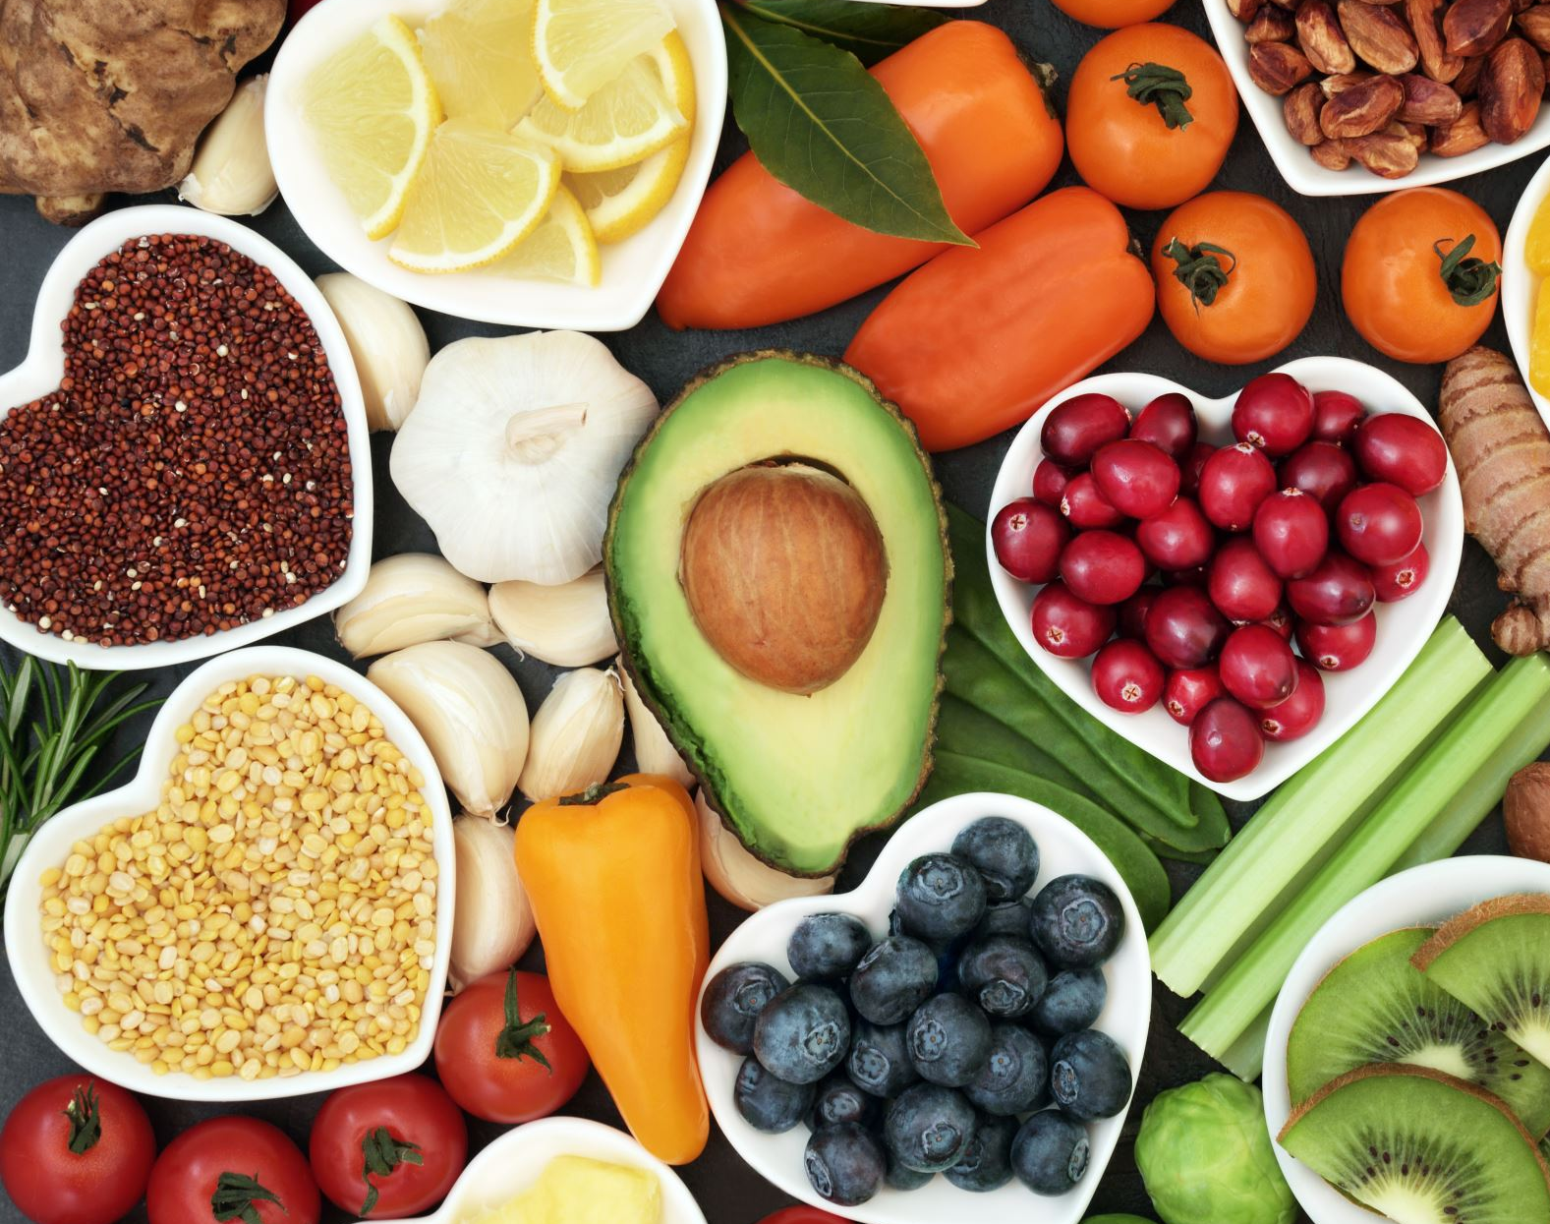
“The goal isn't to give people more nutrition rules.
Our role is to translate the evidence into care that is practical, personal, and possible.”
ADA Standards of Care, 2026

Slide 24

Case Study

Slide 25
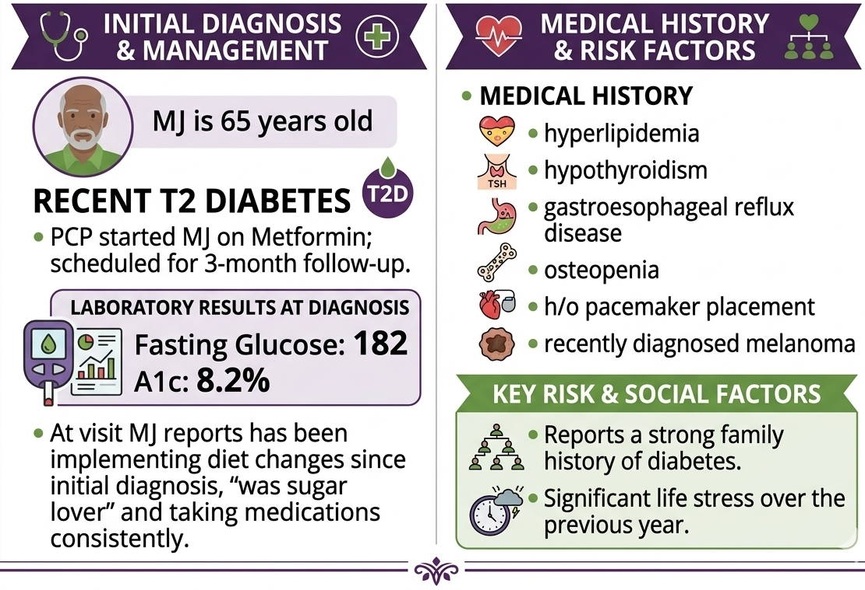
MJ Case Study
Medical history:
hyperlipidemia, hypothyroidism, gastroesophageal reflux disease, osteopenia, h/o pacemaker placement, and recently diagnosed melanoma.
Reports a strong family history of diabetes. Significant life stress over the previous year.
MJ is 65 years old with recent T2 Diabetes. PCP started MJ on Metformin and scheduled for 3-month follow-up.
Fasting glucose: 182
A1c: 8.2% at time of diagnosis.
At visit MJ reports has been implementing diet changes since initial diagnosis, “was sugar lover” and taking medications consistently.

Slide 26
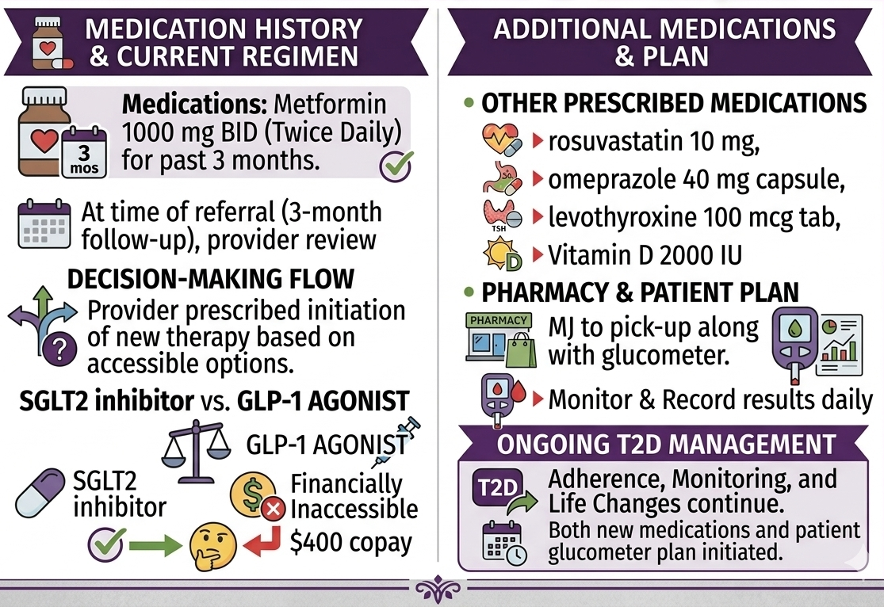
MJ Case Study: Medications
Medications: Metformin 1000 mg BID for past 3 months.
At time of referral (3 month follow-up), provider prescribed initiation of an SGLT2 inhibitor because a GLP-1 was financially inaccessible, ($400 copay.)
Both options were prescribed and MJ to pick-up along with glucometer.
Other:
rosuvastatin 10 mg,
omeprazole 40 mg capsule,
levothyroxine 100 mcg tab,
Vitamin D 2000 IU

Slide 27
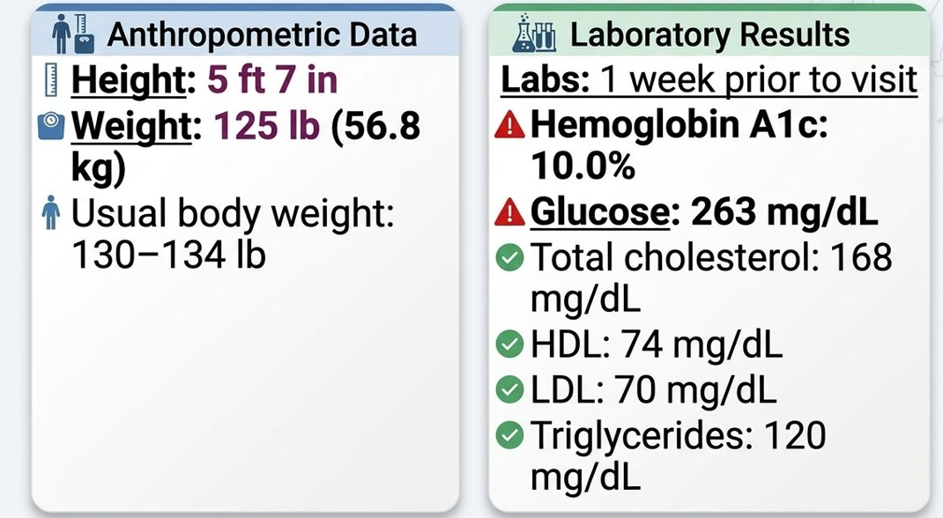
Physical and Labs
Anthropometric:
Height: 5 ft 7 in
Weight: 125 lb (56.8 kg)
Usual body weight: 130–134 lb
Labs: 1 week prior to visit.
Hemoglobin A1c: 10.0%
Glucose: 263 mg/dL
Total cholesterol: 168 mg/dL
HDL: 74 mg/dL
LDL: 70 mg/dL
Triglycerides: 120 mg/dL

Slide 28
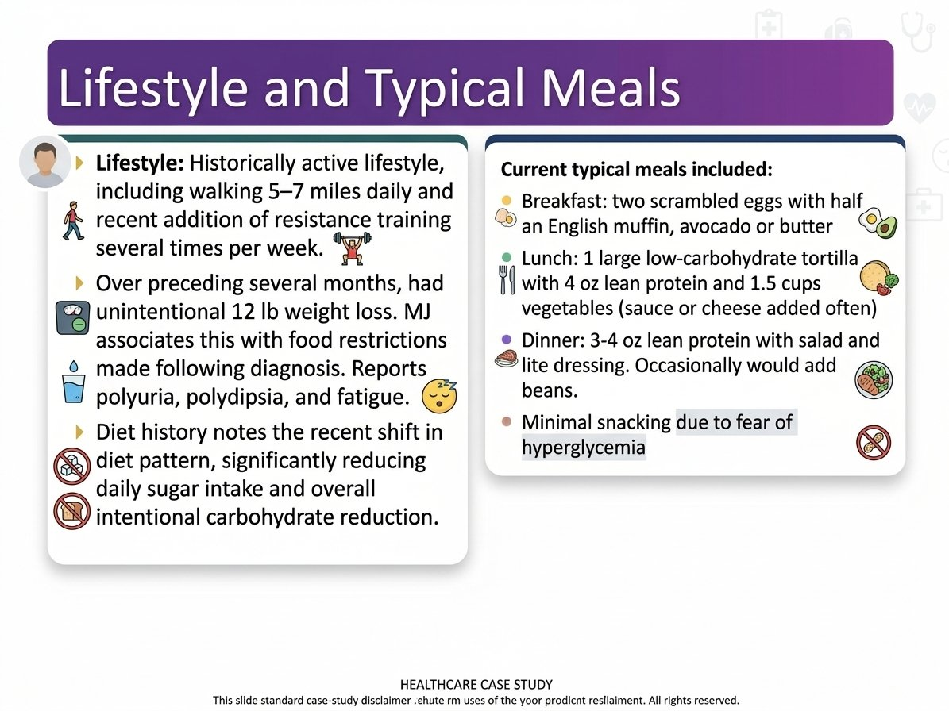
Lifestyle and Typical Meals
Lifestyle: Historically active lifestyle, including walking 5–7 miles daily and recent addition of resistance training several times per week.
Over preceding several months, had unintentional 12 lb weight loss. MJ associates this with food restrictions made following diagnosis. Reports polyuria, polydipsia, and fatigue.
Diet history notes the recent shift in diet pattern, significantly reducing daily sugar intake and overall intentional carbohydrate reduction.
Current typical meals included:
Breakfast: two scrambled eggs with half an English muffin, avocado or butter
Lunch: 1 large low-carbohydrate tortilla with 4 oz lean protein and 1.5 cups vegetables (sauce or cheese added often)
Dinner: 3-4 oz lean protein with salad and lite dressing. Occasionally would add beans.
Minimal snacking due to fear of hyperglycemia

Slide 29
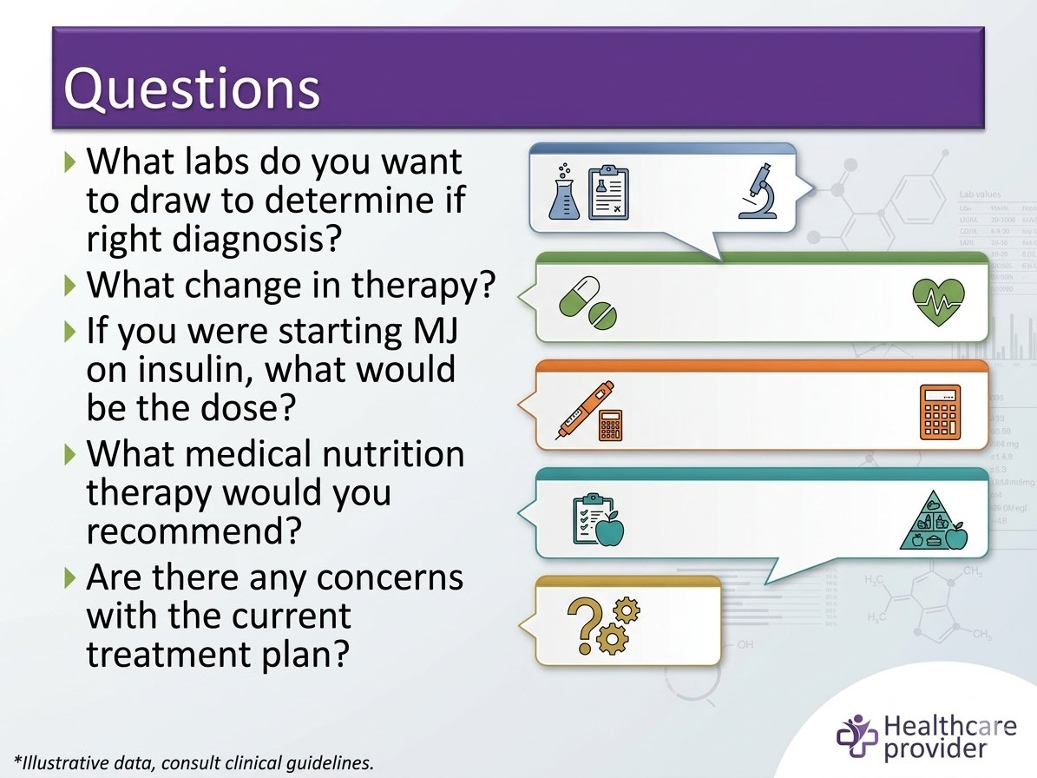
Questions
What labs do you want to draw to determine if right diagnosis?
What change in therapy?
If you were starting MJ on insulin, what would be the dose?
What medical nutrition therapy would you recommend?
Are there any concerns with the current treatment plan?

Slide 30
Questions & Answers
GADA, IAA, ZnT8A, IA-2A
What labs do you want to draw to determine if right diagnosis?
What change in therapy?
If you were starting MJ on insulin, what would be the dose?
What medical nutrition therapy would you recommend?
Are there any concerns with the current treatment plan?
Start on Basal Bolus Therapy
56kg x 0.5 = 28 units
14 basal & ~4-5 units ac
Discuss fears around food, consider incorporating carbs to match with insulin.
Stop Metformin, SGLT-2, See Endo, CGM/Ketones & connect with diabetes education team.

Slide 31
Healing through Connection for Healthcare Professionals
Beverly Thomassian, RN, MPH, CDCES, BC-ADM
Pronouns: she, her and hers
President & Founder – Diabetes Education Services
www.DiabetesEd.net

Slide 32

Diabetes Visit – What do you think?
How Does JR Feel?
JR arrives at the clinic and says they are injecting their basal insulin 5 times a week.
HCP says “If you don’t inject your insulin everyday, you are going to get complications.” (Door closed)
Defeated
Embarrassed
Ashamed
Angry
Hurt
How does the HCP feel?

Slide 33

Diabetes Visit – Let’s Go through
How Does JR Feel?
JR arrives at the clinic and says they are injecting their basal insulin 5 times a week.
HCP says “If you don’t inject your insulin everyday, you are going to get complications.” (Door closed)
HCP smiles and says, “Hi JR, how are you doing? I heard you are taking your insulin on most days. Great job. What’s going on on the other days?”
Door Open – Connection made
Reassured
Heard & Seen
Recognized
Confident
Connected
How does the HCP feel?
A small adjustment can make a BIG Difference
Healing to HCP
Bidirectional Healing
Healing to Person

Slide 34

Missed Appointments due to Stigma and Shame
A recent survey of over 2,600 people with diabetes across eight countries revealed that nearly 40% of missed doctor’s appointments are due to stigma or shame.
Abbott. (2025, February 4). Abbott’s Above the Bias film reveals misconceptions can impact diabetes care. https://abbott. mediaroom.com/2025-02-04-Abbotts-Above-the-Bias-FilmReveals-Misconceptions-Can-Impact-Diabetes-Care
Notes:
Many healthcare professionals incorrectly assume that people with
diabetes are not reaching their goals due to a lack of effort. If they
“just tried hard enough,” they could reach the recommended timein-range target. Unfortunately, this false belief can build a wall of
misunderstanding between the HCP and the person with diabetes

Slide 35

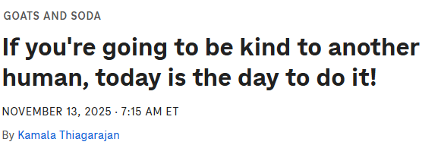
Kindness is Healing for both the Receiver & Giver
https://www.npr.org/sections/goats-and-soda/2025/11/13/g-s1-97432/world-kindness-day-kind-compassion-empathy

Slide 36
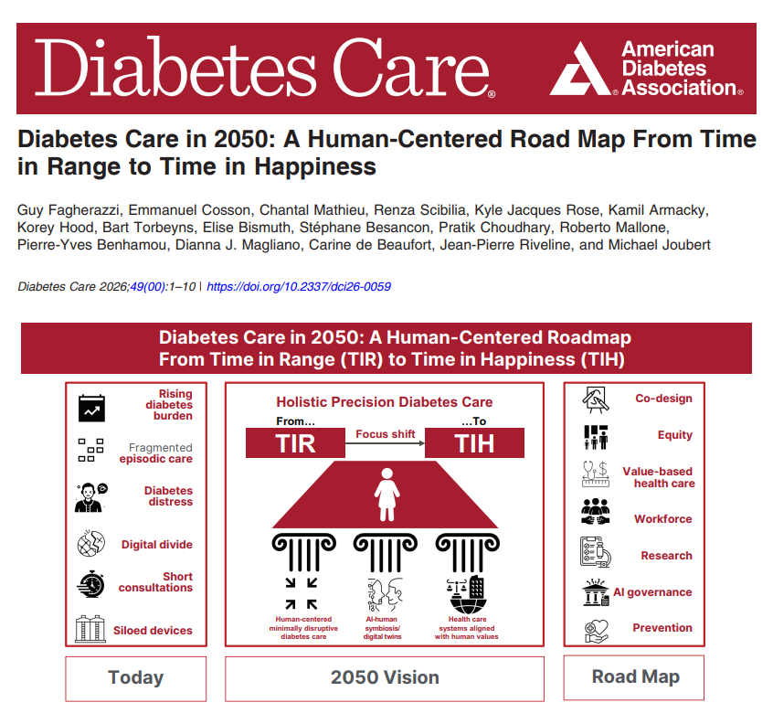



Camille at Nerdabetic
Instagram: / nerdabetic
Twitter: / nerdabetic
“Before you ask me about Time in Range, please ask:
How are you?
What can I help you with?

Slide 37
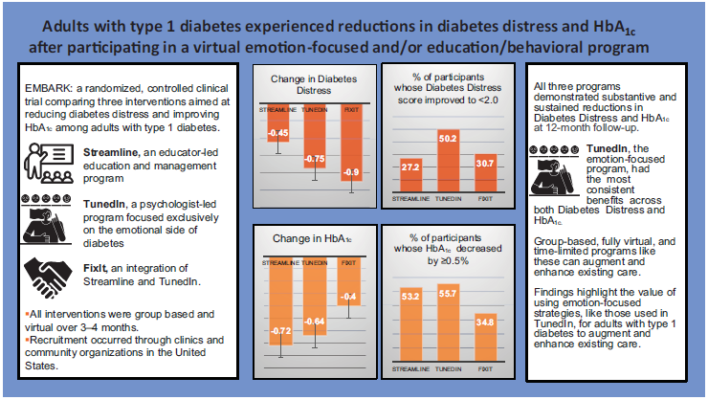
EMBARK Trial
EMBARK: A Randomized, Controlled Trial Comparing Three Approaches to Reducing Diabetes Distress and Improving HbA_{1c} in Adults With Type 1 Diabetes. Diabetes Care 2024; dc232452. https://doi.org/10.2337/dc23-2452

Slide 38

Embark Trial – Emotions as Priority
I have finally given myself permission to make addressing the emotional aspects of diabetes a priority.
~Coach Beverly

Slide 39


The ABCs of Creating a Judgement Free Connection
“Out beyond ideas of wrongdoing and right doing, there is a field. I’ll meet you there.”
-Rumi

Slide 40



ABC’s of Diabetes Care and Education
and Healing Through Connection

Slide 41

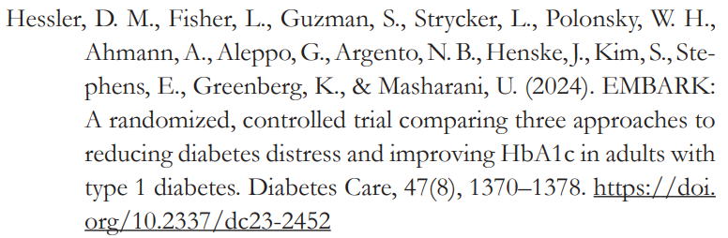
Ask, “How are you doing/feeling?”
Ask, “What is most difficult about your diabetes right now?
Ask about their life (SDOH)
Assess current self-management behaviors
Assess your feelings
Accept without judgement
Acknowledge one thing they are doing right
Advocate for needed resources

Slide 42

Commit to Listening at least Half of the Time

Slide 43

Fishing Trip Question

Slide 44
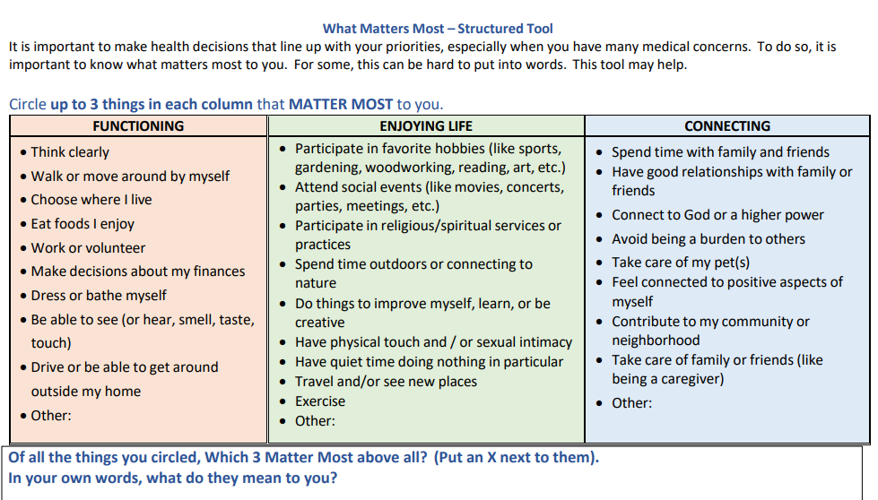
What Matters Most to YOU?
Moye J, Driver JA, Owsiany MT, Chen LQ, Whitley JC, Auguste EJ, Paik JM. Assessing What Matters Most in Older Adults With Multicomplexity. Gerontologist. 2022 Apr 20;62(4):e224-e234. doi: 10.1093/geront/gnab071. PMID: 34043004; PMCID: PMC8982330.

Slide 45

Beliefs about health and diabetes
Barriers can be confused with non-compliance
Burnout lookout. On extended diabetes vacation due to diabetes distress?
Bouncing back – leaning into resilience

Slide 46
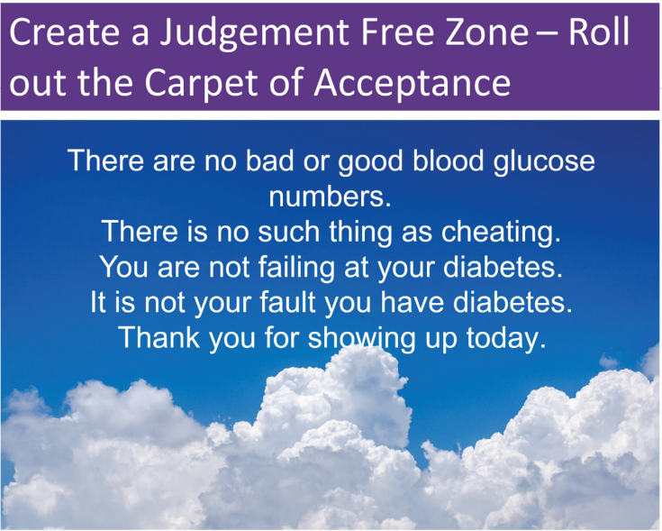

Slide 47

Having the Conversation - Curiosity
Coaching that highlights their knowledge and resilience.
Carrots – problem solve together and dig for solutions that are meaningful in everyday life.
Compassion for the people in our care and ourselves.
Connection through – opening the door.

Slide 48


To My Healthcare Professional Colleagues
It’s about Presence
This is not about Perfection!

Slide 49

Healing the Healer
“The work of healing requires that we bring our full selves – messy, tired, hopeful, broken and brave – to the table.”
- adrienne maree brown

Slide 50


Our Curiosity Makes a Difference
What is something you would like me to know about you?

Slide 51

Considering the Diabetes Connection as a Sacred “I see you” Space
Listening to stories isn’t simply an exchange of information; it’s an invitation into someone’s lived experience.
When we truly listen, with presence and without judgment, we enter a sacred space within diabetes care.
In these moments, connection becomes the medicine. The person receiving care feels seen, heard, and valued.
And something extraordinary happens for us as HCPs, too. We feel reconnected to our humanity.
Thomassian, B. (2025). Healing through Connection for Healthcare Professionals: Stories and wisdom from the heart of a diabetes nurse.

Slide 52

Healing trough Creativity & Connection
“Each of us is a creative being. Whether or not we recognize it, we all have the potential to bring beauty, meaning, and healing into the world.”
-Julia Cameron

Slide 53

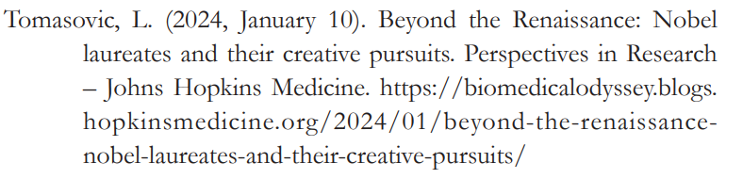
Creativity & Nobel Prizes
Scientists who are Nobel laureates are:
22 times more likely than typical scientists to perform, sing, or act in their spare time
12 times more likely to write fiction, plays, poetry, or short stories
5 times more likely to engage in crafting, woodworking, mechanics, or glassblowing
7 times more likely to enjoy designing, painting, drawing, or sculpting
They are more open to novel experiences and often turn to their creative endeavors when working through challenges.

Slide 54
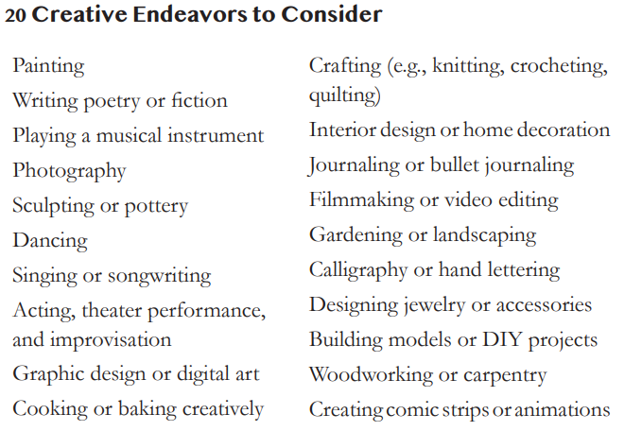
What creative endeavors could you engage in?

Slide 55

Homework
If you had 5 other lives to live, what would you do in each of them?
The point of these lives is to have fun in them – more fun than you might be having in this one.
Look over your list and select one.
Then do it this week.

Slide 56

Notes from Coach Beverly
Take the risk. Say yes.
Try that thing you’ve been putting off.
Love your body exactly as it is.
Be bold. Step into your authenticity.
Make time to ReCreate!
Think with your heart. Surrender. Show up.
Move beyond your comfort zone and speak your truth.
Get enough sleep.
Ask for help when you need it.
Stay connected to the people who lift you up.
Seek out deep conversations, embrace your growth, and get ready for transformation.
Dive into creativity.

Slide 57


Thank You
Questions?
Email info@diabetesed.net
Web www.DiabetesEd.net
Phone 530-893-8635

