Slide 1


San Diego DiabetesEd Training Conference 2026 – Day 1
Day 1 October 22, 2026
www.DiabetesEd.net

Slide 2



Welcome Everyone
Class starts at 8:00am
Welcome!
DiabetesEd Training Conference
October 22 & 23rd
Celebrating 27 Years
Scan QR code for CDCES Coach App
Store open both days
Choose Team name
Get Book signed at 6:00pm
Dinner tonight at 6:30pm
Enjoy Breakfast & Beverages
Make yourself at home
Download CDCES Coach App for Resource page, Store & More

Slide 3
Land Acknowledgment
“We acknowledge that we are gathered on the traditional territory of the Kumeyaay Nation. We pay respect to their elders, both past and present, and acknowledge their enduring relationship to this land and their continuing sovereignty and cultural traditions in the San Diego community".

Slide 4


Our Virtual Customer Happiness Team!
Bryanna or Ashlie Sabourin
Director of Operations
Customer Happiness
If you have questions, You can chat with Ashlie or Bryanna. See envelope.

Slide 5



Keeping in Touch with You - Email

Slide 6
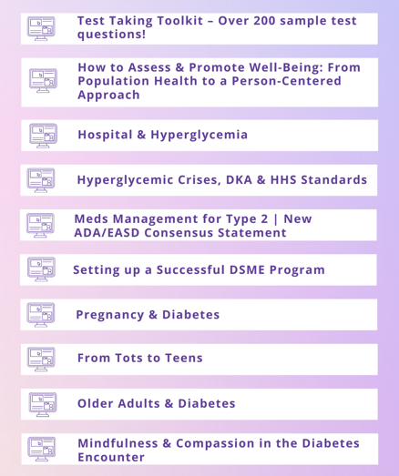
FREE Bonus Courses on Online University
We can’t cover it all in this live course.
So, we provide supplemental courses.
Now includes “Learning Theories made Easy”

Slide 7
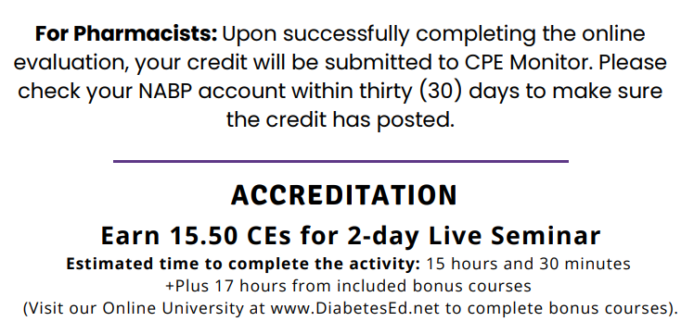



We Expanded our Certification
Joint Accreditation Statement
Nursing Continuing Professional Development
The maximum number of hours awarded for this Nursing Continuing Professional Development activity is 15.5 contact hours.
Pharmacy Continuing Education
Partners designates this continuing education activity for 15.5 contact hour(s) (1.5 CEUs) of the Accreditation Council for Pharmacy Education.
(Universal Activity Number - J JA4008073-9999-25-206-L01-P)
Type of Activity: Application
Dietitian Continuing Education
This program offers 15.5 CPEUs for dietitians.
In support of improving patient care, this activity has been planned and implemented by Partners for Advancing Clinical Education (Partners) and Diabetes Education Services. Partners is jointly accredited by the Accreditation Council for Continuing Medical Education (ACCME), the
Accreditation Council for Pharmacy Education (ACPE), and the American Nurses Credentialing Center (ANCC), to provide continuing education for the healthcare team.
Physician Continuing Education
Partners designates this live activity for a maximum of 15.5 AMA PRA Category 1 Credit(s)™. Physicians should claim only the credit commensurate with the extent of their participation in the activity.
Complete Eval at end of Day 2 to get CE Certificates

Slide 8



Slide 9
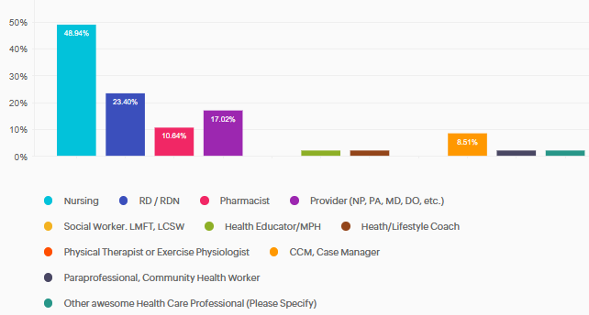
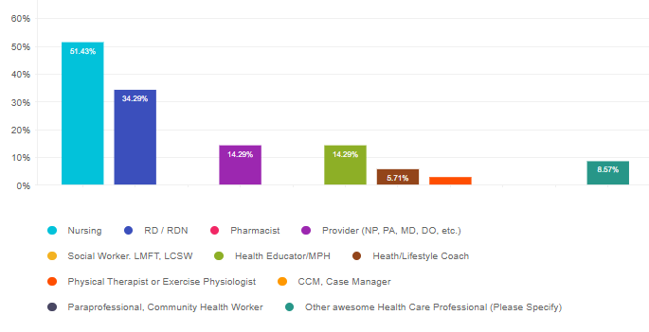
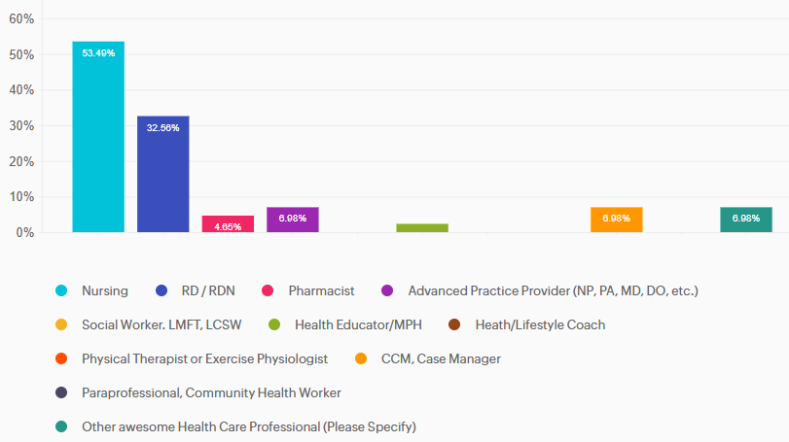
Who is attending this conference?
Other
Public Health Nurse
Social Worker, MSW
RN, CNM, CDCES

Slide 10
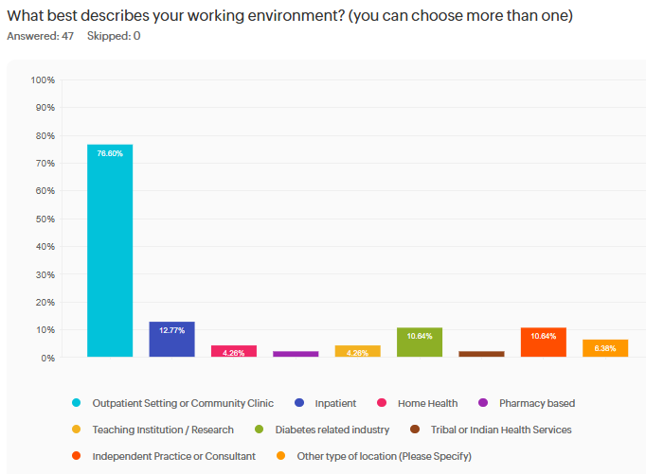
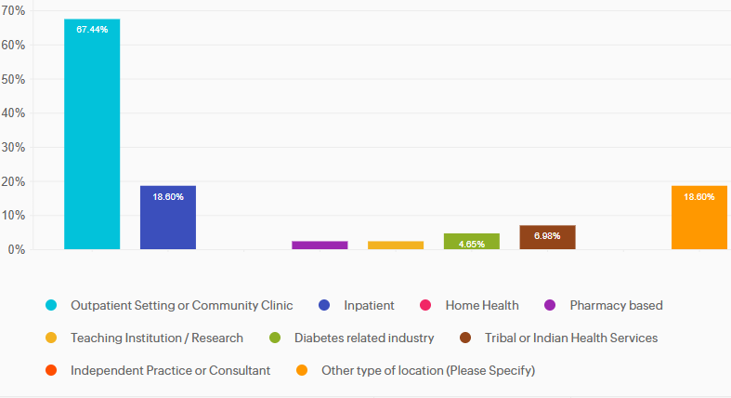
What is your job setting?
Other
Dialysis
External Case manager
Online MNT Provider
Boutique telehealth
Maternal Fetal Medicine
OmniPod Insulet Clinical Mgr
Health plan high risk preg care manager
Home telehealth remote monitoring

Slide 11
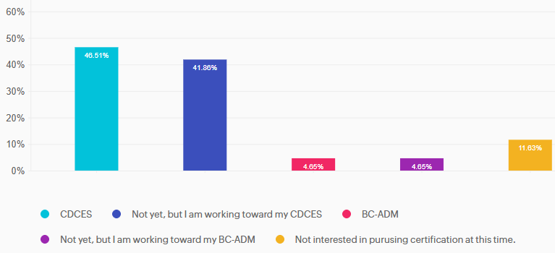
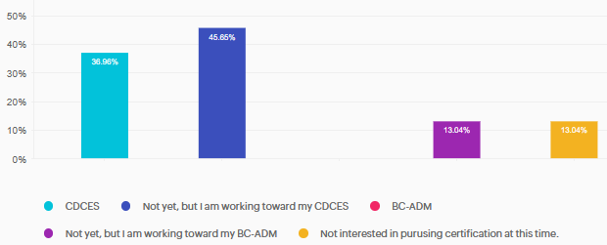
Certifications?

Slide 12
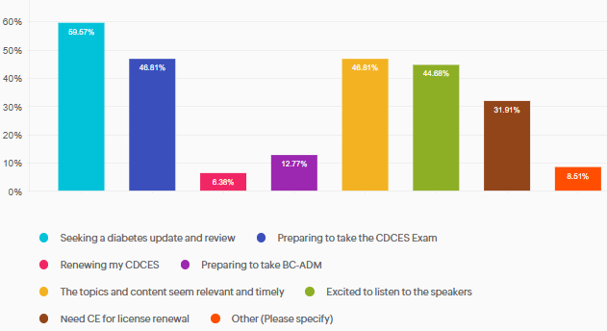
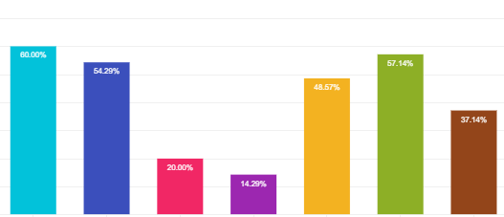
What motivated you to attend?
“Want to bring back info/updates to my inpatient diabetes educator team.”
“I am need of inspiration in order to update our clinic on DM care!”

Slide 13
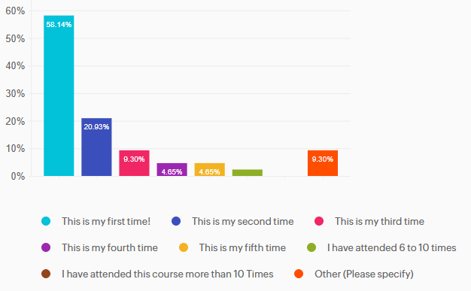
How Many Times Have You attended?
“Could not wait to see this in person.”
“3 Virtual Attendance.”
“6-10 times, I think.”

Slide 14


Thank you for Being a Part of This Awesome Community – Join Conference FB Page & Ad Pics

Slide 15

Important Stuff
Sign in each day please
Breakfast & lunch provided!
  Vegetarian options for those who requested
Green Envelope
  PocketCards, Sticker, Chat 411
Resource page has PDF of all Slides
Team Names & Quick Quizzes– Note your table number
Giving Out Prizes is BACK
Enter Raffle
DiaBingo Prizes
Who made longest journey?

Slide 16


Making a Difference Scholars

Slide 17


Thank You Missy, Jeff and Lonnie
Melissa Hodges, RN, CDCES
Educator of Year 2026, MI
Jeff Morales – Emotional
Support Husband
Lonnie Vaughn, RN, CDCES
Diabetes Nurse Champion/Mentor
Doctors Medical Center, Modesto

Slide 18


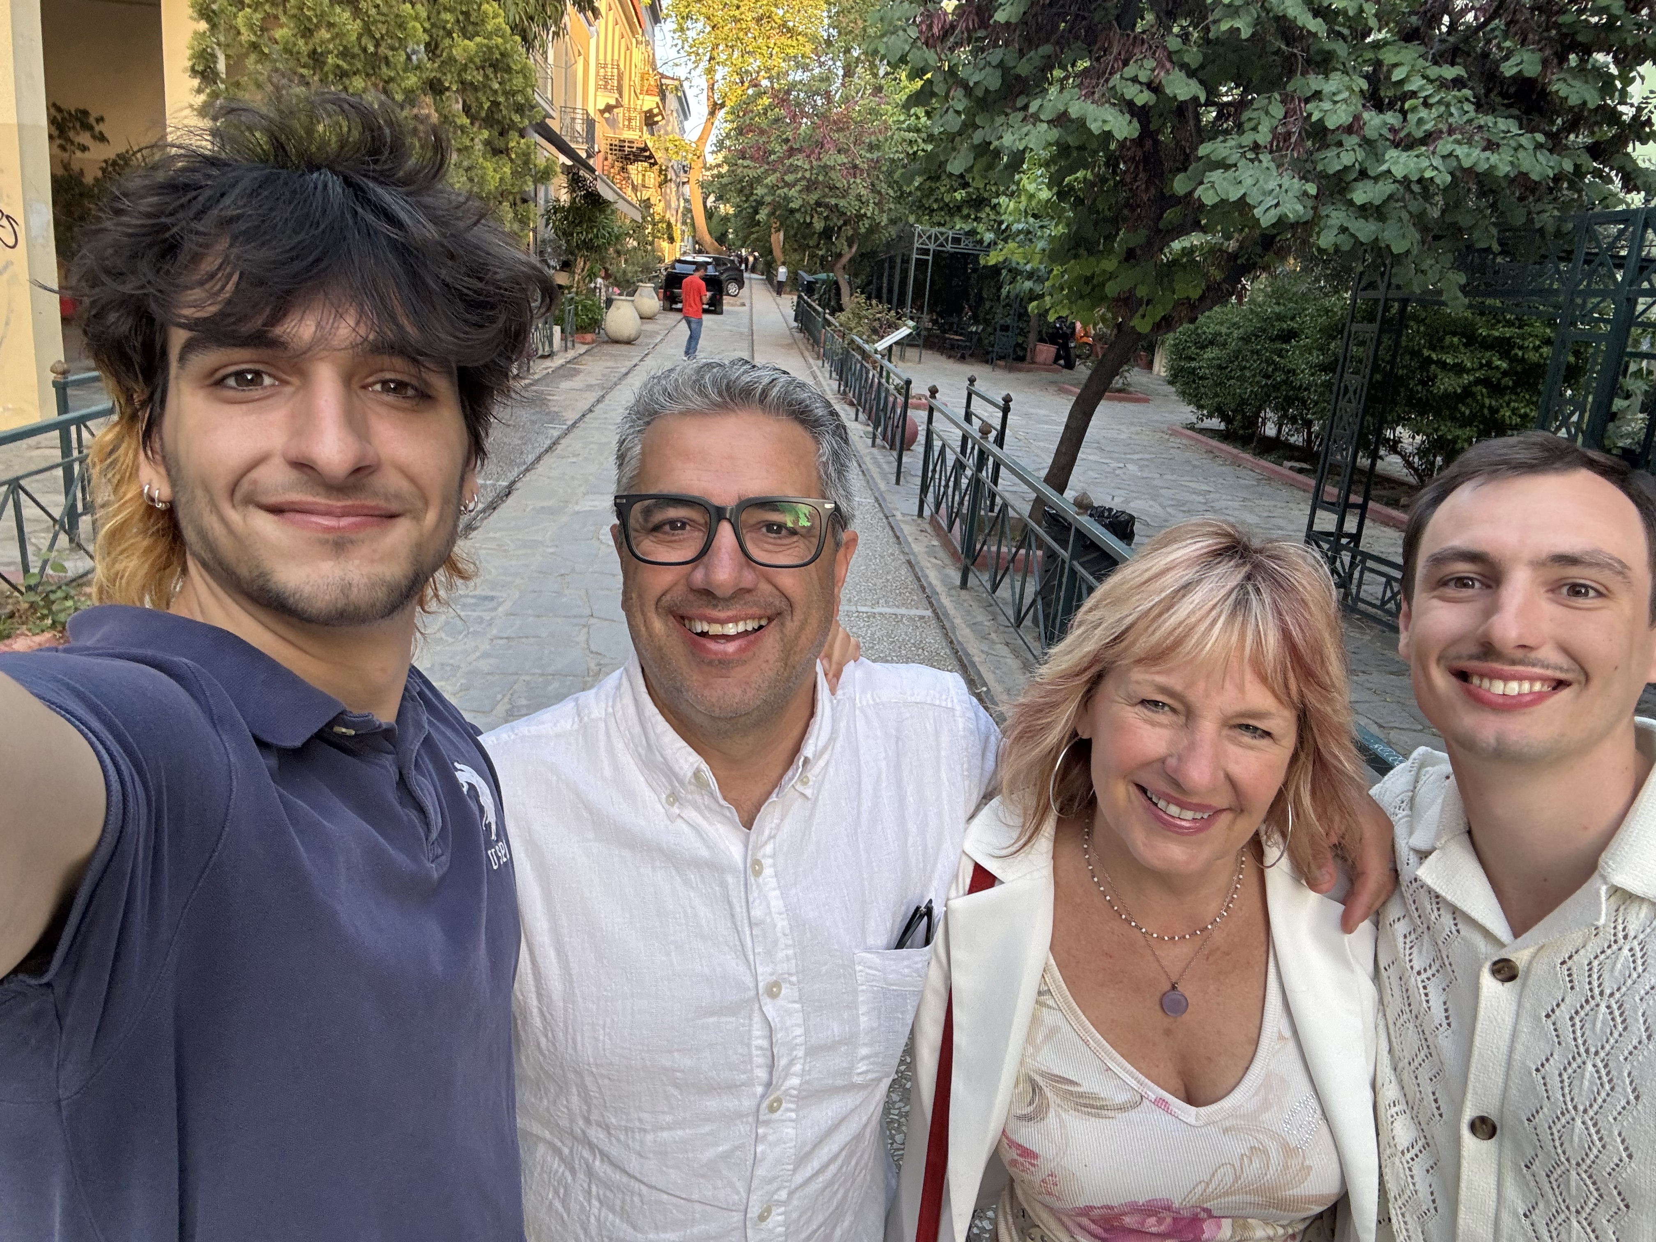
Thank you to my Hubby & Boys
Kristapor Thomassian – husband of 28 years
Kris, Robert and Jackson

Slide 19


Thank you Speakers & Enthusiasts

Slide 20
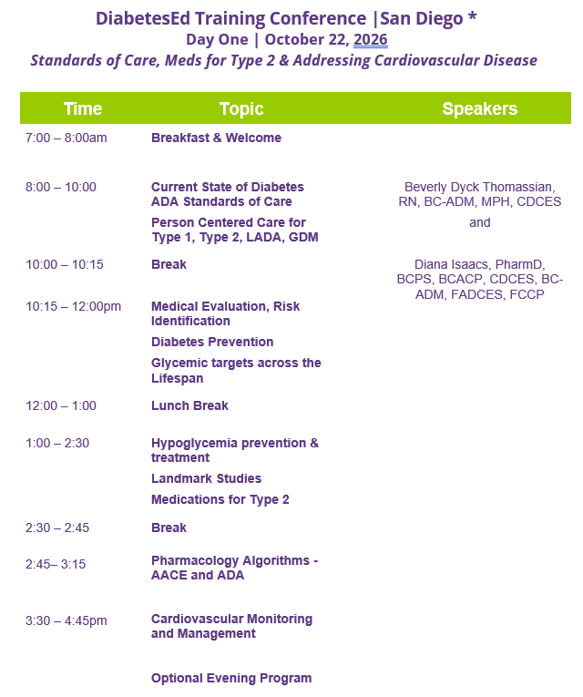
Course Schedule – Day 1
October 22
Handouts & Resource Page

Slide 21
Coach Bev has no Conflict of Interest
She’s not on any speaker's bureau
Does not invest or have any financial relationships with diabetes related companies.
Gathers information from reading package inserts, research and articles
The ADA Standards of Medical Care is main resource for course content

Slide 22

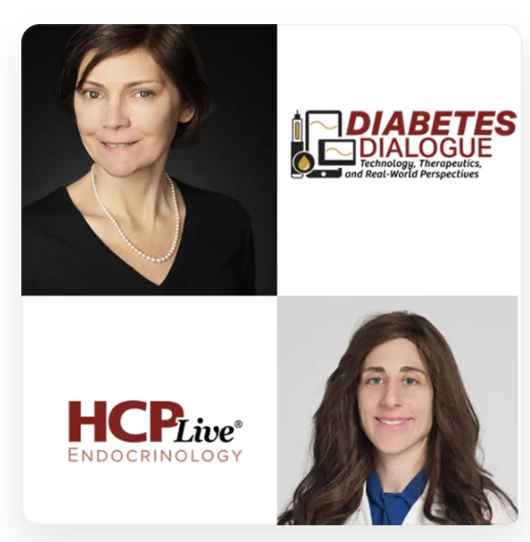
Diana Isaacs, PharmD, BCPS, BCACP,
BC-ADM, CDCES, FADCES, FCCP
Provides diabetes care to diverse population including T1D, T2D, transplant, pregnancy and other high-risk individuals
Engaged in clinical research and diabetes advocacy
Usually sees about 10 clients a day – Constantly mentoring
Author, Researcher, Podcaster, Thought Leader
Endocrine Clinical Pharmacy Specialist
Director, Education & Training in Diabetes Technology
Co-Director Center for Endocrine Disorders in Pregnancy
Cleveland Clinic Endocrinology and Metabolism Institute
ADCES Educator of the Year in 2020 | ADA Outstanding Educator in Diabetes 2026

Slide 23

Diabetes Overview and Glycemic Goals
Objectives:
Discuss current Diabetes ADA & AACE Standards
Describe person-centered care for Type 1, Type 2, LADA, GDM
List steps for Medical Evaluation, Risk Identification and Prevention
State glycemic targets across the lifespan
Discuss hypoglycemia prevention & treatment
Describe significance of Landmark Diabetes Studies
List medications considerations for Type 2
Describe the pharmacology Algorithms
Discuss most recent cardiovascular risk mitigation strategies and goals.

Slide 24
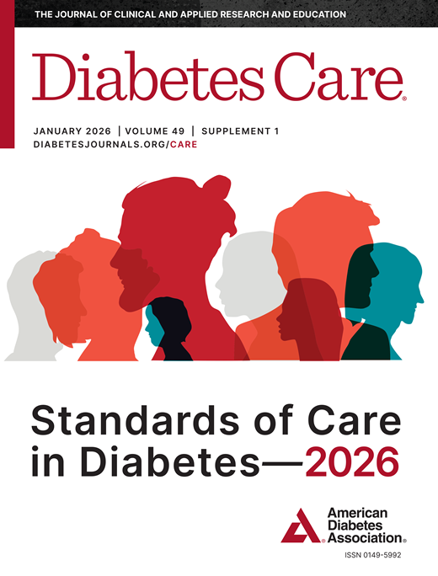

Standard 17 – Diabetes Advocacy

Slide 25

17. Diabetes Advocacy
People living with diabetes deserve to be free from the burden of discrimination.
We need to all be a part of advocating to ensure a healthy and productive life for people living with diabetes.
Make sure cost is not a barrier to diabetes self-management.
Diabetes Care needs to meet outlined standards in all settings.
- In school setting
Young children in childcare
For Drivers
In work settings
In Detention Facilities
Insulin Access & Affordability

Slide 26


CDC Announces
35% of Americans will have Diabetes by 2050
Boyle, Thompson, Barker, Williamson
2010, Oct 22:8(1)29
www.pophealthmetrics.com

Slide 27

Poll Question 1
What percent of total people in the U.S. are living with undiagnosed and diagnosed type 2 diabetes?
A. About 30%
B. 11.3%
C. 14.7%
D. 25.6%

Slide 28
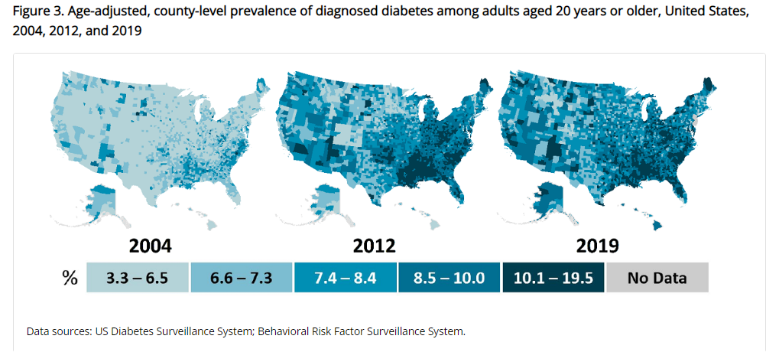
Type 2 Diabetes in America 2026
14.7% with Diabetes - 38 million adults
  25% don’t know they have it
38% with Prediabetes – 100+ million adults
https://gis.cdc.gov/grasp/diabetes/diabetesatlas-statsreport.html

Slide 29

Standard 1- Improving Care & Population Health

Slide 30


1. Improving Care - Population Health
“Health outcomes of a group of individuals
  including the distribution of health outcomes within the group”
These outcomes can be measured in terms of health outcome:
  mortality, morbidity, health, and functional status
  disease burden
    (incidence and prevalence)
  behavioral and metabolic factors
    (exercise, diet, A1C, etc.)
ADA Standards 2026

Slide 31
Diabetes Prevalence Stats
For adults in U.S., diabetes prevalence:
  American Indians and Alaska Natives – highest rates
  Non-Hispanic Blacks (17.4%),
  People of Hispanic origin (15.5%),
  Non-Hispanic Asians (16.7%)
  White Individuals (13.6%)
  Education and SES and Location
    Less than high school ed (13.1%)
    More than high school (6.9%)
    Living below federal poverty (13.1%)
    Living at 500% of federal poverty (5.1%)
    Rural living (9.5%)
    Metropolitan (8.1%)

Slide 32
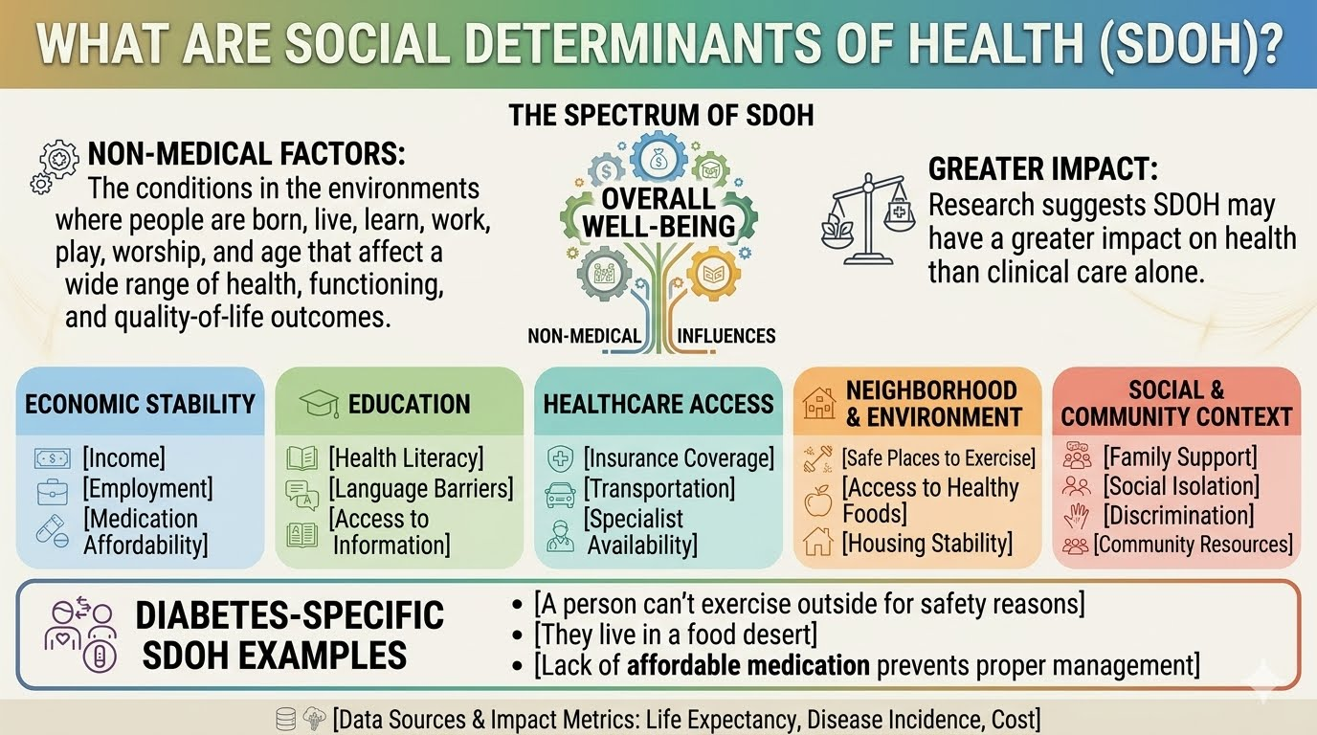
Social Determinants (Drivers) of Health
Graphic generated with https://chat.openai.com/chat

Slide 33

Status of Diabetes Care
In 2015–2018, U.S. community-dwelling adults with diabetes achieved:
  A1C <7% by 50.5%
    75.4% achieved A1C <8%.
  BP target of <130/80 achieved by 47.7%
    70.4% achieved blood pressure <140/90 mmHg.
  Lipid control (non-HDL cholesterol) <130 mg/dL, achieved by 55.7%
22.2% met targets for all three risk factors
Many not receiving adequate lifestyle or pharmacotherapy.

Slide 34

Rising Complication Rates
Since 2010, adults with diabetes across the U.S. complication rates are increasing for:
  kidney failure,
  nontraumatic lower-extremity amputations,
  stroke,
  heart failure, and
  hyperglycemic crises
  Rates of myocardial infarction have plateaued, reversing decades of earlier improvements

Slide 35
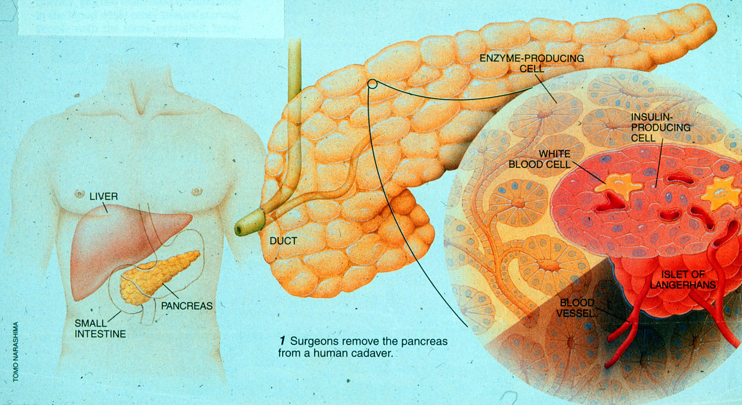
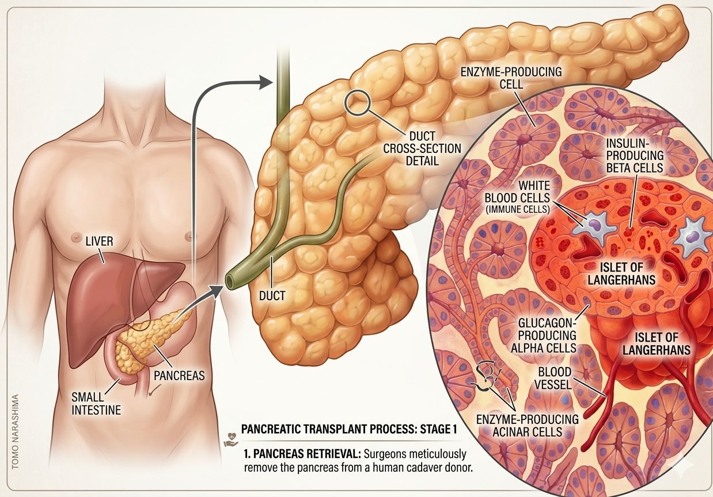

Notes:
Measurement of C-peptide is preferable to the measurement of insulin as it has a longer half-life, not subjected to the first-pass hepatic metabolism, and a steady-state clearance from the circulation. Insulin undergoes first-pass hepatic metabolism, has variable clearance, a much shorter half-life, and exogenously administered insulin can confound results.

Slide 36
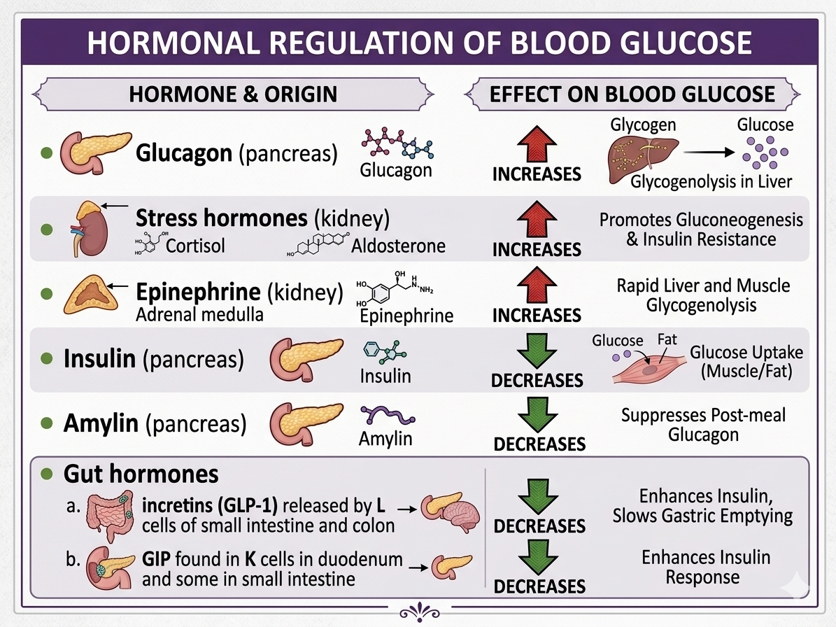
Hormones Effect on Glucose
Effect



⇒
⇒
⇒
Hormone
Glucagon (pancreas)
Stress hormones (kidney)
Epinephrine (kidney)
Insulin (pancreas)
Amylin (pancreas)
Gut hormones
  incretins (GLP-1) released by L cells of small intestine and colon
  GIP found in K cells in duodenum and some in small intestine

Slide 37
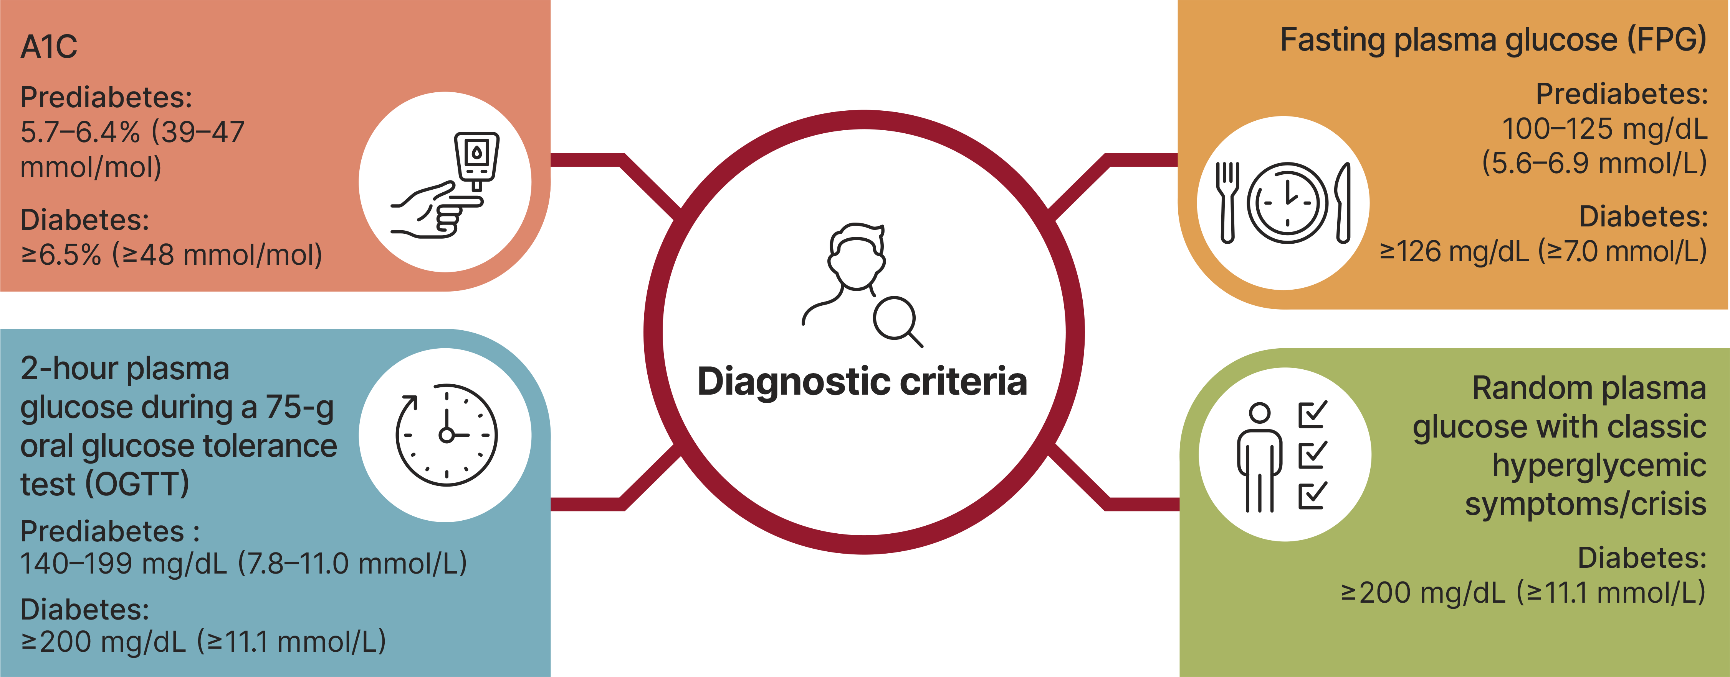
Standard 2 – Diagnosis & Classification

Slide 38

Pre Diabetes & Type 2- Screening Guidelines (ADA 2026 Clinical Practice Guidelines)
Start screening all people at age 35.
Screen at any age if BMI ≥ 25 (Asians BMI ≥ 23) plus one or > additional risk factor:
  First-degree relative w/ diabetes
  Member of a high-risk ethnic population
  Habitual physical inactivity
  History of heart disease
  Check more frequently if taking high risk meds; antiretrovirals, 2nd generation antipsychotics or steroids or other high risk medications
  History of pancreatitis, prediabetes, GDM, periodontal disease

Slide 39

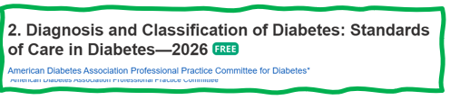
Risk-Based Screening for Prediabetes or Type 2 in Children and Youth
Test youth with excess weight (BMI >85% percentile)
Plus any ONE of following risk factors:
    Maternal diabetes or GDM during child’s gestation
    Family history type 2 in 1st or 2nd degree relative
    Native American, African American, Latino, Asian American, Pacific Islander
    Signs of insulin resistance (acanthosis nigricans, HTN, dyslipidemia, Polycystic Ovary Syndrome – PCOS, large or small for gestational-age birth weight
Test at 10 yrs or puberty (whichever is first and at least every 3 yrs or more frequently if indicated. Consider earlier screening if multiple risk factors.

Slide 40
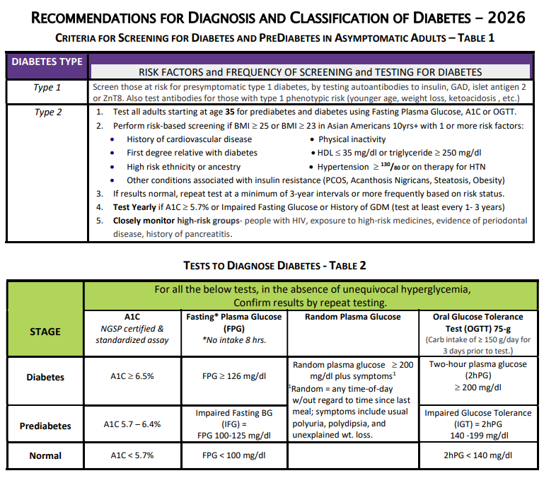
Diabetes Screening Guidelines
(ADA 2026 Clinical Practice Guidelines – Cheat Sheet)
Bigger version of slides available in
“Slide handouts” or Cheat Sheets

Slide 41
Poll Question 2
Which of the following level is considered diabetes range?
  a. Fasting BG of 122
  b. A1c of 5.9 %
  c. After meal BG of 207
  d. Random BG of 143

Slide 42
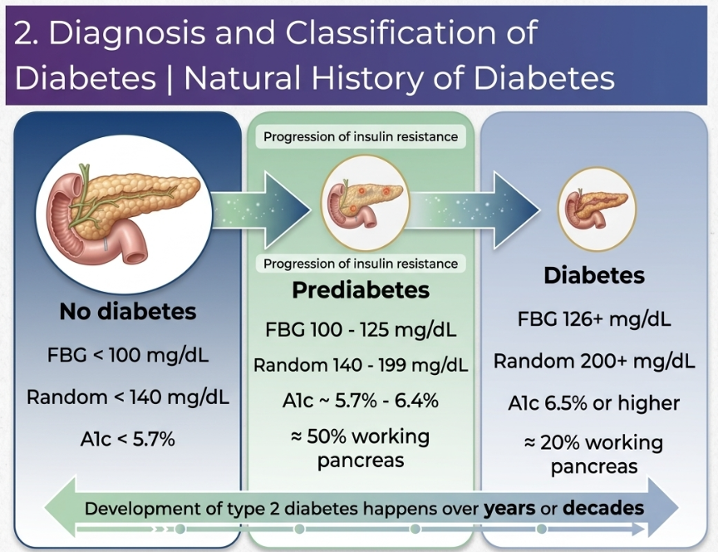
2. Diagnosis and Classification and of Diabetes Natural History of Diabetes
No diabetes
FBG <100
Random <140
A1c <5.7%
Prediabetes
FBG 100-125
Random 140 - 199
A1c ~ 5.7- 6.4%
50% working pancreas
Diabetes
FBG 126 +
Random 200 +
A1c 6.5% or +
20% working pancreas
Yes!
NO
Development of type 2 diabetes happens over years or decades

Slide 43
DiabetesEd.net Cheat Sheets

Slide 44

Diabetes is Complex
Goal – achieve well being and negotiated outcomes
Psychological factors:
  Environmental
  Social
  Behavioral
  Emotional
Keep it person centered while integrating care into daily life
  Consider the individual

Slide 45

Let’s meet people where they are at.

Slide 46
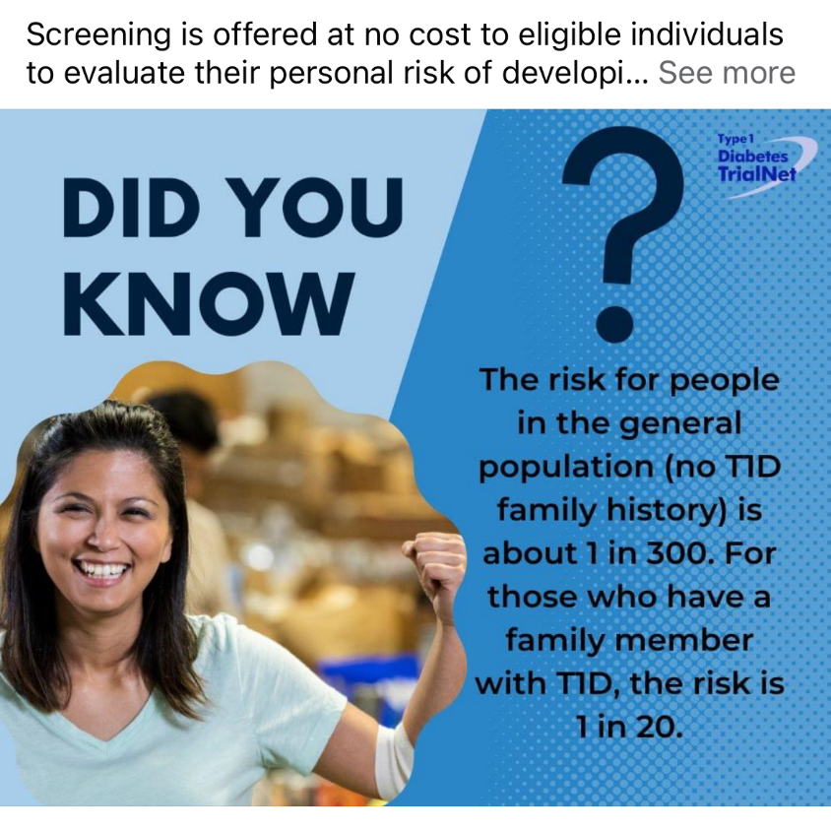

Type 1 ~ Immune Mediated
5-10% of Diabetes
1.5 Million people have type 1 in U.S.
Prevalence increasing:
2001 – 1.48 per 1000 youths diagnosed with diabetes
2017 - 2.15 per 1000 youths diagnosed with diabetes
Incidence & Prevalence increasing
Highest incidence in Finland or Northern Europe.
ADCES In Practice - March 2024 Recent Advances in Type 1 Diabetes: Teplizumab (Tzeild®)
Karen S. Fiano, PHARMD, BCACP, Devada Singh-Franco, PHARMD, CDCES, Young M. Kwon, BS, PHD

Slide 47


Slide 48



“Diabetes is my biggest competitor” Gary Hall Jr

Slide 49

Type 1 is 5- 10% of all Diabetes
Auto-immune pancreatic beta cells destruction
Most commonly expressed at age 10 – 14
Insulin sensitive (require 0.5 - 1.0 units/kg/day)
Expression due to a combo of genes and environment:
  Autoimmunity tends to run in families
  Exposure to virus or other environmental factors
49
Diagnostic Criteria for Diabetes
Notes:
When you get to the insulin piece, please mention we will get into great detail about insulin in the pharmacotherapy module

Slide 50
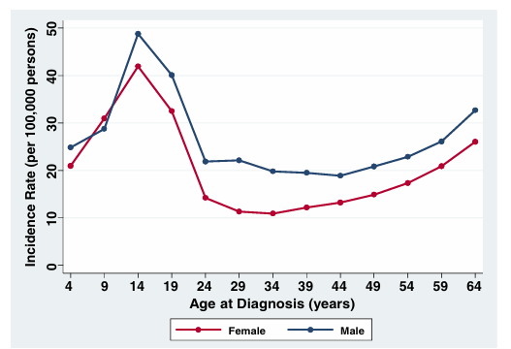
T1D Can Occur at Any Age
* A longitudinal study comprising 32,476 commercially insured Americans aged 0-64 years who developed T1D between 2001 and 2015.
Rogers MAM, et al. BMC Med. 2017;15(1):199.

Slide 51
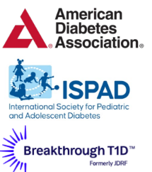
Screen People at Increased Risk of T1D
First-degree relatives of individuals with T1D
Individuals with personal or family history of select autoimmune diseases
Screening for T1D autoantibodies is recommended by
2-3X greater risk of T1D in individuals with select autoimmune diseases
~15x greater risk
of T1D versus the general population
Thyroid disorders
  Hashimoto’s thyroiditis
  Graves’ disease
Celiac disease
Also screen those with phenotypic risk factors that overlap with T1D (ex. Younger age at diagnosis, intentional weight loss, ketoacidosis, short to insulin treatment)

Slide 52
Benefits of Early T1D Detection
Decreased frequency of insulin treatment at diagnosis
Lower HbA1C
Lower rates of DKA
98.1%
10.5%
62%
6.8%
72.3%
6%
Screened & diagnosed
Not screened
Screened & diagnosed
Not screened
Screened and diagnosed
Not screened
Sims E. et al. Diabetes. 2022 Apr 1;71(4):610-623.
Hummel S, et al. Diabetologia. 2023 Sep;66(9):1633-1642
Notes:
Hummel S, et al. Diabetologia. 2023 Sep;66(9):1633-1642. doi: 10.1007/s00125-023-05953-0. Epub 2023 Jun 17. PMID: 37329450; PMCID: PMC10390633.

Slide 53
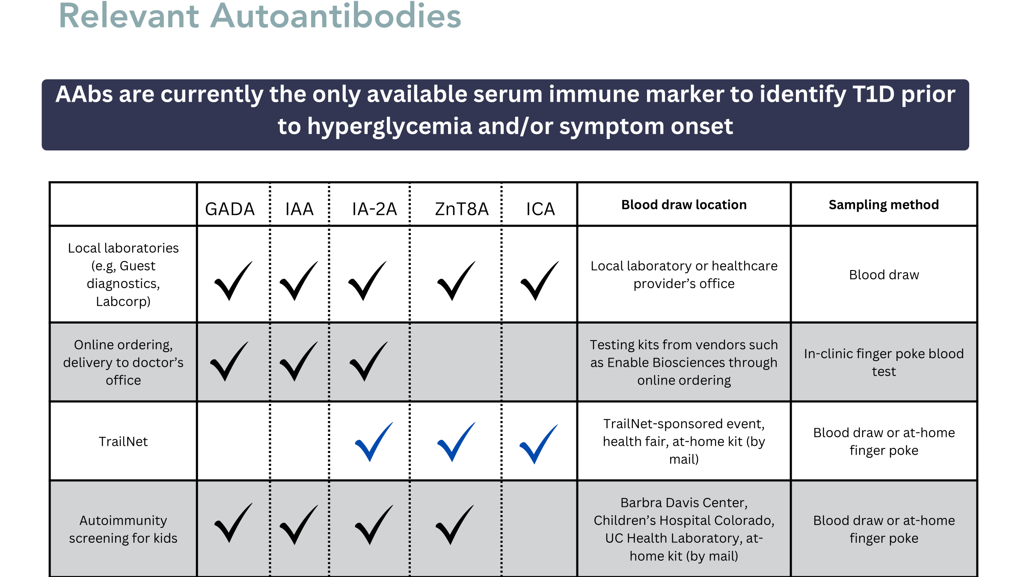
Ordering Autoantibodies
Patients at increased risk should be screened for type 1 diabetes
First-degree relatives of individuals with T1D
Individuals with personal or family history of select autoimmune diseases
Screened for T1D autoantibodies is recommended by
2-3X greater risk of T1D in individuals with select autoimmune diseases
~15x greater risk
of T1D versus the general population
Thyroid disorders
  Hashimoto’s thyroiditis
  Graves’ disease
Celiac disease
Glutamic acid decarboxylase 65 autoantibody (GADA)
Insulin autoantibody (IAA)
Insulinoma-associated antigen 2 autoantibody (IA-2A)
Zinc transporter 8 autoantibody (ZnT8A)
Islet cell autoantibody (ICA)

Slide 54
Stages of T1D
 | Stage 1 | Stage 2 | Stage 3
Characteristics | • Autoimmunity | • Autoimmunity | • Autoimmunity
 | • Normoglycemia | • Dysglycemia | • Overt hyperglycemia
 | • Presymptomatic | • Presymptomatic | • Symptomatic
Diagnostic criteria | • 2 or more islet autoantibodies Glucose levels are in normal range FBG<100mg/dL A1C<5.6% 2-h PG <140mg/dL | • 2 or more islet autoantibodies Dysglycemia: Elevated IFG and/or IGT • FPG 100–125 mg/dL • 2-h PG 140–199 mg/dL • A1C 5.7–6.4% or ≥10% increase in A1C | • Autoantibodies may disappear over time (5-10% may not express antibodies) • Diabetes diagnosed by standard criteria

Slide 55
Pharmacologic Intervention to Delay Stage 3 T1D
Teplizumab-Tzield (CD3-monoclonal antibody)
An option for individuals aged ≥1 years with stage 2 T1D to delay progression to Stage 3 T1D
14-day infusion for stage 2 T1D
In a single trial, 44 individuals received 14-day course of teplizumab vs 32 in placebo
The median time to delay stage 3 T1D was 2 years
  48.4 months in teplizumab group vs. 24.4 months placebo
Financial assistance available
Herold KC, et al; Type 1 Diabetes TrialNet Study Group. An Anti-CD3 Antibody, Teplizumab, in Relatives at Risk for Type 1 Diabetes. N Engl J Med. 2019 Aug 15;381(7):603-613.
Notes:
Herold KC, Bundy BN, Long SA, Bluestone JA, DiMeglio LA, Dufort MJ, Gitelman SE, Gottlieb PA, Krischer JP, Linsley PS, Marks JB, Moore W, Moran A, Rodriguez H, Russell WE, Schatz D, Skyler JS, Tsalikian E, Wherrett DK, Ziegler AG, Greenbaum CJ; Type 1 Diabetes TrialNet Study Group. An Anti-CD3 Antibody, Teplizumab, in Relatives at Risk for Type 1 Diabetes. N Engl J Med. 2019 Aug 15;381(7):603-613. doi: 10.1056/NEJMoa1902226. Epub 2019 Jun 9. Erratum in: N Engl J Med. 2020 Feb 6;382(6):586. doi: 10.1056/NEJMx190033. PMID: 31180194; PMCID: PMC6776880.

Slide 56
Templizumab for Stage 3 T1D
An option for individuals aged 6-17 with stage 3 T1D diagnosed to delay the decline in endogenous insulin
Must start within 8 weeks of diagnosis
Requires 2, 12 day infusions, 6 months apart
Patients treated with teplizumab (217 patients) had significantly higher stimulated C-peptide levels than patients receiving placebo (111 patients) at week 78 (95% CI, 0.09 to 0.17; P<0.001)
Caution: cytokine release syndrome, lymphopenia
TZIELDHCP.com | For US Healthcare Providers
Ramos EL, et al ; PROTECT Study Investigators. Teplizumab and β-Cell Function in Newly Diagnosed Type 1 Diabetes. N Engl J Med. 2023 Dec 7;389(23):2151-2161.
Notes:
Herold KC, Bundy BN, Long SA, Bluestone JA, DiMeglio LA, Dufort MJ, Gitelman SE, Gottlieb PA, Krischer JP, Linsley PS, Marks JB, Moore W, Moran A, Rodriguez H, Russell WE, Schatz D, Skyler JS, Tsalikian E, Wherrett DK, Ziegler AG, Greenbaum CJ; Type 1 Diabetes TrialNet Study Group. An Anti-CD3 Antibody, Teplizumab, in Relatives at Risk for Type 1 Diabetes. N Engl J Med. 2019 Aug 15;381(7):603-613. doi: 10.1056/NEJMoa1902226. Epub 2019 Jun 9. Erratum in: N Engl J Med. 2020 Feb 6;382(6):586. doi: 10.1056/NEJMx190033. PMID: 31180194; PMCID: PMC6776880.

Slide 57
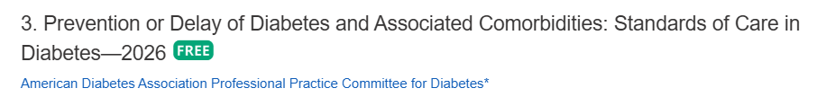
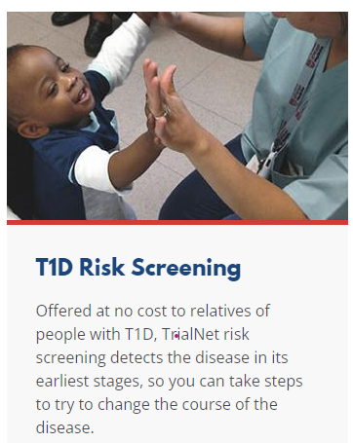
Monitoring for T1D Progression
In people with presymptomatic T1D; Monitor for disease progression
  A1C every 6 months
  75- OGTT every year
  Modify screening frequency based on number/type of antibodies, age and glycemic metrics.
  May benefit from CGM to monitor progression
In kids, monitor every 3 months
Trialnet.org
Phillip M, et al. Diabetes Care. 2024 Aug 1;47(8):1276-1298.

Slide 58
Type 1 & Lifestyle Prevention
Observational studies in those with antibodies, shed light on factors that increase β-cell demand:
  Less physical activity
  Consuming higher glycemic index foods
  Sugar intake
Factors that reduced risk of progression from TEDDY study:
Daily minutes spent doing vigorous physical exercise.
More info needed

Slide 59
Quick Question 3
Question: LT is diagnosed with stage 1, type 1 diabetes. He has 2 positive autoantibodies and his glucose is in normal range. He asks you if he is a candidate for “that therapy” that can protect beta cells and slow progression of type 1 diabetes. What is the most accurate response?
  Unfortunately, you are not a candidate, since you already have 2 positive autoantibodies.
  Let’s talk to your provider about the possibility of starting teplizumab therapy.
  Since you have T1D, the best early intervention is insulin therapy.
  Since you are in stage 1, the therapy is not indicated, but let’s talk about monitoring.
Notes:
Answer, D

Slide 60

Determine if Type 1 - Use AABBCC Approach
Age
  e.g., for individuals <35 years old, consider type 1 diabetes
Autoimmunity
  e.g., personal or family history of autoimmune disease or polyglandular autoimmune syndromes
Body habitus
  e.g., BMI <25 kg/m2
Background
  e.g., family history of type 1 diabetes
Control
  e.g., level of glucose control on noninsulin therapies
Comorbidities
  e.g., treatment with immune checkpoint inhibitors for cancer can cause acute autoimmune type 1 diabetes or presence of other autoimmune conditions

Slide 61

Type 1 Diabetes Features?
For JR, a 28 admitted to the ICU with a blood glucose of 476 mg/dl, pH of 7.1, anion gap of 15. Recently lost 13 pounds.
Type 1 Most Discriminative Features
Younger than 35 years at diagnosis
Lower BMI (<25 kg/m²)
Unintentional weight loss
Ketoacidosis
Glucose 360 mg/dl or greater.
Misdiagnosis is common and can occur in ∼40% of adults with new type 1 diabetes

Slide 62

What kind of Diabetes?
58 yr old, states she has had type 1 diabetes for 18 years. Quit smoking a year ago and gained about 20 lbs. BMI 25.
Meds
  Lispro 18-23 units before each meal
  Glargine 28 units at bedtime
  Metformin 500mg TID
What tests would you recommend?
25% of ind’s with Type 1 also have type 2 diabetes.
ADA Post Grad, 2010

Slide 63
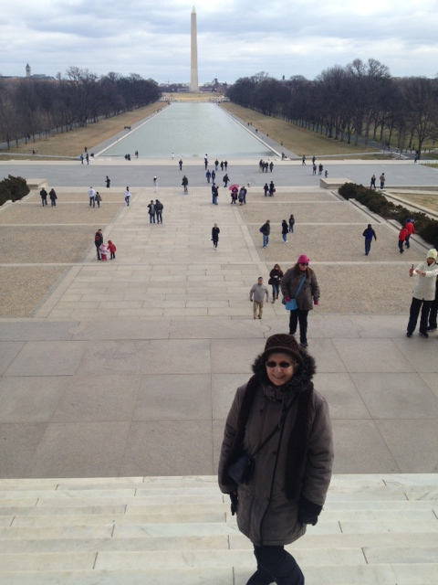
What type of Diabetes?
72 Years old
A1c 3 months prior 6.2%
A1c now 13.9%
BMI 24.5
Lost about 10 pounds over last month

Slide 64

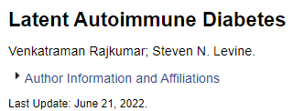
Latent AutoImmunity Diabetes in Adults (LADA)
Antibody positive to 1-2 of below
  GAD-65 autoantibodies
  Insulin Autoantibodies
  Islet Cell antigen-2
  ZnT8
Adult Age at onset
Usually benefit from insulin w/in first 6 months of diagnosis
Early insulin therapy may preserve beta cell function
Diabetes Care 26:536-538, 2003
Jerry P. Palmer, MD and Irl B. Hirsch, MD

Slide 65
LADA Clinical Features Compared to Type 2
Feature LADA Type 2
Age <50 63% 19%
Acute hyperglycemia 66 24
BMI < 25 33 13
Hx of autoimmune dx 27 12
Family hx autoimmune 46 35
Practical Diabetology March 08, Unger MD

Slide 66
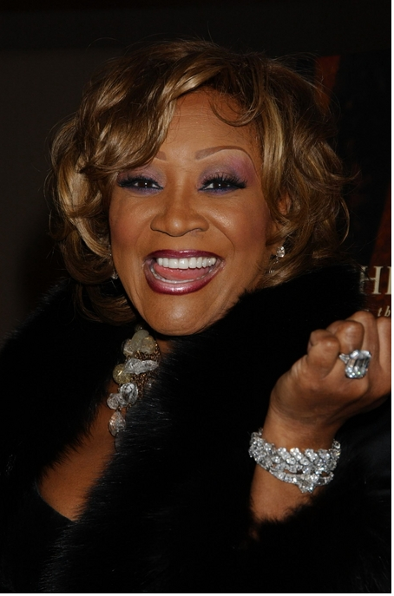
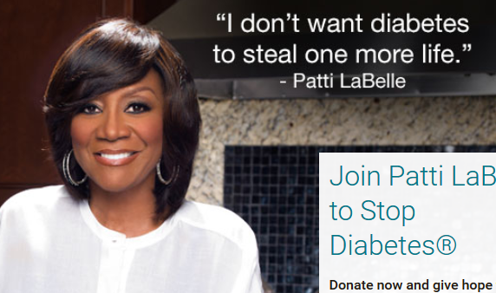
Patti Labelle
"divabetic”
“I have diabetes, it doesn’t have me”

Slide 67
Signs of Diabetes
Polyuria
Polydipsia
Polyphasia
Weight loss
Fatigue
Skin and other infections
Blurry vision
Glycosuria, H₂O losses
Dehydration
Fuel Depletion
Loss of body tissue, H₂O
Poor energy utilization
Hyperglycemia increases incidence of infection
Osmotic changes

Slide 68
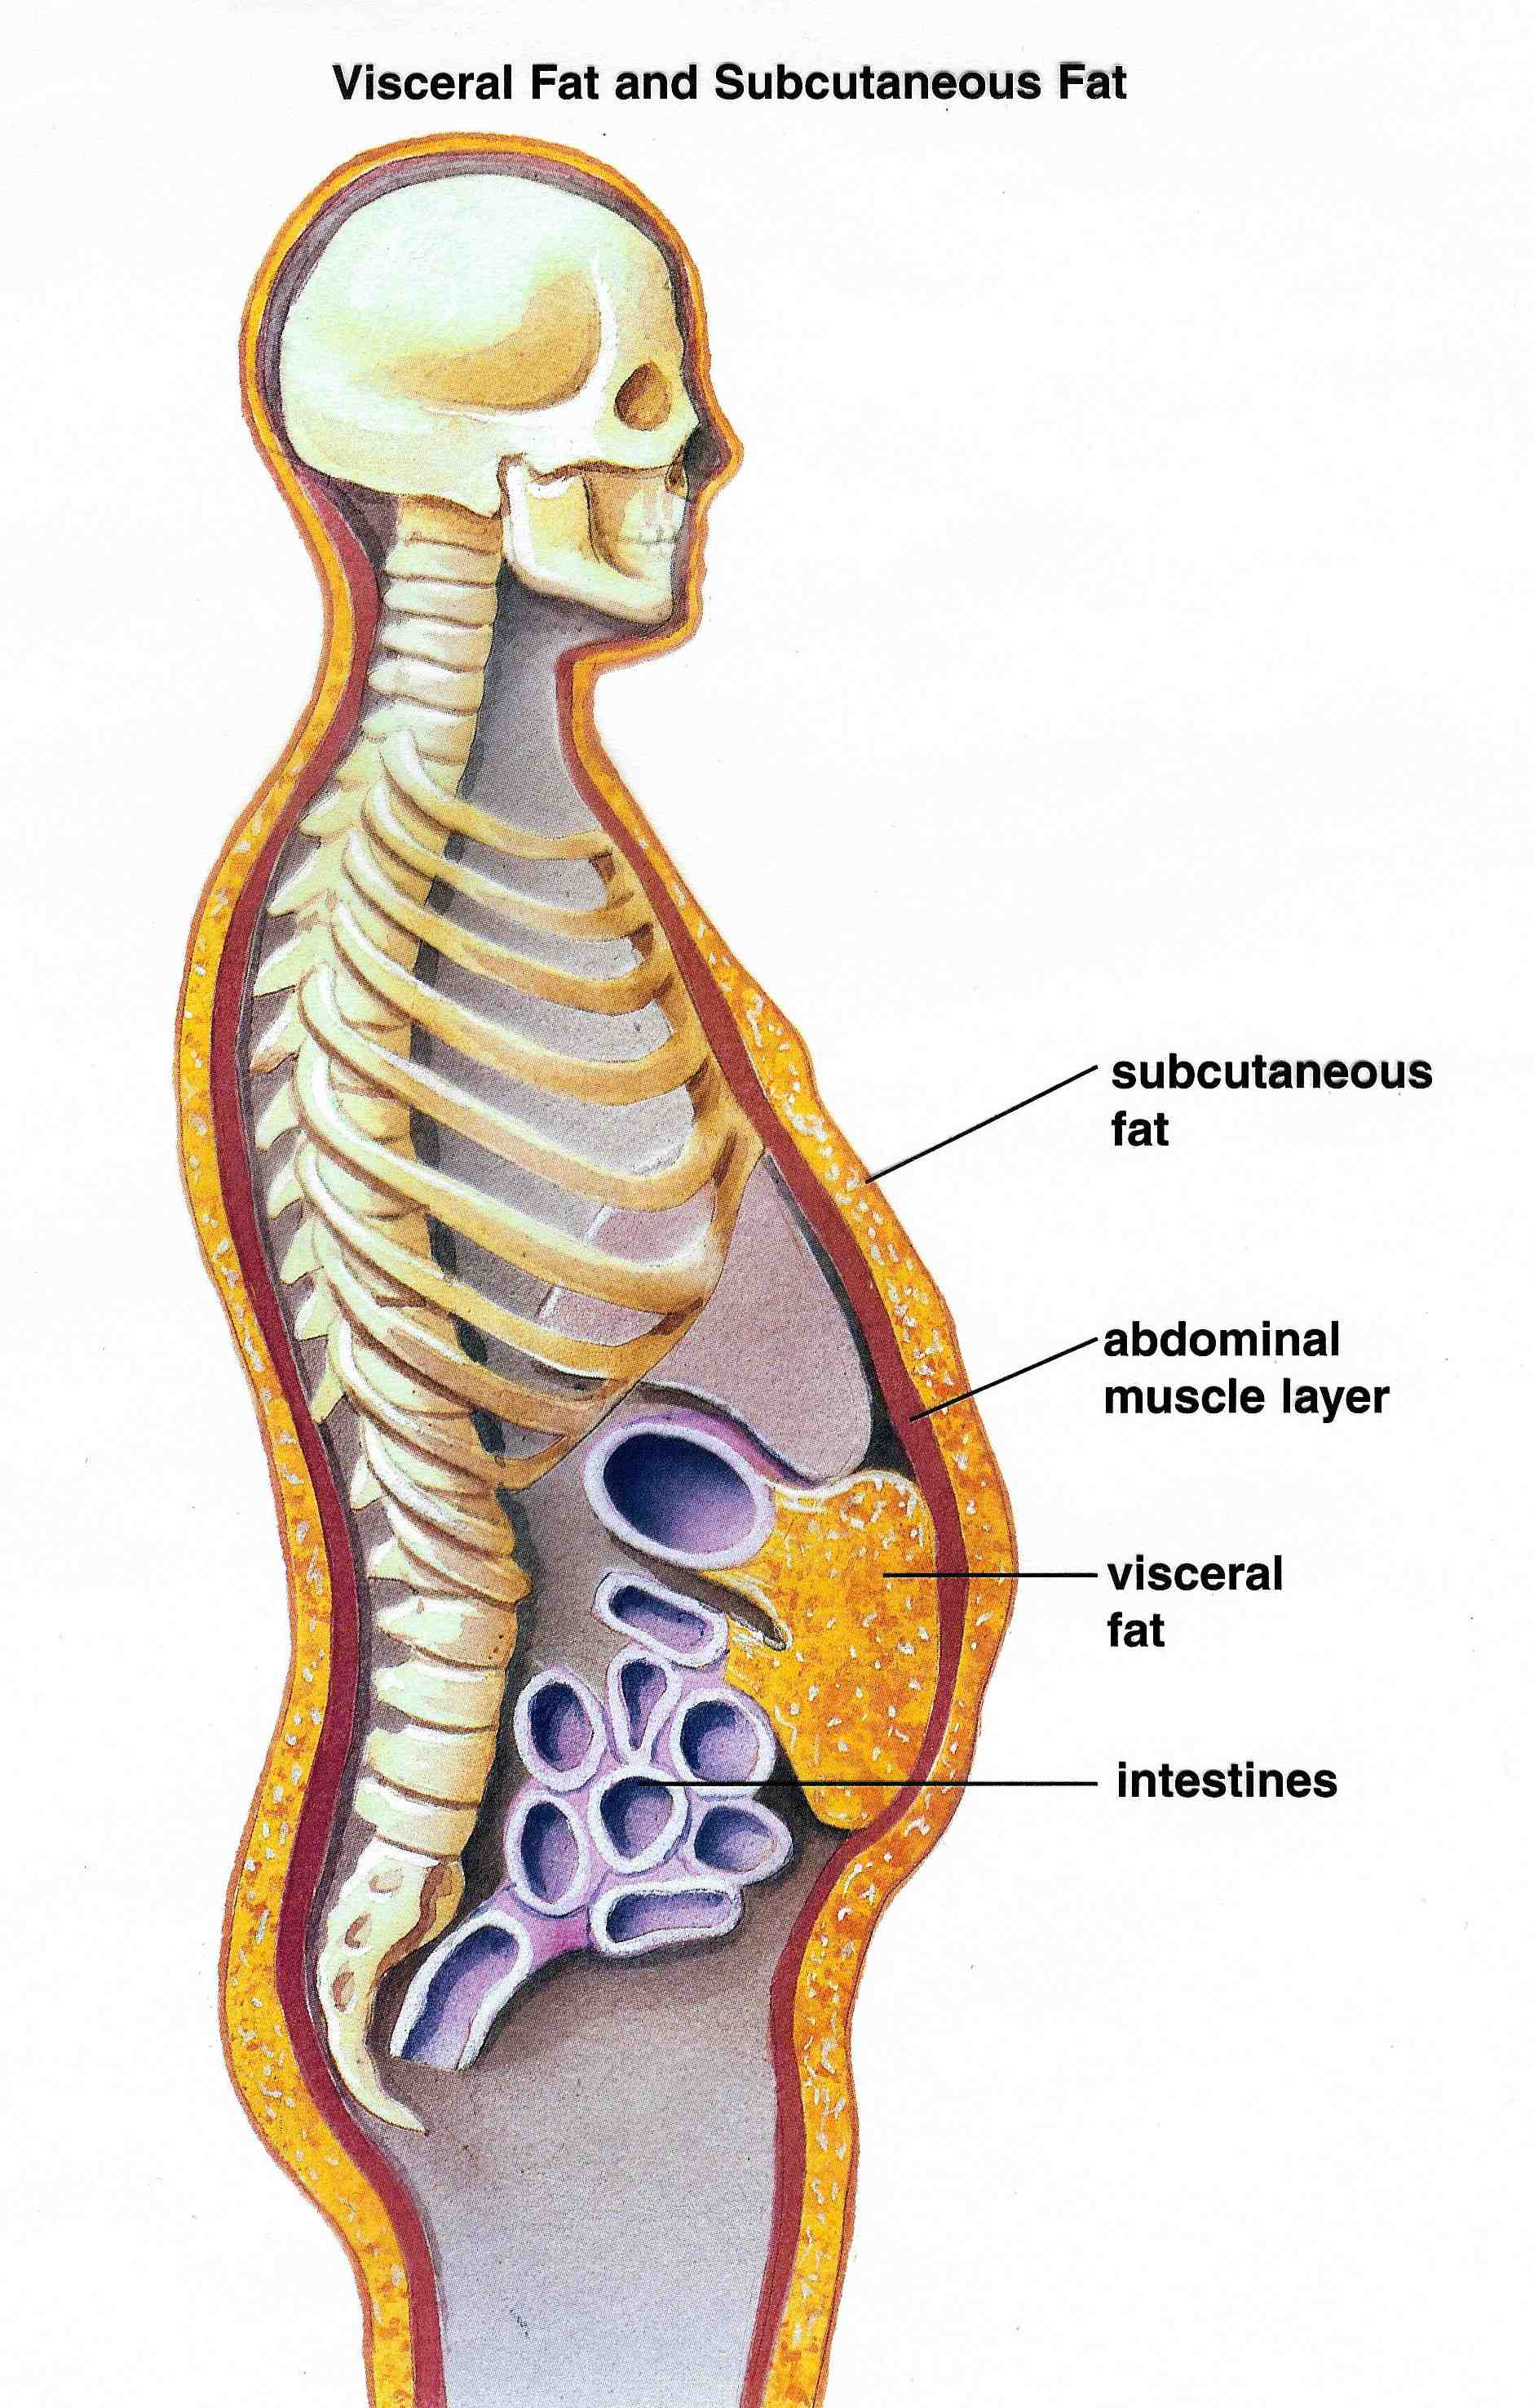



Slide 69


What is Type 2 Diabetes?
Type 2 diabetes is associated with insulin secretory defects related to
  genetic predisposition,
  epigenetic changes (how genes are expressed)
  inflammation, and
  metabolic stress.
Future classification schemes for diabetes will likely focus on the pathophysiology of the underlying β-cell dysfunction.

Slide 70

Life Study – Mrs. Jones
MJ is 62 years old, with a BMI of 36 and complains of feeling tired and urinating several times a night. Has a urinary tract infection. Her A1c is 8.3%, glucose 237.
MJ is hypertensive with a history of gestational diabetes. No ketones in urine.
What are risk factors and signs of diabetes?
You find a few moments to
teach and MJ asks you
some questions.

Slide 71
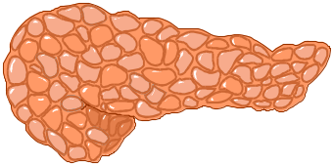

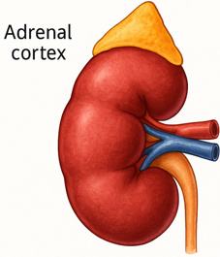
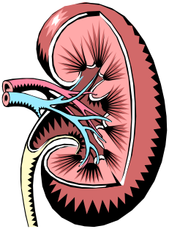
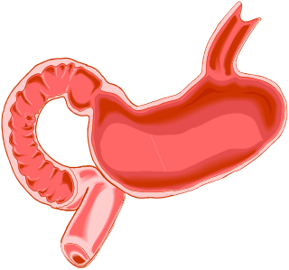

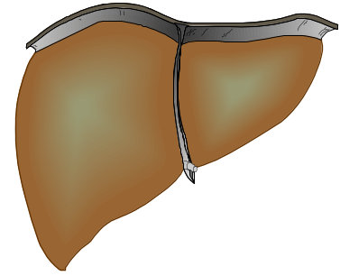

The Noxious Nine – Pathophysiology T2D
Hypercortisolism
Neurotrans-mission dysfunction
Decreased
Insulin β-cell secretion
Increased renal glucose reabsorption
Decreased
incretin effect
Gut hormones
G
Increased glucagon α-cell secretion
I
G
I
G
G
I
I
G
Increased lipolysis
G
G
I
I
G
G
I
Increased hepatic glucose
production
I
G
G
Decreased muscle glucose uptake
DeFronzo, Auchus-Hypercortisolism June 2025
Notes:
71
ummary: The Noxious Nine in Diabetes Pathophysiology
Ralph A. DeFronzo expanded his earlier conceptual model of diabetes—known as the Ominous Octet—to include a ninth element: hypercortisolism. This updated framework is referred to as the Noxious Nine, highlighting the important role of cortisol dysregulation in difficult-to-control type 2 diabetes currentsciencedaily.com+8HCP Live+8HCP Live+8.
Recent research, including the CATALYST trial, shows that about 24% of patients with difficult-to-control T2D have underlying hypercortisolism. Treating this condition with mifepristone, a glucocorticoid receptor antagonist, led to significant improvements in HbA1c—averaging around a 1.5% reduction pmc.ncbi.nlm.nih.gov+3HCP Live+3medscape.com+3.
These findings emphasize the importance of recognizing hypercortisolism in T2D care and suggest that addressing it may help improve glycemic and metabolic control in a subset of patients.
71

Slide 72
Hypercortisolism in Type 2
Cortisol increases gluconeogenesis in the liver
Reduces peripheral glucose uptake → insulin resistance
Stimulates protein catabolism and lipolysis
Chronic cortisol elevation → persistent hyperglycemia and hypertension
Can lead to “Difficult to Control Type 2 Diabetes”
CATALYST study revealed about 24% of people with elevated BG despite meds, may be due to hypercortisolism.
Treatment with mifepristone decreased weight and BG.
DeFronzo, Auchus-Hypercortisolism June 2025
pmc.ncbi.nlm.nih.gov+3HCP

Slide 73
Comparison of Type 1,Type 2, LADA
Type 1
Type 2 LADA
Excess weight
x
xxx x
Insulin dependence
xxx
30% 6mos
Respond to oral agents
0
xxx x
Ketosis
xxx
x x
Antibodies present
xxx
0 xx
Typical Age of onset
teens
adult adult
Insulin Resistance
0
xxx
x

Slide 74
Specific type of diabetes due to other causes
  Medications:
    Steroids
    Anti-retroviral meds
    Antipsychotic meds
    Transplant meds
    Checkpoint inhibitors
  Exocrine pancreas disease:
    Cystic fibrosis
    Type 3c
    Pancreatitis
  Monogenic diabetes
  syndromes
  Agent Orange

Slide 75

Standard 2 & 15 Diagnosis |Pregnancy & Diabetes

Slide 76

Poll question 4
What best describes gestational diabetes?
Diabetes discovered within the first 12 weeks of pregnancy.
Diabetes discovered in the 24-28 weeks of pregnancy.
Risk of getting diabetes before pregnancy.
Diabetes discovered at any point during pregnancy.

Slide 77

Diabetes in Pregnancy Background
Prevalence of diabetes in pregnancy is increasing
Definitions
  Pre-gestational diabetes: pre-existing type 1 or type 2 diabetes in pregnancy
  Gestational diabetes: diabetes diagnosed in the 2nd or 3rd trimester of pregnancy
Notes:
ADA SOC

Slide 78

Rates of Gestational Diabetes (GDM) and Diabetes in Pregnancy increasing
1% to 2% have type 1 or type 2 during pregnancy
~9% develop GDM
From 2000 to 2010
  GDM rates increased 56%
  Type 1 or type 2 before pregnancy increased 37%.
Asian and Hispanic women have higher rates of GDM
Black and Hispanic women have higher rates of type 1 or type 2 diabetes during pregnancy.
CDC https://www.cdc.gov/reproductivehealth/maternalinfanthealth/diabetes-during-pregnancy.htm

Slide 79
Screening in Early Pregnancy
Before 15 weeks, screen those with risk factors (B)
Consider screening everyone before 15 weeks (E)
If BG in normal range, recheck at 24-28 weeks for Gestational Diabetes using OGTT
If fasting BG 110+ or A1C 5.9%+
  At higher risk of adverse outcomes and more likely to experience GDM and need insulin.
2. Diagnosis and Classification of Diabetes: Standards of Care in Diabetes—2026 Diabetes Care 2026;49(Suppl. 1):S27–S49 | https://doi.org/10.2337/dc26-S002

Slide 80

Gestational DM ~ 9% of all Pregnancies
Detected at 24-28 weeks of pregnancy (most insulin resistant phase)
Rates are increasing:
  Women getting pregnant later
  Higher rates of obesity
50% chance of getting diabetes post delivery
Offspring at greater risk of insulin resistance and diabetes

Slide 81
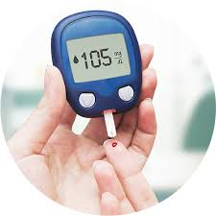
Glucose Monitoring in Pregnancy
Check FBG and 1 or 2 hour PPG
Pre-existing type 1, need to also check premeal BG
CGM can help to achieve A1C targets when pre- and postprandial glucose targets
Recommended for T1D and may be beneficial for other types of diabetes in pregnancy
  Can reduce macrosomia and neonatal hypoglycemia in pregnancy complicated by type 1 diabetes.
15. Management of Diabetes in Pregnancy: Standards of Care in Diabetes—2026 Diabetes Care 2026;49(Suppl. 1):S321–S338
Notes:
CGM) can help to achieve glyce mic goals (e.g., time in range, time above range) A and A1C goal B in type 1 diabetes and pregnancy and may be beneficial for other types of diabetes in pregnancy.

Slide 82
Glucose Targets in Pregnancy
 | Blood Glucose Goal
Glucose measurement | T1D or T2D | GD treated with insulin | GD not treated with insulin
Fasting glucose | 70-95 mg/dL | 70-95 mg/dL | <95 mg/dL
1 hr post-prandial glucose | 110-140 mg/dL | 110-140 mg/dL | <140 mg/dL
2 hr post-prandial glucose | 100-120 mg/dL | 100-120 mg/dL | <120 mg/dL
Monitor at least 4 times daily (FBG, PPG after each meal) or use CGM)
ADA. Diabetes Care. 2026; 49(Suppl 1): S27-49
Notes:
Lower glucose limits do not apply to individuals with t2DM treated with nutrition alone. Aim for less stringent goals if these cannot be achieved without significant hypoglycemia, based on clinical experience and individualization of care
* Optimal goal includes either a 1 hour post-prandial glucose level or 2 hour post-prandial glucose level within column of type of diabetes

Slide 83
CGM targets in Pregnancy
Pregnancy:
T1D
Pregnancy:
T2D
Pregnancy: GD
>140 mg/dL
<25%
>140 mg/dL
<15%
>140 mg/dL
<15%
Target range:
63-140 mg/dL
>70%
Target range:
63-140 mg/dL
Target range:
63-140 mg/dL
>80%
>90%
<63 mg/dL
<4%
<63 mg/dL
<4%
<63 mg/dL
<4%
<54 mg/dL
<1%
<54 mg/dL
<1%
<54 mg/dL
<1%
.
Battelino T, et al. Diabetes Care. 2019;42(8):1593-1603.
Benhalima K, et al. Lancel Diab, 2025. doi: 10.1016/S2213-8587(25)00335-3.

Slide 84

Pharmacologic Treatment during Pregnancy
Insulin is preferred therapy for all forms of diabetes in pregnancy
  Does not cross placenta
  Can overcome insulin resistance assoc w/ type 2
Sulfonylureas pass through placenta / associated with neonatal hypo (glyburide)
Metformin – lower risk of hypo and maternal wt gain but may increase prematurity rate/childhood obesity
  Passes through placenta
  If using for PCOS, stop by end of first trimester
Refer to specialized center

Slide 85

Pregnancy and Hypertension
If pregnant with diabetes and hypertension
  Blood pressure target of <140/90 mmHg
    Reduces risk for accelerated maternal hypertension
    Minimizes impaired fetal growth
  Initiate therapy if BP>140/90, reduce therapy if <90/60
  Stop potentially harmful medications in prep for pregnancy
    Avoid ACE inhibitors, angiotensin receptor blockers (ARBs), statins in sexually active women of childbearing age if not using reliable contraception
    Preferred HTN meds: labetolol, nifedipine , clonidine, methyldopa
    Other beta blockers except atenolol can be used
15. Management of Diabetes in Pregnancy: Standards of Care in Diabetes—2026 Diabetes Care 2026;49(Suppl. 1):S321–S338
Notes:
5.24 In pregnant individuals with di abetes and chronic hypertension, a blood pressure threshold d d

Slide 86
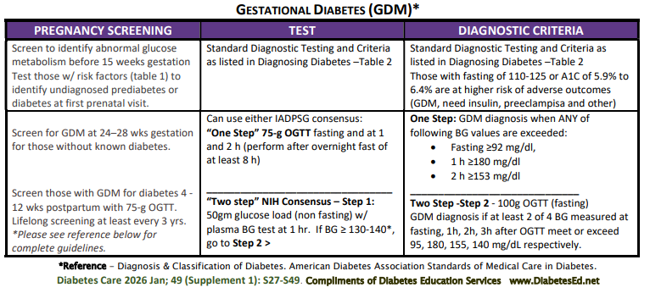
See Diabetes and Pregnancy Level 2
Screening and Diagnosis of Diabetes Cheat Sheet

Slide 87

Diabetes Bingo “DiaBingo”
Shout out Right Answer

Slide 88
DiaBingo
B Frequent skin and yeast infections
B A BMI of ____ or greater indicates increased pre/diabetes risk?
B To reduce complications, control A1c, Blood pressure, Cholesterol
B PreDiabetes – fasting glucose level of ___ to ____
B Erectile dysfunction indicates greater risk for ____
B Diabetes – fasting glucose level____ or greater
B Type 1 diabetes is best described as an ______ disease
B People with diabetes are ______ times more likely to die of heart dx
B Elevated triglycerides, < HDL, smaller dense LDL
B Each percentage point of A1C = _____ mg/dl glucose
B At dx of type 2, about __% of the beta cell function is lost
B Diabetes – random glucose ____ or greater

Slide 89

Standard 3 & AACE Prevention and Delay of Diabetes

Slide 90
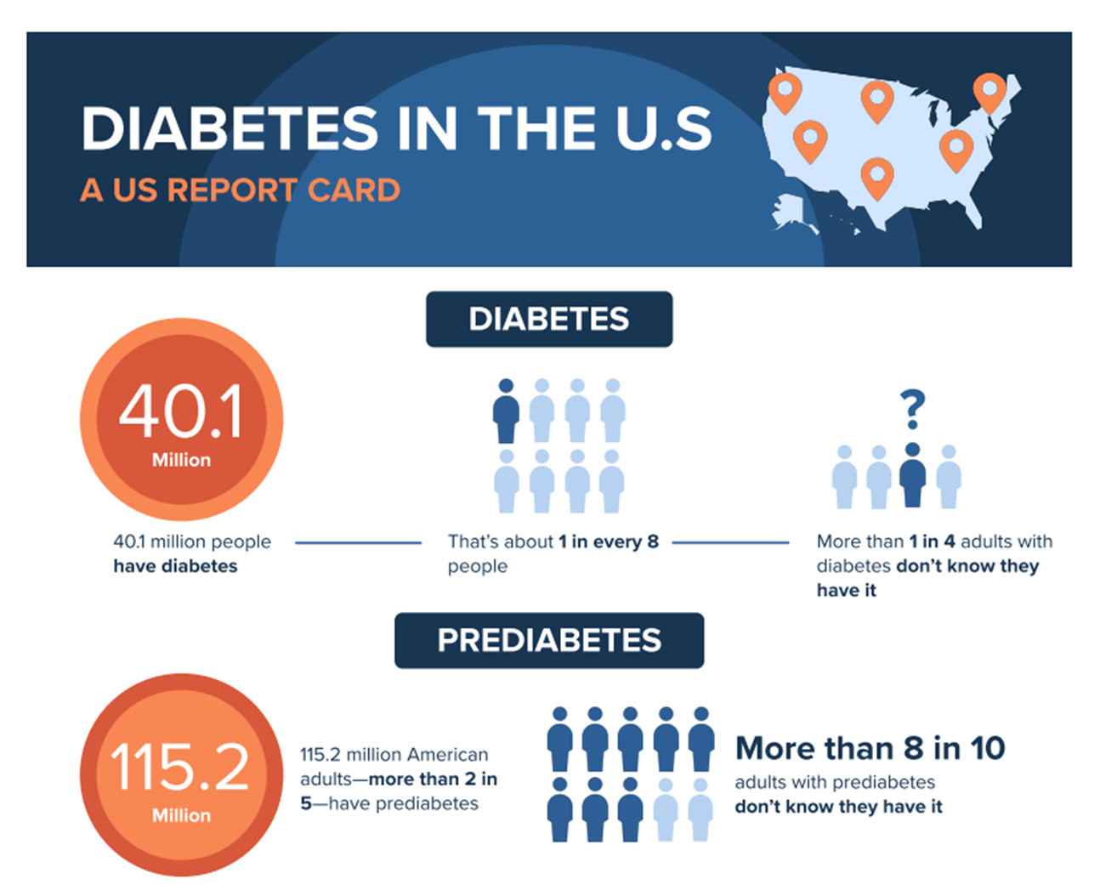

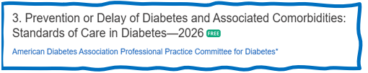
PreDiabetes is FREAKING ME OUT
96 million people in US
80% don’t know they have it
In 3-5 years, about 30% of predm will get diabetes
Associated with higher rates of heart attack, stroke, neuropathy and vessel disease

Slide 91

3. Prevent or Delay Diabetes for those with Prediabetes
Prediabetes defined as:
  A1c 5.7 – 6.4% or fasting BG 100 -125mg/dl
Action:
  Screen yearly for diabetes
  For adults with BMI 23/25
    Refer to DPP approved programs
  Should be covered by third-party payers,
  Address inconsistencies in access – leverage technology
Monitor people with prediabetes at least annually for development of type 2 diabetes.

Slide 92
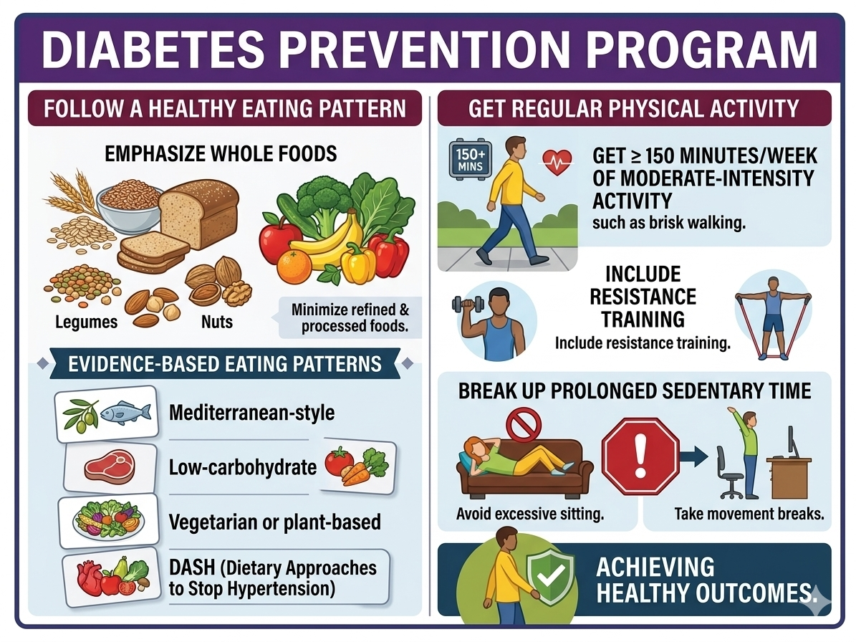
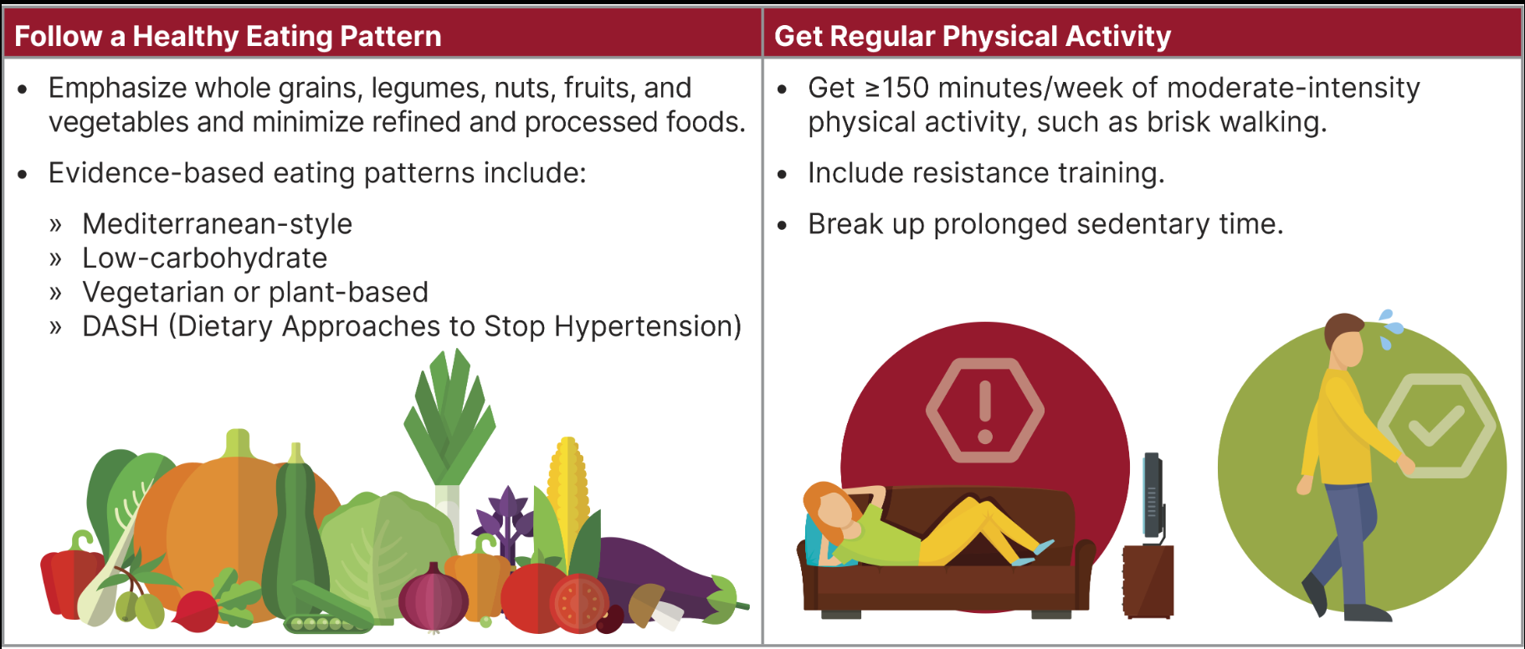
Diabetes Prevention Program

Slide 93
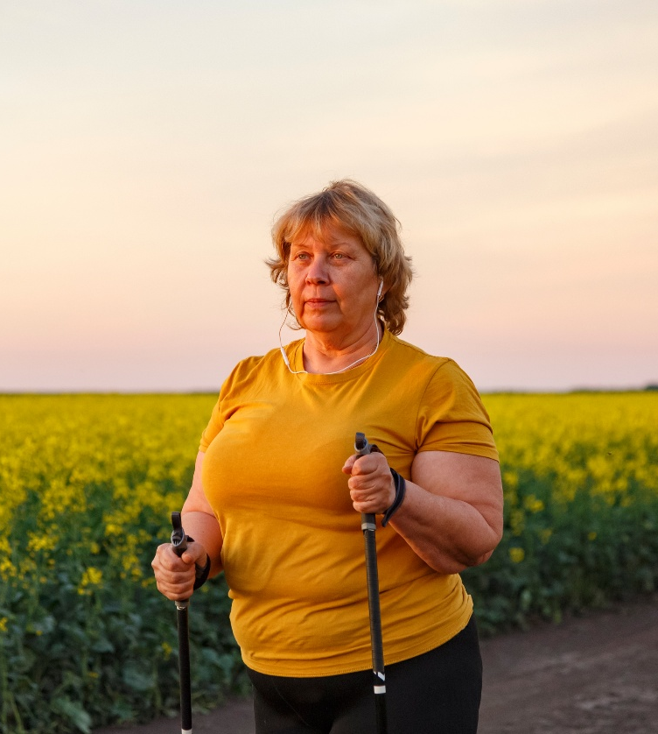
DPP Short Term & Long-Term Evidence
The U.S. DPP trial demonstrated intensive lifestyle intervention
Reduces risk of incident type 2 diabetes by 58% over 3 years.
In the U.S. Diabetes Prevention Program Outcomes Study (DPPOS) benefits continued:
  34% reduction at 10 years
  27% reduction at 15 years
  24% reduction at 21 years*
*major cardiovascular events were not significantly different from comp group 21 years after the DPP concluded.

Slide 94

Sleep quality and Diabetes Risk
Sleep quality “an individual’s self-satisfaction with all aspects of sleep experience.”
Sleep modulates important metabolic, endocrine, cardiovascular processes.
Poor sleep quality associated with 40% increased risk of developing type 2 diabetes
Night owls have 2.5 higher odds for type 2 than early birds (chronotype)

Slide 95
3. Metformin & Prediabetes
Use metformin for prevention of type 2 for those at high risk:
  25–59 yrs with BMI ≥35
  A1C 6.0% or more
  History of GDM
Periodic assess of B12, esp if have anemia, peripheral neuropathy.
Consider Metformin to prevent hyperglycemia in high-risk individuals:
Ind’s treated with Chemo medications:
  Phosphatidylinositol 3-kinase α (PI3Kα) inhibitor (e.g., alpelisib and inavolisib).
  High dose steroids

Slide 96
Poll Question 5
A 36-year-old has an A1C of 6.2%, BMI of 36, hypertension, and a strong family history of type 2 diabetes. Despite sustained nutrition and physical activity interventions, they can’t seem to lower their A1C. They ask whether medication could help reduce their risk of developing type 2 diabetes. Which approach is MOST consistent with American Association of Clinical Endocrinology (AACE) recommendations?
A. Avoid pharmacologic treatment until the A1C or FPG reaches the diagnostic threshold for diabetes.
B. Consider pharmacotherapy, including metformin or GLP-1–based therapy to reduce metabolic risk.
C. Initiate a sulfonylurea to improve beta-cell function and prevent progression to type 2 diabetes.
D. Initiate basal insulin to preserve pancreatic beta-cell function and lower A1C.

Slide 97
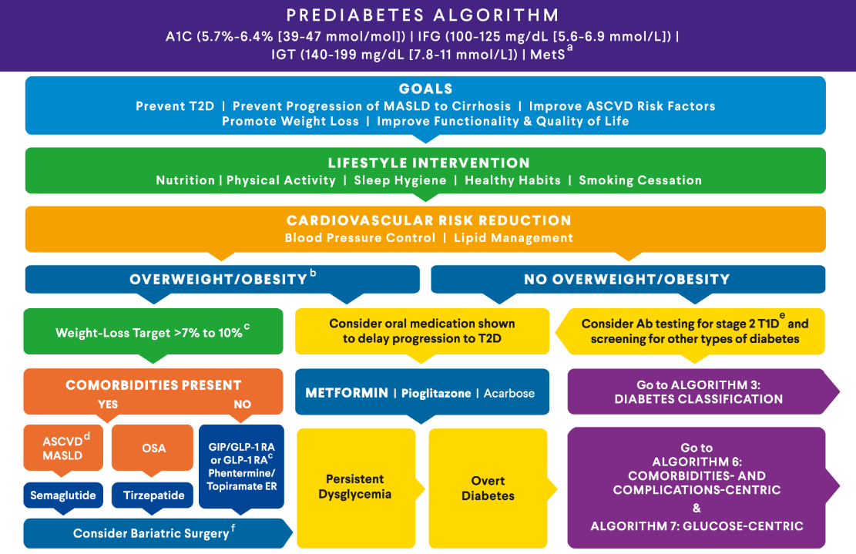
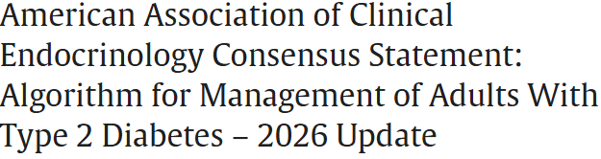

Slide 98

GLP-1 Therapy for Prediabetes?
The use glucagon-like peptide 1–based therapies for weight management in individuals with BMI of 25+ is highly beneficial and should be considered.
Every kilogram of weight loss confers a 16% reduction in risk of progression over 3.2 years

Slide 99

Incretins:
GLP-1 & GLP-1/GIP Receptor Agonists
GLP-1: glucagon like peptide 1
GIP: glucose-dependent insulinotropic polypeptide

Slide 100

The Rise of GLP-1 Agonists
1st available in 2005 (exenatide)
Semaglutide FDA approval 2017
Tirzepatide FDA approval 2022
12% (1 in 8 adults) said they have taken a GLP-1 agonist
KFF Health Tracking Poll May 2024: The Public’s Use and Views of GLP-1 Drugs | KFF
Notes:
KFF Health Tracking Poll May 2024: The Public’s Use and Views of GLP-1 Drugs | KFF
12% (1 in 8 adults) said they have taken a GLP-1 agonist including 43% of people with diabetes

Slide 101
Polling Question 6
GLP-1 Medications are approved for all of the following conditions except:
Obesity
Type 2 Diabetes
Sleep apnea
Alcohol use disorder
Kidney disease
Notes:
Correct answer: D

Slide 102

Understanding the Natural Role of Incretins
GIP secreted by K-cells upon ingestion of food in the proximal small intestine
GLP-1 secreted upon ingestion of food by L-cells in the distal small intestine
Promotes satiety and
reduces appetite
Alpha cells:
↓ Postprandial
glucagon secretion
↑ Beta-cell
response
Liver:
↓ Glucagon reduces hepatic glucose output
Beta cells:
Enhances glucose-dependent insulin secretion
Stomach:
Helps regulate gastric emptying
Adapted from Flint A, et al. J Clin Invest. 1998;101:515-520
Adapted from Larsson H, et al. Acta Physiol Scand. 1997;160:413-422
Adapted from Nauck MA, et al. Diabetologia. 1996;39:1546-1553
Adapted from Drucker DJ. Diabetes. 1998;47:159-169
GLP-1 degraded by
DPP-4 w/in minutes
Notes:
102
102
DISCUSSION POINTS:
--Upon food ingestion, GLP-1 is secreted into the circulation from L cells of small intestine.
--GLP-1 increases beta-cell response by enhancing glucose-dependent insulin secretion.
--GLP-1 decreases beta-cell workload and hence the demand for insulin secretion by:
--Regulating the rate of gastric emptying such that meal nutrients are delivered to the small intestine and, in turn, absorbed into the circulation more smoothly, reducing peak nutrient absorption and insulin demand (beta-cell workload)
--Decreasing postprandial glucagon secretion from pancreatic alpha cells, which helps to maintain the counterregulatory balance between insulin and glucagon
--Reducing postprandial glucagon secretion, GLP-1 has an indirect benefit on beta-cell workload, since decreased glucagon secretion will produce decreased postprandial hepatic glucose output
--Having effects on the central nervous system, resulting in increased satiety (sensation of satisfaction with food intake) and a reduction of food intake
--By decreasing beta-cell workload and improving beta-cell response, GLP-1 is an important regulator of glucose homeostasis.
SLIDE BACKGROUND:
--Effect on Beta-cell: Drucker DJ. Diabetes. 1998; 47:159-169
--Effect on Alpha cell: Larsson H, et al. Acta Physiol Scand. 1997; 160:413-422
--Effects on Liver: Larsson H, et al. Acta Physiol Scand. 1997; 160:413-422
--Effects on Stomach: Nauck MA, et al. Diabetologia. 1996; 39:1546-1553
--Effects on CNS: Flint A, et al. J Clin Invest. 1998; 101:515-520

Slide 103

Action of GLP-1 and GIP
Samms RJ, Coghlan MP, Sloop KW. How May GIP Enhance the Therapeutic Efficacy of GLP-1? Trends Endocrinol Metab. 2020 Jun;31(6):410-421.
Notes:
GIP: Glucose-dependent Insulinotropic Polypeptide
GLP: glucagon-like peptide

Slide 104

PocketCard: GLP-1 & GIP RA

Slide 105
Incretin Device Show/Tell

Slide 106
Oral Semaglutide (Rybelsus, Ozempic)
Barriers to GLP-1 oral absorption:
  Degradation by gastrointestinal enzymes
  pH induced conformational changes
  Limited protein permeability of the intestinal membrane
Semaglutide co-formulated with sodium N-(8-[2-hydroxybenzoyl] amino) caprylate (SNAC), an absorption enhancer
Absorbed in stomach where SNAC causes a localized increase in pH, leading to higher solubility and protection against proteolytic degradation
Take daily at least 30 mins before first food, beverage, or other oral meds
Take with no more than 4 ounces of plain water
Swallow tablets whole (don't cut or crush)

Slide 107


SURPASS (Tirzepatide): A1C Change
Rosenstock J, et al. Lancet. 2021;398:143–55. Frias JP, et al. N Engl J Med. 2021;358:503–15. 82. Ludvik B, et al. Lancet. 2021;398:583–98. 83. Del Prato S et al. Lancet. 2021;398:1811–24. 84. Dahl Det al. Diabetologia. 2021:64(Suppl. 1):S13. Abstr 20. Kaneko S.. touchREV Endocrinol. 2022 Jun;18(1):10-19.

Slide 108

SURPASS (Tirzepatide): Body Weight Change
Rosenstock J, et al. Lancet. 2021;398:143–55. Frias JP, et al. N Engl J Med. 2021;358:503–15. 82. Ludvik B, et al. Lancet. 2021;398:583–98. 83. Del Prato S et al. Lancet. 2021;398:1811–24. 84. Dahl Det al. Diabetologia. 2021:64(Suppl. 1):S13. Abstr 20. Kaneko S.. touchREV Endocrinol. 2022 Jun;18(1):10-19.

Slide 109

GLP-1 Safety Profile
Drucker DJ. Efficacy and Safety of GLP-1 Medicines for Type 2 Diabetes and Obesity. Diabetes Care. 2024 Nov 1;47(11):1873-1888.
Notes:
Figure 2—Established and putative AEs associated with GLP-1 medicines. AEs in gray background described with red boldface text are established and common, with gastrointestinal AEs observed in 40%–65% of participants, whereas gallbladder AEs are reported in up to 3% of exposed participants, acute kidney injury is reported in

Slide 110
Poll Question 7
Alice injects tirzepatide once a week. Which of the following is true?
May experience constipation
May cause hypoglycemia
Muscle aches are common
Doubles risk of pancreatitis
Notes:
Answer: A

Slide 111
GLP-1 Adverse Effects
GI side effects
  Nausea, appetite loss, diarrhea, constipation, dyspepsia, abdominal pain
Pancreatitis
Hypoglycemia with concomitant use of insulin or secretagogues
Acute kidney injury
Thyroid C-Cell tumors –black box warning
  Avoid if personal or family history of medullary thyroid carcinoma or personal history of MEN-2
Acute gallbladder disease
Worsening retinopathy
Package inserts.
Notes:
Pancreatitis: Acute pancreatitis, including fatal and nonfatal hemorrhagic or necrotizing pancreatitis, has been observed in patients treated with GLP-1 receptor agonists. Pancreatitis has been reported in Mounjaro clinical trials. Mounjaro has not been studied in patients with a prior history of pancreatitis. It is unknown if patients with a history of pancreatitis are at higher risk for development of pancreatitis on Mounjaro. Observe patients for signs and symptoms including persistent severe abdominal pain sometimes radiating to the back, which may or may not be accompanied by vomiting. If pancreatitis is suspected, discontinue Mounjaro and initiate appropriate management.
In both male and female rats, tirzepatide causes dose-dependent and treatment-duration-dependent thyroid C-cell tumors at clinically relevant exposures. It is unknown whether Mounjaro causes thyroid C-cell tumors, including medullary thyroid carcinoma (MTC), in humans as human relevance of tirzepatide-induced rodent thyroid C-cell tumors has not been determined.
Mounjaro is contraindicated in patients with a personal or family history of MTC or in patients with Multiple Endocrine Neoplasia syndrome type 2 (MEN 2). Counsel patients regarding the potential risk for MTC with the use of Mounjaro and inform them of symptoms of thyroid tumors (e.g., a mass in the neck, dysphagia, dyspnea, persistent hoarseness). Routine monitoring of serum calcitonin or using thyroid ultrasound is of uncertain value for early detection of MTC in patients treated with Mounjaro.
Mounjaro has been associated with gastrointestinal adverse reactions, which include nausea, vomiting, and diarrhea. These events may lead to dehydration, which if severe could cause acute kidney injury. In patients treated with GLP-1 receptor agonists, there have been postmarketing reports of acute kidney injury and worsening of chronic renal failure, sometimes requiring hemodialysis. Some of these events have been reported in patients without known underlying renal disease. A majority of reported events occurred in patients who had experienced nausea, vomiting, diarrhea, or dehydration. Monitor renal function when initiating or escalating doses of Mounjaro in patients with renal impairment reporting severe adverse gastrointestinal reactions.
In clinical trials, acute gallbladder disease was reported by 0.6% of Mounjaro-treated patients and 0% of placebo-treated patients. If cholelithiasis is suspected, gallbladder diagnostic studies and appropriate clinical follow-up are indicated.

Slide 112
GLP-1 FDA Warning
Pulmonary Aspiration During General Anesthesia or Deep Sedation
Rare post marketing reports of pulmonary aspiration in patients receiving GLP-1 RA undergoing elective surgeries or procedures requiring general anesthesia or deep sedation who had residual gastric contents despite following preoperative fasting recommendations
Instruct patients to inform healthcare providers prior to any planned surgeries or procedures if they are taking a GLP-1 RA

Slide 113
Holding GLP-1 RA Before Surgery?
Balance withholding GLP-1 RA with risk of hyperglycemia
Consider rapid sequence intubation, longer liquid fast or POC ultrasound to reduce risk of aspiration
Bridging off therapy can be resource intensive, and lead to other SE-hyperglycemia or hypoglycemia
If decision to hold, general guidance
  1 day for daily formulations
  1 week for weekly formulations
Joshi, Girish P. et al. Preprocedure Care of Patients on Glucagon-like Peptide-1 Receptor Agonists: A Multisociety Clinical Practice Guidance. Anesthesiology 141(6):p 1208-1209, December 2024.
Notes:
1a. When an elevated risk of delayed gastric emptying and aspiration exist, withholding of GLP 1RAs should be balanced with the surgical and med ical risk of inducing the potential for a hazardous, metabolic disease state, like hyperglycemia. Further, bridging therapy off a GLP-1RA may be resource intensive, cost or insurance prohibitive, and risk other adverse side effects like hypoglycemia. Finally, with holding GLP-1RA perioperatively only for patients with the diseases of overweight and obesity, without an indication as described in Recommendation 1a, could constitute overweight and obesity bias, which should be avoided. c) If the decision to hold GLP-1RAs is indicated givenan unacceptable safety profile following shared decision making in the preoperative period, the duration to hold therapy is unknown [7]. At this time, it is suggested to follow the original guidance of the American Society of Anesthesiologists, holding the day of surgery for daily formulations, and a week prior to surgery for weekly formulations [4]. All patients should still be assessed on the day of procedure for symptoms sug gestive of delayed gastric emptying.

Slide 114

Counseling Points: GLP-1 RA & GLP-1/GIP
Avoid in combo with DPP-4 inhibitors
Potential risk of pancreatitis
Watch for intestinal obstruction
Increased risk of biliary disease
Education: Eat smaller meals to reduce nausea and limit high fat meals
Use of non-FDA compounded products not recommended
If on tirzepitide, use back up contraception for first 4 weeks
Ask about recent eye exam
  Potential increase in diabetes retinopathy
  Nonarteritic anterior ischemic optic neuropathy (NAION) reported (rare incidence)
Notes:
Biliary disease: evaluate for gallbladder disease if chole lithiasis or cholecystitis is suspected; avoid use in at-risk individuals • Ileus: reported, but risk level is not well established • Diabetic retinopathy: close monitoring of retinopathy in those at high risk (older individuals and those with longer duration of T2D [≥10 years]) • Nonarteritic anterior ische mic optic neuropathy (NAION) reported (rare inci dence); monitor for NAION during eye examinations

Slide 115

Poll Question 8
AR is 36 years old with type 2 diabetes and a BMI of 41kg/m². Current diabetes medications include: metformin, sitagliptin (Januvia) and empagliflozin (Jardiance) at maximum doses. AR is prescribed tirzepatide (Mounjaro). Based on this information, what action do you recommend to the provider?
Verify kidney function first.
Stop the sitagliptin when initiating tirzepatide.
Decrease the dose of metformin to prevent hypoglycemia.
Evaluate thyroid function before starting tirzepatide.
Notes:
Answer is B.

Slide 116

Standard 8 Obesity and Weight Management

Slide 117
Injectable Incretins Approved for Weight Loss
Liraglutide:
  Saxenda 3 mg
Semaglutide inj:
    Wegovy 2.4mg
    Wegovy high dose 7.2mg
Tirzepatide
  Zepbound 15mg (wt loss)
All 3 Approved for use in adults:
  to reduce excess body weight and maintain weight reduction long term in adults with obesity or adults with overweight in the presence of at least one weight-related comorbid condition
Semaglutide (Wegovy) also indicated for those overweight/obesity & ASCVD to reduce CVD events and for those with metabolic dysfunction-associated steatohepatitis (MASH)
Tirzepatide (Zepbound) also indicated for those with obesity & Sleep Apnea

Slide 118
Oral GLP-1 RA Approved for Weight Loss
Semaglutide oral:
  Wegovy 25mg
Orforglipron oral
  Foundayo 17.2 mg
Both Approved for use in adults with :
  to reduce excess body weight and maintain weight reduction long term in adults with obesity or adults with overweight in the presence of at least one weight-related comorbid condition
Oral Semaglutide (Wegovy) also indicated for those overweight/obesity & ASCVD to reduce CVD events
Notes:
Orforglipron is a non-peptide small molecule that doesn’t require special consdierations when eating/drinking or taking other pills.

Slide 119


GLP-1/GIP Receptor Agonist Indications
Package inserts, dailymed.nlm.nih.gov 2026

Slide 120
Where Do Incretins Fit within the Guidelines for Diabetes?

Slide 121



Slide 122

AACE Glucose-Centric Algorithm

Slide 123


Slide 124
The Future of Incretins is Bright
TIRZEPATIDE
PEMVIDUTIDE
SURVADUTIDE
ORAL
Monthly GLP-1/GIP agonist
Amylin and GLP-1 Agonist
Cagri-Sema Redefine
GIP
Glucagon
GLP-1 Agonist
Monoclonal antibody blocking activin type 2 receptors
GIP/GLP-1 Agonist
SURMOUNT trials
Glucagon/
GLP-1 Agonist
GLP-1 Agonist
High dose oral semaglutide
Non peptide
Orforglipron
Maritide
CAGRILINTIDE-SEMAGLUTIDE
RETATRUTIDE
BIMAGRUMAB

Slide 125

Standard 4 – Comprehensive Medical Evaluation & Assessment

Slide 126


4. Comprehensive Medical Evaluation and Assessment of Comorbidities
Use person-centered communication, culturally sensitive, strength-based language and active listening;
Elicit individual preferences and beliefs; develop self-management plan together.
Diabetes Care coordinated by multi disciplinary team:
  CDCES, Providers, nurses, dietitians, exercise specialists, pharmacists, dentists, podiatrists, and behavioral health professionals.
Goal is to optimize health outcomes and quality of life.

Slide 127


Slide 128

Diabetes Goals and Treatment Plan
The goals of treatment for diabetes are to prevent or delay complications and optimize quality of life.
Goals and plans co-created by the care team and individual based on preferences, values, and goals.
Management plan considers the person’s:
Age, cognitive abilities, school/work schedule and conditions,
Health beliefs, support systems, social situation, financial concerns, cultural factors, literacy and numeracy
Eating patterns, physical activity, (mathematical literacy)
Diabetes history (duration, complications, and current use of medications), comorbidities, disabilities, health priorities, other medical conditions
Preferences for care, access to health care services, and life expectancy

Slide 129


Standard 4 – Diabetes Medical Evaluation

Slide 130

Assessment and Treatment of Disabilities
Diabetes associated with increased risks of disability due to neuropathy, visual impairment and lower limb complications
Refer to specialist
Take preventive action to maximize quality of life.
Assess for disability at the initial visit and for decline in function at each subsequent. If a disability is impacting functional ability or capacity to manage their diabetes, refer to appropriate specialist.

Slide 131

Lab Eval at Initial & Annual Visit
A1c (each 3-6 mo’s)
Each year
  Lipids, CBC with platelets
  Liver function
  Spot urinary albumin-to-creat ratio (UACR))
  Serum creat and GFR
  TSH, celiac (type 1)
  B12 if on metformin >5yrs
  Calcium, Vita D, and phosphorus if appropriate
Serum K
  If on ACE, ARBs or diuretics

Slide 132

Referrals for Initial Care Mgmt
Eye professional – annual check
Family planning
RDN for Med Nutrition Therapy
DSMES - Diabetes Self-Management Education Support
Dentist for comprehensive dental examination
Behavioral health professional
Audiology if indicated
Social worker/community resources
Rehab medicine for cog/disability eval

Slide 133
Type 3c Diabetes (Pancreatogenic)
Includes both structural and functional loss of insulin secretion in the context of exocrine pancreatic dysfunction.
About 5-10% of diabetes, often misdiagnosed as type 2 diabetes.
Insulin sensitive
Assess wt loss, fatty stools – indications may need pancreatic enzyme replacement therapy (PERT).
The diverse set of etiologies includes:
  pancreatitis (acute and chronic) ~70%
  trauma or pancreatectomy
  neoplasia
  cystic fibrosis
  hemochromatosis
  fibrocalculous pancreatopathy
Screen for diabetes within 3-6 months of pancreatitis & annually.

Slide 134

Pancreatitis
People with diabetes 2xs risk of acute pancreatitis
After episode of pancreatitis, one third of people will get prediabetes or diabetes
  About 25% to 80% of people with chronic pancreatitis develop Type 3c diabetes.
Pancreatitis is an exocrine dysfunction:
  Disrupts global architecture or physiology of pancreas
  Results in both exocrine and endocrine dysfunction.
Screen people for diabetes within 3–6 months following an episode of acute pancreatitis and annually thereafter

Slide 135

AACE 2026 Classification Algorithm

Slide 136


Assess Risk factors for Fracture
Avoid TZDs if high risk and use caution with medications that can cause hypo (insulin, meglitinides and sulfonylureas)

Slide 137

Sexual and Dental Health
Screen for those with prediabetes and diabetes for sexual dysfunction.
Men – erectile dysfunction and level of libido
Dental health
Coordinate efforts between medical and dental teams.
Refer for dental exam at least once a year.
Treatment can lower A1C 0.4%

Slide 138

Women with Diabetes & Sexual Health
Screening for desire (libido), arousal, and orgasm difficulties, particularly in those who experience depression and/or anxiety and those with recurrent urinary tract infections
In postmenopausal women, screen for symptoms and/or signs of genitourinary syndrome of menopause, including vaginal dryness and dyspareunia.

Slide 139

PCOS to PMOS

Slide 140



Metabolic dysfunction–associated steatotic liver disease (MASLD)
Recent studies estimate that MASLD is prevalent in >70% of adults with type 2.
50% of people with MASLD have MASH (Metabolic Associated Steatohepatitis)
  MASH = 5% plus hepatic steatosis with inflammation and hepatocyte injury (hepatocyte ballooning), with or without evidence of liver fibrosis
Screen for liver fibrosis using FIB 4 Index
  Uses liver enzymes (ALT & AST), platelet count plus age
  If positive, (FIB ≥ 1.3) follow-up with imaging or ultrasound
Join our Level 2 Critical Assessment of People with Diabetes

Slide 141

Screening for MASH – FIB-4
FIB-4 estimates risk of hepatic cirrhosis (age 35+):
Calculated by imputing:
  Age
  plasma aminotransferases (AST and ALT)
  and platelet count
FIB-4 Risk Levels
  Lower risk is <1.3
  Intermediate 1.3 to 2.67
  High risk >2.67
    considered as having a high probability of advanced fibrosis (F3–F4).
The American College of Gastroenterology considers Upper limit of normal ALT levels:
29–33 units/L for males
19–25 units/L for female individuals
(mdcalc.com/calc/2200/fibrosis-4-fib-4-index-liver-fibrosis).

Slide 142


Poll Question 9
In the 2026 ADA Standards they recommend pharmacologic agents along with lifestyle interventions to treat people with diabetes and Metabolic Associated Steatohepatitis (MASH). Which of the following are the recommended diabetes medications to treat MASH?
Vitamin E and SGLT-2
Pioglitazone and/or GLP-1 RA / GIP
Fish oil supplements and statin
Metformin and/or bolus insulin therapy

Slide 144


Insulin Sensitizers
Action: decrease insulin resistance by making muscle and adipose cells more sensitive to insulin; decrease free fatty acids
Name:
  pioglitazone (Actos) – bladder cancer warning
    Dosing: 15-45 mg daily
    Consider adding low dose if history of stroke or have steatosis
Efficacy/ Considerations
  Reduce A1C ~0.5-1.0%
  6 to 12 weeks for maximum effect
  pioglitazone $5 a month
  Can cause fluid retention, avoid w/ CHF
Notes:
144
144

Slide 145
AACE Glucose-Centric Algorithm

Slide 147

Immunization Schedule for Diabetes 2026
Vaccine | Who by Age | Series and Frequency
Hepatitis B Vaccine | Adults ≤ 60 years* | 2-3 dose series
RSV | Adults ≥ 60 years | Single dose
Influenza (avoid live attenuated vaccine) | All | Annually
Tetanus, diphtheria, pertussis (Tdap) | All adults; extra dose during pregnancy | Booster every 10 years.
Zoster | Adults ≥ 50 years | 2 dose Shingrix
COVID-19 | Starting at age 6 mo’s | Initial vaccination and boosters
Pneumonia (PPSV23) Pneumovax | Adults19-64* | See Standards for schedule and details and for those 65 or older.
*Pneumococcal Conjugate Vaccine (PCV15, PCV20) | Adults 19-64 with underlying risk factors or no previous vaccination* | May need PPSV23 follow-up vaccine ≥1 year.* If 65+, discuss with provider.
2026 ADA Standards, Vol.49, s67 – s68
*See Table 4.3 for detailed info/considerations
.
For education purposes only. Compliments of www.DiabetesEd.net

Slide 148

Samson SL, Vellanki P, Blonde L, Hirsch IB, Hoang TD, Isaacs SD, Izuora KE, Low Wang CC, Ooi CP, Padilla BI, Schulman-Rosenbaum R, Twining CL, Umpierrez GE, Valencia WM. American Association of Clinical Endocrinology Consensus Statement: Algorithm for Management of Adults With Type 2 Diabetes - 2026 Update. Endocr Pract. 2026 Mar 17:S1530-891X(26)00022-4. doi: 10.1016/j.eprac.2026.01.006. Epub ahead of print. PMID: 41842862.
Notes:
Samson SL, Vellanki P, Blonde L, Hirsch IB, Hoang TD, Isaacs SD, Izuora KE, Low Wang CC, Ooi CP, Padilla BI, Schulman-Rosenbaum R, Twining CL, Umpierrez GE, Valencia WM. American Association of Clinical Endocrinology Consensus Statement: Algorithm for Management of Adults With Type 2 Diabetes - 2026 Update. Endocr Pract. 2026 Mar 17:S1530-891X(26)00022-4. doi: 10.1016/j.eprac.2026.01.006. Epub ahead of print. PMID: 41842862.
CopyDownload .nbib

Slide 149

Herbal Supplements
Berberine
Zinc
Vitamin D
Cinnamon
Ginseng
Aloe Vera
Chromium
Alpha lipoic acid
Magnesium
Gymnema
Notes:
10 Supplements to Help Lower Blood Sugar
NatMed Pro
Natureal medicine database

Slide 150

Deciding to Take Herbal Supplements
Lack of regulation with herbal supplements
Provide reliable education on costs/benefits/risks
Empower patients to make informed decisions

Slide 151

Standard 5 Lifestyle & DSMES

Slide 152


5. Facilitating Positive Health Behaviors and Well Being to Improve Health Outcome
Building positive health behaviors and maintaining psychological well-being are foundational for achieving diabetes management goals and maximizing quality of life
Engage in person-centered collaborative care and shared decision making

Slide 153

Critical Times to Provide/Modify DSMES
At diagnosis.
Annually and/or when not meeting treatment goals.
When complicating factors develop (medical, functional, psychosocial).
When transitions in life and care occur.
Powers MA, Bardsley JK, et al. DSMES Consensus Report, The Diabetes Educator, 2020
ADCES. AADE7 Self-Care Behaviors, The Diabetes Educator, 2020
Notes:
Referral to DSMES is fluid and applied when needed. The ADA has listed the critical times to refer to DSMES. All people with diabetes should participate in a developmentally and culturally appropriate DMSES as it helps identify appropriate strategies and coping skills.

Slide 154
DSMES Benefits
↑ Knowledge
↓ A1c and weight
↑ Quality of life
↓ Mortality
Positive coping
↓ Cost
< 10% referred receive DSMES
↑ primary care, preventive services
↓ frequency of acute care and inpt admissions
More likely to follow best practice recommendations (esp. those with Medicare)
Notes:
With engagement and tailoring of DSMES interventions we see greater outcomes and benefits.
DSMES has been shown to…..
Lower A1c by about 0.55% (https://www.cdc.gov/diabetes-toolkit/php/business-case/overall-value-roi.html#:~:text=A%20systematic%20review%20of%20DSMES,in%20hemoglobin%20A1C%20of%200.55%25.)
Reduced cost: In 2022 cost was 413 billion dollars annually (about 20000 per person) with $307 billon dollars in direct health care costs and the remainder in reduced productivity.
Less than 5% of Medicare beneficiaries and 6.8% of people with private insurance use these services in their first year of diagnosis. And only 53% of individuals eligible receive it.
https://www.cdc.gov/diabetes/health-equity/increase-diabetes-education.html

Slide 155

Diabetes Distress & Screening Tools
Screen for diabetes distress at least annually in people with diabetes, caregivers, and family members.
Repeat screening when treatment goals are not met, at transitional times, and/or in the presence of diabetes complications.
Consider referral to a qualified behavioral health professional, ideally one with experience in diabetes, for further assessment and treatment if not adequately addressed during medical appointments
The ADA provides access to tools for screening specific psychosocial topics, such as diabetes distress, fear of hypoglycemia, and other relevant psychological symptoms
professional.diabetes.org/sites/default/files/media/ada_mental_health_toolkit_questionnaires.pdf

Slide 156

Addressing Diabetes Distress
Involves initiating a conversation about feelings and beliefs in a respectful, sensitive, and direct manner.
Create a space for emotional disclosure, validating the emotional aspects of diabetes, and linking emotions to self-management behaviors.
HCP’s can introduce brief coping strategies (e.g., values affirmation, mindful breathing, cognitive reframing) and highlight past successes to reinforce resilience.

Slide 157

EMBARK Trial
EMBARK: A Randomized, Controlled Trial Comparing Three Approaches to Reducing Diabetes Distress and Improving HbA_{1c} in Adults With Type 1 Diabetes. Diabetes Care 2024; dc232452. https://doi.org/10.2337/dc23-2452

Slide 158

Embark Trial – Emotions as Priority
I have finally given myself permission to make addressing the emotional aspects of diabetes a priority.
~Coach Beverly

Slide 159

Cognitive Capacity Monitoring
Monitor cognitive capacity throughout the life span for all individuals with diabetes.
Particularly in those who have:
  documented cognitive disabilities,
  those who experience severe hypoglycemia,
  very young children, and
  older adults.
If cognitive capacity changes or appears to be suboptimal for decision-making and/or behavioral self-management, consider referral for a formal assessment.

Slide 160

Medical Nutrition Therapy Works
MNT is effective and beneficial to people with prediabetes and diabetes.
When delivered by an RDN, MNT is associated with A1C absolute decreases of:
  1.0–1.9% for people with type 1 diabetes and
  0.3–2.0% for people with type 2 diabetes

Slide 161

Enjoy Lunch Break 12:00 to 1:00 PM

Slide 162

Standard 9 & AACE – Pharmacologic Therapy for Type 2 Diabetes

Slide 163

SGLT-2 Inhibitors

Slide 164

SGLT and the Kidney

Slide 165

Additional SGLT2 Inhibitor Effects
Gaggini M, et al. Cells. 2025 Mar 6;14(5):387. doi: 10.3390/cells14050387.
Notes:
Gaggini M, Sabatino L, Suman AF, Chatzianagnostou K, Vassalle C. Insights into the Roles of GLP-1, DPP-4, and SGLT2 at the Crossroads of Cardiovascular, Renal, and Metabolic Pathophysiology. Cells. 2025 Mar 6;14(5):387. doi: 10.3390/cells14050387. PMID: 40072115; PMCID: PMC11898734

Slide 166

Poll Question 1
FZ has type 2 diabetes and kidney disease. He was recently diagnosed with an A1C of 7.1%. What is the best medication to start?
Pioglitazone
Tirzepatide
Metformin
Dapagliflozin
Notes:
Answer: d

Slide 167


SGLT-2 Inhibitors- “Flozins”
Action: decrease renal reabsorption of glucose in the proximal tubule of kidneys (reset renal threshold)
Preferred diabetes treatment for people with heart failure and kidney disease. Decreases BG & CV Risk
Dapagliflozin now generic
% ‘f
Notes:
167
167

Slide 168
SGLT-2 Inhibitor Dosing and Renal Adjustments
Drug | Dose | Renal Adjustment
Ertugliflozin (Steglatro) | 5-15 mg daily | Not recommended for eGFR <45
Dapagliflozin (Farxiga) | 5-10 mg daily | Not recommended to initiate with eGFR <45 (glycemic control) or <25 (other conditions): may continue for CV, CKD benefits
Empagliflozin (Jardiance) | 10-25 mg daily | Not recommended to initiate for eGFR <30 (glycemic control), may continue for CV, CKD benefits
Canagliflozin (Invokana) | 100-300 mg daily | eGFR 30 to <60: 100 mg once daily eGFR <30: avoid initiation, may continue 100mg daily for kidney benefits
Bexagliflozin (Brenzavvy) | 20 mg daily | Not recommended for eGFR <30
Package inserts, dailymed.nlm.nih.gov
Package inserts, dailymed.nlm.nih.gov
Notes:
Withhold DAPAGLIFLOZIN TABLETS for at least 3 days, if possible, prior to major surgery or procedures associated with prolonged fasting.

Slide 169
SGLT-2 Inhibitor Indications
Drug | Lowers BG | CV Indication | Heart Failure Indication | Kidney Indication
Dapagliflozin (Farxiga) | Yes for 10 yrs and older | Yes | Yes +/- Diabetes | Yes +/- Diabetes
Empagliflozin (Jardiance) | Yes for 10 yrs and older | Yes | Yes +/- Diabetes | Yes +/- Diabetes
Canagliflozin (Invokana) | Yes for 10 yrs and older | Yes | Yes w/ Diabetes | Yes w/ Diabetes
Ertugliflozin (Steglatro) | Yes | No | No, although showed benefit | No
Bexagliflozin (Brenzavvy) | Yes | No | No | No
Package inserts, dailymed.nlm.nih.gov

Slide 170
Benefits of SGLT-2 Inhibitors
A1C lowering
Modest weight loss
Cardiovascular
Renal
Heart failure
Blood pressure lowering

Slide 171
Side Effects of SGLT-2 Inhibitors
Tip: Hold for 3 days prior to surgery or procedures with prolonged fasting
Genitourinary infections
Volume depletion
Increased urination
Hypotension
Electrolyte changes
Diabetes ketoacidosis (DKA)
Amputation risk, Bone fracture (Canagliflozin)

Slide 172

Managing Adverse Effects
Maintain good hygiene to reduce risk of genital mycotic infections
  Higher risk with higher glucose
DKA risk
  Use caution with reducing insulin dose
  Report nausea, vomiting and malaise
Monitor BP
  May need to reduce antihypertensive meds (esp diuretics)
UTI risk greater with hyperglycemia

Slide 173
Where do SGLT2-2 Inhibitors Fit within the Guidelines?

Slide 174


Slide 176
AACE Glucose-Centric Algorithm

Slide 178

Case Study: Rick
Rick is a 51yoM diagnosed with type 2 diabetes 5 years ago.
He takes metformin 1000mg twice daily and semaglutide 2mg weekly. His A1C=6.7%.
In the last 3 months, he was diagnosed with heart failure with reduced ejection fraction. His kidney function is normal.
Weight: 205lbs, 5”7, BMI=32kg/m²
Notes:
Answer: D Metformin

Slide 179
Case Study: Rick
What is the best recommendation for Rick?
Focus on weight loss efforts
Add empagliflozin
Add pioglitazone
Add bexagliflozin
Notes:
Answer: B.

Slide 180
SGLT2 Inhibitors- How do they rate?
Question Answer
Cause hypoglycemia?
Cause weight gain?
Affordable?
Lowers Cardiorenal risk?
Can most tolerate /use?
No
No
Yes
Yes
Yes

Slide 181



Standard 6 - Glycemic Goals, Hypoglycemia and Hyperglycemic Crises

Slide 182

6. Glycemic Goals & Hypo
  A1C
  Blood Pressure
  Cardiovascular risk reduction

Slide 183
ADA 2026 ABC Goals
A1c less than 7% (individualize)
Pre-meal BG 80-130
Post meal BG <180
Time in Range (70-180) 70% of time
Blood Pressure
<130/80
<120/80 for high risk
Cholesterol
Statin therapy based on age & risk status
If 40+ with ASCVD Risk, decrease LDL by 50%, LDL <70
If 40+ with ASCVD, decrease LDL by 50%, LDL <55

Slide 184


Poll Question 2
Which of the following methods can be used to assess glycemic status?
    A. A1C
    B. Blood glucose monitoring
    C. Time in Range
    D. Fructosamine
    E. All of the above

Slide 185


6. Assess Glycemic Status
A1C measurement
Blood glucose monitoring (BGM)
  by capillary (finger-stick) devices
Continuous glucose monitoring (CGM)
  using time in range (TIR) or
  mean CGM glucose.
Fructosamine – 2-4 wk glucose average
  glycated albumin for those with anemia or hemoglobinopathies

Slide 186

6. Glycemic Targets for Non-Pregnant Adults
  A1c < 7% - a reasonable goal for adults.
  A1c < 6.5% - for those without significant risk of hypoglycemia
  A1c < 8% - for those with history of hypoglycemia, limited life expectancy, or those with longstanding diabetes and vascular complications.
  A1c Check Frequency:
    If meeting goal - At least 2 times a year
    If not meeting goal – Quarterly
  Also review Ambulatory Glucose Profile

Slide 187

A1c and Estimated Avg Glucose (eAG)
A1c (%) eAG__
5 97 (76-120)
6 126 (100-152)
7 154 (123-185)
8 183 (147-217)
9 212 (170 -249)
10 240 (193-282)
11 269 (217-314)
12 298 (240-347)
eAG = 28.7 x A1c-46.7 ~ 29 pts per 1%
Translating the A1c Assay Into eAG – ADAG Study

Slide 188


Slide 189



Time in Range
Strong correlation between TIR and A1C, with a goal of 70% TIR aligning with an A1C of ∼7%
Battelino T, et al. Diabetes Care. 2019;42(8):1593-1603.
Notes:
Beck RW, Bergenstal RM, Cheng P, Kollman C, Carlson AL, Johnson ML, Rodbard D. The Relationships Between Time in Range, Hyperglycemia Metrics, and HbA1c. J Diabetes Sci Technol. 2019 Jul;13(4):614-626. doi: 10.1177/1932296818822496. Epub 2019 Jan 13. PMID: 30636519; PMCID: PMC6610606.

Slide 190

Blood Glucose Monitoring vs. Continuous Glucose Monitoring (CGM)
= glucometer readings
Undetected hyperglycemia
Undetected hypoglycemia
Image created and permission to use granted by John Moorman, PharmD.
SMBG, self-monitoring of blood glucose.

Slide 191

(
American Diabetes Association Dia Care 2022 6.2 45- S89
Table 6.2
Notes:
Patient and disease factors used to determine optimal glycemic targets. Characteristics and predicaments toward the left justify more stringent efforts to lower A1C; those toward the right suggest less stringent efforts. A1C 7% = 53 mmol/mol. Adapted with permission from Inzucchi et al. (59).

Slide 192

Standard 7 - Diabetes Tech Tomorrow

Slide 193

6. Hypoglycemia – A Big Deal

Slide 194


Hypoglycemia (Glucose) Alert Values
BG <70mg/dl – Level 1
Follow 15/15 rule and contact provider to make needed changes
BG < 54mg/dl – Level 2
Indicates serious hypo. Contact provider for med change. Glucagon Emergency Kit
Severe Hypoglycemia – Level 3
Requires external assistance – no threshold

Slide 195

If hypo 15 Gm Carb Sources
4 ounces apple juice
3 - 4 Glucose Tablets
8 - 10 Lifesavers candy
8 - 10 Hard candies
2 Tablespoons Raisins
4 - 6 oz’s Fruit juice/soda
*Individuals using automated insulin delivery systems should typically ingest 5–10g carbs, unless hypo due to exercise or over insulinization.
Avoid foods with protein for people with type 2, since can stimulate insulin production.

Slide 196

Tx of Level 2 & 3 Hypoglycemia
If can swallow w/out risk of aspiration, try gel, honey, etc. inside cheek
If unable or unwilling to swallow, D50 IV or Glucagon
If on Insulin at risk for high risk for hypoglycemia, prescribe Glucagon ER Kit.
Glucagon injection (need Rx)
  Inform and instruct caregivers, school personnel, family, coworkers of hypo signs and appropriate action
  Dosing: Adults 1mg, Children <20kg 0.5mg
  Glycemic effect 20 - 30mg, short lived
  Must intake carb as soon as able
Re-evaluate diabetes med treatment plan.

Slide 197



Slide 198
SDOH and Hypoglycemia
Food insecurity, housing instability, underinsured, under-resourced living areas is associated with increased risk of hypoglycemia-related emergency department visits
Identify if fasting part of religious observances
Young children and older adults at highest risk due to lack of recognition of hypo symptoms
Insulin pumps with automated low-glucose suspend and automated insulin delivery systems have been shown to be effective in reducing hypoglycemia in type 1 diabetes

Slide 199

Assess Hypo History
Review history of hypoglycemia at every clinical encounter for all individuals at risk for hypoglycemia
Evaluate hypoglycemic events
Screen for impaired hypoglycemia awareness at least annually.
Consider individual’s risk for hypoglycemia when selecting diabetes medications and glycemic goals.
Use of CGM is beneficial and recommended for individuals at high risk for hypoglycemia.

Slide 200

Hypoglycemia: Clinical Risk Factors

Slide 201

Poll Question 3
JL is 78 and drinks a “few cocktails” every night. Lives with partner and takes basal insulin at night and bolus insulin as needed. Has had a few low blood glucose levels in past week of 62, 49 and 51. What is the most important recommendation?
A. Decrease alcohol intake
B. Check BG at least 4 times a day.
C. Double check injection sites.
D. Get glucagon rescue medication.

Slide 202


Slide 203


Sulfonylureas - Secretagogues or “Squirters”
Mechanism: Stimulate beta cells to release insulin
Dosed 1-2x daily before meals
Adverse effects
  Hypoglycemia, weight gain, watch renal function (increases risk of hypo)
Low cost, $12 for 3 months supply
Can help with glucose toxicity, lowers A1C 1-2%
Notes:
CAROLINA tral (linagliptin vs glimepiride)
Meta-analysis: In type 2 diabetes, the use of sulfonylureas is associated with increased mortality and a higher risk of stroke

Slide 204
Meglitinides - Squirts
Action: stimulates beta cells to release insulin –rapid and shorter duration than sulfonylureas
Names:
  Repaglinide (Prandin)
    Dosing: 0.5 to 4 mg, 2-4 x daily with meals, max dose 16mg
    Metabolized by liver and mostly excreted in feces (some via kidney)
  Nateglinide (Starlix)
    Dosing: 120 mg tid a.c. with meals
    Metabolized by liver, excreted by kidney
Take 1-30 minutes before the meal
Efficacy:
  Decreases peak postprandial glucose by 60-70mg/dL
  Reduce A1C 0.5-1%%
Notes:
204
204
The mechanism of action of repaglinide is similar to that of the sulfonylurea drugs: binding to beta cell receptors to stimulate insulin secretion. The major difference between the two drug classes is that meglitinides are shorter-acting, and are most effective when taken after meals in the presence of glucose.
Adverse effects include weight gain and hypoglycemia. An additional drawback to this drug is the dosing schedule since it must be taken with meals.

Slide 205

Case Study Ken – Poll 4
Ken is a 67yoM with type 2 diabetes x 5 years. He complains of dizziness/shakiness 3x/week. Last A1C=6.7%. Which of his medications is most likely causing hypoglycemia?
  A. Metformin
  B. Bexagliflozin
  C. Repaglinide
  D. Pioglitazone
Notes:
Answer. C

Slide 206
Reducing Hypoglycemia
Which are the only diabetes meds that directly cause hypoglycemia?
Insulin
Secretagogues (sulfonylureas, glitinides)

Slide 207
AACE Glucose-Centric Algorithm

Slide 208
Quick Question 5
JZ is excited about his A1c of 5.4%. He takes rapid acting insulin 3 times a day using a pen to keep his BG to target. Plus, he adjusts glargine as needed if his pm BG is elevated. What is your biggest concern?
A. Does he change his needle each time?
B. How is he adjusting glargine?
C. Is he adjusting insulin for exercise?
D. How many hypoglycemic events per week?

Slide 209
Preventing Hypoglycemia
In people taking insulin or secretagogues
Other
Monitor kidney function / wt loss
Monitor BG trends
Too much meds?
Skipped /delayed meals?
Plan ahead
Alcohol precautions
Exercise planning
CGM
Nocturnal Lows
If bedtime glucose <110, reduce meds
If increased daytime activity, may need extra snack
Eval pre-dinner insulin/meds

Slide 210

The Ups and Downs

Slide 211

Risk Factors for Hyperglycemic Crises
Type 1 diabetes/absolute insulin deficiency
Younger age
Prior history of hyperglycemic crises
Prior history of hypoglycemic crises
Presence of other diabetes complications
Presence of other chronic health conditions (particularly in people with type 2 diabetes)
Presence of behavioral health conditions (e.g., depression, bipolar disorder, and eating disorders)
Alcohol and/or substance use
Elevated A1C level
Insulin rationing
SGLT2 (SGLT1/2) inhibitor use
Social determinants of health
Data are from McCoy et al. (194), Gibb et al. (195),
Randall et al. (196), Thomas et al. (197), and Borden et al. (198)

Slide 212

DKA EDKA
Labs | DKA | EDKA
Glucose | 200+ | <200
Beta-hydroxybutyrate | 3+ | 3+
Urine ketones | 2+ | 2+
Blood pH | < 7.3 | <7.3
Bicarb | <18 | <18
Anion gap | >12 | >12
Usually < 40 yrs old
< 2 days symptoms
Glucose 200+ or anyone with diabetes
Beta-hydroxybutyrate 3.0 + or Urine ketone of 2+
p
ADA/EASD/AACE 2024 Hyperglycemic Crises in Adults Consensus Report

Slide 213
Diabetes Bingo “DiaBingo”
Shout out Right Answer

Slide 214
DiaBingo- G
G ADA goal for A1c is less than ____%
G People with DM need to see their provider at least every month
G Blood pressure goal is less than
G People with DM should see eye doctor every
G The goal for triglyceride level is less than
G Goal for LDL cholesterol if 40+ with diabetes is ____
G The goal for blood sugars 1-2 hours after a meal is less than:
G People with DM need this shot every year
G People with DM need to get urine tested yearly for ___________
G Periodontal disease indicates increased risk for heart disease
G The goal for blood sugar levels before meals is:
G The activity goal is to do ___ minutes on most days

Slide 215

Case Study - Janet
Janet is a 36yoF with a history of GDM and newly diagnosed with type 2 diabetes. A1C=7.4%. Normal kidney function. Past medical history includes hypertension for which she takes HCTZ 25mg daily.
Weight: 140lbs, BMI=27kg/m²
Social history
  Works full time as an accountant
  Skips breakfast, eats a small lunch, eats a large dinner, snacks in evening
  No Exercise
  Loves Starbucks Frappuccino's
Notes:
Answer: D Metformin

Slide 216
Poll 6. What Treatment is recommended for Janet?
  A. Semaglutide (GLP-1 inhibitor)
  B. Linagliptin (DPP-4 inhibitor)
  C. Empagliflozin (SGLT-2 inhibitor)
  D. Metformin (Biguanide)
  E. Lifestyle modifications only
Notes:
Answer: D

Slide 217

Why Metformin?
Longstanding evidence
High efficacy and safety
Inexpensive - 3 months for $12
Weight neutral
Reduces risk of microvascular complications, cardiovascular events, and death

Slide 218
AACE Glucose-Centric Algorithm

Slide 219
Metformin Dosing and Mechanism
Mechanism: decreases hepatic glucose production
Do not initiate when eGFR < 45
May be safely continued with eGFR of 30-45 mL/min/1.73m² with dose reductions
Max effective dose: 2000mg/day, max dose 2550mg/day
Monitor vitamin B12 levels and renal function
GI issues: nausea, vomiting, diarrhea
  Consider long-acting formulation, dose reduction

Slide 220

Metformin

Slide 221
Metformin – How Does it Rate?
Question Answer
Cause hypoglycemia?
Cause weight gain?
Affordable?
Lowers CV risk?
Can most tolerate /use?
(GI, CKD)
No
No
Yes
Yes
Yes/No

Slide 222

Cancer Treatment & Hyperglycemia
Hyperglycemia due to chemotherapy may either be transient (improving upon treatment cessation) or represent permanent diabetes.
Immune checkpoint inhibitors (ICIs) can cause autoimmune toxicities, including an autoimmune form of diabetes that results in β-cell destruction (incidence approximately ≤1%)

Slide 223
Hyperglycemia w/ Immunotherapy
Assess for hyperglycemia during treatment with immunotherapy
  Including anti-PD-1 or anti-PD-L1 therapy, e.g., nivolumab, pembrolizumab, or avelumab)
  Eval if need insulin therapy due to DKA risk
  Perform additional testing to determine if the hyperglycemia is related to immunotherapy-associated diabetes.
  Close monitoring, education, and dose adjustment are needed if insulin is started.

Slide 224
Treating Hyper due to P13k Inhibitor
Metformin first-line oral agent to treat PI3K inhibitor–induced hyperglycemia, with up titration of the dose as tolerated.
Pioglitazone is also an option as monotherapy or in combination with metformin, but its slow onset of action can limit its effectiveness
SGLT2 inhibitors have also shown efficacy, but close monitoring is needed, as ketoacidosis has been reported.
Insulin and sulfonylureas should be considered only as a last resort, as increased insulin levels may reactivate the PI3K pathway, counteracting the antitumor effects of PI3K inhibition.
There is no direct evidence for the use of GLP-1 RAs for PI3K inhibitor–induced hyperglycemia.

Slide 225
Standard 12 - Microvascular Disease

Slide 226
12. Microvascular Complications - Eyes
  Optimize BG and B/P Control to protect eyes
  Screen with initial dilated and comprehensive eye exam by ophthalmologist or optometrist
    Type 2 at diagnosis, then every year*
    Type 1 within 5 years of dx, then every year*
    *If no evidence of retinopathy and glycemic indicators within goal range, then screening every 1–2 years may be considered.
    Type 1 or type 2 need eye exam before pregnancy and in the 1st trimester and may need monitoring every trimester and 1 year postpartum
  Appropriate to use retinal photography with remote reading or U.S. FDA of approved artificial intelligence algorithms to improve access to diabetes retinopathy screening – need follow-up.

Slide 227
12. Microvascular Complications Nerves
Nerve Disease
  Optimize glucose to prevent/delay.
  Optimize wt, BP, lipids to slow progression.
  Screen for nerve disease using simple tests:
    Type 2 at diagnosis, then annually
    Type 1 diabetes 5 years, then annually
      10-g Monofilament - protective sense
      Pinprick & temperature - small nerve fiber
      Reflexes & vibration – Large nerves
  Assess and treat to reduce pain, improve sleep, and address mood disorders.
Avoid opioids for pain management

Slide 228
Lower Ext Annual Assessment
Perform a comprehensive foot evaluation at least annually to identify risk factors for ulcers and amputations.
Include inspection of the skin, assessment of foot deformities, neurological assessment (10-g monofilament testing or Ipswich touch test with at least one additional assessment: pinprick, temperature, or vibration), and vascular assessment, including pulses in the legs and feet.

Slide 229
Factors of at-risk Feet Include:
Chronic hyperglycemia
Peripheral neuropathy/LOPS
PAD
Foot deformities (bunions, hammertoes, Charcot joint, etc.)
Preulcerative corns or calluses
Prior ulceration
Prior amputation
Smoking
Retinopathy
Nephropathy (particularly individuals on dialysis or posttransplant)
Social determinants of health such as socioeconomic status, and access-to-care factors

Slide 230
Standard 13 Older Folks

Slide 231
When Does Old Age Start?

Slide 232
Poll Question 7
What percent of the population over the age of 65 has prediabetes?
  50%
  18%
  29%
  34%

Slide 233
Older People and Diabetes Stats
29% of Americans age 65 or older have diabetes (11.8 million seniors)
50% of people with diabetes, 65 yrs plus
50% of older adults have prediabetes
Rate of older population with type 1 diabetes growing due to increasing life expectancy.
Diabetes prevalence to double in next 20 years, in part due to the aging population
Need regular assessment of medical, psychological, functional, and social domains

Slide 234
13. Older Adults Goals – Whole Picture
Consider the assessment of medical, psychological and self-care domains to provide context to determine targets and therapeutic approaches for management.
Screen for geriatric issues
  polypharmacy,
  cognitive impairment, depression
  urinary incontinence, falls, and persistent pain
  that can affect diabetes self-management and diminish quality of life
See Level 2 Course, Older Adults and Diabetes

Slide 235
Treatment Goals Based On:
  Length of time living with diabetes (new onset, undiagnosed for many years or longer history)
  Presence or absence of complications
  Comorbidities
  Degree of frailty
  Cognitive function
  Life expectancy (often longer than expected)
  Functional status

Slide 236
Poll Question 8
RT, is a healthy 74-year-old who is on metformin 1000mg BID. Has had diabetes for 11 years. Latest A1c was 7.3% What is best response?
  A. Good job, let’s get the A1c less than 7%
  B. Have you been snacking more than usual?
  C. What do you think about your A1c level?
  D. Let’s add on another medication to get your A1c to target.

Slide 237
13. Older Adults
Healthy & Good Functional Status
Assess the medical, psychological, functional (self-management abilities), and social domains
Screen annually for geriatric syndromes (e.g., cognitive impairment, depression, urinary incontinence, falls, persistent pain, and frailty), hypoglycemia, and polypharmacy
  may affect diabetes management and diminish quality of life.
If on insulin or hx of hypo, eval for CGM or AIDS
Goals:
  Reasonable A1c goal <7.0 - 7.5%
  TIR ~ 70%, Below range ≤4%
  Fasting BG 80 – 130
  Bedtime Glucose 80-180
  Blood Pressure < 130/80
  Statin unless contraindicated or not tolerated
65 or older
- 29% have diabetes
- 50% have prediabetes
Please see Older Adults Level 2 Course

Slide 238
Older Adults and Medications
In older adults at increased risk of hypoglycemia, meds with low risk of hypoglycemia are preferred.
Overtreatment of diabetes is common in older adults and should be avoided.
Deintensification (or simplification) of complex regimens is recommended to reduce the risk of hypoglycemia, if it can be achieved within the individualized A1C target.

Slide 239
Older Adults with Complications and Reduced Functionality - Less Intense Goals
Intermediate remaining life expectancy, high treatment burden, hypo and fall risk.
Consider DE-Intensification
Goals:
  Reasonable A1c goal <8.0%
  TIR ≥ 50%, Below range ≤1%
  Fasting BG 90 – 150
  Bedtime BG 100-180
  Blood Pressure < 130/80
  Statin unless contraindicated or not tolerated

Slide 240
4 M’s Framework of Age Friendly Health Systems

Slide 241
Standard 14 – Children & Diabetes

Slide 242

14. Children & Adolescents: Individualize Glycemic Goals
  Generally, goal is <7.0%
  A goal <6.5% may be considered for those at low risk of excessive hypoglycemia
  Less stringent goal of <7.5% may be needed for safety
  CGM metrics are recommended to be used in conjunction with or without A1C whenever possible.
Please see Peds and Diabetes Level 2 Course

Slide 243
Type 2 and Kids Goals
A1c goal of 6.5% or less
Individualize
Initiate pharmacologic therapy, in addition to lifestyle therapy, at diagnosis
Confirm diagnosis with antibody testing
Treat glucose, B/P and lipids
Engage in lifestyle coaching
Please see Kids and Diabetes Level 2 Course

Slide 244
Tobacco, Electronic Cigarettes, Alcohol, and Cannabis
Screen adolescents and young for tobacco or nicotine, electronic cigarettes, substance use, and alcohol use at diagnosis and regularly thereafter.
Discourage all youth with diabetes not to use cannabis recreationally in all form. Increase risks of hyperemesis syndrome.
  For adolescents with type 1 diabetes presenting with hyperglycemic emergencies, consider hyperglycemic ketosis-cannabis hyperemesis syndrome in individuals with pH ≥7.4 and bicarbonate >15 mmol/L in the presence of ketosis.

Slide 246
Standard 16 Hospitals & Hyperglycemia

Slide 247

16. Diabetes Care in the Hospital -
What’s the Big Deal?
Hyperglycemia is associated with increased morbidity and mortality in hospital settings.
  Acute Myocardial Infarction
  Stroke
  Cardiac Surgery
  Infection
  Longer lengths of stay

Slide 248

Hospital Admission and Diabetes
The hospital readmission rate is 14% and 20% for people with diabetes – which is 2x the rate for for people without diabetes
About 28% of people in hospitals at any given time have diabetes.
Of people with diabetes who are hospitalized, 30% have two or more days of hospital stays.
Hospitalization accounts for over 50% of care costs for diabetes
To prevent readmissions, monitor insulin adjustments for individuals admitted with A1C >9% or DKA and follow a transitional care model – plus other ideas

Slide 249

ADA Goals and Treatments for Hospitalized Patients
  Once insulin therapy initiated, blood glucose goal is:
  140-180 critical Care
  100-180 non-critical care
    Individualize based on pt status
    More stringent goals may be appropriate in ICU, with careful consideration of preventing hypoglycemia.
  Critical Care:
    Insulin drip preferred treatment

Slide 250

Glucose Monitoring & CGM
If using a personal continuous glucose monitoring (CGM) device
  Continue CGM during hospitalization if clinically appropriate
  Use confirmatory point-of-care (POC) glucose measurements for insulin dosing decisions and hypoglycemia assessment
  According to an institutional protocol.
Monitor BG before meals and hs if eating
If on Parenteral nutrition, monitor Q 4-6 hours

Slide 251

Diabetes and Surgery
20% of individuals undergoing major general surgery have diabetes,
23–60% have prediabetes or undiagnosed diabetes
A1C target <8% for elective surgeries or Time in Range >50%.
Perioperative glucose target of 100-180
Postponing surgery based on A1C or TIR not recommended, as it may lead to unnecessary delay or denial of required surgery.

Slide 252

Preparation for Surgery
Perioperative glucose target is 100-180
Hold diabetes meds day of surgery
Hold SGLT-2 for 3-4 days before surgery
For individuals taking a GLP-1 RA or a dual GIP and GLP-1 RA, personalize approach.
Basal Insulin injection or pump:
  NPH – cut dose by 50% (type 2)
  Basal insulin - give 75 - 80% (individualize, type 1 may need 100% of basal)
Bolus insulin:
  Monitor BG every 2-4 hours while NPO
  Use mild insulin bolus coverage as needed

Slide 253
How Many Drug Options for Diabetes?
Biguanide
Sulfonylureas
Meglitinides
Glucagon-like-peptide-1 (GLP-1) receptor agonists
GLP/GIP receptor agonist
Sodium glucose cotransporter-2 (SGLT-2) inhibitors
Thiazolidinediones (TZD’s)
Dipeptidylpeptidase-4 (DPP-4) inhibitors
Alpha-glucosidase inhibitors
Bile acid sequestrant
Dopamine-2-agonist
Insulin
GIP: glucose-dependent insulinotropic polypeptide

Slide 254
Dipeptidyl Peptidase-4 (DPP-4) Inhibitors
Mechanism of action
    Prevents the breakdown of GLP-1 and GIP, resulting in 2-3X increased endogenous incretin levels
Efficacy
    Hemoglobin A1C reduction by 0.6%–0.8%
    Primarily lowers postprandial glucose levels
    Not as effective as GLP-1 agonists
    CV neutral, increased HF hospitalization with alogliptin/saxagliptin
Adverse effects
    Generally well tolerated, dosed once daily
    Avoid in combo with GLP-1 agonist
    Caution with h/o pancreatitis
    Potential joint pain
Dipeptidyl Peptidase-4 (DPP-4) Inhibitors

Slide 255
DPP4 Inhibitor Dosing
Drug | Dose | Renal Adjustment
Sitagliptin | 100 mg daily | 50 mg/day eGFR 30–45 mL/min/1.73m² 25 mg/day eGFR <30 mL/min/1.73m²
Linagliptin | 5 mg daily | None necessary
Saxagliptin | 5 mg daily | 2.5 mg/day eGFR < 45 mL/min/1.73m²
Alogliptin | 25 mg daily | 12.5 mg/day eGFR 30–59 mL/min/1.73m² 6.25 mg/day for eGFR <30 mL/min/1.73m²
Where do DPP4 inhibitors fit within the treatment algorithm?

Slide 257
AACE Glucose-Centric Algorithm

Slide 258

Alpha-glucosidase Inhibitors
Action: blocks enzymes that digest starches in the small intestine
Name: acarbose (Precose) or miglitol (Glyset)
  Dosing: 25-100mg TID, max 300mg/day
Efficacy
  Decrease postprandial glucose 40-50 mg/dl
  Decrease A1C 0.5-1.0%
Other Effects
  Flatulence or abdominal discomfort
  Contraindicated in patients with inflammatory bowel disease or cirrhosis
Special Consideration
  In case of hypoglycemia, treat with glucose tabs or milk
  (other starches are blocked by medication))
Notes:
258
258
Alpha-glucosidase inhibitors (AGIs) work by blocking the enzyme in the small intestine that breaks down complex carbohydrates, alpha-glucosidase. By blocking this enzyme these drugs prevent starches from being absorbed into the bloodstream and in doing so lower blood glucose levels. AGIs are the only drug class used to treat type 2 diabetes that does not specifically target the pathology of the disease.
Because AGIs work in the digestive tract, they are more effective at lowering postprandial glucose levels than fasting plasma glucose levels. On average, AGIs are less effective at lowering A1c levels than biguanides or sulfonylureas.
What makes this class of drug attractive to patients and physicians is it's disassociation with weight gain and hypoglycemia. However, it is known to cause abdominal discomfort and diarrhea. AGIs are also rarely used as monotherapy because of their low efficacy.

Slide 259
Non-Insulin Drug Comparison
Class | Efficacy | Hypo | Weight | Effect on MACE | Heart Failure | Kidney | MASH | Cost
Metformin | High | No | Neutral/ Loss | Potential benefit | Neutral | Neutral | Neutral | Low
SGLT2 Inhibitors | Intermediate to High | No | Loss, intermediate | Benefit | Benefit | Benefit | Unknown | High
GLP-1 RA | High to Very High | No | Loss, intermediate to very high | Benefit | Benefit: sema | Benefit | Benefit | High
GIP and GLP-1 RA | High to Very High | No | Loss, very high | Under investigation | Under investigation | Under investigation | Potential Benefit | High
DPP-4 Inhibitors | Intermediate | No | Neutral | Neutral | Risk: saxa/alogliptin | Neutral | Unknown | High
Pioglitazone | High | No | Gain | Potential benefit | Risk | Neutral | Potential Benefit | Low
Sulfonylurea | High | Yes | Gain | Neutral | Neutral | Neutral | Unknown | Low

Slide 261


Slide 262
Diabetes Bingo “DiaBingo”
Shout out Right Answer

Slide 263
DiaBingo – O
SGLT-2 Inhibitors main action
Januvia(sitagliptin) belongs to which class?
These diabetes pills increase insulin release
People with high am fasting glucose may benefit from
On Acarbose (Precose) should treat hypo with ___
On Metformin (Glucophage) stop med if GFR ___
On which med should ind’s know about hypoglycemia SE’s
Possible side effects of pioglitazone (Actos) include
Metformin can damage kidney function
Warnings for GLP-1 /GIP RA – Intestinal Obstruction
Side effects SGLT-2s Include – UTI Genital infections
If GI side effects on Metformin try XR___
2026

Slide 264
Break

Slide 265

Standards 10, 11 | CKD & Cardiovascular Disease Risk Managment

Slide 266
Chronic Kidney Disease - Choosing glucose-lowering medication
In kidney disease, use SGLT-2 in people with GFR ≥ 20 and continue until initiation of dialysis or transplantation.
(When GFR <45, SGLT-2’s don’t lower BG much.)
Or
GLP-1 RA with proven CVD CKD benefit
*Semaglutide improves kidney function (FLOW trial)
New in 2026: In adults with T2D and advanced CKD (eGFR <30), a GLP-1 RA is preferred for glycemic management due to lower risk of hypoglycemia and for CV event reduction

Slide 267

Risk of CKD Progression, CVD

Slide 268
Treating CKD
  Use max tolerated ACEI or ARB
  Optimize glucose and BP to protect kidneys
  Aim to reduce urinary albumin by ≥30% in people with CKD
    *SGLT-2i’s with proven benefit
      Empagliflozin (Jardiance), canagliflozin (Invokana), dapagliflozin (Farxiga)
    *GLP-1 RA’s with proven benefit
      Semaglutide (Ozempic)-has indication, liraglutide (Victoza), dulaglutide (Trulicity)

Slide 269
New in 2026: GLP-1 in Kidney Disease
In adults with T2D and advanced CKD (eGFR <30), a GLP-1 RA is preferred for glycemic management due to lower risk of hypoglycemia and for CV event reduction.
Individuals on dialysis can be safely initiated or continued on GLP-1 based therapy to reduce CV risk and mortality
Reminder: only GLP-1 with renal restrictions are exenatide and lixisenatide

Slide 270
Kidney Goals and MNT
Nutrition Recommendations
For people with non–dialysis-dependent stage 3 or higher chronic kidney disease
  dietary protein intake aimed to a target level of 0.8 g/kg body weight per day.
For those on dialysis,
  consider protein intake of 1.0–1.2 g/kg/day since protein energy wasting is a major problem in some individuals on dialysis
Refer to nephrology
  If GFR < 30 or uncertain CKD etiology

Slide 271
Figure 11-12 Holistic Approach to Diabetes + CKD

Slide 272
Finerenone
Indications: to reduce the risk of
  sustained eGFR decline, end-stage kidney disease, CV death, non-fatal MI, and HHF in adult patients with CKD associated with T2D and T1D
  CV death, HHF, and urgent heart failure visits in adult patients with heart failure with left ventricular ejection fraction (LVEF) ≥ 40%.
Dosing
  Do not initiate if potassium > 5.0 mEq/L
  Monitor potassium levels
DailyMed - KERENDIA- finerenone tablet, film coated KERENDIA- finerenone tablet

Slide 274
Stroke and Heart Attack
Make sure people with diabetes know the signs and seek immediate help.
People with diabetes may not experience intense chest or jaw pain during heart attack due to neuropathy.

Slide 275
Stroke of Luck

Slide 276
10. Cardiovascular Disease and Risk Management
  CVD includes ASCVD and heart failure
  ASCVD
    Acute coronary syndrome
    Myocardial infarction (MI)
    Stable or unstable angina
    Coronary or other arterial revascularization
    Stroke, transient ischemic attack
    Peripheral artery disease (PAD) including aortic aneurysm
CVD is the leading cause of morbidity and mortality in people with diabetes
Large benefits are seen when multiple CV risk factors are addressed simultaneously
With more aggressive goals, rates of CVD have decreased.
CV Risks predicted to increase in future.

Slide 277
Assess ASCVD and Heart Failure Risk
Duration of diabetes
BMI
Hypertension
Dyslipidemia
Smoking
Family history of premature coronary disease
Chronic kidney disease – presence of albuminuria
ASCVD risk factors and 10-year ASCVD risk assessment
Treat modifiable risk factors as described in ADA guidelines.
Notes:
ASCVD and heart failure history
ASCVD risk factors and 10-year ASCVD risk assessment

Slide 278
Reducing CV Risk Factors
Modifiable
  Sleep
  Smoking
  Oral Care
  Weight
  Dietary Habits
  Glucose
  Blood Pressure
  Lipids
  UACR
Make small, achievable goals. We are in this for the long run.

Slide 279
ASCVD Targets
Targets Achieved in US Adults 2015-2018
  A1C <7% by 50.5%
  BP target of <130/80 achieved by 47.7%
  Lipid control (non-HDL cholesterol) <130 mg/dL, achieved by 55.7%
22.2% met targets for all three risk factors
      Largest contributor to direct and indirect costs - $37.3 billion/year
      Rates of heart failure hospitalization are 2x higher in people with diabetes.
Notes:
Defined as ACS, history of MI, stable or unstable angina, coronary or other arterial revascularization, stroke, TIA, or PAD of atherosclerotic origin
Prevalence of HTN is 80% in adults with type 2 DM (AHA HTN guideline)

Slide 280
High Risk or Establish CVD, CKD, HF

Slide 281
Indicators of High CV Risk
Over 55 years with 2 or more additional risk factors:
  Obesity
  Hypertension
  Smoking
  Dyslipidemia
  Albuminuria

Slide 282
Calculating ASCVD Risk
The American Heart Association PREVENT™ Online Calculator - Professional Heart Daily | American Heart Association

Slide 283
Cardiovascular Disease or High Risk
  Most effective meds based on Cardiovascular Outcomes Trial (CVOT) to Reduce MACE
  GLP-1 RA’s Preferred
  semaglutide (Ozempic), liraglutide (Victoza), dulaglutide (Trulicity)
  Tirzepatide (Mounjaro)
  ~ Or~
  SGLT2i
  empagliflozin (Jardiance), canagliflozin (Invokana),
  dapagliflozin (Farxiga)
ASCVD = atherosclerotic cardiovascular disease
MACE: major adverse cardiovascular events
Notes:
For people with established atherosclerotic cardiovascular disease or indicators of high risk our recommendation is to choose a GLP-1 receptor agonist or an SGLT-2 inhibitor with proven cardiovascular benefit. In case HbA1c remains above target one should add an agent from the other category or pioglitazone as deemed necessary. Our recommendation is based on the favourable results of cardiovascular outcomes trials that established the favourable effect of GLP-1 receptor agonists and SGLT-2 inhibitors on a series of hard clinical outcomes including major adverse cardiovascular events and all-cause mortality.

Slide 285
Heart Failure
In people with heart failure, use SGLT2i because they improve heart failure and kidney outcomes.
New for 2026:
9.9 In adults with T2D, obesity, and symptomatic HFpEF, the glucose-lowering treatment plan should include a GIP/GLP-1 agonist or GLP-1 agonist with demonstrated benefits for HF-related symptoms and reduction in HF events (irrespective of A1C).
  GLP-1 RA
  Semaglutide
  GLP-1/GIP RA
  Tirzepatide
  SGLT2i
  Empagliflozin
  Canagliflozin
  Dapagliflozin
  Ertugliflozin
HFpEF Heart failure with preserved ejection fraction ≥40% )
(HFrEF) Heart failure with reduced ejection fraction ≤40% )
Notes:
For individuals with heart failure our recommendation is that SGLT2i with proven benefit should be used because they improve heart failure and kidney outcomes.

Slide 286
Sotagliflozin (Impefa)
SGLT1/SGLT2 inhibitor
Indicated to reduce risk of CV death, hospitalization for HF, and urgent HF visit in adults with:
  HF or
  T2D, CKD, and other CV risk factors
Dose: 200mg once daily not more than 1 hour before first meal
Titrate up to 400mg daily after at least 2 weeks
Studied in the SCORED and SOLOIST trials.
SCORED: A total of 10.584 people with T2D and additional CV risk factors
  After 16 months, rate of primary endpoint (death from CV causes, hospitalization for HF and urgent visits for GF) was reduced (5.6 events/100 patient years with sotagliflozin compared to 7.5/100 patient years with placebo)
Notes:
Sotagliflozin was evalu ated in the SCORED trial (281) and SOLOIST-WHF trial (297). A total of 10,584 people with type 2 diabetes, CKD, and additional cardiovascular risk were enrolled in SCORED and random ized to sotagliflozin200mgoncedaily (uptitrated to 400 mg once daily if toler ated) or placebo. SCORED ended early due to a lack of funding; thus, changes to the prespecified primary end points were made prior to unblinding to accom modate a lower-than-anticipated number of end point events. The primary end point of the trial was the total number of deaths from cardiovascular causes, hospi talizations for heart failure, and urgent visits for heart failure. After a median of 16 months of follow-up, the rate of pri mary end point events was reduced with sotagliflozin (5.6 events per 100 patient years in the sotagliflozin group and 7.5 events per 100 patient-years in the pla cebo group [HR 0.74; [95% CI 0.63–0.88]; P < 0.001]). Sotagliflozin also reduced the risk of the secondary end point of to tal number of hospitalizations for heart failure and urgent visits for heart failure (3.5% in the sotagliflozin group and 5.1% in the placebo group [HR 0.67 [95% CI 0.55–0.82]; P < 0.001]) but not the sec ondary end point of deaths from cardio vascular causes.

Slide 287
SGLT-2 Inhibitor Dosing & Indication
Once an SGLT2i is initiated, it is reasonable to continue an SGLT2i even if the eGFR falls below 20 ml/min/1.73 m2 , unless it is not tolerated or kidney replacement therapy is initiated.
Drug | Dose | FDA Approved Indications
Ertugliflozin (Steglatro) | 5-15 mg daily | As an adjunct to diet and exercise to improve glycemic control in adults with T2DM (All)
Dapagliflozin (Farxiga) | 5-10 mg daily | To reduce the risk of hospitalization for HF in adults with T2DM and established CVD or multiple CV risk factors. To reduce the risk of CV death and hospitalization for HF, and urgent HF visit in adults with HF. To reduce the risk of sustained eGFR decline, ESKD, CV death, and hospitalization for HF in adults with CKD at risk of progression.
Empagliflozin (Jardiance) | 10-25 mg daily | To reduce the risk of CV death in adults with T2DM and established CVD. To reduce the risk of CV death and hospitalization for HF in adults with HF To reduce the risk of sustained decline in eGFR, ESKD, CV death, and hospitalization in adults with CKD at risk of progression.
Canagliflozin (Invokana) | 100-300mg daily | To reduce MACE in adults with T2DM and established CVD. To reduce the risk of ESKD, doubling of serum creatinine, CV death, and hospitalization for HF in adults with T2DM and diabetic nephropathy with albuminuria >300 mg/day.
Bexagliflozin (Brenzavvy) | 20mg daily | As an adjunct to diet and exercise to improve glycemic control in adults with T2DM
Package inserts, dailymed.nlm.nih.gov

Slide 288
Meet Alice
Alice is a 56yo AAF presenting for follow-up for type 2 diabetes. Alice reports that her blood pressure has been higher lately. Denies s/sx of hypoglycemia.
PMH
  Type 2 diabetes x5 years
  HTN x 5 years
  Depression
Meds
  Metformin1000mg PO bid
  Glipizide 10mg PO qam
  Chlorthalidone 25mg PO daily
  Escitalopram 10mg PO daily
PE
  Ht: 5’3” Wt: 185lbs , BMI:32.8kg/m²
  BP: 140/88mmHg
  A1c=6.9%, K: 4.5mEq/L, Scr:0.8mg/dL, ACR 202 mg/g
  Tchol=204mg/dL, HDL=34mg/dL, LDL=120mg/dL, TG=250mg/dL
Social history
  (+)Alcohol: 1-2 drinks/week
  (+) Tobacco use: 1/2ppd
  Exercise: walks 15 min twice/week
  Occ: receptionist
Home monitoring
  FBG and pre-meal: 110-130 mg/dL
  BP: 140-150/80-90mmHg

Slide 289
Questions to Think About
What are Alice’s blood pressure, cholesterol and glucose targets?
What lifestyle changes should be advised to reduce cardiovascular risk?
What changes should be made to optimize Alice’s medication regimen?

Slide 290
Hypertension Management in People with Diabetes

Slide 291
Classifying Hypertension
BP Category | SBP |  | DBP
Normal | <120 mmHg | And | <80mmHg
Elevated | 120-129mmHg | And | <80mmHg
Hypertension
Stage 1 | 130-139 mmHg | Or | 80-89mmHg
Stage 2 | ≥140mmHg | Or | ≥90mmHg
Individuals with SBP and DBP in 2 categories should be designated to the higher BP category

Slide 292
Taking an accurate Blood Pressure

Slide 293
BP and Diabetes Targets 2026
BP target <130/80
(if it can be safely attained)
A systolic BP <120 should be encouraged in individuals with high CV or kidney risk
Confirm systolic BP ≥ 130 or diastolic BP ≥ 80 using multiple readings, including measurements on a separate day, to diagnose hypertension.
If BP ≥ 180/110, can be diagnosed at single visit
BP target based on individual assessment, shared decision making and potential adverse effects
Monitor BP at each office visit and home for those with HTN
During pregnancy, BP Target of 110 -135/85

Slide 294
Cost vs Benefit of Lower BP Targets
Consider potential adverse effects of BP medications
  Hypotension, syncope, falls, acute kidney injury, and electrolyte abnormalities
  Older people, those with CKD, and frailty have been shown to be at higher risk
  People with orthostatic hypotension, substantial comorbidity, functional limitations, or polypharmacy higher risk and may prefer relaxed BP targets to enhance quality of life.

Slide 295
BP Treatment in addition to Lifestyle
First Line BP Drugs if 130/80 +
  With albuminuria or CAD
    Start either ACE or ARB*
  No albuminuria - Any of the 4 classes of BP meds can be used:
    ACE Inhibitors, ARBs, thiazide-like diuretics or calcium channel blockers.
    Monitor K+/Scr 7-14 days after initiation and dose increase for diuretics, ACEI/ARB
  Avoid ACE and ARB at same time
  Multiple Drug Therapy often required
If BP ≥ 150 /90 start 2 drug combo
*Albuminuria = Urinary albumin creatinine ratio of 30+

Slide 296
Hypertension Management

Slide 297
Hypertension Management (Cont)

Slide 298
HTN Lifestyle Treatment Strategies
If BP > 120/80, start with lifestyle
DASH Diet
Weight loss if indicated
Sodium intake <2,300mg/day
Eat more fruits & veggies (8-10 a day)
Low fat dairy products (2-3 servings/day)
Limit alcohol 1-2 drinks a day
Increase activity level

Slide 299
Cardiac and Renal Disease
The combination of 3 comorbidities has been termed cardiorenal metabolic disease or cardiovascular-kidney-metabolic health
  ASCVD, heart failure, and chronic kidney disease (CKD)
Recognized interrelationship of cardiometabolic risk factors leading to cardiovascular disease and adverse kidney outcomes in people with diabetes.
  3 comorbidities frequently associated with metabolic risk factors & extra weight
  Incidence of all three conditions rises with increasing A1C levels.

Slide 300
Back to Alice
Alice is a 56yo AAF presenting for follow-up for type 2 diabetes. Alice reports that her blood pressure has been higher lately. Denies s/sx of hypoglycemia.
PMH
  Type 2 diabetes x5 years
  HTN x 5 years
  Depression
Meds
  Metformin1000mg PO bid
  Glipizide 10mg PO qam
  Chlorthalidone 25mg PO daily
  Escitalopram 10mg PO daily
PE
  Ht: 5’3” Wt: 185lbs , BMI:32.8kg/m²
  BP: 140/88mmHg
  A1c=6.9%, K: 4.5mEq/L, Scr:0.8mg/dL, ACR 202 mg/g, eGFR=88
  Tchol=204mg/dL, HDL=34mg/dL, LDL=120mg/dL, TG=250mg/dL
Social history
  (+)Alcohol: 1-2 drinks/week
  (+) Tobacco use: 1/2ppd
  Exercise: walks 15 min twice/week
  Occ: receptionist
Home monitoring
  FBG and pre-meal: 110-130 mg/dL
  BP: 140-150/80-90mmHg

Slide 301
Calculating ASCVD Risk
The American Heart Association PREVENT™ Online Calculator - Professional Heart Daily | American Heart Association
What is Alice’s Risk?

Slide 302
Poll 9 - What is the blood pressure goal for Alice?
A. BP<120/80 mmHg
B. BP<130/80 mmHg
C. BP<140/80 mmHg
D. BP<140/90 mmHg
What drugs should we use to treat?
Notes:
Answer A

Slide 303
BP & Lipid Meds Cheat Sheet
www.DiabetesEd.net

Slide 304
ACE Inhibitors
Initial dose adjustment may be needed for renal dysfunction or elderly
See Med Cheat Sheets

Slide 305
Angiotensin Receptor blockers (ARB’s)
Initial dose adjustment may be needed for renal dysfunction or elderly
Med Cheat Sheets

Slide 306
ACEI/ARB Adverse Effects
Adverse effects
  Dry cough with ACEI
    Caused by inhibition of bradykinin breakdown
  Hyperkalemia
  Angioedema (< 1%)
    Occurs 2-4x more frequently in African Americans
  Bump in SCr
    Up to 30% is acceptable
  Orthostatic hypotension (initial dose)
  Skin rash (captopril)
Contraindications
  Pregnancy
  Bilateral renal artery stenosis
Notes:
Hyperkalemia, especially in patients receiving potassium sparing diuretic, adlosterone antagonist, ARB or direct renin inhibitor,

Slide 307
Thiazide diuretics
See Med Cheat Sheets

Slide 308
Calcium Channel Blockers

Slide 309
Beta Blockers
Use in recurrent MI, heart failure, angina
Side effects: depression, sexual dysfunction, exercise intolerance, sedation, dizziness
Monitor BP, lipids, heart rate, glucose
When stopping, taper dose gradually
Can elevate glucose and mask adrenergic symptoms of hypoglycemia (ex. tachycardia)
  Sweating will still occur (cholinergic mediated)

Slide 310
AHA/ACC/AANP/AAPA/ABC/ACCP/ACPM/AGS/AMA/ASPC/NMA/PCNA/SGIM Guideline for the Prevention, Detection, Evaluation and Management of High Blood Pressure in Adults: A Report of the American College of Cardiology/American Heart Association Joint Committee on Clinical Practice Guidelines. Aug 14, 2025.

Slide 311
Resistant hypertension
Not meeting BP targets on 3 classes of antihypertensive meds (including a diuretic) at optimal doses
Add mineralocorticoid receptor antagonist
  Spironolactone (Aldactone®) 25-100mg daily
  Eplerenone (Inspira®) 50-100mg daily
Monitor serum creatinine, potassium
Avoid use with finerenone

Slide 312
Poll 10 - What Changes are Best to Make to Alice’s Hypertension Regimen?
Add lisinopril
Replace chlorthalidone with lisinopril
Add amlodipine
Replace chlorthalidone with amlodipine
Assume all choices include lifestyle modifications
Notes:
Answer: A

Slide 313

Lipid Therapy for Primary Prevention
Higher cardiovascular risk*
  (*HTN, Smoke, CKD, BMI 30+ albuminuria, family hx ACSVD)

Slide 314

Poll Question 11
RZ is 47 years old with type 2 diabetes and hypertension. RZ takes metformin 1000 mg BID, plus lisinopril 20mg daily. RZs LDL is 140 mg/dL. Based on the most recent ADA Standards, what is the LDL Cholesterol target for RZ?
LDL less than 100 mg/dL.
LDL less than 70mg/dL
LDL less than 55mg/dL
Determine LDL target based on ASCVD risk.
Notes:
Answer: B since primary prevention.

Slide 315


Lipid Goals/Therapy for People with ASCVD
For people of all ages with diabetes and ASCVD:
  Add high-intensity statin to lifestyle therapy.
  Reduce LDL cholesterol by 50% or greater from baseline with LDL goal <55.
  Addition of ezetimibe or a PCSK9 inhibitor with proven benefit is recommended if goal is not achieved on max tolerated statin therapy.

Slide 316


Slide 317
Statin Dosing
High Intensity:
Lowers LDL ≥50%
Moderate Intensity:
Lower LDL 30-<50%
  Atorvastatin (lipitor)
    40-80mg
  Rosuvastatin (crestor)
    20-40mg
  Atorvastatin (lipitor)
    10-20mg
  Rosuvastatin (crestor)
    5-10mg
  Simvastatin (zocor)
    20-40mg
  Pravastatin (pravachol)
    40 – 80mg
  Lovastatin (mevacor)
    40 mg
  Fluvastatin (lescol/XL)
    80mg
  Pitavastatin (livalo)
    2-4mg
***If person can’t tolerate intended statin dose, use maximally tolerated dose
See Med Cheat Sheets

Slide 318
Additional Agents to Lower LDL
  Bempedoic acid (Nexletol)
  Novel LDL cholesterol lowering agent acting in the same pathway as statin but without activity in skeletal muscle, which limits the muscle-related adverse effects
  Lowers LDL cholesterol levels by 15% for those on statins and 24% for those not taking statins
  CLEAR Outcomes trial found a reduction in 4 point MACE events by 13% compared with placebo for individuals with established ASCVD or high ASCVD risk
  Dose: 180mg orally once daily
  Available with ezetimibe as Nexlizet
  Once daily with or without food
Notes:
. The Evaluation of Major Cardiovas cular Events in Patients With, or at High Risk for, Cardiovascular Disease Who Are Statin Intolerant Treated With Bempedoic Acid or Placebo (CLEAR Outcomes) trial found a reduction in four-point major ad verse cardiovascular events by 13% com pared with placebo for individuals with established ASCVD (70% of population) o

Slide 319
Additional Agents to Lower LDL
  Injectable PCSK9 Inhibitors
  Evolucumab (Repatha) 140mg SC q2 weeks or 420mg SC q 4 monthly
  Alirocumab (Praluent) 75-150mg SC q 2 weeks or 300mg SC q monthly
  When added to max tolerated statin, decreases LDL from 52-65%
  For secondary prevention, significantly reduced the risk of MACE by 15-20% in FOURIER (evolucumab) and ODYSSEY (Alirocumab)
  For primary prevention, evolocumab 140 mg SC every 2 weeks significantly reduce MACE in the VESALIUS-CV trial
  Fewer skeletal muscle adverse effects compared to statins
Notes:
When added to a maximally tolerated statin, these agents reduced LDL cholesterol by ∼60% (115) and significantly reduced the risk of major adverse cardiovascular events by 15–20% in the FOURIER (evolo cumab) and ODYSSEY OUTCOMES (Evalu

Slide 320
New Oral PCSK9 Inhibitor
  Lifendra (enlicitide)
  Dosing
    20 mg tablet once daily
    Take on an empty stomach in the morning with water, black coffee, or plain tea
    Swallow the tablet whole. Do not split, crush, or chew the tablet
    Wait at least 30 minutes before eating food or drinking beverages other than water, black coffee, or plain tea
    No CV outcome data yet
lipfendra_pi.pdf
Notes:
When added to a maximally tolerated statin, these agents reduced LDL cholesterol by ∼60% (115) and significantly reduced the risk of major adverse cardiovascular events by 15–20% in the FOURIER (evolo cumab) and ODYSSEY OUTCOMES (Evalu

Slide 321
Additional Agents to Lower LDL
  Iclisiran (Leqvio)
  Indicated as adjunct to diet and statin therapy to lower LDL
  Lowers LDL by ~50% when added to statin
    Targets PCSK9
    SC injection, day 1, 90 days, then every 6 months
  Exploratory analysis showed reduced CV events vs. placebo
  Ongoing CV outcome trial in people with established CVD and primary prevention
Notes:
In addition to the monoclonal antibod ies, an siRNA, inclisiran, which also targets PSCK9, has demonstrated the ability to re duce LDL cholesterol by 49–52% in trials evaluating individuals with established cardiovascular disease or ASCVD risk equivalent (129). Inclisiran allows less frequent administration compared with monoclonal antibodies and was admin istered on day 1, on day 90, and every 6monthsinthesetrials.Inanexploratory analysis, the prespecified cardiovascular end point of nonadjudicated cardiovascu lar events, including cardiac death, signs or symptoms of cardiac arrest, nonfatal MI, or stroke, occurred less frequently with inclisiran than placebo (7.4% vs. 10.2% in one trial and 7.8% vs. 10.3% in another trial). Cardiovascular outcome trials using inclisiran in people with estab lished cardiovascular disease (130,131) and for primary prevention in those at high risk for cardiovascular disease (132) are currently ongoing.

Slide 322
Treating High TG
In adults with high fasting TG>150, evaluate secondary causes: diabetes, chronic liver or kidney disease, hypothyroidism, alcohol, meds that raise TG
Consider fibrates or fish oil when TG>500mg/dL and definitely when TG>1000mg/dL
  High TG puts people at increased pancreatitis risk
In People with ASCVD or other CV risk factors on a statin with managed LDL but elevated TG (150-499mg/dL), adding icosapent ethyl (Vascepa) can be considered to reduce CV risk (REDUCE-IT trial)
  Individuals randomized to 2g BID who had either established CVD or diabetes + at least 1 risk factor, icosapent ethyl demonstrated a 25% risk reduction in 3 point MACE
Notes:
In individuals with ASCVD or other cardiovascular risk factors on a statin with managed LDL cholesterol but ele vated triglycerides (150–499 mg/dL [1.7–5.6 mmol/L]), the addition of ico sapent ethyl can be considered to re duce cardiovascular risk.

Slide 323

Fibrates
Statin plus fibrate combination therapy has not been shown to improve ASCVD outcomes and is generally not recommended. (A)
  Fibrates include fenofibrate and gemfibrozil
  May be appropriate for a person with very high TG
Statin plus niacin combination therapy has not been shown to provide additional cardiovascular benefit above statin therapy alone, may increase the risk of stroke with additional side effects, and is generally not recommended. (A)

Slide 324


For exam, be familiar with content on Cheat Sheets
For CDCES – be familiar with the action, side effects and monitoring for the main BP meds and lipid meds.
For BC-ADM, be familiar with list above, plus dosing parameters and be comfortable looking at research results.

Slide 325
Lipid Monitoring and Lifestyle Treatment Strategies
Lipid Goals
  HDL >40 (men), >50 (women)
  Triglycerides <150
  LDL target based on risk
Weight loss if indicated
Mediterranean or DASH Diet
Reduction of saturated fat intake
Increase of omega-3 fatty acids, viscous fibers and plant stanols/sterols
Increase activity level
BG lowering
Reduce alcohol
Monitoring:
If not taking statins and underage of 40.
- check at time of diagnosis and every 5 yrs.
On statin
Monitor lipids at diagnosis, 4-12 weeks after starting statin or dose adjustment and yearly

Slide 326

Back to Alice
Alice’s lipid panel is as follows:
  Total cholesterol: 204mg/dL
  LDL: 120mg/dL
  HDL: 34mg/dL
  Triglycerides: 250mg/dL
Which ASCVD risk factors does Alice have?
  Low HDL, smokes, obesity, HTN, albuminuria
27.9%, 10 year ASCVD risk

Slide 327
Poll 12 - What is the best Lipid Recommendation for Alice?
Optimize lifestyle modifications only
Lifestyle + initiate a moderate intensity statin
Lifestyle + initiate a high intensity statin
Lifestyle + initiate high intensity statin + icosapent ethyl
Lifestyle + initiate high intensity statin + bempedoic acid
Notes:
Answer: C
Technically ezetimibe + high intensity statin could be considered since she’s such high risk.

Slide 328
Antiplatelet Agents

Slide 329

10 - ADA Antiplatelet Agents
Use aspirin therapy (75–162 mg/day) as a secondary prevention strategy in those with diabetes and a history of atherosclerotic cardiovascular disease.
    Aspirin therapy dose (75–162 mg/day)
    Increased bleeding risk
    Dual antiplatelet therapy with a P2Y12 inhibitor for 1 year after acute coronary syndrome and may have benefits beyond
Aspirin may be considered as a primary prevention strategy in diabetes (usually over age 50) with increased CV risk.
  Requires comprehensive discussion w/ person on benefits versus increased risk of bleeding.
Aspirin allergy, consider different agent

Slide 330

Should Alice start aspirin?
Yes
No
Individualized discussed with shared decision making
Notes:
Do not make this a polling question.

Slide 331
Would you change Alice’s Diabetes Regimen?
Current meds
  Metformin1000mg PO bid
  Glipizide 10mg PO qam
  Chlorthalidone 25mg PO daily
  Escitalopram 10mg PO daily
Home monitoring
  FBG and pre-meal: 110-130mg/dL
  Denies s/sx hypoglycemia.
A1C=6.9%

Slide 332
Which of the Following Changes Would you Make to Alice’s regimen? Poll 13
No changes since A1C is at target
Add pioglitazone
Add semaglutide (Ozempic)
Add linagliptin (Tradjenta)
If you add an agent, would you stop or decrease any of the others?
Notes:
Answer: b since albuminurea
And yes, would stop or decrease sulfonylurea.

Slide 333
Poll 14- What Lifestyle Modifications are Recommended for Alice?
Tobacco cessation
Weight loss
Increase physical activity
Reduce alcohol intake
Reduce salt intake
Social history
  (+)Alcohol: 1-2 drinks/week
  (+) Tobacco use: 1/2ppd
  Exercise: walks 15 min twice/week
  Occ: receptionist
BMI:32.8kg/m²
Select all that apply

Slide 334
ADA 2026 ABC Goal Summary
A1c less than 7% (individualize)
Pre-meal BG 80-130
Post meal BG <180
Time in Range (70-180) 70% of time
Blood Pressure
<130/80
<120/80 for high risk
Cholesterol
Statin therapy based on age & risk status
If 40+ with ASCVD Risk, decrease LDL by 50%, LDL <70
If 40+ with ASCVD, decrease LDL by 50%, LDL <55

Slide 335


You Did IT! - See You …
Tonight at 6:00pm for drinks/book signing
Dinner and talk with Diana at 6:30pm
Tomorrow Morning at 7am –8am Breakfast and Product Reps Booths

