Slide 1


San Diego DiabetesEd Training Conference 2026 – Day 1
Day 2 October 23, 2026
www.DiabetesEd.net

Slide 2


Welcome Everyone
Welcome!
DiabetesEd Training Conference
October 23rd
Stop by Photo Booth
Enjoy meeting vendors and breakfast!
Class starts at 8:00am
Download CDCES Coach App for Resource page, Store & More
Store open both days
Choose Team name

Slide 3
Team Names

Slide 4
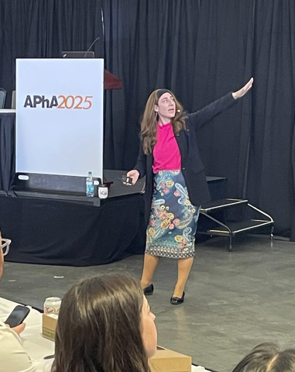
Insulin – Ultimate Hormone Replacement Therapy
Diana Isaacs, PharmD, BCPS, BCACP, CDCES, BC-ADM, FADCES, FCCP
Endocrine Clinical Pharmacy Specialist
Co-Director Endocrine Disorders in Pregnancy
Director, Education & Training in Diabetes Technology
Cleveland Clinic Diabetes Center
Notes:
2.5 hours.
Ideal is 150 slides.

Slide 5
Objectives – Insulin –The Ultimate Hormone Replacement Therapy
Objectives:
  Discuss the actions of different insulins
  Describe how to use the ADA algorithm for insulin management
  Counsel a person with diabetes on safe and effective insulin use
  Discuss strategies to determine and fine-tune basal and bolus insulin settings based on glucose pattern management
  Describe how insulin settings are used to program insulin pumps and connected insulin pens
Notes:
o Latest update on available insulins
o How to use ADA algorithm for insulin management
o Teaching pointers for safe and effective insulin use

Slide 6
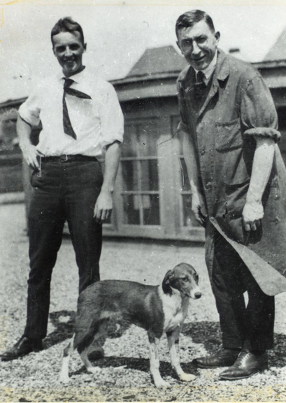
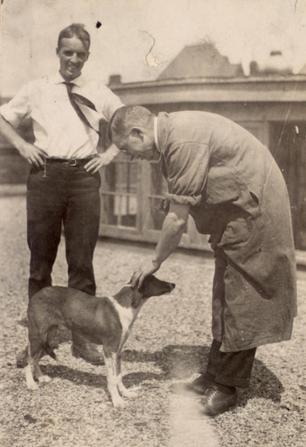
Best and Banting – U of Toronto 1921

Slide 7
History of insulin
Insulin is produced by beta cells in the pancreas
Discovered in 1921 by Frederick Banting and his assistant Charles Best from a dog’s pancreas
First used in a dog with diabetes and kept him alive for 70 days until they ran out of extract
With the help of JB Collip and John Macleod, insulin was derived from the pancreas of cattle and in January 1922, given to a 14-year-old dying from diabetes in a Toronto hospital
In 1923, Banting and Macleod received the Nobel Price in Medicine which they shared with Best and Collip
Soon after, Eli Lilly started large-scale production of insulin
ADA. The history of a wonderful thing we call insulin (accessed 2020 Aug 29).

Slide 8
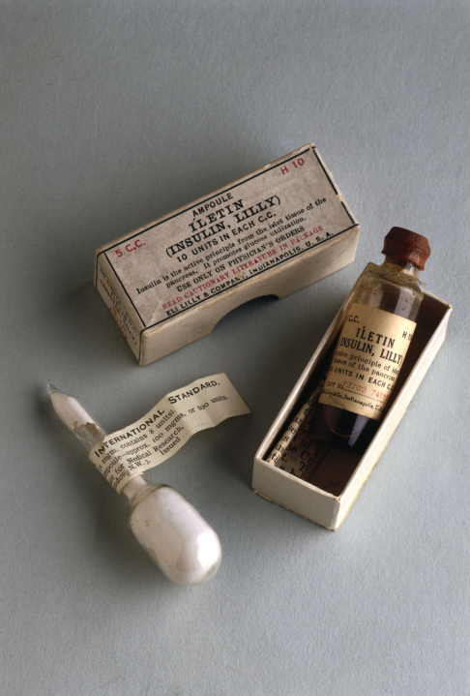

1st Insulin Available - 1922

Slide 9

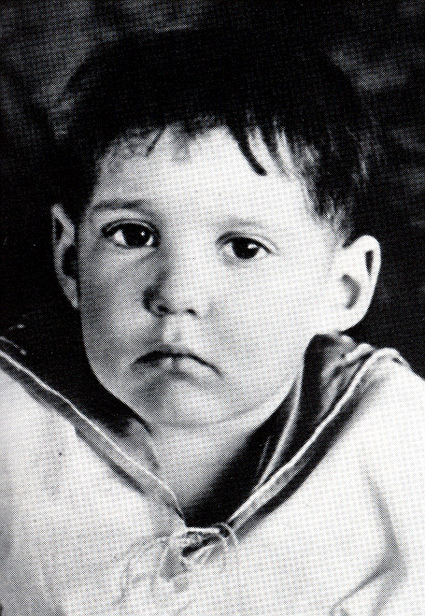
Miracle of Insulin
The Miracle of Insulin
February 15, 1923
Patient J.L., December 15, 1922

Slide 10
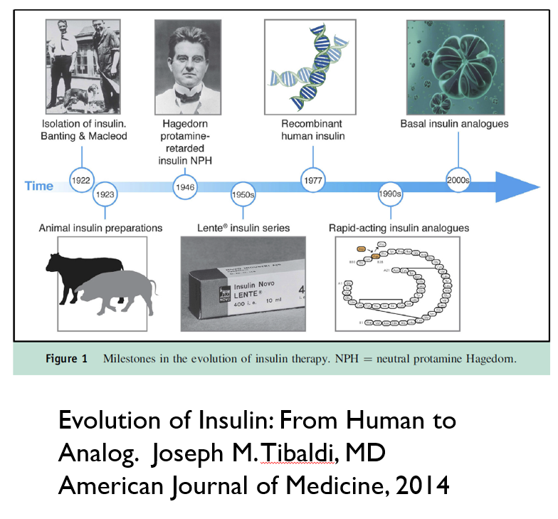
100 Years of Insulin | FDA
Notes:
Earlier insulins derived from bovine and porcine pancreas
All human insulin now made from recombinant DNA technology
Modification of human insulin molecules
Overcame problems with human insulin
Onset of action
Duration of action
Absorption
ince the 1920s insulin production required enormous quantities of animal pancreases, generally from cows or pigs. Advancements in chromatographic processing in the 1970s enabled firms to produce purer insulin, reducing the risk of the development of anti-insulin antibodies that had been found to induce insulin resistance in a significant number of patients. Yet, these techniques required even more glands per unit of insulin (IU). By 1981 production of one pound of insulin required 8,000 pounds of glands from 23,500 animals – but this was only enough insulin to treat 750 patients with diabetes for one year. Because insulin production was so fundamentally dependent on animal glands, both the supply and the cost of insulin depended on gland availability, and over the course of the 1970s the U.S. supply of pancreas glands declined significantly, while the cost of beef and pork fluctuated wildly. These market forces revealed the unsustainable nature of dependency on animal sources for insulin production.
n 1978 scientists at City of Hope and Genentech developed a method for producing biosynthetic human insulin (BHI) using recombinant DNA technology in a unique multi-step process. After extracting and manipulating the two polypeptide chains, A and B, that make up the human insulin gene, they inserted these into a common bacteria, which they programmed genetically to produce large amounts of insulin. Eli Lilly & Co. signed an agreement with Genentech to use the rDNA method to make human insulin commercially available. On October 28, 1982, after only 5 months of review, the FDA approved Humulin, the first biosynthetic human insulin product and the first approved medical product of any kind that derived from this technology.

Slide 11
Physiologic Insulin Release:
Individuals without diabetes
Bolus
Bolus
Bolus
Insulin
Blood glucose
Basal insulin
Meal
Meal
Meal
Blood glucose– goes up after eating

Slide 12
Physiologic Insulin at Meals
1st phase: peak 1-2 minutes, duration 10 minutes, suppresses hepatic glucose production
2nd phase: duration 1-2 hours
The perfect insulin would be fast enough to match the absorption of carbohydrates
Freeman JS. J Am Osteopath Assoc. 2009;109:26-36.
Notes:
Freeman. The Journal of the American Osteopathic Association, January 2009, Vol. 109, 26-36.
http://jaoa.org/article.aspx?articleid=2093701#72978607
Within seconds of food ingestion, there is an initial release of insulin, which peaks in 1 to 2 minutes and lasts about 10 minutes.^{21,22} This first phase is responsible for suppressing hepatic glucose output, limiting PPG elevations, and stimulating phase 2 insulin release of newly manufactured insulin. This second phase lasts 1 to 2 hours until normoglycemia is restored.^{20,21} However, in patients with type 2 diabetes mellitus, phase 1 insulin secretion is markedly decreased or absent. As the disease progresses, phase 2 insulin release is also reduced, often by more than 50%

Slide 13
Insulin Overview
None of the commercially available insulins are as fast as true physiologic insulin
Almost all insulin is injected (SC or IV) with 1 inhaled option
All people with T1D require basal + bolus insulin or insulin pump therapy
Many people with T2D require insulin due to the progressive nature of the condition
  Start with basal (long-acting), then add bolus if needed

Slide 14
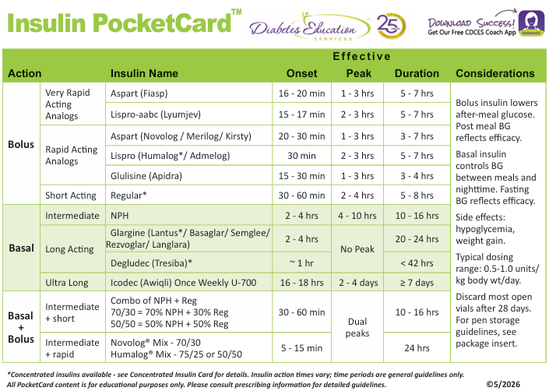
www.DiabetesEd.net FREE > PocketCards

Slide 15
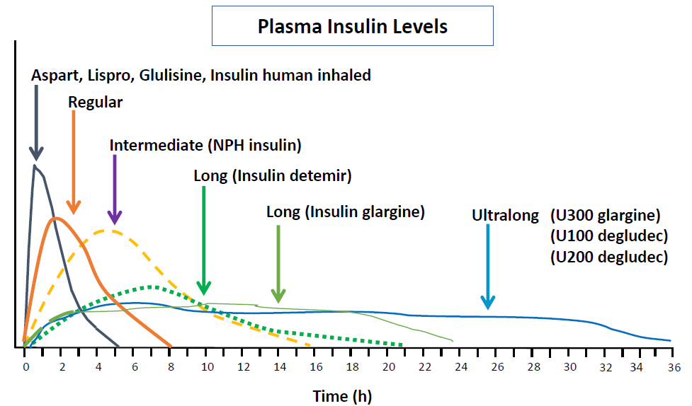
Insulin Profiles
Detemir is no longer available.
Weekly insulin
Hirsch IB. NEJM 2005;352:174-183.
Lexicomp Online, Lexi-Drugs Online, Hudson, Ohio: UpToDate, Inc; 2020; August 21, 2020.

Slide 16
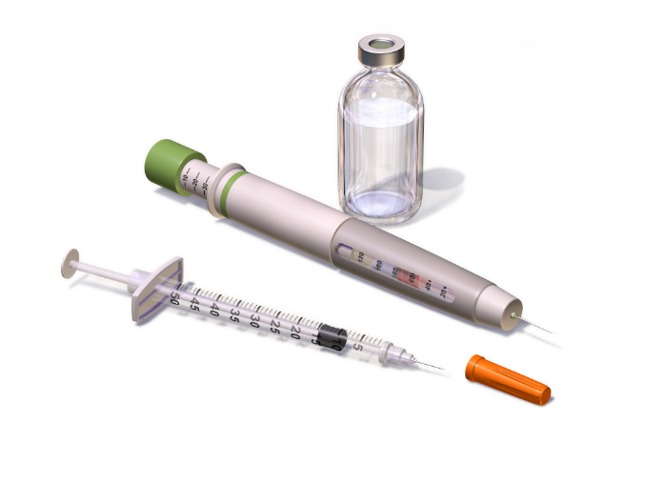
Insulin Concentration
Most insulin is U100: 100 units/mL
There is also concentrated insulin
  U500 insulin, 500 units/mL, U300, 300 units/mL, U200, 200 units/mL, and /u700, 700 units/mL
Insulin is available in a vial, pen, or cartridge
U100 insulin:
  1 vial =10mL = 1000 units
  1 pen =3 mL = 300 units
  1 cartridge = 3 mL = 300 units
  1 box of pens = 5 pens = 1500 units
Inhaled insulin
  4, 8, 12 units cartridges
Insulin package inserts.

Slide 17
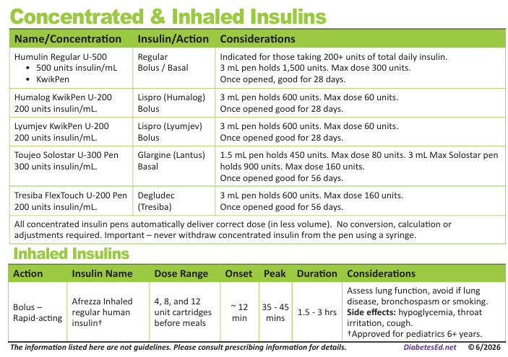
Concentrated and Inhaled Insulin

Slide 18
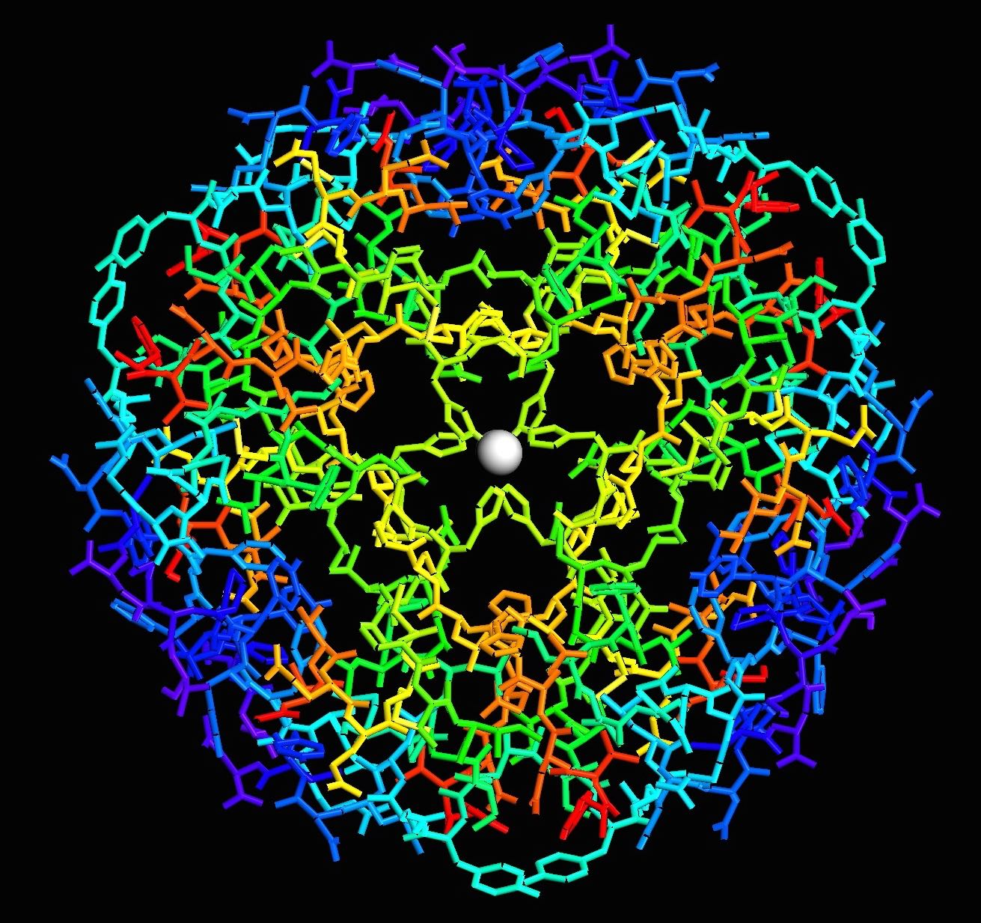
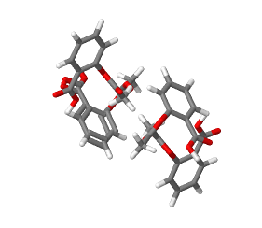
Follow-On Insulin & Biosimilars
These follow-on insulin products require a separate prescription (not directly interchangeable):
  Insulin glargine (Lantus), follow-on product (Basaglar)
  Insulin lispro (Humalog), follow-on product (Admelog)
However, these have demonstrated bioequivalence and are interchangeable with the reference product:
  Insulin glargine-yfgn (Semglee), Insulin glargine-aglr (Rezvoglar), insulin glargine-aldi Langlara) are interchangeable with Lantus
  Insulin aspart-szjj (Merilog) and insulin aspart-xjhz (Kirsty) are interchangeable with Novolog
Insulin – Large Molecule
Aspirin – Small Molecule
Notes:
MERILOG™ (insulin aspart-szjj)
Sanofi makes merilog (Aspart)

Slide 19
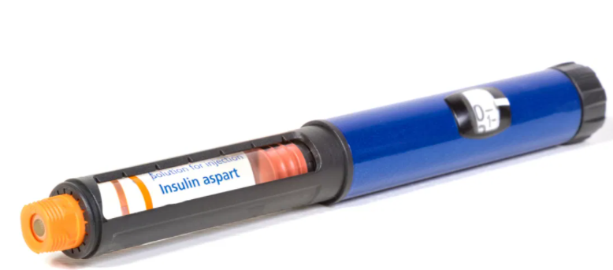
Generic Insulins
Insulin aspart
Insulin lispro
Insulin glargine
About half the cost of the brand name
Exact same formulation, produced by same manufacturer, interchangeable at pharmacy

Slide 20

Which Insulin is Interchangeable with Lantus (Insulin glargine U100)? Poll 1
Toujeo (Insulin glargine U300)
Basaglar (Insulin glargine U100)
Rezvoglar (Insulin glargine U100)
Tresiba (Insulin degludec U100)
All of the above
Notes:
Answer: C

Slide 21
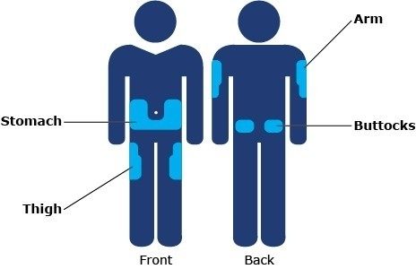
Insulin Injection Sites
Sites should be rotated
Notes:
https://www.bing.com/images/search?view=detailV2&ccid=J0qrzUzi&id=605DACD019791DB4D176BBBA06E2B08398849C0D&thid=OIP.J0qrzUzi0LJ2oJpx5HAGjQHaEy&mediaurl=https%3a%2f%2fwww.cornerstones4care.com%2fcontent%2fcornerstones4care%2fen%2fmedicine%2fwhat-to-do%2fusing-and-taking-care-of-your-medicine%2f_jcr_content%2fpar_left%2fheroimage.img.full.high.jpeg%2f1530054324694.jpeg&exph=300&expw=464&q=insulin+injection+sites&simid=607999160964812015&ck=30C0E430CA937537627C1715925BC74C&selectedIndex=9&qft=+filterui%3alicense-L2_L3_L5_L6&ajaxhist=0
Imagine free to use

Slide 22
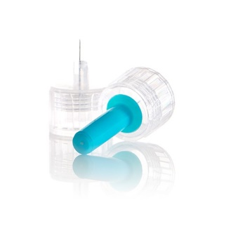
Insulin Key Counseling Points
Do not shake insulin
Cloudy insulin (NPH or pre-mixed) should be rolled before use so suspension is uniform
Skin thickness is usually 2mm regardless of person’s size, so shortest needles (4mm) work well for most
Take outer and inner covering off for pen needles
Leave the needle/syringe in the body for 5-10 seconds
Change needle or syringe with each injection
Dispose of needles/syringes in a sharps container or per local regulations
Dang DK. Taking medication. In: Cornell S et al, eds. The art and science of diabetes self-management education desk reference. 5th ed.

Slide 23
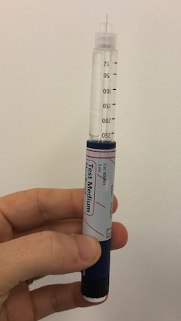
Priming insulin
Prime pens before every use to get air bubbles out
Hold vertically with needle at the top
Turn dial to 2 units
Push plunger
Repeat until insulin comes out of the top
May have to do multiple times for a new pen
This will ensure all air is out and that pen needle works
Do this every time an insulin pen injection is given
Notes:
Image obtained from Diana Isaacs.

Slide 24
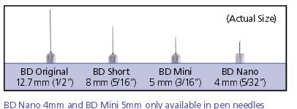
Needle Size Matters
Use shortest needles – 4 mm
Effective for almost ALL patients
Keeps it subq
If thin, inject at angle
To avoid leakage, count to 10 before withdrawing needle
For needle phobias, consider insulin pumps, patches, iport, and/or inhaled insulin

Slide 25
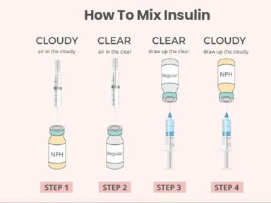
Mixing NPH & Regular Insulin

Slide 26


Storage Options
Notes:
Storage options include frio bag and vivicap, logos covered.

Slide 27
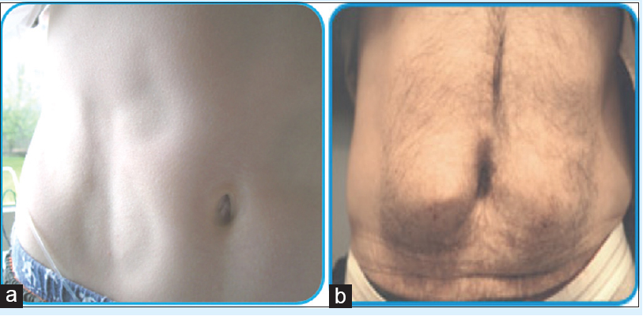
Side Effects of Insulin
Weight Gain
Lipodystrophy/
Lipohypertrophy
Hypoglycemia
Dang DK. Taking medication. In: Cornell S et al, eds. The art and science of diabetes self-management education desk reference. 4th ed.
Notes:
Weight gain is predominantly from increased truncal fat, and tends to be related to daily dose and plasma insulin levels present. Weight gain is undesirable in most type 2 DM patients, but can be seen as beneficial in underweight patients with type 1 DM. Weight gain appears to be related to intensive insulin therapy, and can be somewhat minimized by physiologic replacement of insulin.
Two forms of lipodystrophy, although much less common today in people with diabetes, still occur. Lipohypertrophy is caused by many injections into the same injection site. Because of insulin's anabolic actions, a raised fat mass is present at the injection site with resultant variable insulin absorption. Lipoatrophy, in contrast, is thought to be caused by insulin antibodies, with destruction of fat at the site of injection. Injection away from the site with more purified insulin is recommended, although several reports of lipoatrophy with lispro have been reported.

Slide 28


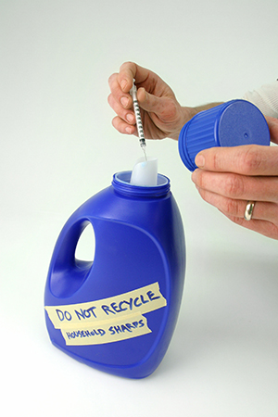
Sharps Disposal: Product and Info
Search for household hazardous waste listing for your city or county.
Call 1-800-CLEANUP (1-800-253-2687)

Slide 29
Polling Question 2
After how many days should an open vial of insulin degludec be discarded?
28 days
30 days
42 days
56 days
Notes:
Answer: D

Slide 30

Question Time
Break for Questions

Slide 31
Inhaled Insulin

Slide 32
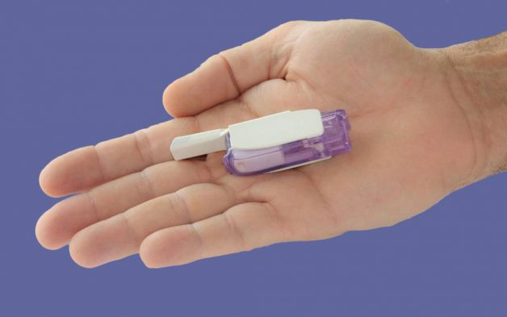
Inhaled Insulin (Afrezza)
Initial dosing: Multiply by 2 and round down to the nearest cartridge.
Example, Person takes 6 units at meals. This would be 12 units of Afrezza
In T1D on injections often a 50/50 split with basal/bolus
With inhaled, often a 30/70 split with 70% bolus
FDA approved for ages over 6 years
Comes in 4, 8 and 12 units cartridges
AFREZZA® Dosing and Prescribing │ Starting Dose and Titration Information

Slide 33
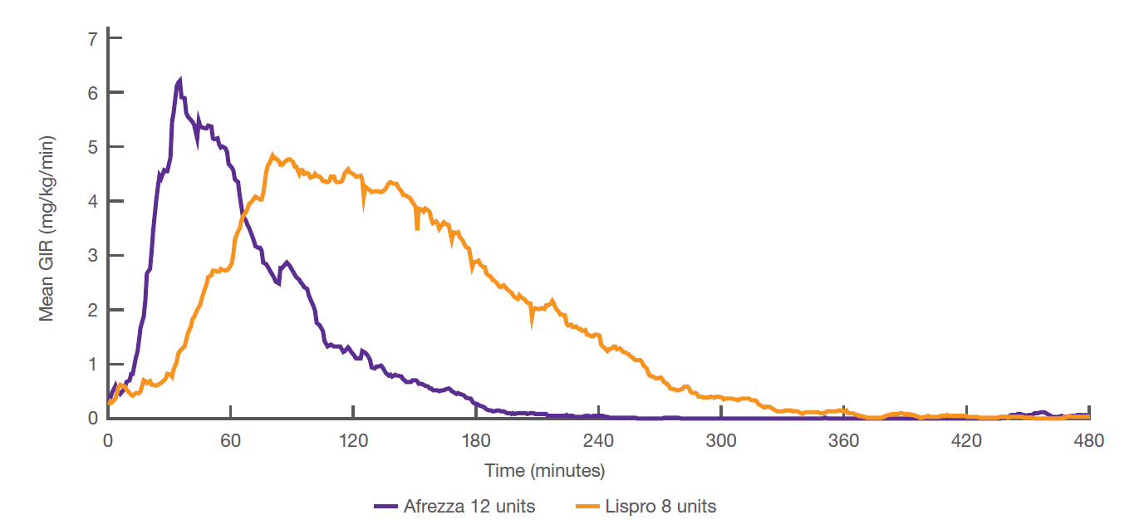
Inhaled Insulin Vs. Insulin lispro
 | Insulin in Healthy Individuals | Inhaled Insulin | Injectable Insulin
Onset (minutes | 10 | 12 | 17-30
Peak effect (minutes) | 45 | 45 | 90-120
Back to baseline (minutes) | 210 | 180 | 275-320
Inhaled insulin
Lispro
.
Grant M, Heise T, Baughman R. Clin Pharmacokinet. 2022;61(3):413-422.
Caumo A, Bergman RN, Cobelli C. J Clin Endocrinol Metab. 2000;85(11):4396-4402.
Afrezza (insulin human) Inhalation Powder Prescribing Information. MannKind Corporation.
Notes:
According to the graph, insulin lispro has a longer time to onset, peak effect, and duration of action than Afrezza.
Pharmacodynamics data from an open-label, randomized, controlled, cross-over study that compared the area under the glucose infusion rate versus time curve (GIR AUC) of inhaled insulin with SC RAI lispro in 30 patients with T1D. Each volunteer received three different doses of each treatment over a series of six euglycemic clamps.⁴
Time to peak effect for inhaled insulin (12 units) was 42 minutes vs. 93 minutes for insulin lispro (8 units).⁴
The time to peak effect for circulating insulin in healthy individuals is approximately 45 minutes.⁵

Slide 34
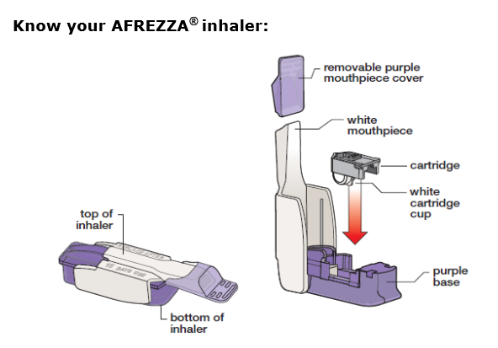
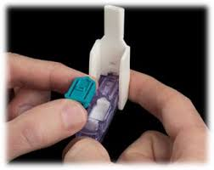
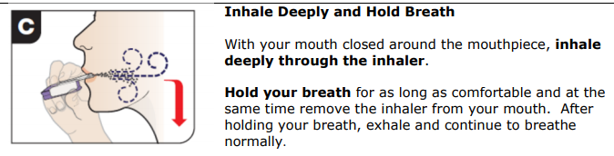
Inhaled Insulin

Slide 35
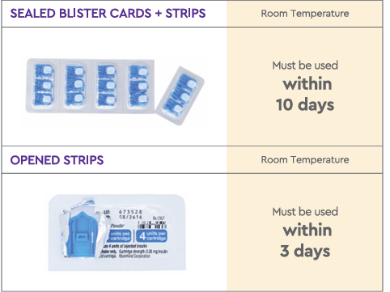
Inhaled Insulin Storage
Opened inhaler: use in 15 days
Sealed foil packages: refrigerate until expiration date on package
Sealed blister card strips: room temp-use within 10 days, fridge-30 days
Opened strips: room temperature, use within 3 days
Before using, inhaler and strips should be at room temperature for at least 10 minutes
Storage-and-Handling-with-ISI-Afrezza-Assist-Update.pdf

Slide 36
Inhaled Insulin Dosing and Counseling
Bolus insulin – inhaled at meals
Usually requires 2-3x injected dose
May inhale more 1-2 hours after a meal as needed
Use with a basal insulin
Lung function test before start (FEV1)
  Not for those w/ chronic lung issues
    Asthma, COPD, history of lung cancer, smoking within past 6 months
    Can cause acute bronchospasm – Black box warning
Side effects:
  Sore throat, cough
  Less hypoglycemia than injected insulin
Inhaled Insulin Tip Sheet - DiabetesSisters

Slide 37
Weekly Insulin

Slide 38
Rationale for Developing Once-Weekly Insulin
Potential benefits from prolonged, flatter pharmacokinetic and pharmacodynamic profiles
Reduced glycemic variability
Longer duration makes them more forgiving of missed doses
Reduced injection frequency, potentially improving medication taking behavior and patient satisfaction
Rosenstock J et al. Endocr Rev. 2024;45(3):379-413.
Notes:
A once weekly insulin would cut down on the number of times a person has to inject themselves. This can overcome injection related barriers and also people that forget to take every day.

Slide 39

Icodec (Awiqli)
Icodec
  An ultra long acting insulin – lasts 7 days
  Approved for adults with T2D
  Binds reversibly to albumin allowing for slow release
  Peaks in 2-4 days
  Takes 3-4 weeks to reach steady state
Available in U-700 pens dosed in 10 units increments
Max 700 units/injection
Dose changes take longer, make them less often (Ex. 3-4 weeks instead of 3-4 days)
Notes:
Awiqli® binds reversibly to albumin, resulting in a depot in the circulation from which insulin icodec-abae is slowly released

Slide 40

Icodec Dosing Considerations
When initiating insulin icodec:
Multiply existing daily basal dose by 7 to estimate the initial once-weekly dose, followed by careful titration based on fasting glucose trends.
Consider a loading dose of 50% more in the 1st week when switching
70 units for those new to insulin
Individualization is key—consider factors such as hypoglycemia risk, renal function, ability to monitor glucose when determining and adjusting the dose.
Notes:
Missed Doses:
If 3 or fewer days until next regularly scheduled dose:
Administer missed dose as soon as possible.
Reset weekly dosing schedule to start one week later.
If 4 or more days until next regularly scheduled dose:
Administer missed dose as soon as possible.
Continue current weekly dosing schedule.
See Package Insert for Dosing Info

Slide 41
Polling Question 3
Janet is starting insulin icodec. She currently takes insulin degludec 30 units qpm. What should be her starting dose in the 1st week, assume a loading dose.
A. 70 units
C. 110 units
C. 210 units
D. 320 units
Notes:
Correction answer: 320 units

Slide 42
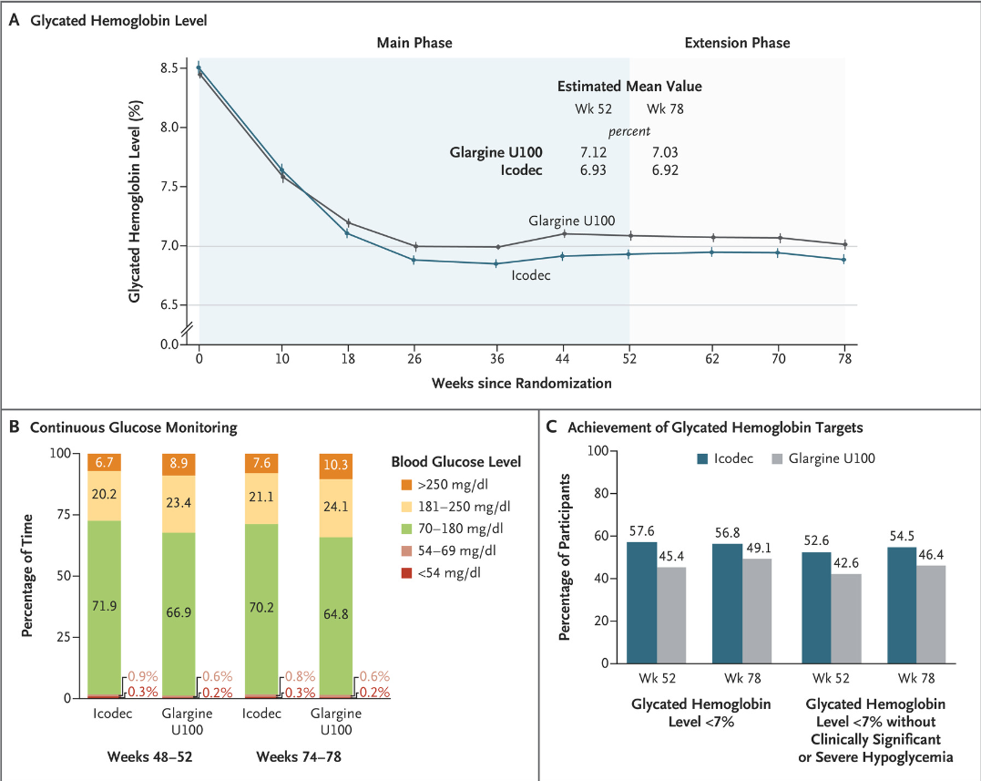
Glargine vs. Icodec in T2D
492 pts in each group
Primary outcome: change in A1C
Conclusion: glycemic control better with icodec
Rosenstock J, et al. Weekly Icodec versus Daily Glargine U100 in Type 2 Diabetes without Previous Insulin. N Engl J Med. 2023 Jul 27;389(4):297-308.
Notes:
Insulin naieve people with T2D
Background: Insulin icodec is an investigational once-weekly basal insulin analogue for diabetes management.
Methods: We conducted a 78-week randomized, open-label, treat-to-target phase 3a trial (including a 52-week main phase and a 26-week extension phase, plus a 5-week follow-up period) involving adults with type 2 diabetes (glycated hemoglobin level, 7 to 11%) who had not previously received insulin. Participants were randomly assigned in a 1:1 ratio to receive once-weekly insulin icodec or once-daily insulin glargine U100. The primary end point was the change in the glycated hemoglobin level from baseline to week 52; the confirmatory secondary end point was the percentage of time spent in the glycemic range of 70 to 180 mg per deciliter (3.9 to 10.0 mmol per liter) in weeks 48 to 52. Hypoglycemic episodes (from baseline to weeks 52 and 83) were recorded.
Results: Each group included 492 participants. Baseline characteristics were similar in the two groups. The mean reduction in the glycated hemoglobin level at 52 weeks was greater with icodec than with glargine U100 (from 8.50% to 6.93% with icodec [mean change, -1.55 percentage points] and from 8.44% to 7.12% with glargine U100 [mean change, -1.35 percentage points]); the estimated between-group difference (-0.19 percentage points; 95% confidence interval [CI], -0.36 to -0.03) confirmed the noninferiority (P<0.001) and superiority (P = 0.02) of icodec. The percentage of time spent in the glycemic range of 70 to 180 mg per deciliter was significantly higher with icodec than with glargine U100 (71.9% vs. 66.9%; estimated between-group difference, 4.27 percentage points [95% CI, 1.92 to 6.62]; P<0.001), which confirmed superiority. Rates of combined clinically significant or severe hypoglycemia were 0.30 events per person-year of exposure with icodec and 0.16 events per person-year of exposure with glargine U100 at week 52 (estimated rate ratio, 1.64; 95% CI, 0.98 to 2.75) and 0.30 and 0.16 events per person-year of exposure, respectively, at week 83 (estimated rate ratio, 1.63; 95% CI, 1.02 to 2.61). No new safety signals were identified, and incidences of adverse events were similar in the two groups.
Conclusions: Glycemic control was significantly better with once-weekly insulin icodec than with once-daily insulin glargine U100. (Funded by Novo Nordisk; ONWARDS 1 ClinicalTrials.gov number, NCT04460885.).

Slide 43
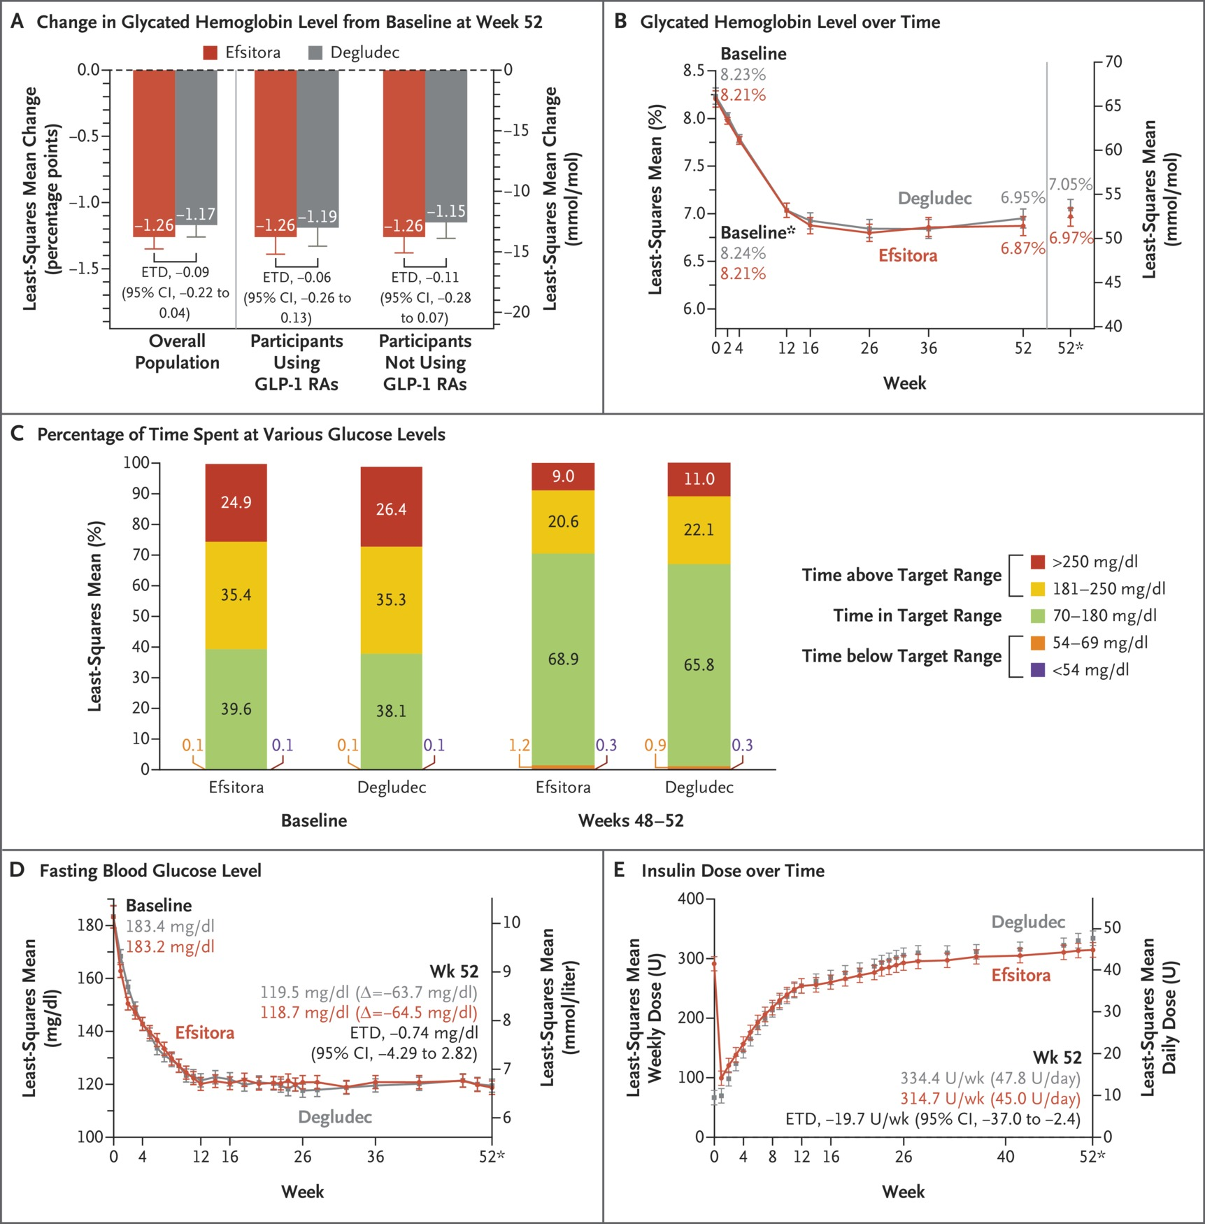
Degludec vs. Efsitora in T2D
Insulin efsitora alfa: once-weekly, Fc-fusion basal insulin with ~17-day half-life
928 pts
Primary outcome: change in A1C
Efsitora non-inferior

Slide 44
How to Dose Insulin

Slide 45
How to Dose Insulin? T1D
Newly diagnosed T1D
  Total insulin dose: 0.4-0.5 units/kg/day
  50% basal
  50% bolus
Bolus can initially start with set doses or calculations can be used to determine initial carbohydrate ratio and correction factor
9. Pharmacologic Approaches to Glycemic Treatment: Standards of Care in Diabetes—2026 Diabetes Care 2026;49(Suppl. 1):S183–S215

Slide 46
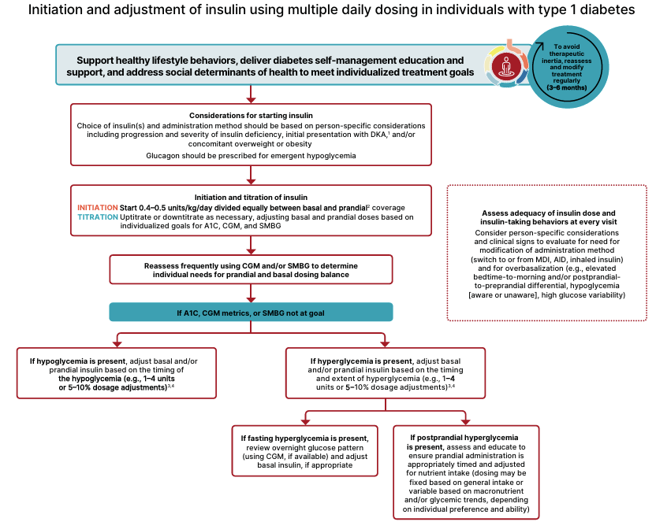
T1D Initiation & Adjustment
Basal
Insulin
Bolus Insulin
+
9. Pharmacologic Approaches to Glycemic Treatment: Standards of Care in Diabetes—2026 Diabetes Care 2026;49(Suppl. 1):S183–S215

Slide 47
www.DiabetesEd.net FREE > PocketCards

Slide 48
T1D: Insulin Dosing Regimens
Time of Insulin Administration | Before breakfast | Before lunch | Before dinner | Bedtime
Method 1 | Intermediate: Regular (2/3 TDD) 2:1 ratio |  | Intermediate: Regular (1/3 TDD) 2:1 ratio
Method 2 | Regular/ analog (1/2 TDD ÷ by 3) | Regular/ analog (1/2 TDD ÷ by 3) | Regular/ analog (1/2 TDD ÷ by 3) | Long-acting (1/2 TDD)
***These are starting regimens and are adjusted based on ability to carbohydrate count and glycemic management as determined by A1C, BGM and/or CGM

Slide 49
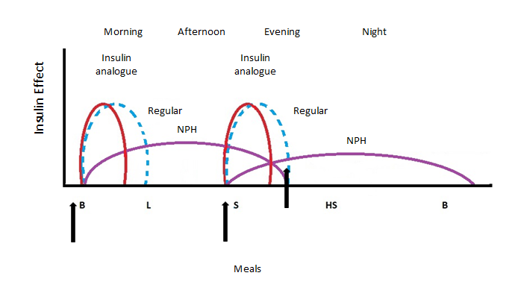
Intermediate-acting Insulin + Regular Insulin or Insulin Analog
Intermediate insulin serves as basal while
regular or insulin analog serves as bolus
Regular insulin: Novolin R, Humulin R
Intermediate insulin: Novolin N, Humulin N
Insulin analogue: aspart, lispro, glulisine
Dipiro JT et al, eds. Pharmacotherapy: a pathophysiologic approach. 11th ed. 2020.
Notes:
Drawn by Jill Haug

Slide 50
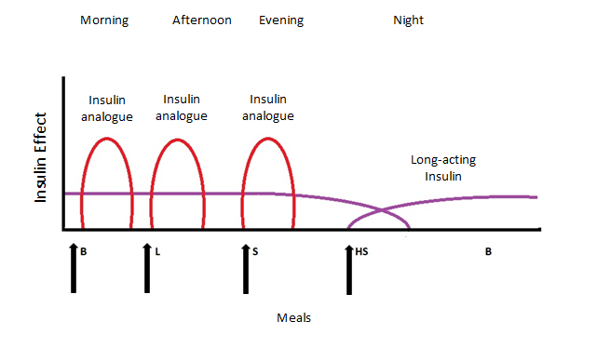
Long-acting Insulin with Insulin analog
Long-acting serves as basal
insulin analog serves as bolus
Dipiro JT et al, eds. Pharmacotherapy: a pathophysiologic approach. 11th ed. 2020.
Notes:
Drawn by Jill Haug

Slide 51
Carbohydrate Ratio
Insulin to carbohydrate ratio (ICR)
  1 unit of insulin is expected to cover X grams of carbohydrates
Rule of 450 or 500 can be used
  450/TDD = estimated carbohydrate ratio
Trujillo J et al. Diabetes mellitus. In: Dipiro JT et al., eds. Pharmacotherapy: a pathophysiologic approach. 11th ed.

Slide 52
Correction Factor
Insulin correction factor (ICF)
  Also known as insulin sensitivity factor (ISF)
  1 unit of insulin is expected to lower glucose by Y points
Rule of 1700 or 1800 can be used
  1700/TDD = estimated ICF
For regular insulin, the rule of 1500 is typically used
Trujillo J et al. Diabetes mellitus. In: Dipiro JT et al., eds. Pharmacotherapy: a pathophysiologic approach. 11th ed.

Slide 53
An Example: Meet Austin
Austin is a 12-year-old newly diagnosed with T1D, he weighs 40kg
He is started on 0.5 units/kg/day of total insulin
  40*0.5=20 units
  50% basal=10 units
  50% bolus=10 units
Austin is prescribed 10 units of long-acting insulin and 3 units of rapid-acting insulin at meals
The insulin doses will be adjusted based on glucose data

Slide 54

Austin Calculation cont’d
Austin is ready for carbohydrate counting
Based on the rule of 450 and rule of 1700, what should his ICR and ICF be?

Slide 55
Poll Question 4
Based on the rule of 450 and rule of 1700, what should Austin’s ICR and ICF be? (TDD=20 units/day)
ICR=22, ISF=85
ICR=20, ISF=60
ICR=15, ISF=50
ICR=30, ISF=75
I am not sure

Slide 56
Answer and Explanation
ICR=450/20=22.5
  This means that 1 unit of insulin covers 22 grams of carbohydrate
  If Austin eats 45 grams of carbohydrate, he should inject 2 units
ISF=1700/20=85
  This means that 1 unit of insulin is expected to lower glucose by 85 mg/dL
  Austin’s glucose target is 100
  If his current glucose is 185, he should take 1 extra unit of insulin

Slide 57
Correction Scale 1
Rapid/Fast Acting Insulin (1 unit:50 mg/dl>150)
Less than 70 | Subtract 1 unit
70-150 mg/dl | 0 units
151-200 mg/dl | 1 unit
201-250 mg/dl | 2 units
251-300 mg/dl | 3 units
301-350 mg/dl | 4 units
351-400 mg/dl | 5 units

Slide 58
Correction Scale 2
Rapid/Fast Acting Insulin (2 units:50 mg/dl>150)
Less than 70 | Subtract 1 unit
70-150 mg/dl | 0 units
151-200 mg/dl | 2 unit
201-250 mg/dl | 4 units
251-300 mg/dl | 6 units
301-350 mg/dl | 8 units
351-400 mg/dl | 10 units

Slide 59
Poll Question 5
How much insulin would you start on a a child with T1D that weighs 66lbs?
  10 units/day
  15 units/day
  30 units/day
  40 units/day
Hint: To calculate Kg, take the weight in pounds and divide by 2.2
Notes:
Answer: B

Slide 60

U500 Insulin

Slide 61
More than 200 units a day?
Drug Name | Availability | Pen Units | Expiration | Onset | Peak Effect | Duration of Action | Clinical Pearls
Insulin human regular (humulin R U500) | Pen | 5 unit | 28 days | 0.25-0.5 hours | 4-8 hr | 13-24 hr | This insulin is 5 time as concentrated. If using a vial, use the special U500 syringe.
DailyMed: https://dailymed.nlm.nih.gov/dailymed/index.cfm
Stahnke AM et al. ADCES in Practice. March, 2020. https://doi.org/10.1177/2633559X20896414

Slide 62
Switching to U500 insulin
Typically reserved for people requiring insulin >200 units/day
U500 acts like an intermediate acting insulin but replaces both the basal and bolus doses
  If A1C< 8%, recommend to reduce TDD by 10-20%
  If A1C≥ 8%, consider 1:1 conversion
Typically dosed 2-3 times daily
Take 30 minutes prior to meals
Often initiated as a 60/40 or 40/30/30 split
Reid TS, et al. Postgrad Med. 2017;129(5):554-562.
Notes:
New Reference: Reid TS, Schafer F, Brusko C. Higher concentration insulins: an overview of clinical considerations. Postgrad Med. 2017;129(5):554-562. doi:10.1080/00325481.2017.1325311

Slide 63

U500 Example: Let’s Practice
A woman with obesity, T2D, and insulin resistance takes insulin glargine 120 units BID and insulin aspart 60 units TID a.c. Her most recent A1C=9%. How would she switch to U500?
  Will it be a 1:1 conversation or dose reduce?
  How to split: 60/60 or 40/30/30?
New Dose:
  Must round to nearest 5 unit increment
Reid TS, et al. Postgrad Med. 2017;129(5):554-562.

Slide 64
U500 Example: Answer
Previous dosing: insulin glargine 120 units BID and insulin aspart 60 units TID a.c. A1C=9%.
Answer
  1:1 conversion since A1C > 8%
  TDD=180+240=420 units split as 40/30/30
New Dose:
  U500 165 units QAM, 125 units at lunch, 125 units at dinner
  Must round to nearest 5 unit increment
  Inject 30 minutes before each meal
Reid TS, et al. Postgrad Med. 2017;129(5):554-562.

Slide 65
How To’s of Adding Insulin in Type 2 DM

Slide 66

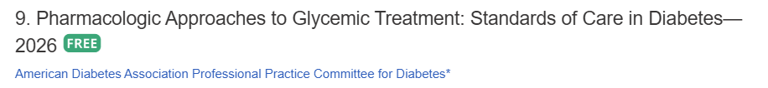
1st Injectable: GLP-1 if Possible
In adults with T2D without severe hyperglycemia or hyperglycemic crisis, a GLP-1 based therapy is preferred to insulin for initial or add-on glucose lowering therapy (A)
ADA SOC 2026

Slide 67

Insulin + GLP-1? YES!
If insulin is used, combination therapy with a GLP-1RA or GIP/GLP-1RA, is recommended for greater glycemic effectiveness and beneficial effects on weight and hypoglycemia risk
In adults with T2D who are initiating insulin therapy, continue glucose-lowering agents (unless contraindicated or not tolerated) for ongoing glycemic and metabolic benefits (i.e., weight, cardiometabolic, or kidney benefits).

Slide 68
Insulin With Other Glucose-Lowering Agents
Drug class/name | Recommendations for use with insulin
Metformin | Continue use when initiating basal insulin
GLP-1 RA or GLP-1/GIP RA | Combination with basal insulin limits weight gain, poses relatively low hypoglycemia risk, and may reduce need for prandial insulin Consider for people with ASCVD/indicators of high ASCVD risk, CKD, HF, and obesity
SGLT2i | May reduce need for insulin and limit weight gain Reduced insulin dose may be needed to prevent hypoglycemia Consider for people with ASCVD/indicators of high ASCVD risk, CKD, or HF
DPP-4i | Continue with basal insulin; discontinue if patient is also using a GLP-1 RA
TZDs | Can be combined with insulin; consider reducing dose or stopping if problems with weight gain, edema, or is at risk for HF
Sulfonylureas and meglitinides | Stop when initiating basal insulin to reduce hypoglycemia risk
American Diabetes Association Professional Practice Committee for Diabetes. Diabetes Care. 2026;49(Supplement_1):S183-S215 ; Forst T et al. Diabetes Metab Res Rev. 2021;37(6):e3418; Mehta R et al. Ann Med. 2021;53(1):998-1009.
CKD, chronic kidney disease; GIP, glucose-dependent insulinotropic polypeptide; HF, heart failure; TZDs, thiazolidinediones.
Notes:
One of the common questions that comes up is what to do with the non-insulin agents once insulin is added. Most agents can be continued safely. In the case of SGLT2 inhibitors and GLP-1 therapies, they have beneficial cardiovascular benefits and should definitely be continued in people with heart failure, kidney disease, cardiovascular disease or high cardiovascular disease risk.
Other therapies like metformin, DPP 4inhibitors, TZD’s can also be continued and may reduce the need for as much insulin. DPP4 inhibitors should not be used in combination with GLP-1 therapies including GLP-1 receptor agonists and GLP-1/GIP receptor agonists.
Sulfonylureas and meglitinides are secretagogues and put a person at greater risk of hypoglycemia when combined with insulin. They should be discontinued when insulin is initiated.

Slide 69
ADA Recommendations for Initiating and
Adjusting Basal Insulin
Initiate with a single daily dose of basal insulin
Daily dose: 10 units or 0.1-0.2 units/kg
Consider glucagon, CGM
Bedtime or morning long-acting insulin
OR bedtime intermediate-acting insulin
Adjust dose 10%-15% or 2-4 units
once to twice weekly to reach FBG target of
80-130 mg/dL
In the event of hypoglycemia or
FBG level <70 mg/dL, determine the cause. If there is no clear reason, reduce the insulin dose by 10%-20%.
Assess adequacy of insulin dose at every visit
Assess for overbasalization
Diabetes. Diabetes Care. 2026;49(Supplement_1):S183-S215.
FBG, fasting blood glucose.
Notes:
This is the algorithm provided by the ADA for initiating and adjusting basal insulin. They recommend starting with 10 units of 0.1-0.2 units/kg/day. For someone with a higher body weight, it may be more efficient to start with weight based dosing. The initial basal insulin could be one of the long acting insulins or a bedtime intermediate acting insulin.
Adjust dose 10-15% or 2-4 units once or twice weekly to reach the fasting blood glucose target of 80-130mg/dL. Other dose strategies include having the person raise the dose by 2 units every 3 days to reach FBG.
Assess the adequacy of insulin dosing at every visit. Check for signs of overbasalization such as high basal dose without prandial cover, over 0.5 units/kg/day.
Another sign is a big drop from bedtime to morning glucose or high glycemic variability.
In the event of hypoglycemia or FBG under 70, determine the cause. If there’s not a clear reason, then reduce insulin dose by 4 units or 10-20%.

Slide 70

Overbasalization
Clinical signals of overbasalization include:
    high bedtime-to-morning or preprandial-to-postprandial glucose differential
      (e.g., bedtime to AM glucose ≥50 mg/dL),
    hypoglycemia (aware or unaware)
    high glucose variability

Slide 71
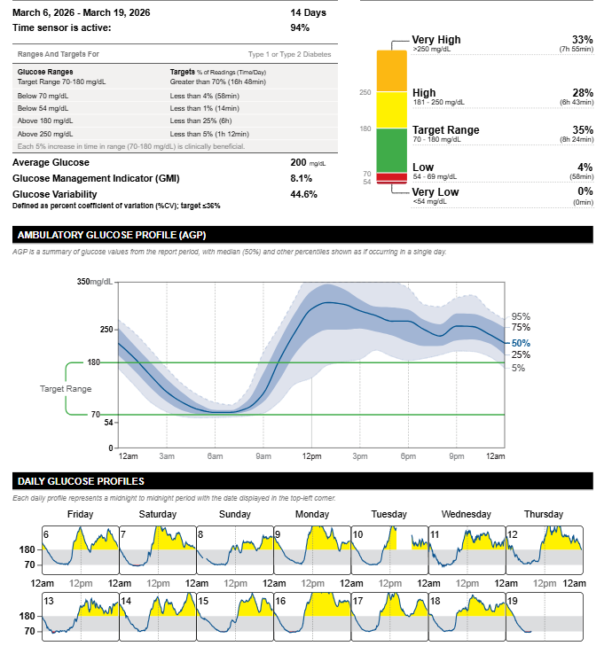
Patient Case
Overbasalization on CGM
Notes:
Shows oversalization but also the confusion that can occur from regimen complexity: this patient was actually taking glargine 3 to 4 times daily !

Slide 72
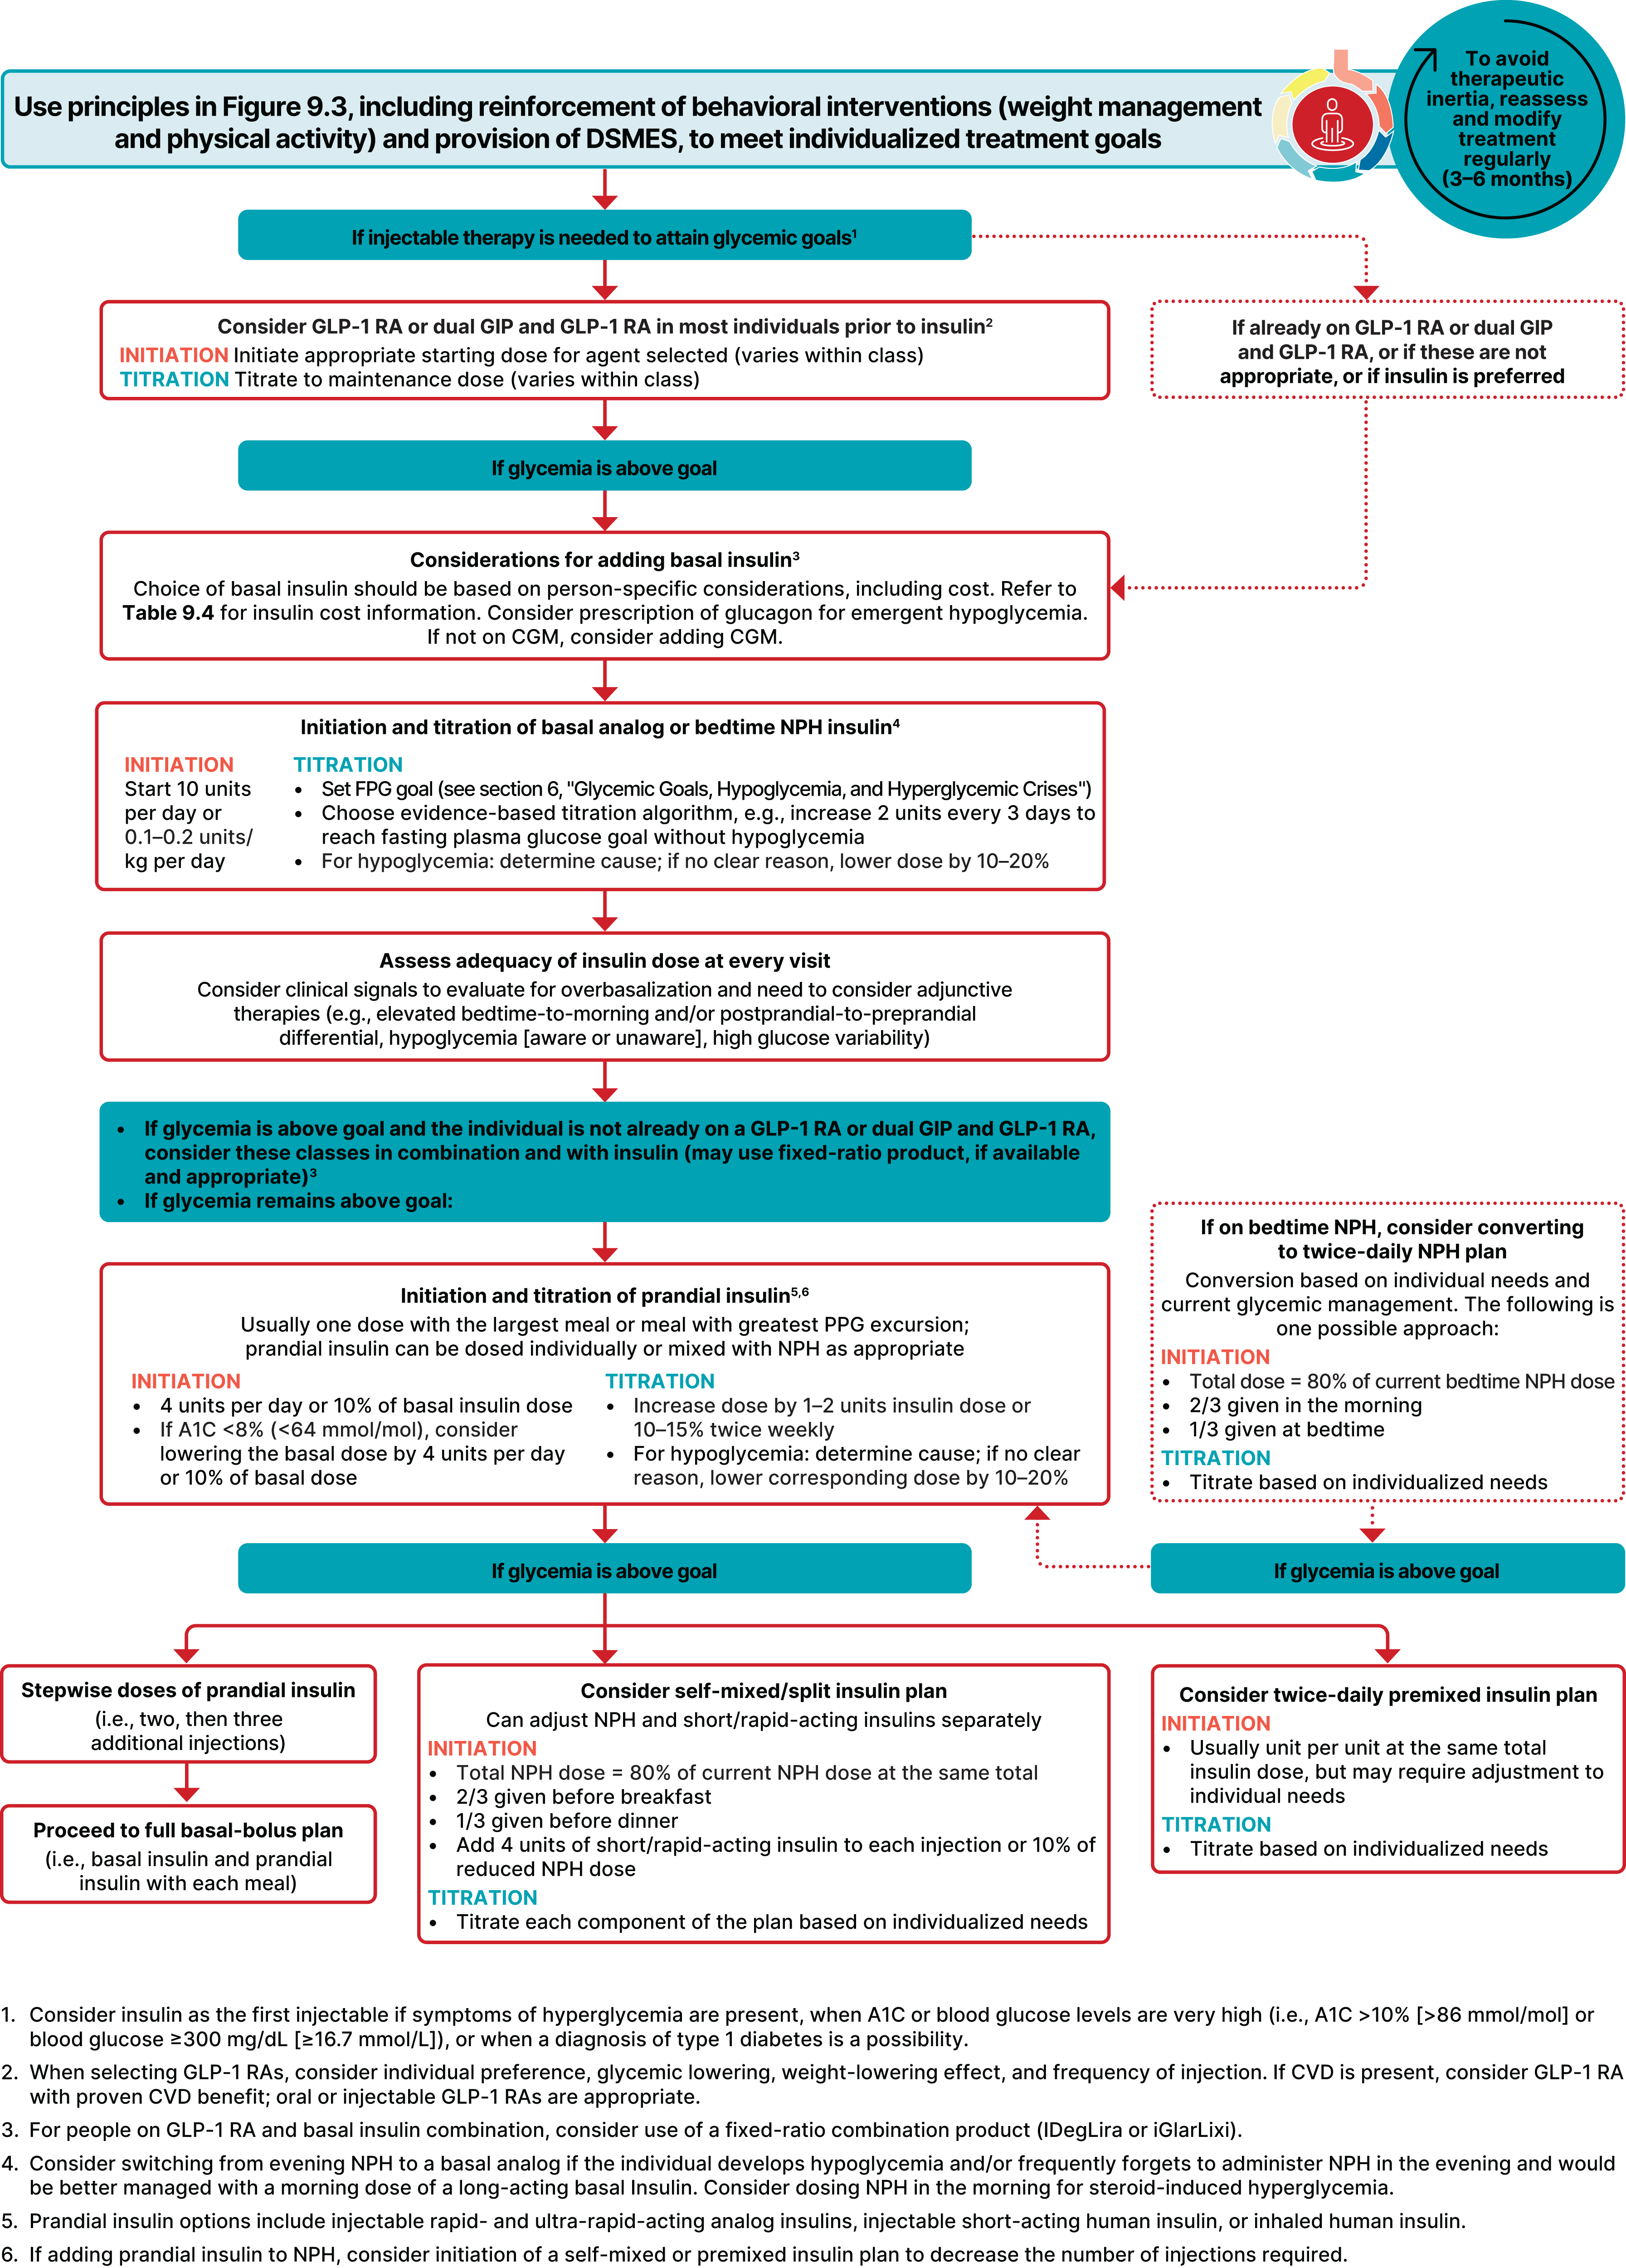

Intensifying Insulin Therapy
Notes:
Basal insulin alone is usually the optimal initial regimen, beginning at 0.1-0.2 U/kg body weight, depending on the degree of hyperglycemia. It is usually prescribed in conjunction with 1-2 non-insulin agents, although insulin secretagogues (sulfonylureas, meglitinides) are typically stopped once more complex regimens beyond basal insulin are utilized.
In patients still not at target after basal insulin has been adequately titrated, and the patient is willing to take >1 injections, there are several options. First, consider GLP-1 receptor agonists (see Fig. 2). The combination of basal insulin + GLP-1RA is becoming well established after several studies confirmed its efficacy on par with more complex multi-dose insulin regimens, but with less hypoglycemia and with weight loss instead of weight gain. If such an approach is not possible or has been tried and proven unsuccessful, there are 3 possible advanced insulin regimens:
Adding 1 injection of a rapid acting insulin analogue before the largest meal,
Adding 2-3 injections of a rapid acting insulin analogue before 2-3 meals, or
Using premixed insulin BID
Each approach has its advantages and disadvantages. The figure describes the number of injections required at each stage, together with the relative complexity and flexibility.
Once a strategy is initiated, titration of the insulin dose is important, with dose adjustments made based on the prevailing BG levels as reported by the patient.
Comprehensive education regarding self-monitoring of BG, diet, exercise, and the avoidance of, and response to, hypoglycemia are critical in any patient on insulin therapy.

Slide 73


Slide 74
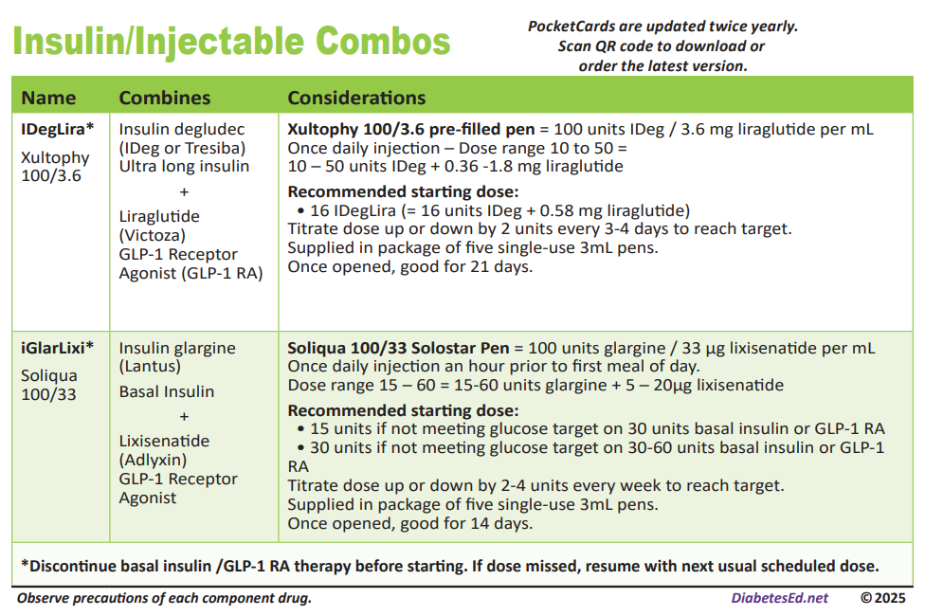

Slide 75
Case Study: Jenny
Jenny is a 50-year-old woman that takes glipizide 10mg BID, metformin 1000mg BID, and linagliptin 5mg daily. A1C is 8.5%. She weighs 110kg. She checks glucose in the AM only. She reports fingersticks ranging from 120-200mg/dL and denies symptoms of hypoglycemia. Her eGFR is 70 and BMI=34kg/m2. She previously had UTI’s with empagliflozin.
How should her medications be adjusted?

Slide 76
Polling Question 6
What medication would be best to add for Jenny?
Insulin glargine
Semaglutide
Dapagliflozin
Pioglitazone
Any meds that you would consider stopping with this addition?

Slide 77
Case Study: Jenny-5 Years Later
Jenny is a 55-year-old woman that takes glipizide 10mg BID, metformin 1000mg BID, Tirzepatide 15mg weekly, and dapagliflozin 10mg daily. A1C is 8.2%. She weighs 100kg. She reports fingersticks range from 150-250mg/dL and denies symptoms of hypoglycemia. Her eGFR is 70 and BMI=31kg/m2. UACR is 335mg/g. (elevated)
Insulin will be added at today’s visit, how should the other meds be adjusted?

Slide 78
Switching Insulin

Slide 79
How to Switch Basal Insulin
When going from twice daily NPH to long-acting insulin, reduce dose by 20%
Switching Insulin glargine U100:
  To glargine U300: 1:1, higher dose 10-18% may be needed
  To degludec or NPH: 1:1 or consider 20% reduction
Switching Insulin degludec to other basal insulins:
  To degludec, NPH or glargine: reduce by 20%
Switching insulin glargine U300:
  To degludec: 1:1 or consider 20% reduction
  To NPH or insulin glargine U100: reduce dose by 20%
Switching NPH to other insulins:
  If twice daily, decrease dose by 20%
  If once daily, 1:1 or consider 20% reduction
Need to use clinical judgement
  For example, if A1C, FBG, and pre-meal BG are all above target, then may not be necessary to reduce basal insulin dose
Clinical Resource, How to Switch Insulin Products. Pharmacist’s Letter/Pharmacy Technician’s Letter/Prescriber Insights. January 2025.

Slide 80


Poll 7 - Making the switch: Meet Joan
Joan is taking insulin NPH 30 units twice daily. Her endo wants her to switch to degludec. Her current A1C is 6.9%. What is the best dose recommendation?
  Insulin degludec 30 units twice daily
  Insulin degludec 60 units once daily
  Recommend against the switch since her A1C is at goal
  Insulin degludec 48 units once daily
Notes:
The correct answer is D. a 20% reduction when going from twice daily to once daily.

Slide 81
Switching Meal time Insulin
This is a 1:1 conversion when switching between regular insulin, aspart, lispro, and glulisine including Fiasp® and Lyumjev™.
The exception is when switching to inhaled insulin (Afrezza), multiple dose by 2 and round down to nearest cartridges
  Often 2-3x is actually needed
Clinical Resource, How to Switch Insulin Products. Pharmacist’s Letter/Pharmacy Technician’s Letter/Prescriber Insights. January 2025.

Slide 82
Poll 8. Patient Case: Lumy
Lumy’s insurance formulary changed from insulin lispro to insulin aspart. Her A1C is 7%.
She was following an insulin to carbohydrate ratio of 1:12 and a correction factor of 1:50.
How should she dose insulin aspart when she switches?
  Reduce all doses by 10%
  Increase all doses by 10%
  Same dosing
  Submit prior authorization so she doesn’t change insulin
Notes:
What if her a1c was 8 or 9%

Slide 83
Insulin Pattern Management

Slide 84

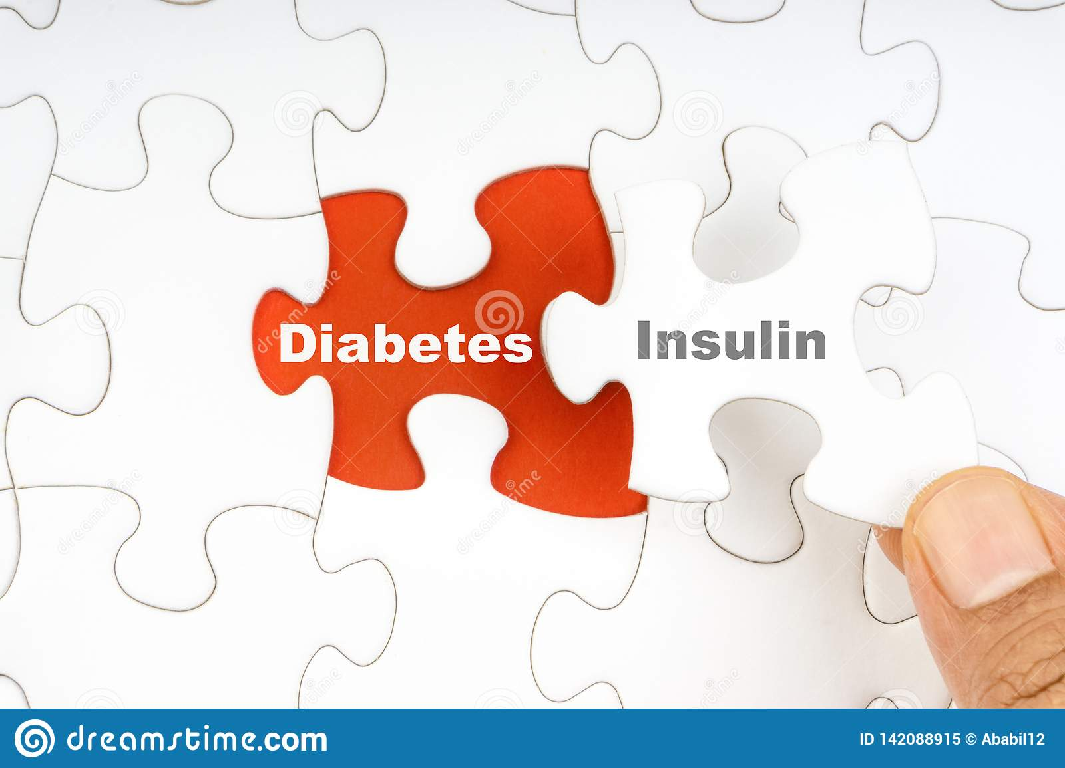
What do the numbers mean?
It’s like a BIG puzzle!
Notes:
_fig3_327175579

Slide 85
At Least 42 Factors Affect Glucose!
Food
Medication
Activity
Biological
Environmental
Behavioral and decision making
↑↑ Carbo-hydrate quantity
→↑Carbo-hydrate type
→↑ Fat
→↑ Protein
→↑ Caffeine
↓↑Alcohol
↓↑ Meal timing
↑Dehydration
? Personal microbiome
→↓Dose
↓↑ Timing
↓↑ Inter-actions
↑↑ Steroid administration
↑ Niacin (vitamin B3)
→↓ Light exercise
↓↑ High/ moderate exercise
→↓ Level of fitness/training
↓↑ Time of day
↓↑ Food and insulin timing
↑ Insufficient sleep
↑ Stress and illness
↓ Recent hypoglycemia
→↑ During-sleep blood sugars
↑ Dawn phenomenon
↑ Infusion set issues
↑ Scar tissue and lipodystrophy
↓↓ Intramuscular insulin delivery
↑ Allergies
↑ A higher glucose level
↓↑ Menstruation
↑↑ Puberty
↓ Celiac disease
↑ Smoking
↑ Expired insulin
↑ Inaccurate BG reading
↓↑ Outside temperature
↑ Sunburn
? Altitude
↓ Frequency of glucose checks
↓↑ Default options and choices
↓↑ Decision-making biases
↓↑ Family relationships and social pressures
Adapted from Brown A. DiaTribe Learn: Making sense of diabetes... diatribe.org/42factors

Slide 86
Poll Question 9
When looking at glucose patterns, which problem do you fix first?
  a. Hyperglycemia
  b. Hypoglycemia
  c. Adherence
  d. Frequency of glucose checking

Slide 87

Pattern Management
Safety 1st!! - Evaluate 3 day patterns
Hypo: eval 1st and fix:
  If possible, decrease medication dose
  Timing of meals, exercise, medications
Hyperglycemia: evaluate 2nd
  Identify patterns
  Before increase insulin, make sure not missing something (carbs, exercise, omission)

Slide 88
Adjusting Insulin Doses in a Basal/Bolus regimen (T1D or T2D)
Out of Range Glucose | Insulin to Adjust
Fasting | Long acting insulin or bedtime NPH
Post-breakfast/pre-lunch | Pre-breakfast rapid/regular insulin
Post lunch/pre-dinner | Pre-lunch rapid/regular insulin or morning NPH
Post-dinner/before bedtime | Pre-dinner rapid/regular insulin

Slide 89
Adjusting Insulin Doses: Let’s Practice
Example
Insulin degludec 20 units QAM
Insulin lispro 5 units TID before meals
Out of Range Glucose | Insulin to Adjust
Fasting
Pre-lunch
Post lunch
Before bedtime
Notes:
Insulin to Adjust
Insulin degludec QAM
Insulin lispro at breakfast
Insulin lispro at lunch
Insulin lispro at dinner

Slide 90

Bolus Insulin Timing
How is the effectiveness of bolus insulin determined?
  1-2 hours post meal
  Before next meal blood glucose
Glucose goals (may be modified based on pt specific factors)
  1-2 hours peak post meal <180 mg/dL (ADA)
  2 hour post meal <140 mg/dL (AACE)
  Before next meal 80 – 130 mg/dL

Slide 91

Poll Question 10
Mary takes 4 units of insulin lispro before breakfast. Which BG result reflects that the dose was the right dose?
Before breakfast BG of 97
1 hour post lunch BG of 160
Before lunch BG of 94
2 hour post breakfast BG of 185

Slide 92
Tips for Data Interpretation
Start by asking the person what they’ve experienced and noticed with their glucose patterns
Avoid judgment
Learn from 1 time episodes, but make changes based on patterns
Fix lows first but some amount is expected (<1-4%) and if you remove all lows, you may end up with too many highs
If it’s not making sense, dig deeper (ex. missed doses, rationing, injection technique, food insecurity, etc)
Eating Patterns
Behaviors
Medications

Slide 93
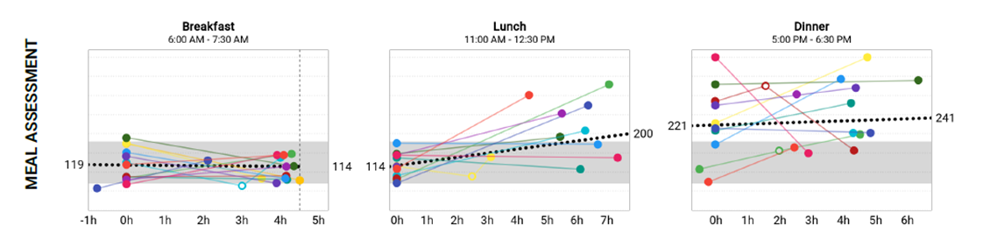
Meal Time Data Review
Glucose data before and after breakfast, lunch and dinner
“Ideally”, 2 hour post-meal should not rise above 180mg/dL or 50mg/dL from the pre-meal start
  Remember though, CGM goal <25% above 180mg/dL
By 4-5 hours, glucose should return to pre-meal level (<130mg/dL)
Notes:
Image from cleveland clinic companion medical patient report

Slide 94
Bolus Pattern Management
Does glucose go low after a correction dose?
  May need a higher sensitivity
  Ex. 1:60 instead of 1:50
Does glucose remain high after a correction dose?
  May need a lower sensitivity
  Ex. 1:40 instead of 1:50
Often people are more sensitive overnight (less insulin needed)
Does the person spike high after eating?
  Is the person bolusing BEFORE the meal
  Counting carbs correctly?
  May need a more intensive carb ratio
  Ex. 1:6 instead of 1:8
Does the person go low after eating?
  Counting carbs correctly?
  May need a less intensive carb ratio
  Ex. 1:10 instead of 1:8
Adjustments typically made 10-20% at a time

Slide 95
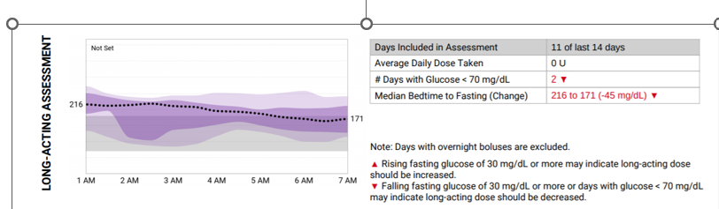
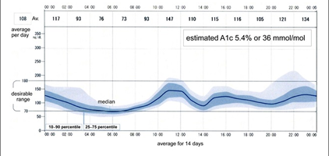
Basal Insulin Review

Slide 96

Case Study: Larry Poll Question 11
Larry takes metformin 1000mg BID, insulin glargine 50 units once daily, empagliflozin 10mg daily. His A1C is 7.8%. His BMI is 32kg/m2. FBG averages 110 mg/dL. 2 hr PP breakfast=190mg/dL, 2 hr PP lunch=210mg/dL, and 2 hr PP dinner is 240mg/dL. What is the best recommendation for an agent to add to the regimen to achieve A1C target<7%?
  Initiate insulin aspart 5 units at dinner, decrease insulin glargine to 45 units daily
  Initiate insulin aspart 5 units with all meals, decrease insulin glargine to 35 units daily
  Initiate insulin aspart 5 units at dinner, continue insulin glargine 50 units daily
  Initiate tirzepatide 2.5mg weekly, decrease insulin glargine to 45 units daily

Slide 97
Summary
Many different types of insulin
Basal + bolus needed for T1D
Weight based dosing and rules of 1700/1800 and 500/450 can be used to calculate correction factor and carb ratio respectively
GLP1 agonist preferred 1st injectable in T2D
Avoid overbasalization, utilize GLP1 agonist +/- prandial insulin if large bedtime-AM glucose drop
Counsel patients on injection site technique, administration and storage
Fine tune insulin settings based on BGM and CGM data

Slide 98

Diabetes Bingo “DiaBingo”
Shout out Right Answer

Slide 99
DiaBingo - I
I Inhaled insulin
I Glargine, icodec, degludec, efsitora, NPH are types of
I Breakdown of glycogen into glucose
I Anabolic hormone made by pancreatic beta cells
I Insulin is released when glucose levels are low
I In which injection site is insulin most rapidly absorbed?
I Elevated post-prandial glucose indicate need for pre-meaI
I Epinephrine increases insulin resistance
I Creation of glucose from amino acids and lactate
I Decreasing renal function for people on insulin can cause
I Bolus insulins
I A hormone that increases blood glucose levels
2026

Slide 100
Integrating Technology: CGM, Connected Pens, and Insulin Pumps
DiabetesEd Training Seminar
2026 – Day 2
Diana Isaacs, PharmD, BCPS, BC-ADM, BCACP CDCES, FADCES, FCCP
Director, Education & Training in Diabetes Technology
Co-Director, Endocrine Disorders in Pregnancy

Slide 101
Learning Objectives
Discuss continuous glucose monitoring (CGM) and the clinical benefits for managing diabetes
Compare and contrast different CGM, insulin pump, and connected pen devices
Describe critical teaching content for insulin pump, connected pen and CGM use
Describe appropriate candidates for insulin pump therapy
List inpatient considerations for insulin pump therapy and CGMs

Slide 102
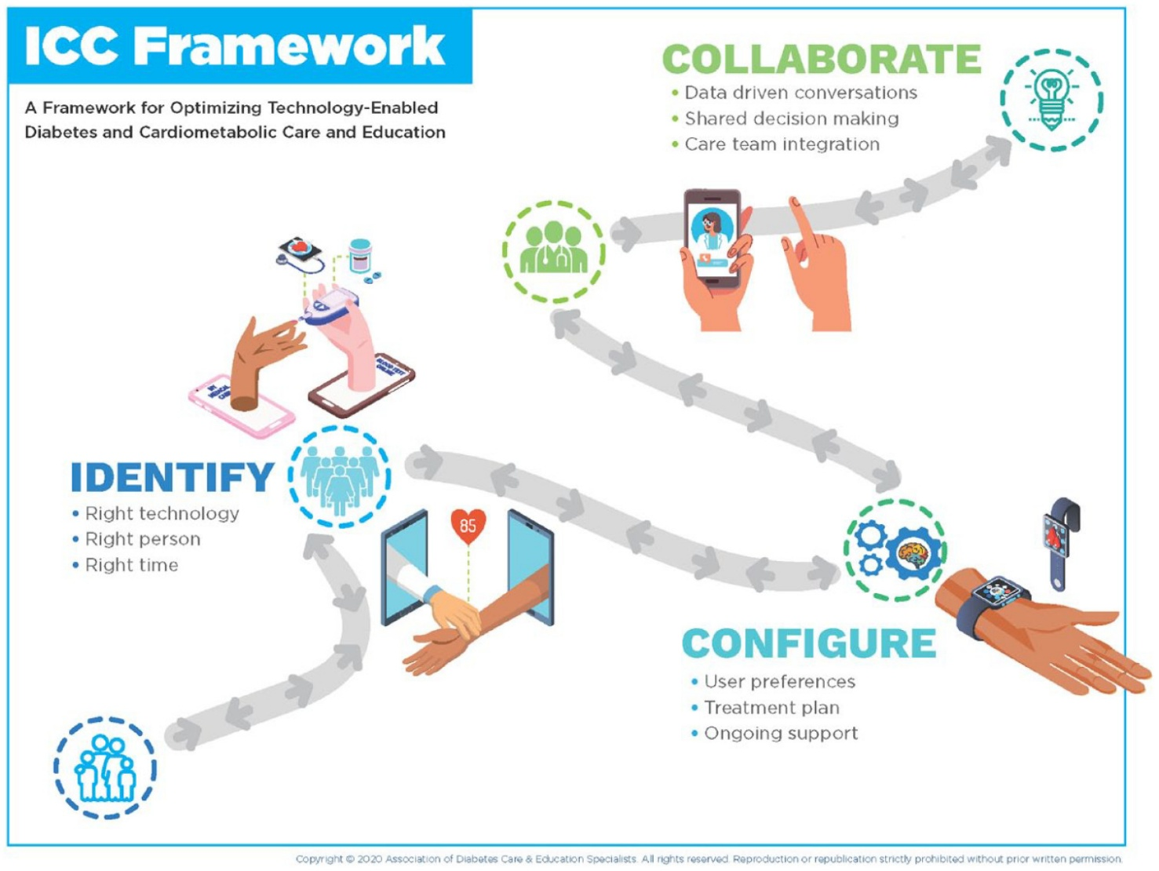
ICC Framework – Identify-Configure-Collaborate
A framework to overcome barriers to technology use and therapeutic inertia
Greenwood DA, Howell F, Scher L, et al. A Framework for Optimizing Technology-Enabled Diabetes and Cardiometabolic Care and Education: The Role of the Diabetes Care and Education Specialist. The Diabetes Educator. 2020;46(4):315-322. doi:10.1177/0145721720935125

Slide 103
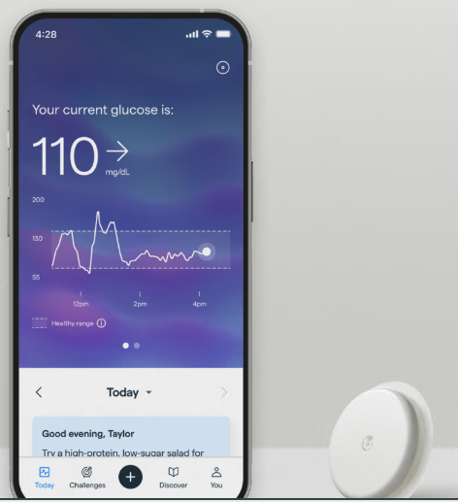


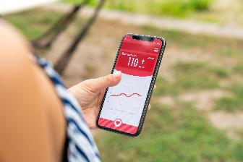
Technology is Here
CONTINUOUS GLUCOSE MONITORS (CGM)
INSULIN PUMPS
CONNECTED PENS AND CAPS
MOBILE APPS
Notes:
Diana start

Slide 104

Identify: PWD Identify the “Right” Technology
Diabeteswise.org, providers.diabeteswise.org/#/

Slide 105
The Importance of Education & Training
“No device used in diabetes
management works optimally
without education, training, and ongoing support.”
ADA. Diabetes Care.
Notes:
no device used in diabetes man agement works optimally without educa tion, training, and ongoing support

Slide 106
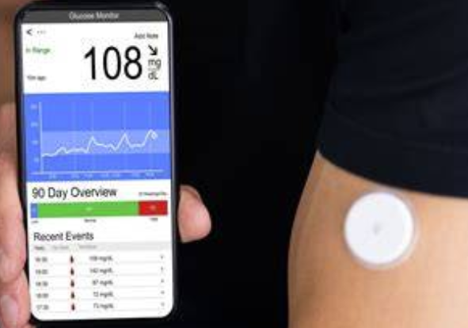
Continuous Glucose Monitors

Slide 107
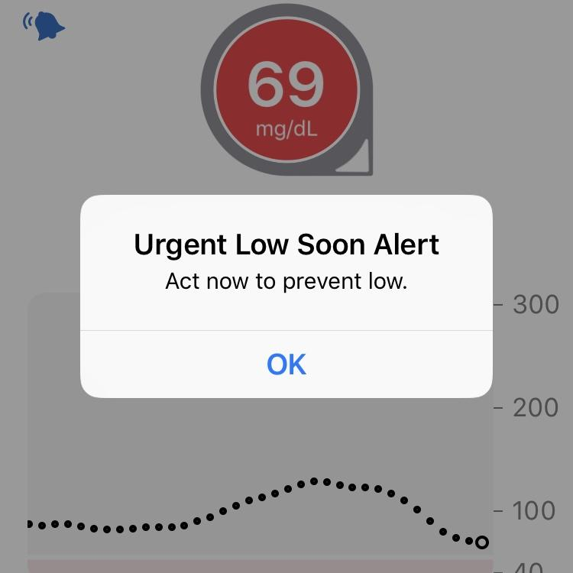
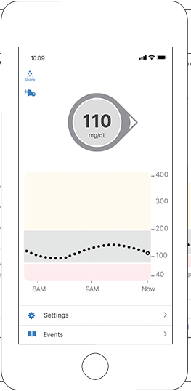
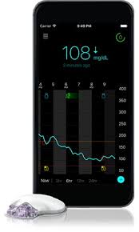
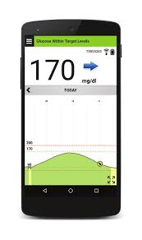
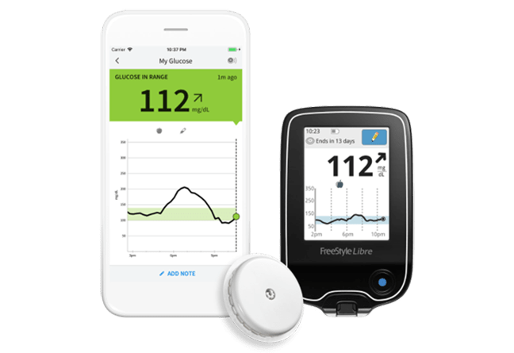
CGM: Real-Time Data

Slide 108

ADA Standards of Care 2026
Diabetes devices should be offered to people with diabetes (A)
Use of CGM is recommended at diabetes onset and anytime thereafter for children, adolescents and adults with diabetes who are on insulin (A) on nonsinulin therapies that can cause hypoglycemia (C ) and on any diabetes treatment where CGM helps in management (C ).
The specific CGM device and method for use should be made based on the individual’s circumstances, preferences and needs. (E )
In people with diabetes on insulin therapy, CGM devides should be used as close to daily as possible for maximal benefit (A)
People who wear CGM devices should be educated on potential interfering substances and other factors that may affect accuracy.
American Diabetes Association. Diabetes Care. 2026;.
Notes:
*Grade A: Clear evidence from well-conducted, generalizable randomized controlled trials that are adequately powered; †Grade B: Supportive evidence from well-conducted cohort studies; §Grade C: Supportive evidence from poorly controlled or uncontrolled studies.

Slide 109
Types of CGM
 | Professional | Personal | OTC
How to obtain | Owned by the clinic | Requires a prescription | Available without a prescription
Type | Blinded and unblinded (real-time feedback) | Real-time | Real time
Wear duration | Short-term use (10 days) | Long-term use | Short- or long-term use
Access | Insurance coverage for most people living with diabetes or prediabetes | Insurance coverage more focused on people taking insulin , although expanding | Cash pay, available to all adults
Compatibility | Smartphone app | Smartphones, reader/receiver, connected pens, mobile apps, insulin pumps | Smartphone app, mobile apps/Oura ring
American Diabetes Association Professional Practice Committee. Diabetes Care. 2025;48(Supplement_1):S146-S166.

Slide 110
Personal CGM Options (Rx)
Freestyle Libre 2+
Freestyle Libre 3+
Eversense 365
Dexcom G7
Instinct
Simplera

Slide 111
Personal CGM Comparison
​ | Dexcom G7​ | Dexcom G7 15 Day | Libre 3​+ | Instinct | Simplera Sync | Eversense​ 365
Max wear time​ | 10.5 d | 15.5 d | 15 d |  | 7 d​ | 365 d
Warm-up time​ | 30 min | 1 h | 1 h |  | Up to 2 h | 24 h
Calibrations ​ | Optional |  | None |  | Optional, | After 14 d, weekly
Water depth | 8 ft, 24 h |  | 3 ft, 30 min |  | 8 ft, 30 min | 3.28 ft, 30 min
Data platforms | Dexcom Clarity |  | LibreView | Carelink |  | Eversense Data Management System
Mobile apps | Dexcom G7, Clarity, Dexcom Follow |  | Libre, LibreLinkUp | CareLink connect, MiniMed mobile |  | Eversense
Reader, receiver, smartphone compatibility | Receiver, smartphone, watch |  | Reader, smartphone | Smartphone |  | Smartphone
Integrations | T:slim X2, Mobi, Omnipod 5, iLet |  | T:Slim X2, iLet, Omnipod 5, Twiist | MiniMed Flex, 780G, MiniMed Go |  | Twiist, iLet
Information from Manufacturer’s user guides

Slide 112
Personal CGM Comparison (cont’d)
 | Dexcom G7 | Dexcom G7 15 Day | Dexcom G7 15 Day | Libre 3+ | Instinct | Simplera Sync | Eversense
FDA-approved sites​ | Upper arm (age 7+ y)​ Upper buttocks (age 2-6 y)​ |  |  | Upper arm​ |  | Upper arm, abdomen​ Upper buttocks (age 2-13 y)​ | Upper arm​
Approved in pregnancy | Yes​ |  |  | Yes​ |  | No​ | No
Transmitter | Disposable |  |  | Disposable |  | Charge weekly | Charge daily
FDA-approved ages (years)​ | ≥ 2​ |  | ≥ 18 | ≥ 2​ ​ |  | ≥ 7 | ≥ 18​ ​
Alarms | High, low, predictive (20 min), rise/fall rates, delayed first alert |  |  | High, low |  | High, low, predictive (60 min), rise/fall rates | High, low, predictive (30 min), rise/fall rates
Drug interactions​ | Hydroxyurea,​ acetaminophen (˃ 4 g/d) |  |  | Vitamin C​ (˃ 1 g/d) |  | Acetaminophen, hydroxyurea​ | Tetracycline antibiotics, mannitol​
Max distance for signal | 33 ft |  |  | 33 ft |  | 20 ft | 24.9 ft, on body vibration alerts
Information from Manufacturer’s user guides: Dexcom G6, Dexcom G7, Libre 2, Libre 3, Medtronic Guardian Connect, Guardian 4, Eversense.
Notes:
Reference: Continuous Glucose Monitors (CGM) l Danatech
The comparison continues with additional details on device features. Understanding these nuances enables pharmacists to tailor recommendations and troubleshoot issues. Device selection should align with patient preferences, clinical goals, and insurance coverage.
For drug interactions, the original libre 2 and libre 3 had an interaction at doses of vitamin c over 500mg, now this is over 1000 mg with the plus versions.
Also, acetaminophen in doses over 1000 mg every 6 s or 4 grams per day will cause false high readings with the Dexcom devices, although this is beyond the max dose.
The alarms are different between devices. For example, libre devices have a high and low alarm. The other devices have high, low, predictive and rise and fall rates.
When used with smart phones, there are accessibility features that may allow the phone to read the information to you, for those that are visually impaired. Iphones may have a feature where you can ask siri what your glucose is.

Slide 113
Poll Question 1
Which of the following sensors is sold over the counter without a prescription?
Simplera Sync
Dexcom G7
Libre 3
Dexcom Stelo

Slide 114
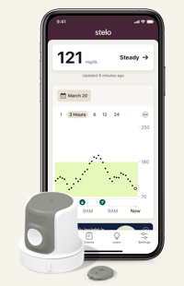

Over-The-Counter CGM
Available without a prescription
Ordered online
Intended for people not taking insulin
No alerts for hypoglycemia
Works with mobile apps that incorporate education on lifestyle and glucose goals
Zahalka SJ, et al. Endocr Pract. 2025 May 21:S1530-891X(25)00893-6

Slide 115
OTC CGM Options
 | Dexcom Stelo | Abbott Lingo
Intended audience | Ages >2 yrs not on insulin with T2D, prediabetes, or who are interested in tracking their glucose | Adults not on insulin interested in understanding how to improve their metabolic health
Wear time | 15.5 days | 14 days
Ability to share data | Dexcom Clarity | No
Glucose range | 70-250mg/dL | 55-200mg/dL
Real-time alerts | Spike detection | No
Special features | “Spike Alerts” – notified that your glucose is rising at a rate the app determines to be a “Spike” Daily insights | Lingo Count – points assigned for elevations in glucose throughout the day, goal is to get fewer total points, Coaching program
Frequency of glucose readings | 15 minutes | 1 minute
Education within App | Yes | Yes
Age | ≥ 18 yr | ≥ 18 yr
Cost | $99/month or $85-$89/month with subscription plans | $49-1 sensor, $89-2 sensors, $249-6 sensors, subscription plan
Information from manufacturers websites: https://www.stelo.com/en-us, Lingo - Made by Abbott: Your body has the answers (hellolingo.com).
Notes:
Zahalka SJ, Akturk HK, Galindo RJ, Shah VN, Low Wang CC. Continuous Glucose Monitoring for Prediabetes - Roles, Evidence, and Gaps. Endocr Pract. 2025 May 21:S1530-891X(25)00893-6. doi: 10.1016/j.eprac.2025.05.742. Epub ahead of print. PMID: 40409607.
Adults not on insulin with type 2 diabetes, prediabetes or who are interested in tracking their glucose Adults not on insulin interested in understanding their metabolic health and a p

Slide 116
CGM Counseling Points
Important to check glucose when indicated
  Symptoms do not match sensor value
  During warm-up period for treatment decisions
Sensors are waterproof
  Showering, bathing, swimming OK
  Check water depth criteria for individual sensor
Overlays and skin preps to help it stay on
Avoid with MRI, CT, diathermy
  Exception: Eversense implantable, transmitter should be removed
  Libre is ok for MRI/CT
Not FDA approved
  Dialysis, critically ill
  Pregnancy-Simplera eversense
  If people choose to use, it is important they know it is off-label

Slide 117
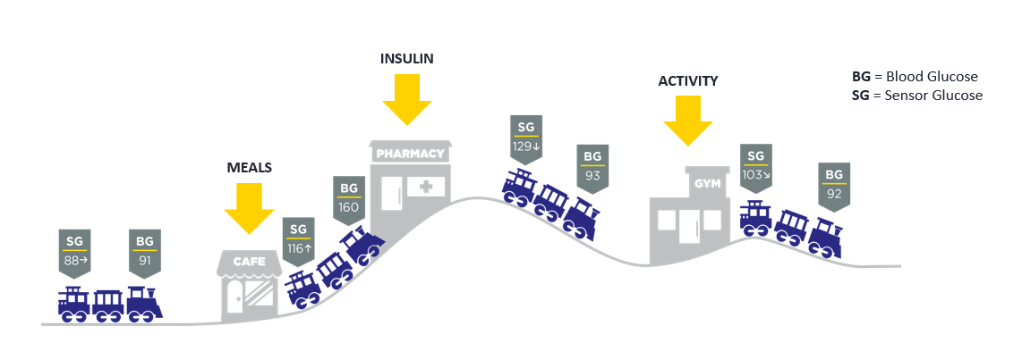
Lag Time
Refers to a delay in CGM sensor readings compared to finger stick blood glucose readings
  Estimated CGM sensor reading ~5 minutes behind
Most apparent when glucose is changing rapidly
Counsel patients on the train analogy

Slide 118
Causes of Falsely High or Low Readings
Interfering substances
  Falsely high
    Vitamin C (Libre)
    Acetaminophen (high dose Dexcom, Simplera)
    Tetracycline antibiotics (Eversense)
Compression Lows
Dehydration
Faulty sensor

Slide 119

When to Check BGM?
A calibration or blood glucose symbol appears on the device
  If making a dosing decisions
Symptoms or expectations do not match CGM readings
Off-label indications to ensure accuracy: dialysis, inpatient use
Possibly after correcting a low
If taking an interfering substance
Counsel pwd about “lag time”
Per ADA, every person using CGM should have access to a meter and test strips
Notes:
Image obtained from: https://lada-diabetes.com/freestyle-libre-14-day-system-review-first-week-thoughts/

Slide 120
Downloading CGM Data

Slide 121

CGM Key Metrics
Recommended Time in Range
for most people with T1D & T2D
Target time
Time above range (TAR)
< 1 hr, 12 min, > 250 mg/dL
< 6 hr, > 180 mg/dL
Number of days CGM is worn 14 days is recommended
Percentage of time CGM is active 70% of data from 14 days is recommended
Mean glucose
Glucose management indicator (GMI) Estimated A1C
Coefficient of variation (CV) This is a measure of glycemic variability. A CV >36% is considered unstable.
>250 mg/dL
<5% Very High
>180 mg/dL
<25%* High
Target Range:
70-180 mg/dL
Time in range (TIR)
> 16 hr, 48 min
>70% In Range
Correlates with
A1c ~7.0%
Time below range (TBR)
< 1hr < 70mg/dL
< 15 min < 54mg/dL
<70 mg/dL
<4%** Low
<54 mg/dL
<1% Very Low
Battelino T et al. Diabetes Care. 2019;42(8):1593-1603. . 2. American Diabetes Association. Diabetes Care 2021;44(Suppl. 1):S73–S84 | https://doi.org/10.2337/dc21-S006.

Slide 122



More Green, Less Red
FNIR
Flat Narrow
In Range
Notes:
Libreview report, my own image

Slide 123
Poll 2. What is the goal time in range for most adults with type 1 or 2 diabetes?
≥50%
≥70%
≥80%
≥90%
Notes:
Learning Objective #: 2
Rationale
Answer: B

Slide 124




Target Glucose Ranges
Same person, same data, look at the difference in time in range!

Slide 125

Isaacs D, Cox C, Schwab K, et al. Technology Integration: The Role of the Diabetes Care and Education Specialist in Practice. The Diabetes Educator. 2020;46(4):323-334. doi:10.1177/0145721720935123

Slide 126

Case Studies & 2 min Stretch

Slide 127

Case 1
Terrance is a 60-year-old man with T2D x 12 years
Current DM2 meds:
  Metformin 1000 mg twice daily
  Glimepiride 8mg daily
Other conditions
  CKD
  Hyperlipidemia
  Hypertension
Unemployed, has Medicaid
Eats 3 meals/day, snacks at night, no regular exercise
Glucose log
Checks BGM once daily
Pertinent Labs
  SCr = 1.38 mg/dL, eGFR = 55
  A1C = 8.2%, BMI = 34 kg/m²
Notes:
Terrance starts CGM

Slide 128




Starts CGM
Which CGM key metrics are at goal?
Which are not?
Overall patterns?

Slide 129
Poll Question 3
1.Which CGM key metrics are at goal?
  Time in range
  Time above range
  Time below range
  Glucose management indicator
Notes:
Correction answer: time below range

Slide 130


Time in Range
Focus on the positive: what’s worked well on Tue 3/16?
Time in range is high this day
Ate a granola bar for breakfast, grilled chicken salad at lunch, steak, greens, potato at dinner
No missed medication doses
Good night’s sleep, low stress

Slide 131

Areas for Improvement
Sun 3/14 glucose went high 12 pm
Reports eating rice bowl and coke
Silver lining
  Walked around 3 pm (helped to lower glucose)
  Avoided afternoon snacking
  Ate low-carb dinner (salmon, salad, small potato)
  Denies missed doses

Slide 132
Poll Question 4
What is the most appropriate medication adjustment for Terrance?
  Add DPP4 inhibitor
  Add GLP-1 receptor agonist
  Add SGLT2 inhibitor
  Lifestyle modifications only
  More than 1 right answer
Notes:
Sglt2 inhibitor or semaglutide since CKD.

Slide 133

Action Plan
In collaboration with Terrance
  Lifestyle changes
    Incorporate a brisk walk 3 days per week
    Reduce high-carbohydrate foods like fries
  CGM optimization
    Alerts, high for 280
  Medication adjustments
      Add a medication to help his CKD + optimize glucose → SGLT2 inhibitor
  Follow-up in 3-4 weeks

Slide 134

3 Months Later
T2D Meds:
Dapagliflozin 10mg qday
Metformin 1000mg BID

Slide 135


Case 2
75 yo F with 25 year h/o T2D. PMH includes HTN, hyperlipidemia, hypothyroid, obesity, ASCVD.
Current DM Meds
-Insulin glargine inject 50 units QAM and 40 at night
-Insulin aspart 8-10-10 units plus correction scale
-Metformin 1000 mg daily
-Semaglutide, 0.25mg weekly (2 doses so far)
Clarity report obtained from Diana Isaacs
Notes:
Did not tolerate higher dose of metformin

Slide 136

Poll 5. Which of the following CGM key metrics is at target?
Time in range
Time above range
Coefficient of variation
Time below range
Clarity report obtained from Diana Isaacs
Notes:
Answer: D

Slide 137




Using DATAA
Less of an appetite since taking semaglutide, often going low during the day
During the day, glucose often steady, but also having to drink juice to keep from going low
Skipping aspart doses because running low, leading to rebound highs
Clarity report obtained from Diana Isaacs

Slide 138

Action Plan
Continue semaglutide 0.25mg weekly x 2 more weeks, then titrate up to 0.5mg weekly
Decrease insulin glargine to 40 units qam and 30 units qpm
Continue insulin aspart 8-10-10 + correction scale
Continue metformin 1000mg daily
Notes:
Current DM Meds
-Insulin glargine inject 50 units QAM and 40 at night
-Insulin aspart 8-10-10 units plus SS
-Metformin 1000 mg daily
-Semaglutide, 0.25mg daily (2 doses so far)

Slide 139

Follow-Up
1 month later
Average glucose improved
Time in range increased
Glucose variability improved
Less hypoglycemia
Clarity report obtained from Diana Isaacs
Notes:
Next plan: continue to titrate the semaglutide
Consider more aspart at dinner or lower carb dinner.
Continue to titrate down the glargine and aspart

Slide 140

Case 3
Person with T2D taking metformin 1000mg twice daily and insulin glargine 20 units daily
Is TIR at goal?
What to ask?
What changes to make?
Notes:
The whole curve is elevated
Needs more insulin-is the person taking insulin?
Ability to use non insulin therapies?
Low on Saturday likely false low.

Slide 141

Case 4
Person with T2D
56yo, BMI=33, A1C=7%
Meds:
  Degludec 40 units daily
  Dulaglutide 4.5mg weekly
  Dapagliflozin 10mg daily
  Metformin 1000mg twice daily
Notes:
Fix lows: too much basals
Fix highs: dietary modification, more potent glp1, possibly meal time insulin.

Slide 142


Case 5
40yo F with T2D, lost 20lbs since starting Semaglutide 6 months ago, A1C=7.4%, also has HTN, dyslipidemia, BMI=34kg/m2
DM Meds:
  Metformin 1000mg twice daily
  Empagliflozin 25mg daily
  Semaglutide 2mg weekly
Is data at goal?
  TBR?
  TIR?
  TAR?
Action plan?
Notes:
Options: Consider switch to tirzepatide or add basal insulin?

Slide 143
Patient Case 6
72yo with type 2 diabetes
Lispro 6 units three times daily with meals + SS#2
Glargine 12 units daily
Goal: transition to GLP-1
DATAA model for interpretation
  Download data
  Assess hypoglycemia
  Time in range: what’s working well?
  Areas for improvement
  Action plan
Notes:
Shows oversalization but also the confusion that can occur from regimen complexity: this patient was actually taking glargine 3 to 4 times daily !

Slide 144
Insulin Pumps

Slide 145

How a Pump Delivers Insulin
Usual Insulin Secretion
Insulin Pump
Insulin
Time
.
Notes:
145
Image available for reuse: https://www.flickr.com/photos/fdaphotos/15657970628

Slide 146




Insulin Pump Basics
Infusion Set
Tubing
Cannula
Insulin Reservoir
Tubeless Pump
Pump
Cannula
Notes:
Image available for reuse: https://www.flickr.com/photos/fdaphotos/15657970628
Second image is of my hand.
Traditional insulin pumps consist of a pump device, tubing, and an infusion set. The pump holds the insulin reservoir and controls delivery, while the tubing connects to the infusion site. Familiarity with these components is crucial for troubleshooting and patient training.
The cannula comes in 6mm or 9mm and is placed under the skin. A person can disconnect from the pump as shown above for showering and bathing and swimming.
There are also tubeless insulin pump options which are waterproof and can remain on the body.
Most pumps are worn for 2-3 days, although now there is an extended infusion set which can be worn up to 7 days.
Of note, while the 7 day infusion set can be worn for 7 days, pumps typically hold anywhere from 180-300 unitso f insulin, so if they use the insulin sooner then that, then they would need to replace the reservoir of insulin.

Slide 147
Definitions:
Mix & Match
Definition
Meaning
Basal rates
Glucose targets
Extended bolus
Carbohydrate ratio
Suspend before low
Glucose number trying to reach with the pump
Rate of insulin administration per hour (units/hour)
A bolus extended given over a longer time period
How long insulin works in the body
How many carbs needed for 1 unit of insulin

Slide 148
Definitions (Cont)
Mix & Match
Definition
Meaning
Temp basals
Correction factor
Max bolus
Activity mode
Suspend before low
The most insulin that can be given at one time
Less intensive insulin delivery to protect against lows
A temporary increase or reduction in insulin delivery
Predictive stop of insulin to prevent lows
How much 1 unit of insulin will lower glucose

Slide 149

Insulin Pump Info
Uses U100 rapid-acting insulin
  Minimizes insulin variability
  Must have dexterity to fill cartridge or device
Bolus calculator incorporating settings
Active insulin to prevent stacking
Multiple basal rates or automated delivery
Small dose increments
Temporary basal rates or temporary glucose targets
Alarms and reminder features
Notes:
Insulin pump basics include the use of U100 rapid-acting insulin, bolus calculators, and customizable basal rates. These features help minimize insulin

Slide 150

Ideal Pump Candidates
Require meal-time insulin
Wearing CGM or frequently checking BGM
Carbohydrate awareness
Willing to follow up regularly with health care team
Can afford the pump/supplies
Problem solving skills (eg, troubleshoot and treating high or low glucose)
Able to use the device independently or with caregiver support
Diabetes Care. 2025;48(Supplement_1):S146-S166. doi:10.2337/dc25-S007.
Notes:
In the past, there was more rigid criteria for who should go on an insulin pump. Because of the improved outcomes, the criteria is much more

Slide 151





Infusion Sets
Infusion sets are usually Teflon
  Available in different sizes (ex. 9mm vs 6mm)
  Silhouette (angled) may be better for kids/thinner/very active people
  Steel infusion sets a good option for people with frequent site occlusions
Longer tubing options
  Good if connected on leg, arm or wearing pump further from site
Caution with kids/babies/pets-pouches available to hide pump
When changing out infusion set, check glucose or CGM 1-2 hours after
  Don't change right before bed

Slide 152

What Happens with a Bent Cannula?
Hyperglycemia
Hypoglycemia
No effect
Notes:
My own picture.

Slide 153








Where to Wear?

Slide 154


Patch Pumps
V-Go
Cequr Simplicity
24 hr. basal/bolus patch pump
Approved for adults with T1D or T2D
Uses rapid acting insulin only
Basal rate dosing options: 20-, 30-, 40-units per 24 hrs
On-demand bolus doses in 2-unit increments
  Up to 36 units (bolus) /24 hrs
    Max: 12u with meals + 40u basal
Doses administered via clicks directly on the device
Must be changed daily
Bolus pump patch only
  Can replaced meal time injections
  Still need separate basal insulin
Approved for adults with T1D or T2D
Holds up to 200 units of rapid acting insulin
On-demand bolus doses in 2-unit increments (1 unit coming soon)
Doses administered via clicks directly on the device
Must be changed every 4 days (7 day and 240 units coming soon)
  Can change sooner if using >200 units in 4 days
May improve adherence → discreet, always with you
Notes:
Patch pumps like Cequr Simplicity and V-Go offer discreet, on-demand insulin delivery without tubing. These devices are particularly useful for adults with T2D seeking simplified insulin regimens.

Slide 155

Coming Soon: Pivot
Holds 300 units
Basal can be set from 0.5 to 4 units/hour
Bolus button through clothing
3 month use, 3mLcartridges are changed out, disposable battery, detach for shower/swimming
Works with pivot app on iphone for data sharing, no CGM connectivity
https://pivotpump.com. Accessed 7/17/26/

Slide 156

Automated Insulin Delivery Systems
Insulin pump
iCGM
Algorithm
Notes:
Alternate cotroller enabled (ACE)

Slide 157

Current AID Systems are Hybrid-Closed Loops
Automated insulin delivery (AID)
Auto adjust background insulin
Some systems give auto corrections
Maximize time 70-180mg/dL

Slide 158
Automated Insulin Delivery Systems
Omnipod 5
(Insulet)
T:slim X2 (Tandem)
Control IQ+
780G
(Minimed)
iLet
(Beta Bionics)
Mobi (Tandem)
Control IQ+
Twiist Loop (Sequel)
Flex (MiniMed)

Slide 159
Current State of Pumps
Every insulin pump has a cloud-based option to obtain data
Every insulin pump is available with CGM as AID
Insulin pump coverage for people with T1D is amazing
3 FDA approved algorithms for T2D
1 FDA approved AID system for T1D pregnancy

Slide 160

2026 ADA Standards of Care and AID
7.25a AID systems are the preferred insulin delivery method over multiple daily injections (MDI), CSII, and sensor- augmented pump in people with type 1 diabetes, A adults with type 2 diabetes, A children and adolescents with type 2 diabetes, E and other forms of insulin-deficient diabetes. B–E Choice of an AID system should be made based on the individual’s circumstances, preferences, and needs. E
7.25b Consider AID systems for select people with type 2 diabetes treated with basal insulin not achieving individualized glycemic goals. B Choice of an AID system should be made based on the individual’s circumstances, preferences, and needs. E
American Diabetes Association. Diabetes Care. 2026;.
Diabetes Care 2026;49(Suppl. 1):S150–S165
Notes:
Grazia to fill out

Slide 161



Custom Foods

Slide 162
AID System Comparison
 | Omnipod 5 | Control IQ+ | 780G/Flex | iLet | Twiist
Max fill | 200 units | 300 units (T:Slim X2) 200 units (Mobi) | 300 units | 180 units | 300 units
CGM compatibility | Dexcom G6, G7, Libre 2+ | Dexcom G7, Libre 3+ | Simplera Sync, Instinct | Dexcom G7, Libre 3+ | Libre 3+, Eversense
Lowest algorithm target/range | 110mg/dL 100mg/dL (coming soon) | 112.5-120mg/dL | 100mg/dL | 110mg/dL | 87mg/dL 67mg/dL (pre-meal preset)
Basal automation | Calculated from total daily insulin, updated each pod change, 60 min prediction | Increases or decreases from programmed basal rates, 30 min prediction | Calculated based on total daily insulin from past 2-6 days | Initiated based on user weight and adapts with glucose profile | Increases or decreased from programmed basal rates, 6 hour prediction
Automated correction bolus | No | 1/hour if glucose predicted >180mg/dL, 60% of calculated dose | If glucose > 120 mg/dL and at max "auto basal" delivery, up to every 5 min | Yes | No
Extended Bolus | No | Yes, up to 8 hours | No | No | No, carb absorption time up to 8 hours
Temp Basals | No | Yes | No | No | No
ICR: insulin to carbohydrate ratio, IAT: insulin action time, ISF: insulin sensitivity factor, NA: not available
Data obtained from user manuals
Notes:
Omnipod-5_User-guide.pdf
MiniMed_770G_System_User_Guide.pdf (medtronicdiabetes.com)
AW-1007704_B User Guide, Mobile Bolus, t:slim X2, Control-IQ, 7.6, mg/dL, Artwork.pdf (tandemdiabetes.com)
User manuals
Omnipod-5_User-guide.pdf
MiniMed_770G_System_User_Guide.pdf (medtronicdiabetes.com)
AW-1007704_B User Guide, Mobile Bolus, t:slim X2, Control-IQ, 7.6, mg/dL, Artwork.pdf (tandemdiabetes.com)
770g and 780 g max is 250 units.

Slide 163


Slide 164
Case Study: Transition from MDI to Insulin Pump
PT: AJ is a 60 year old
Current Medications:
  Insulin degludec 40 units once daily
  Insulin aspart 15 units TID a.c
  Tirzepatide 15 mg once weekly
  Aspirin 81 mg once daily, metoprolol succinate 100 mg once daily, rosuvastatin 40 mg once daily, lisinopril 20 mg once daily
Current Weight: 211 lbs ≈ 96 kg
Notes:
Each insulin pump manufacturer has recommendations for calculating initial settings, whether transitioning from multiple daily injections, or prior insulin therapy. While specific recommendations and values used for calculation vary between systems, fundamentally they are very similar. These recommendations are not meant to replace clinical judgement, especially with consideration of individual patient needs. No explicit adjustments recommended depending other antihyperglycemic therapies.
Start by calculating current total daily insulin. Compare to weight based insulin dosing, and take an average of the two. This will then give us the TDI we will use for pump calculations.
Will allocate 50% of TDI for basal insulin, TDI divided by 2. Then divide by 24 due to 24 hours in a day to calculate an hourly basal rate. May see this expressed as TDI/48 as a shortcut combing steps.
For calculating bolus settings, we will apply familiar concepts such as the rule of 1700 and rule of 500.
ISF: Rule of 1500 traditionally utilized for regular/human insulin with Rule of 1700 updated for rapid acting insulin. Will take our TDI and divide by 1700.
Correction factor: Initially developed as rule of 450, but adjusted to Rule of 500 to reflect greater efficiency with development of rapid acting insulin analogs. However, notably Insulet, makers of Omnipod recently adjusted their initial calculation recommendations to utilize the rule of 400, based on findings that patients often require more intense carbohydrate ratios.

Slide 165
Case Study: Transition from MDI to Insulin Pump
Current Total Daily Insulin (TDI): 40+45=85 Units
Weight = 96 kg
1. (Current TDI) * 0.75
2. Weight (kg) * 0.5
Take Average of 1 and 2 for TDI that will be used for pump calculations.
Notes:
Each insulin pump manufacturer has recommendations for calculating initial settings, whether transitioning from multiple daily injections, or prior insulin therapy. While specific recommendations and values used for calculation vary between systems, fundamentally they are very similar. These recommendations are not meant to replace clinical judgement, especially with consideration of individual patient needs. No explicit adjustments recommended depending other antihyperglycemic therapies.
Start by calculating current total daily insulin. Compare to weight based insulin dosing, and take an average of the two. This will then give us the TDI we will use for pump calculations.
Will allocate 50% of TDI for basal insulin, TDI divided by 2. Then divide by 24 due to 24 hours in a day to calculate an hourly basal rate. May see this expressed as TDI/48 as a shortcut combing steps.
For calculating bolus settings, we will apply familiar concepts such as the rule of 1700 and rule of 500.
ISF: Rule of 1500 traditionally utilized for regular/human insulin with Rule of 1700 updated for rapid acting insulin. Will take our TDI and divide by 1700.
Correction factor: Initially developed as rule of 450, but adjusted to Rule of 500 to reflect greater efficiency with development of rapid acting insulin analogs. However, notably Insulet, makers of Omnipod recently adjusted their initial calculation recommendations to utilize the rule of 400, based on findings that patients often require more intense carbohydrate ratios.

Slide 166
Case Study: Transition from MDI to Insulin Pump, Basal Rates
Basal rate expressed in Units/hr
Approximate 50% of insulin to be basal
TDI /2/24 or TDI/ 48:
Notes:
Each insulin pump manufacturer has recommendations for calculating initial settings, whether transitioning from multiple daily injections, or prior insulin therapy. While specific recommendations and values used for calculation vary between systems, fundamentally they are very similar. These recommendations are not meant to replace clinical judgement, especially with consideration of individual patient needs. No explicit adjustments recommended depending other antihyperglycemic therapies.
Start by calculating current total daily insulin. Compare to weight based insulin dosing, and take an average of the two. This will then give us the TDI we will use for pump calculations.
Will allocate 50% of TDI for basal insulin, TDI divided by 2. Then divide by 24 due to 24 hours in a day to calculate an hourly basal rate. May see this expressed as TDI/48 as a shortcut combing steps.
For calculating bolus settings, we will apply familiar concepts such as the rule of 1700 and rule of 500.
ISF: Rule of 1500 traditionally utilized for regular/human insulin with Rule of 1700 updated for rapid acting insulin. Will take our TDI and divide by 1700.
Correction factor: Initially developed as rule of 450, but adjusted to Rule of 500 to reflect greater efficiency with development of rapid acting insulin analogs. However, notably Insulet, makers of Omnipod recently adjusted their initial calculation recommendations to utilize the rule of 400, based on findings that patients often require more intense carbohydrate ratios.

Slide 167
Case Study: Transition from MDI to Insulin Pump, Bolus Settings
Insulin Carb Ratio: 400 / TDI (recommended for omnipod) or
450/TDI (recommended for others)
Correction Factor: 1700 / TDI
Other settings:
  Target glucose
  Duration of Insulin Action
  Max basal
  Max bolus
  Reverse correction
Notes:
Each insulin pump manufacturer has recommendations for calculating initial settings, whether transitioning from multiple daily injections, or prior insulin therapy. While specific recommendations and values used for calculation vary between systems, fundamentally they are very similar. These recommendations are not meant to replace clinical judgement, especially with consideration of individual patient needs. No explicit adjustments recommended depending other antihyperglycemic therapies.
Start by calculating current total daily insulin. Compare to weight based insulin dosing, and take an average of the two. This will then give us the TDI we will use for pump calculations.
Will allocate 50% of TDI for basal insulin, TDI divided by 2. Then divide by 24 due to 24 hours in a day to calculate an hourly basal rate. May see this expressed as TDI/48 as a shortcut combing steps.
For calculating bolus settings, we will apply familiar concepts such as the rule of 1700 and rule of 500.
ISF: Rule of 1500 traditionally utilized for regular/human insulin with Rule of 1700 updated for rapid acting insulin. Will take our TDI and divide by 1700.
Correction factor: Initially developed as rule of 450, but adjusted to Rule of 500 to reflect greater efficiency with development of rapid acting insulin analogs. However, notably Insulet, makers of Omnipod recently adjusted their initial calculation recommendations to utilize the rule of 400, based on findings that patients often require more intense carbohydrate ratios.

Slide 168
Case Study: Transition from MDI to Insulin Pump, Bolus Settings
Insulin Carb Ratio: 400 / TDI
Correction Factor: 1700 / TDI
Other settings:
  Target glucose (as low as 100mg/dL)
  Duration of Insulin Action: usually 3 hours
  Max basal
  Max bolus
400/56 = 7.14 g/U (round to 7)
1700/56 = 30.36 mg/dL/U (round to 30)
Notes:
For calculating bolus settings, we will apply familiar concepts such as the rule of 1700 and rule of 500.
ISF: Rule of 1500 traditionally utilized for regular/human insulin with Rule of 1700 updated for rapid acting insulin. Will take our TDI and divide by 1700.
Correction factor: Initially developed as rule of 450, but adjusted to Rule of 500 to reflect greater efficiency with development of rapid acting insulin analogs. However, notably Insulet, makers of Omnipod recently adjusted their initial calculation recommendations to utilize the rule of 400, based on findings that patients often require more intense carbohydrate ratios.
ICR: adjusted in 0.1 g/U increments, from 1 – 150 g carbohydrates/Unit of insulin. So in clinical practice in this case, would need to adjust to 7.1 or 7.2.
Correction Factor: adjustable in 1 mg/dL increments from 1 – 400 mg/dL.
Max basal rate: between 0.05-30 U/hr in 0.05 U/hr increments .Default is 3.00 U/hr.
Max bolus: max of 30 units.
Duration of insulin action = Insulin Action time. 2 to 6 hours in 30-minute increments. Default is 4 hours.

Slide 169
Accessing Cloud-Based Data
System: | Associated Mobile Apps | Website to Access Portal | Data Sources
Glooko | Omnipod 5, Glooko | glooko.com | Omnipod 5
Carelink | MiniMed mobile, Carelink mobile | carelink.medtronic.com/login | Minimed pumps, MiniMed Go
Tidepool | Tidepool mobile, Twiist AID system, twist insight | tidepool.org | Twiist, Open-source Loop
Source | T:slim mobile, Mobi mobile | source.tandemdiabetes.com | Tandem pumps
Beta Bionics User Portal | Bionic circle, iLet app | report.betabionics.com/ | iLet

Slide 170

Umpierrez G et al. Diabetes Care 2018 Aug; 41(8): 1579-1589.
Notes:
Most insulin pump users are more knowledgeable than their hospital health care providers about diabetes management; therefore, experienced pump users may be encouraged to self-manage their diabetes during their hospitalization

Slide 171
Contraindications to Insulin Pumps in the Hospital
Impaired level of consciousness (except during short-term anesthesia)
Patient’s inability to correctly demonstrate appropriate pump settings
Critical illness requiring intensive care
Psychiatric illness that interferes with a patient’s ability to self-manage diabetes
Diabetic ketoacidosis and hyperosmolar hyperglycemic state
Refusal or unwillingness to participate in self-care
Lack of pump supplies
Lack of trained health care providers, diabetes educators, or diabetes specialist
Patient at risk for suicide
Umpierrez G et al. Diabetes Care 2018 Aug; 41(8): 1579-1589.

Slide 172
Connected Insulin Pens

Slide 173
Connected Insulin Pen Basics
A reusable pen or pen cap paired with a smartphone mobile app
Calculates and tracks insulin doses
Tracks active insulin time
Pairs with connected BGM and CGM
Cloud-based data access
Dose reminders
Insulin expiration
Temperature indicator

Slide 174
ADA SOC 2026:
Who Should Use Connected Pens?
7.23 Offer connected insulin pens for people with diabetes taking multiple daily insulin injections when appropriate. B
7.24 FDA-approved insulin dose calculators/decision support systems may be helpful for calculating insulin doses. B

Slide 175
InPen
Reusable pen for up to 1 year without charging
InPen app – Bluetooth connected
  Integrated with Dexcom G7 (original inpen)
  Integrated with Instinct (Minimed Go)
Works with Fiasp, Humalog, NovoLog cartridges
Delivers boluses in 0.5 unit increments up to 30 units/dose
Monitors insulin temperature excursions
Dose calculator, records exact doses, priming doses

Slide 176



Dose Calculator
Carb Counting
Meal Estimation
Fixed Dose

Slide 177




Therapy Settings
Customize insulin settings:
Duration of Insulin Action
Target Blood Glucose
Insulin Sensitivity Factors
Insulin/carbohydrate ratios or meal-size dose
Carb Counting
Meal Estimation
Fixed Dose
Adjust based on time of day or use same settings for entire day
Notes:
Permission to use from companion medical
Showing how it can be set to carb counting or meal estimates, for small, medium or high carb meals or just using set doses.
With all of the, you can set the insulin sensitivity factor and BG target, to add or subtract insulin if glucose is out of range.

Slide 178
In Summary
There are several CGM, connected pen and insulin pump options, and the DCES can help PWD select the best device for their individual needs
New era of hybrid closed loops
No artificial pancreas yet, but we are getting closer to closing the loop
Connected data can be used to discussion diabetes self-management with the person with diabetes and help to make meaningful changes-think DATAA

Slide 179
Resources

Slide 180
How to Share Data
System: | Associated Mobile Apps | Data Sources
Glooko | Glooko | Omnipod 5, Dexcom, Libre, Eversense, many glucose meters, InPen
Clarity | Dexcom G7, Clarity, Dexcom Follow, | Dexcom, InPen
LibreView | Libre, Libre 2, Libre 3, LibreLinkUp | Libre
Carelink | MiniMed Connect, Carelink Connect | 780G, Simplera, Instinct, MiniMed Go, Flex
Tidepool | Tidepool Mobile | Twiist,, Dexcom, Libre, many glucose meters, InPen
Source | Tandem t:slim mobile app, Tandem mobi mobile app | T:Slim X2, Mobi
Eversense Data Management System | Eversense | Eversense

Slide 181






Simulation Apps/Websites to Try it Out
MiniMed Virtual Pumps
T:simulator app
Virtual Pump Demo | Medtronic https://www.medtronicdiabetes.com/minimed-virtual-pump
Mobi https://main.dugvvq4v5elvs.amplifyapp.com/dashboard
Omnipod 5 Simulator
iLet simulator
https://simulatorapp.betabionicsweb.com/SimulatorEntry
twiist™ AID System Interactive Demo
Notes:
Add twist simulator

Slide 182




Learn All About the Tech
https://pro.diabeteswise.org/
https://www.diabeteseducator.org/danatech/home)/

Slide 183

A Great Resource: Panther Tools
https://www.pantherprogram.org/clinic-tools

Slide 184

Panther Tools
Data Interpretation
Diabetes Technology. Deciphered. | PANTHER Program (https://www.pantherprogram.org)

Slide 185

Diana Isaacs, PharmD
isaacsd@ccf.org
Instagram/Twitter: dianamisaacs
Podcast: https://www.hcplive.com/podcasts/diabetes-dialogue

Slide 186

Thank You –
Thanks for joining us!
Questions?
Info@diabetesed.net
Call us at 530-893-8635
www.DiabetesEd.net

Slide 187
Background Insulin Modulation
Control IQ+
Target range
ISF
iLet
Target
Omnipod 5
780G
Target
Target
Basal rates
Twiist
Correction range
ISF
Basal rates
Max basal
Glucose safety limit
ISF: insulin sensitivity factor

Slide 188
Bolus Insulin Modulation
Control IQ+
ICR
ISF
iLet
Meal announcements
Omnipod 5
780G
ICR
ICR
Twiist
Correction range
ISF
ICR
ISF
AIT
Reverse correction
Glucose target
Carb absorption
AIT
ISF: insulin sensitivity factor, ICR: insulin to carbohydrate ratio, AIT: active insulin time

Slide 189
Medical Nutrition Therapy - Latest Updates Macronutrients: Carbs, Fats and Protein
2026 Live Seminar

Slide 190
Christine Craig, MS, RDN, CDCES has No Relevant Conflicts of Interest
Information is based on:
  The ADA Standards of Care in Diabetes
Christine is the Founder of Nutrition for Daily Living, where her mission to increase access to compassionate and evidenced-based nutrition and diabetes care.
She authors a very popular monthly blog and question of the week for our company.
Her experience is vast and includes providing diabetes care within Primary, Telemedicine and Endocrinology clinics.

Slide 191

“Nutrition therapy for diabetes is not one-size-fits-all;
it must be personalized to meet the unique needs, preferences, and circumstances of each individual,
helping them manage their condition and improve overall health.”
Alison B. Evert, Michelle Dennison, Christopher D. Gardner, W. Timothy Garvey, Ka Hei Karen Lau, Janice MacLeod, Joanna Mitri, Raquel F. Pereira, Kelly Rawlings, Shamera Robinson, Laura Saslow, Sacha Uelmen, Patricia B. Urbanski, William S. Yancy; Nutrition Therapy for Adults With Diabetes or Prediabetes: A Consensus Report. Diabetes Care 1 May 2019; 42 (5): 731–754
Notes:
Medical Nutrition Therapy (MNT) is nutrition based treatment for a condition. It is based in evidence based interventions and the nutrition care process.
While MNT is typically provided by and can be billed for when provided by a dietitian or other qualified professional (some states allow certification).
All diabetes care and education specialists must be ready to apply the principles of MNT when working with those who live with diabetes.

Slide 192

Medical Nutrition Therapy (MNT)
Evidence-based treatment of a disease or condition through the modification of nutrient or whole-food intake
Nutrition-based treatment provided by an RDN or similarly qualified professional
All healthcare team members should complement MNT, providing guidance on healthy food choices for the individual and behavioral support
Notes:
Medical Nutrition Therapy (MNT) is nutrition based treatment for a condition. It is based in evidence based interventions and the nutrition care process.
While MNT is typically provided by and can be billed for when provided by a dietitian or other qualified professional (some states allow certification).
All diabetes care and education specialists must be ready to apply the principles of MNT when working with those who live with diabetes.
.

Slide 193

Goals of MNT for All Persons with PreDiabetes
Prevent or delay progression to T2DM by:
Improving glycemia
Address risk factors - obesity, hypertension, disorders of lipid metabolism
  Refer those at risk for diabetes to an intensive lifestyle program
    Ex: Diabetes Prevention Program and/or individualized MNT
Briggs Early, Kathaleen et al. Position of the Academy of Nutrition and Dietetics: The Role of Medical Nutrition Therapy and Registered Dietitian Nutritionists in the Prevention and Treatment of Prediabetes and Type 2 Diabetes. Journal of the Academy of Nutrition and Dietetics, Volume 118, Issue 2, 343 - 353
Notes:
The primary goal of MNT for those living with prediabetes is to reduce the risk of developing diabetes and cardiovascular disease. This is done by providing education and supporting individuals in implementing lifestyle change.
The standards recommended that a person with prediabetes gets referred into a program to provide support in making these lifestyle adjustments. That could be a diabetes prevention program or an individualized medical nutrition therapy program.
recommend referral of individuals with overweight or obesity at high risk for type 2 diabetes to a diabetes prevention program with the goal of achieving and maintaining weight reduction of at least 5–7% of initial body weight.

Slide 194

MNT Outcomes: Diabetes Prevention
Primary Goal: Prevent/Delay Progression to T2DM
  Fasting glucose reduction
  Healthy lifestyle changes: healthy eating & physical activity
  Energy balance - Reduced body weight & waist circumference
  Blood Pressure reduction
  Increased quality of life
Greater outcomes with increased visit frequency
Briggs Early, Kathaleen et al. Position of the Academy of Nutrition and Dietetics: The Role of Medical Nutrition Therapy and Registered Dietitian Nutritionists in the Prevention and Treatment of Prediabetes and Type 2 Diabetes. Journal of the Academy of Nutrition and Dietetics, Volume 118, Issue 2, 343 - 353
Notes:
MNT over at least 3 months demonstrated a reduction of fasting blood glucose.
Fasting glucose reduction 2-9 mg/dL
Energy balance: Body weight reduction of 2.6-7.1 kg, waist cir by 3.8-5.9 cm
Healthy lifestyle changes
Pre-Diabetes MNT: 3-6 visits over 6 months.
Intensive is > 16 visits over 6 months.

Slide 195
The Power of Prevention Programs
Diabetes Prevention Program (DPP) showed lifestyle changes over 3 years reduced risk of T2DM by 58%
> 60 y/o more benefit, decrease risk of T2DM by 71%
Effective for both sexes, across all racial & ethnic groups, & in people predisposed to diabetes
10-year Follow-Up
Participants were 1/3 less likely to develop T2DM
Those who did develop T2DM delayed onset by ~ 4 yrs
The Diabetes Prevention Program Research Group. (2002). Reduction in the incidence of type 2 diabetes with lifestyle intervention or metformin. New England Journal of Medicine, 346(6), 393–403. https://doi.org/10.1056/nejmoa012512
Diabetes Prevention Program Research Group; Knowler WC, Fowler SE, Hamman RF, Christophi CA, Hoffman HJ, Brenneman AT, Brown-Friday JO, Goldberg R, Venditti E, Nathan DM. 10-year follow-up of diabetes incidence and weight loss in the Diabetes Prevention Program Outcomes Study. Lancet. 2009 Nov 14;374(9702):1677-86.
Notes:
Diabetes prevention programs showed strong evidence that lifestyle changes are effective in delaying and potentially preventing type 2 diabetes.
Research group randomly assigned ~3200 participants with prediabetes who were living with overweight or obesity into one of three groups:
lifestyle intervention aimed at modest weight loss through diet and exercise
treatment with generic metformin or
a placebo control group
The findings were published in the Lancet in 2002. They showed that over 3 years, when compared to placebo, that:
lifestyle intervention (wt loss of 5-7%) reduced the conversion rate to diabetes by 58% and
metformin reduced the rate to diabetes by just 31%
The program has lasting results, showing that participants had a 34% lower rate of type 2 diabetes 10 years after they completed the program.
US DPP showed: 27% at 15 years and 24% at 21 years.
XXXXXXXXXXXXXXXXXX
And we have comparative studies showing:
The 15 year showed at 27% reduction in progression to DM (Finish Study)
The 30-year follow-up (Da Qing study) showed 39% reduction at 30 years.
____________________________________________________________________________________
ORIGINAL PARAGRAPH
The DPP was a comparative effectiveness trial involving 3234 overweight or obese adults with impaired glucose tolerance (prediabetes). Forty-five percent of the participants belonged to racial or ethnic minority groups that have an increased risk of type 2 diabetes. Participants were assigned to receive one of three interventions: lifestyle intervention aimed at modest weight loss through diet and exercise, treatment with generic metformin, or a placebo control. DPP findings published in 2002 indicated that, relative to placebo, lifestyle intervention and metformin reduced the rate of conversion to diabetes by 58% and 31%, respectively, over 3 years.1 Subgroup analyses showed that lifestyle intervention was effective in both sexes, across all racial and ethnic groups, and in people with a genetic predisposition to diabetes. Lifestyle intervention worked best in participants 60 years of age or older, a group in which metformin did not provide a significant benefit. Metformin worked well among younger participants and was particularly effective in women with a history of gestational diabetes. Most DPP participants (88%) enrolled in the DPPOS, in which continued follow-up demonstrated that the 10-year risk reduction for type 2 diabetes was 31% for lifestyle intervention and 18% for metformin.
Beyond reducing diabetes risk, lifestyle intervention led to substantial health benefits and health care cost savings. Even though these interventions were initially delivered by highly trained professionals who conducted individual sessions, the net 10-year cost was quite modest; although metformin conferred fewer benefits and prevented fewer cases of diabetes, thanks to its lower cost it yielded net savings.

Slide 196
DPP: The Power of Prevention
Lifestyle intervention/goals in DPP included:
  Increase physical activity: goal of 150 minutes of physical activity per week
  Decrease fat and calorie intake*
  Decrease weight: sustained loss of 7% of initial body weight**
*DPP initially encouraged a lower fat/calorie eating plan but current data suggests there is no ideal percentage of calories from carbs, protein, and fat to prevent diabetes. A variety of eating patterns may be appropriate.
**Currently >5-7% wt loss/maintenance is recommended as part of DPP.
Diabetes Prevention Program (DPP) Research Group. (2002). The Diabetes Prevention Program (DPP): Description of lifestyle intervention. Diabetes Care, 25(12), 2165-2171. doi:10.2337/diacare.25.12.2165
American Diabetes Association Professional Practice Committee for Diabetes; 3. Prevention or Delay of Diabetes and Associated Comorbidities: Standards of Care in Diabetes—2026. Diabetes Care 1 January 2026; 49 (Supplement_1): S50–S60
Notes:
The focus of Lifestyle intervention in the Diabetes Prevention Program was to increase physical activity and decrease calorie intake, with weight loss in mind.
16-week session core curriculum – covered lowering calories, increasing physical activity, self-monitoring, maintaining a healthy lifestyle, and managing psychological, social and motivational challenges.
Specifically, participants in the lifestyle group were asked to
Increase physical activity to 150 minutes per week. The intensity of the activity was equivalent to brisk walking.
Minimum frequency was 3 days per week at least 10 min per session.
Including resistance training is also thought to be beneficial but maxed at 75 minutes of the 150 per week.
reducing long periods of sedentary time as it reduces post-prandial glucose
Addition of activity without weight loss reduced incidence of type 2 diabetes by 44% (3 year arm)
Dietary changes
The DPP used fat and calorie restriction - Calorie goals were calculated by estimating daily calories needed to maintain initial weight and then subtracting 500-1000 calories (avg 700 calorie deficit) with the aim of losing 1-2 lbs per week.
While the program initially used fat and calorie restriction, I want to mention that the current evidence shows there are a variety of eating patterns that may be appropriate for people with prediabetes; what's more important is calorie reduction and overall quality of diet. Reducing a specific macronutrient is thought to be less important.
3. The trial also focused on sustained weight loss of 7% of initial body weight. 7% was selected as a target in the study because it was thought to be feasible to achieve and maintain. Longer term data revealed greater prevention of diabetes at about 7-10% of weight loss relative to starting body weight.
- Weight loss was the most significant factor in reducing incidence of diabetes but the exercise behavioral goal was also impactful. Adding 150 minutes a week independently reduced the risk of converting to diabetes by 44%.

Slide 197

Newer Updates: Power of Prevention
Prescribe an evidenced-based eating pattern
  Individualize based on current eating patterns, preferences & metabolic goals
  Overall quality of food is associated with lower risk of type 2 diabetes
Sleep: quantity, quality & timing (6-9 hrs)
Delivery: Consider technology-assisted diabetes prevention programs, CHW support DDP-like interventions
American Diabetes Association Professional Practice Committee for Diabetes; 3. Prevention or Delay of Diabetes and Associated Comorbidities: Standards of Care in Diabetes—2026. Diabetes Care 1 January 2026; 49 (Supplement_1): S50–S60
Notes:
More recent studies show a variety of patterns
Sleep Duration of < 6 hours or > 9 hours was associated with a 50% increased risk of T2DM development.
Poor sleep quality was associated with a 40-84% increased risk of developing type 2 DM. Sleep quality is defined as “individuals self-satisfaction with all aspects of the sleep experience”
Timing: going to bed late and getting up late increased risk 2.5 fold.
Delivery:
Access to programs can be challenging.
Group – reduces costs while producing outcomes
Consider technology-assisted diabetes prevention programs (smartphones,, web-based applications, telehealth.

Slide 198
Lifestyle Factors and Type 1 Progression
Factors that increase beta-cell demand, progression to T1:
  Lower physical activity, higher glycemic index eating patterns, total sugar intake.
Reduced time to progression to T1D for children with + antibodies
  Daily vigorous activity
  Lower consumption of high glycemic foods and sugar
American Diabetes Association Professional Practice Committee for Diabetes; 3. Prevention or Delay of Diabetes and Associated Comorbidities: Standards of Care in Diabetes—2026. Diabetes Care 1 January 2026; 49 (Supplement_1): S50–S60
Notes:
While antibodies presence is not affected there are studies that show the risk of beta cell failure may be modified in children with type 1 diabetes.
Daily vigorous activity reduced risk of progression to type 1 diabetes in children age 5-15 who had positive antibodies. (HR 0.92 per 10 minute increase). (TEDDY study).
(DAISY)- in children with islet antibodies showed consumption of higher glycemic index foods and total sugar were both associated with progression to type 1 diabetes.

Slide 199
MNT Goals in All Persons with Diabetes
1. Support healthful eating patterns Emphasize eating a variety of nutrient dense foods in appropriate portions to: Attain individualized BP, glycemic and lipid goals Attain and maintain body wt goals Delay and/or prevent complications | 2. Individualize nutrition care based on: Personal and cultural preferences Health literacy and numeracy Access to healthful foods Willingness and ability to make behavioral changes Barriers to Change
3. Maintain pleasure of eating. Provide positive, nonjudgmental messages about food Limit food choices only when backed by science | 4. Provide practical tools for developing healthful eating patterns
American Diabetes Association Professional Practice Committee for Diabetes*; 5. Facilitating Positive Health Behaviors and Well-being to Improve Health Outcomes: Standards of Care in Diabetes—2026. Diabetes Care 1 January 2026; 49 (Supplement_1): S89–S131
Notes:
Promote healthy eating patterns
Improve overall health
Delay or prevent diabetes complications
Individualize nutrition care
Avoid “one-size-fits-all” food lists
Consider preferences, culture, and goals
Maintain the pleasure of eating
Reduce guilt, shame, and food judgment
Use neutral language (e.g., “more/less nutritious”)
Avoid terms like “good/bad” or “cheat day”
Focus on adding vs. restricting
Emphasize foods to add vs. restrict fiber, vitamins, and minerals
Limit foods only when evidence supports it
Provide practical, realistic guidance
Tailor to what the individual can and will do
Support sustainable behavior change

Slide 200
Benefit of MNT for Individuals
With Diabetes
Decrease in A1C After 3-6 Months of Receiving MNT
Type 1 Diabetes | 1.0% - 1.9%
Type 2 Diabetes | 0.3% - 2.0%
Refer people with diabetes to RDN at dx, as need throughout lifespan
  Sustained A1C improvement with ongoing support from RD/RDN
  MNT is cost-effective
Franz, M. J., MacLeod, J., Evert, A., Brown, C., Gradwell, E., Handu, D., Reppert, A., & Robinson, M. (2017). Academy of Nutrition and Dietetics Nutrition practice guideline for type 1 and type 2 diabetes in adults: Systematic review of evidence for medical nutrition therapy effectiveness and recommendations for integration into the Nutrition Care Process. Journal of the Academy of Nutrition and Dietetics, 117(10), 1659–1679. https://doi.org/10.1016/j.jand.2017.03.022
Notes:
Improves A1C Type 1 diabetes: ↓ 1.0–1.9%
Type 2 diabetes: ↓ 0.3–2.0%
Similar to DSMES we refer to MNT:
Type 2 diabetes is progressive Lifestyle changes alone may not sustain euglycemia
Medications may be needed over time, MNT is associated with reduced dose and need.
MNT remains essential Continue after pharmacotherapy is started
Adjust nutrition plan with medication changes
_______________________________________________
_______________________________________________
The evidence in support of this is:
Outcomes in type 1 diabetes,
6 Months: individualized MNT using carbohydrate counting to determine premeal insulin doses assisted in decreasing baseline mean HbA1c levels by 1.0% and 1.9%.
initial series of RDN encounters (4 to 6; total encounter time of 4 to 6 hours) with regular continued RDN encounters were reported.
Ongoing MNT support provided by RDNs resulted in maintenance of the reduced HbA1c levels at 1 year The Diabetes Control and Complications Trial (DCCT) assisted in maintaining the mean HbA1C level at 6.9% in the intensive treatment arm throughout the 6.5 years of the trial.
Outcomes in Type 2 Diabetes.
At 3 months; 13 study arms from 11 studies
reported decreases from baseline HbA1c levels ranging from 0.3% to 2.0%, at 6 months
12 study arms reported decreases from baseline in HbA1C ranging from 0.3% to 1.8%
ongoing MNT support at 12 months, 6 study arms from 4 studies reported continued decreases ranging from 0.3% to 1.6%, and at >12 months, 4 study arms from 3 studies28,30,34 reported decreases ranging from 0.6% to 1.8%.
Although MNT interventions were effective throughout the disease process, the decrease in HbA1c was the largest in studies in which participants were newly dx or baseline levels >8.0%,
An initial series of RDN encounters (3 to 11; total encounter time of 2 to 16 hours) with continued RDN encounters throughout the studies were reported.
A variety of nutrition therapy interventions, such as individualized nutrition therapy, energy restriction, portion control, sample menus, carbohydrate counting, exchange lists, simple meal plans, and low-fat vegan diet, were implemented and effective. All nutrition interventions resulted in a reduced energy intake.

Slide 201

Individualize Nutrition Care
Effective nutrition therapy tailors to individual needs
“During clinical encounters assess/address SDOH- including food security- to inform treatment decisions”
Food Insecurity
Unreliable availability of nutritious food & inability to consistently obtain nutritious food
Lack of consistent access to enough food for an active, healthy life
American Diabetes Association Professional Practice Committee for Diabetes*; 5. Facilitating Positive Health Behaviors and Well-being to Improve Health Outcomes: Standards of Care in Diabetes—2026. Diabetes Care 1 January 2026; 49 (Supplement_1): S89–S131
This Photo by Unknown Author is licensed under CC BY-NC
Notes:
We cannot talk about nutrition's role in diabetes management without pausing to realize the impacts of SDOH.
In 2023, 13.5% of individuals were food insecure
food insecurity affects 16% of adults with diabetes compared to 9% without diabetes.
That’s a lot- it’s 1 in 6. So for many of us, we are going to be working with those that are food insecure.
Lack of consistent access to food and/or types of foods has a direct relationship on diabetes risk.
Food insecurity is associated with
lower engagement in the self-care behaviors
Med use, depression, diabetes distress, and worse glycemia
At risk for both uncontrolled hyperglycemia (consumption of inexpensive carb dense foods, financial constraints with obtaining medication) and severe hypoglycemia (in those on insulin or sulfonyureas where carb intake is inconsistent)

Slide 202

Assess for Food Insecurity
Any member of the health care team can screen for food insecurity using
The Hunger Vital Sign.
Households are considered at risk if they answer either or both of the following statements as “often true” or “sometimes true”
“Within the past 12 months, we worried whether our food would run out before we got money to buy more.”
“Within the past 12 months, the food we bought just didn’t last, and we didn’t have money to get more.”
https://childrenshealthwatch.org/public-policy/hunger-vital-sign/
Notes:
A validated screening tool is the Hunger Vital Sign.
Household considered at risk if they answer either or both of the following statements as “often true” or “sometimes true”.

Slide 203
Food Insecurity: Providing Support
Assess & Collaborate:
  Consider completing demands: economic, behaviors, mental health
  Balance
    budget-friendly meal planning with assessment of time to prepare foods, access to foods/refrigeration & cooking means
  Support shifts in foods by problem solving specific situations & finding solutions
Refer to food programs when possible
  Shopping smart:
    seasonal produce, frozen or canned fruits and vegetables, low-cost proteins (beans, peas, lentils, canned tuna, eggs), grains like brown rice & oatmeal are often more affordable
American Diabetes Association Professional Practice Committee for Diabetes*; 5. Facilitating Positive Health Behaviors and Well-being to Improve Health Outcomes: Standards of Care in Diabetes—2026. Diabetes Care 1 January 2026; 49 (Supplement_1): S89–S131
This Photo by Unknown Author is licensed under CC BY-SA-NC
Notes:
Individual’s Social determinants of health, individual needs needs to be at the center of what we do when providing nutrition and diabetes care.
We can suggest lower cost food options but we need to be aware of other factors like time to prepare foods, access to foods, refrigeration and cooking means.
Be aware of time, budget considerations and just time to plan/cook meals. If a person is working long hours or irregular schedules this may impact their ability to cook and prepare foods.
Support shifts in foods they are eating by problem solving their specific situations and finding solutions.
Give example of mindful eating assumes people can have access to foods when hungry and stop when they are full.
XXXXX
Remember that healthy eating doesn’t need to be expensive, and it is often cheaper when done at home compared to eating out:
Frozen or canned fruits and vegetables – on canned items you can teach people to look for those with less added sugar/sodium and also teach them to rinse
Low-cost proteins include beans, peas, lentils, canned tuna, eggs
Grains like brown rice and oatmeal are often more affordable

Slide 204

Nutrition Therapy for
Weight Management
In Individuals at Risk for Diabetes or
Living with Diabetes
Notes:
Next we will talk about nutrition therapy for weight management in those at risk for developing diabetes and in those who live with diabetes

Slide 205
Effectiveness of Weight Loss in T2D
Percent Weight Loss from Initial Weight | Results
>5-7% | Benefits glycemia, lipids, and blood pressure. Recommended for most people w/ T2D and BMI ≥25
≥10%* *When feasible, sustainable, & safe | May lead T2DM remission, improved CVD & metabolic comorbidities & reduced mortality Reduced need for medications Optimal, especially in those who are newly diagnosed.
Clinical benefit of weight loss is progressive, more intensive loss maximizes benefit “In DM2 and overweight/obesity any magnitude of weight loss may benefit.”
American Diabetes Association Professional Practice Committee for Diabetes*; 8. Obesity and Weight Management for the Prevention and Treatment of Diabetes: Standards of Care in Diabetes–2026. Diabetes Care 1 January 2026; 49 (Supplement_1): S166–S182.
Notes:
Any degree of weight reduction is helpful
At least 5 is needed to show metabolic benefits.
>10% shows greater benefits CVD, metabolic co-morbitites and liver steatosis is which is a growing concern within diabetes population.
the justification for a weight-based approach to diabetes treatment has been expanded. The recommendations and text pertaining to weight management treatment have been expanded to acknowledge the expected range of benefits across the spectrum of weight loss.
In people at risk, 3–7% weight loss reduces progression to diabetes (2,7,8,41,42). Greater weight loss may produce additional benefits (20,21). Mounting data have shown that >10% body weight loss usually confers greater benefits on glycemia and possibly diabetes remission and improves other metabolic comorbidities, including cardiovascular outcomes, nonalcoholic steatohepatitis, nonalcoholic fatty liver disease, adipose tissue inflammation, and sleep apnea, as well as physical comorbidities and quality of life
S168
_______________
As diabetes progresses and an individual becomes more insulin deficient, weight loss may not significantly improve glycemia so it is appropriate for focus to shift away from weight loss and more towards maintenance
Big book p462

Slide 206
Knowledge Check: Poll Question #1
JC is 5’9” and weighs 202 lbs. (BMI 29.8). They were just diagnosed with prediabetes with an A1C at 6.3%. They do not want to start medication. What is the best option?
    Lose 5-10 lbs
    Lose 10-20 lbs
    Decrease his fat intake by 5-10%
    Reconsider medications and try Metformin
Notes:
D – No, remember that care should be patient-centered; Joe doesn’t want to start medication so D should be out. Further, results from the DPP show us that lifestyle adjustments is nearly twice as effective as medications in preventing diabetes.
C – Yes dietary improvements are helpful, but remember a variety of eating patterns may be appropriate.
A may not be adequate for prevention- alhough any degree is helpful.
B – The key for prevention of diabetes is thought to be weight loss of at least 5% is recommended; do the math you end up with answer B (5-10% wt loss).

Slide 207

BMI and Diabetes Risk
WHO defines Obesity as: abnormal or excessive fat accumulation that presents a risk to health
ADA Professional Practice Committee. Obesity and Weight Management for the Prevention and Treatment of Diabetes, 2026. Diabetes Care. 2026;49(Suppl 1):S166–S182.
ADA Professional Practice Committee for Obesity. Screening, Diagnosis, Evaluation, and Staging of Obesity in Adults, 2026. Diabetes, Obesity, and CardioMetabolic CARE. 2026;1(4):536–571.
Notes:
S167 Text:
BMI is especially prone to misclassification in individuals who are very muscular or frail and in populations with different body composition and cardiometabolic risk
A diagnosis of obesity should be made based on an overall assessment of the individual’s adipose tissue mass (BMI can be used as a general guide), distribution (using other anthropometric measurements, like waist circumference, waist-to-hip circumference ratio, or waist to-height ratio),
or function and, importantly, the presence of associated health or well-being consequences: metabolic, physical, or psychological/
Talk about the criteria for other ethnic groups and why.

Slide 208

ADA Standards: Assessment of Weight
Take weight, screen BMI annually, assess weight trajectory to inform approach
  Active in weight mgmt - weigh every 3 months
To confirm adiposity and risk, use other measures, if available
  Waist circumference, Wasit-hip ratio, DEXA scan, BIA
BMI does not measure:
Adipose tissue distribution/function,
Wt-related heath/wellbeing consequences
American Diabetes Association Professional Practice Committee for Diabetes*; 8. Obesity and Weight Management for the Prevention and Treatment of Diabetes: Standards of Care in Diabetes–2026. Diabetes Care 1 January 2026; 49 (Supplement_1): S166–S182.
Notes:
The ADA standard is to take the weight once per year and to make accommodations so that there is privacy when someone is being weighed. Remember, we don’t necessarily need a weight at every visit.
the weight-neutral perspective favours neutral descriptors like “a person with a larger body” or “a person with a high BMI”.
Once a year……
Reasons to weight more frequently would be heart failure, explained weight change or to monitor active weight loss.
If such measurements are questioned or declined by the individual, the practitioner need to be mindful of possible prior stigmatizing experiences and query for concern

Slide 209

Weight is a Heavy Issue
“Health care professionals are strongly encouraged to increase their awareness of implicit and explicit weight-biased attitudes”
American Diabetes Association Professional Practice Committee for Diabetes*; 8. Obesity and Weight Management for the Prevention and Treatment of Diabetes: Standards of Care in Diabetes–2026. Diabetes Care 1 January 2026; 49 (Supplement_1): S166–S182.
Notes:
52% of adults with type 2 Diabetes perceive social stigma of their condition.
32% of women with obesity and 55% of women with severe obesity reported delaying or canceling health care appointments because they knew they would have to be weighed during the appointment (Weight bias and health care utilization: a scoping review)
Adverse health consequences of weight stigma have been well documented and include
psychological distress and disordered eating behaviors and physical consequences that directly
increase rates of cardiometabolic risk factors that are particularly relevant to the development of type 2 diabetes.
So, it is important as providers that we understand our bias and consider weight is not the only indicator of health and not every person with diabetes will need or want to lose weight.

Slide 210


Weight Stigma in Healthcare
Key Recommendations
Train all health care staff on weight bias
Create size-inclusive clinical spaces
Use respectful, person-first language
Set goals based on patient values, not weight alone
Use proven strategies to reduce bias
Bannuru RR. Weight stigma and bias: standards of care in overweight and obesity—2025. BMJ Open Diabetes Research & Care. 2025;13:e004962. https://doi.org/10.1136/bmjdrc-2025-004962
Notes:
People with diabetes are vulnerable to not only medical stigma but weight stigma.
Adverse health consequences can include psychological distress and disordered eating behaviors.
The Obesity Association is a new division (founded in June of 2024) of the American Diabetes Association. Last year, 2025, they released standards recommend to address weight bias and focused on key recommendations including……..
The language we use and how we approach discussing weight is an important factor in reducing stigma.
Never assuming an individual wants to discuss weight, we can ask permission to discuss, ensure weight is taken privately and focus on shared decision making and importance of weight loss goals for the individual. There are so many things we can discussed related to diabetes care and we take take a behavioral health approach vs. solely focusing on weight loss as the goal.
XXX
Weight Stigma: Key Impacts
Weight stigma → chronic stress
Stress drives harmful cycles across behaviors, physiology, and care
Behavioral Effects
Binge eating, higher calorie intake
Reduced activity and exercise motivation
Poorer weight control → weight gain
Physiological Effects
Increased cortisol, CRP, A1C
Elevated blood pressure
Worse glycemic and metabolic control
Health Care Impacts
Less trust and poorer communication
Avoidance/delays in preventive care
Lower quality of care experiences
Health Outcomes
↑ Depression, anxiety, low self-esteem
↑ Chronic disease burden
↓ Quality of life
Weight stigma perpetuates stress and negative feedback loops that worsen physical health, mental health, and health care engagement.

Slide 211

Weighing with Respect
Regard weight & BMI as sensitive health information
Situate scales in a private area/room
Measure & report weight nonjudgmentally
If weighing is questioned or refused
  Be mindful of possible prior stigmatizing experiences
  Consider/discuss the value of weight monitoring
  Is it needed to inform treatment decisions?
Puhl RM, Himmelstein MS, Speight J. Weight Stigma and Diabetes Stigma: Implications for Weight-Related Health Behaviors in Adults With Type 2 Diabetes. Clin Diabetes. 2022 Jan;40(1):51-61. doi: 10.2337/cd20-0071.
Notes:
So, a few things to consider:
When it comes to taking weight, work to be respectful of your client’s wishes.
Weighing may be declined by someone, and that’s ok. We will review the ADA standards on taking weight on the next slide, but until we do that, ask yourself: if you didn’t weigh a person, how much would it really influence your appointments and care plan?
I work with several individuals who do not want to be weighed. We have a note in their chart so our staff is aware. The reality is, this doesn’t influence our care plan. We have very similar conversations to any other visit – I encourage selection of nutrient dense foods to fuel the body. We might discuss movement for benefits like stress management, improved glycose levels, and improved energy.
I also want to encourage you to situate scales in private areas. Weight is it’s own bit of protected health information and needs to be treated as such.
And always, measure weight in a non-judgmental way using appropriate neutral language

Slide 212

Nutrition for Weight Management
Interventions to create an energy-deficit is recommended, NOT one specific macronutrient composition or type of eating pattern
  Aim for 500-750 kcals/day energy deficit
  High frequency of counseling is beneficial
  Consider SDOH & health disparities
  Tailor to cultural needs to increase impact
  Very low-calorie eating (800-1,000 kcals/day) should only be prescribed to selected individuals by trained practitioners
  Nutrition supplements have no effect; not rec.
  Monitor to ensure adequate intake, prevent protein/micronutrient def.
American Diabetes Association Professional Practice Committee for Diabetes*; 8. Obesity and Weight Management for the Prevention and Treatment of Diabetes: Standards of Care in Diabetes–2026. Diabetes Care 1 January 2026; 49 (Supplement_1): S166–S182.
Notes:
If you are counseling someone regarding weight loss, keep in mind that it is primarily associated with energy-reduction NOT macronutrient composition or type of eating pattern.
For weight loss, aim for an energy deficit of 500-750 kcals/day. This is thought to translate to weight loss of 1-2 lbs per week.
Interventions with high frequency of sessions (more than 16 in 6 months), that focus on nutrition, exercise, and behavioral strategies to achieve the deficit of 500-750 kcals per day have been shown to be beneficial for weight loss and should be considered when available.
When we develop a nutrition plan it is important that we consider the No one size fits all approach. We must take into consideration individual needs, barriers and social determinants of health affecting interventions and outcomes.

Slide 213


Using a Weight Neutral Approach
Ask Permission to Discuss Weight
  Ask whether weight loss is a goal before assuming
Focus on Actionable Changes
Remember: there are many indicators of success!
                or
Notes:
Weight-Neutral/Mindful Eating/HAES approaches for diabetes care focus on behaviors.
They make no promises about the resulting weight a person will be because of any behavioral change and therefore do not set goals surrounding weight or weight change.
Never assume that weight loss is a goal for a client. Always ask, as not all individuals will desire weight loss.
There are a variety of ways to ask this question. In my clinic, we ask “is weight something you would like to discuss? Or are you comfortable with your current weight?” to help understand this.
In general, I also believe that it is a good practice is to avoid commenting on how someone looks, particularly as it relates to weight – for instance, avoid saying “oh wow, you look good today! Did you lose weight?” – first, we don’t know the full story behind weight loss. I’ve got a client right now who has a history of disordered eating patterns, and stress in her life has triggered some of those challenges to reemerge. She has lost weight, but it’s unintentional and she is concerned. I’ve got another individual who lost weight prior to receiving a diagnosis of cancer. Neither of these individuals want to be congratulated for weight loss. Also, I'm always aware that commenting on someone’s weight sets a precedent that it’s something I’m noticing; that is not the impression I want to give. I want my clients to know that their wellbeing is my priority, regardless of the numbers on the scale.
So, instead, consider more weight neutral messages that celebrate things that are unrelated to weight. Even if a client has decreased their weight and you notice, perhaps, greet them by saying something like “I’m so happy you made it in to see me today. I’m really looking forward to hearing about how you’re doing.” OR “I know you’re busy and appreciate that you prioritized our appointment today. It’s so good to see you.” – both of these message suggests that you value them as a person, regardless of weight.
If someone does say they’ve lost weight and they’re glad, try shifting the conversation to focus on behaviors that are supporting weight loss rather than the number on the scale. Try asking what strategies the person has been using to achieve weight loss and reinforce healthful behaviors.
An example of that may be it is consistent use of their weight loss medication OR maybe it is regular activity OR focusing on smaller portions and more nutrient dense foods.

Slide 214

Healthy Eating Patterns & Macronutrients
Carbohydrates, Protein & Fat
Notes:
Next we are going to transition to talk about healthy eating patterns and macronutrients

Slide 215


ADA Standards: Macronutrients
“People eat food, not nutrients, nutrient recommendations need to be applied to WHAT people eat”
https://innerbody.com/nutrition/macronutrients
American Diabetes Association Professional Practice Committee for Diabetes*; 5. Facilitating Positive Health Behaviors and Well-being to Improve Health Outcomes: Standards of Care in Diabetes—2026. Diabetes Care 1 January 2026; 49 (Supplement_1): S89–S131
Notes:
The focus on the dietary guidelines is moving away from specific macronutrient recommendations and more towards eating patterns.
In the 2025 Standards Update the focus on HOW the individual will making nutrition behavior changes is emphasized.
Simply, people eat food, not nutrients, nutrient recommendations need to be applied to WHAT people eat. For example carbohydrates can come from legumes and whole grains or can come from added sugars.
As we will discuss in future slides, many of recommendations are specific to the individual and not the diabetes population.

Slide 216
Healthy Eating Patterns: Pre-DM & DM
Healthy Eating
pattern of eating high quality, nutritionally dense foods in amounts that lead to better health & wellness
Consensus Recommendation: There is no ideal percentage of calories from carb, protein, and fat for people with diabetes.
Standard of Care: Keep nutrient quality, total calories, & metabolic goals in mind
Alison B. Evert, Michelle Dennison, Christopher D. eta al.; Nutrition Therapy for Adults With Diabetes or Prediabetes: A Consensus Report. Diabetes Care 1 May 2019; 42 (5): 731–754
American Diabetes Association Professional Practice Committee for Diabetes*; 5. Facilitating Positive Health Behaviors and Well-being to Improve Health Outcomes: Standards of Care in Diabetes—2026. Diabetes Care 1 January 2026; 49 (Supplement_1): S89–S131
Notes:
The current consensus report from ADA on Nutrition Therapy for Adults states that there is not an ideal percentage of calories from carbohydrate, protein, and fat for people with diabetes or those at risk for diabetes. Therefore, macronutrient distribution should be based on an individualized assessment of someone’s current eating patterns, preferences, and metabolic goals.
ADA's statement concludes that a variety of eating patterns are acceptable for the management of diabetes. It’s not a one size fits all approach. A variety of nutrition therapy interventions are reported to be effective.
In general, a healthful eating pattern consists of a variety of vegetables, fruits, grains, low fat dairy, and a variety of proteins. In doing this we limit processed foods that contain trans/saturated fat, added sugars, and sodium.

Slide 217

Eating Patterns:
Key Nutrition Principles
Until there is more evidence:
Emphasize non-starchy vegetables in a rainbow of colors
⬆ Whole fruits, legumes, whole grains, nuts & seeds, lean proteins, low-fat dairy/alternatives
⬇️ Red meat, added sugars, SSB, refined grains & processed/ultra-processed foods
Any approach should consider:
  Individual needs: “health status, personal & cultural preferences, ability to sustain recommendations, food access & nutrition security”
Notes:
No one eating pattern is better than another and we find many similarities among eating patterns.
Until there is more evidence the ADA Standards of Care recommend we emphasize

Slide 218

Carbohydrates
Sugars, High Intensity Sweeteners, Sugar Alcohols, Starch, & Fiber
Notes:
Although we don’t specifically recommend specific macronutrients as health professionals it is important to understand the role each plays in diabetes management and metabolism.

Slide 219


Carbohydrate: ADA Standard of Care
Inconclusive evidence for ideal amount of carbs per day
  RDA is 130 g/day in people w/o diabetes
  This can be fulfilled via intake or by body’s metabolic processes
Monitoring carbohydrate- key strategy for T1DM & T2DM to achieve glucose goals
Amount & Type directly impact glucose values
Alison B. Evert, Michelle Dennison, Christopher D. et. Al. Nutrition Therapy for Adults With Diabetes or Prediabetes: A Consensus Report. Diabetes Care 1 May 2019; 42 (5): 731–754
Notes:
The amount of carb eaten at a meal is one of the primary dietary influences on postprandial blood glucose levels.
Generally, the more carbs someone eats the higher the blood sugar will go. Less carbs means a lesser degree of rise in the blood sugar.
Current evidence is inconclusive on the ideal amount of carbohydrate intake per day. The amount required for optimal health is unknown.
Recommended dietary allowance is 130 g/day in people without diabetes. This value is based on the amount of sugar and starch that is required to provide the brain with an adequate supply of glucose.
This can be fulfilled via diet but it doesn’t have to be. That glucose can be made through the body’s metabolic processes like gluconeogenesis (metabolism of the glycerol component of fat or gluconeogenic amino acids in protein or ketogenosis in very low dietary carbohydrate intake.
_____________
_____________
ADA consensus statement p 733

Slide 220

Carbohydrate Amount
Amount of carb is main dietary influence on postprandial BG
Consider reducing carb intake for some adults to improve glycemia- focus on reduced processed foods.
Systematic reviews and RCT found:
Very low carbohydrate diet (<26%) effectively reduced A1c at 6 months, less difference beyond 1 year.
Ketogenic Diet (20-50g) increased LDL & no sig. difference in A1c compared with low-carb Mediterranean diet.
Most PWD report carb intake
(~ 44-46% of total calories)
American Diabetes Association Professional Practice Committee for Diabetes*; 5. Facilitating Positive Health Behaviors and Well-being to Improve Health Outcomes: Standards of Care in Diabetes—2026. Diabetes Care 1 January 2026; 49 (Supplement_1): S89–S131
Notes:
Because of this, reducing overall carbohydrate intake for individuals with diabetes has demonstrated the most evidence for improving glycemia, particularly in improving the post prandial glucose response.
Reducing carbohydrate intake has shown most evidence for helping improve glycemia but where you start and where you end up is individualized. We can also apply this concept to a variety of eating patterns and nutrient quality is also taken into account.
However, efforts to modify habitual eating patterns are often unsuccessful in the long-term. People generally go back to their usual macronutrient distribution. Thus, while reducing overall carbohydrate intake may improve glycemia, it is recommended to individualize meal plans with a macronutrient distribution that is more consistent with personal preference and usual intake. This can increase the likelihood for long-term maintenance
One study published in the SOC found a low carb diet defined here as < 26% of carbs reduced A1c at 6 months but less differences were seen at 12 months.
Average fiber intake is 14 grams and average carb intake according to the National center of health statistics = 46.7%
https://www.cdc.gov/nchs/hus/topics/nutrition.htm
(stds of care p S90)

Slide 221

Very Low Carb Meal Plan Not Recommended for:
Women who are pregnant or lactating or children
People with/at risk for disordered eating
People who have kidney disease
Avoid ketogenic diets if taking SGLT-2 Inhibitor due to high risk of ketoacidosis
  Educate: prevention, signs of DKA, how to measure ketones.
  Avoid excessive alcohol intake, ensure adequate hydration.
Notes:
Very low carb or less than 26% of kcals from carbohydrates is not recommended for the following individuals. We also should take caution in those that are using an SGLT2 due to risk of euglycemic ketoacidosis.
The 2025 ADA standards of care added emphasis in this recommendation with focus on T1 and T1 on SGLT-2 inhibitors should avoid ketogenic eating patterns and be educated on the signs and symptoms of ketoacidosis. It is important to

Slide 222

Carbohydrates Type
Type- Different carb foods will have different effects
Focus on the “quality of carb foods selected”
  ⬆️ Emphasize minimally processed, nutrient-dense, high-fiber sources
Alison B. Evert, Michelle Dennison, Christopher D. et. Al. Nutrition Therapy for Adults With Diabetes or Prediabetes: A Consensus Report. Diabetes Care 1 May 2019; 42 (5): 731–754
Notes:
The amount of carb eaten at a meal is one of the primary dietary influences on postprandial blood glucose levels. Generally, the more carbs someone eats the higher the blood sugar will go. Less carbs means a lesser degree of rise in the blood sugar.
However, the type of carb, how its prepared, the other nutrients it’s consumed with, also have an impact. Some will have an extended rise while others will have a more rapid rise and fall.
Quality should be addressed.
Encourage individuals to focus on selecting nutrient dense carbs with fiber, vitamins, and minerals to maximize health.
For example, if someone really loves bread – can you get them to transition from white bread to whole wheat.

Slide 223
Carbohydrates: The Basics
Starch
Fiber
Sugar

Slide 224

Sugar Types
Glucose: If eaten alone, has highest glycemic peak relative to other sugars. Digestion time is minimal.
Fructose: metabolized mostly in the liver; goes to replenish liver glycogen & triglyceride synthesis so it has less acute impact on BG
Sucrose: Broken into 50% glucose and 50% fructose
Lactose: Broken into 50% glucose and 50% Galactose
  Galactose- Milk sugar, primarily converted into glucose in the liver. Modest glucose increase.
Notes:
Lets talk about carbohydrates a little further. We are going to break carbs into 3 groups: sugars, starch, and fiber.
Sugars, as many of you know, are a subgroup of carbohydrates. There are several types of sugars. For example:
Glucose. When eaten alone, glucose has the highest glycemic peak compared to other sugars. This is in part because glucose is the type of sugar that circulates in our blood, so digestion time is minimal. It can move through the digestive process and absorb into the blood rapidly.
Fructose – a type of sugar that is metabolized mostly in the liver and then it goes to replenish liver glycogen & for triglyceride synthesis. This means it will have a lesser acute impact on blood glucose when compared to other sugars.
Sucrose – a single sucrose is composed of a glucose and a fructose bound together. When digested it breaks into glucose and fructose, and then these are metabolized individually. While the glucose will go directly into the blood, the fructose is metabolized by the liver into glucose, glycogen, and triglycerides. Again, a lesser amount of fructose will enter into general circulation.

Slide 225

ADA Recommendations: Caloric Sweeteners
Nutritive sweeteners: Sweet-tasting substances that provide energy
Typically 4 calories per gram.
No specific ADA limit for added sugars
  Strongly discourages added sugars - can displace healthier, more nutrient-dense foods & increase inflammation
American Diabetes Association Professional Practice Committee for Diabetes*; 5. Facilitating Positive Health Behaviors and Well-being to Improve Health Outcomes: Standards of Care in Diabetes—2026. Diabetes Care 1 January 2026; 49 (Supplement_1): S89–S131
Notes:
Diet guidelines rec less than 10% of kcals from added sugars
Higher amounts are associated with

Slide 226

Fructose in Fruit
No evidence to avoid naturally occurring fructose in fruits and vegetables
  “Free fructose” in fruit may
    improve glycemia compared with isocaloric intake of sucrose or starch
    not likely to impact triglycerides - unless consumed in excess
Notes:
When it comes to fructose in fruit, two review studies conducted in persons with diabetes showed that naturally existing “free fructose” like that found in fruit, may result in more optimal glycemic control compared to isocaloric intake of sucrose or starch, and its not likely to have detrimental effects on triglycerides.
This is assuming it is not consumed in excessive amounts, which was defined as >12% of energy intake.
For most people, fructose intake typically accounts for about 3-4% energy intake.
As a dietitian, I do encouraged people with diabetes to eat fruit. Fruit is a nutrition powerhouse, filled with vitamins, minerals, fiber, and other good things our bodies need. Encouraging fruit is a great way to help displace other more processed foods like cookies or chips that may contain more saturated fat and sodium and less fiber and micronutrients.
I always educate that it will cause blood glucose levels to rise. But again, so would many other snacks and fruits overall nutrition profile is excellent. I encourage a few pieces of fruit per day. I recommend that they are spread out through the day rather than eating them all at once. That the fruit be whole, rather than blended or dried, to maximize satiety and assist with glucose response.
You can also try to have fruit with a protein or a heart healthy fat, like low-fat/low sugar Greek yogurt, cottage cheese, or nut butter , which as we will discuss later can help slow digestion/absorption so it doesn’t raise blood sugar as quickly.

Slide 227

Added Sugars in the US Diet
Average intake = ~ 17 tsp added sugar per day or 67 grams of added sugar
U.S. Department of Agriculture and U.S. Department of Health and Human Services. Dietary Guidelines for Americans, 2020-2025. 9th Edition. December 2020. Available at DietaryGuidelines.gov.
Notes:
266/4 = 66.5 grams OR 16.6 tsp of added sugar/day.
The top sources from the US population as reported in the most recent dietary guidelines indicated sugar-sweetened beverages make up 24% of added sugar consumption, followed by desserts and sweet snacks.
The average daily intake of added sugars was 19 teaspoons for men and 15 teaspoons for women.
The average daily intake of added sugars was:
19 teaspoons for non-Hispanic Black adults.
17 teaspoons for non-Hispanic White adults.
16 teaspoons for Hispanic adults.
10 teaspoons for non-Hispanic Asian adults.
Reference: https://www.cdc.gov/nutrition/php/data-research/added-sugars.html

Slide 228

Sugar Sweetened Beverages (SSBs)
General population: SSBs should be avoided to ↓risk of T2DM, heart disease, weight gain, MASLD & tooth decay
In people at risk and with diabetes: ADA Standard of Care
  Replace SSBs (including juice) with water or low-calorie/no-calorie beverages, as often as possible
    To manage glycemia & ↓ risk of CVD.
How!
  Encourage water as first choice
  Add lemon, lime, cucumber slices or berries to water
  Choose no calorie flavored/sparkling waters
American Diabetes Association Professional Practice Committee for Diabetes*; 5. Facilitating Positive Health Behaviors and Well-being to Improve Health Outcomes: Standards of Care in Diabetes—2026. Diabetes Care 1 January 2026; 49 (Supplement_1): S89–S131
Notes:
Lets now turn our attention to sugar sweetened beverages. Interestingly, about 25% of sugar in the American pattern comes from sugar sweetened beverages.
I don’t think this will be a surprise to anyone but both people with and without diabetes should be encouraged to replace SSBs with water as often as possible.
Meta analysis studies have shown that individuals with prediabetes who consume at least 1 serving of SSB per day had a 26% greater risk of developing diabetes. Another meta-analysis showed consumption of regular soda increased risk of developing type 2 diabetes by 13%.
Conversely, replacing SSBs with an equal amount water has shown to reduce the risk of type 2 diabetes and other chronic health conditions.
Vasanti S. Malik, Barry M. Popkin, George A. Bray, Jean-Pierre Després, Walter C. Willett, Frank B. Hu; Sugar-Sweetened Beverages and Risk of Metabolic Syndrome and Type 2 Diabetes: A meta-analysis. Diabetes Care 1 November 2010; 33 (11): 2477–2483. https://doi.org/10.2337/dc10-1079
ADA consensus statement

Slide 229

Good Time for Sugar:
Hypoglycemia Treatment
Standard of Care:
All individuals taking insulin, sulfonylurea or at risk of hypo should receive education for prevention, treatment
Rule of 15: Treat hypoglycemia with 15g fast-acting carbs if glucose level reaches <70 mg/dl
  Best option: pure glucose
  Other options: glucose-containing carbs
  Do NOT select foods with fat or protein
Recheck 15 minutes later; retreat if still low
If on AID system, consider less treatment (5-10g)
American Diabetes Association Professional Practice Committee for Diabetes*; 6. Glycemic Goals, Hypoglycemia, and Hyperglycemic Crises: Standards of Care in Diabetes—2026. Diabetes Care 1 January 2026; 49 (Supplement_1): S132–S149.
Notes:
While we are discussing sugar, I want to take a minute to discuss hypoglycemia treatment.
ADA recommends treatment of low blood sugar less than 70 by using 15-20 grams of sucrose or glucose in the form of glucose tablets, liquid, or gel. This is recommended OVER fruit snacks or juice. That’s not to say that a person having a low blood sugar couldn’t use juice if that’s what was available, but glucose products are preferred. Remember, glucose is the type of sugar that circulates in the blood, so its digestion and absorption is quick.
Added fat may slow and then prolong the acute glycemic response. and in type 2 diabetes Dietary protein intake may increase insulin secretion and should not be used to treat hypoglycemia.
This means avoiding foods like peanut butter sandwich, milk, chocolate, or ice cream during a low.
At every visit assessment of hypoglycemia and education on management is recommended. I find in my clinic frequently individuals are started on insulin or are taking sulfonylurea and are not educated on low glucose treatment. Discussing what they carry, how they treat is supportive and checking for glucagon RX is also recommended.
XXXXXXXXXXXXXXXX
S141
Health care professionals should counsel individuals with diabetes to treat hypoglycemia with fast-acting carbohydrates at the hypoglycemia alert value of 70 mg/dL (3.9 mmol/L) or less (131–133). Individuals should be counseled to recheck their glucose 15 min after ingesting carbohydrates and to repeat carbohydrate ingestion and seek care for ongoing hypoglycemia.
These instructions should be reviewed at each clinical visit.
For most individuals, 15 g carbohydrates should be ingested. Individuals using automated insulin delivery systems should ingest 5–10 g carbohydrates unless there is hypoglycemia in conjunction with exercise or there has been significant overestimation of a carbohydrate/meal bolus (130).
Acute glycemic response to food correlates better with the glucose content than with the total carbohydrate content. Pure glucose is the preferred initial treatment, but any form of carbohydrate that contains glucose will raise blood glucose. People taking acarbose should treat hypoglycemia with only pure glucose, as acarbose inhibits sucrose breakdown, potentially delaying correction of hypoglycemia if sucrose-containing carbohydrates are used (135). Added fat may slow and then prolong the acute glycemic response. Dietary protein intake may increase insulin secretion and should not be used to treat hypoglycemia (136). Ongoing insulin activity or insulin secretagogues may lead to recurrent hypoglycemia unless more food is ingested after recovery.

Slide 230

Non-Nutritive Sweeteners
Safety & Regulation
Food additive with intense sweet taste without calories or nutrients of sugar
FDA approved for public & PWD
US FDA regulates food additives under the Food, Drug and Cosmetic Act
Companies wanting to use a new food additive or use an approved one in a different way, must seek FDA approval OR can use if falls under GRAS
FDA determines safety for intended use & sets ADI
Downloaded March 26rd, 2026 from https://www.fda.gov/food/food-additives-petitions/aspartame-and-other-sweeteners-food
Notes:
The acceptable daily intake (ADI) = 50 mg/kg/body weight per day. For 150 lb person, that’s about 17 diet sodas a day.
Sweeteners, like other ingredients added to food in the U.S., must be safe for consumption under the federal Food, Drug and Cosmetic Act.
Companies that want to market a new food additive, or use an already approved one in a different way, must first seek approval from the U.S. Food and Drug Administration. The FDA determines if the ingredient is safe for its intended use based on the latest available science. The agency also establishes an acceptable daily intake (ADI) level. An ADI is the amount of a substance considered safe to consume each day over the course of a person’s lifetime.
Under the law, an ingredient does not have to go through the FDA’s food additive approval process before marketing if the use of the ingredient is “generally recognized as safe” (GRAS) by appropriate qualified experts. The use of an ingredient that is GRAS must meet the same safety standards as an FDA-approved food additive. If a company concludes that the specific use of a sweetener is GRAS, they may submit their information to the FDA through the FDA’s GRAS Notification Program.
International Agency for Research on Cancer and a WHO Expert committee on food additives labeled aspartame as possibly carcinogenic to humans
FDA replied, stating that there were shortcomings in the research used to make this statement.
FDA states no safety concerns for aspartame when used in approved conditions.
Website: https://www.fda.gov/food/food-additives-petitions/aspartame-and-other-sweeteners-food

Slide 231

ADA Recommendations: NNS
Use in moderation & short term to reduce overall kcals /carb
NNS may be acceptable for those transitioning from SSB
  Do not have significant affect on glycemic management
  Do not raise liver enzymes
  Overall reduce calorie & carb intake
Emphasize water intake
American Diabetes Association Professional Practice Committee for Diabetes*; 5. Facilitating Positive Health Behaviors and Well-being to Improve Health Outcomes: Standards of Care in Diabetes—2026. Diabetes Care 1 January 2026; 49 (Supplement_1): S89–S131
Notes:
he thought is that replacing added sugars with sugar substitutes could decrease daily intake of carbohydrates and calories, which could possibly lead to a beneficial affect on glucose levels, weight, and cardiometabolic health.
However, an advisory committee from the American Heart Association that was supported by ADA concluded that there is not enough evidence to determine whether sugar substitutes definitely lead to these benefits.

Slide 232


A Unique Sugar: Allulose
Labeling for allulose:
Not included in “Total Sugars” or ”Added Sugars”
Included in Total Carbohydrates
Calories calculated with 0.4 kcals/gram
Must be in ingredient list
Carbohydrate Count:
Subtract allulose carbs from
total carbs
Notes:
A type of sugar that is GRAS by the FDA
Small amounts naturally in wheat and some fruits; can be manufactured
~70% as sweet as table sugar
Contributes few calories, produces negligible increases in blood glucose and insulin levels, does not promote dental decay

Slide 233

Sugar Substitute: Sugar Alcohols
Another category of sweeteners approved for consumption for general public and PWD
  Calorie contribution is slightly lower than sugar
  25% to 100% as sweet
  Does not promote tooth decay
  Associated with bloating, flatulence, and diarrhea
Examples: Sorbitol, maltitol, erythritol, isomalt, xylitol, lactitol
Notes:
aren’t completely digested by the body so they provider fewer calories and a lesser rise in blood sugar compared to the same amount of sugar.
Different sugar alcohols contribute different amounts of calories, but all have fewer calories than sugar.
The other notable concern with sugar alcohols is their potential to cause gastrointestinal effects in sensitive individuals. Because they’re not fully absorbed, some people note bloating and diarrhea.
___________
So, they exposed human platelets, which control blood clotting, to erythritol. Doing so increased the platelets’ sensitivity to blood clotting signals. Increasing blood erythritol levels also sped up blood clot formation and artery blockage in mice.

Slide 234

Sugar Alcohols
Benefit lacks significant evidence for people w/diabetes
Consumption may lead to small rise in blood glucose
  Postprandial response is lower than sugars like fructose, glucose, or sucrose
  Contributes ~2* Calorie per Gram on Average:
  *erythritol 0.2 kcal/gm, mannitol ~ 2 kcal/gm, others > 2 kcal/gm
Notes:
Currently, there is little research on the potential benefits of sugar alcohols for people with diabetes and little evidence that they improve long-term blood sugar levels or weight.
On average, they contain half the calories of sugar and produce much smaller rise in blood glucose.
However, some have as few as 0.2 calories per gram while others are as high as 3 calories per gram. (Mannitol/Sorbitol/Xylitol-2.6 gm/kg)
That said, they are not as sweet as sugar so a larger amount of them may be required to match the degree of sweetness of sugar. This may bring the calorie content of a food with sugar alcohols to a level that is similar to a food sweetened with sugar.
XXXXXXXXX
Erythritol – a sugar alcohol that contributes close to 0 calories per gram and has essentially no impact on blood glucose.
Although Erythritol and other sugar alcohols are generally thought to be safe, an NIH funded research group recently found an association between higher blood levels of erythritol and an increased risk of heart attack and stroke. The results highlight the need for further study of erythritol’s long-term risks for cardiovascular health.
In 2023, the FDA reviewed the scientific paper and determined that the observational studies cited in the paper did not establish a causal link between consuming erythritol and the observed effects. The FDA will continue to monitor and review new information on erythritol, and other sweeteners, as it becomes available.
We will talk about carb counting more later, but for now I want to mention that a good rule of thumb is that if you’re teaching someone to carb count, consider subtract ½ the grams of of sugar alcohol from the grams of total carb

Slide 235




Sugar Alcohols
Notes:
Here is a label for you to check out – notice that the serving size is the same in both the regular and sugar free brownie mix.
The calorie content is very similar
The total carbohydrates is also similar but when we look at types of carbohydrate this is where it differs.
Brand is Pillsbury

Slide 236

Starch: Amount & Type Matters
Digestion is efficient at breaking starches to glucose
Glycemic effect of a particular starch is determined by:
  Type/structure of starch
  Types of processing & cooking used
Starch–lipid and starch–protein complexes reduce rapidly digestible starch → can delay or extend glucose response
Choose high fiber instead of refined/processed grains
“low glycemic index or “low glycemic load” is synonymous with higher fiber eating patterns*
Zhang J, Du J, Xie L, Ashraf J, Liu S, Qi Y, Xu B. Evaluation, influencing mechanisms, regulatory strategies, and industrial standardization of glycemic index in starchy foods: An integrative framework based on starch digestion. Food Chem. 2026 Oct 1;525(Pt 2):150445.
American Diabetes Association Professional Practice Committee for Diabetes*; 5. Facilitating Positive Health Behaviors and Well-being to Improve Health Outcomes: Standards of Care in Diabetes—2026. Diabetes Care 1 January 2026; 49 (Supplement_1): S89–S131
Notes:
Next we will talk about starch, another type of carbohydrate.
The digestive tract is efficient in breaking starch into glucose. How quickly that happens can depend on many variables like the type or structure of the starch, how it’s processed or cooked, and other macronutrients that are consumed around the same time.
How the starch affects glucose can be call glycemic index or glycemic load. Glycemic index ranks how foods
Talk about outcomes related to glycemic index- how it is complicated and variable.
I don’t teach people to avoid starch. Rather, I focus on incorporating high fiber starch, consideration of portion size, and how to balance the starch with other nutrients to improve after meal glucose levels

Slide 237


Starch: Impact of Type and Structure
Higher amylose (vs. amylopectin) → slower digestion, lower glucose/insulin rise
Intact granular/crystalline structure resists enzymatic breakdown
AMYLOSE
More “resistant starch”
Lesser impact on glucose levels
Example: Long grain rice (basmati), beans, lentils
AMYLOPECTIN
Greater impact on glucose levels
Example: Short grain rice, potatoes
Notes:
Starch can escape digestion by endogenous enzymes in the small intestine when protected by intact plant cell walls (resistant starch type 1), when there is a high concentration of amylose (resistant starch type 2) and when the molecule undergoes retrogradation (resistant starch type 3) or chemical modification (resistant starch type 4).
Starch is a long strand of glucose units bound together. There are two types: amylose and amylopectin.
Amylopectin is generally easier to break down than amylose because its branched structure allows enzymes better access to digest it quickly
Because of amylose's chemical structure, it is harder to digest and it contains more resistant starch which is a type of fiber. Resistant starch is a portion of starch that cannot be digested by amylases in the small intestine and passes to the colon to be fermented by gut bacteria.
The more amylose a food contains the less water the starch will absrb and the slower its rate of digestion.
Studies have suggested that resistant starch can help with weight loss and benefit heart health. It may also improve blood sugar levels, insulin sensitivity, and digestive health. This means that starches with more amylose and less amylopectin will have a lesser impact on blood glucose levels. Examples of starches with more: long-grain rice, beans, lentils vs. short-grain rice, potato
There are different types of resistant starch. Another type is retrograded starch, where the cooking then cooling process actually allows more resistant starch to form.
To make that practical, you can recommend cooking starches like rice, potatoes, beans, and pasta a day in advance and cooling them in the refrigerator overnight. It’s ok to reheat the starch before eating. Reheating doesn’t destroy the resistant starch that’s created

Slide 238

Starch: Impact of Cooking Time
Cooking/gelatinization (heat + water) increases digestibility and glucose response
Cooling/retrogradation and less-gelatinized starch lowers it
Fine milling disrupts food structure → higher glucose and greater glycemic variability than intact grains
  Example: The longer pasta cooks, the more water-logged its molecules become, making it easier for the body to break it down to glucose.
  Al dente pasta have less gelatinization.
Notes:
Al dente pasta may also impact blood sugar more slowly compared to pasta that’s been cooked longer. The more water-logged its molecules become, making it easier for the body to break it down to glucose

Slide 239


Fiber
Type of carbohydrate that passes through the body largely undigested, contributes minimally to postprandial rise
Associated with:
  Lower all cause mortality
  Inverse association with risk of T2DM
  Increased microbiome diversity
  Reduced cholesterol
Notes:
Fiber amount in starch- viscosity (soluble vs. insoluble as well as physical entrapment can also impact how the glucose response.
Now lets talk about fiber.
fiber is a type of carbohydrate that passes through the body largely undigested, thus it contributes less glucose to the postprandial rise relative to the other types of carbohydrates
The benefits of fiber are vast:
Help with weight management
Reduce cholesterol and improve heart health
Support a healthy intestinal tract and prevent constipation
Consumption may help with blood sugar management
Regular intake of fiber is associated with lower all cause mortality in people with diabetes

Slide 240

Fiber
Goal: 14 grams of fiber/1000 kcal
  Typical American gets ~15 grams/day
  Improved glycemia with > 50 grams/day; may be difficult due to palatability and GI side effects
Choose whole intact grains
Encourage foods form due to co-existing micronutrients and phytochemicals
Notes:
Intrinsic fibers are found in fruits, vegetables, nuts, seeds, whole grains. These foods are often colorful. For example, sources are fruits, vegetables, legumes, whole grains, nuts and seeds, and more. Notice that fiber is found in foods that are also rich with vitamins and minerals.
There are also isolated and synthetic fibers that are approved by the FDA to be added to foods. These foods may not have the nutrient density that the intrinsic fibers have.
The goal for intake of fiber is 14grams per every 1000 calories. Unfortunately, the typical American gets only about 15grams per day total.
Studies show improved glycemia of -0.2-0.3% with ~44-50 grams/day however this may be difficult due to palatability and GI side effects (bloating, flatulence and diarrhea.
S66

Slide 241

Tips to Increase Fiber
Avoid/limit highly processed foods
Choose > 3 gm fiber per serving
Choose High Fiber Foods: Whole intact grains, legumes, fruits, veggies, nuts/seeds, avocados
Choose whole grain- when culturally appropriate
Eat whole fruit instead of drinking juice
Include plant-based proteins- Substitute beans/lentils for meat in a salad, chili, or soup
Add onions, celery, carrots, other veggies when cooking
Replace white flour/rice with brown rice/whole grains
Snack on nuts, seeds, fruit, or veggies more often
How!
American Diabetes Association Professional Practice Committee for Diabetes*; 5. Facilitating Positive Health Behaviors and Well-being to Improve Health Outcomes: Standards of Care in Diabetes—2026. Diabetes Care 1 January 2026; 49 (Supplement_1): S89–S131
Notes:
Processed foods are ones that have undergone changes to their natural state.
Highly or ultra processed foods go beyond general chopping, blending, cooking etc and have multiple additives and ingredients.
These foods are often low in fiber. Low fiber is defined by < 3 grams of fiber and we consider a high fiber foods those with more than 5 grams of fiber.
The Standards of Care of 2026 has moved towards tips for nutrition behaviors to encourage. The first three are explicitly listed within the ADA SOC.
Here are a few tips to support a person in increasing their fiber intake.
READ THE EXAMPLES

Slide 242

100 Trillion Friends

Slide 243

100 Trillion Friends to Call Your Own
From way back when, to current time
man and bacteria have been intertwined.
Start with your head, it's a happening place,
there's staphylococcus all over your face.
Next up is gums, teeth and mouth,
You'll find streptococcus inside and out!
Now to your stomach, to keep the pH,
H. pylori is on the case!
Inside the intestines, 30 feet of tube,
3 pounds of bacteria digesting your food.
From Bacteroidetes to keep you lean,
to Firmicutes, a junk food digesting machine!
Prevotella another bug on the scene,
breaks down fiber, veggies and beans!
Lactobacillus is a newborn's friend,
lining birth canal from tip to end.
Down to your feet, in-between the toes,
that's where lots of pseudomonas grows!
Short chain fatty acids, you wanna keep them around
Protects gut mucous lining from breakin’ down
So here’s my message, always nourish your gut
With fresh fruit, grains, veggies, beans and nuts
More kefir, miso, sauerkraut, kimchi
Less sugar and fast foods to keep away disease
Breast feed, get dirty, limit antibiotic use
Let newborns come out through the natural shoot
Be reassured that you're never alone
You've got 100 trillion friends to call your own!
Copyright Diabetes Education Services© May not be used without written permission. www.DiabetesEd.net
100 Trillion Friends to Call Your Own by Beverly Thomassian, RN, MPH, CDE, BC-ADM to the tune “Yeah” in the style of Usher.

Slide 244
Knowledge Check: Poll Question #2
Which of the following is true about sucrose digestion?
Sucrose is broken down into glucose & fructose, and the fructose is metabolized almost completely in the liver
Sucrose is broken down into glucose & maltose, and the glucose is metabolized almost completely in the liver
Sucrose is broken down into glucose & fructose, and the glucose is metabolized almost completely in the liver
Sucrose is broken down into glucose & maltose, and the maltose is metabolized almost completely in the liver

Slide 245
Knowledge Check: Poll Question #3
Taylor, who has type 1 diabetes, begins experiencing symptoms of hypoglycemia after a long-day of swimming. When she checks, her blood sugar is 63 mg/dl. What should she do?
  Drink 8 oz of soda and recheck her glucose level in 15 minutes
  Eat 4 glucose tablets and recheck her glucose level in 15 minutes
  Drink 15g of liquid glucose and recheck her glucose level in 30 minutes
  Eat a piece of fruit and recheck her glucose level in 30 minutes
Notes:
Correct answer: B
Remember, for the use of carbs in treating lows, ADA recommends 15-20g of sucrose or glucose in the form of tablets, liquid, or gel, rather than fruit snacks or juice.
The blood glucose level should be rechecked in 15 minutes; if still low, retreat until reaching >70 mg/dl

Slide 246

Protein

Slide 247

Protein: ADA Standard of Care
Inconclusive: No ideal amount of dietary protein to optimize glycemic management or CVD risk
  RDA for Americans: 0.8 gm/kg, newest DG: 1.2-1.6 gm/kg
  Typical consumption: 0.8-1.5 gm/kg
  Individualize protein goals based on current eating patterns
Increase plant-based protein for people with or at risk of diabetes to reduce CVD
American Diabetes Association Professional Practice Committee for Diabetes*; 5. Facilitating Positive Health Behaviors and Well-being to Improve Health Outcomes: Standards of Care in Diabetes—2026. Diabetes Care 1 January 2026; 49 (Supplement_1): S89–S131
Notes:
Similar to carbs, research to determine an ideal amount of protein to optimize glucose control is inconclusive.
Individualize based on current eating patterns.
Some research that shows higher protein, 20-30% of kcals, eating plans in type 2 diabetes improve satiety and glucose management.
which is still within the food and nutrition board references of 10-35% of calories from protein.
Overall though, protein goals should be individualized based on current eating patterns.
s66

Slide 248

Protein & Kidney Disease:
ADA Standard of Care
Diabetes & Non-Dialysis CKD
Individualize based on eating pattern
  0.8 gm/kg/day for > stage G3
  Below this – does not improve BG, CVD or slow kidney disease progression - may increase malnutrition
Increase plant-based sources
  Lower risk of all cause mortality
Higher plant protein intake is associated with lower risk of all-cause and CVD mortality
Women’s Health Initiative cohort study
American Diabetes Association Professional Practice Committee for Diabetes*; 11. Chronic Kidney Disease and Risk Management: Standards of Care in Diabetes—2026. Diabetes Care 1 January 2026; 49 (Supplement_1): S246–S260. https://doi.org/10.2337/dc26-S011
Notes:
The National Kidney Foundation does have lower protein goals.
Historically, low-protein eating plans were recommended for those with diabetic kidney disease, where there was with albuminurea or a reduction in GFR
However current recommendation is to aim for 0.8 grams of protein per kg body weight for people with CKD stage 3 or 4 (DG 2025-2030= 1.2-1.6 gm/kg)
Higher levels of dietary protein intake (>1.3g of protein per kg body weight per day) are associated with increased albuminuria and a more rapid rate of decline in kidney function.
Evidence suggests that lowering intake beyond this level may not improve glucose levels, reduce CV risk, or alter the course of GFR decline BUT, it could increase the chance of malnutrition.

Slide 249

Protein & Kidney Disease
For persons with diabetes on dialysis
  Malnutrition is common
  1-1.2 gm/kg/day should be considered to reduce risk
  Rec Na+, K+, Phos individualized based on comorbid conditions, medications, BP, labs
American Diabetes Association Professional Practice Committee for Diabetes*; 11. Chronic Kidney Disease and Risk Management: Standards of Care in Diabetes—2026. Diabetes Care 1 January 2026; 49 (Supplement_1): S246–S260. https://doi.org/10.2337/dc26-S011
Notes:
For persons with diabetes on dialysis, malnutrition is common
Due to:
Diet restrictions
high nutrient losses during dialysis
increased metabolic needs
chronic inflammation
decreased appetite caused by uremic toxins
Recommend protein is higher and individualized but generally around 1-1.2 gm/kg.

Slide 250
Protein Sources
Meat: beef, pork, lamb, veal, etc.
Plant-based meats
Poultry
Fish and seafood
Eggs
Dairy products: milk, yogurt, cheese, cottage cheese
Soy milk
Nuts, seeds, nut butters
Tofu, tempeh, edamame
Beans, lentils, peas, hummus
Grains: quinoa, wheat berry, millet, buckwheat, oatmeal
Notes:
Here is a list of protein sources.
Protein related behavior changes that are encouraged include:
Choosing plant-based proteins like legumes, nuts and seeds.
meats and poultry should be fresh, frozen or low sodium
Heart-healthy wild caught fatty fish from salmon, tuna, sardines, mackerel.
Just take a second to notice how many foods have protein.
In our currently protein focused world helping individuals to expand their understanding of those choices is important
A general exchange rule of thumb is 1 ounce or 1/2 cup beans/legums is about 7 grams of protein so 3-4 ounce portion of meat has about 20-30 grams of protein and a cup of beans would be about 14 grams but lentils are actually as high as 18 grams.
Protein has many roles in the human body, from helping to repair and build body tissue to assisting with fluid balance. It’s also a nutrient that helps us feel satisfied when eating.
Satiety Hormones: Protein intake triggers the release of hormones like cholecystokinin (CCK), glucagon-like peptide-1 (GLP-1), and peptide YY (PYY), which are known to suppress appetite and promote feelings of fullness.
Ghrelin Reduction: Protein consumption also helps to decrease the levels of ghrelin, a hormone that stimulates hunger.
This may have to do with the fact that protein intake has been linked with release of GLP-1 hormone in the gut. GLP-1 = enhanced satiety and reduced energy intake, also helps to stimulate insulin secretion (i.e., to act as an incretin hormone) and to inhibit glucagon secretion

Slide 251



Protein & Hypoglycemia
Treatment of hypoglycemia: avoid high fat, protein foods/beverages
  Food examples: to avoid are whole milk, nuts, peanut butter
In individuals with T2DM, do not use protein foods to treat/prevent hypoglycemia
  Protein intake may stimulate the release of insulin
American Diabetes Association Professional Practice Committee for Diabetes*; 6. Glycemic Goals, Hypoglycemia, and Hyperglycemic Crises: Standards of Care in Diabetes—2026. Diabetes Care 1 January 2026; 49 (Supplement_1): S132–S149. https://doi.org/10.2337/dc26-S006
This Photo by Unknown Author is licensed under CC BY-NC
Notes:
Fun fact on protein:
Protein intake can enhance or increase insulin response to dietary carbohydrates in Type 2 diabetes. Therefore, the use of carbohydrate sources high in protein to treat/prevent hypoglycemia should be avoided due to the potential concurrent rise in endogenous insulin
Examples of foods to be avoided include: milk, nuts, and peanut butter
Remember that this is not as relevant for those with type 1 diabetes who don’t have endogenous insulin production. Although protein may still delay digestion, so generally more pure carbohydrate choices are recommended.

Slide 252

Protein: Timing Considerations
Individuals with T2DM
consuming non-starchy veggie & protein 5-15 minutes before carb foods was shown to
⬇️ postprandial glucose & insulin excursions
Shukla AP, Andono J, Touhamy SH, Casper A, Iliescu RG, Mauer E, Shan Zhu Y, Ludwig DS, Aronne LJ. Carbohydrate-last meal pattern lowers postprandial glucose and insulin excursions in type 2 diabetes. BMJ Open Diabetes Res Care. 2017 Sep 14;5(1):e000440.
Notes:
Another interesting piece on protein:
Multiple randomized cross over studies have shown that when eating a meal, the order that macronutrients are consumed can impact post-prandial glucose response. Eating protein and non starchy vegetables first, then carbohydrates last may significantly lower postprandial glucose and insulin levels in people with type 2 diabetes. This was in comparison to eating carbohydrates first or together with non-starchy vegetables and protein (eg a sandwich) at the same time.
The thought is that eating the protein or vegetable first may increase GLP-1 secretion and delay gastric emptying which leads to a reduction in blood sugar excursions. Research has suggested that the benefit may be quite significant.
I like to provide patients with this tip; although it may not always be practical particularly with mixed meals

Slide 253

Fats:
Saturated & Unsaturated Fats

Slide 254
Knowledge Check: Poll Question #4
In counseling an individual with prediabetes on improving fat quality in their diet, which of the following is the most appropriate recommendation?
  Replace olive oil with butter for cooking to increase flavor & satisfaction.
  Eliminate all fats from the diet to reduce calorie intake.
  Replace saturated fats with monounsaturated fats reduce CV risk
  Choose coconut oil as the primary fat source because it is a natural, plant-based fat.

Slide 255

Fats: ADA Standard of Care
No optimal amount of fat for
people with or at risk of diabetes
Goals should be individualized for eating pattern, preferences & metabolic goals
Type of fat consumed is more important than total fat
  Limit percent of calories from saturated fat
American Diabetes Association Professional Practice Committee for Diabetes*; 5. Facilitating Positive Health Behaviors and Well-being to Improve Health Outcomes: Standards of Care in Diabetes—2026. Diabetes Care 1 January 2026; 49 (Supplement_1): S89–S131
Notes:
Again, similar to protein and carbs, evidence suggests there is not an ideal percentage of calories from fat for people at risk for or living with diabetes.
The type of fat consumed is more important than total fat when looking at metabolic goals and CVD risk
S66-67

Slide 256

Fats: ADA Standard of Care
Mediterranean “like” Patterns
  RCT shows improved A1c & Lipids
Follow guidelines for general population:
  NAM: 20-35% of Kcals from Total Fat
  Cholesterol- "as low as possible”
    without nutrient compromise
  Saturated fat - < 10% of total kcals
  Trans fat: Avoid trans fat
Cook with vegetable oils (canola, avocado, olive) - instead of butter, coconut oil, lard, shortening.
How!
American Diabetes Association Professional Practice Committee for Diabetes*; 5. Facilitating Positive Health Behaviors and Well-being to Improve Health Outcomes: Standards of Care in Diabetes—2026. Diabetes Care 1 January 2026; 49 (Supplement_1): S89–S131
Notes:
Again, similar to protein and carbs, evidence suggests there is not an ideal percentage of calories from fat for people at risk for or living with diabetes.
The type of fat consumed is more important than total fat when looking at metabolic goals and CVD risk
The national Academy of Medicine Guidelines recommends 20-35% of kcals from fat (average American consumption is 35-36%).
Don’t replace saturated fats with simple sugars and refined carbohydrates but replace with poly or monounsaturated fats there is improved glycemia and lipid reduction.
Diets like the Mediterranean diet may be as high as 40% of calories from fat. So in therapeutic changes we must review each individuals eating pattern then give tailored recommendations.
Talk about the American Health Association guidelines –know diabetes by heart…… less than 6% of kcals from saturated fat. And most recent March Dyslipidemia guidelines indicated 2026 report indicated < 10% of kcals from saturated fat.
S66-67

Slide 257

Fats: Functions & Types
Function:
  Provides energy, insulation, absorption of fat-soluble vitamins (A, D, E, and K), nerves/brain fxn, healthy skin, body cell structure, cushion vital organs.
Monounsaturated Fat | Polyunsaturated Fat | Saturated Fat
Foods: Avocado, Olives, Nuts Oils: Avocado, olive, peanut, canola | Foods: Walnuts, sesame, flax, sunflower seeds, fish (salmon, albacore tuna) Oils: corn, soybean, safflower, sesame | Animal: red meat (beef, lamb, pork), chicken skin, whole fat dairy: milk, cream, cheese, butter, ice cream Plant: palm, coconut, palm kernel oil
↓ TC & LDL ↑ HDL | ↓ TC & LDL ↓ TG (n-3) | Solid at room temp
Notes:
Dietary fat is needed for absorption of fat-soluble vitamins, function of nerves and brain, and healthy skin and body cells.

Slide 258

Saturated Fat: ADA Standard of Care
Limit foods high in saturated fat to reduce CVD risk
  Quality more important than quantity
  Replace saturated with unsaturated; not refined carb
  Why: ⬇️ total cholesterol, LDL & CVD risk
      Refined carbs may increase triglycerides & reduce HDL
      Higher saturated fat → increased liver fat deposition
American Diabetes Association Professional Practice Committee for Diabetes*; 5. Facilitating Positive Health Behaviors and Well-being to Improve Health Outcomes: Standards of Care in Diabetes—2026. Diabetes Care 1 January 2026; 49 (Supplement_1): S89–S131
Alison B. Evert, Michelle Dennison, Christopher D. Gardner, W. Timothy Garvey, Ka Hei Karen Lau, Janice MacLeod, Joanna Mitri, Raquel F. Pereira, Kelly Rawlings, Shamera Robinson, Laura Saslow, Sacha Uelmen, Patricia B. Urbanski, William S. Yancy; Nutrition Therapy for Adults With Diabetes or Prediabetes: A Consensus Report. Diabetes Care 1 May 2019; 42 (5): 731–754
Notes:
The consensus from ADA is to limit calories from saturated fat by substituting for other types of more healthful fats.
Doing so can improve total and LDL cholesterol without negatively influencing triglycerides and HDL cholesterol.
Interestingly, epidemiological data and clinical trials have suggested that chronic intake of higher levels of total dietary fat, particularly saturated fat, may be associated with insulin resistance and increased liver fat deposition.
Studies showing reduction in saturated fat have indicated that it may improve insulin sensitivity, even without energy restriction.
Wt loss less than 5% no impact on lipid levels, 5-10% only impacts TG and HDL chol.
Exercise with aerobic and resistance is benficial.
____________________________
______________________________
ADA consensus statement – section on preventing complications

Slide 259

Polyunsaturated Fats
Consumption associated with lower risk of T2DM.
Increasing foods with the long-chain omega-3 fatty acids (EPA and DHA) is recommended for prevention of CVD
Have two servings of fatty fish per week
  Wild salmon, mackerel, herring, anchovies, tuna
  NOT commercially fried fish filets
Plant sources for vegetarian/vegan eating patterns (ALA)
Ground flaxseed/flax meal, chia seeds, walnuts, soybeans, mung beans, green leafy vegetables, whole grains, beans
Alison B. Evert, Michelle Dennison, Christopher D. Gardner, W. Timothy Garvey, Ka Hei Karen Lau, Janice MacLeod, Joanna Mitri, Raquel F. Pereira, Kelly Rawlings, Shamera Robinson, Laura Saslow, Sacha Uelmen, Patricia B. Urbanski, William S. Yancy; Nutrition Therapy for Adults With Diabetes or Prediabetes: A Consensus Report. Diabetes Care 1 May 2019; 42 (5): 731–754
Notes:
As is recommended for the general public, an increase in foods containing the long-chain, omega-3 fatty acids EPA and DHA, like what is found in fatty fish, is recommended for individuals with diabetes. Consumption is beneficial for prevention of heart disease.
For people following a vegetarian or vegan eating pattern, where they may not be eating fatty fish, the body can get plant-derived omega-3s from alpha-linolenic acid (ALA). The body can then convert ALA into DHA and EPA.
ALA is found in plant foods such as flax, walnuts, and soy.
______________
______________
Omega 3s:
DHA = docosahexaenoic acid (DHA) which is important for brain health—
EPA = eicosapentaenoic acid
ALA = α-linoleic acid (ALA)
Recommended by the ADA consensus

Slide 260

Polyunsaturated Fats
Evidence does not conclusively support omega-3 (EPA and DHA) supplements for all people with DM for the prevention/treatment of CV events.
May benefit individuals needing TG reduction.
Alison B. Evert, Michelle Dennison, Christopher D. Gardner, W. Timothy Garvey, Ka Hei Karen Lau, Janice MacLeod, Joanna Mitri, Raquel F. Pereira, Kelly Rawlings, Shamera Robinson, Laura Saslow, Sacha Uelmen, Patricia B. Urbanski, William S. Yancy; Nutrition Therapy for Adults With Diabetes or Prediabetes: A Consensus Report. Diabetes Care 1 May 2019; 42 (5): 731–754
Notes:
ASCEND: 1 gm/day did not lead to reduction in MI or VITAL did not reduce events.
REDUCE-IT with Icosapent Ethyl-intertion Trial 2 gm twice daily (4 g) reduced CVD events by 25% when compared to placebo.
When it comes to supplementation, evidence is not conclusive on recommending EPA and DHA supplements for people with diabetes in the prevention or treatment of cardiovascular events.
However, these supplements may have utility in people who require triglyceride reduction.
Prescriptions: icosapent ethyl (EPA only) omega-3-acid ethyl esters (EPA + DHA)
Encourage people to find these in foods rather than supplementation.
_____________________________________
ADA Consensus
In the most recent ASCEND trial, supplementation of omega-3 fatty acids compared to placebo did not lead to cardiovascular benefit in people with diabetes without evidence of CVD
(A Study of Cardiovascular Events iN Diabetes)

Slide 261
Knowledge Check: Poll Question #5
Olive oil and canola oil are good sources of:
Monounsaturated fats
Polyunsaturated fats
Saturated fats
Trans fats
Notes:
A.

Slide 262

Micronutrients & Supplements

Slide 263

Sodium
Limit sodium intake to less than 2300 mg/day
Consider palatability, availability, affordability, & difficulty of achieving low-sodium recommendations in a nutritionally adequate diet.
American Diabetes Association Professional Practice Committee for Diabetes*; 5. Facilitating Positive Health Behaviors and Well-being to Improve Health Outcomes: Standards of Care in Diabetes—2026. Diabetes Care 1 January 2026; 49 (Supplement_1): S89–S131
Notes:
Sodium goals are the same for the general population.
Sodium mediates glucose metabolism through its role in SGLT1 metabolism at the gut and SGLT2 metabolism within the kidney.
It can affect affect eGFR and insulin resistance - so limiting is important regardless of BP or kidney function.
In the US most consume over 3500 mg per day, the guideline is less than 2300 mg per day.
Further reduction warrants caution.
Sodium intake goals that are significantly lower than 2,300 mg/day should only be considered only on an individual basis.
Very low sodium diets can actually worsen kidney function- DASH sodium RCT.
__________________________________________________________________
Some studies measuring urine sodium excretion in people with type 1 (313) and type 2 (314) diabetes have shown increased mortality associated with the lowest sodium intakes. A secondary analysis of data from the Ongoing Telmisartan Alone and in Combination With Ramipril Global Endpoint Trial (ONTARGET) suggests sodium excretions <3 g/day and >7 g/day were both associated with increased mortality in people with type 2 diabetes (315), leading to continued controversy over the potential benefits versus harms of lowering sodium intake below the general recommendation. In the absence of clear scientific evidence for benefit in people with combined diabetes and hypertension (313,314), sodium intake goals that are significantly lower than 2,300 mg/day should be considered only on an individual basis. When individualizing sodium intake recommendations, careful consideration must be given to issues such as food preference, palatability, availability, and additional cost of fresh or specialty low-sodium products (316).

Slide 264

Sodium
How!
Focus on whole, fresh foods.
Reduce consumption of processed/ultra processed foods.
Avoid adding salt
Use herbs and spices
Koyama AK, Woodruff RC, Jackson SL, Gunn JP, Self JL. Top Food Contributors of Sodium Intake in US Children and Adults Aged 1 Year or Older, National Health and Nutrition Examination Survey, August 2021–August 2023. Prev Chronic Dis 2026;23:260054.
Notes:
2021–2023 National Health and Nutrition Examination Survey data.
Approximately one-third of total dietary sodium intake among children and adults came from deli meat sandwiches (5.0%), pizza (4.4%), savory snacks (4.4%), soups (4.4%), poultry (3.8%), pasta mixed dishes (3.8%), bread (3.1%), and cheese (2.7%).
Among subgroups, the highest contributor to sodium intake among children aged 1 to 11 years was savory snacks (approximately 8%) and among non-Hispanic Asian participants, soups (8.7%).
For sodium, most agree that intake in the US, which was 3400 mg and now 3103 ,g per day, should be reduced.
Reducing it to the general recommendation of <2,300 mg/day demonstrates beneficial effects on blood pressure. Further reduction warrants caution.
__________________________________________________________________
Some studies measuring urine sodium excretion in people with type 1 (313) and type 2 (314) diabetes have shown increased mortality associated with the lowest sodium intakes. A secondary analysis of data from the Ongoing Telmisartan Alone and in Combination With Ramipril Global Endpoint Trial (ONTARGET) suggests sodium excretions <3 g/day and >7 g/day were both associated with increased mortality in people with type 2 diabetes (315), leading to continued controversy over the potential benefits versus harms of lowering sodium intake below the general recommendation. In the absence of clear scientific evidence for benefit in people with combined diabetes and hypertension (313,314), sodium intake goals that are significantly lower than 2,300 mg/day should be considered only on an individual basis. When individualizing sodium intake recommendations, careful consideration must be given to issues such as food preference, palatability, availability, and additional cost of fresh or specialty low-sodium products (316).

Slide 265

Micronutrients & Supplements
Nutrition therapy should educate on how to acquire adequate amounts of vitamins & minerals from food
Unless specific deficiency noted, scientific evidence does not support use of vit/min supplements for all people with diabetes or prediabetes.
Alison B. Evert, Michelle Dennison, Christopher D. Gardner, W. Timothy Garvey, Ka Hei Karen Lau, Janice MacLeod, Joanna Mitri, Raquel F. Pereira, Kelly Rawlings, Shamera Robinson, Laura Saslow, Sacha Uelmen, Patricia B. Urbanski, William S. Yancy; Nutrition Therapy for Adults With Diabetes or Prediabetes: A Consensus Report. Diabetes Care 1 May 2019; 42 (5): 731–754
Notes:
Teach those with diabetes to eat their vitamins and minerals in their foods.
Unless there is a specific deficiency noted, Scientific evidence does not support the use of vitamins or minerals supplements in people with diabetes or prediabetes.
A recent 2025 study in the BMJ indicated individuals with diabetes are at risker risk for Vitamin Deficiencies especially Vitamin D, Magnesium and B12.
_________________
________________
Current Consensus Statement

Slide 266

Micronutrients & Supplements:
At Risk Groups
Select groups with may need a multivitamin supplement
  Elderly
  Women planning pregnancy, currently pregnant, lactating
  Strict vegetarians/vegans
  People with celiac disease
  Increased risk of malabsorption
  People on calorie or carb-restricted diets
American Diabetes Association Professional Practice Committee for Diabetes*; 5. Facilitating Positive Health Behaviors and Well-being to Improve Health Outcomes: Standards of Care in Diabetes—2026. Diabetes Care 1 January 2026; 49 (Supplement_1): S89–S131
Notes:
That said, there are certain groups that you can see here that may need a multivitamin supplement
A recent 2025 study in the BMJ indicated individuals with diabetes are at risker risk for Vitamin Deficiencies especially Vitamin D, Magnesium and B12.

Slide 267
Calcium & Vitamin D
Fracture risk is 34% higher in people with diabetes
Advise those with diabetes on dietary or supplemental intake of intake of Calcium and Vitamin D
  Calcium – meet age specific recommendations for intake (1000-1300 mg)
  Vitamin D – RDA (600-800 IU)
    Aim for serum levels ≥20 or >30 ng/mL
American Diabetes Association Professional Practice Committee for Diabetes*; 4. Comprehensive Medical Evaluation and Assessment of Comorbidities: Standards of Care in Diabetes—2026. Diabetes Care 1 January 2026; 49 (Supplement_1): S61–S88. https://doi.org/10.2337/dc26-S004
Notes:
In both men and women with t1d or t2d, age specific fracture risk is greater by 34% compared to those without diabetes.
Intake of calcium should reflect age-specific recommendations, same as those in the general population, and it can be obtained through the diet or with supplementation.
The optimal level of vitamin D is controversial, although serum levels of >20 ng/mL is thought to be sufficient. However, because is a risk factor for fractures some guidelines suggest that >30 ng/mL.
______
S66- 2026
Advise people with diabetes on their intake of calcium (1,000–1,200 mg/day) and vitamin D to ensure it meets the recommended daily allowance for those at risk for fracture, either through their food choices or supplemental means.
Substanial disagreement over amounts to include.

Slide 268

Vitamin B12
Long-term metformin use may be associated with vitamin B12 deficiency
  Check B-12 if taking metformin > 5 years.
  Consider periodic testing if taking Metformin chronically, especially for those with anemia or peripheral neuropathy
T1DM: measure in individuals with peripheral neuropathy or unexplained anemia
American Diabetes Association Professional Practice Committee for Diabetes*; 5. Facilitating Positive Health Behaviors and Well-being to Improve Health Outcomes: Standards of Care in Diabetes—2026. Diabetes Care 1 January 2026; 49 (Supplement_1): S89–S131
Notes:
Long term metformin use may be associated with vitamin B12 deficiency. B12 deficiency can lead to anemia and peripheral neuropathy
The cause of deficiency in people taking metformin is unknown. Some research may suggest malabsorption caused by metformin.
If deficient, B12 injections or high-dose oral supplementation may be effective treatment. More research is needed in this area.
________________________
(((( B12 deficiency can lead to anemia and peripheral neuropathy)))))
S42

Slide 269



Supplements: ADA Standards of Care
Ask about supplement use, counsel as needed.
Routine antioxidant supplements (Vit E, C, B-carotene) not recommended.
  B-carotene may increase harm.
Limited evidence for BG benefit unless deficiency is present.
https://www.nccih.nih.gov/health/diabetes-and-dietary-supplements-what-you-need-to-know
American Diabetes Association Professional Practice Committee for Diabetes*; 5. Facilitating Positive Health Behaviors and Well-being to Improve Health Outcomes: Standards of Care in Diabetes—2026. Diabetes Care 1 January 2026; 49 (Supplement_1): S89–S131
Notes:
59% of individuals use supplements
As for antioxidant supplements: Antioxidant supplementation is not recommended due to long-term safety concerns.
And routine use of herbal supplements is generally not recommended either
This is because, as already mentioned, nutritional supplements and herbal products are not standardized or regulated (255,256).
As health care providers, we are encouraged to ask about the use of supplements and herbal products, and discuss the potential benefit of these products weighed against the cost and possible adverse effects and drug interactions.

Slide 270

Alcohol & Glycemia

Slide 271


Alcohol: ADA Standards of Care
  1 drink equals:
  12 oz beer, 5 oz glass of wine, or 1.5 oz distilled spirits (vodka, gin, whiskey, etc)
No benefit for those who do not drink
  Risks: hypoglycemia, delayed hypoglycemia, hyperglycemia, wt gain
To reduce risk of harm: consume in moderation & with food
  Women: < 1 drink per day
  Men: < 2 drinks a day
1 gram of alcohol = 7 calories
  Consider when discussing wt. management

Slide 272

Alcohol & Glycemia
Risk of hypoglycemia:
  Higher risk with Insulin or secretagogues
    Evening alcohol → increased risk of overnight/fasting hypoglycemia.
  Pair alcohol with food to reduce risk.
  Monitor glucose frequently
Educate on recognition and management of delayed hypoglycemia is essential!
Alison B. Evert, Michelle Dennison, Christopher D. Gardner, W. Timothy Garvey, Ka Hei Karen Lau, Janice MacLeod, Joanna Mitri, Raquel F. Pereira, Kelly Rawlings, Shamera Robinson, Laura Saslow, Sacha Uelmen, Patricia B. Urbanski, William S. Yancy; Nutrition Therapy for Adults With Diabetes or Prediabetes: A Consensus Report. Diabetes Care 1 May 2019; 42 (5): 731–754
Notes:
In individuals using insulin or insulin secretagogues, there may risk of hypoglycemia.
The enzyme that metabolizes alcohol- alcohol dehydrogenase blocks gluconeogenesis and reduces the amount of glucose secreted by the liver.
A possible way to reduce the risk is to have an individuals consume a carbohydrate containing snack with alcohol.
Higher risk with insulin or insulin secretagogues Evening alcohol → increased risk of overnight/fasting hypoglycemia Pair alcohol with food to help reduce risk

Slide 273



Alcohol & Glycemia
Risk of hyperglycemia:
  Consistently having 3+ drinks/day can contribute to hyperglycemia
  Carb containing alcohol (e.g. mixed drink, beer, wine) may acutely raise BG
Alison B. Evert, Michelle Dennison, Christopher D. Gardner, W. Timothy Garvey, Ka Hei Karen Lau, Janice MacLeod, Joanna Mitri, Raquel F. Pereira, Kelly Rawlings, Shamera Robinson, Laura Saslow, Sacha Uelmen, Patricia B. Urbanski, William S. Yancy; Nutrition Therapy for Adults With Diabetes or Prediabetes: A Consensus Report. Diabetes Care 1 May 2019; 42 (5): 731–754
Notes:
Where alcohol can contribute to hyperglycemia is:
Drinks that also contain carbohydrate
Consistently having 3+ drinks/day can contribute to hyperglycemia

Slide 274
Knowledge Check: Poll Question #6
Chris has had T1D for 30 years. They use MDI and wear a CGM. Out celebrating they have 4 rum and cokes and appetizers and take insulin for carbs consumed. Now at home before bed, Dexcom shows glucose at 162 mg/dl. Drinking alcohol puts Chris at risk for:
  Hyperglycemia through the night due to gluconeogenesis
  Hyperglycemia through the next day
  DKA due to ketone production associated with excessive alcohol consumption
  Hypoglycemia due to inhibition of gluconeogenesis in the liver

Slide 275

Break

Slide 276
Special Populations:
Nutrition Considerations, Lifting People Up through Person-Centered Care

Slide 277

Youth with Diabetes
Key concepts for youth with all types of diabetes
  Meet energy requirements for growth and activity
  Use food plan or meal plan not diet
    Emphasize key nutrition principles
  Engage youth in planning, shopping, preparing meals for entire family
Notes:
Nutrient recommendations are based on requirements for all healthy children.
Assess changes in food preferences over time
access to food
growth and development
weight status
cardiovascular risk
potential for disordered eating

Slide 278


Youth with T1D: ADA Standards of Care
Refer to RD, individualized MNT essential in treatment plan.
Monitor carb intake and insulin dosing
  Carb counting/Experienced-based estimation
  Integrate insulin regimen into lifestyle
Educate on potential need to adjust for high-fat/protein
  Meal composition affects post-prandial glucose
American Diabetes Association Professional Practice Committee for Diabetes*; 14. Children and Adolescents: Standards of Care in Diabetes—2026. Diabetes Care 1 January 2026; 49 (Supplement_1): S297–S320. https://doi.org/10.2337/dc26-S014
Notes:
Referral to an RD is important to support individualization of plan that supports growth, nutrient needs as wel as diabetes management. The RD works in collaboration with care team with the family and child with diabetes being at the center.
Nutrition principles emphasize a general healthful diets and it is important to balance avoiding over restriction with healthful eating patterns.
In youth with T1D specifically, we aim to avoid food restriction or forcing the child to eat to regulate blood sugars.
The focus is often on mastering the use of insulin to achieve blood sugar targets.
Personally, when I’m working with kids with type 1 diabetes, I aim to normalize their eating experience as much as possible while simultaneously encouraging healthful food choices.
S299 - 2026

Slide 279
Youth with T2D
Provide family-based culturally & developmentally appropriate programs
Integrate lifestyle changes with diabetes care
Goal: > 7-10% wt reduction in youth with overwt/obesity
  Consider behavior strategies focus.
Use chronic care approach, ongoing support
Integrate of early pharmacological interventions
Include 60 min moderate-vigorous exercise daily
American Diabetes Association Professional Practice Committee for Diabetes*; 14. Children and Adolescents: Standards of Care in Diabetes—2026. Diabetes Care 1 January 2026; 49 (Supplement_1): S297–S320. https://doi.org/10.2337/dc26-S014
Notes:
For kids with T2D, youth and family must prioritize lifestyle modifications. Other recommendations are to focus on nutrient dense, high-quality foods, decrease calorie-dense, nutrient-poor foods - particularly sugar sweetened beverages.
As we discussed with weight before, it’s important to be considerate and compassionate. When discussing weight with kids who are in their formative years, this is especially true.
We generally use behavioral strategies rather than talking weight loss directly.
Examples of these include:
- portion management by eating to appetite rather than cleaning plates
- avoid distractions while eating (like tv, phone, computer) to support kiddos in paying attention to appetite

Slide 280

Youth with T2D & Dyslipidemia
Use MNT to support:
  Limit calories from fat: 25-30%
  Limit calories from saturated fat: <7%
  Limit cholesterol: <200 mg/day
  Avoid trans fat
  Aim for ~10% of calories from monounsaturated fat
  For elevated triglycerides
    ↓ carb intake, ↓ simple sugar, ↑ dietary omega-3s
American Diabetes Association Professional Practice Committee for Diabetes*; 14. Children and Adolescents: Standards of Care in Diabetes—2026. Diabetes Care 1 January 2026; 49 (Supplement_1): S297–S320. https://doi.org/10.2337/dc26-S014
Notes:
If lipids are abnormal in kids with diabetes, initial therapy should consist of medical nutrition therapy to swap saturated to more healthful fat sources, and lower simple sugars. These recommendations can support healthy growth and development
It is also important to Assess for MDASLD

Slide 281

Diabetes in Pregnancy
With pre-existing diabetes refer to RDN before & during pregnancy
Prenatal vitamins:
  Key Nutrients: iron, calcium, vitamin D, choline, omega-3, B vitamins, vitamin C
  Pre-Conception Pre-natal: 400-800 ug of Folic Acid & 150 mg potassium iodide
Notes:
Referral to a dietitian for preconception planning to support meal plan and review of nutrient deficiencies is recommended. Preconception A1c Target of < 6.5% in pre-exisiting diabetes and < 6% during pregnancy.
For women with diabetes in pregnancy or GDM, the focus is to incorporate enough calories for appropriate weight gain, minimize blood glucose excursions, and ensure safe nutrition.
When you are pregnant you need 600 micrograms of folic acid each day. Because it’s hard to get this much folic acid from food alone, you should take a daily prenatal vitamin with at least 400 micrograms starting at least 1 month before pregnancy and during the first 12 weeks of pregnancy
The American Thyroid Association and other organizations recommend that women who are pregnant, planning to become pregnant, or breastfeeding take a daily supplement containing 150 mcg of iodine for fetal brain and nervous system development.

Slide 282

Pregnancy: Diabetes in
Pregnancy or GDM
Food Plan Focus:
  Refer to RDN for meal plan & wt gain goals
  Modify for glycemic goals & minimize blood glucose excursions
  Focus on carbohydrate quality
  Common gaps: high fat, low fiber, low quality carbs
  Ensure nutrient-dense, safe nutrition
  Meet nutrition needs
American Diabetes Association Professional Practice Committee for Diabetes*; 15. Management of Diabetes in Pregnancy: Standards of Care in Diabetes—2026. Diabetes Care 1 January 2026; 49 (Supplement_1): S321–S338. https://doi.org/10.2337/dc26-S015
Notes:
For women with diabetes in pregnancy or GDM, the focus is to incorporate enough calories for appropriate weight gain, minimize blood glucose excursions, and ensure safe nutrition.
Diabetes in pregnancy = Women with preexisting diabetes (type 1 or type 2)
Gestational diabetes mellitus is diabetes diagnosed in the second or third trimester of pregnancy (hyperglycemia noted in the first trimester is NOT GDM)
Sate nutrition:
Nonnutritive sweeteners in moderation
No alcohol
No mercury-contaminated fish (shark, swordfish, king mackerel, others)
Avoid deli meat/hot dogs, soft cheese, meat spreads, smoked seafood, raw or unpasteurized milk (risk of Listeriosis)
Avoid raw or undercooked eggs, poultry, meat, and unpasteurized milk or juice (risk of Salmonella)
Stds S311

Slide 283
Pre-pregnancy BMI and Weight Gain
Weight-for-Height Category | Recommended Total Weight Gain (Singleton Gestation)
With Underweight (BMI ≤18.5) | 28-40 lbs
Healthy Weight (BMI 18.6 – 24.9) | 25-35 lbs
With Overweight (BMI 25.0 – 29.9) | 15-25 lbs
With Obesity (BMI ≥ 30) | 11-20 lbs
American College of Obstetricians and Gynecologists. Weight gain during pregnancy. Obstet Gynecol. 2013;121(1):210-212.
Moore Simas TA, Waring ME, Sullivan GM, Liao X, Rosal MC, Hardy JR, Berry RE Jr. Institute of Medicine 2009 gestational weight gain guideline knowledge: survey of obstetrics/gynecology and family medicine residents of the United States. Birth. 2013;40(4):237-246.
Notes:
This table shows the recommended weight gain for women in pregnancy. Remember that weight loss is not recommended in pregnancy for women of any starting BMI.
There is very little data on weight recommendations for women with BMI >35.
The nutrition plan can be modified to support adequate wt gain goals.

Slide 284

DRIs & Pregnancy
Dietary Reference Intake - a minimum of:
  175 grams/day of carbohydrates
  71 grams/day of protein
  28 grams/day of fiber
Amount/Type of Carb impacts glucose values
  emphasize nutrient-dense to promote –
  fasting + post-meal glucose goals, ↓ FFA, ↑ insulin action, vascular benefits
Consider ketone testing, esp in individuals with lower carb consumption
  Higher fat diets may –
  ↑ lipolysis, ↑ FFA, promote insulin resistance, fetal overgrowth
Emphasize key nutrition principles
American Diabetes Association Professional Practice Committee for Diabetes*; 15. Management of Diabetes in Pregnancy: Standards of Care in Diabetes—2026. Diabetes Care 1 January 2026; 49 (Supplement_1): S321–S338. https://doi.org/10.2337/dc26-S015
Notes:
Dietary reference intakes recommend the following for women in pregnancy:
Carbohydrates: 175g per day to support mom’s brain and fetal growth. Glucose is transported across the placenta and is the preferred fuel sources over amino acids and free fatty acids.
- Low and very low carb diets are not recommended for pregnant women
Protein: Recommendation for protein is at 1.1 grams per kilogram per day (about 25 grams extra per day for singleton gestation) in a pregnant woman
Fiber: Aim for 28 grams of fiber per day
Fat: replacement of carb with high fat may lead to fetal overgrowth. Simple carbohydrates increase glucose excursions.
Other Keys:
- Simple carbohydrates will result in higher post meal excursions so minimize.
- Emphasize those heart healthy fats and decrease the saturated and trans fats
- Ultimately, trying to get enough calories and carbs to promote appropriate weight gain and avoid maternal starvation ketosis.
_______________________________
P 749 big book / stds 237

Slide 285
Diabetes in Older Adults
Tailor to frailty status, not just age:
Frail older adults → focus on optimal nutrition + structured exercise (aerobic/resistance/flexibility/balance) to reduce sedentary time, prevent mobility disability, and improve function - not weight loss
Non-frail older adults with overweight/obesity → consider intensive lifestyle intervention (diet + activity + modest 5–7% weight loss) for benefits in quality of life, mobility, and cardiometabolic risk
Recommend healthful eating patterns, adequate protein
to counter sarcopenia/dynapenia risk
Screen for Malnutrition
American Diabetes Association Professional Practice Committee; 13. Older Adults: Standards of Care in Diabetes—2025. Diabetes Care 1 January 2025; 48 (Supplement_1): S266–S282. https://doi.org/10.2337/dc25-S013
Notes:
Inadequate nutritional intake, particularly inadequate protein intake, can increase the risk of sarcopenia and frailty in older adults.
Malnutrition risk is a key concern
closely tied to sarcopenia, frailty, and declines in ADLs, grip strength, mobility, cognition, and quality of life
Encourage aerobic, resistance training, flexibility & balance training

Slide 286

Celiac Disease
Immune-mediated disorder where destruction of the small intestine villi occurs following exposure to gluten
Occurs more often in people with T1D
  1%-16% of individuals compared to 0.3%-1% in general population
  Signs/Symptoms:
  Diarrhea, malabsorption/ fatty stools, abd bloating or pain, wt loss, muscle tenderness, failure to thrive, signs of deficiencies
Notes:
Celiac is a disorder where the immune system causes destruction of the vili in the small intestines after exposure to gluten.
It is more common in people who live with type 1 diabetes
________
Big book 164 / 2022 Stds s215

Slide 287
Celiac Disease
When to Screen for Celiac Disease
Pediatrics with T1D | Adults with T1D
Measure soon after diagnosis Repeat within 2 years of diagnosis Again 5 years after diagnosis, or sooner if symptoms present Consider increased screening if relative with celiac relative | With suggestive GI symptoms (diarrhea, malabsorption, abdominal pain) Signs (Osteoporosis, vitamin deficiency, iron deficiency anemia)
Notes:
When to screen:
In pediatrics within 2 years of type 1 diagnosis and again about 5 years after diagnosis, or sooner if symptoms present.
In adults with type 1 diabetes if signs of symptoms present.
While some people with celiac can be asymptomatic, symptoms include abdominal pain, diarrhea, and malabsorption. It is also associated with osteoporosis, and iron deficiency.

Slide 288
Celiac Disease- Diagnosis
Diagnosis via blood tests and a small intestine biopsy
  Screen for celiac by testing IgA:
    If normal serum IgA, measure IgA-tTG antibodies
    If IgA deficient, measure IgG tTg and IgG DGA
Small bowel biopsy confirms diagnosis if antibody positive
Child Gastroenterology guidelines: biopsy may not be needed if symptomatic + high titers.
IgA: immunoglobulin A
IgG: immunoglobulin G
tTG: tissue transglutaminase
DGA: deaminated gliadin antibodies
American Diabetes Association Professional Practice Committee for Diabetes*; 14. Children and Adolescents: Standards of Care in Diabetes—2026. Diabetes Care 1 January 2026; 49 (Supplement_1): S297–S320. https://doi.org/10.2337/dc26-S014
Notes:
Diagnosis of celiac is done via blood tests looking for antibodies and a biopsy of the small intestine.
screen by measuring IgA tissue transglutaminase antibodies
About 3% of people are deficient in IgA so if that’s the case, we can measure IgG tissue transglutaminase antibodies or IgG deaminated gladin peptide antibodies.
If dx in question then biopsy is recommended.

Slide 289

Celiac Disease- Treatment
Treatment: lifetime gluten-free diet
  Eliminate all wheat (including durum, semolina, spelt, and farro) and the related grains of rye, barley, and triticale.
Refer to a RDN for nutrition assessment & education
  food selection, label reading, understanding cross contamination, other suspects
Products may be labeled gluten-free if they contain less than 20 parts per million (ppm) of gluten
Notes:
Someone who is positive for celiac should be referred to a dietitian for food selection and label reading, as treatment for celiac disease is a lifetime gluten-free diet.
That means eliminate all wheat and the related grains of rye, barley and triticale (tri·tuh·kay·lee), which is a hybrid of wheat and rye.
We want to be cautious with oats – which are naturally gluten free but may be contaminated but may gluten free brands are on the shelves today.

Slide 290
Nutrition Interventions: Celiac Disease
Gluten Free Whole Grains & Starches include:
Quinoa Potatoes Beans & Peas Cassava Corn Oats* Flax Amaranth | Millet Rice Wild rice Buckwheat Job’s Tears (Hato Mugi) Montina (Indian rice grass) Sorghum Teff
  *Oats are inherently gluten-free but may be contaminated with wheat during growing or processing.
Notes:
When focusing on dietary intake it is important to focus on what can eat.
Vegetables, fruits, proteins are all gluten-free for the most part. Often individuals with celiac may have secondary lactose intolerance due to the loss of enyzmes within the epithiium but often dairy free alternatives are gluten free. Many grains and other starches are also gluten freen.
Here is a list of gluten free grains and starches for you to reference.

Slide 291
Disordered Eating Behaviors
Estimated prevalence varies in people with diabetes
Most reported disordered eating behaviors:
T1DM
Insulin omission causing loss of glucose/calories via the urine
T2DM
Binge episodes with an accompanying sense of loss of control most reported. If on insulin, omission also reported.
Higher rates of body concerns, diabetes distress, fear of hypoglycemia
American Diabetes Association Professional Practice Committee for Diabetes*; 5. Facilitating Positive Health Behaviors and Well-being to Improve Health Outcomes: Standards of Care in Diabetes—2026. Diabetes Care 1 January 2026; 49 (Supplement_1): S89–S131
Notes:
Prevalence of disordered eating patterns is estimated to be between 18-40% in people with diabetes.
Caution should be taken in labeling individuals with diabetes as having a diagnosable psychiatric disorder, although they can co-occur, as disordered and disrupted eating patterns are found to be associated with disease and its treatment.
The most commonly reported disordered eating behaviors are different depending on the type of diabetes:
T1D: Insulin omission causing loss of glucose/calories via the urine.
T2D: Binging (excessive intake with sense of loss of control). In those treated with insulin, omission is also common
15% may restrict insulin as means of wt control with inconsistent evidence of it being more consistent in females vs. males. As without diabetes, overall prevalence of disordered eating is no long as gender defined

Slide 292

Disordered Eating Patterns
Screen for disordered/disrupted eating using validated tools
Re-evaluate treatment plan - with disordered eating behaviors, an eating disorder, or disrupted patterns
Consult with qualified professional -
  Multidisciplinary team approach to treatment is the standard of care
Example Screening Tools:
T1D: Diabetes Eating Problem Survey-revised (DEPS-R), mSCOFF- 5
T2 D: Questionnaire on Eating and Weight Patterns, the binge eating scale, Night eating Questionaries
American Diabetes Association Professional Practice Committee for Diabetes*; 5. Facilitating Positive Health Behaviors and Well-being to Improve Health Outcomes: Standards of Care in Diabetes—2026. Diabetes Care 1 January 2026; 49 (Supplement_1): S89–S131
Notes:
Type 1 tool:
Diabetes Eating Problem Survey-revised (DEPS-R)- screens for disordered eating behaviors
mSCOFF- 5 item questionnaire is for eating disorders and insulin omission.
Type 2 tools:
Questionnaire on Eating and Weight Patterns
The binge eating scale
And
Night eating Questionaries
Multidisciplinary team approach to treatment is a standard of care

Slide 293
Disordered Eating Patterns
Anorexia nervosa restricted energy intake relative to need Marked by low body weight, fear of weight gain, and disturbance in the way in which one’s body weight or shape is experienced | Bulimia nervosa recurring binge eating and compensatory behavior Binging characterized by a sense of a lack in control. Compensatory behaviors vary
Binge Eating Disorder overeating in a short period 30-40% of those seeking weight loss treatment. | Diabulimia unofficial diagnostic term, DSM-V Falls under purging behavior: reduction/omission of insulin doses This causes hyperglycemia and loss of glucose calories through the urine.
Notes:
Diabulimia
unofficial diagnostic term, DSM-5 as purging behavior: reduction/omission of insulin doses. This causes hyperglycemia and loss of glucose calories through the urine.
Here are some definitions of disordered eating patterns.
BED: 3.5% of women and 2% of men, and affects 30-40% of those seeking weight loss treatment
Avoidant/Restrictive Food Intake Disorder (ARFID), and Other Specified Feeding or Eating Disorder (OSFED)

Slide 294

Monitor Nutrition Intake
At Risks Groups:
  Individuals on GLP-1 or GIP RA or s/p metabolic surgery
  Individuals with multiple chronic conditions
  Older age groups
  Food insecurity and poverty
Screen:
  Monitor individuals pursing intentional wt loss-
    adequate intake- protein, fluid, and micronutrients.
Goals:
  Ensure adequacy of nutrient intake
  Prevent deficiencies
  Individualize dose titration in GLP-1 or GIP RA
Notes:
Shifting gears a bit we in that disrupted eating patterns and increase risk of malnutrition or sacraopenia.
It is important that we monitor intake in all individuals living with diabetes but especially in high risk groups.
Malnutrition can occur in individuals with varying wt status.
Individuals on incretin therapies or have had metabolic surgery and have experienced significant weight loss of > 20% or more than 4 kg (or about 9 pounds) should be screened for malnutrition.
(Simplified Nutritional appetite Questionaries and Malnutrition Universal Screening tool).

Slide 295
Incretin Therapy: Nutrition Strategies
Adverse Effect | Nutrition Intervention
Malnutrition & Sarcopenia | Sufficient protein (min. 60 gm, up to 1.2-1.5 gm/kg) Nutrient-dense foods eating pattern to support needs Encourage resistance training
Nausea | Small frequent meals Limit high fat foods Stay hydrated, limit carbonation
Constipation | Fiber, Fluids, & Movement Consider stool softener as needed.
Diarrhea | Fiber & Fluids Limit sugar alcohols, coffee, dairy, alcohol and carbonation
- Gigliotti, Linda et al. Incretin-Based Therapies and Lifestyle Interventions: The Evolving Role of Registered Dietitian Nutritionists in Obesity Care. Journal of the Academy of Nutrition and Dietetics
- Pamela Kushner, Carlos Campos, Aaron King, Davida F. Kruger, Javier Morales; Clinician Guidance on the Benefits of Healthy Nutrition and Increased Physical Activity for People With Type 2 Diabetes Following Glucagon-Like Peptide 1 Receptor Agonist Initiation. Clin Diabetes 15 December 2025; 43 (5): 681–695. https://doi.org/10.2337/cd25-0037
Notes:
It has been reported that 37-81% of individuals with discontinue incretin therapy after initiation.
And while individuals with diabetes have lower discontinuation rates than individuals utilizing for weight loss benefit alone. We find other than cost, side effects GI factors including made me feel sick, made me throw up and 5th on the list caused diarrhea, gas and bloating where reasons for stopping this medication.
This year the Academy of Nutrition and Dietetics provided interventions we can utilize to support symptom reduction.

Slide 296
Knowledge Check: Poll Question #7
Sara has just been diagnosed with gestational diabetes. Her current weight is 176 lbs. and her pre-pregnancy BMI was 28. What is the total recommended weight gain for Sara’s pregnancy?
  15 pounds
  15-25 pounds
  25-35 pounds
  28-40 pounds
Notes:
Answer B

Slide 297
Knowledge Check: Poll Question #8
What are the nutrient goals for pregnant women?
  130 grams of carbohydrate/day, 71 grams of protein/day, 14 grams of fiber/day
  130 grams of carbohydrate/day, 90 grams of protein/day, 28 grams of fiber/day
  175 grams of carbohydrate/day, 90 grams of protein/day, 14 grams of fiber/day
  175 grams of carbohydrate/day, 71 grams of protein/day, 28 grams of fiber/day
Notes:
Answer D

Slide 298
Diabetes Bingo “DiaBingo”
Shout out Right Answer

Slide 299
DiaBingo - N
N DPP demonstrated that exercise and diet reduced risk of DM by__%
N Average A1c of 7% = Avg BG of ____
N The goal is to eat 14 gms per 1000 cals of this nutrient a day and it can impact the glycemic effect of food.
N 1 serving of alcohol has ____ kcals
N Individuals taking Metformin can be a risk for _____ deficiency
N Get LDL less than ____for most people with diabetes 40 years+
N This diet pattern is associated with reduced CVD risk.
N 2/3 cups of rice equals ______ serving carbohydrate
N Couscous is safe to consume on a gluten-free diet. Yes/No
N 1 gm of fat equal _____kilo/calories
N SGLT2s and very low carbohydrate diets increase the risk of?
2026
Notes:
1 serving of alcohol has ____ kcals (7 kcal gm carb per oz), 1 serving of alcohol has 100 calories.
Individuals taking Metformin can be a risk for _____ deficiency – B12
This diet pattern is associated with reduced CVD risk. Mediterranean Diet
This can impact the glycemic effect of food – Fiber Content
Couscous is safe to consume on a gluten-free diet. Yes/No - NO!
SGLT2s and very low carbohydrate diets increase the risk of? Euglycemic DKA

Slide 300

“Food choices should be personalized, accessible, shaped through the lens of culture and community, and guided by national standards and recommendations for health and wellness.”
American Diabetes Association Nutrition & Wellness Team. The ADA’s food & nutrition philosophy for people living with diabetes or prediabetes. Diabetes Food Hub. Published April 25, 2025. Accessed April 3, 2026. https://diabetesfoodhub.org/blog/adas-food-nutrition-philosophy-people-living-diabetes-or-prediabetes
Notes:
In April 2025 the ADA nutrition and wellness team commented on the food and nutrition philosophy for people living with diabetes and prediabetes and I believe this quote captures the essence of what we want to consider with establishing individualized nutrition and nutrition plans.

Slide 301
Eating Patterns:
What to Eat for the Management of Diabetes and Comorbidities
Notes:
There are 7 recognized eating patterns by the ADA

Slide 302
“Eating Pattern is the totality of all foods and beverages consumed over a period”.
It classifies nutrition patterns.
American Diabetes Association Professional Practice Committee for Diabetes*; 5. Facilitating Positive Health Behaviors and Well-being to Improve Health Outcomes: Standards of Care in Diabetes—2026. Diabetes Care 1 January 2026; 49 (Supplement_1): S89–S131

Slide 303
Mediterranean Eating Pattern
Description & Notes | Encourages plant-based foods, fish and shellfish, some dairy. Olive oil is primary fat source. Limitations: Moderate number of eggs, minimal red meat, wine in low to moderate amount, rare use of concentrated sugars or honey.
Current Literature | ↓ risk of CVD ↓ 30% relative risk of diabetes , ↓ A1c, ↓ TG Energy restricted version of these meal plans can improve weight and glycemia
Alison B. Evert, Michelle Dennison, Christopher D. Gardner, W. Timothy Garvey, Ka Hei Karen Lau, Janice MacLeod, Joanna Mitri, Raquel F. Pereira, Kelly Rawlings, Shamera Robinson, Laura Saslow, Sacha Uelmen, Patricia B. Urbanski, William S. Yancy; Nutrition Therapy for Adults With Diabetes or Prediabetes: A Consensus Report. Diabetes Care 1 May 2019; 42 (5): 731–754
Notes:
↓The next 3 eating patterns are classic eating patterns in diabetes management. We know a variety of eating patterns are acceptable. There is increased emphasis on inclusion of evidenced based dietary patterns.
Based on traditional eating in countries boarding the Mediterranean Sea
Mediterranean
Encouraged foods:
Plant-based foods, fish and shellfish, olive oil as main sources of culinary fat, some dairy (mainly cheese and yogurt)
Limitations: <4 eggs per week, minimal red meat, wine in low to moderate amounts, rare use of concentrated sugars or honey
Current literature shows this eating plan Improves CVD risk factors and reduced diabetes risk. PredDIMED trial compared med to low fat and found at 30% lower risk reduction compared to lowfat.
Energy restricted version of this meal plan can improve weight and glycemia

Slide 304
DASH Eating Pattern
Description & Notes | Dietary Approaches to Stop Hypertension Encouraged foods: Fruits & Veg (8-10 servings/day), whole grains (6-8 servings/day), low-fat dairy (2-3 servings/day), poultry & fish (6 servings/week), nuts & seeds (4-5 servings/week) Limitations: Red meat, sweets, sugar-containing, processed food, excessive alcohol consumption
Current Literature | ↓ risk of diabetes by 20% ↓ cardiometabolic risk factors ↓ BP in general population & people with diabetes
Notes:
Dietary Approaches to Stop Hypertension
Encouraged foods: Fruits and veg (8-10 servings/day), whole grains (6-8 servings/day), low-fat dairy (2-3 servings/day), poultry and fish (6 servings/week), nuts and seeds (4-5 servings/week)
Limitations: Red meat, sweets and sugar-containing beverages, processed foods, excessive alcohol consumption
Current Literature shows this eating plan Improves BP and reduces risk for CVD in people w/o diabetes
Limited evidence exists for people with diabetes but “one would expect similar results”
DASH4D Diet: Daily Servings (2,000 kcal)
Reduces grain servings to 3-4 per day.
Grain: 1 slice bread or ½ cup rice/pasta
showed in T2 DM improved TIR and reduced BP.
The pattern had reduced total number of grain servings and increase in protein, nuts and fish.

Slide 305
Plant-Based Eating Pattern
Description & Notes | Vegan: eats only plant-based foods Vegetarian: vegan + dairy and/or eggs Plant-based: undefined All associated with lower intake of saturated fat and cholesterol
Current Literature | Energy restricted version of these meal plans improved CVD risk factors, ↓ weight, and ↓ A1c Low-fat Vegan Diet-↓ A1c, ↓Wt, ↓ LDL
Notes:
Adventist health study concluded that vegetarian and vegan eating patterns were associated with less than ½ the risk of developing type 2 diabetes compared to general diet. Pattern.

Slide 306
Low Carbohydrate Eating Pattern
Description & Notes | No consistent definition Very Low Carb: < 50 grams or 26% of kcals Low Carb: often 26-45% of kcals Emphasizes veggies/fruits low in carb, protein & fat from animal foods, oils. Limits/avoids starchy and sugary foods.
Current Literature | ↓ A1c, ↓weight, ↓ BP, ↓ TG & ↑ HDL-C 2022 RCT-no difference 45-65% and LCD patterns in people with/without diabetes.
- American Diabetes Association Professional Practice Committee for Diabetes*; 8. Obesity and Weight Management for the Prevention and Treatment of Diabetes: Standards of Care in Diabetes–2026. Diabetes Care 1 January 2026; 49 (Supplement_1): S166–S182.
--Alison B. Evert, Michelle Dennison, Christopher D. Gardner, W. Timothy Garvey, Ka Hei Karen Lau, Janice MacLeod, Joanna Mitri, Raquel F. Pereira, Kelly Rawlings, Shamera Robinson, Laura Saslow, Sacha Uelmen, Patricia B. Urbanski, William S. Yancy; Nutrition Therapy for Adults With Diabetes or Prediabetes: A Consensus Report. Diabetes Care 1 May 2019; 42 (5): 731–754
Notes:
There is continued debate related to wt loss outcomes of low carbohydrate diets.
The 2022 trial found
In the long term (1–2 years), there is probably little to no difference in weight reduction, HbA1c (blood sugar control), or cardiovascular risk factors (like LDL cholesterol) between low-carbohydrate diets and balanced-carbohydrate (45-65%) diets in people with or without Type 2 diabetes

Slide 307

Nutrition for Lipid Management
Weight and Glycemic Management - if indicated
Follow Mediterranean-style or DASH eating pattern
Reduce saturated and trans fat
Increase
  Omega-3 fatty acids
  Viscous fiber
  Plant stanols/sterols
Add/increase physical activity
Helps improve lipid profile
& reduce ASCVD risk
American Diabetes Association Professional Practice Committee for Diabetes*; 10. Cardiovascular Disease and Risk Management: Standards of Care in Diabetes—2026. Diabetes Care 1 January 2026; 49 (Supplement_1): S216–S245. https://doi.org/10.2337/dc26-S010
Notes:
The Mediterranean diet or DASH diet are thought to be beneficial because they reduce saturated/trans fat, increase fiber. These eating plans increase fruits, vegetables, whole grains, nuts, seeds, fish while lowering red and processed meats and processed foods.
Viscous fibers are a specific type of soluble fiber found in certain plant foods
2025- S214

Slide 308

Nutrition for Hypertension
Managing HTN reduces ASCVD events, HF & microvascular complications
Key Recommendations:
For individuals with BP >120/80 mmHg, focus on:
  Weight loss
  Aim for > 150 minutes aerobic activity/week
  Try DASH-style approach
    ↓ sodium (~2300 mg/day), ↑ potassium
    ↑ fruit /vegetables (8-10 servings/day)
    ↑ low-fat dairy (2-3 servings per day)
  Limit/avoid excessive alcohol consumption
Elevated BP: 120-129/<80
Hypertension: > 130/80
Notes:
Why it matters:
Lowers blood pressure
Enhances medication effectiveness
Improves metabolic & vascular health
Minimal adverse effects
Start with lifestyle ± medication at diagnosis
Appropriate for BP >120/<80 mmHg
Use digital tools/apps to support behavior change
Key Recommendations
Weight loss (if needed)
Physical activity: ≥150 min/week (moderate intensity)
Sodium: <2,300 mg/day
Diet:
8–10 servings fruits & vegetables/day
2–3 servings low-fat dairy or alternatives
Follow DASH-style eating pattern
Alcohol limits:
≤2 drinks/day (men)
≤1 drink/day (women)
Evidence
DASH diet ↓ systolic BP ~3 mmHg
↓ diastolic BP ~2 mmHg
S221-2026

Slide 309
Nutrition for MASLD & MASH
Metabolic dysfunction-associated steatotic liver disease (MASLD)
Steatoic liver disease + >1 cardiometabolic risk factor
Affects >70% of people with T2DM, type 1 diabetes is ∼20%
Metabolic-dysfunction-associated steatohepatitis (MASH)
> 5% hepatic steatosis + inflammation & liver cell injury without fibrosis
Affects >50% of people with T2DM
Nutrition-Related Management
Structured nutrition & activity plan to promote wt loss
↓ ultra-processed foods, sat. fat, added sugar/fructose
↑ high-fiber foods, unsaturated fats
Mediterranean diet ＝ strongest evidence
If indicated:
Wt Loss | Outcome
> % 5 | ↓ steatosis
> 10% | Improved histology
greater | ↓ fibrosis
Kenneth Cusi, Manal F. Abdelmalek, Caroline M. Apovian, et al. Metabolic Dysfunction–Associated Steatotic Liver Disease (MASLD) in People With Diabetes: The Need for Screening and Early Intervention. A Consensus Report of the American Diabetes Association. Diabetes Care 20 June 2025; 48 (7): 1057–1082. https://doi.org/10.2337/dci24-
Notes:
New name for NAFLD
Studies estimate it is prevalent in >70% of people with T2DM
Diets high in saturated fat and added sugars (sucrose, high-fructose corn syrup) are linked to: ↑ Triglycerides after meals
↑ Insulin resistance
↑ Risk of MASLD/MASH and fibrosis progression
Fructose intake is associated with greater liver fibrosis (independent of calories)
A 5% weight loss has been shown to reduce steatosis, a loss of 7% (or more) improves histology, and 10% or greater weight loss can affect fibrosis regression.
However there is significant individual variability when it comes to histological outcomes with weight loss.

Slide 310

Gastroparesis
Gastroparesis: a form of autonomic neuropathy that delays emptying of the stomach
Symptoms: nausea, vomiting, fullness with little food, bloating, & low appetite
Unpredictable movement of food thru GI can cause erratic BGs
Timing of insulin delivery is important;
  hypo can result if insulin is given & gastric emptying is delayed
  Delayed hyperglycemia as food absorbs
Alison B. Evert, Michelle Dennison, Christopher D. Gardner, W. Timothy Garvey, Ka Hei Karen Lau, Janice MacLeod, Joanna Mitri, Raquel F. Pereira, Kelly Rawlings, Shamera Robinson, Laura Saslow, Sacha Uelmen, Patricia B. Urbanski, William S. Yancy; Nutrition Therapy for Adults With Diabetes or Prediabetes: A Consensus Report. Diabetes Care 1 May 2019; 42 (5): 731–754
Notes:
Gastroparesis: a form of autonomic neuropathy that delays emptying of the stomach.
affects 20 – 30% of people w/ longstanding diabetes.
I have an individual living with type 1 diabetes, whom upon her CGM review while working together I noticed a pattern within her CGM report.
Symptoms include nausea, vomiting, fullness with little food, bloating, and low appetite.
Unpredictable movement of food thru GI can cause erratic BGs
Timing of insulin delivery is important; hypo can result if insulin is given and gastric emptying is delayed

Slide 311

Nutrition for Gastroparesis
Eat smaller, more frequent meals
  Meal timing matters: symptoms often worse later in the day
Focus on small food particle size
  Chew well, liquids (mash and grind foods)
  Choose softer/liquid foods
Adjust Nutrients
  ↓ fiber
  Modify Fat: calorie-dense is helpful for intake, liquid fats may be tolerated better
Prevent Deficiencies:
  Monitor nutrition and hydration
  Oral Nutrition Supplements/Tube feeding, if needed
This Photo by Unknown Author is licensed under CC BY-NC-ND
Notes:
Dietary changes are a high priority in treatment
Most nutrition therapy recommendations for gastroparesis are based on the knowledge of the pathophysiology and clinical judgement due to limited research- there are almost no clinical trial results to determine the success of any nutritional intervention for gastroparesis.
The advice focuses on selecting foods that are easy to digest or modifying foods so that they digest easier and faster. This minimizes symptoms.
Lowering fiber intake can be helpful. We need to consider fat intake more closely because it is a good source of calories and some people with gastroparesis struggle with intake. Liquid fat may be more tolerable
Consider nutrition support if unable to meet nutrition goals and wt loss indicates.
Malnutrition: BMI less than 20 kg/m2, or loss of 5 lb or 2.5% of baseline weight within 1 month.
Or > 5% in 3 months or > 10% loss over 6 month is indicative of severe malnutrition.

Slide 312
Knowledge Check: Poll Question #9
Blake has type 1 diabetes and was recently diagnosed with gastroparesis. Blake is runner and has not been able to exercise recently due to nausea, vomiting, bloating, and intestinal pain and the occurrence of lows, about 3 times a week. What hypoglycemia treatment would you recommend?
  Apple Juice
  Fruit
  Glucose tablets or gels
  Peanut butter crackers
Notes:
glucose can be absorbed directly through oral tissue

Slide 313

Dietary Approaches: How Individualizing Diabetes Eating Plan
This Photo by Unknown Author is licensed under CC BY

Slide 314





Dietary Approaches
Eating Approach:
A way to provide practical tools for for developing an eating pattern/plan
  Frequency of Meal Timing
  Diabetes Plate Method
  Carbohydrate Choice
  Carbohydrate Counting
  Individualized behavioral approaches
Notes:
No significant difference in eating approach were found between fixed carb plan, standard education and low glycemic index
Diabetes plate method and carbohydrate counting both effective in improving A1c.
Simplified meal size plan showed TIR of 70.5% vs. 74% for carbohydrate counting.

Slide 315
Intermittent Fasting &
Time Restricted Eating
Description & Notes | TYPES: Alternate-day fasting- 500–600 calories on alternating days 6:1 or 5:2 diet- 500–600 calories on 1-2 days with usual intake the other 5-6 days Time-restricted eating - Daily calorie restriction based on 8-16 hour window of time
Current Literature | No difference in wt loss vs. calorie restriction Time restricted eating: easy to follow, no need to count calories, sustainability Monitor safety: medications (glucose, BP), hydration, etc.
Notes:
Alternate-day fasting (restrict ~500 kcals on alternating days with usual intake the other days)
5:2 diet (restriction of ~500 kcals 2x per week with usual intake the other days)
Time-restricted eating (daily restriction during window of time – typically 8-15 hours)
Shown to support mild to moderate weight loss of 3-8% overbaseline during short periods of time
No difference in weight loss when compared to continuous calorie restriction.
Understanding dx states at risk: diabetes, heart failure, stroke, renal failure and the role of hemodynamic stability
Understanding hypoglycemia risks of sulfonylureas and meglnitides or insulin therapy and combination therapy.

Slide 316
Meal Approaches
Partial/Total Meal Replacements | Bars, shakes, soups with set macros/micros Shown to improve nutrient quality & glycemic management by reduced portions & energy intake Effective short-term strategy for weight loss, A1c & fasting glucose reduction
Chrononutrition | New subspeciality - aims to understand how timing of nutrition impacts metabolic health Early studies - ? CVD benefit of eating earlier vs. increased DM risk in shift workers
American Diabetes Association Professional Practice Committee for Diabetes*; 5. Facilitating Positive Health Behaviors and Well-being to Improve Health Outcomes: Standards of Care in Diabetes—2026. Diabetes Care 1 January 2026; 49 (Supplement_1): S89–S131
Notes:
Glucose metabolism follows daily peaks and valleys related to hormonal shifts throughout the day.
Look Ahead Trials- intensive lifestyle intervention (ILI) for weight loss reduced cardiovascular disease (CVD) morbidity and mortality in overweight/obese adults with Type 2 diabetes. Utilized meal replacements.

Slide 317
Dietary Approaches:
Carbohydrate Mgmt
Therapy | Dietary Approach
Nutrition therapy only or on meds excluding insulin or insulin secretagogues | Consider reducing overall carb intake, portion sizes, simplified meal plan, plate method, or carb counting
Fixed insulin doses or insulin secretagogues | Educate on carbohydrate consistency with respect to time, amount & insulin action. Consider tools like carbohydrate counting or choices, plate method, simplified meal plan, or food lists
Flexible insulin therapy | Educate on carbohydrate counting & using an insulin-to-carb ratio
Franz, M. J., MacLeod, J., Evert, A., Brown, C., Gradwell, E., Handu, D., Reppert, A., & Robinson, M. (2017). Academy of Nutrition and Dietetics Nutrition practice guideline for type 1 and type 2 diabetes in adults: Systematic review of evidence for medical nutrition therapy effectiveness and recommendations for integration into the Nutrition Care Process. Journal of the Academy of Nutrition and Dietetics, 117(10), 1659–1679. https://doi.org/10.1016/j.jand.2017.03.022
Notes:
When working on meal planning, strategies for carbohydrate management may vary depending on the medication therapy being used. When selecting a strategy, it’s important to consider numeracy and food literacy level as well as abilities, preferences and treatment goals.
For example, if someone is not using medications to manage glucose levels then the plate method may be a very effective education tool.
This, compared to someone who is using multiple daily injections of insulin and his or her meal time doses are flexible. In this case, carbohydrate counting and using an ICR may be an excellent strategy. With new AID systems, precise counting may be less important.
We are going to first focus on strategies that are likely more effective for those on oral medications, secretagogues, or fixed doses of insulin.
S90-91 and Franz.

Slide 318

Plate Method
Simplified Visual Approach
  Emphasizes portion control and healthy food choices
  Using a 9” plate and filling ½ plate non-starchy vegetables, ¼ protein and ¼ starch
  Consider using with:
    Basic meal planning in T1DM and T2DM
    Individuals with T2DM not on insulin
    Those with limited health literacy or numeracy
    Older adults prone to hypoglycemia

Slide 319




Plate example
Notes:
Plate Model benefits is it simplicity and way we can communicate different types of foods, portions and general selections.
Harvard School of Public Health alternative =“Healthy Eating Plate” inspis
Visit www.hsph.harvard.edu/nutritionsource

Slide 320
Basic Carbohydrate Counting
Focus on awareness of foods that contain carbohydrate and impact glucose levels.
Notes:
Know what foods contain carbohydrates
Portions
choices or grams in common foods
learn to use the nutrition facts panel.

Slide 321
Carbohydrate Counting:
Fixed-Carb Meal Plans OR Sm, Med, L
Learn about typical meal patterns/goals
  types of foods & schedule
Learn about medications
  Types, doses & schedule
3. Consider carb needs, current intake & glucose patterns
  Divide total CHO by meal & snacks.
  Modify based on eating patterns.
4. Consider servings/grams per meal.
Now:
Plan is developed based on individual goals & glucose
CGM can provide personalized feedback.
Historical Example ONLY: 2000 kcals
PWD eat ~ 45% kcals from carbs
Grams Servings
Each Meal 45-60 gm 3 - 4
Snacks 15-30 gm 1 - 2
Calories | 20% | 30% | 40% | 50%
1500 | 75 g | 113 g | 150 g | 188 g
2000 | 100 g | 150 g | 200 g | 250 g
Nutrition Therapy for Adults With Diabetes or Prediabetes: A Consensus Report. Diabetes Care 1 May 2019; 42 (5): 731–754
Notes:
Basic Carb Counting = General awareness about carb containing foods.
Carbohydrate Counting (Simplified)
More advanced strategy → requires literacy & numeracy skills
Recommended for:
Multiple daily injections (MDI) – fixed dose or can be used in Insulin pump therapy especially with a few of the newer pump algorithms, like ilet, which allows meal size estimation instead and other pumps have shown improved outcomes with use of meal size estimation.
Fixed Insulin Dosing Approach
Use a consistent carbohydrate meal plan
Assess current intake → adjust to meet needs
Provide specific food guidance, not just numbers
Determining Carbohydrate Needs
Typically ~45% of calories from carbs
Example: 2000 kcal → ~225 g carbs/day
Divide across meals/snacks if needed
Adjust based on individual preferences & patterns
Translating Into Practice
Move beyond “grams per meal”
Teach how to apply carbs to real foods and meals
Basic Carbohydrate Counting
Set a fixed carb amount per meal/snack
Teach patients to:
Identify carb-containing foods
Read food labels
Understand portions
Measure foods when needed
1 carb serving = 15 grams carbohydrate
Keep carb amount & timing consistent
Encourage variety in food choices
Consistency Matters
Consistent carb amount + meal timing is key
Especially important for those on fixed insulin regimens
Consider impact of protein & fat on glucose

Slide 322


Exchanges- AKA- Food Lists
The exchange system groups like foods that have similar nutritional value (specifically macronutrient and caloric value) into exchanges that can be swapped for another
  Example: the “starch” predetermined servings are ~80 kcals, ~15g of carb, and ~3g protein
An individual may count the number of food exchanges in each category at each meal/thru the day
Notes:
The first exchange systems in diabetes were first published in the 1950s.
To determine amount of carbohydrate in foods we can use the food lists.
Exchange lists were developed years ago to help standardize meals for people with diabetes. In the original exchange-list system the diet is divided into six major categories, but it has since been expanded upon. Today there are multiple versions of the exchange list available.
The system groups like foods with similar energy and macronutrient content. Each food serving is known as an exchange and can be swapped or “exchanged” for another food within the same group.
An individual may count the number of food exchanges in each category at each meal. It can help with carbohydrate counting

Slide 323
Exchanges – AKA – Food Lists
Advantages
Disadvantages
  Allows for flexibility and personalization
  Can encourage consistency in the timing and amounts at meals and snacks
  Requires Literacy/Numeracy
  Requires learning how to fit unlisted foods into the plan (especially today with so many food choices)
  Less attention given to micronutrient content
Notes:
There are some advantages and disadvantages.

Slide 324









Count Your Carbs - Food Groups
Categories within the exchange food list
  Starch
  Fruit
  Dairy / Milk
  Sweets/ Dessert
  Non-Starchy Vegetable
  Meat / Protein
  Fats
  “Free”
  Combination Foods
American Diabetes Association. Complete Guide to Carb Counting. 5th ed. American Diabetes Association; 2025.
American Diabetes Association. The Official Pocket Guide to Diabetes Food Choices. 6th ed. American Diabetes Association; 2025.
Notes:
The Exchange groups may include:
Starch (may be referred to as bread/cereal)
Fruit
Milk or dairy
Sweets / desserts
Veggies
Meat / meat substitutes, may be referred to as protein
Fat (sometimes called fats/oils)
Free foods – in the portion sizes described they are generally omitted from calculations since they don’t include significant amounts of macronutrients and usually have <15-20 kcals per serving. However, individuals may be cautioned to limit their intake to no more than 3 servings through the day because they can add up both from a calorie perspective and for their impact on blood glucose

Slide 325
Food List: 1 Carb Choice
 | Exchange | Carb | Prot | Fat | Cals | Examples
 | Starch | 15 | 3 | 0-1 | 80 | ⅓ rice, pasta, ½ cup beans, peas, ½ cup cooked cereal, corn, potato, 1 oz. bread (1 slice) or ¼ bagel, ½ English muffin
 | Fruit | 15 | 0 | 0 | 60 | 1 small apple , ½ large banana, 1¼ cup whole strawberries, 1 cup raspberries, 1 cup blackberries, Juice: ½ (most) to ⅓ (grape, cran) cup
 | Dairy / Milk | 12 | 8 | 0-8 | 100-160 | 1 cup milk, 6 oz. non-fat plain yogurt (any fat content)
 | Sweets/ Desserts | 15 | Varies | Varies | Varies | 1 oz trail mix, ½ cup frozen yogurt, ½ cup regular ice cream (any flavor)
Notes:
<<Review how to read the table>>
Notice that each exchange group here has 15g of carb per serving, with the exception of milk which has 12g.
Sometimes we see simplified lists where all servings are 15 grams. It is important to the know the differences
On the exam, exchanges may come up. So aim to understand how many carbs are in each exchange.
Someone is eating 2/3 cup of rice, 1.25 cups strawberry's, and 3 oz of fish. How many carbs are in the meal.
__________________
_________________
Sweets / desserts = combination food
Granola 1 starch, 1 fat
1 small granola bar 1 starch 1 fat
Frozen yogurt 1 starch
Ice c cream 1 starch, 2 fats

Slide 326

Food List: 1 Choice
 | Exchange | Carb | Prot | Fat | Cals | Examples
 | Veggies | 5 | 2 | 0 | 25 | 1 cup raw vegetables, ½ cup cooked vegetables of vegetable juice
 | Meat / Protein | 0 | 7 | 2-8 | 45-100 | 1 oz. fish, chicken, beef, pork or cheese, ½ cup tofu, 1 egg
 | Fat | 0 | 0 | 5 | 45 | 1 tsp. oil, butter, or mayo, 6 almonds, 2 whole walnuts
 | Free | 0-5 | 0 | 0 | 0-20 | Sugar free gelatin, 1 tbsp catsup, 2 tsp sugar free jam, 2 tbsp sugar free syrup, coffee, tea, spices
Notes:
And here are the vegetables, protein groups, fat, and the free group. I also want to mention that not all free foods are actually free. It depends on the serving size consumed.

Slide 327
Carbohydrate Food Groups
General Rules for Serving Sizes
 | Exchange | Category | Measure
 | Starch | Quinoa/Rice/Pasta | ⅓ cup
 |  | Beans/Lentils/Peas/Potato/ Cooked Cereal | ½ cup
 |  | Bread Products | 1 ounce
 | Fruit | Fresh | 1 small piece
 |  | Dried | 2 Tbsp
 |  | Juice/Canned/Applesauce | ½ cup
 |  | Cubed Melon | 1 cup
Notes:
The next couple of slides provide general guidance on serving sizes within each exchange group. For instance, with fresh fruit, 1 small piece is generally 1 carbohydrate exchange.
I encourage you to spend some time on starches, fruit, dairy, and the sweets (the carb foods) to be aware of the general measures for each of these categories. There are a few benefits of doing so:
- that if you’re preparing for the exam, test you’ll able to do the carb counts in any questions
- Good to have a baseline knowledge about carb containing foods and their amounts to help you teach this to a person with diabetes or assess someone’s ability to carb count.

Slide 328
Carbohydrate Food Groups
General Rules for Serving Sizes
 | Exchange | Category | Measure
 | Dairy / Milk | Skim, 1%, 2%, Whole | 1 cup
 |  | Ice Cream | ½ cup
 |  | Yogurt, nonfat | ³/₄ cup (6 oz)
 | Sweets / Desserts | Cookies | 2 small (2¼”)
 |  | Sugar-free pudding | ½ cup
 |  | Cake, unfrosted | 2” square

Slide 329
Low-Carbohydrate Food Groups
General Rules for Serving Sizes
 | Exchange | Category | Measure
 | Vegetables | Raw | 1 cup
 |  | Cooked | ½ cup
 |  | Salad or Leafy Greens | 3 cups
 | Protein | Meats/Chicken/Fish | 1 ounce
 |  | Cheese | 1 ounce
 |  | Egg | 1 each

Slide 330

Low-Carbohydrate Food Groups
General Rules for Serving Sizes
 | Exchange | Category | Measure
 | Fat | Avocado | 2 Tbsp
 |  | Butter/Margarine/Oil/Mayo | 1 tsp
 |  | Seeds | 1 Tbsp
 | Free | Coffee, tea | Unlimited
 |  | SF Syrup | 2 Tbsp
 |  | SF Jam/Jelly | 2 tsp
Notes:
The food lists give us general guidelines but we know that foods infact can have variyng about of carbohydrates.

Slide 331

Carbohydrate Counting: Reading the Label
  Look at the serving size
  Look at “Total Carbohydrates”
    Consider subtracting ½ of sugar alcohols.
    Don’t need to adjust fiber
  Adjust the count depending on the number of servings that will be eaten
  Total the carbs for all items in the snack/meal
NOTE: The 1 cup measure as the serving size is for convenience only!
All information provided by the Nutrition Facts label is based on the weight (the information in parentheses) of the food serving.
Notes:
Next, we are going to review carb counting…
Carb counting may be something to do with some clients. Remember that carbohydrates do have the most significant impact on blood glucose levels, so being aware of carb counts may benefit some persons with diabetes.
The label provides the most detail about portions for foods to carbohydrate count.
Here are the steps to carb count…
Look at the serving size
Look at “Total Carbohydrates”
Consider subtracting ½ of sugar alcohols if dosing for insulin.
Adjust the count depending on the number of servings that will be eaten
Total the carbs for all items in the snack/meal

Slide 332
Carbohydrate Counting
Things to consider:
  Portion consumed vs. listed?
  Does the PWD have measuring tools?
  Does the PWD feel comfortable doing the math?
  Is the PWD motivated/able to learn carb counting?
Notes:
For this label... (ADVANCE)
We have 26 grams carb (ADVANCE) in 1 cup of cereal.
The 1 cup measure at the top of the label is for convenience only.
The nutrition facts for a food are based on the weight of 1 serving of the food, which is found in parentheses next to that 1 cup measurement (in this case its 31g).
This can get tricky
think about when you first open the box of cereal when the pieces are whole vs at the very end, when the pieces are crumbled. You can fit a lot more of those crumbles into a measuring cup, and thus get a lot more carb in your 1 cup.
If a PWD is calculating an insulin dose based on that incorrect carb count, the dose is likely to be incorrect.
Another tricky point is counting the carbs in fruit or other foods without labels. How does one really count the carbs in those items, aside from memorizing a list of estimates? there can be a big difference between a small banana and a large banana.

Slide 333



Tips for Teaching Carb Counting
Use measuring cups/spoons, available dollar store
Review basic portions & fractions (videos can help)
Encourage use of a calculator for math
Practice with food logs
  Review logs before advancing, like using an ICR
Encourage tools for support:
  phone apps, books, & carb counting guides/sheets

Slide 334

Top Diabetes Apps CHEAT Sheet
Notes:
Counting Carbohydrates and Determining What to Eat can be the most challenging part of diabetes management.
Tools like apps can provide support.
Others I like include
Under My Fork which pairs with Dexcom and BGM to pair pictures of food intake with post-prandial glucose trends.
And SNAQ which uses AI to help track carb counts and pairs with CGM data.

Slide 335



Tools for Carbohydrate Counting:
Smart Scales
Smart food scales can be purchased to do the math
Kitrics Nutritional Scale
Renpho Nutritional Scale
Perfect Portions Scale
Notes:
So without further ado, I want to introduce smart food scales.
These are so cool! ((Describe))
Available on Amazon, Target, home goods, etc.
Lets talk a minute about foods scales - food scales can be a great tool for someone with diabetes who carb counts.
17-45 dollars for the scale.

Slide 336


Tips for Carb Counting
Understanding and teaching carb counting:
Practice carb counting your own meals!
Keep foods/labels in your office for practice
Encourage the PWD to bring in familiar foods into the office to practice with you
Track for 1 week and create a “cheat sheet”/database with counts for regularly consumed foods
Share portion guides to support experienced estimation
Try divided plates, bowls with markings to help portion estimation

Slide 337
Dietary Approaches:
Carbohydrate Mgmt
Therapy | Dietary Approach
Nutrition therapy only or on meds excluding insulin or insulin secretagogues | Consider reducing overall carb intake, portion sizes, simplified meal plan, plate method, or carb counting
Fixed insulin doses or insulin secretagogues | Educate on carbohydrate consistency with respect to time, amount & insulin action. Consider tools like carbohydrate counting or choices, plate method, simplified meal plan, or food lists
Flexible insulin therapy | Educate on advanced carbohydrate counting & using an insulin-to-carb ratio.
Franz, M. J., MacLeod, J., Evert, A., Brown, C., Gradwell, E., Handu, D., Reppert, A., & Robinson, M. (2017). Academy of Nutrition and Dietetics Nutrition practice guideline for type 1 and type 2 diabetes in adults: Systematic review of evidence for medical nutrition therapy effectiveness and recommendations for integration into the Nutrition Care Process. Journal of the Academy of Nutrition and Dietetics, 117(10), 1659–1679. https://doi.org/10.1016/j.jand.2017.03.022
Notes:
The previous strategies we discussed may assist you in guiding the PWD who is using dietary modifications, oral meds, or fixed insulin doses.
Now we are going to move into calculating meal time insulin for those who are on flexible insulin therapy. This will combine carb counting with use of an insulin to carb ratio, and we will also get into how to lower elevated blood sugars using a sensitivity factor.
Patients using multiple daily injection therapy: This consists of injecting basal insulin one to two times per day and bolus insulin at meals. Advanced carbohydrate counting is best suited for this therapy since bolus insulin can be adjusted based on carbohydrate intake to maximize postmeal blood glucose management.
• Patients willing to quantify their food intake: Patients must count the total carbohydrate grams or carbohydrate choices eaten to dose their mealtime insulin adequately. Whether they count carbohydrate grams or choices is a matter of choice and at the educator’s discretion.
• Patients using insulin pump therapy: Insulin pumps are designed to closely mimic normal pancreatic function. A three-day reservoir houses rapid-acting insulin that’s delivered as basal and bolus. Basal is a constant infusion delivered 24 hours per day to mimic pancreatic basal insulin secretion. Bolus is given as needed or on demand in response to meals or to correct high blood glucose. The pump is programmed with the individual’s ICR; the patient inputs the amount of carbohydrates eaten, and the pump calculates the bolus.
• Patients who can perform basic math skills: Individuals not using insulin pump therapy must calculate their bolus using their ICR. While those with poor math skills or who are intimidated by math can be taught to identify larger carb vs. smaller carb meals and inject predetermined bolus doses accordingly, this isn’t an optimal approach and should be used at the educator’s discretion after assessing patients’ skills and abilities.
• Patients willing to check blood glucose before and after meals: A premeal blood glucose reading is necessary to determine whether additional insulin should be added to the bolus to cover premeal blood glucose excursions using a sensitivity factor (SF). Initially after starting advanced carbohydrate counting, blood glucose readings are taken following a meal (about two hours after) to assess the ICR. As the ICR is determined to be correct, postmeal readings can then be taken periodically as needed.

Slide 338

Calculating Mealtime Insulin
Advanced Carbohydrate Counting: Carbs & Carb Ratios PLUS Blood Sugar & Correction Factors

Slide 339



Advanced Carb Counting:
Calculating Mealtime Insulin
Carb counting and using an insulin-to-carb ratio (ICR)
  Can be used with flexible insulin therapy, including MDI and CSII, where bolus insulin is used at mealtimes
  Insulin dose is based on consumed carbohydrate.
Pros | Cons
Flexibility for the PWD Carb consumed/Amt of Insulin matched = improved BGs | Can lose sight of overall nutritional quality Requires math skills Fine tuning needed
Notes:
Carb counting can be used with flexible insulin therapy, including MDI and CSII, where bolus insulin is used at mealtimes
Pros
Flexibility for the PWD
Insulin/food matched precisely = improved BGs
Cons
It is easy to lose sight of overall nutritional quality
Requires not only basic carbohydrate counting knowledge but also understanding of insulin actions.

Slide 340
Calculating Mealtime Insulin
To calculate mealtime insulin, you will need the following pieces of information:
  Total grams of carbohydrate being eaten
  Carbohydrate ratio (ICR)
  Current BG
  Target BG
  Insulin sensitivity factor (ISF)
  Total Bolus ＝ food bolus + correction bolus
Food Bolus
Correction Bolus
Notes:
To calculate mealtime insulin using this method, you will need the following pieces of information: (ADVANCE)
** We are going to go through the calculation for the food bolus first, then the correction bolus afterwards***
To get the total bolus, we then add the two doses together

Slide 341
Calculating Mealtime Insulin
Insulin to Carb Ratio (ICR): how many grams of carb are “covered” by 1 unit of insulin.
  For example, a 1-unit-per-10-grams-of-carb (1:10) ratio ＝ 1 unit of insulin will “cover” 10 grams of carb
  ICRs are personalized based on insulin sensitivity
Use this formula to calculate the amount of insulin needed for carbs:
Food Bolus
# of units of insulin required to cover carbs
Total carbs (g) =
ICR
Notes:
Calculations used to determine need: 350-500*/Total Daily Dose (TDD) = ICR)
*Rule of 450 and 500 are most common, lower are used in AID therapies.

Slide 342

Calculating Mealtime Insulin
Example: VW needs to take Novolog, using an insulin pen, for a meal that has 86 grams of carbohydrate. The insulin to carb ratio is 1:8.
How many units of insulin are needed to cover food?
86 grams of carb ÷ 8
= 10.75 units of insulin

Slide 343
Calculating Mealtime Insulin
Insulin sensitivity factor (ISF) or Correction Factor (CF): specifies how far a unit of bolus insulin will lower glucose
  For example, a 1-unit-per-50 mg/dl (1:50) factor ＝ 1 unit of insulin will lower the glucose by 50 mg/dl.
  Based on personalized insulin sensitivity.
  Use the following formula to calculate amount of insulin to lower BG/SG* to goal:
(Current BG – Goal BG) =
ISF
Correction Bolus
# of units of insulin required to bring glucose to goal

Slide 344

Calculating Mealtime Insulin
Example: VW checks their glucose and it is 280 mg/dl. Target glucose is 120 mg/dl. ISF is 1:40. How many units of insulin are needed to lower for “correction” to lower glucose to target?
(280 mg/dl – 120 mg/dl)
40
= 4.0 units of insulin

Slide 345
Calculating Mealtime Insulin
Food Bolus | Correction Bolus | Total Bolus
VW takes Novolog for a meal that has 86 grams of carbohydrate. The insulin to carb ratio is 1:8 | VW glucose is 280 mg/dl before the meal. Target glucose is 120 mg/dl. ISF is 1:40. | Add the food bolus and correction bolus to get the total
10.75 units | 4.0 units | 14.75 units
Since VW is using an insulin pen…
15 units
*Ideally take 15 minutes before eating,
with Regular Insulin 30 minutes before eating.

Slide 346


Calculating Mealtime Insulin
On the exam, round your final answer when using an insulin pen or syringe
  Round up to nearest whole unit if ≥ 0.5
  Round down to nearest whole unit if ≤ 0.4
On the exam, is ok to use decimal places if PWD uses CSII
In real life, consider:
  Insulin sensitivity
  Starting blood sugar/glucose
  What’s happening: exercise, alcohol, stress, illness
Notes:
On the exam, round your final answer when using an insulin pen or syringe
Round up to nearest whole unit if ≥ 0.5
Round down to nearest whole unit if ≤ 0.4
If a PWD is utilizing an insulin pump it is ok to use decimal places
In real life, consider:
Insulin sensitivity
Starting blood sugar (rounding up if starting blood sugar is above goal or down if starting blood sugar is below goal)
What’s happening next (round down if activity is expected or up if planning to be sedentary or if glucose elevated due to stress)

Slide 347

Glucose Trends in T1 DM &
Mixed Meals
3 hrs
5 hrs
Figure 1. Postprandial glucose profile (median sensor glucose and hypoglycaemic events) in the 5 hours following a standardized meal with either carbohydrate‐only (standard) or with added fat (HF), protein (HP) or both (HFHP)
Gingras V, et al. Diabetes Obes Metab. 2018 Nov;20(11):2695-2699.
Notes:
Mixed Meals have different impacts on glucose trends.
Fat is very slow to digest relative to carbohydrate alone. When mixed with carb, it may delay the digestion and absorption of the carb to glucose. Also, free-fatty acids may induce insulin resistance, ultimately leading the person with diabetes to need more insulin. There might also be more gluconeogenesis later (and if you’re not remembering from biochemistry, I’ll remind you that gluconeogenesis is when the liver makes glucose from other sources)
Because of these factors, when research looks at the blood sugar levels in someone with diabetes following a meal higher fat meal, it was noted that:
Blood sugars are reduced in the first 2–3 h
Then this is often followed by: Hyperglycemia, which occurs later in the post-prandial period and can last for several hours, some research shows as long as 5-8 hours afterwards.
The impact appears to be dose dependent; so more dietary fat = more hyperglycemia later.
Lets now talk about protein:
After protein is digested and absorbed into the body, the amino acids can be converted into glucose. This takes some time to occur, so we may see a rise in glucose levels later in the post-prandial period. In fact, the research looking at this shows that blood glucose levels may rise between 100 minutes and 4 hours after the meal.
The extent to which this occurs appears to depend on the amount of protein consumed. More protein means more of a rise later-on. The effect also changes depending on how much carb is consumed with the protein.

Slide 348

Flexible Insulin Therapy:
T1 DM & Mixed Meals
Insulin in Mixed Meals (Carb + Fat/Protein)
Insulin needs not just based on carbs - protein & fat matter
High-fat/protein meals may require:
  ↑ total dose
  Adjustment of timing (dual wave if on CSII)
Monitor and individualize:
  Affect of protein/fat differ widely in individuals.
  Use CSII split-bolus, if available (Start 50/50% - modify)
  Check glucose 3 hours after
Research is ongoing: Optimal strategies vary.
  No formal ADA recommendation
American Diabetes Association Professional Practice Committee for Diabetes*; 5. Facilitating Positive Health Behaviors and Well-being to Improve Health Outcomes: Standards of Care in Diabetes—2026. Diabetes Care 1 January 2026; 49 (Supplement_1): S89–S131
Notes:
Historically, the focus in type 1 diabetes has been to count carbs and match insulin to carb intake only, without considering the other macronutrients. Since 2022 it is been recommended those on MDI receive education on how carbs, fat and protein impact blood sugar.
acknowledging that high fat and/or high protein meals may impact the post prandial glucose response in a significant way and require more insulin.
I want to briefly review some of the thoughts behind how fat and protein impact blood sugar and then talk about strategies to deal with it when counseling individuals with type 1 diabetes.
So that’s some of the science behind fat and protein metabolism. While the research providing us with this information is strong, and the standards recommend that we educate on this topic, they also note that more research is needed. There is no consensus on optimal dosing strategies to address this.
If you do some reading online, there are a multitude of strategies that you may see, but none have been formally endorsed by ADA.
At our clinic, we do our best to address this issue despite the lack of formal advice. In counseling people with type 1 diabetes:
I always start by learning about how the person with diabetes eats. This helps to steer the conversation. Our discussion varies depending on whether the person follows a diet that is more balanced with carb/fat/protein vs if someone follows a lower carb diet.
For the person who follows a more balanced diet, my strategy is to:
Educate and focus on carbohydrate counting, using a ICR, and dosing accordingly. This will work for the majority of meals.
After that… then we talk fat and protein.
I acknowledge that fat and protein do impact blood sugar
I then go through examples of high fat and high protein meals that might cause this. Examples might include foods like pizza, fried chicken or steak with mashed potatoes and gravy, or a burger with fries and a milk shake, etc.
At this point we go through practical advice about how to approach these meals.
3) The person with diabetes can split doses for meals like this; basically, count the carbs and determine the dose for the carbs. Then, administer the insulin with special consideration to timing.
MDI: half at start of meal, half 1 hour later- we can increase the dose 20-35% based on previous patterns)
Pump: extended doses with ~50/50 split over 1-2.5 hours
4) Encourage monitoring glucose levels in the hours after the meal; administer a correction dose of insulin if needed.
We use this particular strategy of correcting after the fact because much of the available research on other strategies, where additional insulin is taken earlier, shows more hypoglycemia. Plus, the calculations can also be complicated.
For individuals following low carb diets, other strategies may be necessary.
I’ve found more of these individuals’ dose their insulin from “experience” rather than using a strategy that involves carb counting or use of an ICR. They also may benefit from dosing later – like at the start of the meal or a little after.
Up regular of amino acids conversion and type of protein does appear to make a big difference.

Slide 349

Knowledge Check: Poll Question #10
Sam is going to eat the following breakfast: A whole english muffin, 2 scrambled eggs with 1 oz cheese, ½ a large banana, and an 8 oz. glass of 1% milk. Using the exchange list, how many grams of carbohydrate are in the breakfast meal?
  42g
  57g
  60g
  72g
Notes:
SHOW BREAKFAST
Answer B

Slide 350
Knowledge Check: Answered
Food | Amount | Carbs (g)
English muffin | 1 whole | 15 x 2 = 30
Eggs, scrambled | 2 | 0 x 2 = 0
Cheese | 1 oz. | 0 x 1 = 0
Banana, large | ½ | 15 x 1 = 15
Milk, 1% | 8 oz. | 12 x 1 = 12
Total 57g

Slide 351
Knowledge Check – Continued - Poll #11
Before the meal Sam’s sensor glucose reads 298 mg/dl. The target is 150 mg/dl. How much Humalog insulin is need to take by syringe if the carb ratio is 1:12 and correction factor is 1:60?
7 units
7.2 units
8 units
9.7 units
10 units
Reminder: Total Carbs consumed is 57 grams
Notes:
Answer A
Give longer for this calcuation

Slide 352



Knowledge Check - Answered
Calculate the food dose
  Total Carbs: 57g
  ICR: 1:12
Calculate the correction dose
  Current sensor glucose: 298 mg/dl
  Target glucose: 150 mg/dl
  ISF: 1:60
  +
57g ÷ 12
=
4.75 units
=
2.46 units
60

Slide 353

Knowledge Check - Answered
Sam will need: 4.75 units + 2.46 units = 7.21 units
  = 7 units
*Remember: Since Sam is injecting insulin with a syringe, dosing will be based on whole units of insulin

Slide 354
Knowledge Check: Poll Question #13
Ari has T2DM managed with lifestyle. A typical weekday breakfast is 2 eggs, 2 slices turkey bacon,1 slice WW toast with margarine, and ½ cup apple juice. During the week, the 2-hour post-prandial BG generally runs < 140. However on weekends, after a breakfast consisting of 1 English muffin with margarine, ½ banana, and 1 cup skim milk, 2-hour post-prandial BG generally runs higher. Why?
Breakfast carbohydrate intake is higher on the weekend
Breakfast carbohydrate intake is lower on the weekend
Physical activity is likely lower on the weekend
Variation in meal timing is contributing to glucose variation

Slide 355
“The goal isn't to give people more nutrition rules.
Our role is to translate the evidence into care that is practical, personal, and possible.”
ADA Standards of Care, 2026

Slide 356

Case Study

Slide 357

MJ Case Study
Medical history:
hyperlipidemia, hypothyroidism, gastroesophageal reflux disease, osteopenia, h/o pacemaker placement, and recently diagnosed melanoma.
Reports a strong family history of diabetes. Significant life stress over the previous year.
MJ is 65 years old with recent T2 Diabetes. PCP started MJ on Metformin and scheduled for 3-month follow-up.
Fasting glucose: 182
A1c: 8.2% at time of diagnosis.
At visit MJ reports has been implementing diet changes since initial diagnosis, “was sugar lover” and taking medications consistently.

Slide 358

MJ Case Study: Medications
Medications: Metformin 1000 mg BID for past 3 months.
At time of referral (3 month follow-up), provider prescribed initiation of an SGLT2 inhibitor because a GLP-1 was financially inaccessible, ($400 copay.)
Both options were prescribed and MJ to pick-up along with glucometer.
Other:
rosuvastatin 10 mg,
omeprazole 40 mg capsule,
levothyroxine 100 mcg tab,
Vitamin D 2000 IU

Slide 359

Physical and Labs
Anthropometric:
Height: 5 ft 7 in
Weight: 125 lb (56.8 kg)
Usual body weight: 130–134 lb
Labs: 1 week prior to visit.
Hemoglobin A1c: 10.0%
Glucose: 263 mg/dL
Total cholesterol: 168 mg/dL
HDL: 74 mg/dL
LDL: 70 mg/dL
Triglycerides: 120 mg/dL

Slide 360

Lifestyle and Typical Meals
Lifestyle: Historically active lifestyle, including walking 5–7 miles daily and recent addition of resistance training several times per week.
Over preceding several months, had unintentional 12 lb weight loss. MJ associates this with food restrictions made following diagnosis. Reports polyuria, polydipsia, and fatigue.
Diet history notes the recent shift in diet pattern, significantly reducing daily sugar intake and overall intentional carbohydrate reduction.
Current typical meals included:
Breakfast: two scrambled eggs with half an English muffin, avocado or butter
Lunch: 1 large low-carbohydrate tortilla with 4 oz lean protein and 1.5 cups vegetables (sauce or cheese added often)
Dinner: 3-4 oz lean protein with salad and lite dressing. Occasionally would add beans.
Minimal snacking due to fear of hyperglycemia

Slide 361

Admitted to Hospital in DKA

Slide 362

Questions
What labs do you want to draw to determine if right diagnosis?
What change in therapy?
If you were starting MJ on insulin, what would be the dose?
What medical nutrition therapy would you recommend?
Are there any concerns with the current treatment plan?

Slide 363
Questions & Answers
GADA, IAA, ZnT8A, IA-2A
What labs do you want to draw to determine if right diagnosis?
What change in therapy?
If you were starting MJ on insulin, what would be the dose?
What medical nutrition therapy would you recommend?
Are there any concerns with the current treatment plan?
Start on Basal Bolus Therapy
56kg x 0.5 = 28 units
14 basal & ~4-5 units ac
Discuss fears around food, consider incorporating carbs to match with insulin.
Stop Metformin, SGLT-2, See Endo, CGM/Ketones & connect with diabetes education team.

Slide 364
Healing through Connection for Healthcare Professionals
Beverly Thomassian, RN, MPH, CDCES, BC-ADM
Pronouns: she, her and hers
President & Founder – Diabetes Education Services
www.DiabetesEd.net

Slide 365

Diabetes Visit – What do you think?
How Does JR Feel?
JR arrives at the clinic and says they are injecting their basal insulin 5 times a week.
HCP says “If you don’t inject your insulin everyday, you are going to get complications.” (Door closed)
Defeated
Embarrassed
Ashamed
Angry
Hurt
How does the HCP feel?

Slide 366

Diabetes Visit – Let’s Go through
How Does JR Feel?
JR arrives at the clinic and says they are injecting their basal insulin 5 times a week.
HCP says “If you don’t inject your insulin everyday, you are going to get complications.” (Door closed)
HCP smiles and says, “Hi JR, how are you doing? I heard you are taking your insulin on most days. Great job. What’s going on on the other days?”
Door Open – Connection made
Reassured
Heard & Seen
Recognized
Confident
Connected
How does the HCP feel?
A small adjustment can make a BIG Difference
Healing to HCP
Bidirectional Healing
Healing to Person

Slide 367

Missed Appointments due to Stigma and Shame
A recent survey of over 2,600 people with diabetes across eight countries revealed that nearly 40% of missed doctor’s appointments are due to stigma or shame.
Abbott. (2025, February 4). Abbott’s Above the Bias film reveals misconceptions can impact diabetes care. https://abbott. mediaroom.com/2025-02-04-Abbotts-Above-the-Bias-FilmReveals-Misconceptions-Can-Impact-Diabetes-Care
Notes:
Many healthcare professionals incorrectly assume that people with
diabetes are not reaching their goals due to a lack of effort. If they
“just tried hard enough,” they could reach the recommended timein-range target. Unfortunately, this false belief can build a wall of
misunderstanding between the HCP and the person with diabetes

Slide 368


Kindness is Healing for both the Receiver & Giver
https://www.npr.org/sections/goats-and-soda/2025/11/13/g-s1-97432/world-kindness-day-kind-compassion-empathy

Slide 369




Camille at Nerdabetic
Instagram: / nerdabetic
Twitter: / nerdabetic
“Before you ask me about Time in Range, please ask:
How are you?
What can I help you with?

Slide 370


The ABCs of Creating a Judgement Free Connection
“Out beyond ideas of wrongdoing and right doing, there is a field. I’ll meet you there.”
-Rumi

Slide 371



ABC’s of Diabetes Care and Education
and Healing Through Connection

Slide 372


Ask, “How are you doing/feeling?”
Ask, “What is most difficult about your diabetes right now?
Ask about their life (SDOH)
Assess current self-management behaviors
Assess your feelings
Accept without judgement
Acknowledge one thing they are doing right
Advocate for needed resources

Slide 373

Commit to Listening at least Half of the Time

Slide 374

Fishing Trip Question

Slide 375
What Matters Most to YOU?
Moye J, Driver JA, Owsiany MT, Chen LQ, Whitley JC, Auguste EJ, Paik JM. Assessing What Matters Most in Older Adults With Multicomplexity. Gerontologist. 2022 Apr 20;62(4):e224-e234. doi: 10.1093/geront/gnab071. PMID: 34043004; PMCID: PMC8982330.

Slide 376
Beliefs about health and diabetes
Barriers can be confused with non-compliance
Burnout lookout. On extended diabetes vacation due to diabetes distress?
Bouncing back – leaning into resilience

Slide 378

Having the Conversation - Curiosity
Coaching that highlights their knowledge and resilience.
Carrots – problem solve together and dig for solutions that are meaningful in everyday life.
Compassion for the people in our care and ourselves.
Connection through – opening the door.

Slide 379
OARS Communication Framework
Open-ended Questions: 'What concerns you most?'
Affirmations: 'You've worked hard.'
Reflective Listening: 'This feels exhausting.'
Summaries: 'Let me summarize...'

Slide 380
To My Healthcare Professional Colleagues
It’s about Presence
This is not about Perfection!

Slide 381
Healing the Healer
“The work of healing requires that we bring our full selves – messy, tired, hopeful, broken and brave – to the table.”
- adrienne maree brown

Slide 382
Our Curiosity Makes a Difference
What is something you would like me to know about you?

Slide 383
Considering the Diabetes Connection as a Sacred “I see you” Space
Listening to stories isn’t simply an exchange of information; it’s an invitation into someone’s lived experience.
When we truly listen, with presence and without judgment, we enter a sacred space within diabetes care.
In these moments, connection becomes the medicine. The person receiving care feels seen, heard, and valued.
And something extraordinary happens for us as HCPs, too. We feel reconnected to our humanity.
Thomassian, B. (2025). Healing through Connection for Healthcare Professionals: Stories and wisdom from the heart of a diabetes nurse.

Slide 384
Healing trough Creativity & Connection
“Each of us is a creative being. Whether or not we recognize it, we all have the potential to bring beauty, meaning, and healing into the world.”
-Julia Cameron

Slide 385

Creativity & Nobel Prizes
Scientists who are Nobel laureates are:
22 times more likely than typical scientists to perform, sing, or act in their spare time
12 times more likely to write fiction, plays, poetry, or short stories
5 times more likely to engage in crafting, woodworking, mechanics, or glassblowing
7 times more likely to enjoy designing, painting, drawing, or sculpting
They are more open to novel experiences and often turn to their creative endeavors when working through challenges.

Slide 386

What creative endeavors could you engage in?

Slide 387

Homework
If you had 5 other lives to live, what would you do in each of them?
The point of these lives is to have fun in them – more fun than you might be having in this one.
Look over your list and select one.
Then do it this week.

Slide 388

Notes from Coach Beverly
Take the risk. Say yes.
Try that thing you’ve been putting off.
Love your body exactly as it is.
Be bold. Step into your authenticity.
Make time to ReCreate!
Think with your heart. Surrender. Show up.
Move beyond your comfort zone and speak your truth.
Get enough sleep.
Ask for help when you need it.
Stay connected to the people who lift you up.
Seek out deep conversations, embrace your growth, and get ready for transformation.
Dive into creativity.

Slide 389

You are Appreciated
Thank you

Slide 390


1936 Quivira Way, San Diego, CA, 92109

Slide 391



Thank You!
Scan QR to complete
Evaluation

